Slide 1
A GEOS-Based OSSE
for the “MISTiC Winds” Concept
W. McCarty, J. Blaisdell, M. Cordero-Fuentes, D. Carvalho,
R. Errico, R. Gelaro, L. Kouvaris, I. Moradi, S. Pawson,
N. Privé, M.E. Sienkiewicz, J. Susskind
With substantial input from K. Maschoff and his team
Working Group on Space-based Lidar Winds February 7-8, 2018, David Skaggs Research Center, Boulder, CO
Presented by Steven Pawson, steven.pawson-1@nasa.gov

Slide 2
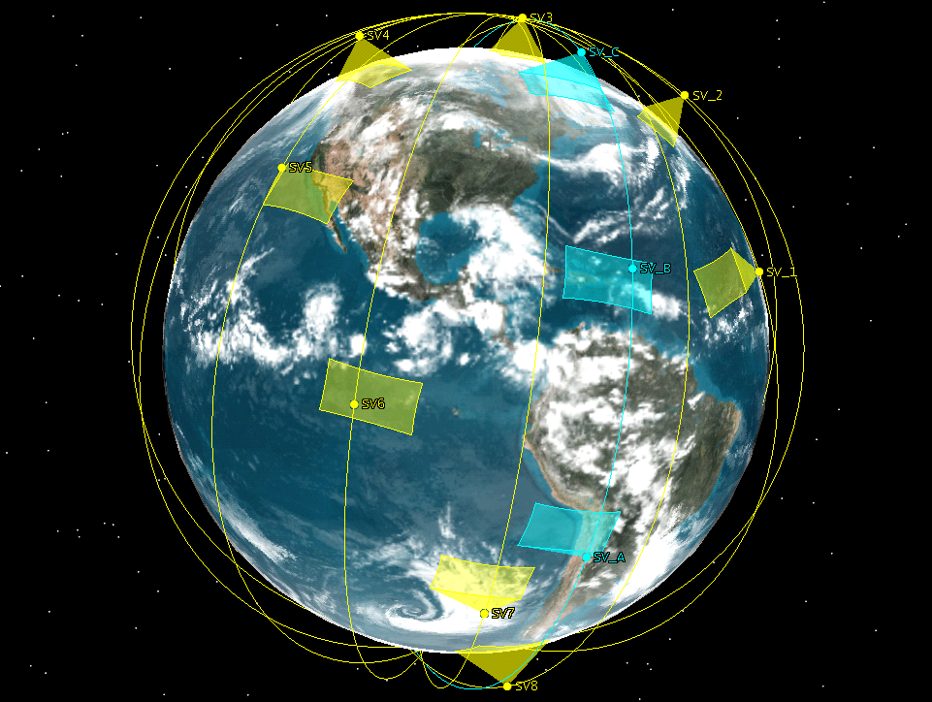
MISTiC Winds
System Approach in NWP Context
Use the GMAO’s GEOS-based OSSE system to examine the impact of the MISTiC Winds concept on NWP
Demonstrate impacts of:
both derived winds and radiances
observation error
constellation size (four – vs – one)
Emphasize the importance of the water vapor channels
GEOS: Goddard Earth Observing System
OSSE: Observing System Simulation Experiment
NWP: Numerical Weather Prediction
MISTiC Winds: Midwave Infrared Sounder for Temperature and humidity in a Constellation for Winds

Slide 3
Context: GMAO’s work on OSSEs and Wind Data Assimilation
GMAO’s “7-km GEOS-5 Nature Run” (7km-G5NR) provides the “truth”
GEOS OSSE system (Errico et al.) includes:
simulation of complete current observing system
careful treatment of observation error for all instruments
ability to use GMAO’s suite of tools to assess observation impacts
Suited to test a wide range of new observations and sampling strategies
Daily products from the GEOS data assimilation system are used widely in support of NASA’s missions
GEOS is being used in several “wind-focused” projects, including:
Scatterometers, including Rapidscat
GPM/GMI all-sky radiance
MISR-based winds (JPL-GMAO)
Loon (Google-SGT-GMAO)
CYGNSS impacts in reanalysis context (JPL-GMAO)

Slide 4
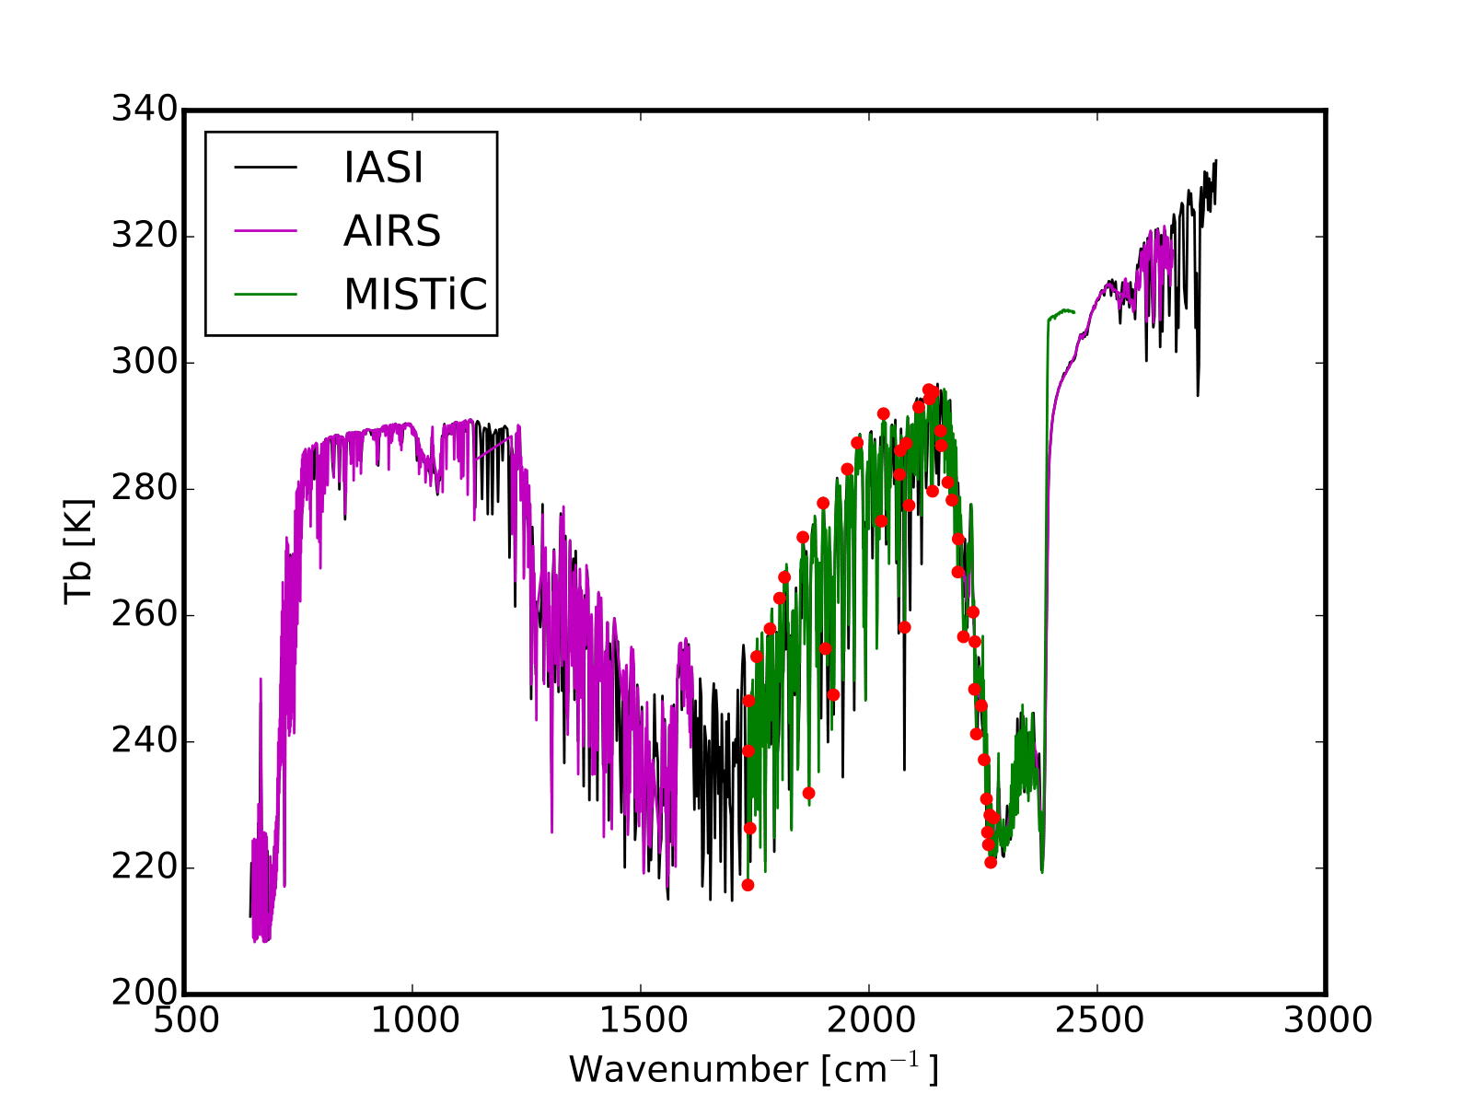
MISTiC Winds: Radiances - Context and Use in GEOS
MISTiC Winds radiances span about 1/3 the spectral range of AIRS, CrIS, IASI
Simulated MISTiC spectrum shown in green, based on BAE-provided specs
590 channels (1735-2450 cm⁻¹)
Down-selected to 46 channels for OSSEs
Necessary as correlated observation error not considered in the analysis
Thermal contrast in the water vapor, temperature sounding channels is a proxy for independent information content
Nature run clouds used in simulation to produce realistic yields
● Assimilated Channels

Slide 5
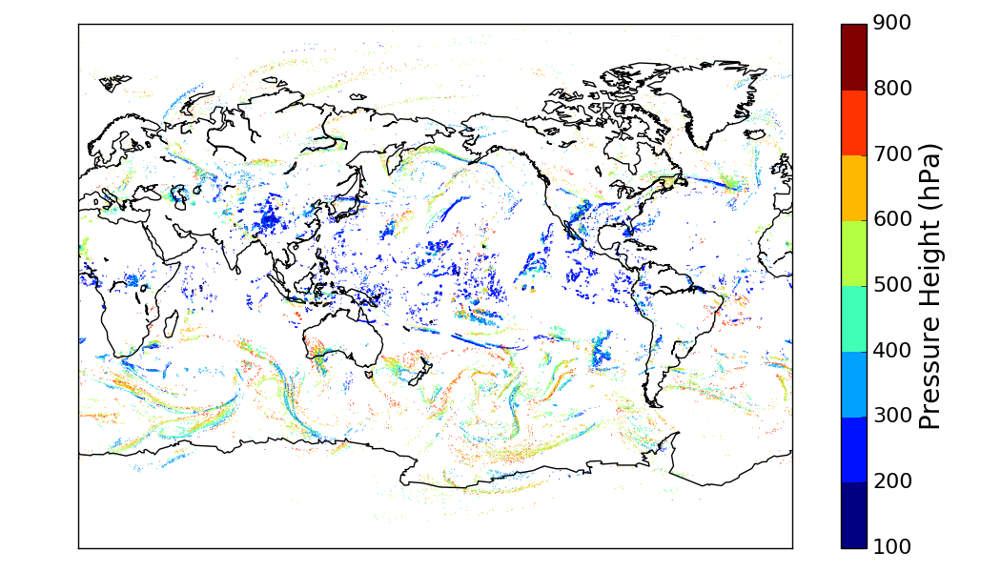
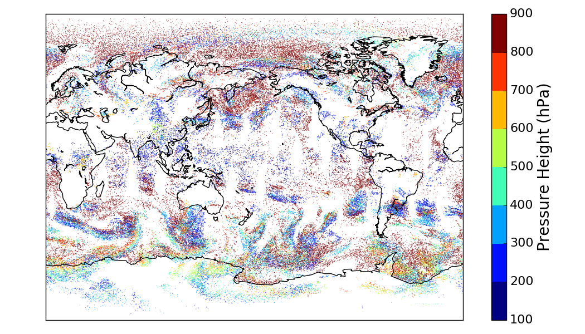
Observation Simulation – Wind
Wind Simulator
Observations are derived from 7km-G5NR and are “downscaled” (from 7km, 30-min) for this work
Probability of cloud AMV is determined as a function of modeled cloud fraction. (Considers sub-column based on maximum-random overlap.)
Probability of water vapor AMV determined on fixed pressure surfaces. (Function of RH and RH gradient.)
The purpose of this is that an observing system based on AMVs will not have regular sampling
Based on distributions of trackable features
Exploits assets of data assimilation to produce regularly gridded fields
Water Vapor
Cloud

Slide 6
Experimental Configuration
Control (Present-Day Observing System) - CTL
Described in Errico et al. (GMAO Tech Memo 2017)
Simulates full Observing System (circa 2016)
Conventional: RAOB, surface, aircraft
Satellite Retrieved: GEO AMVs (Himawari/ MeteoSat/GOES), Polar LEO AMVs (MODIS Aqua/Terra)
Radiances:
AIRS, IASI (Metop-A/B), CrIS, HIRS (Metop-A)
Microwave T: AMSU-A (NOAA-15/18/19, Metop-A/B, Aqua), ATMS, SSMIS F17
Microwave Q: MHS (NOAA-18, Metop-A/B)
All observations have error models applied
Perfect MISTiC Winds – 4PERF
Control + 4 Orbit Configuration
MISTiC Radiances (46 channel selection)
Channel selection performed to reduce interchannel correlations
MISTiC AMVs (Cloud & WV)
No additional errors applied to either radiances or AMVs
Realistic MISTiC Winds – 4ERR
4PERF + error covariance models applied to radiances and winds
Himawari specs used for AMVs
Convolved IASI radiances uses for radiance error estimation

Slide 7
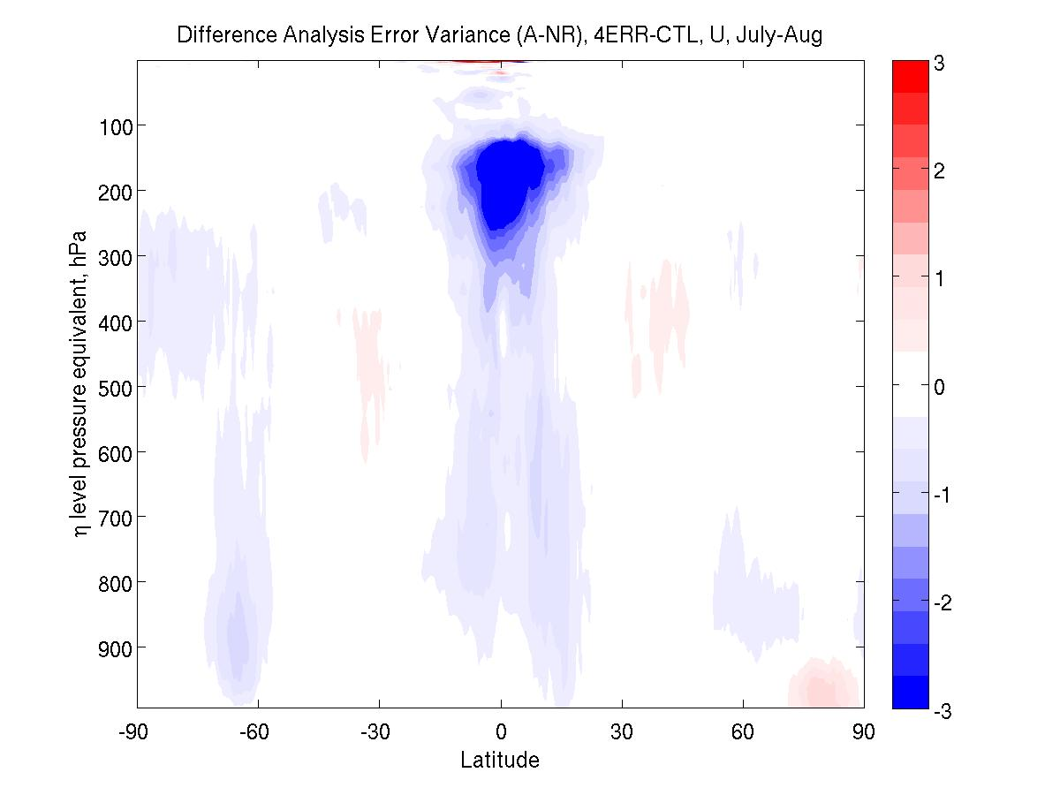
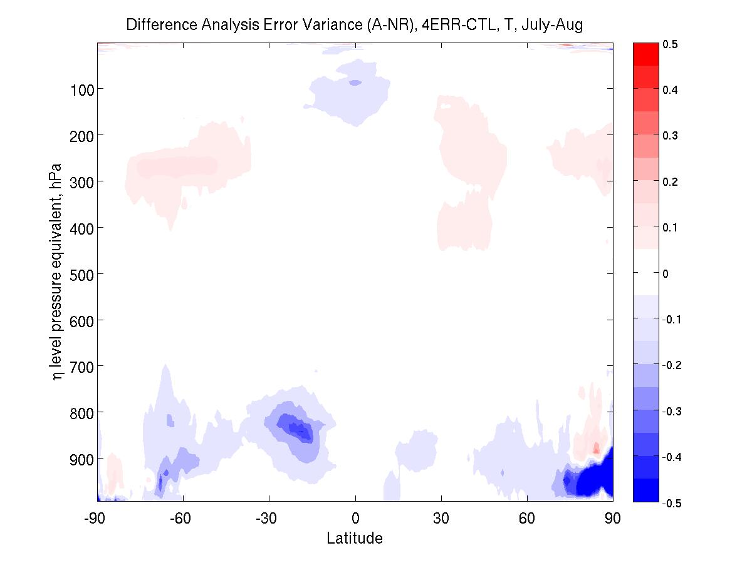
Analysis Error Variance Difference – Zonal Average, July-August
Zonal Wind: 4ERR minus CTL
Temperature: 4ERR minus CTL
Error variance calculated relative to Nature Run (truth)
Difference relative to CTL – MISTiC Winds observations lead to an error reduction (blue) in more regions than a degradation (red)
Experiment 4PERF (not shown) has a similar pattren with more improvement throughout

Slide 8
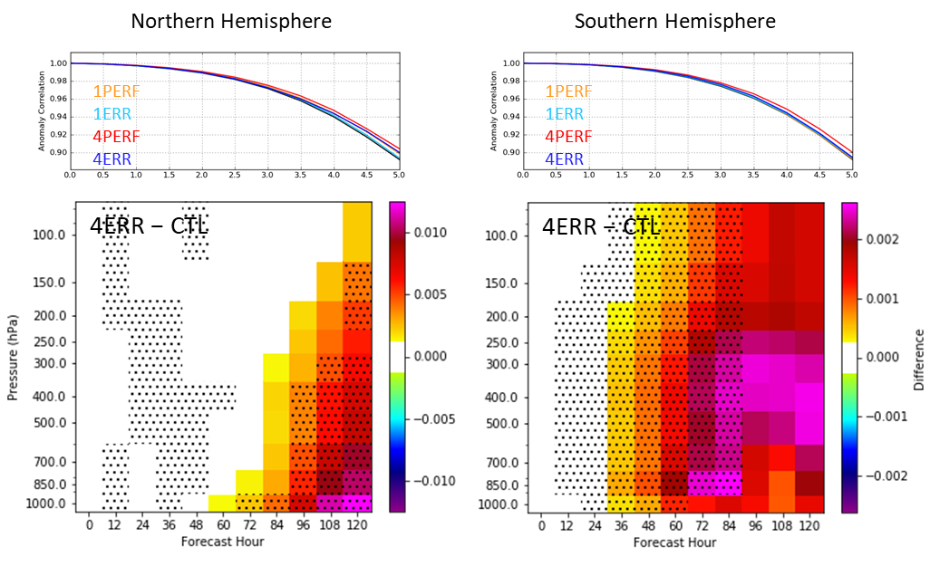
Impacts on Forecast Skill: Height Anomaly Correlation (pressure-time)
Forecast skill improvements: largest with 4 MISTiC systems and when obs errors are neglected
Are largest close to the surface in NH, but throughout column in SH
Retain significance out to 5 days in NH, but only out to about 2.5 days in SH

Slide 9
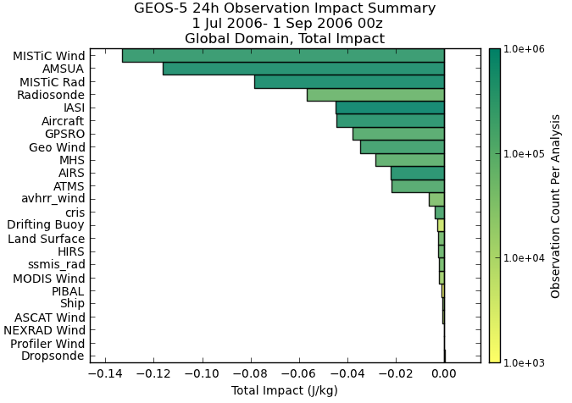
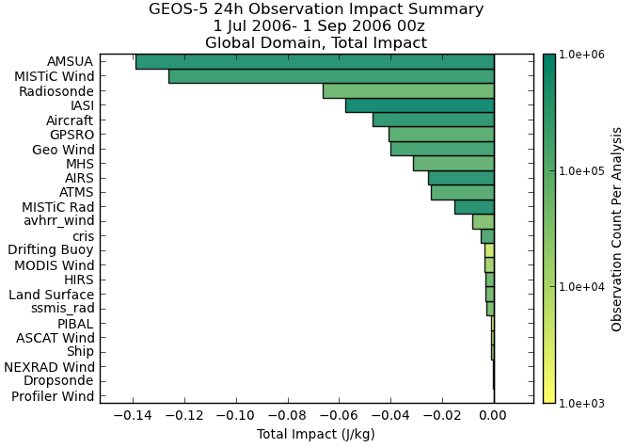
Forecast Impact (FSOI Metric)
Perfect MISTiC Obs 4PERF
Imperfect MISTiC Obs 4ERR
MISTiC Winds observations have a substantial impact on the skill of 24-hour forecasts, traced using an adjoint-based impact tool. Accounting for observation error shows that MISTiC Winds wind data have a high impact, while the impact of the radiances drops substantially in the “mix”

Slide 10
Impact of MISTiC Wind AMVs
No of Obs used
(millions)
Impact per Obs
(negative is good!)
Cloud and WV AMVs combined
The MISTiC Winds sampling strategy results in a consistent distribution of observations through troposphere
The OSSE demonstrates that the highest impact of MISTiC Winds measurements comes from middle troposphere
It is the winds derived from water-sensitive radiances that are the most impactful

Slide 11
FSOI Metric for the MISTiC Winds Spectral Radiances
Spectrum (on its side)
Per channel impact on one-day forecast skill (negative is error reduction)
“temp” channels
Big benefit
moisturechannels
Moisture channels: beneficial impacts persist from “perfect” to “imperfect” case
Temperature channels: large beneficial impact in “perfect” observation scenario turns around when errors are introduced – main uncertainty here is in radiation transfer model – this is not a limitation of the observation concept and will be addressed

Slide 12
Summary of Main Results
This GEOS OSSE study has demonstrated the beneficial impacts of the MISTiC Winds concept on global weather prediction
A four-plane constellation has more impact than a single plane
The most beneficial impact is from the mid-tropospheric winds derived from radiance channels that are not available from other platforms
It is important to perform a detailed analysis of errors and their impacts
Development of (used) radiation-transfer code in the short-wave IR is likely to lead to more beneficial impacts – this is also applicable to existing hyperspectral data
The GMAO’s GEOS OSSE suite is suited to other studies, including active wind sensing techniques

Slide 13
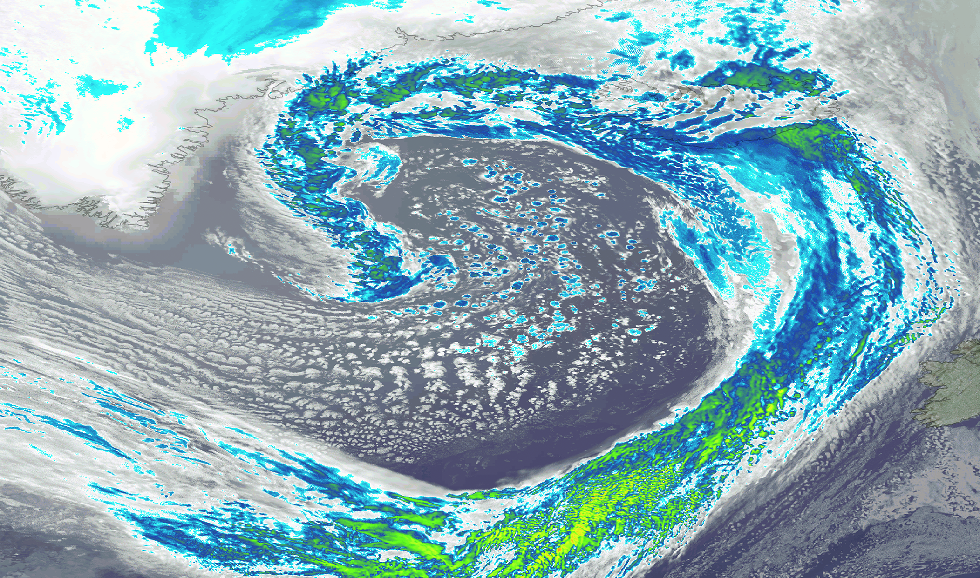
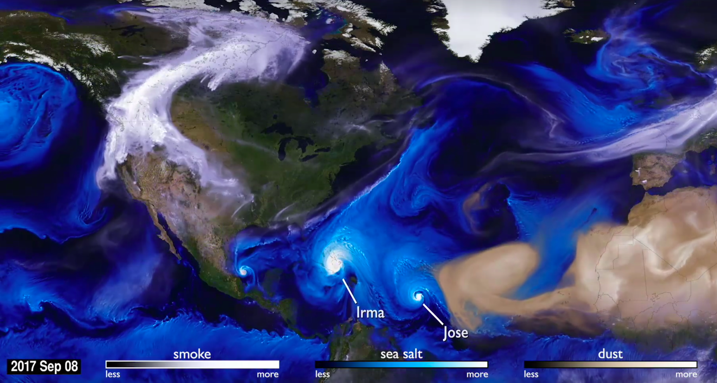
Future Developments that will Enhance GMAO’s Contributions
Repeat MISTiC Winds experiments in a 4D assimilation system
Radiation transfer model – better represent the IR “temperature” (CO₂) channels
Systems approach to combinations of passive-active wind measurements
Other metrics – extreme weather, air pollution, etc. (close to GMAO’s core)
Move away from any “twin” issues as GEOS model evolves (new PBL, cloud, etc.)
New Nature Run at higher resolution (GEOS has been run at 1.5km globally)

