Slide 1
NOAA’s Hurricane Forecast Improvement Project - HFIP
Frank Marks
HFIP Research Lead
AOML/Hurricane Research Division
3 November 2015
Notes:
Hurricane Edouard 16 September 2014

Slide 2

Vision
  Organize hurricane community to dramatically improve numerical forecast guidance to NHC in 5-10 years
Goals
Improve forecast accuracy for track & intensity by 20% in 5 years, 50% in 10 years
Extend forecast reliability to 7 days
Increase rapid intensity change detection
http://www.hfip.org/
Notes:
http://www.nrc.noaa.gov/HFIPDraftPlan.html
HFIP Team
Frank Marks, research lead
Ed Rappaport, operations lead
Fred Toepfer, project manager
Robert Gall, development manager
Mark DeMaria
Chris Fairall
Jim McFadden
Daniel Melendez
HFIP executieve oversight board:
OAR AA/Robert Detrick, co-chair
NWS AA (acting)/Laura Furgione, co-chair
NCEP/Louis Uccellini,
NHC/Rick Knabb,
NESDIS/Mark DeMaria,
NOS/Jesse Feyen,
AOML/Bob Atlas
PPI/Paul Doremus
NMFS/Bonnie Ponwith,
NOS/Liz Scheffler,
NMAO-PM Aircraft/Mike Devany
OFCM/Sam Williamson
Executive Secretariat: OAR/Brian Orndorff and NWS/Nasheema Lett
http://www.hfip.org/

Slide 3
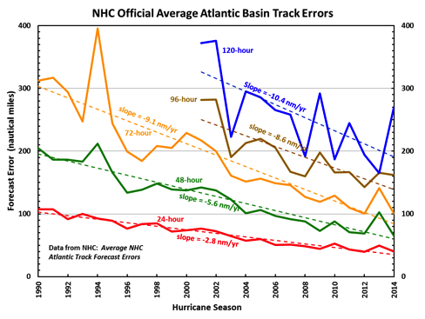
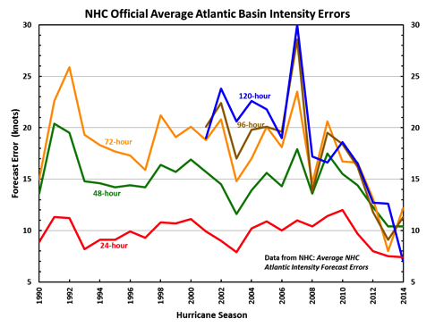
Current State of the Art
HFIP
Errors cut in half over past 15 yr
10-yr improvement - As accurate at 48 h as we were at 24 h in 2000
24-48 h intensity forecast off by ~1 category
Some intensity gains since 2009, especially >48 h
Notes:
Images from: http://www.nhc.noaa.gov/verification/verify5.shtml

Slide 4
HFIP Successes to date:
HWRF Forecast Improvements
Improvements of the order of 10-15% each year since 2012
Dramatic improvement in first 5 years of HFIP
http://www.emc.ncep.noaa.gov/gc_wmb/vxt/
Notes:
Added 3rd nest in 2012

Slide 5
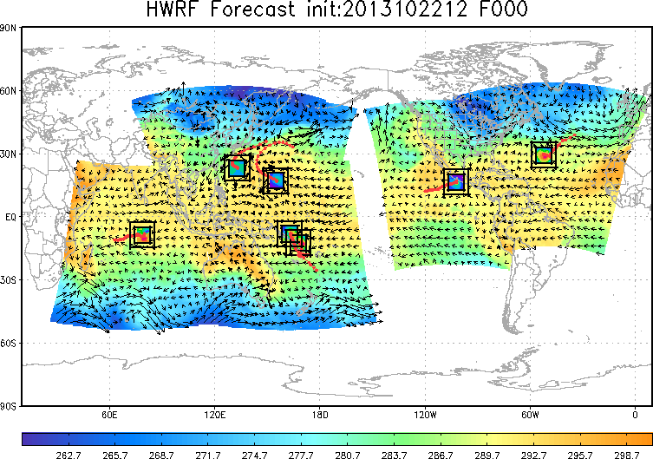
HFIP Successes to date:
Global HWRF
http://www.emc.ncep.noaa.gov/gc_wmb/vxt/
Notes:
Right: Experimental Real-Time Forecast Guidance from Operational HWRF for all Tropical Oceanic Basins Including Southern Hemisphere:
Cyclone Guito (15S)
Left: Composite Radar Reflectivity Animation for Typhoon Rammasun (09W)

Slide 6
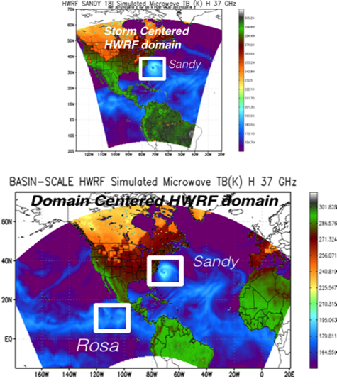
HFIP Successes to date:
Basin-scale HWRF
Storm Centric -vs- Domain Centric Forecasts
Tropical prediction system
Improved storm-storm & multi-scale interactions
Landfall and post landfall (storm surge & rainfall)
Genesis
Regional ensembles
Data assimilation
Notes:
Right: Experimental Real-Time Forecast Guidance from Operational HWRF for all Tropical Oceanic Basins Including Southern Hemisphere:
Cyclone Guito (15S)
Left: Composite Radar Reflectivity Animation for Typhoon Rammasun (09W)

Slide 7
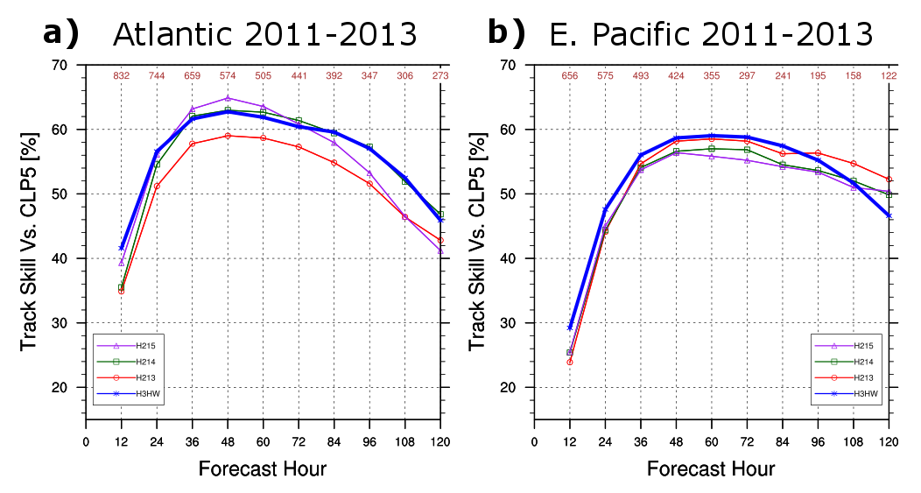
HFIP Successes to date:
Basin-scale HWRF: 2011-2013 Verification
H3HW is consistently one of the most skillful models in terms of track.

Slide 8
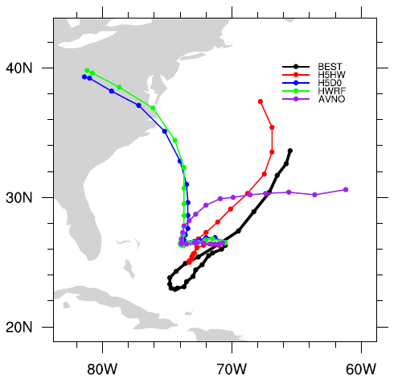
HFIP Successes to date:
2015 Basin-scale HWRF (H5HW)
H5HW produces a good track for Joaquin.
Comparing H5HW with H5D0 directly tests the role of multi-storm interactions.
Simply removing all other nested disturbances (e.g., AL99, AL90) results in a similar track to HWRF (H215).
0-hr

Slide 9
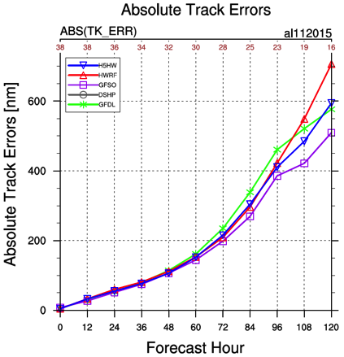
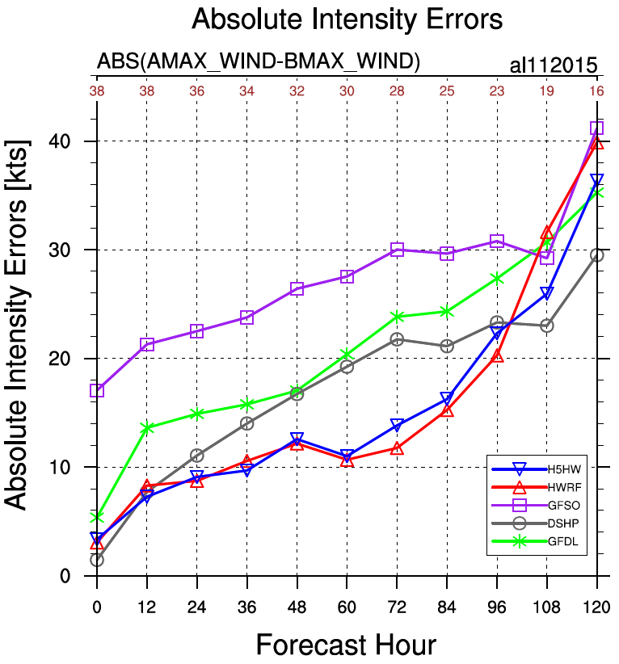
HFIP Successes to date:
H5HW: Joaquin Verification
HWRF & H5HW have smaller intensity errors than DSHP through 96-h.
H5HW has better track forecasts than HWRF after 96-h.

Slide 10
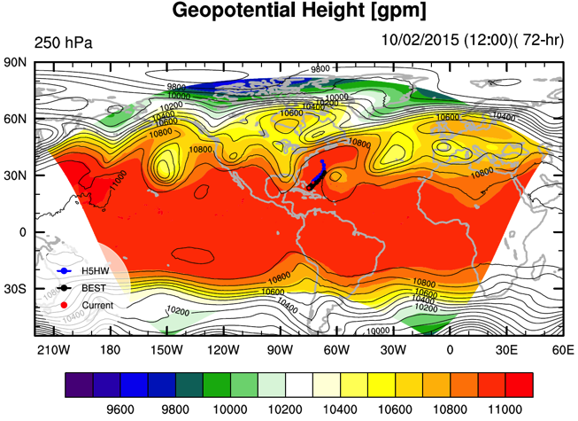
HFIP Successes to date:
H5HW: Multi-Storm vs. Single-Storm
H5HW does a good job simulating the large-scale environment.
Interactions of Joaquin with 3-km nests for 2 invests make a big difference.
AL99
AL90
Joaquin
H5HW 72-h Fcst (shading) GFS Analysis @ Fcst Time (contours)

Slide 11
HFIP Priorities 2015-2016
Operational Impact
Demonstrate Basin-HWRF during hurricane season
Demonstrate impact of aircraft data & Doppler Radar (TDR)
Demonstrate multi- & single-model ensembles for Track & Intensity
Research & Development
Develop HWRF GSI hybrid DA - Focus on high resolution inner domains
Improve use of satellite data in TC DA (QOSAP)
Improve use of inner core observations in operations, TDR, UAS, DWL, etc.
Improve HWRF physics using aircraft observations (IFEX, SHOUT)
Develop global physics for high resolution (HIWPP, R2O)
Technical Advancements
Transition HWRF to Basin-NMMB (HIWPP, R2O)

Slide 12
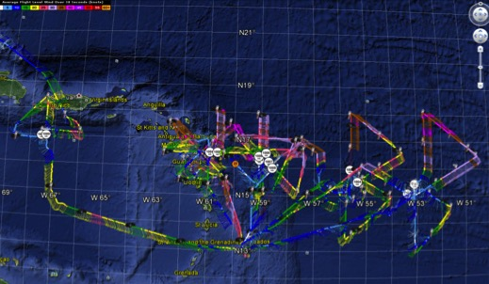
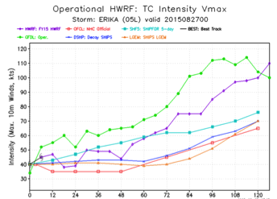
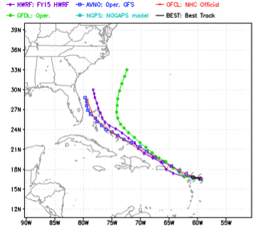
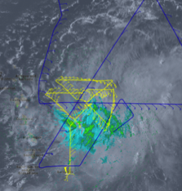
HFIP Successes to date:
Impact of aircraft observations: TDR
5 P-3 Flights
25 - 28 August 2015
5 P-3 missions from 25-28 August 2015 at 12 h Doppler sampling (HEDAS/GSI) & 1 G-IV mission
Doppler data transmitted in real-time for assimilation into HWRF
Sampled Erika as a tropical storm
12
Notes:
Map shows flight tracks for all of the NOAA missions (color coded are the flight level winds for the P-3 missions, dropsonde symbols denote G-IV patterns)
Flight track plots courtesy of Tropical Atlantic - http://tropicalatlantic.com/recon/
Model data available at: http://www.emc.ncep.noaa.gov/gc_wmb/vxt/RT_ATLANTIC/ARTHUR01L/

Slide 13
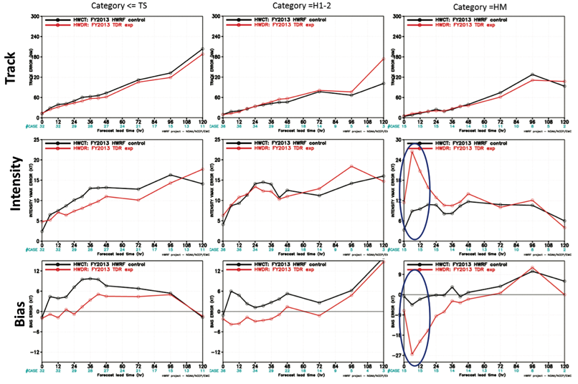
HFIP Successes to date:
Impact of aircraft observations: TDR
32 cases
34 cases
15 cases
Notes:
84 cases in 39 storms over 5 years (2008-2012)
Major issue is with initializing strong storms.

Slide 14
HFIP Lesson Learned
Fully engage operational partners to set goals & milestones to reflect requirements
Provide support for real-time demonstration as part of T&E leading to faster R2O
Initialization still major issue, particularly in strong storms: Make better use of vortex-scale observations (in-situ & satellite)
Develop strategies for ensembles (single & multi-model) to address uncertainty in track, intensity, & structure
Model architecture must include environmental changes on times scales ~10 days (global model), and resolve rapidly changing inner core structure (moving nests)
Notes:
http://www.hfip.org/documents/reports2.php

Slide 15
Challenges
How can we use this research capacity and approach to accelerate TC forecast improvement?
  HFIP approach & infrastructure allows for rapid T&E of emerging research and observations for potential R2O into operational hurricane model and DA systems.
  Expand and leverage HFIP partnership to take advantage of new initiatives within NOAA to foster and enhance existing HFIP partnership, promote collaboration with basic research community, and address near-term opportunities
Notes:
15
With increasing budget uncertainty we need to leverage on the successful HFIP approach to further our enhancements of the operational system. HFIP demonstrated an approach similar to that outlined in the OFCM Interagency Strategic Research Plan for Tropical Cyclones: The Way Ahead that is working and accelerating improvements.
In challenging and volatile budget times OFCM serves as an honest broker in bringing together partners from across federal services to insure return on investment and coordination. WG/TCR serves as lynch pin in this endeavor to coordinate and track research across agencies to insure operational requirements are addressed. IHC plays critical role in providing a forum to monitor progress, and for this coordination to be discussed and debated.

Slide 16
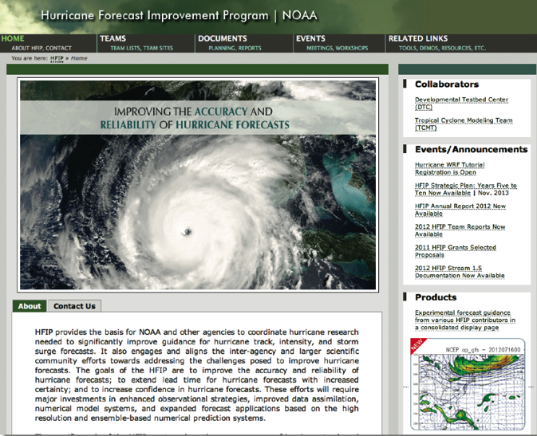
Questions?
Go to
www.hfip.org
for more details
16
Notes:
16
Since 15 May 2010 HRD has maintained our Blog on Wordpress which supports a RSS feed, Twitter, and Facebook accounts.
Wordpress Stats: 854 posts (18-19 posts per month), 179 comments. Most posts are during the hurricane season where we post our updates on field activities whenever we are operating.
Wordpress Blog Views by Month and Year
Months and Years
Jan Feb Mar Apr May Jun Jul Aug Sep Oct Nov Dec Total
2010 152 753 1,790 3,463 5,521 2,047 1,479 1,019 16,224
2011 1,028 927 1,152 1,143 1,417 1,495 1,959 7,195 2,588 1,885 1,659 1,231 23,679
2012 1,139 1,179 1,305 1,456 1,754 1,855 1,929 14,433 4,537 5,302 3,179 2,770 40,838
2013 3,702 1,880 1,687 1,323 2,264 1,736 2,622 4,619 7,276 1,369 1,167 1,292 30,937
2014 1,250 1,250
Since late September 2013 HRD has tracked web pages using Google Analytics:
HRD Web site Stats: Since late September 2013 a total of 188,460 visits or 47,000 visits per month with 383,873 page views
Twitter Stats: 1,334 tweets of which 854 are directly from the Wordpress Blog and the rest from “Tweets from the Eye” which we do directly to Twitter from the NOAA aircraft during missions. “Tweets from the Eye” are a very effective and popular outreach tool helping educate the Public to what NOAA does.

Slide 17
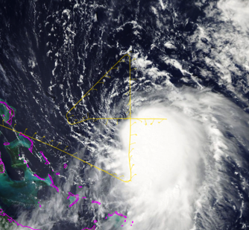
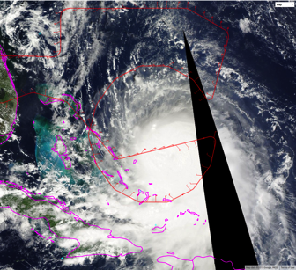
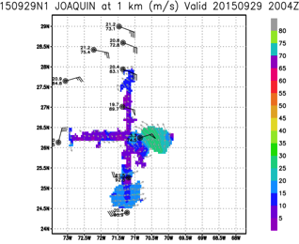
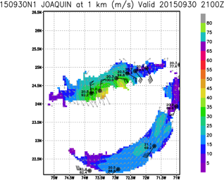
  Develop & refine observing technologies: G-IV TDR
G-IV flight tracks in Hurricane Joaquin 29 & 30 September 2015
G-IV Doppler analysis at 1-km altitude
17

Slide 18
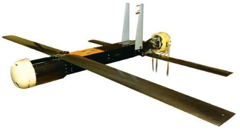
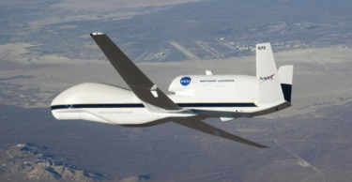
  Develop & refine observing technologies: UAS
No Coyote UAS cases flown in 2015. Evaluated observations in Edouard (2014), tested extended range, and demonstrated data transmission to National Hurricane Center.
SHOUT for 2015 (25 August - 21 September). 2 Global Hawk flights sampled life cycle of TS Erika.
Notes:
NOAA successfully deployed an unmanned aircraft, the Coyote, from a hurricane hunter into the eye of Hurricane Edouard last season, and is expanding the use of this small unmanned aircraft.
Planned flights will measure the regions of strongest winds at low altitudes in hurricanes and send that data in real-time to forecasters at the National Hurricane Center.
NOAA is adding a Doppler wind Lidar on the P-3 aircraft used to collect, process and transmit atmospheric data from within a hurricane .
The Lidar will complement the P-3 tail Doppler radar allowing NOAA to sample the winds inside the hurricane, even within the clear eye, that may be driving hurricane intensity changes.

Slide 19
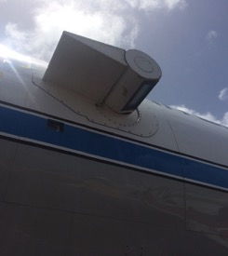
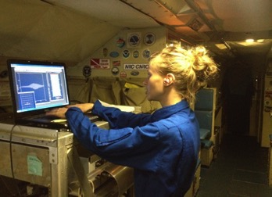
  Develop & refine observing technologies: DWL
9 flights into Tropical Storms Danny and Erika
    7 flights collected data
    Data available on Google Drive
    Currently being processed by Dave Emmitt and Chris O’Handley
Elevation angle range of -110° to +110°
Azimuth angle range +/- 30°
Preset scanning modes: conical, sweeps, etc.
Access DWL computer via laptop
(see Lisa Bucci’s presentation)
Notes:
NOAA successfully deployed an unmanned aircraft, the Coyote, from a hurricane hunter into the eye of Hurricane Edouard last season, and is expanding the use of this small unmanned aircraft.
Planned flights will measure the regions of strongest winds at low altitudes in hurricanes and send that data in real-time to forecasters at the National Hurricane Center.
NOAA is adding a Doppler wind Lidar on the P-3 aircraft used to collect, process and transmit atmospheric data from within a hurricane .
The Lidar will complement the P-3 tail Doppler radar allowing NOAA to sample the winds inside the hurricane, even within the clear eye, that may be driving hurricane intensity changes.

