Slide 1
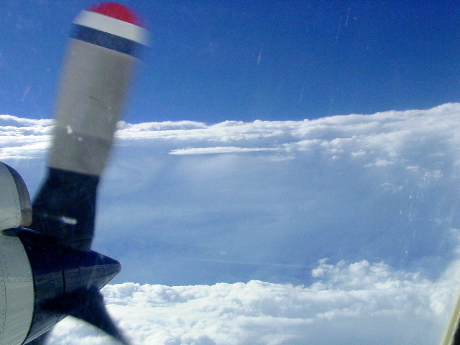
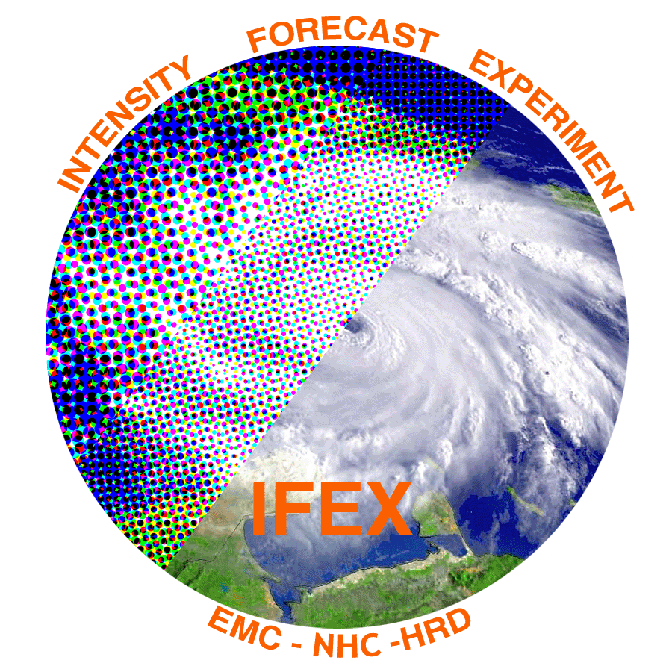
The 2015 Hurricane Field Program
Robert Rogers
NOAA/AOML Hurricane Research Division

Slide 2
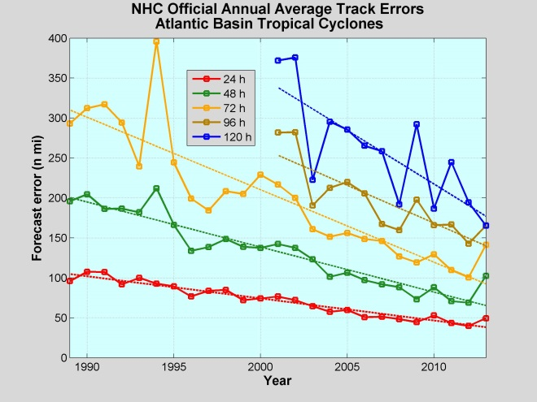
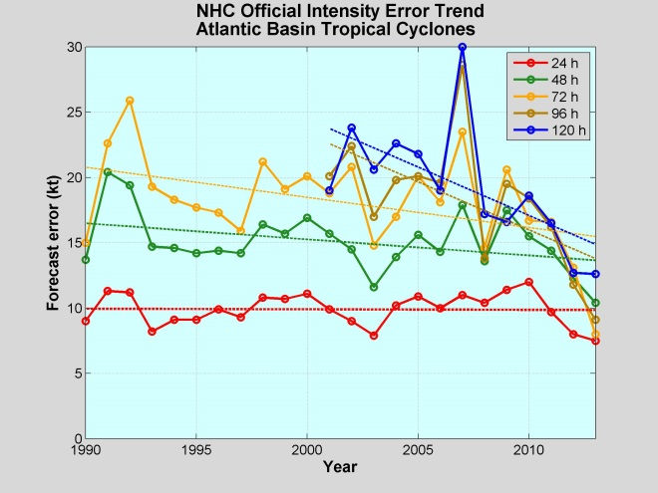
The challenge: TC intensity forecasting
Advances in forecasts of TC intensity lag advances in TC track forecasts
Multiscale nature of processes are major reason
Environmental - O(1000 km) - troughs, shear
Vortex - O(1-100 km) - symmetric/asymmetric dynamics, VRWs
Convective - O(1 km) - convective bursts, vortical hot towers
Turbulent - O(1-100 m) - surface fluxes, PBL mixing, entrainment
Microscale - O(1mm) - hydrometeor production, latent heating
NOAA is addressing this challenge with modeling,
data assimilation, observations, and theory
Hurricane Forecast Improvement Project (HFIP) – modeling, data assimilation
Intensity Forecasting Experiment (IFEX) – observations, theory
Track
Intensity
Forged over decades of field work, IFEX supports HFIP by serving as the key observational resource for initialization and evaluation of the model guidance

Slide 3
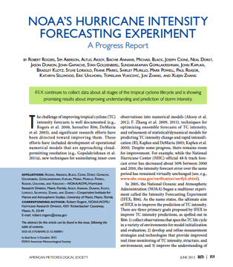
Intensity Forecasting Experiment (IFEX)
Rogers et al., BAMS, 2006
Rogers et al., BAMS, 2013
IFEX intended to improve prediction of TC intensity change by addressing three goals:
Collecting observations that span TC life cycle across scales for model initialization and evaluation
Developing and refining measurement technologies that provide improved real-time monitoring of TC intensity, structure, and environment
Improving understanding of physical processes important in intensity change for a TC at all stages of its life cycle
These goals provide the linkage between observations, modeling, DA, and theory that form the foundation of the work done at HRD

Slide 4
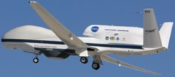
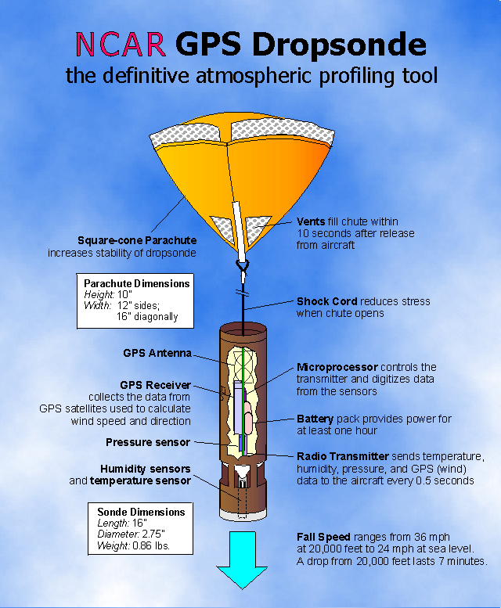
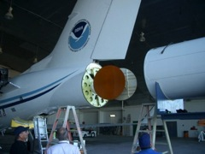
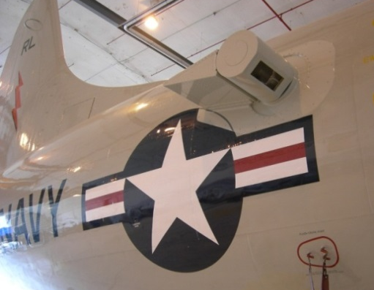
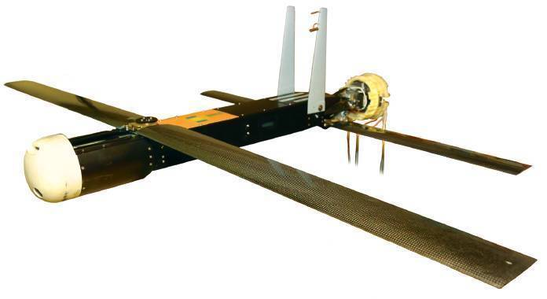
Intensity Forecast Experiment Observing platforms and instruments
In-situ
Wind, press., temp.
Expendables
Dropsondes
AXBT, AXCP, buoy
Remote Sensors
Tail Doppler Radar(TDR)
SFMR/HIRAD
WSRA
Scatterometer/profiler
UAS
NOAA P-3s
NASA Global Hawk
NOAA G-IV
GPS Dropsonde
G-IV Tail Doppler Radar
Coyote UAS
Doppler Wind Lidar

Slide 5
Overview and accomplishments of 2015 missions
Operational and research missions flown in four tropical cyclones with P-3 and/or G-IV:
Hurricane Danny - First major hurricane of season, weakened in shear/dry air
Tropical Storm Erika - Struggled with shear/dry air entire lifecycle
Hurricane Joaquin – Major hurricane incorrectly forecast to threaten U.S. at one point
Hurricane Patricia – EPac, strongest storm on record in western hemisphere
Distribution of flights by storm (both operational and research)
 | P-3 | G-IV | GH | Total
Danny | 5 | 2 | 0 | 7
Erika | 5 | 3 | 2 | 10
Joaquin | 0 | 4 | 0 | 4
Patricia | 3 | 0 | 0 | 3
Total | 13 | 9 | 2
Provided real-time data to operational models
Pre-storm ocean survey for Danny
DWL operated for nearly all P-3 missions for Danny, Erika
Two unmanned gliders operating near Puerto Rico during Danny, Erika

Slide 6
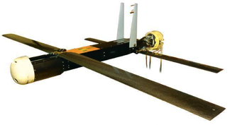
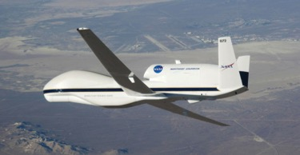
New observing technologies: UAS
No Coyote UAS cases flown in 2015. Evaluated observations in Edouard (2014), tested extended range, and demonstrated data transmission to National Hurricane Center.
SHOUT for 2015 (25 August - 21 September). 2 Global Hawk flights sampled life cycle of TS Erika.

Slide 7
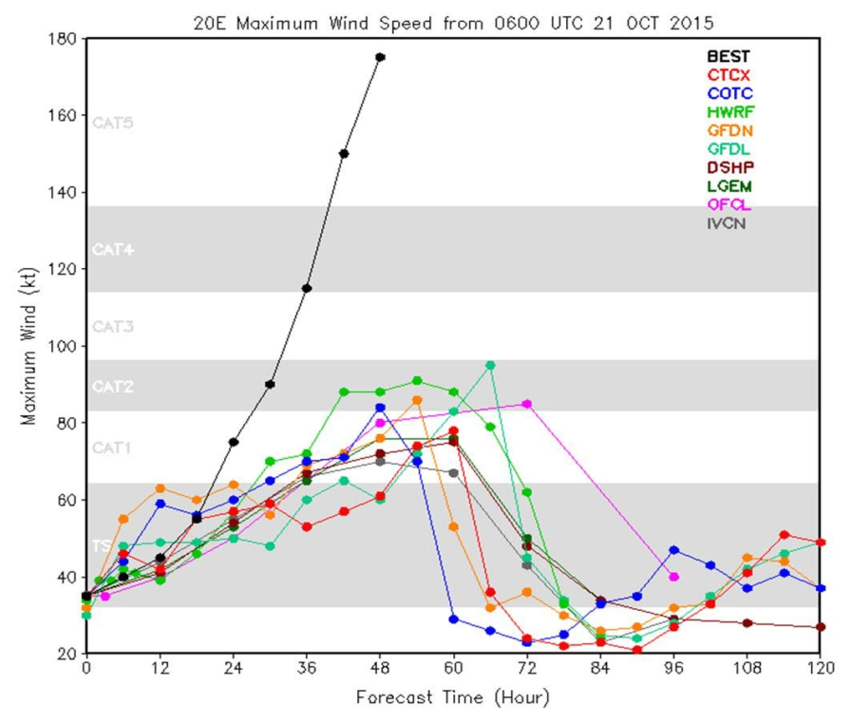
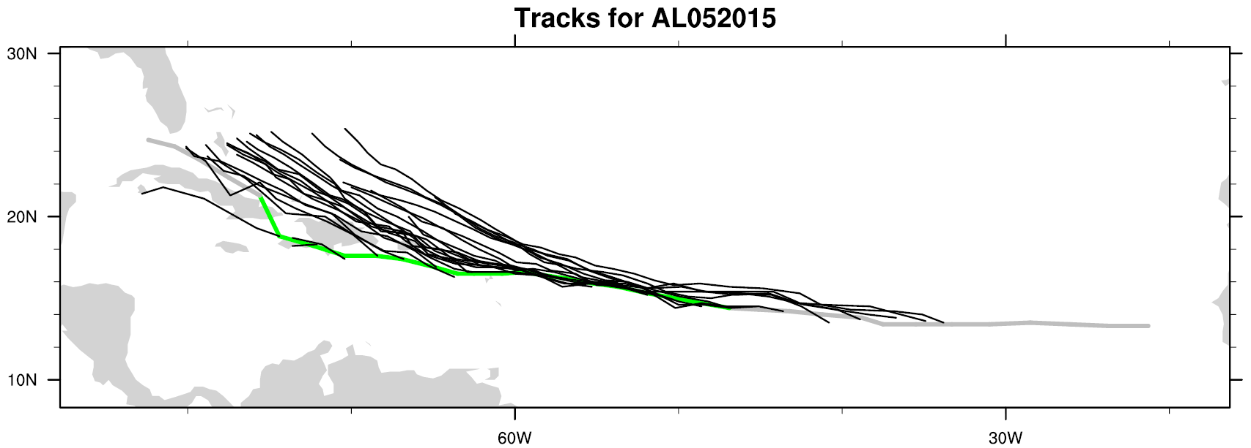
Forecasting challenges in 2015:
Both track and intensity
Patricia intensity forecasts
Erika track forecasts
observed
HWRF forecasted tracks
forecasted
Observed storm track
How can observations collected during IFEX help to address these forecast errors?

Slide 8
Track Forecast Challenge of Erika
NOAA’s HWRF Forecast Tracks
HWRF forecast tracks
Observed storm track
(green line = Best Track)
Consistent north bias for Erika track forecasts in HWRF (and other models)
Why did the northwest turn never happen?
Errors in storm structure?
Errors in storm environment?

Slide 9
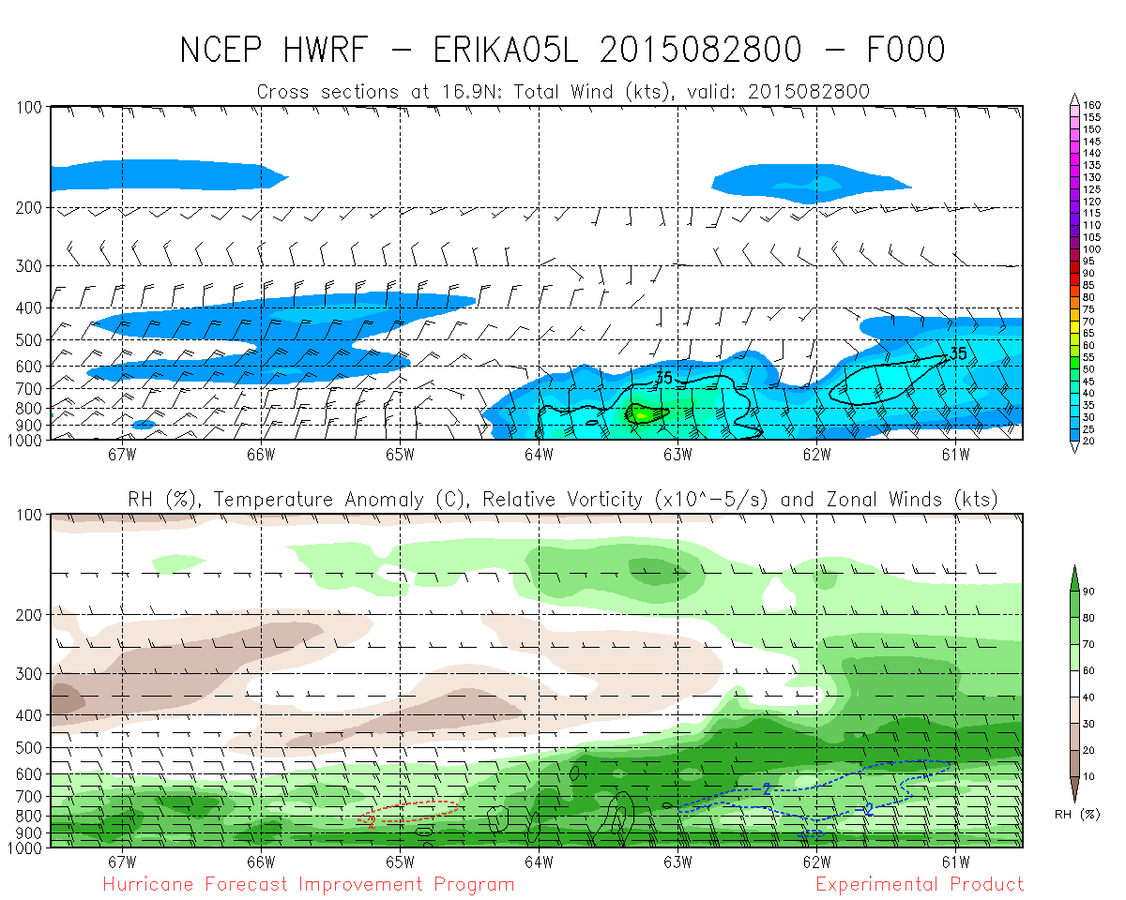
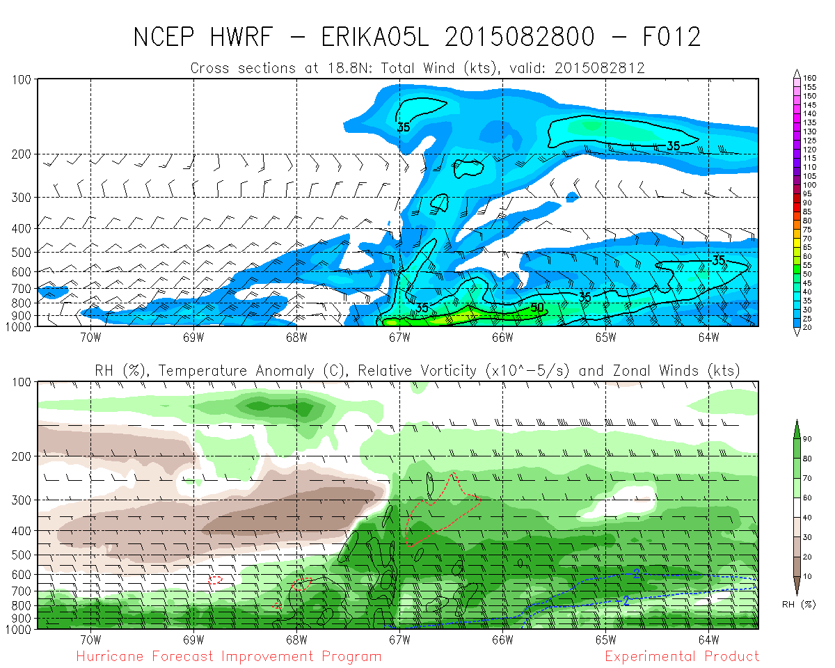
Track Forecast Challenge of Erika - structure
Aircraft observations of Erika’s winds at different altitudes – 10 UTC Aug 28
HWRF representation of Erika’s winds – vertical cross section
00 UTC Aug 28
6 km
vortex top
too deep
12 UTC Aug 28
4 km
Shallow vortex, not above 4 km
Initial vortex structure looks reasonable
12 h into forecast, vortex much too deep
Problem with model initial conditions? Physics?
circulation center
2 km

Slide 10
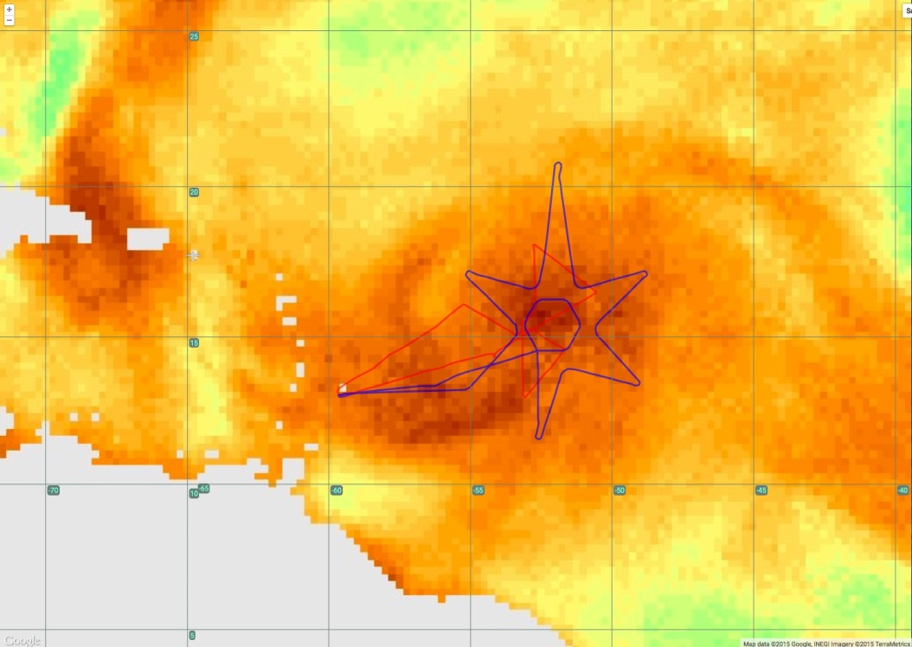
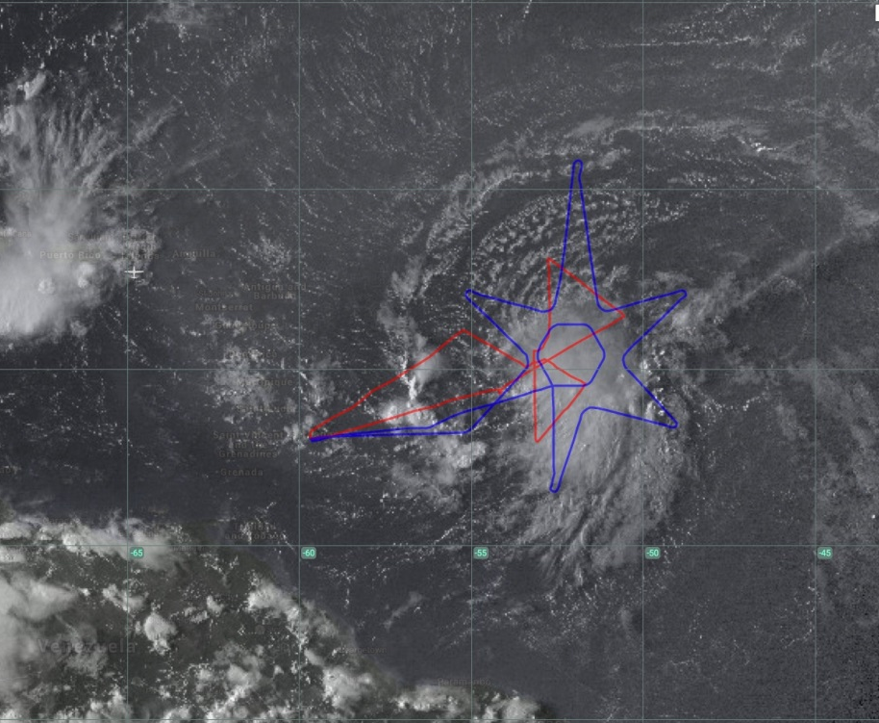
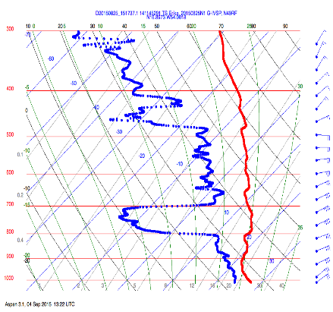
Track Forecast Challenge of Erika - environment
GOES visible image and in situ temperature and humidity profile from G-IV dropsonde
Satellite-derived total precipitable water (TPW) product and G-IV flight track
G-IV flight track
G-IV flight track
RH=15%
red=moist lower trop
green=dry lower trop
Based on TPW, Erika seems to be embedded in moist lower tropospheric air
Dropsonde shows very dry layer in lower troposphere, in contrast with TPW
Did this dry layer play a role in Erika’s inability to intensify, and not track northward?
Did the models depict this initial moisture structure?
Can we improve how models depict this structure?

Slide 11
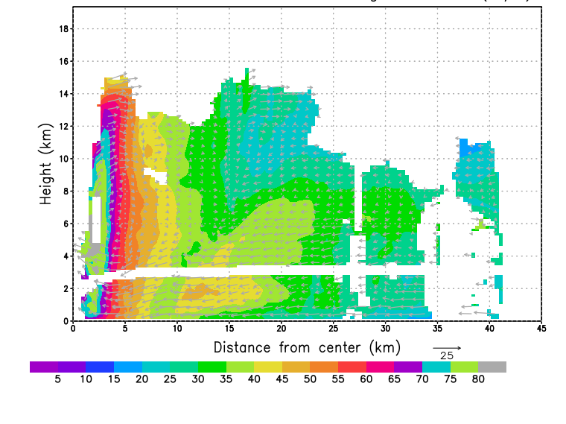
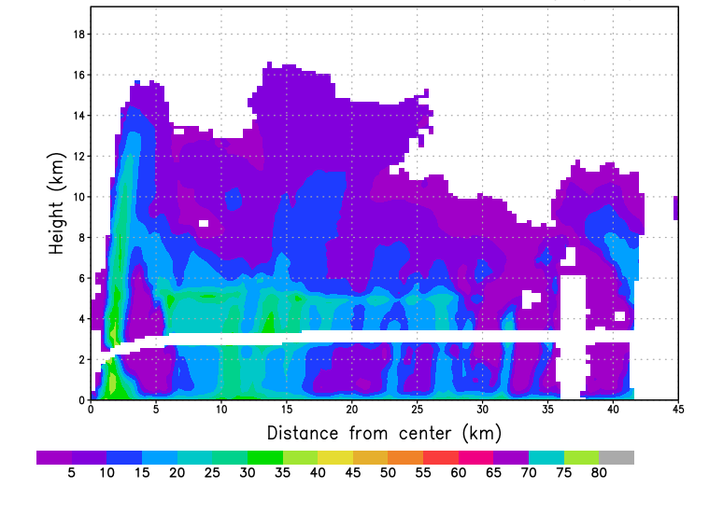
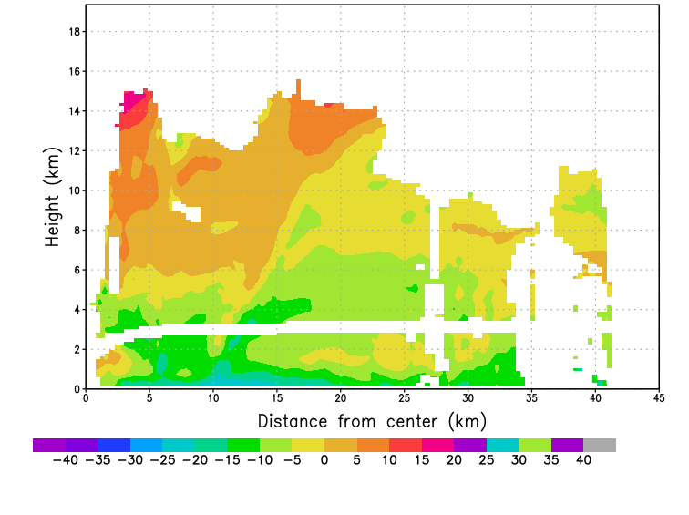
Intensity Forecast Challenge of Patricia - structure
Vertical cross section of tangential wind (m/s) at ~21 UTC Oct 23
RMW
Vertical cross section of reflectivity (dBZ) at ~21 UTC Oct 23
Vertical cross section of radial wind (m/s) at ~21 UTC Oct 23
Incredibly small RMW of ~3 km
PBL inflow > 25 m/s
Nearly completely vertical eyewall
How does a model with 2-3 km grid length represent this? What resolution is needed? < 1 km?

Slide 12
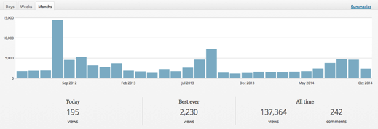
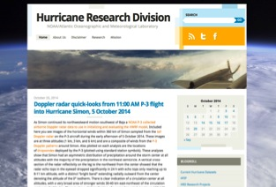
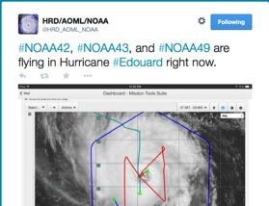
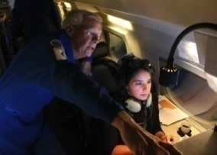
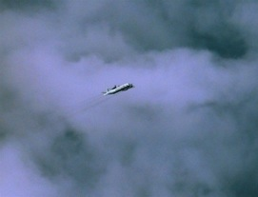
Outreach
Our blog
http://noaahrd.wordpress.com
HRD Web page
http://www.aoml.noaa.gov/hrd
Facebook (3,475 likes)
http://www.facebook.com/noaahrd
Twitter (12,900 followers)
http://twitter.com/#!/HRD_AOML_NOAA
Tweets from the eye
Visiting scientist program

Slide 13
Thank you!

Slide 14
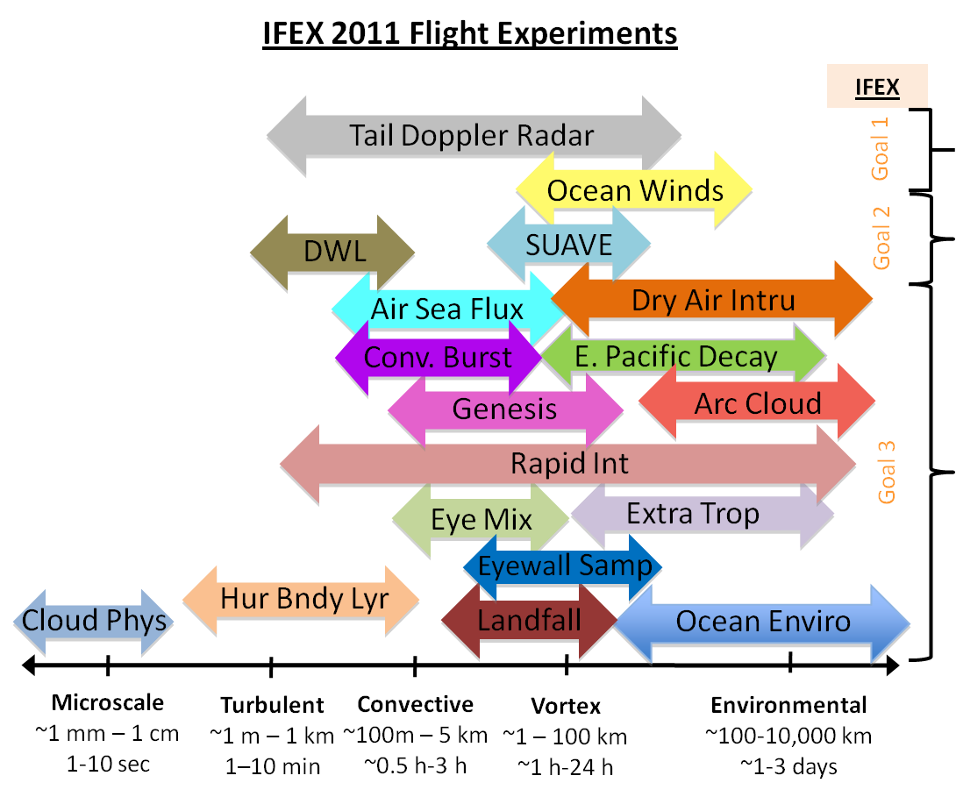
IFEX Goal 1: Collecting observations across scales
Spatial/temporal scales of IFEX flight experiments
IFEX experiments span the multitude of spatial and temporal scales important in TC intensity change
Notes:
Schematic of field experiments from 2012 HFP and where they fit in the statio-temporal spectrum. You don’t need to read over every experiment; just make the point that IFEX experiments are designed to cover wide spectrum of scales, in keeping with multiscale nature of TC intensity change.

Slide 15
IFEX goal 2: Develop & refine observing technologies: UAS
No Coyote UAS cases flown in 2015. Evaluated observations in Edouard (2014), tested extended range, and demonstrated data transmission to National Hurricane Center.
SHOUT for 2015 (25 August - 21 September). 2 Global Hawk flights sampled life cycle of TS Erika.

Slide 16
IFEX Goal 3: Improve understanding of physical processes: Intensification
Vertical velocity (shaded, m/s) and inertial stability (contour, x 10⁻⁷ s⁻²) left of shear vector
in Hurricane Edouard (2014)
USL
DSL
14 Sept
Intensifying
Stronger updrafts DSL, closer to center on 14 Sept
Persistent strong updrafts aloft USL on 14 Sept, co-located with high inertial stability in that quadrant. Little to no updrafts USL on 16 Sept.
Upper-level updrafts USL are important for TC intensification
RMW
RMW
vortex core
USL
DSL
16 Sept
Weakening
RMW
RMW

