Slide 1
Doppler Wind Lidar on the Hurricane Reconnaissance Aircraft
G. D. Emmitt (Simpson Weather Associates)
R.Atlas, L. Bucci and K. Ryan (NOAA/AOML)
Lidar WG meeting
3 November 2015

Slide 2
Overview
Army’s WTX system (Dave Ligon) “finally” installed and flown on NOAA N43.
Same system that flew on Navy’s P3 during TPARC-08
Trained three NOAA people to operate the system
Conducted flight test on August 6, 2015
System flew until August 28 when it was removed from N43 per schedule.
While some useful data was collected, there were multiple problems
Scanner sticking
Operation faults…exception handling
Profiles processed and provided to AOML for impact study

Slide 3
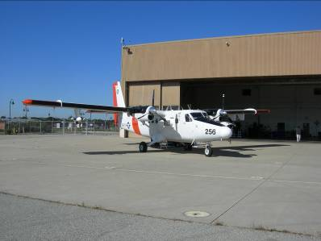
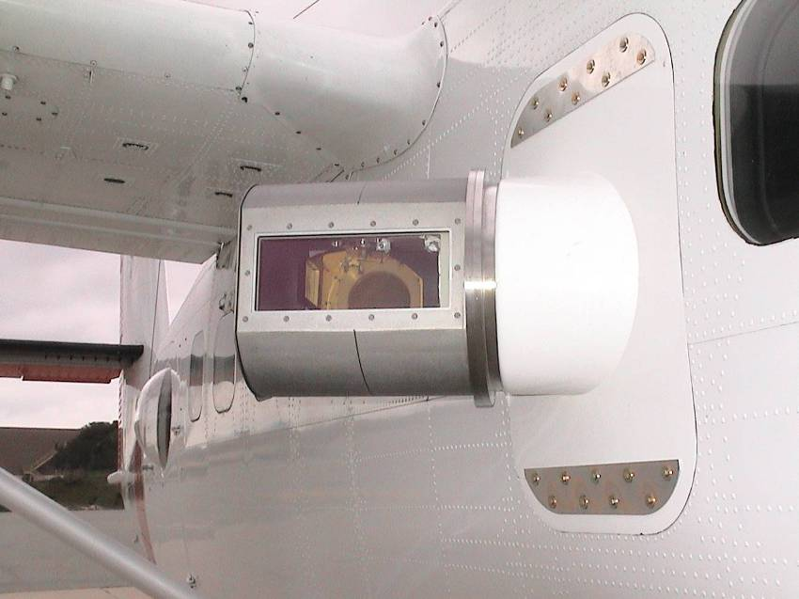
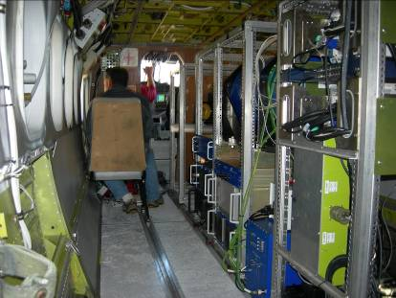
The TODWL system
A CIRPAS instrument
(Twin Otter Doppler Wind Lidar
primary funding by ONR and NPOESS)

Slide 4
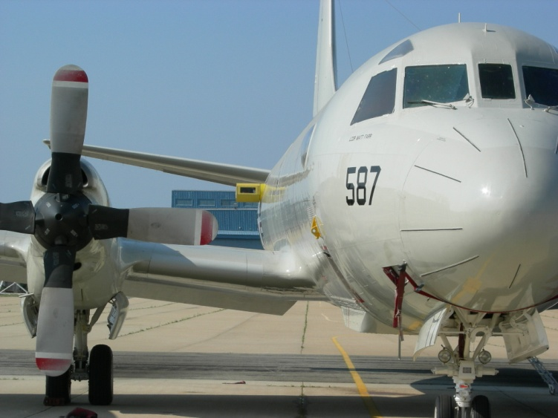
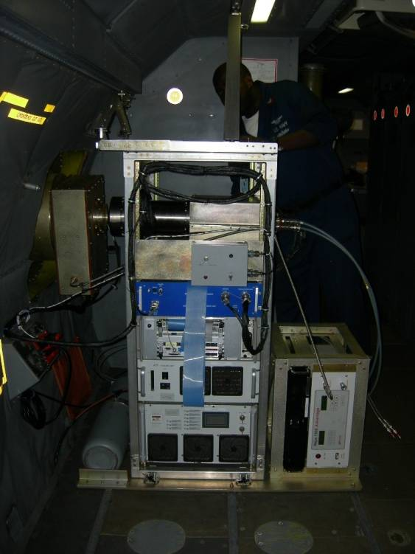
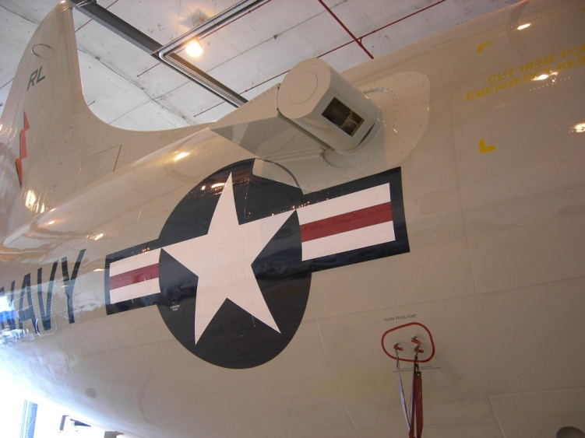
P3DWL for ONR TPARC and NOAA HFIP
1.6 um coherent WTX (ARL/LMCT)
10 cm bi-axis scanner (NASA)
P3 and other parts (NRL)
Analyses software (SWA/CIRPAS)

Slide 5
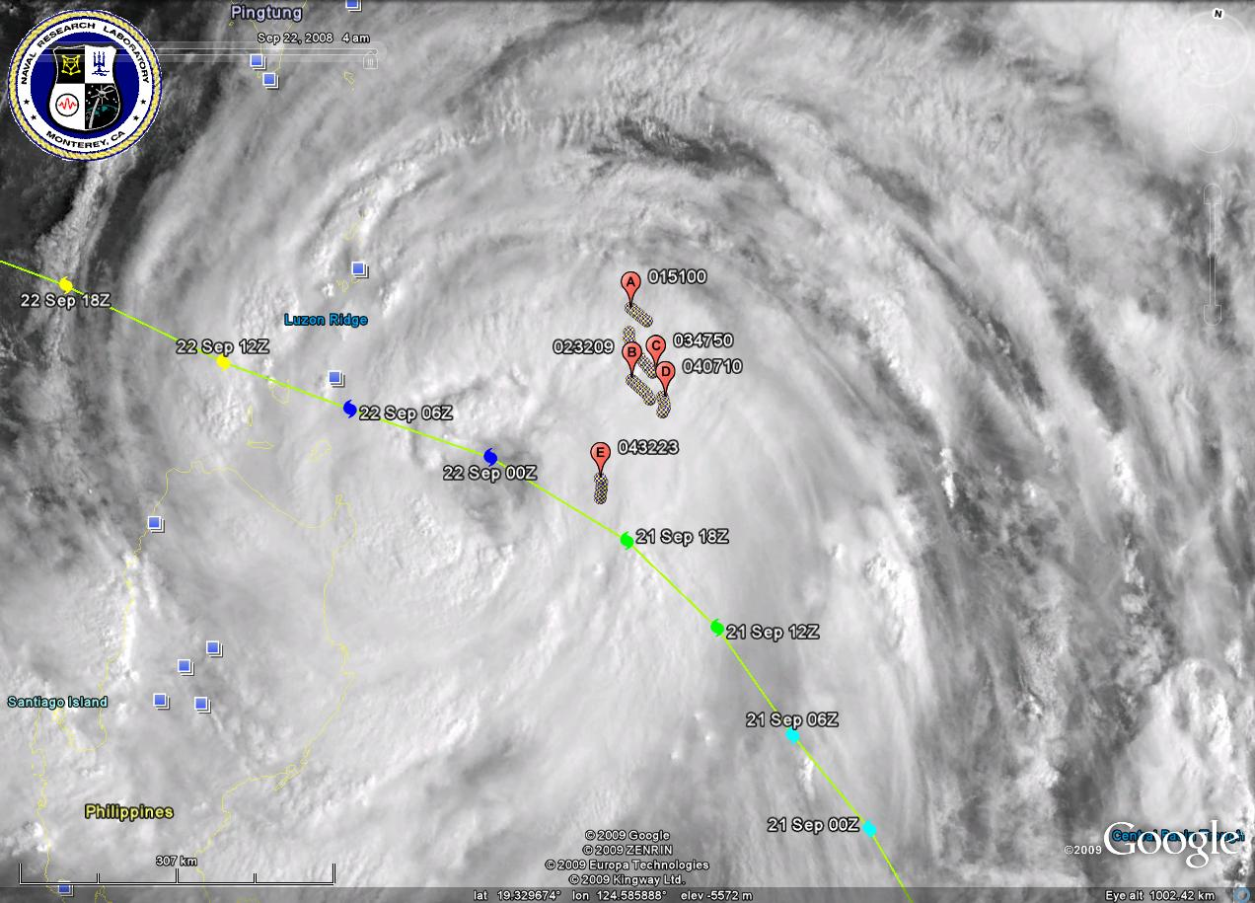

Slide 6
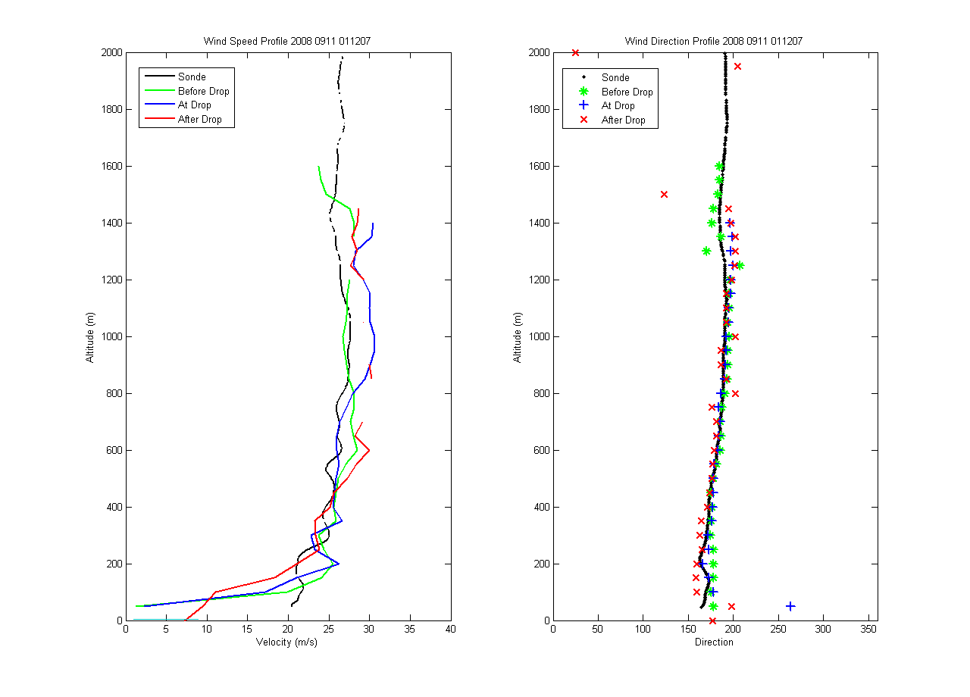
DWL vs. Dropsonde
(high wind speed near eye, no clouds below FL)

Slide 7
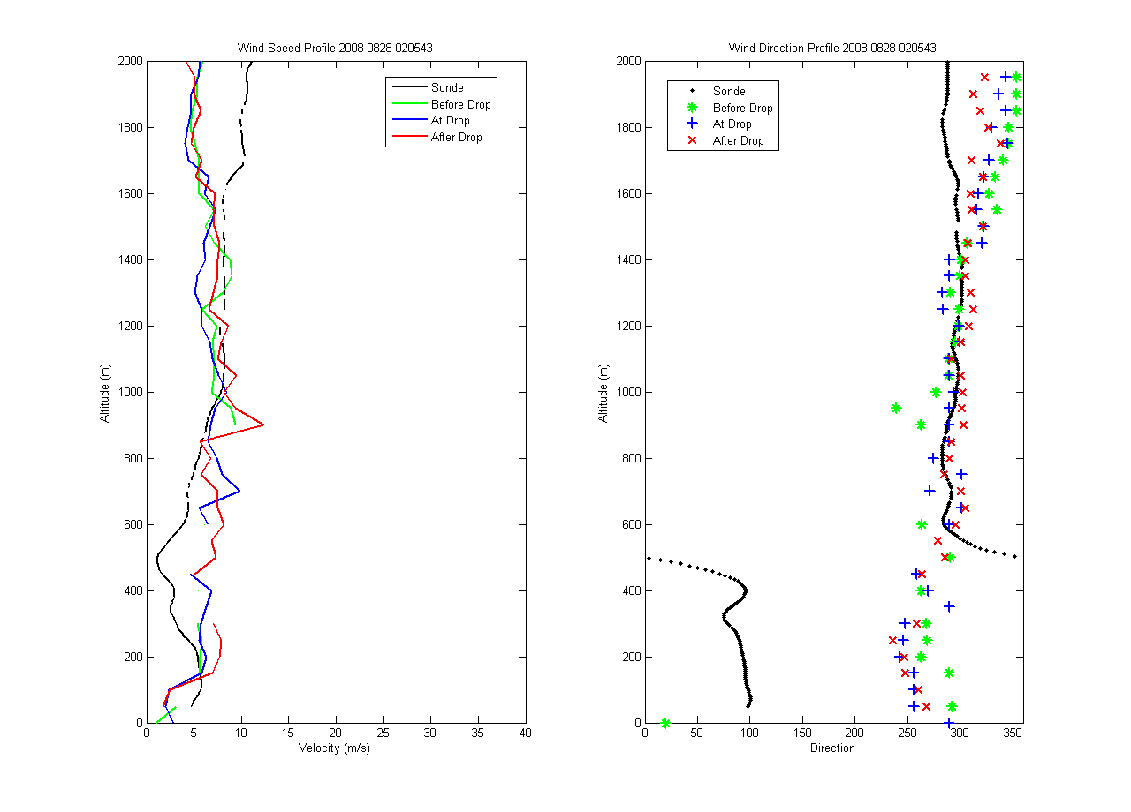
DWL vs. Dropsondes
(low wind speed, no clouds)

Slide 8
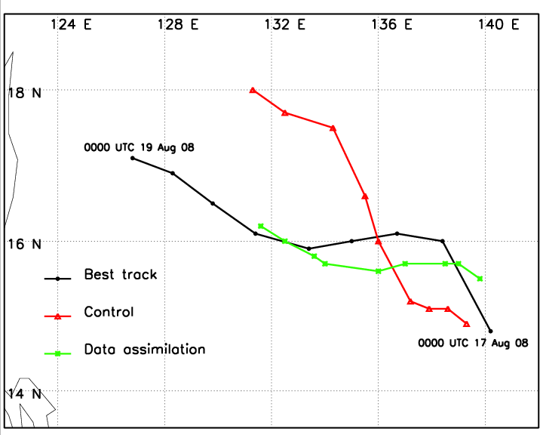
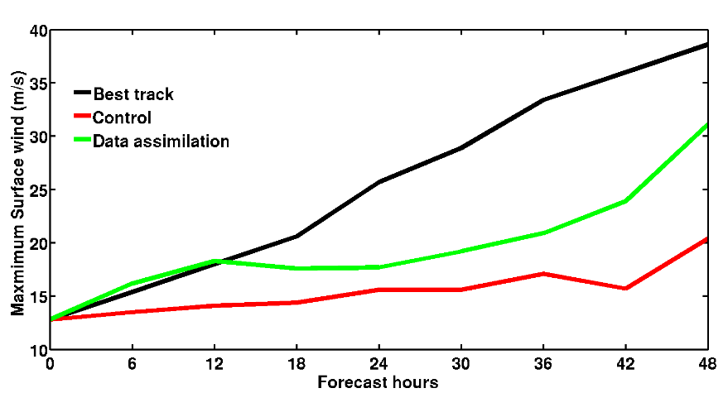
Impact of Airborne Doppler Wind Lidar Profiles on Numerical Simulation
of Tropical cyclones: First snapshot with Typhoon Nuri (2008)
Zhaoxia Pu and Lei Zhang, Department of Atmospheric Sciences, University of Utah
G. David Emmitt, Simpson Weather Associates, Inc.
Model: Mesoscale community Weather Research and Forecasting (WRF) model
Data: Doppler wind Lidar (DWL) profiles during T-PARC for the period of 0000UTC –0200 UTC 17 August 2008
Forecast Period: 48-h forecast from 0000UTC 17 August 2008 to 0000UTC 19 August 2008
Control: without DWL data assimilated into the WRF model.
Data Assimilation: With DWL data assimilated into the WRF model
Data impact: Control vs. Data assimilation
Assimilation of DWL profiles eliminated
the northern bias of the simulated storm
track .
Assimilation of DWL profiles resulted in a stronger storm that is more close to the observed intensity of the storm.

Slide 9
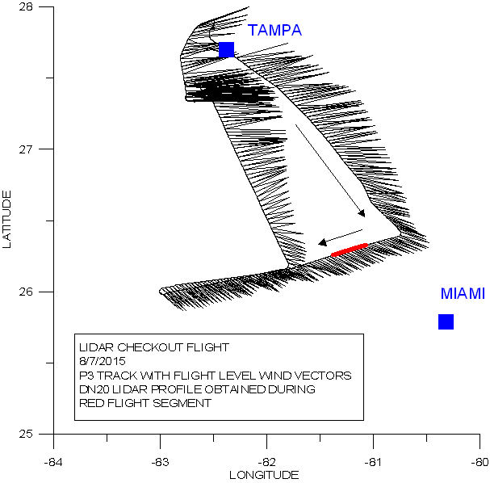
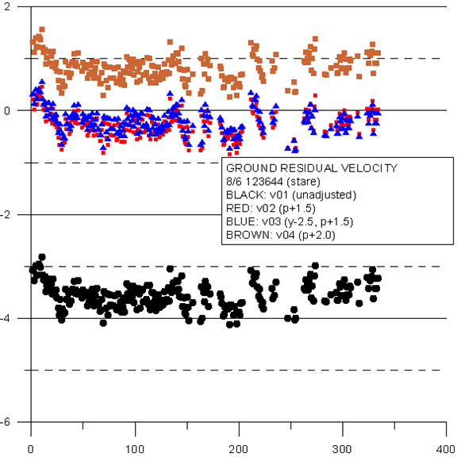
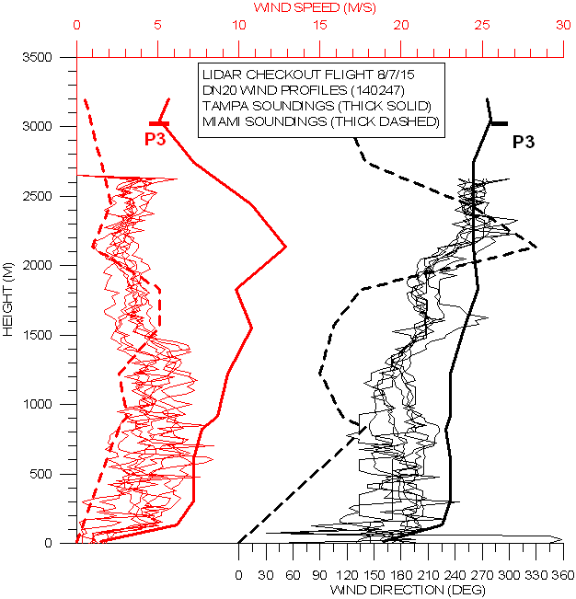
Checkout flight
August 6, 2015
Residual LOS speeds in
ground returns
5 minutes of P3DWL
wind profiles compared
to Tampa and Miami
rawinsonde soundings
Scan pattern was a
12 point step stare
with 20 degree off nadir angle

Slide 10
Scanner issue workaround
Scanner would work properly in the hanger and for the first 1 hour or so after takeoff. The scanner elevation stage would then begin sticking then become unmovable. This problem was more evident at ferry altitudes above 25Kft.
A workaround was coded and sent down to the P3DWL team. The elevation stage was positioned at 30 degrees forward of nadir and the azimuth stage was swept +- 30 degrees in 5 degree increments. Two second dwells at each 5 degree step plus the slew time between stares provided 13 perspectives every 30 seconds.

Slide 11
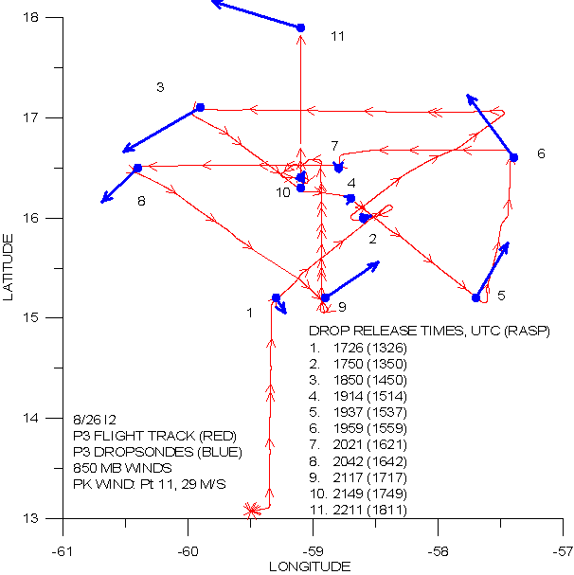
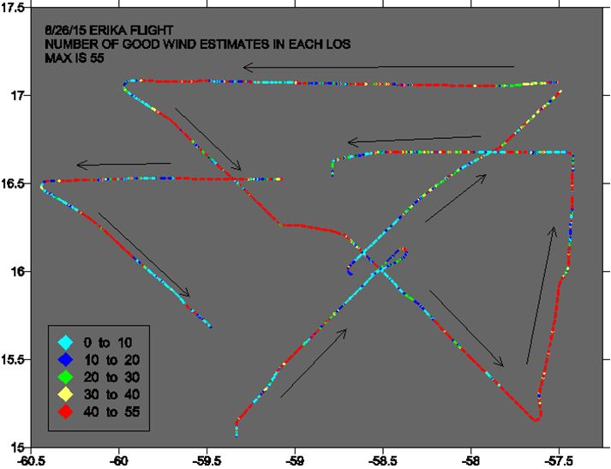
Dropsonde locations and P3DWL coverage
for Erika reconnaissance flight 8/26/15

Slide 12
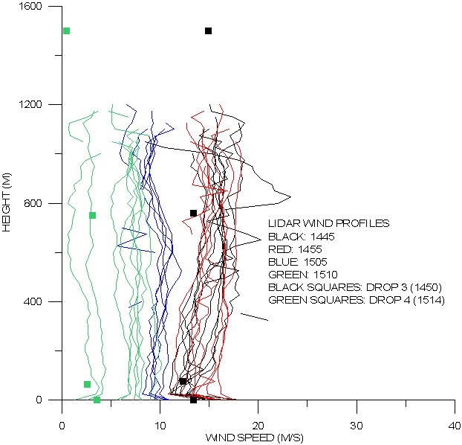
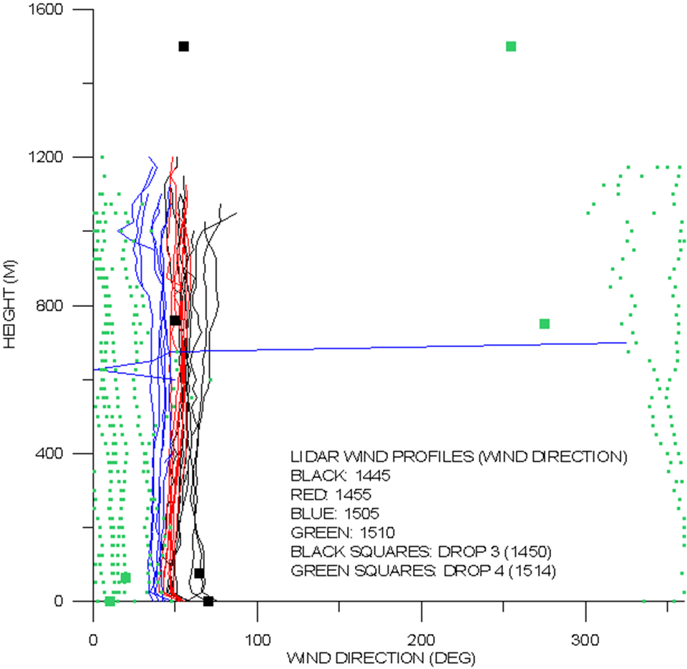
Series of P3DWL profiles and dropsonde data
between drop 3 and 4 in Erika

Slide 13
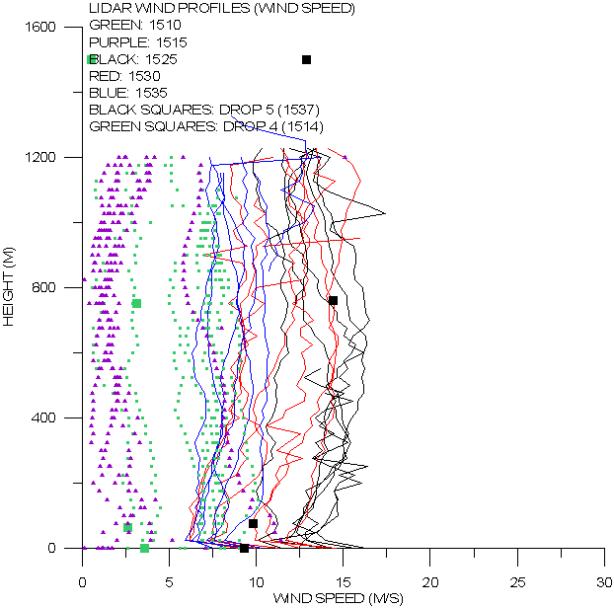
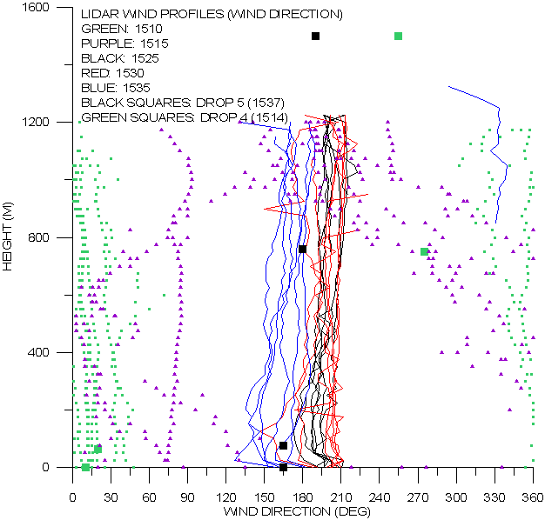
Series of P3DWL profiles and dropsonde data
between drop 4 and 5 in Erika

Slide 14
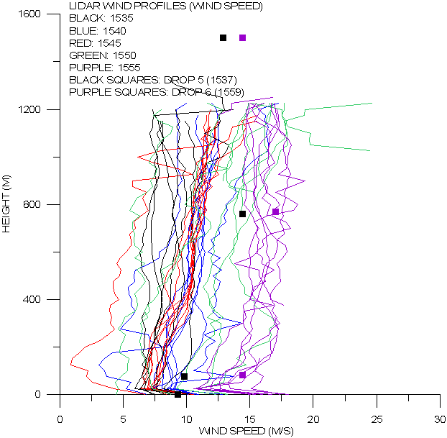
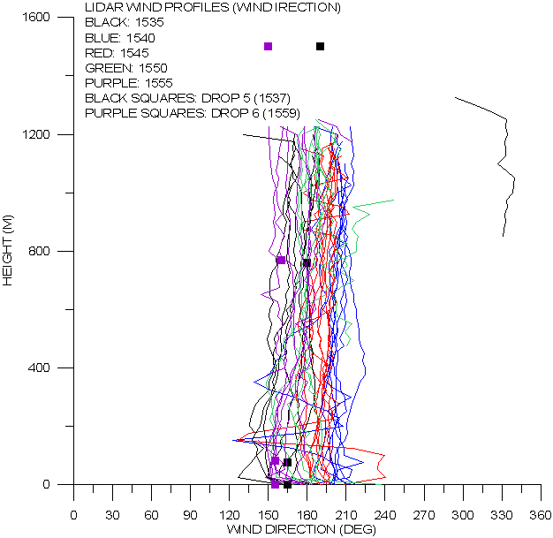
Series of P3DWL profiles and dropsonde data
between drop 5 and 6 in Erika

Slide 15
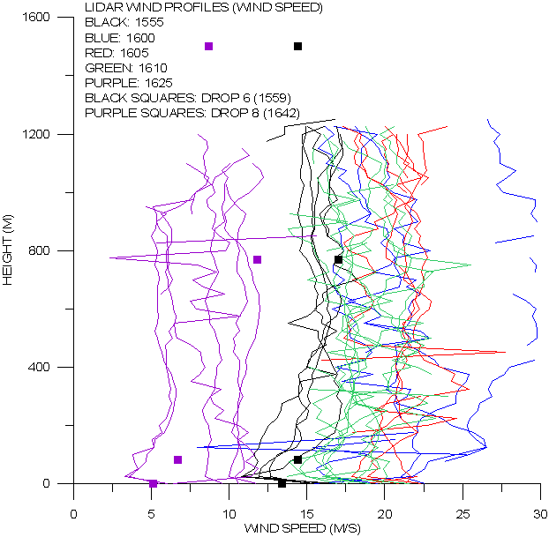
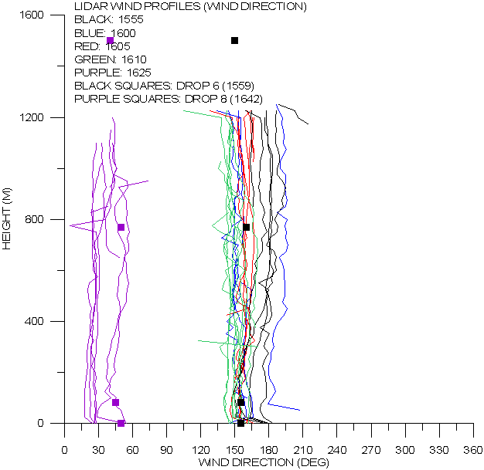
Series of P3DWL profiles and dropsonde data
between drop 6 and 8 in Erika

Slide 16
Comments on sweep soundings
Noisier in the vertical than complete VADs
Profiles of wind speed and wind direction appear to be quite reasonable and show changes along the flight path that are consistent with the more coarse dropsonde soundings.
One question is “ are the differences between sequential P3DWL sweep soundings random ?

Slide 17
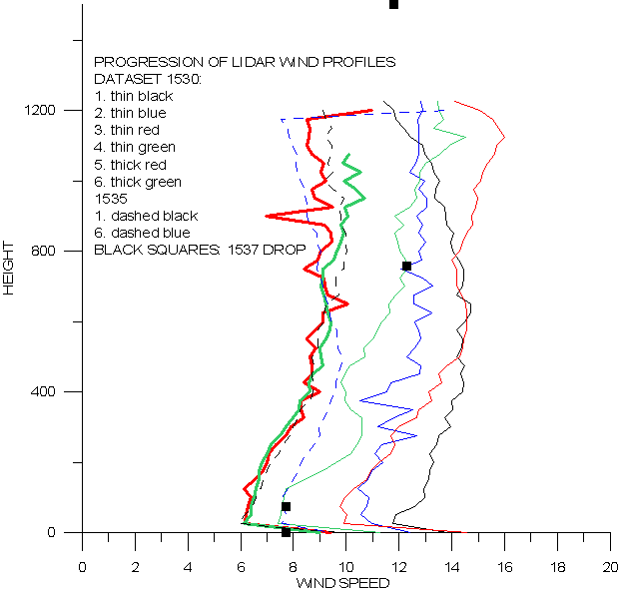
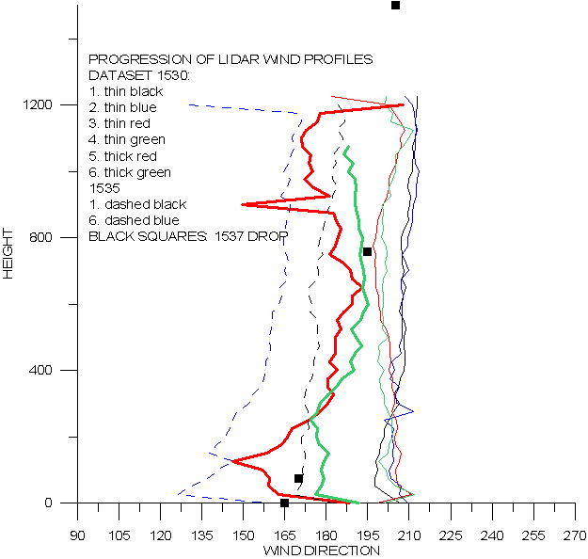
Closer look at profile trends revealed by P3DWL

Slide 18
Plans for 2016
Repair scanner
Spare parts for major components have been found
Planning to conduct temperature chamber tests at NOAA AOC to establish temperature cause of sticking and to checkout any modifications made during the repair.
Add a UPS to guard against power spikes during transfer from APU to aircraft supply.
Assures that system remains stable after startup (~ 15 minutes) and is ready for data taking immediately after takeoff.
Modify data system to capture 100% of data generated by the new WTX
Currently only capturing 20% of 500Hz data stream with old data system
Conduct test flights in spring 2016 on the N43 before it gets new wings.
Transfer system to N42 for the 2016 hurricane season.

