Slide 1
Initial Assessment of the P3 DWL Impact
L. Bucci
Lidar Working Group- Tuesday, November 3rd
Presentation represents collaboration between HRD’s OSSE and DA groups, HFP and SWA

Slide 2
Background
9 flights into Tropical Storms Danny and Erika
7 flights with DWL data
Variety of scanning patterns
Downward conical scans
Down and forward, sweeping side to side
Point and stares

Slide 3
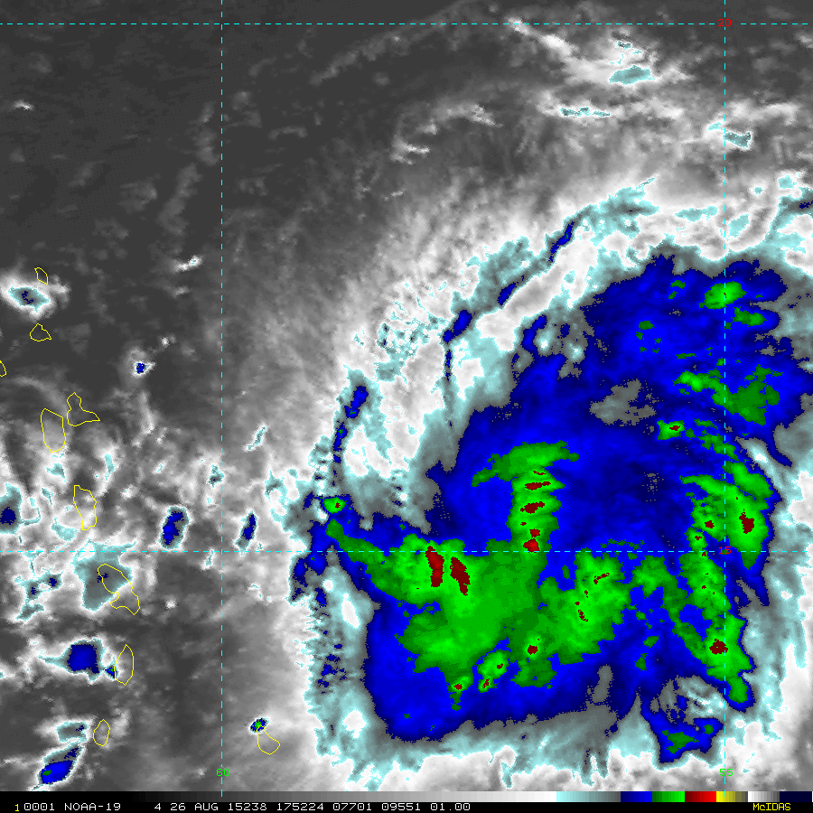
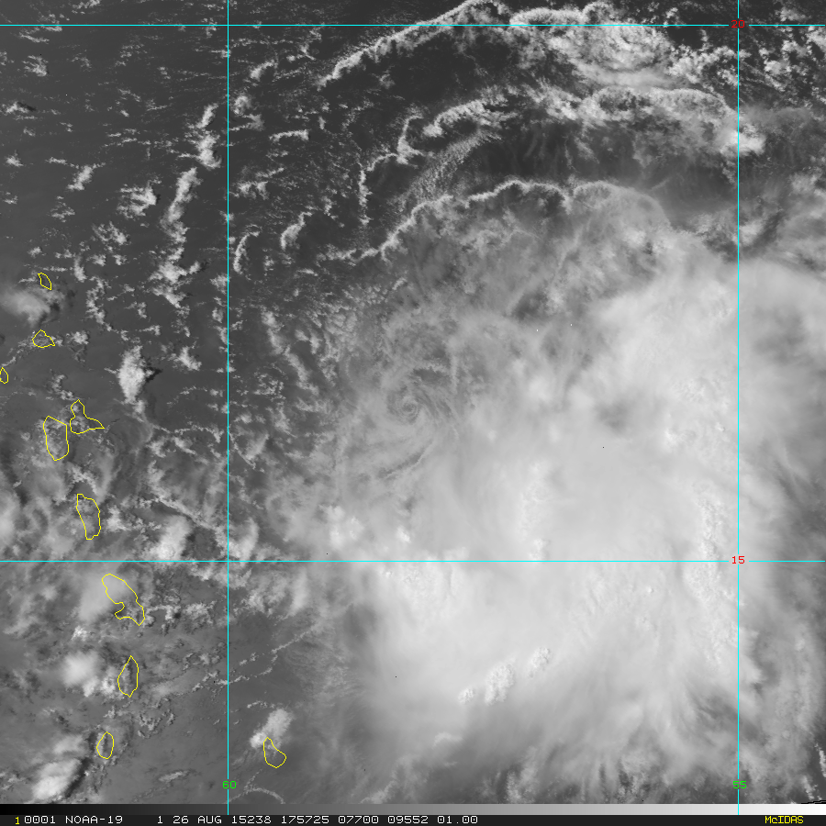
TS Erika: 18 UTC August 26th
Enhanced IR (MODIS/AVHRR
Visible 1 km (MODIS/AVHRR

Slide 4
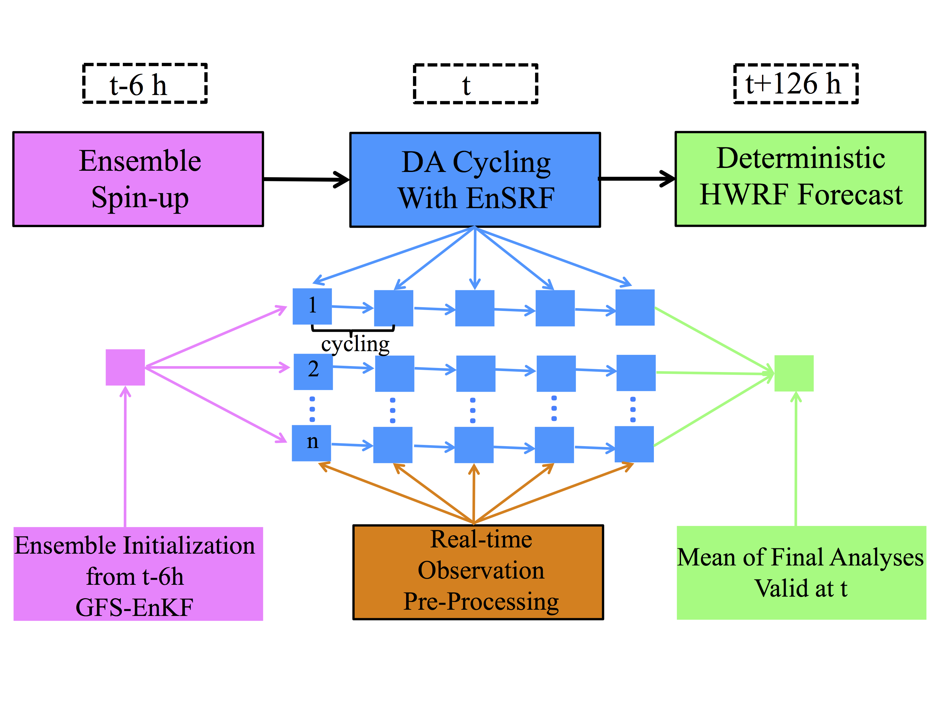
HRD’s Hurricane Ensemble Data Assimilation System (HEDAS)
Ensemble square-root Kalman filter (Whitaker and Hamill 2002)
Storm-relative processing capability (Aksoy 2013)
HWRF modeling system
Hurricane inner-core data assimilation for high-resolution vortex initialization
12Z
18Z
16Z
20Z
Slide courtesy of Hui Christophersen

Slide 5
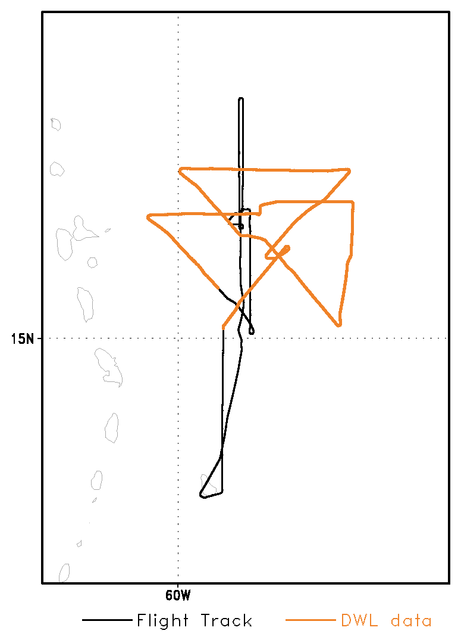
Experiment Setup
Two assimilation/forecasts using HEDAS for 18 UTC Aug 26, 2015:
No DA (model evaluation only)
P3 (standard data only)
Flight level, dropsondes, TDR, SFMR, satellite retrievals
P3+ DWL_thinned
Model horizontal resolution:
Parent domain: 9km
Nested domain: 3km
30 ensemble members
124 hour deterministic forecast (not complete)

Slide 6
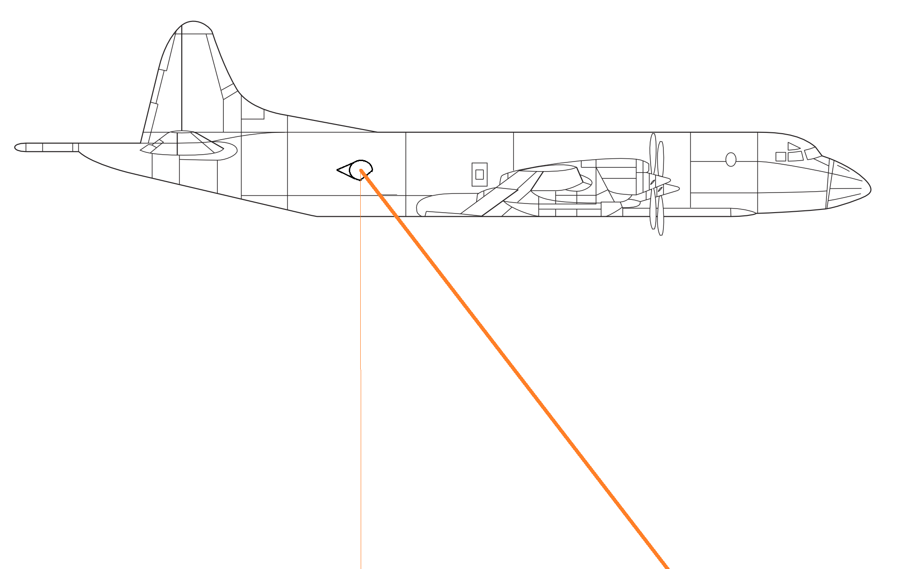
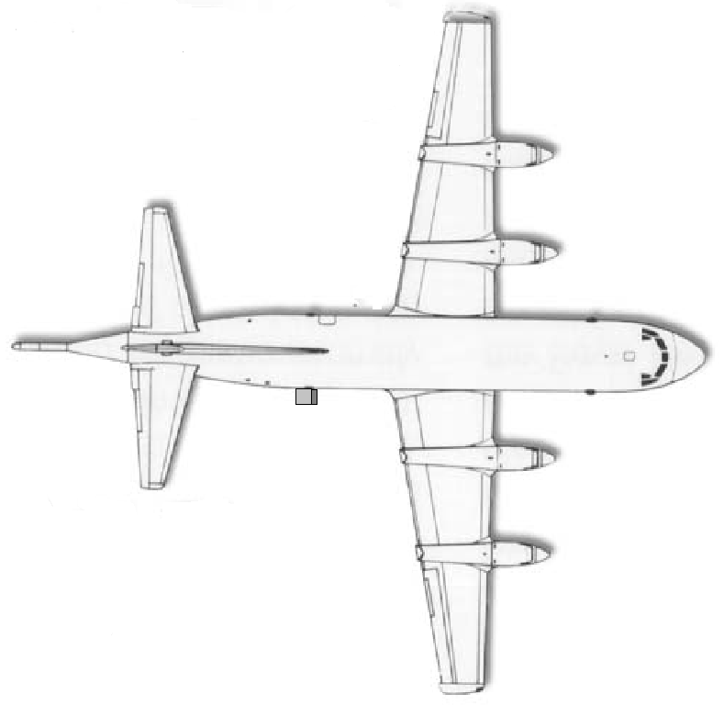
Forward Sweep Scanning Pattern
P3 Orion Side View
P3 Orion Top View
30° off nadir
-10°
5° intervals
+30°

Slide 7
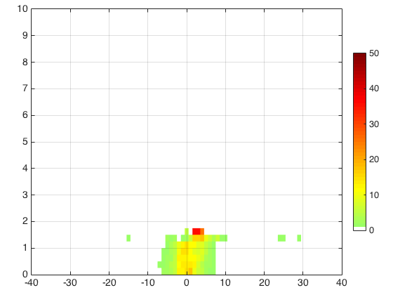
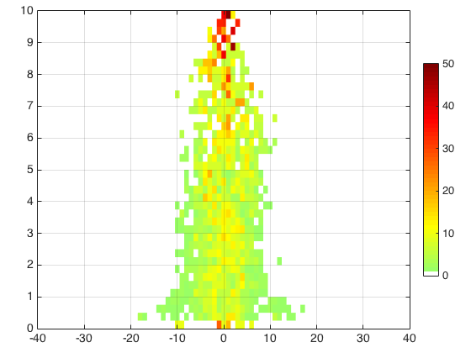
Model Validation: Experiment 1 (NoDA)
Observation-minus-Background
DWL
TDR
Altitude (km)
LOS (m/s)
LOS (m/s)
Colorbar indicates % of population in each bin
Figures courtesy of Altug Aksoy

Slide 8
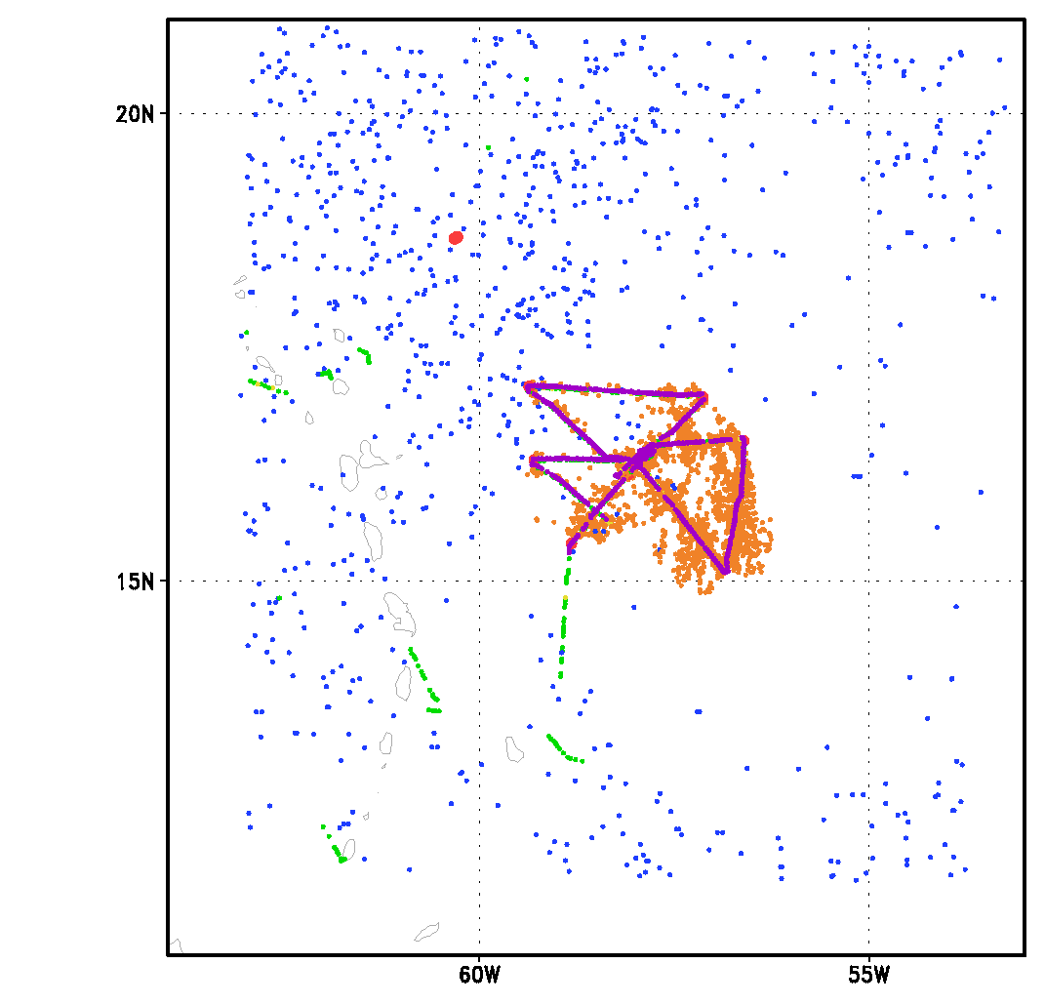
Observation Distribution: Exp. 3
Cycle 1
Number of observations

Slide 9
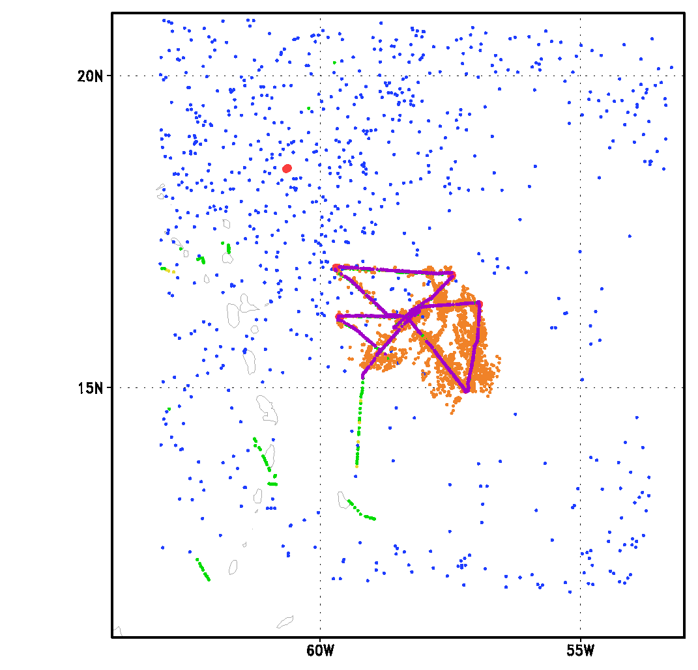
Observation Distribution: Exp. 3
Cycle 2
Number of observations

Slide 10
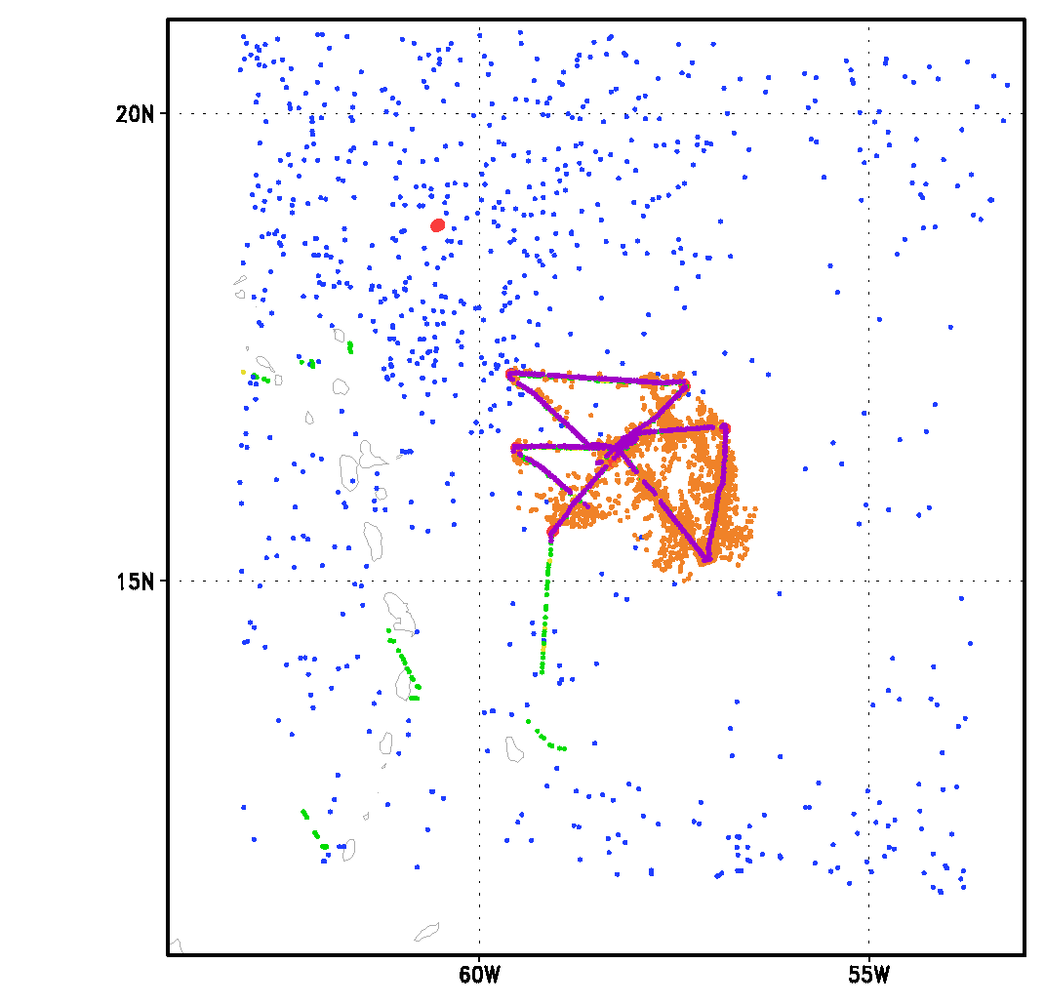
Observation Distribution: Exp. 3
Cycle 3
Number of observations

Slide 11
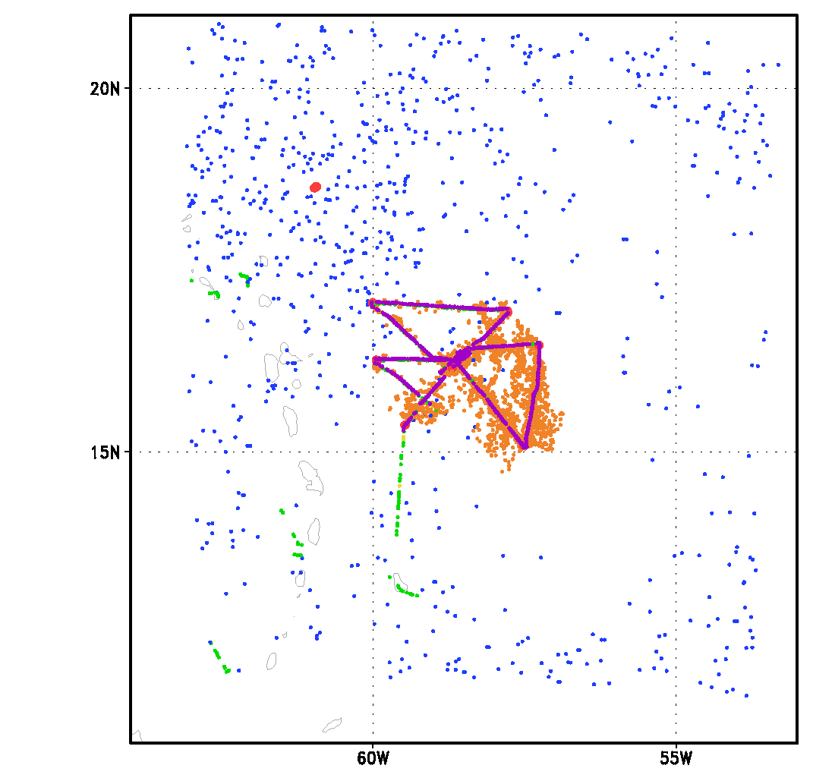
Observation Distribution: Exp. 3
Cycle 4
Number of observations

Slide 12
Observation Distribution: Exp. 3
Cycle 5
Number of observations

Slide 13
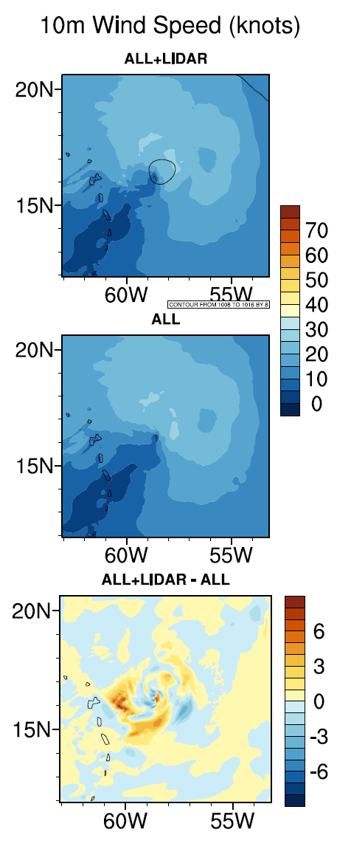
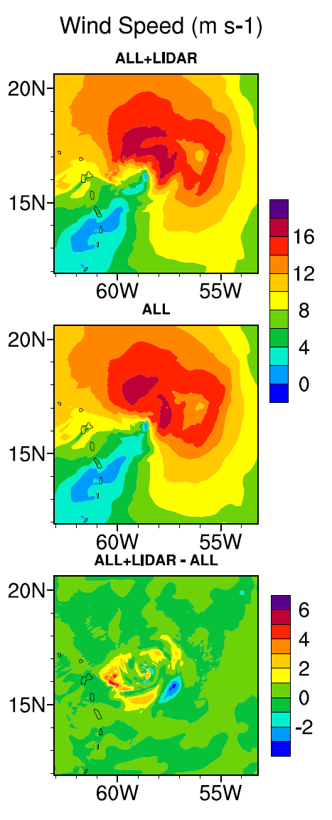
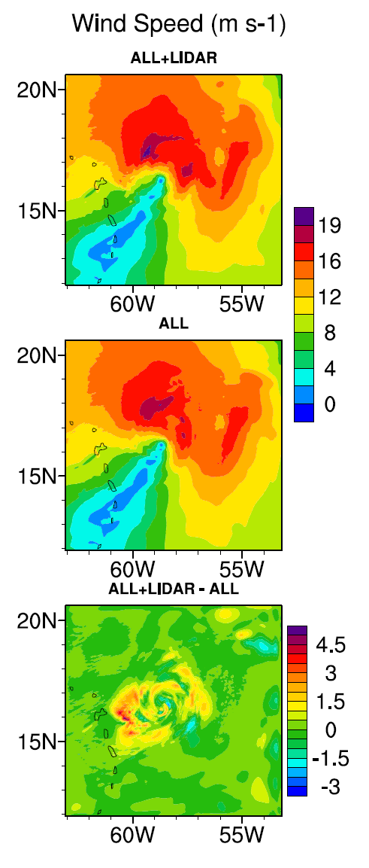
Results: Analyses
P3+DWL_thin
P3
Difference
Field
10 Meters
200 Meters
730 Meters
Figures courtesy of Hui Christophersen

Slide 14
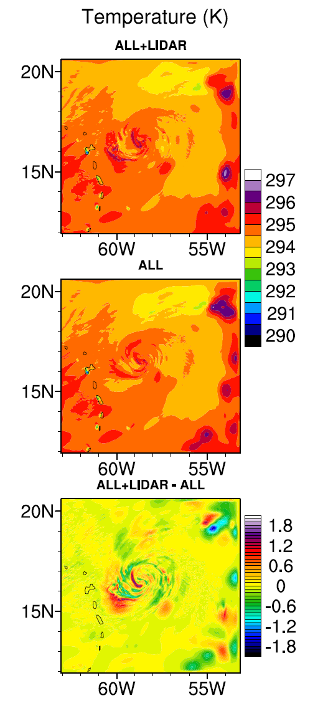
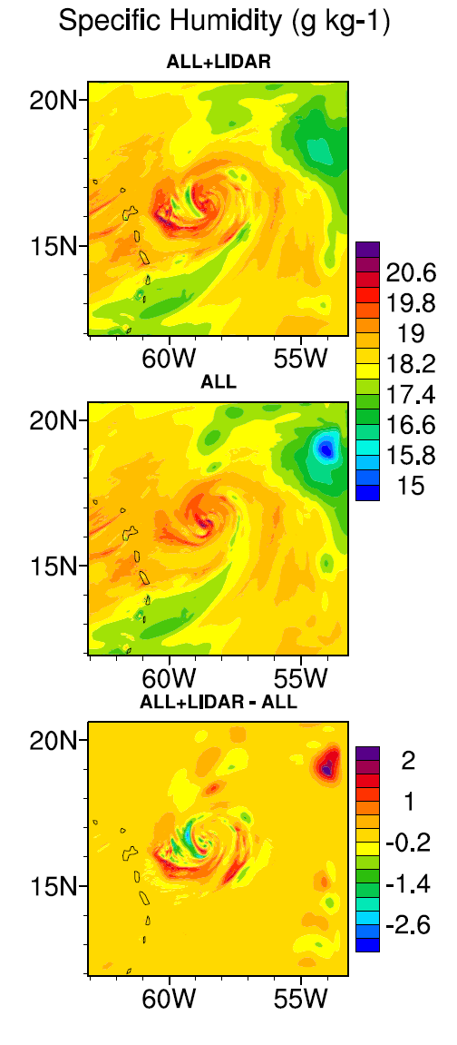
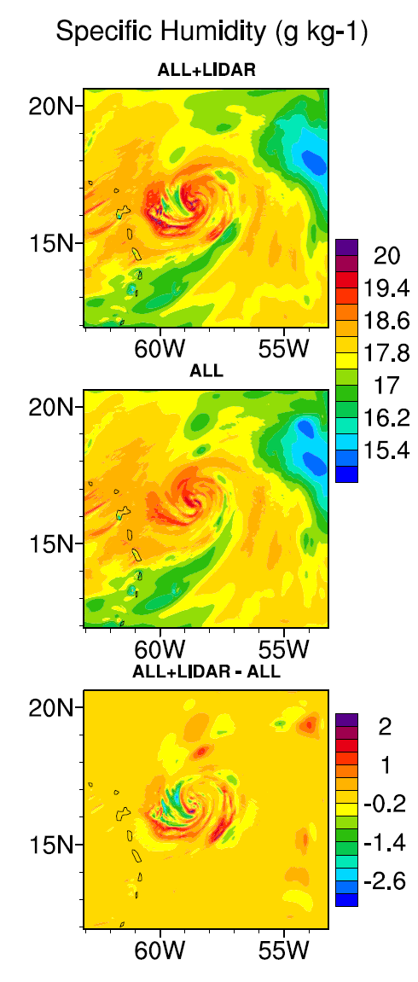
Results: Analyses
Drying
Warming near core
More Moisture
200 Meters
730 Meters
200 Meters
440 Meters
Figures courtesy of Hui Christophersen

Slide 15
Preliminary Conclusions
Experiment 1 (NoDA):
Information content of the DWL dataset is not biased and showed potential to have an impact in the boundary layer
Experiments 2 & 3 (P3 & P3+DWL):
Areas with less TDR data tend to be more greatly influenced by DWL data
Smaller impacts were observed in regions with more TDR

Slide 16
Future Work
OSE Work:
Analyze forecast impact of DWL
Test DWL from the 6 flights
Compare results between assimilating LOS and vector data
Perform experiments with the 2015 HWRF system
Field Work:
Test new scanning patterns
Example: upward scanning
Train new scientists to operate DWL
OSSE Work:
Identify regions in tropical cyclone where the DWL can provide useful information not already collected by other P3 instruments
Test which scanning patterns provide the most useful data within those regions
Kelly Ryan operating DWL on NOAA P3 for Erika mission

Slide 17
Questions?
Taken August 26, 2015 in TS Erika by L. Bucci

