Slide 1
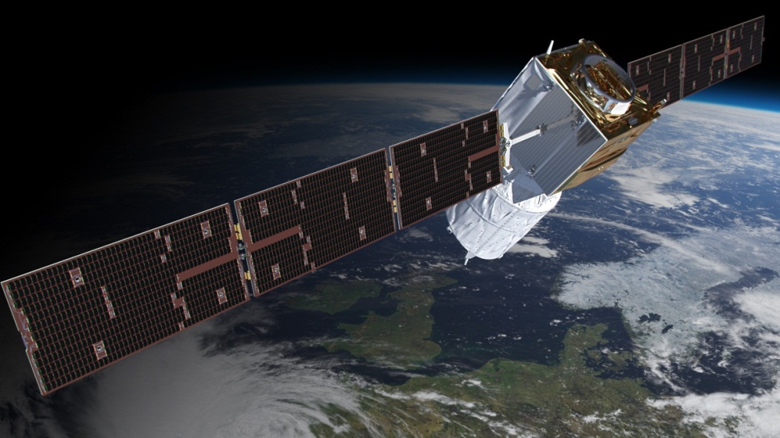
ADM-Aeolus – getting ready for CAL/VAL and the scientific exploitation
D. Schuettemeyer¹, A.G. Straume¹, T. Kanitz¹, F. de Bruin¹, A. Elfving¹,
F. Buscaglione², A. Dehn², S. Casadio², J. v. Bismarck², W. Lengert²
¹ESA-ESTEC, The Netherlands ²ESA-ESRIN, Italy
http://www.esa.int/esaLP/LPadmaeolus.html

Slide 2
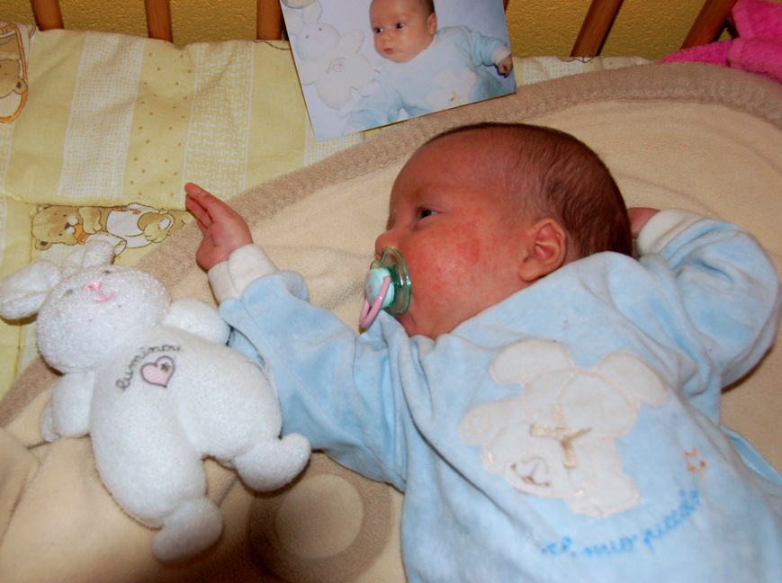
Why are ESA Earth Observation campaigns required ?
Explore EO possibilities before going to space
Prove EO measurement concepts work
Develop interpretation methodology
Develop calibration approach
Develop validation methods using independent data
Simulate data products (pre-launch)
Validate results using independent data
Develop applications
Close range observation during new development phase

Slide 3
Programmatic Background
ESA campaign activities started in 1981
125 campaigns as of September 2015 (+5 since last report)
Typically 4-7 campaigns/year
Strategic objectives:
Support to EO programs
Transnational access to airborne facilities in member states
Partnerships with national and international organisations
Campaign activities address three main areas:
Technology
Mission development
Calibration/validation
Campaign data archive supporting science and applications
Notes:
ESA campaigns strongly linked to EO missions (various phases of development)
Dynamic program
Partnerships to be as effective as possible

Slide 4
Campaigns for different project phases
ESA campaigns are performed during full life cycle of a typical ESA space mission
Different types of campaigns are performed during specific phases of a space mission (concept, feasibility, development and operations)
 | Pre-Phase A | Phase A Feasibility | Phase B Design | Phase C/D Development | Phase E1 Commissioning | Phase E2 Operation | Data Archive
Technology | X | X
Mission Development (Geophysical) | X | X | X | X
Mission Development (Simulation) | X | X | X | X
Cal/Val |  |  |  | X | X | X
Science/ Applications |  |  |  |  |  | X | X

Slide 5
Campaign Phases
E
x
p
e
r
i
m
e
n
t
M
O
p
e
r
a
t
i
o
n
s
i
s
s
i
o
n
a
n
d
d
a
t
a
D
a
t
a
D
a
t
a
P
u
b
l
i
c
a
t
i
o
n
D
e
f
i
n
i
t
i
o
n
D
e
f
i
n
i
t
i
o
n
a
c
q
u
i
s
i
t
i
o
n
P
r
o
c
e
s
s
i
n
g
A
n
a
l
y
s
i
s
o
f
r
e
s
u
l
t
s

Slide 6
Aeolus campaigns in the Past
Objectives:
Validation of the predicted instrument radiometric and wind measurement performance using the Aladin Airborne Demonstrator (A2D)
Establishing a dataset of atmospheric measurements obtained with an Aeolus type Lidar to improve algorithm development
2006 – 2009 A2D Campaigns:
Two ground-based (2006, 2007) and three airborne (2007, 2008 and 2009)
So far, on the order of 100 recommendations for the Aeolus mission (instrument and algorithm development and testing)
First atmospheric measurements worldwide with a Fizeau and Double Fabry-Perot UV lidar system
A further pre-launch campaign in spring 2015 in order to:
extend Rayleigh and Mie observations in highly heterogeneous conditions (vert./hor.)
extend dataset on nadir response calibrations over ice and land
rehearsal and preparation for CAL/VAL activities
Preliminary comparisons of A2D and DLR 2μm wind lidar measurements on-board the Falcon, near Greenland, 2009.
Courtesy: U. Marksteiner, DLR

Slide 7
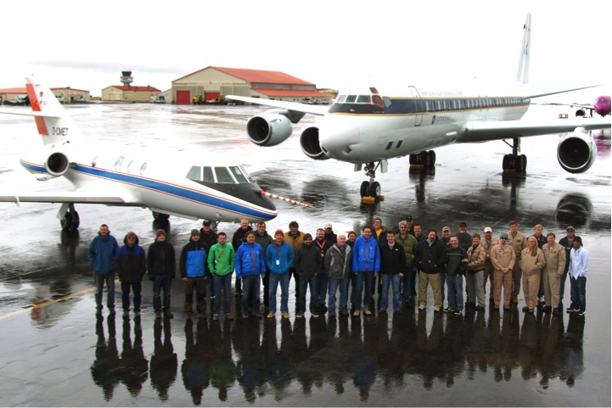
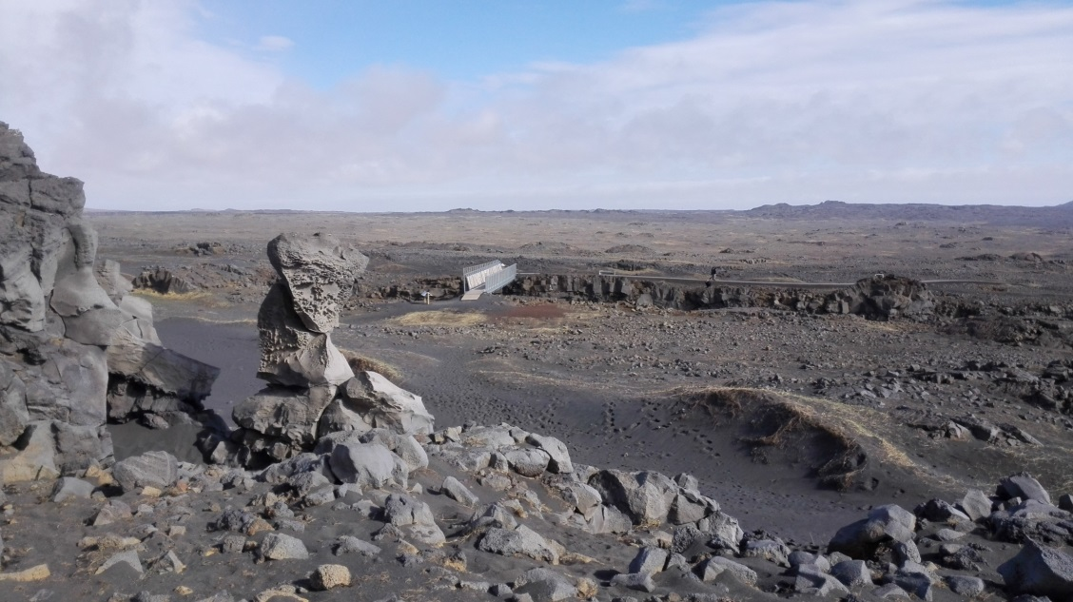
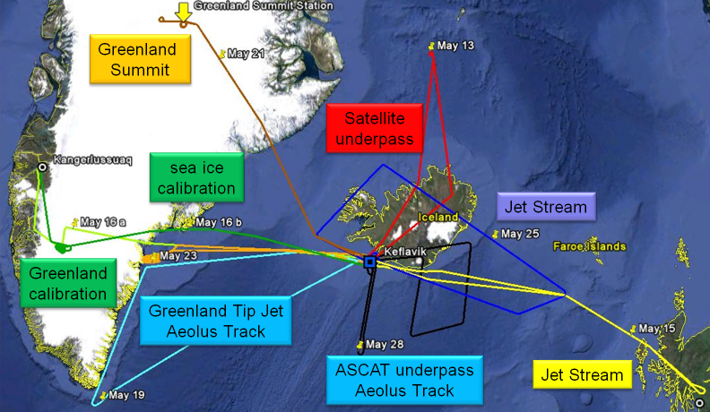
ADM/AEOLUS: WindVal
WindVal campaign team
Campaign details
Campaign executed in collaboration with NASA and DLR in May 2015
First time with collocated 4 Wind Lidars on 2 aircrafts
DLR Payload: The ALADIN airborne demonstrator + 2-µm reference wind lidar
Data processing and analyses underway
DLR Falcon
NASA DC-8

Slide 8
WindVal Objectives
Confirm and document the technical performance of the ALADIN Airborne Demonstrator (A2D) lidar and its suitability for the foreseen calibration/validation of ADM-Aeolus.
Demonstrate the performance and adequacy of the A2D data processing chain for the foreseen Aeolus CAL/VAL campaign
Extend existing datasets on Rayleigh and Mie wind observations. This shall include measurements in highly variable atmospheric conditions (vert./hor.) w.r.t. wind, clouds and aerosols.
Extend existing datasets on response calibrations over favourable areas for Aeolus calibrations, i.e., ice or land with high surface albedo in nadir-pointing mode. As a secondary objective, calibrations during less favourable conditions (cloud contamination or strongly varying ground albedo conditions, PBL snow drift conditions) could be attempted.
Extending measurement dataset in homogeneous and heterogeneous atmospheric scenes w.r.t. aerosols and clouds. Measurements in scenes with low, medium and high backscatter and with different polarization are desirable.
Demonstrate complementarities and synergies between different measurement techniques utilized aboard the same platform, from co-located platforms and on-ground during the campaign.
Demonstrate the ADM-Aeolus capabilities in resolving the vertical structure of the atmosphere and compare measurements to output from numerical weather prediction models.
The execution of a flight(s) leading to A2D and TDS-1 satellite measurements of wind vectors collocated in space and time
Provide feedback on measurement strategies and procedures of data collection for future campaigns
Extend lessons learnt from previous campaigns

Slide 9
Tentative schedule
March 23-30 Start of integration of instruments in DLR Falcon aircraft
end March EMC Test and Ground Tests in Falcon aircraft
April 23 Container pickup at DLR for delivery to Iceland
April 24 Finalisation of airworthiness certification => STC Supplemental Type Certificate
April 29-May 4 Test flight with Falcon aircraft
May 7 First persons from DLR travel to Iceland
May 11 Transfer of DLR Falcon from Germany to Iceland, arrival early afternoon
May 13 First scientific flight
May 28 Last scientific flight ≈ 15 days of operation in Iceland
May 29 Transfer back to Germany (+-1 day depending on weather conditions)

Slide 10
Summary
Scientific analyses on track. Progress Meeting held yesterday
Already successful in providing first feedback on measurement strategies and procedures of data collection for future campaigns
Successful Collaboration between US and EU partners
Supporting missions in development (Level-2 product development, preparation of user community, prototype products, mission design
Supporting wider science community through the ESA campaign database on the EOPI portal

Slide 11
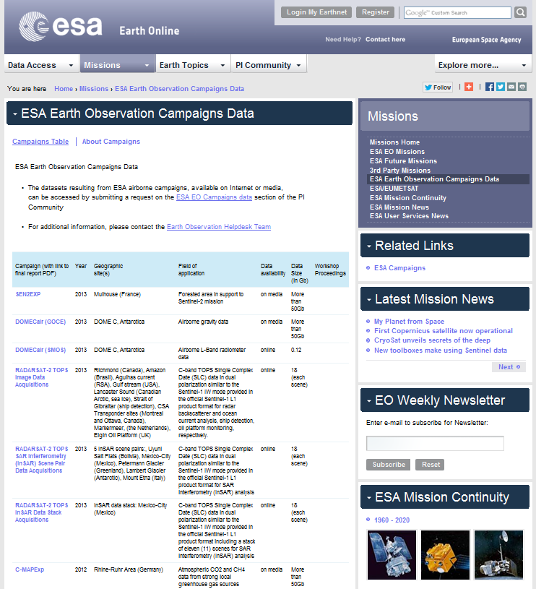
Access to ESA Campaign Data
ESA campaign data available to interested PIs
Formatted and documented datasets
Data Inventory
Final report with full description of campaign activity and analyses
Final report accessible directly through web
Access to datasets provided through Category 1 mechanism (short proposal incl. identification of desired datasets)
Currently 64 campaign datasets available
https://earth.esa.int/web/guest/campaigns

Slide 12
Aeolus CAL/VAL AO delta-call
Call issued May 2014
17 Proposals, all accepted
Individual review reports ready, Summary Report still to be finalized (with 1st draft CAL/VAL Implementation Plan)
Most proposals presented and discussed at Aeolus CAL/VAL Workshop (see next pages)
Next steps:
CAL/VAL Implementation Plan to be drafted and sent to PIs
CAL/VAL Implementation Plan to be presented to DOSTAG (February 2016)
Further CAL/VAL coordination/rehearsal Workshop in 2016 (TBD Wednesday)

Slide 13
Summary Aeolus CAL/VAL Workshop
Workshop Summary provided on
http://www.aeolus-science-calval-2015.org/
~100 participants: Scientific and CAL/VAL community, WCRP, WMO, EUMETSAT, Airbus, ESA, …
Slightly more participants than at Science Workshop in 2006
Aeolus instrument, products, processors and CAL/VAL activities presented
Campaigns, lessons learnt
Science and intended use (mostly via CAL/VAL activities)
CAL/VAL Proposals
CAL/VAL challenges discussed
Recommendations (see next slide)

Slide 14
Further CAL/VAL Schedule
CAL/VAL Implementation plan presentation to member states – February 2016
Further CAL/VAL Workshop 2nd half 2016 to
consolidate CAL/VAL organization and
coordinate with other projects
Satellite launch readiness: Q1 2017
Commissioning Workshop : L+3 months
Phase E CAL/VAL monitoring (coordinated by Mission Manager and Aeolus Product Quality Manager)
ESA: Ground Segment, post-launch support office, steering groups, …
Quality Working Group (selected CAL/VAL teams)
Regular CAL/VAL / science Workshops (substituting a science call)

Slide 15
Recommendations from Aeolus CAL/VAL Workshop
Recommendation 1:
Further promote (the use of) ADM-Aeolus
Recommendation 2:
To contact South American and Alaskan lidar station networks and ask for their interest in participating in Aeolus CAL/VAL
Recommendation 3:
To contact the Australian lidar network and ask for their interest in participating in Aeolus CAL/VAL
Recommendation 4:
To organize an Aeolus Science Workshop in collaboration with ECMWF and WCRP
Recommendation 5:
To coordinate polar CAL/VAL efforts for Aeolus

Slide 16
Actions related to the recommendations
Promotion on the way e.g. Anne Grete Straume attending SPARC meeting
Campaign ideas for collaboration with South-America under development; ALCANTARA
bilateral meeting with Australia ( CSIRO and Geo Sciences Australia) is planned for the November 5.

Slide 17
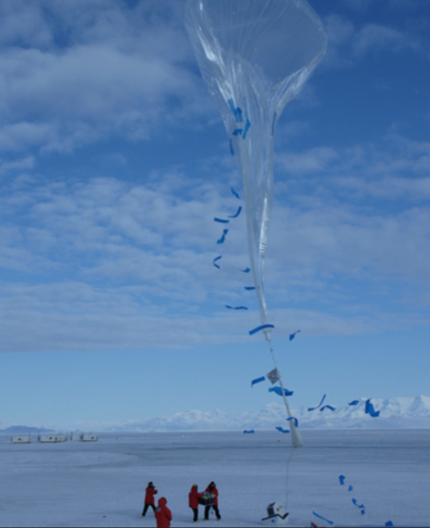
Recent related developments
Capacity building in new ESA member states
HRSL airborne lidar development (RO, PO)
Multimission atmospheric campaign AROMAT-1/-2 (RO)
Young Graduate Trainee & Research fellow to work on campaign data
International collaboration leading to enhanced campaigns and science return (Member states, EUFAR NASA, NSF…)
Develop pre-launch campaign plans for EarthCARE
Strateole-2: Turbulence and mixing Dynamics of the Equatorial Stratosphere

Slide 18
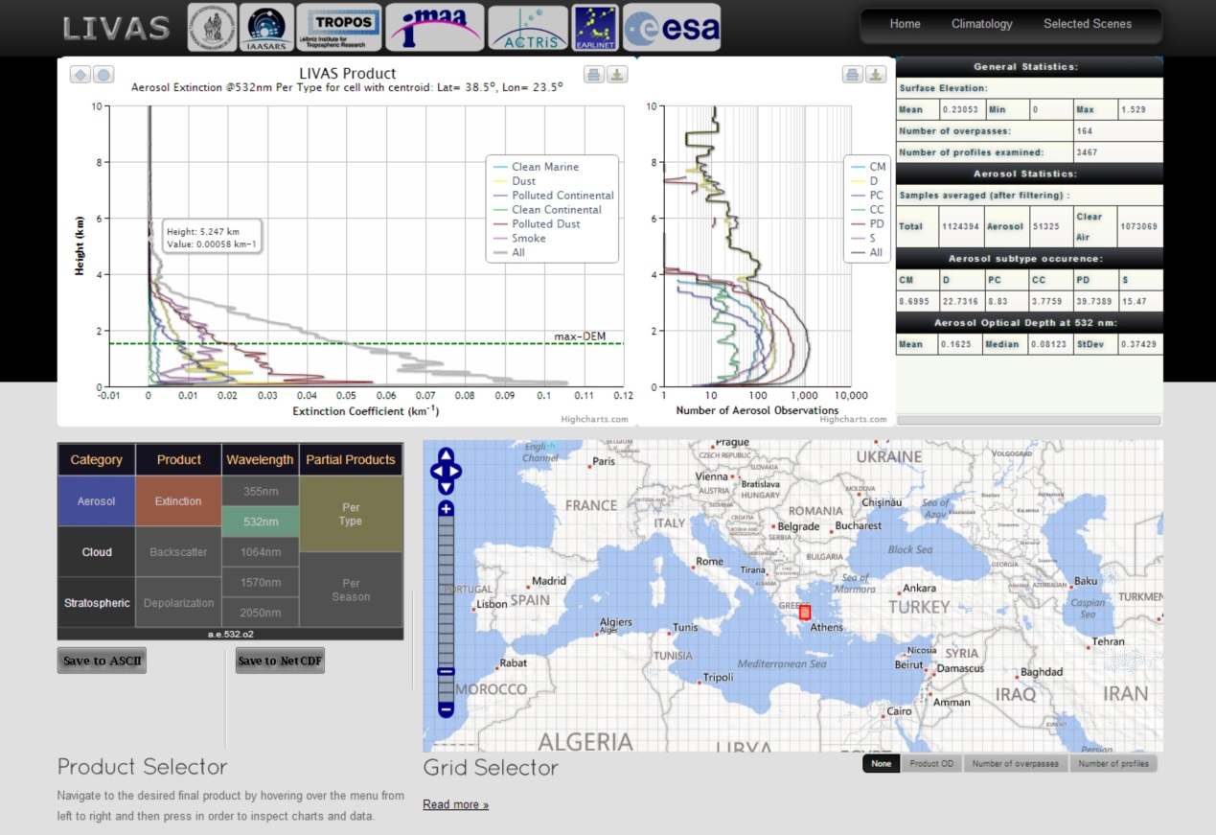
LIVAS
LIVAS is aiming to provide a climatological database of the aerosol/cloud vertical distribution at 355nm based on the almost 10-year dataset provided by CALIPSO at 532 nm.
The optical properties provided so far are the extinction and backscatter coefficients, while new studies in the framework of the CHARADMexp and DEDICAtE ESA studies are expected to provide conversion factors also for the depolarization ratio, aiming to upgrade LIVAS also for this parameter at 355nm.
http://lidar.space.noa.gr:8080/livas/

Slide 19
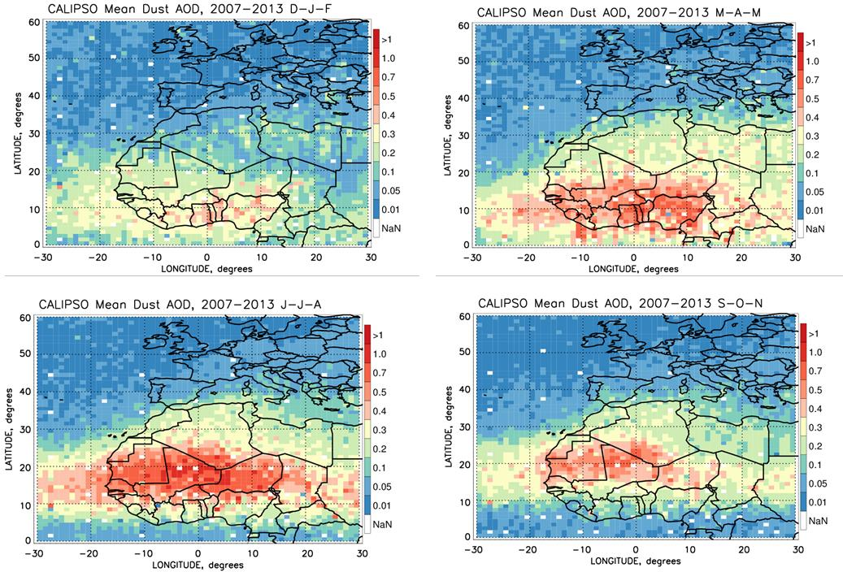
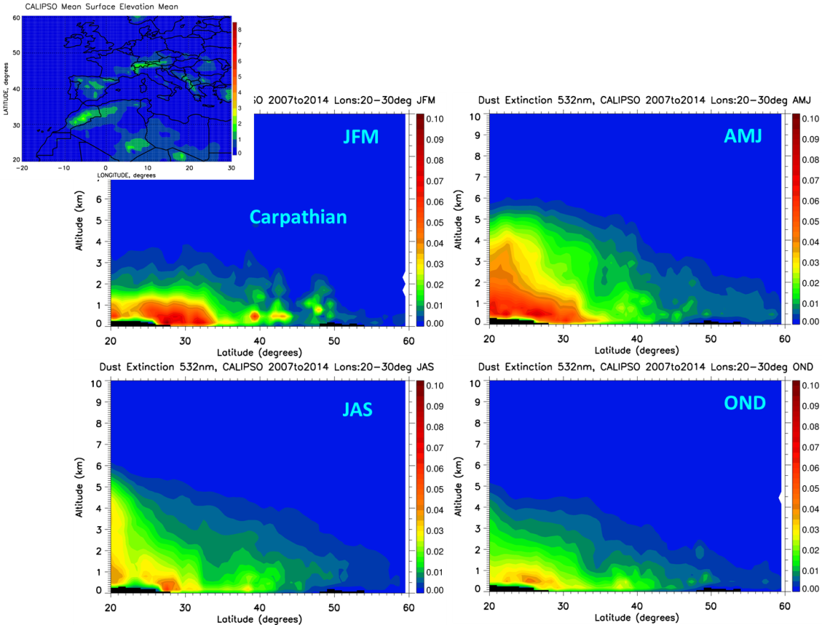
A new algorithm has been developed that delivers for the first time, the dust aerosol 3D distribution.
This is achieved through the use of combined depolarization and backscatter CALIPSO products along with dust microphysical properties taken from the EARLINET European Lidar Network.
The database is provided by NOA (contact: Vassilis Amiridis) and beyond its scientific significance, it will be used for pointing (and potentially correcting) ADM aerosol byproducts in dusty environments.

Slide 20
Scientific Validation Implementation Plan
Authors: AGS, DS (ESA EO Mission Science Division) with inputs from Aeolus project, EOP-GQ, MAG, and Validation teams
Draft from February in-line with CAL/VAL Plans from latest EE and GMES missions
Being reworked to follow closer Cryosat CAL/VAL Plan model
To be presented to DOSTAG February 2016

Slide 21
Aeolus CAL/VAL Implementation Plan - Content
Present mission and products in brief
Role of CAL/VAL Teams, Algorithms teams, ESA and industry
Phase E1 and E2 timelines
List Aeolus CAL/VAL requirements/objectives referencing:
MRD (ESA Mission science division)
CAL/VAL Requirements document (ESA Mission science division)
Commissioning and CAL/VAL Plan (Aeolus Project)
List Aeolus CAL/VAL Call requirements and link them to products
List CAL/VAL Proposals, facilities, instrumentation, etc.
Present maps and tables of geographical coverage (land, upper air, models, …)
Map proposals to CAL/VAL objectives
Gap analysis
Present data distribution, analysis, and further facilities - ESA

Slide 22
Objectives and use
Clear roadmap for CAL/VAL organization of activities
Areas covered
Gap analysis
CAL/VAL coordination
Include Aeolus Workshop brainstorming input
For funding agencies to attract national funding
For ESA to organize product monitoring in phase E2
Outcome of activities shall contribute to demonstration of mission fulfilment of MRD

Slide 23
Examples of Implementation Plan content (1/6) – CAL/VAL timeline
Launch
3 months
IOCR
Industry
Launch
Campaign
LEOP
IOV and
Commissioning
IOCR and
E2 Preparation
E2 Phase
Mission
Management
Data
Quality
Cal/Val
Continuation
LEOP -
Launch and Early Operations
IOV -
In Orbit Verification
IOCR -
In Orbit Commissioning Review
ESA
GSOV &
Preparation
Commissioning of Payload Data Ground
Segment and Flight Operations Segment
Management and Operations
GSOV -
Ground Segment Overall Validation
CalVal
Teams
CalVal
Preparation
CalVal
Preparation
Initial CalVal Phase
E2
Preparation

Slide 24
Examples of Implementation Plan content (2/6) – Link parameters and requirements

Slide 25
Examples Implementation Plan content (3/6) – Summary of CAL/VAL activities
Activity Schedule
IP | Name | Address | Topic | Pre-Launch | Phase 1 | Phase E2 | Remarks
5156 | DABAS Alain | W, A | RO, AC, GC
5166 | Apituley Arnoud | W, A, C | GC
5177 | Hardesty Robert Michael | W, A, C | RO, AC, GC, M, S
5186 | Baumgarten Gerd | W, A | RO, GC, M
5188 | Apituley Arnoud | W, A, C | RO, GC
5190 | Stoffelen Ad | W, A | M, A
5192 | Schyberg Harald | W, A, C | RO, M, A |  |  |  | linked to 5186
26989 | Gausa Michael | W, A, C | AC, GC
27329 | Reitebuch Oliver | W, A | AC, GC
27389 | Stebel Kerstin | W, A | RO, GC, S
27409 | Amiridis Vassilis | A, C | RO, GC
27411 | Wu Songhua | W, A, C | GC
27449 | Zagar Nedjeljka | W | M
27529 | Forsythe Mary | W, A | AC, M, S
27589 | Ishii Shoken | W | GC
27590 | Joe Paul | W, A, C | RO, GC, M, S
28295 | Kushner Paul | W | M
 | W = Wind | RO = Routine Operations |  |  |  | funding secured
 | A = Aerosol | AC = Airborne Campaigns |  |  |  | funding partly secured
 | C = Clouds | GC = Ground Based Campaigns |  |  |  | no secured funding
 |  | M = Model Studies |  |  |  | unknown
 |  | S – Other satellite obs
 |  | A – Alternative L2 products

Slide 26
Examples Implementation Plan content (4/6) – Mapping activities to CAL/VAL objectives
Site | PI | 1 | 2 | … | 6 | … | 12…
Cabauw | Apituley |  |  |  |  |  | ☑
Greenland | Reitebuch | ☑ | ☑ | ☑ |  | ☑
Tropics | Dabas |  |  |  | ☑ | ☑
…

Slide 27
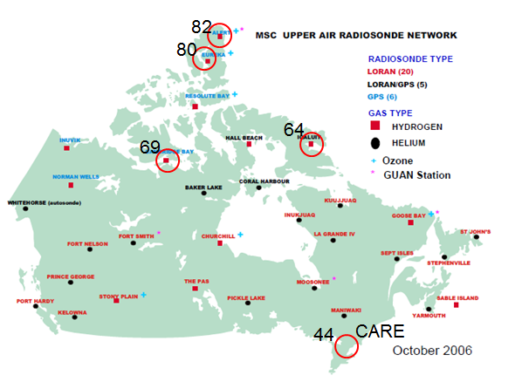
Examples of Implementation Plan content (5/6) – Geographical coverage - maps
Figure 1: Environment Canada radiosonde network . Red circles, marked with latitude, represent existing research sites that could serve as ADM‐Aeolus super‐sites.

Slide 28
Examples of Implementation Plan content (6/6) – Presentation of facilities

Slide 29
Conclusions and general perspectives
2 Successful pre-launch campaigns so far
Recommendations from the workshop are discussed
Reworking current draft to include more elements as found in Cryosat CAL/VAL Plan
Review by CAL/VAL PIs - mid November/December
Presentation to DOSTAG - February 2016

