Slide 1
ADM Cal/Val 2015: DAWN and Dropsonde contributions
G. D. Emmitt
Simpson Weather Associates
M. Kavaya
NASA/LaRC
Lidar Working Group Meeting
Miami, 2015

Slide 2
Polar Winds & ADM Cal/Val Team
Emmitt, Greco and Godwin, SWA
Michael Kavaya, NASA/LaRC
Grady Koch
Bruce Gentry and H. Chen, NASA/GSFC
John Cassano, CU
Keith Hines, OSU
Dave Winker, NASA/LaRC

Slide 3
Science (PolarWinds)
Tip Jet
Two visits; one ideal; the other was confounded by clouds and weaker than model predicted.
Marginal Ice
Four visits; one failure due to clouds; other two were ideal
Katabatic flows
Two visits; two ideal
Iceland flow splitting
One experiment; successful

Slide 4
Satellite underflights
CALIPSO
One successful underflight
MODIS
Six underflights
ASCAT
Eight underflights (no clouds)
TDS-1
One underflight with Falcon

Slide 5
ADM Cal/Val
Shear aloft
High level jet between Iceland and Scotland
High level jet along southern east coast of Greenland
Ice surface calibration
Three segments over the Greenland ice cap
TDS underflight
1st formation flight with Falcon
ADM stares by DAWN
Two > 100km legs

Slide 6
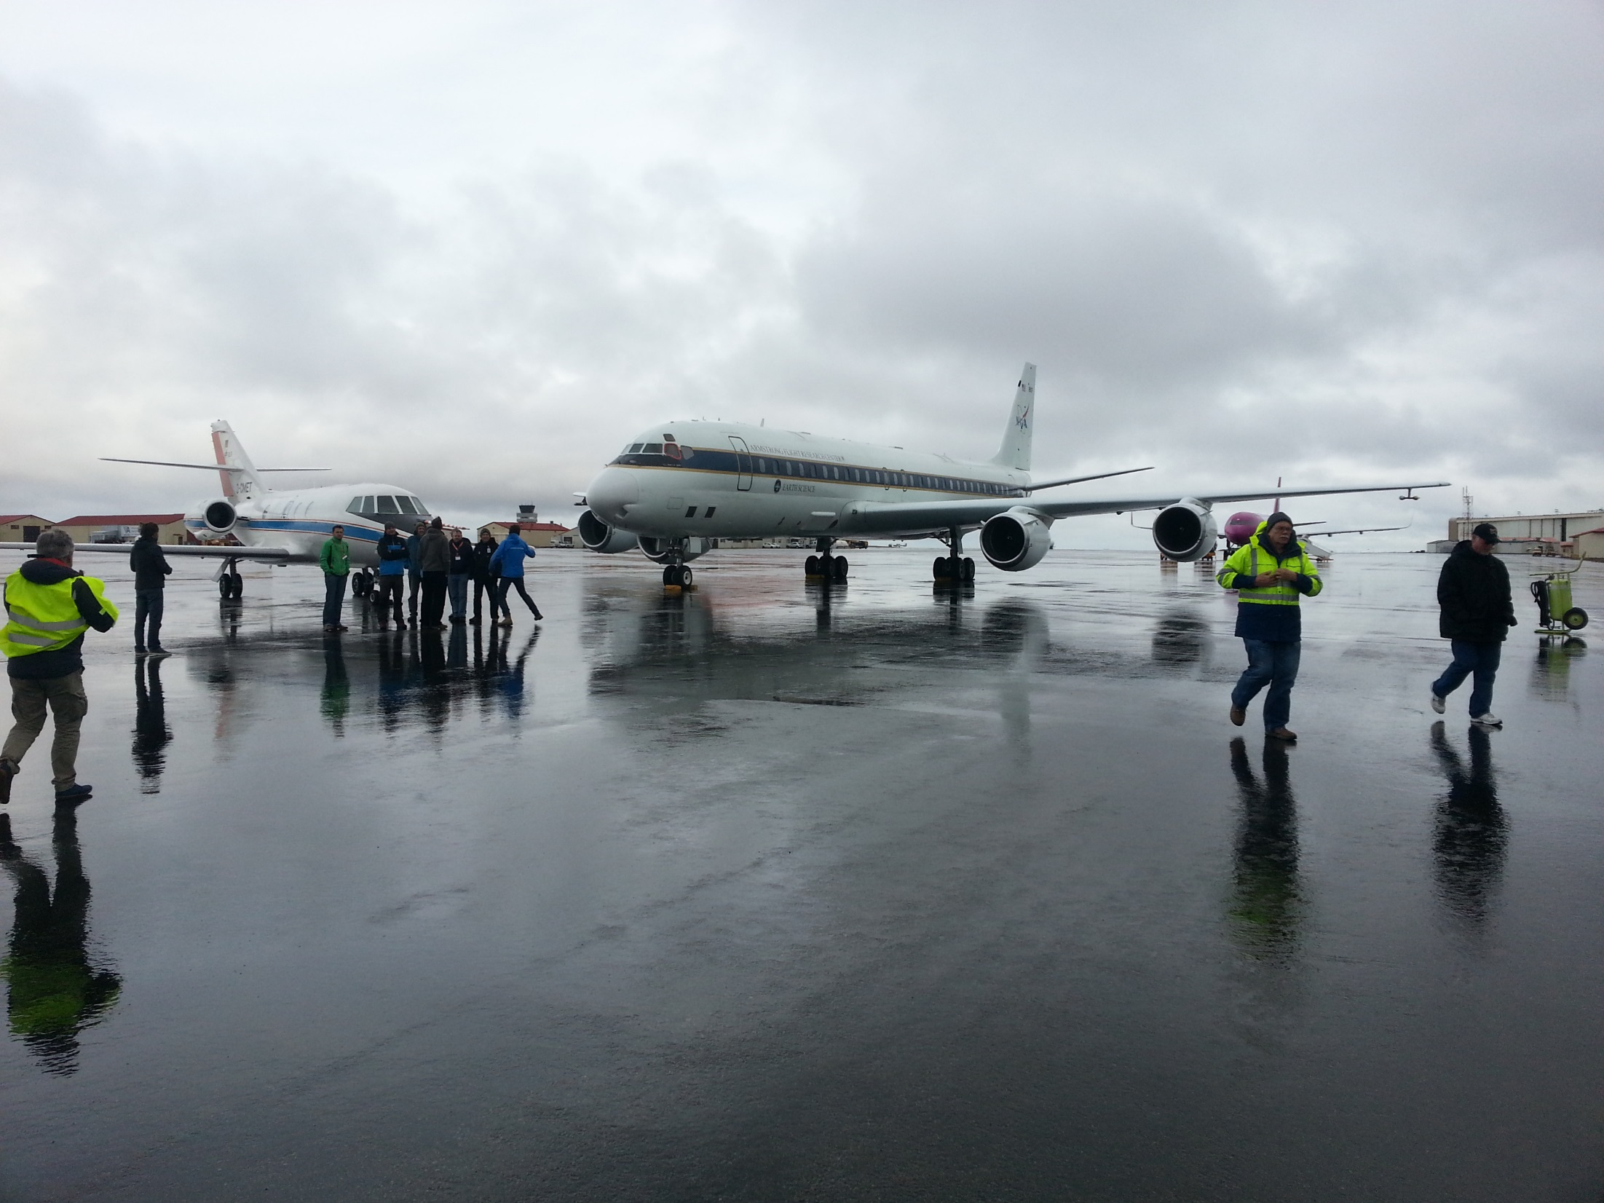

Slide 7
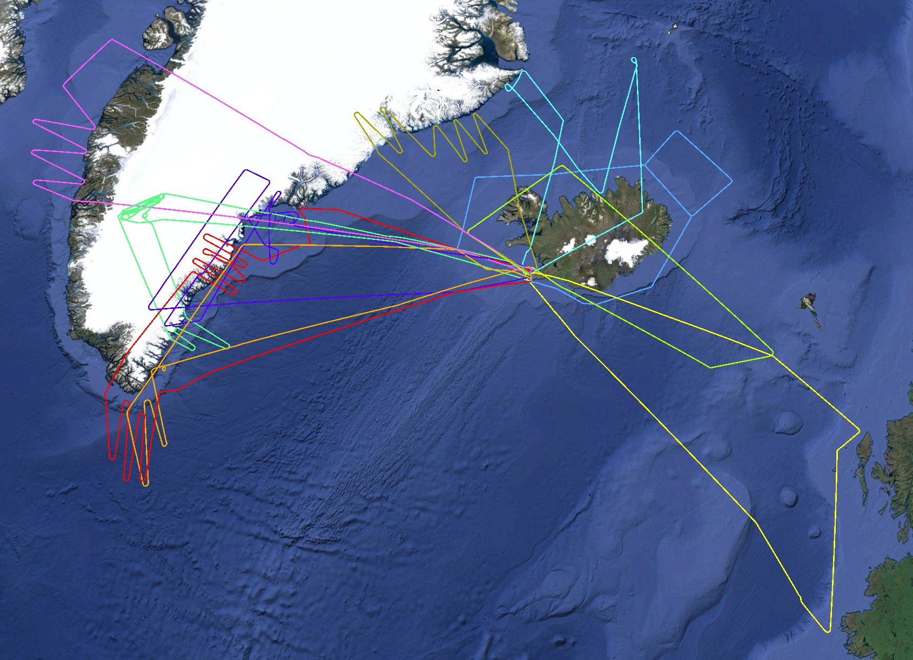
2015 May 24
2015 May 13
2015 May 11
2015 May 21
2015 May 16
2015 May 25
2015 May 23
Polar Winds Iceland
Ten Science Flights
2015 May 29
2015 May 17
2015 May 15

Slide 8
Mission Summary (51 hours not including ferry hours)
Date | Mission | DC-8 | Falcon | Drops | DAWN | TWiLiTE
5/11 | Iceland flow splitting with NE BL winds | x |  | 3/5 | x | x
5/13 | TDS underflight(DLR/NASA) and Greenland CIZ (NASA) | x | x | 5/6 | X | X
5/15 | Upper level jet between Iceland and Scotland | x | x | 10/12 | X | X
5/16 | ADM cal/val over Greenland ice cap; CIZ and Kat-winds | x | x | 8/10 | X | x
5/17 | CALIPSO, MODIS, ASCAT underflights; CIZ;Tip jet | x |  | 8/9 | X | X
5/19 | Upper level jet over southern Greenland; Tip jet | x | x | 7/8 | X | X
5/21 | Barrier jet | x |  | 7/11 | X | X
5/23 | Katabatic flows off Greenland east coast; ADM cal/val CIZ | x | x | 15/19 | X
5/24 | Baffin Strait ice edge west coast of Greenland; rolls | x |  | 11/12 | X
5/25 | Upper level jet south of Iceland | x | x | 5/6 | X | X

Slide 9
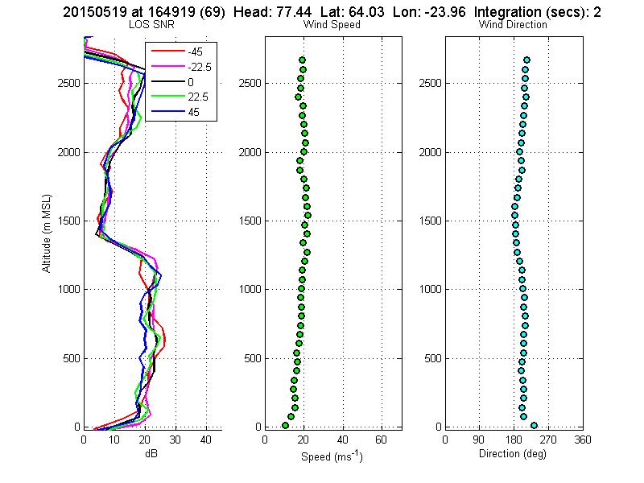
Boundary layer work (10,000’)

Slide 10
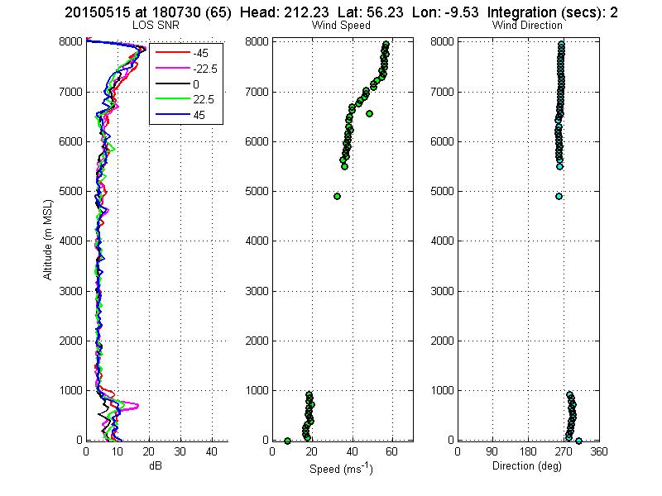
05_15_15 Upper Level Jet

Slide 11
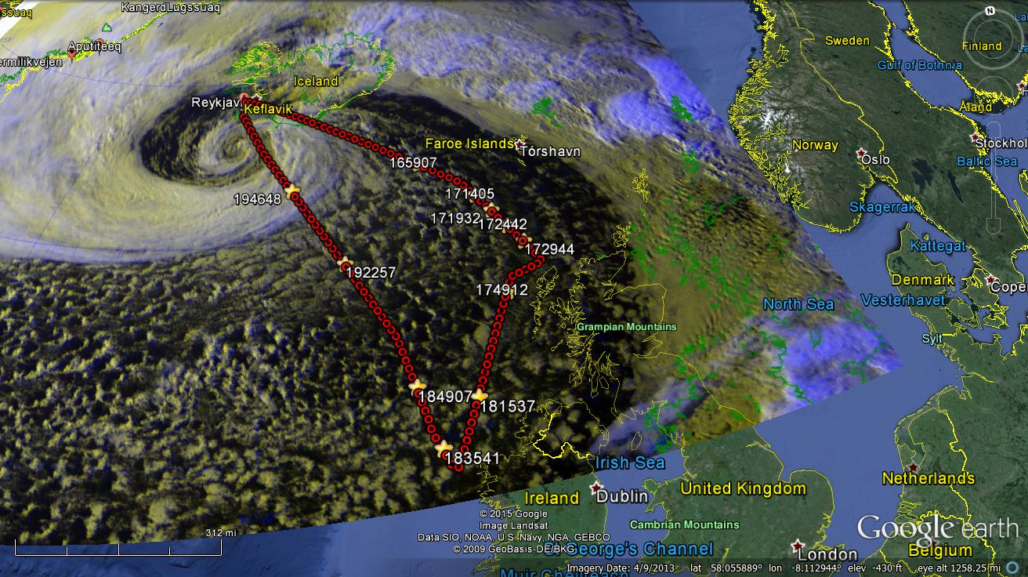

Slide 12
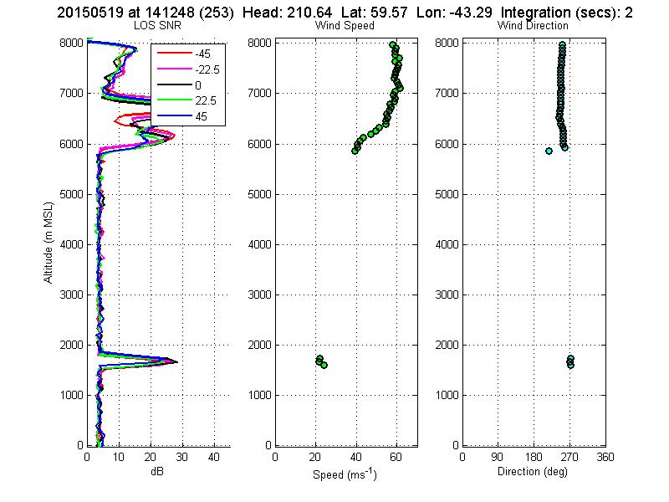
05_19_15 Upper Level Jet

Slide 13
DAWN under performance
DAWN designed for 220mJ and 10Hz was operated at 100mJ and 5 Hz during Campaign II based upon system performance analyses conducted at LaRC between Campaigns I and II.
While the wind observations obtained with DAWN are judged to be very reliable, the vertical coverage of the soundings was less than expected based upon designed system capabilities.
DAWN is currently scheduled to undergo an external (Beyond Photonics) evaluation followed by steps to recover the designed performance.

Slide 14
DAWN comparison with dropsondes
101 Yankee dropsondes were released from the NASA DC-8 during the 10 missions
17 returned no data
All remaining sondes reported useful wind data for most of descent.
Slow mode descents take ~ 10 – 15 minutes (from 19Kft)
Fast mode descents take ~ 5 – 6 minutes
DAWN takes 35 seconds (20 shot) or 115 seconds (100shot) per 5 point scan.
DC-8 moves ~ 7.7 km (20 shot scan) or 25.3 km (100 shot scan)
General conclusion: DAWN and Dropsondes agree quite well.

Slide 15
DAWN vs Dropsonde
15.05.2915

Slide 16
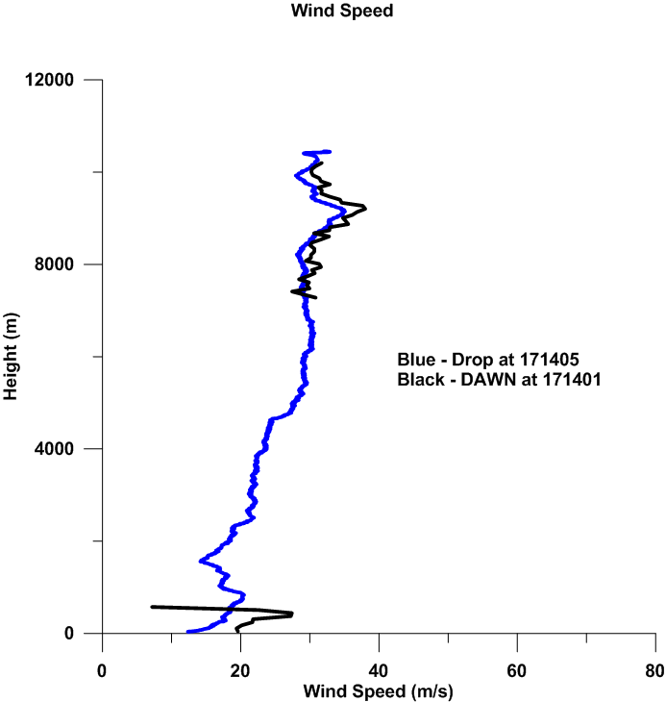
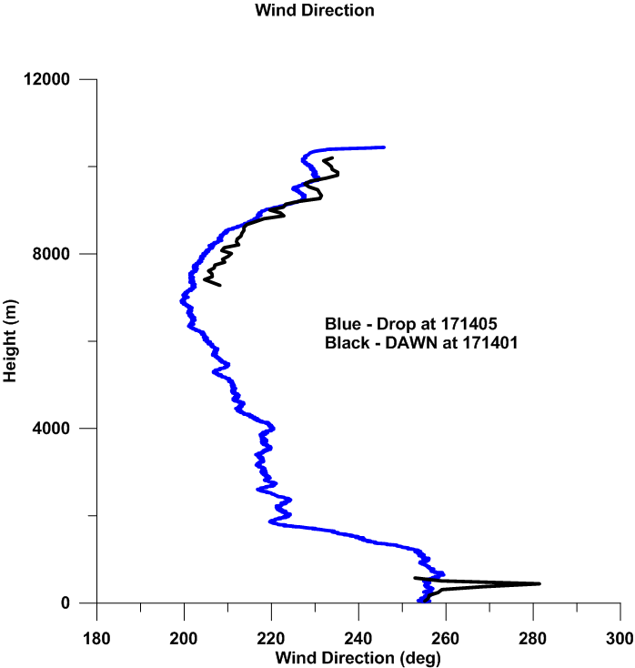

Slide 17
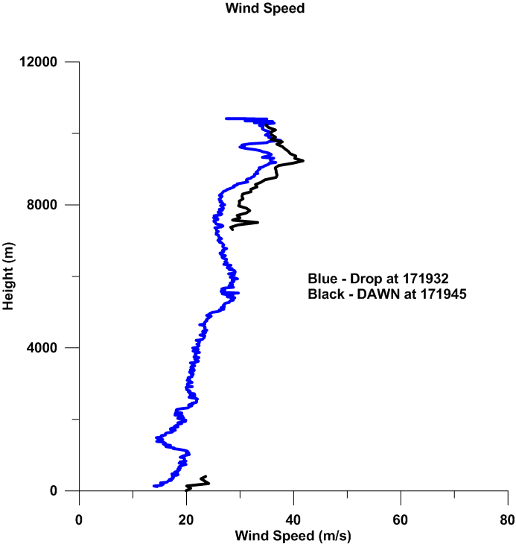
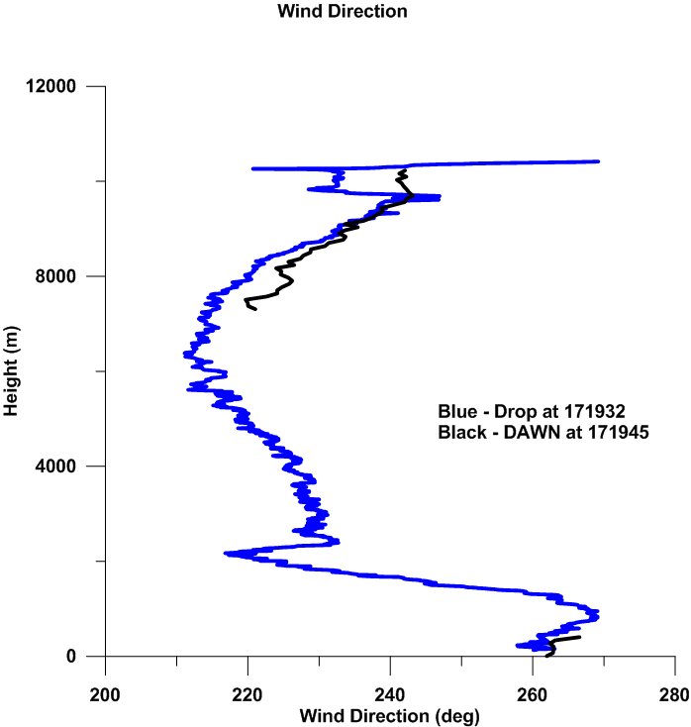

Slide 18
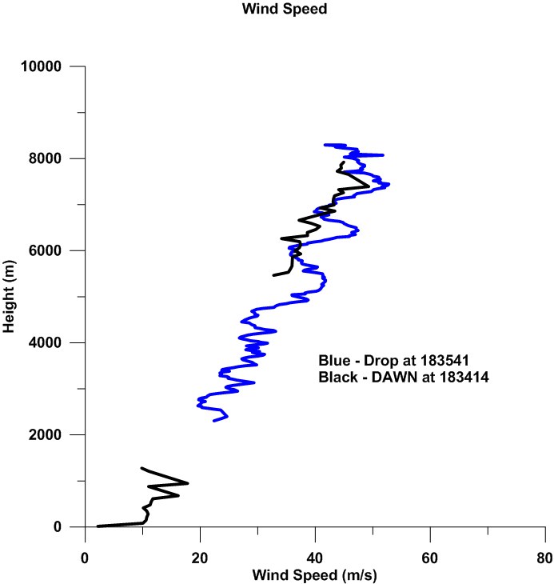
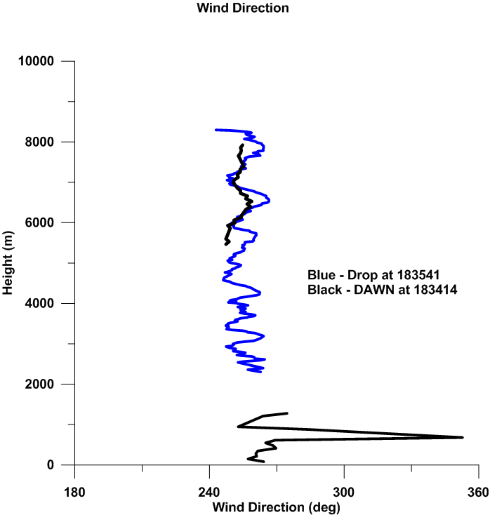

Slide 19
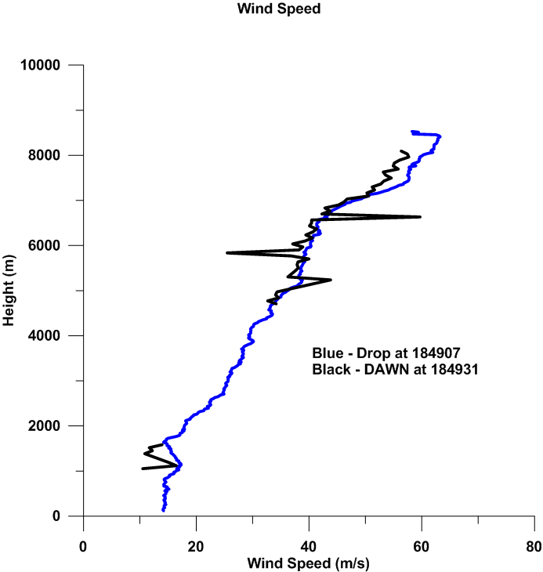
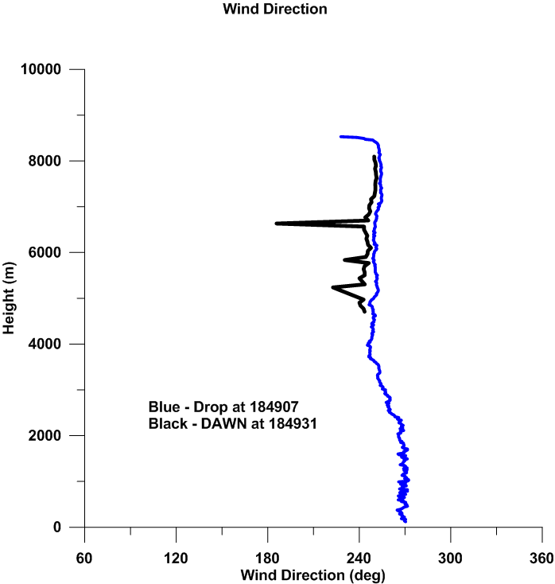

Slide 20
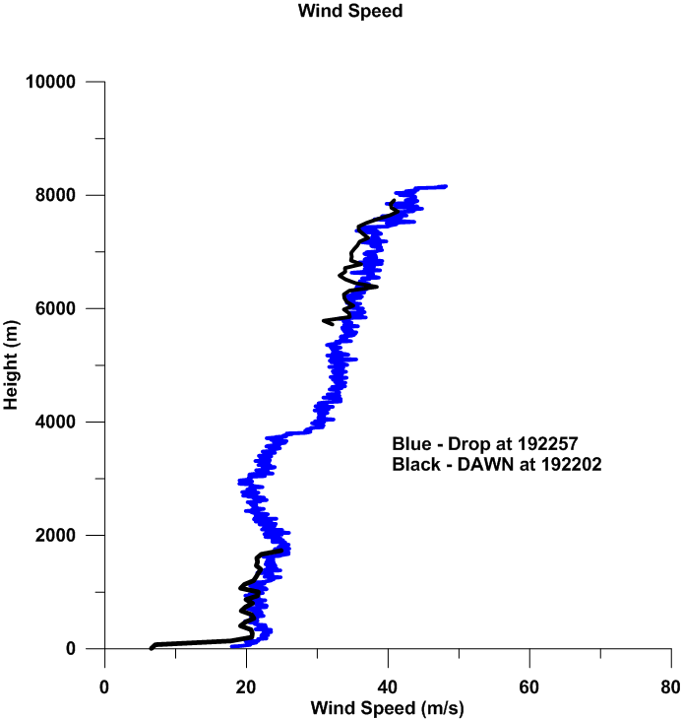
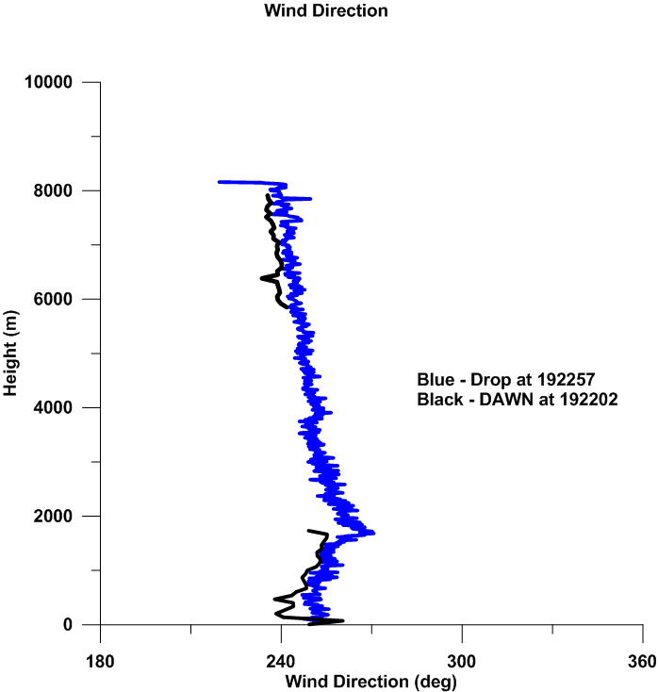

Slide 21
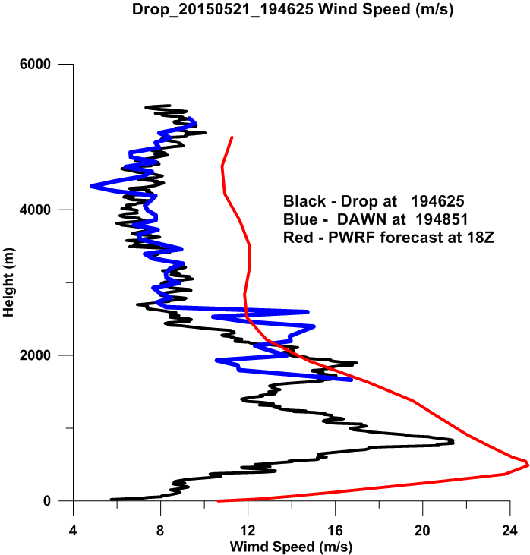
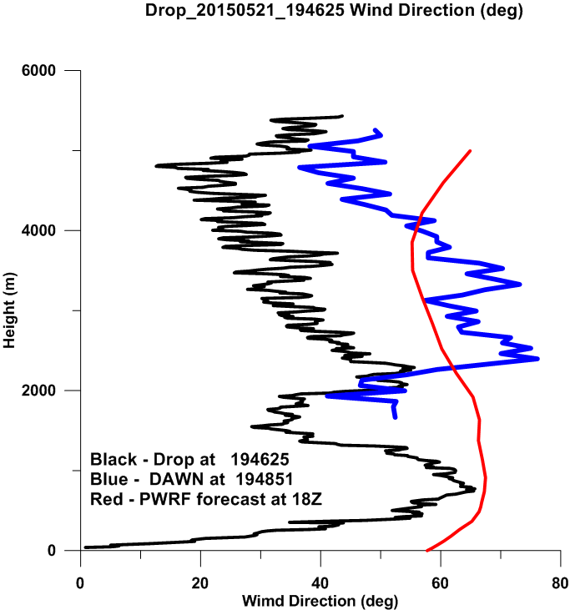
Clouds Around 2KM

Slide 22
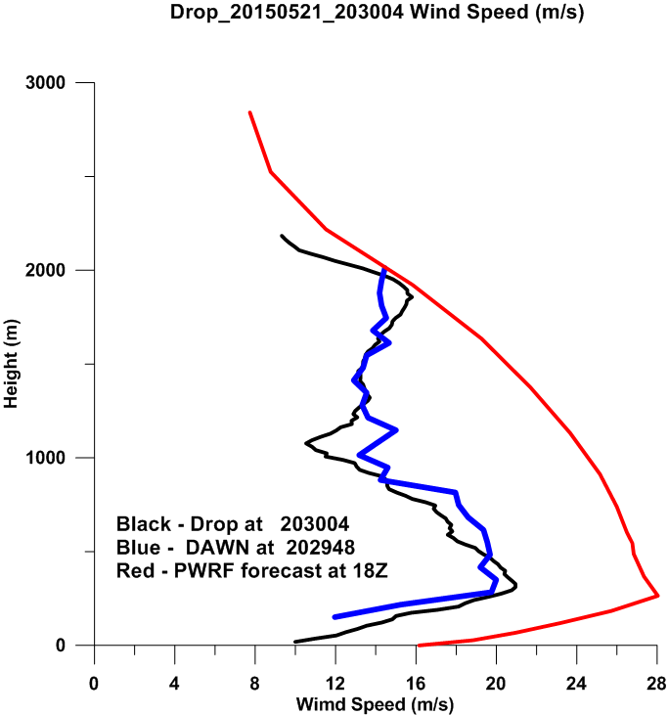
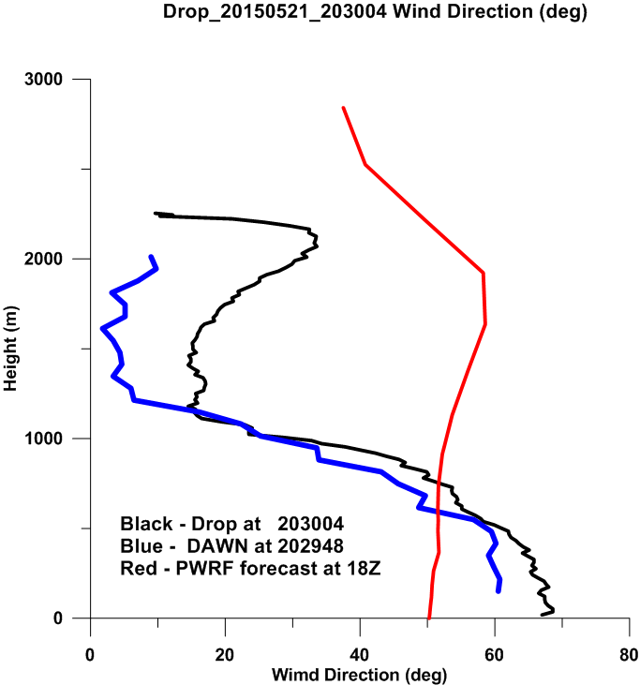

Slide 23
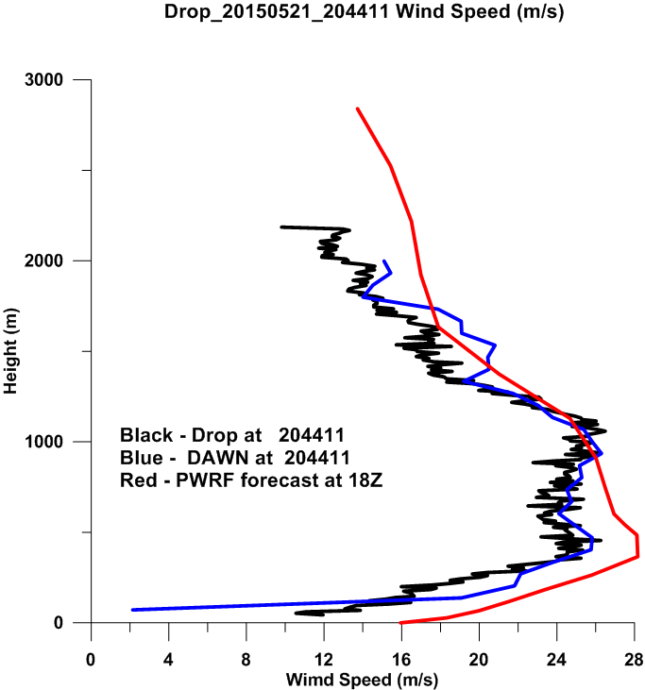
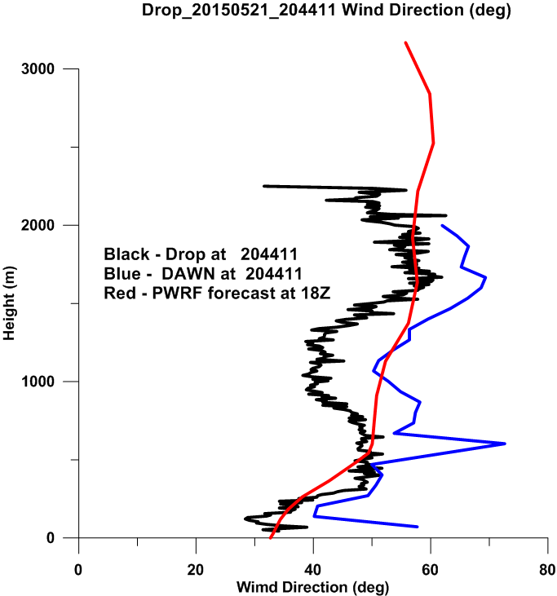

Slide 24
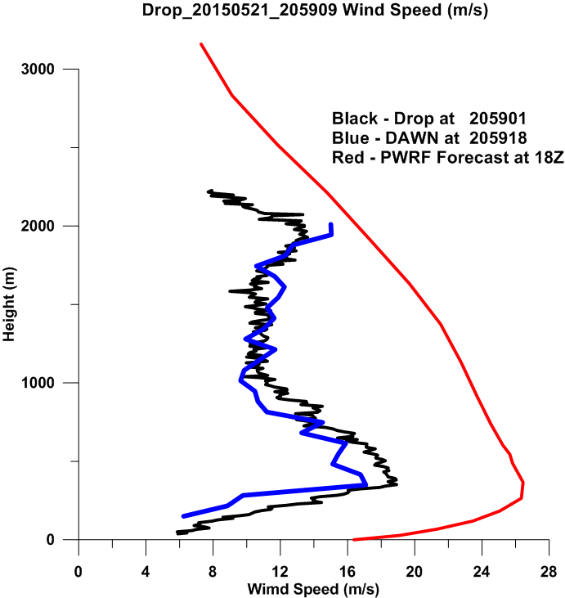
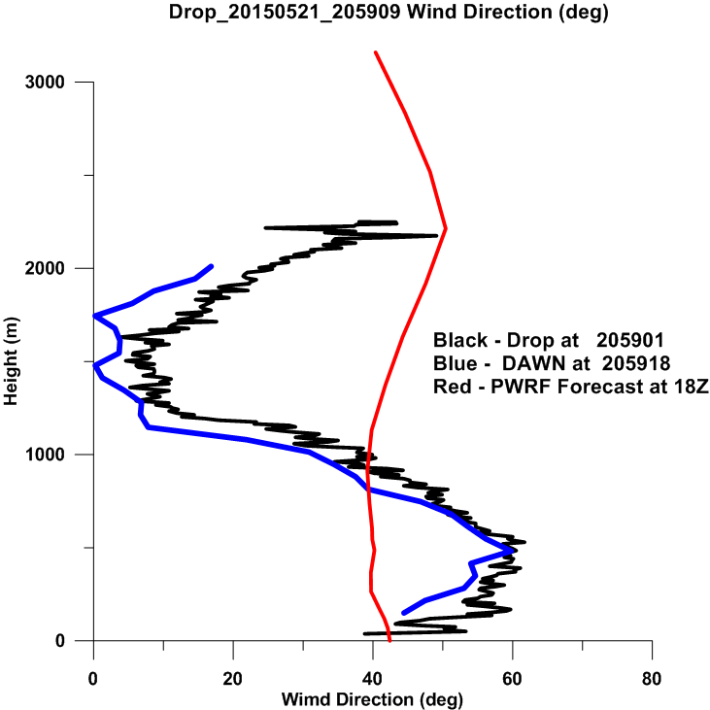

Slide 25
Data processing status
Mission summaries
With model, satellite, pictures, tracks etc. by June 30 (Complete)
DAWN
SWA complete quicklook processing for all cases by June 30 (Complete)
NASA/LaRC performance review plots by June 30 (Complete)
Final DAWN processing for distribution by November 30 (In progress)
TWiLiTE
First look products by July 15 for priority case(s) (In progress)
Dropsondes
First tier processing by June 30. (completed 6/15/15) (Complete)
Final processing by July 30. (not needed)

Slide 26
Data processing plan FY16
Implement surface return based pointing corrections over ice on a case by case basis.
Finish MatLab coding and evaluation of SWA’s Supervised Search Window and Adaptive Integration Algorithm using Campaign II DAWN and dropsonde data.
Provide “final” DAWN profiles to ESA for use in ADM Cal/Val efforts derived from Campaign II.
Continue special studies
Ice movement velocity vs. wind and current
CALIPSO and DAWN comparisons in the presence of clouds given priority
Rolls over ice, near tip jet and over west coast of Greenland.
More Polar WRF studies
Collaborative studies with ESA/DLR

Slide 27
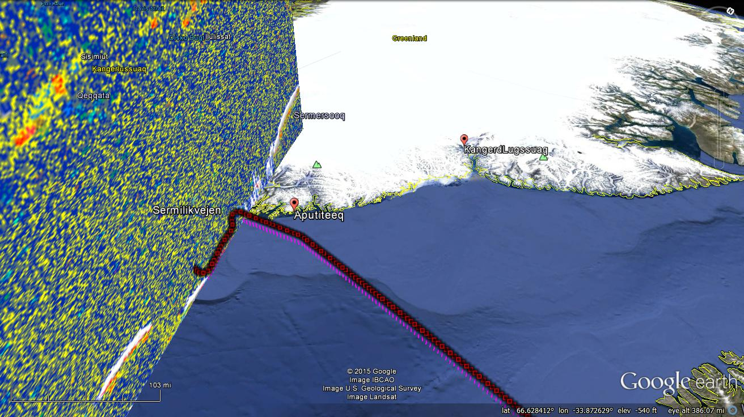
A
B

