Slide 1
Preparing for ADM at the JCSDA
Presented By: Jim Yoe
(Slides liberated from a variety of sources...)

Slide 2
Overview
Recalling
JCSDA Partners, Mission, and Vision
JCSDA Science Priorities
JCSDA Status Update
Elements to Leverage for ADM
Summary

Slide 3
Partners, Vision, and Mission
NOAA/NESDIS
NOAA/NWS
NASA/Earth Science Division
NOAA/OAR
US Navy/Oceanographer and
Navigator of the Navy and NRL
US Air Force/Director of Weather
Vision:
An interagency partnership working to become a world leader in applying satellite data and research to operational goals in environmental analysis and prediction
Mission:
To accelerate and improve the quantitative use of research and operational satellite data in weather, ocean, climate and environmental analysis and prediction models.

Slide 4
JCSDA Science Priorities
Overarching goal: Help the operational services improve the quality of their prediction products via improved and accelerated use of satellite data and related research
Radiative Transfer Modeling (CRTM)
Preparation for assimilation of data from new instruments
Clouds and precipitation
Assimilation of land surface observations
Assimilation of ocean surface observations
Atmospheric composition; chemistry and aerosol
Driving the activities of the Joint Center since 2001, approved by the Science Steering Committee

Slide 5
JCSDA Status Update
New Director - Dr. Tom Auligne
Assumed the Position in May, 2015
Overhauling JCSDA Strategic Plan
Renewing MOA and TOR
Planning to convene Science Steering Committee
Developing Initiatives and Practices
To improve and enhance the collaboration
See Website
http://www.jcsda.noaa.gov/
Note bio for Tom Auligne
Quarterly newletters, upcoming meetings – Joint WS

Slide 6
Leverage for ADM
Capabilities Including:
Operations-to-Research Capability
Satellite Data Impact Assessment
OSEs (and OSSE experience)
JOSASC
Partner Agency Tools

Slide 7
JCSDA R2O Concept
Goal: Accelerates the use of satellite data in NWP centers
Ensures resources are in place to achieve successful transition: supercomputer, a software integration team, etc.
Ensures consistency and demonstrates benefits with operational systems like: Hybrid GDAS system (global), HWRF (Hurricane forecast).
Scientific efforts in satellite DA in research community
Diverse R&D activities
Scientific efforts in satellite DA in academia, CIs
Scientific efforts in satellite DA in NOAA/OAR
Scientific efforts in satellite DA in NOAA/NESDIS
(funded by GOES-R PGs, JPSS PGs, etc)
JCSDA’s own DA Activities
Products, techniques, improvements, with direct and immediate relevance to NWP Operational Models
(both global and regional)
Made consistent with Operational Systems
Select projects for R2O Transition
NWP Operational Centers
Ongoing Baseline Improvement in NWP centers
Objective: Improvements in Forecast skills
Notes:
This was possible thanks to the JIBB supercomputer (JCSDA In a Big Box) and the S4 supercomputer (Supercomputer for Satellite Simulations and data assimilation Studies).
The main goal of this environment is to (1) mature a diverse set of R&D activities (funded for instance by JPSS PG&RR, by GOES-R PG&RR, NESDIS, etc) to become operations-relevant and tested and then (2) transition the most mature projects into operations, thanks to a strong collaboration between the PIs, the JCSDA scientists and the scientists from the NWP operational centers.

Slide 8
What is an O2R? Why is it important?
O2R infrastructure brings the Operational environment to researchers
It allows scientists to perform their research in a system that is compatible with operational needs
When a successful research project is performed in an O2R environment, it increases its chances to transition to Operations (R2O)
Without an O2R environment, R2O is at best difficult

Slide 9
How does O2R/R2O work?

Slide 10
O2R Environment
This is a critical piece for a successful R2O. O2R involves:
Supercomputer(s) : JIBB, S4, Zeus Allocation
Porting/benchmarking codes/systems/libraries
Documentation to help researchers navigate
User Support
Status:
GSI, GFS implemented/benchmarked
HWRF implemented and benchmarked
Synchronization with T1534 completed
JCSDA secured an upgrade to its JIBB and S4 supercomputers to perform OSSEs/OSEs and to keep up with the newest resolution
JCSDA secured an increase to its NOAA R&D allocation for this year on Zeus (1million core hours) to allow contribution to the H. Sandy data gap mitigation effort. [yet to be implemented]
In progress:
Extension of O2R to include Ocean DA (NCODA, HYCOM)
Extension of O2R to include Land Systems (LIS).
Extension of O2R to include NAM
Scientific efforts in satellite DA in research community
Scientific efforts in satellite DA in academia
Scientific efforts in satellite DA in NOAA
Scientific efforts in satellite DA in JCSDA
(funded by GOES-R, JPSS, etc)
More than ~ 50 users on both JIBB and S4 (total more than ~100). Mixture of NOAA and Researchers
Products, techniques, improvements, with direct and immediate relevance toNOAA NWS Operational Models
(both global and regional)

Slide 11
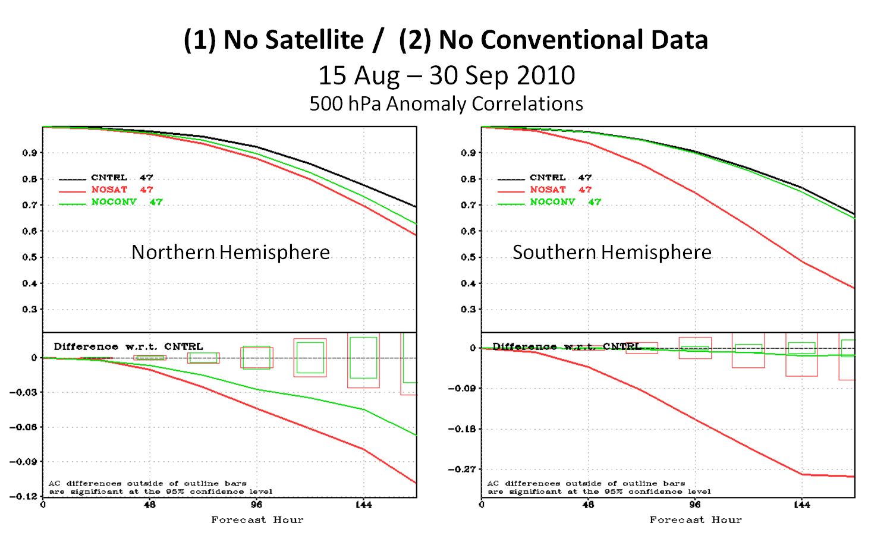
OSE Activities / Impact Assessment
An extensive assessment of the global observing system impact on NOAA forecast system has been undertaken.
The impact assessment was done wrt satellite data (collectively &individually: microwave AMSU, MHS, GPS, hyperspectral IR, AMVs, etc) as well as conventional data.
Satellite data as a group, had a very significant impact which surpasses the conventional data impact (by a wide margin), especially in the southern hemisphere.
The impacts of individual classes of sensors did not add up to the significant impact above.
Results from the extensive data denials experiments performed in the JCSDA, aimed at assessing the impact of the global Plots courtesy of J. Jung.

Slide 12
JOSASC – Potential NOAA Contribution
Requirements and Resources for Observation System Experiments
Determine the Impact of: | Expected Nature of Experiment | Time to Complete | Current Resources | Additional Resources
One or more specific (existing) sensors or data products on NWP forecasts Example: Impact of losing a CrIS, etc. | Limited duration (1 season for 2 weeks) to provide insight; Global system; Reduced resolution | 2 months | In-house expertise for supervision; Leverage base for data handling, O2R; S4, JIBB, or Theia | - 1 additional contract FTE; Including to maintain/update O2R environment; - HPC resources dedicated: Four to six experiments per year
a)-specific sensor(s) or product(s) or b) Orbital configuration on forecasts Example: PM data gap mitigation impacts | 2 seasons for 1month each; Full resolution Statistically significant result, to support OS configuration decisions | 6 months | In-house expertise for supervision; Leverage base for data handling, O2R; S4, JIBB, or Theia | 2 additional contract FTE - HPC resources dedicated Four to six experiments per year
An Observing System component on the forecast of a hurricane, tropical storm, winter storm | Rapid Response for Illustration and insight Not statistically significant to support decision making. | 1-2 weeks | In-house oversight | 0.5 additional contractor FTE annually (10 storms per year) - HPC resources dedicated
Assumptions: Development work previously completed (data already assimilated)
Standard Metrics: AC, Precip Skill, RMS wind error, storm track/intensity error

Slide 13
JOSASC – Potential NOAA Contribution (cont’d)
Determine the Impact of: | Expected Nature of Experiment | Time to Complete | Current Resources | Additional Resources
Existing selected sensors/prods on the forecast skills, related to land, ocean, aerosols , cryosphere (non-weather) Example: GPM, Jason, SMAP, Aquarius, etc | Statistically significant result; | 6 months (Once the capability established | No. Environments need to be developed, based on coordination with NWS experts, metrics selected for each application. - Leverage possible of existing projects on S4 | 1FTE per application area (ocean, land, aerosol) to build capability in O2R. For one year 0.5FTE per application area once capability in place (on-going)
Requirements and Resources for Forecast Sensitivity to Observations (FSO) Tool
Determine the Impact of: | Expected Nature of Experiment | Time to Complete | Current Resources | Additional Resources
All operationally used sensor data and products on the forecast skill of the GFS, simultaneously. | Ensemble-based FSO diagnostic (effort already funded by EMC via H. Sandy) | On-going once established and implemented | 1 contractor FTE under NCEP/EMC supervision to develop, test, and coordinate operational integration in the Global Forecast System | 0.25 additional contractor FTE per area once capability in place (ongoing). User access, web-based display, reports.
Assumption is that FSO capability will be led and implemented by EMC and be run operationally at NCO.

Slide 14
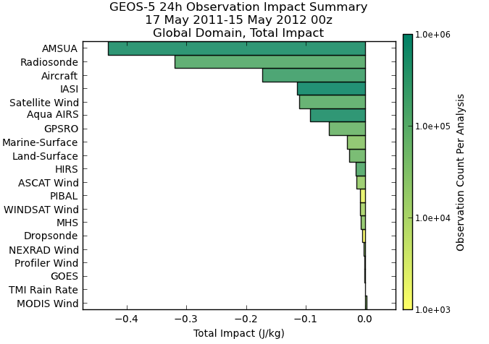
Partner Tools: NASA FSO

Slide 15
Summary
JCSDA will be prepared to perform OSEs using ADM/Aeolus
Research-to-demonstration using JOSASC personnel and O2R environments
Could extend, and repeat as models and DAS evolve
Without NRT data, implementation transition on hold
JCSDA will be prepared to perform new OSSEs for DWL concepts after ADM

