Slide 1
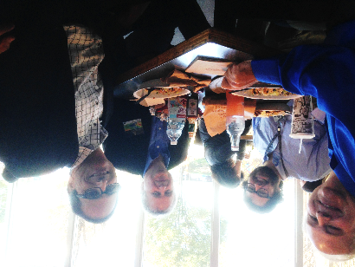
Activities at NASA towards 3D wind retrievals from “hyperspectral” IR sounders
Tom Pagano
AIRS Project Manager
Caltech NASA JPL
4800 Oak Grove Dr. Pasadena, Ca 91109
tpagano@jpl.nasa.gov (818) 393-3917
October 13, 2015
With contributions from
David Santek (UW/SSEC), Kevin Maschhoff (BAE Systems), Will McCarty (NASA GMAO)
© 2015 California Institute of Technology. Government sponsorship acknowledged.

Slide 2
Agenda
Recent developments at NASA related to wind retrievals from IR Sounders
Science and Simulation
MODIS and AIRS Water Vapor Winds (Santek, SSEC, NASA ROSES)
Forecast Departures (McCarty, GMAO)
Technologies for IR Sounding
JPL AIRS and Future Sounding Instruments
MISTiC Winds (Maschhoff, BAE Systems, NASA IIP)
CubeSat Infrared Atmospheric Sounder (Pagano, JPL, NASA InVEST)
Call for additional modeling, simulation, technology development, and flight demonstrations

Slide 3
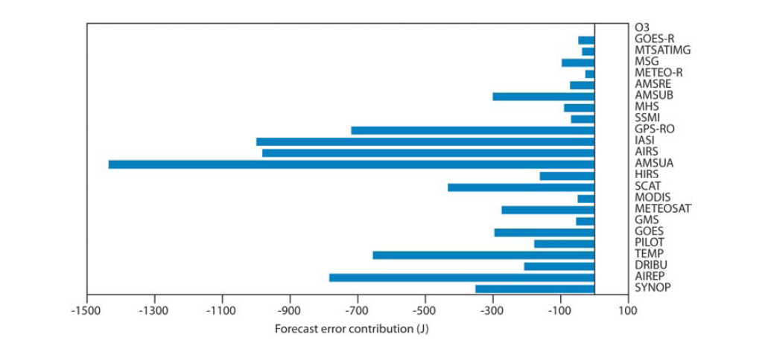
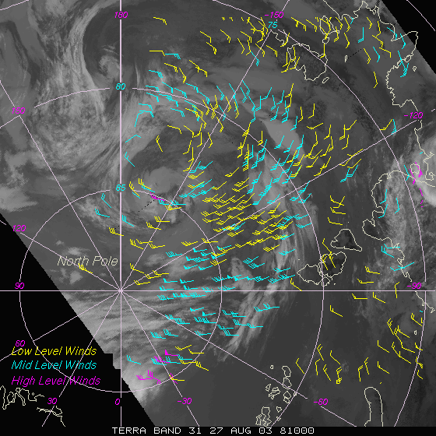
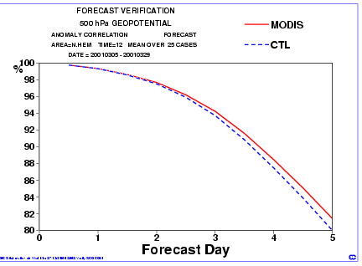
MODIS Winds have impact to forecast
MODIS Polar Winds have impact on global 24Hr forecast
MODIS Polar Winds Product
AIRS
IASI
4 AMSUs
MODIS
Winds
(Cardinali, ECMWF Tech. Memo. 599, 2009)
MODIS Polar Winds impact in Arctic
https://stratus.ssec.wisc.edu/projects/polarwinds/impacts/impact.html

Slide 4
AIRS water vapor isosurface shows 3D variability

Slide 5
AIRS Ozone Hole formation in 3D

Slide 6
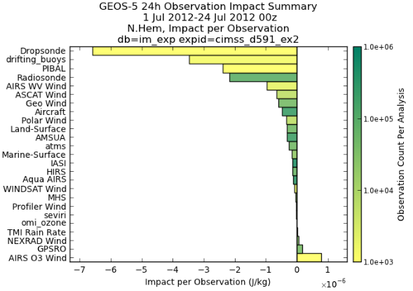
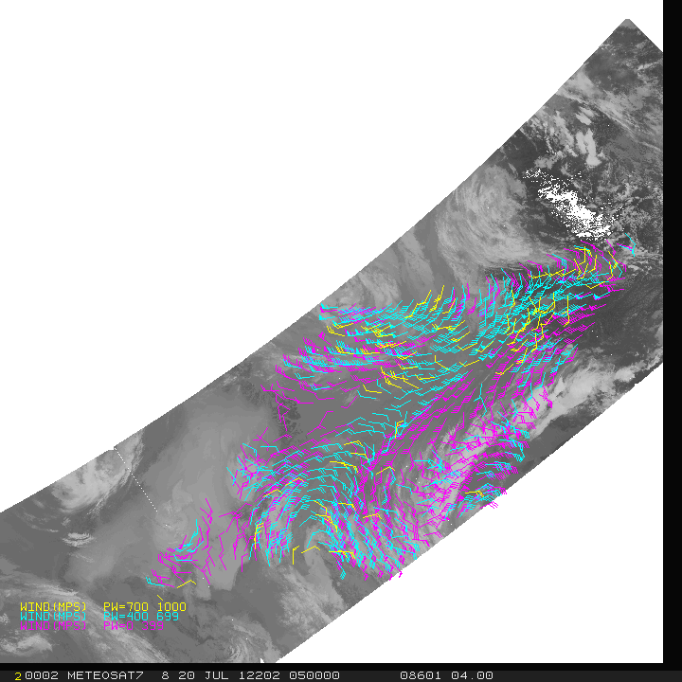
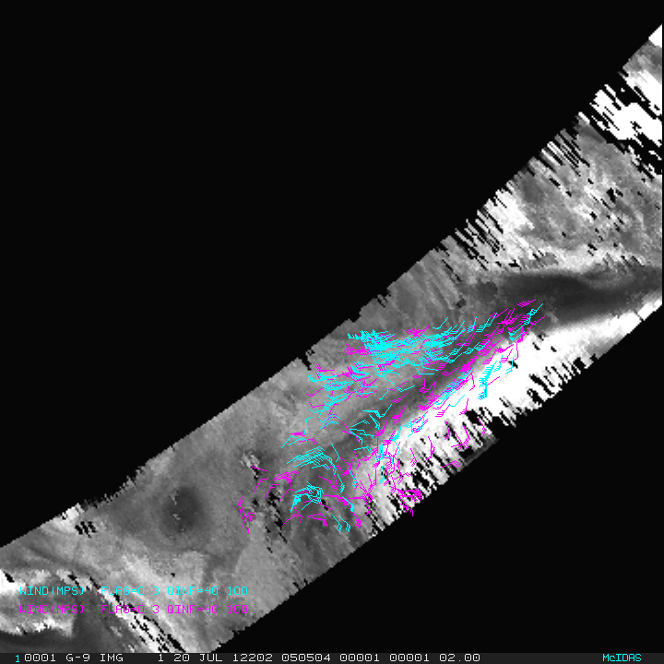
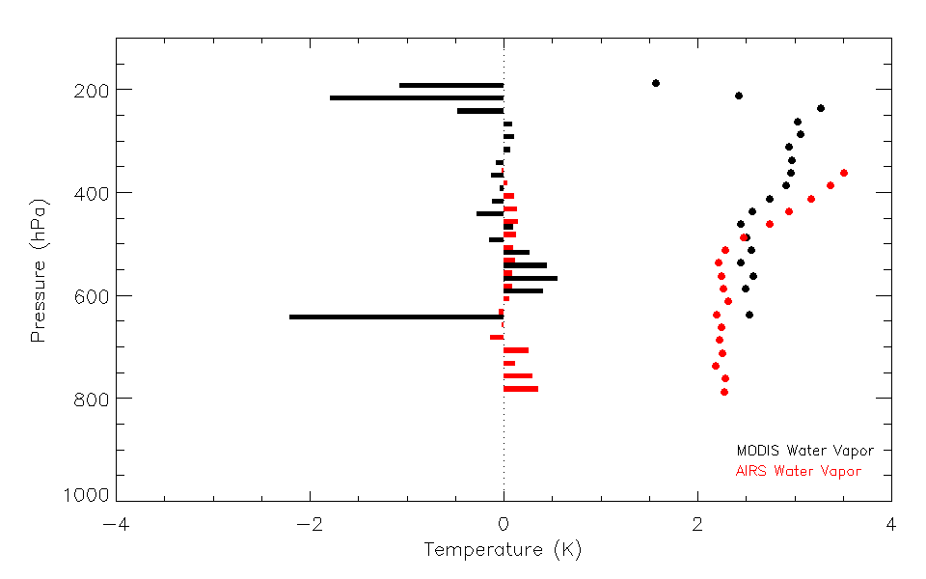
Current Status of 3D Winds from IR Sounders
MODIS 20 July 2012 0551 UTC
Infrared and Water Vapor (including clear sky)
Good Impact of AIRS WV Wind per Observation
by David Santek (UW, SSEC)
AIRS 20 July 2012 0505 UTC
Ozone: 103 to 201 hPa Moisture: 359 to 616 hPa
The mean and standard deviation of the observation departures (ms⁻¹)
(Observation minus 6-hr Forecast) for AIRS and MODIS water vapor winds
May to July 2015
AIRS winds preliminary evaluation by Will McCarty (NASA/GMAO)

Slide 7
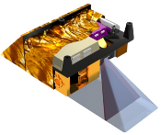
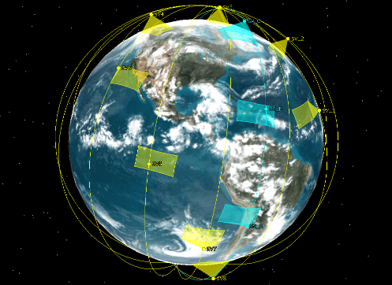
MISTiC Winds: Midwave Infrared Sounding of Temperature and humidity in a Constellation for Winds
PI: Kevin R. Maschhoff, BAE Systems
Advance the readiness of a miniature, high resolution, wide field, thermal emission imaging spectrometer to measure vertically resolved tropospheric profiles of temperature and humidity for deriving global 3-D wind measurements.
Provide ~ 2-3 km spatial resolution temperature and humidity soundings of the troposphere using an AIRS-like (Atmospheric Infra-red Sounding) method.
Enable a LEO constellation approach that provides 3-D Wind field measurements and atmospheric state and transport observations at low system cost.
Reduce technology risks with the Infrared Focal Plane Array (IRFPA) and spectrometer technologies critical for significant instrument size, weight and power reduction (20 x 30 x 30 cm, 15 kg, 50 W).
IR Sounding
Constellation
MISTiC Instru-ment will fit on a 27U CubeSat or a ESPA-Class Micro-Sat
705 km
Orbits,
Sun-Synchronous
Motion
Vector
Winds
Formation
Optimize and refine space-based measurement approach based on experience with AIRS, AIRS-Light and small satellite provider experiences.
Demonstrate calibration stability of miniature MWIR spectrometer (4.08 - 5.8 um) in ground testing.
Demonstrate robustness of spectrometer by performing space level thermal fluctuation testing and vibration testing to launch levels.
Verify instrument measurement capability of 3-D cloud-drift and water vapor motion vector winds on high altitude balloon or high-altitude fixed-wing platform.
Demonstrate IRFPA space radiation tolerance (> 25 krad).
Co-Is/Partners: J. Susskind, NASA GSFC; H. Aumann, JPL
Instrument science and payload requirements review 10/14
Instrument science and payload concept review 12/14
Airborne demonstration plan review 06/15
Detector/ROIC radiation test/analysis complete 09/15
Calibration stability test complete 03/16
Airborne instrument design/build complete 05/16
Airborne demonstration complete 10/16
Airborne demonstration data analysis complete 12/16
TRL_{in} = 4 TRL_{current} = 4
IIP-13-0004

Slide 8
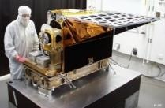
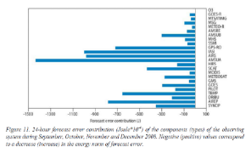
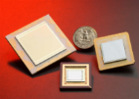
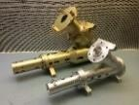
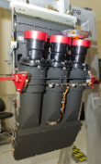
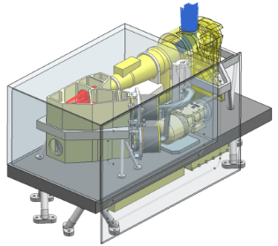
Infrared Sounding at JPL
Ongoing IR Sounder Projects at JPL
AIRS/AMSU: Instrument Operations, Calibration, Product Development and Validation. Aqua Retires 2022
SIPS (CrIMSS): L2/L3 Product Development, Cross-Calibration, and Validation. Climate Data Record Continuity
Cutting Edge Research: Retrieval Development, Water Vapor Transport, Climate Model Validation, Cloud Properties, LES Models, Instrument Simulation, OSSE’s
R2O: AIRS V5 Retrieval basis of NUCAPS. For AWIPS-II
JPL Technologies Support Next-Gen IR Sounders
HotBIRD Infrared Detector Materials
Advanced Cryocooler Characterization Lab
Advanced IR Grating Spectrometer Developments
CubeSat Development Laboratory
Many options for Next-Gen IR sounders
1km LEO: MIRIS: IR Sounder w/ VIIRS IR Imaging. Full Swath, Full Spectral Range. Post-JPSS, NOAA
3km - 13.5km LEO: CIRAS 6U CubeSat: Tech Demo for NASA InVEST. NOAA Study for EON-IR (Follow-on to CIRAS)
5km GEO: SIRAS. Full Spectral Range, Hosted Payload
100m LEO: Boundary Layer Processes Sounder. Narrow (100km) swath, pointable for special events
AIRS
JPL/BAE AIRS
From Cardinali (ECMWF Tech. Memo. 599, 2009)
JPL Sounding Products Support Weather, Climate and Atmospheric Composition Research
HotBIRD MWIR Detectors
RTD Wide-Field Grating Spectrometers
OCO-2 Spectrometers
Moderate Resolution Infrared Imaging Spectrometer (MIRIS)

Slide 9
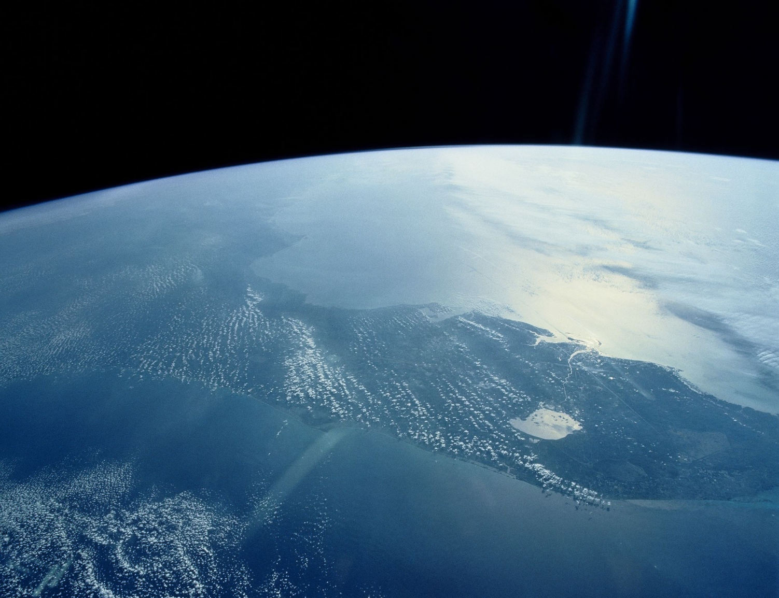
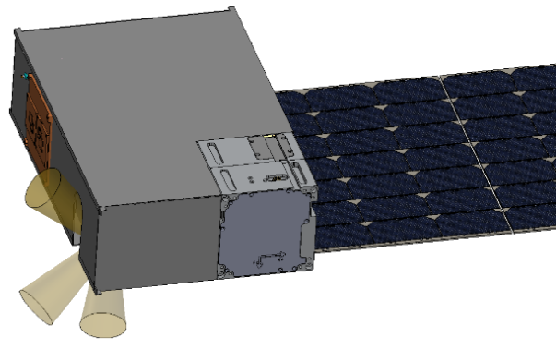
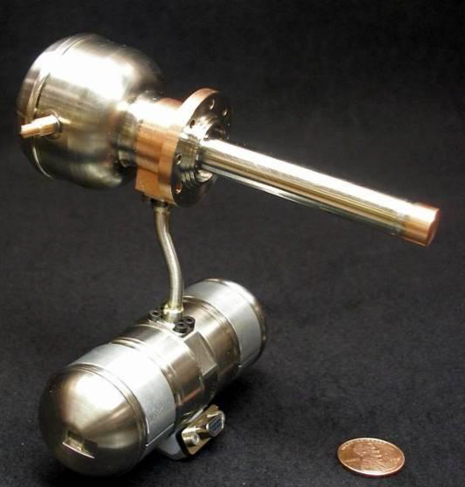
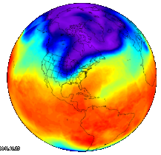
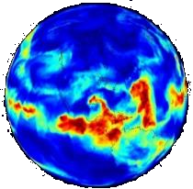
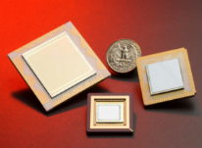
CubeSat Infrared Atmospheric Sounder (CIRAS)
For NASA InVEST
PI: Tom Pagano (JPL)
Sponsor: NASA ESTO
CIRAS will significantly reduce the cost of atmospheric sounding in the infrared and enable improved timeliness through constellations
CIRAS Technologies
CIRAS Mission
Demonstrate Key Technologies needed for Infrared Instruments on CubeSats
Demonstrate fidelity of Hyperspectral Mid IR radiance measurements to retrieve Temperature and Water Vapor Profiles
Fill Coverage Gaps and Improve Timeliness of Operational IR Sounders
TRL in: 5-6, TRL out: 7
Build: 2016, 2017. Launch 2018 (TBD)
Micro Pulse Tube Cryocooler (Lockheed Martin)
CIRAS
Parameter | CIRAS
Spatial
Orbit Altitude | 600-850 km
Scan Range | 0.84° - 57°
Horizontal Res’n | 1.6 km - 13.5 km
Spectral
Method | Grating
Band 1 | 4.78-5.09 µm
Res’n / Sampling | 0.5 / 0.2 cm⁻¹
Total Channels | 625
Radiometric
NEdT (@250K) | <0.25 K
Resources
Size | 6U Cubesat
Mass | 8.5
Power | 37.5
Data Rate | 2 Mbps
CIRAS Measurements
Lower Tropospheric Temperature Profiles
Lower Tropospheric Water Vapor Profiles
Goal: Experimental Demonstration of 3D Winds
JPL GRISM Spectrometer
JPL HOT-BIRD Detector
© 2015 California Institute of Technology. Government sponsorship acknowledged.
*Patent Pending

Slide 10
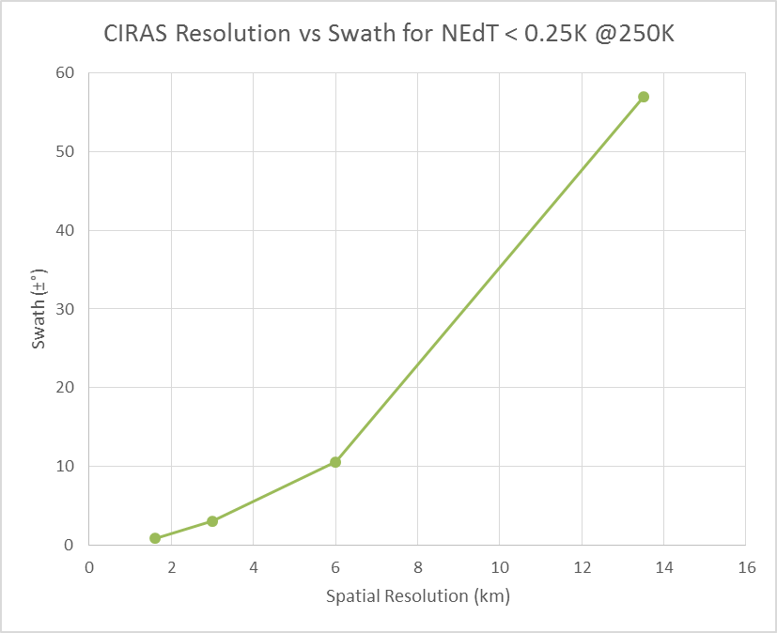
CIRAS can demonstrate higher spatial resolution hyperspectral IR sounding
CIRAS bins pixels and multiple frames while scanning to achieve desired spatial resolution
Pixel binning scheme and scan rate are programmable while in orbit
Native resolution of CIRAS is 0.8 km
Changing scan range (and rate) and pixel binning can improve spatial resolution at the expense of coverage (see right)
CIRAS limited due to cost, but future instruments can have wider swath
Fixed NEdT @ <0.25K
2200 km
AIRS, CrIS, IASI, and CIRAS Requirement
225 km
For Winds
63 km
18 km

Slide 11
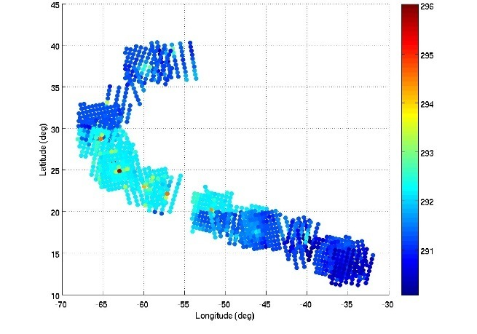
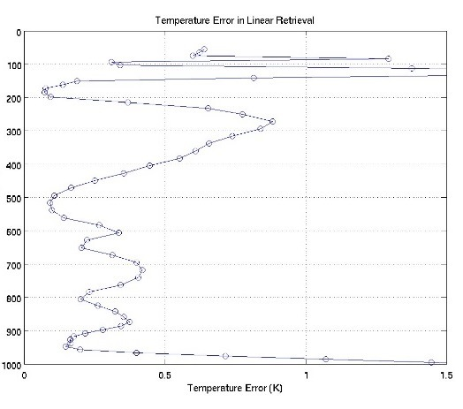
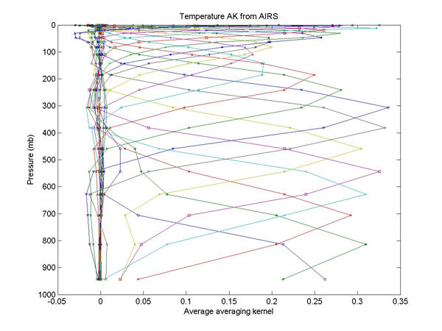
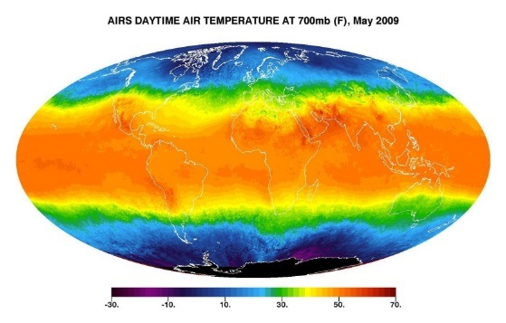
Method Developed using AIRS Linear Retrievals and STK to Simulate Sounder Data
Nature run profile sampled by AIRS, ARIES, GEO scan pattern and footprint
RMS Temperature Error (K) between Simulation and Nature Run
Linear retrieval to simulate AIRS
f_{T,i} = a _{T,i} + b _{T,i} ln (p_cld) + … c _{T,i} (f_cld), i = 1 to 23
Similar for water vapor with add’l q_tot
Objective
Provide simulated temperature and water vapor retrievals from Hurricane Nature run
Method
Satellite Took Kit Mapping, Footprint Binning: AIRS (13.5 km), CIRAS (3 km), GEO (5km)
Linear Retrieval based on AIRS Performance
Results
AK’s for CIRAS 2x Higher than AIRS (Less Cloud Effect)
Results sent to Bob Atlas at AOML for Assimilation Impact Studies. Results show short term (< 12 hr) improvement.
Method can be used to simulate wind data
Averaging Kernel and Cloud Dependence from Real AIRS Data
T.S. Pagano, W. Mathews, F. Irion, E. Sturm, “Simulating satellite infrared sounding retrievals in support of observing system simulation experiments (OSSEs)”, Proc. SPIE 9222, San Diego, CA (2014); doi: 10.1117/12.2061468

Slide 12
Summary and Recommendations
Measurements of winds in 2D using water vapor features now possible with polar orbiting and GEO imagers.
Provides valuable data to forecasters, particularly in northern latitudes
Accuracy impacted by variability in 3rd (z) dimension.
Since imagers not designed for winds, the coverage is limited to polar regions (polar orbiters), or GEO FOR
Winds measurement using current IR sounders has been demonstrated
AIRS in polar regions. CrIS and IASI in process
Coarse spatial resolution of current IR polar sounders limit wind speed accuracy
NASA supporting 3D winds using hyperspectral IR Sounding
Retrievals from AIRS and assimilation testing
Technology development (MISTiC Winds and CIRAS)
Several issues remain for hyperspectral IR Sounders
Cloud interference
Feature coherence
Retrieval accuracy (especially over land and with Mid-IR)
Cost of GEO or LEO Constellation
Recommended Multi-agency Activities
Development of a multi-agency forward model for the Midwave IR
IR sounder wind-retrieval simulations
OSSE’s to determine forecast impact of IR sounder winds
Assimilation impact studies using Midwave IR from IASI
Additional technology development
Additional airborne and spaceflight demonstrations

