Slide 1
On the complementary nature of
satellite Atmospheric Motion Vectors (AMVs) and
Doppler lidar winds
Iliana Genkova, Chris Velden
M. Weissmann, S. Wanzong, Kathrin Folger
D. Santek, B.Hoover, J. Key, M. Lazzara

Slide 2
"A US Effort for ADM-Aeolus Calibration and Validation”, Michael Hardesty and 15 co-PIs
Proposed Work: Comparison of ADM-Aeolus winds to
conventional Atmospheric Motion Vectors (AMVs) (2008)
Team: Iliana Genkova and Chris Velden (UW-CIMSS)
Compare ADM-Aeolus global-coverage line-of-sight wind profiles with current state of the art feature-tracked AMVs. The AMVs are operationally produced from several geostationary satellites and polar orbiters, yielding global tropospheric wind vector coverage with consistent quality. Imagery from passive remote sensors is used to deduce AMVs by tracking clouds or water vapor gradients. By comparing the ADM wind profiles with this global AMV data set, ADM vector coverage, properties and differences with AMVs will be documented, thus assessing the complementary value of the ADM winds to the existing upper-air winds observing system.
Investigate how ADM-Aeolus wind profiles can be used to assess the uncertainty introduced by the assumption that cloud/water vapor features are ideal tracers, and additionally interpret how the ADM cloud top heights and wind vector altitudes correlate. Such study would be most valuable over ocean where limited RAOBs are available for similar type studies. Further analysis to improve utilizing the U and V winds components separately in NWP models.

Slide 3
"A US Effort for ADM-Aeolus Calibration and Validation”, Michael Hardesty and 15 co-PIs
Proposed Work: Comparison of ADM-Aeolus winds to
conventional Atmospheric Motion Vectors (AMVs)
Team: Iliana Genkova and Chris Velden (UW-CIMSS)
Compare ADM-Aeolus global-coverage line-of-sight wind profiles with current state of the art feature-tracked AMVs. The AMVs are operationally produced from several geostationary satellites and polar orbiters, yielding global tropospheric wind vector coverage with consistent quality. Imagery from passive remote sensors is used to deduce AMVs by tracking clouds or water vapor gradients. By comparing the ADM wind profiles with this global AMV data set, ADM vector coverage, quality and differences with AMVs will be documented, thus assessing the complementary value of the ADM winds to the existing upper-air winds observing system.
Investigate how ADM-Aeolus wind profiles can be used to assess the uncertainty introduced by the assumption that cloud and water features are ideal tracers, and additionally interpret how the ADM cloud top heights and cloud-independent wind vector altitudes correlate. Such study would be most valuable over ocean where limited RAOBs are available for similar type studies. Further analysis to improve utilizing the U and V winds components separately in NWP models.

Slide 4
"A US Effort for ADM-Aeolus Calibration and Validation”, Michael Hardesty and 15 co-PIs
Proposed Work: Comparison of ADM-Aeolus winds to
conventional Atmospheric Motion Vectors (AMVs)
Team: Iliana Genkova and Chris Velden (UW-CIMSS)
Compare ADM-Aeolus global-coverage line-of-sight wind profiles with current state of the art feature-tracked AMVs. The AMVs are operationally produced from several geostationary satellites and polar orbiters, yielding global tropospheric wind vector coverage with consistent quality. Imagery from passive remote sensors is used to deduce AMVs by tracking clouds or water vapor gradients. By comparing the ADM wind profiles with this global AMV data set, ADM vector coverage, quality and differences with AMVs will be documented, thus assessing the complementary value of the ADM winds to the existing upper-air winds observing system.
Investigate how ADM-Aeolus wind profiles can be used to assess the uncertainty introduced by the assumption that cloud and water features are ideal tracers, and additionally interpret how the ADM cloud top heights and cloud-independent wind vector altitudes correlate. Such study would be most valuable over ocean where limited RAOBs are available for similar type studies. Further analysis to improve utilizing the U and V winds components separately in NWP models.

Slide 5
"A US Effort for ADM-Aeolus Calibration and Validation”, Michael Hardesty and 15 co-PIs
Proposed Work: Comparison of ADM-Aeolus winds to
conventional Atmospheric Motion Vectors (AMVs)
Team: Iliana Genkova and Chris Velden (UW-CIMSS)
Compare ADM-Aeolus global-coverage line-of-sight wind profiles with current state of the art feature-tracked AMVs. The AMVs are operationally produced from several geostationary satellites and polar orbiters, yielding global tropospheric wind vector coverage with consistent quality. Imagery from passive remote sensors is used to deduce AMVs by tracking clouds or water vapor gradients. By comparing the ADM wind profiles with this global AMV data set, ADM vector coverage, quality and differences with AMVs will be documented, thus assessing the complementary value of the ADM winds to the existing upper-air winds observing system.
Investigate how ADM-Aeolus wind profiles can be used to assess the uncertainty introduced by the assumption that cloud and water features are ideal tracers, and additionally interpret how the ADM cloud top heights and cloud-independent wind vector altitudes correlate. Such study would be most valuable over ocean where limited RAOBs are available for similar type studies. Further analysis to improve utilizing the U and V winds components separately in NWP models.

Slide 6
"A US Effort for ADM-Aeolus Calibration and Validation”, Michael Hardesty and 15 co-PIs
Proposed Work: Comparison of ADM-Aeolus winds to
conventional Atmospheric Motion Vectors (AMVs)
Team: Iliana Genkova and Chris Velden (UW-CIMSS)
Compare ADM-Aeolus global-coverage line-of-sight wind profiles with current state of the art feature-tracked AMVs. The AMVs are operationally produced from several geostationary satellites and polar orbiters, yielding global tropospheric wind vector coverage with consistent quality. Imagery from passive remote sensors is used to deduce AMVs by tracking clouds or water vapor gradients. By comparing the ADM wind profiles with this global AMV data set, ADM vector coverage, quality and differences with AMVs will be documented, thus assessing the complementary value of the ADM winds to the existing upper-air winds observing system.
Investigate how ADM-Aeolus wind profiles can be used to assess the uncertainty introduced by the assumption that cloud and water features are ideal tracers, and additionally interpret how the ADM cloud top heights and cloud-independent wind vector altitudes correlate. Such study would be most valuable over ocean where limited RAOBs are available for similar type studies. Further analysis to improve utilizing the U and V winds components separately in NWP models.

Slide 7
Questions to answer:
1) How do feature tracked AMVs and Doppler lidar winds compare?
2) How can Doppler lidar winds help us address the uncertainties in AMV
height assignments?
3) How can ADM-Aeolus wind profiles be used to assess the uncertainty introduced by the assumption that cloud/ water vapor features are ideal tracers?
4) Further analysis to improve utilizing the U and V winds components separately in NWP models – designing and conducting OSEs for understanding and evaluating the impact of Doppler lidar wind profiles (i.e. simulated data, ADM Aeolis winds) on NWP models

Slide 8
Questions to answer:
1) How do feature tracked AMVs and Doppler lidar winds compare?
2) How can Doppler lidar winds help us address the uncertainties in AMV
height assignments?
3) How can ADM-Aeolus wind profiles be used to assess the uncertainty introduced by the assumption that cloud/ water vapor features are ideal tracers?
4) Further analysis to improve utilizing the U and V winds components separately in NWP models.

Slide 9
Data and Method
THORPEX Pacific Asian Regional Campaign (T-PARC) 2008 - airborne Doppler wind lidar (DWL) profiles (~2500) measured by the DLR Falcon aircraft during the life cycle of Typhoon Sinlaku in the western North Pacific (11 – 21 September 2008 ) with a 2 μm scanning coherent DWL;
DWL profiles with a horizontal resolution of about 5 km and a vertical resolution of 100 m ; On average, every DWL wind profile during T-PARC provided wind information for about 20 – 25% of the vertical profile (Weissmann et al., 2005). The highest coverage of DWL observations occur between 250 and 300 hPa and the second highest coverage in the atmospheric boundary layer due to higher aerosol concentrations, whereas the coverage was particularly low between 500 and 800 hPa; Only profiles, which pass data assimilation’s quality control are used
Dropsondes (DS) every 3h
Satellite AMVs from MTSAT imagery and CIMSS retrieval - produced every hour; quality controled;
Triple Collocation (DWL, DS, AMV) : ± 60 min, 0.5 deg; ±50 hPa (WMO: ±90 min, 150km)
122 collocated points in all vertical bins (low, mid, high)

Slide 10
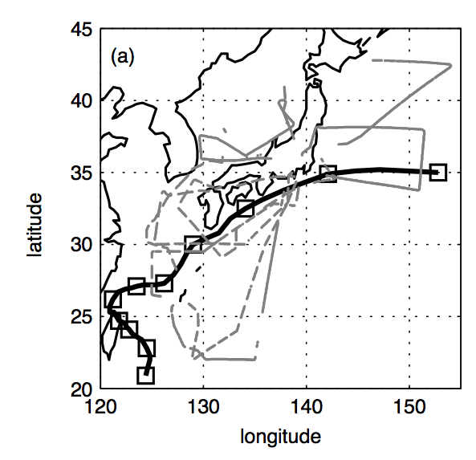
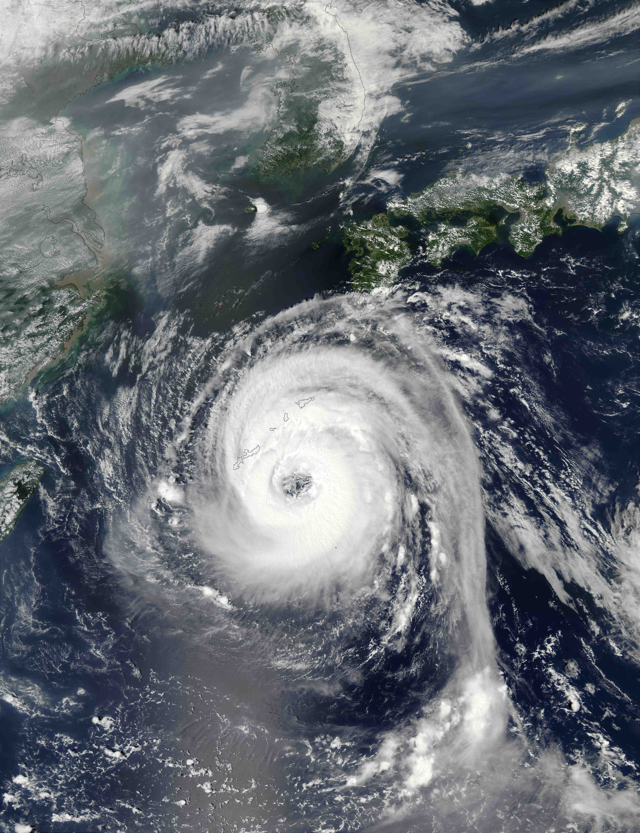
<- Location of DWL profiles (grey) and Typhoon Sinlaku (black line - according to the JMA best-track) for 11–21 September 2008; ‘Squares’ at 00UTC;
->
Sinhaku
09/19/2008
Image courtesy of NASA

Slide 11
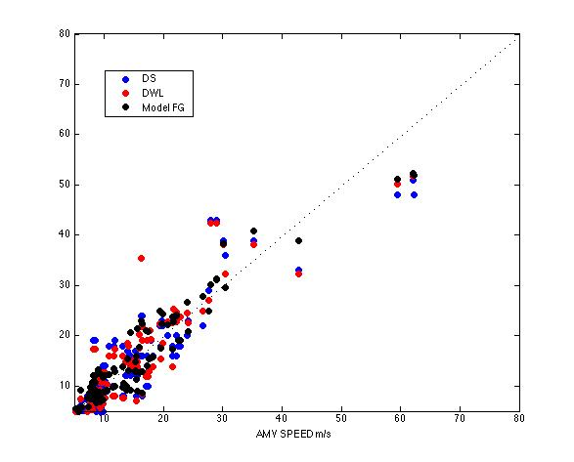
Corr_AMV_DS = 0.89
Corr_AMV_DWL = 0.91
Corr_AMV_FG = 0.95
AMV Speed (x) vs. Dropsonde Speed/DWL/Model (y) , [m/s]

Slide 12
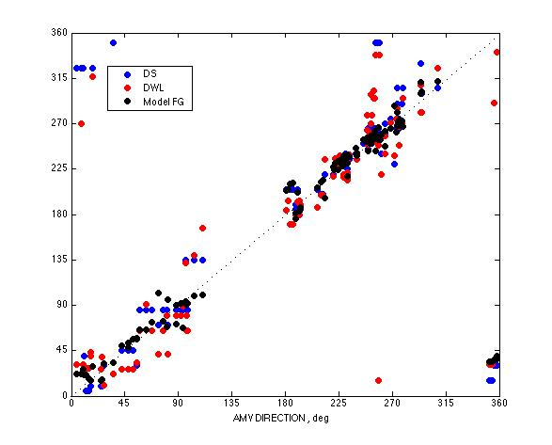
AMV Direction (x) vs. Dropsonde Direction/DWL/Model (y) , [deg]

Slide 13
Collocated data set statistics
Speed [m/s] | Count | Mean | STD
AMVs | 122 | 14.24 | 10.54
Dropsondes | 122 | 13.89 | 10.95
DWL | 122 | 14.03 | 11.09
Model FG | 122 | 13.68 | 10.31
Model First Guess departures (Obs-Mod)
Speed [m/s] | Count | Mean | STD
AMVs - FG | 122 | 0.55 | 3.27
Dropsondes - FG | 122 | 0.78 | 2.63
DWL - FG | 122 | 0.63 | 2.72

Slide 14
Speed Bias and RMS between the various data
 | Count | SPEED Bias | SPEED RMS
AMV - Dropsondes | 122 | 0.35 | 6.14
AMV - DWL | 122 | 0.21 | 6.58
AMV - Model | 122 | 0.55 | 3.79
DWL – DS | 122 | 0.13 | 4.38
 |  | Spectral type |  | Altitude |  |  | Height Assignment Method
 | All AMV-DWL | VIS+SWIR | IR+WV | LOW | MID | HIGH | H2O | HIST | WIN | BASE
Bias | 0.21 | 0.19 | 0.23 | -0.11 | 1.83 | 0.25 | -0.47 | 0.7 | -0.41 | 0.47
RMS | 6.58 | 4.52 | 7.41 | 4.17 | 4.92 | 7.79 | 8.08 | 7.8 | 4.5 | 4.08
Notes:
If we assume that the Doppler lidar winds are ‘error free’ (or far better than the AMVs), we can use the bottom table as a guide at refining the existing AMV Observation Errors in NWP models, be replacing the current Obs Err profile with something reflecting the AMV spectral type, Altitude, Height Assignment Method

Slide 16
Questions to answer:
1) How do feature tracked AMVs and Doppler lidar winds compare?
2) How can Doppler lidar winds help us address the uncertainties in AMV
height assignments?
3) How can ADM-Aeolus wind profiles be used to assess the uncertainty introduced by the assumption that cloud/ water vapor features are ideal tracers?
4) Further analysis to improve utilizing the U and V winds components separately in NWP models.

Slide 17
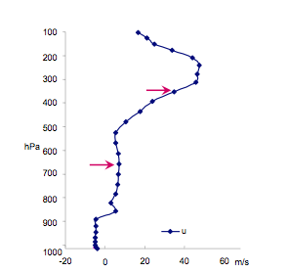
AMV Press (x) vs. “Best-Fit” Dropsonde/DWL Press (y), [hPa]
DS/DWL wind profile
AMV Press
AMV U/V Best Fit => Best Fit AMV Press

Slide 18
AMV Press (x) vs. “Best-Fit” Dropsonde/DWL Press (y), [hPa]

Slide 19
Questions to answer:
1) How do feature tracked AMVs and Doppler lidar winds compare?
2) How can Doppler lidar winds help us address the uncertainties in AMV
height assignments?
3) How can ADM-Aeolus wind profiles be used to assess the uncertainty introduced by the assumption that cloud/ water vapor features are ideal tracers? Level or Layer?
4) Further analysis to improve utilizing the U and V winds components separately in NWP models.

Slide 20
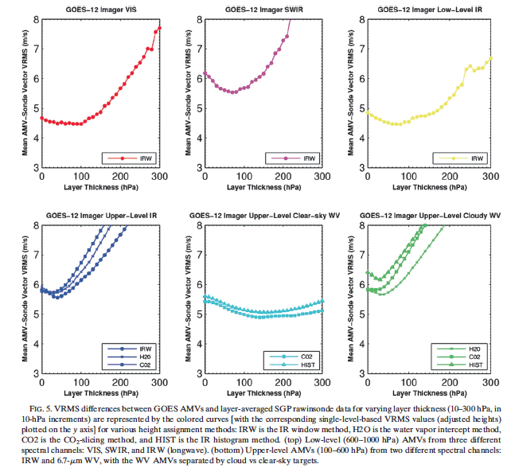
Christopher S. Velden and Kristopher M. Bedka, 2009, Identifying the Uncertainty
in Determining Satellite-Derived AMVr Height Attribution. JAMC., 48, 450–463.

Slide 21
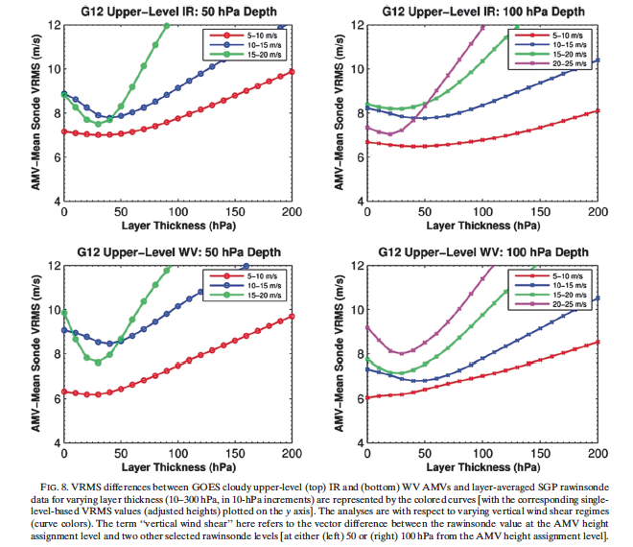
Christopher S. Velden and Kristopher M. Bedka, 2009, Identifying the Uncertainty
in Determining Satellite-Derived AMVr Height Attribution. JAMC., 48, 450–463.

Slide 22
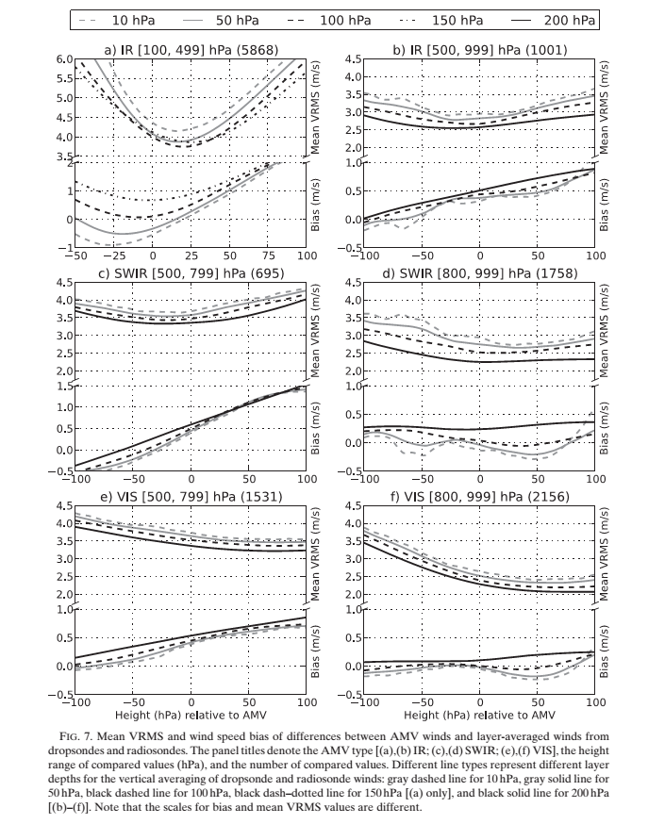
Martin Weissmann, Kathrin Folger,
and Heiner Lange, 2013,
Height correction of AMVs Using Airborne Lidar Observationsn.
J. Appl. Meteor. Climatol., 52, 1868–1877.

Slide 23
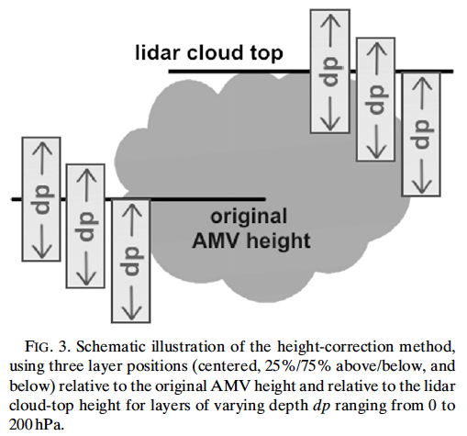
WV clear
original AMV
height
50/50
25/75
VIS, IR,
WV cloud
all types
Velden, 2009
Weissmann, 2014

Slide 24
Kathrin Folger and Martin Weissmann, 2014
Height Correction of AMVs Using Satellite Lidar Observations from CALIPSO
J. Appl. Meteor. Climatol.,, 1809-1819

Slide 25
WV clear
original AMV
height
50/50
25/75
VIS, IR,
WV cloud
Velden, 2009
all types
50/50
25/75
original AMV
height
⬅ Can we evaluate the Mean VRMS and winds Speed Bias of differences between AMVs and layer-averaged Doppler wind profiles ???
all types

Slide 26
Examples of AMV - Doppler wind profiles collocations

Slide 27
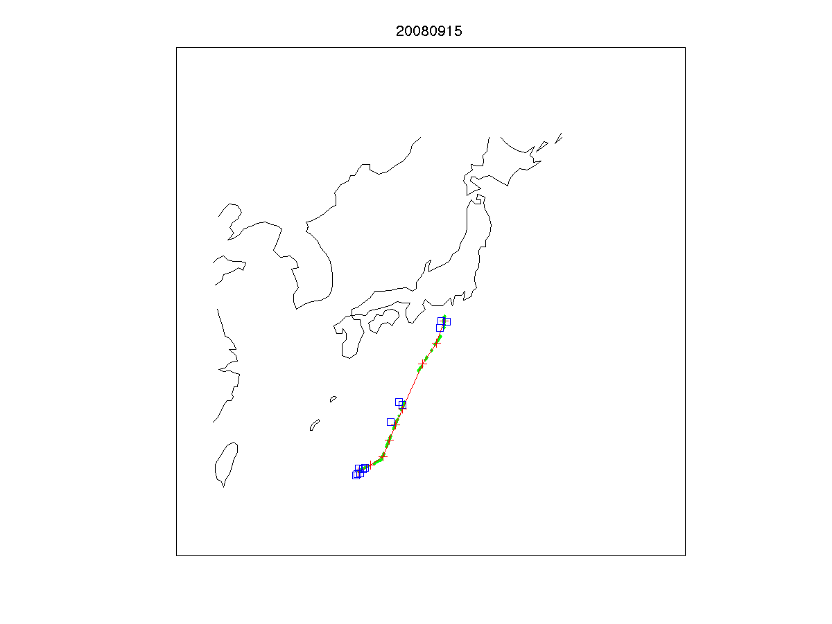
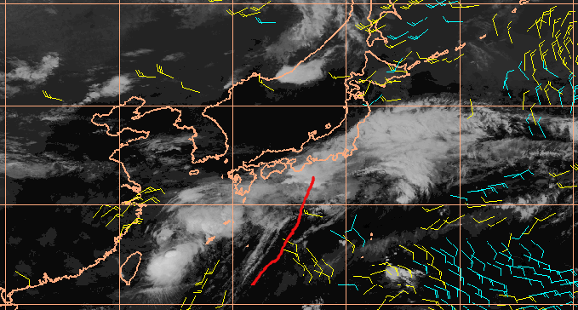
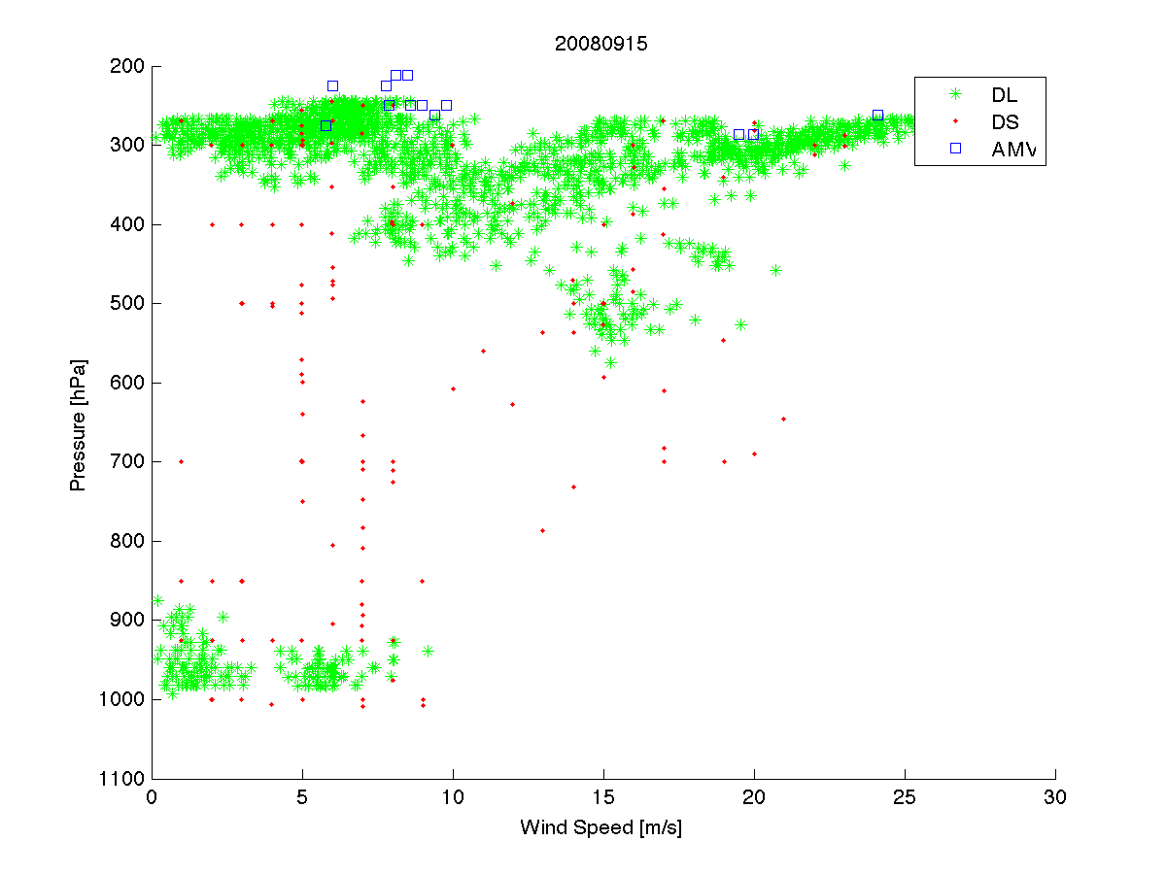

Slide 28
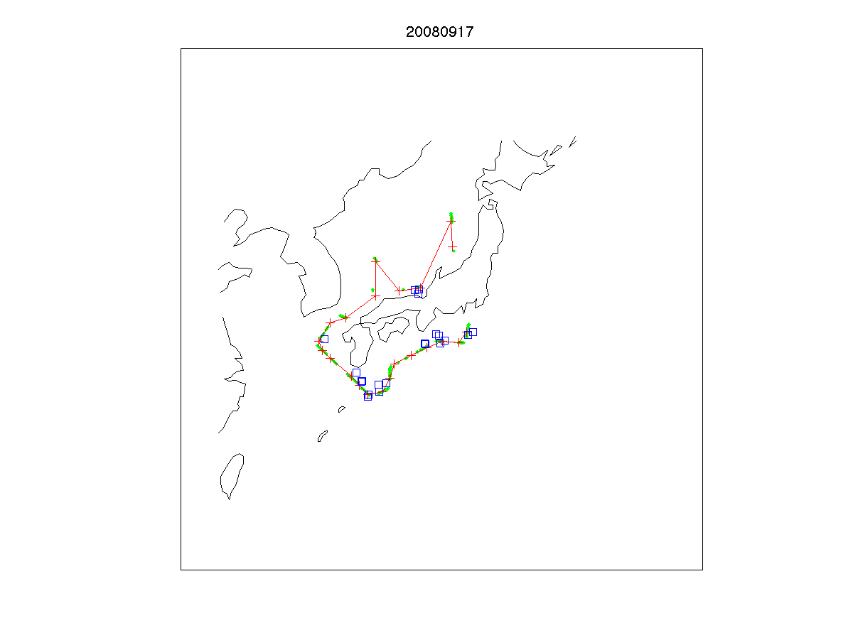
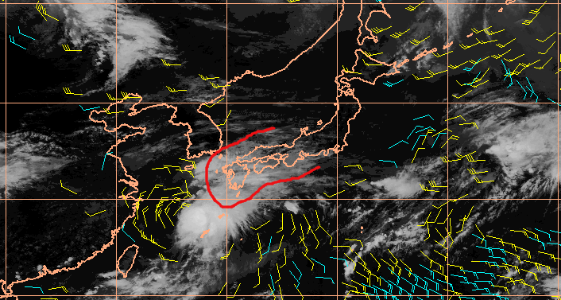
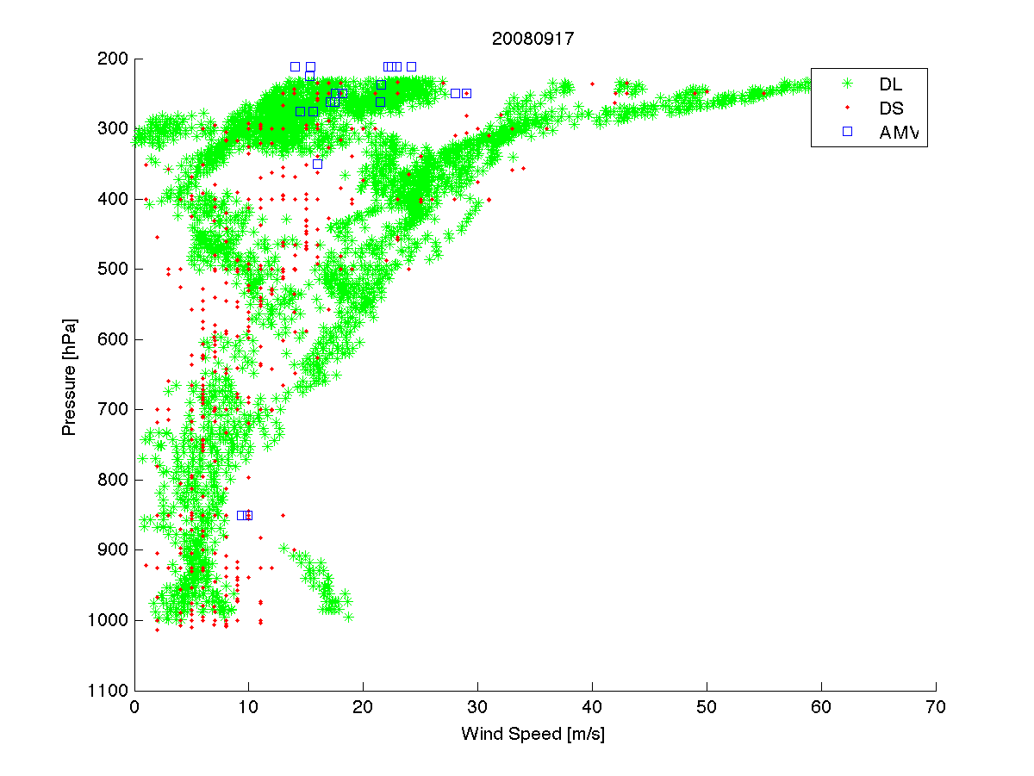

Slide 29
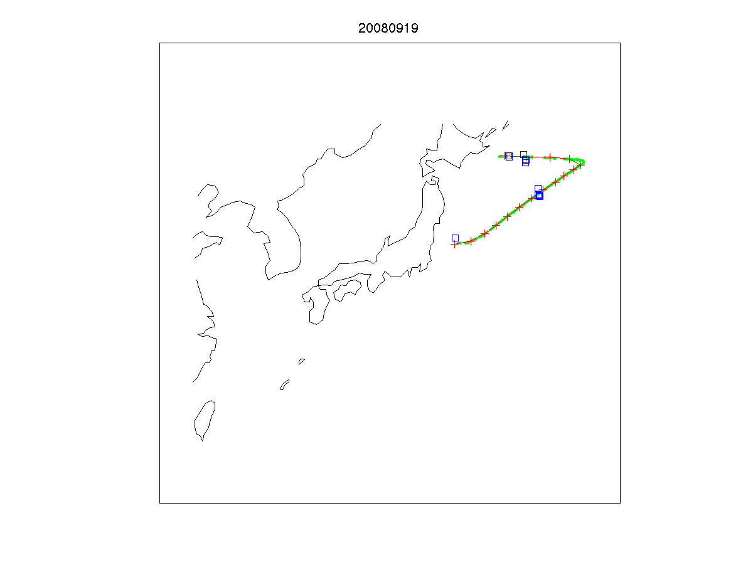
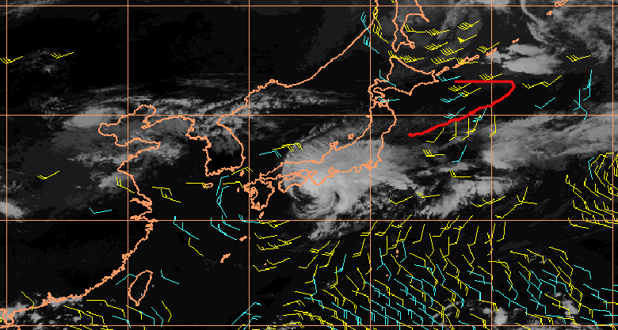
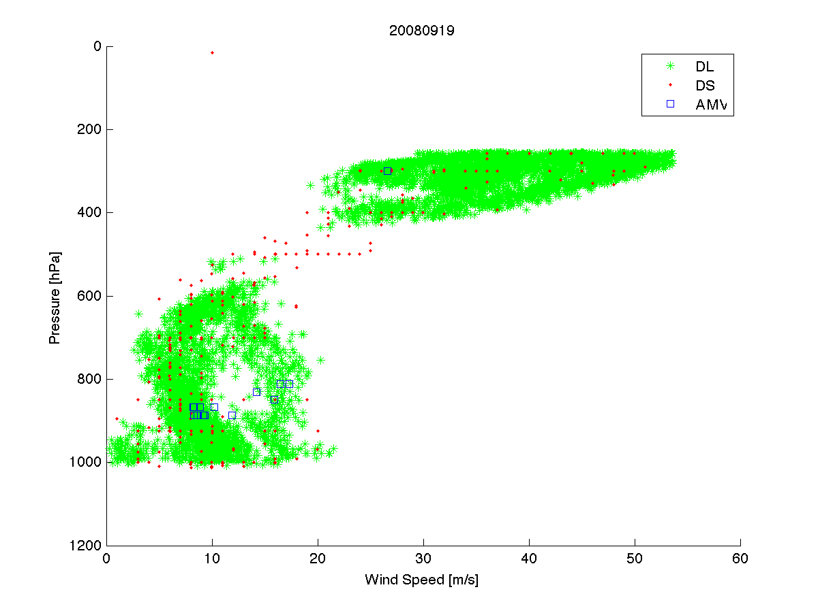

Slide 30
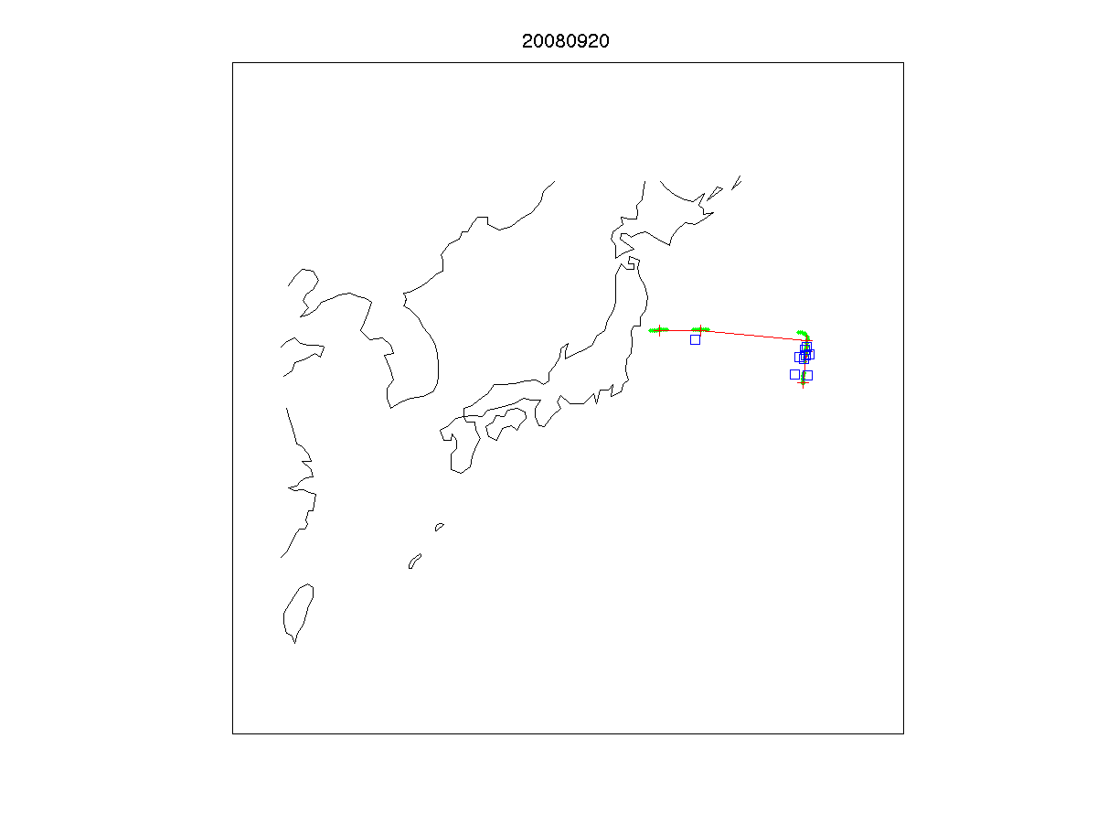
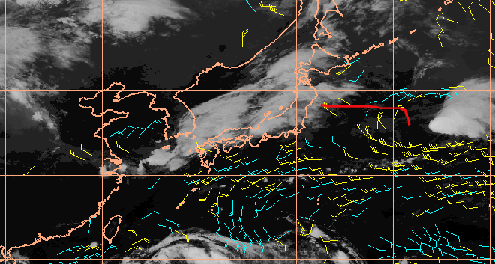
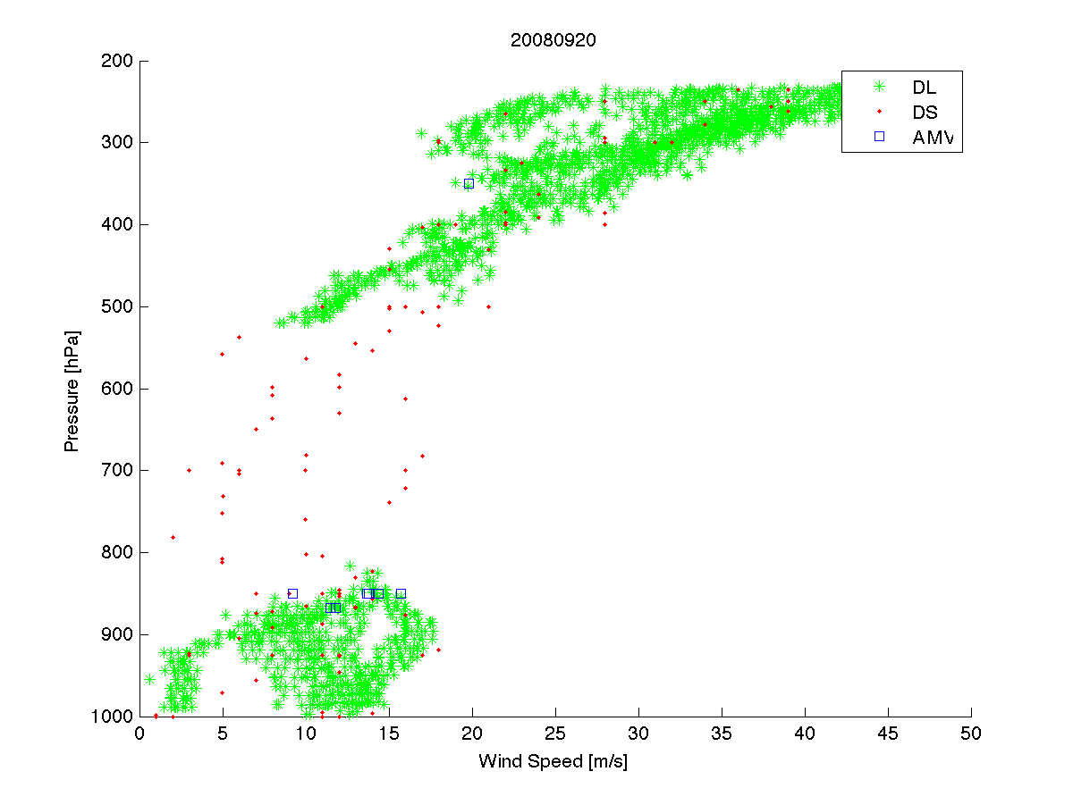

Slide 31
Questions to answer:
1) How do feature tracked AMVs and Doppler lidar winds compare?
2) How can Doppler lidar winds help us address the uncertainties in AMV
height assignments?
3) How can ADM-Aeolus wind profiles be used to assess the uncertainty introduced by the assumption that cloud/ water vapor features are ideal tracers? Level or Layer?
4) Further analysis to improve utilizing the U and V winds components separately in NWP models.

Slide 32
Satellite AMVs and Doppler lidar winds in NWP • Weissman - positive impact of assimilating airborn doppler lidar winds assimilation in the ECMWF DA system (2004) (aircraft data) • Rennier - ‘ADM Aeolus only’ observation operator at ECMWF • JCSDA – ADM Aeolus related activities (when? who? what?) • We propose treating Doppler lidar winds as satellite AMVs with revised error characteristics and quality control

Slide 33
Satellite AMVs and Doppler lidar winds in NWP • 24 level profiles, but with consistent global coverage • Thanks to the two channels on ADM, profiles in cloud free AND cloudy areas will be available (TOA to surface, TOA to top of cloud) • Augmented polar winds coverage • Significantly improved ‘Leo-Geo belt’ coverage

Slide 34
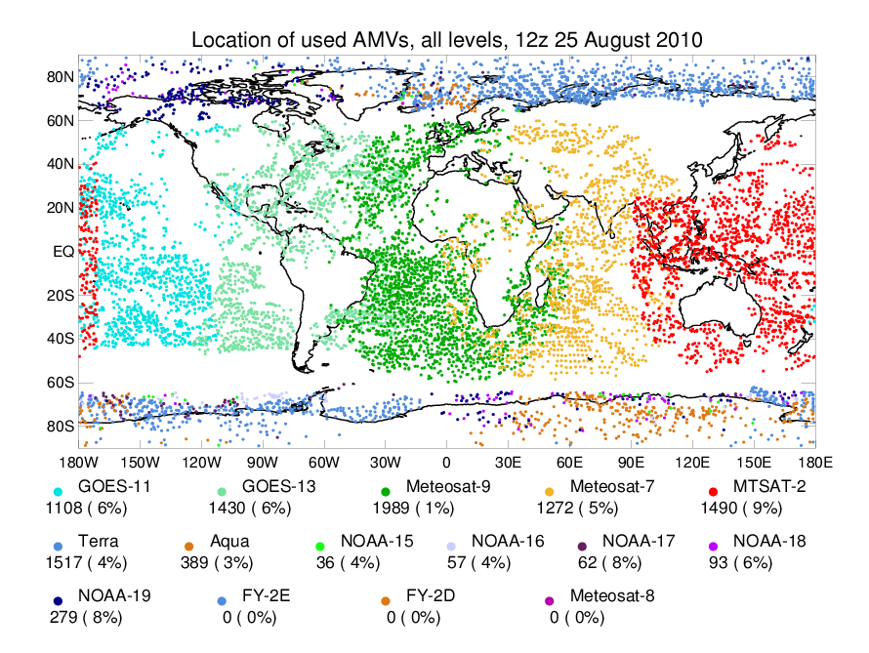
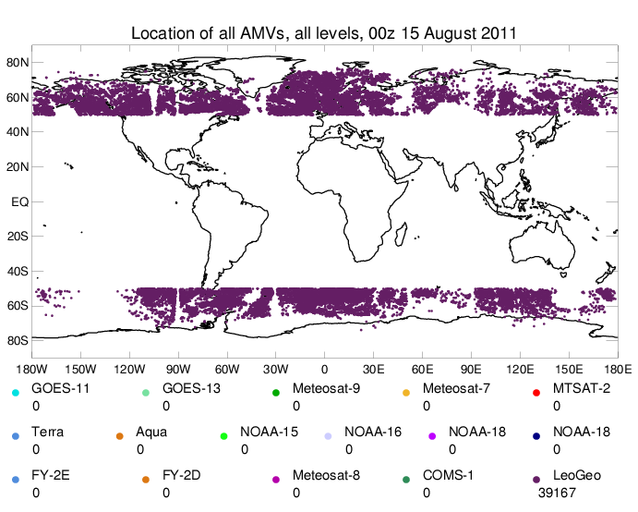
Geostationary and Polar-orbiting Atmospheric Motion Vectors
Missing winds – gap in coverage
NWP centers: the polar jet stream can be located in this gap; improper model initialization can lead to errors in the forecasts.
CIMSS research: the addition of the wind information is important in this region.
Plot courtesy of James Cotton: LeoGeo AMVs - ECMWF, 5 October 2011
UK Met Office monitoring plot: 25 August 2010
Santek, Hoover, Key, Lazzara (2015, personal communication)
Notes:
4 UTC to 9 UTC coverage of GEO and Polar AMVs over 6 UTC AMRC Antarctic and Arctic Composites – a gap in coverage – can we fill it from the composites?

Slide 35
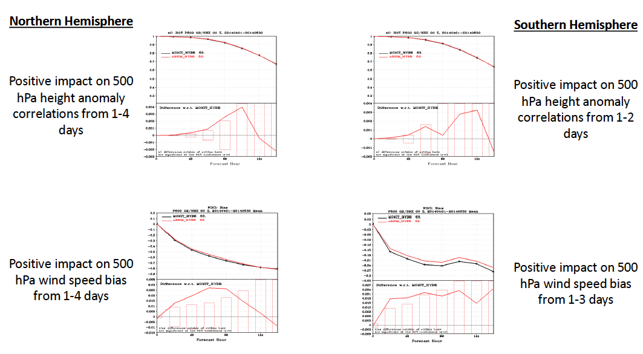
LEO-GEO winds assimilation in NCEP’s GSI
Hoover, Santek (2015, personal communication)

Slide 36
Summary / Outlook • Preliminary results show that AMVs and DWL winds are similar when strict collocation criteria are applied • DWL winds can be used to revise the AMV’s Observation Errors • It is feasible to use DWL wind profiles for ‘best fit’ AMV height correction • Doppler lidar wind profiles may be useful for assigning an AMV to a layer instead of a level. Some AMV producers will soon report relevant cloud information along with each AMV vector, thus facilitating the transition level-to-layer when using AMVs in NWP models • Leo-Geo winds in the polar regions have positive impact. We hope assimilating ADM winds to make things even better
We can’t wait to get ADM-Aeolus winds!

Slide 37
Thank you!

Slide 38
ABSTRACT
Many NWP models have successfully assimilated satellite AMVs for years. Recently, experiments at ECMWF showed positive impact when assimilating airborne wind-lidar winds. Thus, in preparation for the ADM Aeolus launch and inclusion of Doppler lidar winds in data assimilation (DA) it is important to understand how cloud tracked AMVs compare and complement the wind-lidar derived winds. A preliminary case study using T-PARC campaign data from hurricane Sinlaku inter-compared Doppler-wind lidar (DWL) profiles, dropsondes (DS), ECMWF’s First Guess (FG) and 6h MTSAT AMVs offered a first look into how satellite and airborne wind-lidar winds compare. Despite the different physical nature of the retrievals, AMVs showed similar speed bias and RMS against DWL, DS and FG winds. Due to the limited data samples these results were rather preliminary, yet illustrative and encouraging.
Applying CIMSS's AMV extraction algorithm to hourly MTSAT imagery yields a much larger AMV data set, allowing us to repeat the study and further the investigation. The inter-comparison now looks at speed, direction, altitude displacement and also the U and V components of the wind vector. Results can be binned by altitude (low, mid, high winds), cloudy/non-cloudy conditions and the AMVs height assignment method. A three-way collocated data set (AMV-DS-DWL) analysis suggests that ADM Doppler wind profiles i) can be used instead of RAOBs for evaluating the accuracy of AMVs wherever RAOBs are not available on a global scale; ii) can be used to develop an AMV height correction method and/or overall revision of the AMV Observation Error profiles normally used in NWPs models.
Recent research suggests that AMVs may be better represented and assimilated in NWP models by assigning them to tropospheric layers, rather than discrete levels. We present results from correcting AMVs heights using airborne lidar observations, and first ideas on how Doppler wind profiles can be used to assess the uncertainty introduced by the assumption that cloud and water features are ideal tracers.

Slide 39
SUGGESTIONS by Conf Organiser
Discuss the difference in the centre of gravity of the signal used for the AMV height assignment and the centre of gravity of the return signals from the lidar vertical bins. This was extensively discussed at the IWWG meeting in Copenhagen in June after the DWD talk, which looked into CALIPSO and AMV estimated cloud heights. This is also relevant for Aeolus Doppler Mie winds in complex scenes. The retrieved/attributed cloud wind and lidar bin height very much depend on the centre of gravity and signal attenuation, which is wavelength and signal strength dependent.
Briefly describe the plans for comparison of Aeolus Mie wind products with AMVs, as outlined in the join US CAL/VAL proposal

Slide 40
Mean VRMS and winds speed Bias of differences between AMVs and layer-averaged Doppler wind profiles (IR and WV winds combined) from T-PARC. Layers are relative to the original AMV pressure height.

