Slide 1
NASA Science Overview
Ramesh Kakar
NASA Program Scientist for Wind Lidar
(also, Aqua, TRMM, GPM and CYGNSS)
November 3, 2015

Slide 2
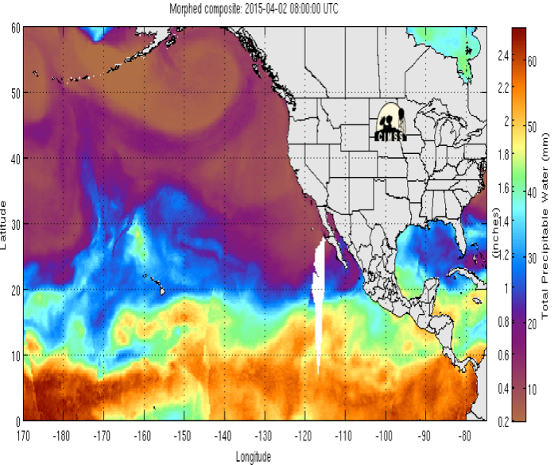
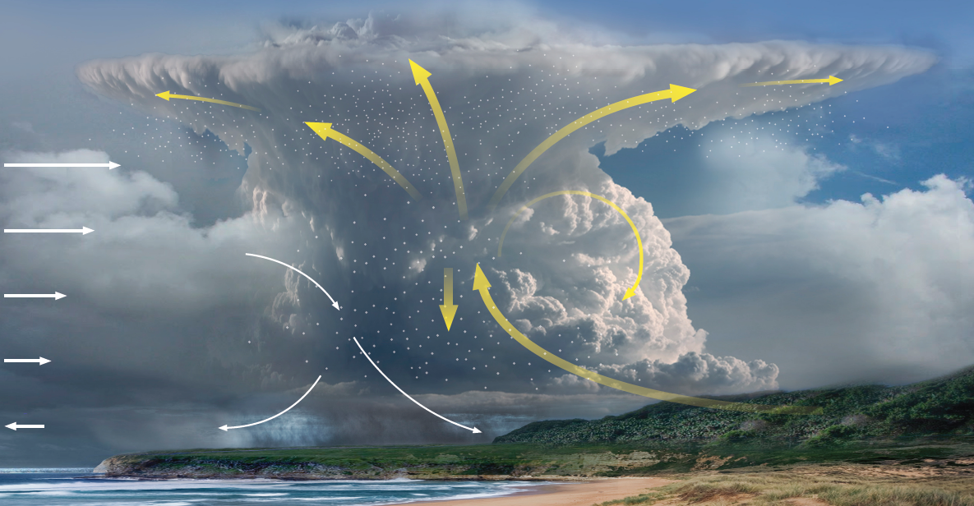
NASA Weather Focus Area Workshop Preliminary Result, April 7 – 9, Arlington, VA
About 80 people attended the two and a half days NASA weather focus area workshop
Top phenomena:
Extreme events
Top observations:
high res wind profile obs in all weather
high res temp and moisture profiles
Atmosphere – Land fluxes
Top system capability development
advanced DA (including coupled)
high res global models
OSSE
New ROSES element planned
Strategic planning for the next NRC decadal survey

Slide 3
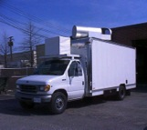
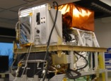
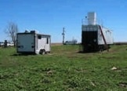
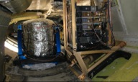
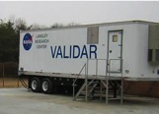
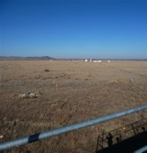
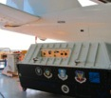
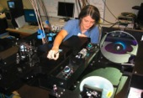
Earth Science Technology Highlight:
Toward 3D-Winds - Active Optical Investments
Tropospheric Wind Lidar Technology Experiment (TWiLiTE)
Flew on the ER-2 in 2009 & 2011 and on the DC-8 in Feb. 2015 and again during the PolarWinds campaign.
3D-Winds Decadal Survey Mission
UV Direct Detection
Molecular Winds
(Gentry, NASA GSFC)
Doppler Aerosol Wind Lidar
(DAWN)
2008 Ground Comparison
Flew 112 hours over 15 flights on the DC-8 in 2010 in support of the NASA GRIP campaign. Flew on B200. Additional flights on the UC12 in 2014 and DC8 in 2015 supporting PolarWinds & Aeolus cal/val.
2.0 um Coherent Doppler
Aerosol Winds
(Kavaya, NASA LaRC)
Optical Autocovariance Wind Lidar (OAWL)
2011 Ground Comparison with NOAA mini-MOPA
Test flights conducted on WB-57 in 2011. Instrument /
UV Direct Detection
Aerosol & Molecular Winds
(Tucker, Ball Aerospace)
mission design study for ISS completed in 2012. An Observing System Simulation Experiment (OSSE) completed in 2013. Partial funding for EVI-2 provided.
Technology Development
Demonstrations / Campaigns
Science Measurements

Slide 4
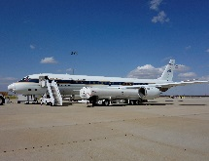
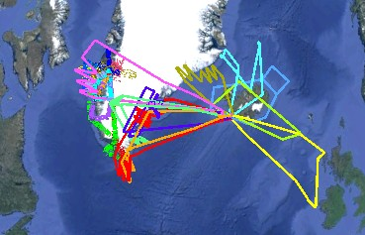
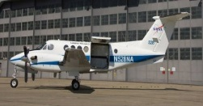
PolarWinds and ADM Cal/Val Preparatory Campaigns
Campaign Objectives
PolarWinds
Mesoscale model (PolarWRF) validation/development
Stable boundary layers; katabatic flows; marginal ice zone dynamics
ADM Cal/Val
Obtain Doppler Wind Lidar observations that mimic those expected with ADM
Co-fly with DLR Falcon in Campaign 2 to calibrate ESA’s Aeolus simulator (A2D)
Campaign 1: 10/26 – 11/14/14; 40 science hours
LaRC’s UC-12B; Kangerlussuaq, Greenland
Campaign 2: 05/11 – 05/29/15; 53 science hours
NASA DC-8; Keflavik, Iceland
Leads: NASA LaRC (DAWN PI); Simpson Weather Associates (Science PI), NASA GSFC (TWiLiTE PI)
Science Team: Colorado University, Ohio State University, University of Washington, NASA LaRC, Simpson Weather Associates and NASA GSFC.

Slide 5
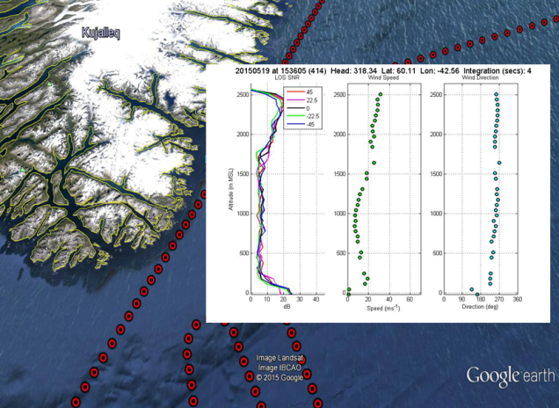
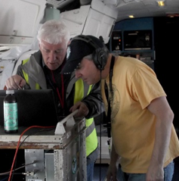
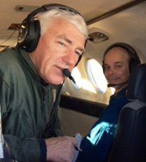
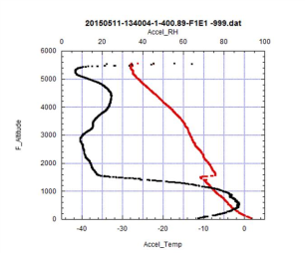
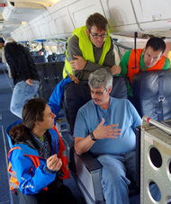
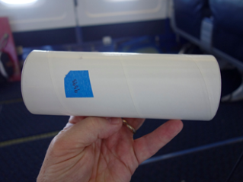
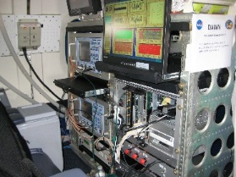
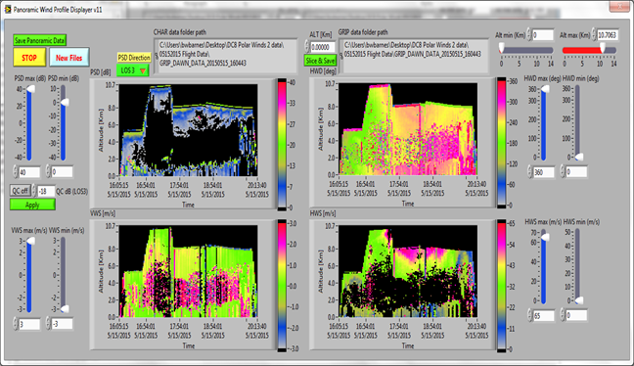
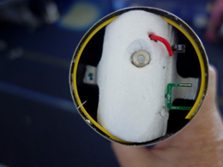
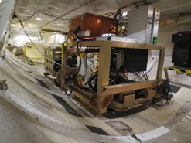
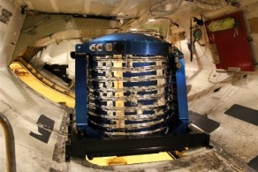
PolarWinds and ADM Cal/Val Preparatory Campaigns
Instrumentation
Campaign 1: DAWN only on LaRC’s UC-12B
Campaign 2: DAWN, Yankee dropsondes, TWiLiTE on DC-8
MAG1 and A2D wind lidars on ESA/DLR Falcon
NASA LaRC DAWN
Yankee Dropsondes
NASA GSFC TWiLiTE
Surface temperature sensor

Slide 6
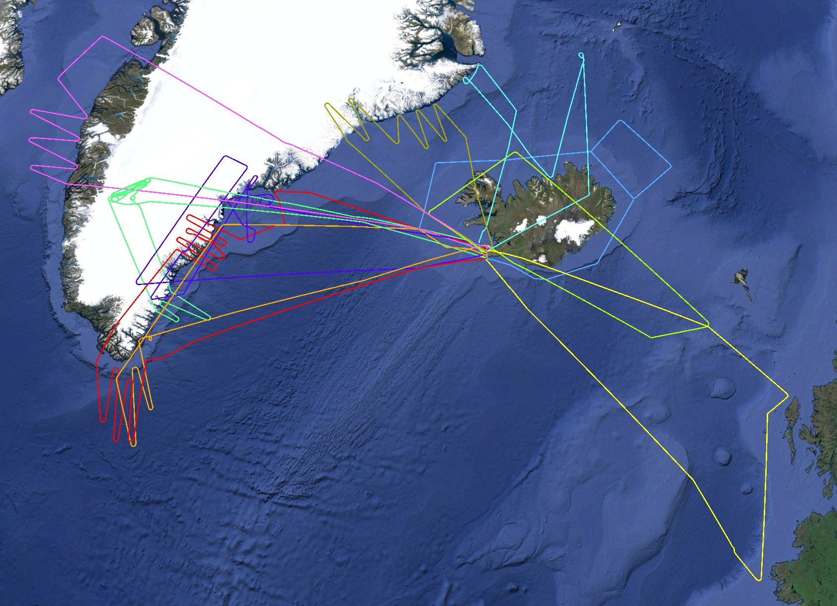
Polar Winds ADM Cal/Val Iceland 2015
2015 May 24
2015 May 13
2015 May 11
53 flight hours
79 dropsondes
10 Science Flights
on 10 Days
6 Formation Flights
with ESA/DLR Falcon
2015 May 21
2015 May 16
2015 May 25
2015 May 23
2015 May 29
2015 May 17
2015 May 15

Slide 7
Mission Summary (53 hours not including ferry hours)
Date | Mission | DC-8 | Falcon | Drops | DAWN | TWiLiTE
5/11 | Iceland flow splitting with NE BL winds | x |  | 3/5 | X | X
5/13 | TDS underflight(DLR/NASA) and Greenland CIZ (NASA) | x | x | 5/6 | X | X
5/15 | Upper level jet between Iceland and Scotland | x | x | 10/12 | X | X
5/16 | ADM cal/val over Greenland ice cap; CIZ and Kat-winds | x | x | 8/10 | X | x
5/17 | CALIPSO, MODIS, ASCAT underflights; CIZ;Tip jet | x |  | 8/9 | X | X
5/19 | Upper level jet over southern Greenland; Tip jet | x | x | 7/8 | X | X
5/21 | Barrier jet | x |  | 7/11 | X | X
5/23 | Katabatic flows off Greenland east coast; ADM cal/val CIZ | x | x | 15/19 | X
5/24 | Baffin Strait ice edge west coast of Greenland; rolls | x |  | 11/12 | X
5/25 | Upper level jet south of Iceland | x | x | 5/6 | X | X
Note: x/y under Dropsondes indicates number of full profiles (x) over the number of sondes (y) dropped.

Slide 8
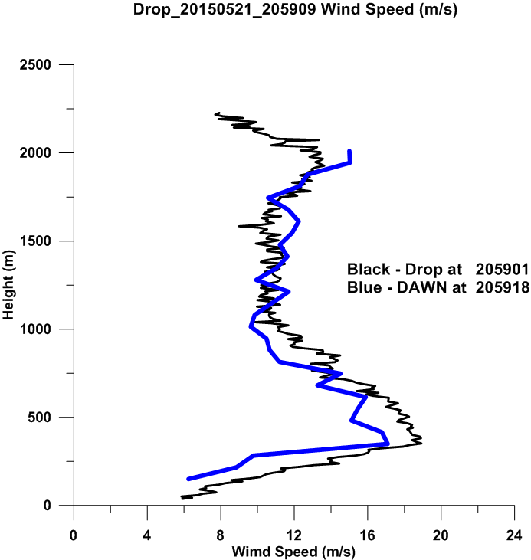
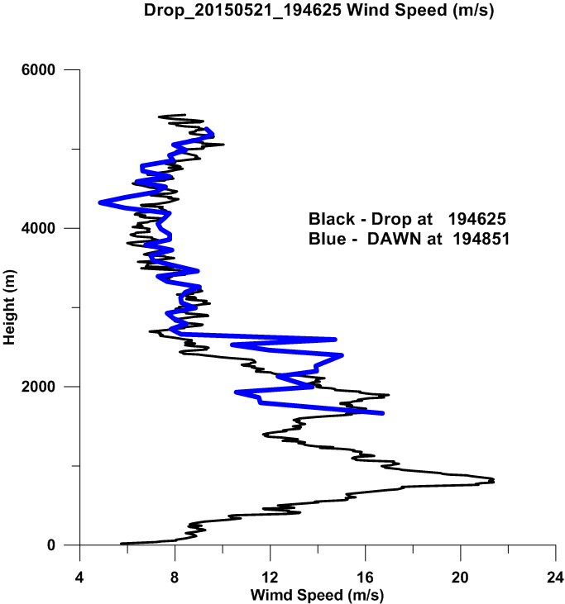
05_21_15 Sounding off the east coast of Geenland
DAWN Profiles vs. Dropsondes
05_21_15 Sounding off the East coast of Greenland

Slide 9
Summary
Conducted wind profiling and dropsondes over Greenland coastlines and ice fields on several occasions, especially on the 16,17,19,21,23 and 24th of May 2015.
DC8 w/ Falcon stares over long flight legs to simulate ADM sampling on the 13th. The DC-8 was used on solo missions to simulate the ADM stare as well.
High aspect racetracks with DC8 moving in the center relative to Falcon flying 20 degree bank circles on the 16th and 23rd.
Four of the six DC-8/Falcon missions were focused on situations with strong shear in the wind speed; situations that will challenge the long integrations expected for the molecular channel. The co-flights on the 16th and 23rd were very specific to using the ice surface to calibrate the Falcon A2D. The DC-8 flew back and forth over a small area while the Falcon flew in circles for many 10s of minutes.
NASA has sent all dropsonde data as well as the DAWN profiles to ESA and we are interested in learning how this data has helped with the ADM calibration.
Future Plans?
The DC8 has been tentatively reserved for a tropical campaign during June 1 to July 30, 2017 for a tropical campaign. However, no funding is in place for this campaign at the present time.
New ROSES element

