Slide 1
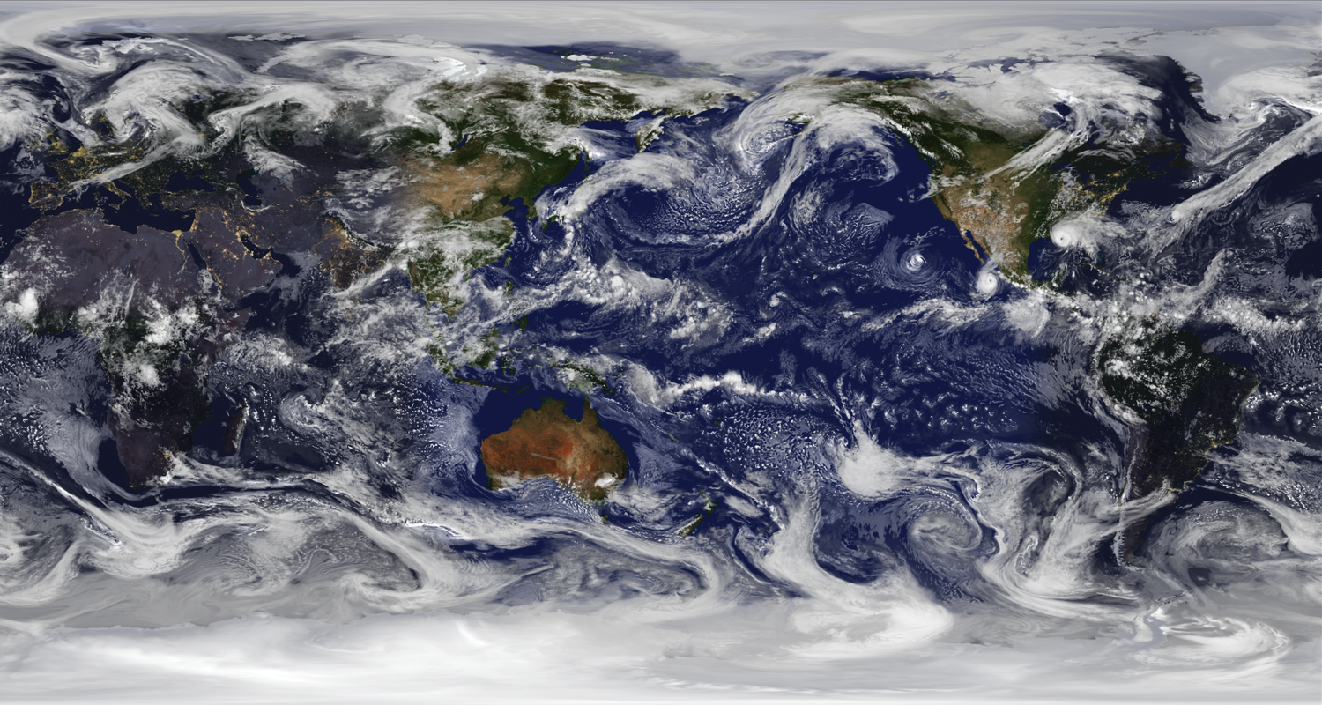
Quantitative Observing System Assessment Program (QOSAP)
GMAO 7km resolution global nature run
Robert Atlas
Office of Oceanic and Atmospheric Research

Slide 2
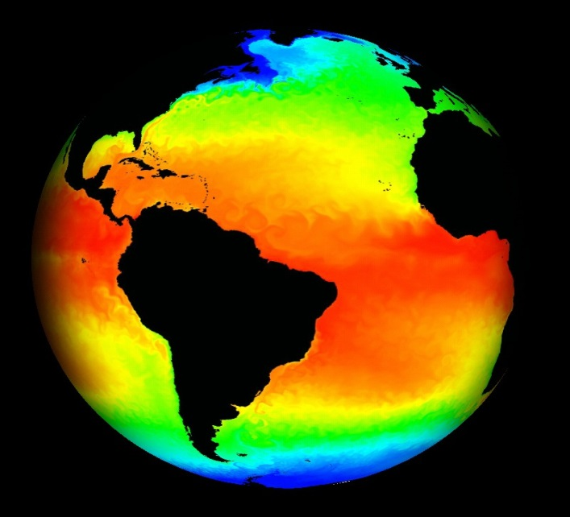
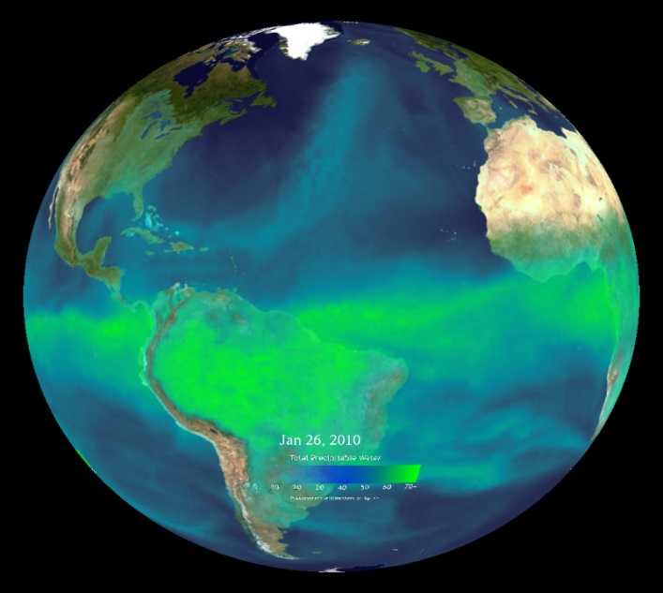
QOSAP’s Primary Objective
Improve quantitative and objective assessment capabilities to analyze and evaluate operational and future observation system impacts and trade-offs to assess and prioritize NOAA’s observing system architecture.
Increase NOAA’s capacity to conduct quantitative observing system assessments.
Develop and use appropriate quantitative assessment methodologies.
QOSAP, integrated with the NOSC’s complementary programmatic prioritization activities conducted by the TPIO (NOSIA methodology and PALMA tool), will inform major decisions on the design and implementation of optimal composite observing systems.

Slide 3
OSE and OSSE
Observing system experiment (OSEs): An OSE focuses on identifying the impact of a current observing system on data assimilation and numerical weather prediction while testing ways to improve the quality and usefulness of data products.
Observing system simulation experiment (OSSEs): An OSSE is a type of observing system experiment that assesses the potential impact of proposed/future observing systems on numerical weather, ocean, and climate prediction of assimilating observations from proposed/future observing systems.
Trade-offs in instrument or orbital configurations and methods of assimilating a new type of observing system can be determined by an OSSE and ultimately result in both time and cost savings.
Data impact experiments can identify an optimal configuration for a future observing network and help recognize weaknesses in the processing or assimilation of the observations.
The same data assimilation systems, models, and diagnostic tools used for performing OSEs are also used for OSSEs.

Slide 4
OSSE Schema
“Nature”
Simulation of Observations
Data Assimilation
Forecasts with and without
Verification
Calibration
View Nature Run Simulation
Notes:
The methodology currently used for OSSEs worldwide is shown schematically on this slide. This methodology was redesigned in the early 1980’s by Dr. Bob Atlas in order to ensure the realism and reliability of OSSEs. This methodology was accepted by both the U.S. Weather Research Program and the World Meteorological Organization. Dr. Atlas used this methodology to conduct all of NASA’s OSSEs from 1985-2005.

Slide 5
QOSAP’s Multi - LO Governance
Champion
(Craig McLean)
NOSC
(Oversight)
TPIO
(NOSIA Integration)
Executive Lead
(Steve Fine)
QOSAP
Program Lead
(Bob Atlas)
Deputy Program Lead
(Shanna Pitter)
Sid Boukabara
NESDIS
Stephen Gill
NOS
James Yoe
NWS
Kevin Kelleher
OAR
Bonnie Ponwith
NMFS
Kristie Twining
OMAO
Notes:
The Line and Staff Offices are working well together and it is paying dividends with the advances being made.

Slide 6
QOSAP’s Annual Milestones
Milestones/Deliverables to NOSC | Planned Completion Date
Annual plan: quantitative assessment project prioritization and selection | Q2
Performance reports on projects | Q4
Inventory of Results of Quantitative Assessments | Q4
Collection of Driving Research Questions for a QOSAP needs assessment | Q4
End of Fiscal Year Progress Report to NOSC | Q1 of next FY
In May 2014, OMB was provided with an INVENTORY of OSSE/OSE assessments conducted within NOAA over the previous 5 years.
55 assessments were reported with their main results and applicable publication(s) at that time, then an additional assessment was added in a subsequent update.

Slide 7
Assessment Prioritization Schema
For each proposed assessment topic/question we answered:
Question 1: Is there a pressing need for the assessment to be executed in the current FY? [Yes/No]
Question 2: Does NOAA currently have the capabilities in place to execute the assessment? [Yes/No]
Question 3: Are there existing resources available for the assessment? [Yes/No] Estimate the amount needed/or additional above existing $ [$k]
Question 4: Can the assessment be completed in the next 1-2 years? [Yes/No]
Question 5: What is the potential value to NOAA and partners? [High, Medium, Low]
Notes:
Pressing need defined as "NOAA contractual agreement or necessary for FY14/15 investment decision“. This includes any on-going studies (ie are currently funded), thus expectation of the study’s execution.

Slide 8
FY14 Prioritized Tiers
Priority Tier 1: Has Pressing need for immediate execution
1A: All factors align; need, $, capability, FY15 finish, high value
1B: All but 1 factor align; Need, capability, $, FY15 finish, yet lower value
1C: Need and high value, yet no capability or $
1D: Need, yet medium value and no capability or $ available.
Priority Tier 2: No pressing need for immediate execution yet capability exists (may need $)
2A: At least 2 other factors align
2B: 1 factor aligns and medium+ value
2C: 1 factor aligns
Priority Tier 3: No pressing need, capability, nor resources
3A: High value
3B: Medium-Low value
Priority Tier 2 may be started in current or next FY
Priority Tier 1 will be started in current FY*
*If the capability cannot be developed in current FY, it will be deferred
Priority Tier 3A will be further defined in

Slide 9
Current Status and Select Results

Slide 10
Current Status of OSSEs
Limited OSSEs have been performed using an older global OSSE system based on an ECMWF T511 nature run and a new regional Hurricane OSSE system.
A new state of the art global OSSE system based on the NASA Cubed Sphere at 7 km resolution has been developed and is being calibrated at this time. This will replace the current global OSSE system at OAR/ESRL and JCSDA.
New and expanding regional OSSE systems for high impact weather are being developed.
A state of the art ocean OSSE System has been developed and is expanding.

Slide 11
Sample Assessment Results
OSSE on the impact of Enhanced GPS Radio Occultation (COSMIC-2 equatorial and polar; commercial options). $; Responsibility: ESRL/GSD, JCSDA, AOML
Status: Preliminary OSSEs have been completed, working with a more realistic OSSE system soon. Completion expected by December 31, 2015.
The preliminary results show that increasing the number of assimilated RO satellites results in better weather forecast skill:
18 sat is better than 12 sat;
12 sat is better than 6 sat.
However, there is a lot of room to optimize the assimilation system and some cases need to be evaluated with more detail to understand how results can be improved. The preliminary studies used the earlier OSSE system: low-resolution nature run, low-resolution assimilation system, perfect observations, non-hybrid analysis, RO refractivity profiles, top of the RO profiles stops at 30 km.
$= Fully Funded existing LO project (incl Sandy Supplemental)

Slide 12
Results of the GPSRO Occultation OSSE
Experiments (preliminary OSSEs)
OSSECTRL (6 satellites): control, all observations
OSSENOGPS: control without RO observations
C2EQ (12 satellites): control + COSMIC-2 equatorial
C2PO (18 satellites): control + COSMIC-2 equatorial + COSMIC-2 polar
500-mb geopotential height anomaly correlation
Southern Hemisphere

Slide 13
Sample Assessment Results
OSSE on the impact of Geostationary Hyperspectral sensors (including commercial alternatives and GOES-R ABI). $$; Responsibility: AOML, NESDIS, JCSDA, NSSL
Status: Preliminary OSSEs have been completed, working with a more realistic OSSE system soon. Completion expected by December 31, 2015.
The preliminary experiments showed a significant improvement in forecast accuracy in the southern Hemisphere, but not over North America.
The results of hurricane model experiments are mixed, but indicate modest potential to improve hurricane forecasts. Further testing is underway.
$= Fully Funded existing LO project (incl Sandy Supplemental), $= QOSAP provides additional/all funding

Slide 14
Preliminary AIRS_G Preliminary AIRS_G13 impacts (00Z runs)13 impacts (00Z runs)
 |  |  | Anomaly Correlation |  |  |  |  |  |  |  | RMS Error |  |  |  |  |  |  |  |  | Anomaly Correlation |  |  |  |  |  |  |  | RMS Error
Domain | Parameter | Level |  | Forecast Day |  |  |  |  |  |  | Forecast Day |  |  |  |  |  | Domain | Parameter | Level |  | Forecast Day |  |  |  |  |  |  | Forecast Day
 |  |  | 1 | 2 | 3 | 4 | 5 | 6 | 7 | 1 | 2 | 3 | 4 | 5 | 6 | 7 |  |  |  | 1 | 2 | 3 | 4 | 5 | 6 | 7 | 1 | 2 | 3 | 4 | 5 | 6 | 7
 |  | 250/200 hPa |  |  |  |  |  |  |  |  |  |  |  |  |  |  |  |  | 250/200 hPa
 | Temperature | 500 hPa |  |  |  |  |  |  |  |  |  |  |  |  |  |  |  | Temperature | 500 hPa
 |  | 850 hPa |  |  |  |  |  |  |  |  |  |  |  |  |  |  |  |  | 850 hPa
 | Wind | 250/200 hPa |  |  |  |  |  |  |  |  |  |  |  |  |  |  |  | Wind | 250/200 hPa
PNA |  | 850 hPa |  |  |  |  |  |  |  |  |  |  |  |  |  |  | SH |  | 850 hPa
 |  | 250/200 hPa |  |  |  |  |  |  |  |  |  |  |  |  |  |  |  |  | 250/200 hPa
 | Geopotential | 500 hPa |  |  |  |  |  |  |  |  |  |  |  |  |  |  |  | Geopotential | 500 hPa
 |  | 700 hPa |  |  |  |  |  |  |  |  |  |  |  |  |  |  |  |  | 700 hPa
 |  | 1000 hPa |  |  |  |  |  |  |  |  |  |  |  |  |  |  |  |  | 1000 hPa
 |  | 250/200 hPa |  |  |  |  |  |  |  |  |  |  |  |  |  |  |  |  | 250/200 hPa
 | Temperature | 500 hPa |  |  |  |  |  |  |  |  |  |  |  |  |  |  |  | Temperature | 500 hPa
 |  | 850 hPa |  |  |  |  |  |  |  |  |  |  |  |  |  |  | Tropics |  | 850 hPa
 | Wind | 250/200 hPa |  |  |  |  |  |  |  |  |  |  |  |  |  |  |  | Wind | 250/200 hPa
NH |  | 850 hPa |  |  |  |  |  |  |  |  |  |  |  |  |  |  |  |  | 850 hPa
 |  | 250/200 hPa |  |  |  |  |  |  |  |  |  |  |  |  |  |  |  | prs382hwa significantly better than prs382hna
 | Geopotential | 500 hPa |  |  |  |  |  |  |  |  |  |  |  |  |  |  |  | prs382hwa better than prs382hna, nonsignificant
 |  | 700 hPa |  |  |  |  |  |  |  |  |  |  |  |  |  |  |  | no discernible difference
 |  | 1000 hPa |  |  |  |  |  |  |  |  |  |  |  |  |  |  |  | prs382hwa worse than prs382hna, nonsignificant
 |  |  |  |  |  |  |  |  |  |  |  |  |  |  |  |  |  | prs382hwa significantly worse than prs382hna
Bright Green, Red = statistically significant
Visual interpretation, erred on side of caution (i.e., calling results “significant” only if clear without a doubt)

Slide 15
Sample Assessment Results
OSSE to determine the potential impact of a geostationary microwave sensor. $; Responsibility: AOML, JCSDA
Status: In progress, main experiment will begin by early 2016.
AOML completed two initial studies that showed potential to improve the hurricane analyses and short-range forecasts.
OSSE to determine the potential impact of CYGNSS surface wind observations on hurricane analyses and forecasts.$; Responsibility: AOML
Status: In progress.
AOML completed an initial study using the HWRF model with GSI, that showed potential to improve hurricane analyses and short-range forecasts, provided the CYGNSS mission meets it’s performance requirements.
$= QOSAP provides additional/all funding

Slide 16
Impact of CYGNSS on Surface analyses using HWRF GSI
NATURE
CONTROL
CYGNSS

Slide 17
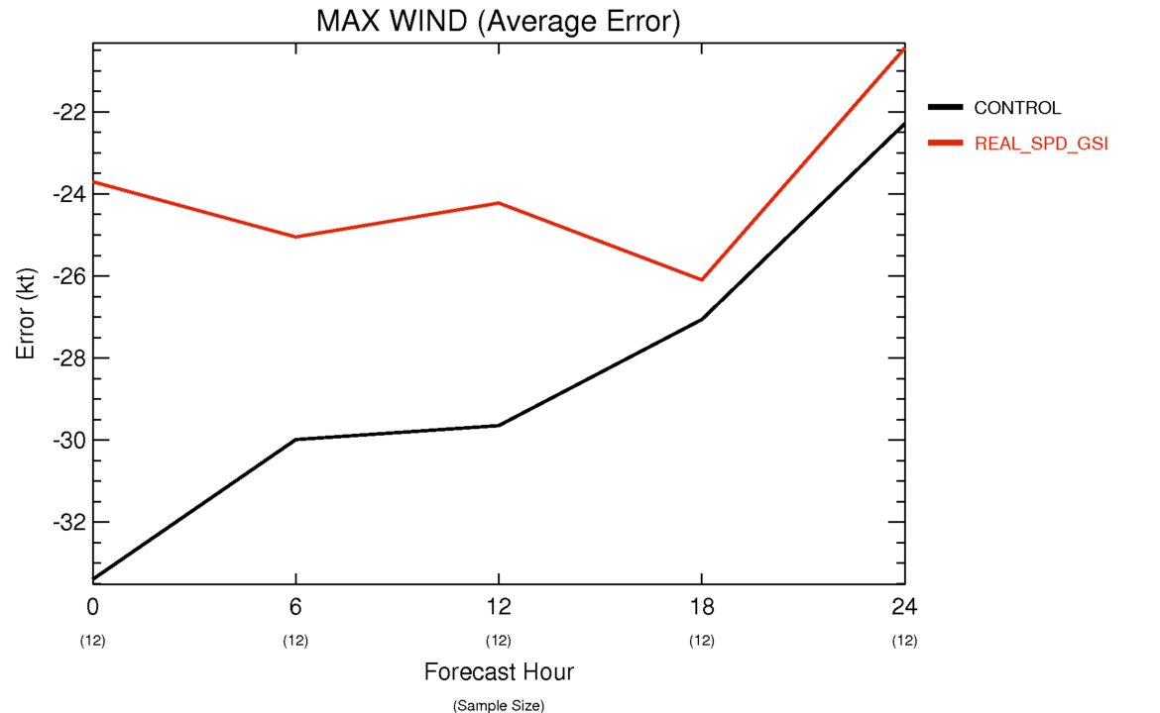
Impact of CYGNSS Data
(with realistic errors on HWRF 24 h Max Wind Forecasts)

Slide 18
Sample Assessment Results
Ocean OSSE System
Developed by the joint AOML/CIMAS/RSMAS Ocean Modeling and OSSE Center (OMOC)
Incorporates all design criteria and rigorous validation methods developed for atmospheric OSSE systems
Initial Gulf of Mexico implementation
The system was validated by comparing OSEs to OSSEs for the following experiments:
Assimilate all observations
Deny airborne ocean profiles collected during the Deepwater Horizon oil spill
Further deny two of three altimeters
Further deny the third altimeter
Deny all observations
System validation results for the Gulf published in JTECH, Jan. 2014

Slide 19
Results of the Ocean OSSE (1)
Impact of denying airborne profiles
Analysis RMS errors of Sea Surface Height (SSH) and Tropical Cyclone Heat Potential (TCHP) increased by ~50%
TCHP bias of near zero increased to ~10 kJ cm⁻²
Forecast RMS error increased, initially by 50% and then by 20-30% between forecast days 5 and 60.
Horizontal profile resolution
Analysis RMS errors increased by 20-30% for SSH and 30-40% for TCHP when resolution decreased from 0.5 degree to 1.0 degree
TCHP bias of ~1 kJ cm-2 increased to 3-4 kJ cm-2
Profile surveys are effective at controlling the smaller-scale structure of ocean features that is poorly constrained by altimetry

Slide 20
Results of the Ocean OSSE (2)
Profiler type and depth range (400 m AXBT versus 1000 m AXCTD)
Analysis RMS errors increased 10-20% for SSH; no impact on TCHP
AXCTDs, which also measures salinity and samples a larger depth range compared to AXBTs, are more effective at constraining the structure of upper-ocean dynamical fields
Temporal resolution of surveys
Experiments performed for temporal resolutions of 1, 2, 4, 8, and 16 days
RMS error reduction for SSH was 10% for 16 days and nearly 50% for daily surveys
RMS error reduction for TCHP was 10% for 16 days and nearly 40% for daily surveys
Airborne surveys need to be conducted at least twice weekly to approach maximum error reduction

Slide 21
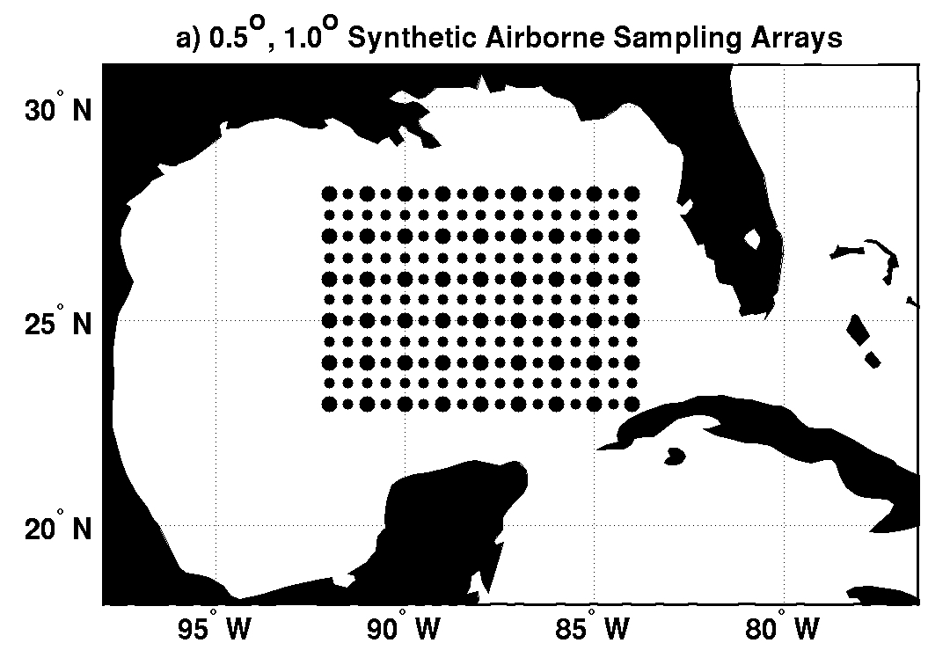
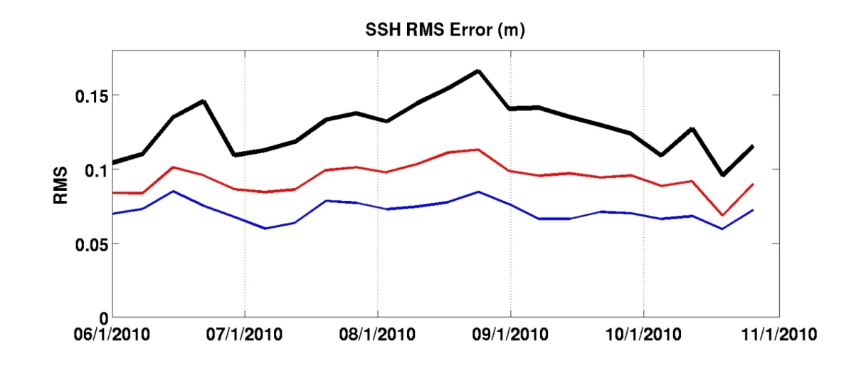
Impact of Horizontal Profile Resolution on SSH (RMS error)
The idealized airborne survey patterns on the 0.5º grid (all points) and the 1.0º grid (large points only) is shown at left.
Large area chosen to obtain robust statistics.
Ocean dynamical fields represented by SSH
Impact assessments recently accepted by Progress in Oceanography
Decreasing horizontal resolution has a large impact on RMS errors of SSH
Higher-resolution profiling constrains smaller-scale horizontal structure (fronts and small-scale eddies) that is not well constrained by satellite altimetry.
Deny all synthetic profiles
1.0° resolution
0.5° resolution

Slide 22
Plans for FY16+
Complete the development and validation of the new global OSSE system and expanded regional OSSE capabilities.
Conduct OSSEs for GPS RO and Geostationary Hyperspectral sounders and the combination of DWL and CYGNSS with the new global and regional OSSE systems.
Develop initial capabilities for NMFS, NOS, and OMAO.
Work with TPIO to incorporate the quantitative results from QOSAP into NOSIA-2.

Slide 23
Summary
QOSAP provides quantitative impacts of observations on products while NOSIA-2 has qualitative impacts on products and services. NOSIA should incorporate QOSAP results into that analysis.
Successes due to leveraged work across LOs.

Slide 25
Questions?

