Slide 1








NOAA Working Group on Space-Based Lidar Winds
(Nov. 3, 2015, AOML NOAA, Miami FL)
Feasibility Study for Space-borne Doppler Wind Lidar
S. Ishiiª, A. Sato ^{b, a}, K. Akahaneª, S. Naganoª,
T. Umezawaª, K. Mizutaniª, P. Baronª, S. Ochiaiª,
K. Okamoto^{c,} ª, T. Kubota^{d}, Y. Satoh^{d}, D. Sakaizawa^{d},
R. Oki^{d}, M. Satoh^{e}, and T. Iwasaki^{f}
National Institute of Information and Communications Technology (NICT),
Tohoku Institute of Technology (TIT)
Japan Meteorological Agency/Meteorological Research Institute (JMA/MRI)
Japan Aerospace Exploration Agency (JAXA)
The University of Tokyo
Tohoku University

Slide 2
Outline
Background and objectives
Comparison of space-borne Doppler wind lidar
Super-Low-Altitude-Satellite-borne Doppler wind lidar
  Specifications
  Geometry
Development of key technology
  Single-frequency pulse laser
  Detector
Summary

Slide 3
Background and Objective
Background
WMO technical report 2012-1
  Development of satellite-based wind profiling systems remains a priority for the future global observing system.
ESA is planning to launch the first space-borne Doppler Wind Lidar (DWL) ADM-Aeolus for obtaining LOS wind profiles.
Working group is studying a space-borne coherent DWL for vector wind measurement in Japan.
  NICT has developed key technologies of 2-μm coherent lidar for CO₂ and wind measurements.
  ISS-borne CDWL (2001-2005)
  Ground-Based 2-μm Coherent Lidar (2006-2010)
  Ground-based and airborne system (Ongoing)
Objective
For realizing a future space-borne DWL, to demonstrate key technologies is very important. Objective of the study is to develop and demonstrate the key technologies: 2-µm single-frequency pulse laser and a high-speed detector.

Slide 4
Comparison of space-borne DWL for WMO requirement
 | Wind profile | Application | Horizontal resolution (km) |  |  | Vertical resolution (km) |  |  | Observing Cycle (h) |  |  | Accuracy (m/s)
 |  |  | Goal | B/T | T/H | Goal | B/T | T/H | Goal | B/T | T/H | Goal | B/T | T/H
WMO requirement | U,V (LT) | Global NWP | 15 | 100 | 500 | 0.5 | 1 | 3 | 1 | 6 | 12 | 1 | 3 | 5
 | U,V (HT) | Global NWP | 15 | 100 | 500 | 0.5 | 1 | 3 | 1 | 6 | 12 | 1 | 3 | 8
 | U,V (LS) | Global NWP | 15 | 100 | 500 | 0.5 | 1 | 3 | 1 | 6 | 12 | 1 | 3 | 5
ESA ADM | 0-2 km | Global NWP | 100 |  |  | 0.5 |  |  |  |  |  | ≤1-2 (Bias: ≤0.5)
 | 2-16 km | Global NWP | 100 |  |  | 1 |  |  |  |  |  | ≤2 (Bias: ≤0.5)
 | 16-20 (30) km | Global NWP | 100 |  |  | 2 |  |  |  |  |  | ≤3 (Bias: ≤0.5)
Japan | 0-2 km | Global NWP | 100 |  |  | 0.5 |  |  |  |  |  | 1
 | 2km | Global NWP | 100 |  |  | 0.5 |  |  |  |  |  | 1
 | 5km | Global NWP | 100 |  |  | 1 |  |  |  |  |  | 2
 | 10km | Global NWP | 100 |  |  | 2 |  |  |  |  |  | 4
NASA | 0-2 km | Global NWP | 80-350 |  |  | 1 |  |  |  |  |  | ≤2 (Bias: ≤0.5)
 | 2-12 km | Global NWP | 80-350 |  |  | 2 |  |  |  |  |  | ≤2 (Bias: ≤0.5)
 | 16-25 km | Global NWP | 80-350 |  |  | 4 |  |  |  |  |  | ≤3 (Bias: ≤0.5)
Direct
1 LOS wind spd
Depends on orbit and number of satellite
Coherent
2 LOS wind spd
Direct/Coherent
2 LOS wind spd
or
4 LOS wind spd
B/T: Breakthrough, T/H: Threshold
www.wmo-sat.info/oscar/variables/view/179
WMO requirement: horizontal wind vector
ESA ADM-Aeolus: 1 LOS wind measurement, no wind vector.
Japan and NASA: 2 LOS wind measurement, wind vector.

Slide 5
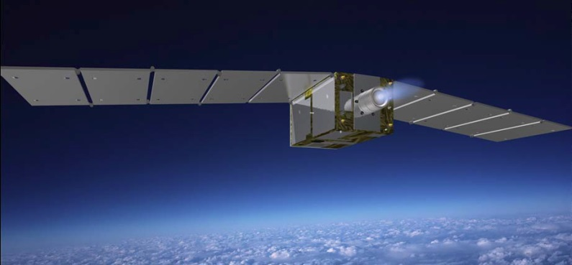
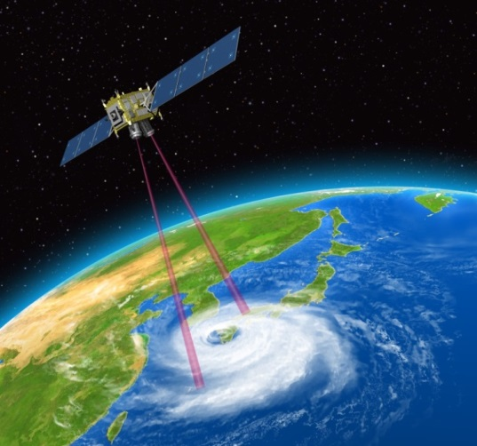
Specifications of Super-Low-Altitude-Satellite-borne DWL
 | Super Low Altitude space-borne Coherent Doppler Wind Lidar
Orbital altitude Inclination | 220km TBD
Instrument volume | 1.5×1×1 m³
Mass | 600 kg (bus + Instrument)
Power | 1600 W(bus + Instrument)
Laser power | 3.75 W (125 mJ/pulse×30 Hz) @2µm
 | 3.75 W (10 mJ/pulse×2500 Hz) @1.6µm
Telescope | 0.4 m (primary mirror) x 2
Horizontal resolution | <100 km
Vertical resolution | Altitude 0.5-3 km: 0.5 km Altitude 3-8 km: 1 km Altitude 8-20 km: 2 km
Nadir angle | ~35 degree
Looking angle | 45 and 135 degrees along direction of travel
Super Low Altitude Test Satellite
Launch: 2016

Slide 6
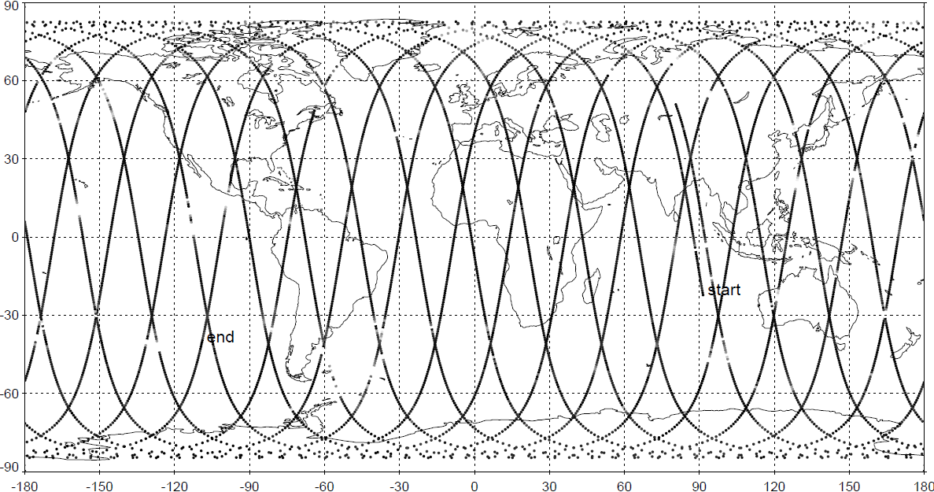
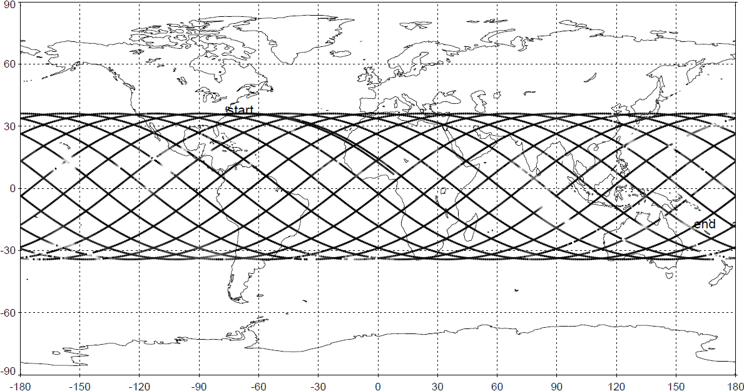
Super-Low-Altitude-Satellite-borne DWL: Orbit
We are discussing candidate orbits, sun-synchronous polar orbit (LST18) and low inclination orbit like TRMM (0-20, 20-45).
(Upper panel) sun-synchronous orbit (98 degree) and (lower panel) low inclination angle orbit (35 degree)

Slide 7
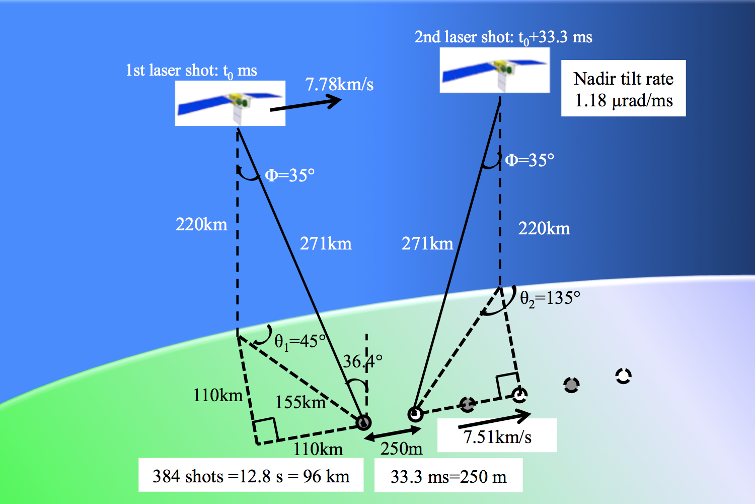
Super-Low-Altitude-Satellite-borne DWL: Geometry
Orbital period of Satellite: 88.9 minutes
Gap between orbits: 1922 km =2032 km – 110 km
220km, 29.2s
45°
135°
45°
135°
45°
Satellite track
FWD 1st
FWD end
AFT1st
FWD 1st
AFT end
FWD end
AFT1st
FWD 1st
AFT end
FWD end
AFT1st
FWD: forward
110km
AFT: afterward
90°
Ground track speed
7.51km/s
90°
Ground track speed
7.51km/s
Foot print Track
96km, 12.8s
105 km, 14s
Forward foot print
Afterward foot print
FWD
AFT

Slide 8
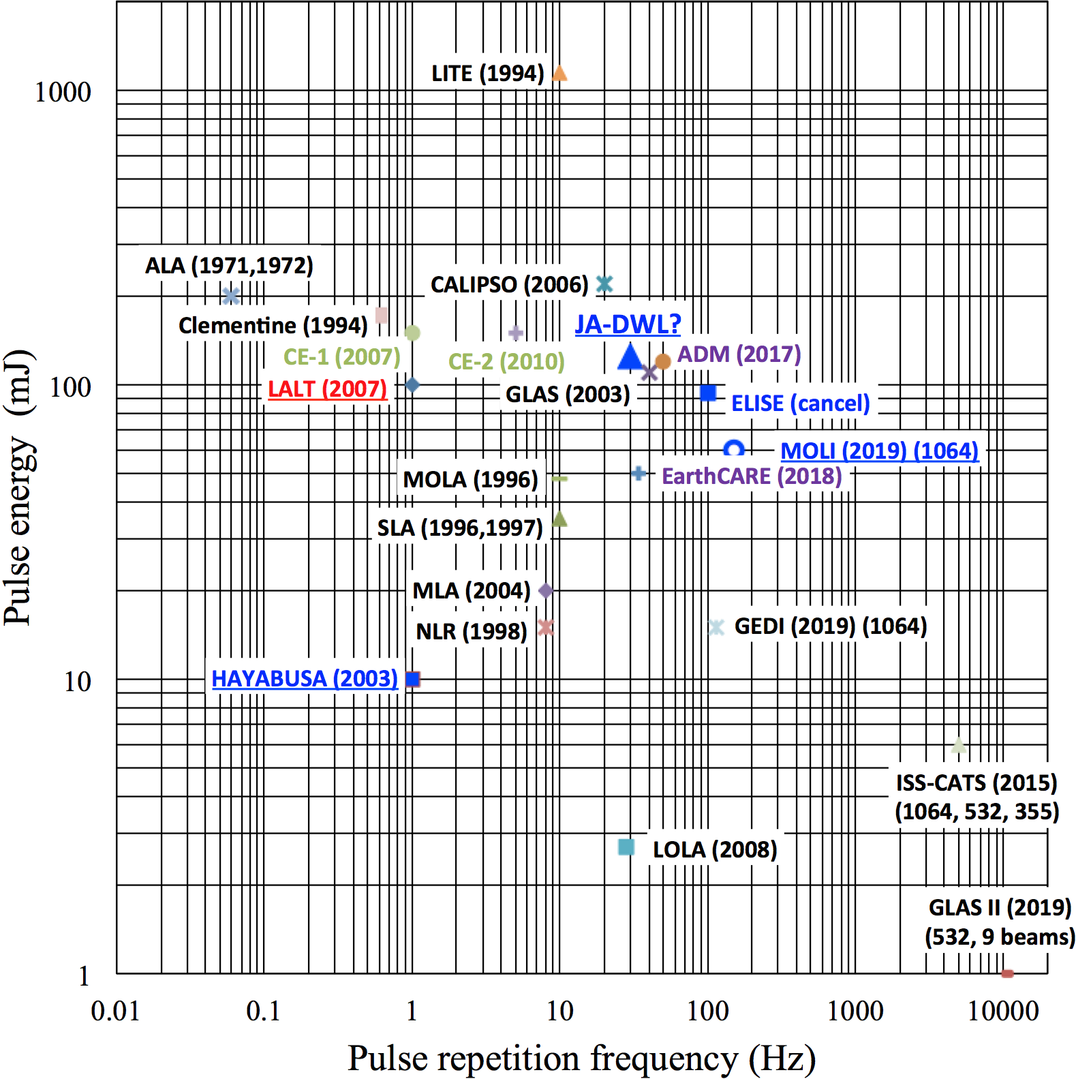
Technologies required for space-borne DWL
Technologies required for space-borne CDWL |  | Task
Single-frequency 2-µm pulse laser | Single-frequency 2-µm CW laser for seeding technique | High power High stability Narrow line width Price/Availability
 | High pulse-energy laser | High power High stability High efficiency
Detector |  | High-speed response Low NEP
fFuture
  Target: 125mJ at -40 ºC
  Current Tm,Ho:YLF laser system: 80mJ × 30Hz at –80 ºC.
  Power consumption of the cooling system is more than 2 times higher than that of the laser. (Laser:84W, Cooling system:199W)
  Current InGaAs detetor developed for 2-µm optical communication experiment: 1GHz, NEP≅0.2pw/√Hz
  Target:
  cut-off frequency: >4 GHz
  NEP : <10 ｆw/√Hz

Slide 9
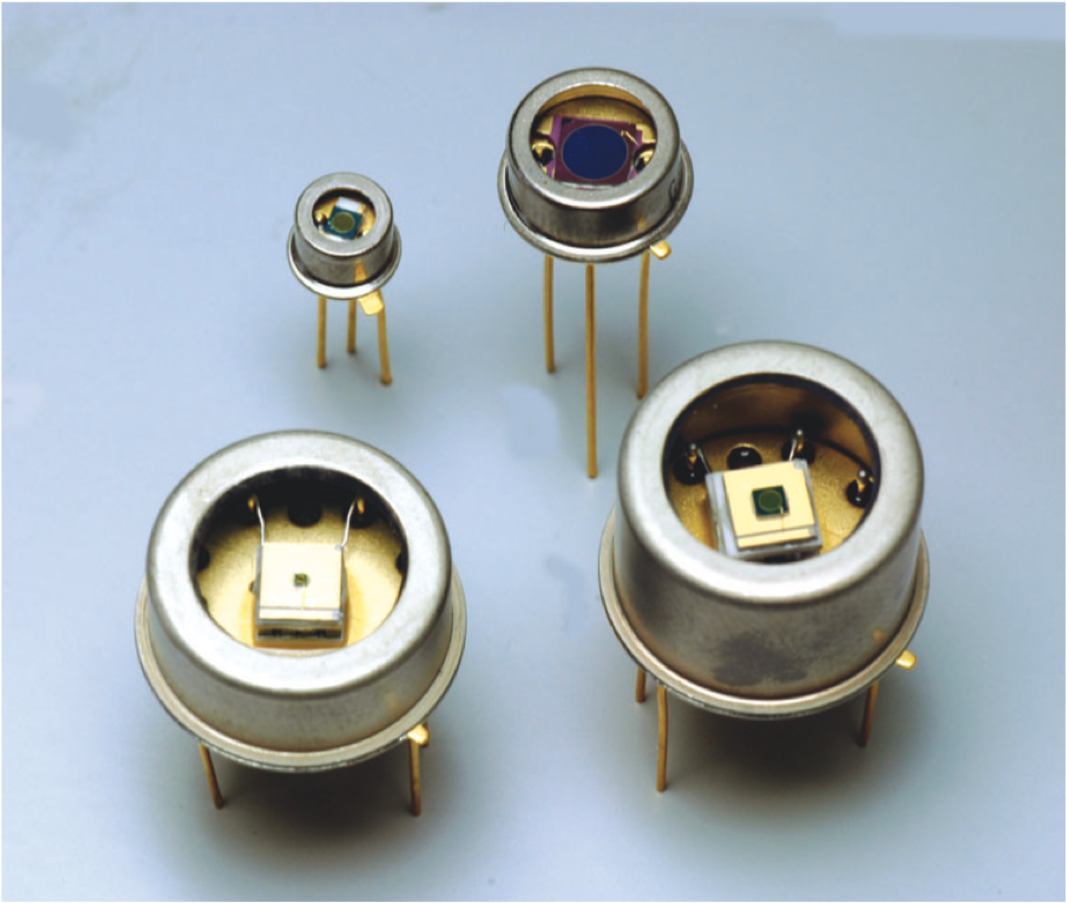
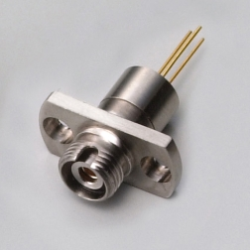
Single-frequency high power laser
2μm Quantum-dot laser
NICT
2μm detector （Future)
narrow line width, high power, high stability
2µm semiconductor laser
2µm optical fiber amplifier
2μm Quantum-dot laser
（pigtail, Future)
2µm optical fiber amplifier
Single-frequency high pulse energy 2µm laser
Commercial detector (non space -qualification
2μm pulse laser
NICT
2μm Quantum-dot laser + AMP
（pigtail, Future)
NICT, TIT
NICT

Slide 10
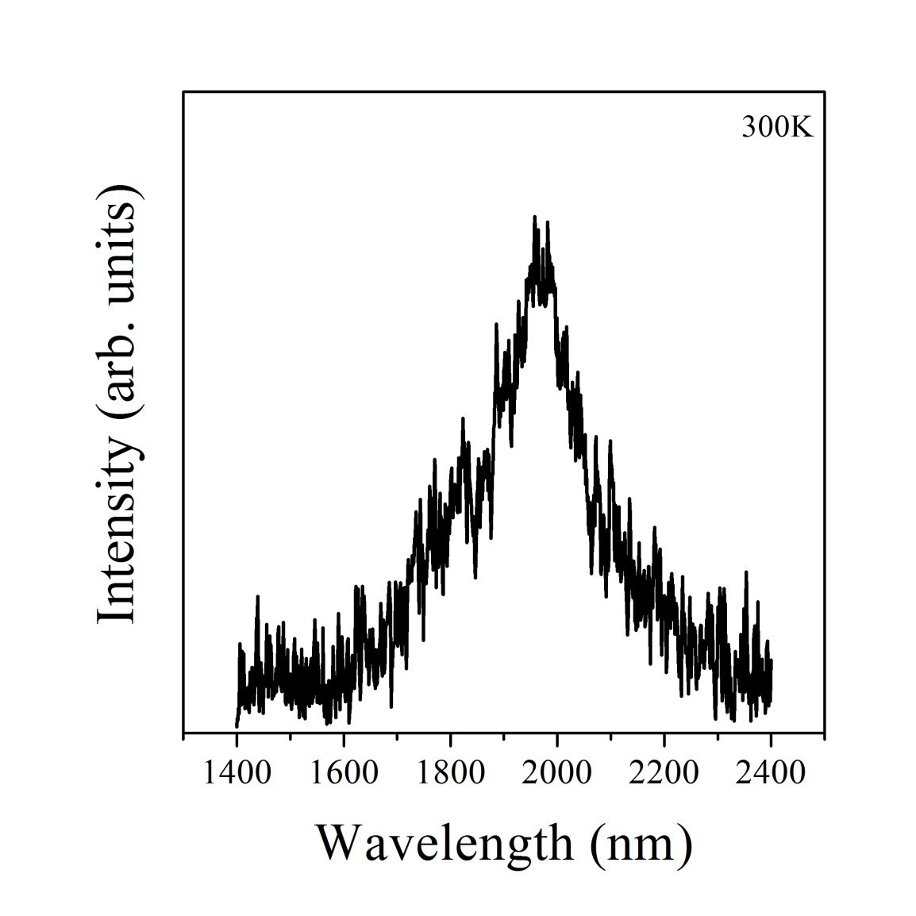
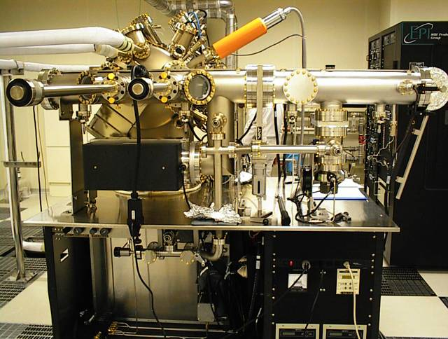
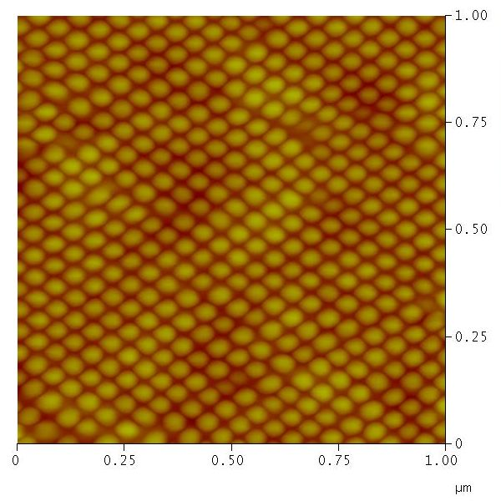
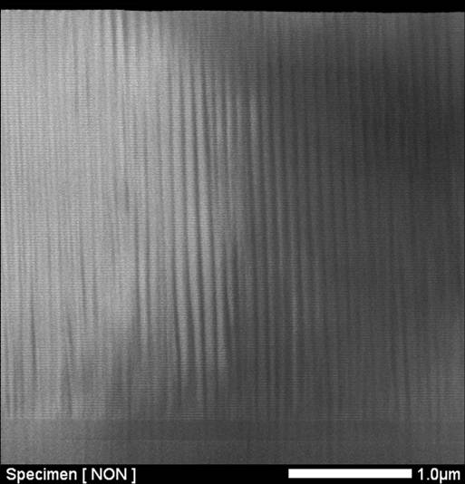
Single-frequency 2-µm CW laser： semiconductor laser
Molecular beam epitaxial growth device
Preliminary result
Development of gain medium for 2-µm laser
Highly-stacked InAs quantum dot layer for 1.55-µm laser
EL
Laser
Highly-stacked InAs quantum dot layer for 2-µm laser
Demonstration at 2-µm
Next step
  High output power
  Narrow linewidth
Highly-stacked quantum dot laser fabricated by a strain compensation technique at NICT
Notes:
Lightwave device laboraty use a strain compensation technique to form uniform and ordered QD structure without degrading crystal quality.
They can fabricate highly stacked InAs QD structure and incorporate it into a QD laser. They achieved ground-state lasing of between 1.47 and 1.7µm from highly stacked InAs QD layers
They have already gain medium for lasing at 2-µm. As next step, we study narrow line-width and high output power. Optical output is low. I introduce to amplify the output power in the next slide.
S −K モ ードによる自己組織化量子ドットは格子定数差に起因する歪エネルギ ーをその形成のドライビングフォ ースとして利用しているため 、多層化する際には残留歪の影響による量子ドット形状の変化 、および結晶欠陥や転位の発生等の問題があった 。
歪補償技術は 一組の量子ドットとそれを埋め込む歪補償中間層で歪を相殺するため 、積層数に制限が無くなるだけでなく 、歪補償条件を満たしている限り量子ドットおよび歪補償中間層の構造パラメ ータが可変である 。この特性を活かし 、量子ドットの膜厚 、歪補償中間層の膜厚および組成を変化することによりPL 、 EL 発光で150nm 以上の発光ピ ークシフトを観測した 。さらにレ ーザ発振波長では1472nm から1705nm の波長範囲で発振を確認し 、230nm のレ ーザ発振波長の卩∫変性を示した 。これらの結果は高性能な広帯域波長可変レ ーザなど への応用が期待できるe

Slide 11
Single-frequency 2-µm CW laser： Optical fiber amplifier
Requirement for optical output power
  Wavelength: 2051nm
  Gaing：13dB（input optical power:~1mW）
  Output：>20mW
Other requirements
  Long-term mechanical stability
  (vibration and shocks）
  Maintenance-free
  Compact and high efficiency
  （E-O conversion, removal heat）
  Space-qualification
Previous TDFA research
  Small signal gain: 16 dB at 2050 nm
  Output power: >100mW @1.9µm
  （420mW pumped@1550nm）
  All optical fiber
  Low E-O efficiencty: ~10% （w/o TEC E.P.）
    Z.Li et al., Opt. Express, 21, 9282 (2013)
    Z.Li et al., Opt. Express, 21, 26450 (2013)
  High E-O efficiency in the free space pumped at 793nm
Y. Jung et al., Opt.Express, 22, 10544 (2014)
  Photobrightening (793 nm) recovering from photodarkening due to cosmic radiation exposure
      Y. Xing et al., Opt. Lett, 40, 681 (2015)
Erbium-Doped Fiber AMP:EDFA
Concept of TDFA for space application
Double-crad Tm optical fiber
793nm multi-mode LD pump
All optical fiber
Thulium-Doped Fiber AMP:TDFA

Slide 12
    2μm laser block diagram
1 Oscillator
1 Oscillator+ 1 Power amplifier
Output
125mJ×30Hz
Tm,Ho:YLF
(-40 ºC)
Q-sw
OC
AMP
l/4
Output
125mJ×30Hz
Tm,Ho:YLF
(-100 ºC)
Q-sw
Laser rod=44mm
Laser rod <44mm
OC
High-density excitation
Understanding of temperature dependence of the Q-switched Tm,Ho:YLF laser at temperatures lower than -20 ºC.
Investigations of parameters needed for the design of a 125-mJ laser transmitter operating around -40 ºC.
Tm,Ho:YLF
(-40 ºC)
OSC
OC: Output Coupler

Slide 13
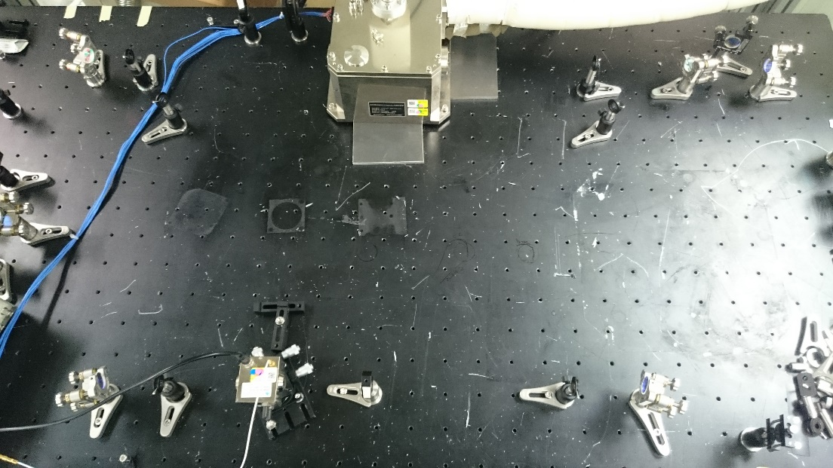
Setup for 2-µm laser experiment
Tm,Ho:YLF laser head
Output mirror
This mirror was used to achieve unidirectional lasing in the ring resonator.
HR
HR
Operating conditions
Pulse repetition frequency: 30 Hz
Pump pulse length: 1 ms
Q-sw trigger time: 1.6 ms
Resonator length: 3.86 m
f=3m
HR
Acousto-optic
Q-switch
HR
2-µm laser output
HR
Laser head
Output
mirror
HR
HR mirror
High reflection at 2051 nm, flat
Output mirror
R=61, 74, 81%, flat
Q-switch
Fused silica, RF signal: 27.12MHz
(Gooch & Housego QS027-4M-0S5)
f=3m
HR
Q-switch
HR
Sato et al., CLEO-PR 2015, Paper 25F3-3より

Slide 14
Experiments
R=74%
Sato et al., CLEO-PR 2015, Paper 25F3-3より

Slide 15
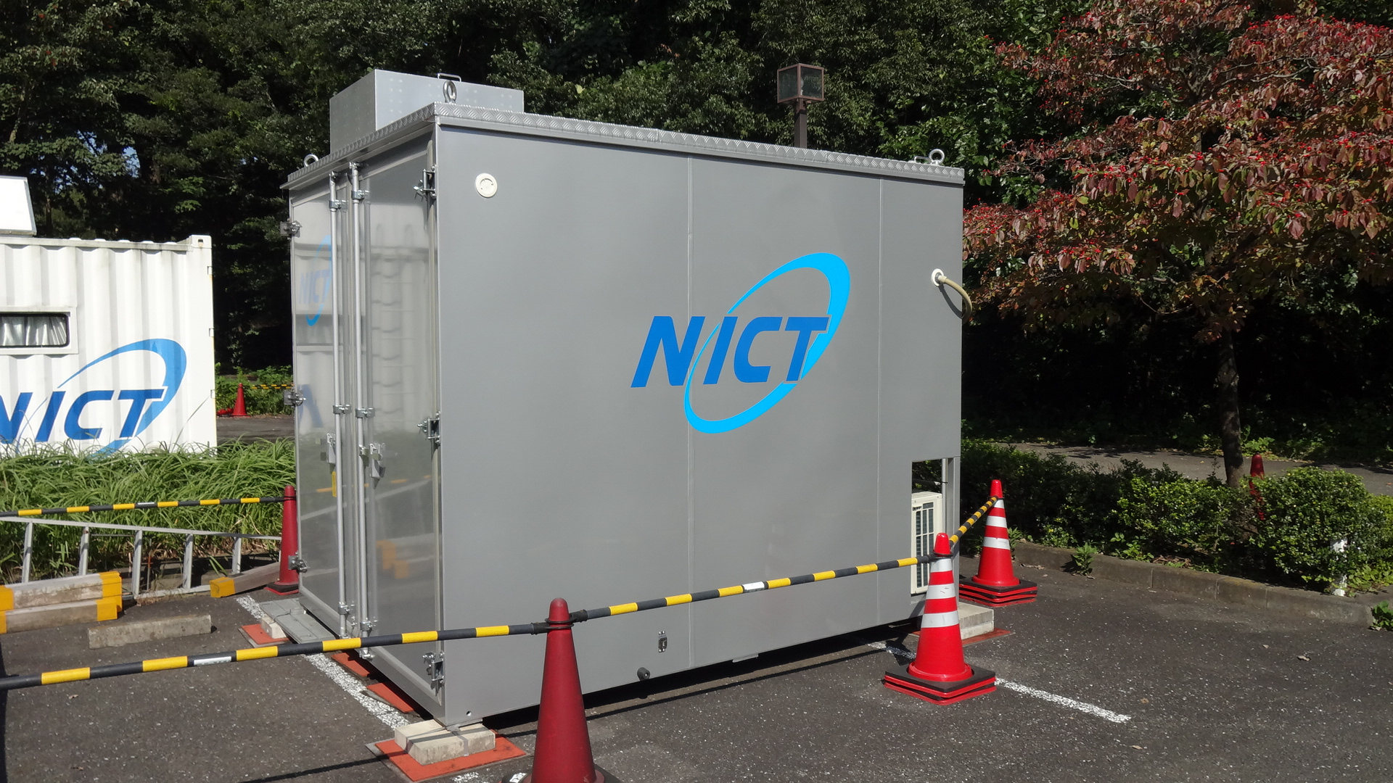
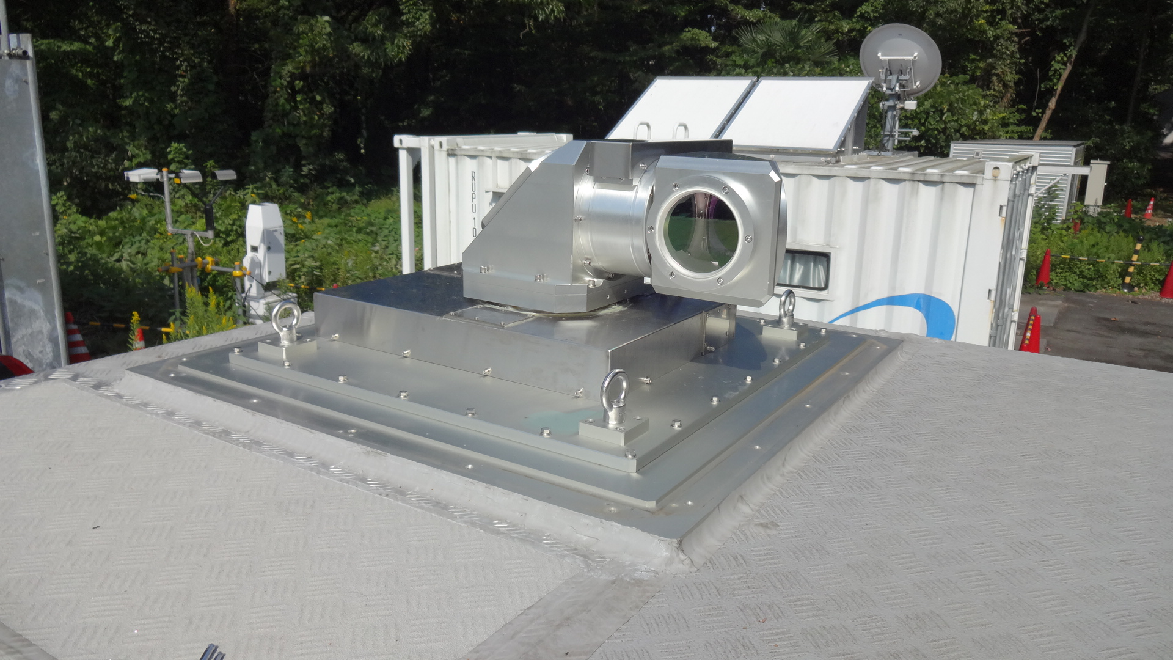
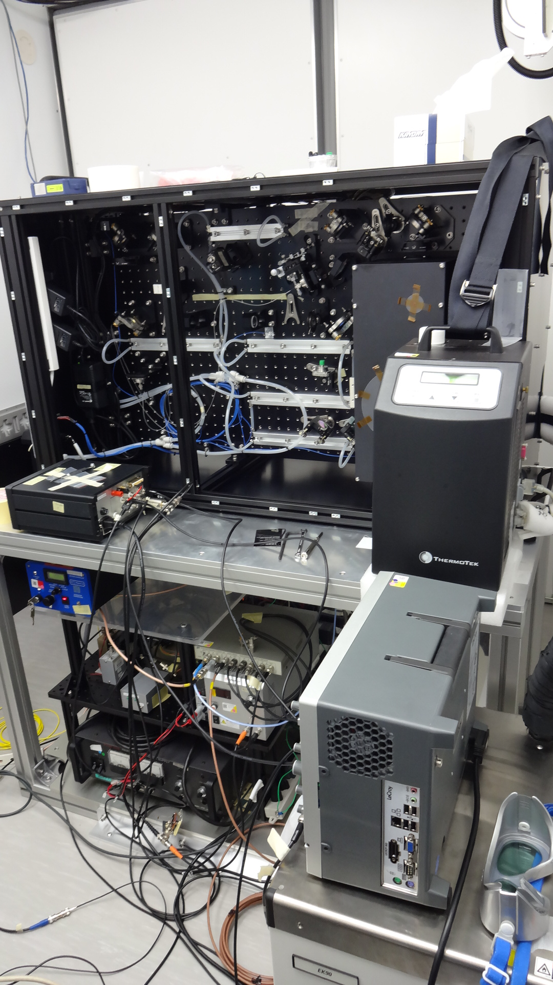
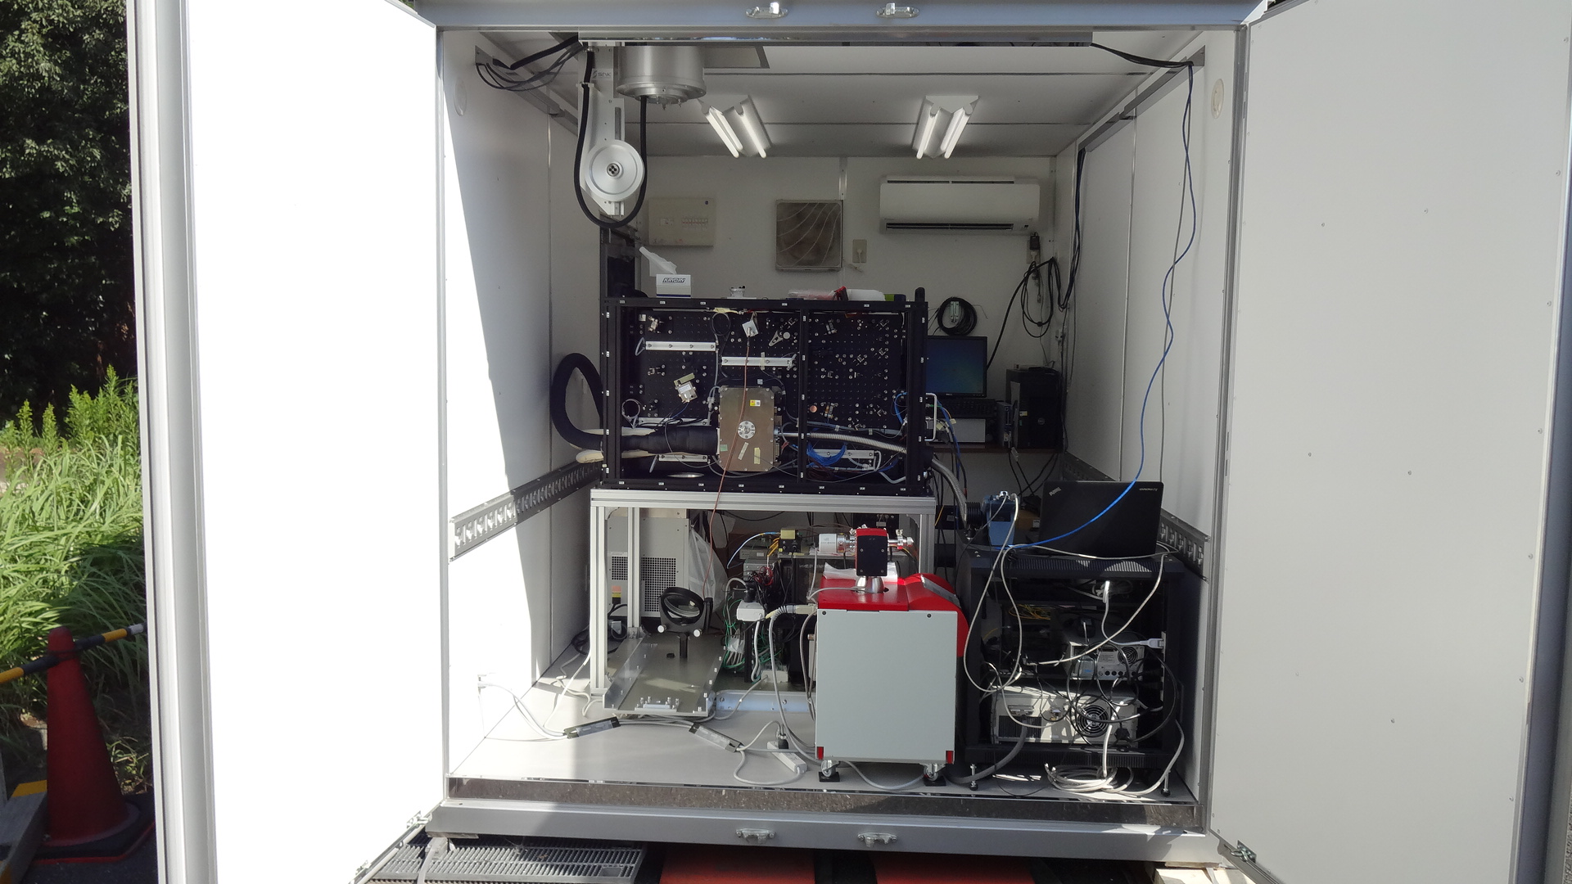
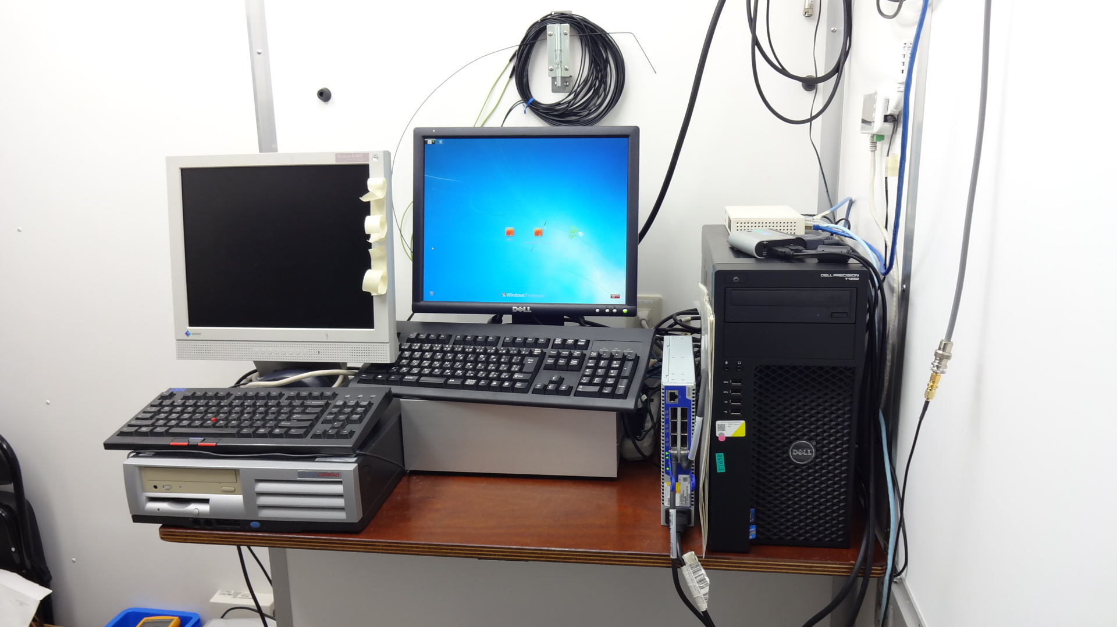
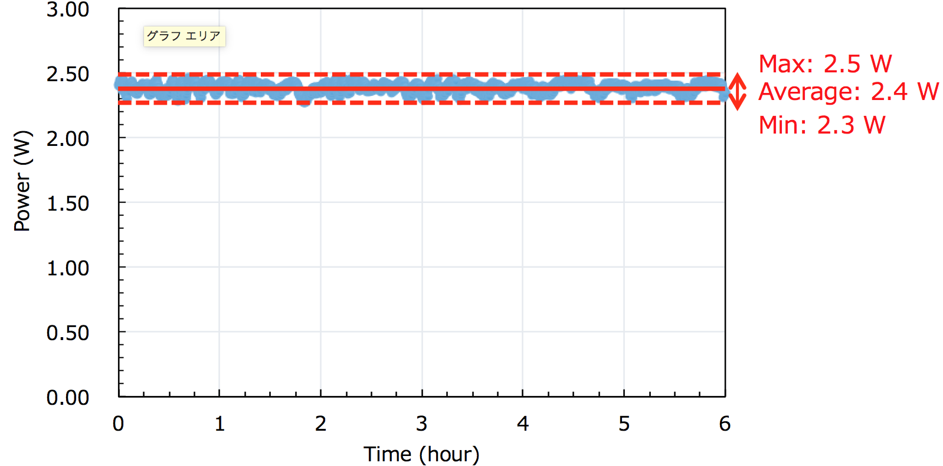
New ground-based 2-µm Doppler Wind lidar
2.4 W (80mJ, 30Hz)

Slide 16
Summary
A new super low altitude test satellite will be launched after 2016. NICT is developing key technologies required for a future super-low-altitude-borne DWL.
  Geometry
  Laser
    2-μm semiconductor CW laser
    Tm optical fiber amplifier
    High pulse-energy 2-μm laser
  2-μm detector
Future works:
  Demonstration of single-frequency 2-μm CW laser
  Demonstration of high pulse-energy 2-μm laser
  Evaluation of high-speed 2-μm detector
  Evaluation of impact on forecasts in one-month assimilation experiments (summer and winter)
  Minor updating of ISOSIM-L (ongoing)
  Improve data assimilation pre-processing including QC (ongoing)
  Comparison SOSE-OSSE with different systematic parameter (lidar, spatiotemporal resolution, systematic geometry)
  Comparison SOSE-OSSE with different OSSE (nature run / ensemble OSSE)
  A part of this research was supported by JSPS KAKENHI Grant Number 15K05293 and 15K06129.

