Slide 1
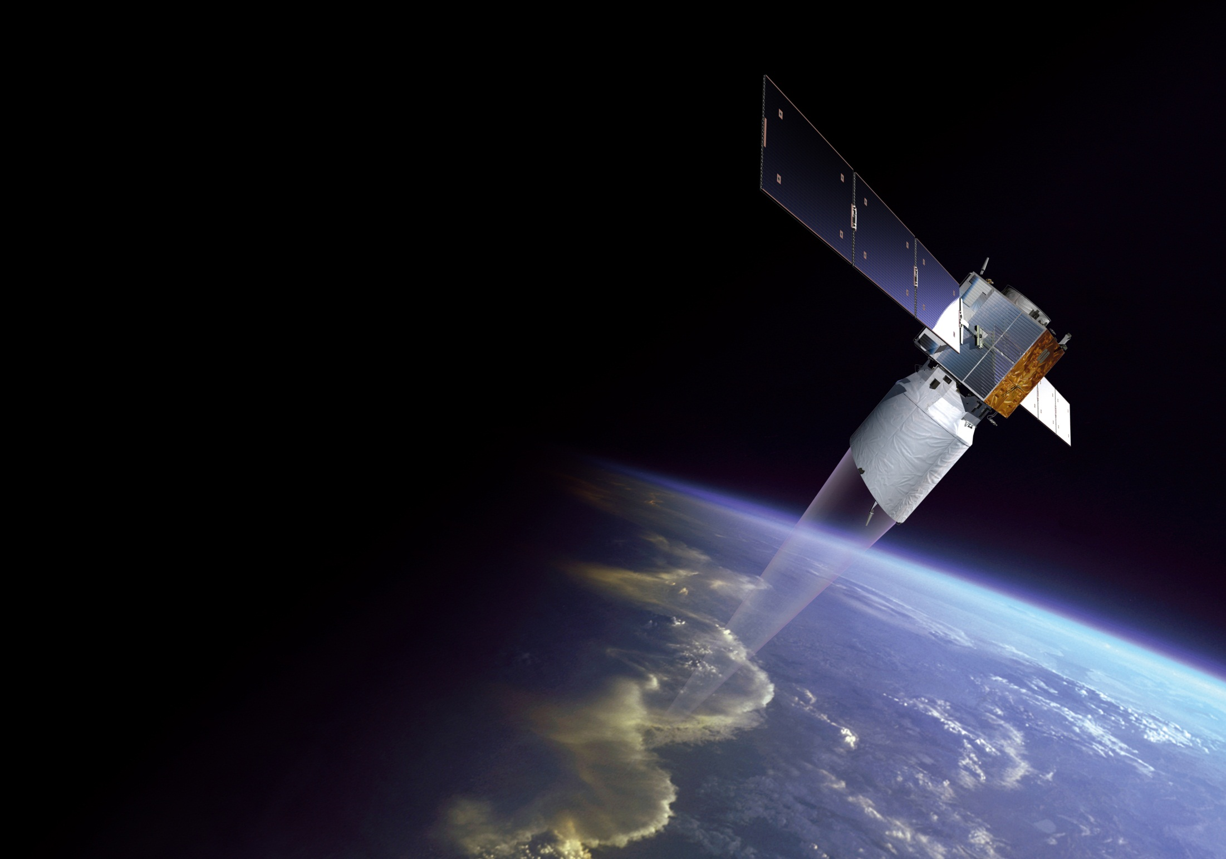
Aeolus: Development and Status
Thomas Kanitz
on behalf of
the Aeolus Project Team
WLWG – Miami
3rd November 2015

Slide 2
Outline of the Presentation
Objectives
Status of Aeolus Integration and Tests
Challenges

Slide 3
Objectives
4d horizontal wind information
Improve understanding of atmospheric dynamics and climate
Improve weather forecast
Demonstrate potential of wind lidars in space

Slide 4
Aeolus: Requirements
 |  | PBL | Troposphere | Stratosphere
Vertical domain | [km] | 0-2 | 2-16 | 16-20 (30)*
Vertical resolution¹ | [km] | 0.5 | 1.0 | 2.0
Horizontal domain |  | Global
Number of profiles | [hour⁻¹] | >100
Horizontal track data availability |  | > 90%
Temporal sampling | [hr] | 12
Horizontal resolution / integration length² | [km] | 15 (target) – 100 (threshold)
Horizontal sub-sample length | [km] | km scale
Random error (HLOS Component) | [m/s] | 1 | 2.5 | 3*
Systematic error (HLOS component) | [m/s] | 0.7 | 0.7 | 0.7
Dynamic Range, HLOS | [m/s] | ±150
Error Correlation per 100 km |  | < 0.1
Probability of Gross Error | [%] | 5
Timeliness |  | 3
Length of Observation Dataset | [yr] | 3
¹ 24 atmospheric samples for Mie & Rayleigh channel with 0.25km minimum vertical resolution
² L1B data: ~90 km horizontal integration length
Page 4

Slide 5
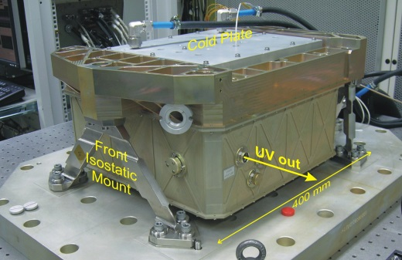
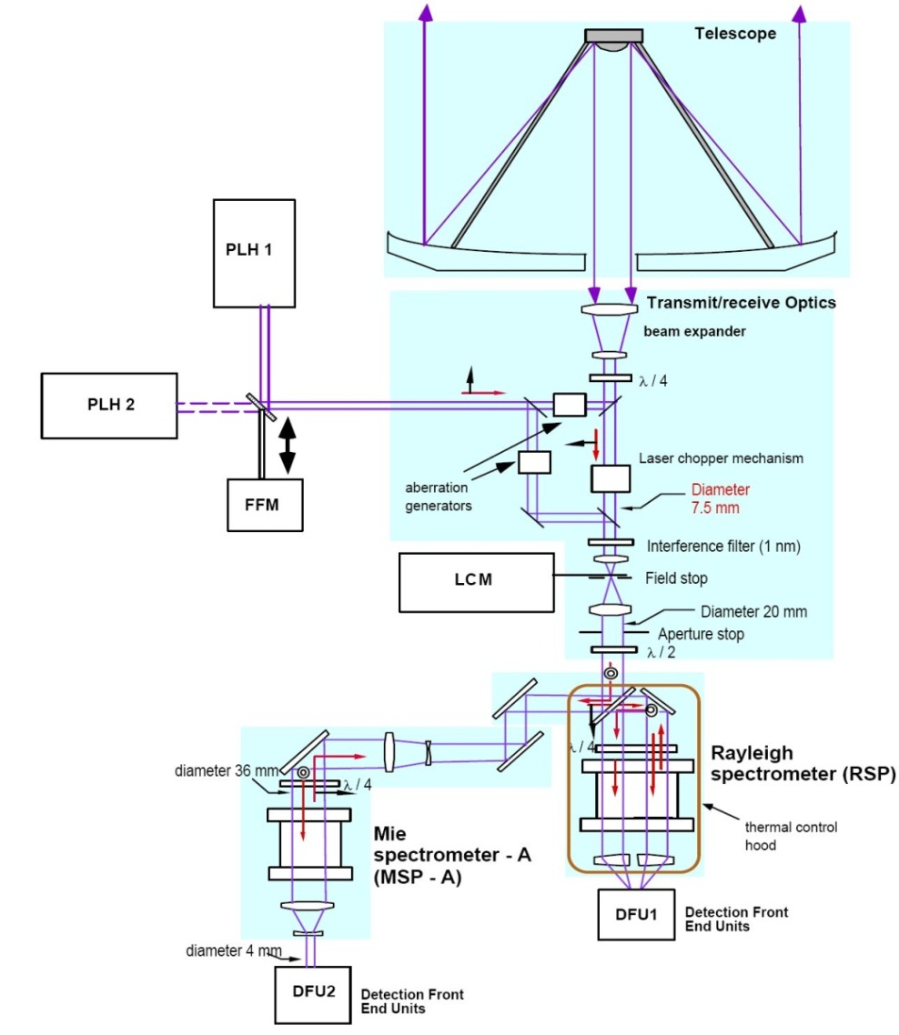
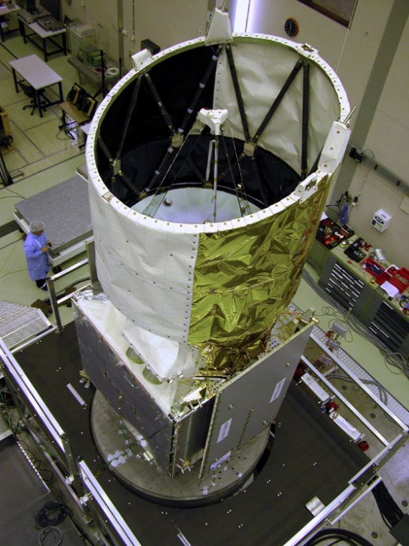
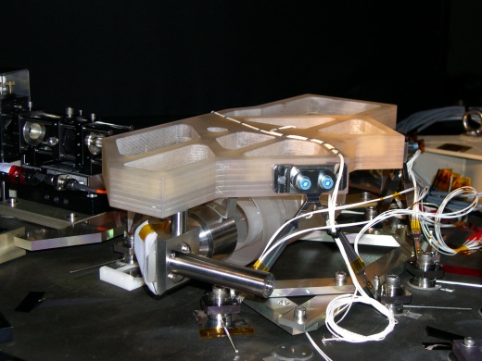
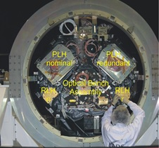
Aeolus: Instrument
Optical
Bench
Page 5

Slide 6
Aeolus: Instrument
Page 6

Slide 7
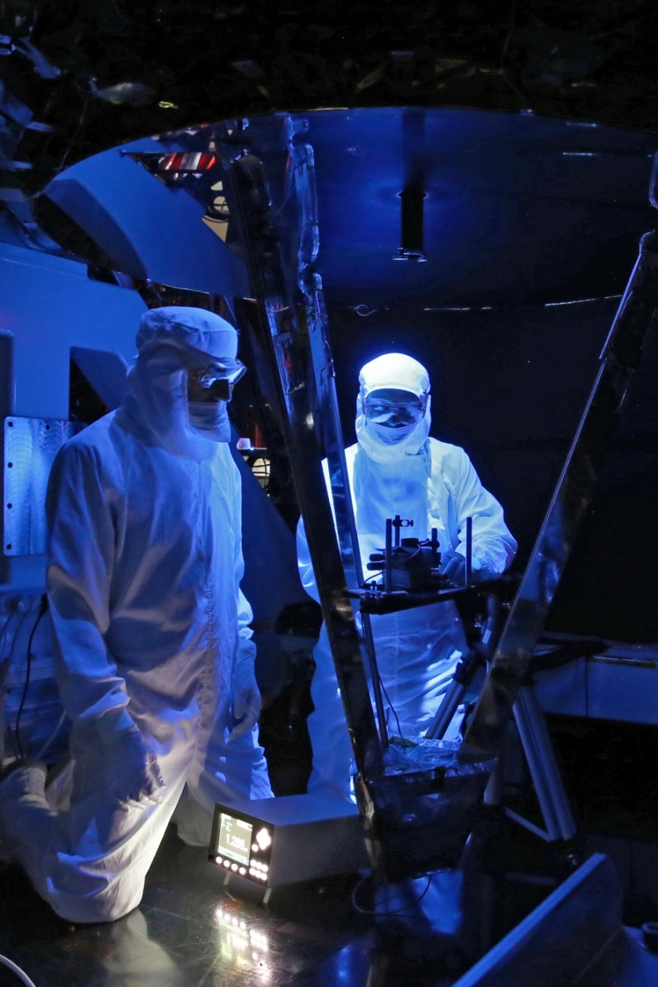
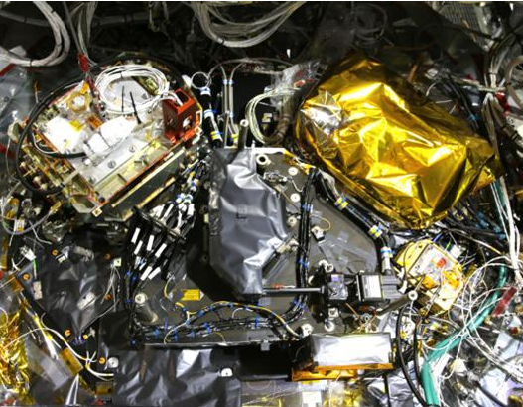
Aeolus: Instrument
Page 7

Slide 8
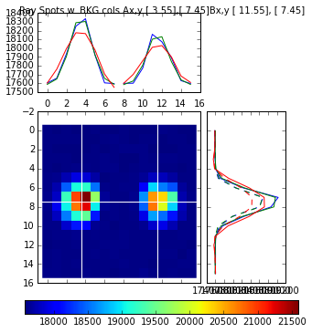
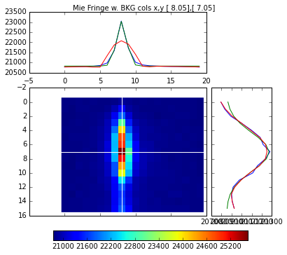
Aeolus: Instrument
Page 8

Slide 9
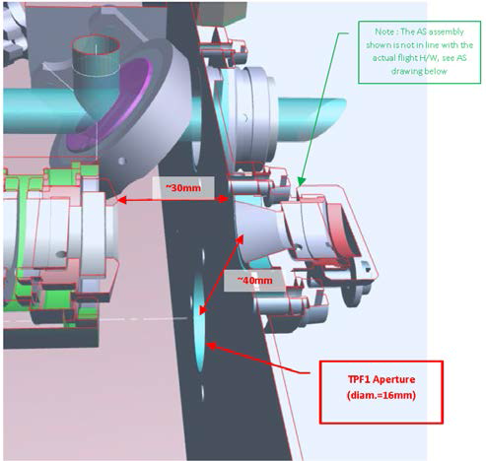
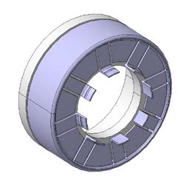
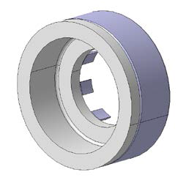
Aeolus: Instrument
Transmit & Receive path:
Optical Bench and Flight Model laser have been integrated and aligned
Calibration path performance initially assessed
LID risk at aperture stop identified
Alternative machinable ceramic
Mounted on Flight Model laser B
Operated at 110mJ
30mm
40mm
d=16mm
Page 9

Slide 10
Aeolus: Instrument
Transmit & Receive path:
Some evidence of reduced transmission efficiency in the emission path, root cause analysis has so far not been conclusive
Laser transmitter optics: coating quality intact after 450Mshots/4.5 months of operation
Transmit optics: no UV throughput performance loss after 200Mshots/2 months of operation
Power Laser Head output window showed contamination
Overall investigation ongoing to rule out LIC and LID within the transmit optics
Page 10

Slide 11
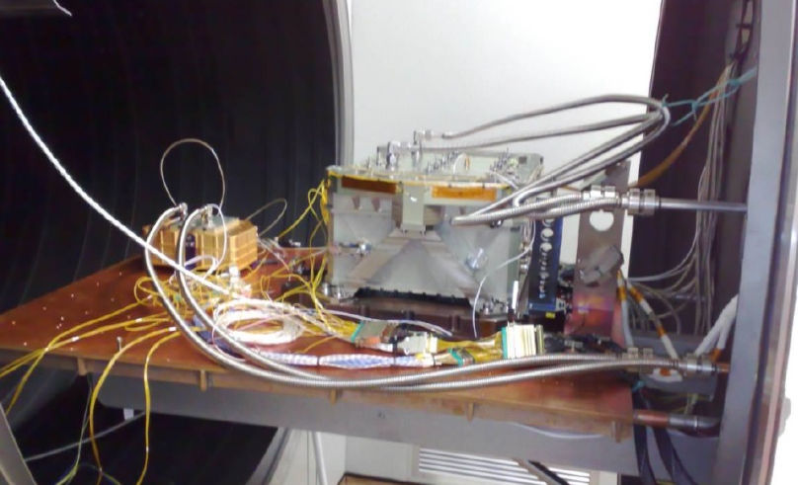
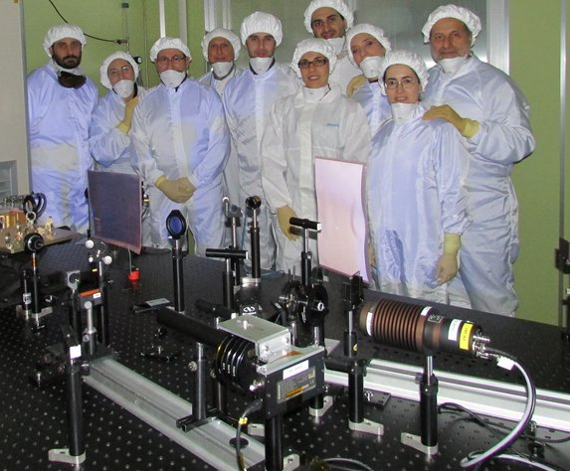
Aeolus: Instrument
3rd Laser Transmitter (life model):
Completed initial functional tests and Electro Magnetic Compatibility in ambient conditions
Thermal Vacuum test completed
Life test to be started in 11/2015
Page 11

Slide 12
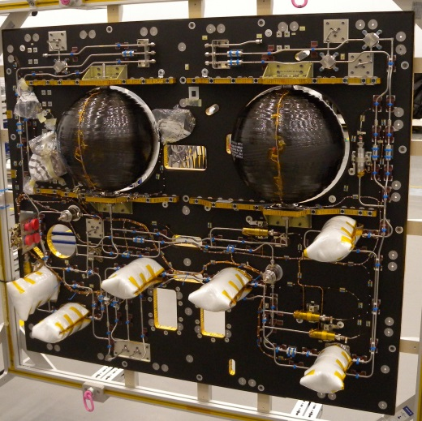
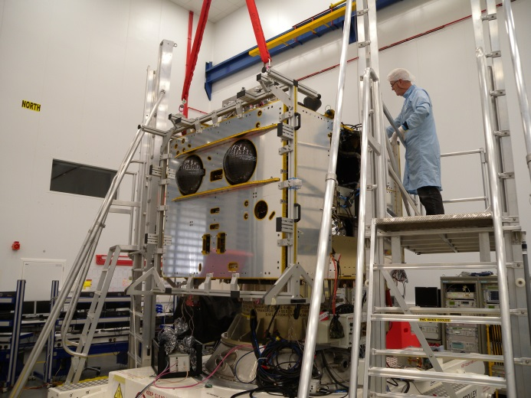
Aeolus: Platform
Latest on-board SW successfully tested on the flight platform
In-situ Cleaning Subsystem completed and fit checked at the platform
…
Page 12

Slide 13
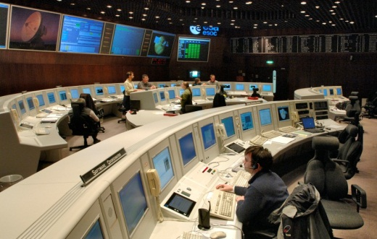
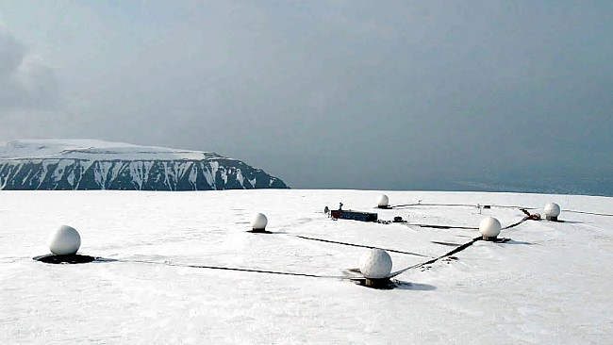
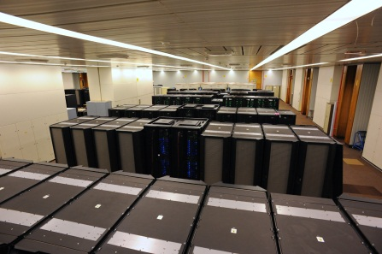
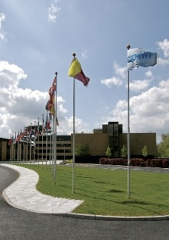
Aeolus: Ground Segment
Flight Control at ESOC
Svalbard
Tromsø
ECMWF
ESOC
Data reception at Svalbard
ESRIN
Data processing at Tromsø
Wind data assimilation at ECMWF
Page 13

Slide 14
Aeolus: Ground Segment
Ground Segment
1st Acceptance Tests at Processing Facility and Calibration & Monitoring Facility successful
1st Compatibility Tests between Facilities performed
Mission Management Planning Facility Re-Kick-Off
Slow down due to update process of instrument operational procedures
Mission Control System and Simulator being upgraded
Improvement of data orchestration
can generate L2A Aerosol & Cloud product as soon as L1B files are available
can generate ECMWF L2B Wind data as soon as L1B files become available
Page 14

Slide 15
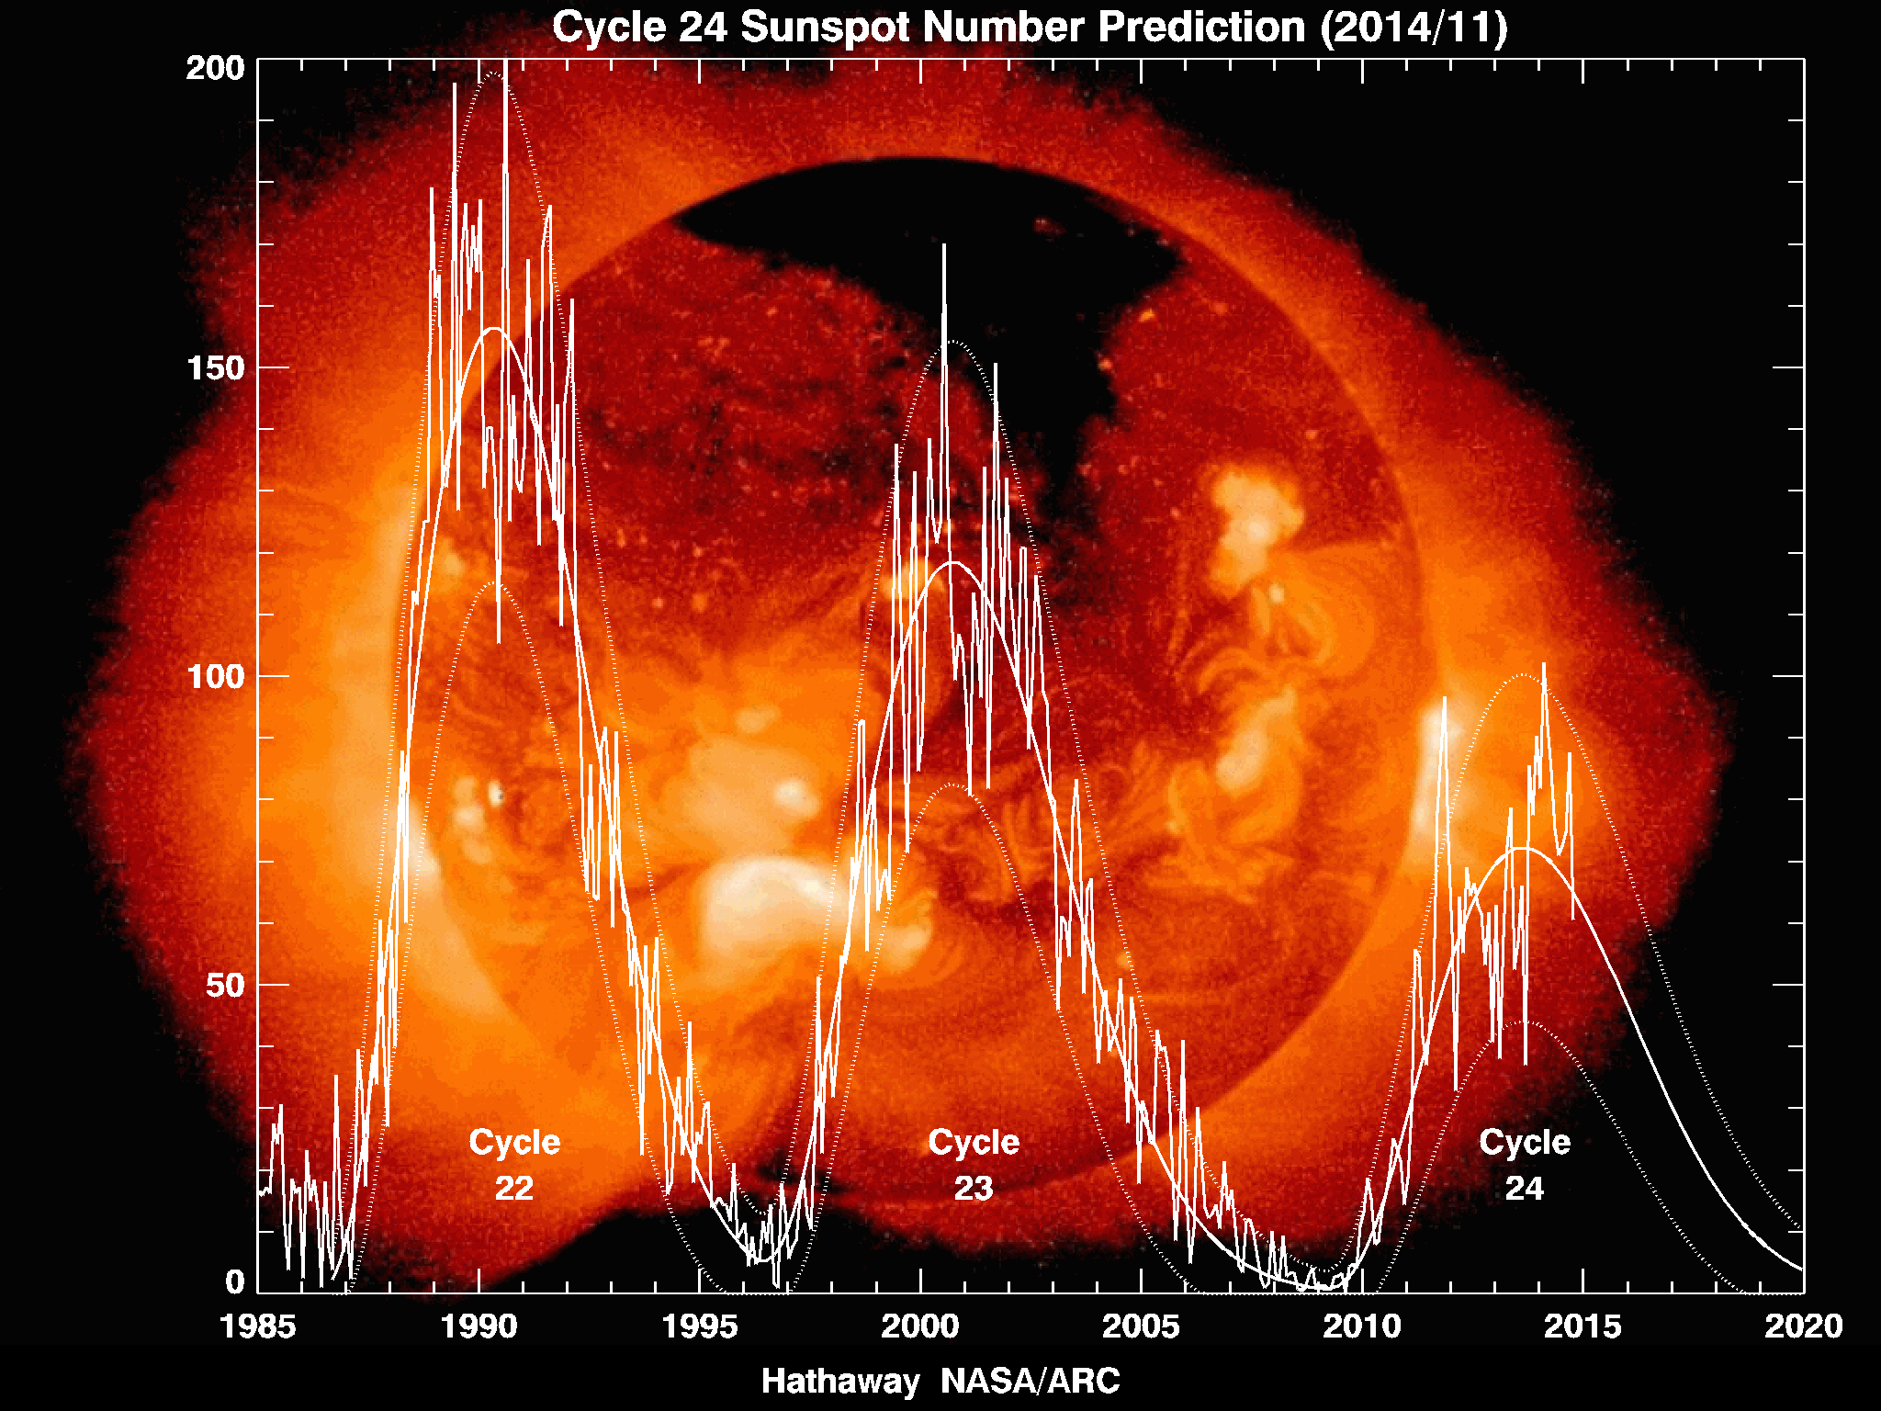
Lower Orbit
The Aeolus orbit and associated mission analysis is based on a worst case solar activity condition, launch Oct 2010
Aeolus launch in 2017 leads to solar minimum conditions for a 3.5 year mission:
Page 15

Slide 16
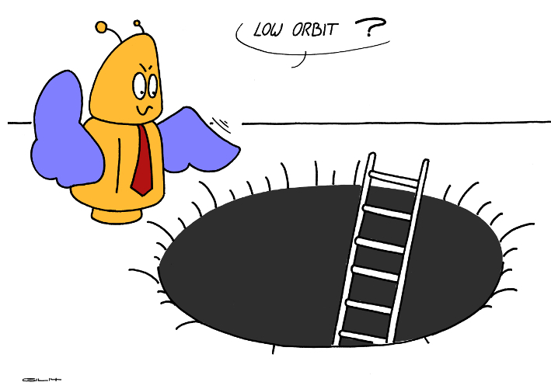
Lower Orbit: What is the deal?
Lower solar activity → less atmospheric drag:
Less fuel at baseline altitude, or
Lower altitude at baseline fuel budget
→ Lower altitude:
More performance at given output energy, or
Adequate performance at lower output energy
Page 16

Slide 17
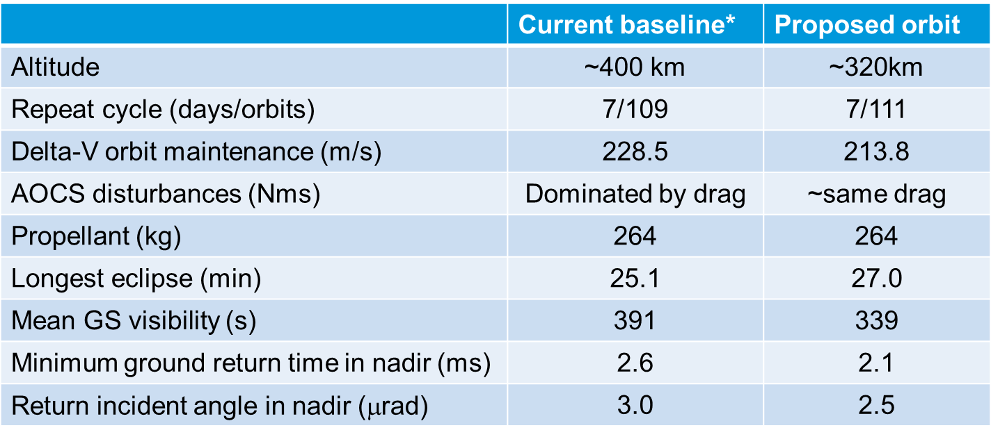
Lower Orbit: Proposal
Page 17

Slide 18
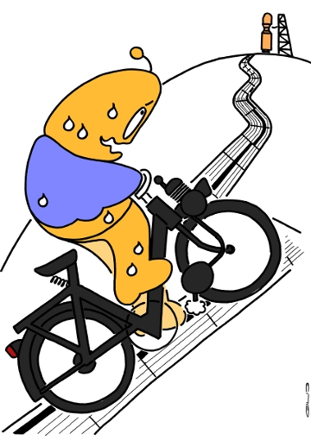
Next challenges
Gravity test in two 90 degrees rotations 4th/4 2015
Instrument functional and performance test → 1st/4 2016
Platform integration of Laser Cooling System → 1st/4 2016
Instrument delivery to platform → 1st/4 2016
1st Ground Segment Overall Validation Tests → 4th/2015
Life test on OBA optics to start in the ESTEC laser laboratory
Life test on Flight Model laser C
Page 18

Slide 19
Next challenges
Hands-on system monitoring and calibration
Preparations of in-orbit validation
Calibration & Validation with the scientific teams
Page 19

Slide 20
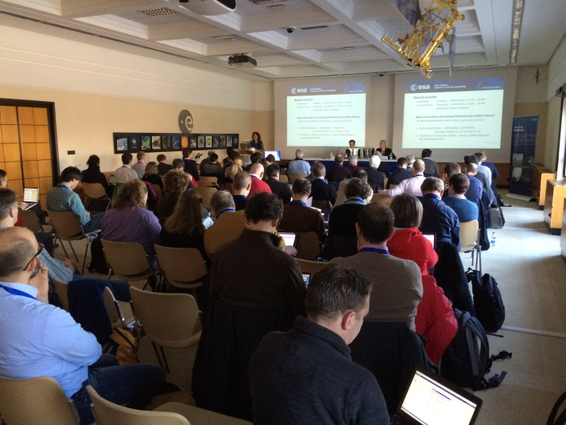
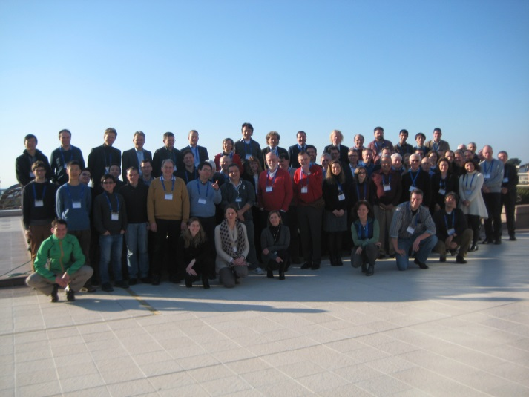
Calibration & Validation
85 participants - science community, CAL/VAL PIs, industry and ESA
Wind and aerosol in-situ, remote sensing, modelling groups
WMO, Met services, universities, national space research organizations … in Europe, US and Canada, China, Japan…
10 - 13 February 2015
Page 20

Slide 21
Next challenges
Hands-on system monitoring and calibration
Preparations of in-orbit validation
Calibration & Validation with the scientific teams
Impact studies showed: Small wind biases can be detrimental
Wind bias calibration efforts will be essential!
… Surprises …
Launch planned for 04/2017
Page 21

Slide 22
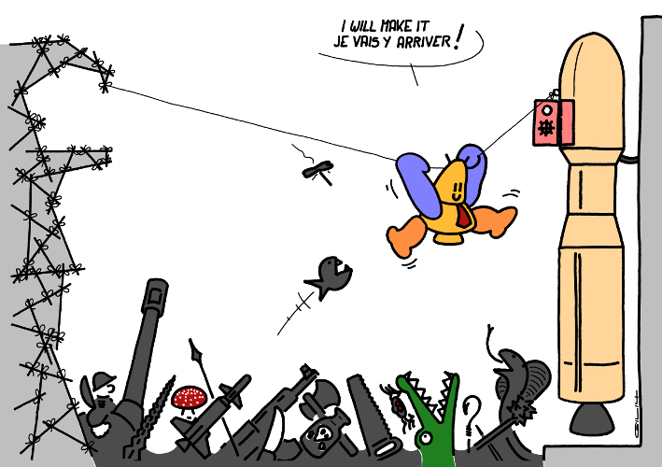
Conclusions
More than 10 years of development challenges
Invaluable experience has been gained
Page 22

Slide 23
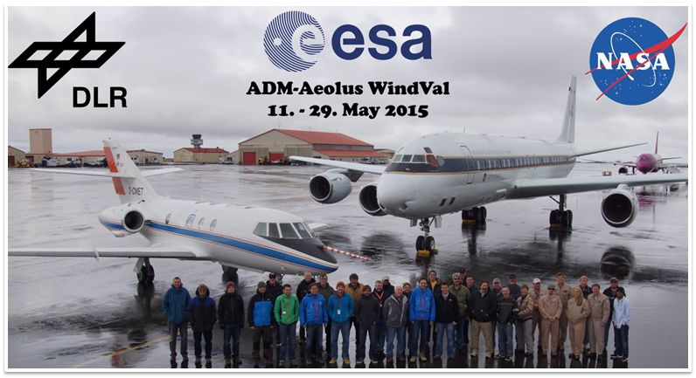
Conclusions
More than 10 years of development challenges
Invaluable experience has been gained
Page 23

Slide 24
Conclusions
More than 10 years of development challenges
Invaluable experience has been gained
Laser and LIDAR modifications are very time consuming
Enthusiastic user communities anticipating break-through in weather forecast and climate research
Page 24

Slide 25
Thanks to all involved parties!
visit: www.esa.int/The_Living_Planet_Programme/ADM-Aeolus
Page 25

Slide 26
Aeolus: Highlights of Laser Test Experiences
2005: Laser Diode Performance
2006: Optical Mount Instability
2008: LID of IR Optic Coatings
2009: LIC in Vacuum
2010: Long Term UV Energy Drift
2012: LID on UV Optic Coatings
2014: LIF on UV Optic Coatings

Slide 27
Aeolus: Mission Impact for Weather Forecast
Summary conclusions by two impact studies led by ECMWF and KNMI
Especially beneficial in the tropics and at high altitudes
HLOS winds provides approximately 75% of the full wind vector information
Impact on forecast quality is of the same order as the currently available radiosonde observation network
Impact rather insensitive to random wind error variation
Even small wind biases can be detrimental, so try to reduce biases!
Wind bias calibration efforts will be essential!

Slide 28
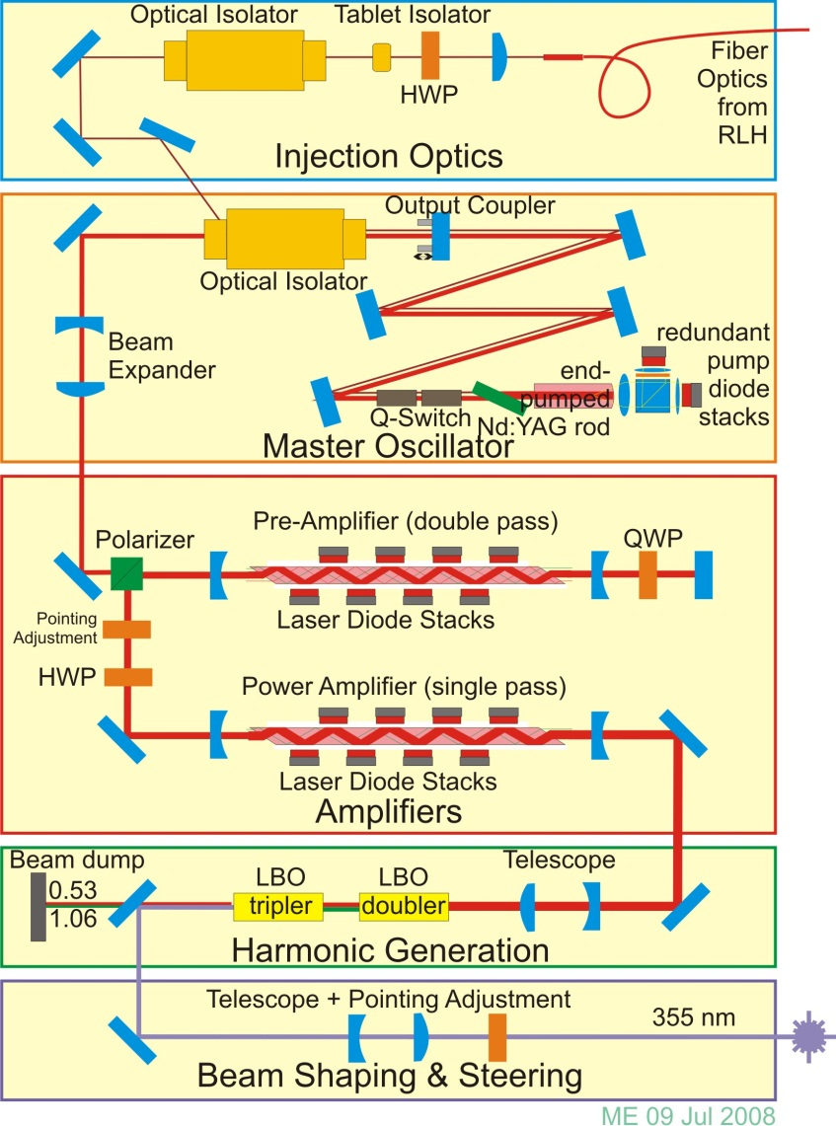
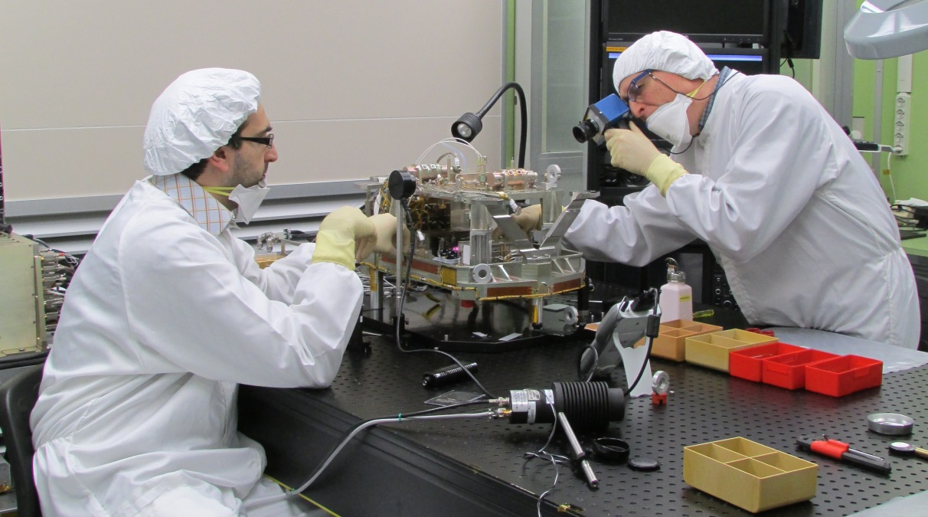
Aeolus: ALADIN Laser Transmitter
The Master Oscillator is a stable resonator with an end-pumped rod. An RTP crystal q-switch is used. Pulses of about 5 mJ energy at 1065 nm are generated.
Two diode pumped slab amplifiers generate about 350 mJ at 50 Hz pulse repetition frequency.
These IR pulses are frequency tripled to the UV (355 nm) in two LBO crystals with ~40% efficiency.
UV optics to shape and steer the output beam for compatibility with Aladin transmit optics.
PLH FM-A during final integration

Slide 29
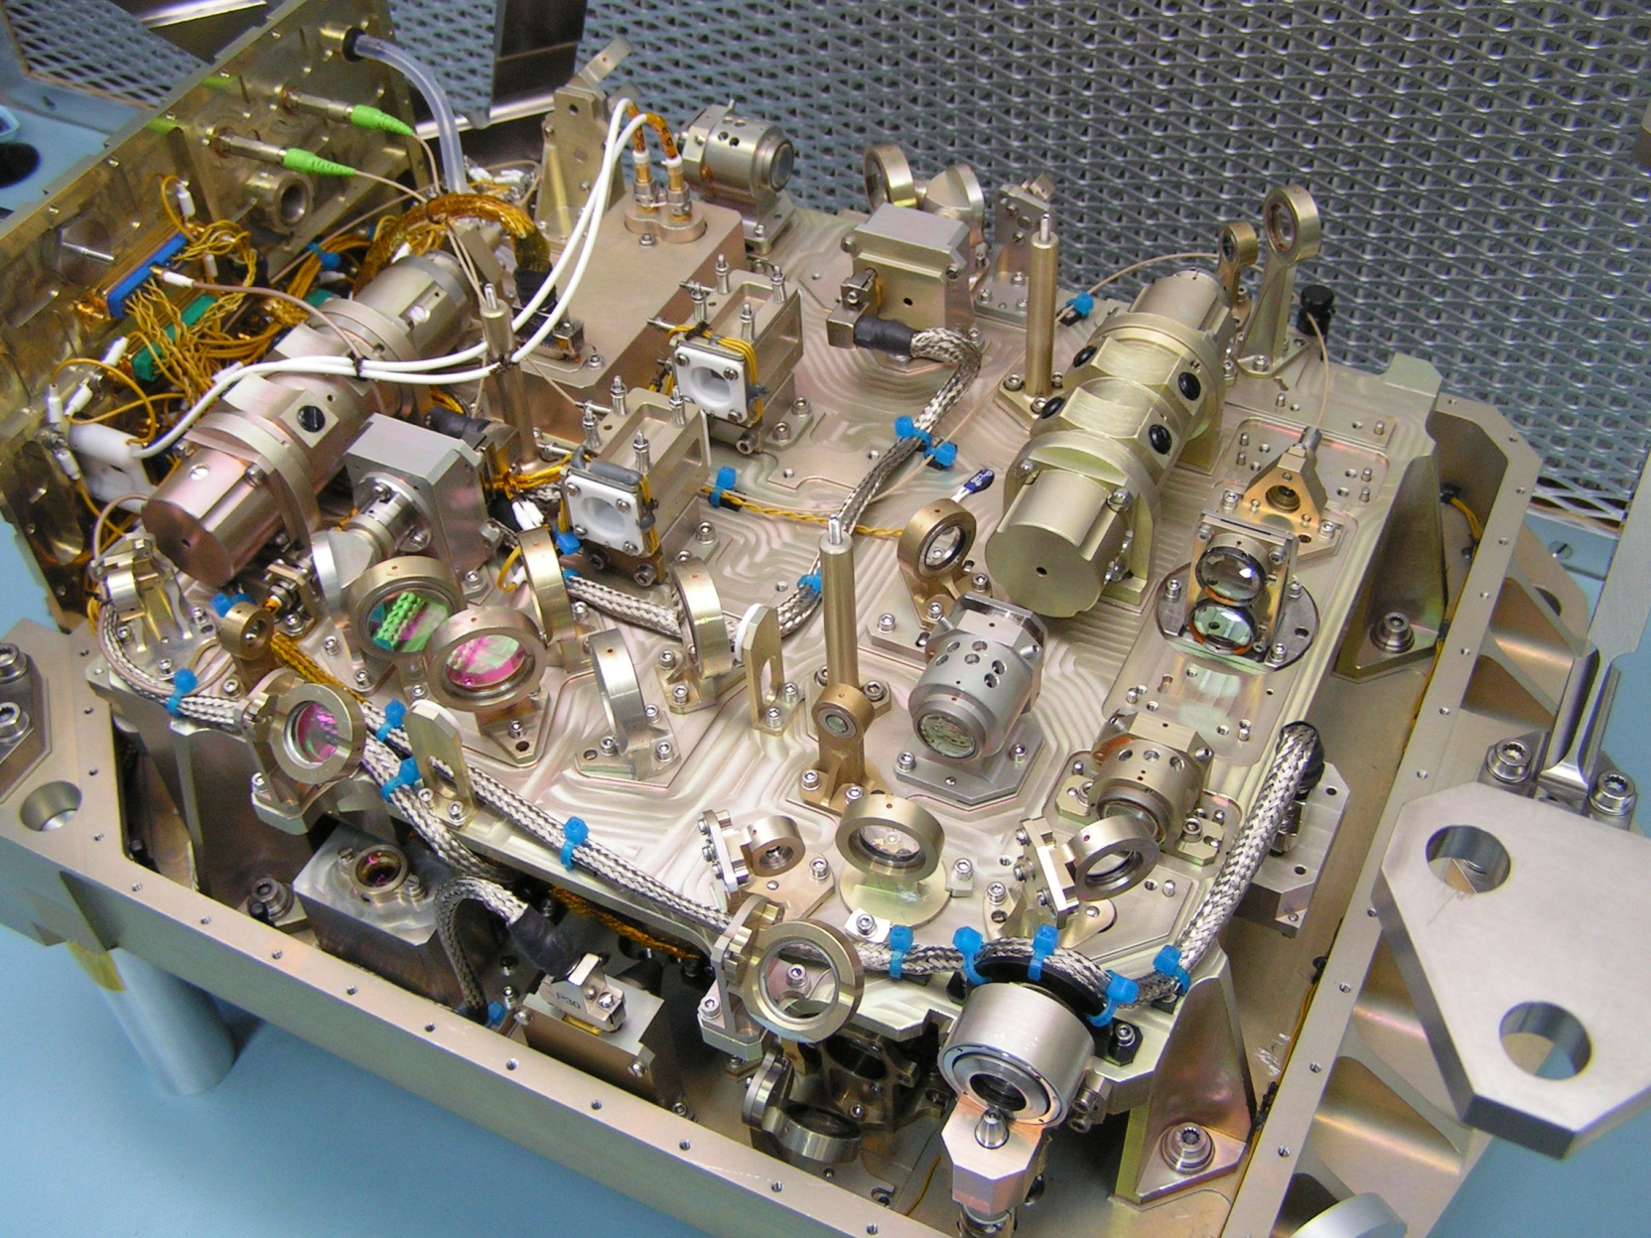
Harmonic Conversion and UV section

Slide 30
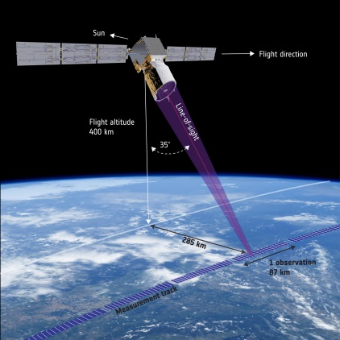
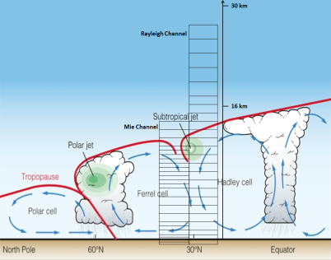
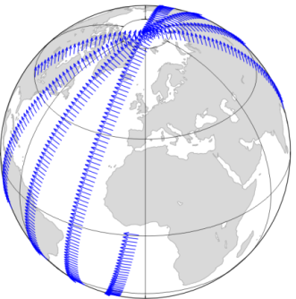
Aeolus atmospheric products
Primary (L2b) product:
Horizontally projected LOS (HLOS) wind profiles
Approximately zonal at dawn/dusk (6 am/pm)
3 km-averaged measurements and ~85 km observation averages – scene classified
From surface to ~30 km in 24 vertical layers
Random errors: 1-2(PBL), 2(Trop), 3-5 (Strat) m/s
Bias requirements: 0.5 m/s
Spin-off (L2a) products:
Optical properties profiles
β, σ, lidar ratio
3 km averaged measurements and <85 km observation averages
From this one can deduce:
Cloud/aerosol cover/stratification
Cloud/aerosol top heights
Cloud/aerosol base height (optically thin)
Aerosol typing (limited)
Flight direction
Courtesy
N. Žagar
Dusk/dawn orbit

Slide 31
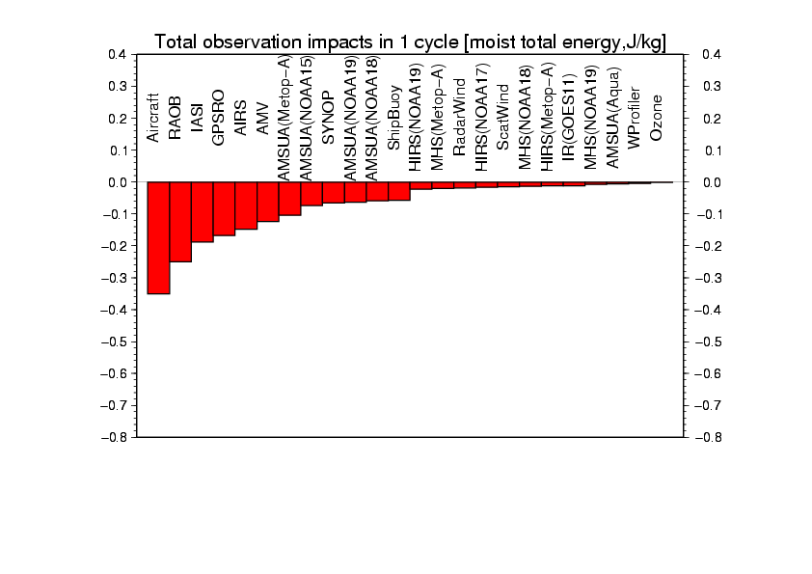
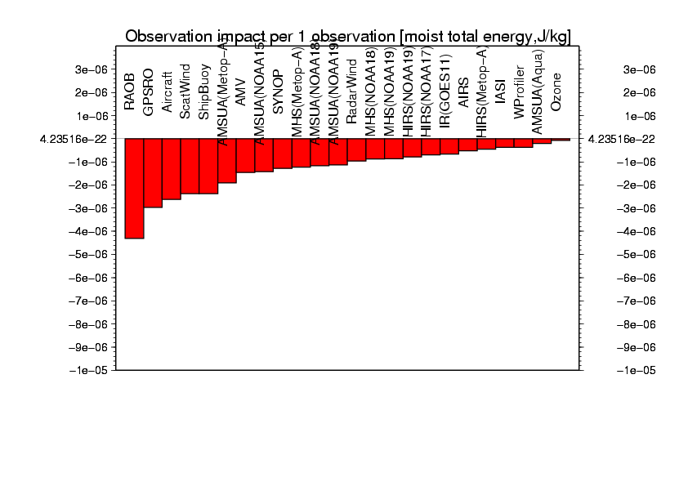
Ensemble-based FSO diagnostics, NCEP GFS, Ota et al., WMO, Sedona, May 2012
Forecast error reduction
Winds
Winds
Total impact
Impacts per obs
All observation types have positive forecast impact on average.
For the total impact, 1: aircraft, 2: AMSU-A, 3: radiosonde, 4: IASI, 5: GPSRO
For impact per 1 obs., 1: radiosonde, 2: GPSRO, 3: aircraft, 4: Scatterometer wind, 5: marine surface observation
Courtesy: L.P. Riishojgaard

