Slide 1
Using TODWL soundings to establish expectations for precision airdrops
G. D. Emmitt, S. Greco and K. Godwin
Simpson Weather Associates
Working Group on Space-based Lidar Winds
3-4 November, 2015

Slide 2
Objectives
Use existing WRF model and TODWL (Twin Otter Doppler Wind Lidar) data sets to investigate the relative merits of single vs. multiple wind lidar soundings or model soundings on the wind drift error contribution to the precision of Precision Air Drops (PADs).
More specifically, address the following questions:
What are the expected errors if a sounding taken up to 30nm from the drop zone (DZ) is the last known profile to be used to compute the bundle Release Point (RP)?
What , if any, are the benefits of having TODWL wind soundings between 30nm out from the RP and within a kilometer of the RP?

Slide 3
Conclusions
Both WRF and TODWL soundings yield large scatter in the impact errors.
Errors in targeting (Release Point calculations) do not necessarily improve with soundings taken closer to the DZ.
Use of a series of real (ADWL) soundings on approach to DZ will improve targeting over the use of model winds at target. This will require rapid and temporally relevant “last minute” adjustments to RP.
Rather than a single, non-representative sounding, a series of soundings provides a superior basis for:
generating PDFs of likely bundle drifts derived from drop simulations applied to several (~30) independent wind profiles.
expressing the likelihood of success for drops of differing criticality.

Slide 4
Assets
Simplified Bundle Drift FOM (Figure of Merit) for sounding impacts on PAD accuracy.
TODWL soundings taken during the MATERHORN experiment at DPG (Dugway Proving Grounds) in October 2012.
WRF model output for DPG over that same period.
Prior WRF model simulations of PADs near the Salinas Valley in California.

Slide 5
Simplified Bundle Drift Simulator (used in prior SWA PAD research)
Simplified Bundle Drift Figure of Merit (BDFOM)
Assumes a massless payload; limited to the effects of wind profile variability in space and time.
Advection of the bundle by x,y distances by average winds in 50m layers during time spent in those individual layers.
BDFOM = |Impact Point (IP) - Target Location (X) |
Use open cell diagram to illustrate the dependency of BDFOM on last wind profile used to compute RP
Use a scatter diagram to illustrate variability in simulated air drop accuracy generated from multiple instantiations of input wind profiles

Slide 6
BDFOM
In this current study, drops are considered from ~10 Kf (model and TODWL)and 17.5 Kf (model only) MSL
Fall speeds as shown in next slide.
Transpose distant soundings to target location
Calculate a RP
Simulate bundle drifts through WRF model and TODWL wind fields at the target location.

Slide 7
Air Drop Fall Speed Profile
Sample Times for Each Air Drop Stage
Stage | Fall Speed (fps) | 3K feet (seconds) | 10K feet (seconds) | 17.5K feet (seconds)
Stabilization | 180 | 1 | 1 | 1
Ring Slot | 96 | 22 | 95 | 175
Main | 28 | 18 | 18 | 18
Total Time |  | 42 | 115 | 195
Assumptions:
Near free fall is used for first 1 second
Main is opened 500 feet AGL

Slide 8
Simulated Air Drops Using Only WRF Wind Soundings (no lidar)
Use individual WRF model grid point soundings closest to TODWL wind soundings to evaluate the variability of the BDFOM within the air drop simulation domain
No instrument sampling or measurement errors
In the October cases, only spatial variability from the WRF model
Used to illustrate the expected BDFOMs for either a model profile or TODWL profile at various distances from the DZ.

Slide 9
Example of BDFOM from prior PAD simulations near the Salinas Valley, CA.

Slide 10
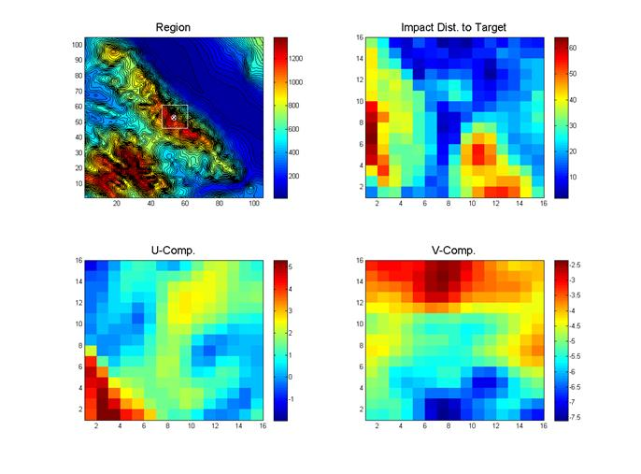
Ridge Example BDFOM Spreads
DZ
60
Height(m)
Distance (m)
0
16 x 16 km
Box around DZ
Winds (mps)
at 50m AGL

Slide 11
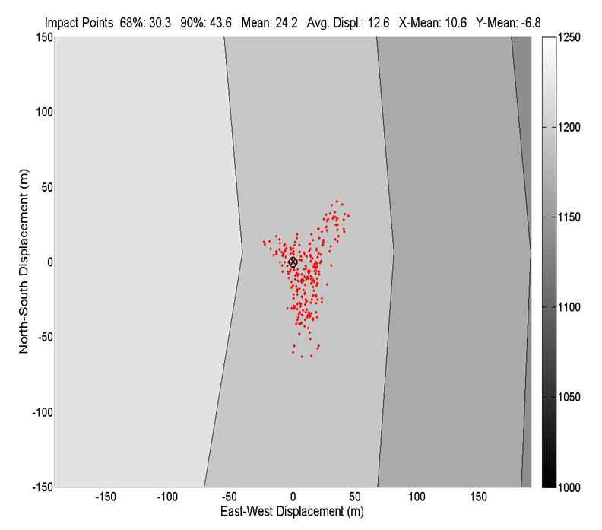
Impact Points for 10,000’ drop
Ridge Target
Terrain Height
(meters MSL)

Slide 12
Dugway case study
October 2012 during ONR/NSF MATERHORN experiment at Dugway Proving Grounds.
3000 TODWL sounding between Salt Lake City and Granite Mountain as well as over and around Granite Mountain. Only using soundings on approach to DPG and near PAWSII test site.
Output from the WRF model for the same period of time.

Slide 13
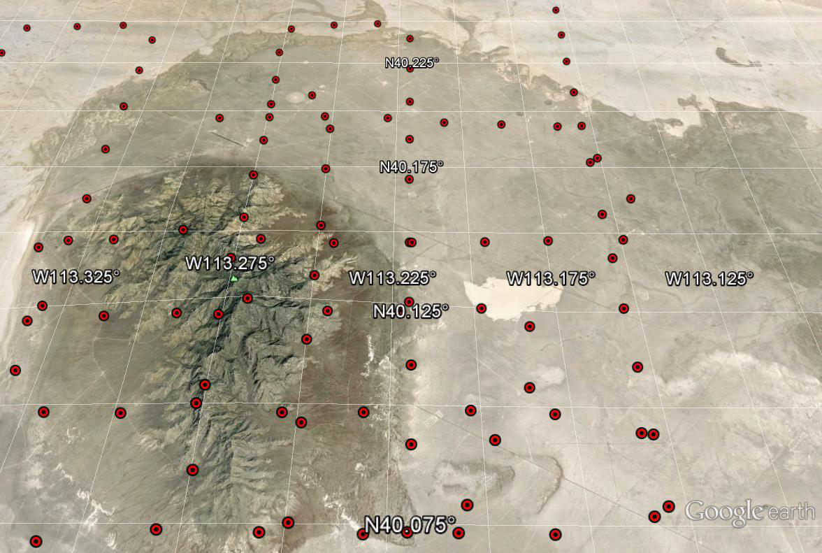
Granite Mountain, DPG

Slide 14
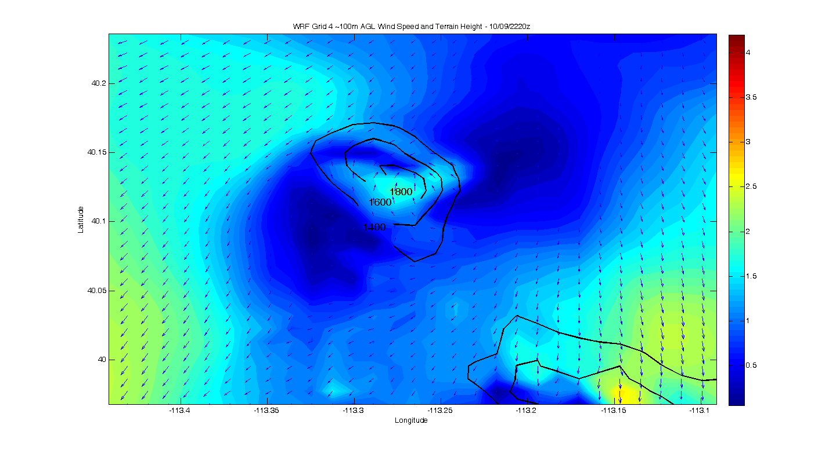
Example of WRF model output winds (100m agl) around Granite Mountain

Slide 15
Dugway case studies
October 06,09,10 and 17, 2012 during ONR/NSF MATERHORN experiment at Dugway Proving Grounds.
TODWL soundings between Salt Lake City and Granite Mountain as well as over and around Granite Mountain. Only using soundings on approach to DPG and near PAWSII operations site.
Output from the WRF model for the same period of time and along the same path as TODWL.

Slide 16
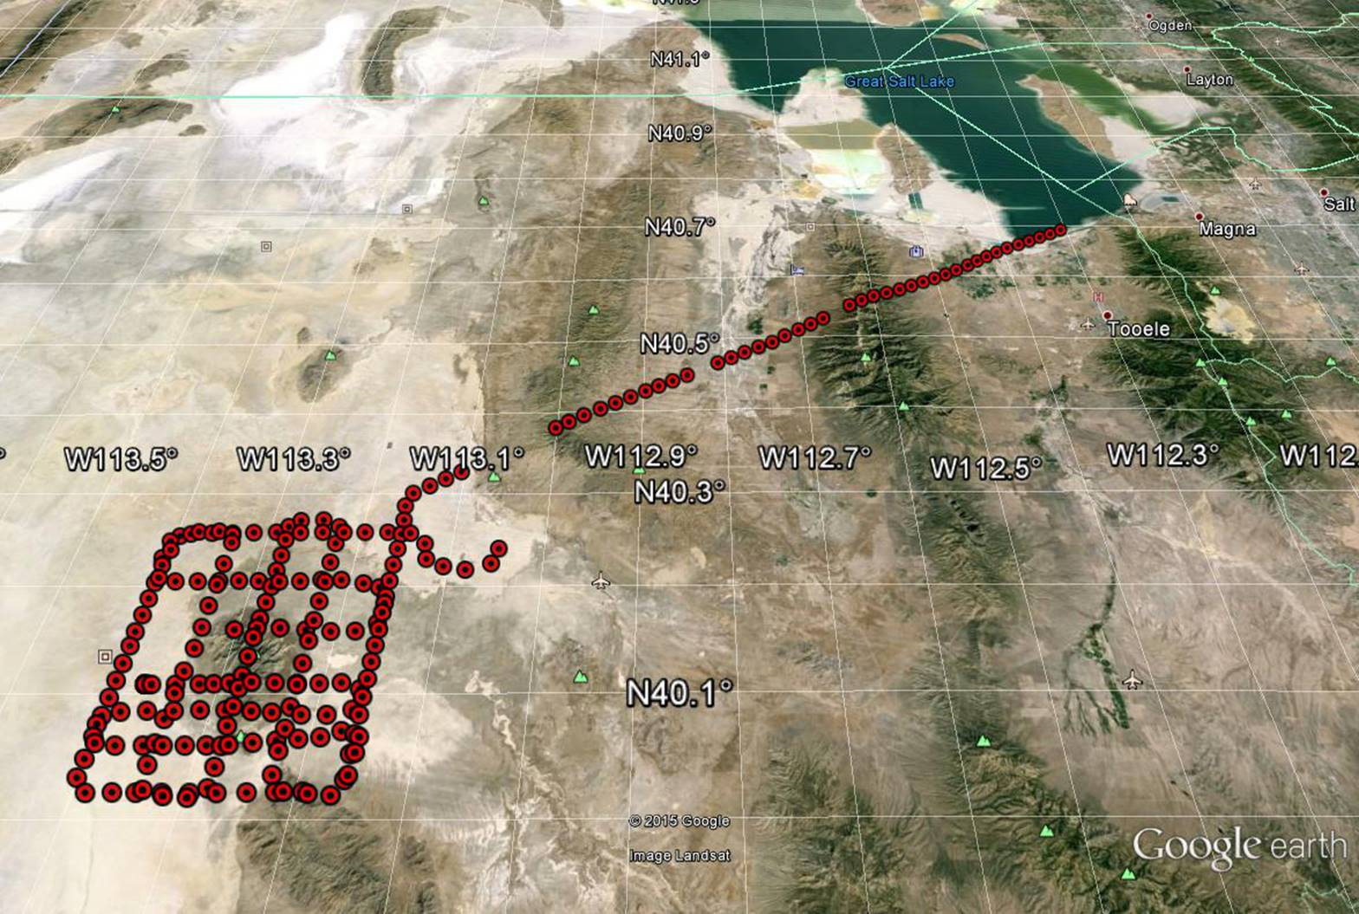
TODWL wind sounding locations October 10, 2012
44nm

Slide 17
WRF/TODWL wind profile comparisons
Example case for DZ location close to the PAWSII operations center site just on the eastern side of Granite Mountain.
Use WRF model output for the approximate times (~ 5 minutes) and locations ( .5km) of TODWL sounding.

Slide 18
Replace

Slide 19
Replace
East Slope Wind Speed from TODWL and WRF

Slide 20
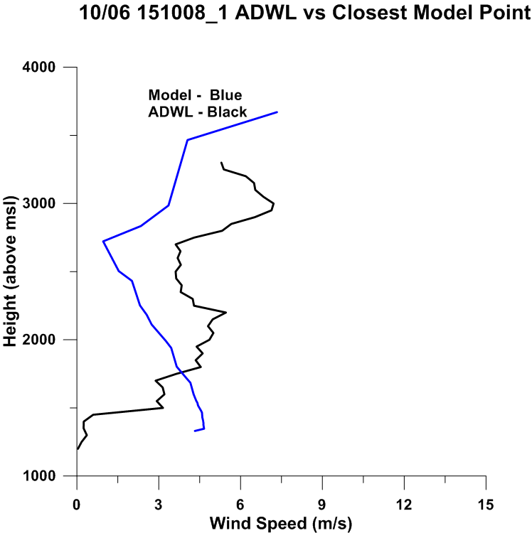
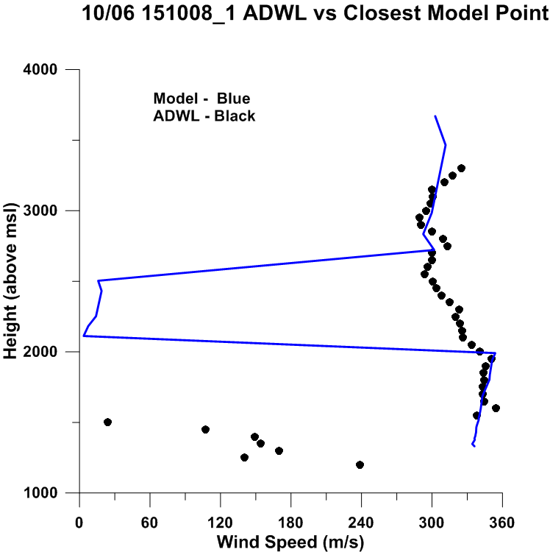
10/06/12 wind profiles at DZ

Slide 21
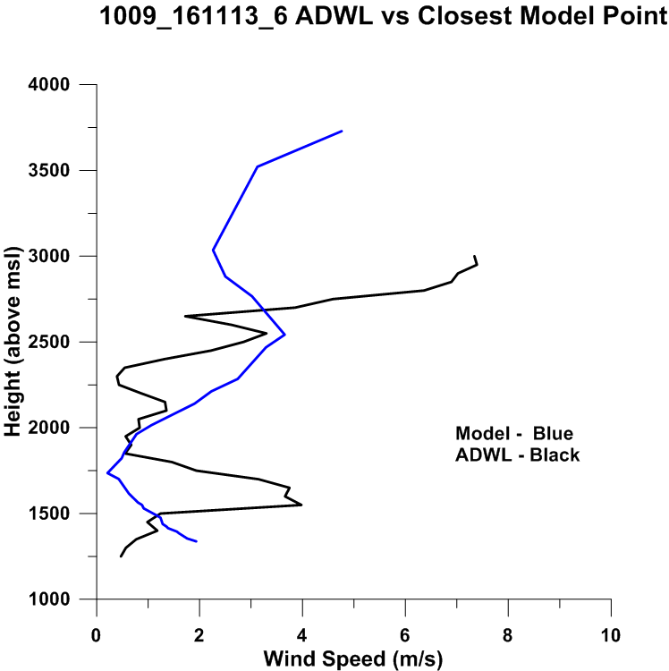
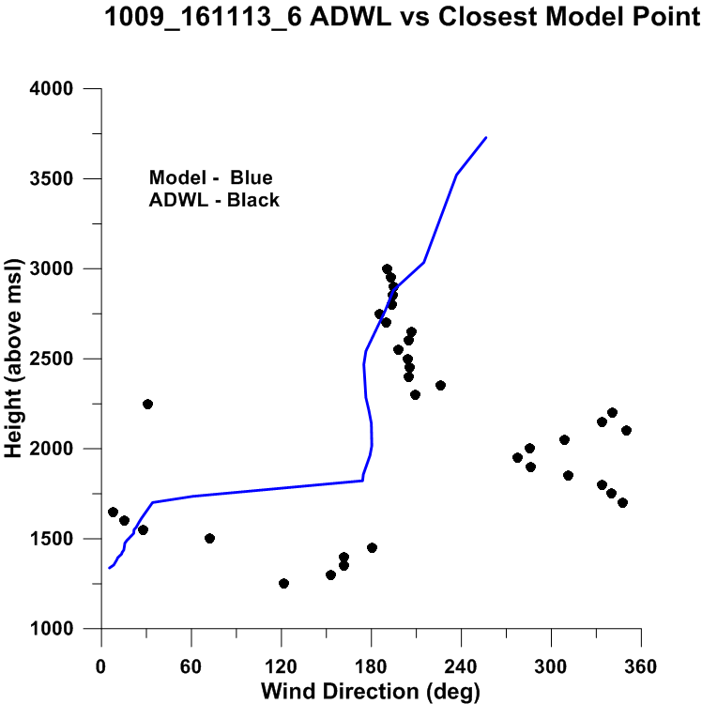
10/09/12 at DZ

Slide 22
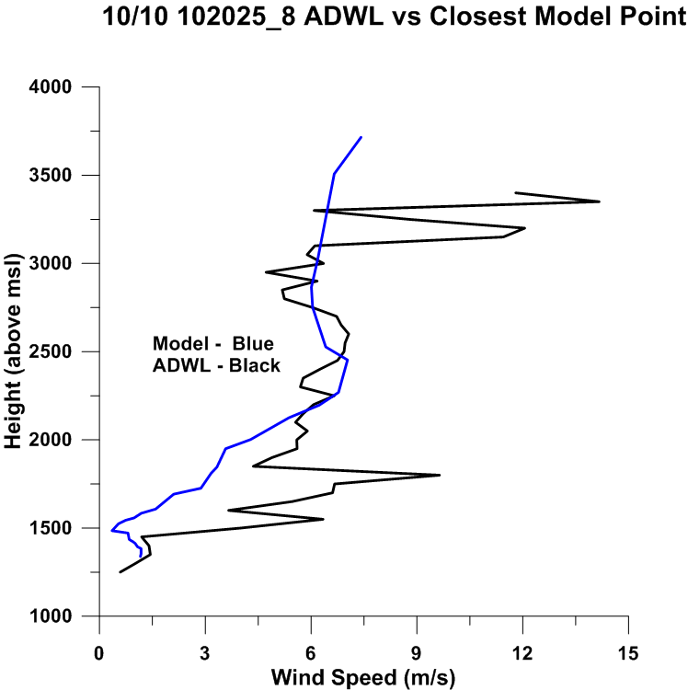
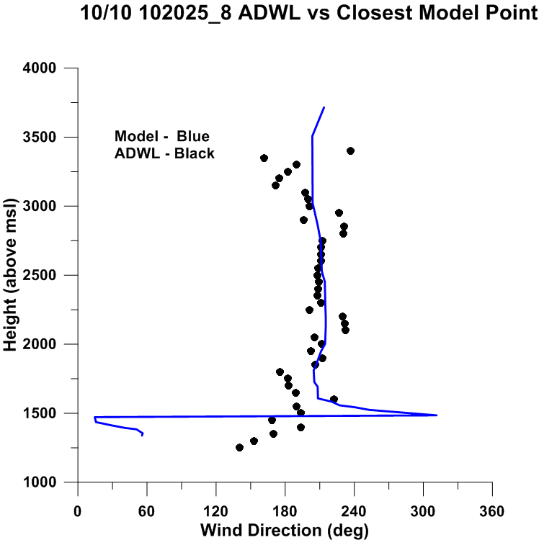
10/10/12 at DZ

Slide 23
Setup for WRF simulations of BDFOM
Locate the WRF soundings nearest to those obtained with the TODWL on an approach path to the Granite Mountain test area.
Compute BDFOM for drops from 10000’ to the surface; also from 17500’ to the surface.

Slide 24
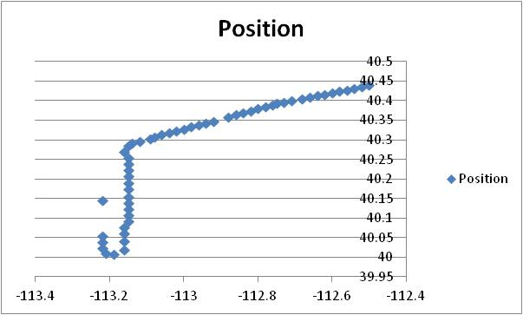
Example approach to Granite Mtn. (08/09/15)

Slide 25
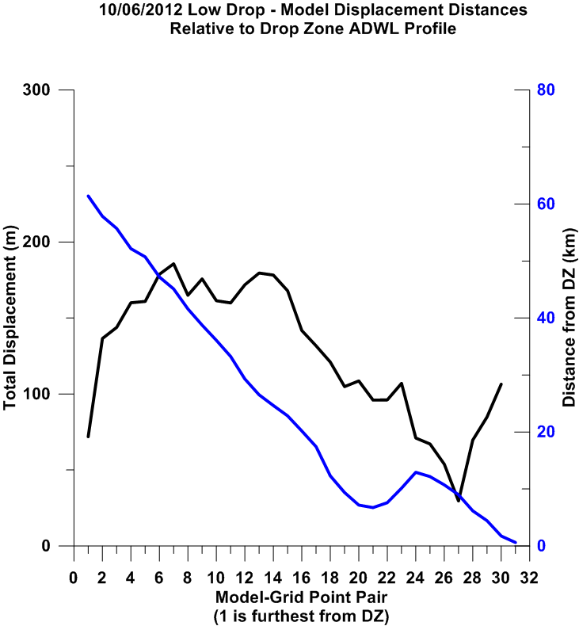
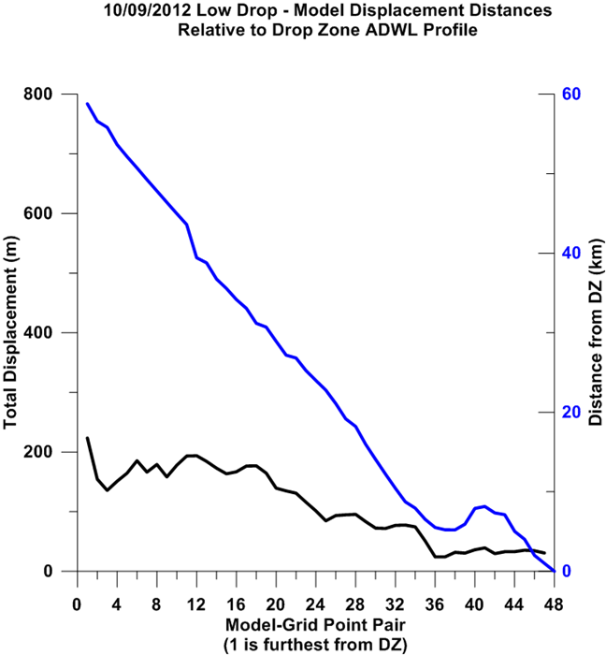
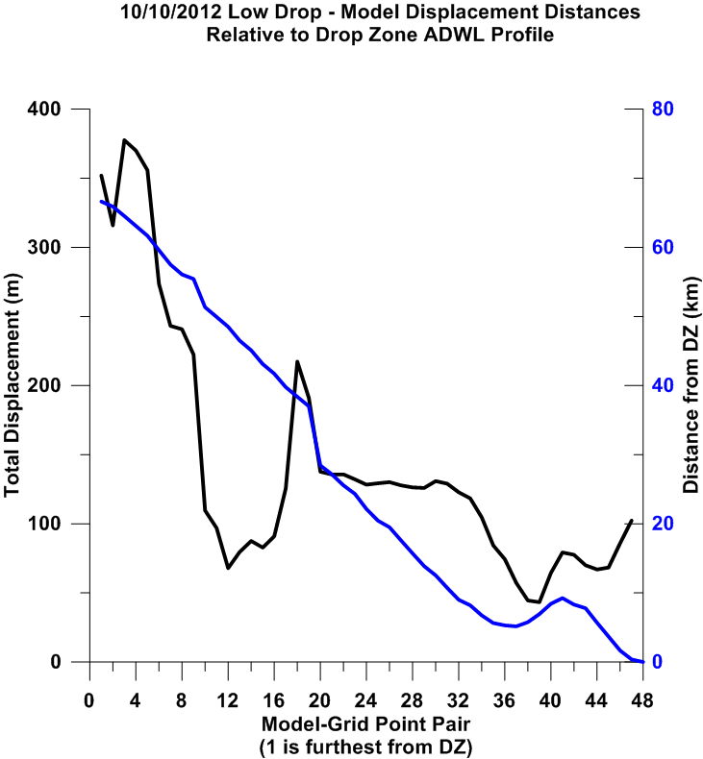
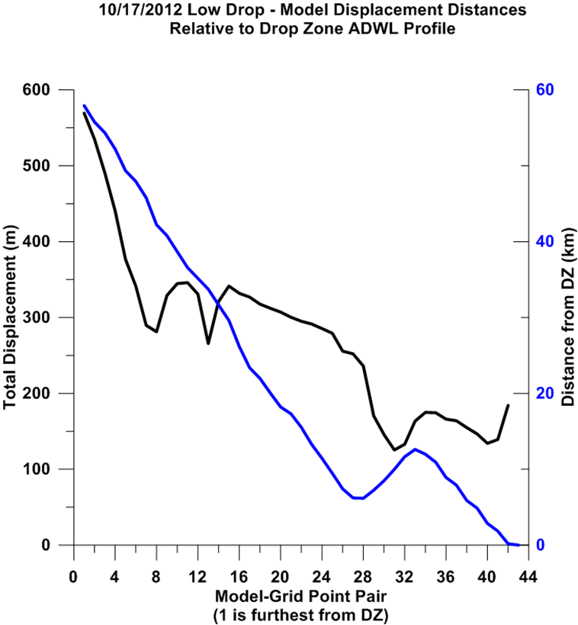
Approach timeline using model
Note: True winds
at DZ are those
obtained with TODWL

Slide 26
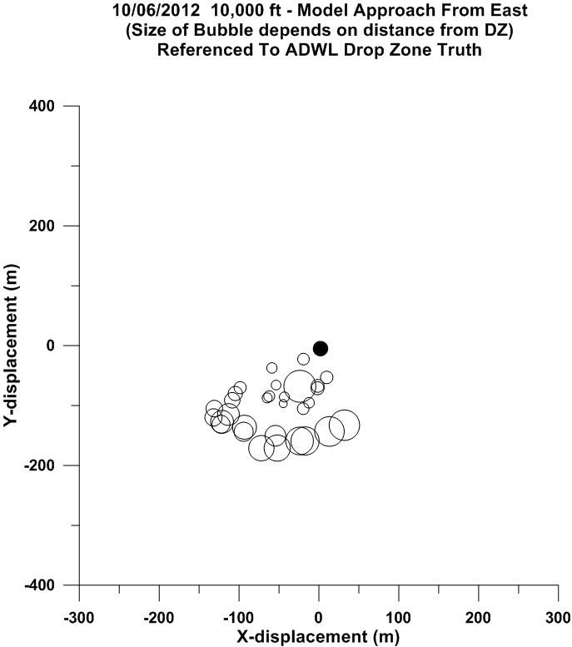
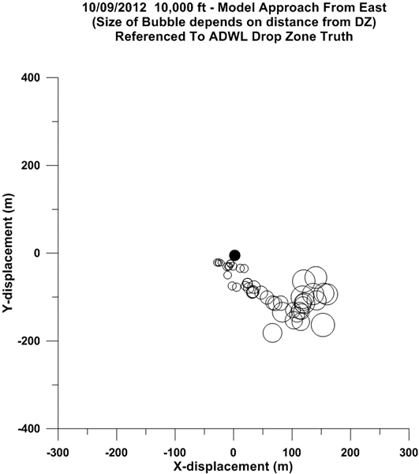
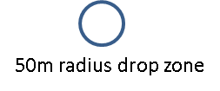
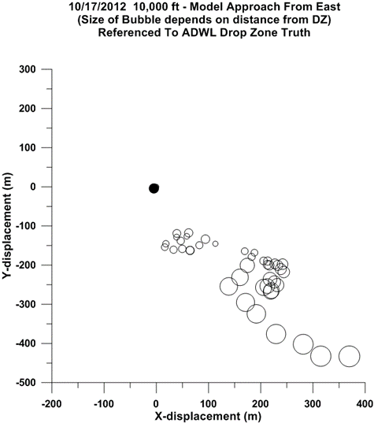
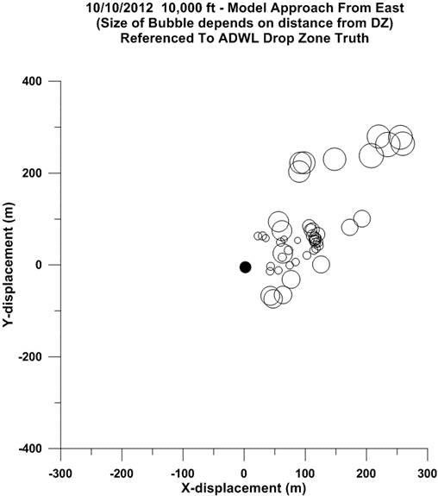
Impact errors
associated with
a series of profiles
along the approach
to the DZ
Size of circle is
proportional to
the linear distance
to the DZ

Slide 27
Impact errors based upon TODWL profiles

Slide 28
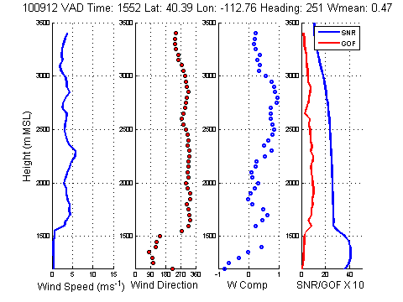
TODWL sounding on approach to MATERHORN control site

Slide 29
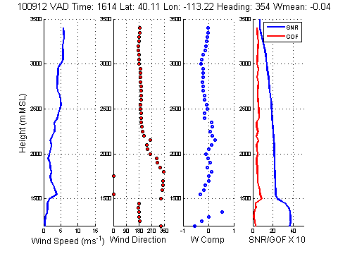
TODWL sounding near DZ

Slide 30
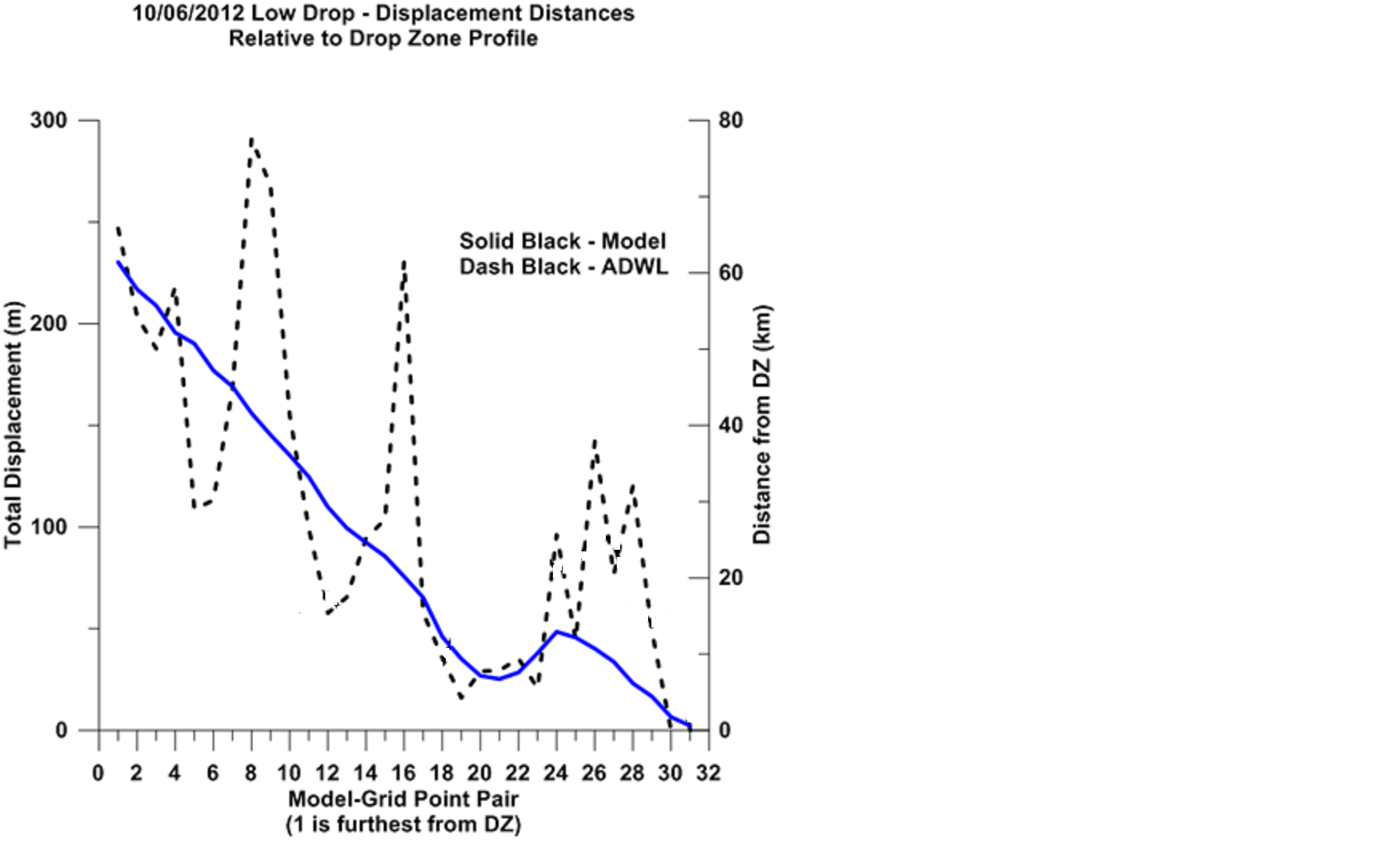
10/06/12 approach time line

Slide 31
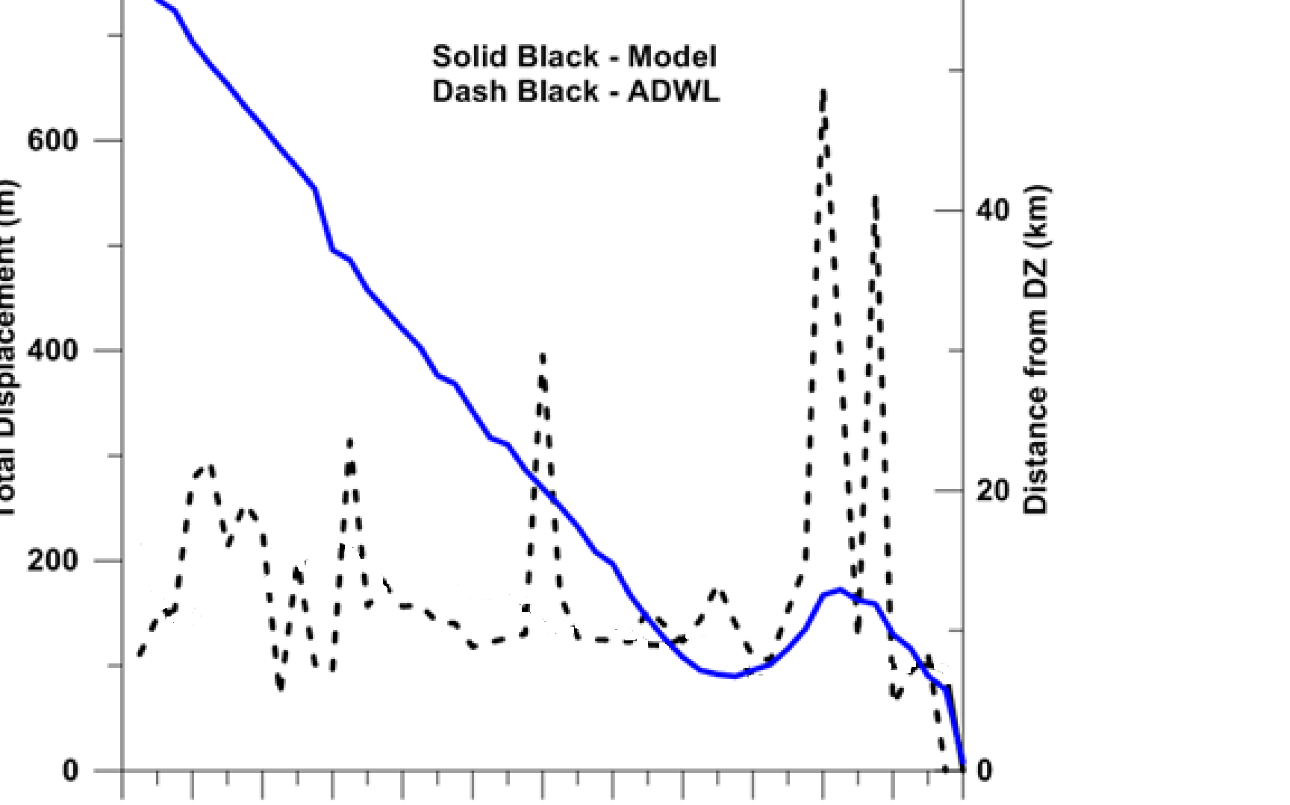
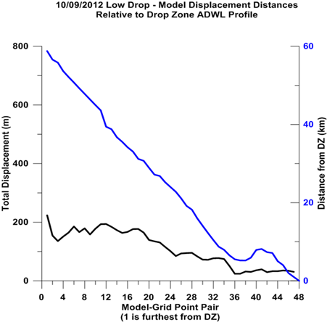
10/09/12 approach time line

Slide 32
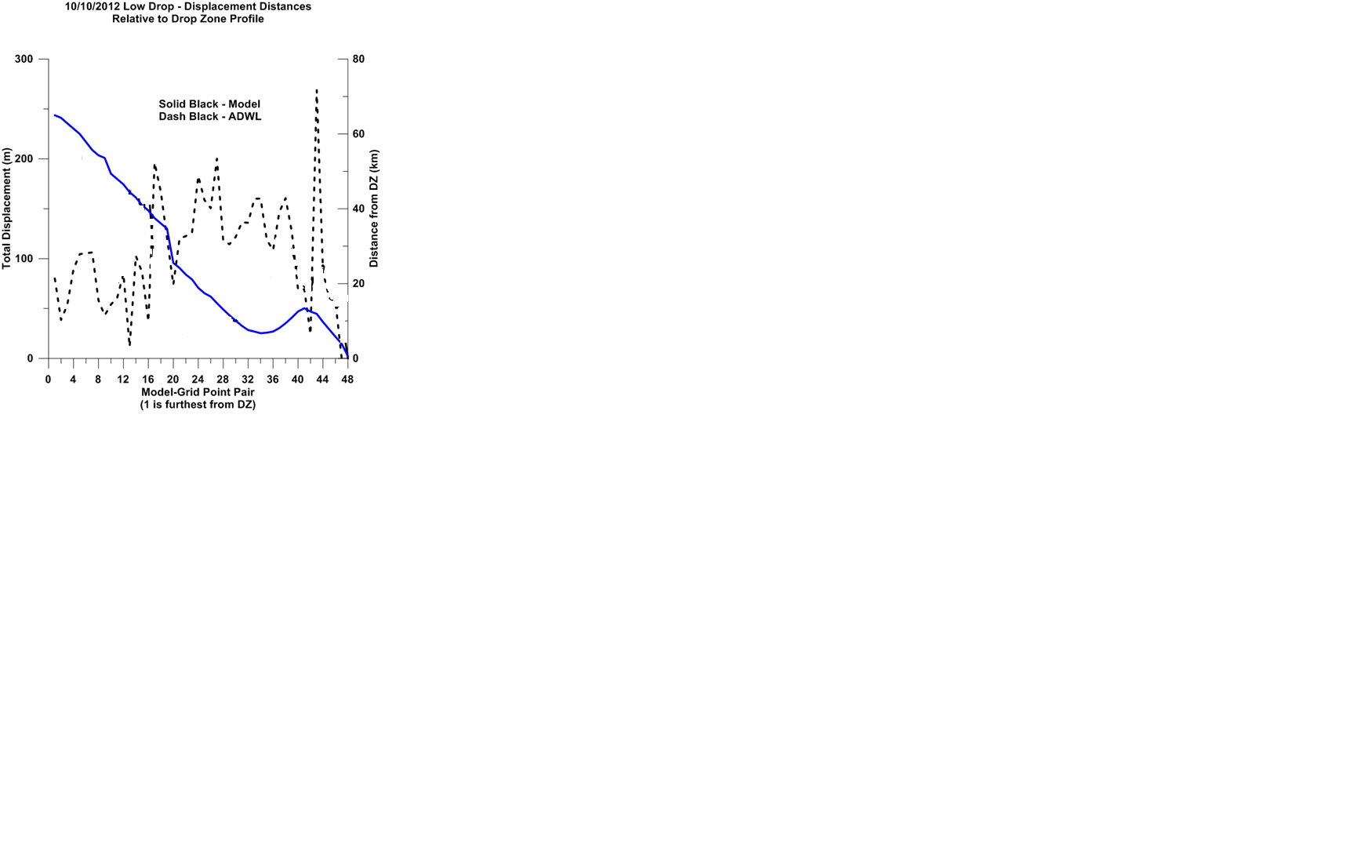
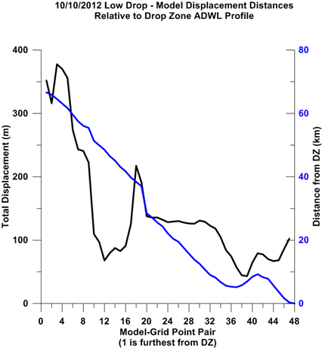
10/10/12 approach time line

Slide 33
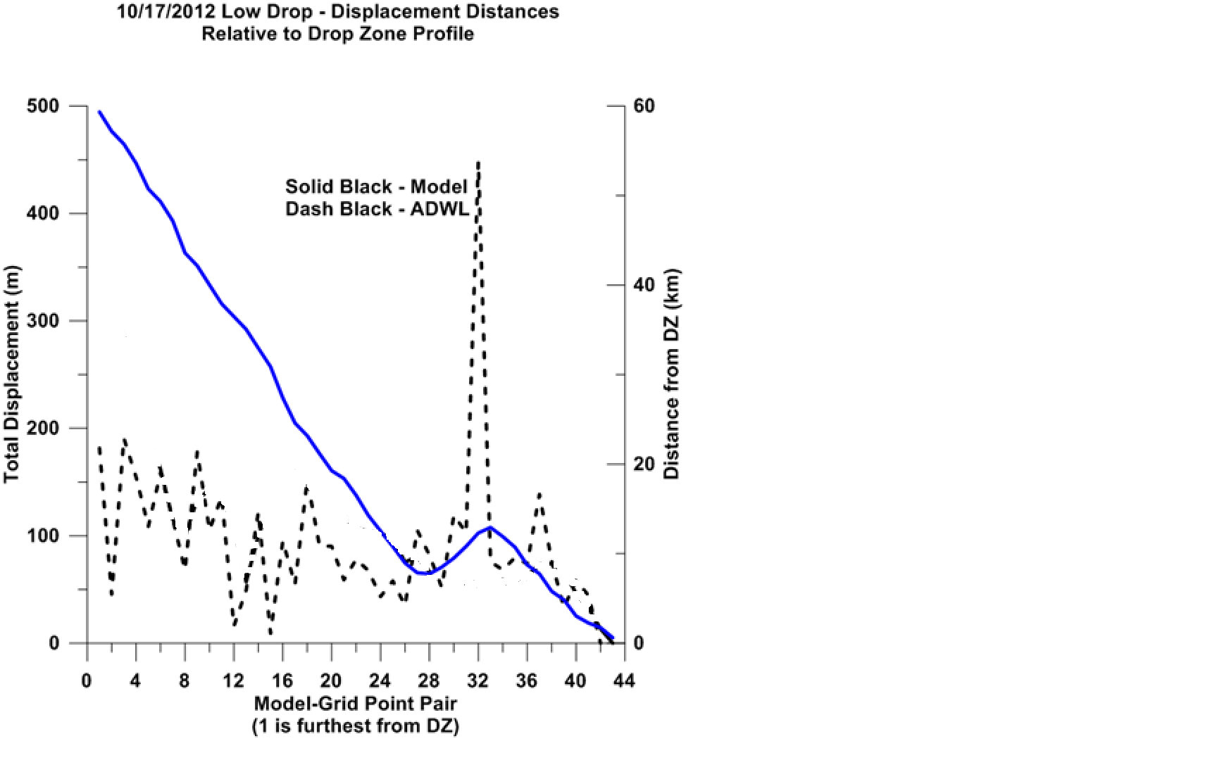
10/17/12 approach time line

Slide 34
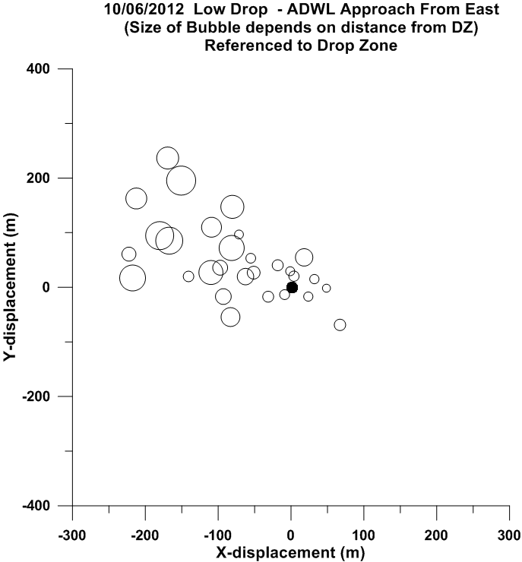
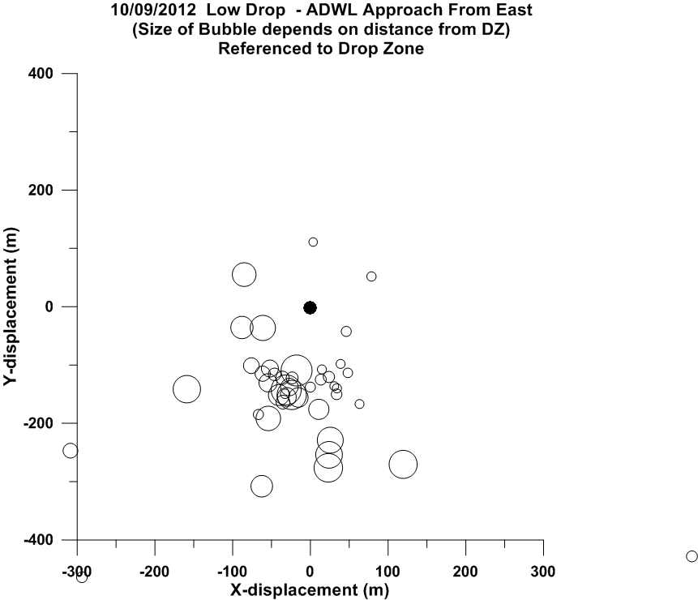
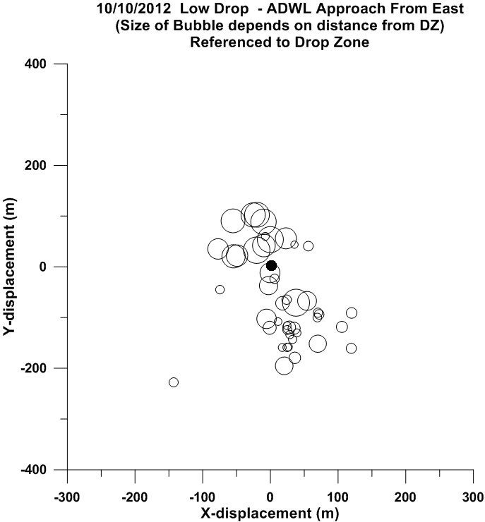
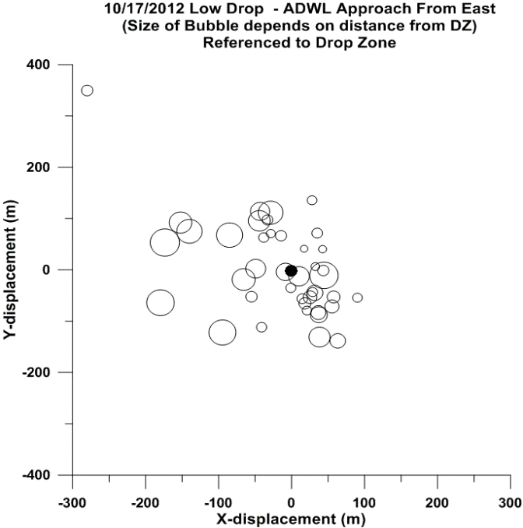
Impact errors
associated with
a series of profiles
along the approach
to the DZ
50m radius drop zone
Size of circle is
proportional to
the linear distance
to the DZ

Slide 35
Comparison between WRF and TODWL impact errors for 10/10/12 case

Slide 36
Conclusions
Both WRF and TODWL soundings yield large scatter in the impact errors.
Error in targeting (RP calculation) does not necessarily improve with closer proximity soundings to the DZ.
Use of a series of real soundings on approach to DZ will improve targeting over the use of model winds at target. This will require rapid and temporally relevant “last minute” adjustments to RP.
Rather than a single, non-representative sounding, a series of soundings provides a superior basis for:
generating PDFs of likely bundle drifts derived from drop simulations applied to several (~30) independent wind profiles.
expressing the likelihood of success for drops of differing criticality.

