Slide 1
2μm DWL observations during WindVAL 2015 and further results from gravity wave experiments
Stephan Rahm,
Benjamin Witschas,
Andreas Schäfler,
Oliver Reitebuch,
Christian Lemmerz, Engelbert Nagel, et al.

Slide 2
ADM and 2 μm Lidar Location and Pointing
2 μm Doppler lidar
ADM Aeolus

Slide 3
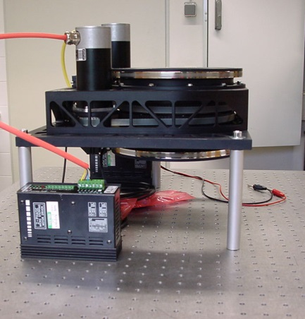
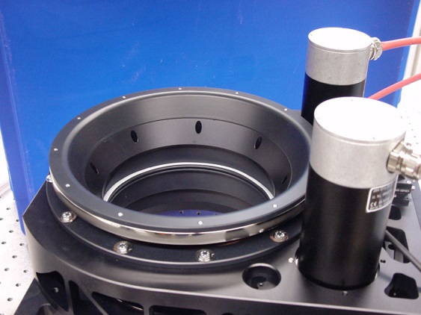
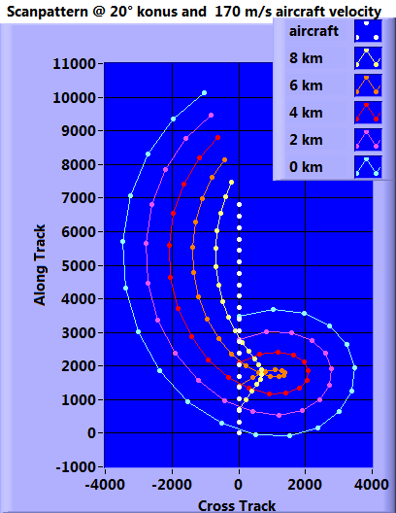
Spec 2 μmTransceiver :
Laser:
wavelength 2.022 µm
repetion rate 500 Hz
pulse energy 1.5 mJ
pulse length 0.5 µs
Off-axis telescope:
aperture 10 cm
Double Wedge Scanner:
max. deviation +/- 30 °
scan speed and pattern: variable
Data acquisition:
early digitising 500 MHz
with quick look
Signal processing: FFT based
Pointing at ADM validation:
Calibration: Parallel to ADM Measurement: Conical step and stare; 21 positions; 1s LOS

Slide 4
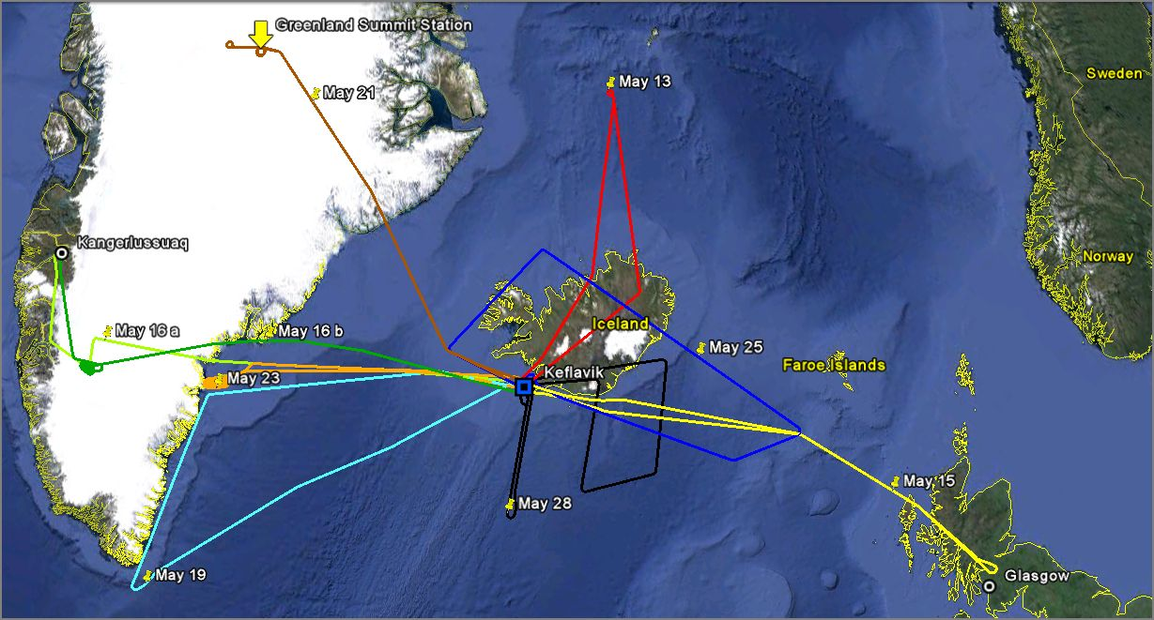
Tracks of all nine Flights from Iceland (+ 4 flights transfer not displayed)

Slide 5
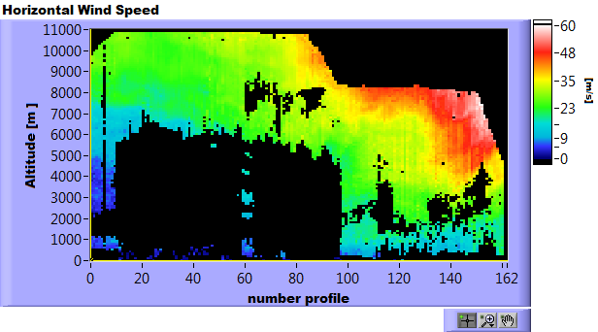
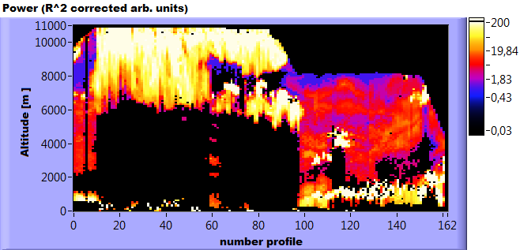
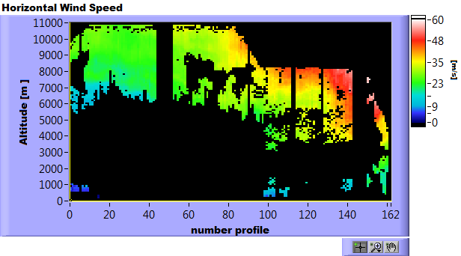
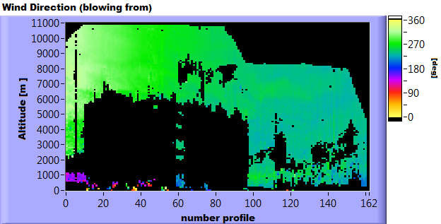
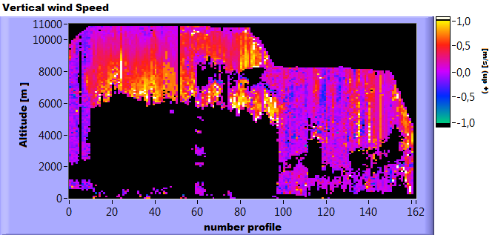
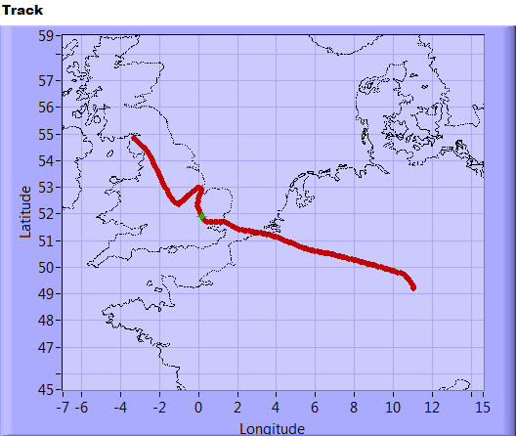
11.05.2015 Transfer Oberpfaffenhofen Keflavik Part 1
113
127

Slide 6
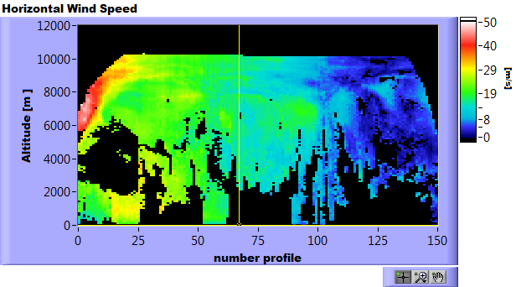
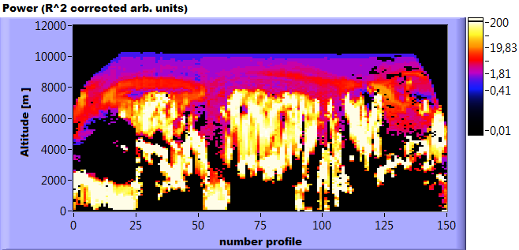
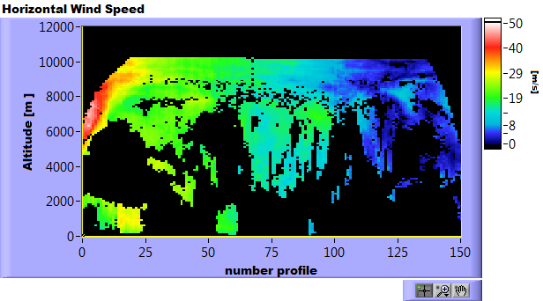
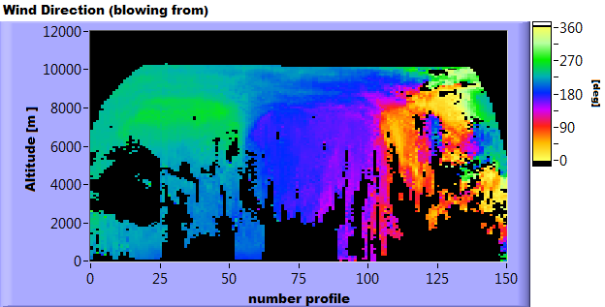
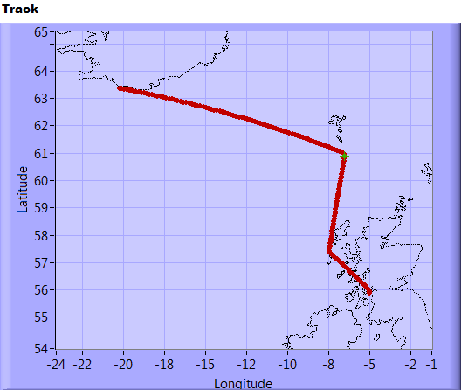
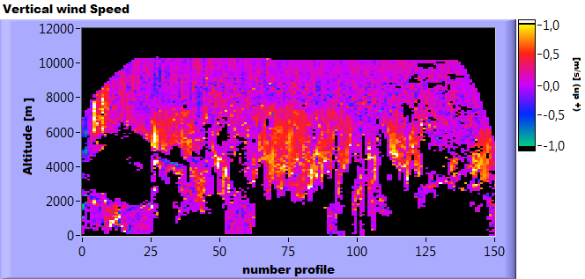
11.05.2015 Transfer Oberpfaffenhofen Keflavik Part 2
77
27

Slide 7
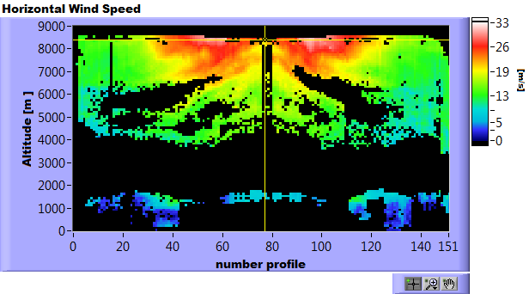
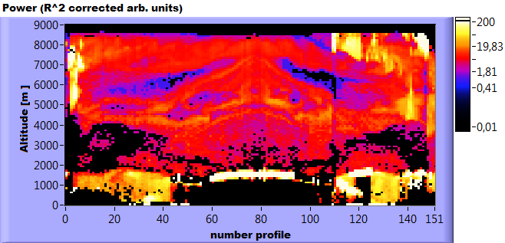
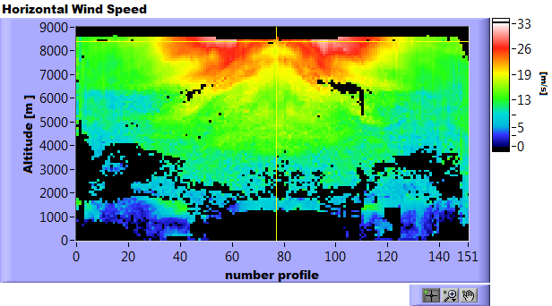
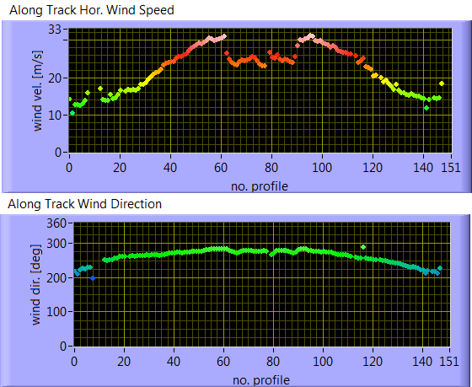
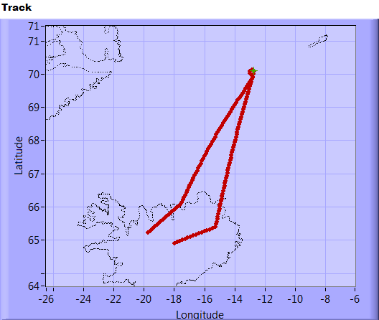
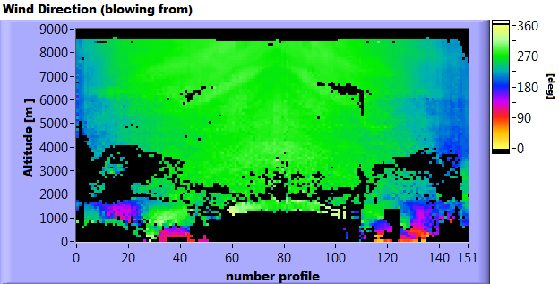
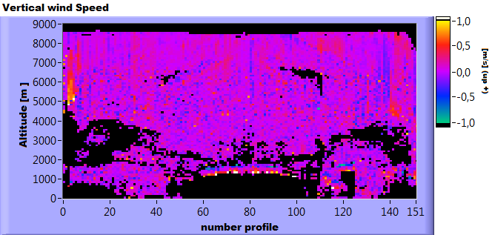
13.05.2015 Iceland
77

Slide 8
15.05.2015 Glasgow Jetstream Weather briefing
ECMWF Analysis – 15 May 2015 – 18 UTC
Geopotential & Wind Speed @ 300 hPa
Potential Vorticity & MSLP @ 310 K

Slide 9
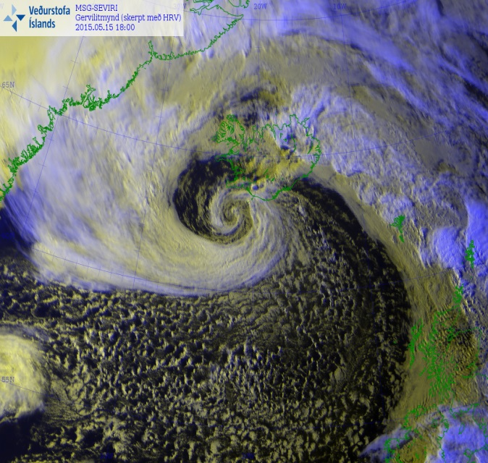
15.05.2015 Glasgow Jetstream Cloud Coverage
MSG Seviri HRV Image – 15 May 2015 – 18 UTC
Produced by the Icelandic Met Service

Slide 10
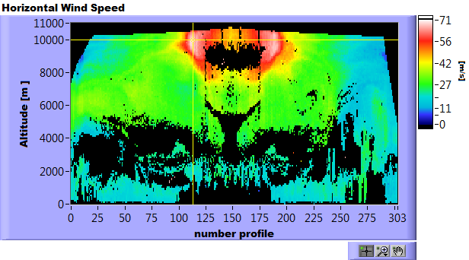
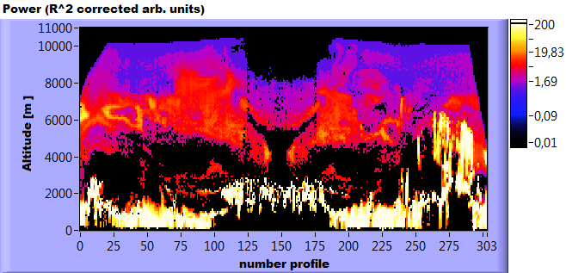
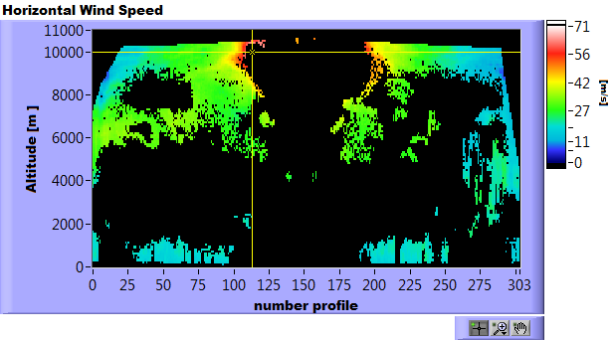
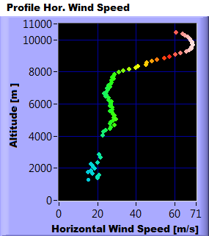
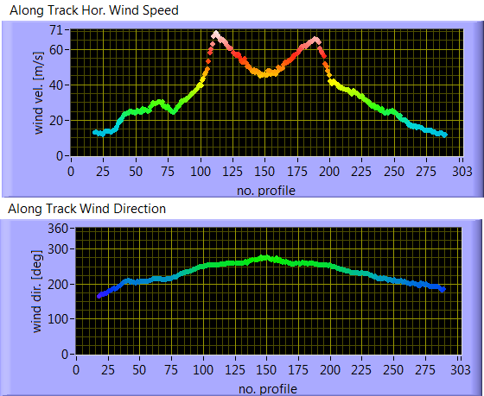
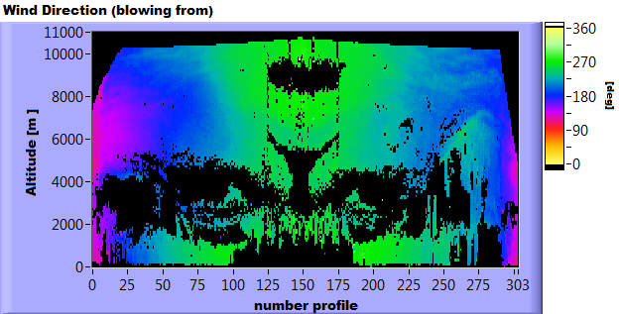
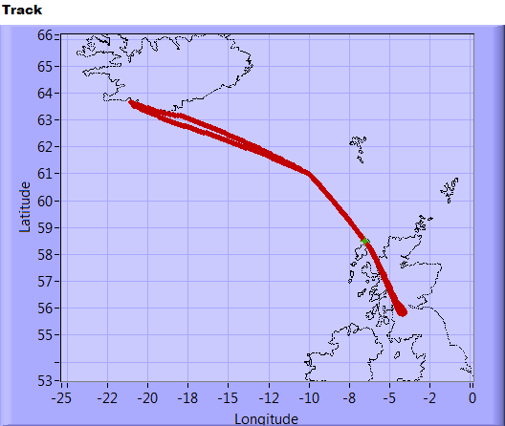
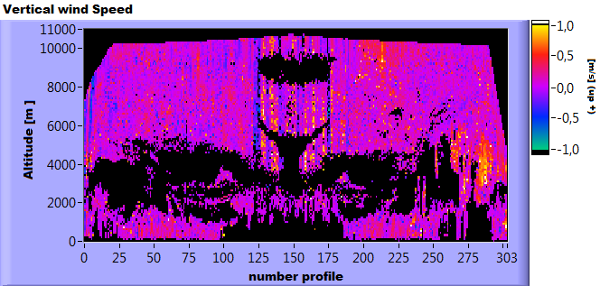
15.05.2015 Glasgow Jetstream

Slide 11
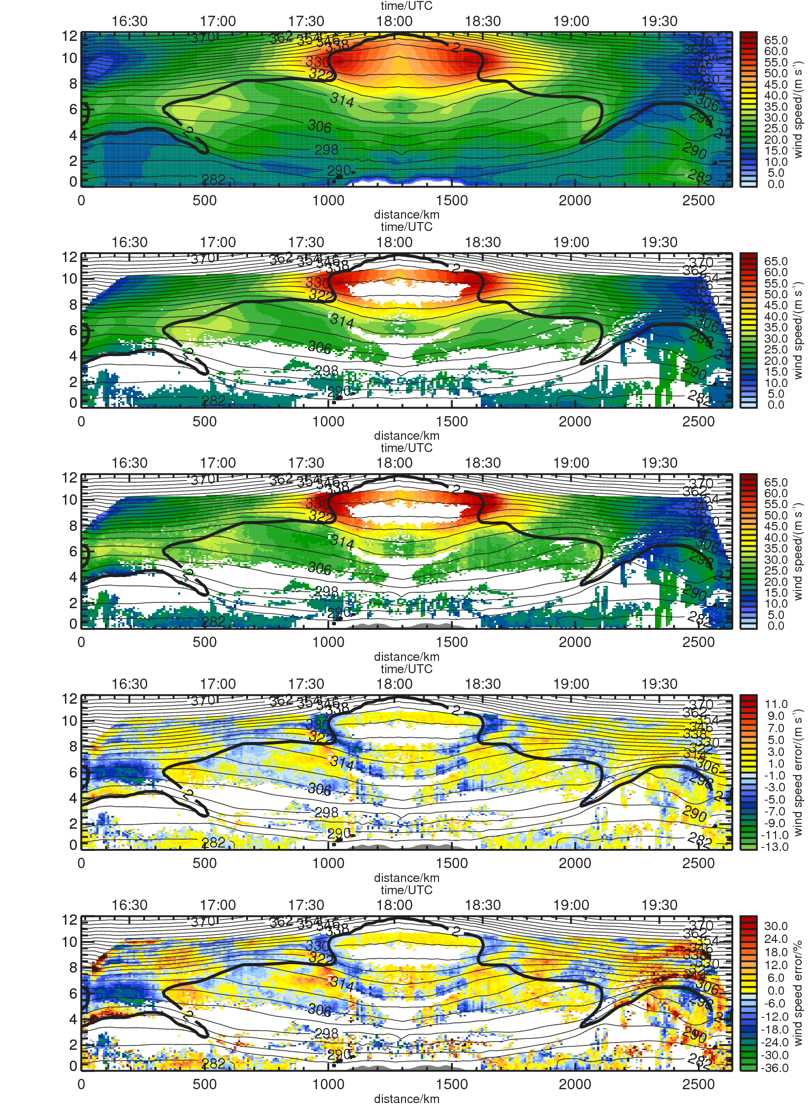
15.05.2015 Glasgow Jetstream ECMWF vs LIDAR
Comparison by A. Schäfler
${WSP}_{ECMWF}$
${WSP}_{ECMWF}$
with 2μm wind lidar coverage
$${WSP}_{Lidar}$$
as observed by the 2μm wind lidar
${WSP}_{ECMWF}−$ ${WSP}_{Lidar}$
$$\frac{{WSP}_{ECMWF}− {WSP}_{Lidar} }{{WSP}_{Lidar}}$$

Slide 12
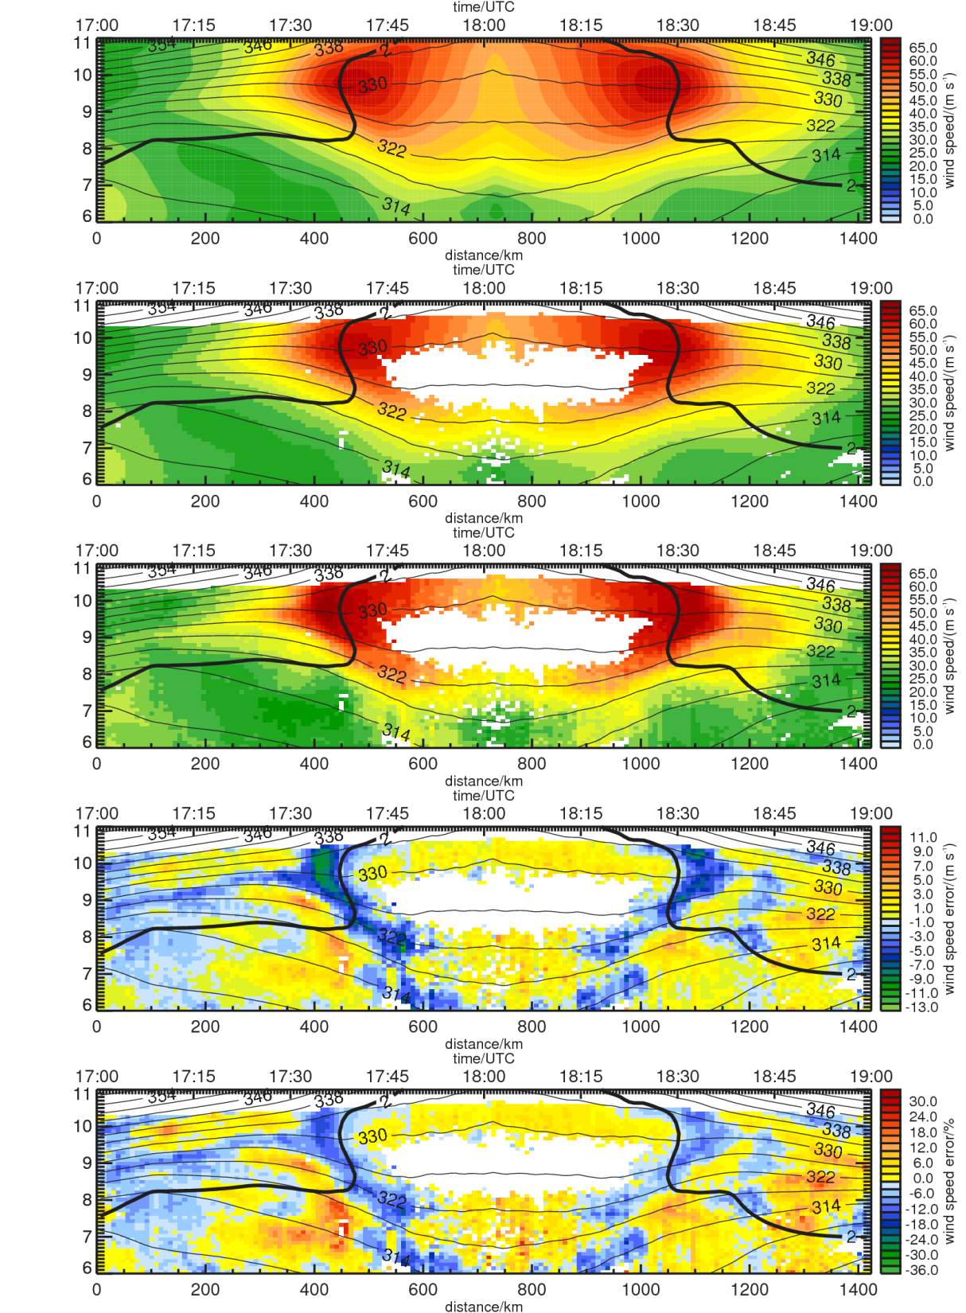
15.05.2015 Glasgow Jetstream ECMWF vs LIDAR
Comparison by A. Schäfler
${WSP}_{ECMWF}$
${WSP}_{ECMWF}$
with 2μm wind lidar coverage
$${WSP}_{Lidar}$$
as observed by the 2μm wind lidar
${WSP}_{ECMWF}−$ ${WSP}_{Lidar}$
$MAX\left({ WSP}_{ECMWF}− {WSP}_{Lidar}\right)$ = 9.2 m s⁻¹
$MAX\left(\frac{{WSP}_{ECMWF}− {WSP}_{Lidar} }{{WSP}_{Lidar}}\right)$= -13.5 %
$$\frac{{WSP}_{ECMWF}− {WSP}_{Lidar} }{{WSP}_{Lidar}}$$

Slide 13
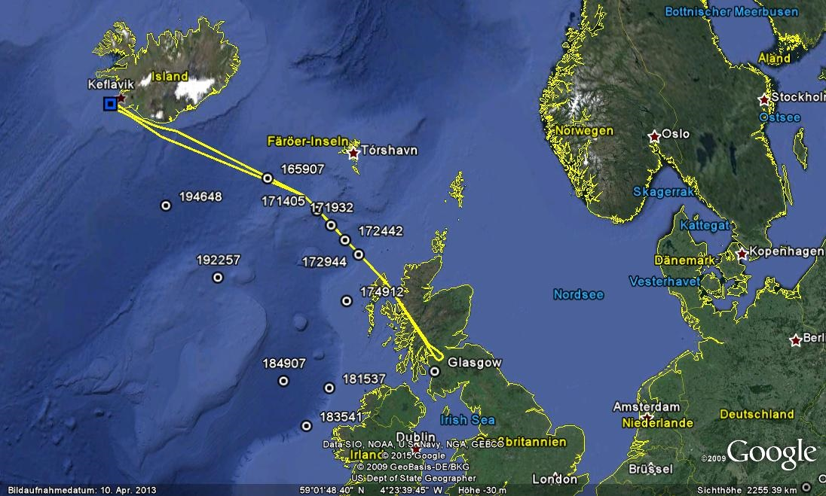
NASA DC8 Dropsondes

Slide 14
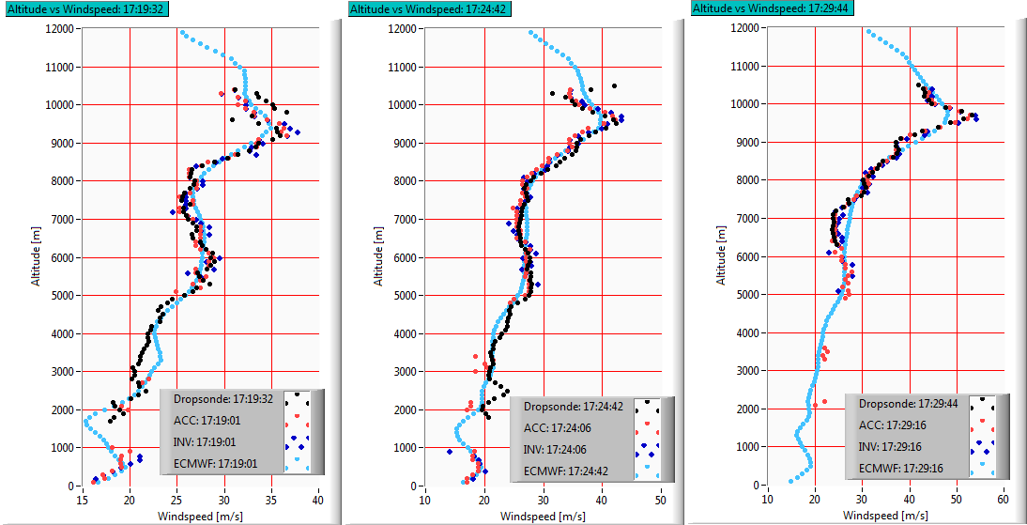
Wind speed comparison
Comparison by A. Schäfler
Sonde – LIDAR: 2.68 km
Sonde – LIDAR: 1.98 km
Sonde – LIDAR: 3.32 km

Slide 15
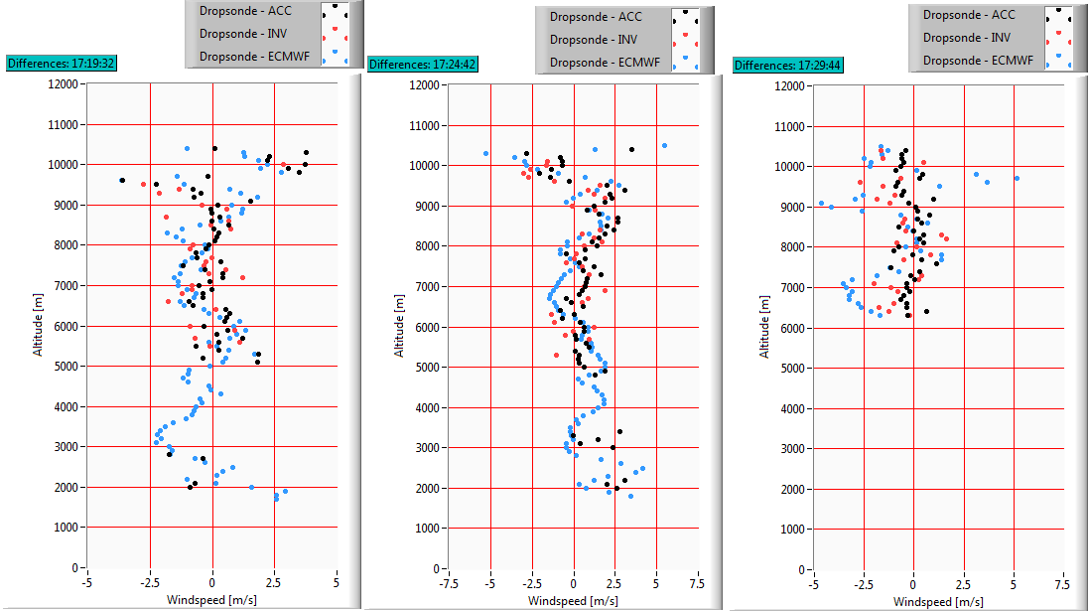
Wind speed comparison 2

Slide 16
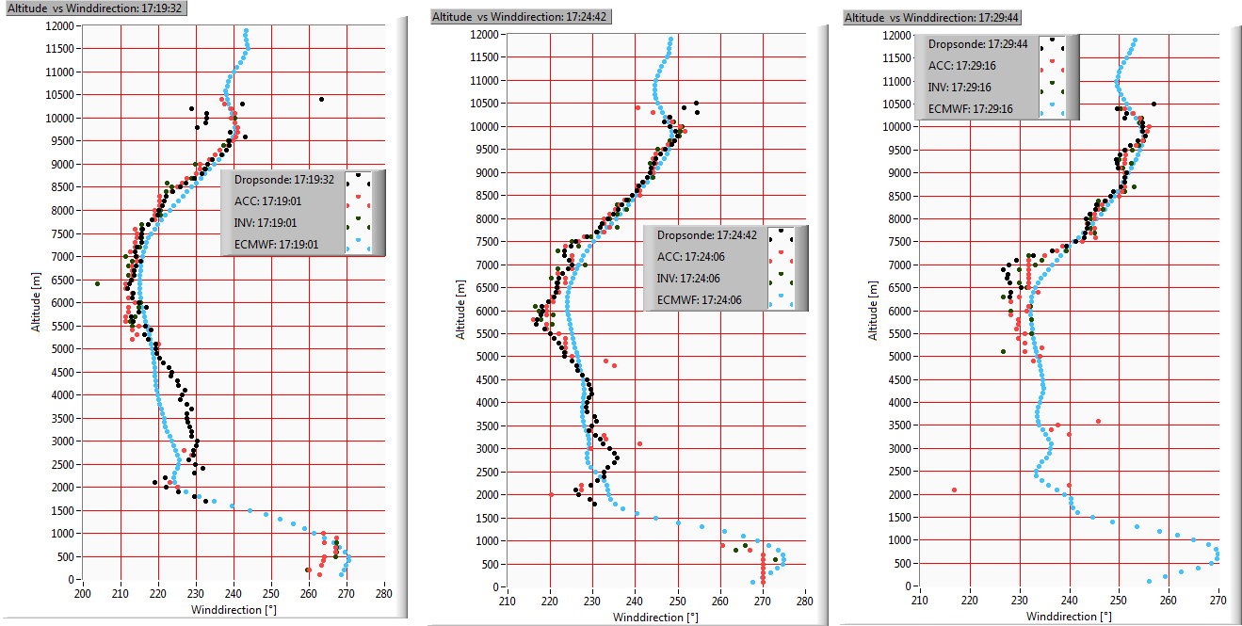
Wind direction comparison
Comparison by A. Schäfler
Sonde – LIDAR: 2.68 km
Sonde – LIDAR: 1.98 km
Sonde – LIDAR: 3.32 km

Slide 17
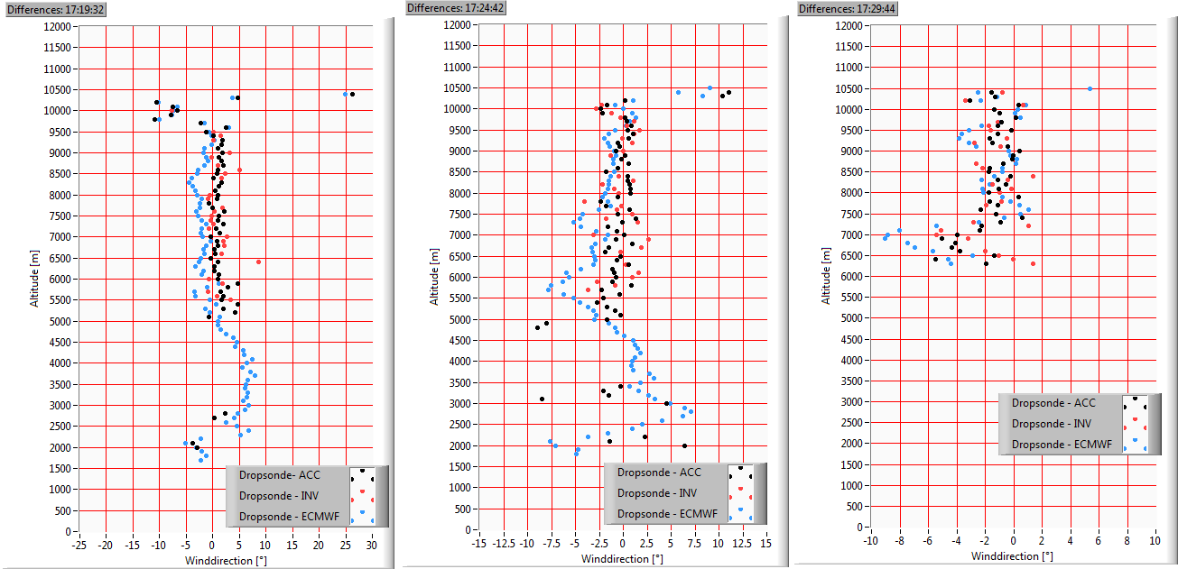
Wind direction comparison 2

Slide 18
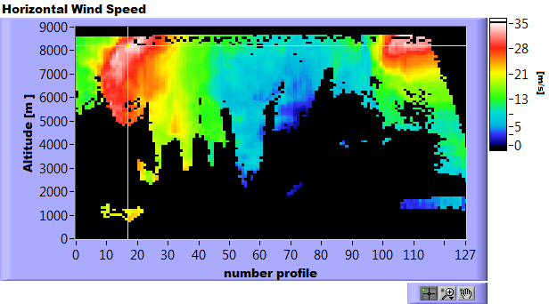
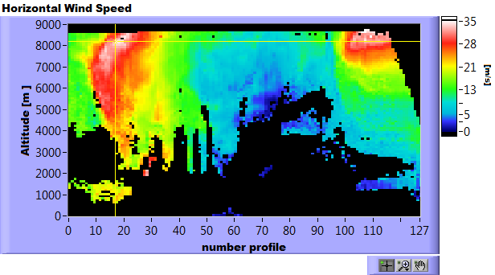
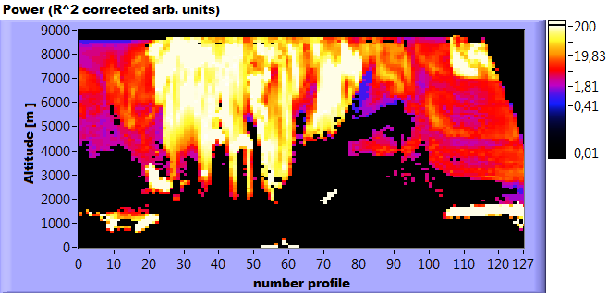
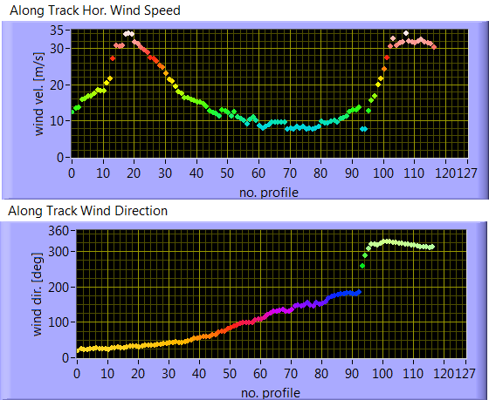
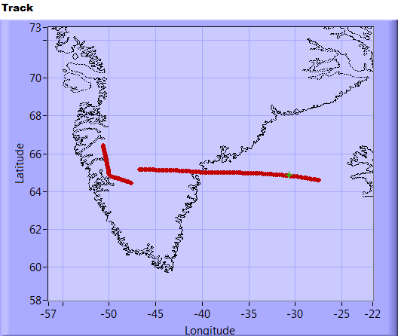
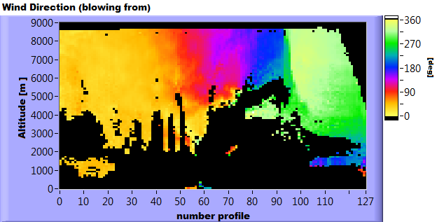
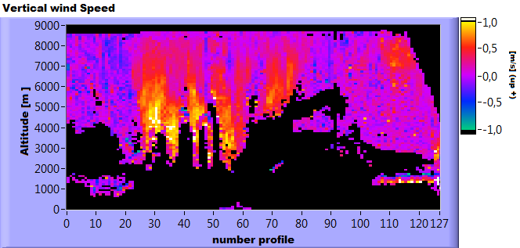
16.05.2015 Kangerlussuaq (ADM calibration)

Slide 19
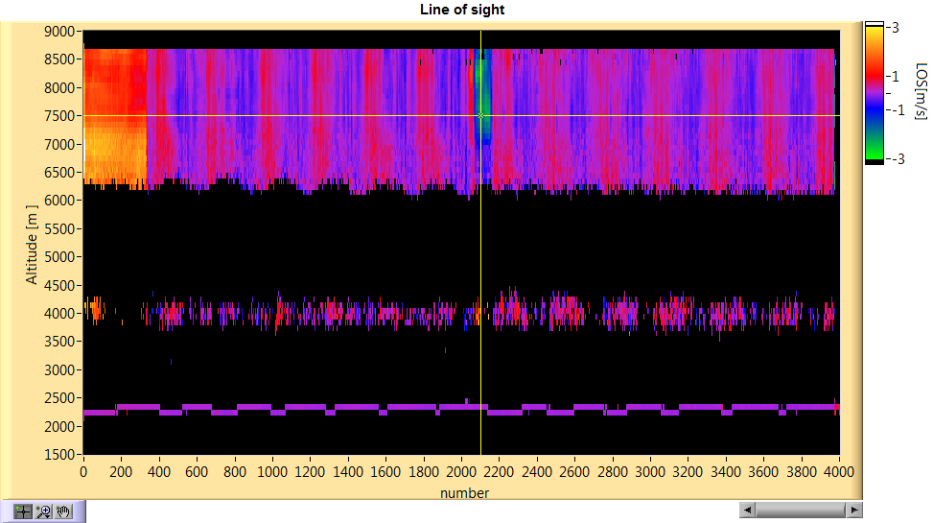
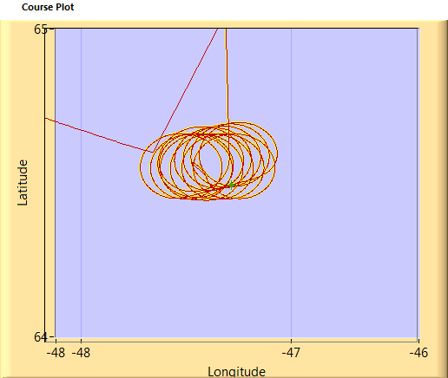
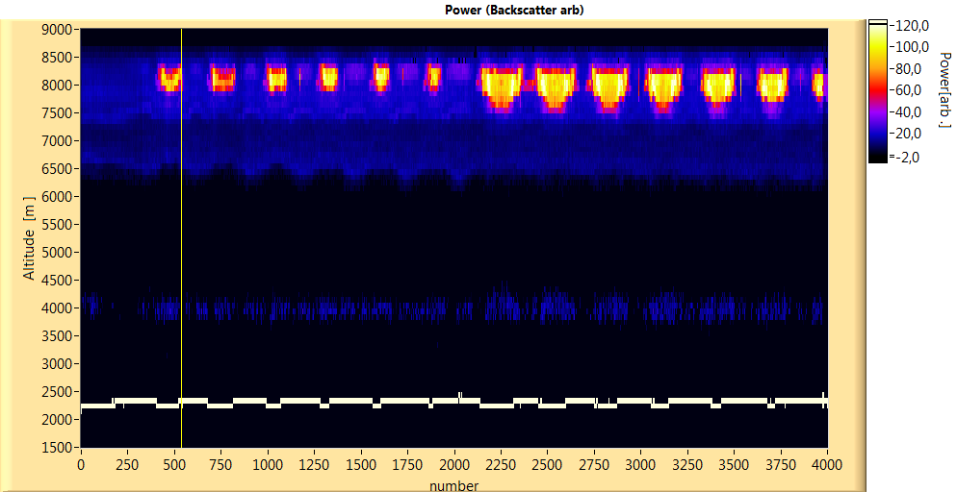
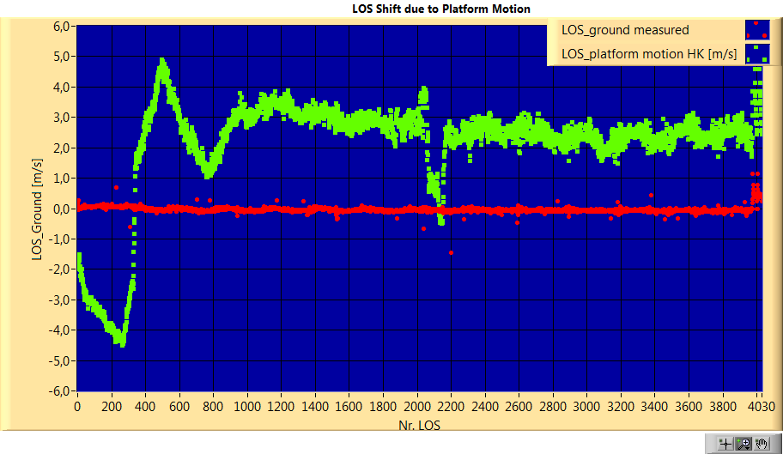
16.05.2015 Kangerlussuaq (ADM calibration)

Slide 20
19.05.2015 Greenland East Coast

Slide 21
25.05.2015 Iceland

Slide 22
Doppler Lidar for Detecting Gravity Waves
Measurement strategy: Flying over moutains parallel with the wind either scanning for obtaining the 3D windfield or looking downward for detecting the gravity waves.
From 2 μm Doppler lidar there are only results obtained in the troposphere
For propagation of gravity waves into the Stratosphers further lidar / sensors are required
Hines (1974)

Slide 23
ROMIC - Field Campaigns
(1) GW-LCYCLE 1
- 2 – 14 December 2013, Kiruna, Sweden
- DLR Falcon
- simultaneous 3 hourly radiosonde launches along a West-East section
from Andøya (N), Esrange (S) to Sodankylä (FIN) during 3 IOPs
- ground-based observations at ALOMAR (radars, lidars) and
at Esrange (Lidar)
(2) DEEPWAVE (DLR contribution)
- total period: 6 June – 22 July 2014, New Zealand
- DLR Falcon participation: 29 June – 21 July 2014
- ground-based observations (Rayleigh-Lidar, radiosondes) at Lauder
(3) POLSTRACC/GW-LCYCLE 2
- winter 2015/2016, Kiruna, Sweden
- coordinated flights of HALO and Falcon
- simultaneous 3 hourly radiosonde launches along a West-East section
from Andøya (N), Esrange (S) to Sodankylä (FIN)
- ground-based observations at ALOMAR (radars, lidars), Esrange (Lidar,
radar, rockets), and Sodankylä (lidars)
Kim et al., 2003

Slide 24
13.12.2013 Kiruna Wind

Slide 25
13.12.2013 Kiruna vertical velocity (gravity waves)

Slide 26
13.12.2013 Kiruna vertical velocity (gravity waves) 2

Slide 27
In-situ Falcon and 2 µm Wind Lidar Data
13 December 2013
Flight 1, 06:00-09:35 UTC

Slide 28
Conclusions:
- At ADM CALVAL coherent Doppler lidar data from 13 flights including transfer were obtained without any mayor problems from the instrument.
Enhanced coverage of the coherent Doppler lidar with a modified accumulation algorithm has been demonstrated
Besides the validation issue several interesting meteorological phenomena were observed as well.
Comparison with dropsond data and ECMWF model was made
New application for coherent Doppler lidar at gravity wave research

Slide 29
Paper in preparation:
“Mountain wave events above northern Scandinavia during the Gravity
Wave Life Cycle I campaign”
Johannes Wagner, Andreas Dörnbrack, Sonja Gisinger, Markus Rapp, Benedikt Ehard, Benjamin Witschas and Stephan Rahm

