Slide 1
Recent Progress on the High Efficiency UV Demonstrator and GrOAWL Lasers
M. Albert, F. Fitzpatrick, K. Puffenburger, T. Schum, S. Litvinovitch, D. Jones, J. Rudd, F. Hovis
Fibertek, Inc.
13605 Dulles Technology Drive
Herndon, VA 20171
fhovis@fibertek.com
703-471-7671

Slide 2
Updated HEUVD Program Objectives & Approach
Develop a 100 mJ, 150 Hz UV laser transmitter with a lifetime of > 5x10⁹ shots
  Design architecture & critical components based on proven HSRL & GOLD laser transmitters
  Develop an improved 1064 nm final power amplifier that can achieve 250 mJ/pulse at 150 Hz with an M² ≤ 2
  Develop a purely conductively cooled Laser Optics Module (LOM) design
  Develop a clean UV module design that converts the 250 mJ pump to 100 mJ at 355 nm
Conduct initial high repetition rate (20 kHz) UV testing of candidate LBO triplers
Conduct full power 1.5 billion shot life test at 532 nm
Conduct half power 1.5 billion shot life test at 355 nm
Conduct full power 1.5 billion shot life test at 355 nm
Conduct environmental testing to advance design from TRL 4 to TRL 6
  Thermal-vacuum & vibration

Slide 3
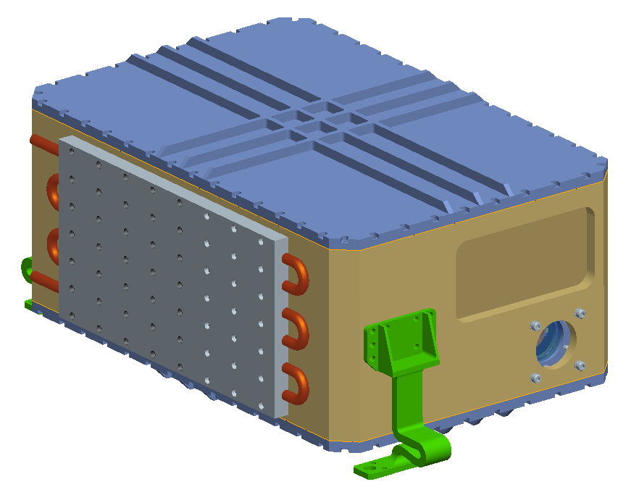
HEUVD Design Overview
Overall Dim: 18.0” x 12.0” x 8.5”
Weight: 88 lbs
Flexure-mounted, dual compartment design
All amplifiers conductively cooled to a single wall
Ring oscillator and first two amps lifted from HSRL-2
New final power amplifier design
  Higher power and beam quality pump on bounce design
Near polymer free UV conversion module
  Only polymers are seal o-rings
  Includes an internal beam expander
Electronics are a mix of COTS and custom designs
Coldplate
Flexures modified from ICEsat-2

Slide 4
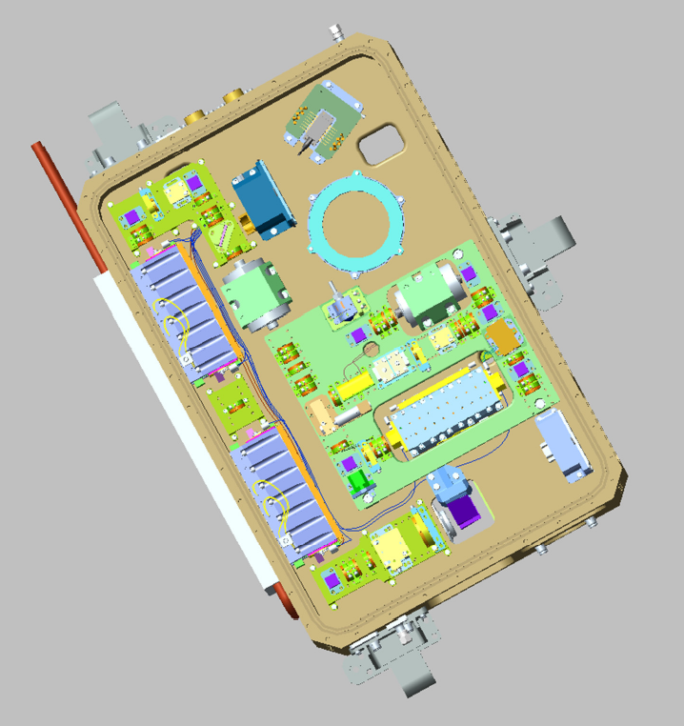
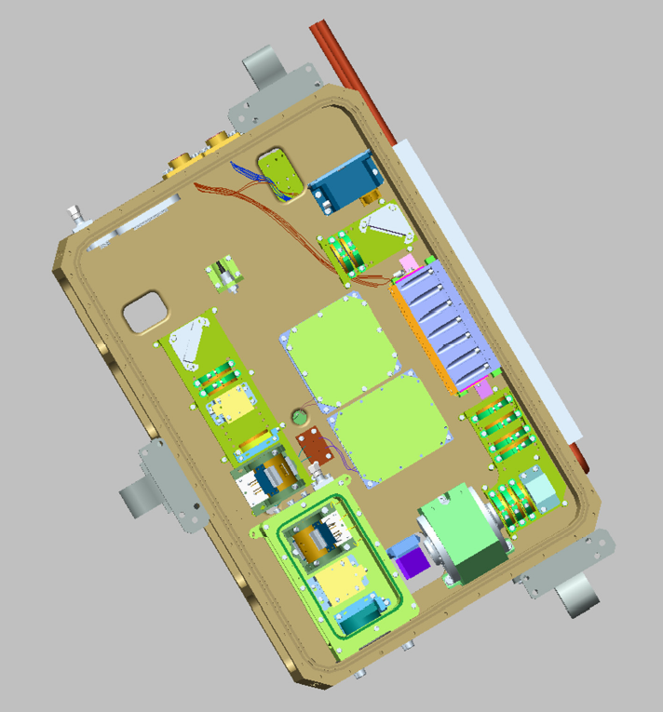
Laser Module Optical Configuration
Seed
Pwr Amp
Pre-Amps
Resonator
SHG
THG
Resonator &
Pre-Amp Side
Power Amp &
SHG/THG Side

Slide 5
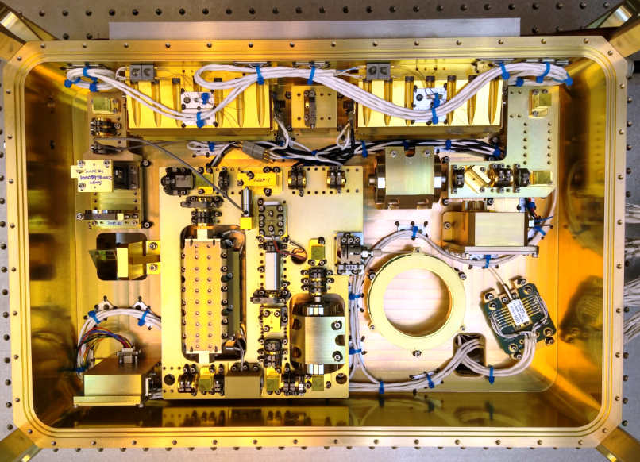
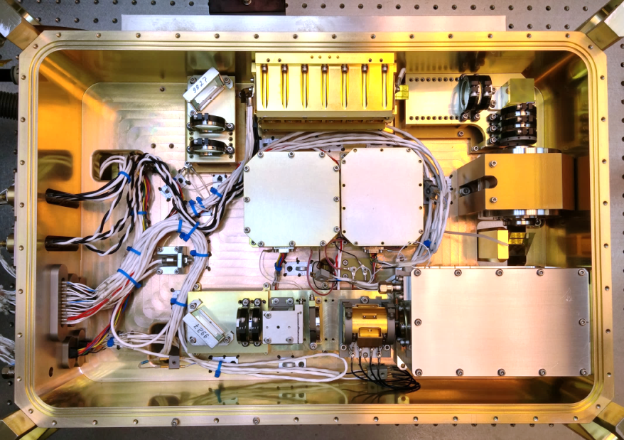
Laser Optics Module is Built and Tested Though the SHG
Seed
Pwr Amp
Pre-Amps
Resonator
SHG
Clean UV box
Resonator &
Pre-Amp Side
Power Amp &
SHG/THG Side

Slide 6
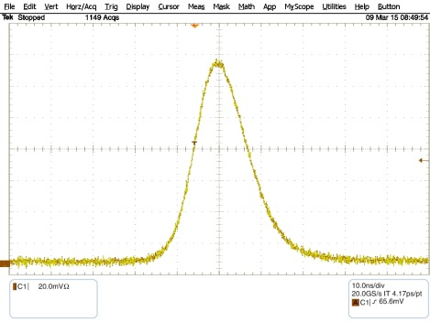
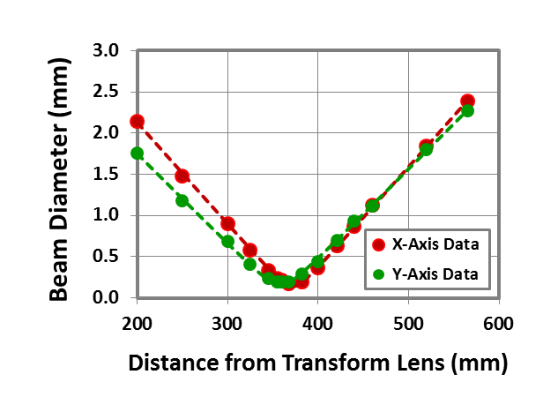
Oscillator Performance
Parameter | Objective | Demonstrated
Pulse Rate | 150 Hz | 150 Hz
Pulse Energy | 25 mJ | 34 mJ
Pulse Width | 10 – 20 ns | 14 ns
Beam Quality | ≤ 1.5 M² | 1.4 M²
Spectral Linewidth | ≤ 100 MHz | 70 MHz
Wavelength | 1064 (nom) | 1064.677 (vac)
Temporal Distribution
Spatial Distributions
Propagation Parameters
2.59 x 2.87 mm
1.1 x 0.8 mr
Astigmatism Uncorrected
14 ns
FWHM
M²_{X} = 1.33
M²_{Y} = 1.42
10 ns/div
Near Field
Far Field
All oscillator performance parameters meet or exceed the design goals

Slide 7
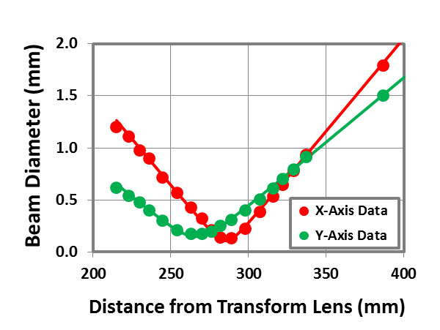
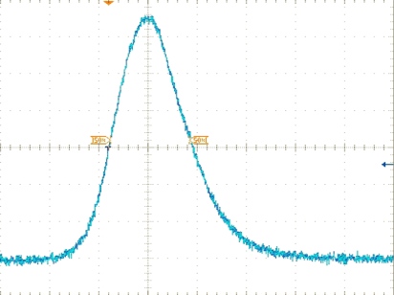
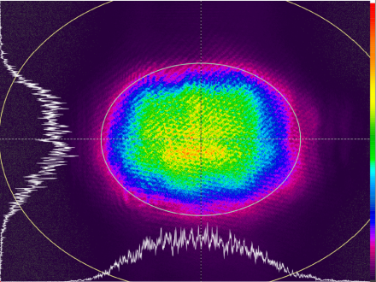
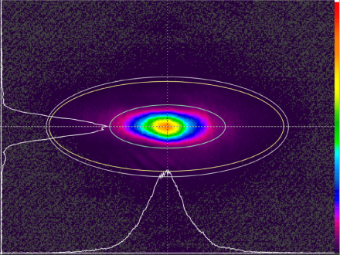
Pre-Amplifier Performance
Parameter | Objective | Demonstrated
Pulse Rate | 150 Hz | 150 Hz
Pulse Energy | ≥ 160 mJ | 205 mJ
Pulse Width | 10 – 20 ns | 15 ns
NF Beam Size | 3.3 x 3.1 mm² | 3.7 x 2.8 mm²
Beam Quality | ≤ 1.5 M² | 1.4 M²
Temporal Distribution
Spatial Distributions
prior to telescope
Propagation Parameters
15 ns
FWHM
3.69 x 2.78 mm
2.4 x 0.9 mr
Astigmatism Uncorrected
M²_{X} = 1.45
M²_{Y} = 1.37
10 ns/div
Near Field
Far Field
All pre-amplifier performance parameters meet or exceed the design goals

Slide 8
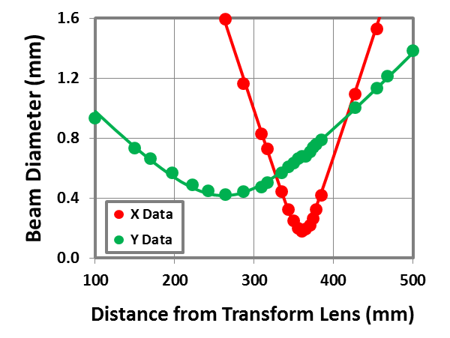
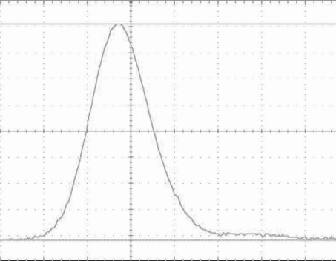
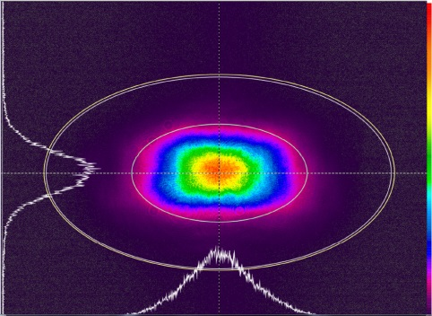
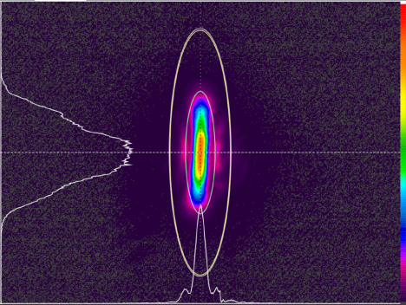
Power Amplifier Performance
Parameter | Objective | Demonstrated
Pulse Rate | 150 Hz | 150 Hz
Pulse Energy | ≥ 250 mJ | 275 mJ ⇨ 245 mJ
Pulse Width | 10 – 20 ns | 15 ns
Beam Quality | ≤ 2.0 M² | 1.9 M²
Spatial Distributions
M²_{X} = 2.0
M²_{Y} = 1.7
5.29 x 2.96 mm
0.50 x 2.05 ur
Astigmatism Uncorrected
15 ns
FWHM
M^2 multiple data points v8-DJ.xmcd
10 ns/div
Near Field
Far Field
Propagation Parameters
Temporal Distribution
All power amplifier performance parameters meet or exceed the design goals

Slide 9
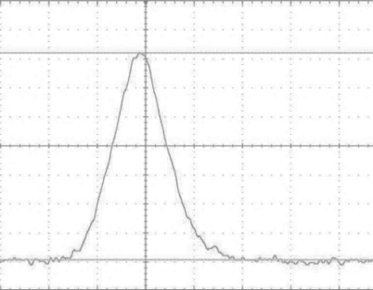
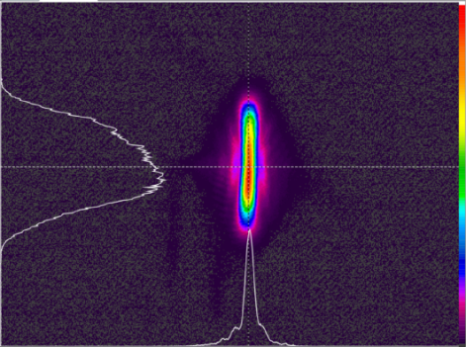
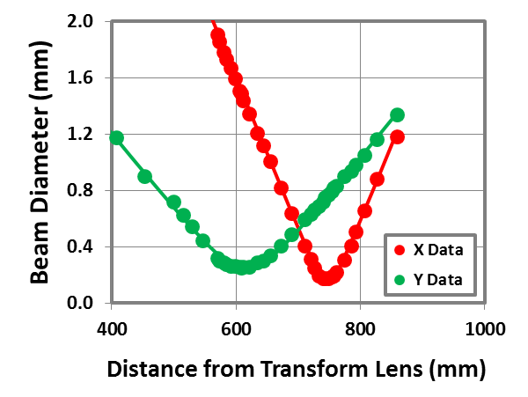
Second Harmonic Generation
Parameter | Objective | Demonstrated
Pulse Rate | 150 Hz | 150 Hz
Pulse Energy | ≥ 135 mJ | 165 mJ
Conversion Efficiency | ≥ 55 % | 70 %
Pulse Width | 10 – 20 ns | 13 ns
Beam Quality | ≤ 3 M² | 2.2 M²
Temporal Distribution
Spatial Distributions
Propagation Parameters
8.48 x 4.33 mm
0.23 x 1.02 mr
Astigmatism Uncorrected
M²_{X} = 3.5
M²_{Y} = 2.3
M²_{X} = 2.4
M²_{Y} = 2.0
13 ns
FWHM
10 ns/div
Near Field
Far Field
All SHG performance parameters meet or exceed the design goals

Slide 10
532 nm Life Test
532 nm Life Test Monitoring
Test Parameter | Measurement Frequency | Comment
532 nm Output Power | Daily | Single daily record
532 nm Output Pulsewidth | Daily | Single daily record
Residual 1064 nm Output Power | Daily | Single daily record
Residual 1064 nm Pulsewidth | Daily | Single daily record
532 nm Near Field Profile | Weekly | 8 shot capture
532 nm Far Field Profile | Beginning & End of Life Test | 8 shot capture
532 nm Beam Quality | Beginning & End of Life Test | M² scan
532 nm Linewidth | Beginning & End of Life Test | Scanning Fabry-Perot
532 nm Wavelength | Beginning & End of Life Test | Wavemeter

Slide 11
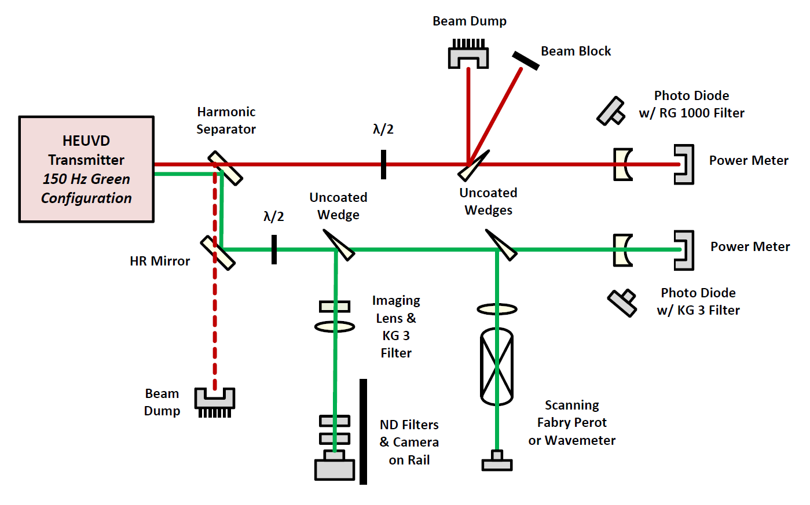
532 nm Life Test
532 nm Life Test Measurement Layout

Slide 12
20 kHz UV Life Test Objectives
Perform pre-screening of the UV approach & key component designs prior to high energy life tests:
  Third harmonic mixing crystal & UV Box assembly
Uncover potential failure mechanisms in a timely manner to allow schedule for corrective actions to be implemented
  20 kHz PRF over 1 month test duration = 50 x10⁹ shots
Operate at the high intensities needed for efficient conversion to further accelerate the damage processes
  100 MW/cm² input intensity to generate ≥ 50 % conversion to the UV
Test layout
Drive Laser
1064 & 532 nm @ 20 kHz
UV
Box
Diagnostics

Slide 13
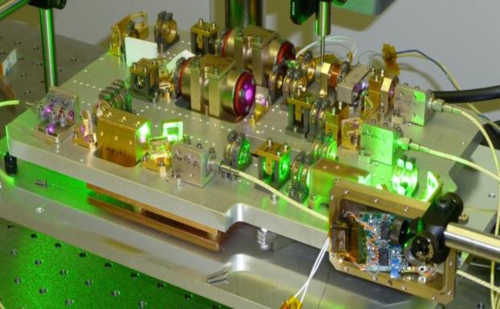
20 kHz Drive Laser
ICESat-2 Life Test Laser #1
YVO₄ based MOPA + SHG with > 1.5 x10¹² shots

Slide 14
20 kHz Life Test Configuration
Pre-Amp
Osc
Pwr Amp
SHG
HR Mirror
ICESat-2 Life Test Breadboard
UV
Box
Harmonic
Beam Splitter
Harmonic
Beam Splitter
Camera
w/ UG-11 Filter
Imaging
Lens
N.D.
Filters
Photo
Diode
Waveplate &
Sampling
Wedge
Image Plane
of THG
Exit Facet
f.l. = 275 mm
Negative
Lenses
Optical
Power Sensors

Slide 15
20 kHz UV Life Test Summary
A UV conversion module designed to isolate optical components from
damaging trace contaminates has been designed, fabricated and assembled IAW existing in-house processes.
The assembly was subjected to a 50 x10⁹ shot, high intensity life test at 355 nm
  6 W of third harmonic UV at was generated at 20 kHz with 50% conversion from the IR using drive intensities of 150 MW/cm²
  This resulted in a life test average UV beam intensity of 3 kW/cm²
    HEUVD 355 nm beam intensity will be < 100W/cm²
Post test inspections confirmed the utility of the approach as a means of extending the life of UV components in high fluence legs of an optical train
  All components interior to the conversion module, including the third harmonic generating crystal, survived the test in excellent condition
    Only noticeable exception being the interior of the output window suffered 3 small
    (≤ 20 μm diameter) and tightly clustered scattering sights in the region of the beam wings
  In direct comparison, the exterior components including the exterior surface of the output window and many of the diagnostics suffer significant surface damage

Slide 16
Key HEUVD Milestones
High rep rate UV screening successfully completed
HEUVD laser assembled through 532 nm generation
  Begin 532 nm lifetest November 2015
  Complete 532 nm lifetest February 2016
HEUVD laser assembled through 355 nm March 2016
  Begin low power 355 nm lifetest March 2016
  Complete low power 355 nm lifetest and begin high power UV lifetest July 2016
  Complete high power UV lifetest November 2016
Environmental testing (vibe and TVAC) November through December 2016

Slide 17
Status of Laser Refurb and New Build for Athena Venture Tech

Slide 18
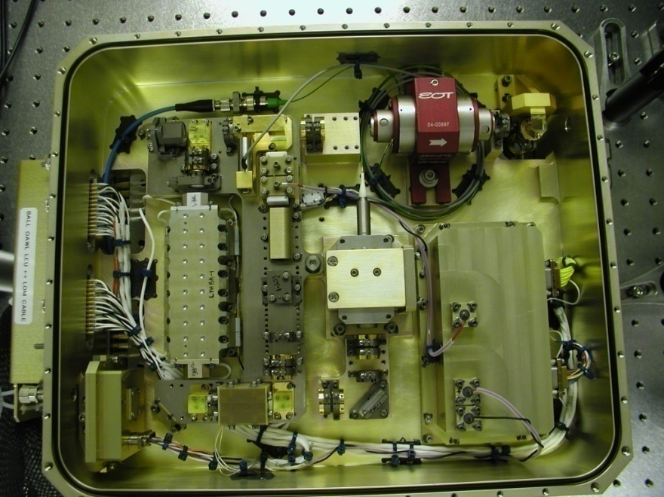
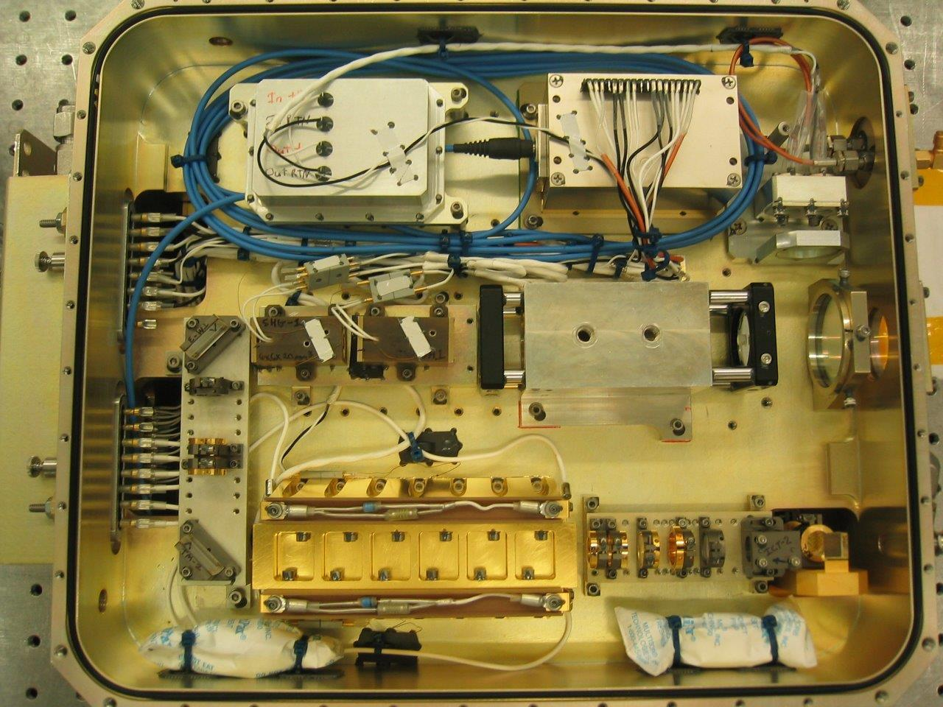
Program Goals for Refurbished Laser
Turn down oscillator for longer pulsewidth and narrower linewidth
Set up nonlinear converters to achieve ≥10 mJ of 532 nm output
Update control electronics to allow interleaving with a second laser
SHG
THG
Output telescope
Ring oscillator
Amplifier
Oscillator compartment
Amplifier & nonlinear converter compartment

Slide 19
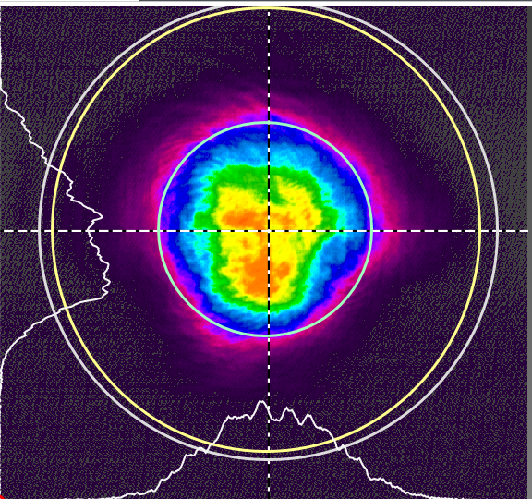
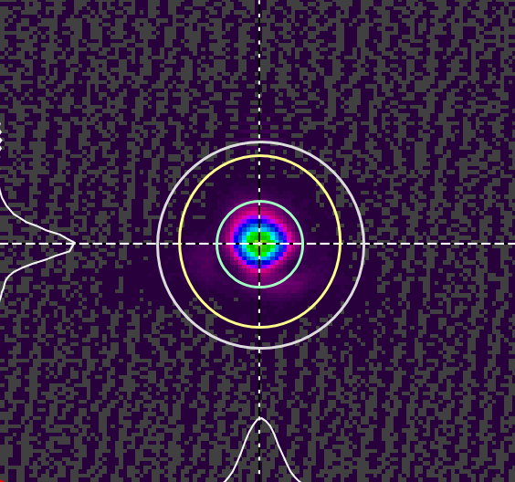
Refurbished Laser Status
1064 nm Performance
Increased oscillator pulsewidth by decreasing the diode pump pulsewidth
  1064 nm pulsewidth ranged from 30 ns to 39 ns
  1064 nm pulse energies ranged from 30 mJ to 50 mJ
Optimized 1064 operating parameters to maintain desired near field and far field characteristics
  Near field diameter 2.5-3.5 mm
  Far field astigmatism < 1.3
Beam profiles for 11 W @ 1064 nm
Near field
  X diameter – 2.80 mm
  Y diameter – 2.90 mm
Far field
  X diameter – 0.259 mm
  Y diameter – 0.274 mm

Slide 20
Refurbished Laser Status
30 MHz @ 532 nm
Characterized 532 nm and 355 nm performance for 45 mJ 1064 nm pump energy
Parameter | Objective | Demonstrated
532 nm pulse width | Not specified | 20.8 ns
532 nm pulse energy | > 10 mJ | 13 mJ
532 nm linewidth (average of 9 Fabry-Perot scans) | < 30 MHz | 30 MHz
532 nm divergence | < 100 µrad | X – 107 µrad, Y – 112 µrad
355 nm pulse width | Not specified | 20.6 ns
355 nm pulse energy | Not specified | 10 mJ
355 nm linewidth (average of 10 Fabry-Perot scans) | < 30 MHz | 34.2 MHz
355 nm divergence | < 100 µrad | TBD
532 nm Fabry-Perot scan
Gaussian fit of 532 nm Fabry-Perot scan

Slide 21
Refurbished Laser Status
24 MHz @ 532 nm
Characterized 532 nm and 355 nm performance for 30 mJ 1064 nm pump energy
Parameter | Objective | Demonstrated
532 nm pulse width | Not specified | 22.6 ns
532 nm pulse energy | > 10 mJ | 10.5 mJ
532 nm linewidth (average of 10 Fabry-Perot scans) | < 30 MHz | 24 MHz
532 nm divergence | < 100 µrad | X – 97 µrad, Y – 106 µrad
355 nm pulse width | Not specified | Not measured
355 nm pulse energy | Not specified | < 1 mJ
355 nm linewidth | < 30 MHz | Not measured
355 nm divergence | < 100 µrad | Not measured
532 nm Fabry-Perot scan
Gaussian fit of 532 nm Fabry-Perot scan

Slide 22
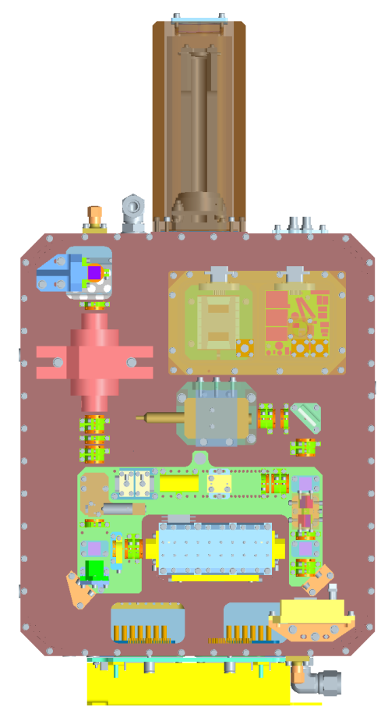
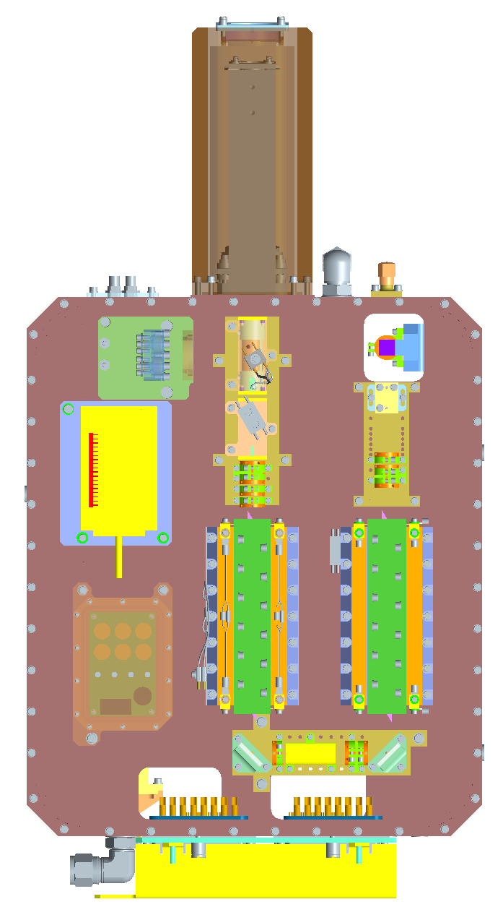
Program Goals for New Laser
Oscillator and first amplifier same as the original laser
  Same timing parameters as the refurbished laser to achieve narrower linewidths
Add second amplifier to meet the original OAWL laser pulse energy and linewidth specifications
  30 mJ @ 355 nm, linewidth < 30 MHz
  20 mJ @ 532 nm, linewidth < 30 MHz
New external beam expander will be provided by BATC
Fibertek will design, build, and install a sealed housing for the new beam expander
Beam expander
Beam expander
THG
SHG
Amp 2
Amp 1
Ring oscillator
Oscillator compartment unchanged from previous design
Amplifier compartment has an added second amplifier

Slide 23
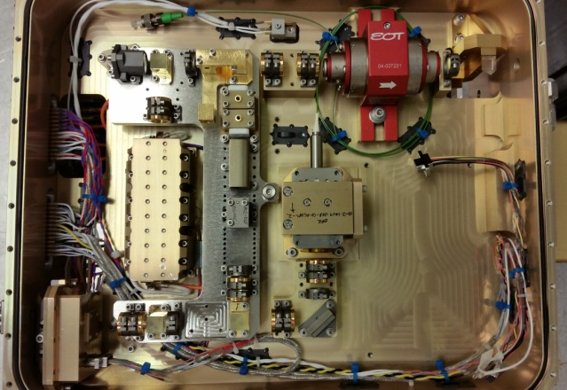
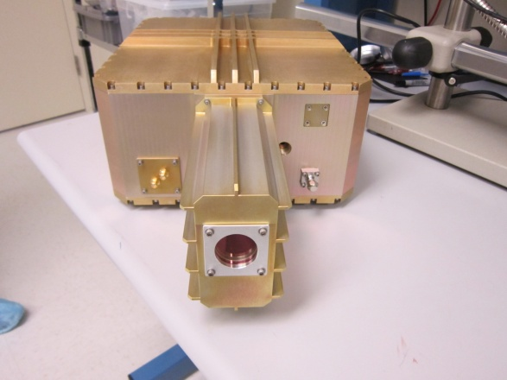
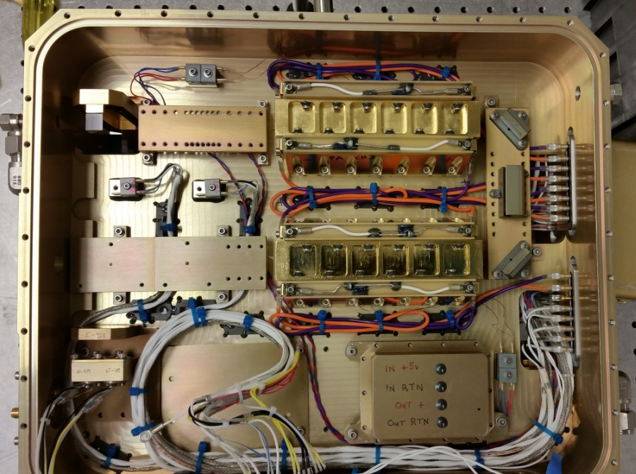
New Laser Design & Build Status
All opto-mechanical analyses and design updates are complete
The layout of an updated control board is complete
All opto-mechanical subassemblies are complete
All the printed circuit boards except the control board have been built tested
Integration of the electronics module has begun
Updates to the software to allow interleaved operation of the two lasers is complete
Integration of the laser optics modules is well underway
Ring oscillator
Oscillator compartment
External view of housing
Output telescope
Amp 1
THG
SHG
Amp 2
Amplifier compartment

