Slide 1
Upendra N. Singh, Mulugeta Petros, Jirong Yu, and Michael J. Kavaya
NASA Langley Research Center, Hampton, Virginia 23681 USA
Timothy Shuman and Floyd Hovis
Fibertek, Inc, Herndon, Virginia, USA
(757).864.1570
Upendra.N.Singh@nasa.gov
Development of a Space-qualifiable, Conductively-cooled 2-micron Coherent Lidar Transmitter for Global Wind Measurements
Acknowledgements: The authors appreciate the support of George J. Komar, NASA Earth Science Technology Office and Ramesh K. Kakar Science Mission Directorate at NASA HQ
Working Group on Space-based Lidar Winds
Miami, Florida
November 3-4, 2015,

Slide 2
Outline
  Technology Development
    Ground and Airborne CDWL development
  Ground and Airborne campaigns
  Fully Conductively-cooled Risk Reduction Laser
  Conclusions

Slide 3
Laser Technology Development
for Coherent Doppler Lidar

Slide 4
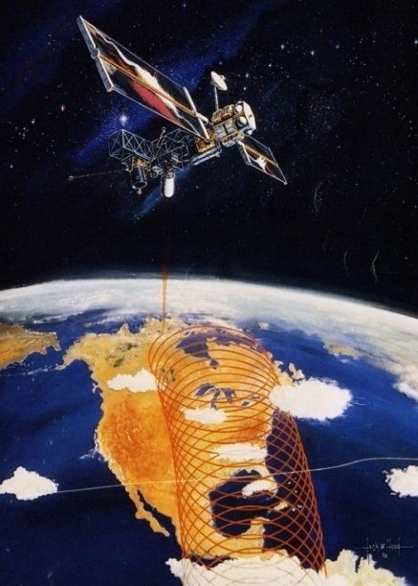
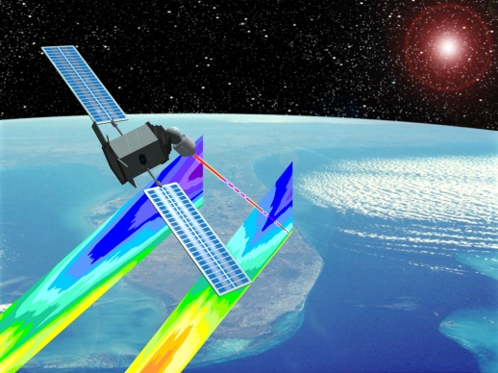
Two Decades of Mission Improvements, Science Refinement & Technology Development
Past
525 km
12 cross-track positions
1 shot measurement
Continuously rotating 1.5-m telescope
Single coherent Doppler lidar
Gas laser*
20 mJ 2-µm solid state energy demonstrated*
Space required energy = 20 J at 10 Hz = 200 W*
Energy deficit = 1,000*
2-µm lidar not aircraft validated*
Today
400 km
2 cross-track positions
Multiple shot accumulation
4 stationary 0.5-m telescopes
Dual coherent & direct “hybrid” Doppler lidar
Solid-state eyesafe laser*
1200 mJ 2-µm solid state energy demonstrated*
Space required energy = 0.25 J at 5 Hz = 1.25 W*
Energy surplus = 5*
2-µm lidar is aircraft validated*
*2-micron coherent lidar

Slide 5
Laser Technology Development
for Coherent Doppler Lidar
Adapted as mission design and coherent lidar requirements changed
Conducted in parallel with direct detection Doppler lidar development
Part of NASA’s Laser Risk Reduction Program (FY02 – FY10)
Comprised technology development, ground and airborne technology validation, and scientific use of technology
Series of several individual projects have maintained progress
Validation and scientific use of liquid-cooled laser in parallel with laser advancement to conductive-cooled

Slide 6
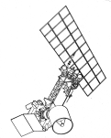

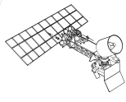
Laser Risk Reduction Program (LaRC-GSFC)
(NASA HQ Funded Directed Program 2001-2010)
2 Lasers, 4 Techniques, 6 Priority Measurements
Pulsed
Laser Development
2.05 micron
DIAL: CO₂
Doppler Lidar: Coherent Ocean/River
Surface Currents
Backscatter Lidar: Aerosols/Clouds
2 MICRON
2.05 micron
Atmosphere:
Lower Upper
Key Technologies in Common
Laser Diodes
Laser Induced Damage
Frequency Control
Electrical Efficiency
Heat Removal
Ruggedness
Lifetime
Contamination Tolerance
Doppler Lidar: Wind
Coherent
Winds
Coherent
Direct
Noncoherent
Winds
X3
0.355 micron
1 MICRON
X2
Altimetry:
1.06 micron
Surface Mapping, Oceanography
DIAL: Ozone
X2
0.532 micron
0.30-0.32 micron
Backscatter Lidar:
Aerosols/Clouds
OPO

Slide 7
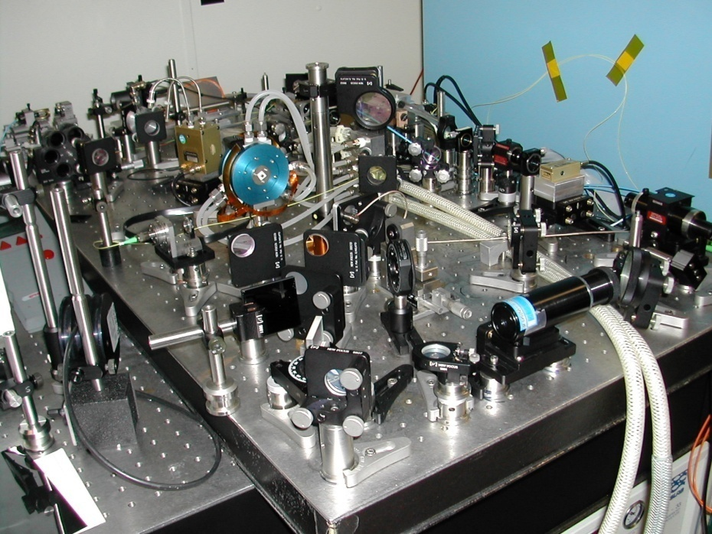
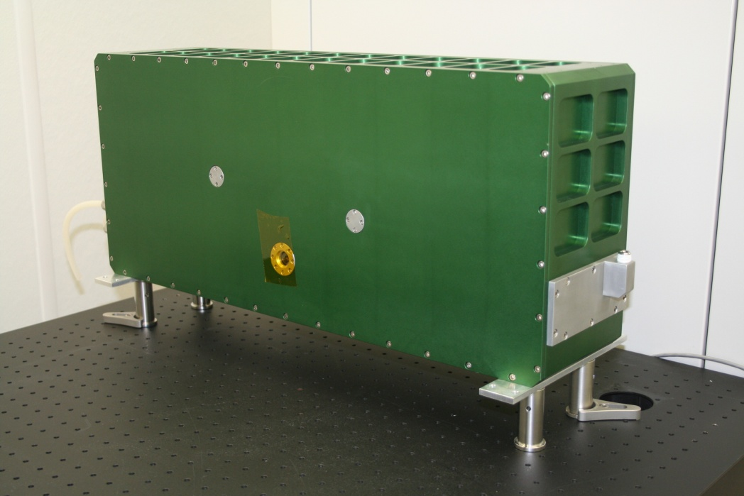
Mobile Ground-Based High Energy Wind Lidar Transceiver – LRRP/DAWN Funded
Table Top Transceiver (Transmitter + Receiver)
90 mJ/pulse, 5 pulses/sec.
3’x4’ Optical Table
(no telescope or scanner)
Engineered Transceiver
250 mJ/pulse, 10 pulses/sec.
5.9” x 11.6” x 26.5”, 75 lbs.;
15 x 29 x 67 cm, 34 kg
(no telescope or scanner)

Slide 8
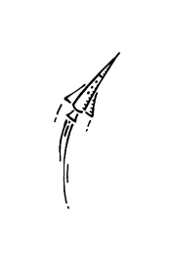


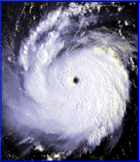

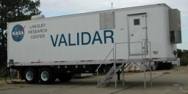
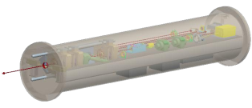
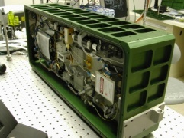
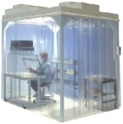
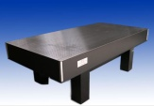
  Technology Development, Validation, and Scientific Use
Tech
Technology
Science Science
NRC Decadal Survey
3-D Winds Space Mission
Polar Winds: Greenland & Iceland
Venture Class Science Flights
7 years
SMD-ESD
ACT
DAWN UC-12B
12 15
GRIP Hurricane Campaign
SMD-ESD
15
SMD-ESD
5 years
SMD-ESD
LaRC
13
DAWN-AIR2
SMD-ESD
10
12
DAWN-AIR1
09
ESTO
11
08
SMD-ESD
10
Ground Intercomparison
IPP
08
SMD-ESD
09
DAWN
08
SMD-ESD
10
LRRP
06
ESTO
08
ATIP
02
ESTO
09
98
ESTO
01
Technology

Slide 9
  Parallel Advancement of Conductive Cooled with Use of Liquid Cooled

Slide 10
  Basic Space Performance Goals for 2-µm Doppler Lidar
Wavelength | 2.053 -µm
Laser Pulse Energy | 250 mJ
Repetition Rate | 10 Hz
Pulse Width | >150 ns
Beam Quality | M² < 1.2
Pulse Spectrum | Single frequency (seeded)
Cooling | Conductively cooled via heat pipes
Laser Size | 23.9” x 14” x 7.7” (L x W x H) Including heat pipes and condenser

Slide 11
Ground and Airborne Campaigns

Slide 12
Ground and Airborne Campaigns
Date | Platform | Location | Objective | Publications
2004-2005 | VALIDAR Trailer | Hampton, VA | Technology Validation | G. J. Koch, J. Y. Beyon, B. W. Barnes, M. Petros, J. Yu, F. Amzajerdian, M. J. Kavaya, and U. N. Singh, “High-Energy 2-micron Doppler Lidar for Wind Measurements,” Opt. Engr. 46(11), 116201-1 to 116201-14 (2007)
Mar 2009 | VALIDAR Trailer | Howard University, Beltsville, MD | Wind Intercomparisons between sensors | Grady J. Koch, Jeffrey Y. Beyon,, Paul J. Petzar, Mulugeta Petros, Jirong Yu, Bo C. Trieu, Michael J. Kavaya, Upendra N. Singh,, Edward A. Modlin, Bruce W. Barnes, and Belay B. Demoz , “Field Testing of a High-Energy 2-Micron Doppler Lidar,” Journal of Applied Remote Sensing, Vol. 4, 043512 (2010) B. Demoz, B. Gentry, T. Bacha, K. Vermeesch, H. Chen, D. Venable, E. Joseph G. Koch, U. Singh, M Boquet, L. Sauvage, “Multi-instrument Wind Comparisons at Howard University Beltsville campus: An update,” Working Group on Space-Based Lidar Winds, Bar Harbor, ME (24-26 Aug 2010)
Aug-Sep 2010 | DC-8 | Based Fort Lauderdale, FL | NASA GRIP campaign | M. J. Kavaya, J. Y. Beyon, G. J. Koch, M. Petros, P. J. Petzar, U. N. Singh, B. C. Trieu, and J. Yu, “The Doppler Aerosol Wind Lidar (DAWN) Airborne, Wind-Profiling, Coherent-Detection Lidar System: Overview, Flight Results, and Plans,” Journal of Atmospheric and Oceanic Technology (JTECH) 34 (4), 826-842 (April 2014)
Oct 2011 | VALIDAR Trailer | Fort Story, Virginia Beach, VA | Offshore wind turbine energy research | G. Koch, J. Beyon, E. Modlin, P. Petzar, S. Woll, M. Petros, J. Yu, and M. Kavaya, “Side-scan Doppler lidar for offshore wind energy applications,” J. Appl. Remote Sens. 6(1), 063562 (2012)
Nov 2012 & July 2013 | UC-12B | Ocean off Virginia Beach, VA and Ocean City, MD | Offshore wind turbine energy research & technology validation | Grady J. Koch, Jeffrey Y. Beyon, Larry J. Cowen, Michael J. Kavaya, and Michael S. Grant, “Three-dimensional wind profiling of offshore wind energy areas with airborne Doppler lidar,” Journal of Applied Remote Sensing 8 (1), 083662 (2014)
Oct-Nov 2014 | UC-12B | Kangerlussuaq, Greenland | ADM cal/val investigations & arctic warming science | G. D. Emmitt, M. Kavaya, G. Koch, S. Greco, R. Kakar, and U. Singh, “USA Airborne Participation in ADM Cal/Val and Lessons Learned from Satellite Validation Campaigns,” ADM Cal/Val Workshop, Frascati, Italy (10-13 February 2015)
May 2015 | DC-8 | Keflavik, Iceland | ADM cal/val investigations with DLR Dassault Falcon 20E & arctic warming science | G. D. Emmitt, S. Greco, and K. Godwin, “PolarWinds Campaign I results and plans for Campaign II,” Working Group on Space-Based Lidar Winds, Boulder, CO (2015)

Slide 13
Comparison of DAWN Coherent Lidar and Sonde
Howard University, Beltsville, MD, March 2009
Root-mean-square of difference between two sensors for all points shown is 1.06 m/s for wind speed and 5.78 deg. for wind direction

Slide 14
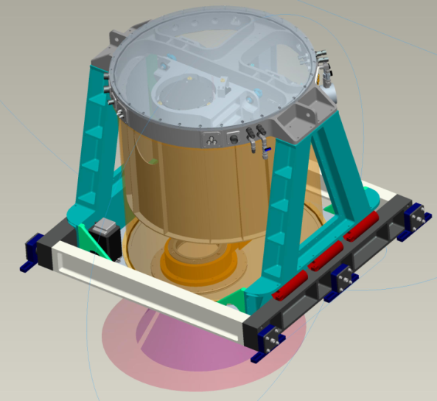
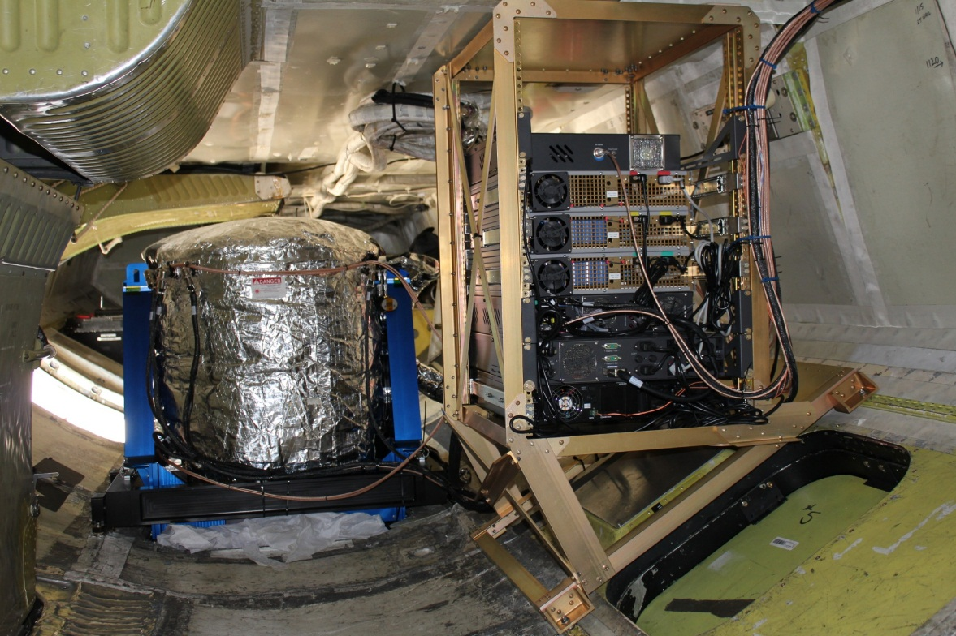
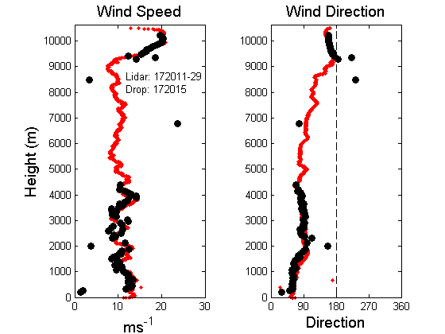
DC-8 Wind Lidar During GRIP (2010)
Harden the transmitter for airborne application
Add telescope and scanner within the enclosure
Airborne wind measurement during GRIP campaign

Slide 15
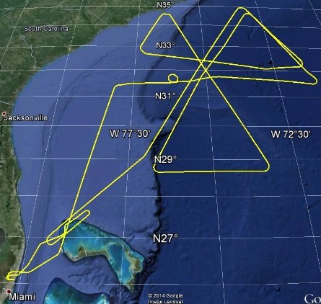
GRIP – 2 Sept 2010 – Hurricane Earl
APR-2 Radar
LASE Aerosols
DAWN SNR
DAWN Wind Speed
DAWN Wind Direction
~400 minutes data
5 eye “crossings”
DC-8 Track

Slide 16
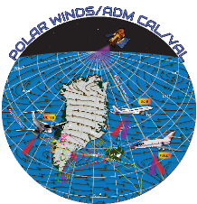
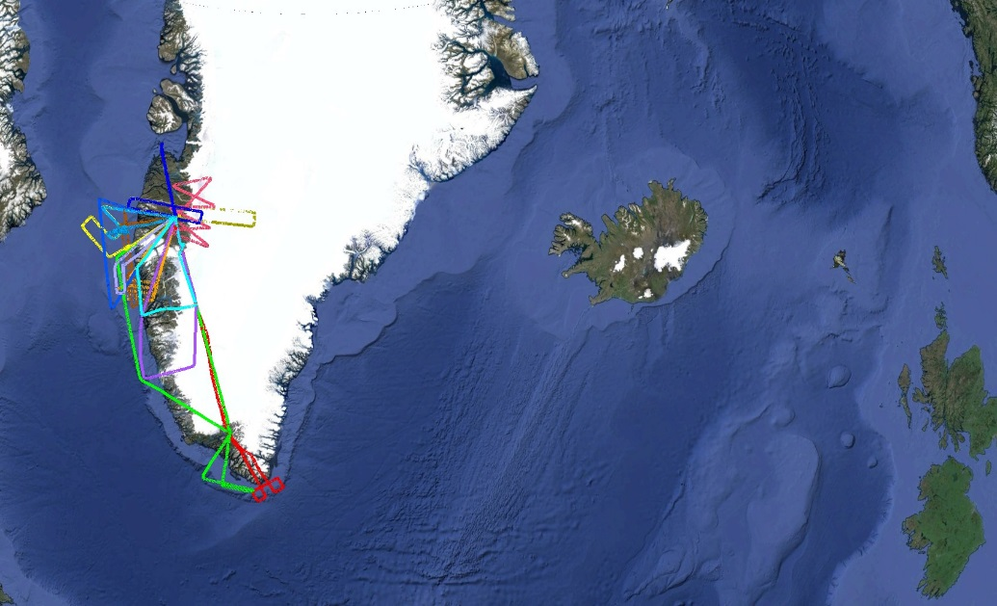
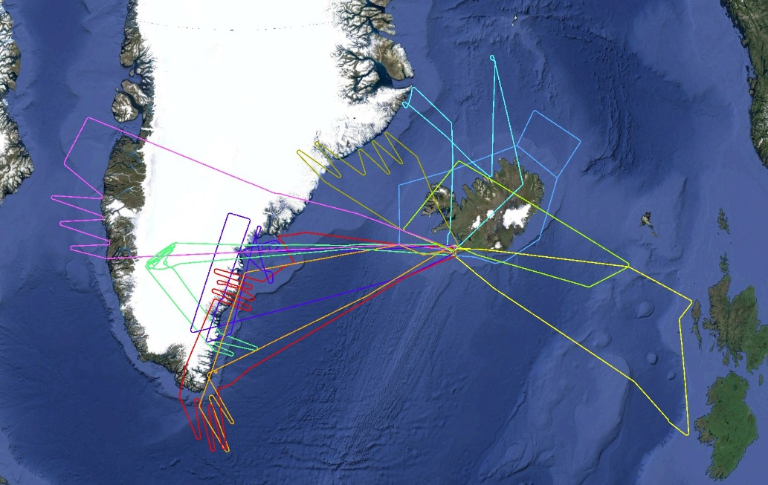
Polar Winds Airborne Campaign
Polar Winds Greenland
10/29 – 11/13/14
13 flight days, 46 science flight hours
DAWN on UC-12B
DAWN: 10 Hz, 220 mJ, with laser amplifier
DAWN: 4,540 vertical profiles of horizontal wind
~$4.5M for 4,540 COTS dropsondes
DAWN: near 100% availability, low signal levels
DAWN: amplifier damage found post-mission
Polar Winds Iceland
5/11 – 5/29/15
10 flight days, 53 science flight hours
6 joint flights with ESA-DLR Falcon
DAWN, TWiLiTE, Dropsondes on DC-8
DAWN: 5 Hz, 100 mJ, without laser amplifier
DAWN: 4,604 vertical profiles of horizontal wind
~$4.6M for 4,604 COTS dropsondes
DAWN: near 100% availability, low signal levels

Slide 17
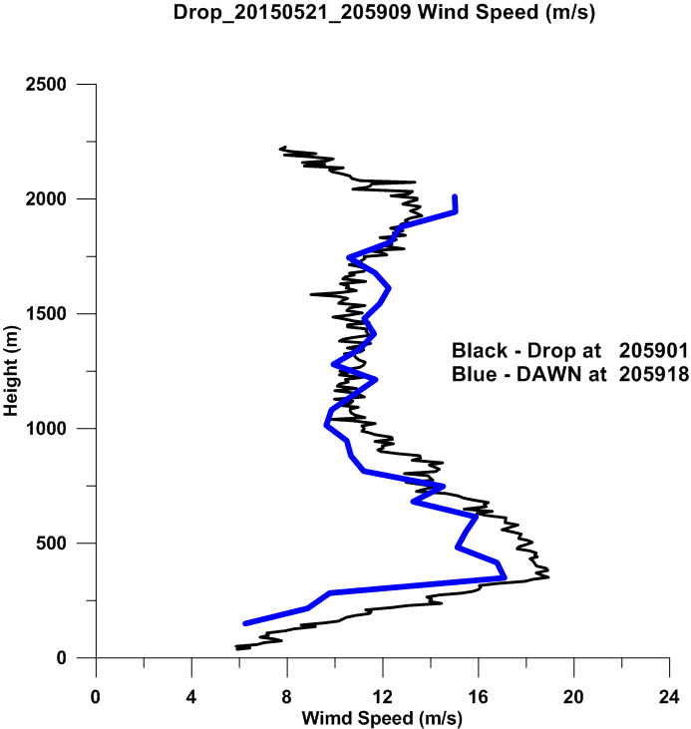
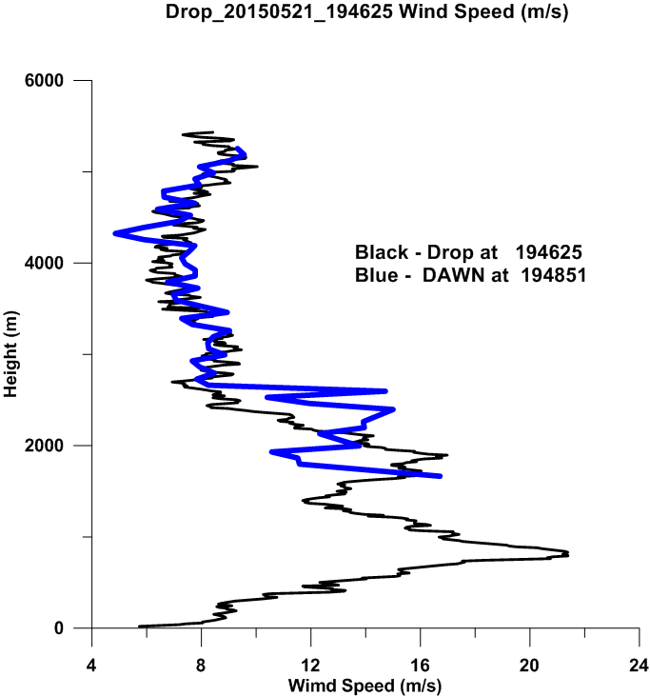
Polar Winds Airborne Campaign
Science PI: Dr. G. David Emmitt
DAWN Profiles vs. Dropsondes
05_21_15 Sounding off the East coast of Greenland
05_21_15 Sounding off the east coast of Greenland

Slide 18
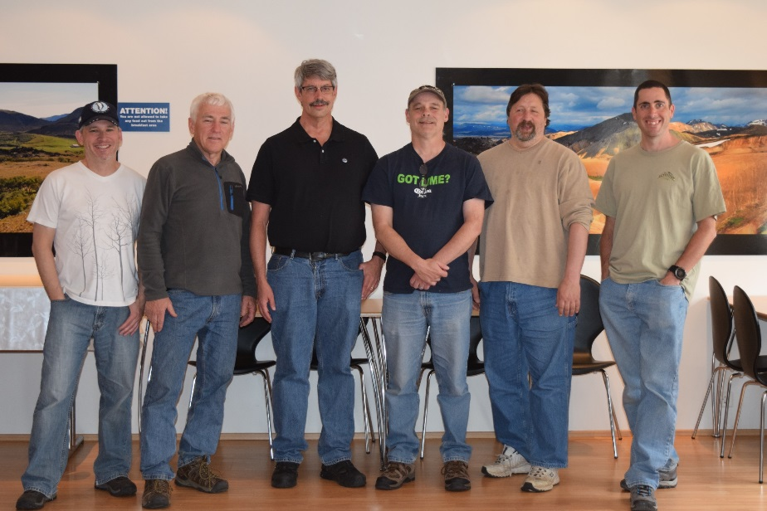

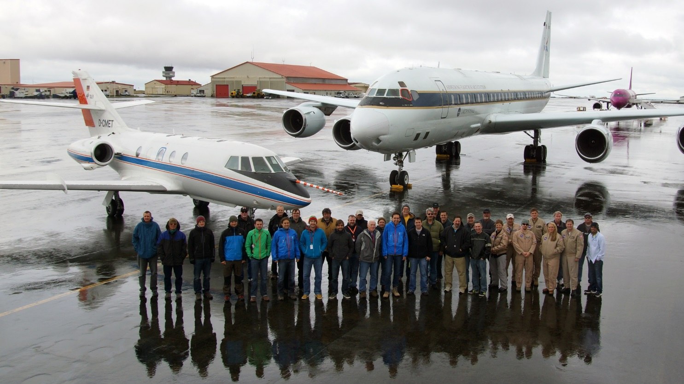
Polar Winds Airborne Campaign

Slide 19
DAWN Status
DAWN airborne coherent lidar system’s 2-micron laser has pulse energy and rate, beam quality and spectrum, and electrical efficiency equal to that required for the space hybrid lidar wind mission
For a space winds mission:
  Laser must be fully conductively cooled; this has been separately demonstrated at LaRC
  Laser must be space qualified
  Laser lifetime must be demonstrated
  Optical diameter must be increased from 0.15 m to 0.5 m (likely two fixed telescopes)
DAWN has participated in five airborne campaigns from 2010 to 2015:
  Availability has been almost 100%
  Wind vectors agree with other sensors
  Signal levels have been consistently lower than expected
Contractor Beyond Photonics/Dr. Sammy Henderson:
  Invented small beam lidar system efficiency diagnostic while at Coherent Technologies, Inc.
  Visited Langley and found DAWN transmit/BPLO beam matching was sub-optimum
  Has been funded to repair beam matching and restore expected signal levels
  After Iceland, DAWN laser cavity found to have 3 damaged optics
  Langley to replace optics, then ship DAWN to Beyond Photonics for repair
Planning to fly DAWN on UC-12B based at Langley in summer 2016 to work on ADM cal/val issues

Slide 20
Fully Conductively-Cooled Risk Reduction Laser

Slide 21
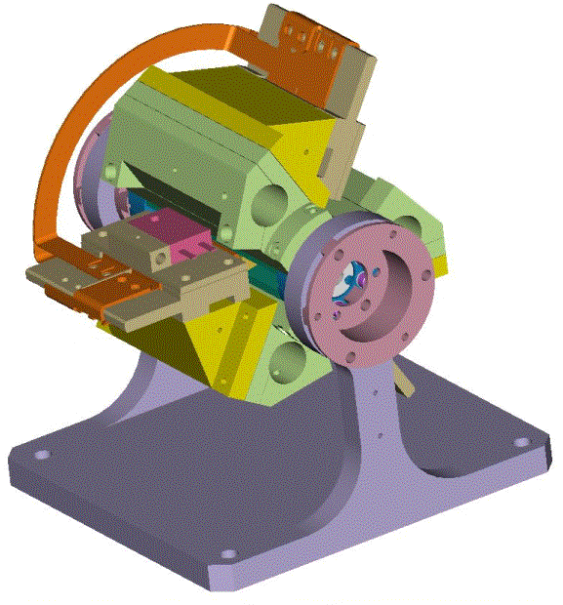
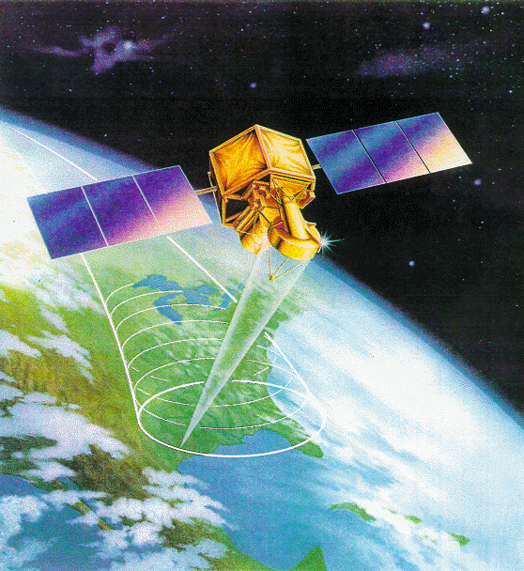
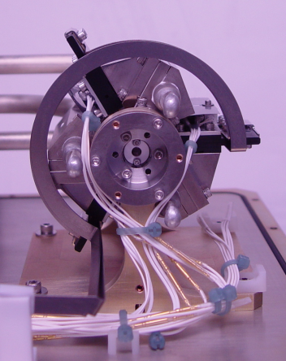
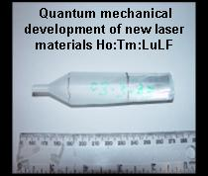
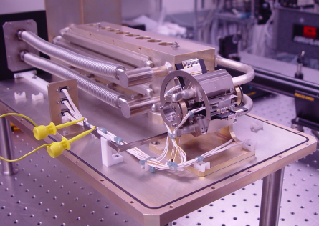
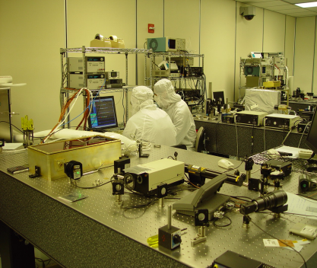
Laser Technology Maturation
A fully conductively cooled 2-micron solid-state pulsed laser has been demonstrated for the first time.
Technology Enables: Measurement of global 3-D Winds
Analysis & Design
Space Qualifiable Design
Fabrication
Quantum Mechanical
Modeling
System Integration
Testing and Model Verification

Slide 22
LaRC Partnership with Fibertek for Space Qualifiable 2-micron Laser Development for NASA 3-D Wind Mission
Laser Risk Reduction Program (ESTO) - 2001-’10
  LaRC has demonstrated fully conductively cooled oscillator/amplifier to 400 mJ, 5 Hz (08/07)
Partnership with Fibertek:
Innovative Partnership Program (LRRP/ESD/Fibertek)
  3-m cavity, 792 nm pumped, conductively cooled 200 mJ, single frequency output at 5 Hz – first generation
  Advanced Component Technology (LaRC/ESTO/Fibertek)
  Compact, 1.5 meter cavity, 808 nm pumped, fully conductively cooled laser transmitter delivering wind quality 250 mJ 10 Hz output for 3-D Wind mission

Slide 23
Innovative Partnership Program (LRRP/ESD/Fibertek)
2007-2010
(PI: Singh, Co-I: Yu, Kavaya LaRC; Co-I: Hovis, Fibertek)
Single frequency 2-micron Laser (200 mJ/5Hz) built and delivered by Fibertek to NASA LaRC
2-micron Risk Reduction Laser Transmitter

Slide 24
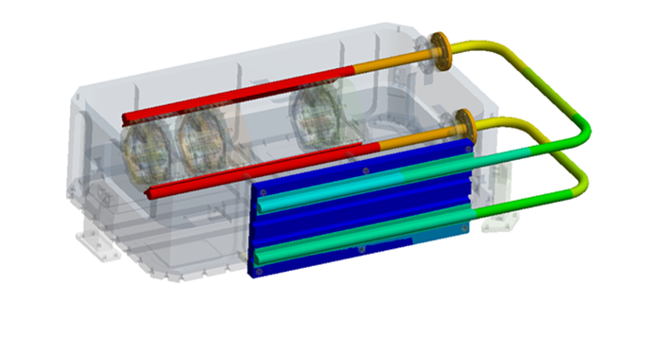
Design and Fabrication of a Breadboard, Fully Conductively Cooled,
2-Micron, Pulsed Laser for the 3-D Winds Decadal Survey Mission
PI: Upendra Singh, NASA LaRC
Design and fabricate a space-qualifiable, fully conductively-cooled, 2-micron pulsed laser breadboard meeting the projected 3-D Winds mission requirements
  Utilize improvements in key technologies including high-power, long-life space-proven 804 nm pump diodes; derated diode operation, and heat pipe conductive cooling
Perform a long-duration life test on the laser system to evaluate mission readiness.
2-Micron Space Qualifiable Pulsed Laser for 3-D Winds
  Leverage LaRC 2-micron laser development from earlier efforts
  Utilize Fibertek CALIPSO mission flight laser design and development knowledge
  Upgrade previous Fibertek two-micron laser design for flight-like laser based on space heritage
  Utilize space-ready, sealed cylindrical package
  Perform vacuum test while operating at the output requirements of the 3-D Winds mission
Complete laser mechanical design update 01/13
and improved laser thermal modeling
Assemble and test heat pipe cooled module 04/13
Fabricate and test ring laser with heat pipe 12/13
cooled module
Install and test amplifiers 03/14
Integrate with canister and test 04/14
Vacuum-test laser 10/14
Complete acceptance testing 07/15
Complete analysis and performance testing 12/15
Co-Is/Partners: Jirong Yu, Michael Kavaya, LaRC; Floyd Hovis, Tim Shuman, Fibertek, Inc.
TRL_{in} = 3 TRL_{out} = 5
04/12

Slide 25
ACT Program Summary
Technical Objective(s)–
  Deliver a ruggedized 2.053 µm MOPA laser with the following parameters:
    250 mJ pulse energy
    10 Hz repetition rate
    Beam quality (M² ) < 1.2
    >100 ns pulse width
    Conductively cooled via heat pipes
  Reach Technical Readiness Level (TRL) 5 by surviving a thermal-vac test.
Period of Performance – 38 months
Deliverable Items - 2 µm laser meeting the performance requirements after surviving a thermal vac test, monthly technical and financial reports, quarterly and yearly financial reports, thermal vac test definition and results report, oscillator test procedure and results report, final technical report
  2 µm laser transmitter meeting the performance requirements and surviving a thermal-vac test
  Thermal vac test procedure and results report
  Oscillator and amplifier performance report

Slide 26
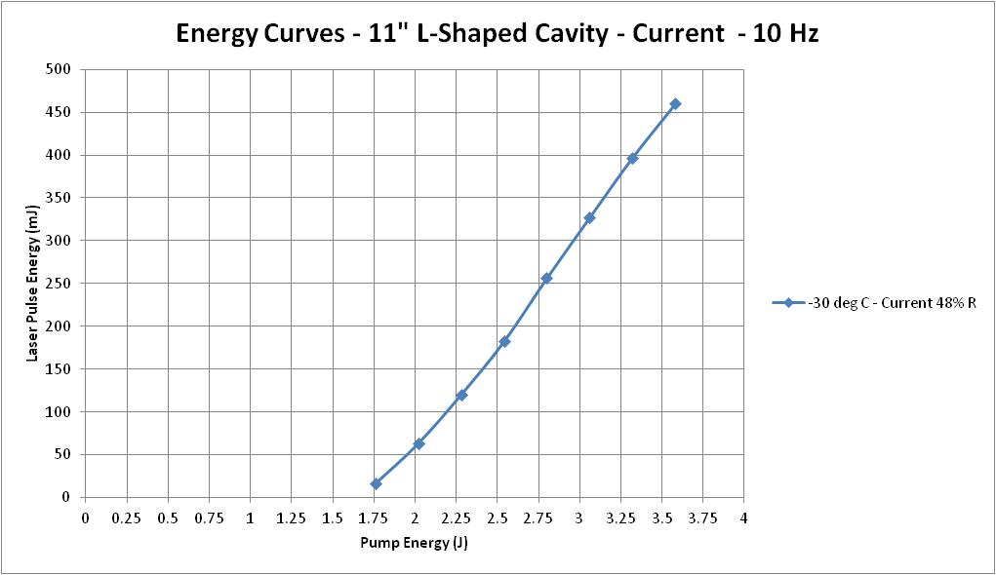
Linear Cavity Data
Now reaching energies
expected from a short cavity!

Slide 27
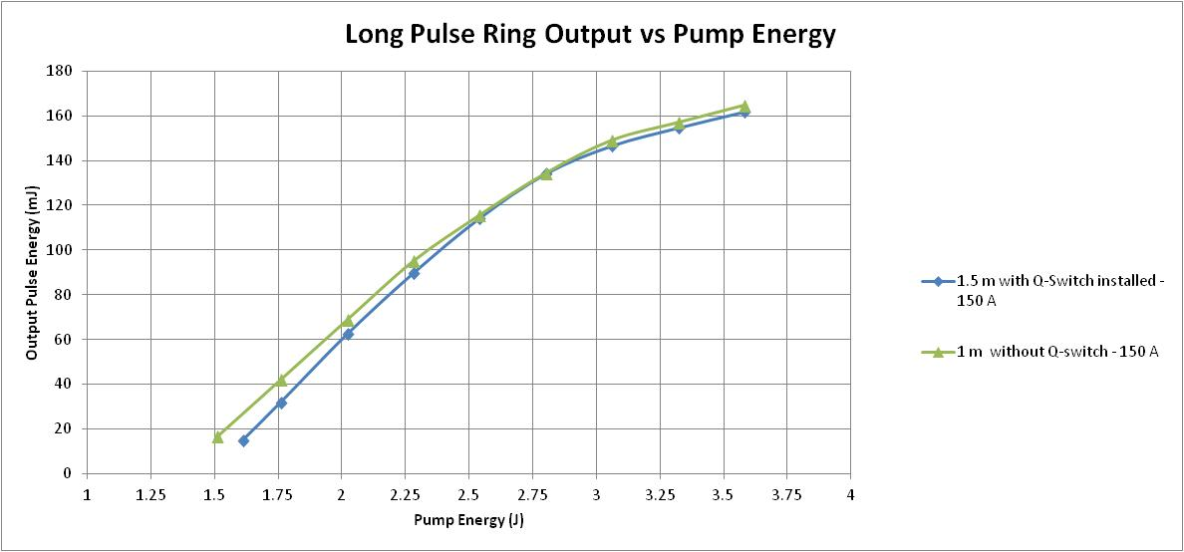
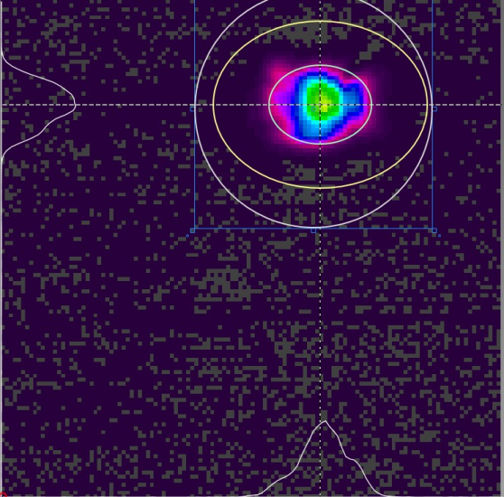
Current Ring Laser Results – Long Pulse
10 Hz, 150 A
Expect 80 mJ of Q-switched output for 3.6 J of pump energy
Phase II achieved 3X amplification – on track for 240 mJ
after amplifier pair
2.36 mm

Slide 28
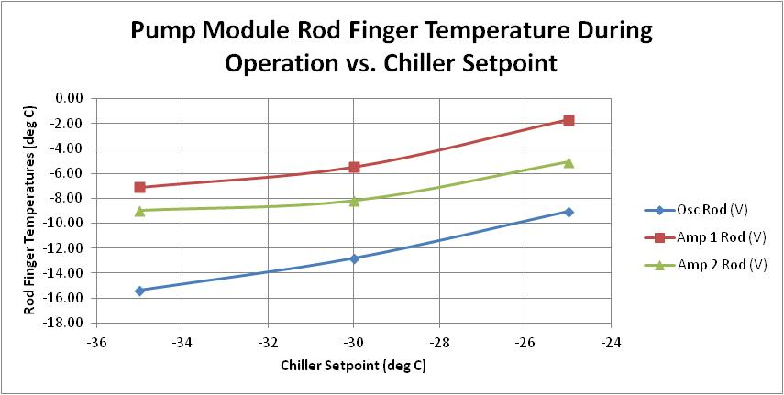
Thermal Performance of Heat Pipes
Heat pipes operate as designed at full heat load:
  Measured thermal performance matched model expectation

Slide 29
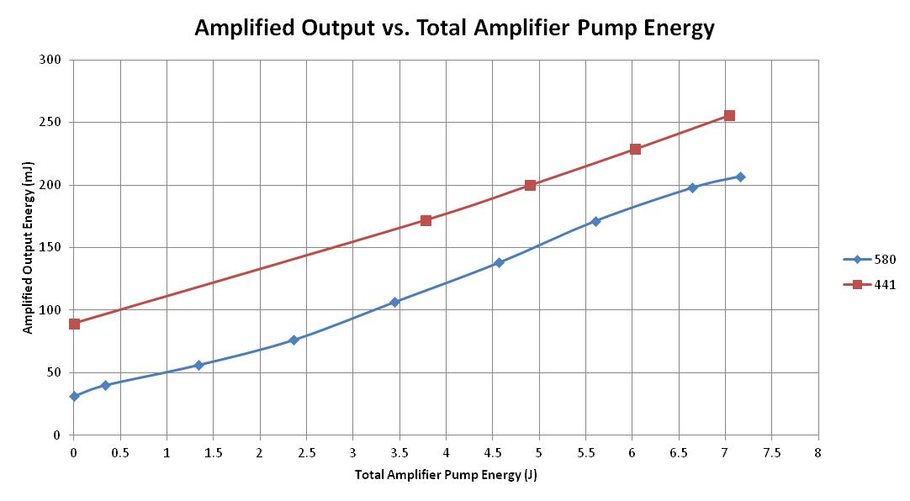
Results – Amplified 2 µm Energy vs. Amplifier Pump Energy (Long Pulse)
Legend:
RRLT = Red (5 HZ)
ACT = Blue (10 Hz)
Amplifiers show similar extraction efficiency to RRLT but at twice the rep rate
  Reduced rod temperature via improved thermal management

Slide 30
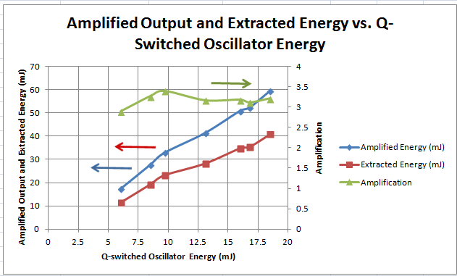
Amplified Q-Switched Oscillator Results
Initial amplifier performance met or exceeded expectation
  Low oscillator energy limits the energy extracted from amplifiers
  Performance projects to >200 mJ for 80 mJ Q-switch at -25 deg C

Slide 31
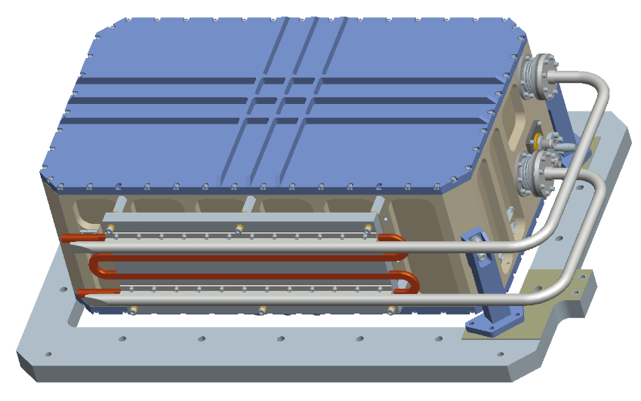
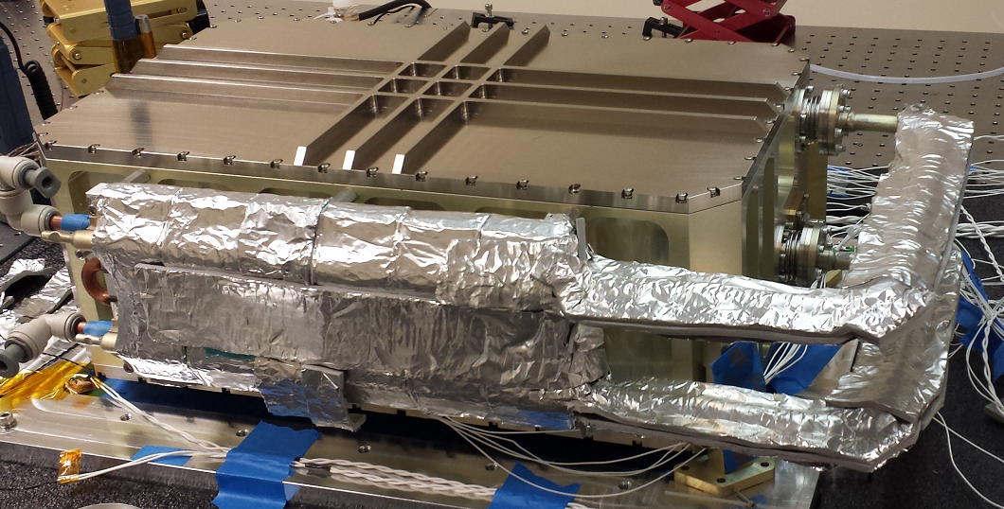
Conductively Cooled Laser Design
Box dims: 19”x11”x7.1” (LxWxH)
ICESat-2: 16”x11”x4.4” (LxWxH)
Mounting feet for illustration only
Housing itself: 19”L x 11”W x 6.1”H
Complete assembly : 23.9”L x 14”W x 7.7”H

Slide 32
Resonator Issues Identified
Cold Diode Operation
  Severely hampered alignment process
    Limited lines of sight; limited finesse to align optics, long pump down times for temperature and humidity control, sensitivity to air currents, limited work time, etc
Long resonator design and single point settings
  Highly alignment sensitive and not compatible thermo-mechanical changes due to cold operation of heads, weight of pump amplifiers, limited optical apertures of components
  PZT stack prone to bending and caused misalignment to cavity due to implementation on key resonator mirror
  Mode and reflectivity optimization not built into the program
  Q-switch extinction could not allow operation of resonator at highest gain levels (-35ºC)
Further mechanical analysis is need for optical bench
  Deformation of bench observed with insertions of amps
  Slow alignment drifts observed over time
Bottom-line – Long and short term resonator instability and alignments precluded achieving expected oscillator performance
    Low energy output and lower than desired beam quality
A new resonator design incorporating lessons learned and guided by optical modeling is needed

Slide 33
Program Lessons Learned and Design Change Recommendations
Present resonator design does not support stable or reliable oscillator output
  Long cavity operates near stability limit and is highly sensitive to pump power and temperature gradients
  Fixed output coupler is not optimum for all conditions and can’t be changed without significant engineering changes to implement polarization coupling
  Direct coupling of PZT to mirror for cavity locking causes resonator misalignment
  Observed long term degradation of oscillator output may be caused by thermal design of the gain module (compression on the rod)
Cold diode operation limited ability to align resonator and diagnose issues effectively
  This was a major obstacle in the program
Recommendations for future systems
  Build in cavity stabilizing elements to move away from resonator stability limit
  Incorporate adjustable polarization output coupling
  Thermally decouple pump diodes from gain module cooling system
    Getting away from cold operating diode
    Remove diode heat load from heat pipes
  Change PZT implementation to incorporate cavity length adjustment that eliminates PZT bending effects
  Investigate changing pump architecture to improve the reliability of the thermal interface

Slide 34
Questions?

