Slide 1
Status of TODWL, TWOLF, P3DWL and DAWN: 2015 applications and plans for the near future
G. D. Emmitt
Working Group on Space-based Lidar Winds
3-4 November, 2015

Slide 2
TODWL (Twin Otter Doppler Wind Lidar)
  2015
    no flights
  2016
    April for 2 weeks to continue investigation of TKE towers associated with BL rolls and gravity waves in complex terrain
    Funded by ONR

Slide 3
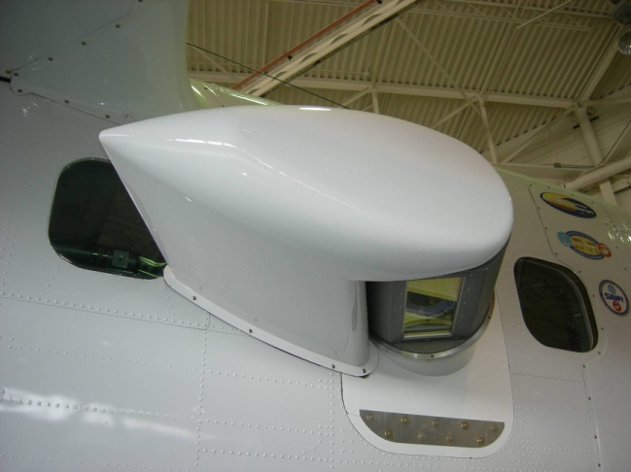

TODWL
Twin Otter Doppler Wind Lidar
CTV
Controlled Towed Vehicle
CTV

Slide 4
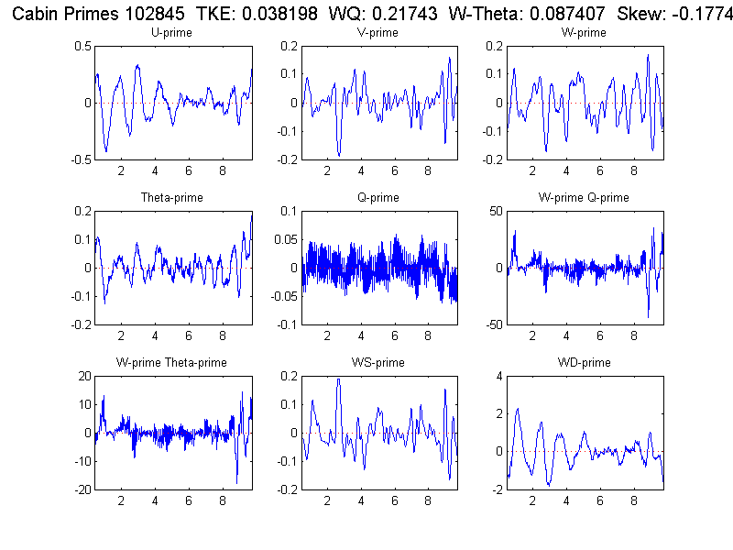
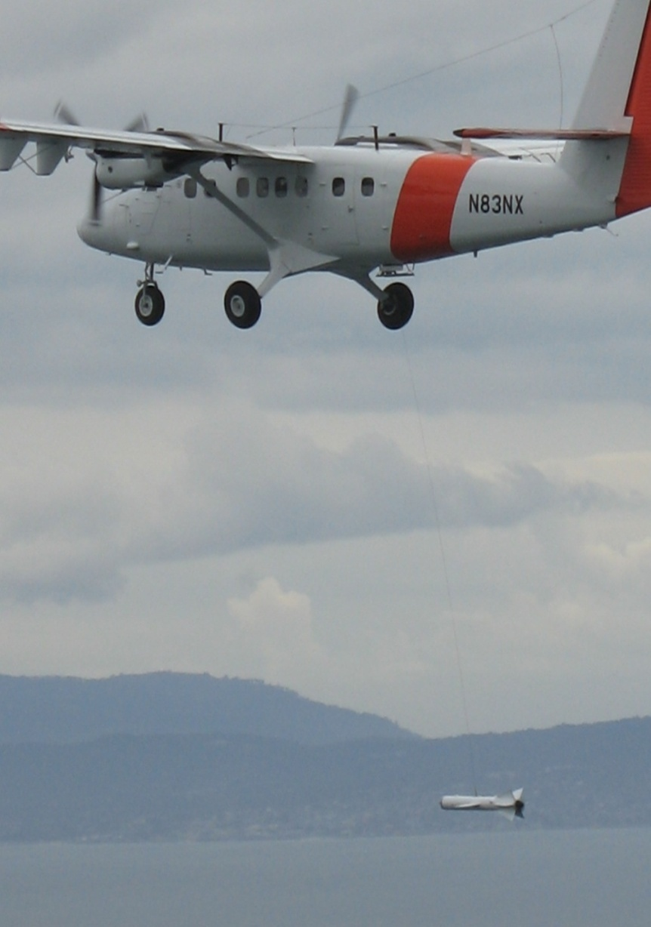
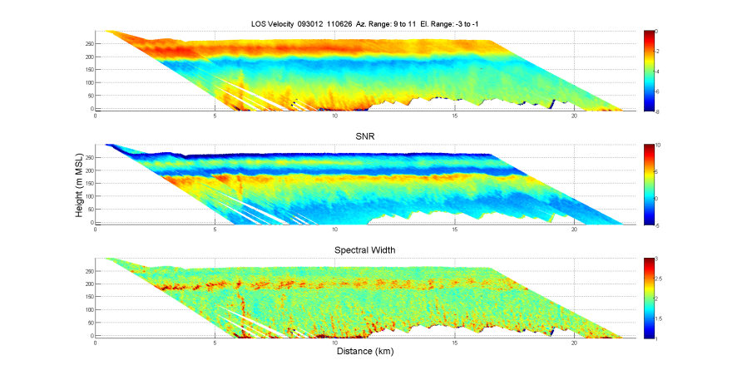
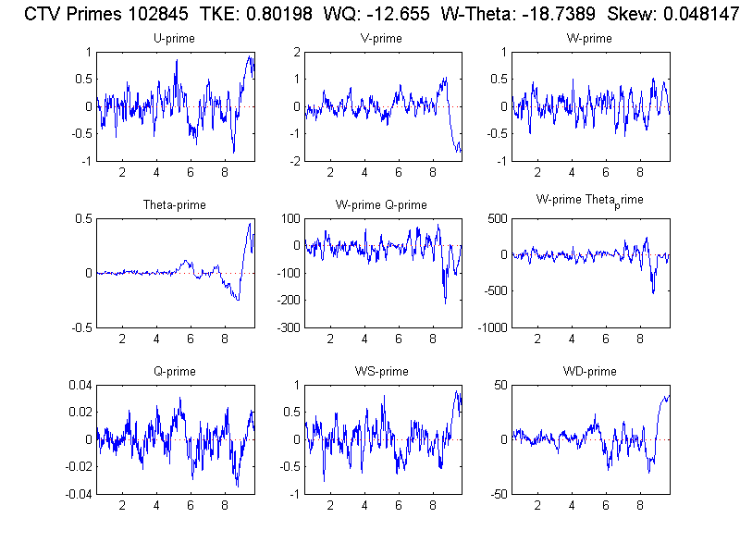
CIRPAS Twin Otter with CTV below
Twin Otter
Probe Data
TODWL
Time/height
Cross sections
Towed Vehicle
Flux Data

Slide 5
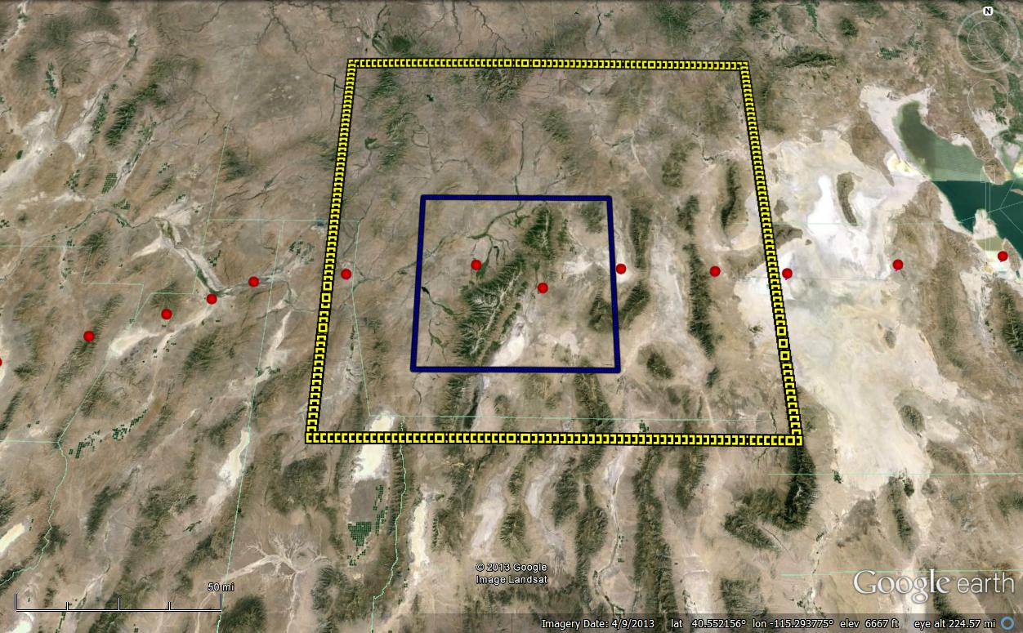
WRF Domains 2 (3 km res.) and 3 ( 1 km res) for 10/04/2012 20Z
Ruby Mountain
Flight
Path

Slide 6
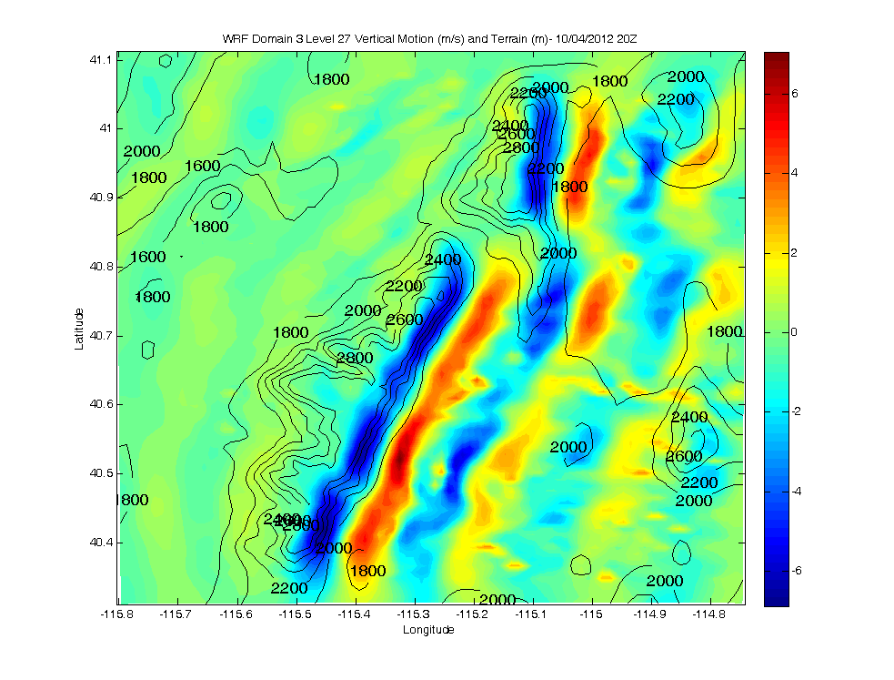
WRF Domain 3 Level 27 Vertical Motion and Terrain
W (m/s)

Slide 7
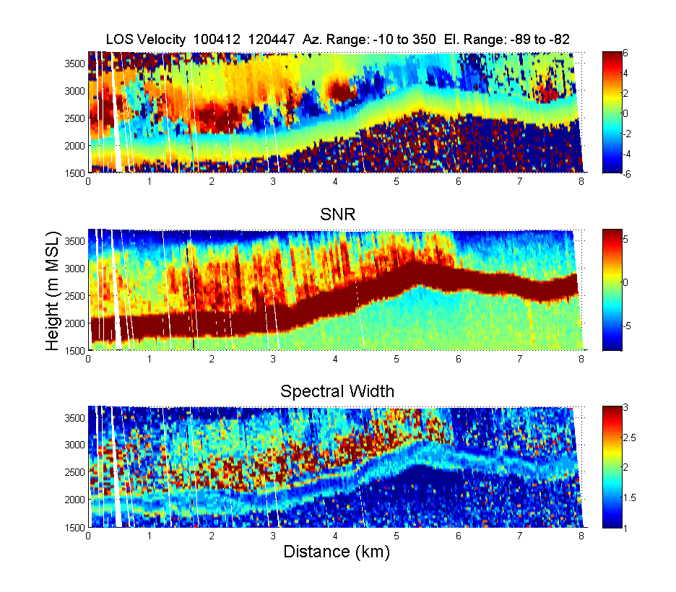

Slide 8
TWOLF (Truck mounted Wind Observing Facility)
  2015
  Tornado “chasing” and PECAN
  2016
    Tornado research in May/June
    Funded by NSF

Slide 9
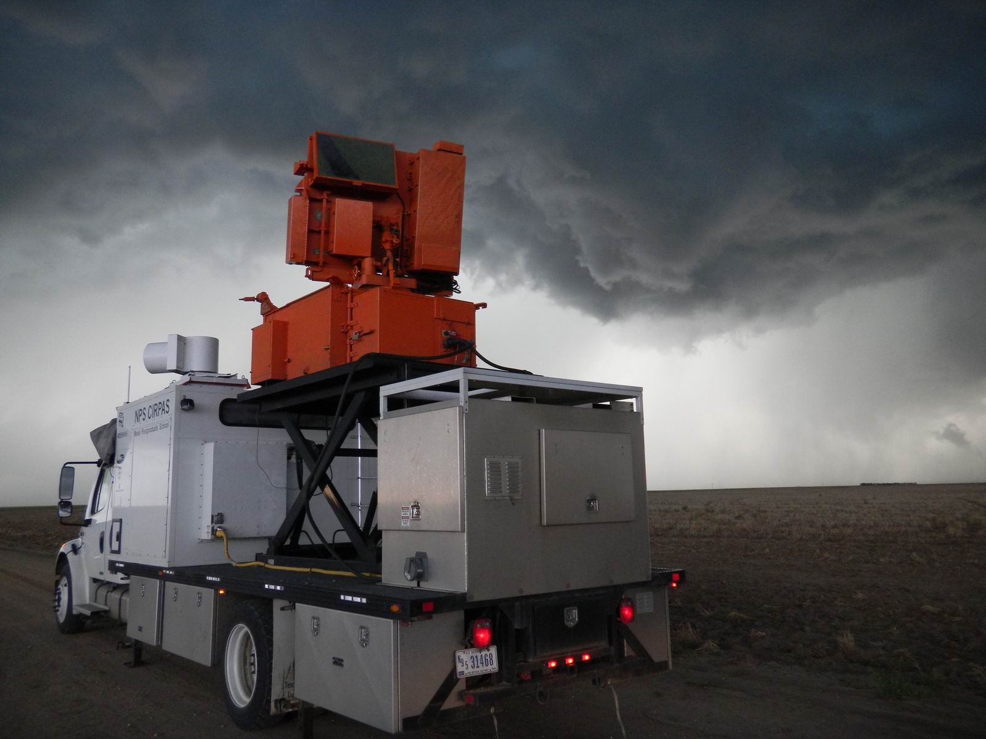
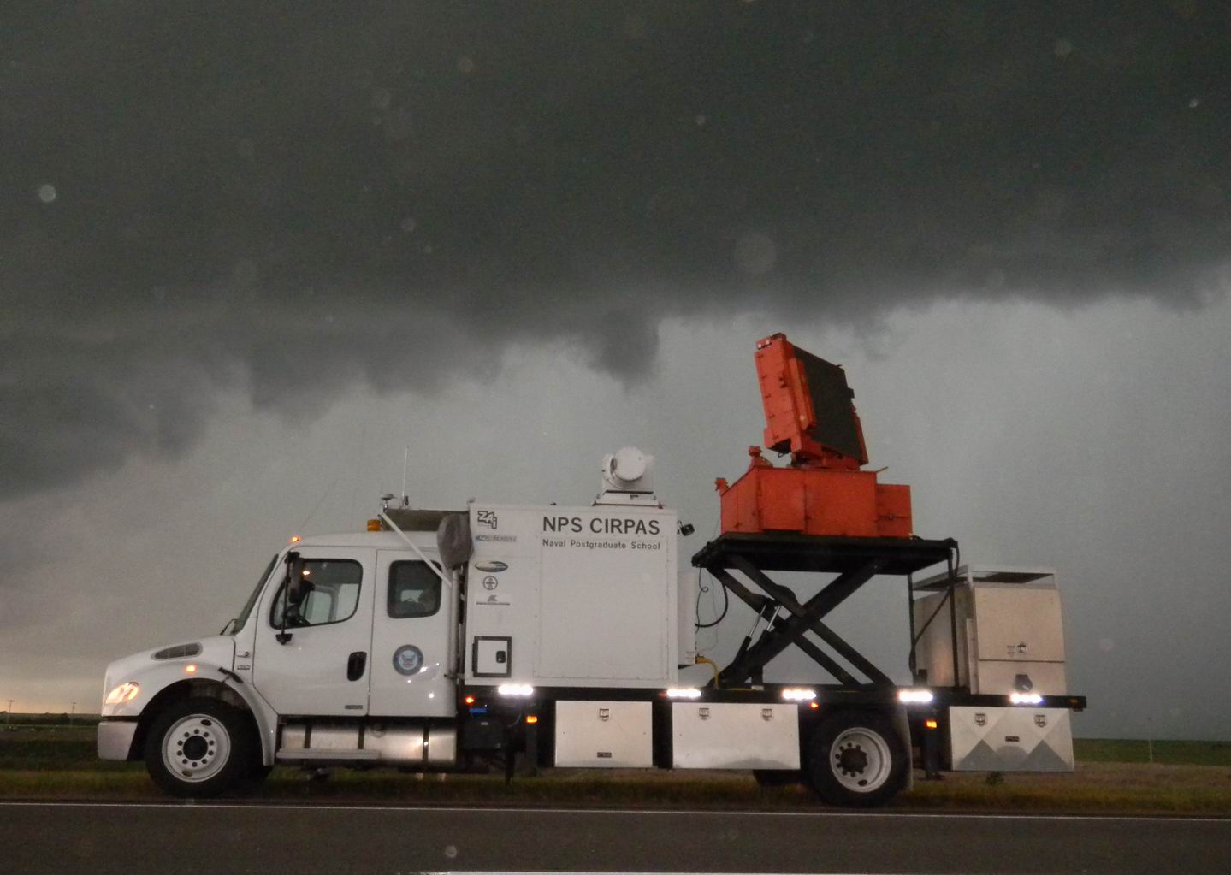
TWOLF
Truck mounted Wind Observing Lidar Facility

Slide 10
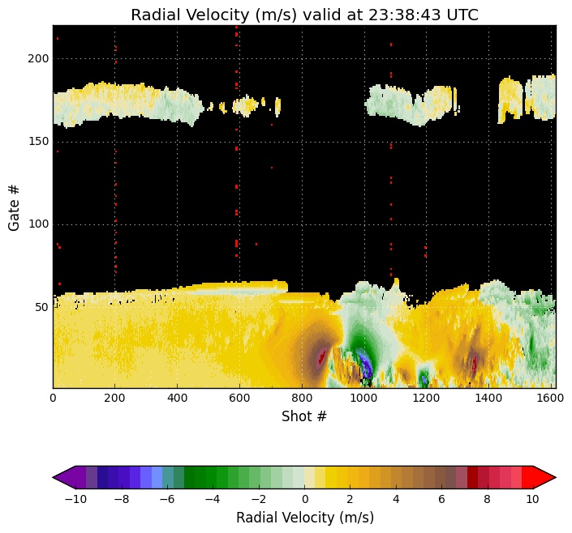
TWOLF vertical stare
during PECAN 2015
(bore case)

Slide 11
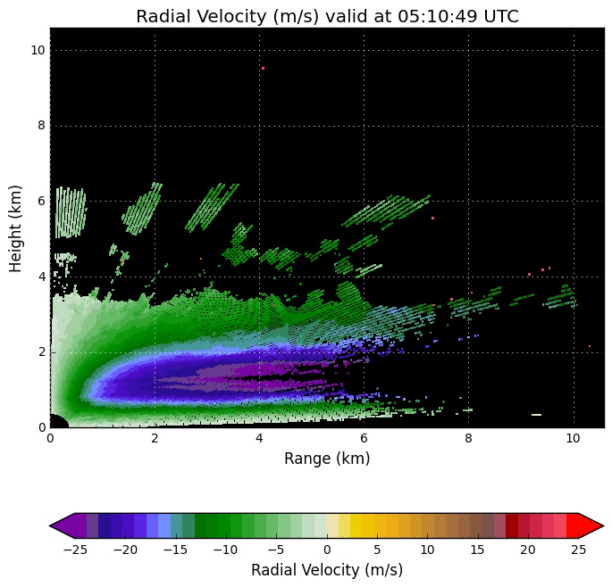
TWOLF RHI through
jet on 07062015
during PECAN

Slide 12
P3DWL
  2015
  Hurricane reconnaissance
  2016
  Repairs and HFIP research
  Funded by NOAA

Slide 13
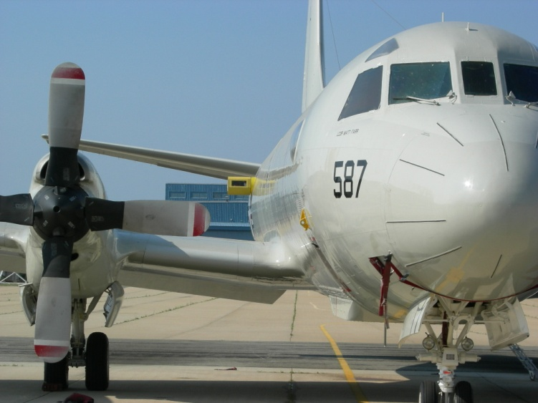
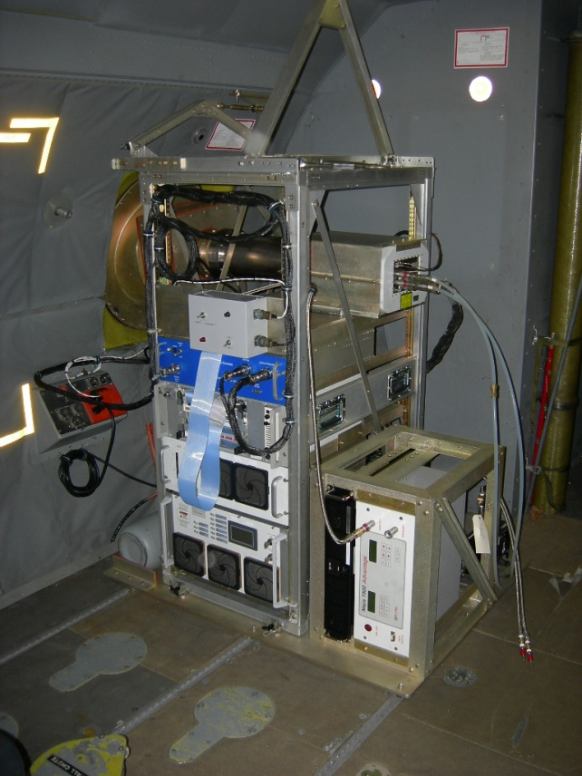
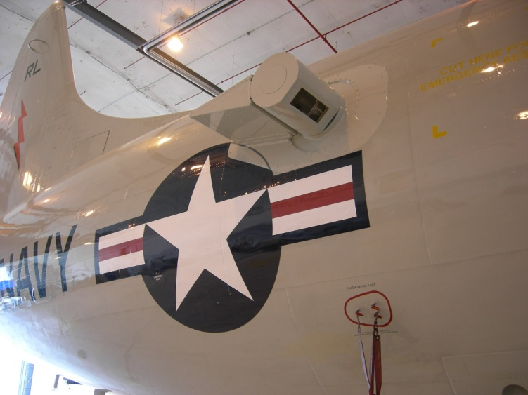
P3DWL for ONR TPARC and NOAA HFIP
1.6 um coherent WTX (ARL/LMCT)
10 cm bi-axis scanner (NASA)
P3 and other parts (NRL)
Analyses software (SWA/CIRPAS)

Slide 14
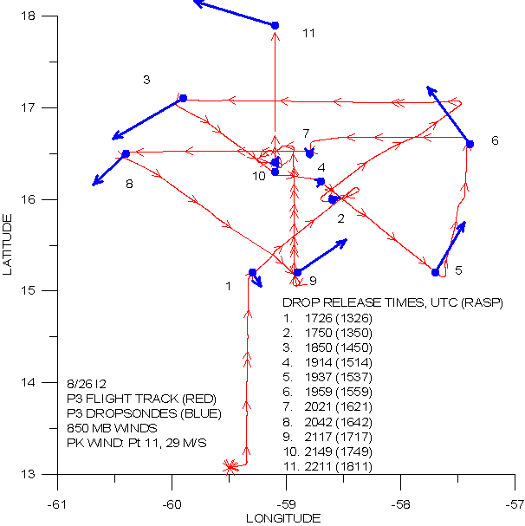
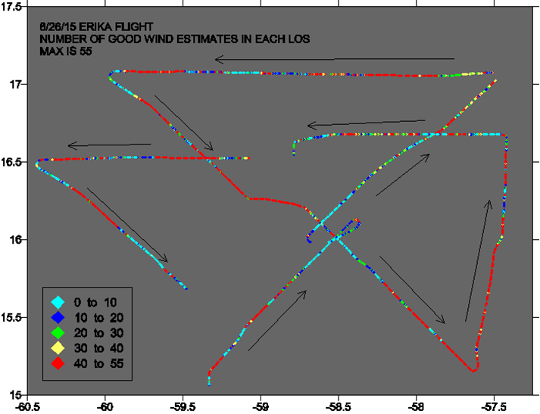
Dropsonde locations and P3DWL coverage
for Erika reconnaissance flight 8/26/15

Slide 15
DAWN
  2015
  PolarWinds and ADM Cal/Val Campaign II
  2016
  Performance optimization
  LaRC based test and evaluation
  Funded by NASA

Slide 16
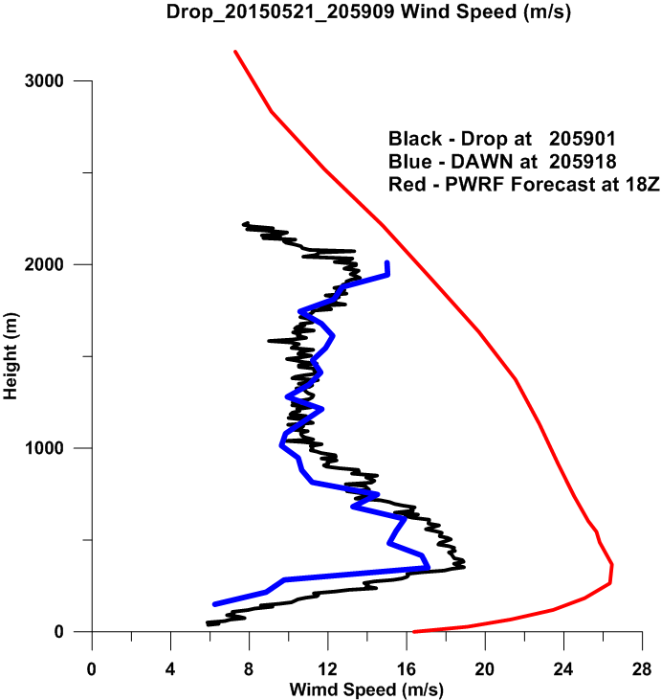
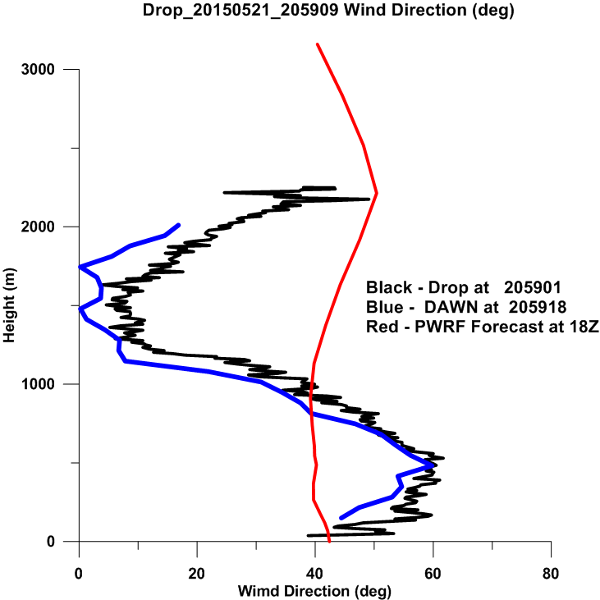
DAWN, dropsondes and PolarWRF comparisons

Slide 17
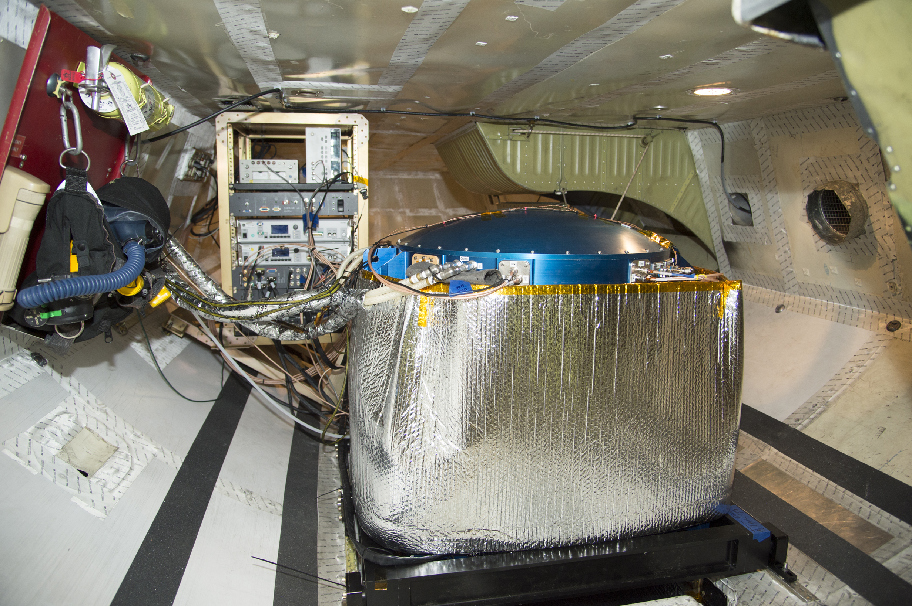
DAWN as installed in NASA DC-8

