Slide 1
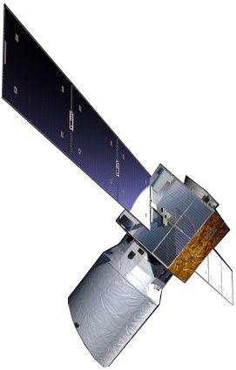
ALADIN Airborne Demonstrator (A2D) – first results from WindVal campaign 2015
Uwe Marksteiner, Oliver Reitebuch, Christian Lemmerz, Benjamin Witschas, Stephan Rahm, Andreas Schäfler, Engelbert Nagel

Slide 2
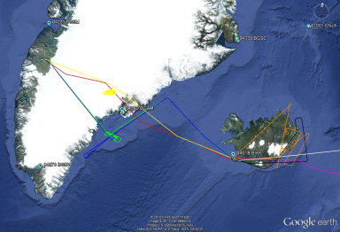
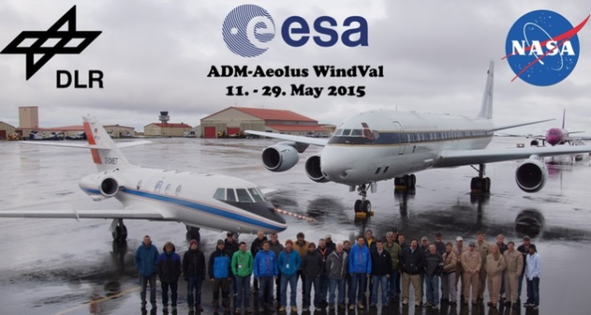
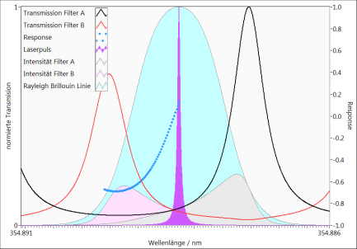
► Outline
Recall of 2009 results
First results from 2015 airborne campaign in Iceland
Calibration
Winds

Slide 3
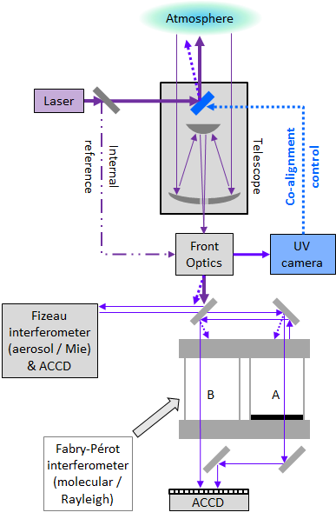
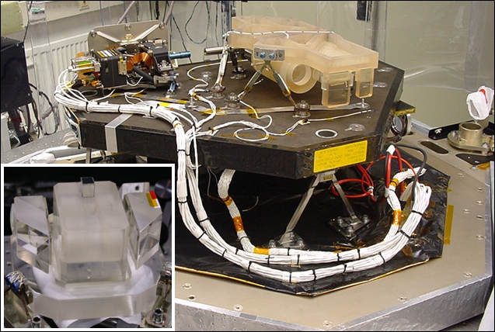
► The A2D subsystems
The A2D is a prototype of the satellite instrument and is operated by DLR from ground and as an airborne demonstrator. Two different types of interferometers analyse Rayleigh and Mie scattering from molecules and aerosols or clouds.

Slide 4
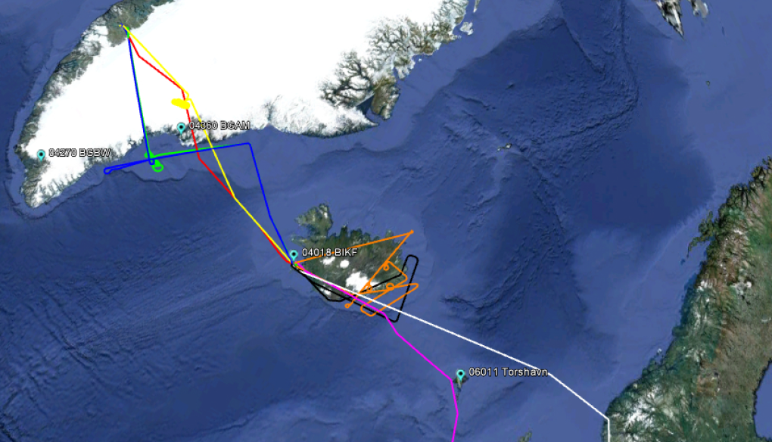
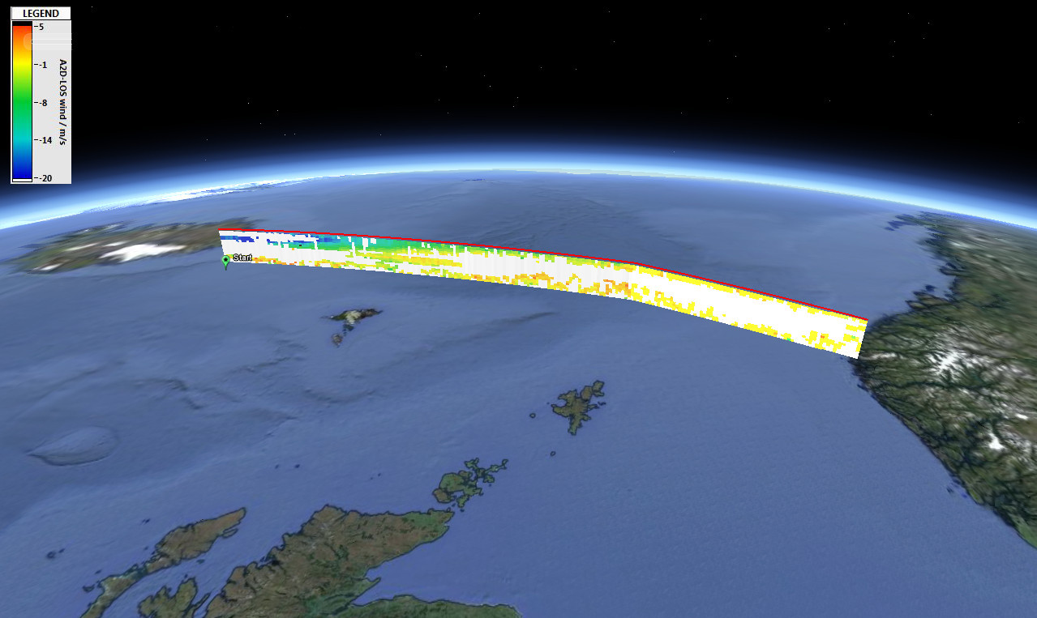
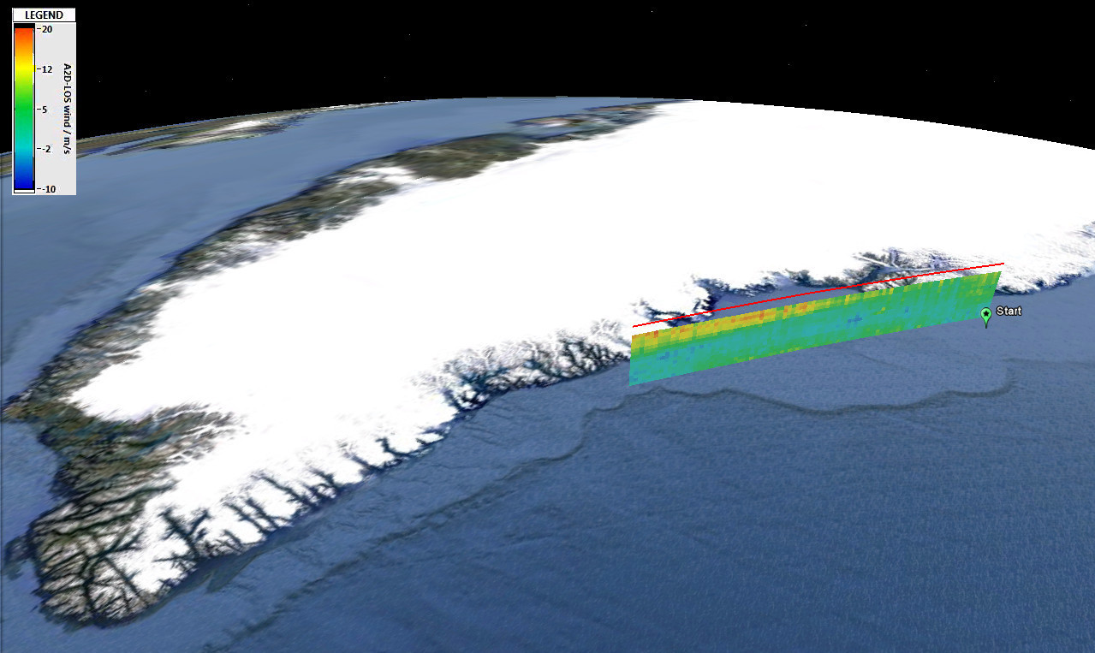
► Airborne campaign 2009
calibrations
wind observations
1st time worldwide 2 wind lidar instruments measuring simultaneously on same aircraft
A2D (direct-detection) and 2-µm (heterodyne)
2-µm: low random & systematic errors → reference lidar
Notes:
For the first time worldwide two wind lidar instruments were operated simultaneously on the same aircraft in 2009: The A2D and a well-established coherent reference lidar at 2 µm, the latter being characterized by low random and systematic errors of about 0.1 m/s. During the campaign in 2015 two additional lidar systems also using both detection principles were operated in paralled on a NASA DC-8 aircraft.

Slide 5
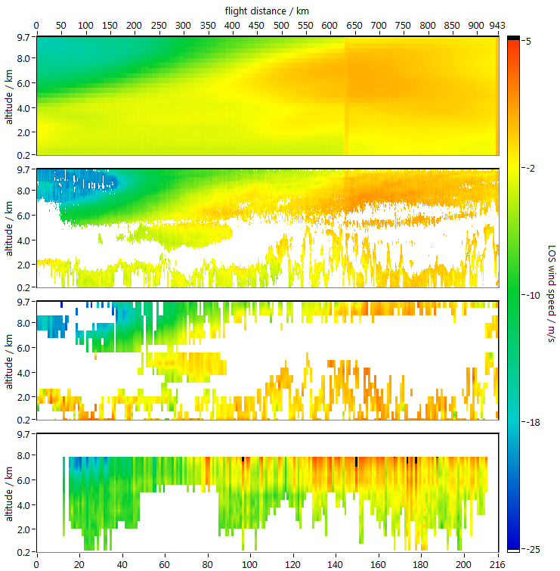
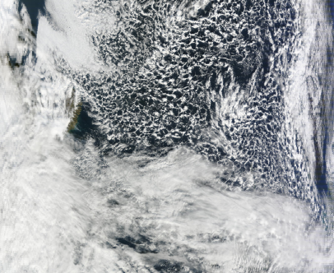
► Airborne observations and ECMWF model
LOS wind observations on 2009/10/01
ECMWF
2-µm
MODIS, Oct. 1st , 2009
Mie
Rayleigh

Slide 6
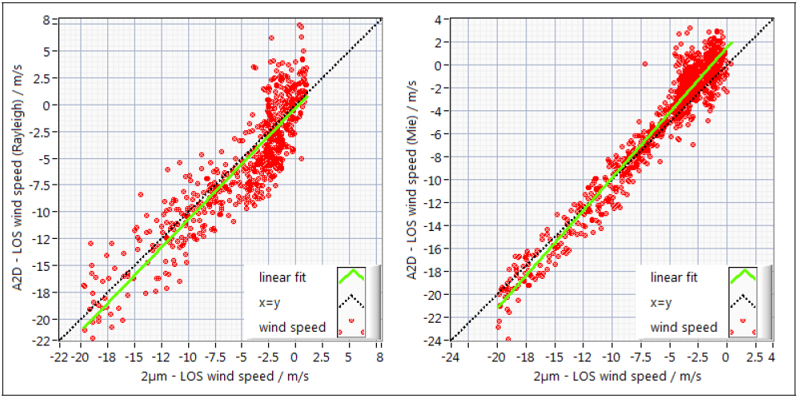
► Statistical Comparison for ALADIN airborne demonstrator
Rayleigh
Mie
slope: 1.04
std. dev.: 2.5 m/s
# of points: 596
slope: 1.14
std. dev.: 1.5 m/s
# of points: 932

Slide 7
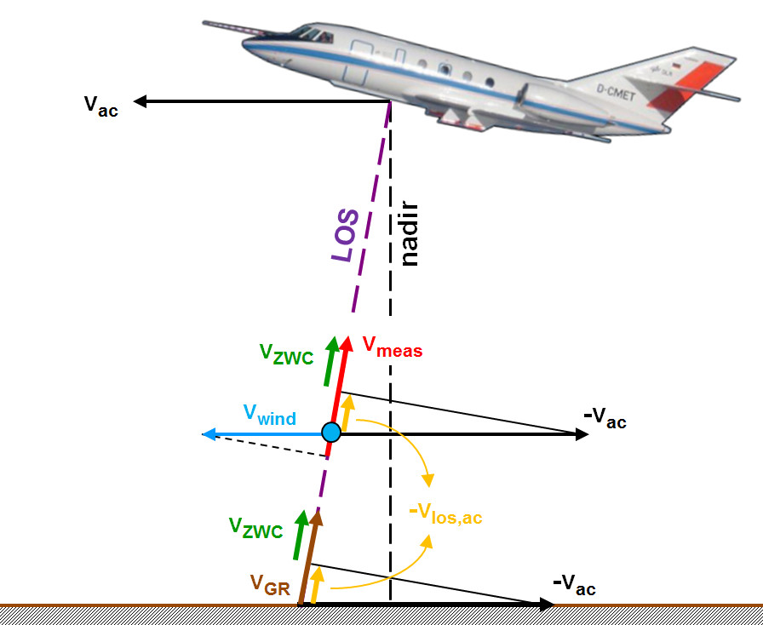
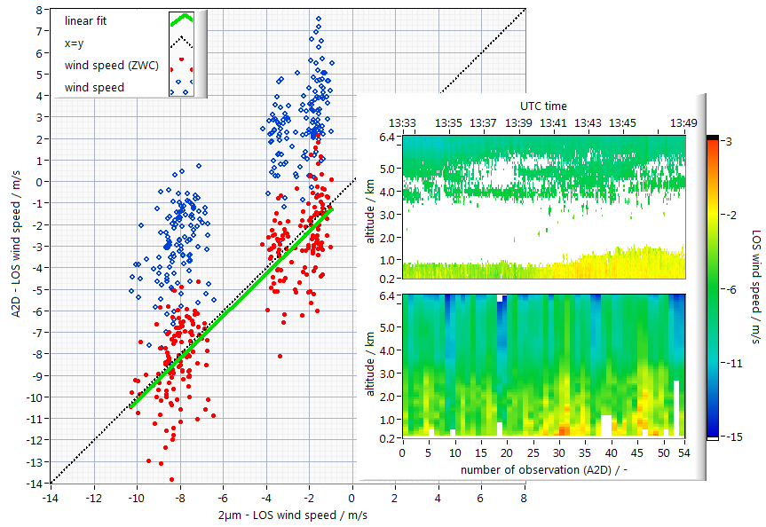
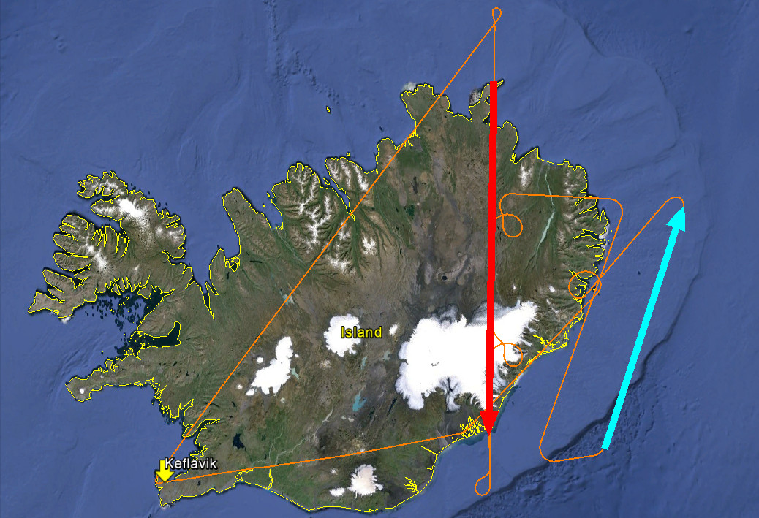
► Zero Wind Correction
blue: measured
red: corrected
2-µm
A2D
Rayleigh
v_{ZWC}: Zero Wind Correction value
v_{ac}: aircraft velocity
v_{GR}: ground return velocity
v_{meas}: correction of measured wind speed
➔ v_{wind}: true wind speed
2009-09-29
blue: wind meas.
red: for ZWC
objective to validate method of ZWC achieved
correction by mean value needed instead of observational basis
ZWC values different for Mie and Rayleigh

Slide 8
► Outline
Recall of 2009 results
First results from 2015 airborne campaign in Iceland
Calibration
Winds

Slide 9
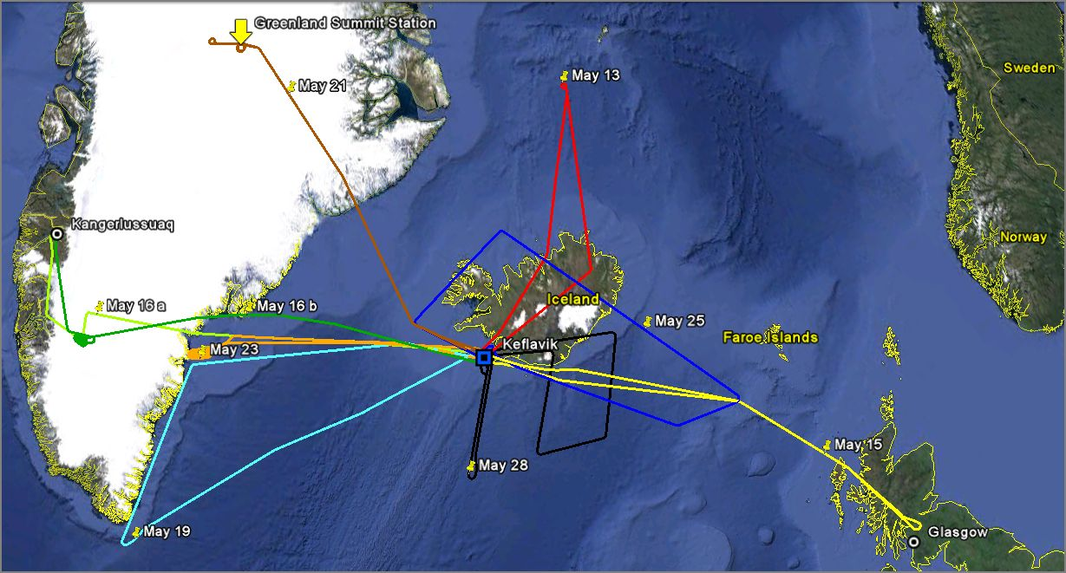
► scientific flights & objectives
Greenland
summit station
TDS underflight
2 calibrations
Iceland & southerly jet
1 calibration
2 calibrations
over sea ice
Tip-Jet
jet stream
ASCAT underflight

Slide 10
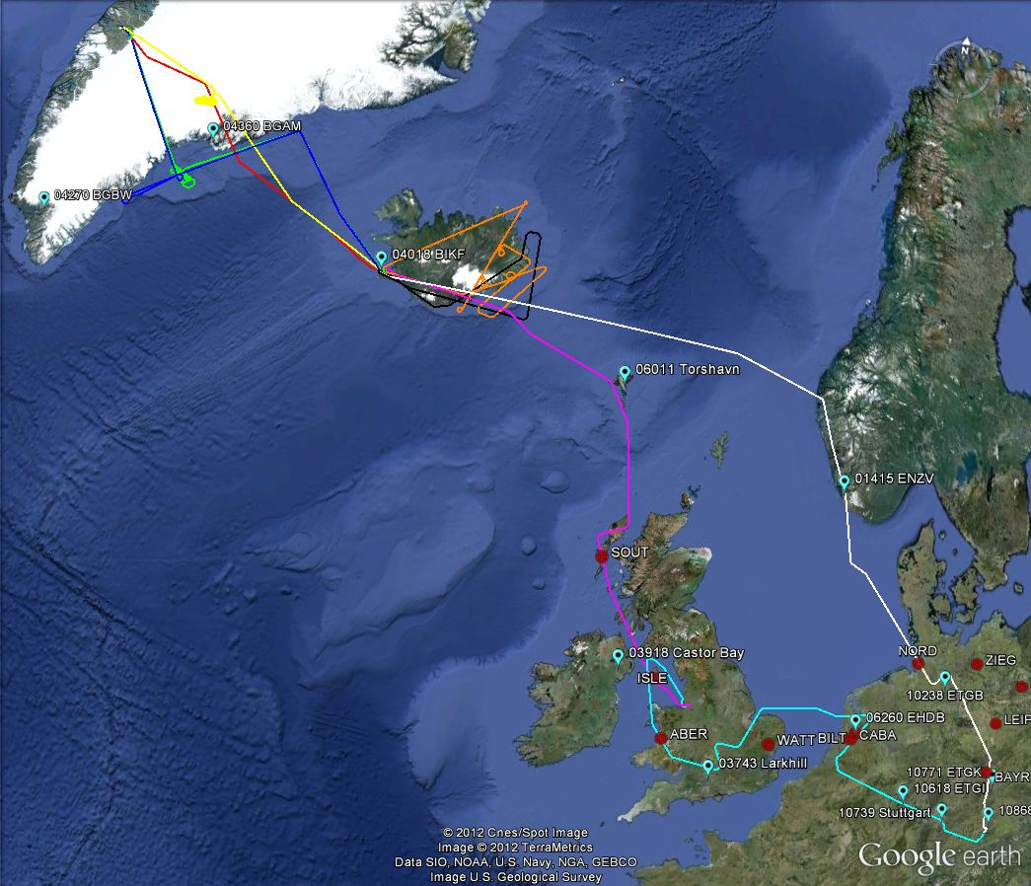
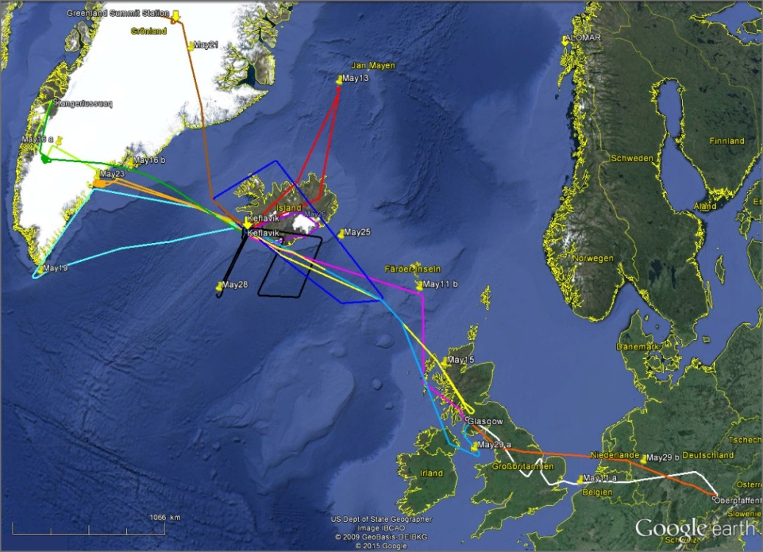
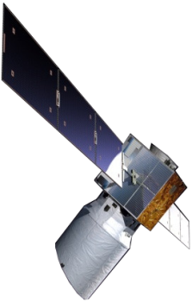
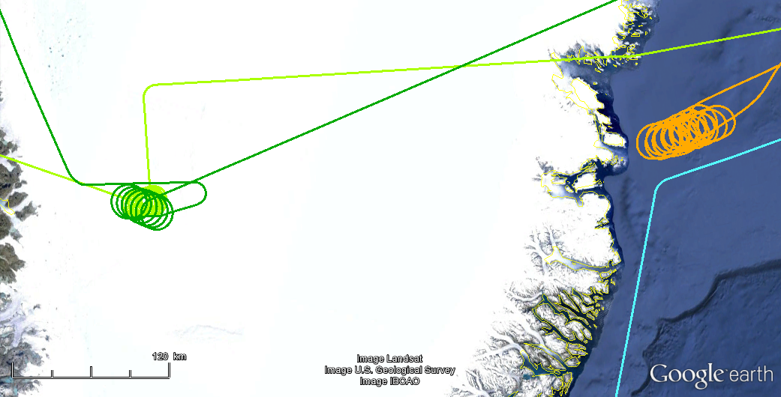
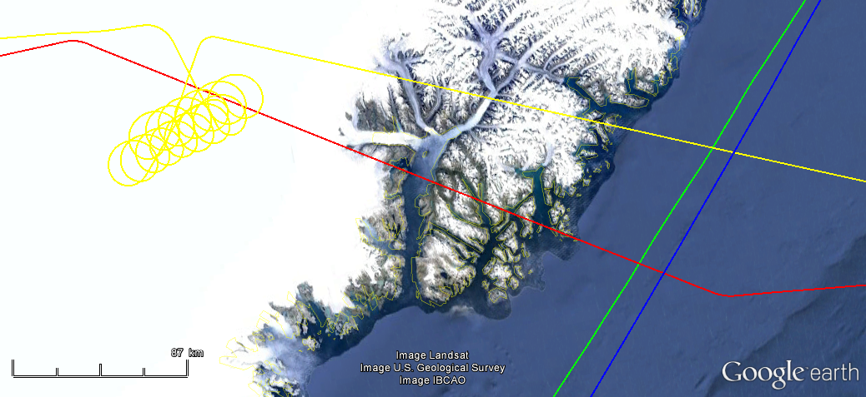
► calibration locations 2009 & 2015
2009
2015
2 calibrations
2 calibrations
over sea ice
2 calibrations
1 calibration

Slide 11
► A2D calibration - Rayleigh channel (movie)

Slide 12
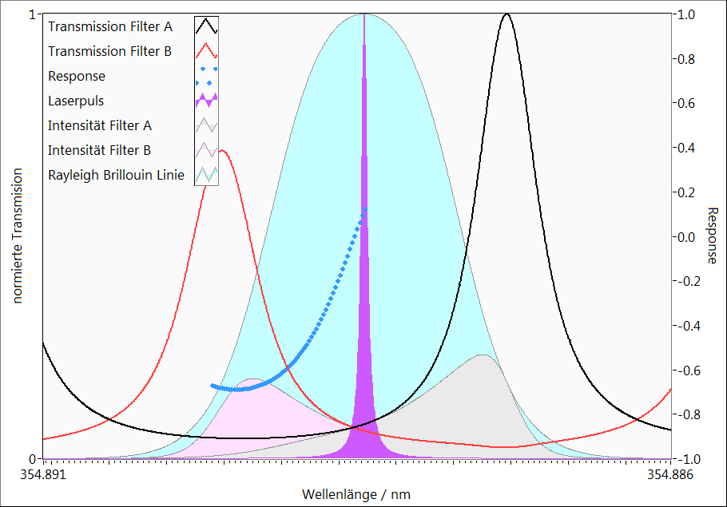
► A2D calibration - Rayleigh channel
I (B)
I (A)
Response:
$$R=\frac{I(A)−I(B) }{I\left(A\right)+I(B)}$$
Wind
Frequency

Slide 13
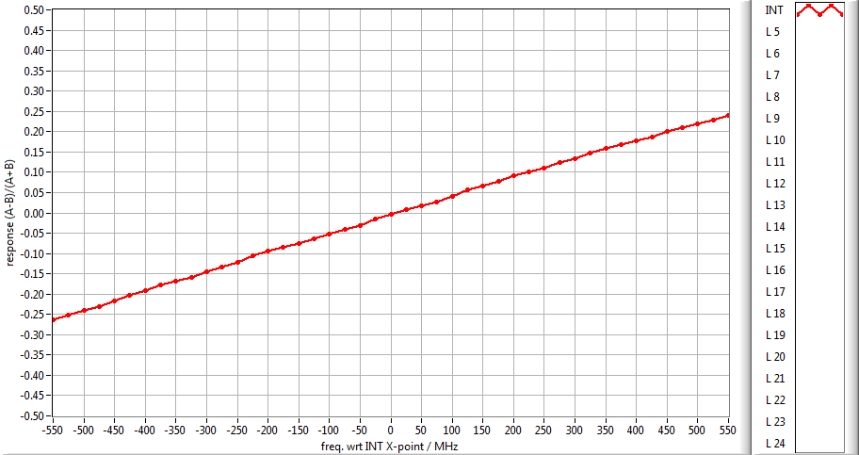
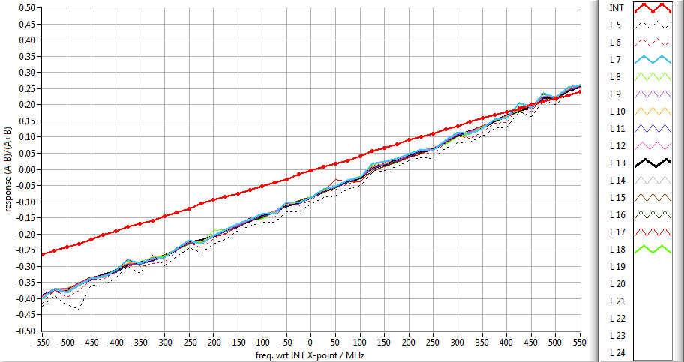
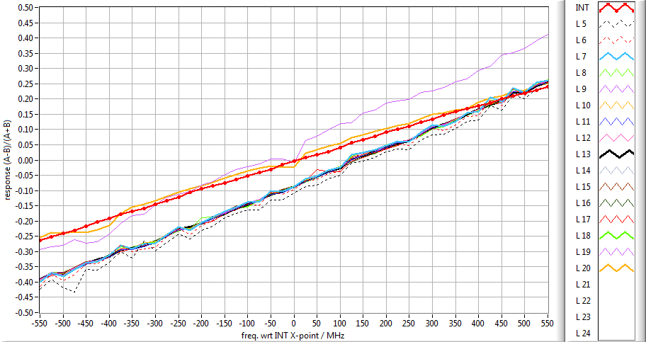
► Rayleigh response curves (2015-05-16 a)
4 × auxiliary range gates (L0-L3)
1 × internal reference (INT=L4)
4 × auxiliary range gates (L0-L3)
1 × internal reference (INT=L4)
20 × atmospheric range gates (L5-L24)
4 × auxiliary range gates (L0-L3)
1 × internal reference (INT=L4)
20 × atmospheric range gates (L5-L24)
2 × ground return (L19-L20)
Notes:
RAY responses per layer for selected pix. / LOSV corr.ected / TLE frequencies

Slide 14
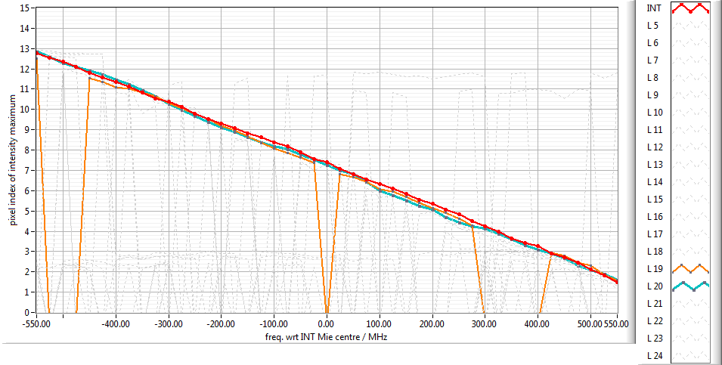
► Mie response curves (2009-09-21 b)
only Internal Reference & ground return

Slide 15
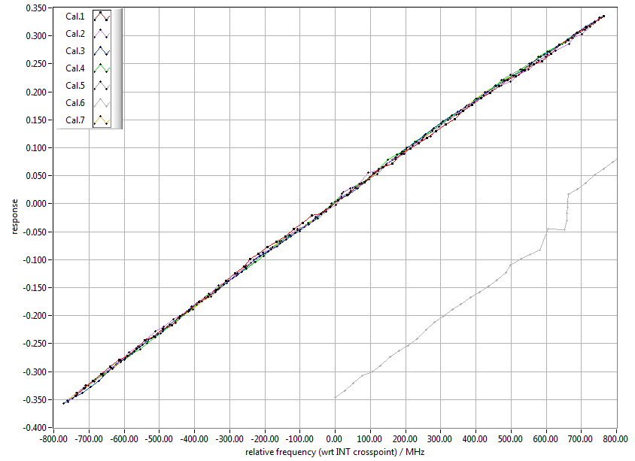
► Rayleigh calibrations – internal reference (WM corrected)
TLE: commanded relative frequencies
⇒ Aeolus & A2D
WM: measured absolute frequencies
⇒ only A2D
Cal. | slope / MHz⁻¹ | intercept / -
1 | 0.000450 | -0.00070
2 | 0.000450 | -0.00096
3 | 0.000458 | -0.00090
4 | 0.000457 | -0.00019
5 | 0.000455 | -0.00133
6 | more QC needed
7 | 0.000456 | -0.00083

Slide 16
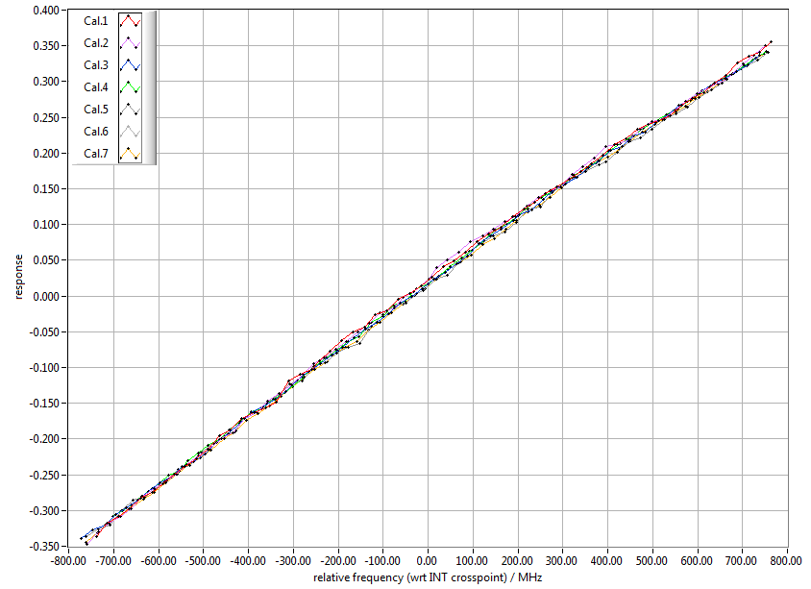
► Rayleigh calibrations – ground return (WM corrected)
Cal. | slope / MHz⁻¹ | intercept / -
1 | 0.000458 | 0.01582
2 | 0.000460 | 0.01592
3 | 0.000455 | 0.01300
4 | 0.000454 | 0.01444
5 | 0.000452 | 0.01025
6 | more QC needed
7 | 0.000457 | 0.00947

Slide 17
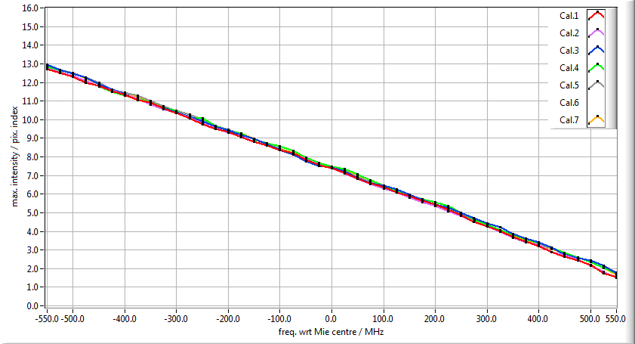
► Mie calibrations – internal reference (TLE)
Cal. | slope / MHz*pix⁻¹ | intercept / pix
1 | -98.85 | 7.30
2 | -98.37 | 7.29
3 | -99.79 | 7.40
4 | -99.94 | 7.41
5 | -98.78 | 7.42
6 | more QC needed
7 | -98.49 | 7.37
Notes:
„wrt Mie centre“ ➔ center frequency is the one of the step with the response closest to 7.5 (same intensity on pixel 7 & 8)

Slide 18
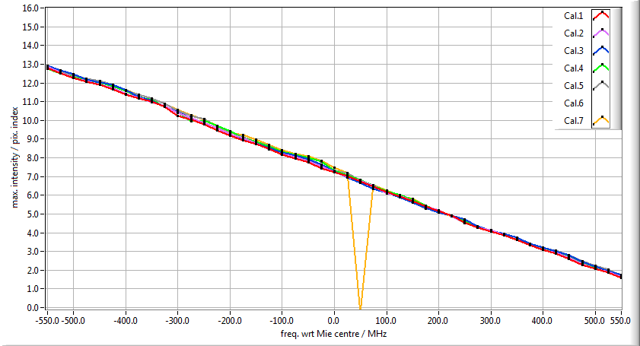
► Mie calibrations – ground return (TLE, sum, LOSV corr.)
Cal. | slope / MHz*pix⁻¹ | intercept / pix
1 | -97.21 | 7.21
2 | -96.75 | 7.24
3 | -96.61 | 7.29
4 | -97.08 | 7.31
5 | -95.99 | 7.32
6 | more QC needed
7 | -94.90 | 7.19

Slide 19
► Outline
Recall of 2009 results
First results from 2015 airborne campaign in Iceland
Calibration
Winds

Slide 20
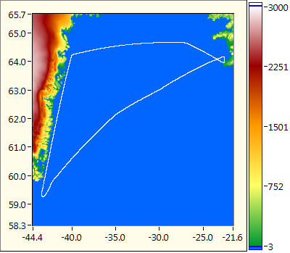
► 2015-05-19 - Greenland: A2D Rayleigh LOS winds
flight altitude 9100 m
Internal Reference (0 m/s)
distributed
ground echo
clouds
ground speed ≈ 0 m/s
(sea surface)

Slide 21
► 2015-05-19: Greenland: valid A2D Mie LOS winds
ground speed ≈ 0 m/s
(sea surface)
altitude ≈ 6300 m
altitude ≈ 1500 m
cloud
Mie winds match well
with Rayleigh wind field
Notes:
Rayleigh winds processed with case 33: Greenland 20150516s2 - Cal.3 (TLE/+-825/DCO checked/ERR 5)

Slide 22
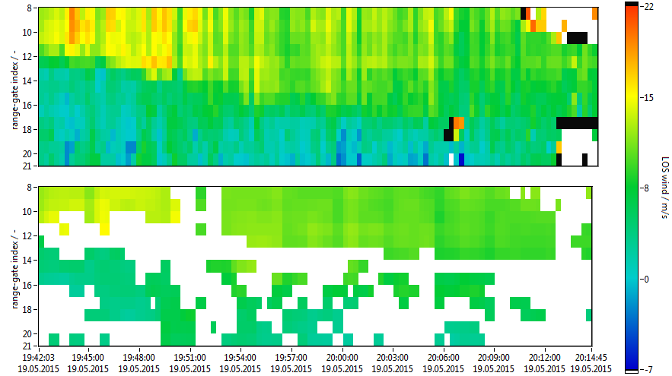
► 2015-05-19: Rayleigh winds A2D ⬄ 2-µm
A2D
2-µm
Notes:
Rayleigh winds processed with case 39: Greenland 20150516s2 - Cal.3 (WM/sym.1500/DCO checked/ERR 5)

Slide 23
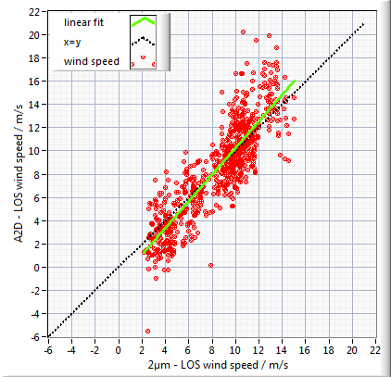
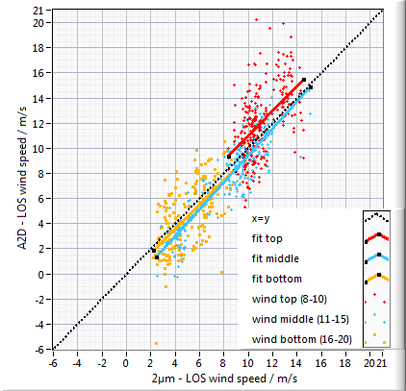
► 2015-05-19: Rayleigh winds A2D ⬄ 2-µm (Cal.7)
Layers 8 – 20 (INT = 4)
coverage threshold = 85%
Statistical results Cal.3 Cal.7
corr. coeff. r 0.90 0.87
N points 759 758
slope 1.27 1.15
intercept (m/s) -2.53 -1.30
std. dev. (m/s) 2.15 2.07
avg. bias (m/s) 0.22 -0.03

Slide 24
► Conclusion
more than 12 hours of wind measurement data from 2015 campaign
similar performance in wind measurement as in 2009
calibrations make the difference
temperature/pressure correction will be investigated using DC-8 dropsondes
more quality control steps still to be included in wind analysis
a lot of manual adaptation and optimization necessary

Slide 25
BACK UP

Slide 26
► Rayleigh calibration profiles (altitude wrt instrument)
Cal.1: 2009/09/21 over Greenland ice sheet
Cal.2: 2009/09/21 over Greenland ice sheet
Cal.3: 2015/05/16 a over Greenland ice sheet
Cal.4: 2015/05/16 b over Greenland ice sheet
Cal.5: 2015/05/16 c over Greenland ice sheet
Cal.6: 2015/05/23 a over sea ice (needs more QC)
Cal.7: 2015/05/23 b over sea ice
extrapolated
values
below ground
2%
atmosphere
sea ice
internal reference
Cal.3 & 4 at
same spot
20 MHz
Cal.1 & 2 at
same spot
Cal.5 deviates
despite same
location as
Cal.3 & 4!
ground
return

