Slide 1



Progress on the ATHENA-OAWL Airborne Demonstrator, GrOAWL
Working Group on Space-based Wind Lidar - 3-5 November 2015, Miami, FL
Sara Tucker – Ball Aerospace
Mike Hardesty & Sunil Baidar – NOAA/CIRES/CU

Slide 2
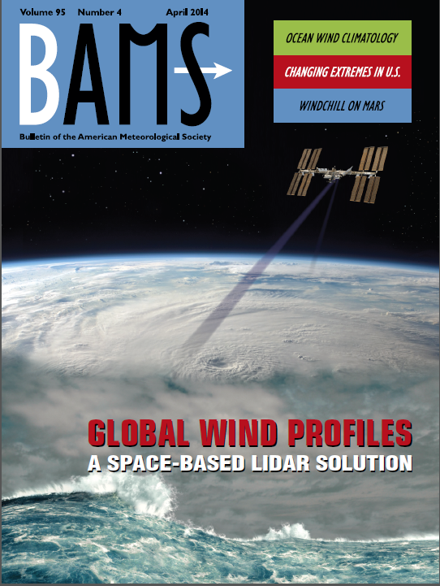
GTWS
GWOS
WISSCR
ATHENA
← Back to <1973 – Heterodyne Detection
CO2
A partial timeline of
space-based Doppler wind lidar
CCOPE/ADLS (Airborne)
NOAA TeaCO
NOAA Mini-MOPA
LAWS
Panel
LAWS Team
Solid State Heterodyne
SPARCLE
NOAA HRDL
VALIDAR
DAWN 1 IIP
DAWN 2 IIP
Decadal Survey
3D-Winds Hybrid
DAWN Flights →
Direct Detection
Edge Technique
Zephyr
TWiLiTE IIP
GLOW Double Edge
Fringe Imaging HRDI
Fringe Imaging Lidar
GroundWinds
TWiLiTE AITT
TWiLiTE Flights →
Optical Autocovariance (OA)
Original OA system development at Ball
OAWL Prototype
OAWL OSSE
April 2014
OAWL IIP
OAWL IDL
Optical Autocovariance
2-4 channel Mach Zehnder
HOAWL & FIDDL ACT
HAWC-OAWL IIP
AOVT
ESA’s ADM Aeolus (single Perspective)
A2D Airborne Demonstrations →
Launch
launched
Ball/NASA CALIPSO >9 Years on orbit!
Notes:
>30 years of NASA investments in wind lidar technology
Multiple technology investments from NASA ESTO.
NASA/NOAA Working Group on Space-Based Wind Lidar (“LWG”, formerly the LAWS science team, 1989)
2007 NRC Decadal Survey “3D-Winds” mission (Tier 3): defined as a hybrid of two separate lidar systems, with two different lasers, on one spacecraft.
The past decade:
Risk tolerance at NASA has decreased significantly
Budgets have decreased as well: NASA asked to do more and more
Industry technology investments help to make missions possible
Contractor efforts are increasingly scrutinized/audited (DCAA)

Slide 3
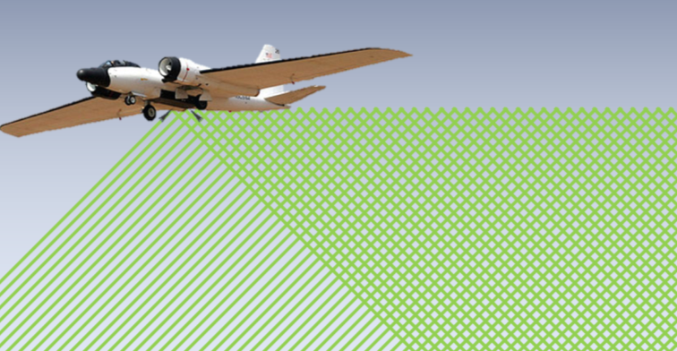
Green-OAWL Airborne Demonstrator
ATHENA-OAWL Venture Tech = AOVT:
ATHENA-OAWL Mission Concept to put a Doppler Wind Lidar on ISS
Not selected for Earth Venture Instrument (EV-I) mission funding, but it was rated Category 3 for it’s important science – eligible for EV-I “Venture Tech” funding.
Overall goal of Venture Tech Funding: address weaknesses identified by the EV-I reviewers. For ATHENA-OAWL this meant:
  Build a robust, two-look, 532 nm version of the OAWL lidar system (Green OAWL = GrOAWL) to measure line-of-sight winds from high altitude (>15 km)
  more aircraft demonstration flight hours (will fly on NASA-WB-57): Focused task on scaling airborne system performance to space, as done for Aeolus
  more measurement validation: Strong
  science team emphasis on validation
  tasks: Verify and validate instrument
  performance based on aerosol presence
  Raise main components of OAWL
  wind technology from TRL4 to TRL6
  Also work with HAWC-OAWL (HSRL for Aerosols,
  Winds, and Clouds using OAWL) which adds
  depolarization and 355 nm channels to retrieve
  aerosol depolarization ratio, backscatter ratio,
  and extinction retrievals - concurrent with the winds

Slide 4
Key GrOAWL Features
Operates at 532 nm (for AOVT) – and at 355 nm for HAWC-OAWL.
Two-look Doppler wind lidar:
  Two lasers transmit (interleaved pulses)
  Two telescopes receive
  Boresight mechanisms maintain overlap.
  Both looks couple into a single interferometer receiver using polarization - no mechanical switching
  Depolarization signals may be captured for use in aerosol characterization on HAWC-OAWL
Airborne specific system designs to ensure successful operation in high altitude (low pressure), high vibration environment.
  opto-mech: vibration isolation & kinematic mounting,
  electrical systems & software control
  cooling/heating loops, etc.
  Variable 532 nm output power (micro-Joules to 10 mJ)

Slide 5
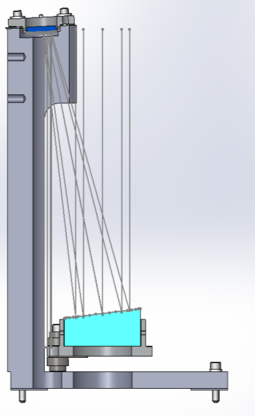
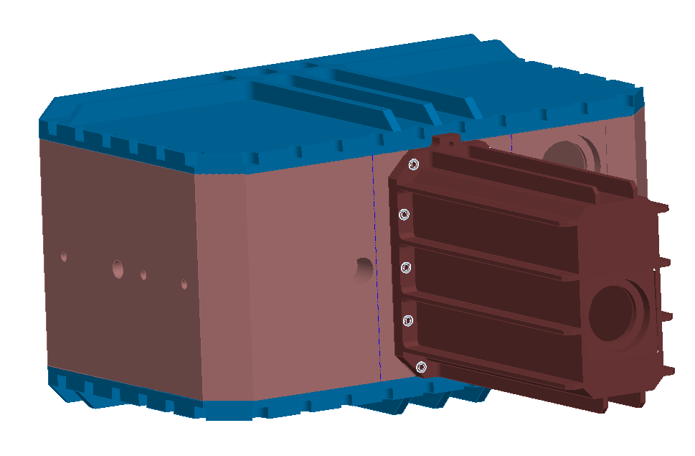
GrOAWL Lasers
Refurbish the old OAWL laser
Build new copy of OAWL laser with second amplifier to meet all original OAWL specs.
New off-axis beam expander to be installed on the 2nd laser
  Fibertek: design/build the external expander housing
  Ball design/build/align the beam expander
  Fibertek will install expander

Slide 6
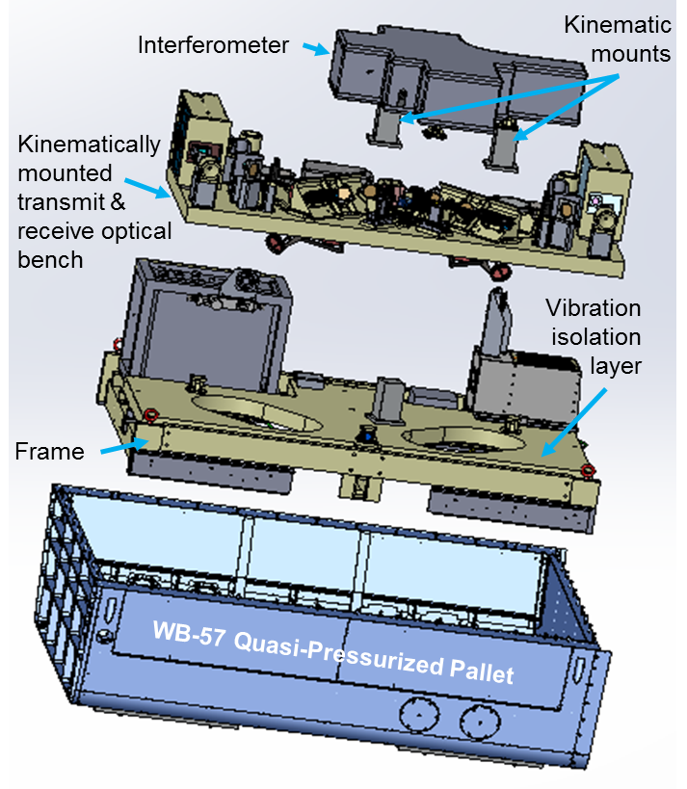
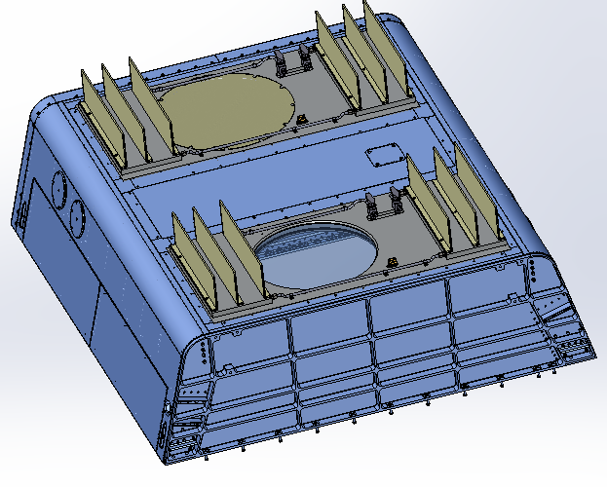
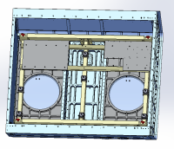
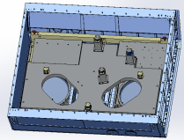
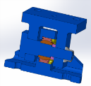
Mechanical Layout
Fits into WB-57 quasi-pressurized pallet
New pallet floor panels designed to provide the two look angles
Cold-plates & fins attached to bottom side of panels provide cooling for the lasers.
Interior frame holds vibration isolators & thermal fluid loop components
Vibration isolation bench sits on isolators and holds the kinematic mounts.
Kinematic mounts support the optical bench and interferometer
Structural analysis on full stack-up demonstrates plenty of margin

Slide 7
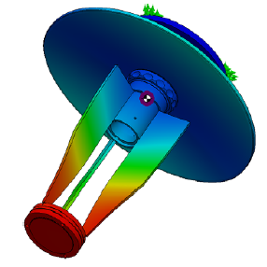
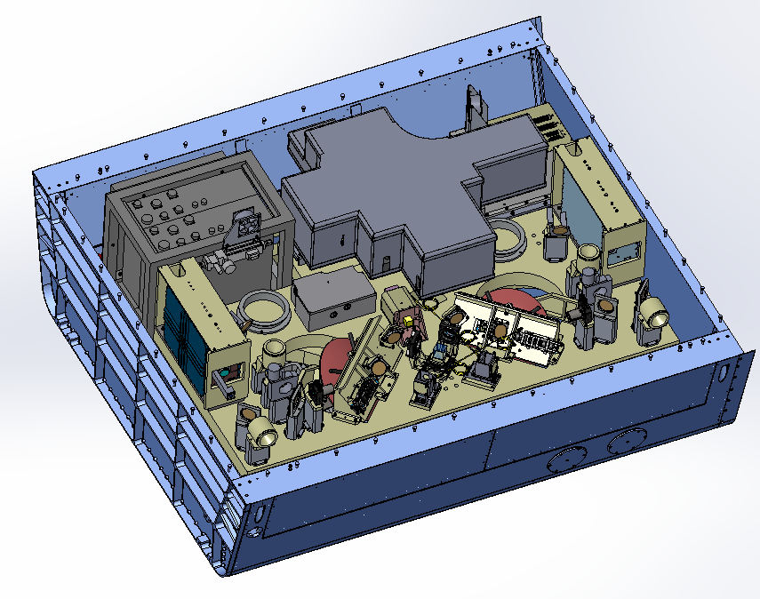
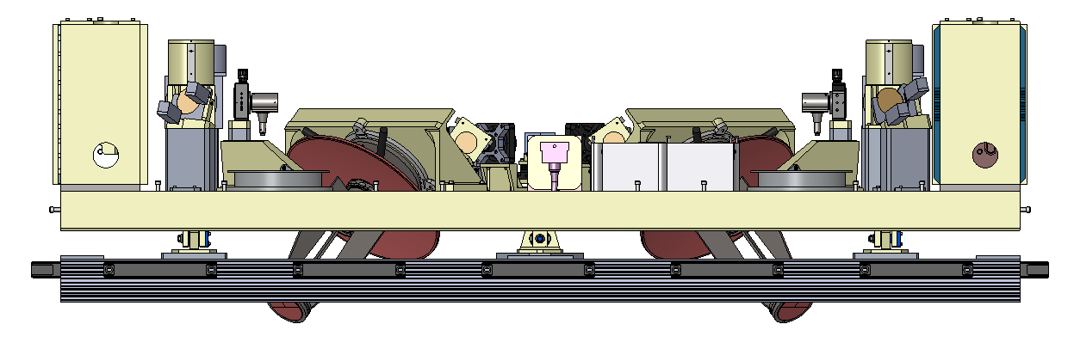
Optical Bench
Laser Electronics rack
Electronics chassis
Lasers
Optical Bench
  lasers
  telescopes,
  transmit/receive optics
  fiber coupling
  GPS/IMU
Electronics rack and payload controller
Interferometer & thermal cover
Fiber coupling connects the telescopes to the interferometer.
Telescopes
Interferometer with thermal cover

Slide 8
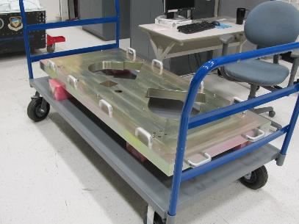
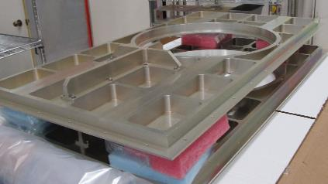
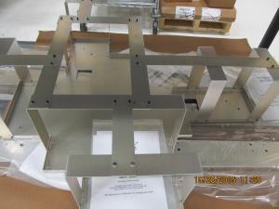
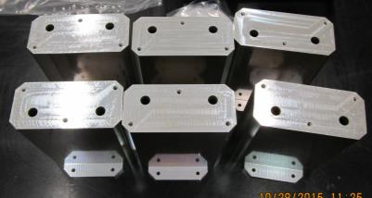
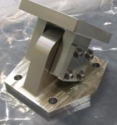
Machined parts – in assembly phase
Main optical bench
New pallet panels
Interferometer thermal enclosure frame
Optical Pedestals
Kinematic Mount

Slide 9
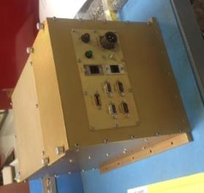
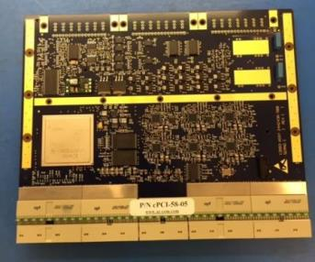
Electrical Subsystems
Conduction cooled payload controller chassis
Single board computer (SBC)
Processor board (built)
  Controls MPPC detector setpoints (HV, Temp)
  Samples signals, and bins the data
  Performs real-time LOS wind processing
  532 nm board has been built and tested. Working integration with the Payload Control chassis.
Auxiliary board (in build phase)
  Measurement and/or Controls for:
    Telemetry/housekeeping sensors
    Cooling loop (heaters, pumps, fans, etc.) & Optical bench heaters
    Boresight Mechanisms
    532 nm attenuation control
  Interface forApplanix GPS/IMU, System interlock, Pilot interface
WB-57 wiring ICD & harness
design/build of cable harness

Slide 10
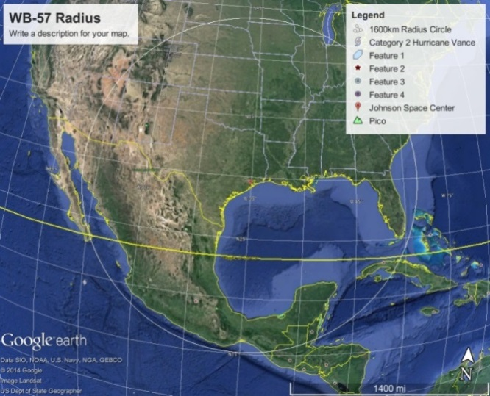
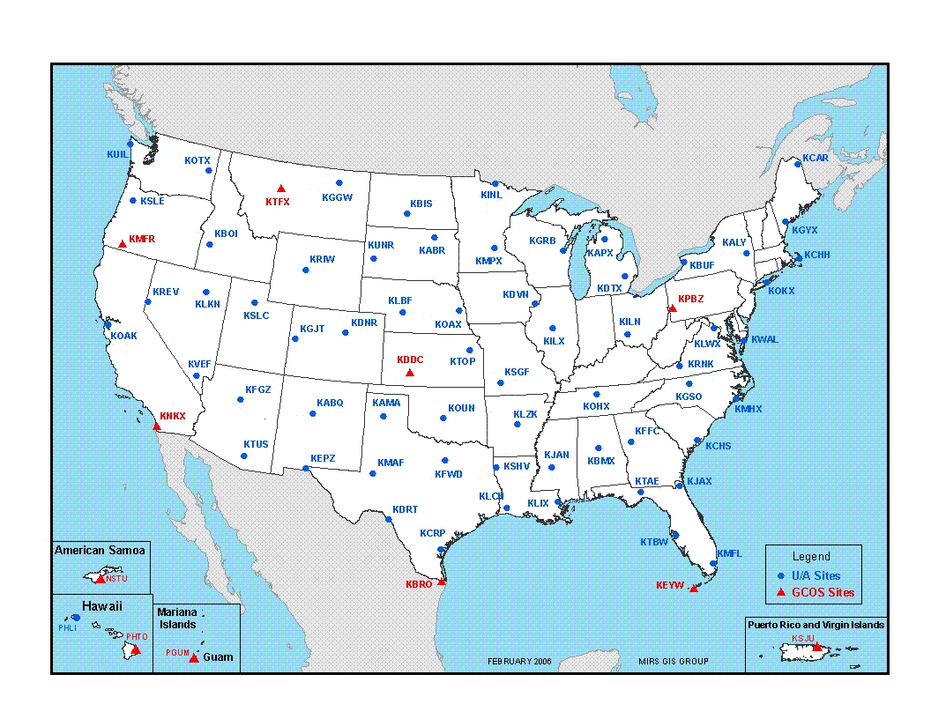
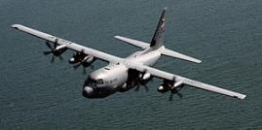

Validation with Sondes
Balloon-sondes
  Arrangements being made with NOAA stations to launch sondes when aircraft is overhead
  Availability of many potential launch sites provides flexibility for bad weather
  Working with White Sands Missile Range (WSMR) to coordinate sonde launches with GrOAWL flights
Dropsondes
  ONR/Yankee Environmental Systems automated dropsonde system HDSS (High Definition Sounding System dropsonde) to be deployed in bay 4 of the WB-57
  ONR indicating that HDSS will be co-deployed with GrOAWL for the AOVT airborne testing
  Will also coordinate with 53rd weather squadron training program (dropping sondes over Gulf of Mexico)

Slide 11
Space-Based OAWL Roadmap
Mission Definition
Science Team
System Requirements
System Architecture (532 nm)
Athermal Interferometer
Pointing Requirements
DS White Papers for Wind Lidar
Prototype
interferometer
532 nm OAWL OSSE
Wind Lidar Data Assimilation
Ball
Investments
2003+
FPGA Real-time winds processing
Architecture Studies
ATHENA-OAWL
EV-I Concept
Earth Venture
Mission (Science Demonstration, ISS)
Winds algorithm development
Radiometric modeling
Decadal Survey
Wind Lidar Mission
ATHENA-OAWL Venture-Tech
(March 2015)
OAWL IIP-07: First system – 355 nm
NASA ESTO Investments (2008+)
OSSE: 355 OAWL impact
HAWC-OAWL
IIP (2014-2017)
Airborne Science
Flights/Missions
(Cal-Val, EV-S, etc.)
GSFC IDL: Cost & tech. feasibility
HOAWL ACT: 2λ winds & HSRL algorithms
HEUVD (Fibertek)
(2015-2016)
FIDDL ACT double Edge Lab demo
Airborne data impact studies
Orbital dynamics studies

Slide 12
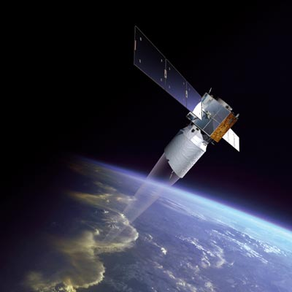
Next steps for (Gr)OAWL
2016 AOVT “GrOAWL” flights (April/May)
  demonstrator for space-based ATHENA-OAWL mission concept
2017: ESA’s Aeolus Mission (ADM)
  Single-perspective line-of-sight winds
  Aerosol & molecular channels: Both at 355 nm
  Aeolus Calibration/Validation Effort
    OAWL is the only (known) airborne 355 nm aerosol wind lidar system in US
    can provide validation for Aeolus 355 nm aerosol channel
2017 (TBD): HAWC-OAWL flights with two wavelengths - HSRL+winds for aerosol transport & chemical weather
2017: Earth Science Decadal Survey
  Build on CALIPSO technology - still working.
  Understand wavelength trades: 355/532/1064

Slide 13
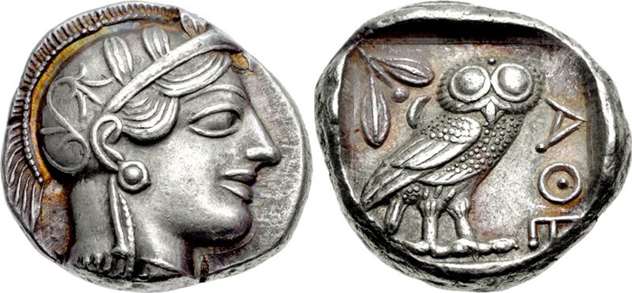
Thank you
Extras follow…

Slide 14

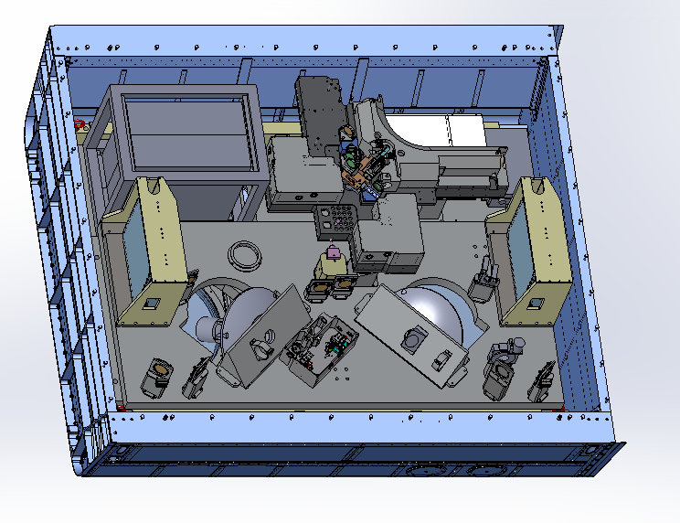
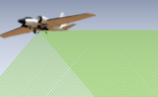

Green OAWL (“GrOAWL”) Airborne Demonstrator for the
ATHENA-OAWL Earth Venture Mission
Science PI: R. Michael Hardesty, University of Colorado at Boulder,
Instrument PI: Sara C. Tucker, Ball Aerospace
Objective
Develop the OAWL receiver into a rugged airborne 532 nm wavelength aerosol Doppler wind lidar with two look angles from a single platform
Perform high altitude aircraft test flights measuring LOS wind profiles from two looks over a series of atmospheric aerosol conditions,
Validate the airborne system performance using ground-based weather radiosondes
Raise the TRL of the OAWL approach to space-based wind lidar for future Earth Venture opportunities.
(Right) ATHENA-OAWL Airborne Demonstrator layout in the NASA WB-57 pallet: two lasers and two telescopes for the two lines of sight (below)
Lasers
Electronics
Payload Controller
OAWL Interferometer
Laser #1
Laser #2
Telescopes & Receive Path Optics
Approach:
Key Milestones
Build on the OAWL receiver technology by
  Integrating a two-look telescope configuration like that planned for space-based configuration for vector winds into the NASA WB-57 pallet
  Improve data precision for wind and aerosol products through design and build of enhanced structural support and thermal control, improved detection and data acquisition electronics, and software.
Validate the airborne Green-OAWL wind data against ground-launched weather service radiosondes.
ATP 3 March 2015
Systems Engineering Plan 04/15
Electrical Functional Designs 05/15
Opto-Mechanical Designs 09/15
Acquisition & Control System Delivery 12/15
Hardware System Assembled 02/16
Flight Implementation Plans &
Ground Testing Complete 03/16
Airborne Test flights Complete 06/16
Presentation of Validation Results 12/16
Completion of All Option Testing 02/17
Final Reporting 02/17
Co-Is: Carl Weimer, Ball Aerospace
Collaborator: Floyd Hovis, Fibertek
TRL_{in} = 3
12/14 Venture-Tech 2014

Slide 15
Laser Eye Safety Drives SNR/Flight locations
350 km = 17.5X Altitude
532 nm wavelength: CALIPSO vs. ATHENA-OAWL
  CALIPSO: 110 mJ, 20 Hz, 705 km altitude, 100 μ-radian divergence
  ATHENA-OAWL: 160 mJ, 150 Hz, 350 km altitude, 150 μ-radian divergence
  The same eye-safety is achieved through the additional divergence
Vs. GrOAWL Aircraft Eye Safety
  0.5-2.5 mJ, 200 Hz, 10-20 km altitude,
  120 μ-radian divergence
  Similar ground footprint intensities
  (different size footprints!)
  Very different intensities from ground to aircraft altitude – puts restrictions on airborne operation at 532 nm
  Easier for 355 nm (eyesafe at
  1km from aircraft)
120km (6x,
for reference)
Eye-safe range for ATHENA-OAWL
20 km
Eye-safe range for GrOAWL
@532 nm
Commercial aircraft

Slide 16
Optical Autocovariance Wind Lidar (OAWL)
Field-widened, .9 m OPD, Mach-Zehnder Interferometer (MZI) works well with
large telescopes; Patent #s: US7929215B1, US8077294B1
Four channels sample interferometer fringe phase (wind) and amplitude (aerosol).
Outgoing “T0” pulse
Atmospheric Returns
Fringes wrap – no “out of band” concerns,
T0 phase used to adjust every pulse: no laser pulse-to-pulse stability requirements
The phase difference Δϕ is related to the line-of-sight wind speed, V_{LOS} by
QWP
d1
d2
d3
d4
0° 90° 180° 270°
Detectors at constant ACF phase

