Slide 1
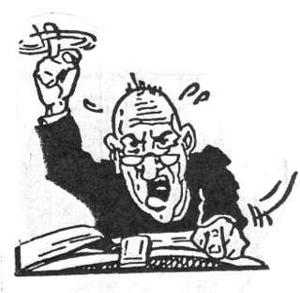
Updating Advice on Selecting Level-2,3 Surface Vector Wind
Datasets: Applications Perspective
Ralph F. Milliff; NWRA/CoRA
Mark Bourassa; COAPS, Florida State Univ.
Dudley Chelton; COAS, Oregon State Univ.
Ernesto Rodriguez JPL, CalTech
IOVWST Meeting, Annapolis, MD
Indentured Review Lecture, May 2011

Slide 2
What this review is about:
Definitions L2B, L3 SVW datasets
Validation of SVW in applications using L2, L3 datasets
Updating/Coordinating SVW dataset repositories on the web
How to comment on/recommend L2, L3 SVW datasets to colleagues
Draft Project Statement (i.e. recommendations to “the community”)
Some L2 and L3 datasets on the (near?) horizon
What this review is not about:
Validation vs. buoys
Special products (e.g. UHR, coastal winds, σ₀, τ, L4, etc.)
“Beauty Contests” or “My Favorite” L2, L3 SVW dataset
Similarly, “My Favorite” L2, L3 SVW distribution web sites
IOVWST Meeting, Annapolis, MD
Invited Review Lecture, May 2011

Slide 3
Definitions:
L2B or Level-2B
In-Swath SVW retrievals (i.e. wind speed and direction) organized in along-
and across-track arrays of wind vector cells (WVCs). Daily representations of
L2 SVW exhibit gaps in coverage; i.e. between swaths.
- flavors include: ASCAT; ERS-1,2; NSCAT and QuikSCAT
50km, 25km and 12.5km standard spatial resolutions
Near Real-Time (NRT) and “science quality”
L3 or Level-3
Gridded SVW fields (usually regular global grids in deg. Lat, Lon) based on
L2 SVW inputs. Daily representations of L3 SVW do not exhibit gaps, but gaps
have been filled by ancillary processing, often involving ancillary datasets
(e.g. weather-center analyses).
- flavors include: single or multi-platform L2 inputs
methods-based constructions (smoothing, Kriging, extrapolation)
ancillary data based constructions
0.25° to 2° presentations
4x daily, daily, 3-daily, climatologies
IOVWST Meeting, Annapolis, MD
Invited Review Lecture, May 2011

Slide 4
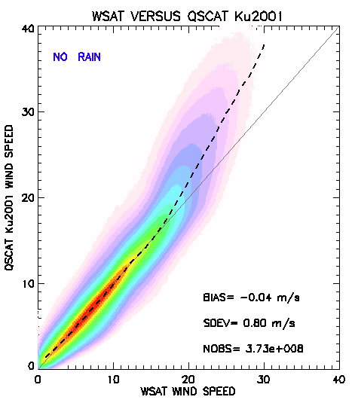
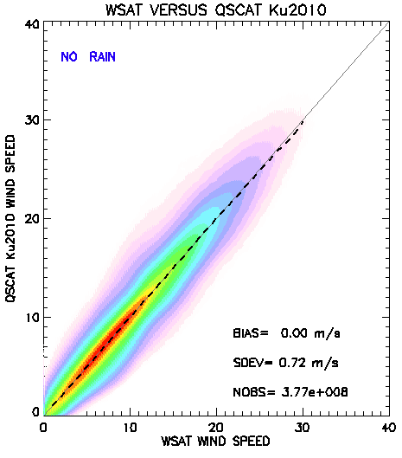
SVW Retrieval:
L2 SVW datasets different, even given same σ₀
- different/improved methods
- additional validation data
Gaps in L2 SVW datasets due to swath configs, rain
KU2001
KU2010
IOVWST Meeting, Annapolis, MD
Invited Review Lecture, May 2011
Notes:
5-yr WindSat validation dataset (wind speed)
Ku2011 just released, to be described later today

Slide 5
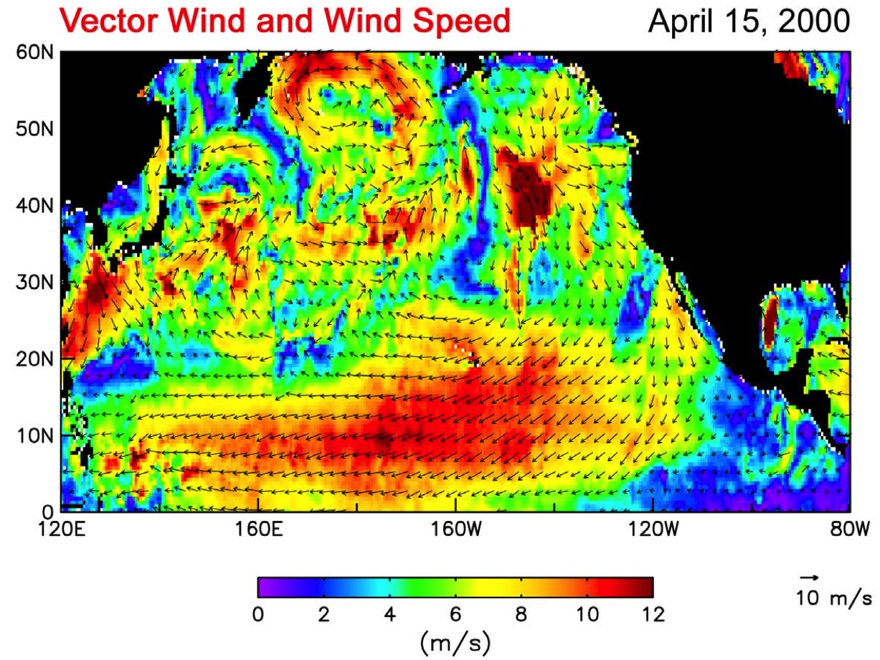
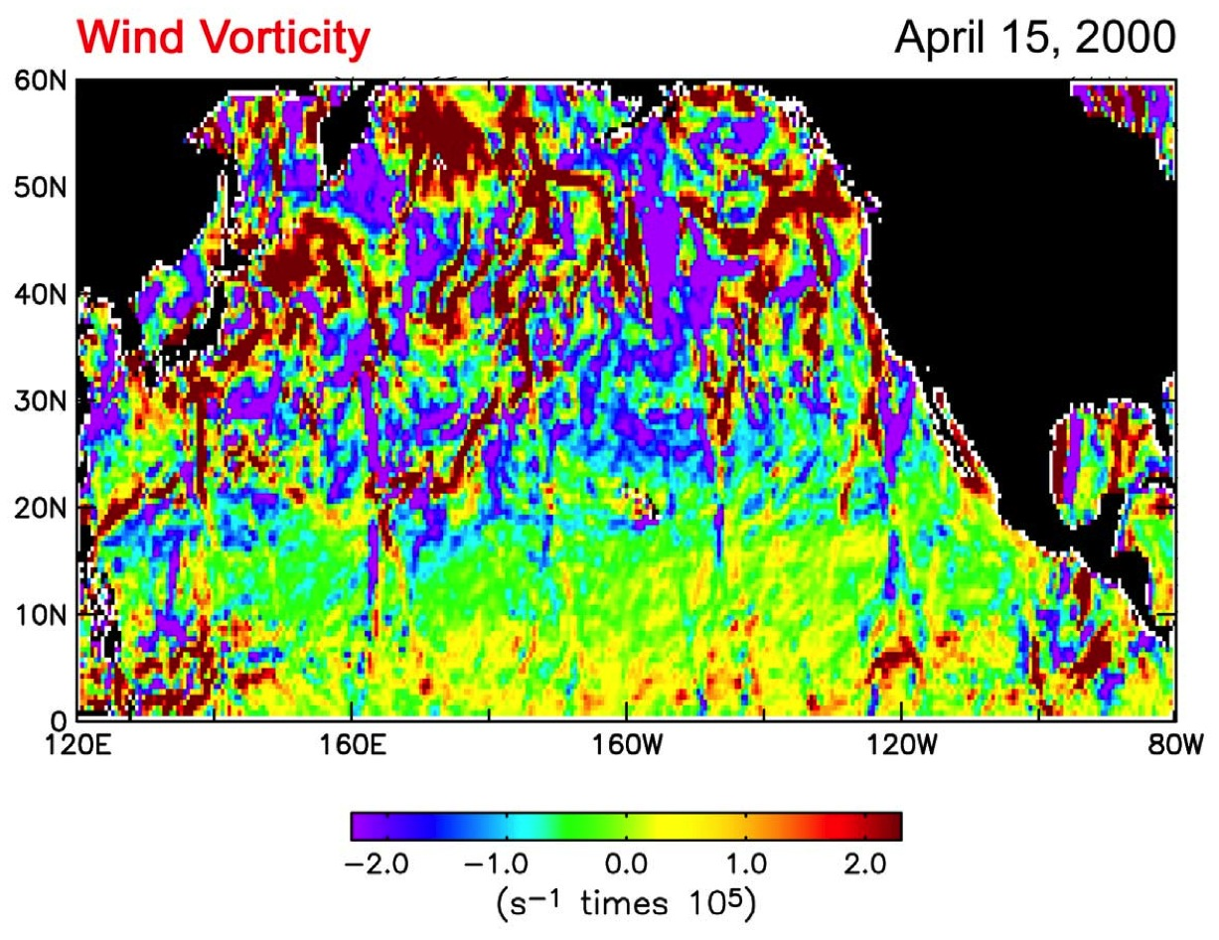
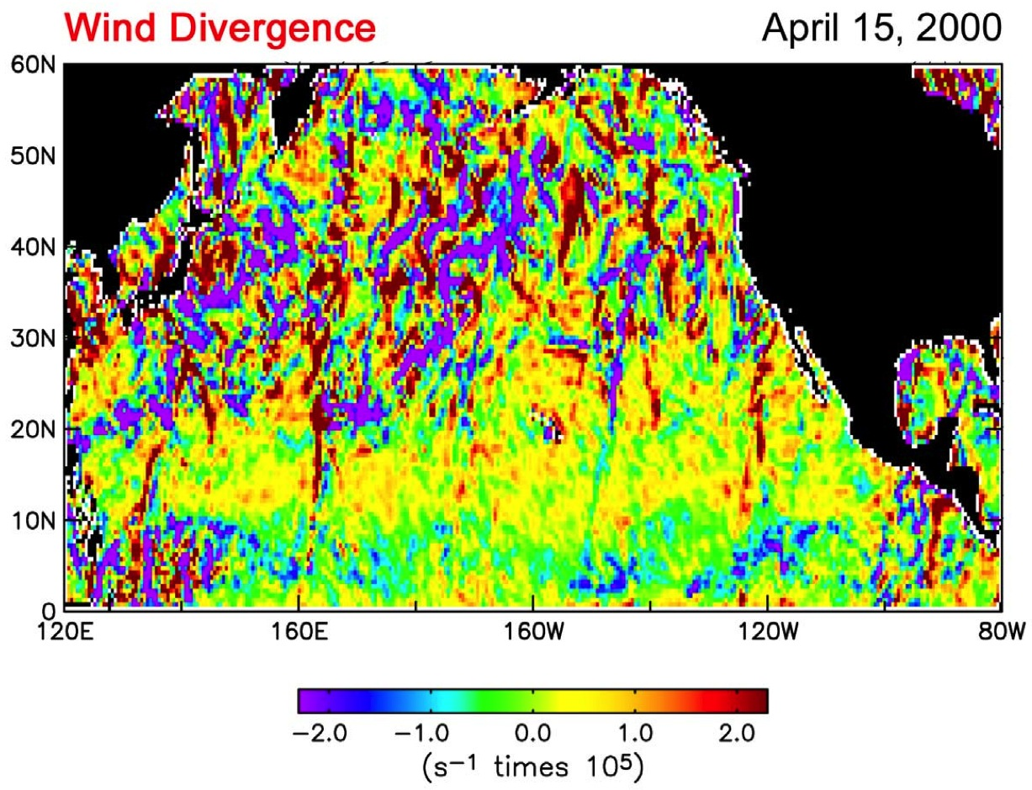
Feature-based Validation L3:
Derivative fields for first-cut assessment
of L3 product; i.e. do you see the swath?
IOVWST Meeting, Annapolis, MD
Invited Review Lecture, May 2011

Slide 6
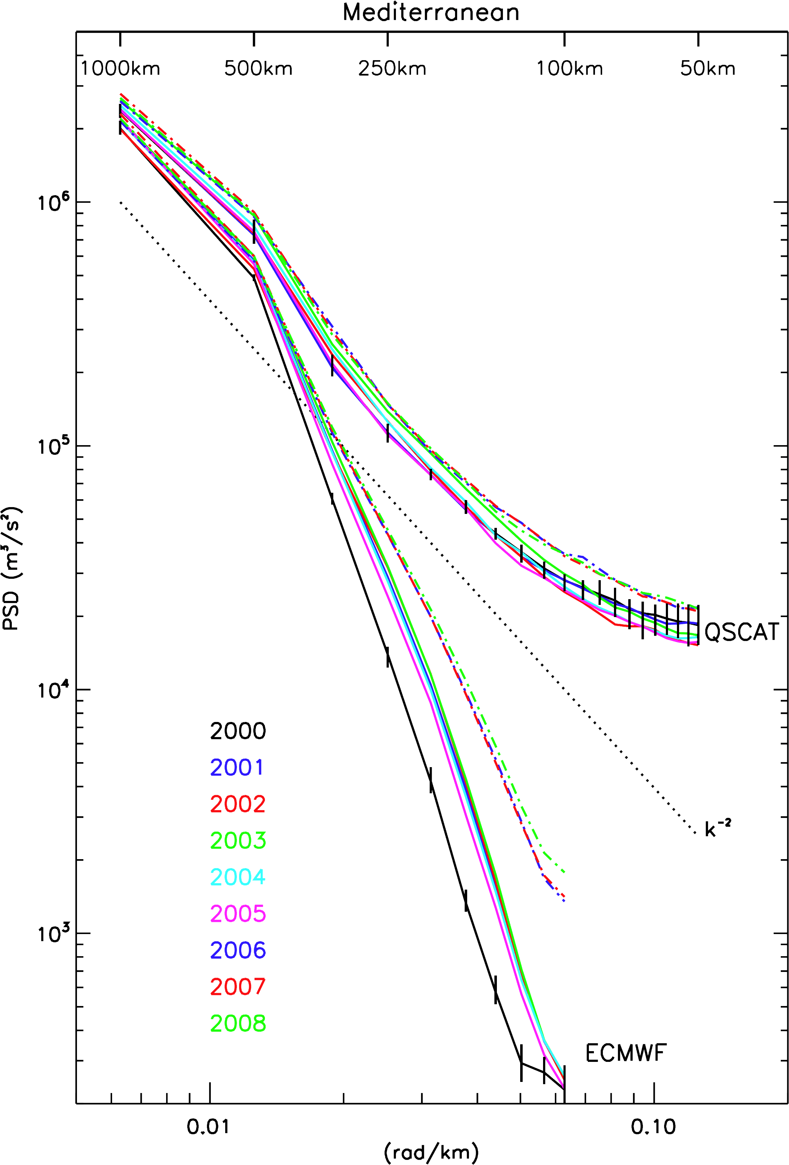
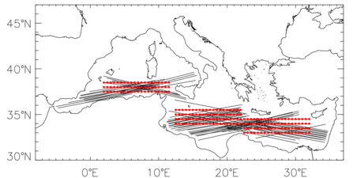
Kinetic energy as a function of spatial scale
Order of Magnitude
difference at ocean
Synoptic and Mesoscales
IOVWST Meeting, Annapolis, MD
Invited Review Lecture, May 2011

Slide 7
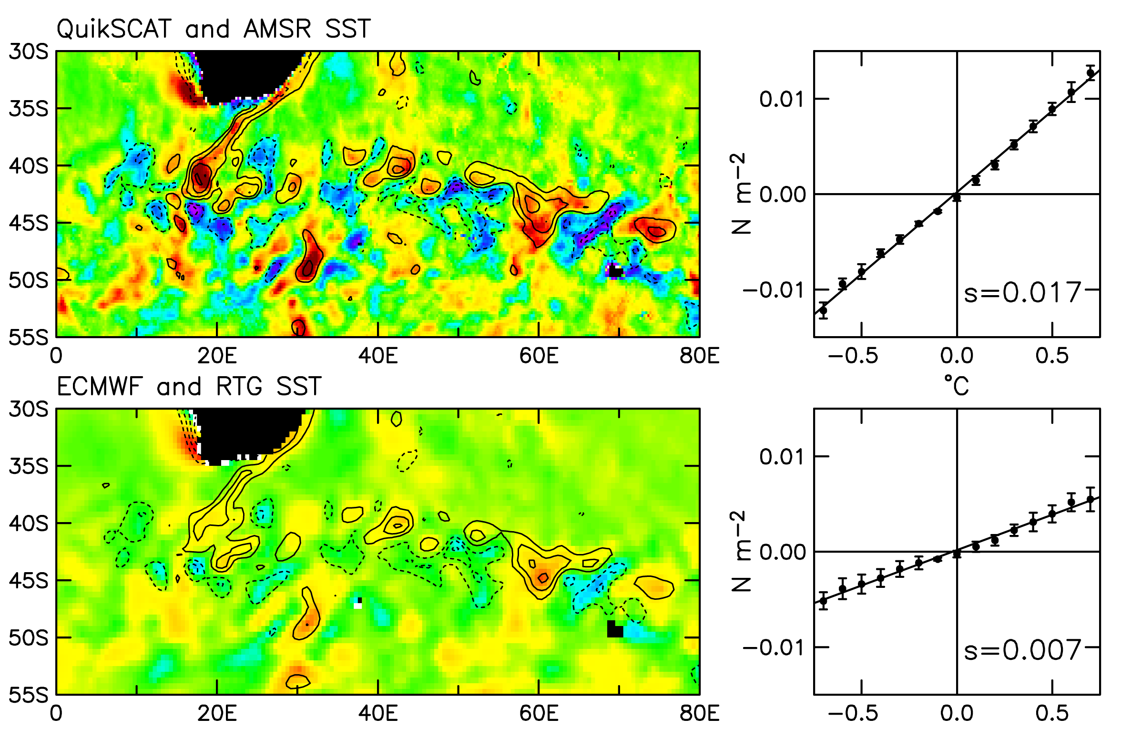
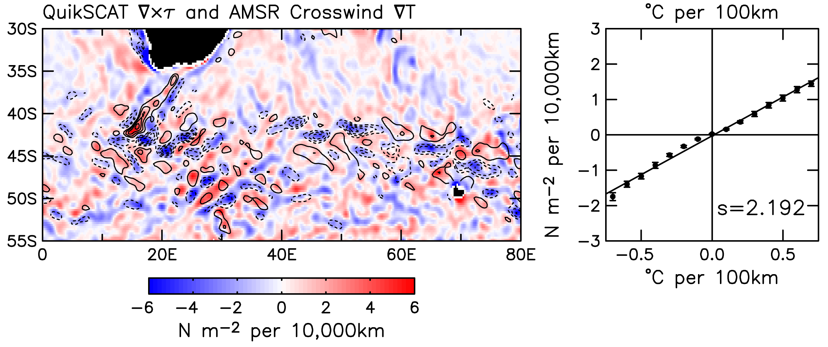
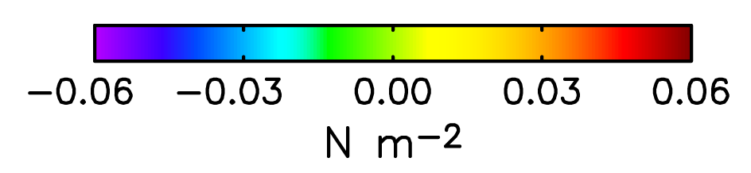
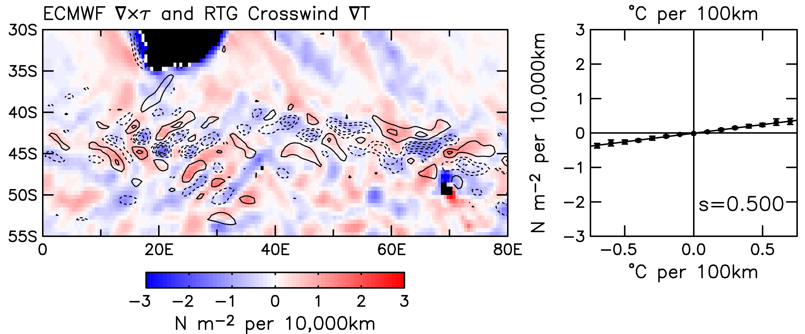
Air-Sea Coupling Amplitude:
Satellite-to-Satellite comparisons yield Strongest Coupling Coefficients
Wind Stress and SST
Ocean scales 10km – 1000km
Slope of linear relation is coupling coeff
Important for fluxes
Wind Stress Curl and SST Gradient
Chelton, D.B. and S-P Xie, 2010: “Coupled Ocean-Atmosphere
Interaction at Oceanic Mesoscales”, Oceanography,
23(4), 52-69.
IOVWST Meeting, Annapolis, MD
Invited Review Lecture, May 2011

Slide 8
Schlax, M.G., D.B. Chelton and M.H. Freilich, 2001: “Sampling errors in wind fields constructed from single and tandem
scatterometer datasets”, J. Atmospheric and Oceanic Technology, 18(6), 1014-1036.
IOVWST Meeting, Annapolis, MD
Invited Review Lecture, May 2011

Slide 9
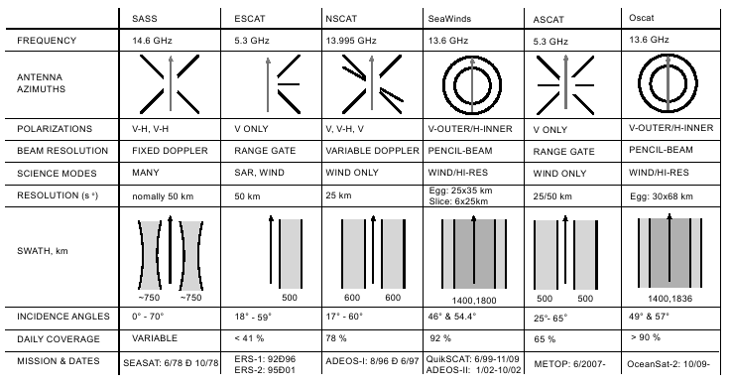
Repositories:
§ - Near Real-Time products
Comprehensive, Services Driven
Less Comprehensive, Research Driven
Update, Coordinate Emphasis
podaac-www.jpl.nasa.gov
www.ssmi.com
www.osi-saf.org§
www.atmos.washington.edu/~jerome/WINDS/
coaps.fsu.edu/scatterometry
dss.ucar.edu/datasets/ds744.*
manati.orbit.nesdis.noaa.gov/datasets§
cersat.ifremer.fr
www.mers.byu.edu/
www.ssmi.com
IOVWST Meeting, Annapolis, MD
Table stolen from BYU/MERS web site
Invited Review Lecture, May 2011

Slide 10
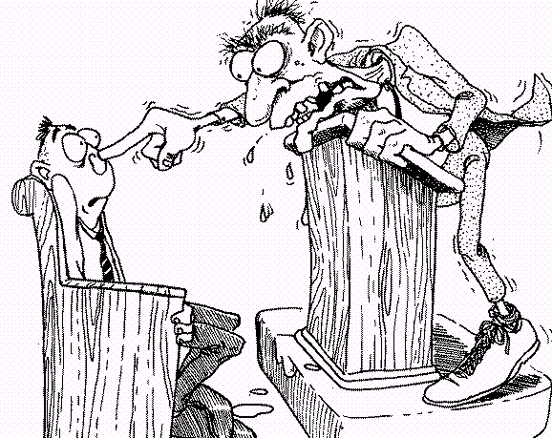
Advice to Community:
Match space-time coherence in SVW with application
  a) feature-based; more than matching Δx, Δt
Areal average of instantaneous σ₀ vs. point support (some time averaging)
Kinetic energy content as a function of spatial scale
  commonly depicted in Fourier spectra; KE vs. k, for spatial wavenumber k
  power-law relations with spectral slopes k⁻² (mid-latitudes), k^{-5/3} (tropics)
    ambiguities in Fourier spectral techniques
  true spatial resolution corresponds to spatial scale at which L3 winds
  depart from k⁻² or k^{-5/3}
    L3 products should not present on grids finer than true resolution
Use latest validated datasets from authoritative sources (repositories)
Air-Sea coupling coefficient magnitudes are strongest for satellite datasets;
e.g. slope of linear relation between SST anomaly and wind stress derivatives
(curl and divergence) on scales 10km to 1000km.
IOVWST Meeting, Annapolis, MD
Invited Review Lecture, May 2011

Slide 11
Project Statement:
Read and comment on Draft Statement (here)
Edits by co-author team (here)
Action items for Project leaders (committees)
Post Advice (KNMI, PO.DAAC, COAPS, Ifremer, etc.)
IOVWST Meeting, Annapolis, MD
Invited Review Lecture, May 2011

Slide 12
Related and Forthcoming L2,L3 SVW Datasets
OceanSat-2 (OSCAT) community datasets
Reprocessing:
OVWST Project at JPL; L2 and L3, when ???
Ku2011 just released (RSS; Lucrezia Ricciardulli)
KNMI ASCAT L3???
Multi-Platform:
CCMP
NWRA/CoRA Global Surface Wind BHM (ensemble winds)
Special Purpose:
BYU Ultra-High-Resolution
OSU COAS Coastal Winds L3
IOVWST Meeting, Annapolis, MD
Invited Review Lecture, May 2011

Slide 13
Global wind products with 6 hour temporal sampling
Wind products that assimilate many different data sources to produce maps with high temporal sampling typically underestimate the high spatial frequency component of the wind field.
Plots based on 1 year of data.
R. Atlas, R. Hoffman, J. Ardizzone, S. Leidner, and J. C. Jusem, “Development of a new cross-calibrated, multi-platform (CCMP) ocean surface wind product,” in AMS 13th Conference on Integrated Observing and Assimilation Systems for Atmosphere,Oceans, and Land Surface (IOAS-AOLS), 2009.

Slide 14
Summary:
L2 datasets can differ for same σ₀
Gaps in L2 from swath configurations and rain
L3 datasets fill gaps in a variety of ways
Applications Users have to evaluate feature/phenomena resolution in L3 data
KE vs k and true spatial resolution
Air-Sea coupling coefficients strongest in satellite datasets
Filtering/Averaging to improve S/N at expense of resolution
Temporal filtering has most dramatic effects
Prominent SVW dataset repositories should be coordinated (updated)
Project statement to guide potential users (need feedback)
New datasets
IOVWST Meeting, Annapolis, MD
Invited Review Lecture, May 2011

Slide 15
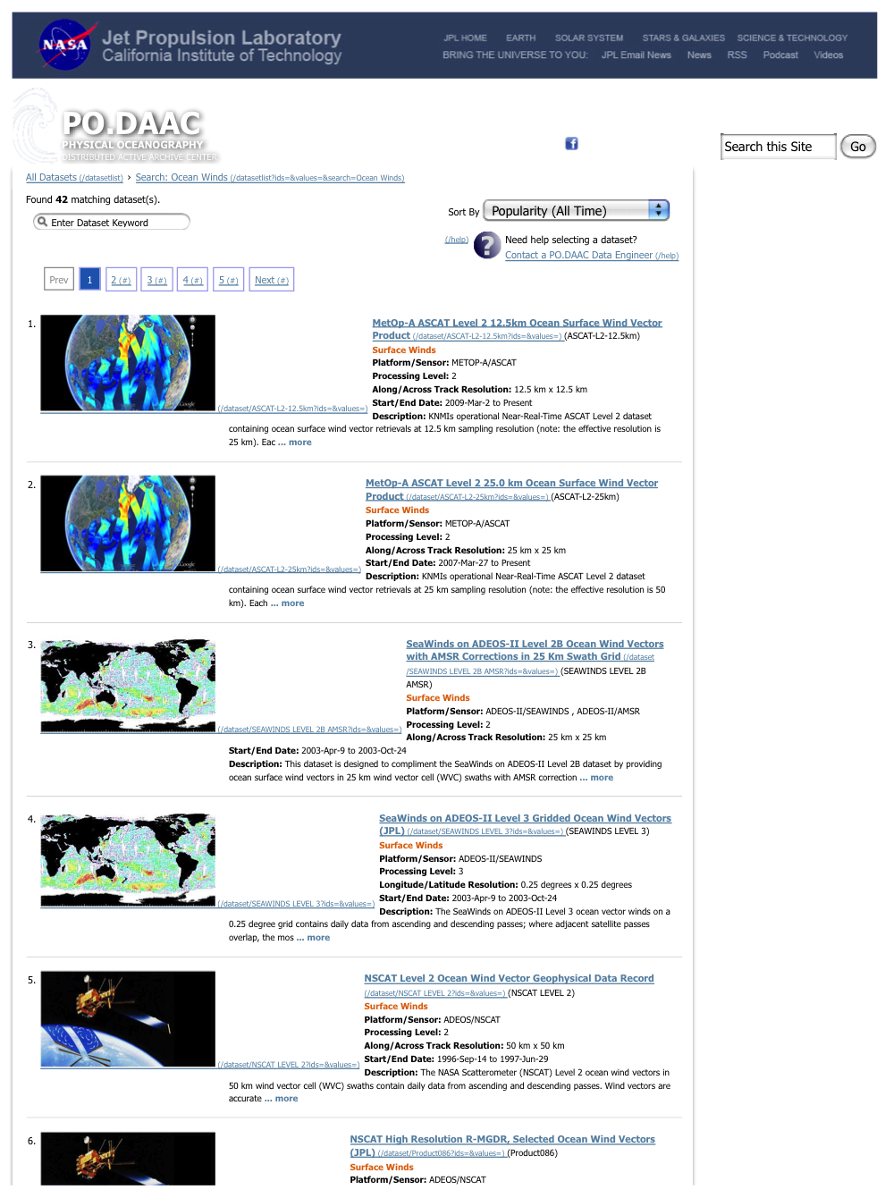
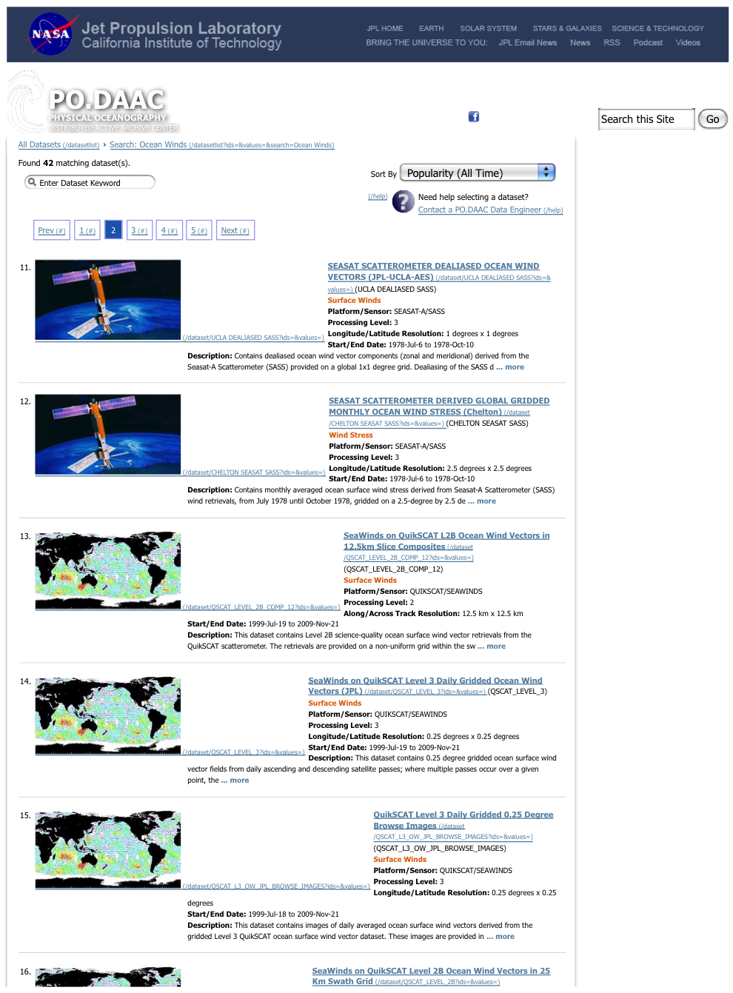

Slide 16
IOVWST Meeting, Annapolis, MD
Invited Review Lecture, May 2011

Slide 17
IOVWST Meeting, Annapolis, MD
Invited Review Lecture, May 2011

