Slide 1
Spatio-Temporal Surface Vector Wind Retrieval Error Models
Ralph F. Milliff NWRA/CoRA
Lucrezia Ricciardulli Remote Sensing Systems
Deborah K. Smith Remote Sensing Systems
Frank Wentz Remote Sensing Systems
Jeremiah Brown NWRA/CoRA
Christopher K. Wikle Statistics, Univ. Missouri
Motivation:
In addition to accurate estimates of the surface vector wind (SVW),
scatterometer observations, and scatterometer datasets include precise
information regarding uncertainties in the SVW retrievals, as functions of
space, time and environmental conditions (e.g. rain).
We exploit the uncertainty information in the Ku2011 retrievals to develop
a space-time error process model for SVW retrievals. This is a necessary
development on a path toward global ensemble SVW from a Bayesian
Hierarchical Model (BHM), based on multi-platform data stage inputs.

Slide 2
Spatio-Temporal Error Model Parameterizations
Let
be an
vector of scatterometer wind component obs at time
Let
be an associated
vector of the “true” wind component from a
prediction grid at time t
Then a Gaussian spatial error model is:
where
is an
matrix that maps obs to the prediction grid,
is an
spatial error covariance matrix, and
is an
incidence matrix for mapping errors to prediction locations
Parameterization 1: Diagonal variance matrix
Let
be m-dimensional scatterometer error estimates for month j,
then
is a diagonal variance matrix approximation to the full covariance
where
is a (monthly) variance inflation parameter

Slide 3
Spatio-temporal Error Model parameterizations (cont’d)
Parameterization 2: EOFs of error variance
Remove temporal mean variance for each x,y
Find the m x p matrix of spatial structure functions
then
Plan
Error estimates from monthly SOS QuikSCAT Ku2011 wind speed vs. Windsat Climo
Monthly Maps for weak ENSO warm event (WE) and neutral years
EOFs and PCs for WE and neutral time series (i.e. as in parameterization 2)
Prototype global wind BHM with spatio-temporal error model
regional (tropical Pacific), parameterization 1

Slide 4
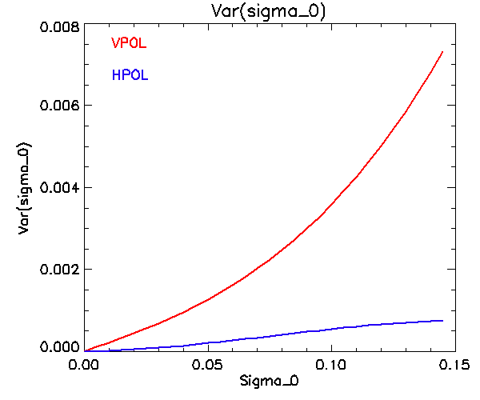
SOS: Sum of Squared Differences
For each cell, with i=1,N observations
Where var(σ_{obs}) represents the
measurement noise

Slide 5
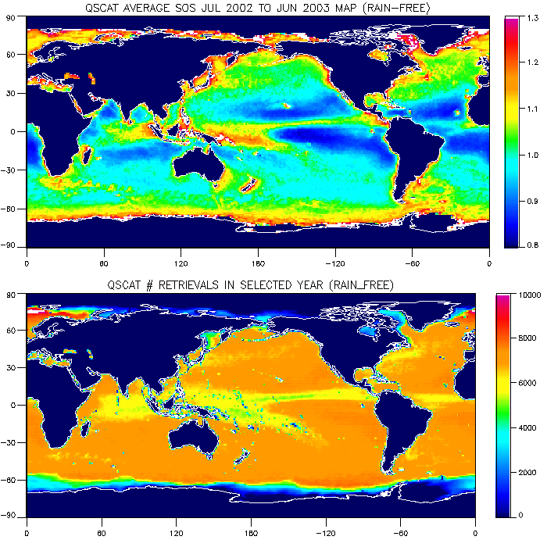
Annual Average SOS in a weak ENSO Warm Event Year (2002-2003)

Slide 6
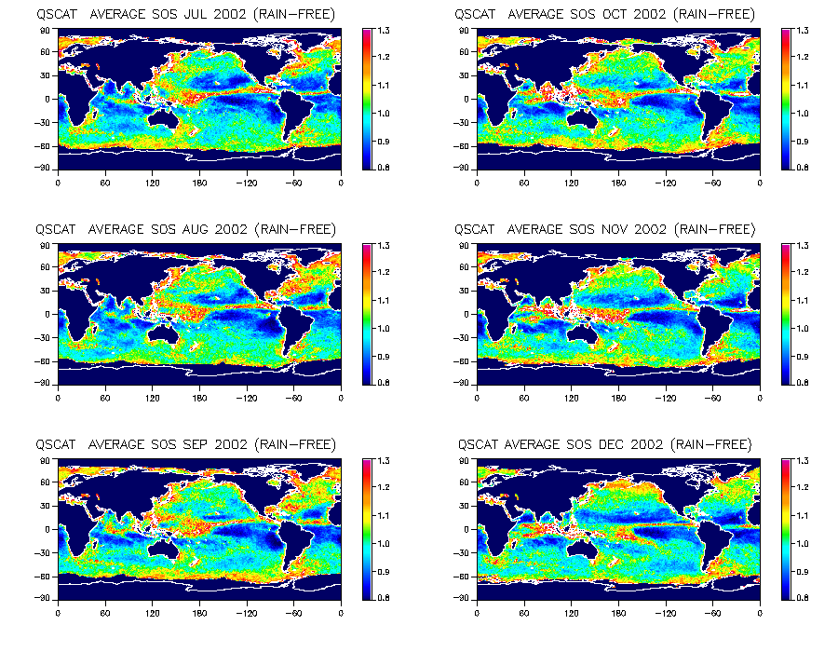
Monthly Average SOS: July 2002 – June 2003

Slide 7
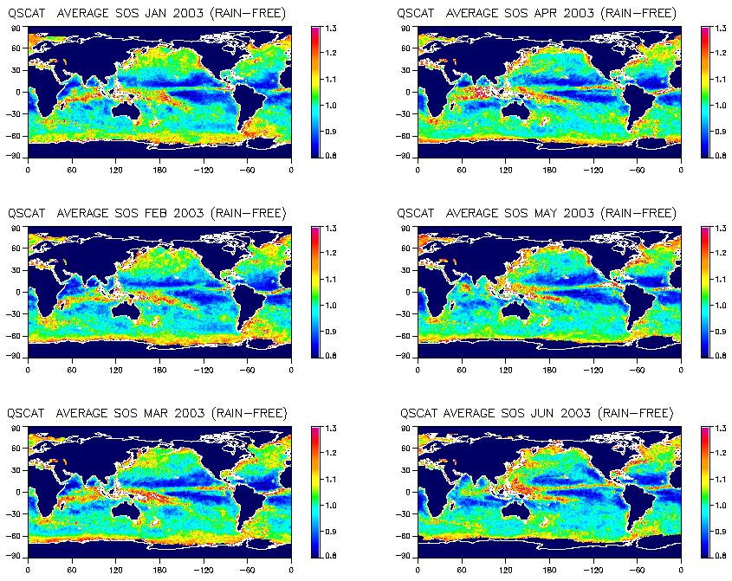
Monthly Average SOS: July 2002 – June 2003

Slide 8
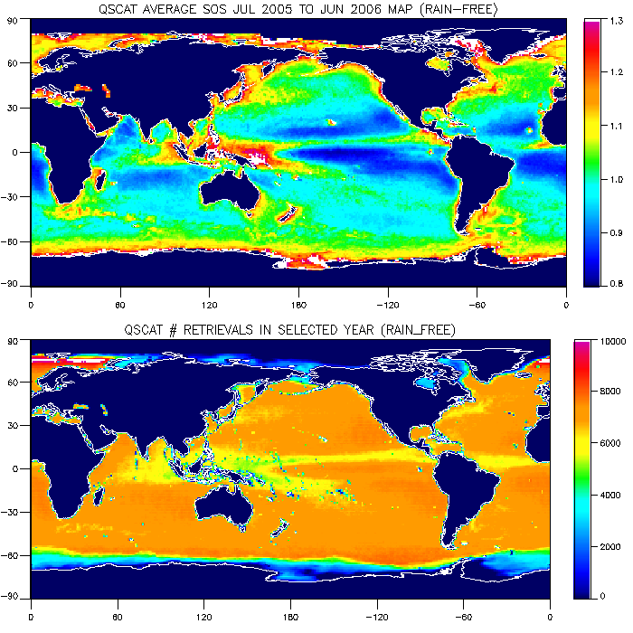
Annual Average SOS in an ENSO Neutral Year (2005-2006)

Slide 9
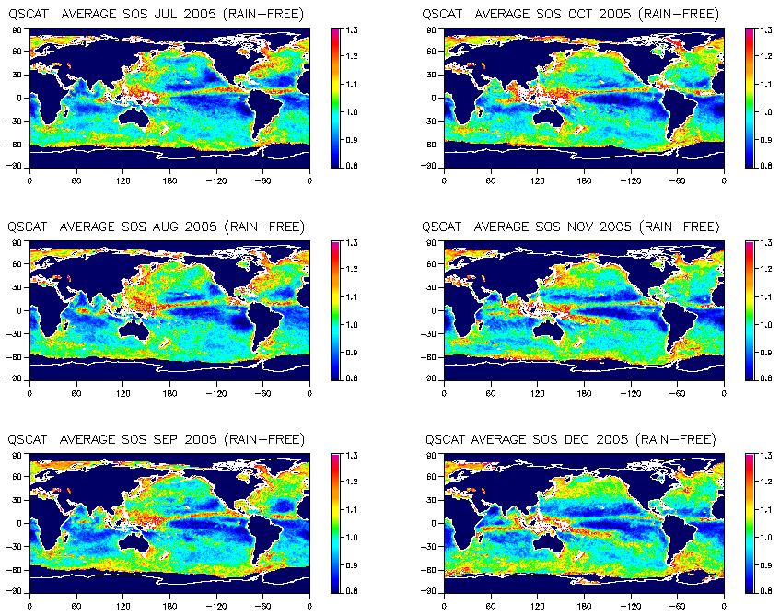
Monthly Average SOS: July 2005 – June 2006

Slide 10
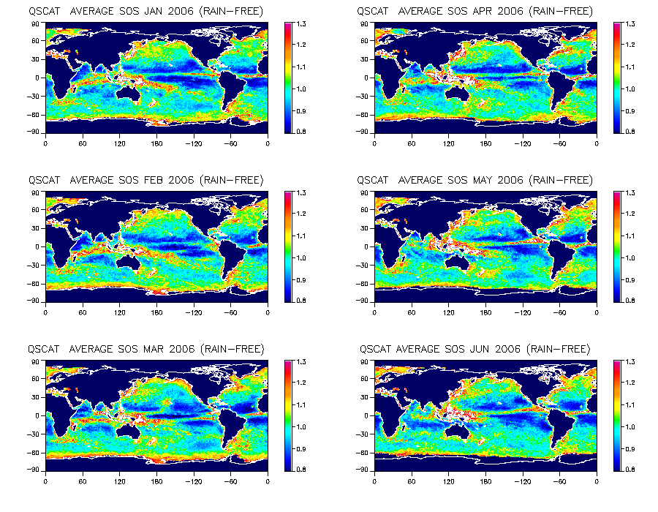
Monthly Average SOS: July 2005 – June 2006

Slide 11
Error EOF and PC Calculation
Monthly diagonal variance matrix from vectorization of SOS maps
Remove temporal mean at each x,y
Singular value decomposition (lose 1 d.o.f. by removing mean)
- yields 11 EOFs and associated PCs for 12 month dataset
Compare ENSO warm event year with ENSO neutral year
- ENSO cold event year (2007-2008) roughly the same as neutral (not shown)

Slide 12
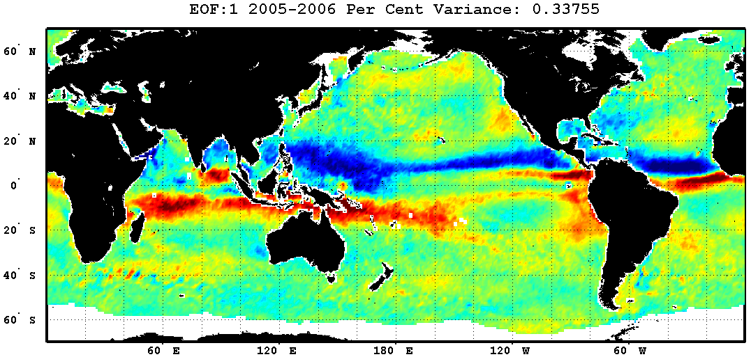
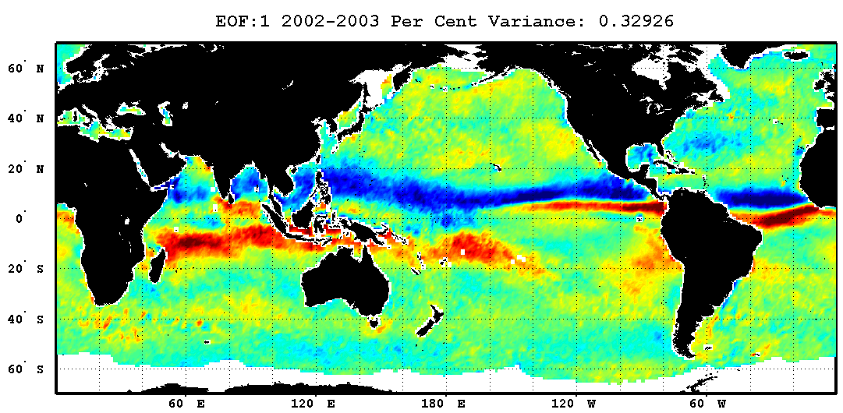
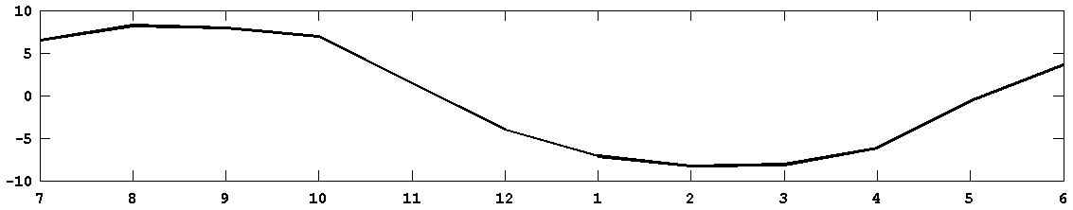
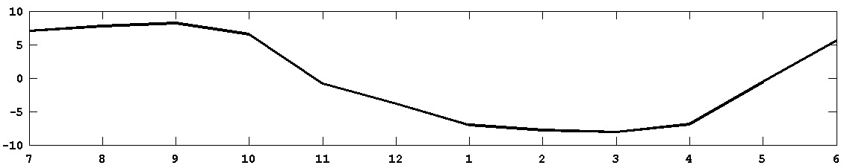
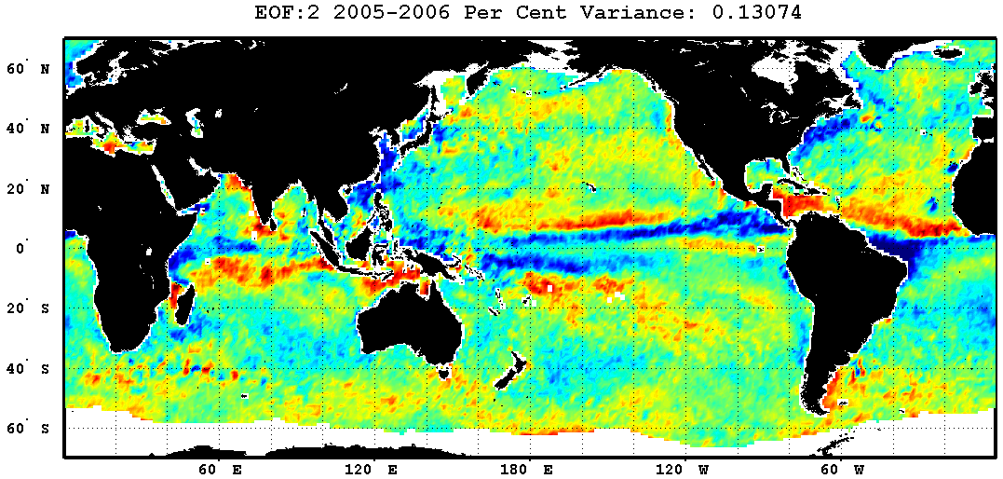
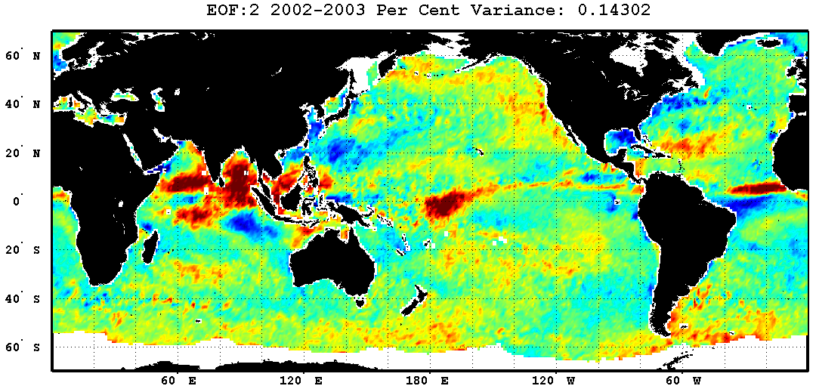
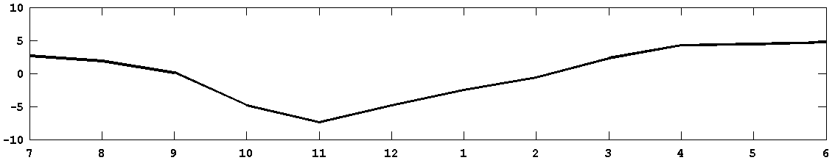
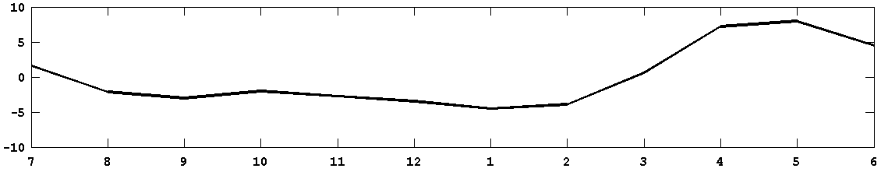
Error EOF and PC Comparison: Leading Modes ENSO WE and Neutral
Neutral Year
Warm Event Year

Slide 13
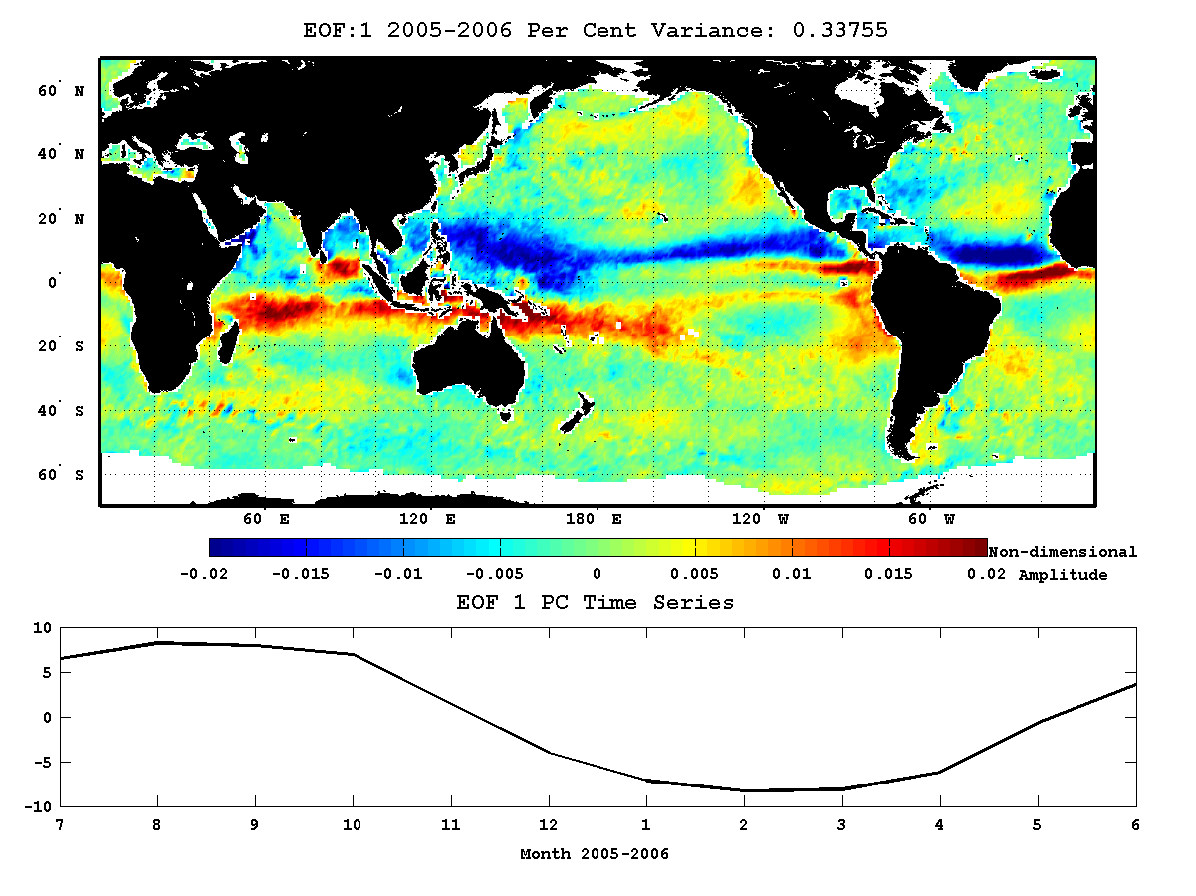
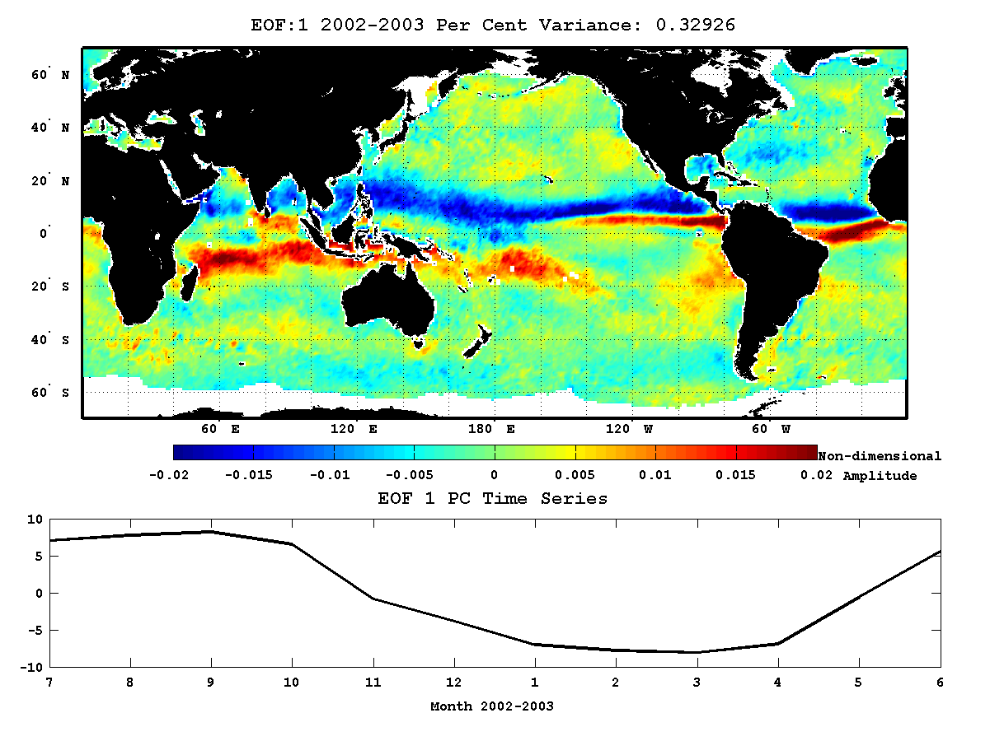
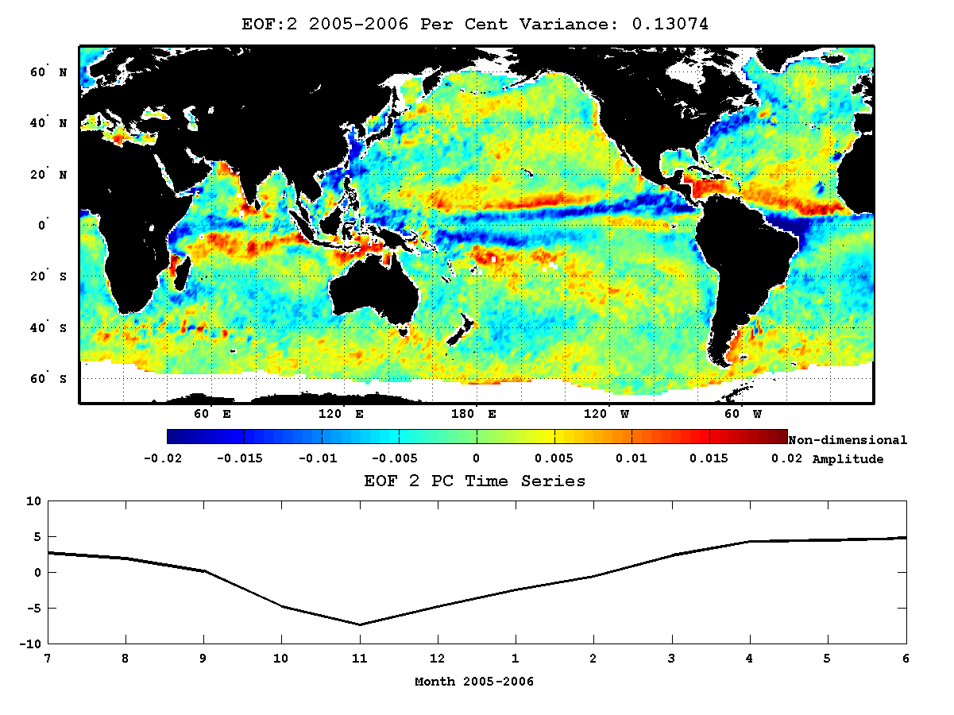
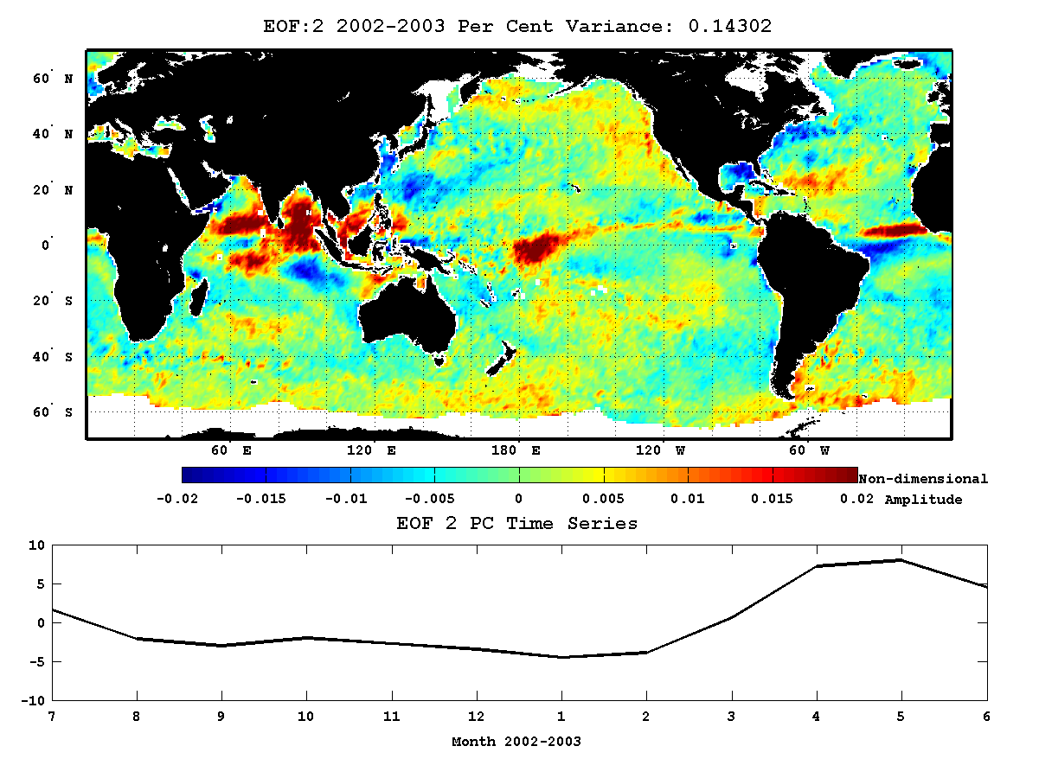
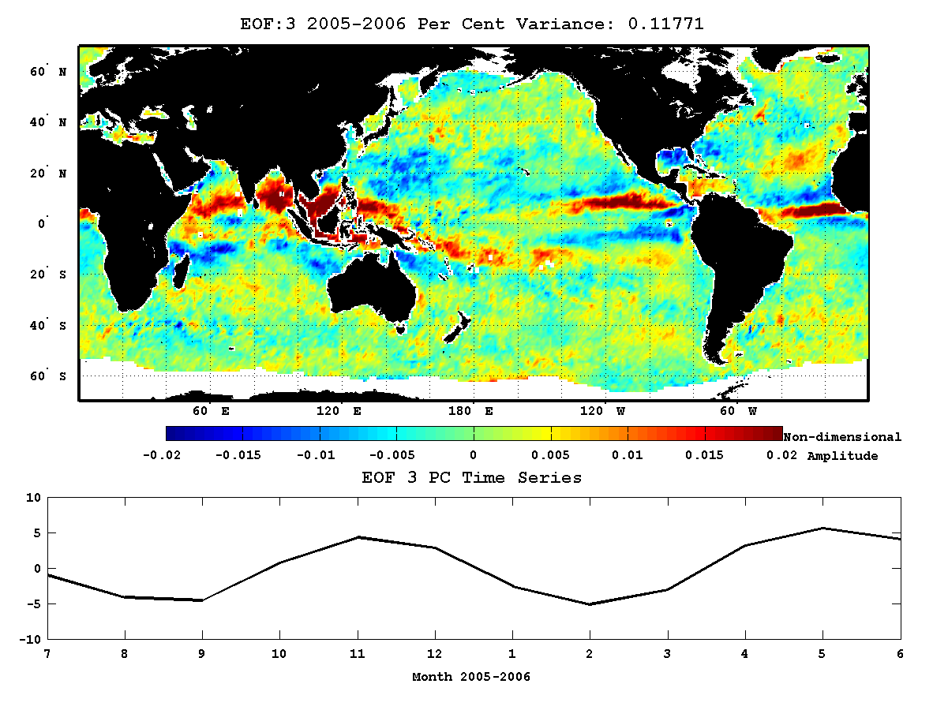
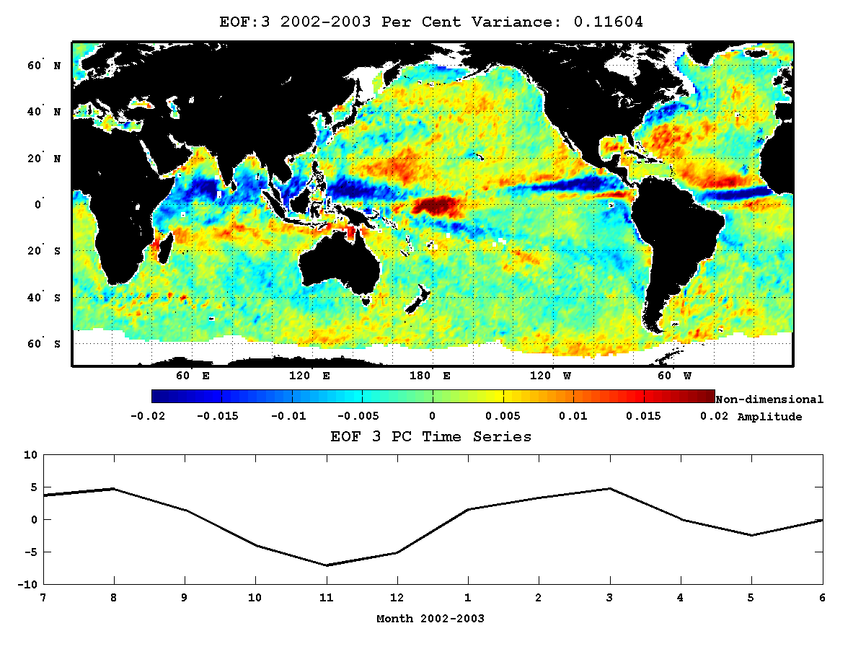
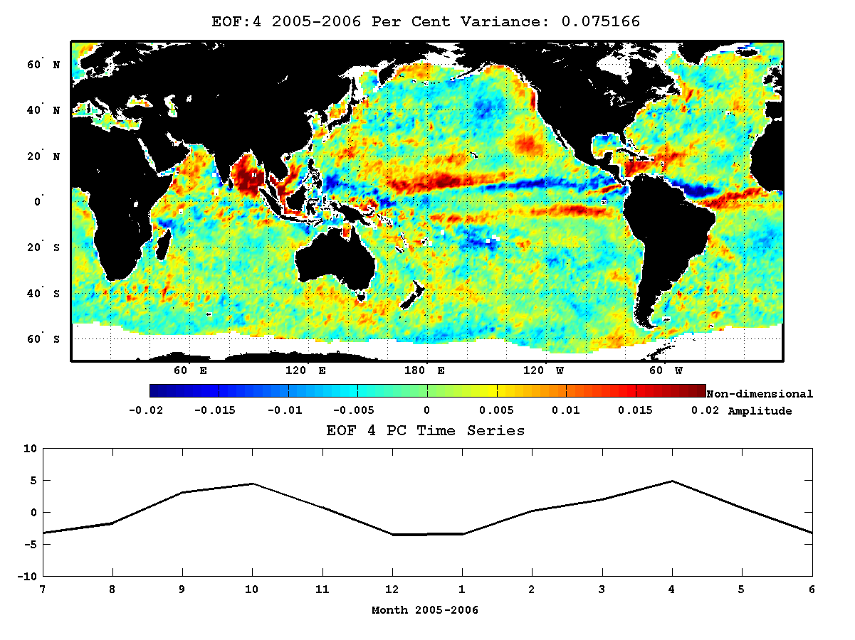
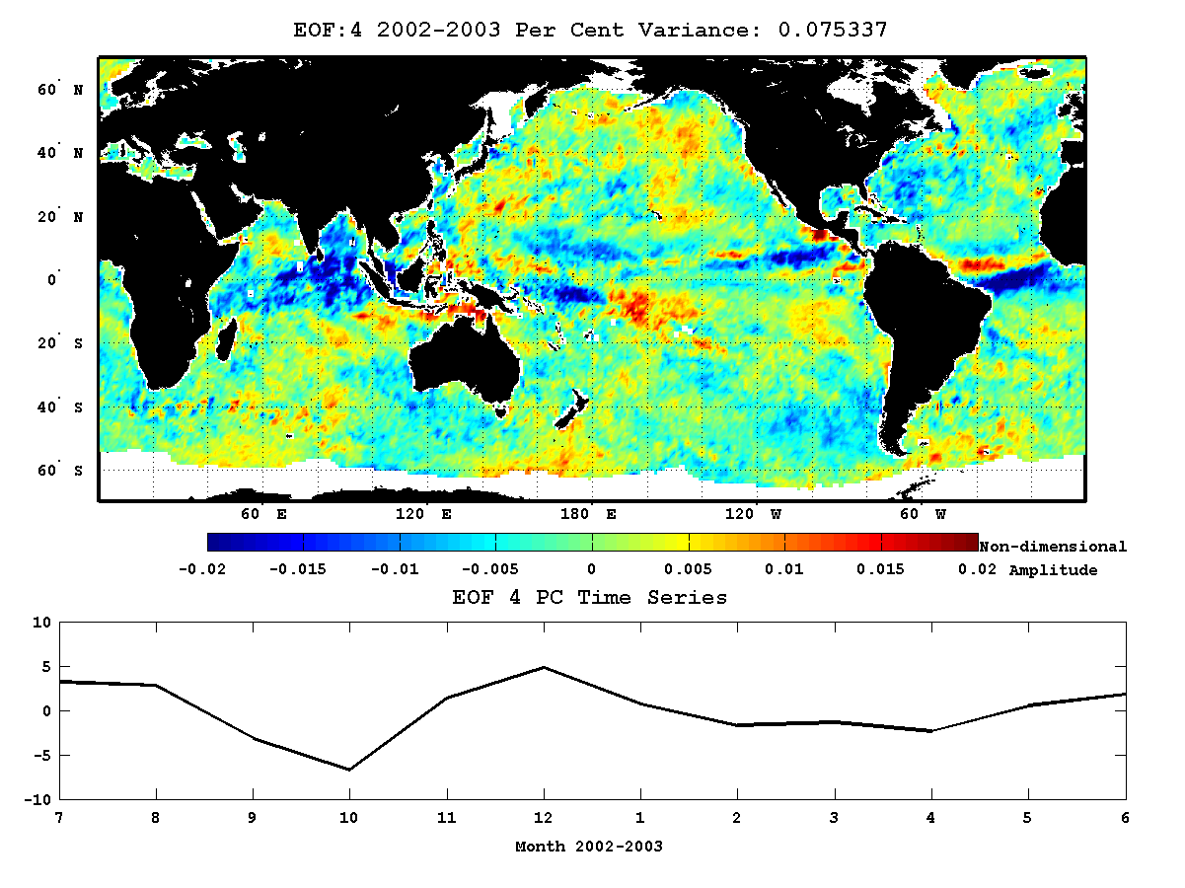

2005-2006 (neutral)
2002-2003 (warm event)
Spatial
Structure
Functions:
Modes 1-4

Slide 14

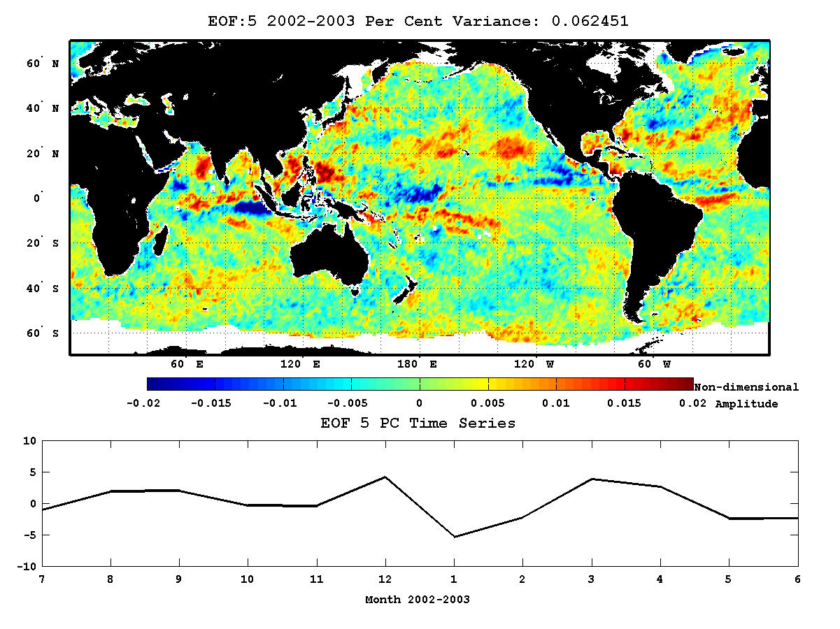
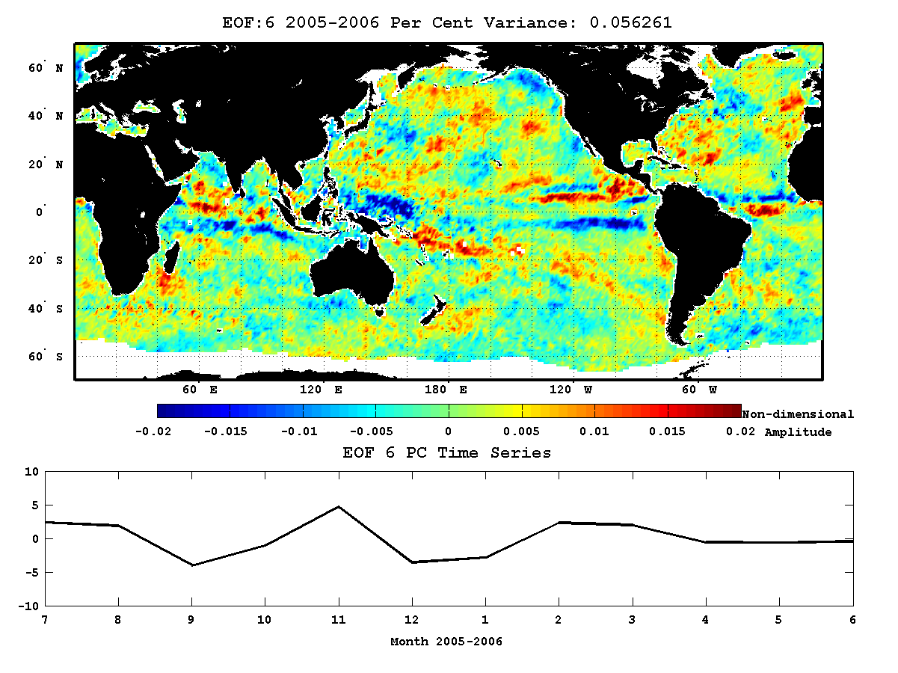
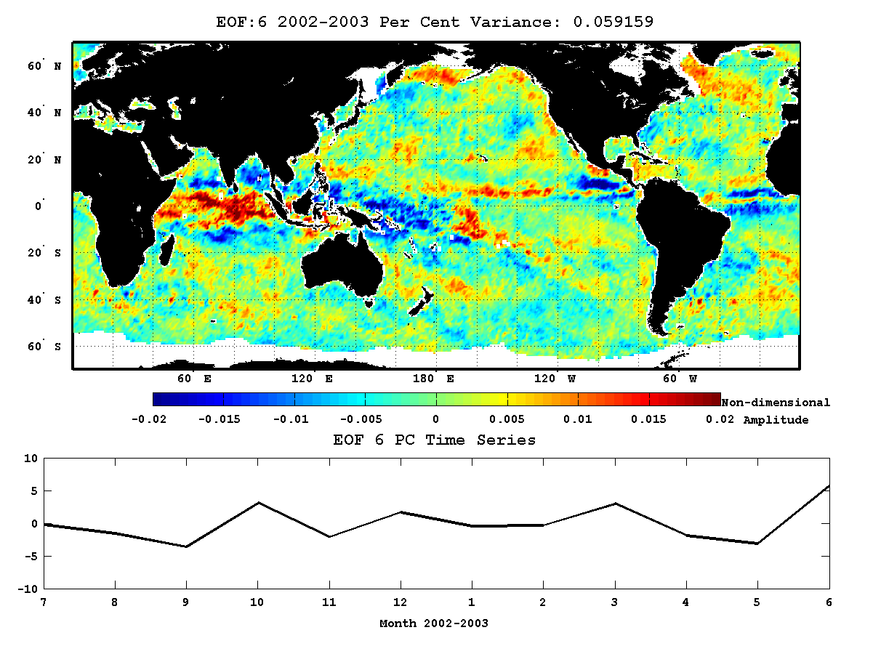
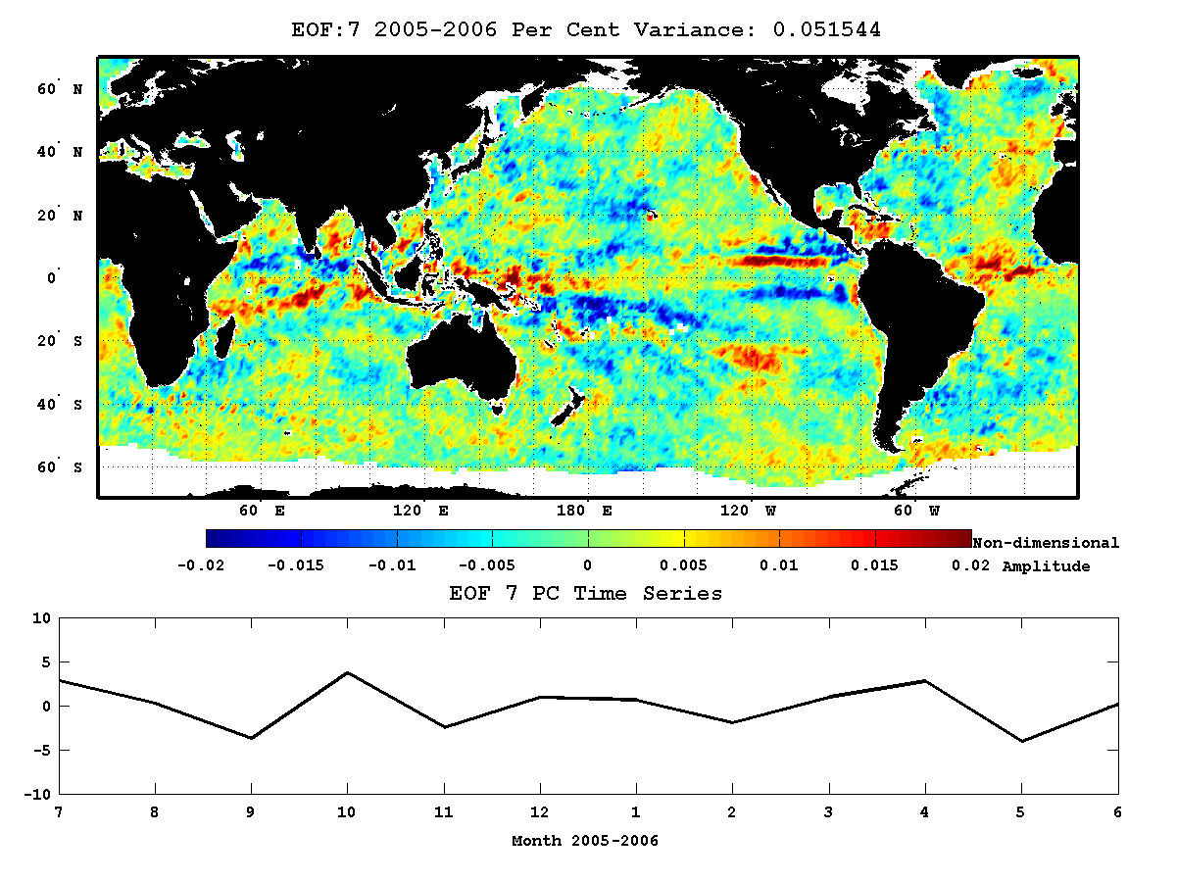


2005-2006 (neutral)
2002-2003 (warm event)
Spatial
Structure
Functions:
Modes 5-8

Slide 15
Principal Components: ENSO Neutral and WE years, modes 1-8
2005-2006 (neutral)
2002-2003 (warm event)
34%
33%
13%
14%
12%
12%
7%
7%
6%
6%
6%
6%
5%
5%
4%
5%

Slide 16
Prototype SVW BHM with a Spatial Error Model

Slide 17
155°E to 105°W; 25°S to 25°N
392 x 200 at 0.25°
Ku2011 3-day Avg L3 SVW
30d (Sep 2002)

Slide 18
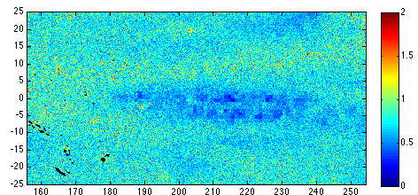
Posterior Mean Results: 10 Sep 2002
ms⁻¹
u(x,y)
σ_{u}(x,y)
missing data
σ_{u}

Slide 19
Summary and Future Plans
Scatterometer retrievals include valuable uncertainty information for constructing
spatio-temporal error models
- useful advances in data assimilation (Kalman gain, denom Cost Function)
- required for global SVW BHM development (“surface wind ensembles”)
Parameterization 1: diagonal error variance matrix
Parameterization 2: diagonal spatial structure functions (EOFs) and PC time series
- model time dependence of leading modes; e.g. ENSO neutral vs. WE
- mixture models
Prototype regional SVW BHM for Sep 2002
- spatially varying u std. deviation from posterior distribution (parameters)
Basis function process model structure as in spectral parts of GCMs
- e.g. Hermite polynomials in tropics
Multiplatform data stage inputs; all with specific spatio-temporal error models
- enforce k⁻² spectral dependence (nested wavelets at small scales)

Slide 20
EXTRAS

Slide 21
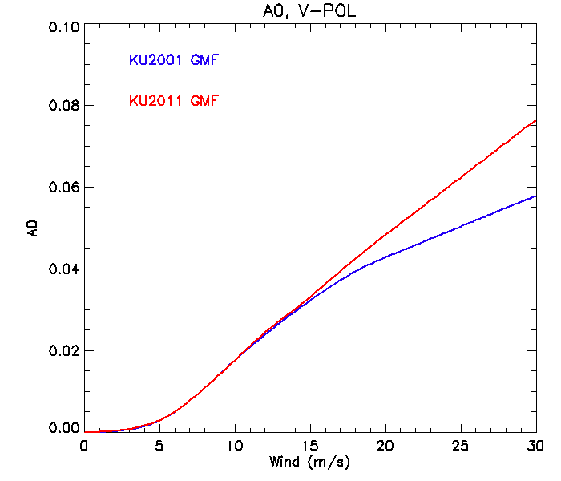
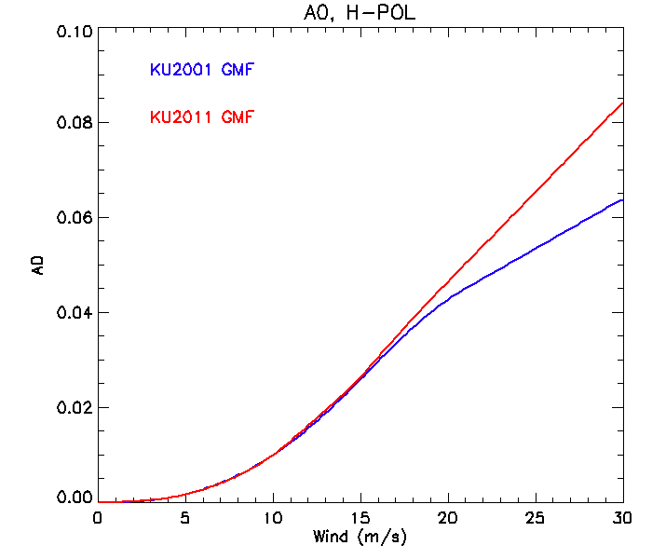
σ₀(wind speed, polarization)
A₀ as a first approximation for σ₀

Slide 22
Posterior Mean Results: 10 Sep 2002
u(x,y)
σ_{u}(x,y)
missing data
σ_{u}

