Slide 1




Observing system simulation experiment (OSSE) for future space-based Doppler wind lidar in Japan
Kozo Okamoto^{1,2}
T. Ishibashi¹, S. Ishii², P. Baron², K. Gamo³, T. Tanaka¹, T. Kubota⁴
1: JMA/MRI, 2:NICT
3:FUJITSU FIP corporation, 4:JAXA
JMA/MRI : Japan Meteorological Agency / Meteorological Research Institute
NICT : National Institute of Information and Communications Technology
JAXA : Japan Aerospace Exploration Agency
Working Group Meeting on Space-based Lidar Winds Meeting 21-23 March 2017, Newport News Marriott at City Center, VA, USA

Slide 2
Content
1. Motivation and purpose
2. Method
OSSE
Lidar simulator
Data assimilation
3. Results of assimilation experiments
4. Summary and plans

Slide 3
1. Motivation and purpose
Global wind profile observations are essential to NWP but is not sufficient in the current observing system
Space-based Doppler wind lidar (DWL) is one of promising candidate to fill the gap
Purpose of this OSSE study:
Assess impacts of DWL on NWP
Investigate DWL configuration to achieve better outcomes
Prepare for operational use of ADM-Aeolus and future DWL in the data assimilation system

Slide 4
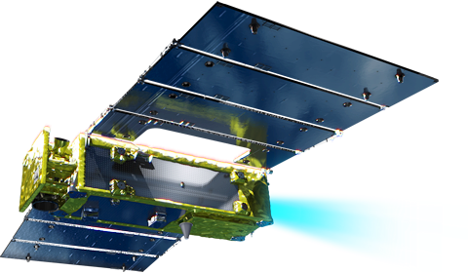
Plans of Japanese DWL and satellite
DWL
Coherent detection
2 azimuthal direction (45, 135 deg), 35 deg off-nadir
Horizontal res: 100 km
Satellite
Super-low altitude satellites (altitude~220km)
Relax requirement of pulse energy and telescope size
Under discussion
Satellite orbit : Polar or low-inclination (Tropical)
Specific lidar parameters: resolution,,,
Better data assimilation settings: observation error, QC,,,
Altitude (km) | V. Res. (km) | Accuracy (m/s)
8~20 | 2 | 5
3~8 | 1 | 3
0~3 | 0.5 | 1
@JAXA/SLATS
Notes:
Coherent detection lidar can be downsized more easily than direct detection lidar.
This enhance the affinity with the satellite system we are discussing.
This has a close affinity with the satellite system

Slide 5
1. Motivation and purpose
2. Method
OSSE
Lidar simulator
Data assimilation
3. Results of assimilation experiments
4. Summary and plans

Slide 6
OSSE
SOSE: Sensitivity Observing System Experiment (Marseille et al. 2008)
Pseudo-truth (PT) field is created by correcting first-guess based on adjoint sensitivity and assimilating real observations
PT field is consistent with obs and reduces forecast-errors
Not need to simule existing observations
Lidar simulator: ISOSIM-L
the Integrated Satellite Observation SIMulator for a spaceborne coherent Doppler lidar
Calculate LOS wind speed and quality information from atmospheric field (e.g. winds), clouds and aerosols based on a maximum likelihood probability approach
Hourly Aerosol field
Generated with global aerosol model (MASINGAR) constrained by the PT winds
Notes:
Full-scale (fully developed) model

Slide 7
OSSE flow
DWL wind simulation (off-line)
SOSE PT
cloud
Lidar simulator (ISOSIM-L)
Simulated W_{LOS}
wind
aerosol
aerosol model
PT: Pseudo-Truth
W_{LOS}: LOS wind speed
data assimilation cycle
Existing observation
Simulated W_{LOS}
first guess
assimilation
analysis
forecast model
first guess
assimilation

Slide 8
Data assimilation
Assimilate LOS (line of sight) wind
Observation operator : W_{LOS} = -(u*sinφ + v*cosφ)*sinθ
QC
Anomalous QC: reject data at the lowest layer and with ISOSIM-flag
SNR-QC: reject data with small signal (N^{1/2}SNR<0.1)
N: total range-bin number in a resolved volume
Gross error QC: reject data with large firstguess departure
|OBS-FG|>0.5m/s (Z<3km), 1.0 (3<Z<8) and 1.5 (Z>8)
Observation error R
E_{mes}: measurement error, estimated by ISOSIM-L
E_{ope}: observation operator error, E_{rep}: representativeness error
➔ assumed E_{ope}² + E_{rep}² = 1.0
C: inflation factor → set to 4.0 in |lat|<60deg, 6.0 otherwise

Slide 9
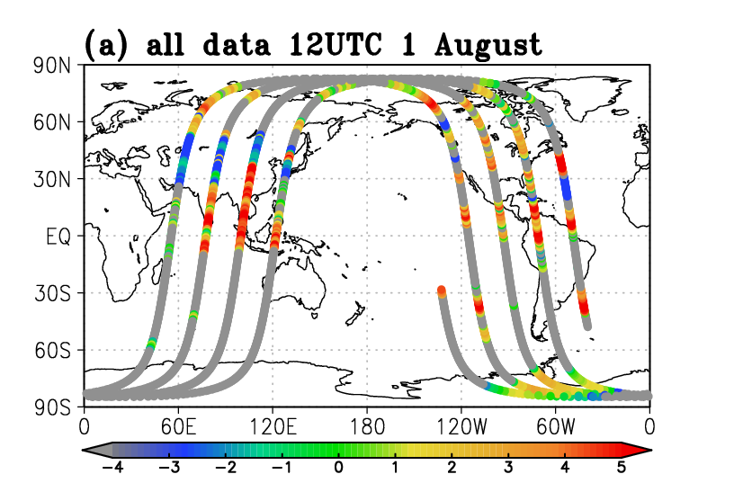
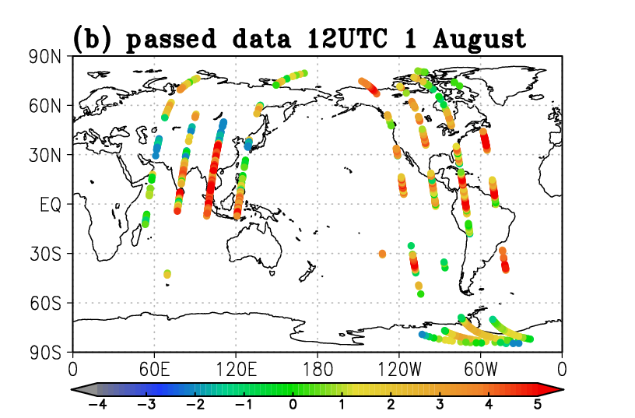
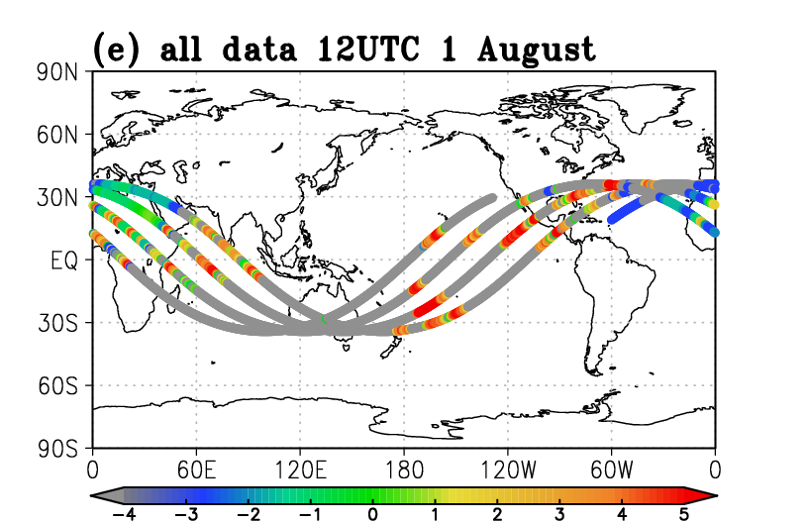
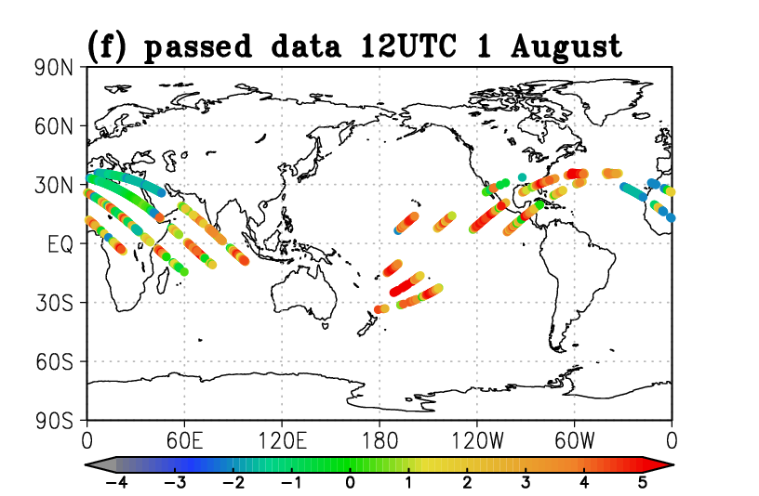
Simulated DWL data (around 11.4km)
09 ~ 15 UTC on August 1.
All
QC passed
Polar Orbit
Tropical Orbit
Log(N^{1/2}SNR)

Slide 10
Number of used and QC-failed DWL at each analysis
15 % data pass all the QC
SNR-QC plays biggest role in rejection (64%)
Notes:
use
Anomaly
SNR
Gross
Polar1
10513
6728
40536
6023
TRMM1
9615
6733
41363
6096
Polar8
8954
6728
39759
8362
TRMM8
10111
6734
39629
7344

Slide 11
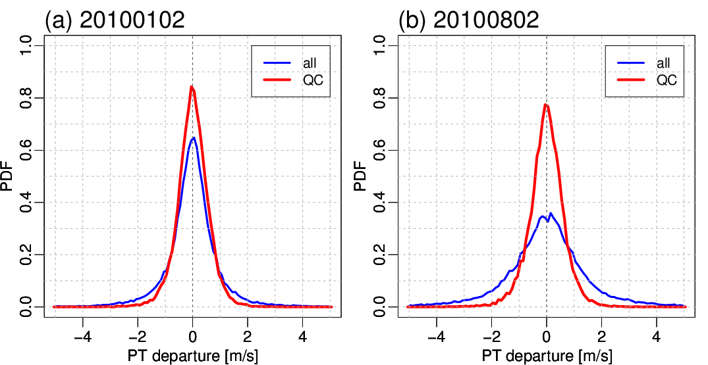
PDF of OBS-PT before/after QC (2 Jan and Aug 2010)
QC successfully reject data with large obs-PT
Data quality is better in Jan than in Aug.

Slide 12
1. Motivation and purpose
2. Method
OSSE
Lidar simulator
Data assimilation
3. Results of assimilation experiments
4. Summary and plans

Slide 13
Data assimilation experiments
Low-res version of operational global DA system of JMA as of 2010.
6-h cycle, incremental 4D-Var, H.res=60km/120km
Data assimilated
Control exp. (CNTL) : full operational data set
Test exp. CNTL + DWL LOS wind profiles
TestP : DWL on a polar satellite
TestT : DWL on a tropical satellite
Experiment period
Winter exp. 20 Dec 2009 – 9 Feb 2010 (DWL assimilation:1 – 31 Jan)
Summer exp. 20 Jul – 9 Sep 2010 (DWL assimilation:1 – 31 Aug)

Slide 14
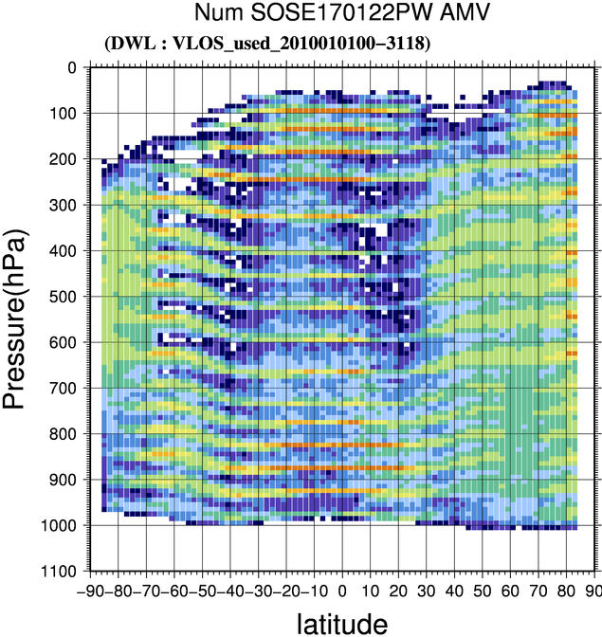
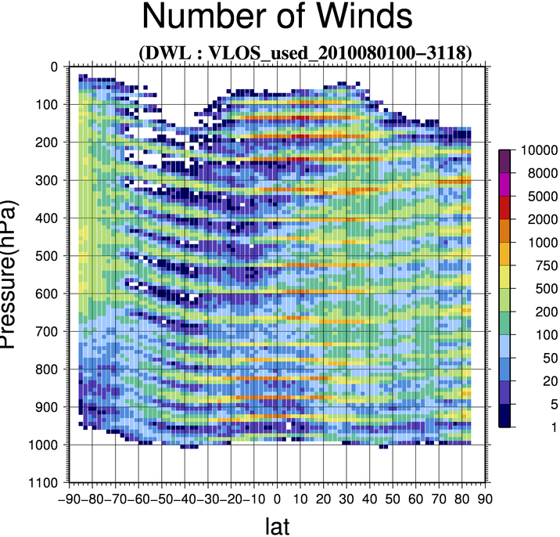
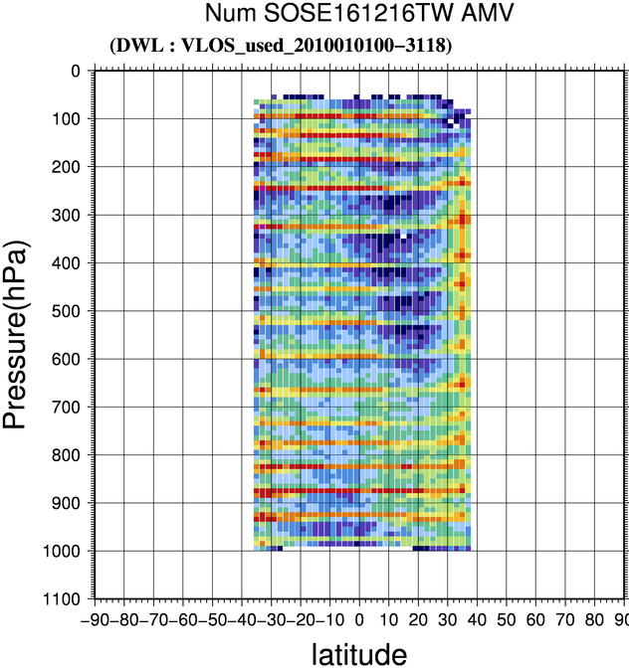
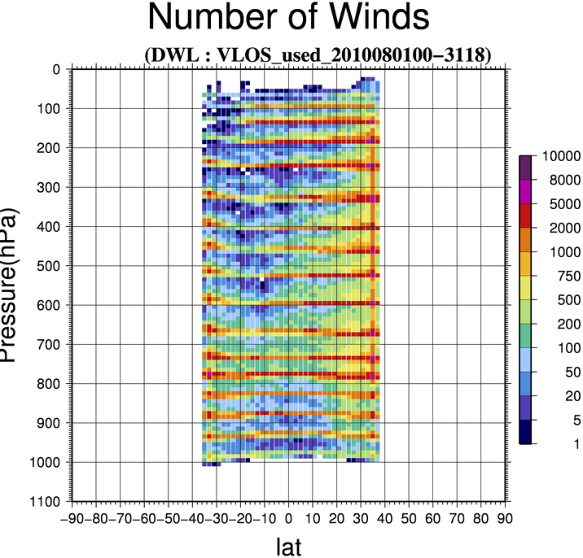
Monthly, zonally accumulated number
Winter exp.
Summer exp.
1-31 Jan. 2010
1-31 Aug. 2010
100
100
500
500
TestP
1000
1000
90S
90N
90S
90N
100
100
500
500
TestT
1000
1000
90S
90N
90S
90N

Slide 15
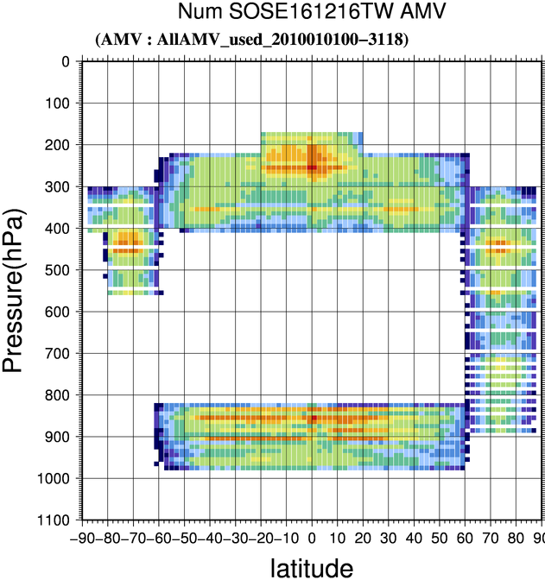
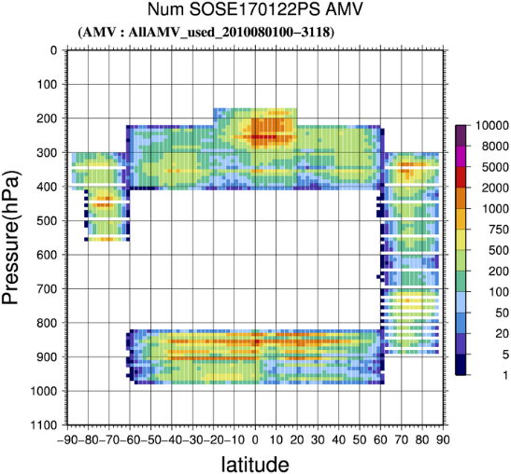
Monthly, zonally accumulated number
Winter exp.
Summer exp.
1-31 Jan. 2010
1-31 Aug. 2010
100
100
500
500
TestP
1000
1000
90S
AMV in winter exp.
90N
90S
AMV in summer exp.
90N
100
100
100
100
500
500
500
500
AMV
1000
1000
1000
1000
90S
90N
90S
90S
90S
90N
90N
90N
Notes:
the lack of vertical variability of cloud and aerosol
due to relatively poor vertical model resolution
in comparison with the vertical bin width
when ISOSIM-L retrieves DWL winds over the fixed altitude ranges

Slide 16
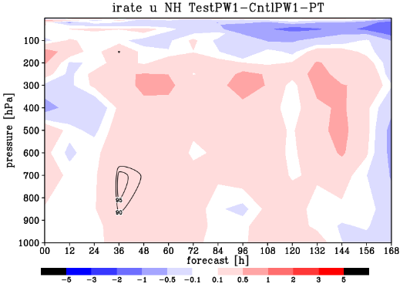
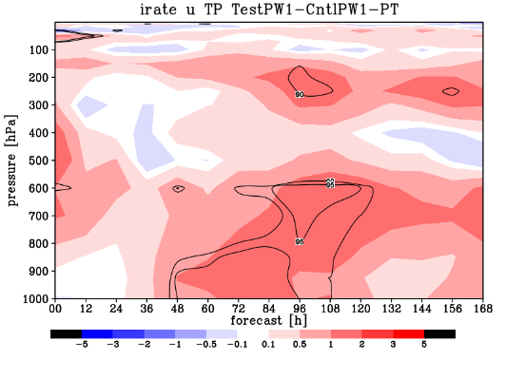
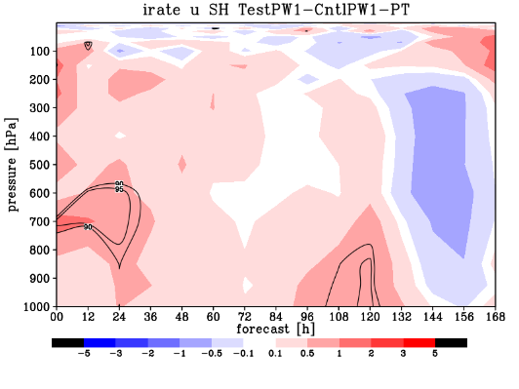
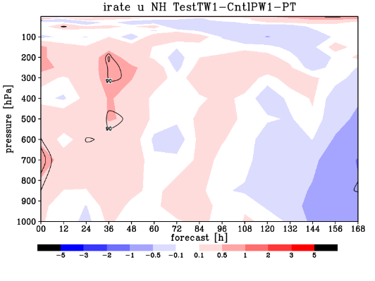
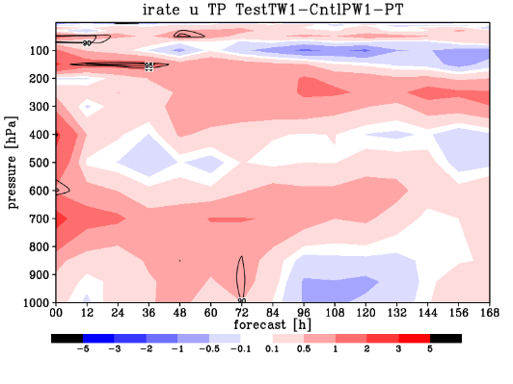
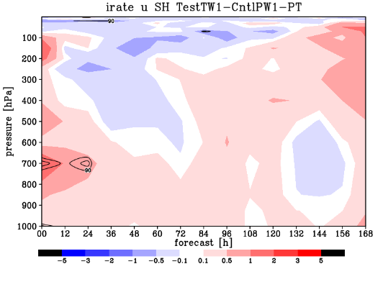
Forecast scores of U in winter exp.
Relative RMS forecast error reduction (%)
Obvious improvement in wide regions and forecast ranges
degrade ← → improve
NH
TR
SH
TestP
100
100
100
TestT
1000
1000
1000
0
24
48
72
96
120
144
168
0
24
48
72
96
120
144
168
0
24
48
72
96
120
144
168
forecast [h]
forecast [h]
forecast [h]

Slide 17
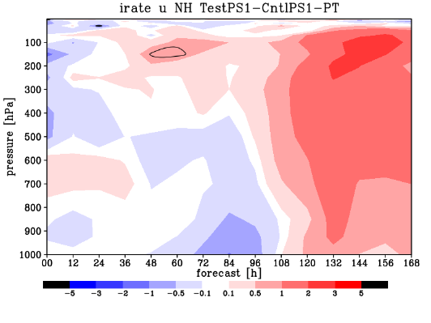
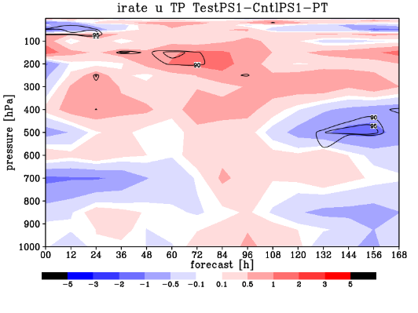
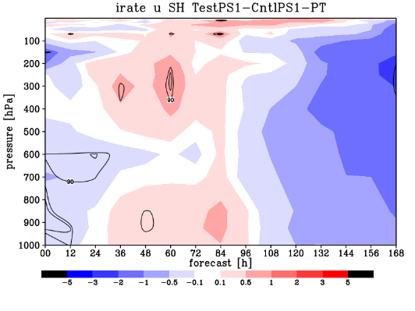
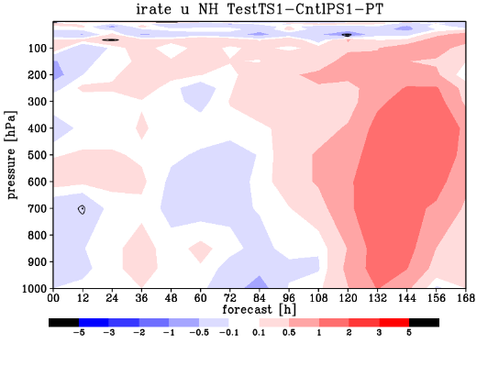
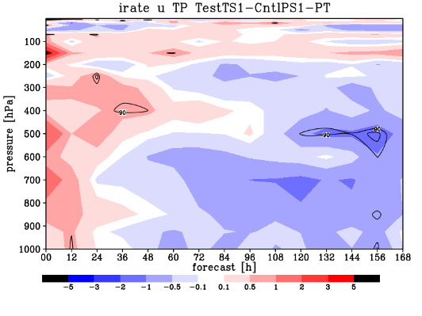
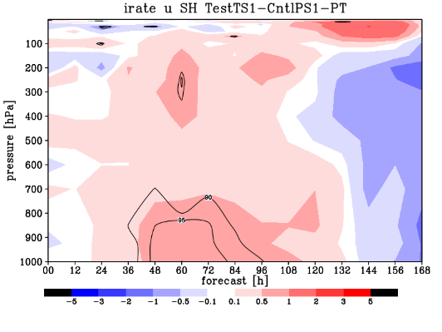
Forecast scores of U in summer exp.
Generally positive, but negative in some regions and forecast ranges
degrade ← → improve
NH
TR
SH
TestP
100
100
100
TestT
1000
1000
1000
0
24
48
72
96
120
144
168
0
24
48
72
96
120
144
168
0
24
48
72
96
120
144
168
forecast [h]
forecast [h]
forecast [h]
Notes:
Contaminated with bad quality data
There is still room to improve [develop more appropriate] obs error and QC criteria.

Slide 18
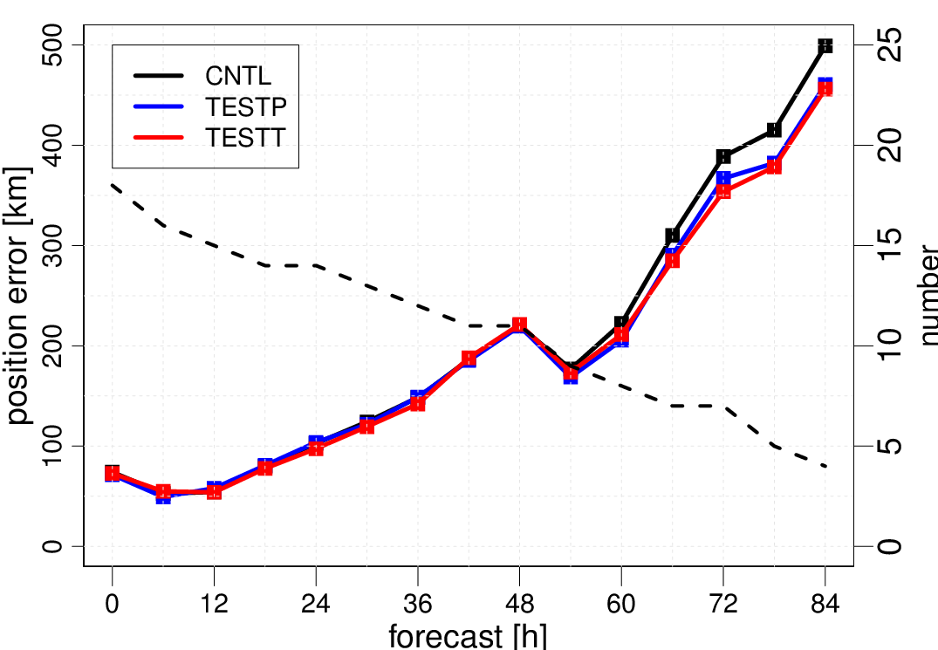
Typhoon track forecast errors
Position errors (km) as a function of forecast hours up to 84-h
Slightly positive impact for both experiments

Slide 19
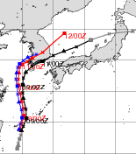
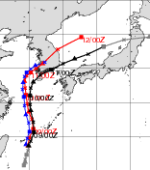
Example of typhoon track forecast
Track forecasts of TC DIANMU (T1004)
TestP
TestT
Cntl
Test
Besttrack

Slide 20
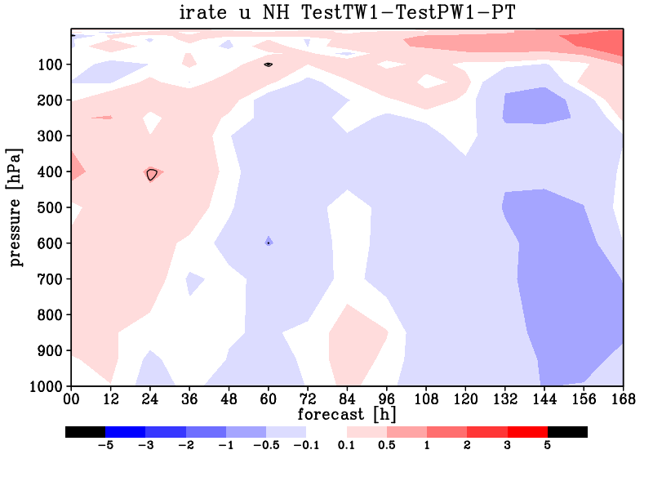
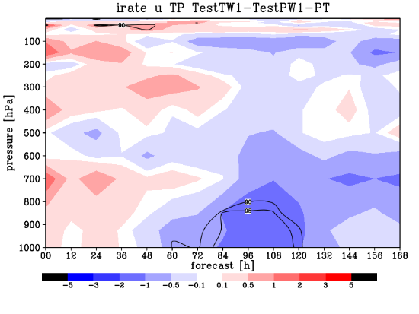
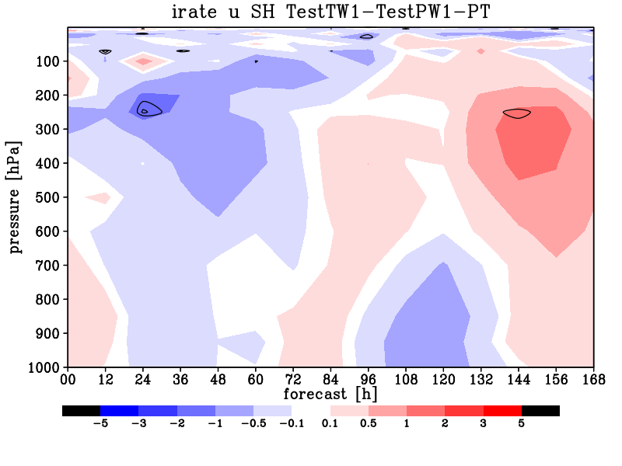
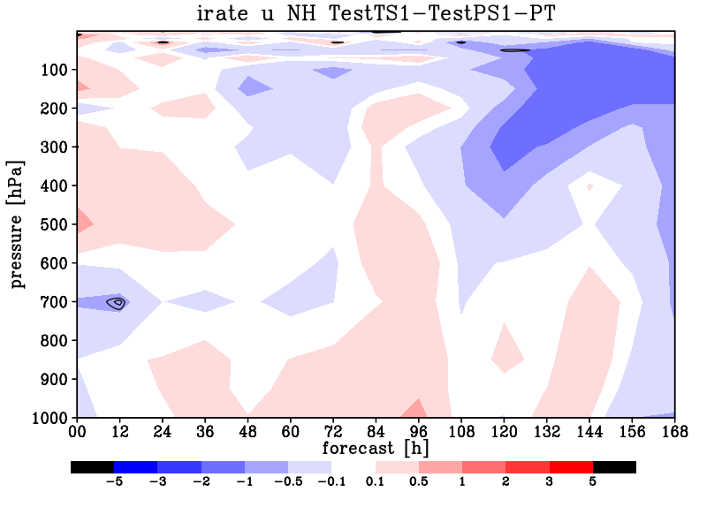
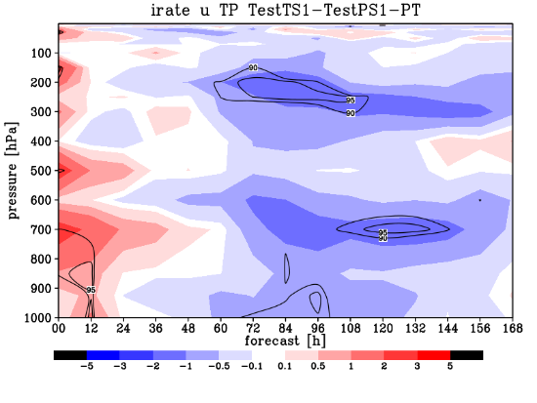
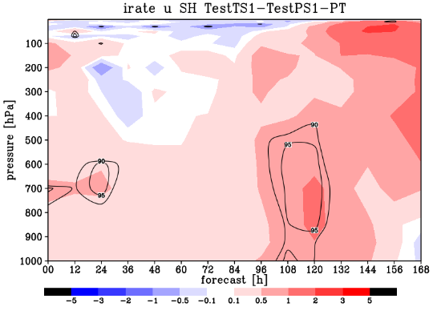
Comparison of TestT and TestP
Relative improvement of U
Mixed results → hard to say which is better!
TestP +ve ← → TestT +ve
NH
TR
SH
Winter
100
100
100
Summer
1000
1000
1000
0
24
48
72
96
120
144
168
0
24
48
72
96
120
144
168
0
24
48
72
96
120
144
168
forecast [h]
forecast [h]
forecast [h]

Slide 21
4. Summary and Plans
OSSE system for space-borne DWL has been developed
SOSE-based OSSE
Produce hourly aerosol filed that is consistent with PT wind
End-to-end simulator ISOSIM-L calculates LOS wind and quality information
Develop QC and observation error based on the quality information
Preliminary results of one-month assimilation experiments
Assess impacts of DWL onboard polar and tropical satellites in winter and summer (Jan and Aug 2010)
Generally positive impacts of DWL, either polar or tropical satellite
Winter experiment show better forecast skills than summer experiment
Unclear superiority of polar and tropical DWLs
Tropical DWL is superior to polar DWL in short-range forecast but inferior later
Typhoon track forecast is slightly improved
Plans
Test various configuration of DWL and assimilation system
Data coverage, resolution
QC, thinning, observation error, different OSSE approach (e.g. NR-OSSE)
Investigate complementary benefits of DWL and other winds (e.g. AMVs)

Slide 22
References
Baron et al. 2017: Feasibility study for future space-borne coherent Doppler wind lidar, Part 2: measurement simulation algorithms and retrieval error characterization. Under revision for J. Meterol. Soc. Japan.
Ishii et al., 2016: Measurement performance assessment of future space-borne Doppler wind lidar. SOLA, 12, 55-59.
Ishii et al. 2017: Feasibility study for future spaceborne coherent doppler wind lidar, Part 1: Global Wind Profile Observing System. Under revision for the J. Meteor. Soc. Japan.
Okamoto et al. 2107:Feasibility study for future Space-borne Coherent Doppler Wind Lidar, Part 3: Initial evaluation using the Operational Global Data Assimilation System. In preperation

Slide 23
Supplemental slides

Slide 24
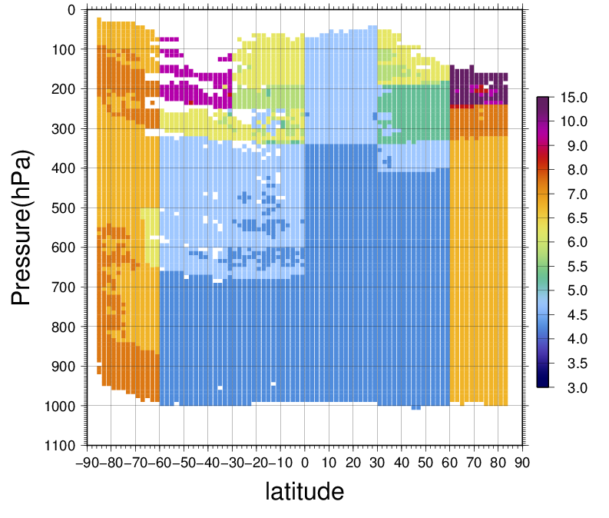
Observation error (after inflation)
Monthly zonalmean average

Slide 25

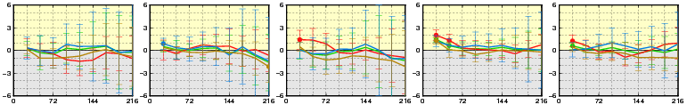
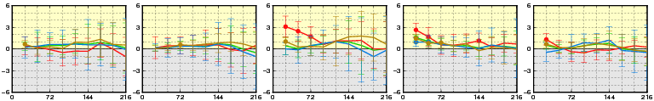
Forecast improvement against own analysis
Normalized RMSE difference
(RMSE_{CNTL}-RMSE_{TEST})/RMSE_{CNTL}
+ve shows improvement. Statistically significance is indicated by circles
Short range wind forecast is improved especially for lower tropospheric wind in the tropics
TestT experiment shows slightly greater improvement
Improve
Forecast hours (~216h)
Degrade
TestP
Psea
T850
Z500
Wsp850
Wsp250
0 72 144 216
0 72 144 216
0 72 144 216
0 72 144 216
0 72 144 216
TestT
Psea
T850
Z500
Wsp850
Wsp250
0 72 144 216
0 72 144 216
0 72 144 216
0 72 144 216
0 72 144 216

