Slide 1




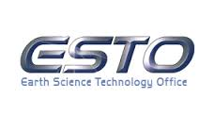
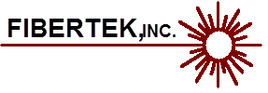


ATHENA-OAWL, the Green OAWL (GrOAWL) Airborne Demonstrator
S. Tucker and C. Weimer – Ball Aerospace
R. M. Hardesty & S. Baidar – NOAA/CIRES/CU
F. Hovis – Fibertek, Inc.

Slide 2
Objectives
Report on the AOVT effort, GrOAWL instrument, and flight testing.
Present recent analysis results of GrOAWL flight performance
Demonstrate scaling performance to space
Dispel myths, rumors, and address “whispers” about GrOAWL performance
Summarize OAWL component technology readiness

Slide 3

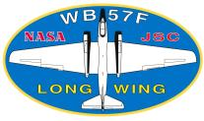
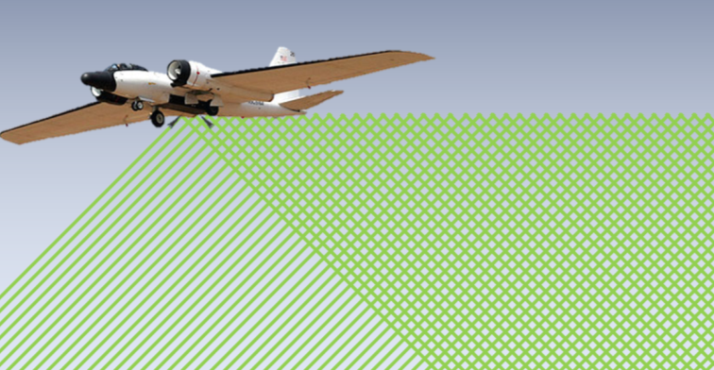
ATHENA-OAWL Venture Tech: Built & flew the Green-OAWL Airborne Demonstrator
ATHENA-OAWL Aerosol Transport, Hurricanes, and Extra-tropical Numerical weAther using the Optical Autocovariance Wind Lidar
Earth Venture Instrument (EV-I 2013) Mission Concept building on CALIPSO technology
First full US mission concept developed and proposed in decades
EV-I “Venture Tech” funding: 2 year ATHENA-OAWL Venture Tech (AOVT):
In ~ 1 year, built the two-look, 532 nm “Green OAWL” (GrOAWL) airborne system
Flew on WB-57 to demonstrate measurement performance from altitude
Provided measurement validation using automated dropsondes
Scaling system performance to space, (like A2D for Aeolus)
Worked to raise OAWL TRL for EV-I 2016 proposal

Slide 4
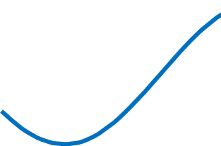
Optical Autocovariance Wind Lidar (OAWL)
Field-widened, Mach-Zehnder Interferometer (MZI): Patent #s: US7929215B1, US8077294B1
Four detector channels sample interferometer fringe phase (wind) and amplitude (aerosol). --- Outgoing “T0” pulses --- Atmospheric Returns at range
Fringes wrap – no “out of band” concerns. Unwrap 2π jumps (100 m/s discontinuities) in processing.
Platform motion translated to phase, added to T0 phase offset and “wrapped”
T0 phase offset used to adjust detector returns for every pulse - prior to accumulation/phase fit: no laser pulse-to-pulse stability requirements
After accumulation, the shifted detector values are fit to determine the return phase, Δϕ, related to the line-of-sight wind speed, V_{LOS} by
QWP
d1
d2
d3
d4
0° 90° 180° 270°
Detectors at constant ACF phase

Slide 5
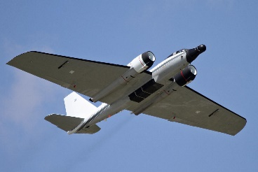
GrOAWL: Optical Autocovariance Wind Lidar
Direct detection aerosol wind lidar
Measures Doppler shifts using a field-widened, quadrature-channel, Mach Zehnder interferometer.
Current configuration: Two-look system to demonstrate the two look concept for space-based platforms
Two lasers – both operate at the 532 nm (green) wavelength and 355 nm (UV) wavelength.
Autonomous operation with real-time winds processing
Parameter | Value (look1/look2)
Pulse Energy 532 nm | 200 μJ – 2.5+ mJ
Pulse Energy 355 nm | 0.5 mJ – 11 mJ
Laser Pulse Repetition | 200 Hz per look
Telescopes eff. Diameter | ~27 cm diameter
Detector Channels | Up to 10
Sample Rate | 140 MHz (1.07 m)
Interferometer OPD | ~0.9 meters
WB-57 chosen mainly for schedule

Slide 6
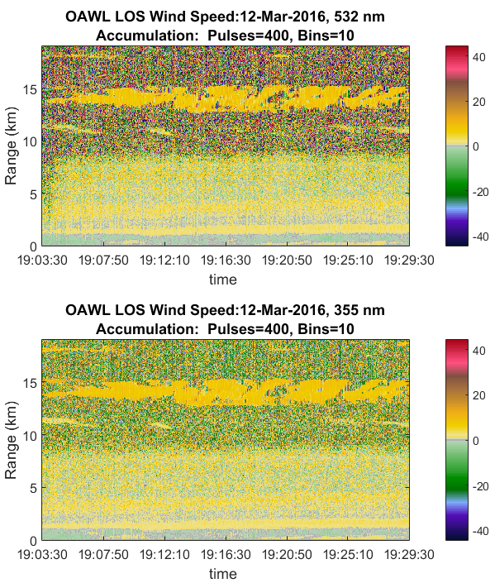
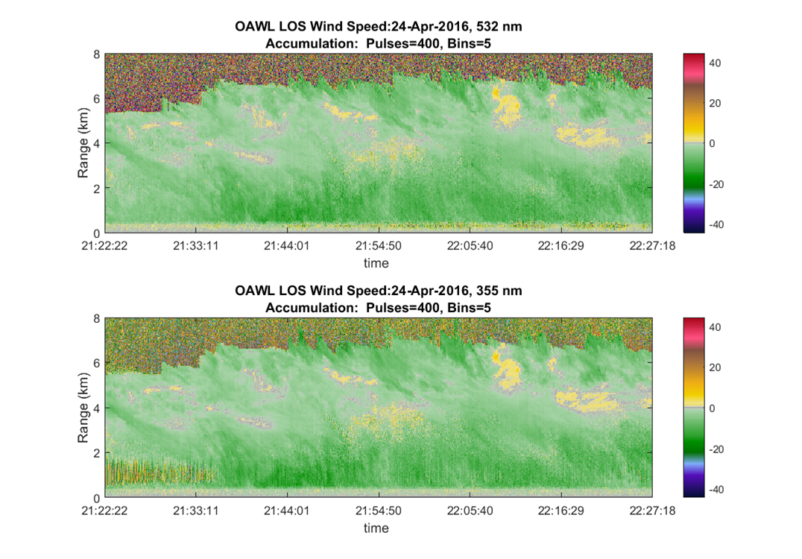
Spring 2016 ground testing “first light” results after upgrade to two-look system
Look 1: 12 March 2016
Look 2: 24 April 2016
532 nm
Daytime Operation, 30⁰ Elevation facing west over Boulder foothills
355 nm

Slide 7
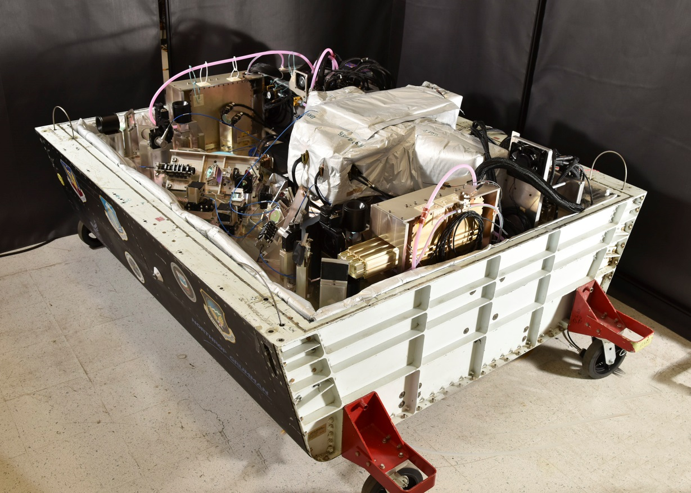
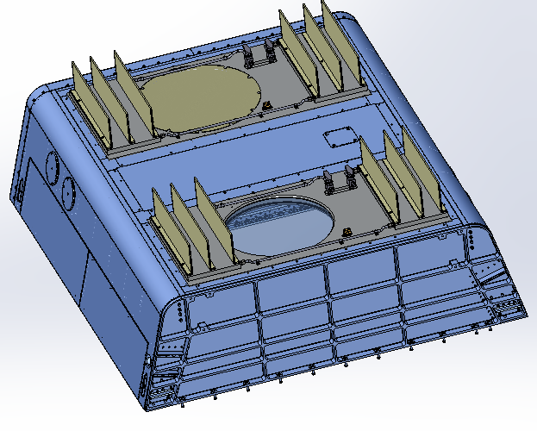
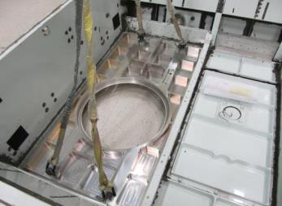
WB-57 Aircraft Integration
WB-57 pallet: pressurized to 5 psi above ambient exterior above 8000 ft
Two custom pallet floor panels with windows
Custom fluid loop cooling system integrated into floor panels
GrOAWL instrument, vibration isolation, & environmental control

Slide 8
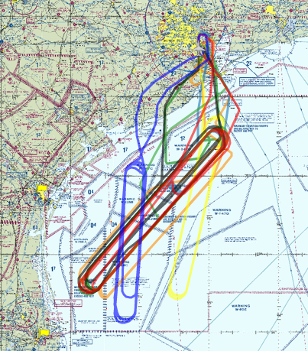
AOVT GrOAWL Airborne Flight Testing on NASA’s WB-57 Jet (N928)
Flights out of Ellington Field at Johnson Space Center.
Remote operation: from SEO seat for laser safety
Ground “control” and telemetry via INMARSAT satellite link
8 flights ~38 flight hours, 3 flights with automated dropsondes
Racetrack flight patterns over the Gulf of Mexico provided:
revisit times (~1 hr/loop)
views of the atmosphere region from opposite sides
Flew over restricted areas, allowing for:
Real-time flight pattern variability: altitude changes, cloud avoidance, airspace coordination, etc.
Testing with variable laser output power
Dropping ONR/Yankee Environmental Systems sondes for winds validation

Slide 9
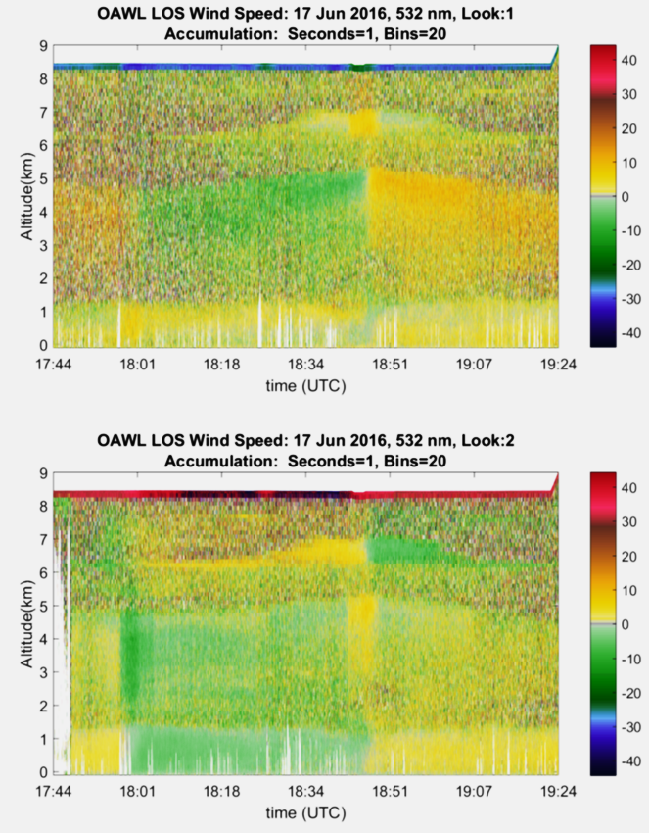
Simultaneous two-look LOS wind speed profiles
17 June 2016: Forward look
Less than 1.5 mJ/pulse per look at 532 nm (< 0.3 W)
Daytime operation; scattered clouds at ~1km altitude
30,000+ ft altitude, (>12 km slant path to the surface). Higher altitude data also available.
According to GEOS-5 models: Low aerosol backscatter conditions above 1 km: below “background” at some levels.
1s accumulation data shown.
Can increase coverage in low-aerosol regions with more accumulation.
1s
Wind speed (m/s)
Aft look
Wind speed (m/s)

Slide 10
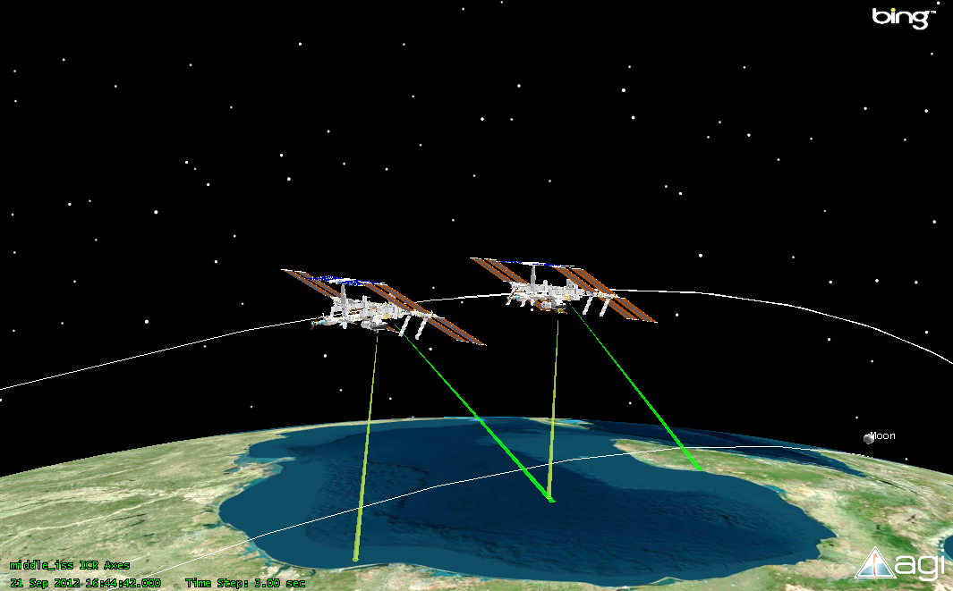
GrOAWL/ATHENA-OAWL: two continuous looks
The GrOAWL validation flights provided the first (known) investigation and demonstration of the continuous two-look approach desired for a space-based mission.
Aircraft for demonstration, CalVal, and EV-S
ISS for Earth Venture Instrument
Two looks enables:
Continuous line coverage of observations at all layers (vs. switching)
Continuous U & V components for NWP
Two looks of GrOAWL data can be combined into continuous speed & direction profiles
Reprocessing of winds on differing time/range scales – improve retrievals
RAM direction
ISS Ground
Track

Slide 11
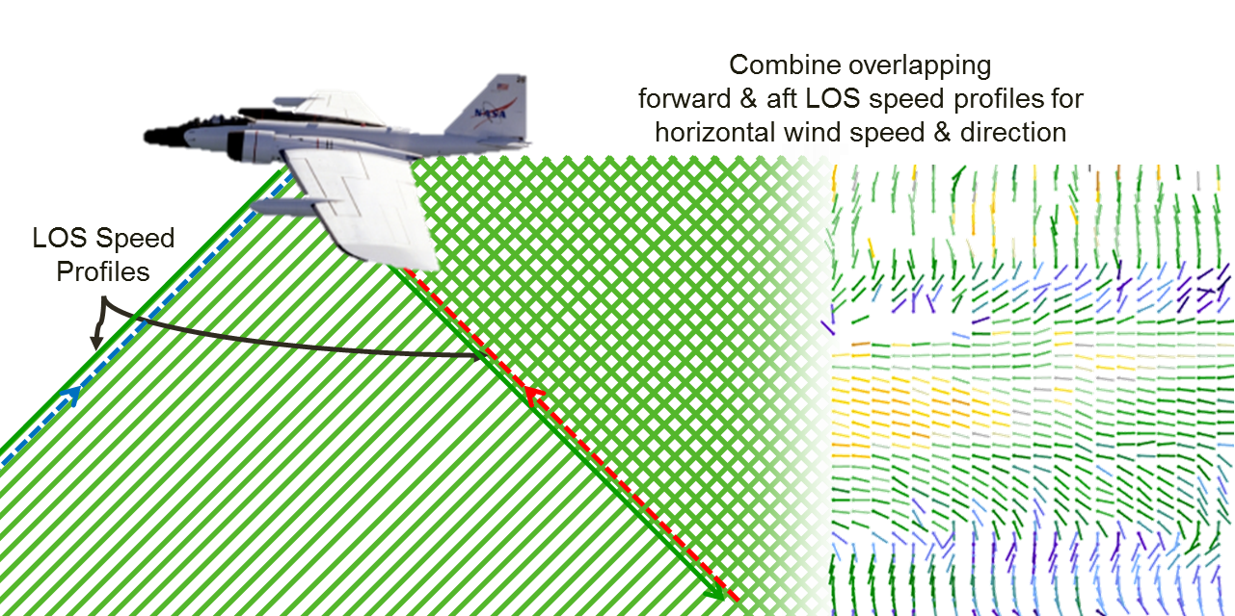
Two-look LOS measurements combine to provide continuous wind speed and direction profiles
Wind barbs: color indicates wind speed, and line (dot at the time of the profile) line points into the wind direction

Slide 12
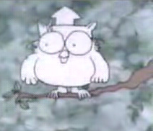
Myths, Rumors, and Whispers
Myth: GrOAWL requires minutes of integration time to get a retrieval.
Fact: GrOAWL retrievals are performed on 1-20s time scales, depending on aerosol loading and desired precision. We’ve used 10 s most of the time for airborne tests.
Myth: GrOAWL results don’t scale to ATHENA operation
Fact: The validated GrOAWL radiometric model is used to scale the performance → predicting required operation to meet ATHENA science objectives. ATHENA proposal modeling done with conservative background aerosol mode only.
Myth: GrOAWL/ATHENA can’t measure winds with background light
Fact: GrOAWL can operate even with more background than lidar photons. CALIPSO-demonstrated etalon provides even more background filtering for ATHENA. Coverage is better at night, but all data to date has been daytime.
Myth: GrOAWL/ATHENA-OAWL aren’t eyesafe
Fact: GrOAWL has variable/controllable attenuation of 532 nm so that it will always be eyesafe at the surface and/or at altitude based on operations – higher altitude allows for more output power. Space-borne-OAWL designs are more eyesafe than CALIPSO.
Myth: OAWL efforts have received “too much” recent NASA funding
Fact: Ball works with NASA and NOAA as part of a public-private partnership to develop high TRL wind lidar technology to address the nation’s weather needs. Ball has received no profit on ESTO funding and has also made significant internal investment. NASA owns all equipment developed on ESTO grants.

Slide 13

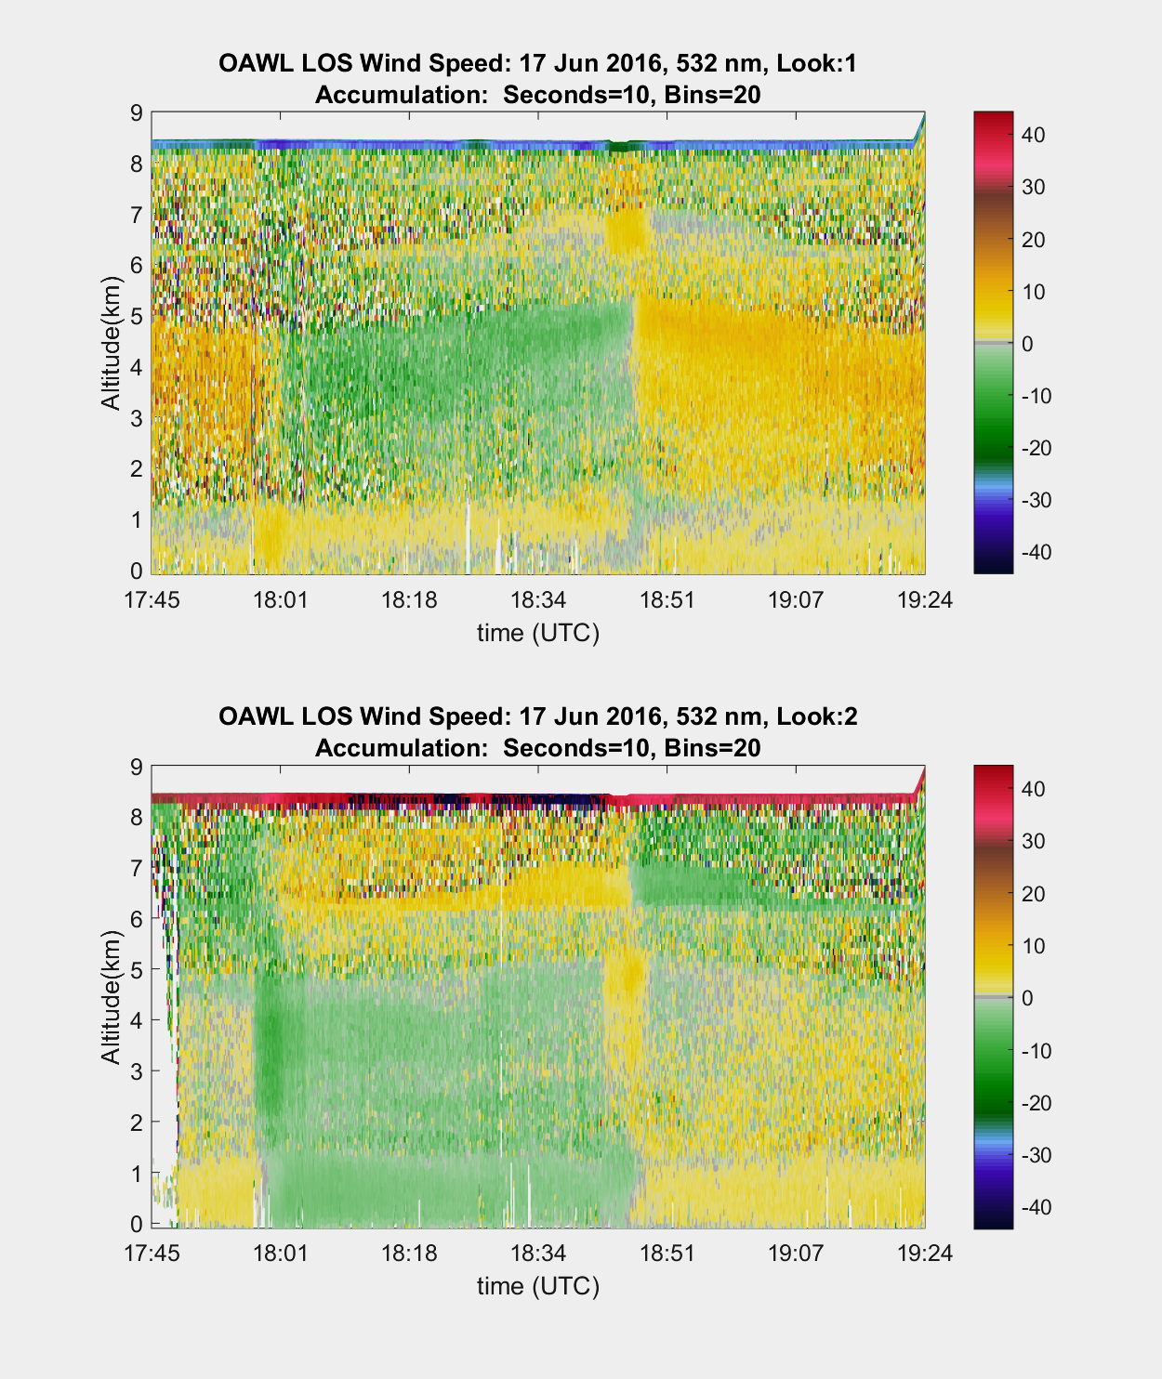
OAWL Integration increases precision
GrOAWL accumulation
Variable 1-20 s (1s and 10 s shown below), depending on desired precision levels, aerosol loading, aircraft-induced limitations, and comparison objectives
Variable range gate processing: 8m and up. 120 m altitude bins shown below.
ATHENA Accumulation
WMO (on-orbit) requirement: 100 km horizontal. ATHENA modeling done for 80 km = 12s
altitude bins also variable: 250-1000 m (30 m sample bin).
17 June 2016: AFT look
1s
Wind speed (m/s)
10s
Wind speed (m/s)

Slide 14
Myths, Rumors, and Whispers
Myth: GrOAWL requires minutes of integration time to get a retrieval.
Fact: GrOAWL retrievals are performed on 1-20s time scales, depending on aerosol loading and desired precision. We’ve used 10 s most of the time for airborne tests.
Myth: GrOAWL results don’t scale to ATHENA operation
Fact: The validated GrOAWL radiometric model is used to scale the performance → predicting required operation to meet ATHENA science objectives. ATHENA proposal modeling done with conservative background aerosol mode only.
Myth: GrOAWL/ATHENA can’t measure winds with background light
Fact: GrOAWL can operate even with more background than lidar photons. CALIPSO-demonstrated etalon provides even more background filtering for ATHENA. Coverage is better at night, but all data to date has been daytime.
Myth: GrOAWL/ATHENA-OAWL aren’t eyesafe
Fact: GrOAWL has variable/controllable attenuation of 532 nm so that it will always be eyesafe at the surface and/or at altitude based on operations – higher altitude allows for more output power. Space-borne-OAWL designs are more eyesafe than CALIPSO.
Myth: OAWL efforts have received “too much” recent NASA funding
Fact: Ball works with NASA and NOAA as part of a public-private partnership to develop high TRL wind lidar technology to address the nation’s weather needs. Ball has received no profit on ESTO funding and has also made significant internal investment. NASA owns all equipment developed on ESTO grants.

Slide 15
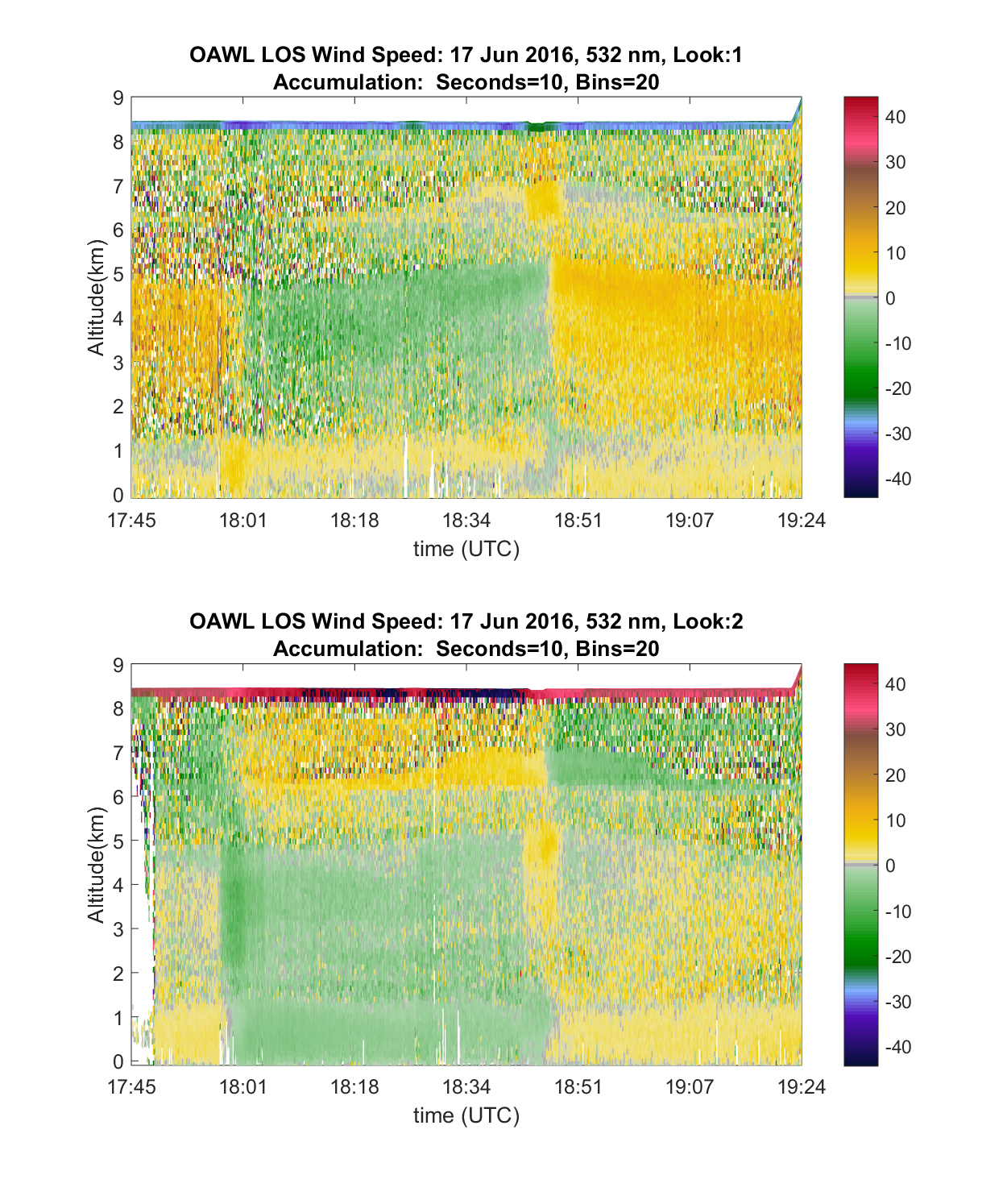
Scaling performance: GrOAWL and ATHENA-OAWL provide similar wind information per retrieval
Biggest drivers in performance model scaling:
Power (including laser & transmission), aperture, & range
GrOAWL has ~10x more Power-Aperture/R²
Background light filtering
ATHENA has ~10X more suppression of background light
Accumulation: pulse accumulation & altitude bin sizes
ATHENA along-range altitude bins are ~6x longer
ATHENA pulse accumulation is 1.2-10x longer
ATHENA-OAWL
Power∙Aperture/R²
N_{G}-Gates
(altitude)
GrOAWL
Wind speed estimate data cubes
P signal photons
Power∙Aperture/R²
P signal photons
Similar # of lidar photons (“cube volume”) per wind speed estimate.
Fewer background photons for ATHENA
M-seconds, N_{P} Pulses
M-seconds, N_{P} Pulses
Background Filter
B background photons
B background photons
Background Filter

Slide 16
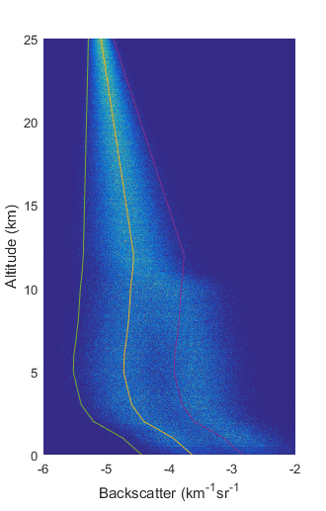
Atmospheric aerosol backscatter input is critical to performance prediction
Aerosol Mode Distributions
50/50 Background/Enhanced
Aerosol mode distributions drive the performance
Shown: 50/50 mix of Background & Enhanced log-normal aerosol distributions from Simpson Weather Associates
Lines shown for background mode ±1-σ.
Use these to bracket performance values using the radiometric model
GrOAWL (aircraft)
ATHENA-OAWL (ISS)

Slide 17
Scaling performance to ATHENA-OAWL
Validation Steps
Run radiometric + instrument performance model using as-built airborne instrument parameters and range of atmospheric parameters
Acquire data with airborne instrument and analyze precision performance
Demonstrate how the model and performance correlate → validate the model
Finally, scale all appropriate parameters in the validated model from aircraft demonstrator instrument/radiometry parameters to space-based instrument/radiometry parameters.
Aerosol input
A 50/50 mix of background/enhanced aerosol log-normal mode distributions from SWA used in the model
Results shown for 10th, 50th, and 90th percentile on the total distribution of returns.
GrOAWL Parameters 532 PE: 1.5 mJ
532 PRF: 200 Hz
532 BW: 30 MHz
532 det: MPPC
532 det QE: 0.32
OPD: 0.90 m
Night data: no
Look Angle: -45.0 deg.
Vert. avg: 0.121 km
Avg. time: 10.0 s

Slide 18
Myths, Rumors, and Whispers
Myth: GrOAWL requires minutes of integration time to get a retrieval.
Fact: GrOAWL retrievals are performed on 1-20s time scales, depending on aerosol loading and desired precision. We’ve used 10 s most of the time for airborne tests.
Myth: GrOAWL results don’t scale to ATHENA operation
Fact: The validated GrOAWL radiometric model is used to scale the performance → predicting required operation to meet ATHENA science objectives. ATHENA proposal modeling done with conservative background aerosol mode only.
Myth: GrOAWL/ATHENA can’t measure winds with background light
Fact: GrOAWL can operate even with more background than lidar photons. CALIPSO-demonstrated etalon provides even more background filtering for ATHENA. Coverage is better at night, but all data to date has been daytime.
Myth: GrOAWL/ATHENA-OAWL aren’t eyesafe
Fact: GrOAWL has variable/controllable attenuation of 532 nm so that it will always be eyesafe at the surface and/or at altitude based on operations – higher altitude allows for more output power. Space-borne-OAWL designs are more eyesafe than CALIPSO.
Myth: OAWL efforts have received “too much” recent NASA funding
Fact: Ball works with NASA and NOAA as part of a public-private partnership to develop high TRL wind lidar technology to address the nation’s weather needs. Ball has received no profit on ESTO funding and has also made significant internal investment. NASA owns all equipment developed on ESTO grants.

Slide 19
ATHENA Background filtering based on CALIPSO
Including CALIPSO’s TRL9 etalon on ATHENA
provides significantly more background light filtering: ~12x more background light suppression
Only ~8% (0.08) additional narrow-band laser light suppression (aerosol/molecular dependent)
Improved SNR
Adding a CALIPSO etalon to GrOAWL:
Improved precision for same accumulation time
Or shorter accumulation times, same precision
GrOAWL
COTS Interference filter
CALIPSO
& ATHENA
Etalon TRL9

Slide 20
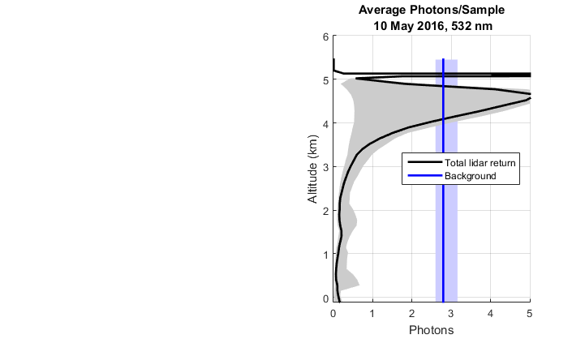
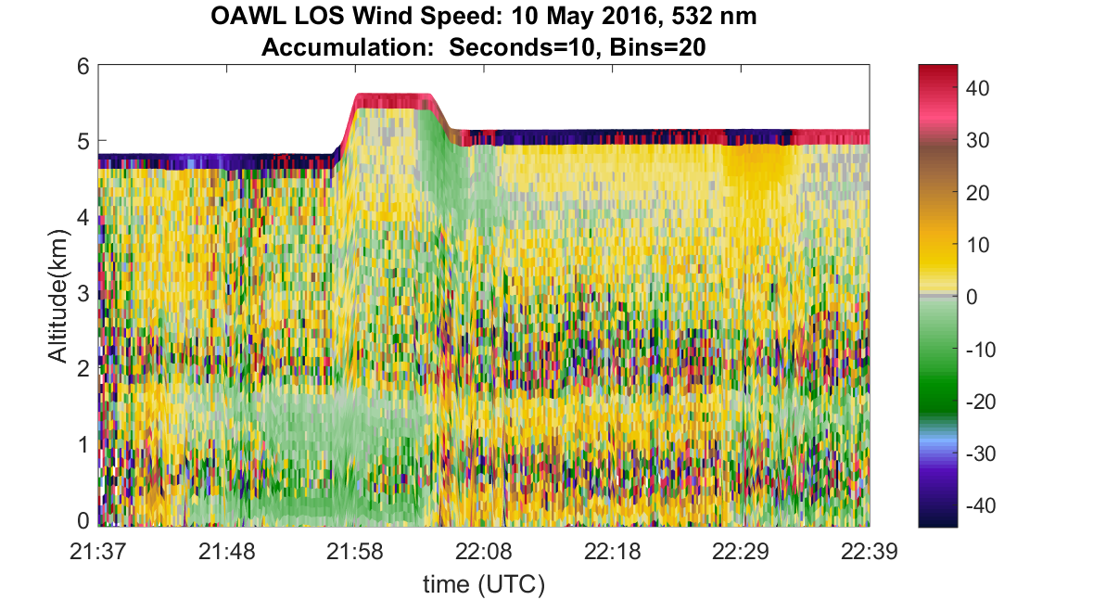
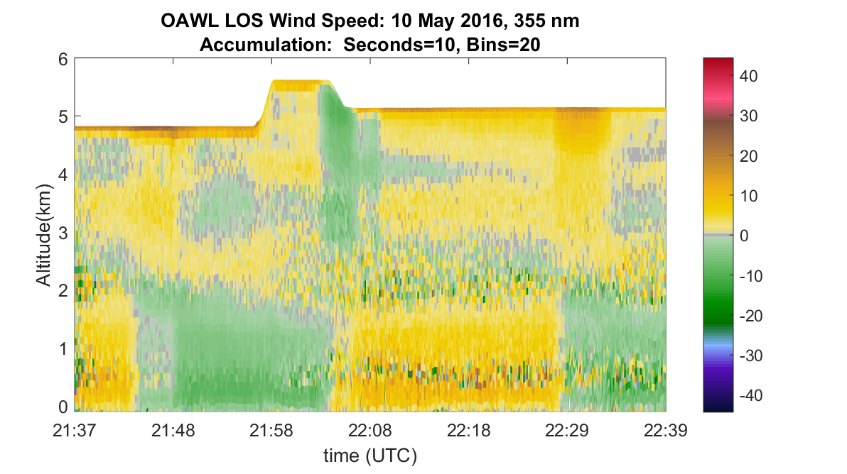
First flight, first (airborne) light
Can retrieve winds - even with more background photons than lidar photons
10 May 2017: 532 nm, 200 μJ (40 mW)
10 May 2017: 355 nm, 11 mJ (2.2 W)
10 May 2016: First flight (heater glitch) – flew 5-6km ASL
Low altitude: operated at 532 with only 200 µJ (40 mW)
More background photons than lidar photons → yet still retrieve winds
355 channel winds also shown

Slide 21
Myths, Rumors, and Whispers
Myth: GrOAWL requires minutes of integration time to get a retrieval.
Fact: GrOAWL retrievals are performed on 1-20s time scales, depending on aerosol loading and desired precision. We’ve used 10 s most of the time for airborne tests.
Myth: GrOAWL results don’t scale to ATHENA operation
Fact: The validated GrOAWL radiometric model is used to scale the performance → predicting required operation to meet ATHENA science objectives. ATHENA proposal modeling done with conservative background aerosol mode only.
Myth: GrOAWL/ATHENA can’t measure winds with background light
Fact: GrOAWL can operate even with more background than lidar photons. CALIPSO-demonstrated etalon provides even more background filtering for ATHENA. Coverage is better at night, but all data to date has been daytime.
Myth: GrOAWL/ATHENA-OAWL aren’t eyesafe
Fact: GrOAWL has variable/controllable attenuation of 532 nm so that it will always be eyesafe at the surface and/or at altitude based on operations – higher altitude allows for more output power. Space-borne-OAWL designs are more eyesafe than CALIPSO.
Myth: OAWL efforts have received “too much” recent NASA funding
Fact: Ball works with NASA and NOAA as part of a public-private partnership to develop high TRL wind lidar technology to address the nation’s weather needs. Ball has received no profit on ESTO funding and has also made significant internal investment. NASA owns all equipment developed on ESTO grants.

Slide 22
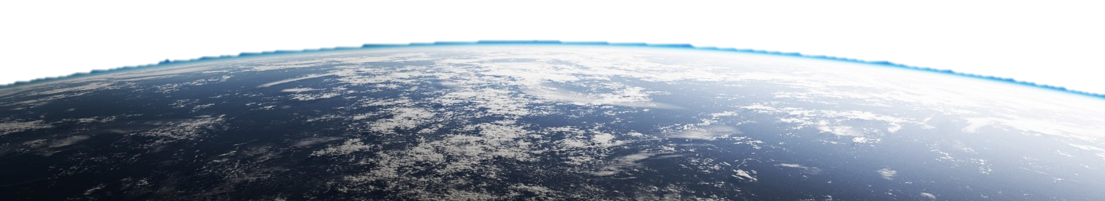
Laser levels (Eye Safety) lower than CALIPSO’s
CALIPSO 705 km orbit
20.15 Hz PRF
110 mJ/pulse
2.25 W
110 µrad
CALIPSO
Eye-safe at all aircraft levels and below
Operating for almost 11 years
ATHENA-OAWL
Lower orbit, 3x power, but beam divergence more than compensates
lower fluence levels than on CALIPSO
ATHENA-OAWL 350 km - 405km orbit
150 Hz PRF
45 mJ/pulse
6.75W
200 µrad
GrOAWL
10-15km aircraft
200 Hz PRF
1.5 mJ/pulse
0.3W
130 µrad

Slide 23
Myths, Rumors, and Whispers
Myth: GrOAWL requires minutes of integration time to get a retrieval.
Fact: GrOAWL retrievals are performed on 1-20s time scales, depending on aerosol loading and desired precision. We’ve used 10 s most of the time for airborne tests.
Myth: GrOAWL results don’t scale to ATHENA operation
Fact: The validated GrOAWL radiometric model is used to scale the performance → predicting required operation to meet ATHENA science objectives. ATHENA proposal modeling done with conservative background aerosol mode only.
Myth: GrOAWL/ATHENA can’t measure winds with background light
Fact: GrOAWL can operate even with more background than lidar photons. CALIPSO-demonstrated etalon provides even more background filtering for ATHENA. Coverage is better at night, but all data to date has been daytime.
Myth: GrOAWL/ATHENA-OAWL aren’t eyesafe
Fact: GrOAWL has variable/controllable attenuation of 532 nm so that it will always be eyesafe at the surface and/or at altitude based on operations – higher altitude allows for more output power. Space-borne-OAWL designs are more eyesafe than CALIPSO.
Myth: OAWL efforts have received “too much” recent NASA funding
Fact: Ball works with NASA and NOAA as part of a public-private partnership to develop high TRL wind lidar technology to address the nation’s weather needs. Ball has received no profit on ESTO funding and has made significant internal investments. NASA owns all equipment developed on ESTO grants.

Slide 24
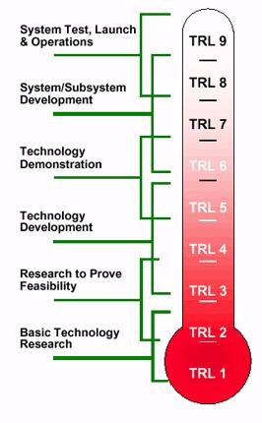
OAWL Path to space
High TRL subsystems
Category | ATHENA-ISS | Free-Flyer: Full Atmospheric Mission
Laser | ESTO-funded Fibertek 532 nm laser development & qualification | ESA’s Aeolus 355 nm laser demonstration + Fibertek 355 nm + 532 nm HEUVD laser qualification
Interferometer | The OAWL interferometer system proven in flights and ground-testing and other MZI-based lidar systems. TRL6 environmental testing in 2017
Electronics & Software | All OAWL electronics components have space-qualified equivalents. Payload control based on CALIPSO & TEMPO OAWL demonstrated autonomous operation (2011 and 2016) from WB-57 aircraft with real-time winds & satellite downlink
Structural & Optical | ATHENA-OAWL optical/mechanical system components have heritage in the CALIPSO lidar (2006 launch) and other space-based missions.
 | Aluminum for ISS |  | Graphite/Beryllium for Free Flyer
Telescopes | GDIT (Axsys) telescopes like those used for CALIOP, CATS, MOLA, and GLAS, ATLAS – Diffraction limited is not required. 1-λ error OK.
Platform | ISS enabling capabilities: power, cooling loop, and TDRSS → providing low latency for the ATHENA measurements | BCP 2000 or CNES (CALIPSO-like) satellite + ground stations
Pointing | Star tracker system provides required pointing knowledge for LOS wind speed accuracy

Slide 25
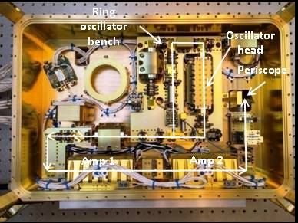
HEUVD Transmitter Design Validated by Performance and Lifetime Testing
Sealed , dual compartment design
Reduced sensitivity to contamination
Vacuum alignment stability
Contamination processing and control per ICESat-2 standards
Improved lifetime
Pure conductive cooling to a single external thermal interface
Simplifies thermal design
Required for a space-based system
Amplifiers mounted on laser module wall
Flexure mounted for high launch vibration levels
Full power 532 nm lifetime successfully completed
1.2 billion shots
Half power UV lifetime test successfully completed
1.5 billion shots
Resonator & preamplifier compartment
Power amplifier & nonlinear conversion compartment

Slide 26
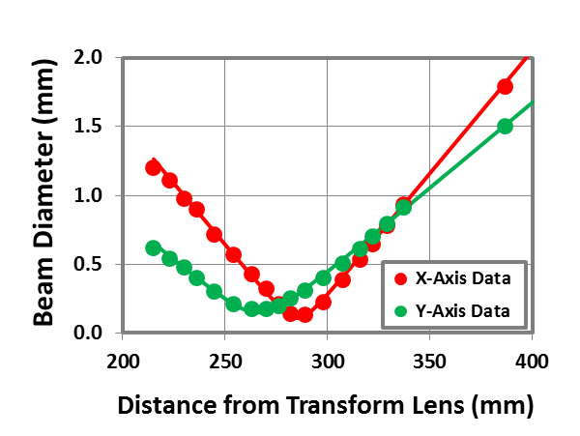
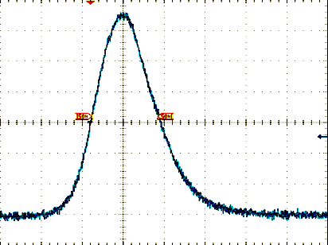
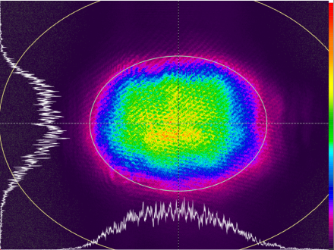
150 Hz HEUVD Pre-Amplifier Performance
HEUVD Transmitter Performance Exceeds the ATHENA-OAWL Requirements With Only Pre-Amps
< 100 mJ @ 1064 nm will meet the Athena-OAWL 532 nm requirement of 50 mJ
Allows for additional diode derating for longer lifetime
Power amplifier compartment will be used for SHG and an expansion telescope
Will meet the ATHENA-OAWL divergence out of the laser box
Parameter | Objective | Demonstrated
Pulse Energy | ≥ 160 mJ | 205 mJ
Pulse Width | 10 – 20 ns | 15 ns
NF Beam Size | 3.3 x 3.1 mm² | 3.7 x 2.8 mm²
Beam Quality | ≤ 1.5 M² | 1.4 M²
Temporal Distribution
Spatial Distributions
Propagation Parameters
15 ns
FWHM
3.69 x 2.78 mm
2.4 x 0.9 mr
M²_{X} = 1.45
M²_{Y} = 1.37
M^2-QSW - AMP 2 Output.xmcd
10 ns/div
Near Field
Far Field

Slide 27
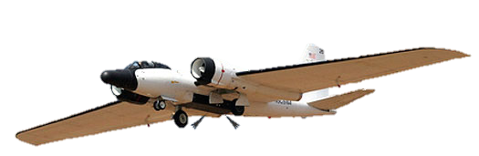
Why OAWL?
From Space
From Aircraft
OAWL is the only Doppler Wind Lidar with a high heritage path to space
High TRL components based on CALIPSO (direct detection): wavelength, optics, filters, etc.
Field widened receiver works well with large telescopes; diffraction limited not required. 1-λ aberrations OK.
Nd:YAG – (including 532 nm) laser technology already proven in space: 10+ years on CALIPSO
Slightly higher power and single mode operation being demonstrated on HEUVD
OAWL can also operate at 355 nm –(Aeolus & HEUVD qualifying the laser)
355 and 532 nm wavelengths see scattering/returns from large portions of the atmosphere.
OAWL offers a full atmosphere solution (later talk)
OAWL wavelengths and autonomous operation enable high altitude airborne studies
ESA’s 355 nm Aeolus CalVal
OAWL is the only validated US 355 nm aerosol wind lidar for Aeolus aerosol channel validation
Suborbital Science missions
OAWL’s small wavelengths scatter from smaller aerosol modes, like those found in the arctic and at higher altitudes
OAWL’s autonomous real-time winds provide immediate feedback to mission science

Slide 28
Summary: OAWL Status
2015-2016: With a ~1.5 year schedule, we
built, integrated, flew and validated the GrOAWL instrument
provided the first demonstration of continuous wind speed and direction profiles using two looks
2016: GrOAWL results critical for ATHENA-OAWL EVi-4 submission
2017: HAWC-OAWL Development
Reconfiguring GrOAWL for DC-8 incl. lessons learned
Building and testing athermal interferometer design
Operating at 355 nm & 532 nm
Developing winds + HSRL product for aerosol transport & chemical weather
2017: HEUVD laser testing
Many thanks to
ESTO for IIP and ACT development funding
ESSP and ESTO for the Venture-Technology funding
The Ball GrOAWL engineering team
Fibertek (Floyd Hovis & Joe Rudd)
YES (Mark Beaubien) & ONR for dropsonde validation support
The engineering team, crew, pilots, and program staff of the WB-57 for all their excellent flight support

Slide 29
Extras

Slide 30
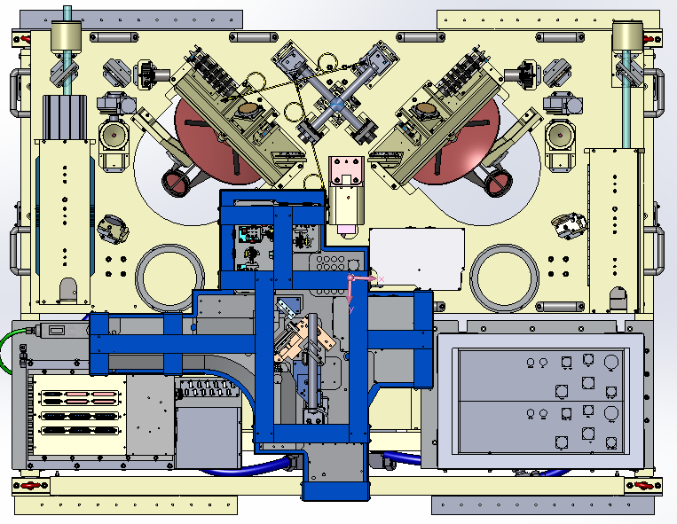
Key GrOAWL Instrument Features
~27 cm diameter effective area Jenoptik Telescopes
Direction of flight
Boresight mechanisms maintain overlap
2 telescopes/looks couple into a single interferometer receiver
Dedicated GPS/IMU (200 Hz)
Variable 532 nm output power (<200 μJ to 2.5 mJ)
New build of 2nd Fibertek OAWL Laser set up to interleave pulses with original
Refurbished OAWL IIP Fibertek Laser
Custom Payload Controller
Fibertek Laser Electronics
Fiber coupled OAWL Interferometer ensures uniform overlap function

Slide 31
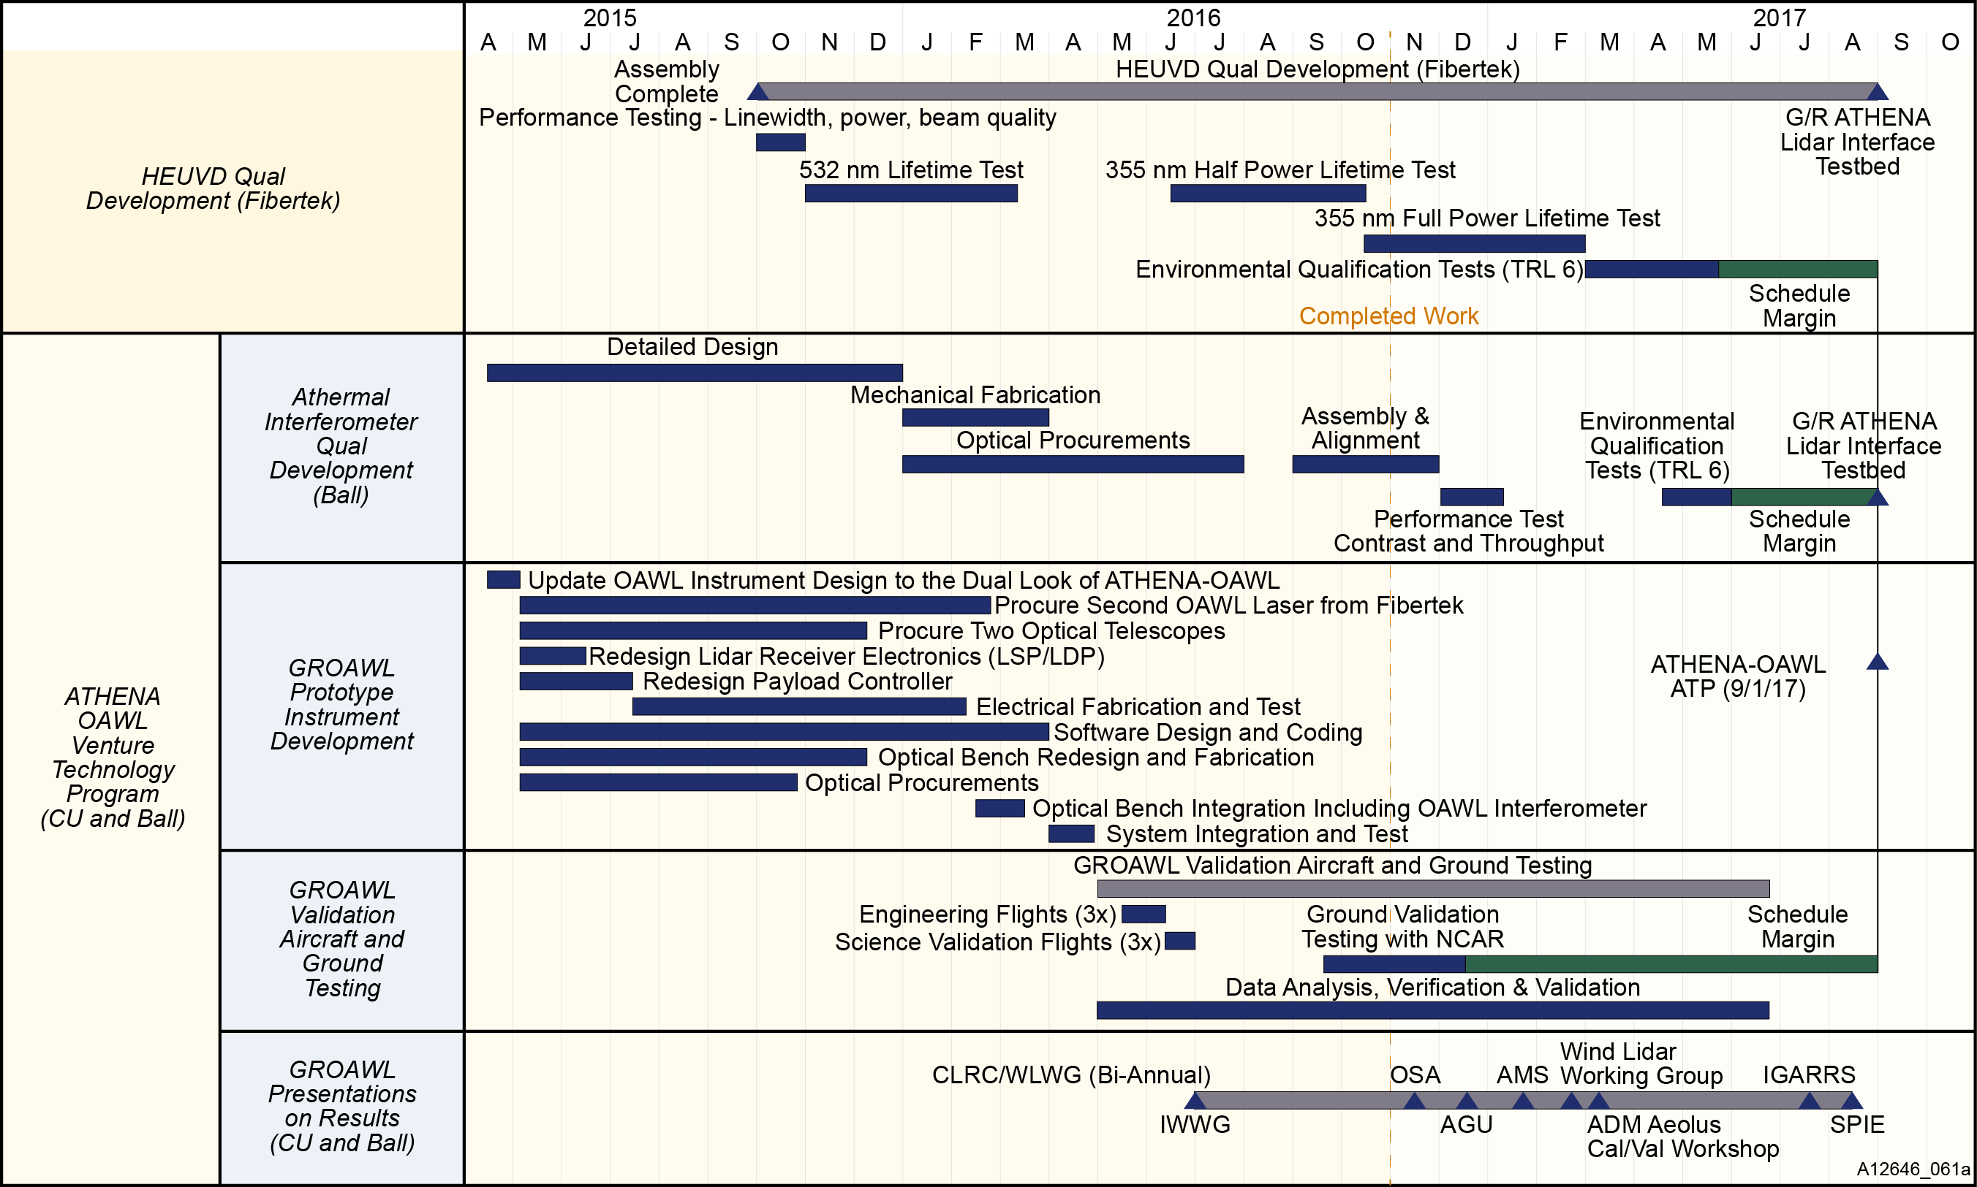
OAWL Technology Development since 2015

