Slide 1
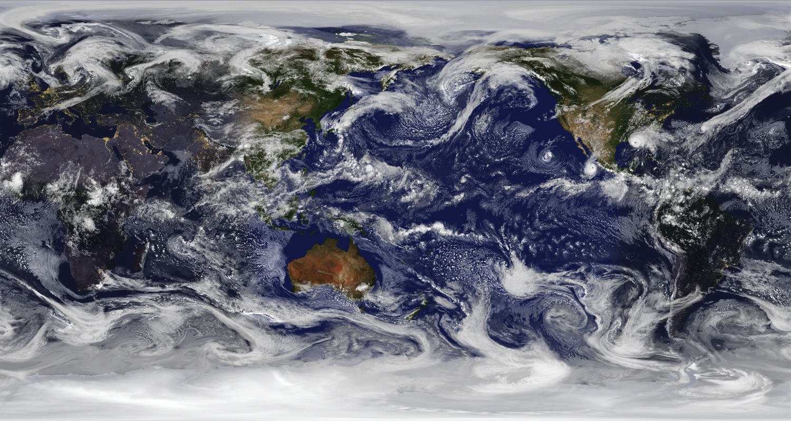
NOAA’s Quantitative Observing System Assessment Program (QOSAP)
GMAO 7km resolution global nature run
Robert Atlas
Office of Oceanic and Atmospheric Research

Slide 2
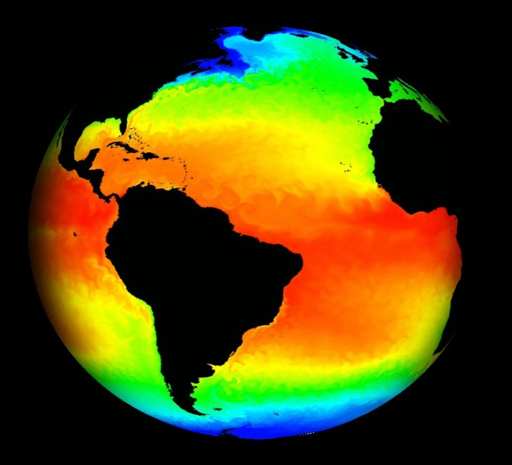
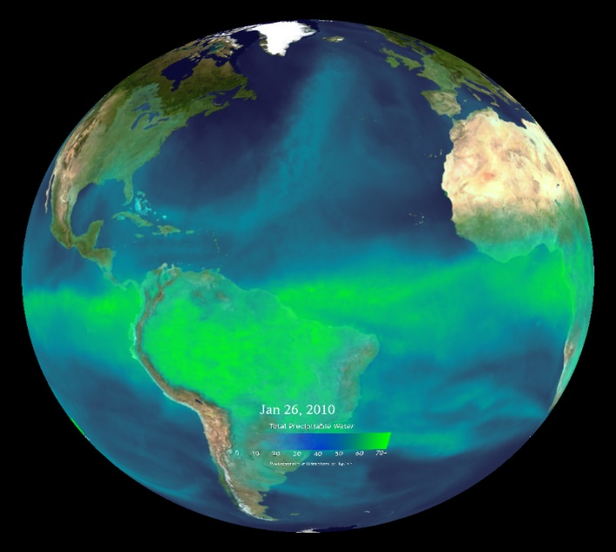
QOSAP’s Primary Objectives
Improve quantitative and objective assessment capabilities to evaluate operational and future observation system impacts and trade-offs to assess and to prioritize NOAA’s observing system architecture.
Increase NOAA’s capacity to conduct quantitative observing system assessments.
Develop and use appropriate quantitative assessment methodologies.
Inform major decisions on the design and implementation of optimal composite observing systems.

Slide 3
QOSAP’s Multi - LO Governance
Champion
(Craig McLean)
NOSC
(Oversight)
TPIO
(NOSIA Integration)
Executive Lead
(OAR DAA)
QOSAP
Program Director
Bob Atlas
QOSAP
Program Deputy Director
Lidia Cucurull
Sid Boukabara
NESDIS
Stephen Gill
NOS
James Yoe
NWS
Lidia Cucurull
OAR
Bonnie Ponwith
NMFS
Kristie Twining
OMAO
Notes:
The Line and Staff Offices are working well together and it is paying dividends with the advances being made.

Slide 4
Key Activities
1. Observing System Experiments (OSE) to evaluate the impact of existing observing systems and to evaluate the ability of data assimilation methodologies to utilize specific types of data effectively.
2. Observing System Simulation Experiments (OSSE): to evaluate the potential impact of proposed observing systems and trade-offs in instrument design, and to improve data assimilation.
3. Develop new capabilities and metrics for observing system assessment.

Slide 5
OSSE Team members and collaborators
Global OSSE Team:, L. Cucurull, R. Atlas, S. Boukabura, S. Casey,, R. Hoffman, J. Woolen, J. Yoe,
Regional OSSE Teams: A. Aksoy, B. Annane, R. Atlas, L. Bucci, H. Christophersen, B.Dahl, J. Delgado, R. Hoffman, S. Majumdar, B. McNoldy, S. Murillo, D. Nolan, K. Ryan, S. Koch, P. Lee
Ocean OSSE Team: G. Halliwell, V. Kourafalou, M. Le Henaff, R. Atlas
CIMSS collaborators: T. Schmit, J. Li, Z. Li
NASA collaborators: D. Posselt, R. Gelaro, J. Susskind,
T. Pagano, B. Lambrigtsen, N. Prive

Slide 6
QOSAP’s Annual Milestones
Milestones/Deliverables to NOSC | Planned Completion Date
Annual plan: quantitative assessment project prioritization and selection | Q2
Performance reports on projects | Q4
Inventory of Results of Quantitative Assessments | Q4
Collection of Driving Research Questions for a QOSAP needs assessment | Q4
End of Fiscal Year Progress Report to NOSC | Q1 of next FY
Each year the INVENTORY of OSSE/OSE assessments conducted within NOAA is updated.
76 assessments are contained in the inventory along with their main results and applicable publications.

Slide 7
Assessment Prioritization Schema
For each proposed assessment topic/question we answered:
Question 1: Is there a pressing need for the assessment to be executed in the current FY? [Yes/No]
Question 2: Does NOAA currently have the capabilities in place to execute the assessment? [Yes/No]
Question 3: Are there existing resources available for the assessment? [Yes/No] Estimate the amount needed/or additional above existing $ [$k]
Question 4: Can the assessment be completed in the next 1-2 years? [Yes/No]
Question 5: What is the potential value to NOAA and partners? [High, Medium, Low]
Notes:
Pressing need defined as "NOAA contractual agreement or necessary for FY14/15 investment decision“. This includes any on-going studies (ie are currently funded), thus expectation of the study’s execution.

Slide 8
Prioritized Tiers for each FY
Priority Tier 1: Has Pressing need for immediate execution
1A: All factors align; need, $, capability, FY finish, high value
1B: All but 1 factor align; Need, capability, $, FY finish, yet lower value
1C: Need and high value, yet no capability or $
1D: Need, yet medium value and no capability or $ available.
Priority Tier 2: No pressing need for immediate execution yet capability exists (may need $)
2A: At least 2 other factors align
2B: 1 factor aligns and medium+ value
2C: 1 factor aligns
Priority Tier 3: No pressing need, capability, nor resources
3A: High value
3B: Medium-Low value
Tier 2 may be started in next FY
Tier 1 will be started in current FY*
Tier 3A will be further defined in current or next FY; Assessment in later FY
*If the capability cannot be developed in current FY, it will be deferred

Slide 9
Current Status of OSSEs in NOAA
Numerous OSSEs have been performed using the global OSSE system based on an ECMWF T511 nature run and the regional Hurricane OSSE system developed at AOML. (These have evaluated Geo HSS, GNSS RO, CYGNSS, TROPICS, DWL, UAS, Recon Aircraft, and others.(See selected 2015 and 2016 publications.))
A new state of the art global OSSE system based on the NASA Cubed Sphere at 7 km resolution NR has been developed and is currently being used in multiple OSSEs to evaluate issues relating to satellite, sub-orbital, and in situ observing systems. (These are focused right now on GNSS RO and GEO HSS.)
New and expanding regional OSSE systems for high impact weather are being developed. (This includes an advanced Hurricane OSSE System based on the basin scale version of HWRF.)
A state of the art ocean OSSE System has been developed and is expanding. OSSEs related to the role of ocean observations in hurricane prediction are being performed.

Slide 10
Recent NOAA AOML OSSE Publications
Androulidakis, Y.S., V.H. Kourafalou, G.R. Halliwell, M. Le Henaff, H.S. Kang, M. Mehari, and R. Atlas. Hurricane interaction with the upper ocean in the Amazon-Orinoco plume region. Ocean Dynamics .
Atlas, R., V. Tallapragada, and S. Gopalakrishnan. Advances in tropical cyclone intensity forecasts. Marine Technology Society Journal, 49(6):149-160 (doi:10.4031/MTSJ.49.6.2) (2015).
Atlas, R., L. Bucci, B. Annane, R. Hoffman, and S. Murillo. Observing System Simulation Experiments to assess the potential impact of new observing systems on hurricane forecasting. Marine Technology Society Journal, 49(6):140-148 (doi:10.4031/MTSJ.49.6.3) (2015).
Atlas, R., R.N. Hoffman, Z. Ma, G.D. Emmitt, S.A. Wood, S. Greco, S. Tucker, L. Bucci, B. Annane, R.M. Hardesty, and S. Murillo. Observing system simulation experiments (OSSEs) to evaluate the potential impact of an optical autocovariance wind lidar (OAWL) on numerical weather prediction. Journal of Atmospheric and Oceanic Technology, 32(9):1593-1613 (doi:10.1175/JTECH-D-15-0038.1) (2015).

Slide 11
Recent NOAA AOML OSSE Publications
Boukabara, S.A., I. Moradi, R. Atlas, S.P.F. Casey, L. Cucurull, R.N. Hoffman, K. Ide, V.K. Kumar, R. Li, Z. Li, M. Masutani, N. Shahroudi, J. Woollen, and Y. Zhou. Community global Observing System Simulation Experiment (OSSE) package: CGOP—Description and usage. Journal of Atmospheric and Oceanic Technology, 33(8):1759-1777 (doi:10.1175/JTECH-D-16-0012.1) (2016).
Boukabara, S.A., T. Zhu, H.L. Tolman, S. Lord, S. Goodman, R. Atlas, M. Goldberg, T. Auligne, B. Pierce, L. Cucurull, M. Zupanski, M. Zhang, I. Moradi, J. Otkin, D. Santek, B. Hoover, Z. Pu, X. Zhan, C. Hain, E. Kalnay, D. Hotta, S. Nolin, E. Bayler, A. Mehra, S.P.F. Casey, D. Lindsey, L. Grasso, K. Kumar, A. Powell, J. Xu, T. Greenwald, J. Zajic, J. Li, J. Li, B. Li, J. Liu, L. Fang, P. Wang, and T.-C. Chen. S4: An O2R/R2O infrastructure for optimizing satellite data utilization in NOAA numerical modeling systems: A step toward bridging the gap between research and operations. Bulletin of the American Meteorological Society (in press).
Halliwell, G.R., A. Srinivasan, V. Kourafalou, H. Yang, D. Willey, M. Le Henaff, and R. Atlas. Rigorous evaluation of a fraternal twin ocean OSSE system for the open Gulf of Mexico. Journal of Oceanic and Atmospheric Technology, 31(1):105-130 (doi:10.1175/JTECH-D-13-00011.1) (2014).

Slide 12
Recent NOAA AOML OSSE Publications
Hoffman, R.N., and R. Atlas. Future observing system simulation experiments. Bulletin of the American Meteorological Society, 97(9):___-___ (doi:10.1175/BAMS-D-15-00200.1) (2016).
Hoffman, R.N., S.-A. Boukabara, V.K. Kumar, K. Garrett, S.P.F. Casey, and R. Atlas. An empirical cumulative density function approach to defining summary NWP forecast assessment metrics. Monthly Weather Review (in press).
Kourafalou, V.H., Y.S. Androulidakis, G.R. Halliwell, H.-S. Kang, M. Mehari, M. Le Henaff, R. Atlas, and R. Lumpkin. North Atlantic Ocean OSSE system development: Nature Run evaluation and application to hurricane interaction with the Gulf Stream. Progress in Oceanography (submitted).
Lee, P., R. Atlas, G. Carmichael, Y. Tang, B. Pierce, A.P. Biazar, L. Pan, H. Kim, D. Tong, and W. Chen. Observing System Simulation Experiments (OSSEs) using a regional air quality application for evaluation. In Air Pollution Modeling and its Application XXIV, D.G. Steyn and N. Chaumerliac (eds.). Springer International Publishing, 599-605 (doi:10.1007/978-3-319-24478-5_97) (2016).

Slide 13
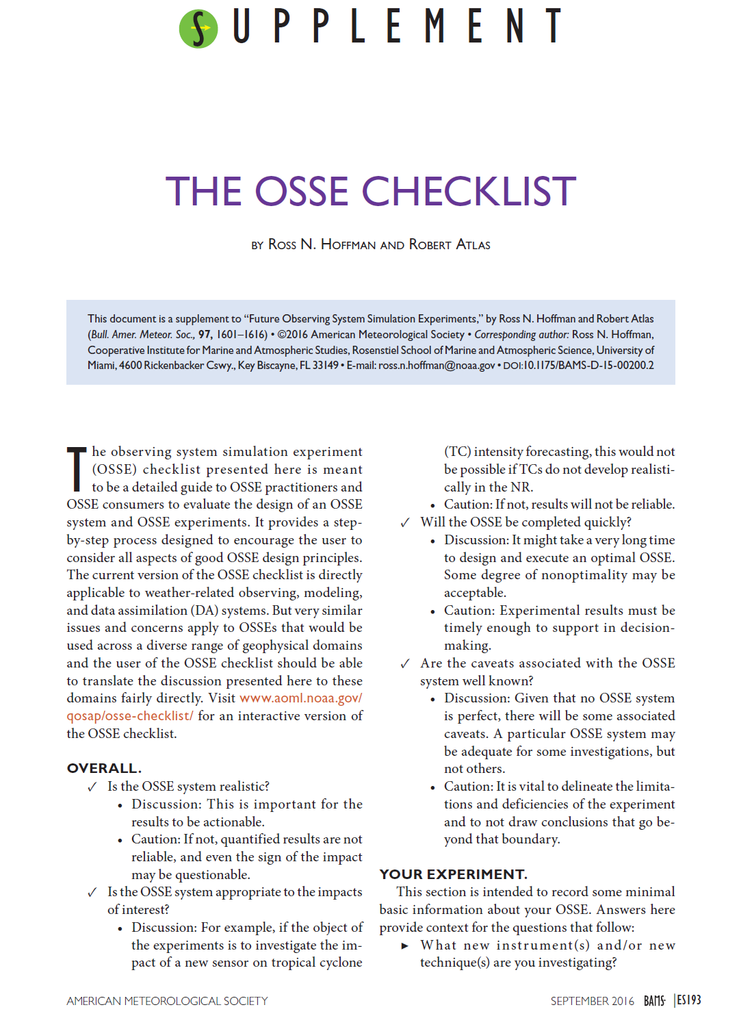
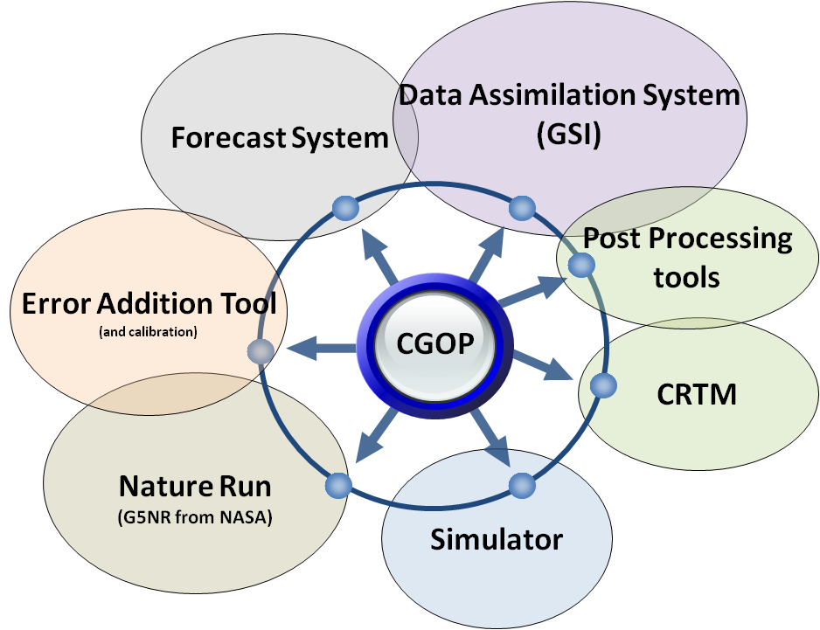
Approach to OSSE Experiments
OSSE performed using a community package, CGOP, shared with community for transparency, assessment, enhancement, feedbacks and was fully described in a peer-reviewed publication (Boukabara et. al, 2016)
For proper OSSE assessment and quality control, we followed the accepted OSSE checklist, as documented in a BAMS, 2016 paper (by Hoffman and Atlas)

Slide 14
OSSE Process
Will the study be completed in time to be useful?
What are the limitations of the OSSE system? Do not draw conclusions that go beyond these.
Is the difference between the NR and forecast models realistic?
Are the simulated errors realistic?
Are the forecast accuracy and impacts of existing observing systems in the OSSE comparable to the real world?

Slide 15
Current
ECMWF T511, T1279 GMAO 7km Cubed sphere WRF 1 km and HWRF Basin-scale Hurricane NRs
OSSE TESTBED COMPONENTS
Validation of End-to-End OSSE Set-up
- Realism of simulated observations and input
- Impact model not too close to NR
Nature Runs
Simulated Observations
DAS
Forecast
Model
Current and
Scatterometer
Rawinsonde
Surface
Aircraft
TOVS
AIRS
AMV
Future
DWL
CMIS
Molnya
UAS
CL Balloon
GPS Sounding
Buoy Rocket
Current
GSI
4DVAR
EnKF
Hybrid
Regional
WRF
HWRF
NAM
Global
GFS
FIM
Validation and Augmentation
OSSE Metrics
Valid.
Cyclones
Mean fields
Clouds
Precip
Aug.
Clouds
Aerosols
Turbulence
Cyclones, Fronts, Jets
Anomaly Correlation
Air Traffic Routing
Precip.Utility Load Mgmt.
Targeting Observation schems

Slide 16
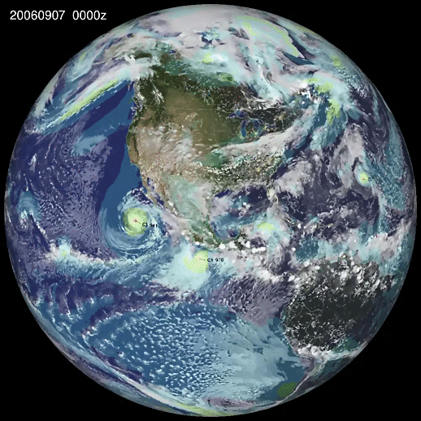
G5NR 2 year NR at 7 km resolution.

Slide 17
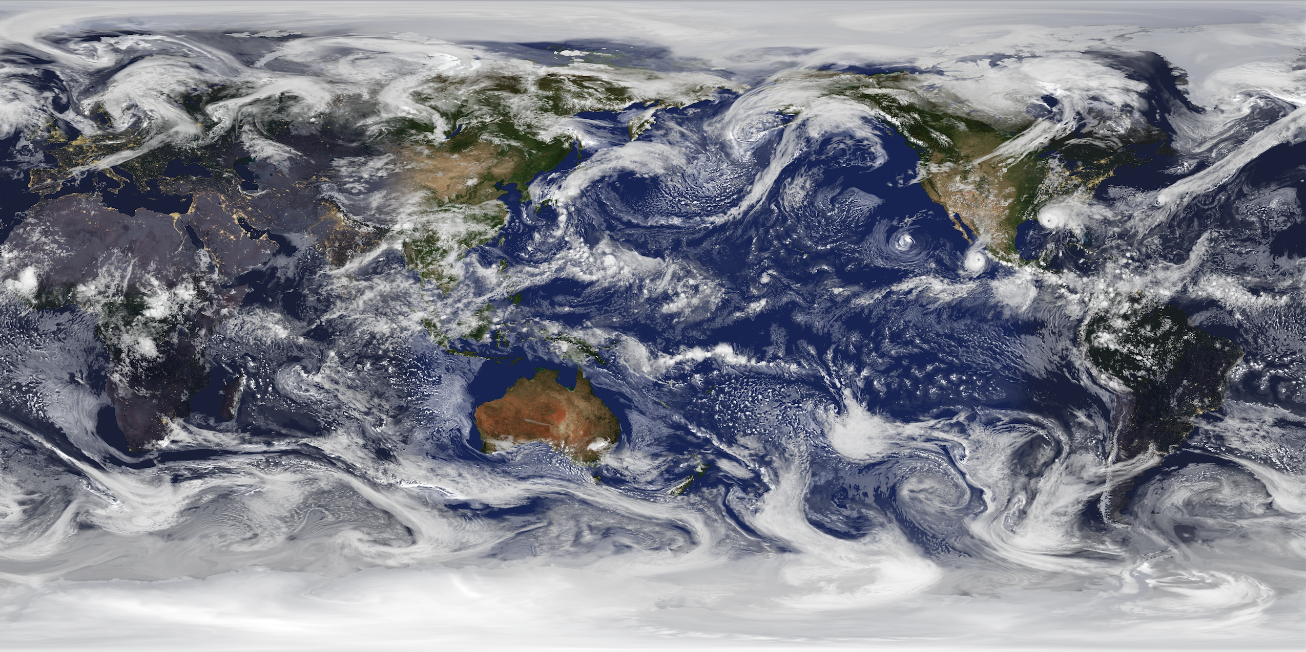
Snapshot from GMAO 7km resolution global nature run

Slide 18
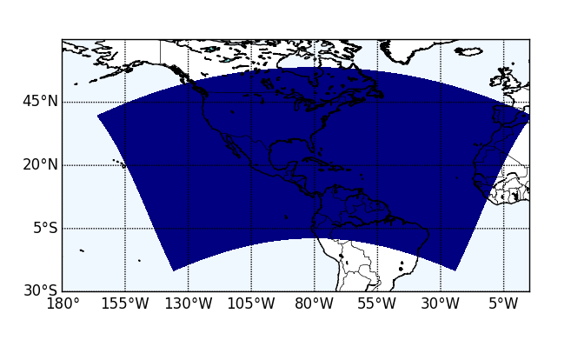
Basin Scale Nature Run for Hurricane OSSEs
NMM-B Forecast Model
NAM Physics
“Basin scale” domain
5000x2500 grid points
Single 1 or 3-km horizontal resolution grid (vs. 7km for G5NR)

Slide 19
Summary
NOAA’s Quantitative Observing System Assessment Program (QOSAP) coordinates OSE and OSSE across NOAA and strives to ensure that all OSSEs are performed in a credible manner.
Observing System Simulation Experiments (OSSEs) provide an effective means to:
Evaluate the potential impact of proposed observing systems
Determine tradeoffs in their design
Evaluate new data assimilation methodology
Great care must be taken to ensure the realism of the OSSE’s and in the interpretation of OSSE results.
OSSEs are currently being conducted to assess the potential impact of many new observing systems in current data assimilation systems.
Rigorous OSSE methodology is being extended to air quality, severe storm, ocean, climate and biological applications.

Slide 20
Summary related to DWL
All of the OSSEs that have been conducted to date have shown significant potential for wind profile observations from space to improve large scale numerical weather prediction.
New OSSEs are needed to evaluate the both the potential impact of passive wind measurements (with realistically simulated errors) and the synergies between passive and active measurements.
The regional hurricane OSSEs that have been performed to date have shown that having adequate coverage over the hurricane circulation and correctly representing the interaction of the hurricane with its environment are needed.
A coherent DWL will be flying on NOAA’s P3 Hurricane Hunter Aircraft beginning September 1 of 2017. OSEs are currently being performed to evaluate the extent to which DWL can complement TDR on the P3, and to evaluate the impact of the the DWL on hurricane analyses and forecasts.

Slide 21
Backup slides

Slide 23
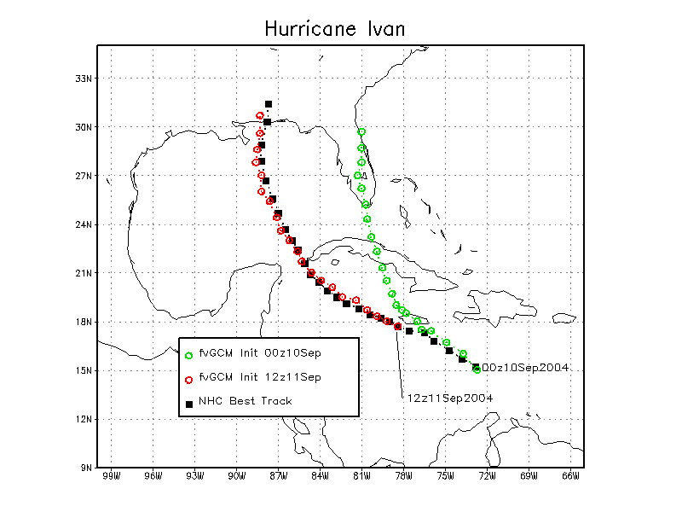

Slide 24
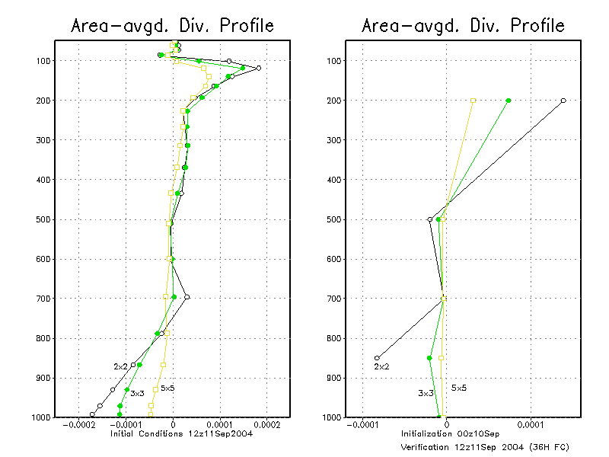

Slide 25
Description of Quick OSSE Experiments
Nature Run : fvGCM .25 x .36 deg horizontal resolution,
start on Sep. 11, 2004 at 12z
Observations : simulated from the Nature Run
for Sep. 11, 12z – Sep.12, 12z, 2004.
Data Assimilation Experiments : fvSSI , 1 x 1.25 deg resolution,
ran Sep. 11, 00z – Sep.12, 12z, 2004.
Control - compliment of operationally globally observed data,
including satellite temperature profiles
Lidar - Idealized wind profiles added in the vicinity of the hurricane
5 Day Forecasts : Started on Sep.11, 12z, Sep.12, 00z and 12z
ran at both 1 x 1.25 deg and .25 x .36 deg horizontal resolution

Slide 27
Predictability Experiments

Slide 28
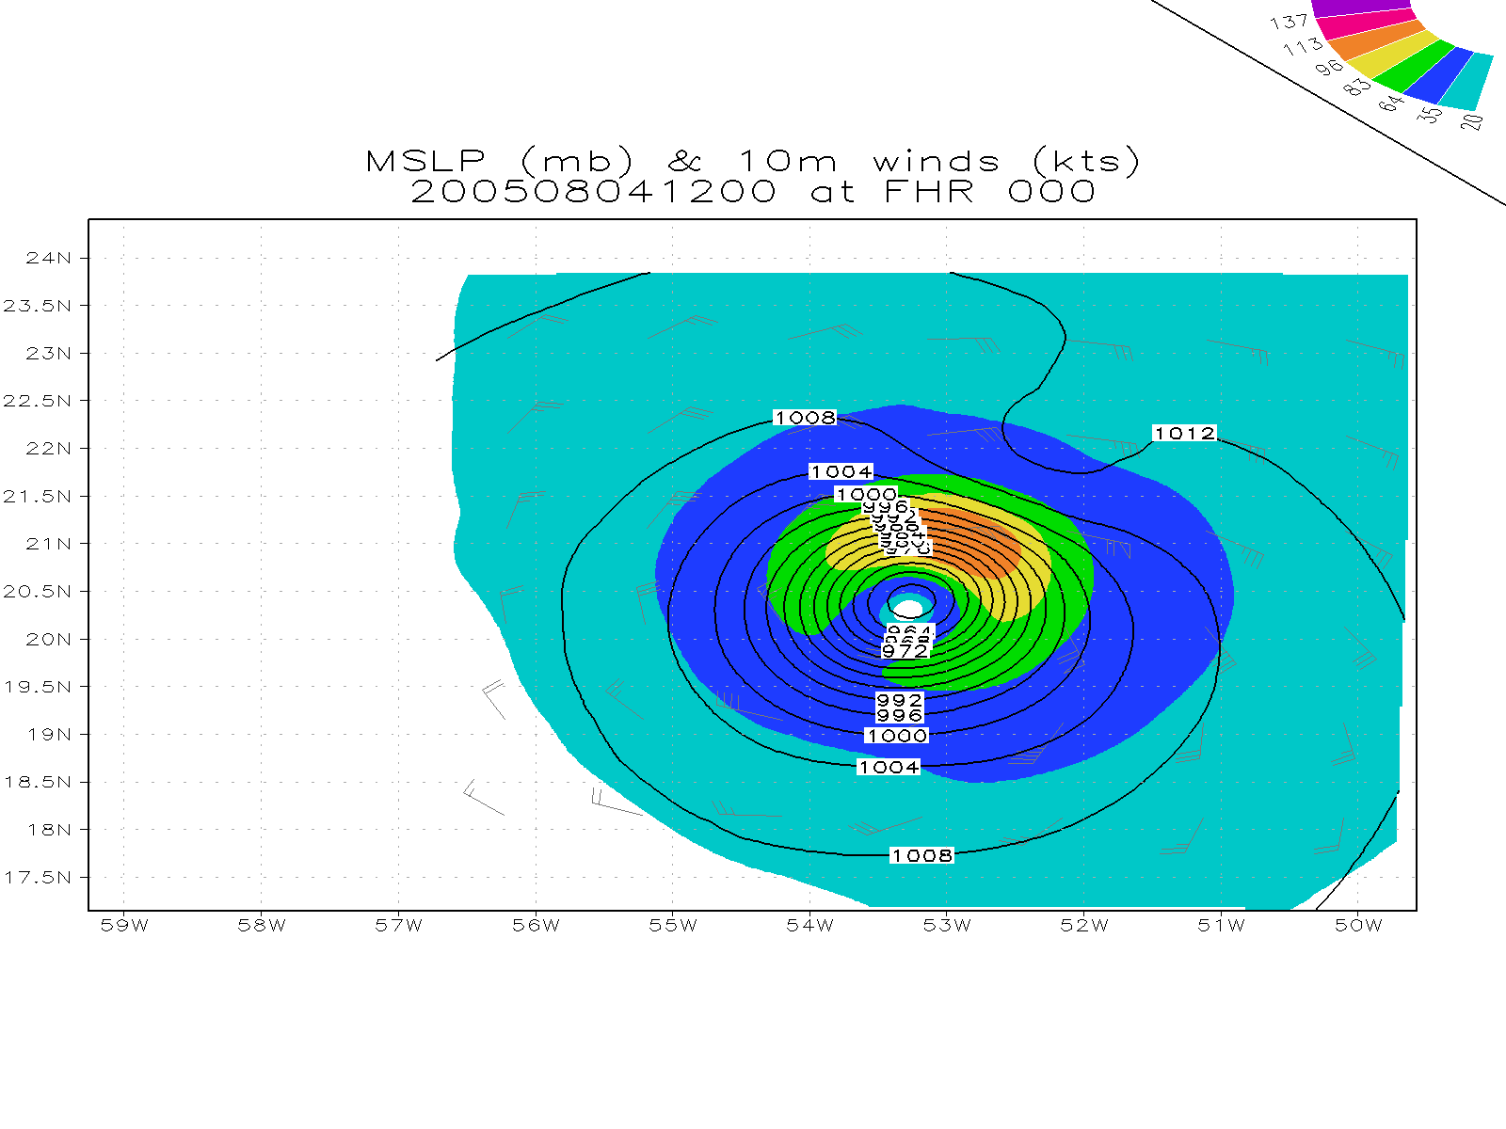
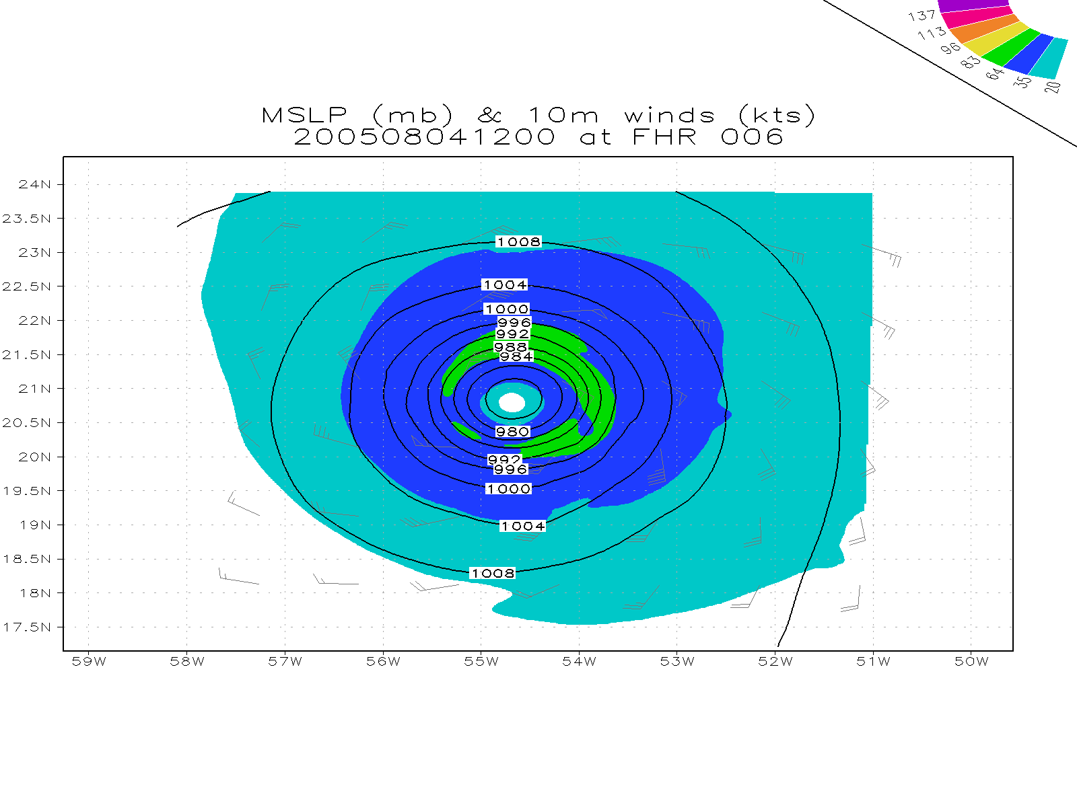
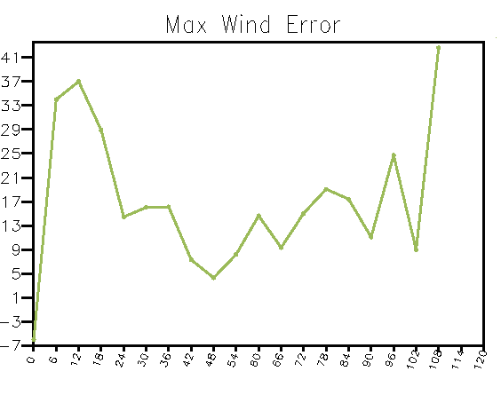
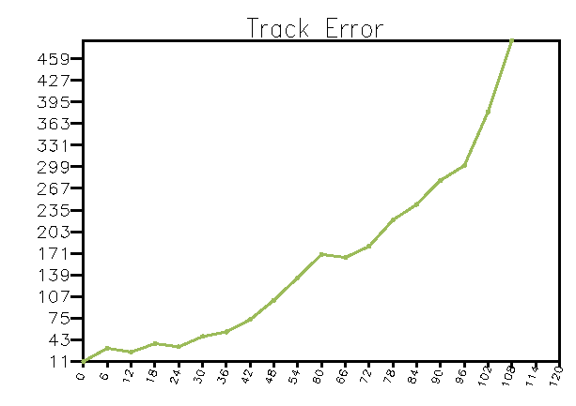
Enkf (control) 08/04 12Z
knots
km
Forecast hour
Forecast hour

Slide 30
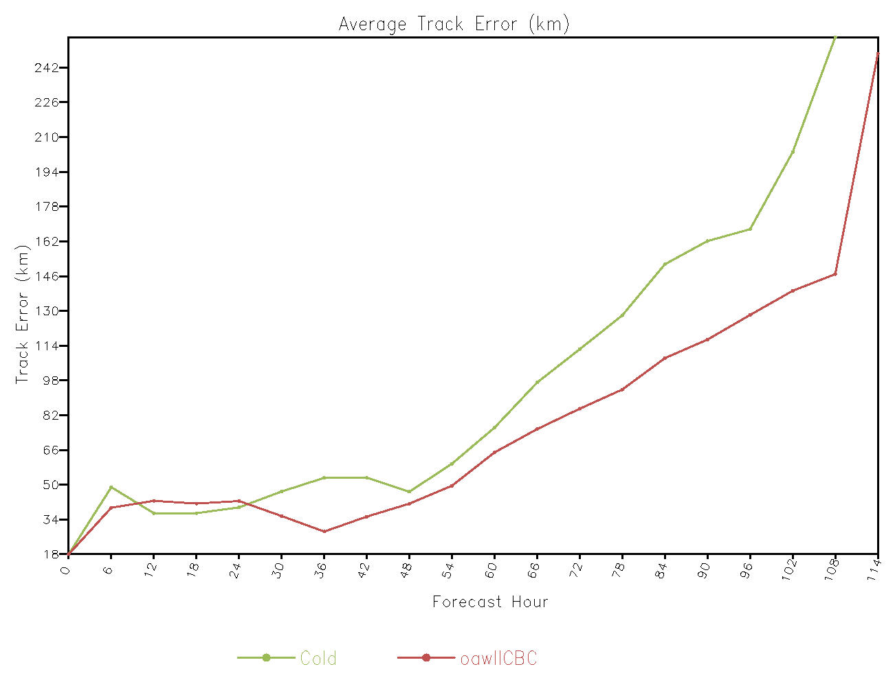
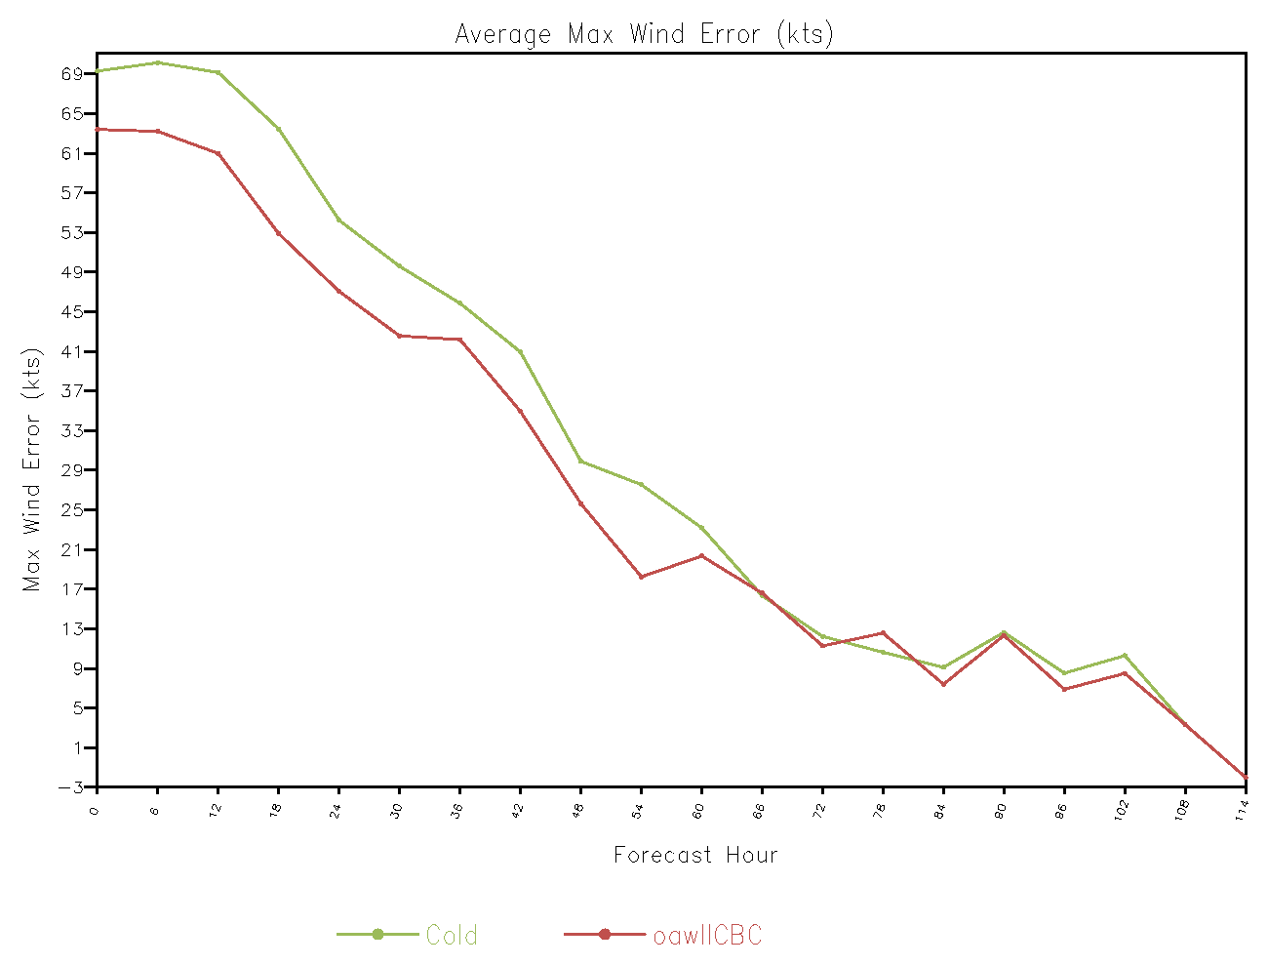
Impact of global model assimilation of OAWL data on HWRF forecasts

Slide 31
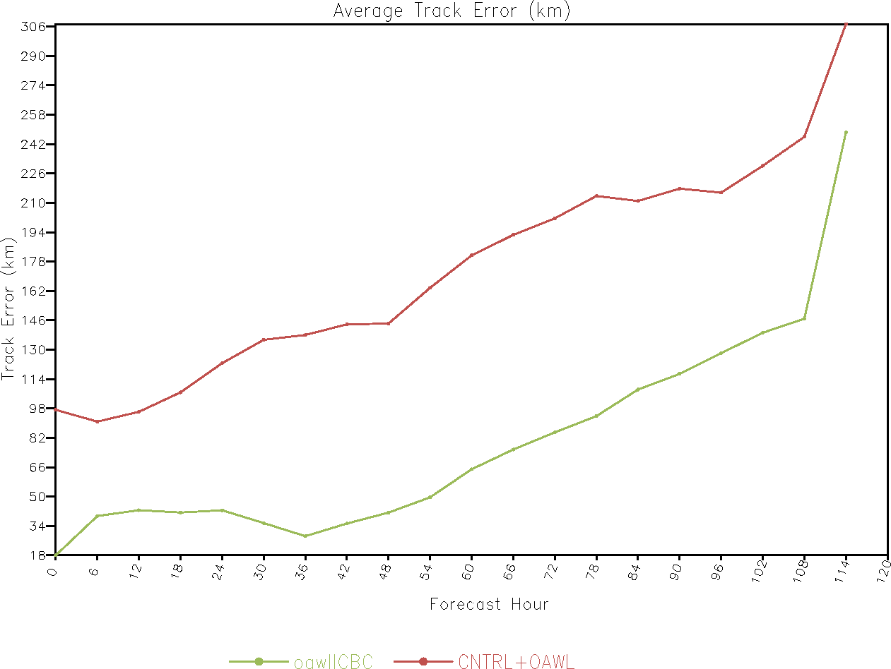
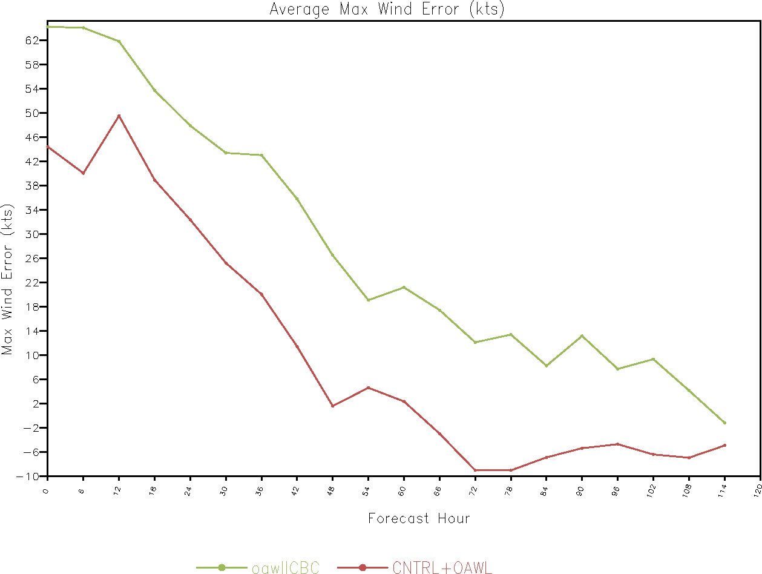
Relative accuracy of HWRF forecasts resulting from global or regional assimilation of OAWL Data

Slide 32
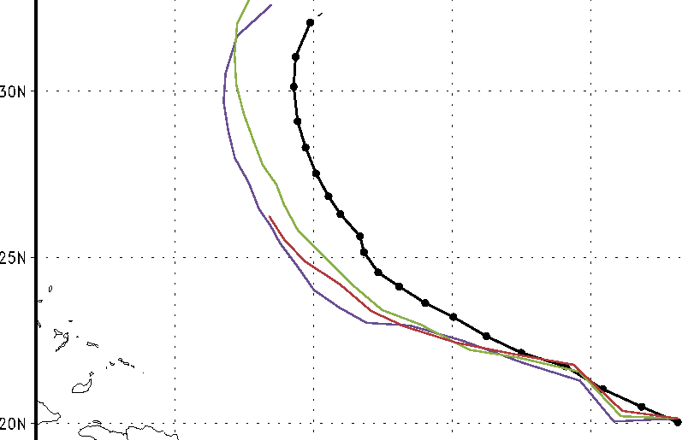
Impact of lidar winds on HWRF Track forecasts
Track forecasts from August 4 06Z for Nature (black), Control (purple),
Control+WISSCR_COH (red) and Control+OAWL (green).

