Slide 1
Atmospheric energy harvesting for autonomous in-flight path planning of a UAV instrumented with Doppler Wind Lidar.
S.A. Wood, G. D. Emmitt, S. Greco, and C. O’Handley
(Subcontractors: Earthly Dynamics and Aurora)
Working Group on Space-based Lidar Winds
Hampton, Virginia
21-23 March, 2017

Slide 2
Objectives of SBIR project AEORA
Extend the mission time of UAVs by autonomously utilizing (harvesting) atmospheric motions, particularly vertical motions.
Provide mission planning tools to estimate the probability and locations of advantageous atmospheric motions as well as deleterious motions to be avoided.
Develop algorithms that use “all available information”, especially an on board DWL, to make in-flight path decisions to optimally use the atmospheric energy opportunities consistent with the mission constraints.
Atmospheric Energy Opportunity and Ranking Algorithm (AEORA)

Slide 3
Potential atmospheric energy sources
Phenomenology | Description (dimensions) | Nominal Magnitudes | Lifecycle Metrics | Remote Sensing Signatures
Thermals (non-orographic); triggered by differential surface heating | Few 100 meters in diameter; vertical extent controlled by environmental structure | 1- 5 m/s | May last for large fraction of an hour; daytime features only | Convergence Optical depth Temperature Refractive turbulence
Thermals (slopes); driven by differential heating of sloped surfaces during direct solar illumination | 100’s meter diameter; vertical extent limited by environmental structure | 1 -5 m/s | May last for hours during the daytime. | Convergence Optical depth Temperature Refractive turbulence
Organized Large Eddies (OLEs); upward branch of a semi-closed vertical circulation within the PBL | A few 100 meters in diameter; vertical extent defined by depth of PBL; organized in lines allowing “next AA” to be more easily predicted than thermals | 1 – 3 m/s | May last for hours but with much variation in strength; Not much known about night-time characteristics | Convergence Optical depth Refractive turbulence
Obstacle flow; Strong horizontal flow deflected upward by orography and airmass collisions; (ridge soaring; frontal soaring) | Many miles in horizontal extent; vertical extent usually a few 100 meters above ridge line | 1 – 10 m/s | May last for many hours and vary as the horizontal flow varies; Occurs at all hours of the day. | The obstacle Convergence Optical depth Refractive turbulence
Cloud updrafts; main targets are cloud base updrafts of non- or lightly precipitating cumuli. | Dimensions similar to thermals (a few 100’s of meters); vertical extent can be 1000’s of meters | 1 – 5 m/s depending upon atmospheric stability. | A few minutes, maximum duration ~ 10 minutes. | The cloud Convergence Temperature Precipitation
Mountain Waves | Horizontal extent of many km; Vertical extent of 10’s of km possible | Up to 10 m/s vertical velocities distributed in bands downwind of ridge line. | May last for hours throughout entire diurnal cycle | Vertical motions; visual wave clouds on occasion.
Gravity waves on density interface | Horizontal extent of many kms (50 – 500); Vertical extent of 5 – 10 km | 1 – 3 m/s | 1 – 3 hours | Vertical motions Inversions
Shear layers | Horizontal extent of many kms defined by surface topography and atmospheric structures; vertical extent a few 100 meters | 10 – 25m/s with a maximum near 100 -300 meters. | May persist for several days lasting through the nighttime | Horizontal wind speed; Optical depths
= features studied with airborne Doppler wind lidar
Source: SWA (Emmitt)

Slide 4
AEORA Software Package
AMPT
AEORA Mission Planning Tool
AOPP
AEORA Onboard Path Planner
FTIG
Flight Trajectory Instruction Generator
Simulation cycle
Realtime
FCSI
Flight Control System Interface

Slide 5
AOPP
(AEORA Onboard Path Planner)
Lidar returns
AMPT Wind Fields
AOPP*
Segmented path updates for FTIG
AMPT PDFs
Initial
Segmented path
Passive sensor returns
* AOPP is the “heart and soul” of AEORA and resides on the UAS. Continuously
processing the lidar and instrument data, running the feature detection software
and ranking the energy features. The segmented path for the top ranked feature
is passed along to the FTIG.

Slide 6
Weather Research Forecast (WRF) Model
• WRF V3.4
• LES options
• Lin Microphysics
• Surface layer physics based on M-O
• Surface physics – Noah Land Surface Model
• Mellor-Yamada Janjic scheme for BL Physics
• Betts-Miller Cum. Parameterization Scheme
• W-damping turned on

Slide 7
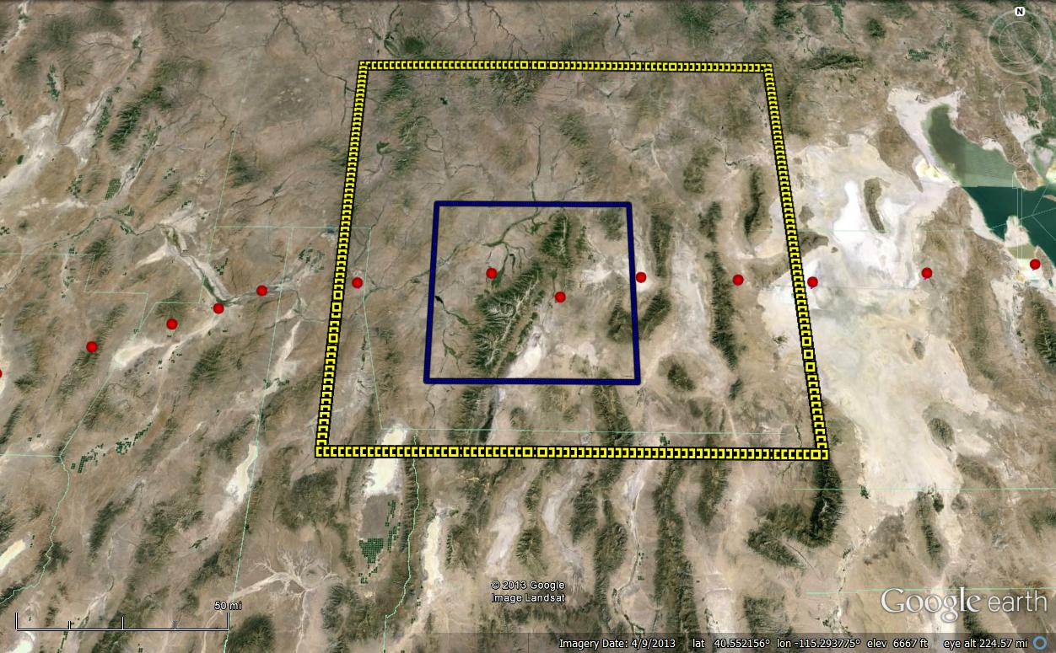
WRF Domains 2 (3 km res.) and 3 ( 1 km res) for 10/04/2012 20Z

Slide 8
Waves and Vertical Motion

Slide 9
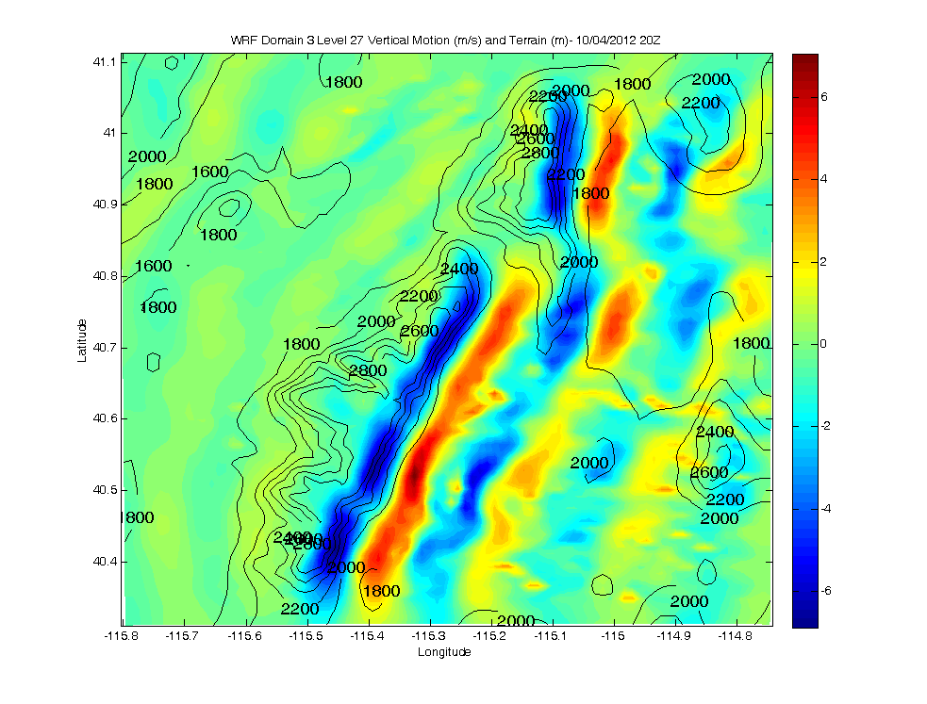
WRF Domain 3 Level 27 Vertical Motion and Terrain
W (m/s)

Slide 10
WRF Domain 3 Level 27 Z-X Vertical Motion Along Lidar Transect
W (m/s)

Slide 11
Waves and Horizontal Motion

Slide 12
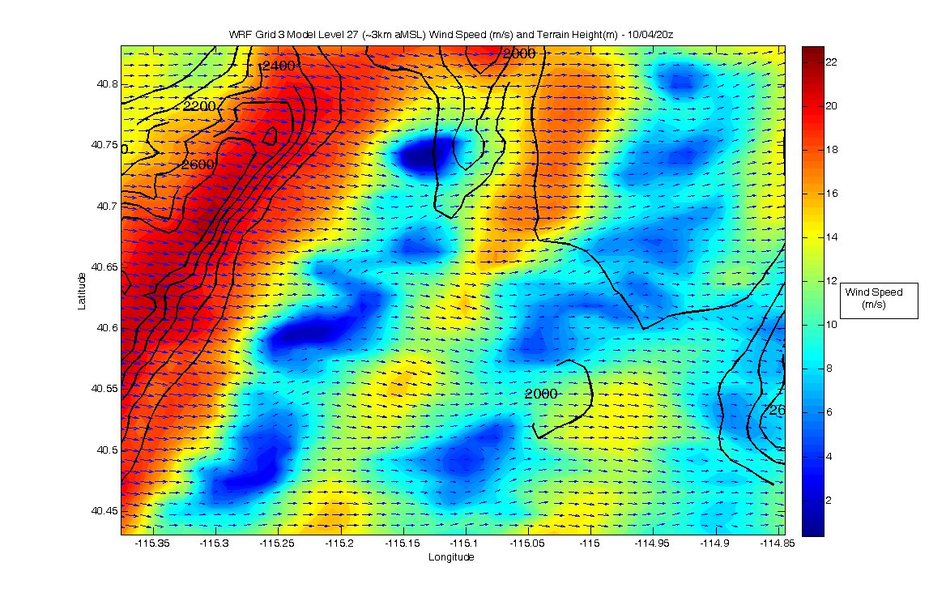
WRF Domain 3 Level 27 Wind Speed and Terrain - Zoom

Slide 13
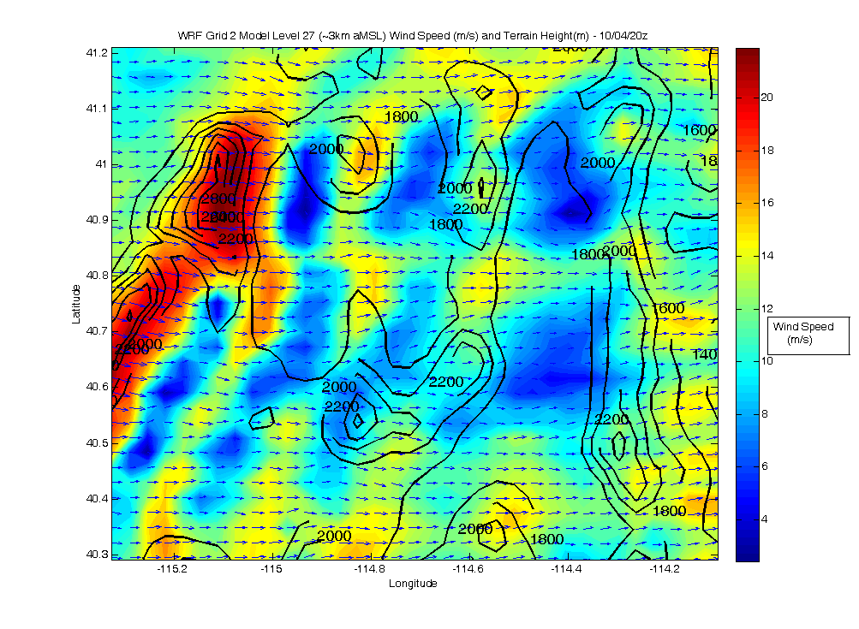
WRF Domain 2 Level 27 Wind Speed and Terrain - Zoom

Slide 14
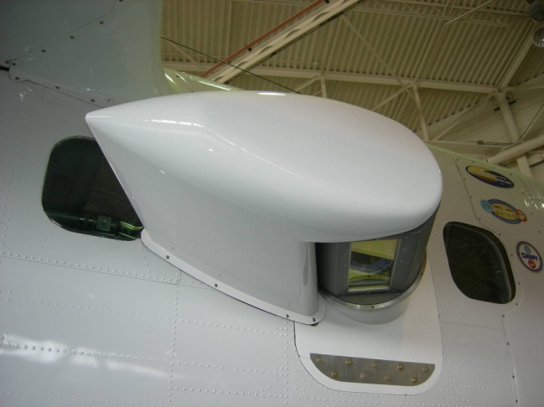

TODWL
Twin Otter Doppler Wind Lidar
CTV
Controlled Towed Vehicle
CTV

Slide 15
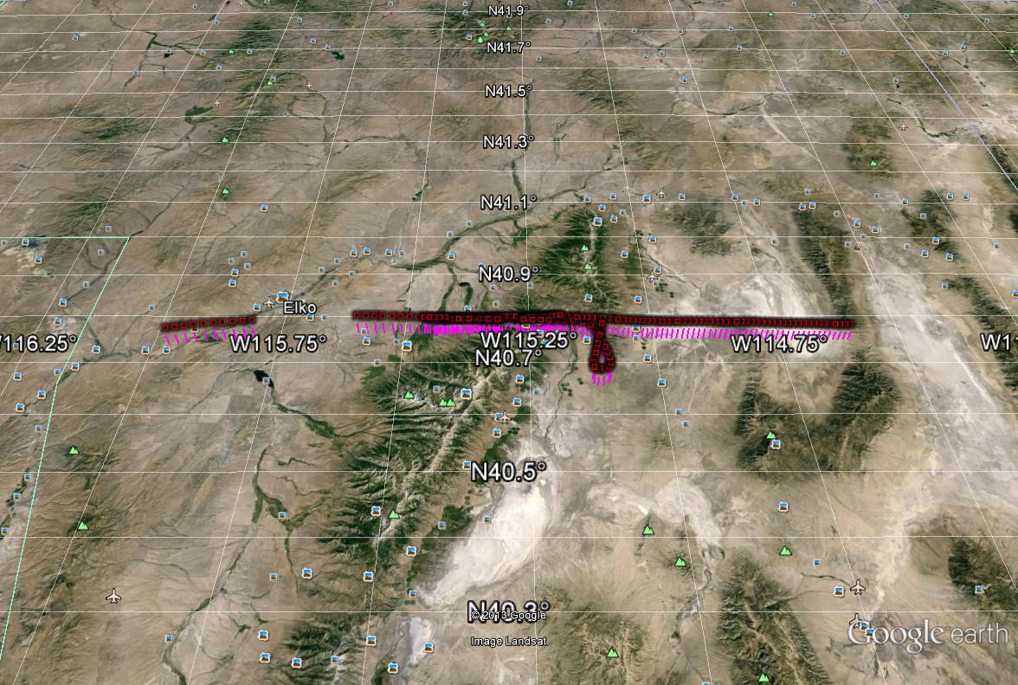

Slide 16
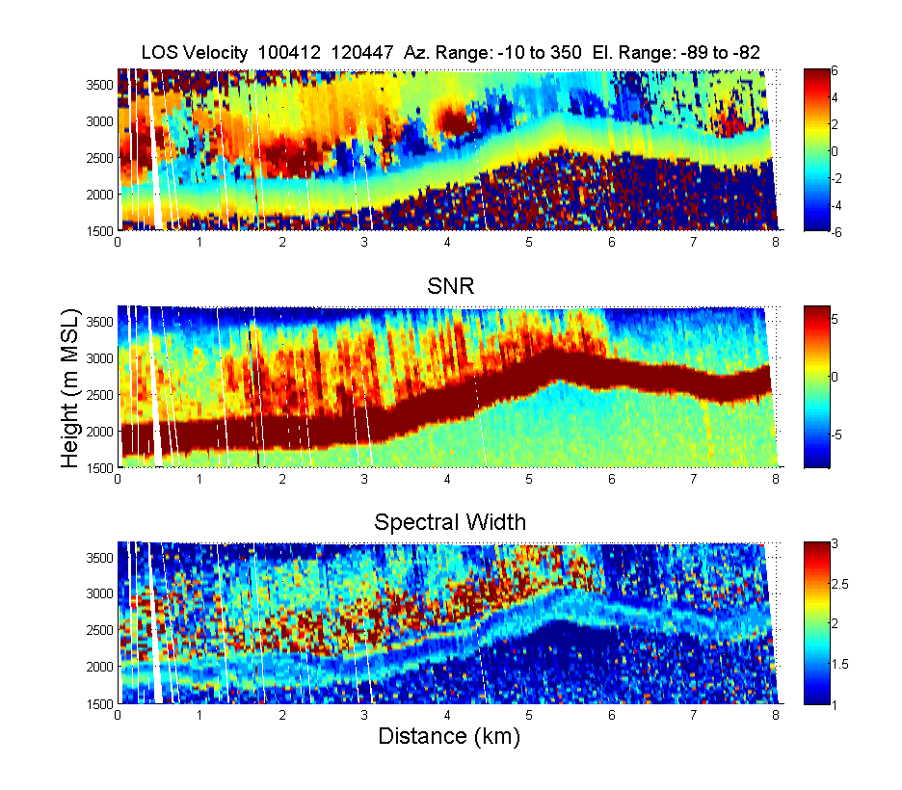

Slide 17
Energy utilization strategies

Slide 18












Simulation Model
Aircraft is modeled as a rigid body with 6 degrees of freedom
Wings and tail are modeled as separated aerodynamic surfaces
There are 4 control surfaces, one for each aerodynamic element, which can modify the lift and drag forces on that element
Parameters set to match RQ7B Shadow
Wing and Tail are Split into Four Aerodynamic Surfaces Producing Lift and Drag and Pitching Moment
$${\overset{⃑}{J}}_{1}$$
$${\overset{⃑}{J}}_{3}$$
$${\overset{⃑}{I}}_{3}$$
$${\overset{⃑}{J}}_{4}$$
$${\overset{⃑}{K}}_{3}$$
$${\overset{⃑}{I}}_{1}$$
$${\overset{⃑}{I}}_{4}$$
$${\overset{⃑}{K}}_{4}$$
$${\overset{⃑}{K}}_{1}$$
$${\overset{⃑}{J}}_{2}$$
$${\overset{⃑}{I}}_{2}$$
$${\overset{⃑}{K}}_{2}$$
Fuselage Produces Only Drag
Aircraft Center of Mass

Slide 19
Atmospheric Energy Extraction
We are assuming that information is provided about the type and the approximate shape, location, and strength of an atmospheric feature (DWL, numerical models, imagers..)
The goal is develop robust control algorithms which can not only fly the feature in an optimal way, but also be robust to uncertainties in the shape and location of the feature
Currently, three areas are being pursued
  Thermal Centering
  Lift Lines (Ridge lift, mountain waves)
  Small scale gust energy extraction
The development of control logic for the robust flight of wind shear (dynamic soaring) and other more complex features is being pursued.

Slide 20

Thermal Centering
The implementation is a very basic, robust centering controller flight tested by Naval Post Graduate School
(Andersson, Kaminer, Dobrokhodov, Cichella, “Thermal Centering Control for Autonomous Soaring: Stability Analysis and Flight Test Results,” Journal of Guidance Control and Dynamics, 2012)
The goal is a circular flight path around the core of a thermal
A desired final bank angle is specified and perturbations are made to center the flight path on the core
  If lift is increasing, the bank angle is decreased, straightening the flight path and bringing the aircraft closer to the core
  Conversely, if the lift is decreasing, bank angle is increased, bringing the aircraft back around to the stronger lift
$$φ=φ_{nom}+k\ddot{h}$$
Commanded Bank Angle
Nominal Thermalling Bank Angle
Control Gain
Rate of Change of Climb Rate

Slide 21
Thermal Centering
The effect of varying control gain (nominal bank angle set to 20 degrees)
K=1
K=2
K=5

Slide 22
Lift Line Controller
Assume there is a known area of lift with a roughly linear shape
This is represented by a line with waypoints at the ends and middle
As the aircraft flies the waypoints, points of strong lift are recorded

Slide 23
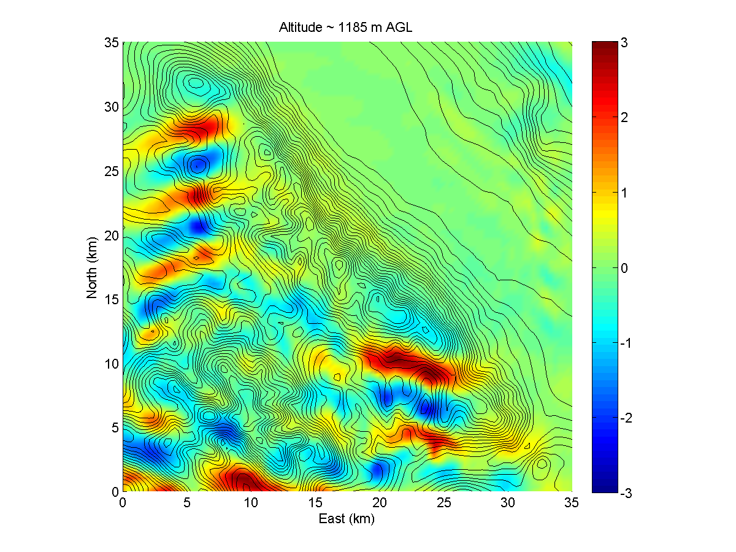
WRF Wind Field
WRF data from a single instant in simulation time of a 35km x 35km grid was provided by Simpson Weather
Simulation results presented here focus on the mountain wave circled below

Slide 24
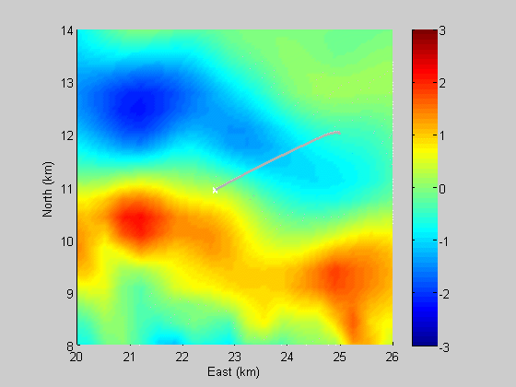

Thermal centering & lift line controller comparisons for mountain waves
Comparing Trajectories using Thermal Centering and Lift Line Controller flying Mountain Wave in WRF simulated wind field

Slide 25
Net advantage comparisons
Lift Line Controller Recomputing Lift Line
Lift Line Controller following Fixed Line
Thermal Centering Controller

Slide 26


Small Scale Energy Extraction
Employ control logic to extract energy from wind gusts to enhance efficiency in transit between waypoints
Some work has been done optimizing simple control laws to enhance gliding efficiency in the presence of random vertical gusts
  Patel, Lee, Kroo, “Extracting Energy from Atmospheric Turbulence,” OSTIV, 2008.
  Langelaan, “Gust Energy Extraction for Mini and Micro Uninhabited Aerial Vehicles,” Journal of Guidance Control and Dynamics, 2009.
This work can be incorporated and also extended by using information from an onboard, forward-looking LIDAR
$$δ_{e}=K_{1}w_{g}+K_{2}V_{a}+K_{3}$$
$δ_{e}=\text{elevator}, w_{g}=\text{vertical} \text{gust}, V_{a}=$ airspeed
$$δ_{e}=K_{1}w_{g}+K_{2}V_{a}+K_{3}+K_{4}w_{g,x+50m}+K_{5}u_{g,x+50m}+…$$

Slide 27
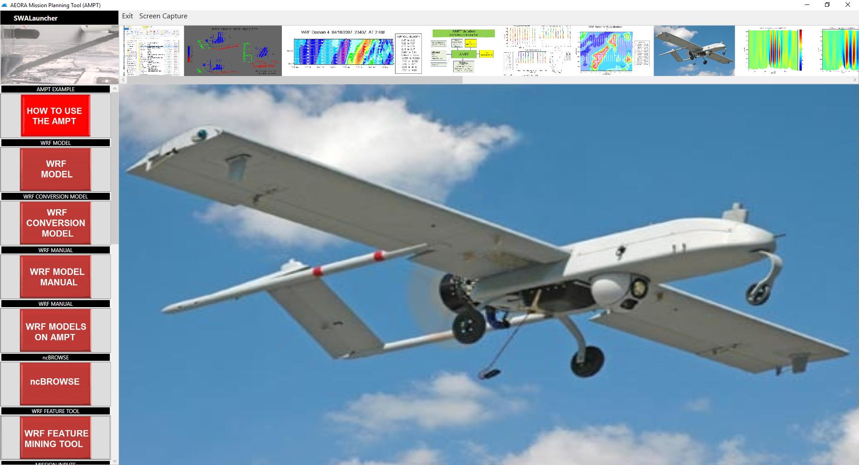
Mission Planning Tool for AEORA

Slide 28
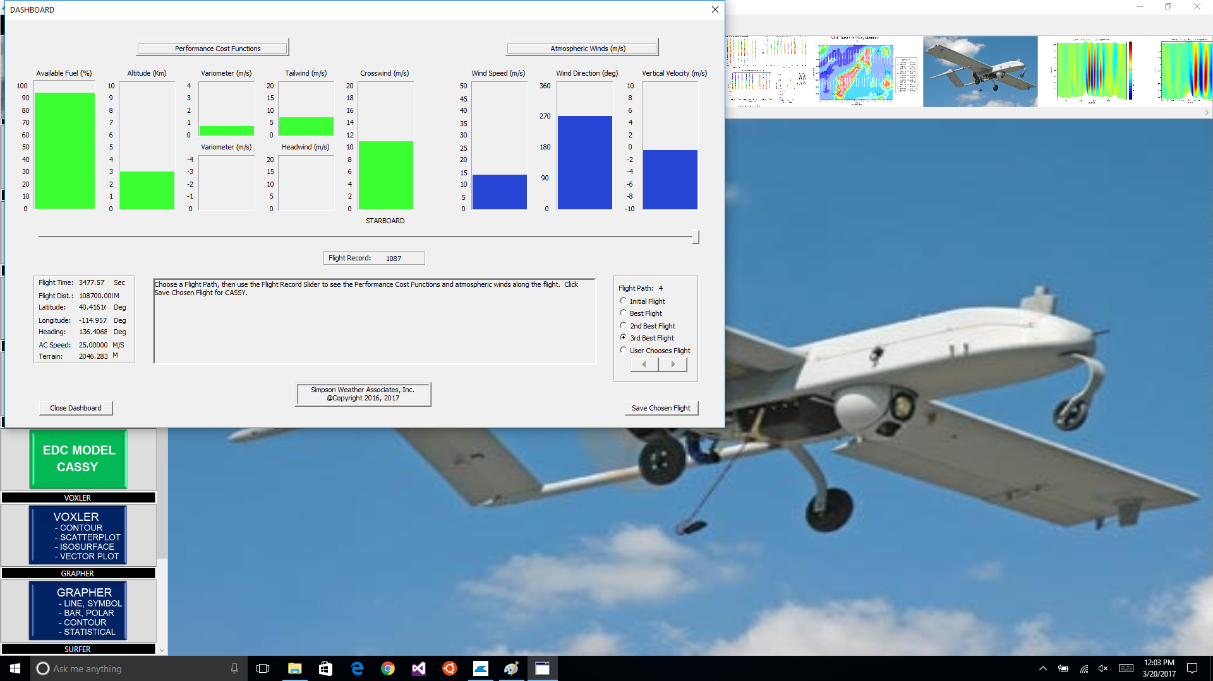
Mission Planning Tool for AEORA

