Slide 1
DAWN Contributions to Investigating Arctic Atmospheric Dynamics and Numerical Model Validation
S. Greco, G.D. Emmitt, A.K. DuVivier, and M. Kavaya
Simpson Weather Associates
University of Colorado - CIRES
NASA LaRC
Working Group Meeting on Space-based Lidar Winds
Newport News, VA
March 21 2017

Slide 2
NASA’s PolarWinds
NASA funded two airborne Doppler Wind Lidar campaigns:
  Campaign 1 Oct-Nov 2014 on NASA UC-12B King Air based Kangerlussuaq, Greenland
  Campaign 2 May 2015 on NASA DC-8 based
  Keflavik, Iceland
Over 80 hours of research flights in the Arctic region near Greenland and Iceland
Purpose was to conduct basic polar science investigations and demonstrate DWL technology readiness for ADM Cal/Val
Included Co-flights (six) with high-altitude DLR Falcon with DWL

Slide 3
PolarWinds Science Objectives
Validate numerical model forecasts (WRF, P-WRF) and reanalysis (ASR, ERA) characterizations of airflow in the lower atmosphere over the open oceans, land, ice sheets and transition zones
Conduct detailed investigations into dynamic features such as Arctic low level jets (Tip Jet), barrier winds and OLEs.
Characterize and study the wind regime of the lower atmosphere over marginal ice zones in the Arctic
Provide wind/aerosol observations to validate or compare with existing remote sensing platforms
- CALIPSO aerosol measurements
  - MODIS Atmospheric Motion Vectors
  - ASCAT Ocean Vector Winds

Slide 4
Instruments and Models
DAWN (Doppler Aerosol WiNd lidar)
- Coherent detection lidar (aerosol)
- Downward pointing scanner
- 2-12 Scanning angles (mostly 2 and 5)
Yankee Environment (YES) Dropsondes
- Campaign 2 – almost 90 dropsondes
OSU Polar WRF run operationally twice daily
University of Colorado WRF for research

Slide 5
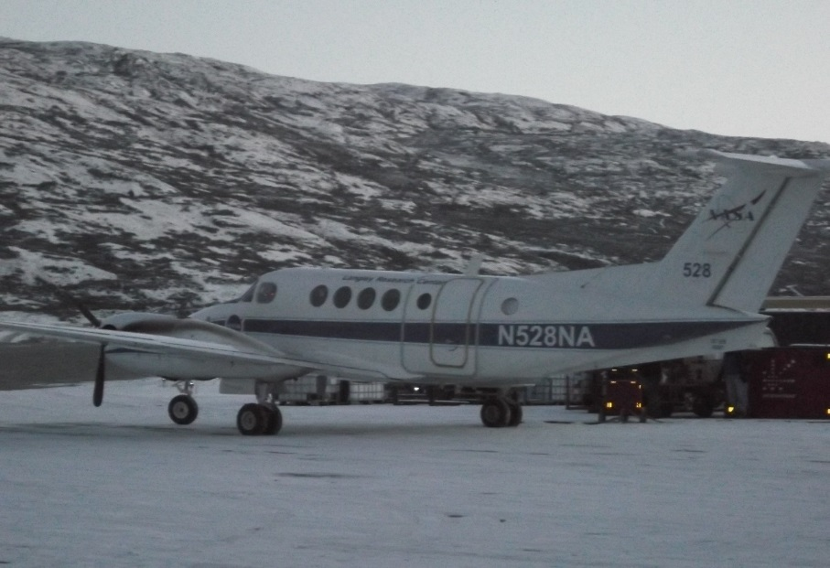
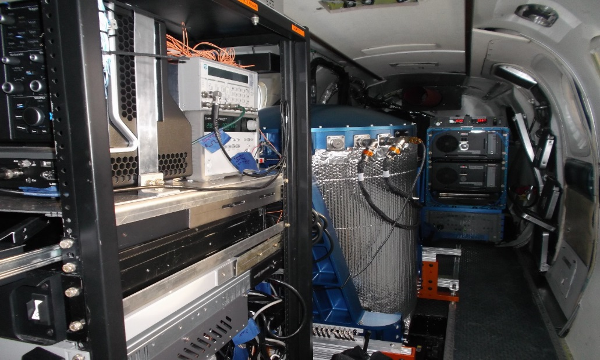
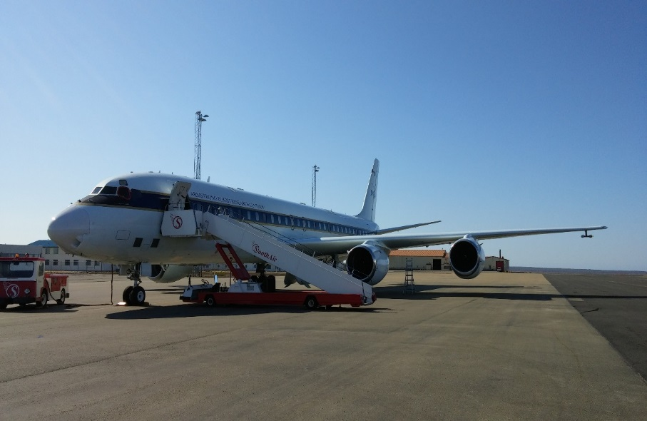
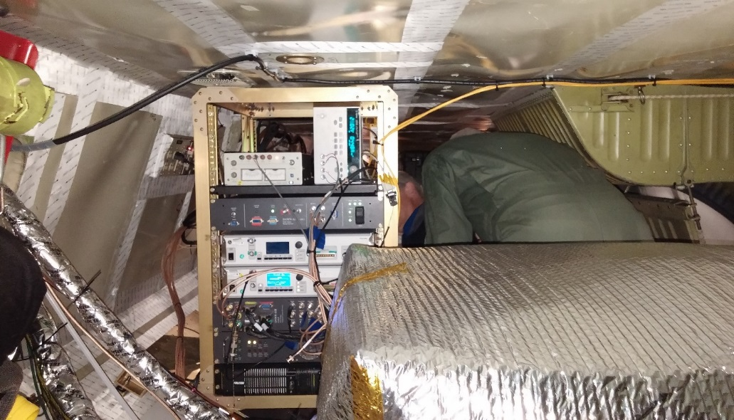
DAWN on board the NASA King Air 12-C (11/2014)
and NASA DC-8 (May 2015)

Slide 6
DAWN
Attribute | Value
Airplanes Flown | DC-8 and UC-12B
Solid-State Laser Crystal and Wavelength | Ho:Tm:LuLiF, 2.053472 Microns
Laser Pulse Energy E, Rate f, FWHM Duration t | 250 mJ, 10 Hz, 180 ns
Pointing Knowledge Technique | Dedicated INS/GPS on Lidar
LOS Wind Measurement Precision | < 1 m/s
u, v, w Measurement Precision | < 1 m/s
Horizontal Resolution of Full Vertical Profile | 2-7 km
Vertical Resolution of Full Vertical Profile | 75 – 150m

Slide 7
DAWN Performance and Data
While DAWN performed less than ideally due to misalignments and sensitivity issues (see Emmitt and Henderson talks), the DAWN profiles demonstrated close agreement with Dropsondes
Post processing for optimum data set removed ground and aircraft effects
Final DAWN data have provided quality data for numerical model (e.g. Polar WRF) validation and for the scientic study of atmospheric circulations such as LLJs and Upper Jets.

Slide 8
Polar Winds DAWN-Dropsonde Comparison – 5 Days (35 Drops)

Slide 9
DAWN-Dropsonde Comparison for May 21, 2015 mission including 8 dropsondes
Height Layer | Number of Comparisons | ∆z (m) | DAWN –Drop (m/sec) Mean ∆WS | DAWN – Drop (m/sec) Mean ABS(∆WS) | DAWN – Drop (deg) Mean ∆WD | DAWN – Drop (deg) Mean ABS(∆WD) | RMSE DAWN -Drop ∆WS
ALL | 468 | 1.97 | -0.004 | 1.15 | -1.75 | 9.11 | 2.28
5200 – 4000 m | 87 | 2.28 | 0.13 | 1.06 | -7.80 | 13.81 | 1.87
4-3000 m | 92 | 2.21 | 0.26 | 1.28 | 0.8 | 13.28 | 2.94
3-2000 m | 92 | 1.92 | -0.005 | 0.92 | -1.95 | 11.33 | 1.32
2-1000 m | 133 | 1.74 | 0.108 | 1.14 | -0.27 | 4.70 | 2.03
1000m – sfc | 64 | 1.73 | -0.815 | 1.52 | 0.084 | 2.67 | 3.81

Slide 10
Polar Winds Model Specifications WRF 3.6.1 with OSU BPCRC polar optimizations (Polar WRF)
- 274 x 324 one-domain grid with 8 km spacing
- 48 layers: Lowest levels at 7 and 14 m; 8 layers at lowest 500 m;
- 60-sec time step; run with 20 tasks; 48-hr runs; output every 3 hr
- Morrison 2-moment microphysics
- RRTMG longwave and shortwave radiation
- MYJ Planetary boundary layer and surface boundary layer
Noah Land surface model
Fractional sea ice 1.5 m thick; albedo 0.82; 5 cm snow on sea ice
- Run TWICE a day with 00 & 12 UTC as its initial times
- IC and BC interpolated from the daily (00, 12Z) NCEP GFS

Slide 11
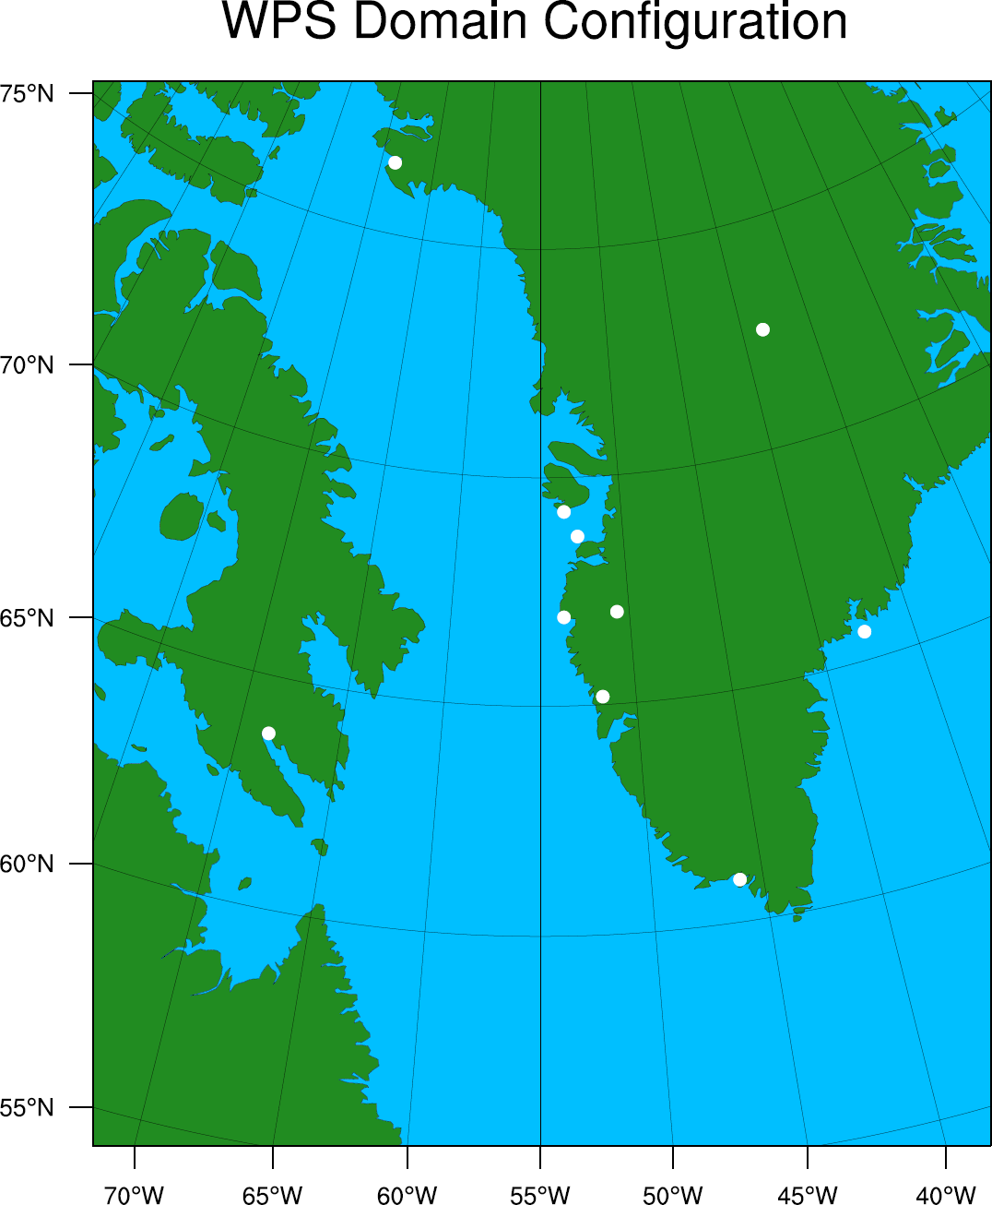
Polar Winds North Atlantic/Greenland Grid
Thule
Summit
Qeqertarsuaq
Aasiaat
Sisimiut
Kangerlussaq
Nuuq
Tasiilaq
Iqaluit
Narsaq
Polar WRF 3.6.1 274 x 324 Points Δx = 8 km

Slide 12
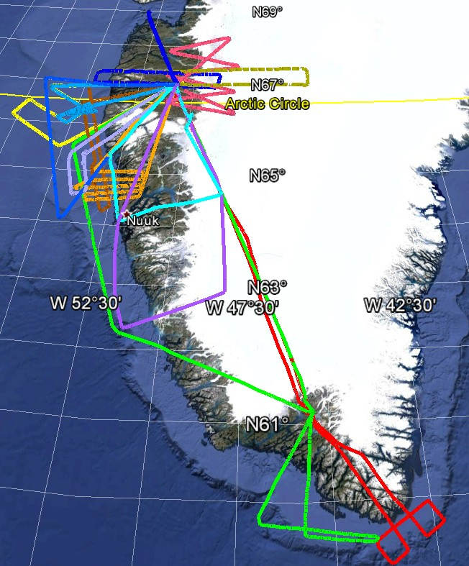
Greenland
PolarWinds
Campaign I
Flight Tracks

Slide 13
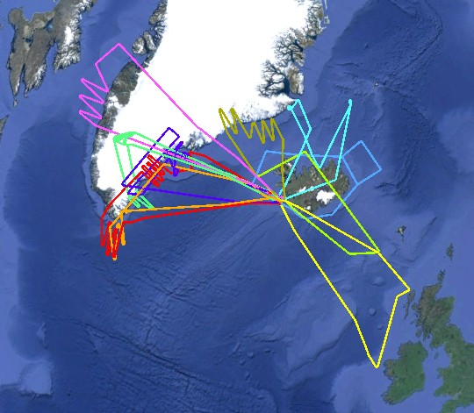
Greenland
PolarWinds
Campaign II
Flight Tracks

Slide 14
May 21, 2015 – Barrier Wind Study
Intercomparison of DAWN, Dropsondes and WRF

Slide 15
Greenland is a barrier to cyclone circulation.
Note: The vertical and horizontal dimensions are not equal scales
(11,000 ft.)
Figure from: Doyle and Shapiro (1999)
Pressure builds up along Coast
Barrier Wind
Wind
L
Notes:
Very sharp jump from sea level to high elevation. Cold air can’t rise over the terrain.
Topography changes local pressure fields: this alters the winds
Air comes shooting off the tip after the barrier flow -> tip jet
Very basic dynamics

Slide 16
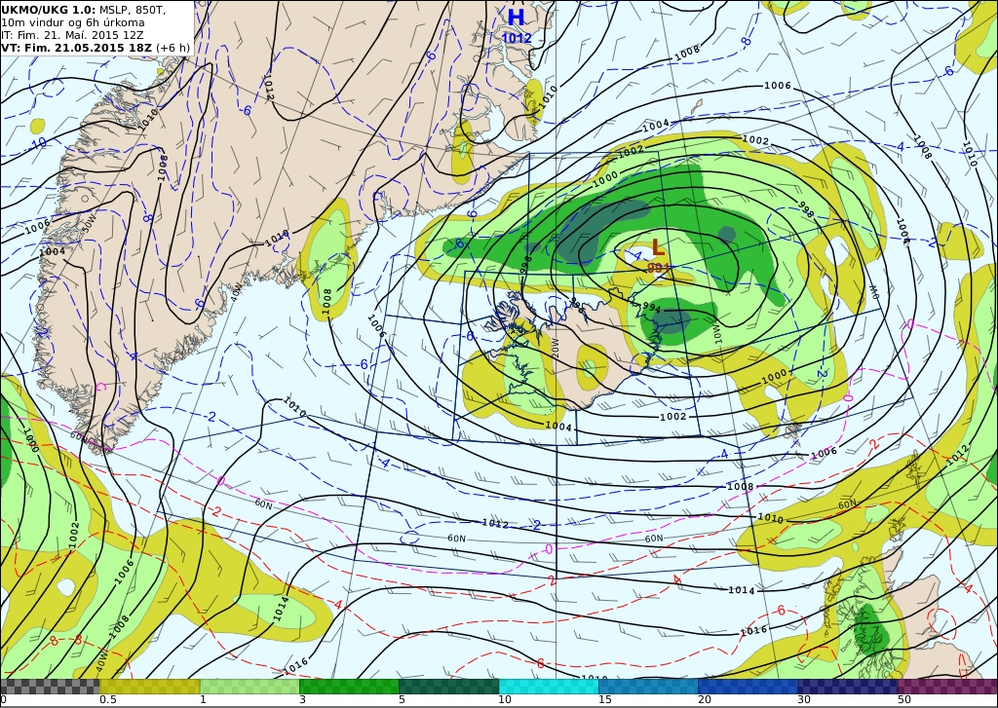

Slide 17
Colorado WRF V3.7.1 – Summary of Model Runs
50, 25, 10, 5 km grid spacing (no nesting) over same domain
40 and 60 vertical Levels
MYNN2.5 and UW Boundary Layer Schemes
Sea ice thickness = 0.5m
RRTMG shortwave and longwave radiation
Kain-Fritsch cumulus
Morrison microphysics
Revised MM5 surface layer
Notes:
WRF: high res marginally better and more vertical levels marginally better.

Slide 18
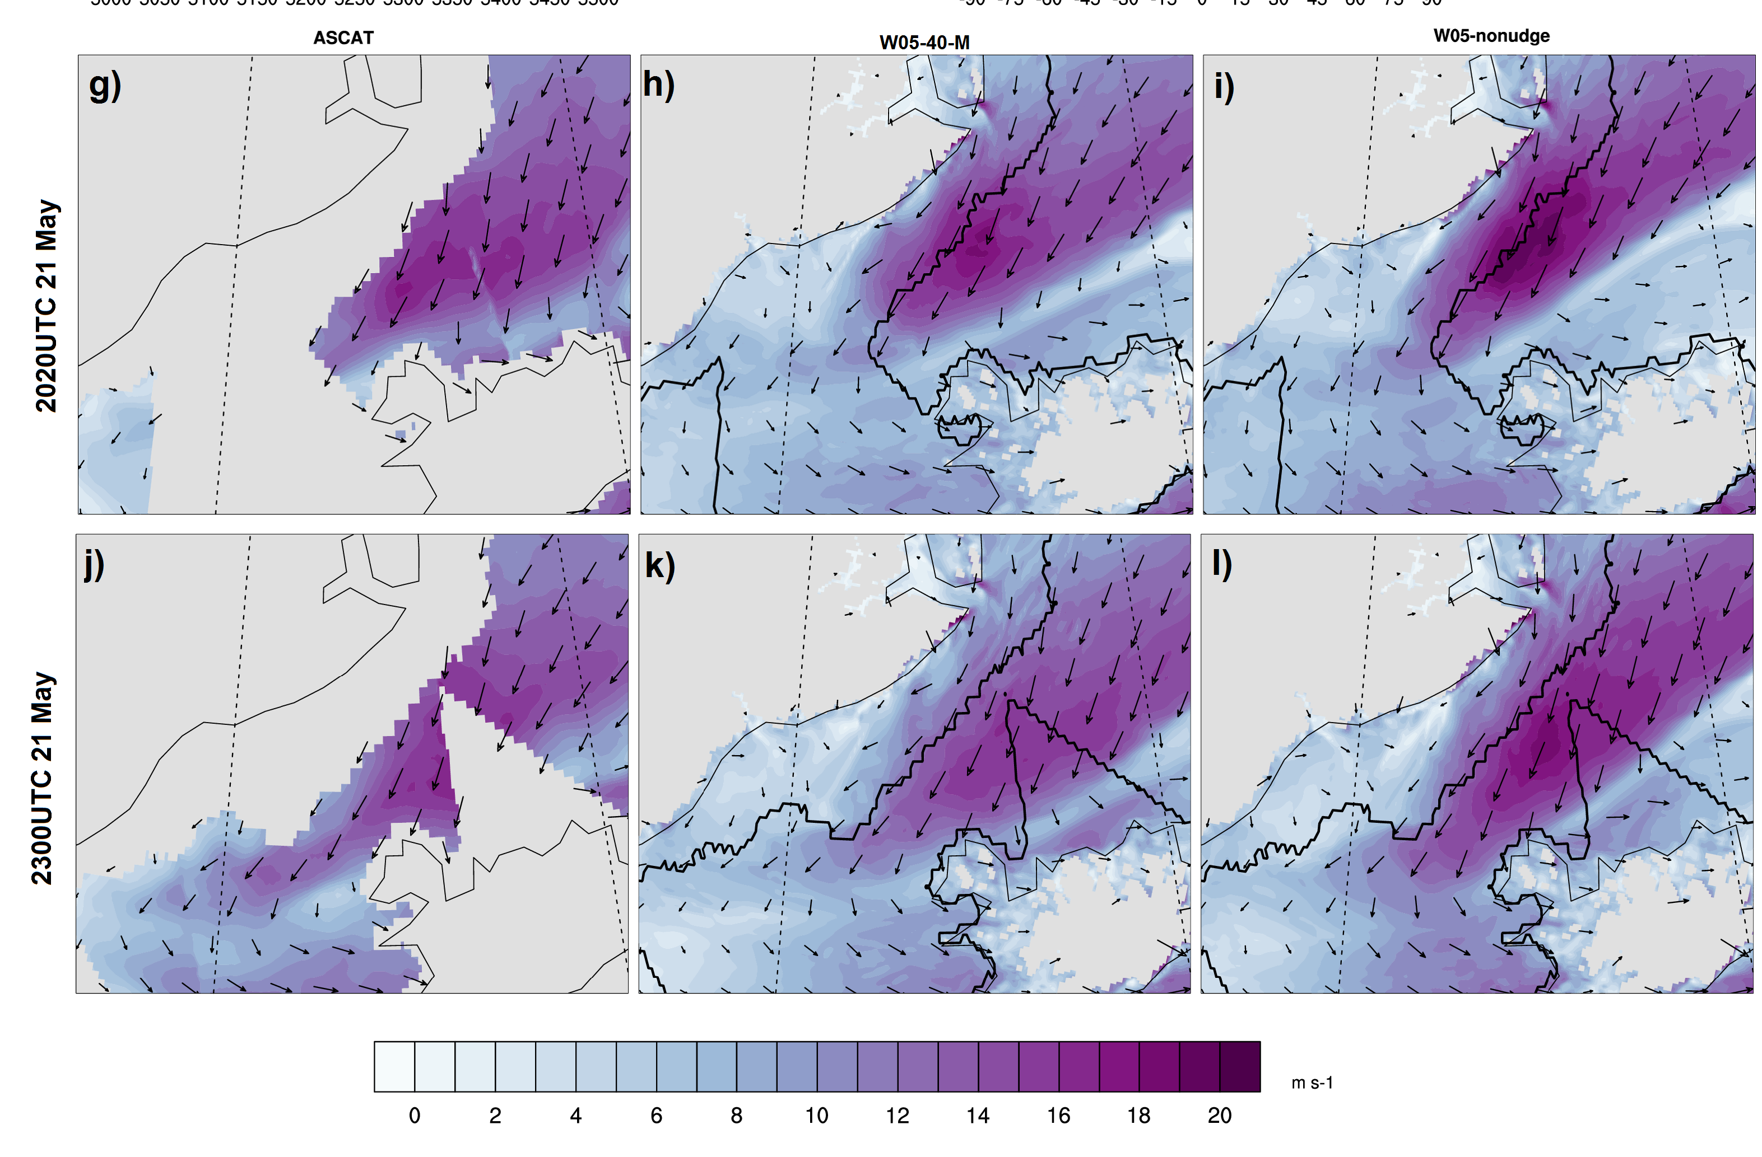
WRF-5KM
ASCAT
WRF-5KM
ASCAT

Slide 19
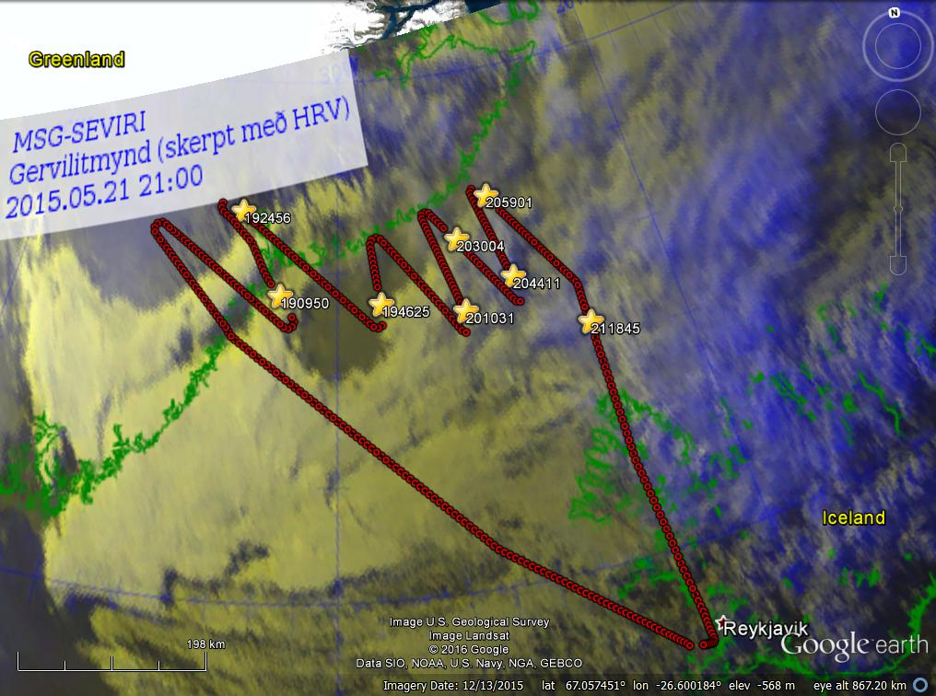
DAWN/dropsonde comparisons in highly varying coastal region:Greenland East Coast Barrier Wind Case
Red circles:
DAWN profiles
Yellow stars:
Dropsondes

Slide 20
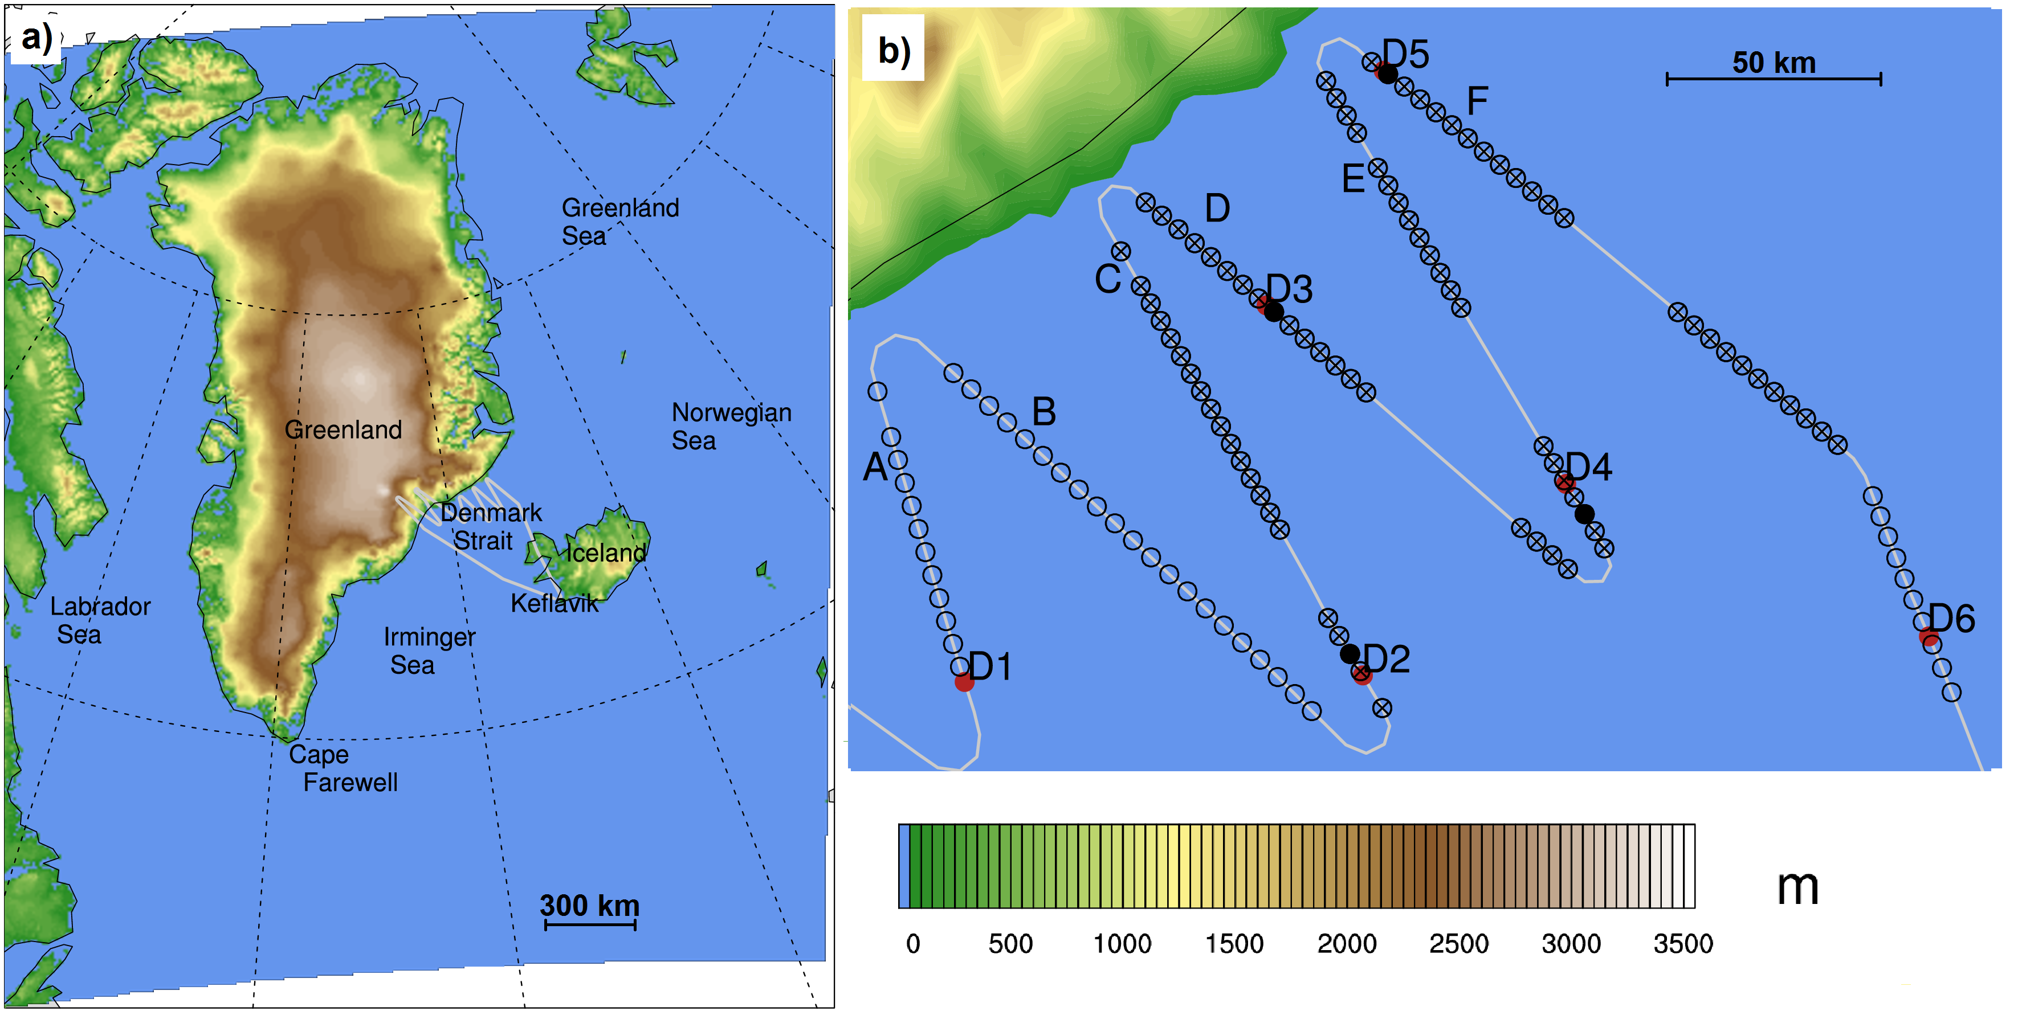
Greenland terrain
Notes:
Two campaigns: compare to obs. Look at satellite data from those times too. Note: surface scatterometers can’t capture winds along coast because of sea ice there.

Slide 21
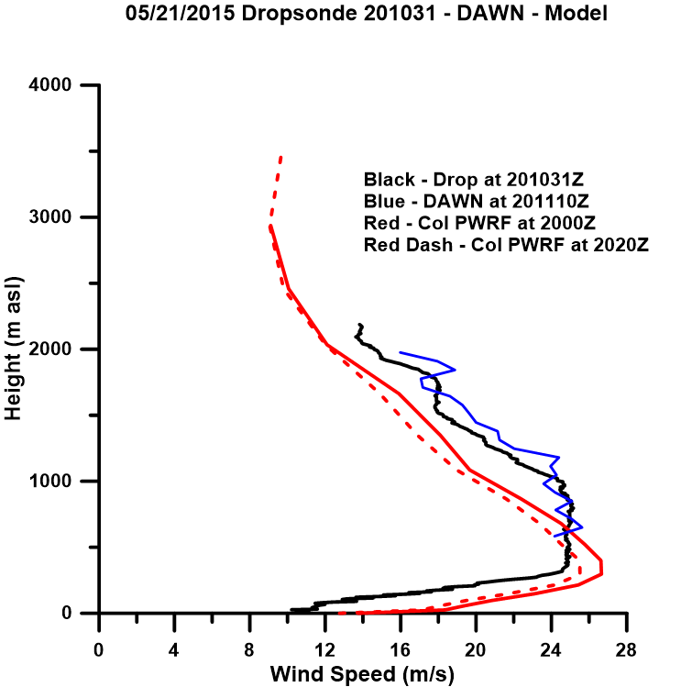
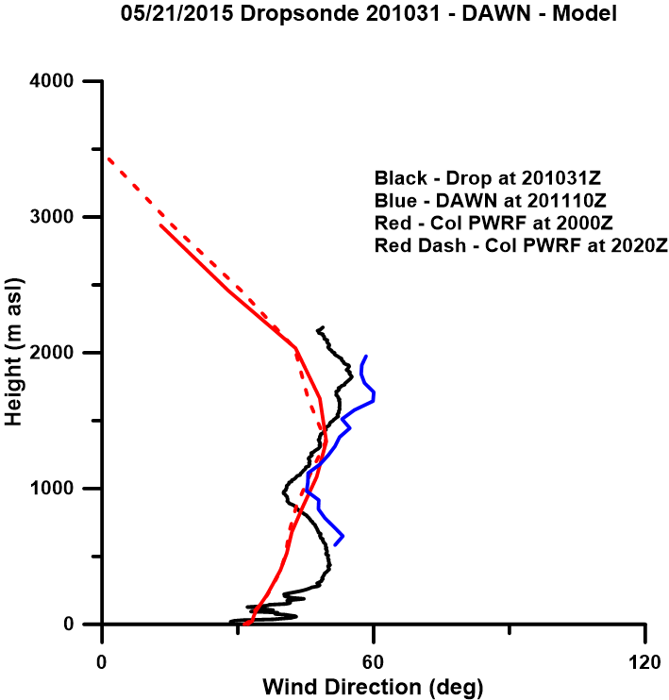
D2
Off Coast

Slide 22
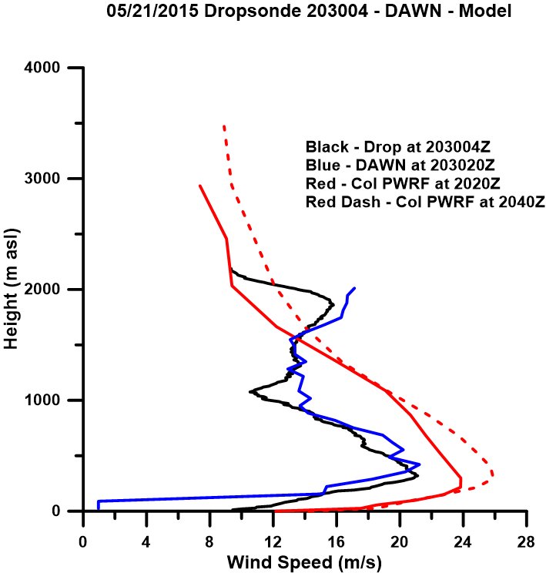
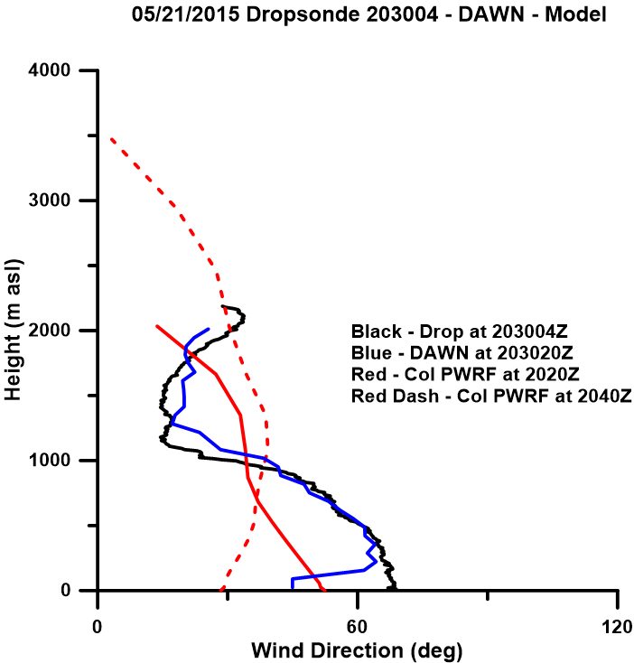
D3
Near Coast

Slide 23
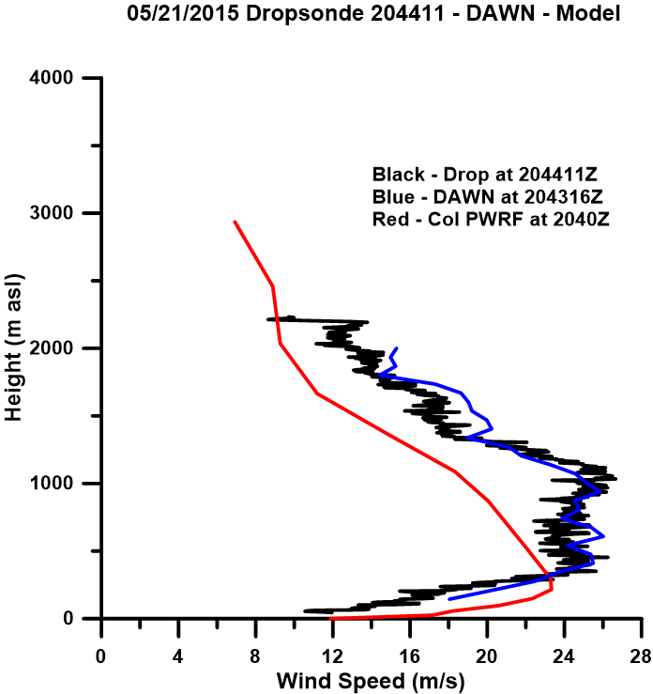
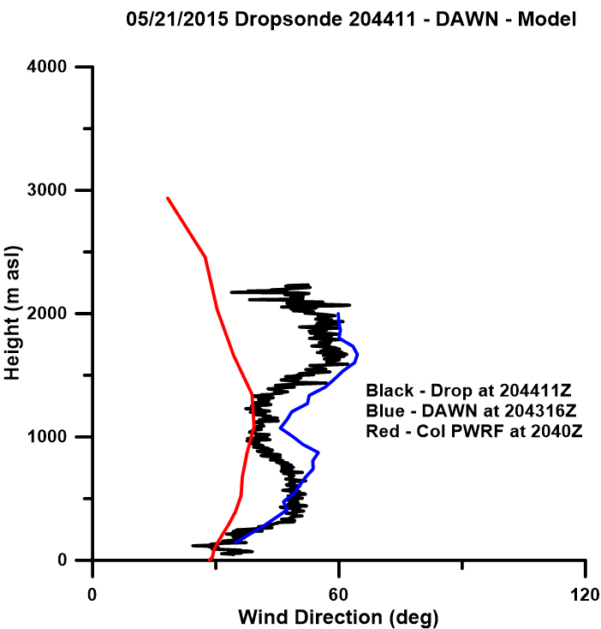
D4
Off Coast

Slide 24
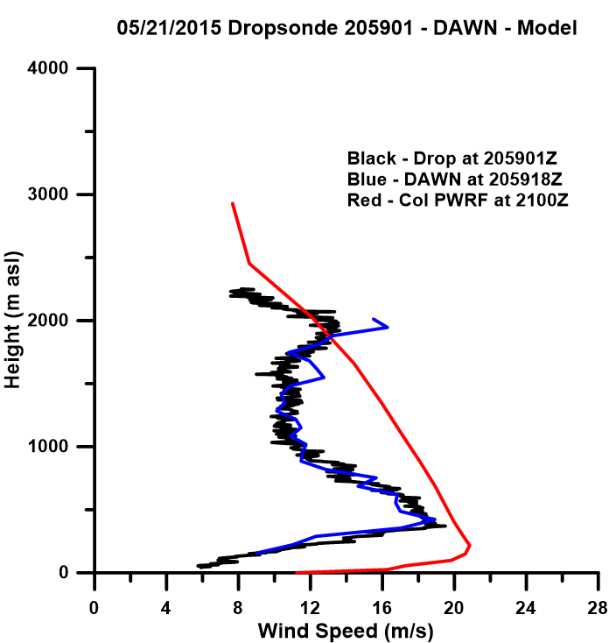
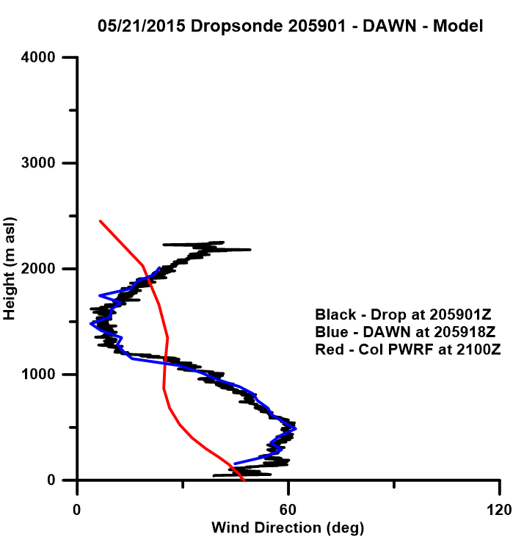
D5
Near Coast

Slide 25
Greenland terrain
F
D
Notes:
Two campaigns: compare to obs. Look at satellite data from those times too. Note: surface scatterometers can’t capture winds along coast because of sea ice there.

Slide 26
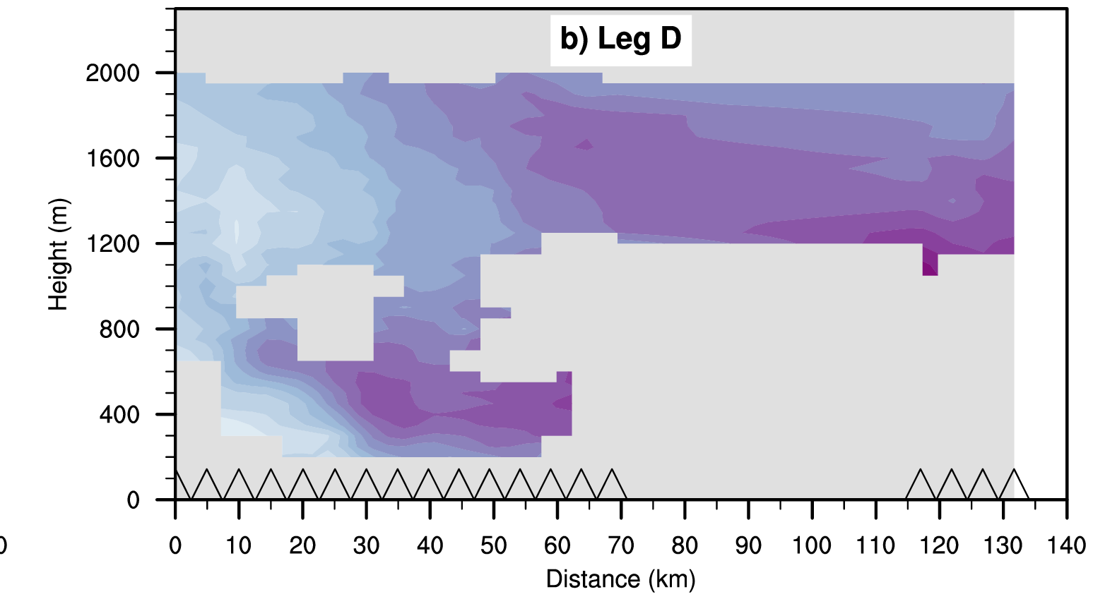
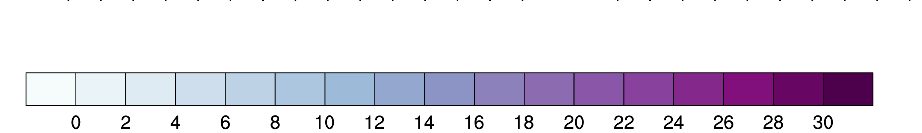

Slide 27
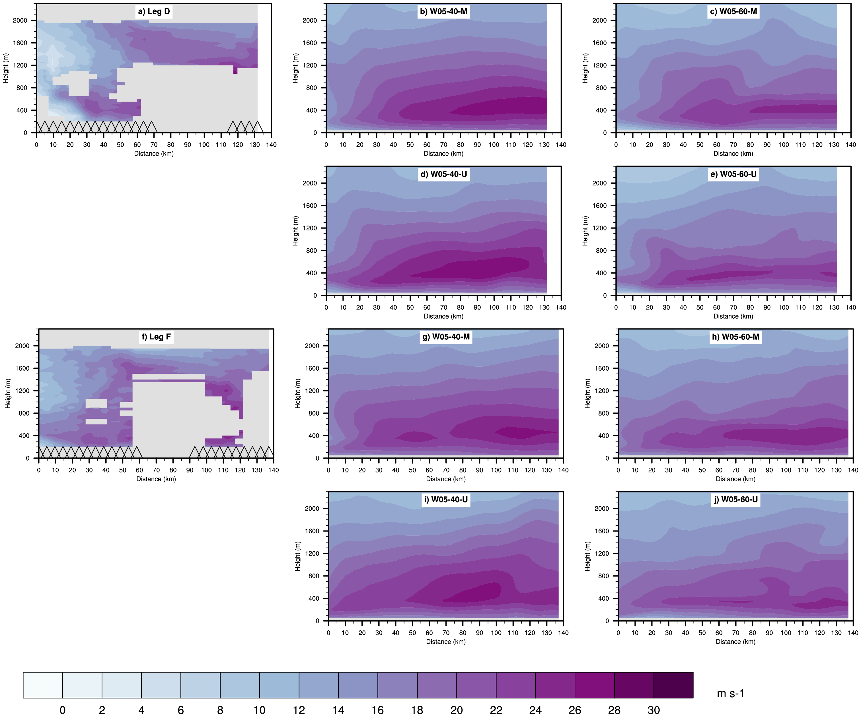

Slide 28
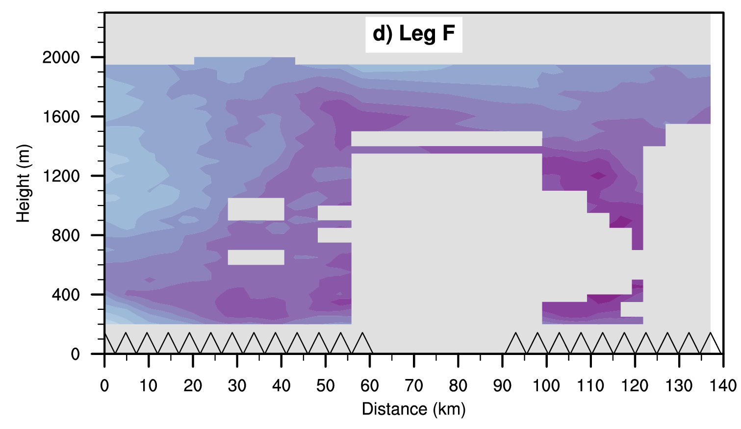

Slide 29
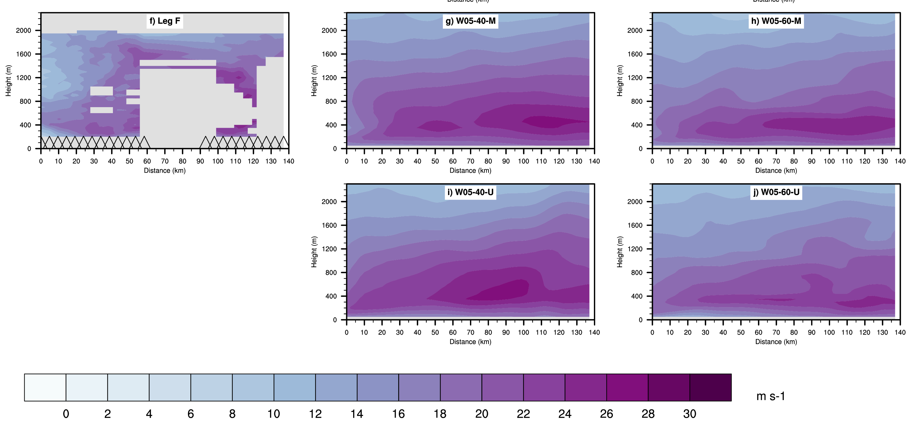

Slide 30
Barrier Winds Summary
DAWN wind profiles closely match dropsondes
DAWN and dropsondes show stronger narrower jet near the coast but a broader/deeper and slightly weaker wind max further off the coast
Higher horizontal and vertical resolution model runs better capture jet winds
Higher vertical resolution run is needed to capture DAWN observed jet structure but WRF still misses speed gradients and variability
Choice of BL scheme made little difference
DuVivier et al., (2017) – complete model study ACCEPTED for publication in MWR

Slide 31
October 31, 2014– Tip Jet Study
Intercomparison of DAWN and OSU Polar WRF

Slide 32
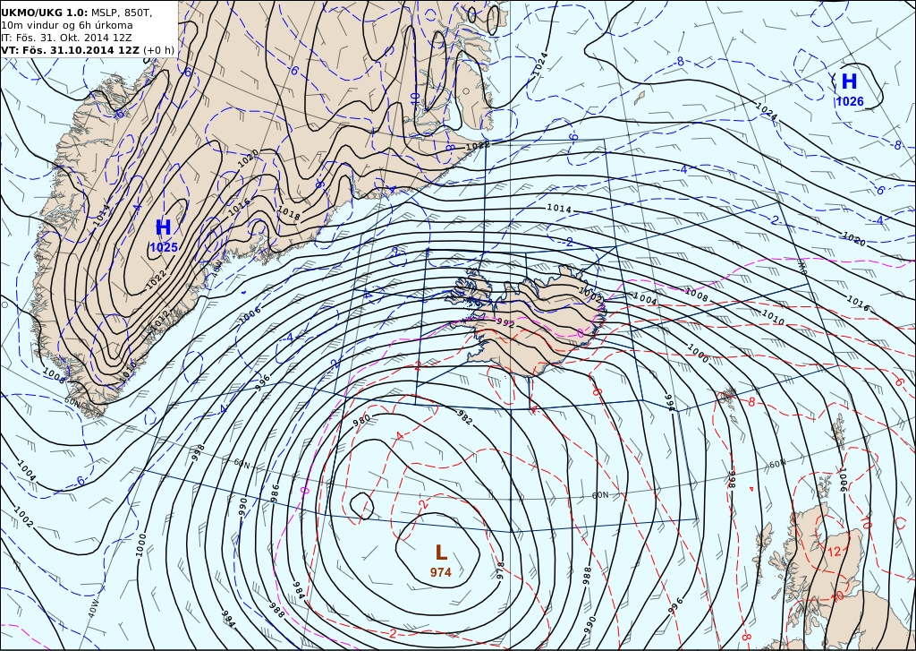
Very similar to the easterly tip jet studied by Renfrew et al., 2009 (QJRMS)

Slide 33
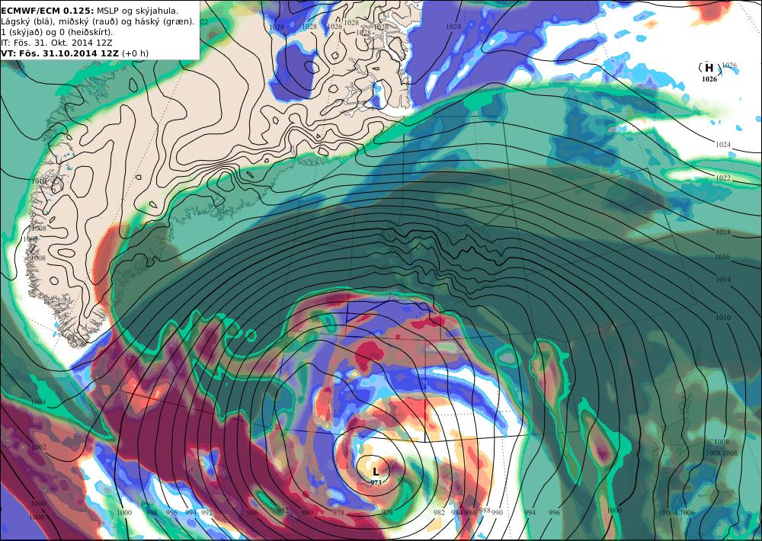

Slide 34
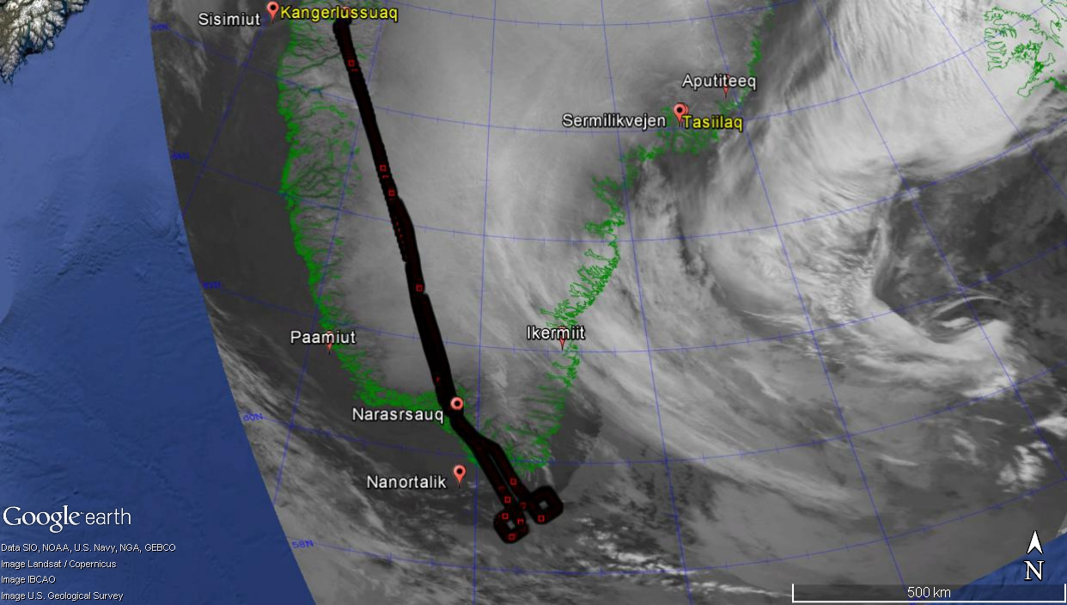

Slide 35
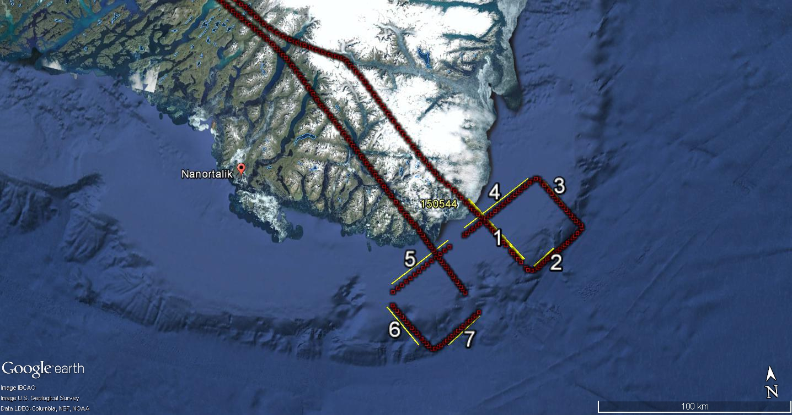
All sections of complete
Profiles below 1-1.2 km

Slide 36
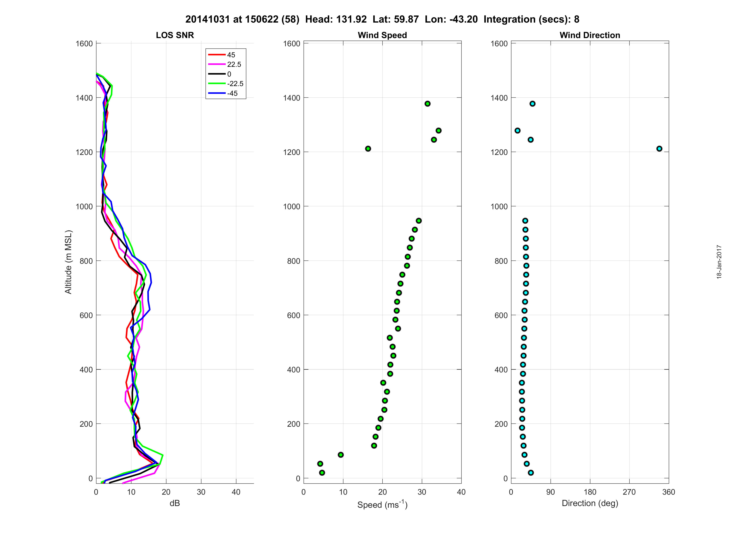
Stronger winds Near Tip
Section 1

Slide 37
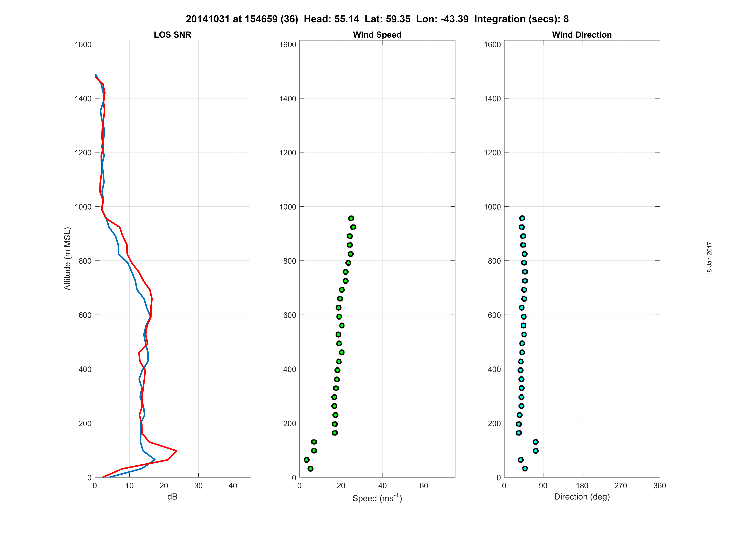
Weaker winds SW of TIP

Slide 38
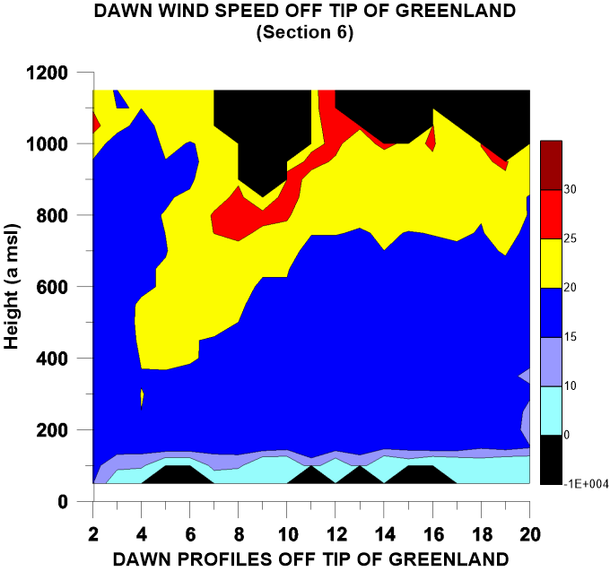
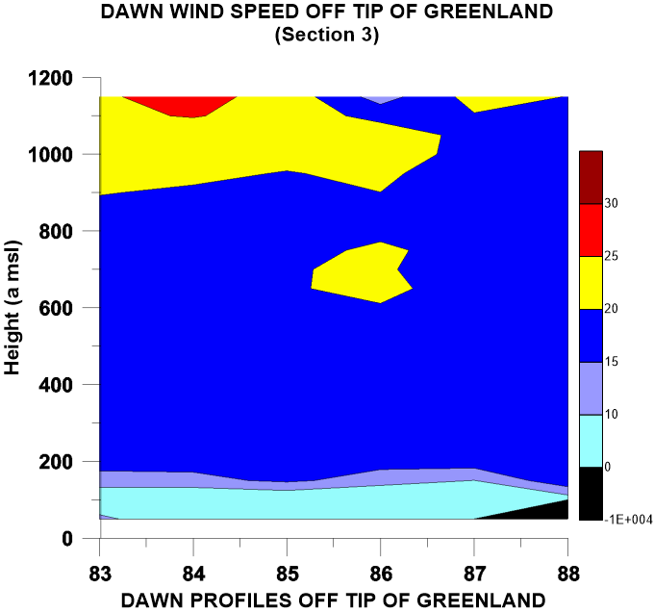
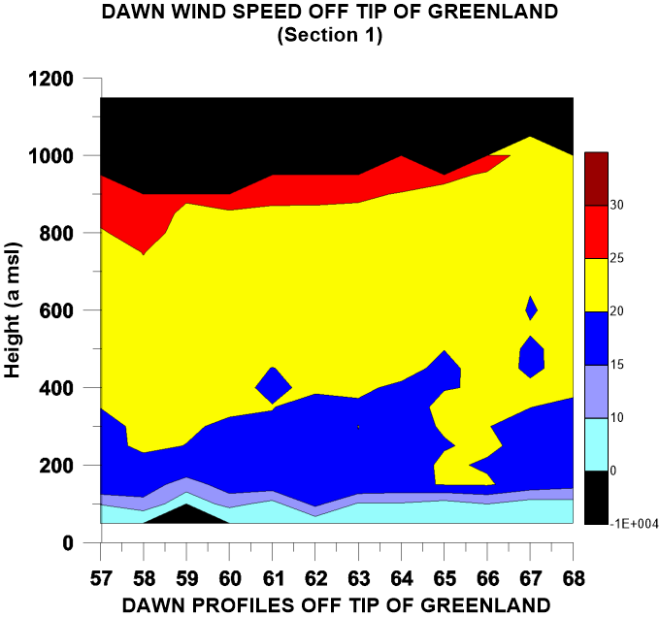
6
3
1
Acceleration near tip

Slide 39
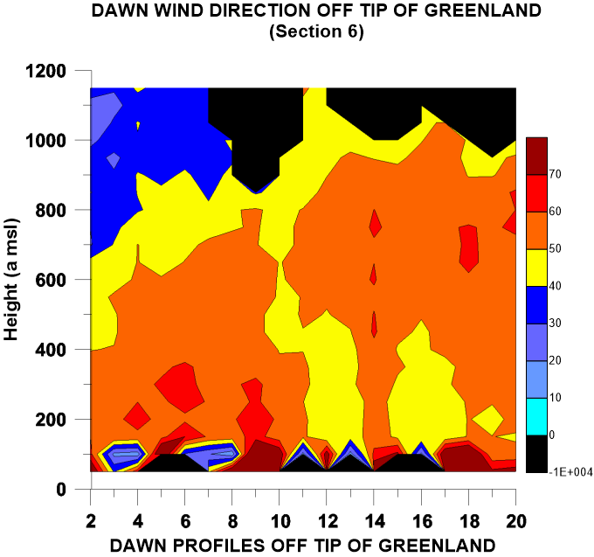
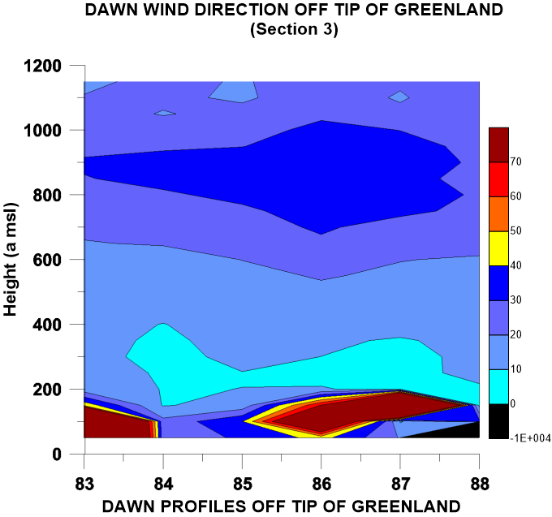
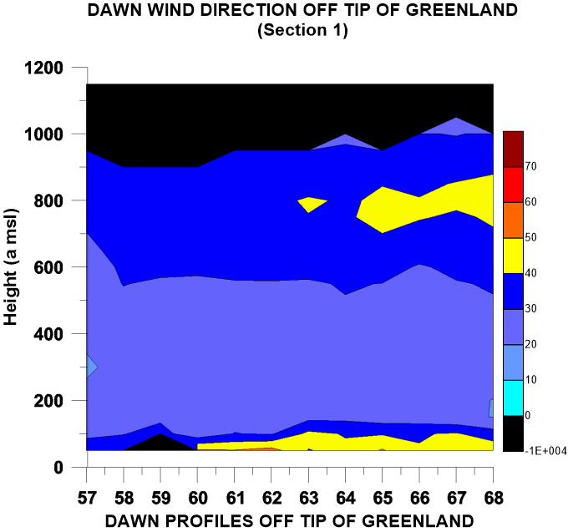
6
3
Veering around tip
Separation of flow layers
1

Slide 41
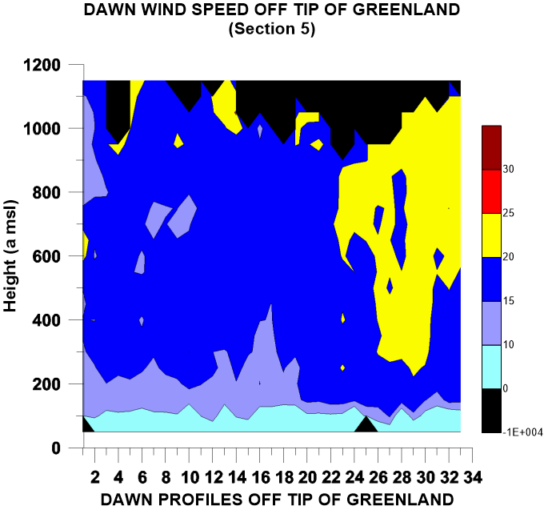
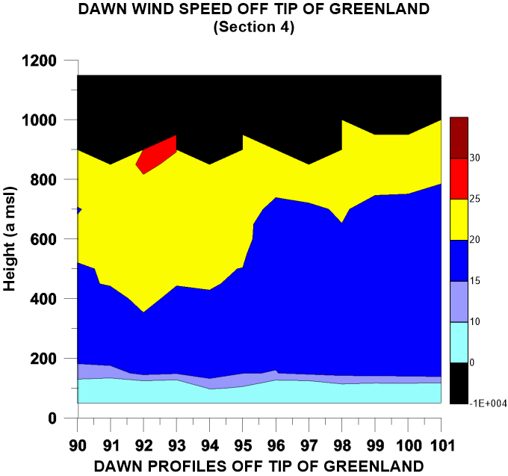
5
Acceleration and deepening near tip
4
Deceleration moving west
of Tip

Slide 42
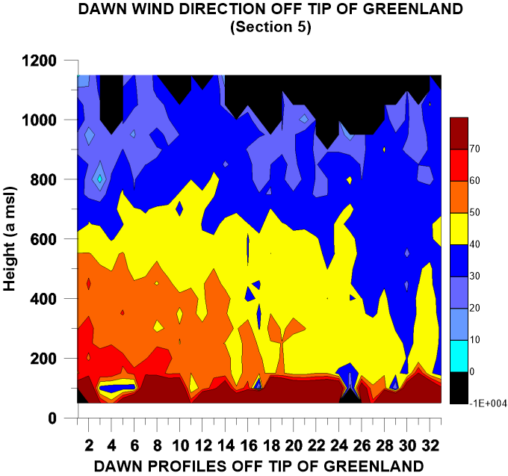
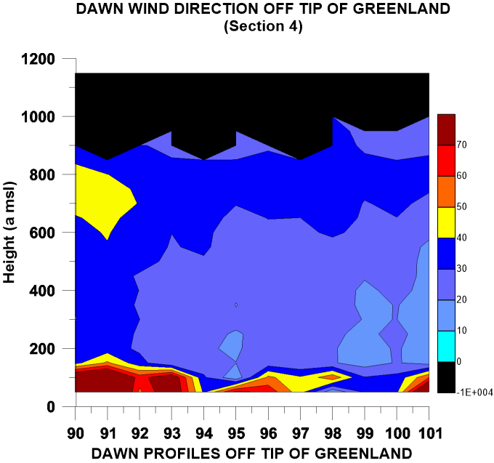
5
4

Slide 43
Polar WRF
Thule
Summit
Qeqertarsuaq
Aasiaat
Sisimiut
Kangerlussaq
Nuuq
Tasiilaq
Iqaluit
Narsaq
Polar WRF 3.6.1 274 x 324 Points Δx = 8 km

Slide 44
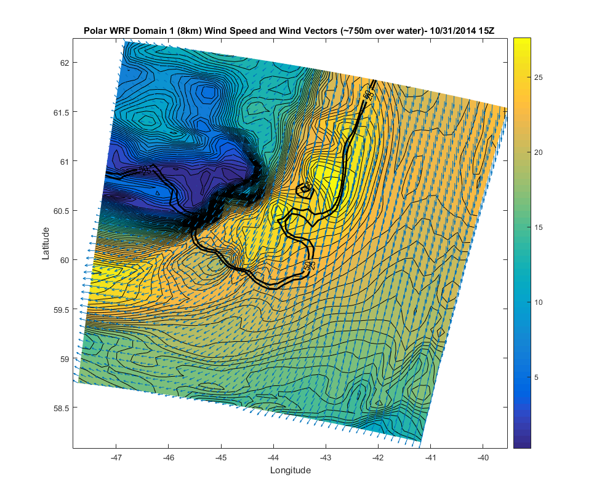

Slide 45
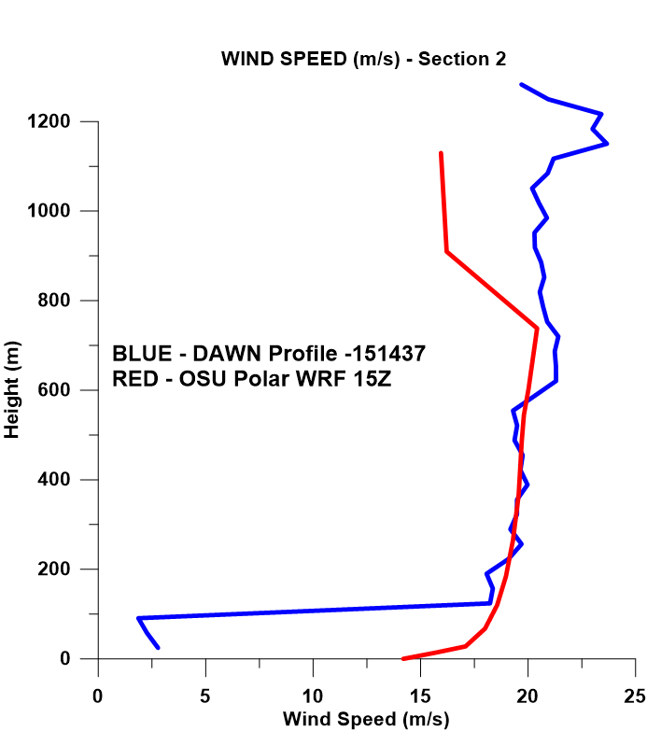
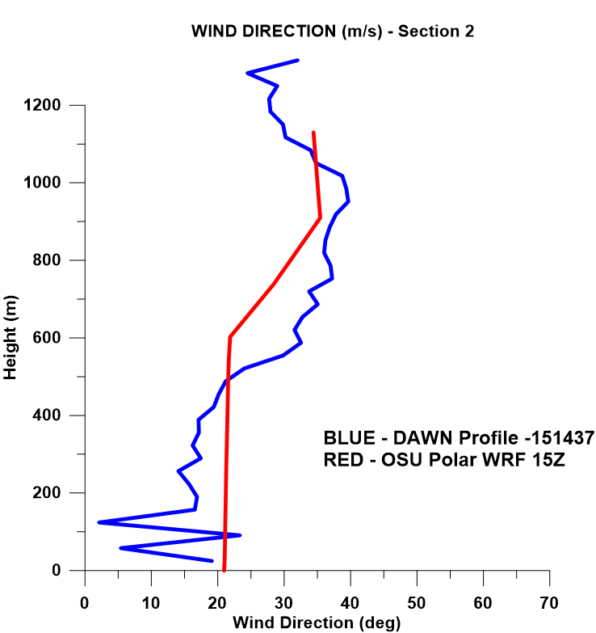
Section 2

Slide 46
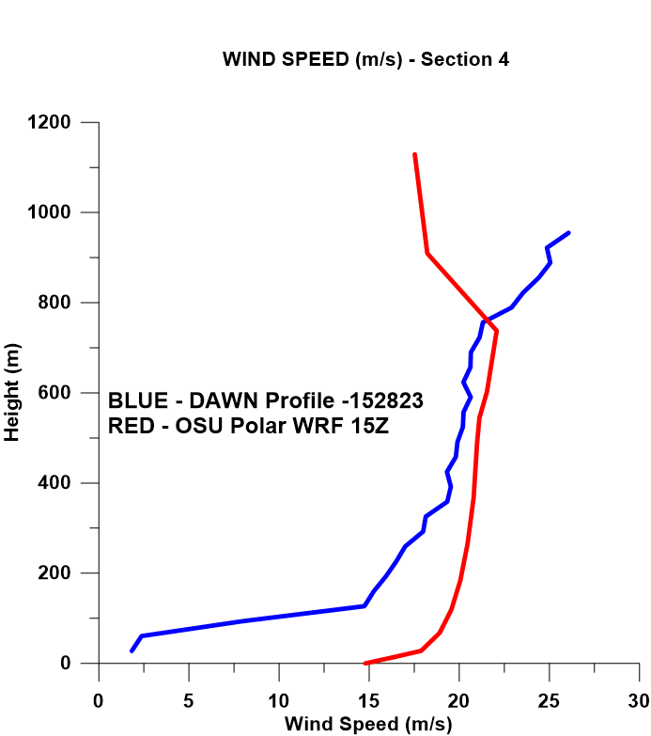
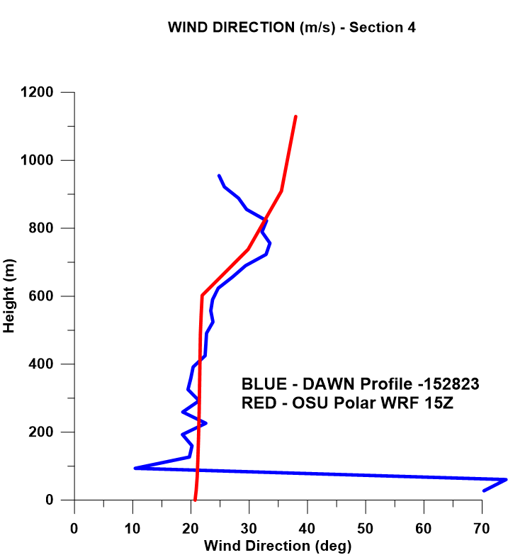
Section 4

Slide 47
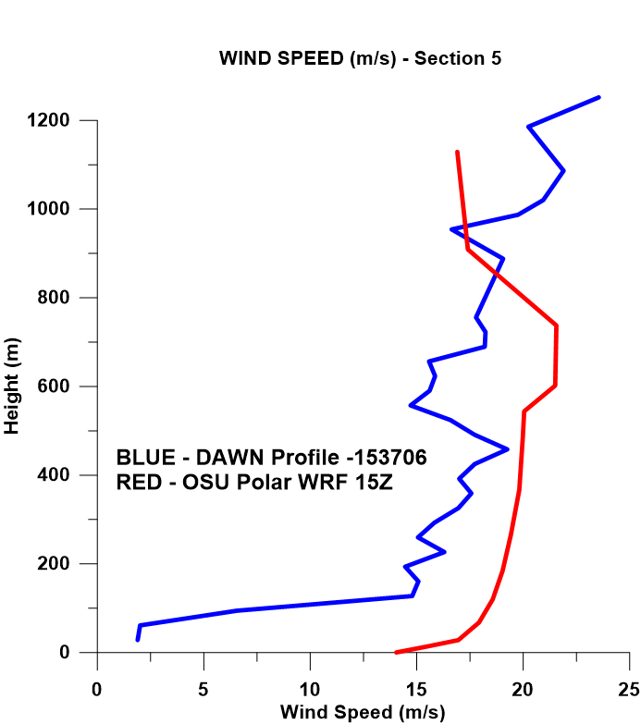
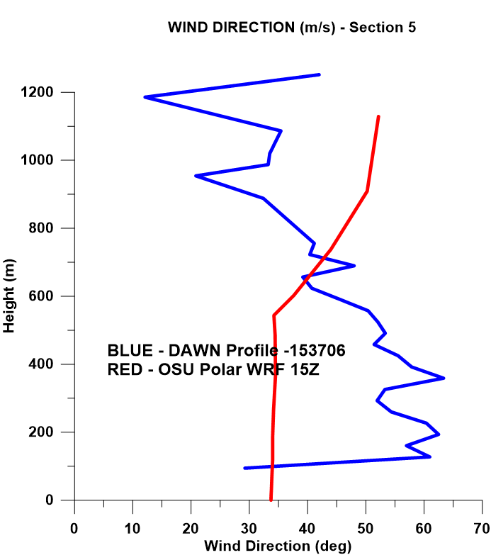
Section 5

Slide 48
Tip Jet Summary
OSU WRF does decent job in forecasting the wind speeds near the tip
BL scheme chosen for PolarWRF results in very smooth and unchanging winds over significant layers and does not capture the variability in the DAWN profiles
WRF does not seem to capture the veering of the wind “around” the tip
Unfortunate that DAWN was unable to produce measurements above 1200-1300m

Slide 49
May 19, 2015– Upper Jet Study
Co-Flight with DLR Falcon
Intercomparison of DAWN and Dropsondes

Slide 50
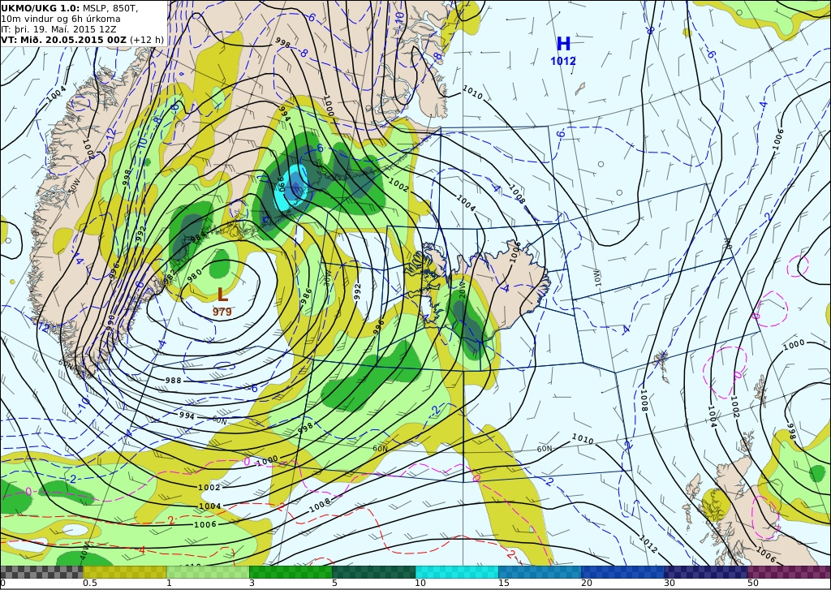
SURFACE

Slide 51
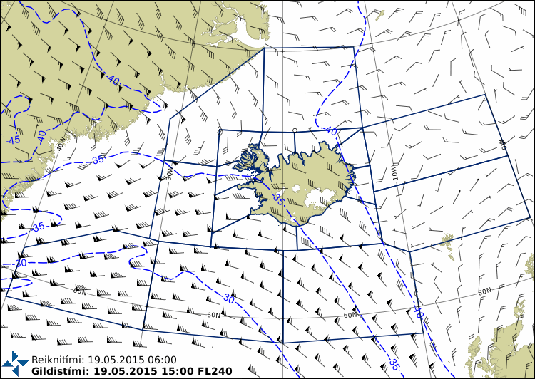
~ 8 km

Slide 52
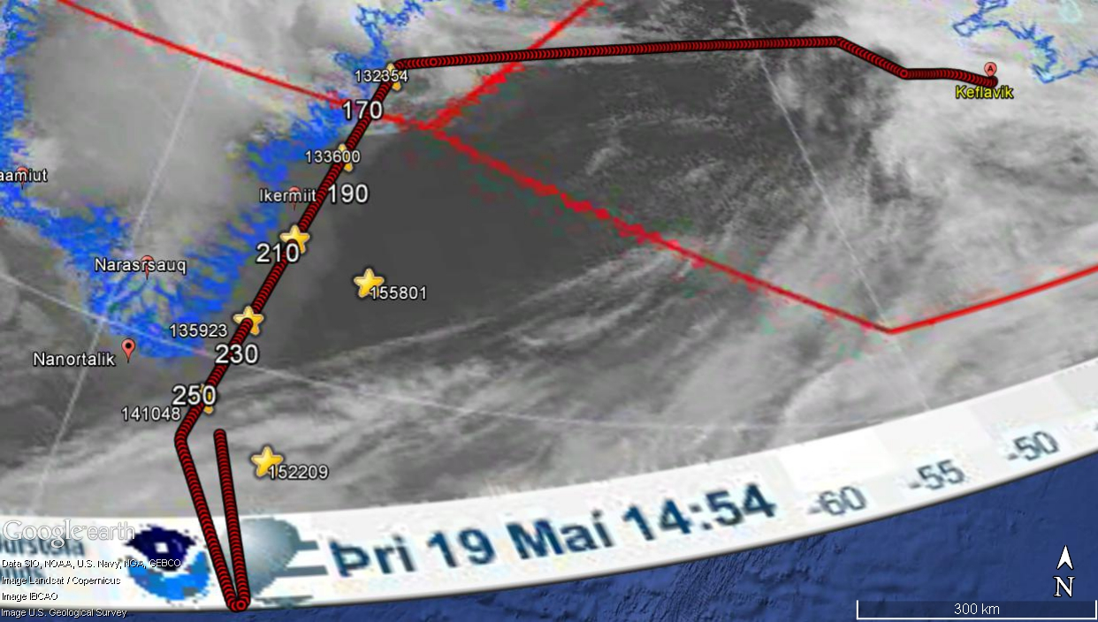

Slide 53


Slide 54


Slide 55


Slide 56
1336z
180

Slide 57
1359z
225

Slide 58
1410z
250

Slide 59
Current and Future Work
Complete model validation for current and futures cases
Complete DAWN-Dropsonde comparisons
Processing and archival of all data
Scientific investigations of:
    Katabatic flows
    OLEs
    Low-level flow over Marginal Ice Zone

