Slide 1
Airborne Convective Processes Experiment (CPEX) and DAWN Participation
Ramesh Kakar
NASA Headquarters
March 21, 2017

Slide 2
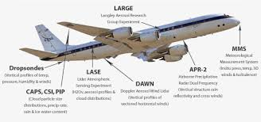
NASA Convective Processes Field Experiment (CPEX)
NASA plans to conduct a Convective Processes Experiment (CPEX) to study the organization and disruption of convective activity in the tropics. This four-week experiment will take place during May 25 – June 25, 2017, and will be based at Fort Lauderdale, FL. NASA will provide the DC-8 aircraft, a recently upgraded coherent Doppler wind lidar (https://airbornescience.nasa.gov/instrument/DAWN ) for wind retrievals in the planetary boundary layer and above, a Doppler radar (http://airbornescience.jpl.nasa.gov/instruments/apr-2 ) to monitor the convection and rains, and dropsondes to provide a broader picture of the tropospheric environment. It is expected that funding will be available to fly the DC-8 for approximately 100 research hours. With CPEX, NASA is also interested in supporting the calibration/validation activities relating to the European Space Agency’s ADM/Aeolus mission scheduled for launch in 2017. In particular, there is interest in developing simulated wind velocity retrieval algorithms under tropical conditions.
Funds are also available to accommodate 2-3 microwave radiometers that have flown previously on the DC-8: HAMSR, MTHP and MASC(?)
Some of the broad questions to be addressed include:
What leads to convective initiation?
What are the relative roles of the environment and the convective storms in determining the convective organization?
-What are the factors that limit the storm growth?
This is a good opportunity to showcase the upgraded DAWN instrument
GRIP DC-8 Payload (2010)

Slide 3
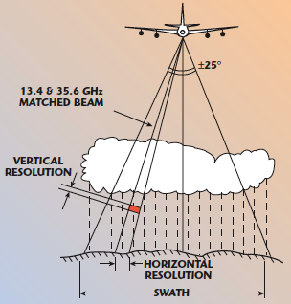
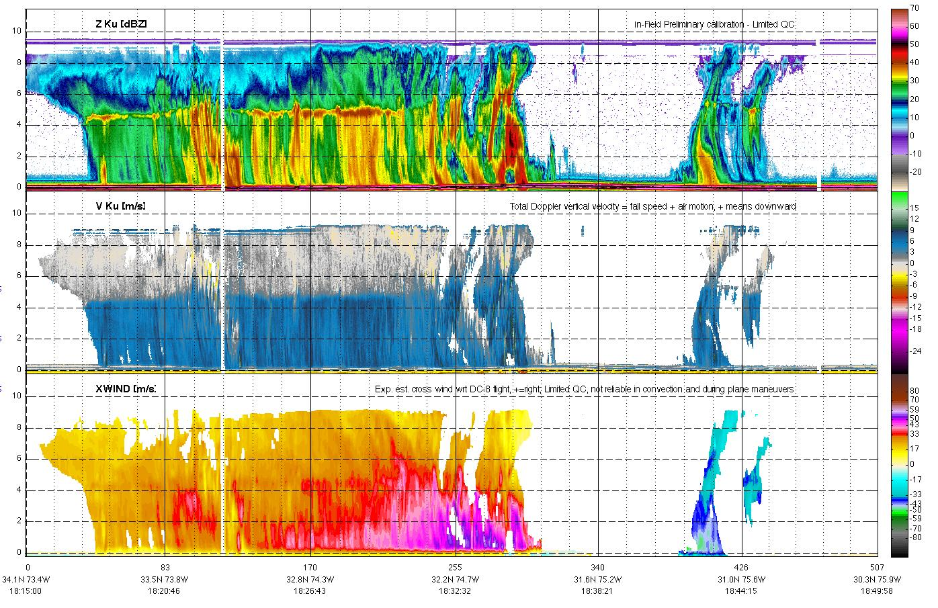
Airborne Precipitation Radar (APR-2)
APR-2 is a dual-frequency, dual-polarization, Doppler radar that operates on the NASA DC-8 aircraft
Below is vertical slice through Earl on Sep 2 from NNE to SSW (1815 UTC); southern eyewall was decaying
13 GHz reflectivity
eye
Vertical motion of precipitation (fall speed + air motion)
Updraft of 5 m/s
Max 58 m/s
out of page
Horizontal wind speed
Max 49 m/s
into page

Slide 4
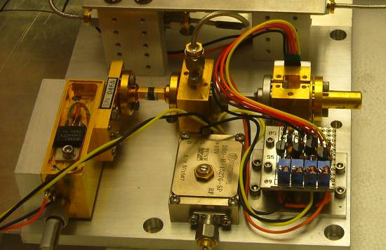
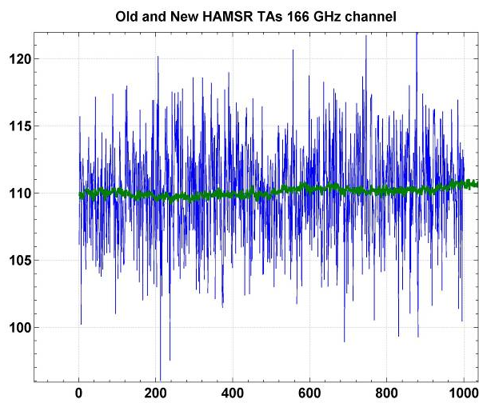
JPL High Altitude MMIC Sounding Radiometer (HAMSR)
JPL High Altitude MMIC Sounding Radiometer (HAMSR)
  Microwave radiometer for 3-D all-weather temperature and water vapor sounding, similar to AMSU on NOAA platform
  25 sounding channels in three bands:
  50-60 GHz, 118 GHz, 183 GHz
Cross track scanning
  + 45º off nadir
  40 km swath at 20 km
  2 km resolution
Flew in CAMEX-4, TCSP and NAMMA
Upgraded for Global Hawk operations under NASA AITT
  New state of the art receiver technology (developed under ESTO/ACT)
  Upgraded data system for real time communication
  Compact instrument packaging
Noise reduced from 2 K to 0.2 K
Notes:
4

Slide 5

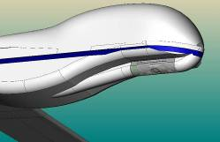
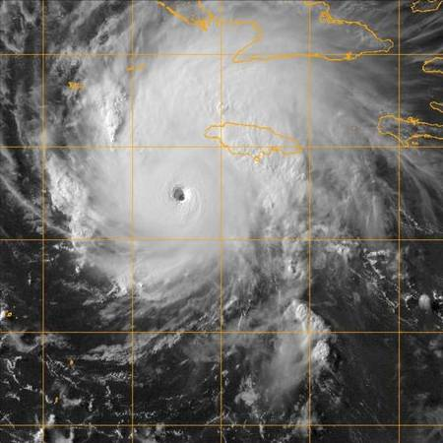
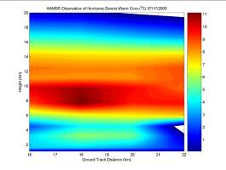
HAMSR Microwave Sounder on Global Hawk
Monitor real-time evolution of tropical cyclones
Thermodynamic and convective structure
Risk reduction for decadal-survey “PATH” mission
New receiver technology
  183 GHz receiver upgraded with LNA developed under ESTO/ACT
  Noise reduced by an order of magnitude
  Defines new state-of-the art
HAMSR on Global Hawk
  Funded under AITT
  Ready for test flights fall 2009
  Ready for field deployment 2010
New science/algorithms
  Radar-like observations
  3D structure of convection
  Enables new investigations
15 km
14 km
13 km
12 km
11 km
10 km
9 km
8 km
7 km
6 km
5 km
Warm Core
4 km
3 km
2 km
Noise reduced from 2 K to 0.2 K
3D reflectivity, Hurricane Emily (2005)
Notes:
5

Slide 7
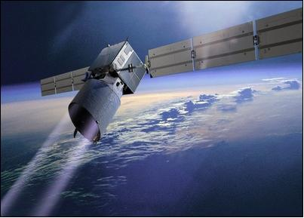
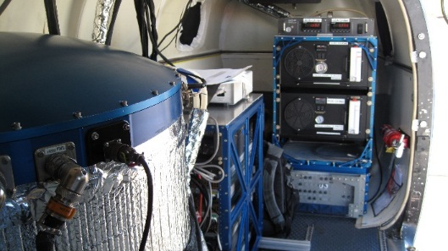
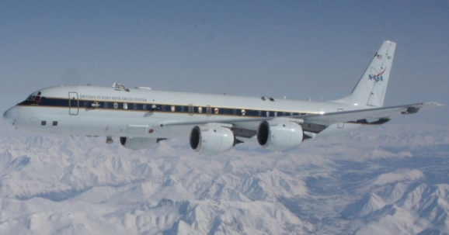
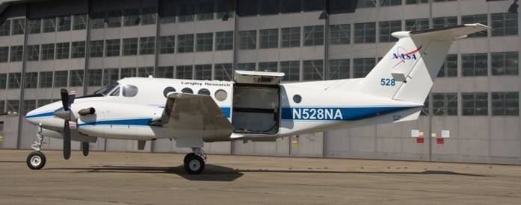
PolarWinds and ADM Cal/Val Preparatory Campaigns
Campaign 1: 10/26 – 11/14/14; LaRC’s UC-12B; Kangerlussaq, Greenland
Campaign 2: 05/11 – 05/29/15; NASA DC-8; Keflavik, Iceland
Leads: NASA LaRC and Simpson Weather Associates (PI)
Science Team: Colorado University, Ohio State University, University of Washington
NASA LaRC, Simpson Weather Associates.
Campaign Objectives:
PolarWinds
Mesoscale model validation/development
Stable boundary layers; katabatic flows; marginal ice zone dynamics
ESA ADM Cal/Val
Obtain DWL LOS observations that mimic those expected with ADM
Co-fly with DLR Falcon in Campaign 2 to calibrate Aeolus simulator (A2D)
Instrumentation:
Campaign 1: DAWN only
Campaign 2: DAWN, Yankee dropsondes,
TWiLiTE (dataTBD), DLR DWLs (2)

Slide 8
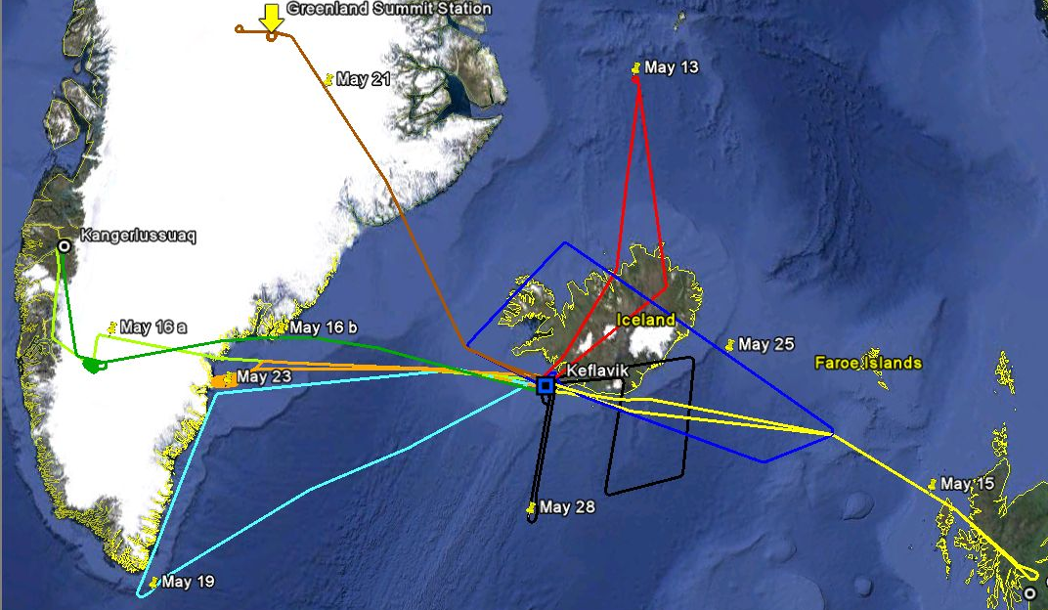
NASA DC-8*/DLR Falcon Flights in May 2015
May 11-29
47.5 flight hours
Greenland
Summit
47.5 flight hours
79 dropsondes
10 Science Flights
on 10 Days
6 Formation Flights
with ESA/DLR Falcon
TDS-1
underpass
Sea ice
calibration
Jet Stream
Ice
calibration
Greenland Tip Jet
Aeolus Track
ASCAT underpass
Aeolus Track
Jet Stream
*Exception: the DC-8 did not accompany the Falcon to the Greenland Summit

Slide 9
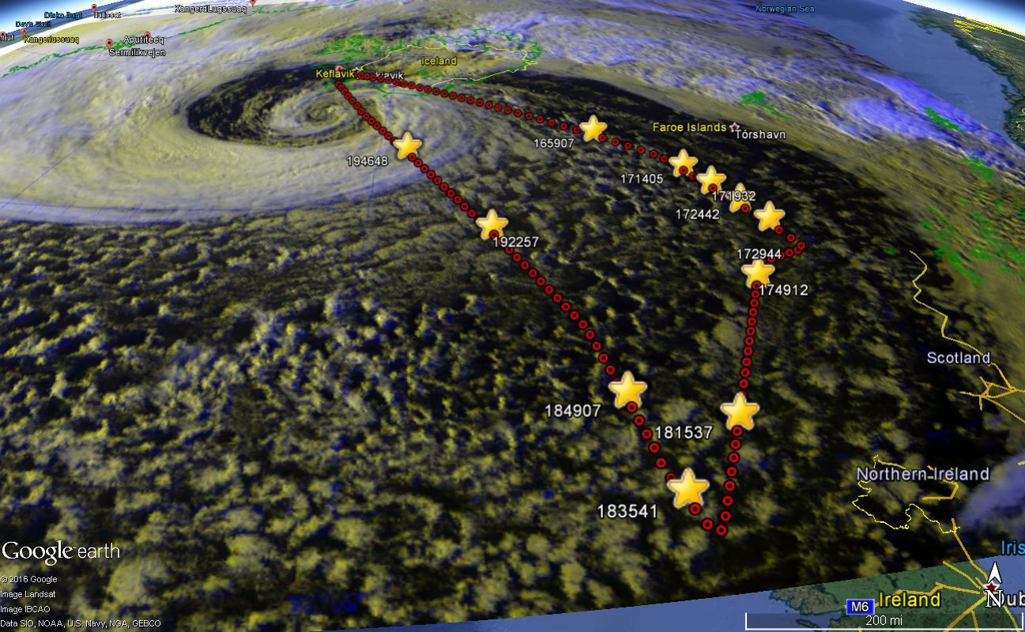
Joint NASA/DLR Wind Shear Mission: 5/15/15
Red circles:
DAWN profiles
Yellow stars:
Dropsondes

Slide 10
Mission Summary for Campaign II
(51 hours not including ferry hours)
Date | Mission | DC-8 | Falcon | Drops | DAWN | TWiLiTE
5/11 | Iceland flow splitting with NE BL winds | x |  | 3/5 | x | x
5/13 | TDS underflight(DLR/NASA) and Greenland CIZ (NASA) | x | x | 5/6 | x | x
5/15 | Upper level jet between Iceland and Scotland | x | x | 10/12 | x | x
5/16 | ADM cal/val over Greenland ice cap; CIZ and Kat-winds | x | x | 8/10 | x | x
5/17 | CALIPSO, MODIS, ASCAT underflights; CIZ;Tip jet | x |  | 8/9 | x | x
5/19 | Upper level jet over southern Greenland; Tip jet | x | x | 7/8 | x | x
5/21 | Barrier jet | x |  | 7/11 | x | x
5/23 | Katabatic flows off Greenland east coast; ADM cal/val CIZ | x | x | 15/19 | x
5/24 | Baffin Strait ice edge west coast of Greenland; rolls | x |  | 11/12 | x
5/25 | Upper level jet south of Iceland | x | x | 5/6 | x | x
CIZ (Coastal Ice Zone); Kat (Katabatic); BL (Boundary Layer)
Dropsonde numbers indicate good/total dropped

Slide 11
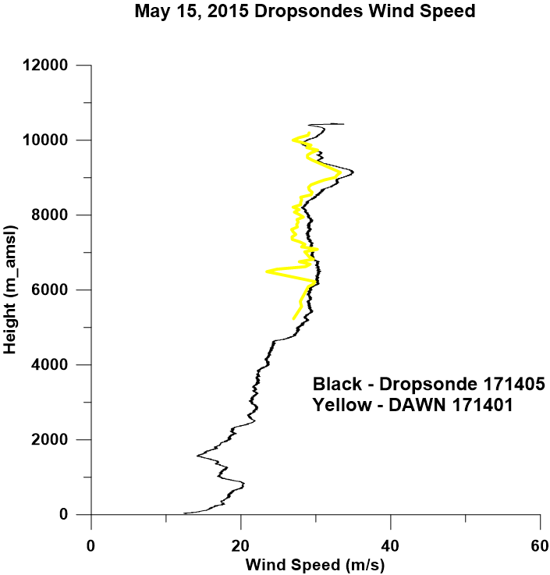
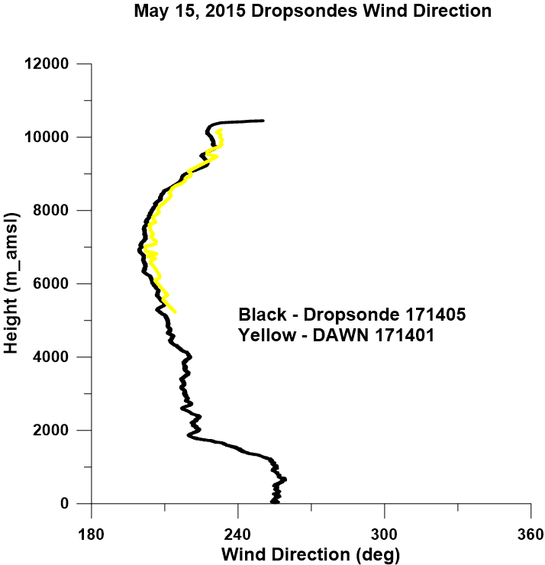

Slide 12
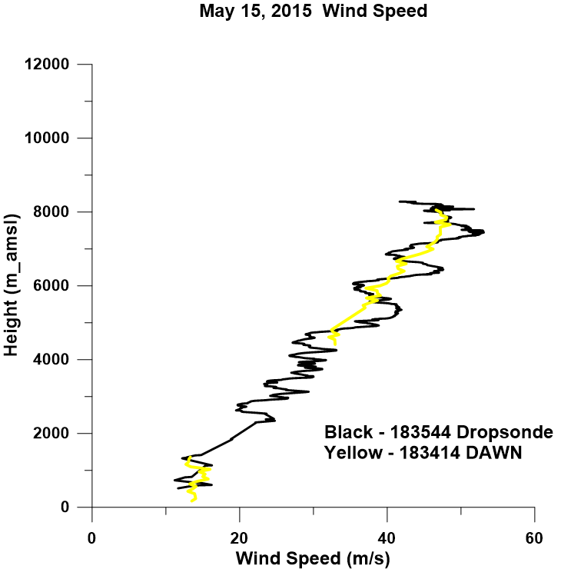
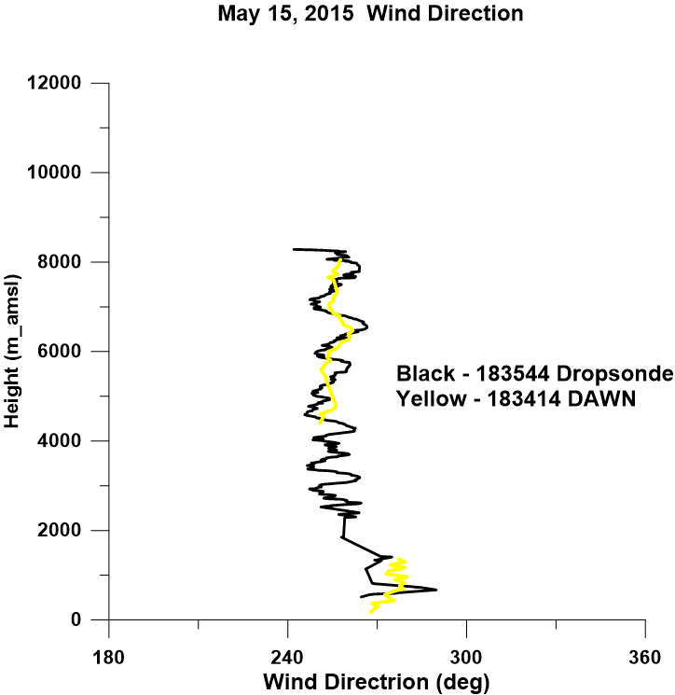

Slide 13
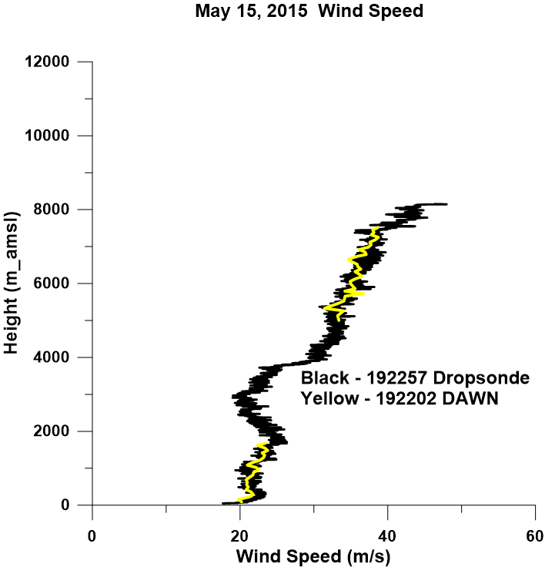
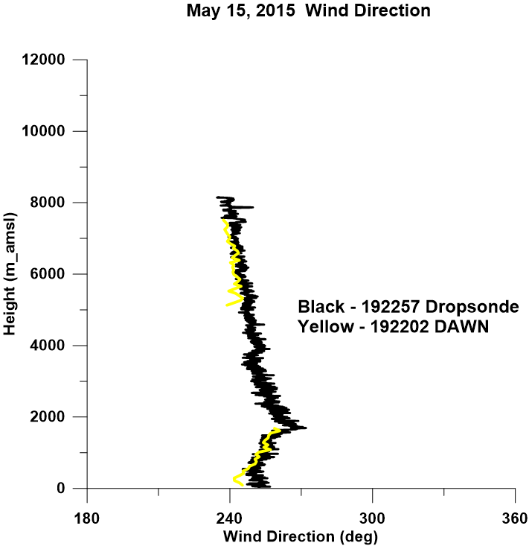

Slide 14
DAWN Data Archive Plans at LaRC ASDC
Level 0 (raw data files) with unpacking software
Documentation of the raw data content, formats and basic DAWN and dropsonde operations
Document of instructions and recommendations in using the DAWN and dropsonde data
Level 1 processed data in the form of integrated LOS products with aircraft motions removed
Level 2 processed vector wind profiles with QC filters
Dropsonde profiles of winds, temperature, humidity, pressure and sea surface temperature
Documentation of the dropsonde system and data processing
Ancillary data including operator’s notes, relevant model runs, relevant satellite data products collected while in the field, etc.

Slide 15
NASA Convective Processes Field Experiment (CPEX)
NASA plans to conduct a Convective Processes Experiment (CPEX) to study the organization and disruption of convective activity in the tropics. This four-week experiment will take place during May 25 – June 25, 2017, and will be based at Fort Lauderdale, FL. NASA will provide the DC-8 aircraft, a coherent Doppler wind lidar (https://airbornescience.nasa.gov/instrument/DAWN ) for wind retrievals in the planetary boundary layer and above, a Doppler radar (http://airbornescience.jpl.nasa.gov/instruments/apr-2 ) to monitor the convection and rains, and dropsondes to provide a broader picture of the tropospheric environment. It is expected that funding will be available to fly the DC-8 for approximately 100 research hours. With CPEX, NASA is also interested in supporting the calibration/validation activities relating to the European Space Agency’s ADM/Aeolus mission scheduled for launch in 2017. In particular, there is interest in developing simulated wind velocity retrieval algorithms under tropical conditions.
Funds are also available to accommodate 2-3 microwave radiometers that have flown previously on the DC-8: HAMSR, MTHP and MASC(?)
Some of the broad questions to be addressed include:
What leads to convective initiation?
What are the relative roles of the environment and the convective storms in determining the convective organization?
-What are the factors that limit the storm growth?
This is a good opportunity to showcase the upgraded DAWN instrument
GRIP DC-8 Payload (2010)

Slide 16
Summary of Results and Plans
More than 80 hours of DAWN research flights in 2014 and 2015 in the Arctic region near Greenland and Iceland. Most hours were related to PolarWinds science objectives. Six missions flown together with DLR Falcon. NASA provided ESA the requested dropsonde and wind profiling support and data. DAWN in final round of processing.
DAWN/dropsonde comparisons demonstrated close agreement.
While DAWN performed less than ideally due to misalignments, the DAWN profiles have provided quality data for numerical model (e.g. Polar WRF) validation. Since Campaign II, DAWN’s performance has been improved by a factor ~ 22x by Beyond Photonics.
All PolarWinds and ADM Cal/Val objectives were met.
Current plans call for the final processed DAWN and dropsonde data from Campaign II (May 2015 based in Keflavik, Iceland) to be completed and sent for archival at LaRC DAAC by June 15, 2017. For DAWN, this will include Level 2 (Line-of-Sight (LOS) products) and Level 2b (vector wind profiles) data.
DAWN, with its precision and restored sensitivity, will represent the most capable coherent airborne DWL available to atmospheric research (e.g. CPEX) and ADM Cal/Val after its launch in 2017.

