Slide 1
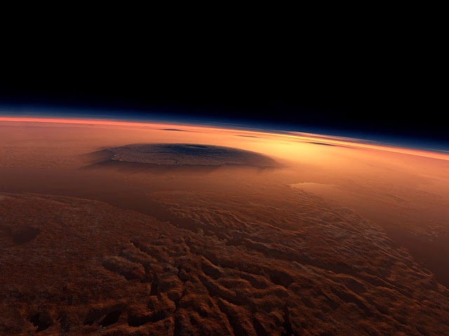
MARS ATMOSPHERIC LIDAR
Farzin Amzajerdian, George E. Busch, Nickolas Heavens, Michelle Munk, Glenn Hines, Diego Pierrottet,
Devin Pugh-Thomas, Keith Murray
NASA Langley Research Center
Meeting of Working Group on Space-based Lidar Winds
March 22, 2017

Slide 2
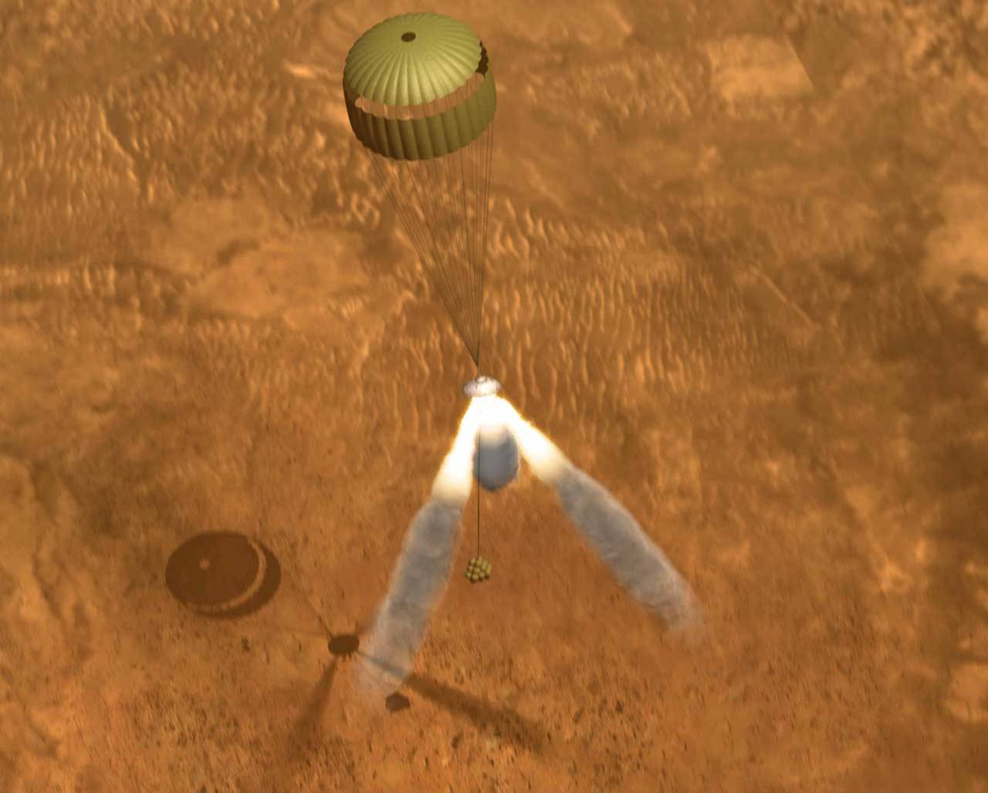
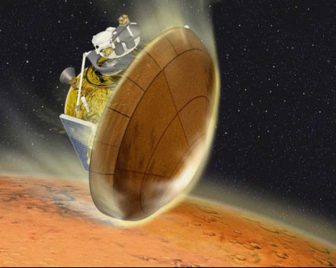
Mars Scientific and Engineering Needs
Measurement of Mars atmospheric winds, density, temperature, and aerosol are essential for “Climate Research”, “Weather Models”, and “Design of Future Large Robotic and Crewed Landing Missions”
Climate Research and Weather Models require:
  Characterization of middle and lower atmosphere structure, and its spatial and temporal variability
Design of low-risk and cost-effective landing missions requires:
  Atmospheric density and its natural variability at altitudes ranging from 100 km to surface
  Accurate wind velocity data from 20 km to surface
Large sample return or human-class spacecrafts using aerocapture techniques require accurate knowledge of upper atmospheric densities
Low-level winds are major source of error for parachute landings

Slide 3
Multi-functional Mars Atmospheric Lidar
A multifunctional lidar instrument is being proposed that capitalizes on recent advances achieved by LaRC on highly efficient lasers and advanced coherent lidar components
Lidar will be capable of providing global profiles of major Mars atmospheric parameters: Winds, Density, Temperature, and Aerosols.
  Proposed Mars lidar is substantially smaller than the ones proposed for Earth-orbiting lidars by taking advantage of:
  Mars higher aerosol mixing ratio
  Low atmospheric density and dominance by CO₂
  Relaxed measurement accuracy and resolution
Single instrument offers higher reliability and significant reduction in complexity, mass, volume, and power compared to multiple systems

Slide 4
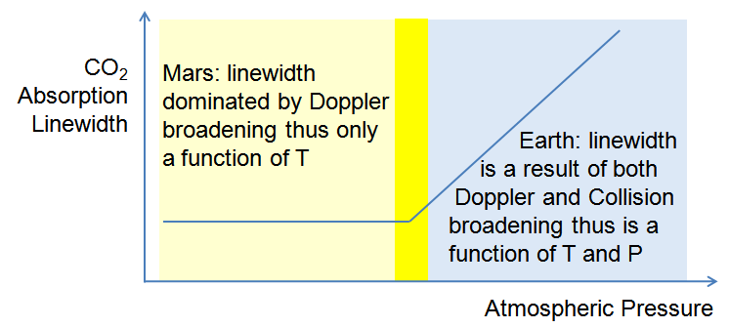
Principle of Mars Atmospheric Lidar
Laser Pulses tuned to a set of discrete frequencies
Signal Intensity
Wind velocity (Doppler shift)
Density and Temperature (Absorption spectral relative strength and width)
CO₂ rotational transition line
Aerosols and clouds concentration
(Signal Intensity)
ν
In Mars atmosphere:
  Width of absorption line is a function of temperature
  Strength of absorption line is proportional to density

Slide 5
Mars Lidar System Diagram
Transmitter Freq. Modulator
Transmit/Receive
Switch
λ/4
Seed
Laser
Laser Pulse Pre-Amplifier
Laser Pulse Amplifier
Beam Steering
Element
Local Osc.
Freq. Modulator
Lens
Telescope
Photoreceiver
Detector
Beam Combiner
Control
Signal
Laser
Beam Pointing Control
Real-time Signal Processor
Commands and Control
A/D
Data
Transmitter
Command & Data
Handling System (C&DH)
S/C Flight
Computer

Slide 6
Leveraging component technologies developed for Navigation Doppler Lidar
NDL Measures velocity and range along three different laser beams
Simultaneous line-of-sight measurements are used to estimate:
  Velocity Vector (V)
  Altitude relative to local ground (No IMU data required)
Navigation Doppler Lidar (NDL)
Fiber Amp
1:3
T/R Switches
Transmitter
Seed Laser
Freq.
Modulator
1:2
Local Oscillator
1:3
Transmit/Receive
Lenses
Photoreceivers
Command and Data Handling (C&DH) unit

Slide 7
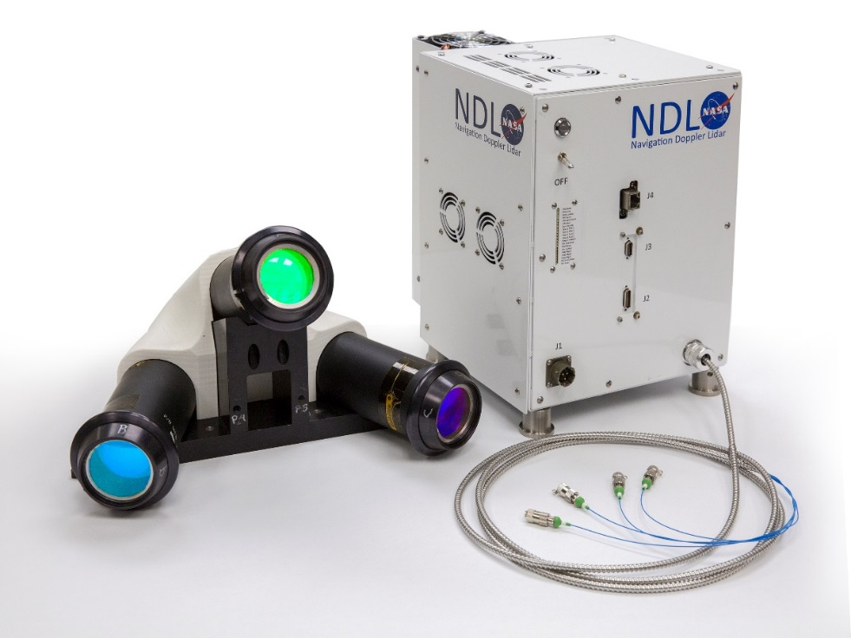
Navigation Doppler Lidar Specifications
Parameter |  | Value
Velocity Errorª |  | 1.7 cm/sec
Altitude Errorª |  | 2.2 m
Maximum LOS Range |  | 4000 m
Maximum LOS Velocity |  | 200 m/sec
Data Rate |  | 20 Hz
Dimensions | Electronic Chassis | 29 x 23 x 20 cm
 | Optical Head | 34 x 33 x 21 cm
Mass | Electronic Chassis | 8.7 kg^{b}
 | Optical Head | 5.0 kg
Power (28 VDC) |  | 80 W^{b}
a. Errors dominated by the vehicle’s vibration and angular motions.
Heatsink and fans module for terrestrial operation adds 1.5 kg and 10 W to GEN 3 unit.
Optical head mounts rigidly to the body of the vehicle with a clear view of the ground while the electronic chassis may be installed anywhere on the vehicle.

Slide 8
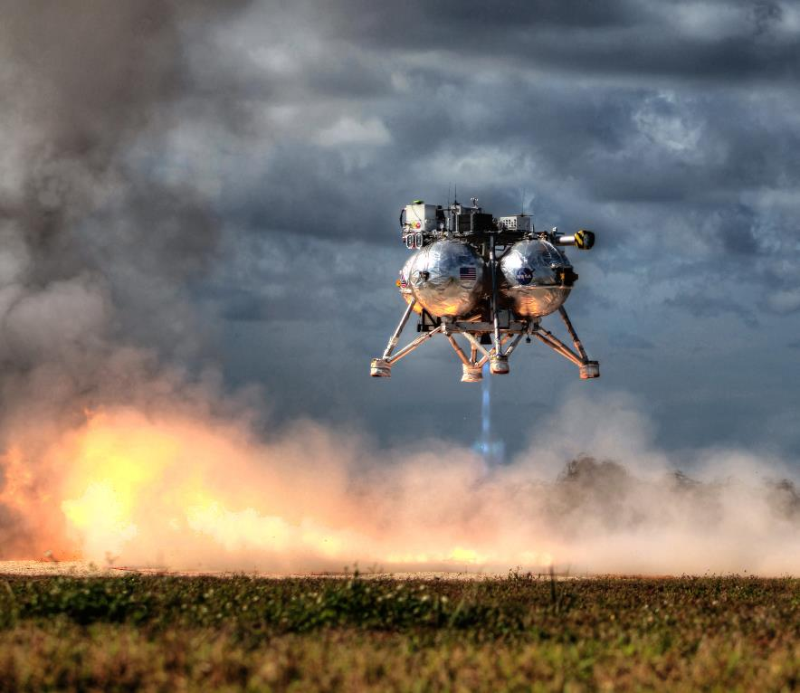
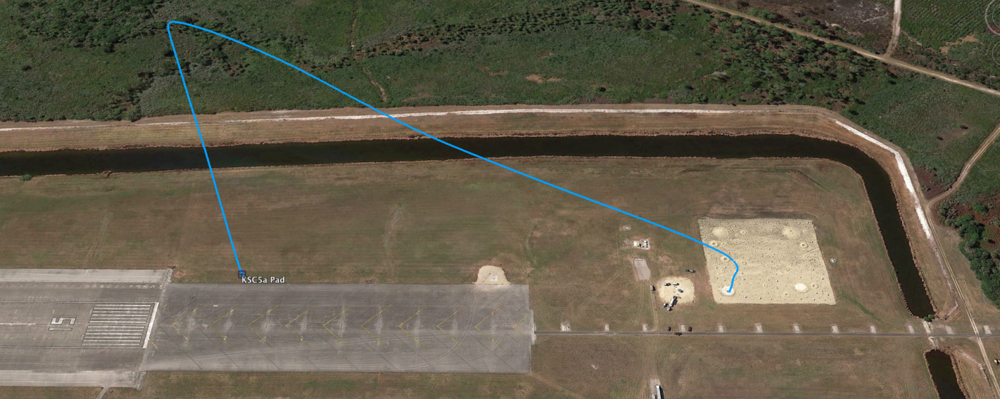

NDL extensively tested during different stages of its development
4 helicopter flight test campaigns
6 flights on rocket-powered free-flyer Morpheus vehicle
Additional free-flyer tests are planned in FY 17
Work on TRL6 system (ETU) is in progress
Navigation Doppler Lidar
Flash Lidar
Doppler Lidar
Head
Laser Altimeter
Morpheus Flight Tests
Shuttle Landing Facility, NASA-KSC
Approx. 450 m slant range
30 degree glideslope
100m x 100 m hazard field

Slide 9
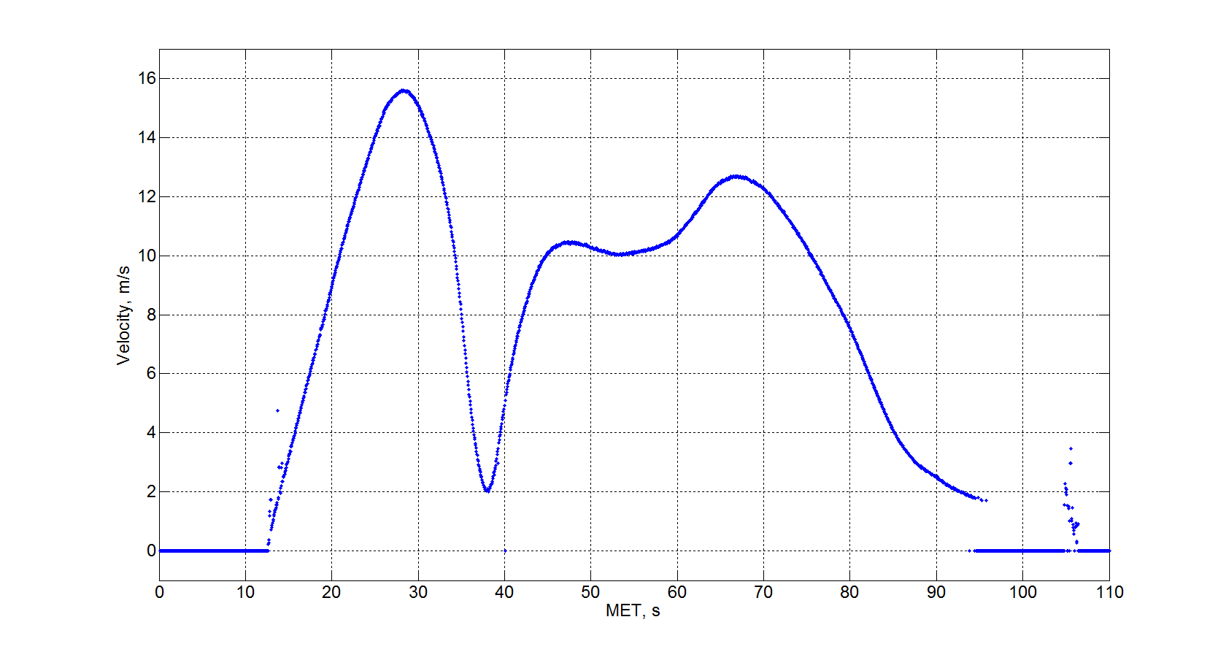
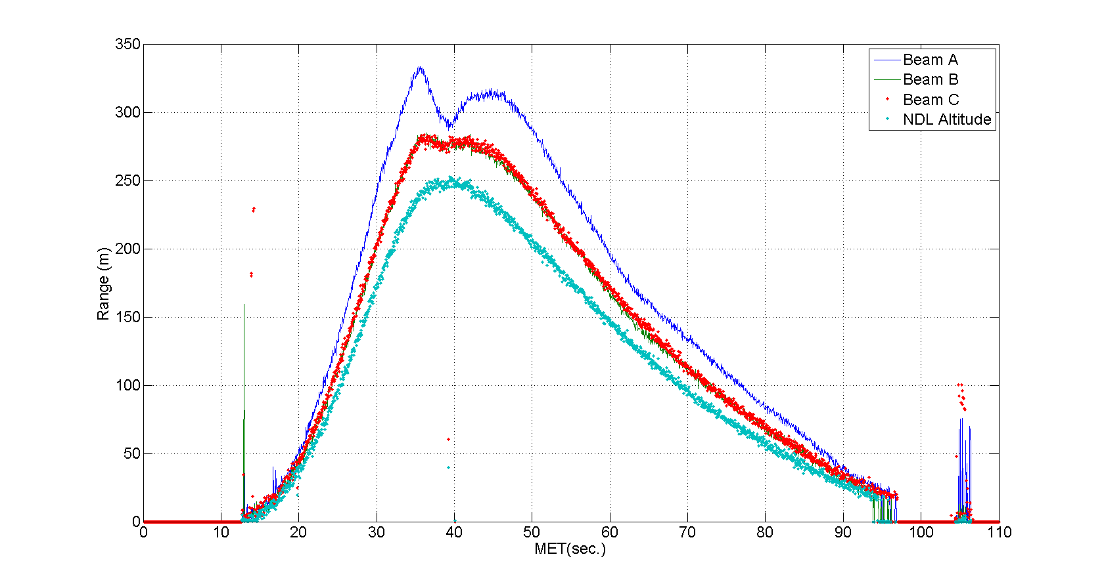
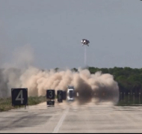
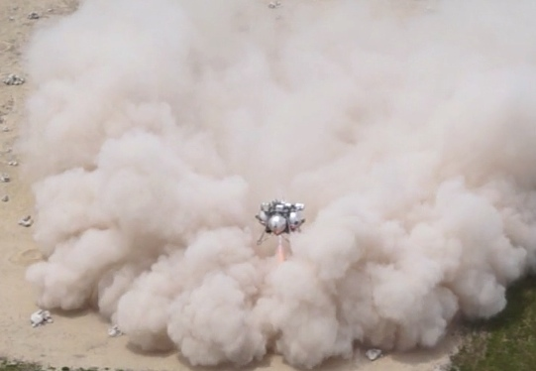
Morpheus/ALHAT Flight Data
16
12
8
4
0
Velocity Magnitude
350
300
250
200
150
100
50
0
Altitude
Range (m)
velocity (m/s)
0 10 20 30 40 50 60 70 80 90 100 110
time (s)
0 10 20 30 40 50 60 70 80 90 100 110 time (s)
Takeoff
Landing

Slide 10
Laser Frequency Modulator
NDL Frequency Modulation (FMCW) Waveform
Can tune the laser frequency to several GHz with 1 GHz/msec rate and better than 2 KHz precision

Slide 11
NDL Real-Time Processor & System Controller
NDL Modulation Waveform

Slide 12
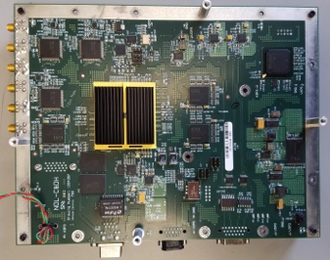
Utilization of NDL C&DH in Mars Lidar
Deterministic operational sequence - essential for autonomous operation
Robust real-time processing - essential for limited data transmission B.W.
Capable of 50M points FFT/sec - can support 500 pulses/sec
Background subtraction
  Eliminate internal backscattering
  Minimize sporadic frequency noises
  Noise whitening
Peak detection algorithm needs to be modified
In-house built single board
Highly compact and powerful:
  9”x7”, 0.08” thick, 20 layers, 1000’s traces

Slide 13
  Non-mechanical Beam Steering
Lightweight and low-power utilizing thin film liquid crystal elements
Capable of steering the beam in Az. And El. with a few milliseconds switching speed
Experimental device being tested
  5.5 cm clear aperture
  Steering angles up to 48 deg.
  98% deflection efficiency
Tests include double-pass throughputs, heterodyne detection efficiency, and switching time
Investigating options for scaling to larger apertures

Slide 14
Highly Efficient and Compact Laser
Hybrid Fiber Rod Amplifier
Master Oscillator Laser
Modulator
Output
Pre-Amplifier
Amplifier
30 mJ
Pump Module
Pump Module
Demonstrated record pulse energy (0.7 mJ)
1.5 μm pump
Er:Glass Fiber
output
input
1.5 μm Pump

Slide 15
SUMMARY
A relatively low-mass and low-power lidar instrument concept has been devised that is capable of providing major Mars atmospheric parameters
Several of the key components of the Mars Atmospheric Lidar have already been developed and tested (high speed real-time Doppler processor, Heterodyne receiver, frequency modulator, master oscillator laser)
A new highly efficient and compact laser suitable for a Mars lidar is being developed under an IRAD project
Development and characterization of low-power, non-mechanical scanner is in progress
Proposed lidar instrument is feasible for a mid 2020s lunch

Slide 16
Instrument Baseline Design
    3 km vertical and horizontal measurement resolution from surface to 50 km
    Column density and temperature measurements from 50 km to 100 km
  Mass: 60 kg
  Power: 250 W
    Estimates based on 300 km orbit

Slide 17


