Slide 1
NOAA’s airborne DWL on Hurricane research aircraft: 2015 -2017
G. D. Emmitt, C. O’Handley, J. Zhang, L. Bucci and R. Atlas
Working Group on Space-based Lidar Winds
Hampton, Virginia
21-23 March, 2017

Slide 2
Outline
Description of the P3DWL
2015 flights
Instrument performance
Data studies
2016 flights
Instrument performance
Data studies
2017 plans

Slide 3
Background
Mounted a Doppler wind lidar to the P3 for the first time (P3DWL)
Wind profile data from the 2015 & 2016 seasons:
TS Erika (1) Forward side-to-side sweep
TS/Hurricane Earl (3) Conical down and up
TS Javier (2) Conical down and up

Slide 4
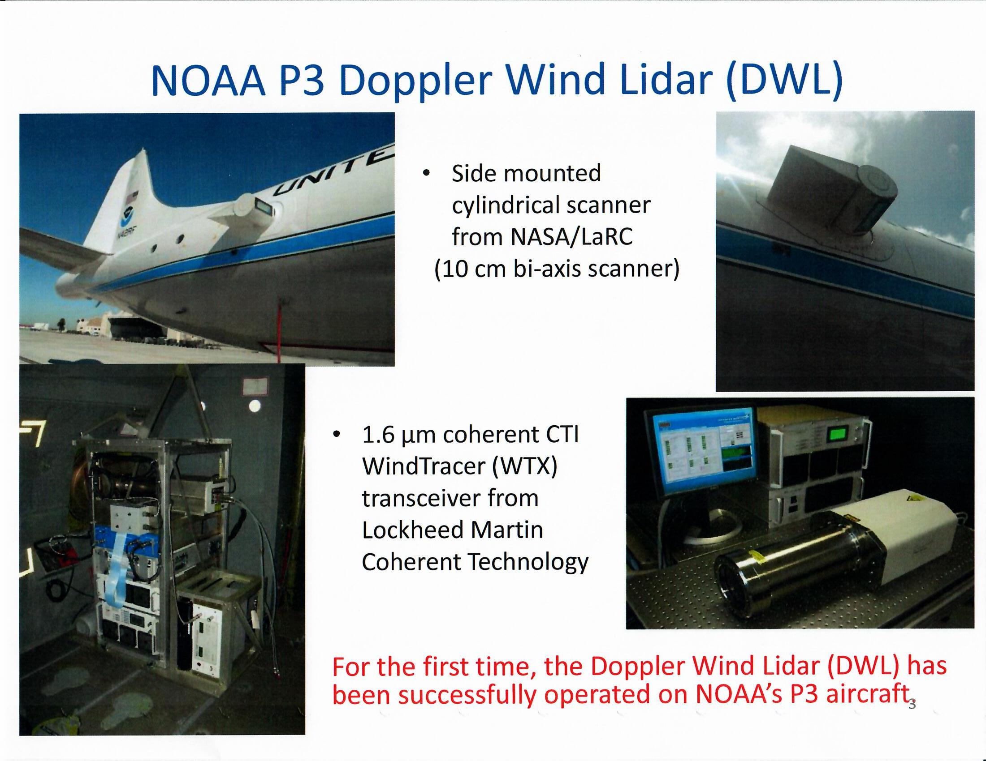

Slide 5
Problems with the
scanner sticking
led to fixing the
elevation angle of
the beam to 60 degrees
off nadir forward and
programming the azimuth
mirror for 9 step stares
subtending 40 degrees.

Slide 6
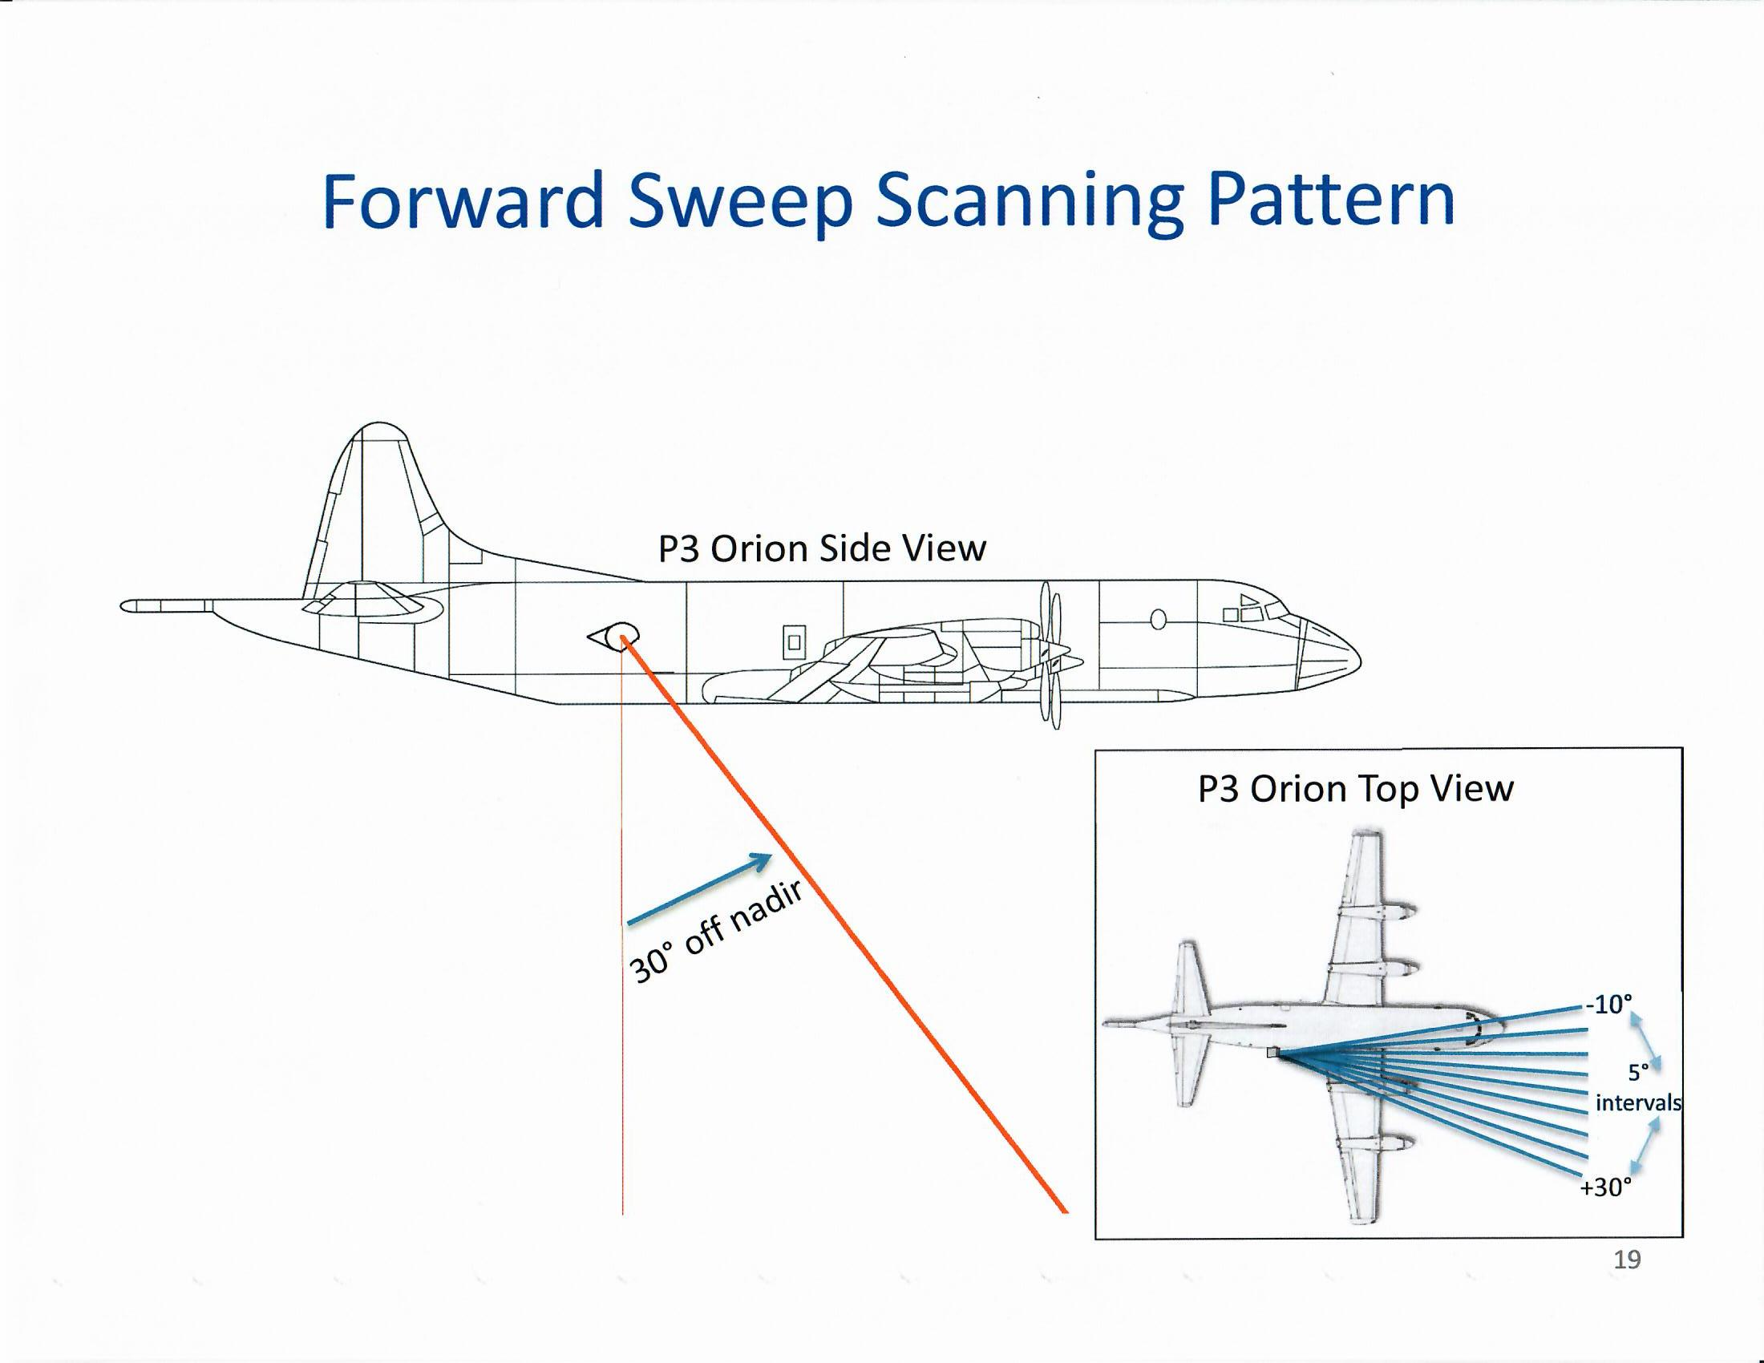
60⁰ off nadir
J. Zhang

Slide 7
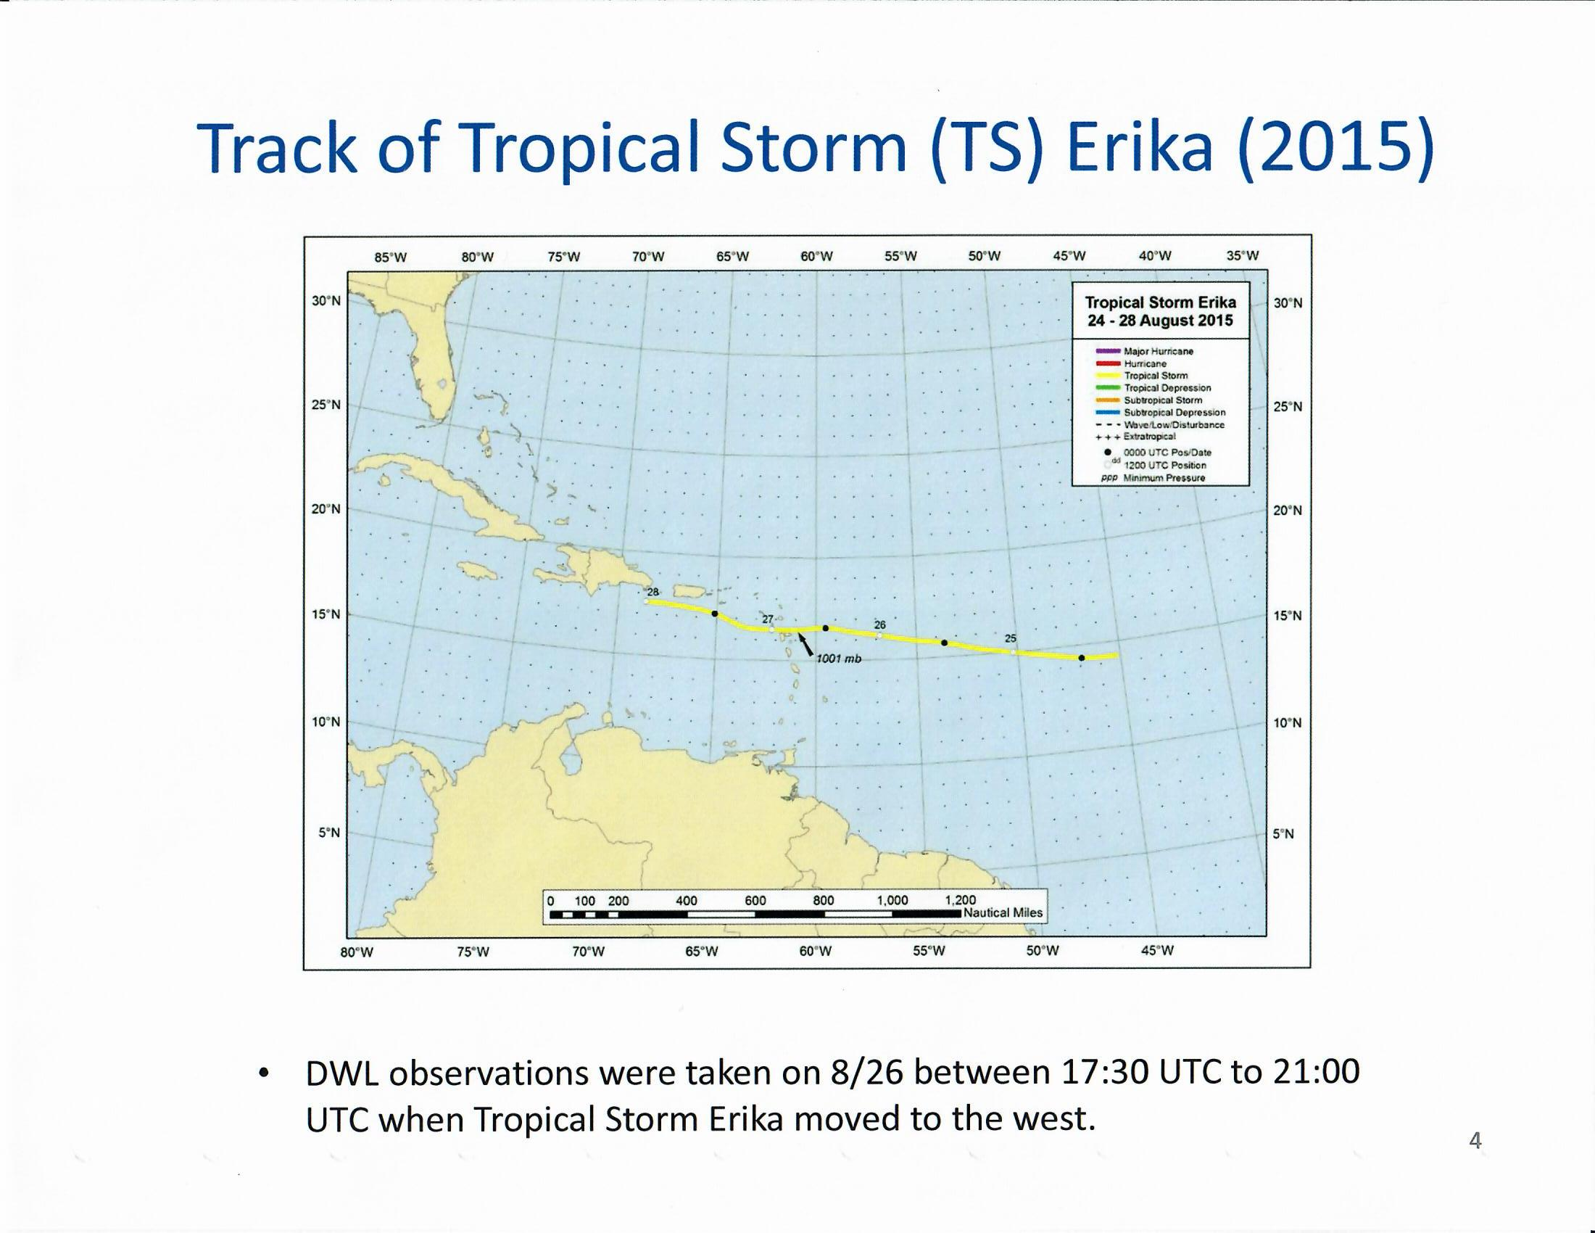
J. Zhang

Slide 8
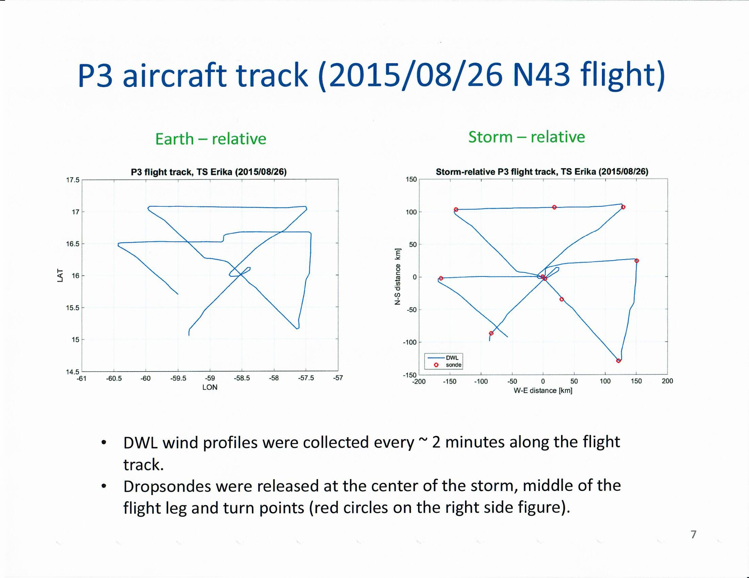
.5
J. Zhang

Slide 9
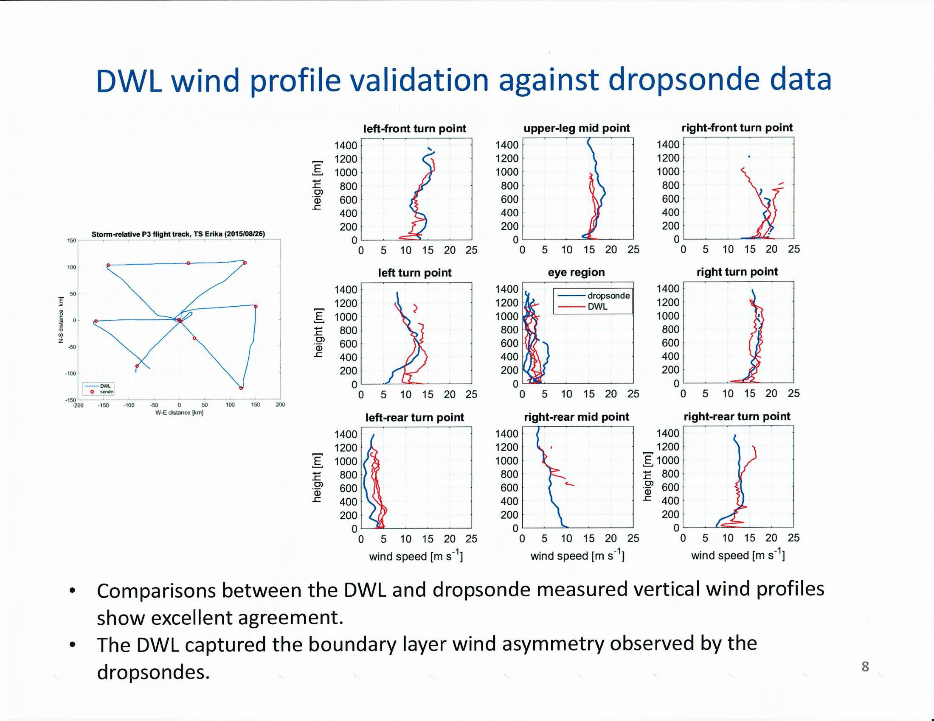
J. Zhang

Slide 10
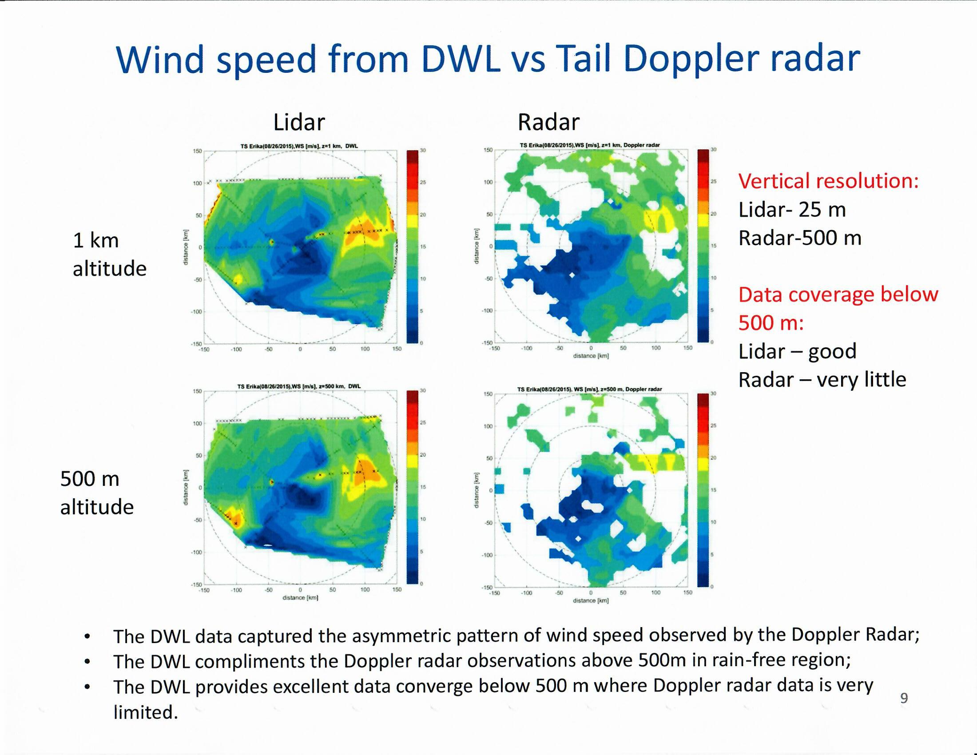
J. Zhang

Slide 11
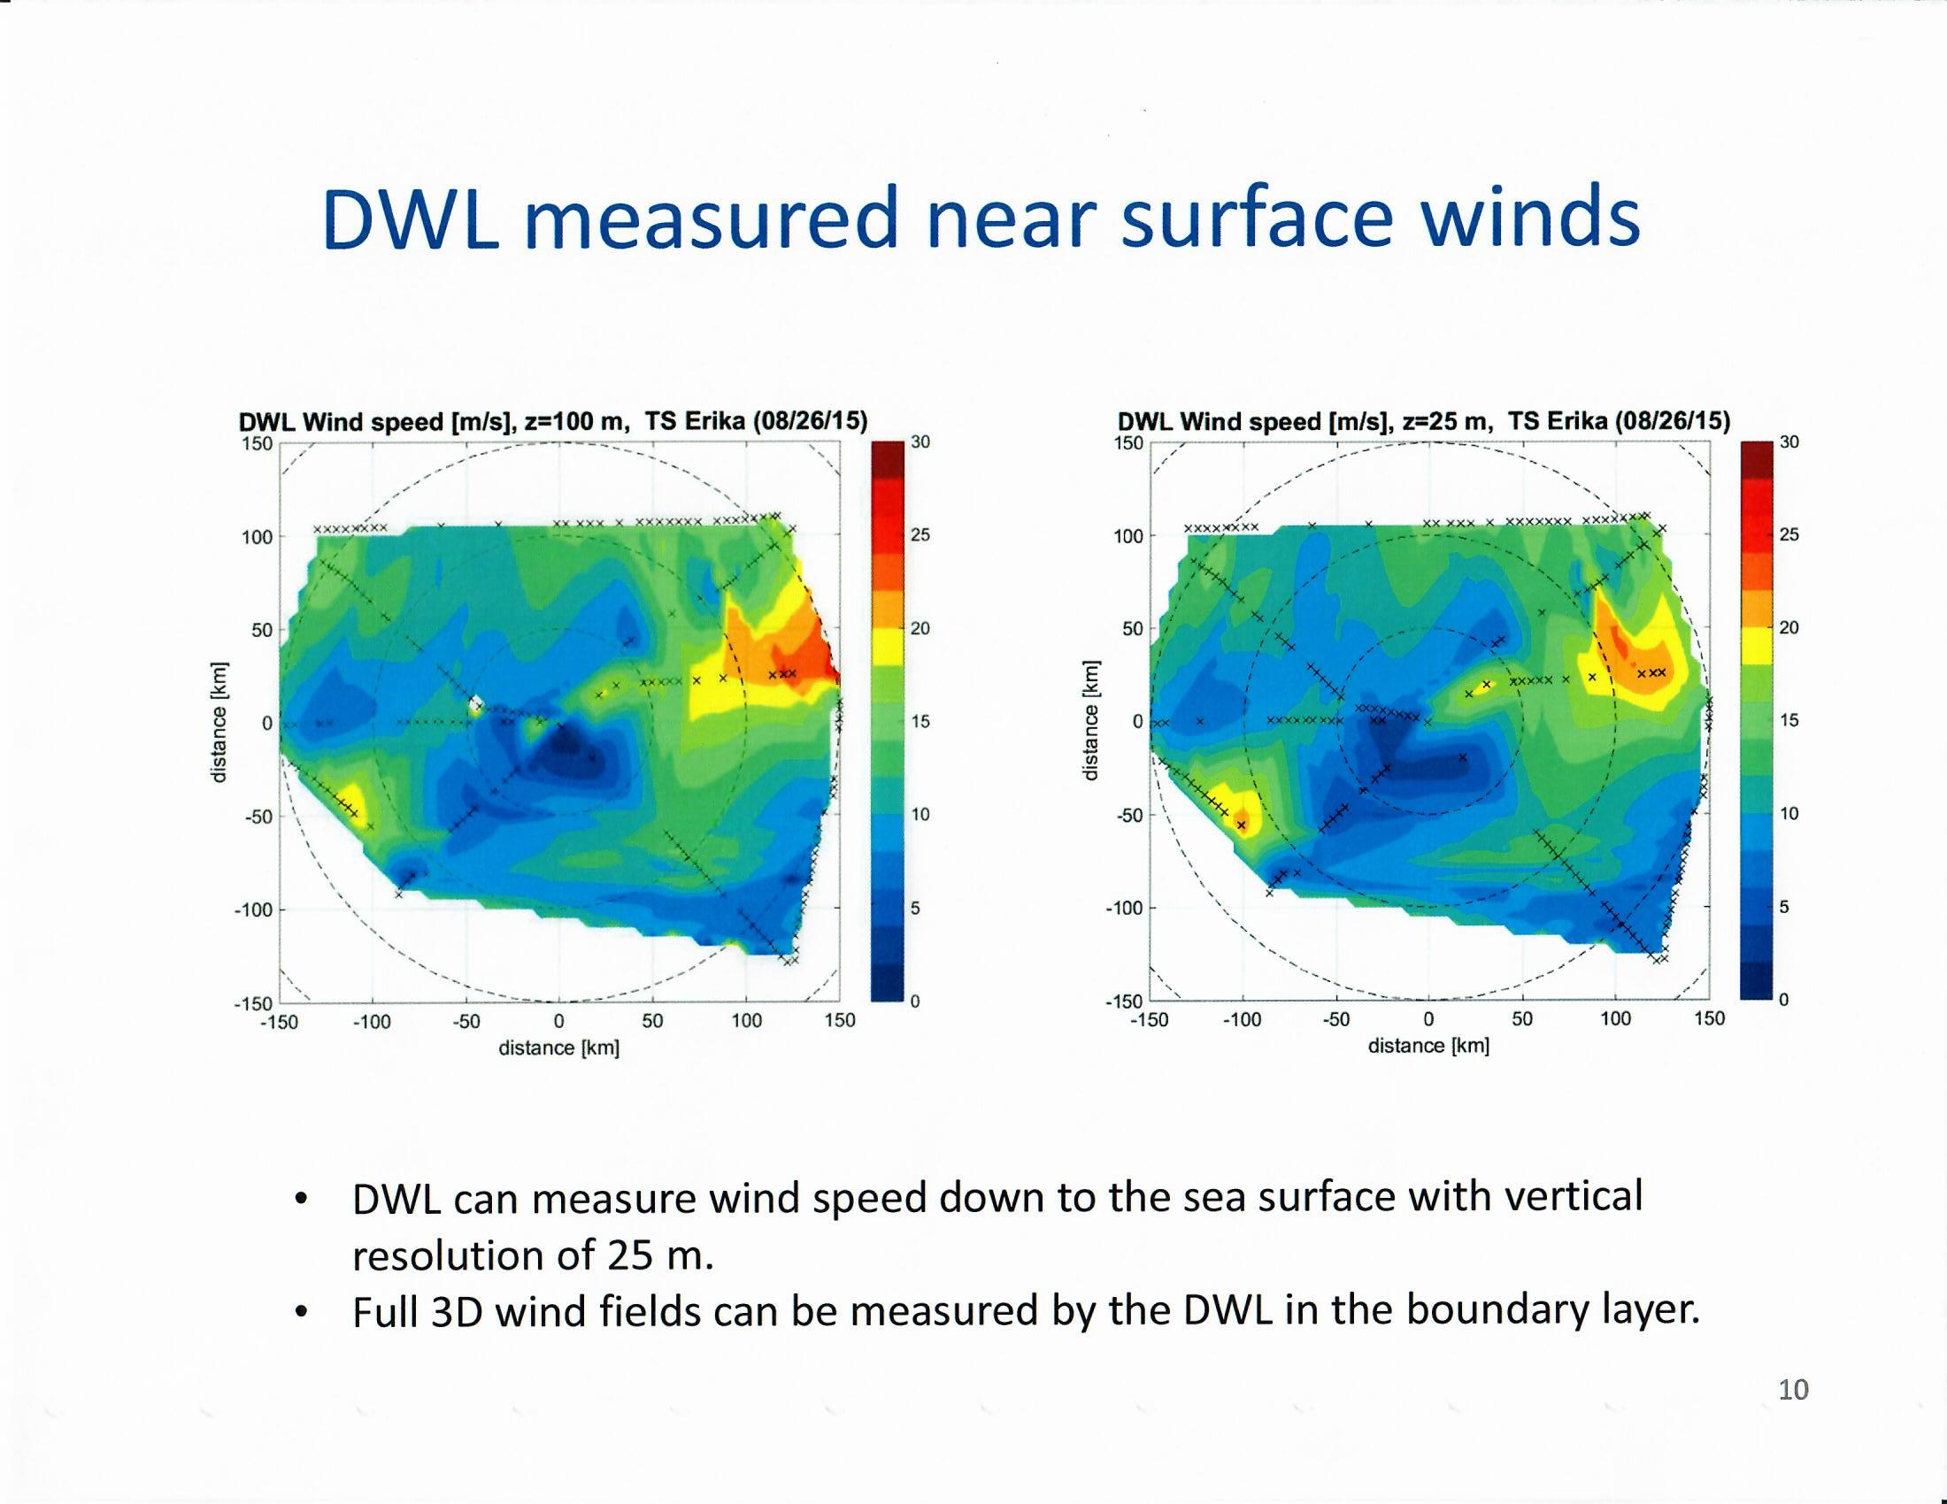
J. Zhang

Slide 12
Erika Case Summary
Wind profile data were collected in Tropical Storm Erika (2015) by a Doppler wind lidar (DWL) successfully installed on NOAA P3 aircraft.
Comparisons between DWL and dropsonde measured vertical wind profiles show good agreement.
The DWL captured the wind asymmetry above 500 m where Doppler radar data were available; the DWL also provided unique observation of boundary layer structure below 500 m with excellent data coverage.
The axisymmetric boundary layer structure of Tropical Storm Erika (2015) is different from that a typical hurricane boundary layer.
The boundary-layer wind asymmetry in Erika is generally consistent with that in hurricane dropsonde composite in shear relative framework.
J. Zhang

Slide 13
Problems with the
scanner sticking
were fixed for the 2016
season. Scanner was
operated with a 20 degree
off nadir elevation
angle and 12 azimuth
step stares.

Slide 14
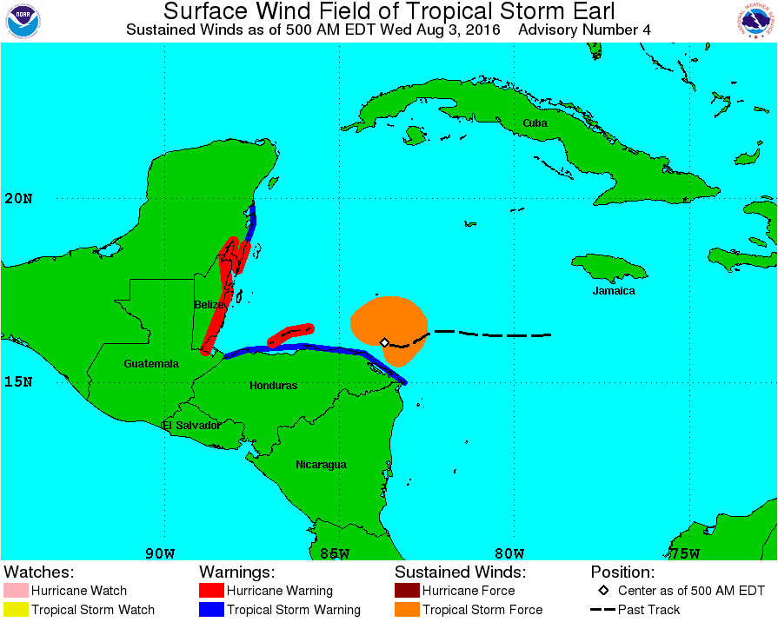
Hurricane Earl – 08/03/2016
L. Bucci

Slide 15
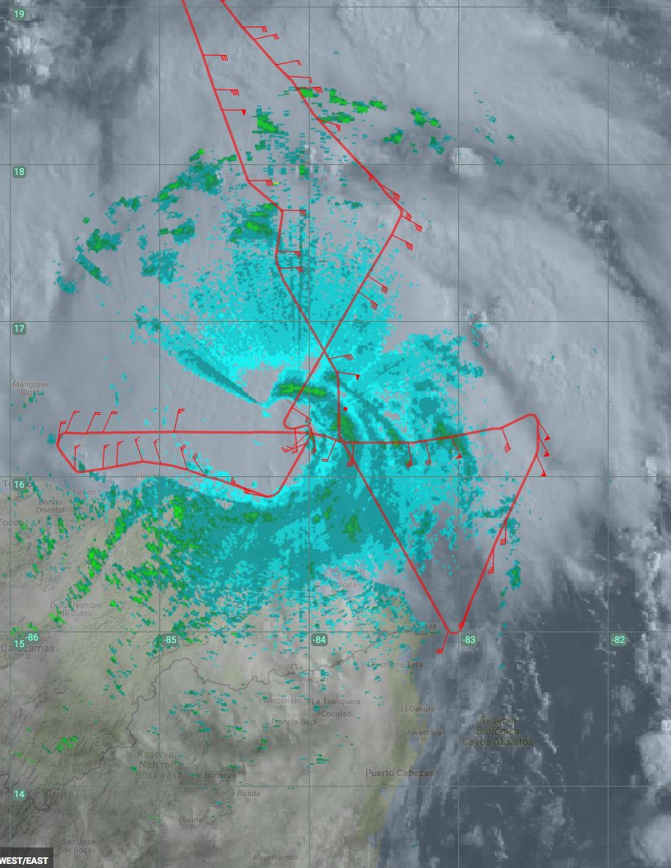
Hurricane Earl – 08/03/2016
11
8
2
L. Bucci

Slide 16
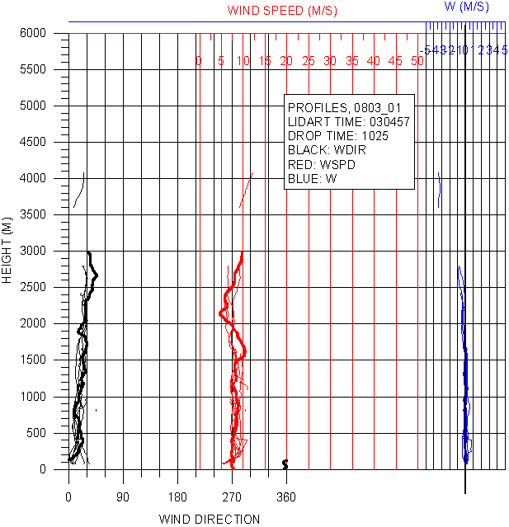
8
L. Bucci

Slide 17
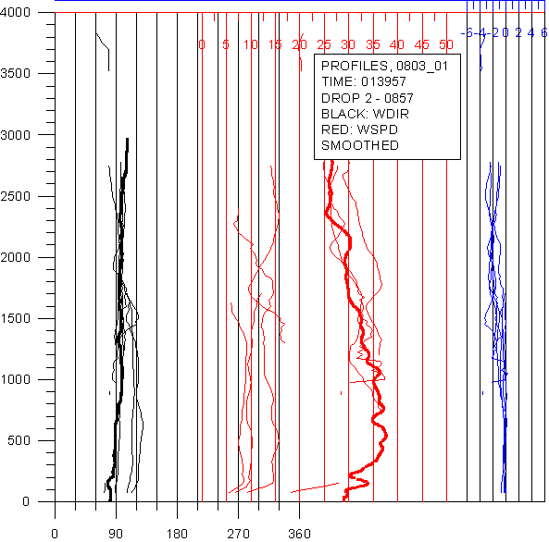
2
L. Bucci

Slide 18
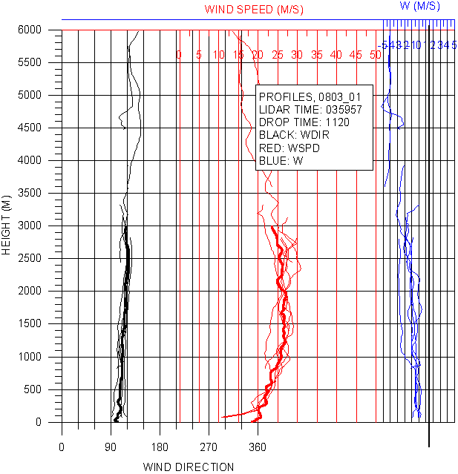
11
L. Bucci

Slide 19
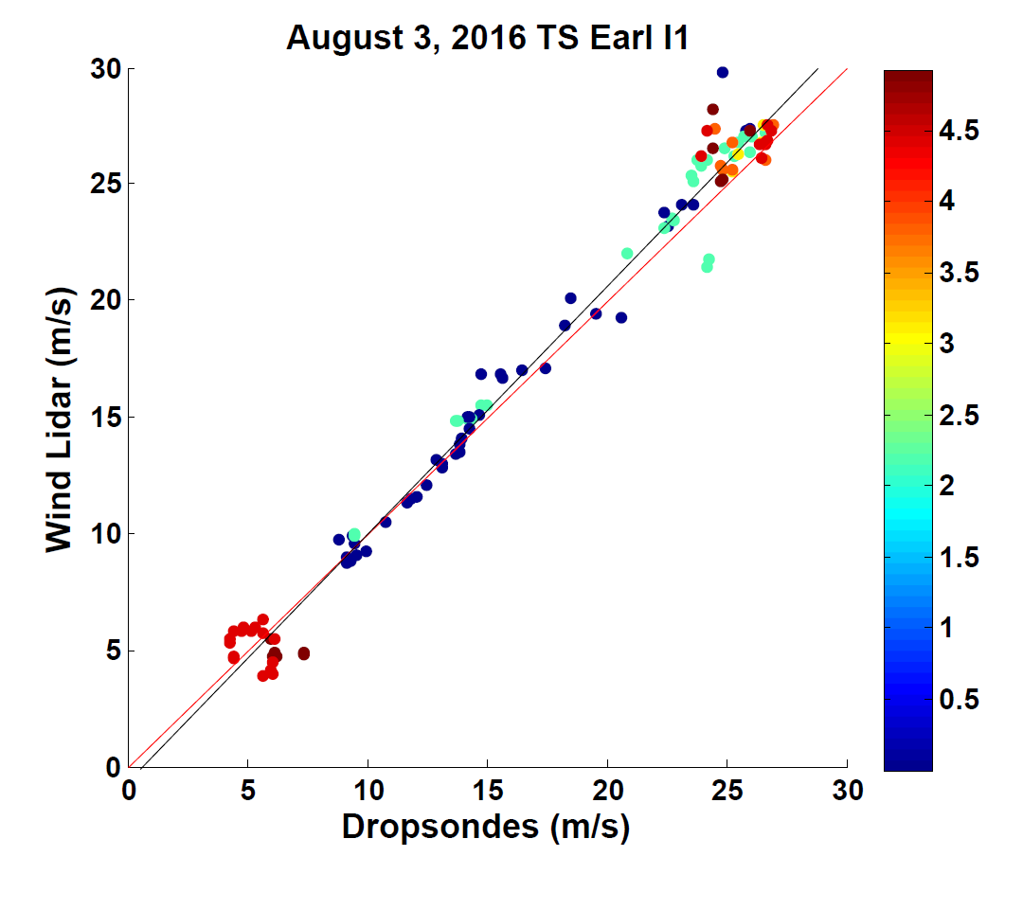
Verification– DWL/GPS speed
y=1.0116*x + 0.5672
n=251
corr=0.9537
Color indicates distance in km
5km or less:
y=1.0622*x - 0.6162
n=114
corr=0.9914
L. Bucci

Slide 20
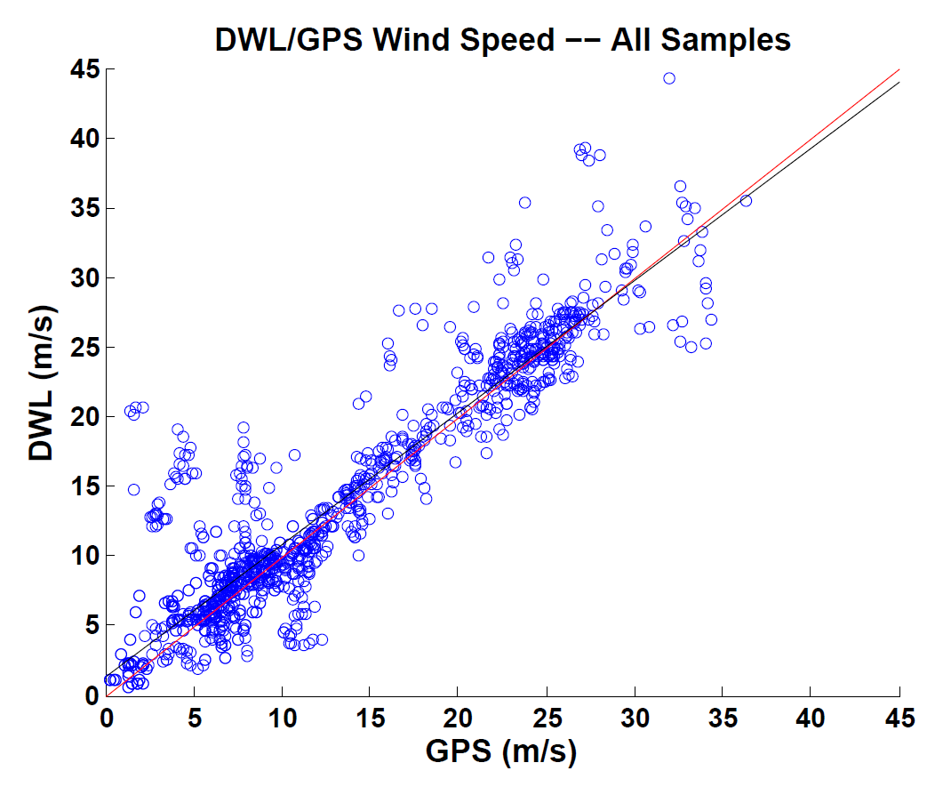
Verification– DWL/GPS speed
10km threshold
5km threshold
n=1200
y=0.9467*x + 1.4104
corr=0.9235
n=497
y=1.0474*x - 0.4104
corr=0.9680
***Sample from 4 flights (2016): 0802I1, 0803I1, 0803I2, 0809I1
L. Bucci

Slide 21
Verification -- DWL/GPS direction
n=497
y=0.9851*x + 4.2349
corr=0.9207
***Sample from 4 flights (2016): 0802I1, 0803I1, 0803I2, 0809I1
L. Bucci

Slide 22
Summary from AOML
What has been done?
Shown P3DWL obs complement TDR obs
Qualitatively compared P3DWL obs to dropsonde
Shown impact in analysis using HEDAS
In progress:
Quantitatively comparing P3DWL observations to other observing platforms on P3
L. Bucci

Slide 23
Continued Verification Work
Compare SFMR to lowest DWL measurements (height varies depending scanning pattern)
Compare flight level to highest DWL winds
Comparison profiling code
L. Bucci

Slide 24
2017 Season
P3DWL to be flown second half of season
Target higher (hurricane force) wind speeds for verification
Training for operators (held at HRD) this spring
L. Bucci

Slide 25
Investigation of the effects of precipitation on DWL wind retrievals
Revival of work done in 2008-2009 using DWL data collected from NRL P3 in TPARC (Western Pacific)
Motion of aerosols and hydrometeors captured in LOS illuminated volumes.
Working in the spectral domain allows us to discriminate between those two contributions.
Four motion contributions that need to be distinguished:
Horizontal and vertical motion of the aerosols
Horizontal and vertical motion of the hydrometeors
Emmitt and O’Handley

Slide 26
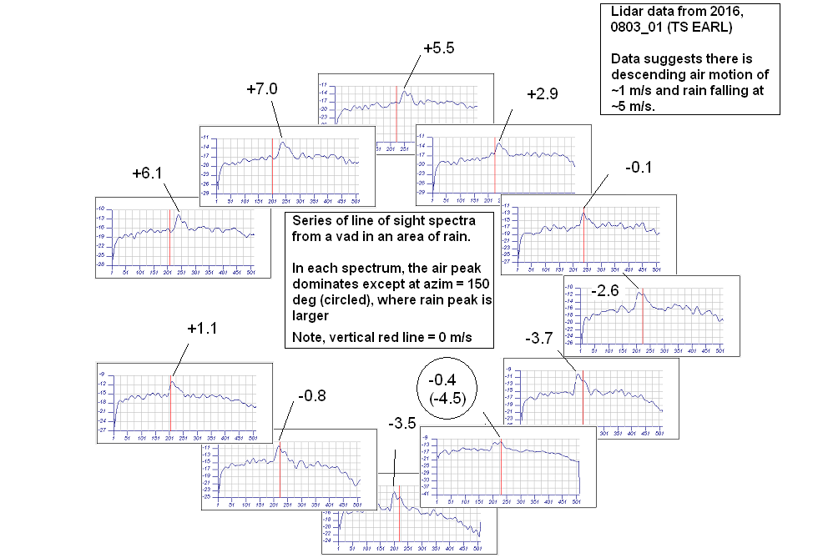

Slide 27
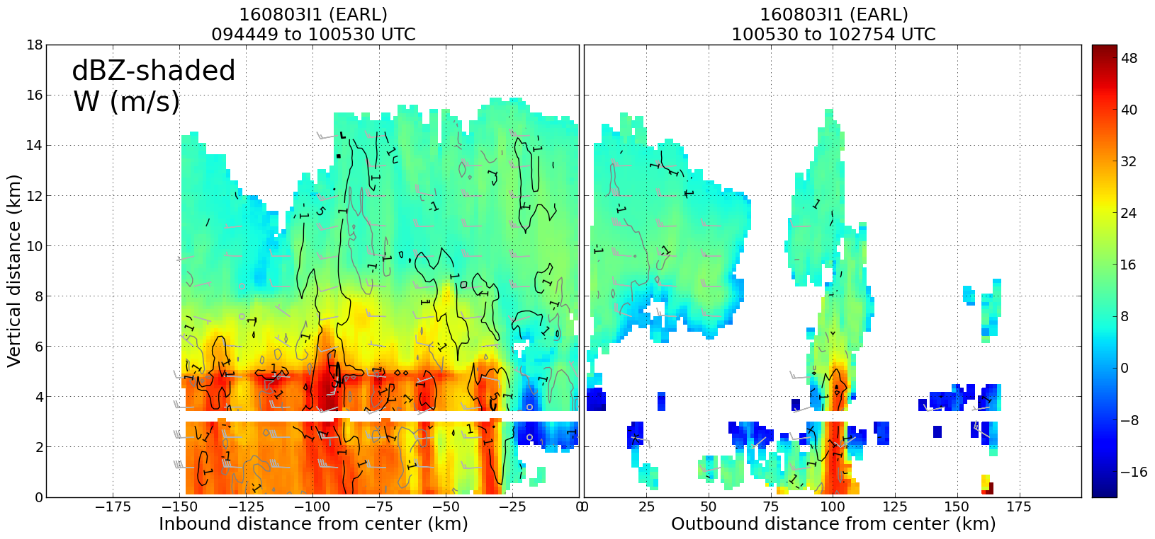
Flight leg through center of Earl: TDR observations
Emmitt and O’Handley

Slide 28
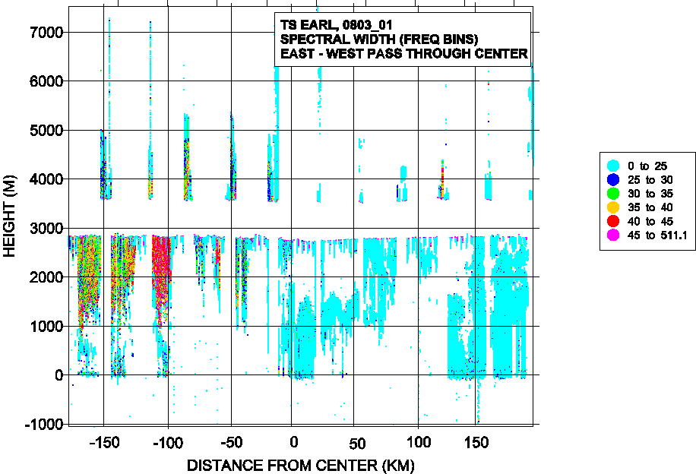
Emmitt and O’Handley

Slide 29
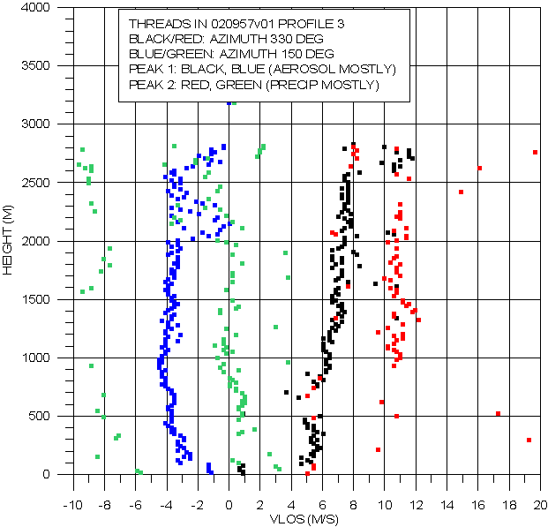
Emmitt and O’Handley

Slide 30
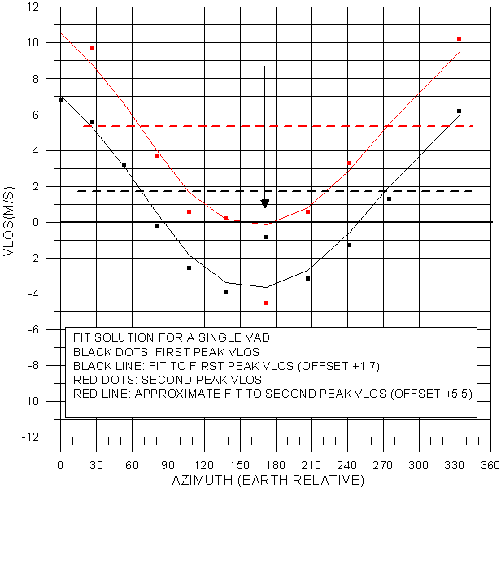
Emmitt and O’Handley

Slide 31
Summary
After 2 seasons of flying on the NOAA P3, the DWL has demonstrated its capabilities to make useful observations within the strong gradient and turbulent environment of tropical cyclones.
The down/up scanning enabled by the side mounted scanner offers perspectives on the aerosol and hydrometeor motions that require advanced processing techniques currently being developed.
New scanning and signal processing algorithms will be evaluated during the 2017 season starting September 1.

