Slide 1

A 10-Year Global Aerosol Climatology Derived from CALIPSO
Jason Tackett
Science Systems and Applications, Inc.
CALIPSO Lidar Science Working Group

Slide 2
CALIPSO:
Over 10 Years of Aerosol and Cloud Observations
56,800 orbits around Earth (1.2 billion miles)
6.3 billion laser shots
124 seconds of light emitted
314 TB of data generated
1.8 TB per second of light!
>1,800 publications

Slide 3
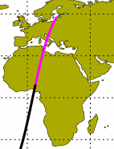
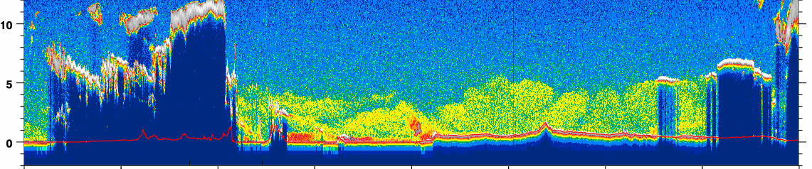
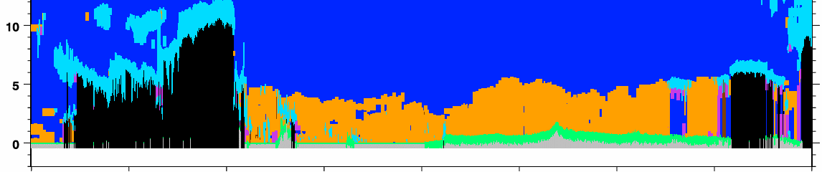
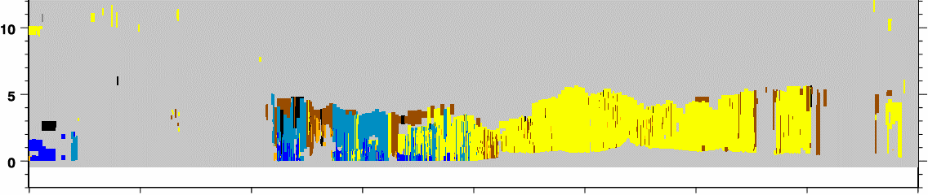
CALIPSO Aerosol Observations
Level 1 Attenuated Backscatter 532 nm
Altitude (km)
Level 2 Vertical Feature Mask
clouds
Altitude (km)
aerosol
57°N
33°N
9°N
Level 2 Aerosol Types
polluted dust
dusty marine
dust
Altitude (km)
57°N
33°N
9°N

Slide 4
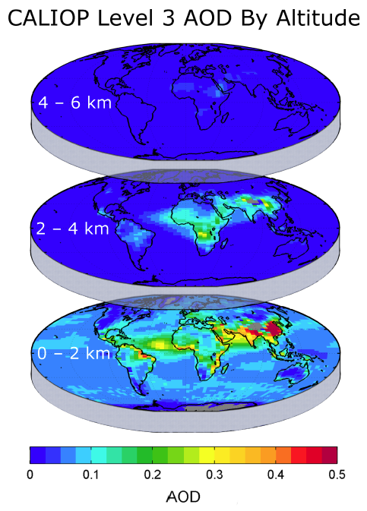
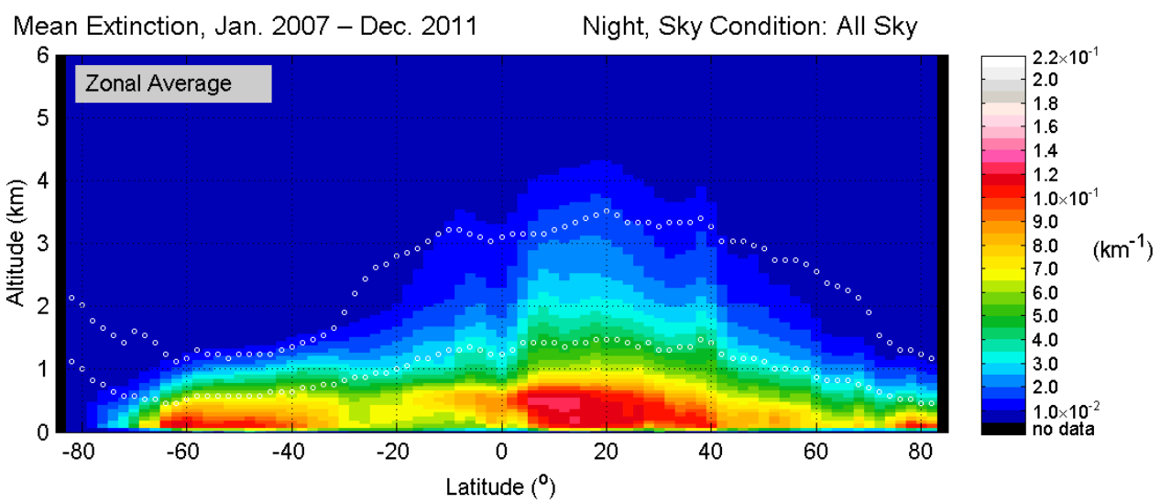
CALIPSO Level 3 Aerosol Profile Product
Monthly Mean
Aerosol Extinction Profiles
Quality Screened
Reported < 12 km on a 2°x5° lat,lon grid
AOD By Altitude
All-sky and cloud-free sky conditions
Includes aerosol typing information
Zonal Mean Aerosol Extinction

Slide 5
Objectives for this Talk
As a function of altitude, what is the…
Aerosol frequency
Magnitude of aerosol extinction/optical depth
Effect of clouds on aerosol frequency
Data:
10 years of CALIPSO nighttime retrievals
(2007 – 2016)

Slide 6
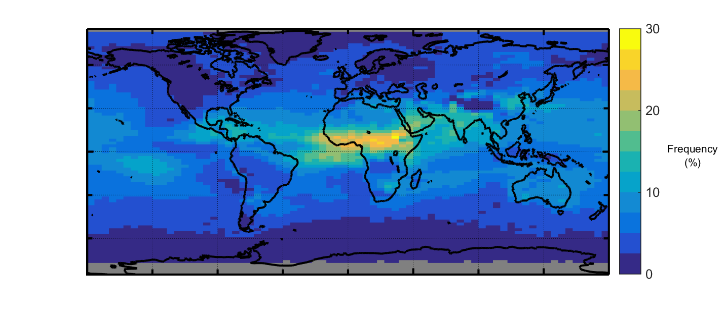
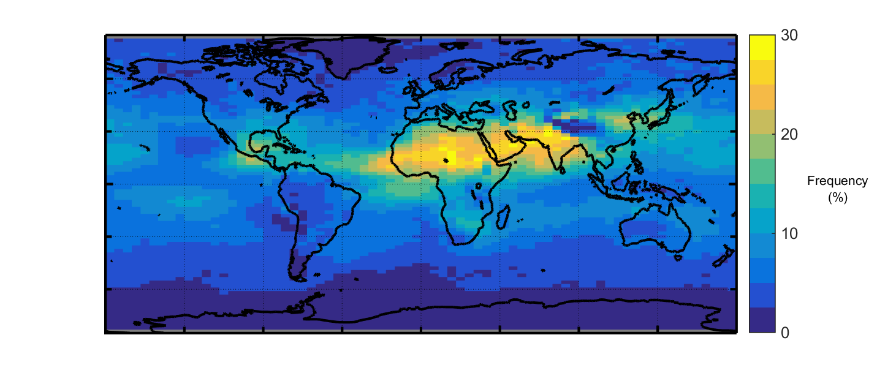
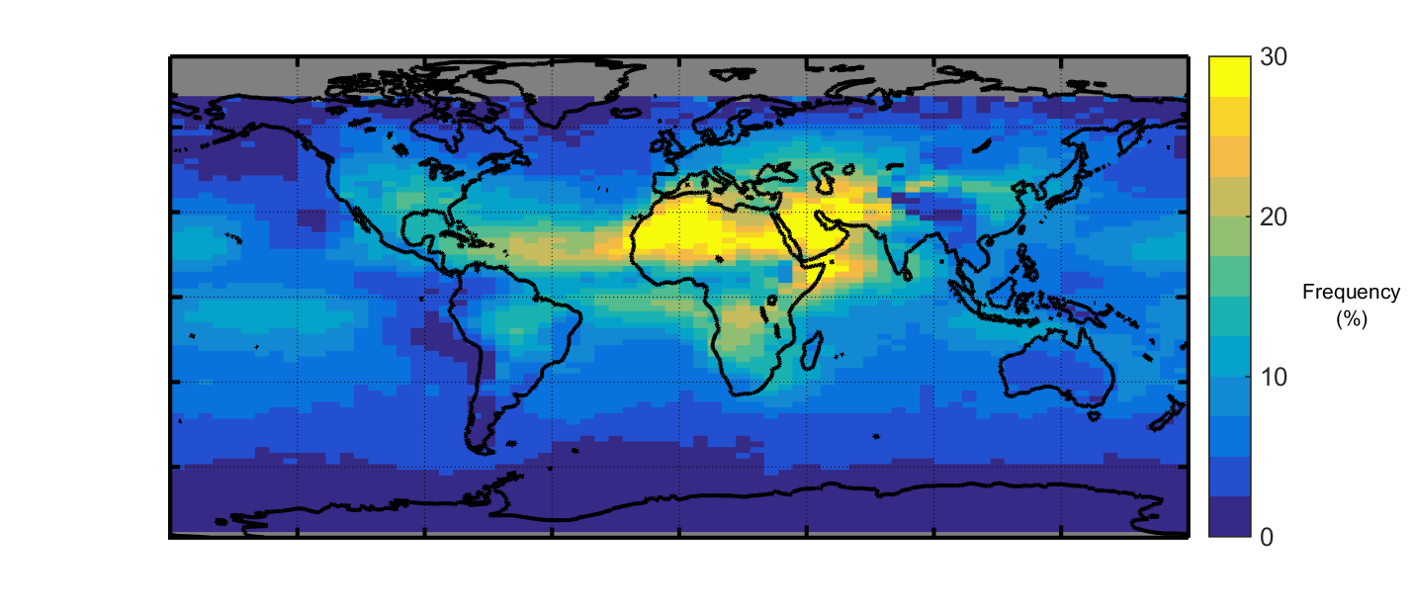
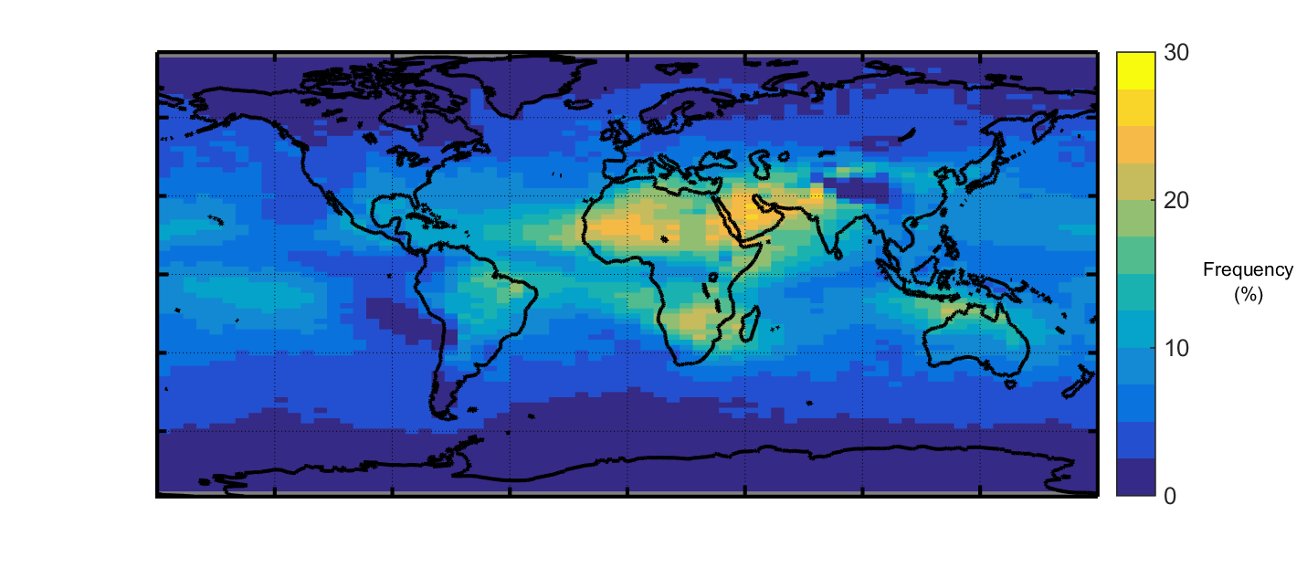
Aerosol Detection Frequency < 12 km
DJF
MAM
JJA
SON
0
10
All-Sky, Night
2007-2016
20
30
Frequency (%)

Slide 7
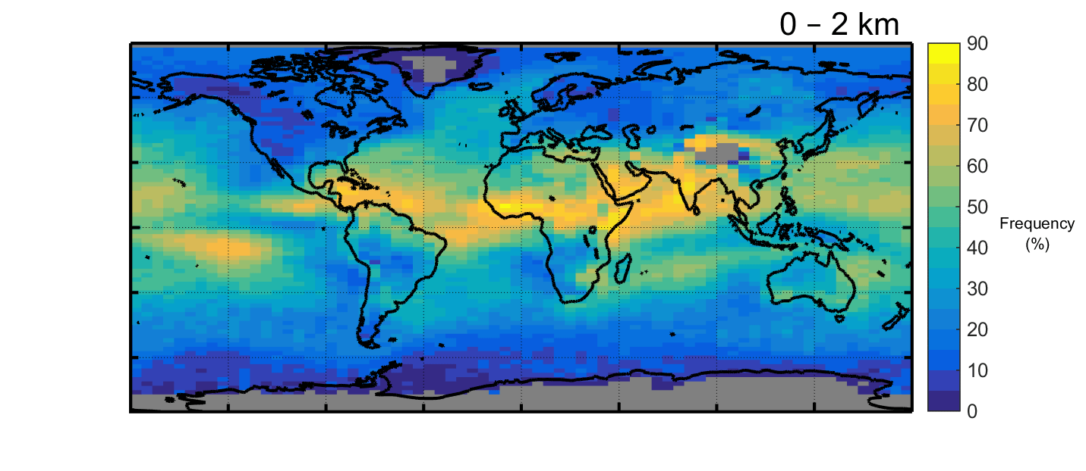
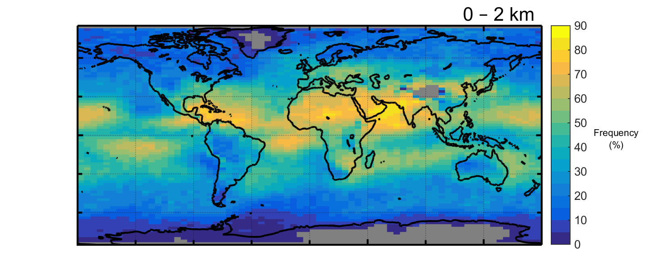
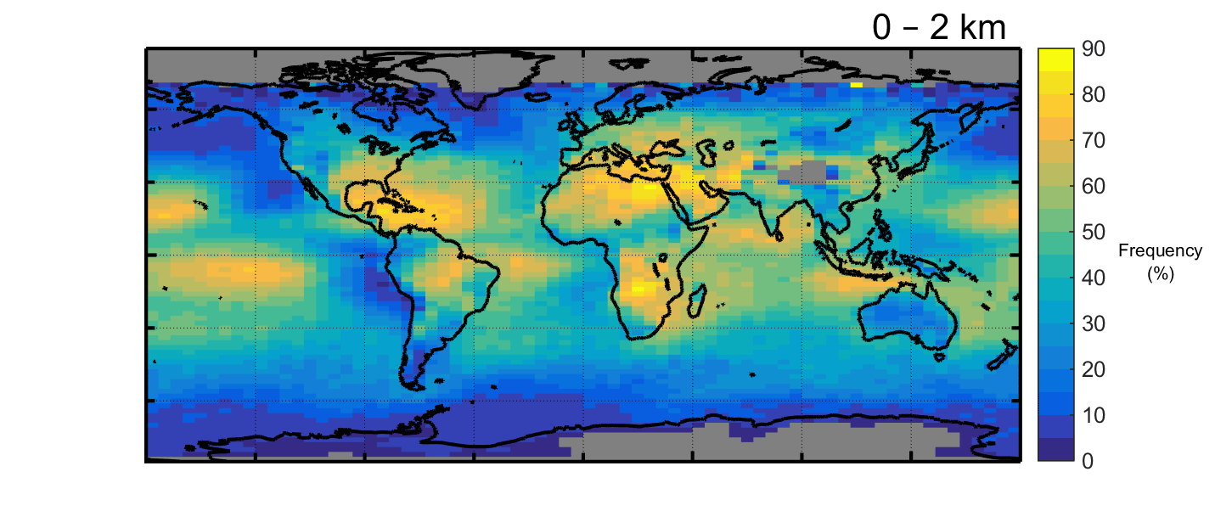
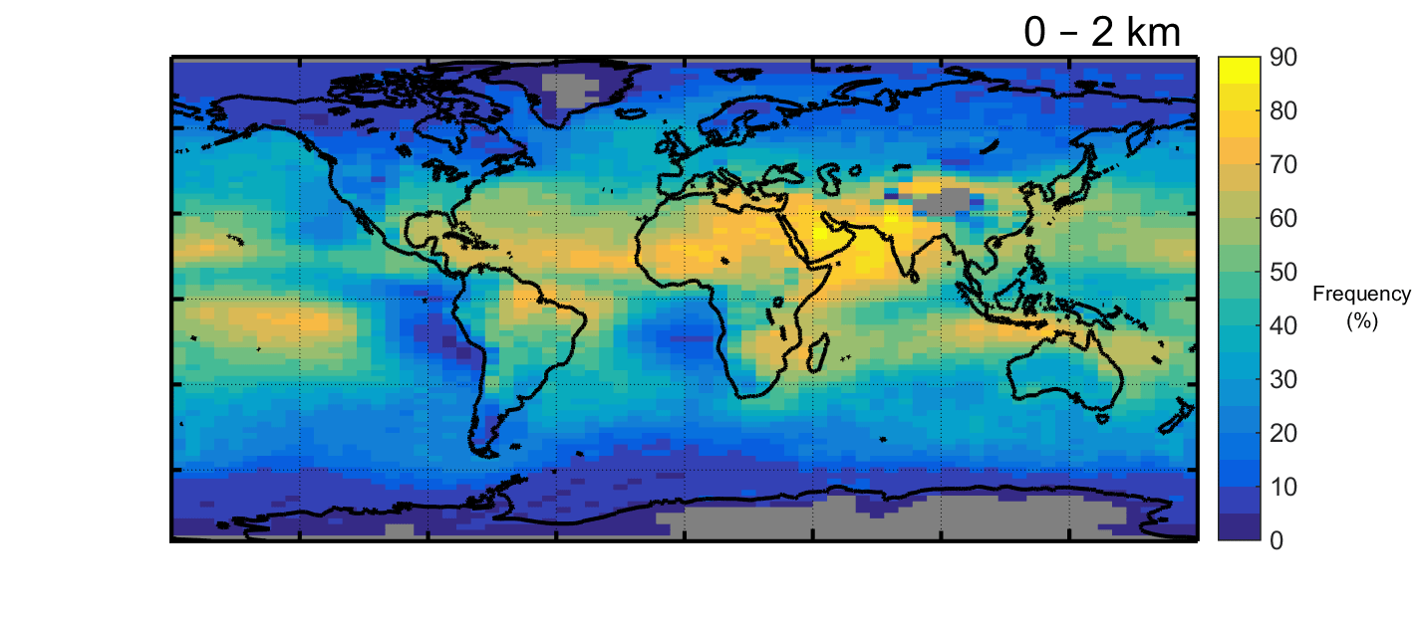
Aerosol Detection Frequency by Altitude
DJF
MAM
JJA
SON
0
20
40
60
80
All-Sky, Night
2007-2016
Frequency (%)

Slide 8
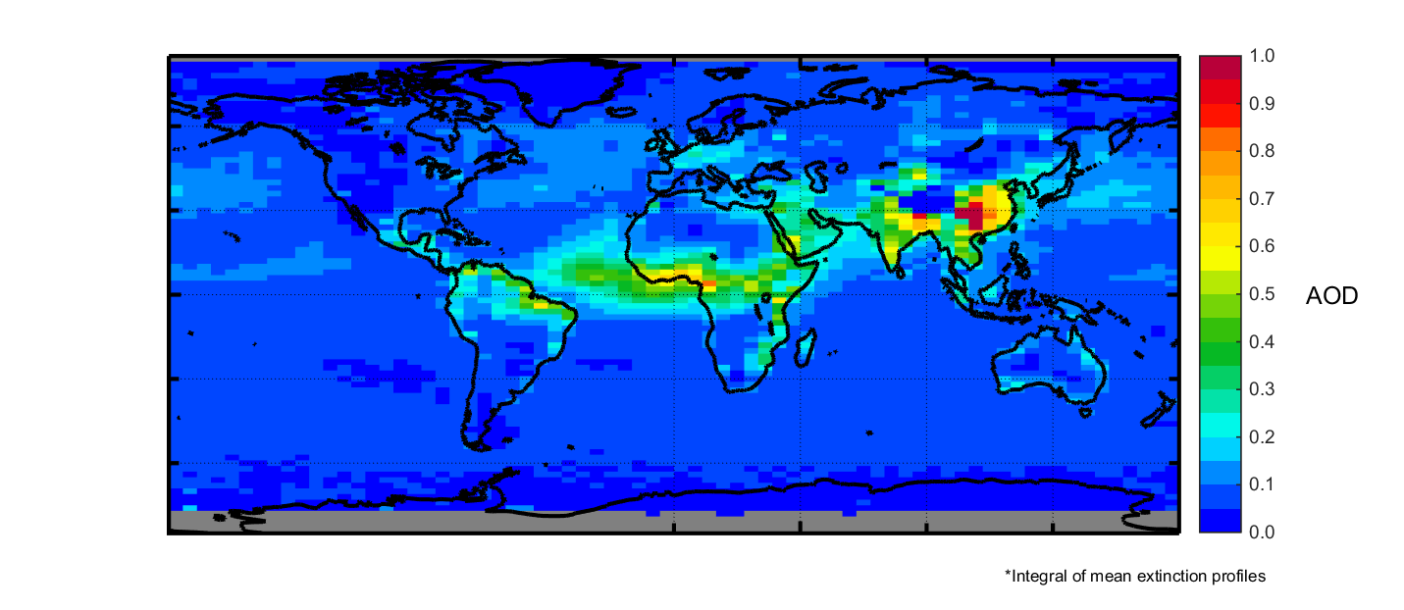
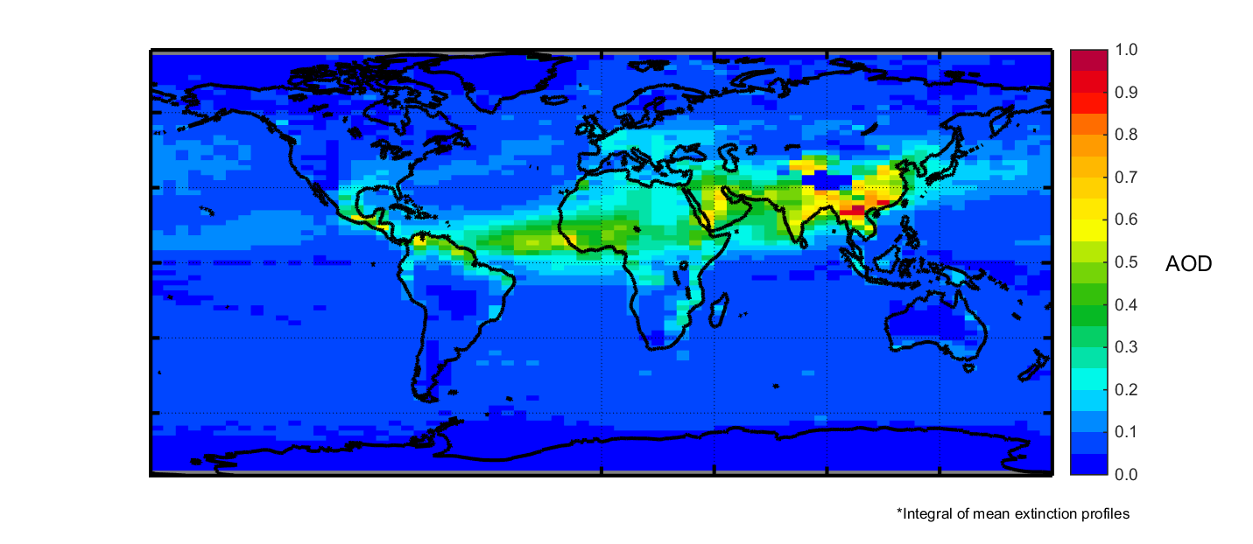
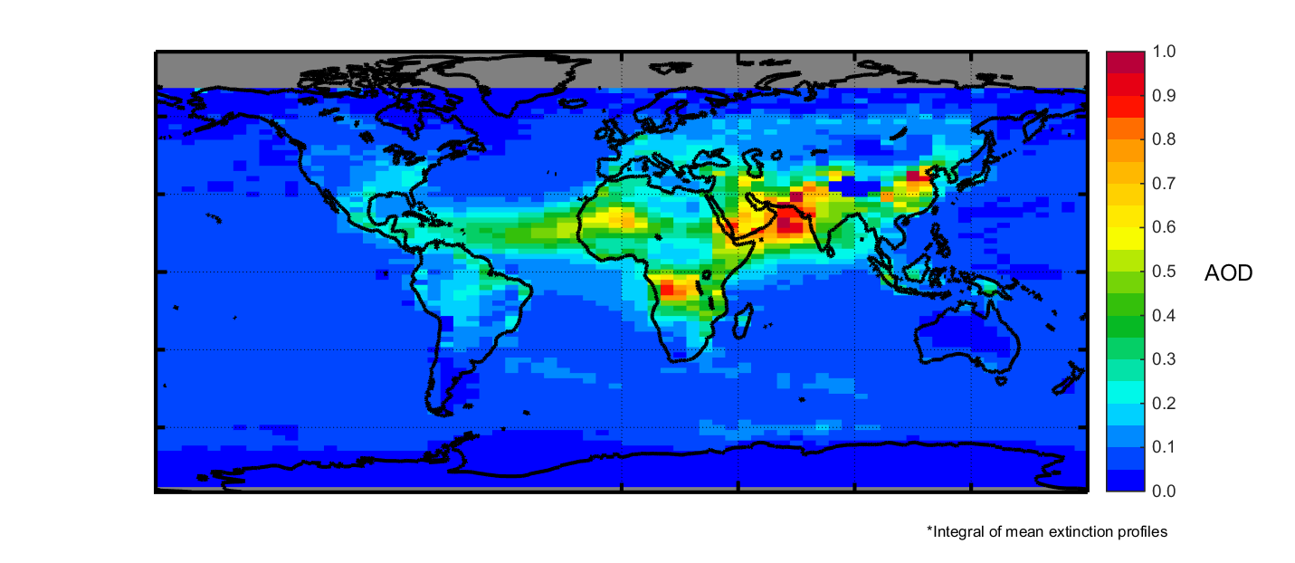
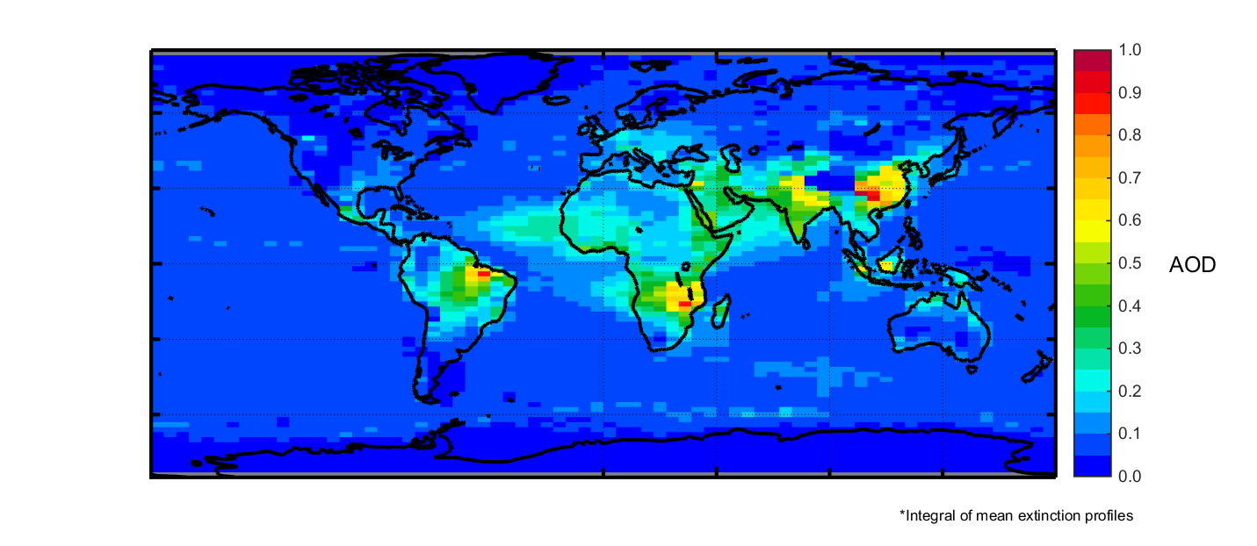

Aerosol Optical Depth < 12 km
DJF
MAM
JJA
SON
0
0.2
0.4
0.6
0.8
1.0
All-Sky, Night
2007-2016
AOD

Slide 9
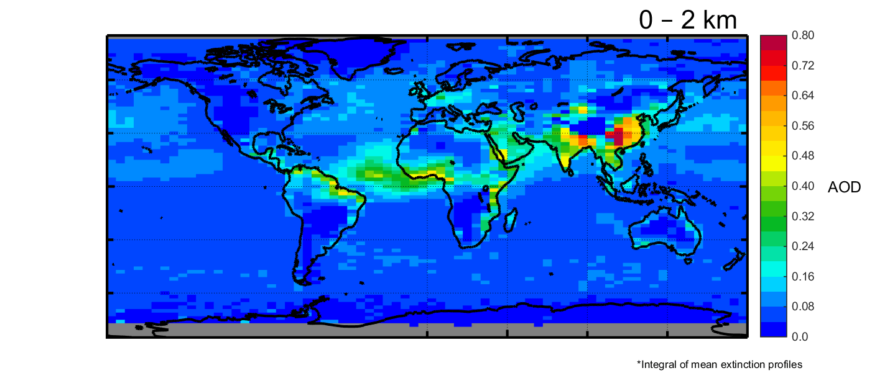
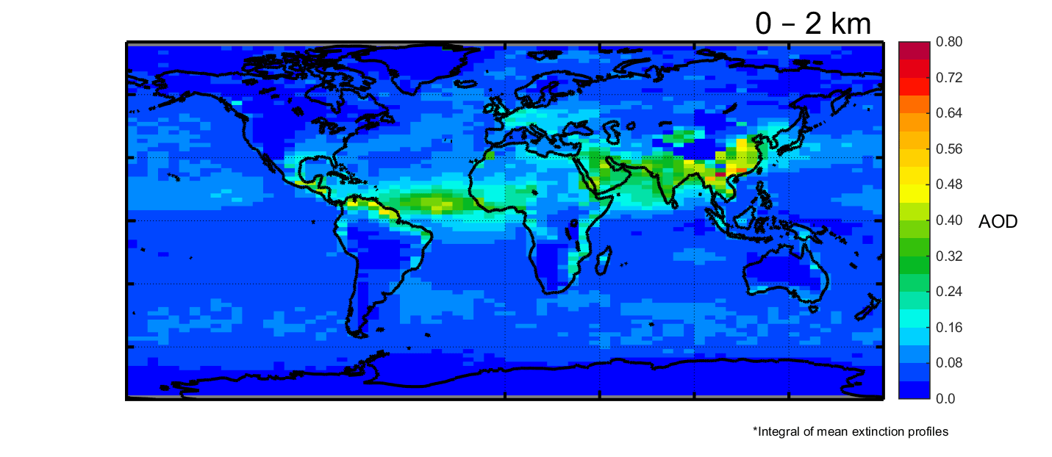
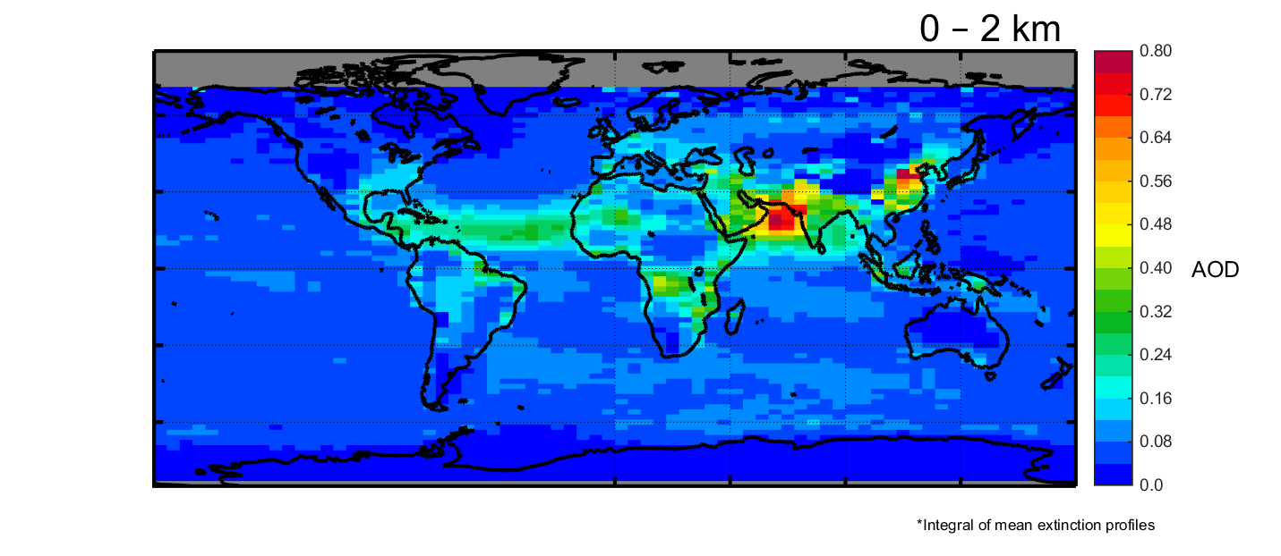
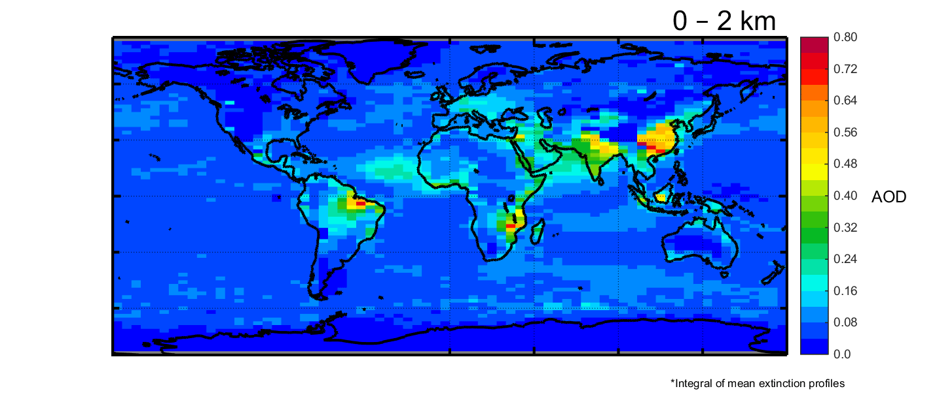
Aerosol Optical Depth by Altitude
DJF
MAM
JJA
SON
All-Sky, Night
2007-2016
0
0.2
0.4
0.6
0.8
All-Sky, Night
2007-2016
AOD

Slide 10
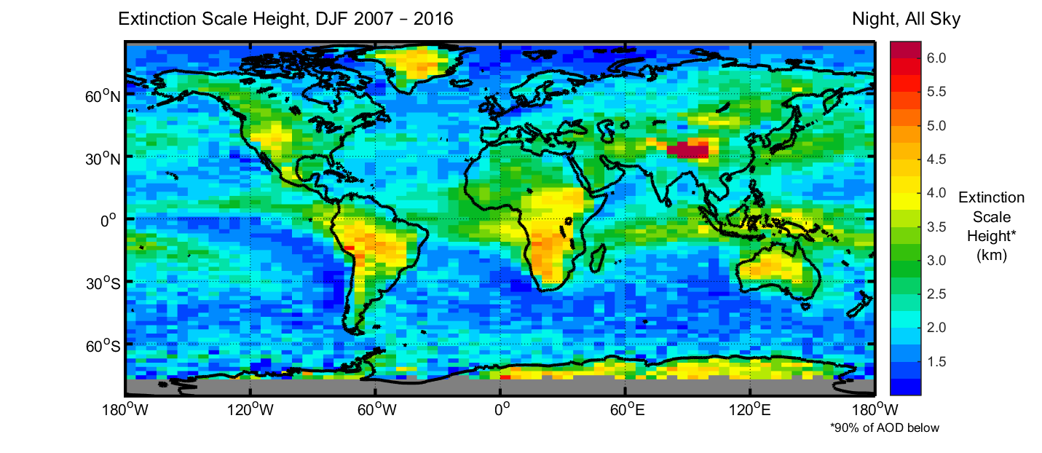
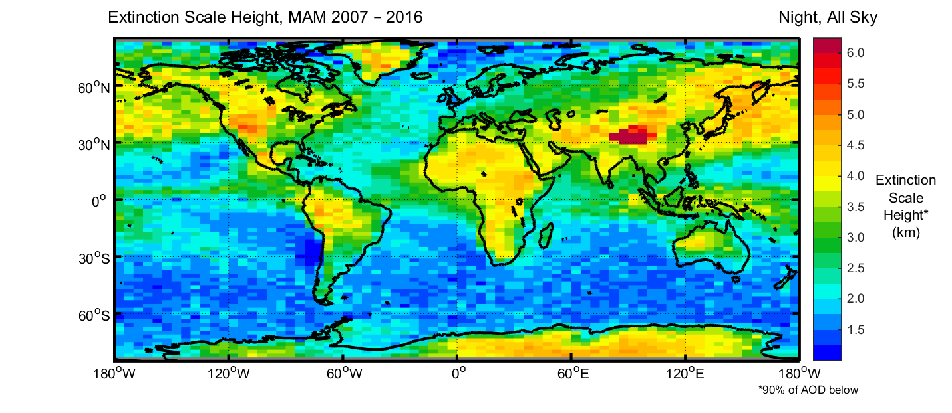
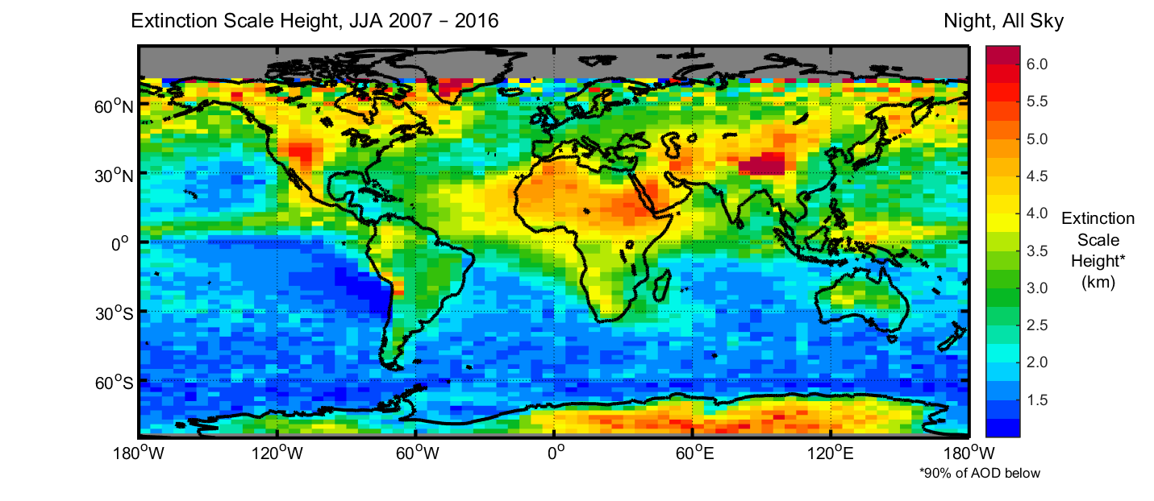
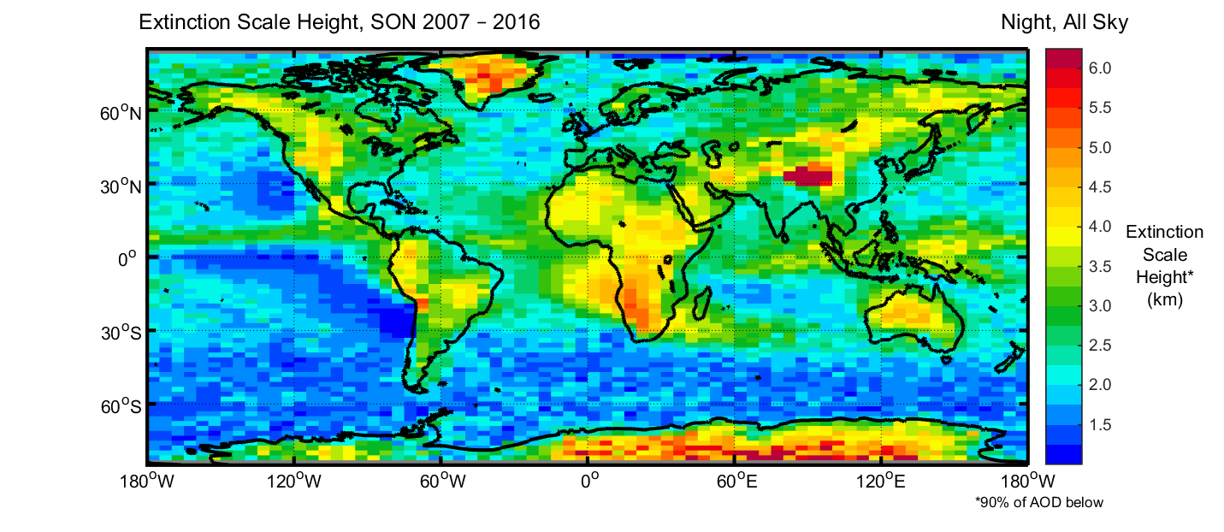

Extinction Scale Height:
Altitude Containing 90% of Total AOD Below
DJF
MAM
JJA
SON
1
2
3
4
5
6
All-Sky, Night
2007-2016
Altitude (km)

Slide 11
Zonal Mean Aerosol Extinction
JJA
Americas
Africa
Asia

Slide 12
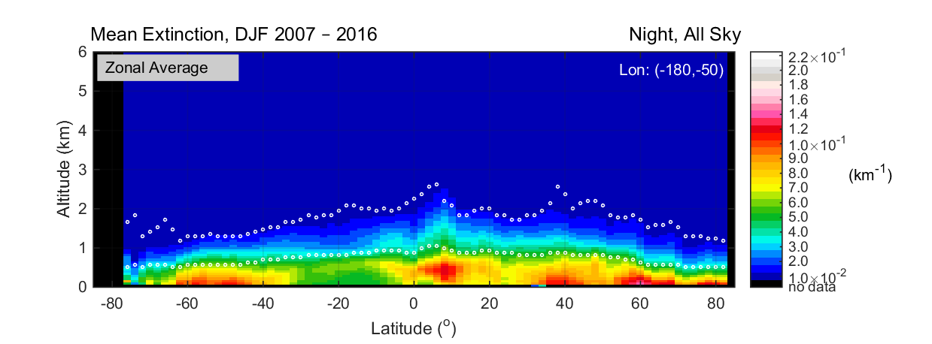
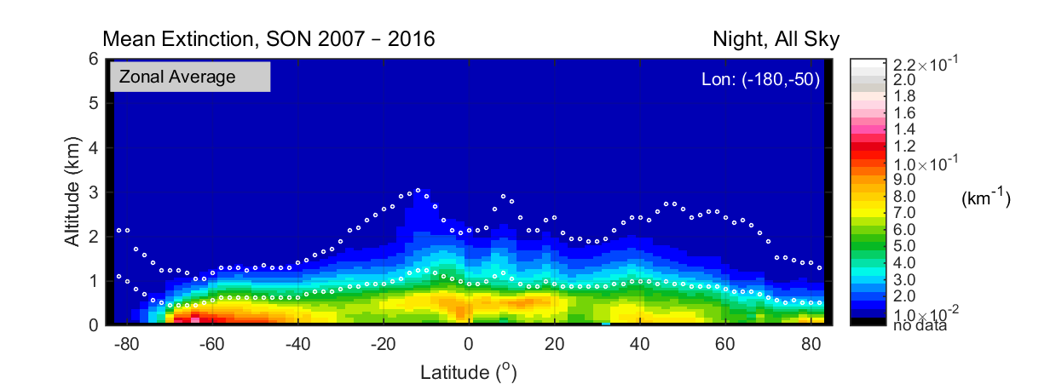
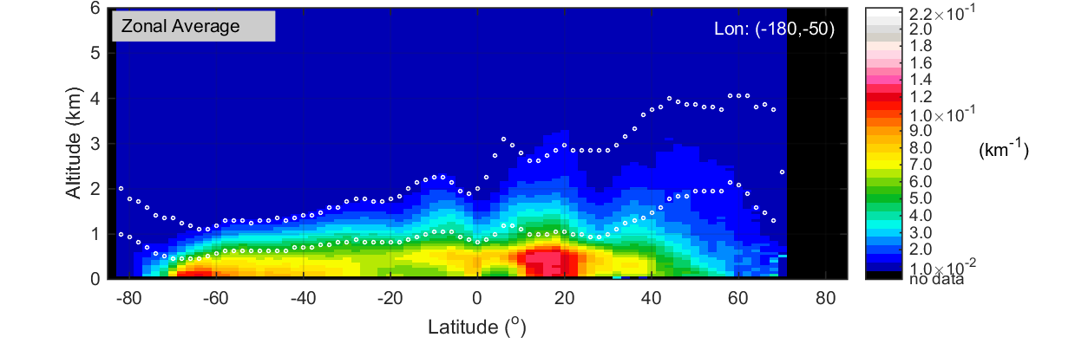
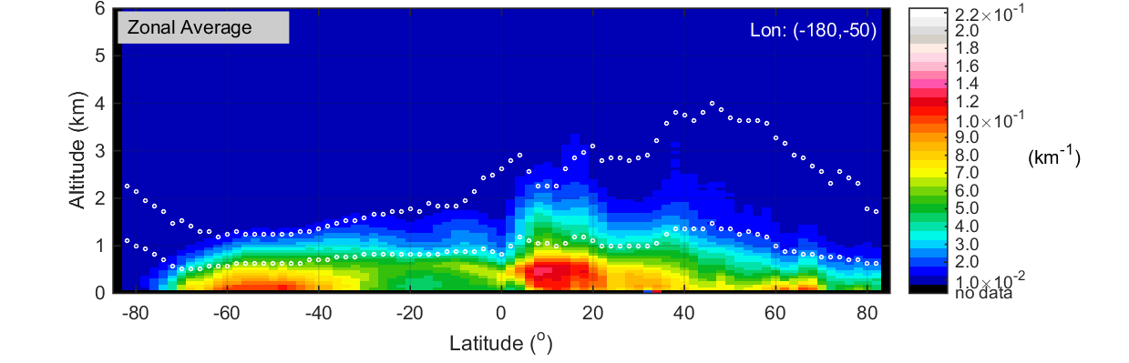
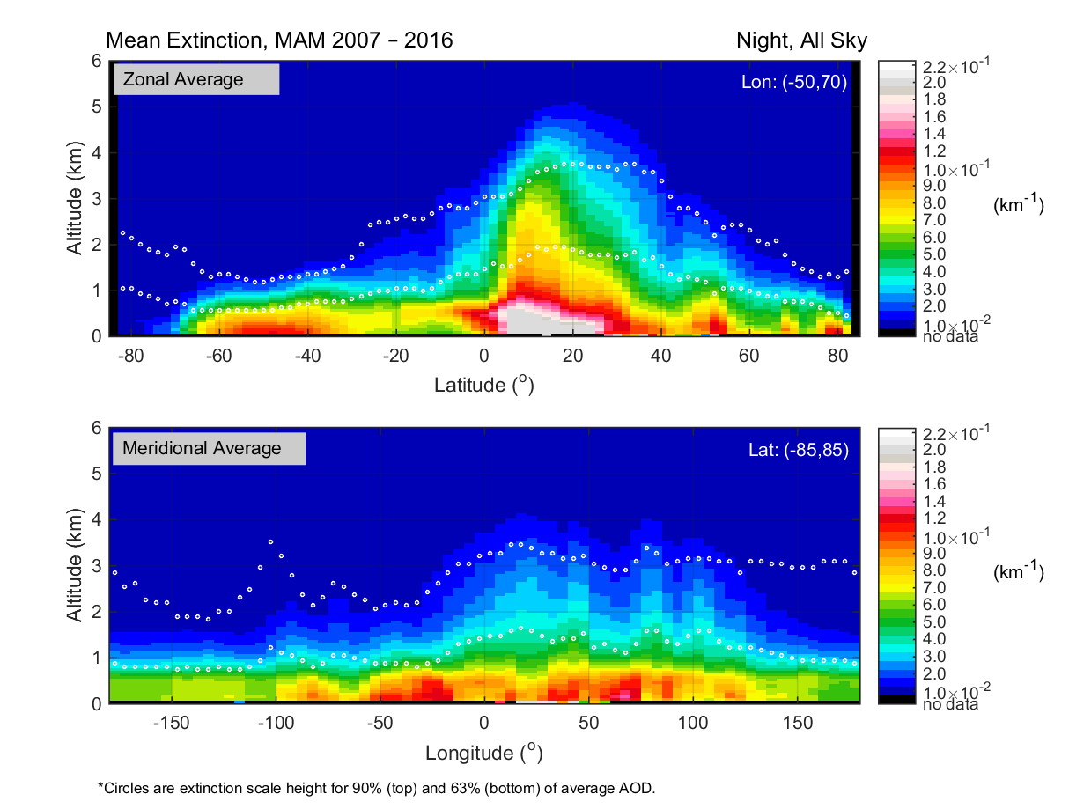
Zonal Mean Aerosol Extinction
Americas
DJF
MAM
JJA
SON
All-Sky, Night
2007-2016
0.01
0.05
0.1
0.2
Aerosol Extinction (km⁻¹)

Slide 13
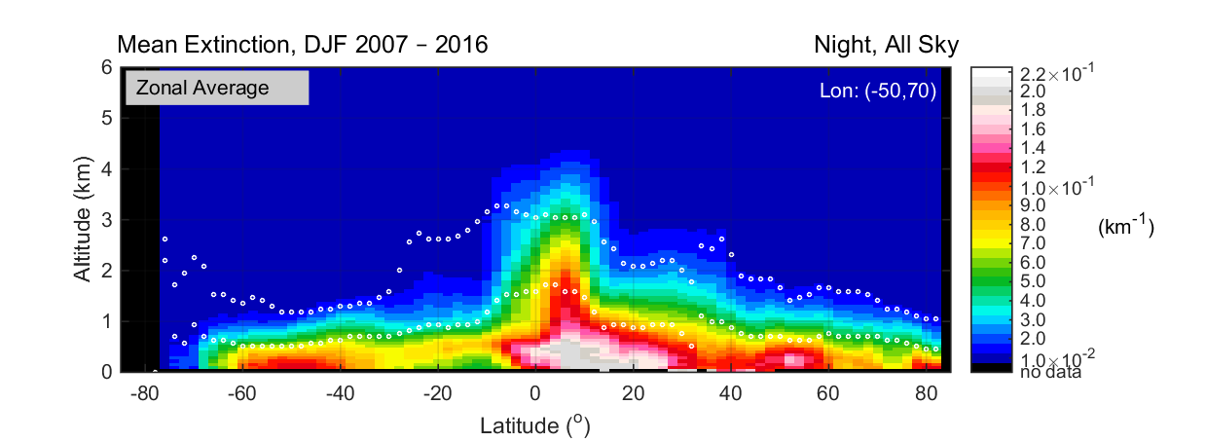
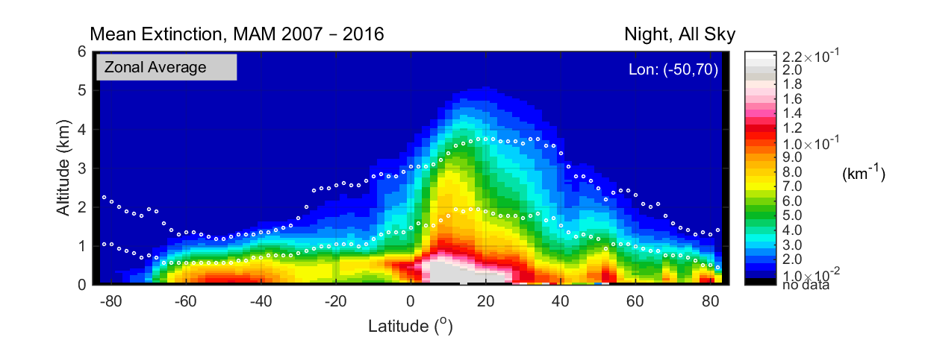
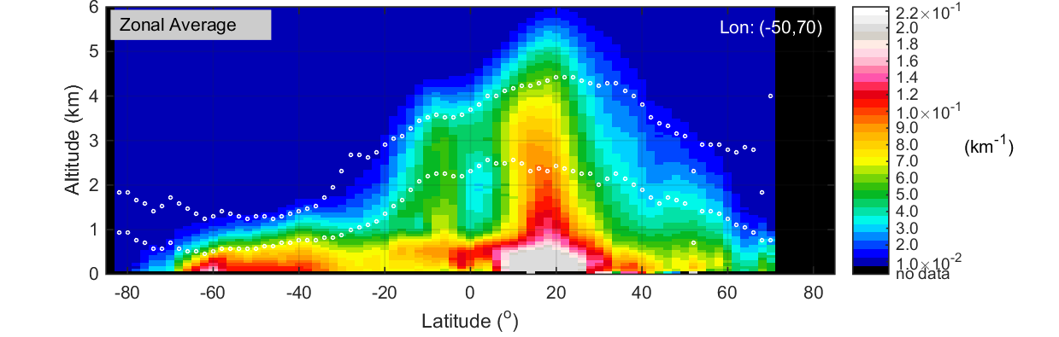
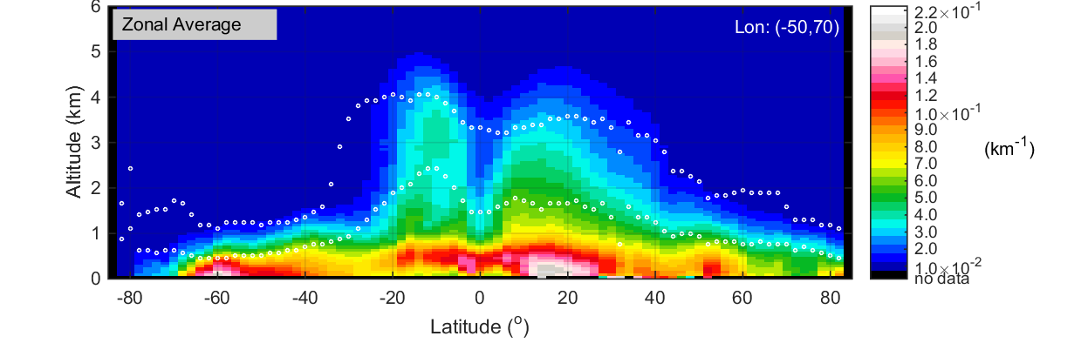
Zonal Mean Aerosol Extinction
Africa
DJF
MAM
JJA
SON
All-Sky, Night
2007-2016
0.01
0.05
0.1
0.2
Aerosol Extinction (km⁻¹)

Slide 14
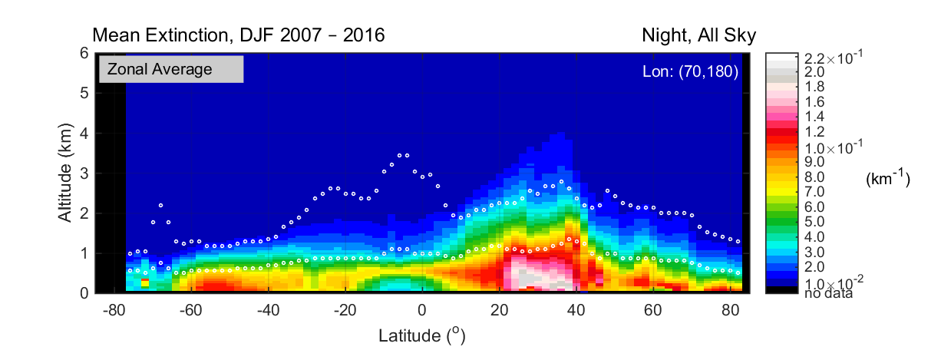
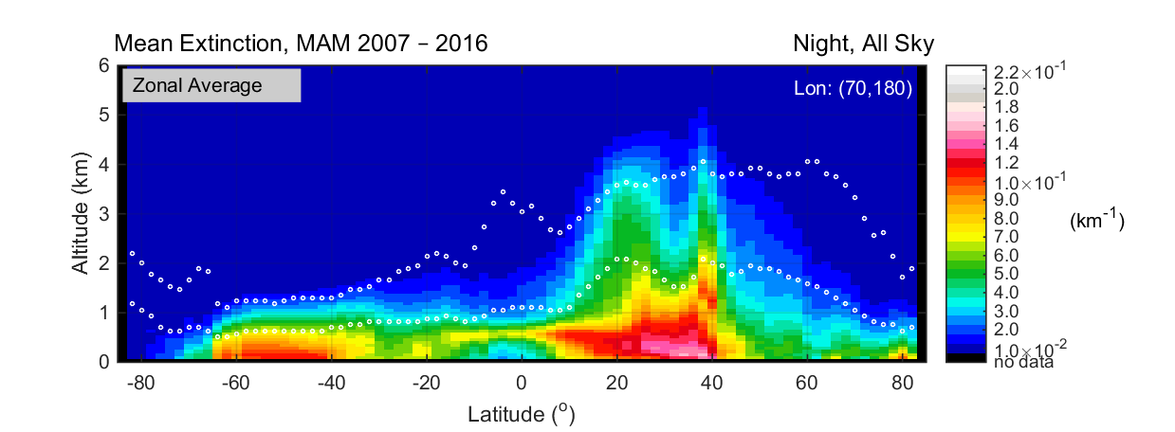
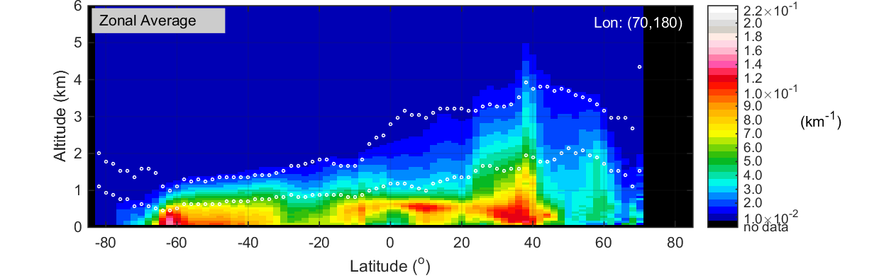
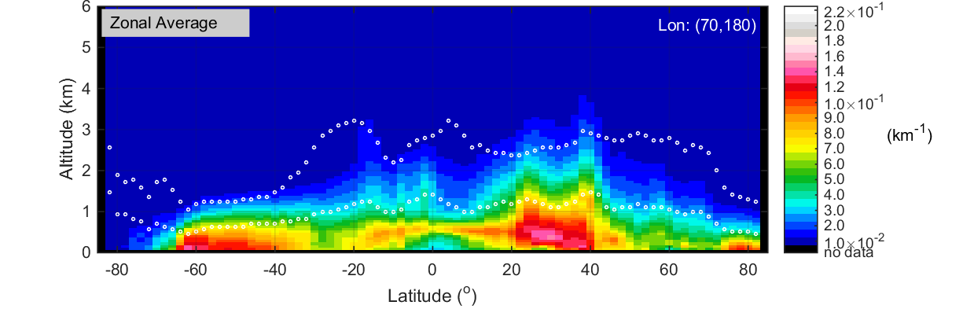
Zonal Mean Aerosol Extinction
Asia
DJF
MAM
JJA
SON
All-Sky, Night
2007-2016
0.01
0.05
0.1
0.2
Aerosol Extinction (km⁻¹)

Slide 15
Effect of Cloud Cover on Aerosol Detection Frequency

Slide 16
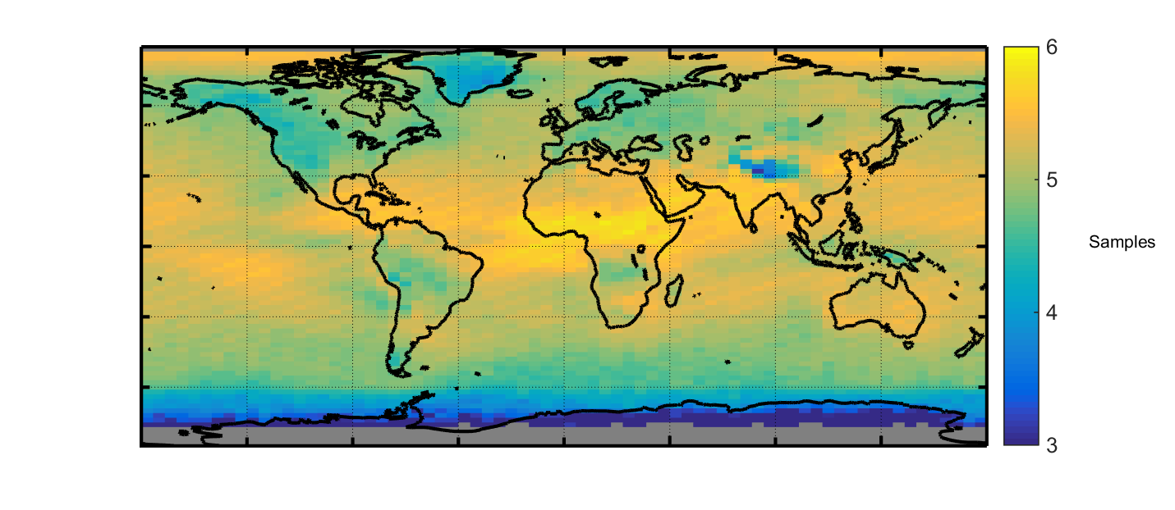
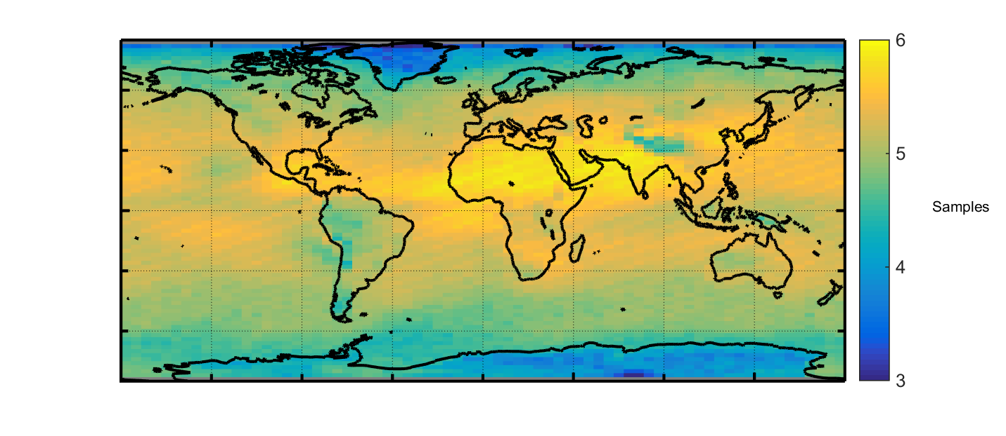
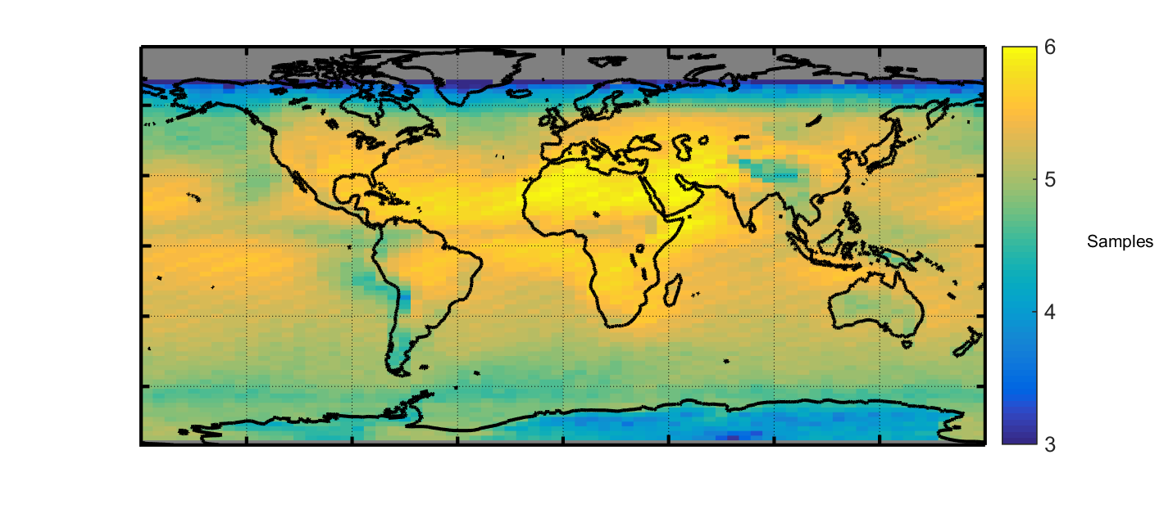
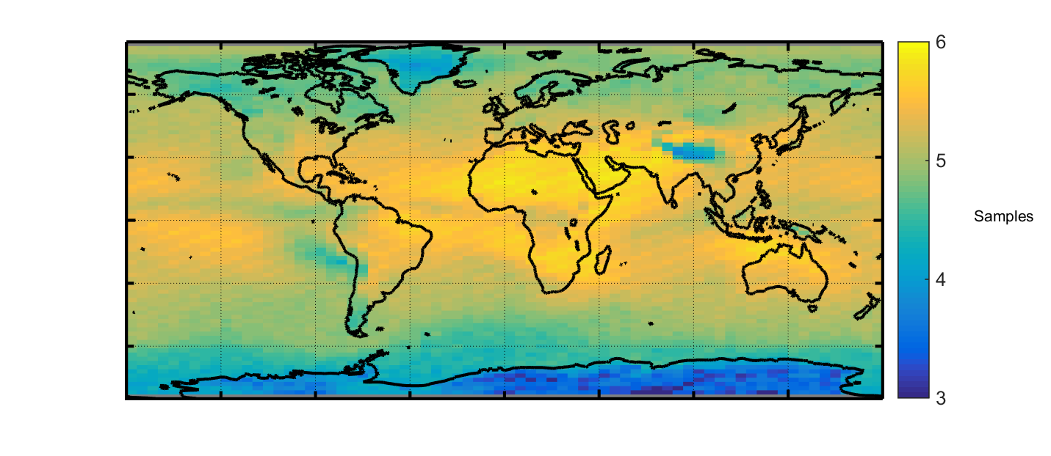
Number Aerosol Samples in All-Sky
DJF
MAM
JJA
SON
3
4
All-Sky, Night
2007-2016
5
6
Log (number)

Slide 17
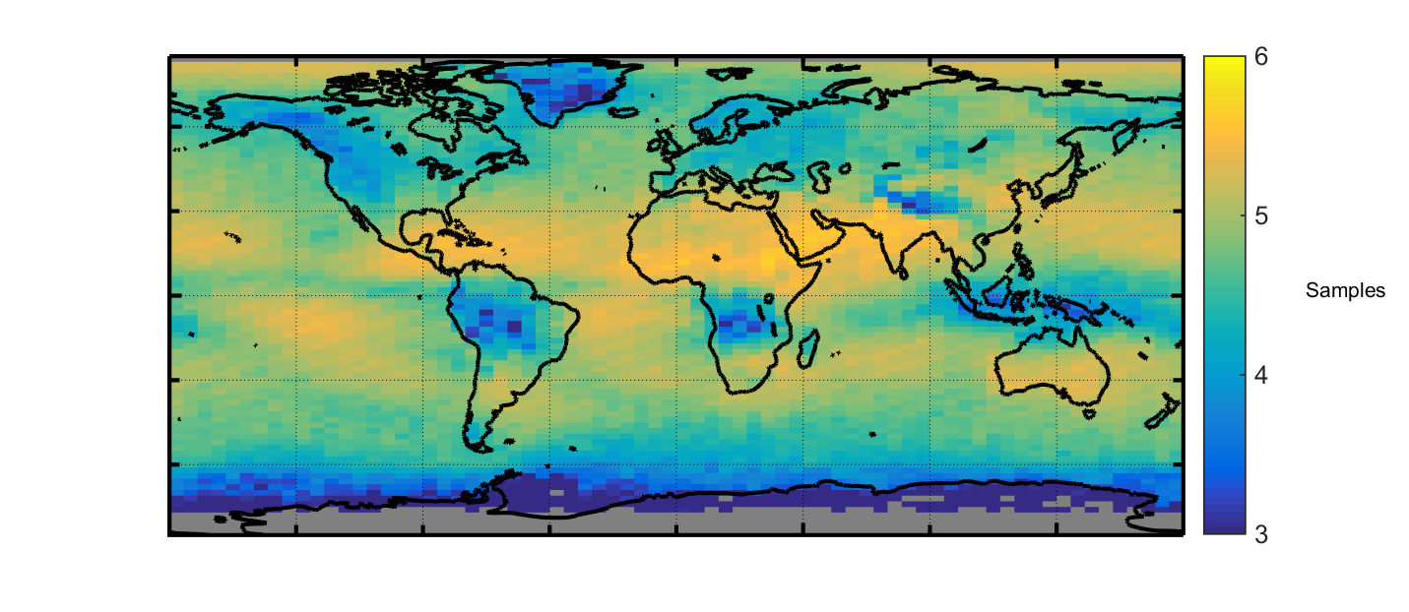
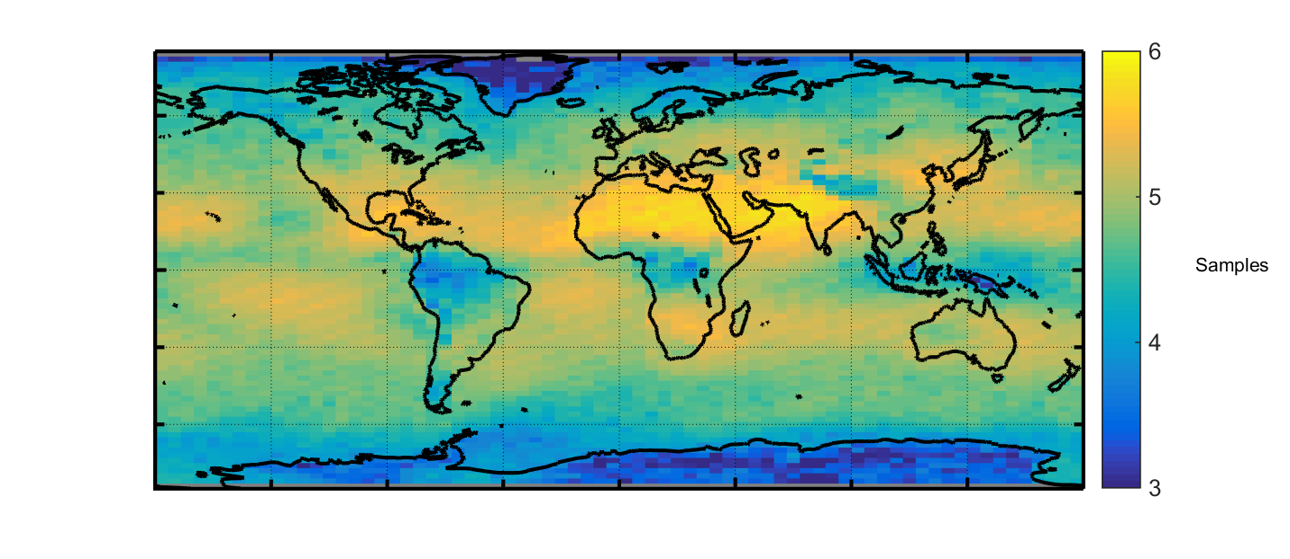
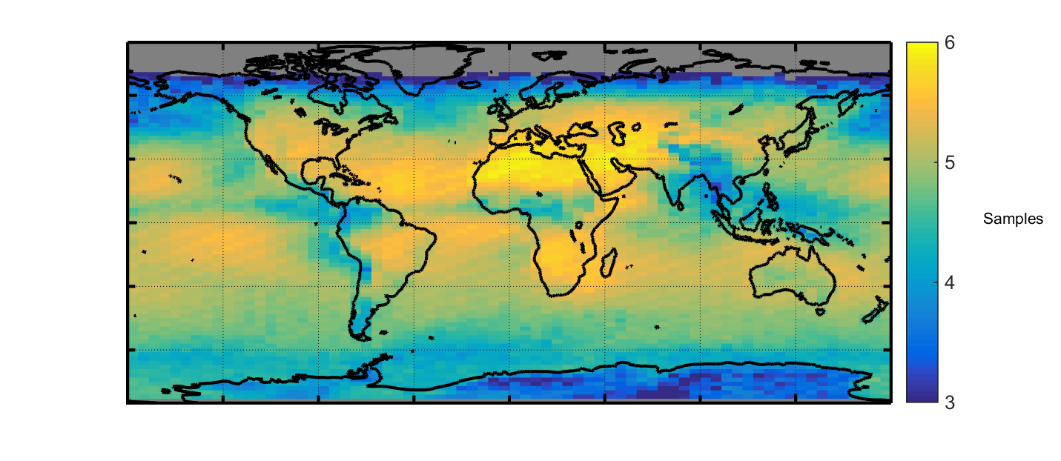
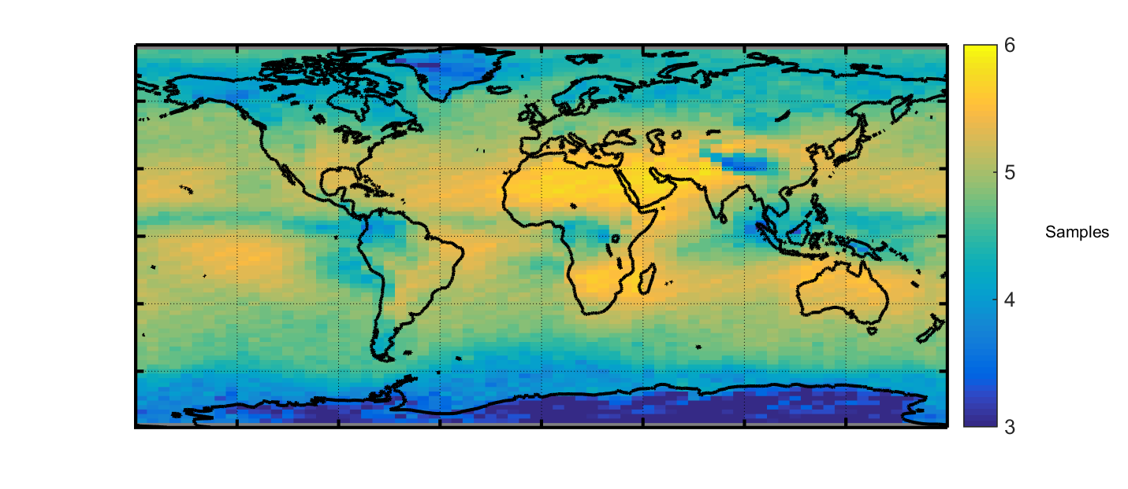
Number Aerosol Samples in Cloud-Free
DJF
MAM
JJA
SON
3
4
5
6
Cloud-Free, Night
2007-2016
Log (number)

Slide 18
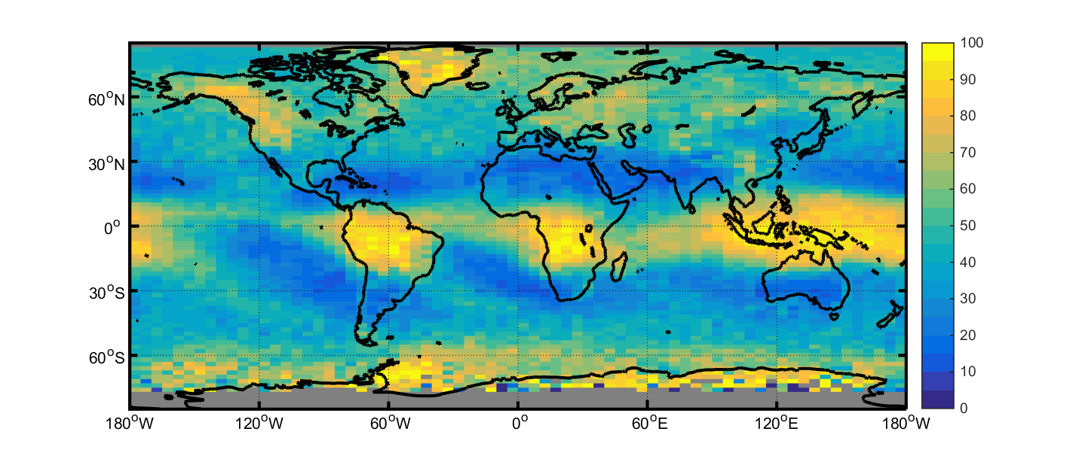
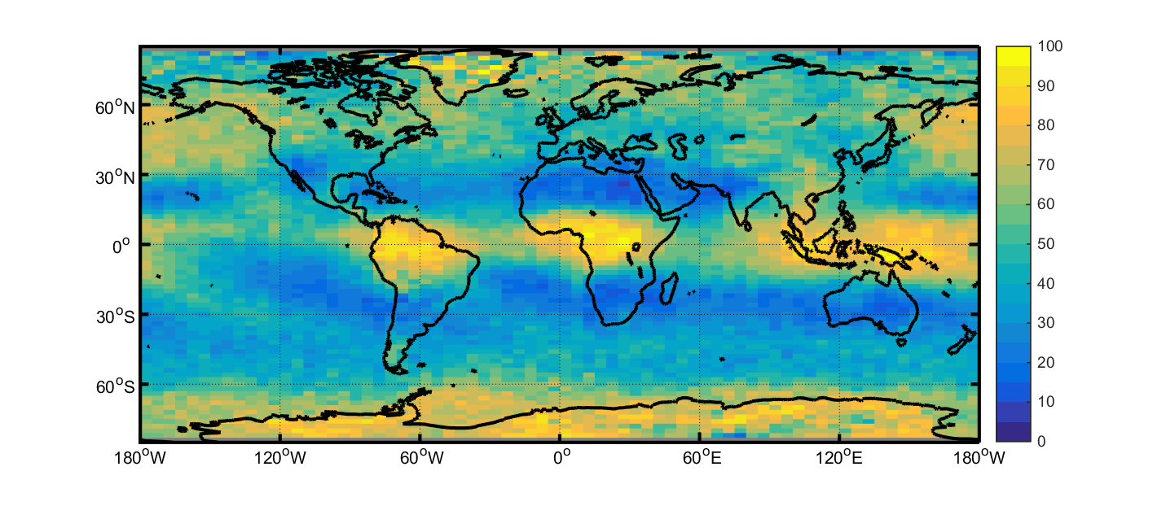
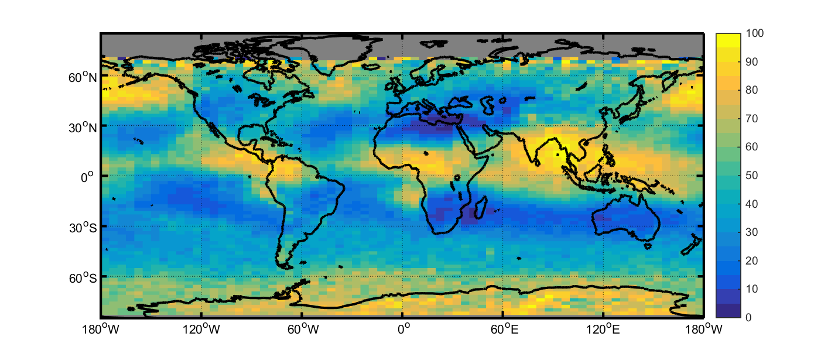

Frequency Aerosol Samples Beneath Clouds
DJF
MAM
JJA
SON
0
20
40
60
80
100
Night
2007-2016
Frequency (%)

Slide 19
Summary
CALIPSO provides a 10+ year record of vertically resolved aerosol observations
Level 3 aerosol product is a concise summary of aerosol presence and extinction

Slide 20
Backup Slides

Slide 21




CALIPSO Level 3 Aerosol Sky Conditions
Cloud
Aerosol
Opaque

Slide 22




Aerosol Detection Frequency
DJF
MAM
JJA
SON
0
20
40
All-Sky, Night
2007-2016
60
80
Frequency (%)

Slide 23




Aerosol Detection Frequency
DJF
MAM
JJA
SON
0
20
40
All-Sky, Night
2007-2016
60
80
Frequency (%)

Slide 24




Aerosol Detection Frequency
DJF
MAM
JJA
SON
0
20
40
All-Sky, Night
2007-2016
60
80
Frequency (%)

Slide 25




Aerosol Optical Depth by Altitude
DJF
MAM
JJA
SON
All-Sky, Night
2007-2016
0
0.1
0.2
0.3
0.4
0.5
All-Sky, Night
2007-2016
AOD

