Slide 1

Spaceflight 1.94 µm Thulium Fiber Laser Development
Fibertek, Inc.
13605 Dulles Technology Drive
Herndon, VA 20171
703-471-7671
www.fibertek.com
March 22, 2017

Slide 2
Outline
1.94 um Fiber Laser Program Overview
  Phase 1 Results
  Path to Space Qualification
  Summary
HEUVD Update
1.94 um fiber laser team
  Doruk Engin
  Brian Mathason
  Mark Storm

Slide 3
Phase 1 SBIR Overview
Develop a prototype 100 W, 1940 nm, fiber laser
  Space qualifiable
  Long-duration unmanned aerial vehicle (UAV) missions
Demonstrate improved performance compared to COTS sources
  3x improvement in efficiency
  Polarization maintaining
Pump source enables Q-switched 2 µm Ho:YLF laser
  80 mJ/pulse at 100-200 Hz for IPDA CO2 and water vapor lidar
Design consistent with compact packaging and high efficiency
  TRL-6 environmental testing in Phase 2
Notes:
1)Significant amount electronics and mechanical development done spend for making the laser reliable

Slide 4
Laser Architecture: Oscillator/Amp
Redundant Pump diodes
793 nm
Redundant Pump Diodes.
793 nm
PM-SM
PM-SM
Redundant Pump Diodes.
793 nm
Laser Oscillator
Power Amplifier
All fiber oscillator/amplifier architecture
High reliability
  Redundant and de-rated pumps.
  De-rated laser operation power vs. breadboard laser power.
Single mode PM fiber
Narrow linewidth
Compact package
Notes:
1)Significant amount electronics and mechanical development done spend for making the laser reliable

Slide 5
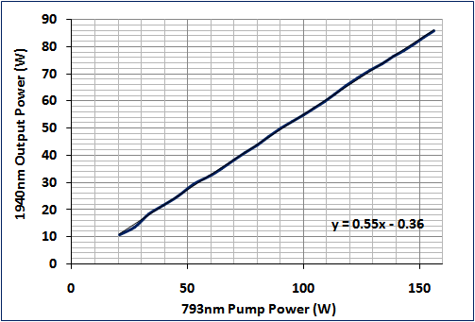
Phase 1 Performance Summary
86 W @ 1.94 µm
Diffraction limited
55% optical to optical efficiency
Output power limited by available pump power
Polarization extinction ratio of 16dB
High reliability
  Significant power margin available relative to 60 W performance requirement
O-O efficiency 55% @86W

Slide 6
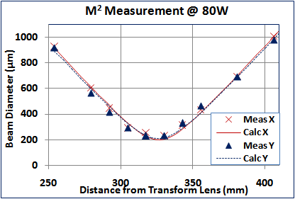
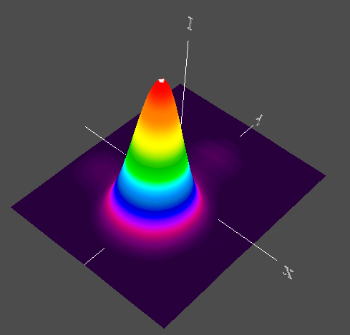
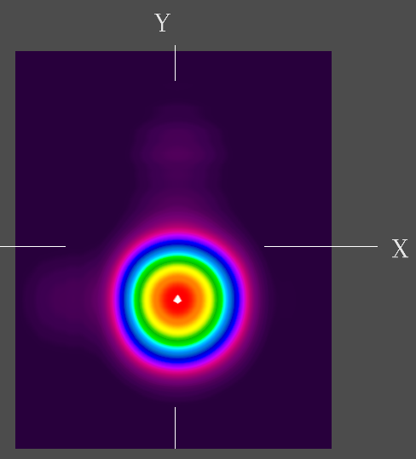
Amplified Beam Quality: Near Diffraction Limited
Far Field images @ 80W
M_{X}²=1.10
M_{y}²=1.12
3D
2D
Diffraction limited beam quality
  Significantly exceeds Ho:YLF pump requirements

Slide 7
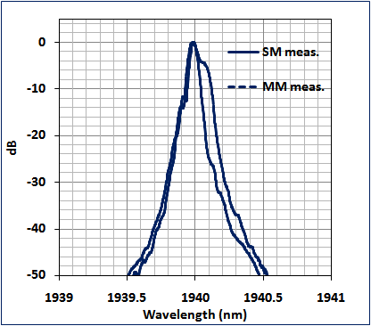
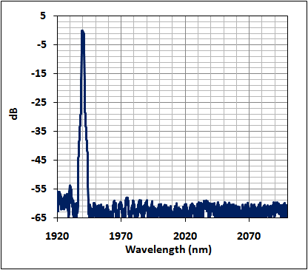
Narrow Laser Oscillator Linewidth
Narrow bandwidth
  99% of energy in ~ 0.25 nm

Slide 8
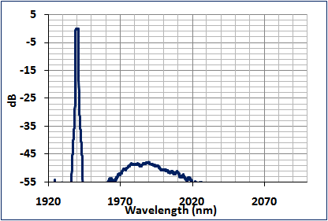
Amplification preserves narrow linewidth
50W
47dB
Narrow linewidth required to maximize the Ho:YLF laser efficiency.
  Absorption line a few nm wide.
Experiments show no amplification distortions
  Full power ~ 0.25 nm
ASE > 30 dB smaller than laser power.

Slide 9
Program Development Path
Phase 2 SBIR
Post Phase 2
Develop requirements
Engineer spaceflight Tm laser package
Thermal cycle testing
  Verify performance over temperature & thermal model
Vibration Testing
  Verify structural analysis
Develop laser electronics
  Commercial/aerospace grade with upgrade path to radiation hardness
Radiation testing
  Build breadboard Tm fiber laser
  Co60 radiation test

Slide 10
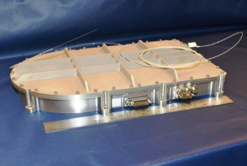
Packaging Will Leverage Prior TRL 6 Fiber Laser
Based previously developed TRL 6 EDFA package (25W at 1.57um)
Thermal Analysis and Structure show good performance and meets margin of safety.
High Reliability, redundant pump diodes.
Radiation testing will confirm acceptable performance for 3 Year ISS mission
Tm fiber laser fits in TRL6 EDFA package (shown right)
Estimated SWaP
  14″ x 8.5″ x 2.1″.
  < 8.5 lbs
  Power consumption will depend on Ho laser output power requirement
  Electrical to optical efficiency ~ 20%
TRL6 6 Erbium Doped Fiber Amplifier Package (25W at 1.57um)

Slide 11
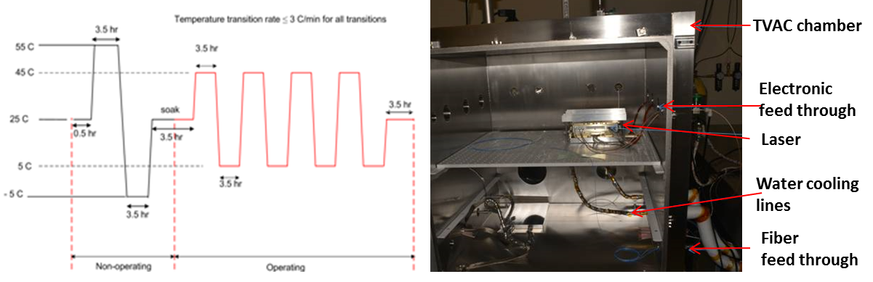
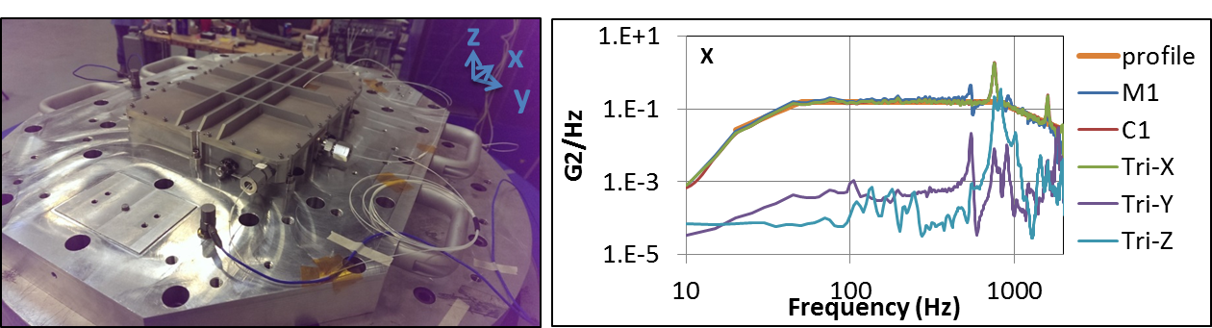
TRL 6 Thermal Vacuum and Vibration Testing of 20 W EDFA Laser
Set ups for GEVS level thermal/vacuum and vibration testing of the 20 W EDFA laser

Slide 12
Summary
Fibertek has demonstrated a brassboard n 86 W (scalable to >100 W) Tm laser
  Design readily converts to space-qualifiable version
  Suitable for pumping a Ho:YLF laser for wind lidar, CO² DIAL, or water vapor DIAL systems
  Brassboard performance meets notional Ho:YLF pump laser requirements
Future Phase 2 effort will leverage an existing TRL 6, GEVS Tested, EDFA Package.
  Thermal and structural analysis shows good performance and meets margins of safety
  Incorporates high-reliability, redundant pump diodes.
Future radiation testing will confirm acceptable performance for 3 Year ISS mission
  55% optical to optical efficiency
  Estimated 20% electical to optical efficiency
  3X better than COTS Tm lasers
  Tm Laser will leverage Fibertek 25W EDFA TRL6 package
    14 x 8.5” x 2.1”
    < 8.5 lbs.

Slide 13
High Energy UV Demonstrator
Program Update

Slide 14
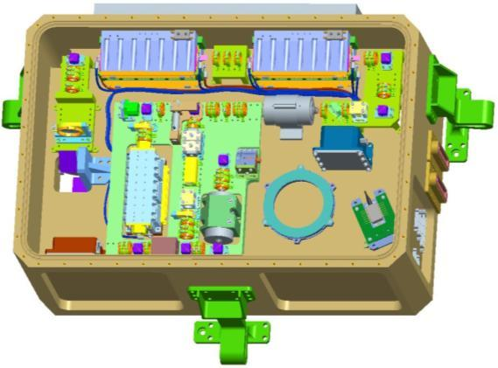
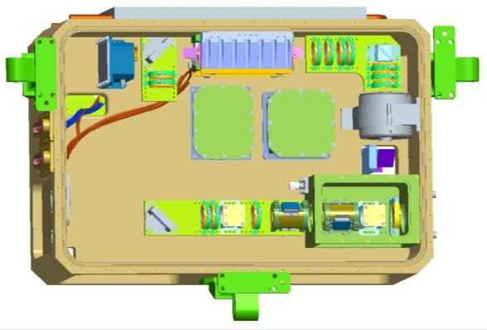
Design Overview
Sealed, dual compartment design
  Reduced sensitivity to contamination
  Vacuum alignment stability
All UV components in a hermetic, polymer free environment
  Improved lifetime
Internal telescope in UV box
  Reduces fluence on down stream optics
Pure conductive cooling to a single external thermal interface
  Simplifies thermal design
  Required for a space-based system
  Amplifiers mounted on laser module wall
Flexure mounted for high launch vibration levels
Improved final power amp design
  Reduced beam distortion
Amp 2
Amp 1
Ring oscillator
Amp 3
UV module

Slide 15
Program Objectives & Approach
Build a lifetime demonstrator to advance the TRL of UV lasers
  Full conductive cooling
  Increased UV lifetime by lower outgassing contamination
  532 nm and 355 nm lifetime testing
  Vibe and TVAC testing
Program objectives
  Conduct a 50 x10⁹ shot high-fluence UV life test using a 20 kHz drive laser
  Configure the HEUVD system hardware for 150 Hz, 250 mJ @ 1064 nm operation
  Conduct a 1.2 x10⁹ shot high-fluence Green life test
  Conduct a 1.5 x10⁹ shot low-fluence UV life test
  Conduct a 1.5 x10⁹ shot high-fluence UV life test
  Conduct thermal-vacuum & vibration testing of the laser optical module

Slide 16
UV Life Test Preparation
Conducted a 20 kHz, 50 billion shot, high-fluence UV life test
  All components interior to the sealed conversion module, including the third harmonic crystal, survived the test in excellent condition
Configured the HEUVD system for 150 Hz, 250 mJ @ 1064 nm operation
  The system was successfully reconfigured for 150 Hz and met program objective performance
    1 µm performance demonstrated at 275 mJ/pulse (>40 W) with 15 ns pulses and an M² of 1.9
  The power amplifier is not optimally suited for efficient extraction at 150 Hz
    Originally designed for 750 mJ output at 50 Hz
    More appropriate approach to 150 Hz power amplifier be a design based on non-Brewster slab architecture developed & demonstrated under a previous NASA program
  The scope of the hardware PRF conversion process to 150 Hz was greater than anticipated and resulted in a 5 month growth to the program
20 kHz UV test validated importance contamination control procedures
Conversion of 1064 nm pump to 150 Hz met or exceeded all requirements

Slide 17
Green Life Test Summary
Conducted a 1.2 x10⁹ shot high-fluence green life test
  All components w/in the LOM survived test in excellent condition
  Total optical power roll-off of 9 %/Gshots was attributed to diode lifetime affecting all
  pump heads
    This fall-off is consistent with the diode life specifications that were established under the original program goals aimed at a 50 Hz/1 Gshot life test requirement
Reconfigured the HEUVD system hardware for enhanced diode lifetime
  Developed an approach for extending diode lifetime based on reliability guidance from Lasertel
  Successfully implemented the corrective action plan in all 4 pump heads with the anticipation of a 2-3x improvement in diode power stability
High power 532 nm only test validated use of 532 nm only HEUVD for Athena –OAWL
33

Slide 18
Low Power UV Life Test Summary
1.5 x10⁹ shot, low-fluence UV life test
  Optical components met initial design objectives
    No degradation of THG input & output facets or bulk crystal
    A small number of optical surfaces exhibited minor optical damage
    Two 1 µm air-spaced wave plates and 2 triple AR coated lenses exhibited internal surface damage
      Waveplate issue was resolved under the ICESat-2 program
      Triple AR coating remains an outstanding issue
  Total power had a 1 um optical power roll-off of 8%/Gshot
  Primarily due to continuing diode decay in all stages
    Additional derating for UV test did not achieve anticipated decrease is diode decay rate
  Damage on waveplate likely caused a small decrease on resonator power
    To be quantified during rebuild for high power UV lifetest
Low power UV lifetest further validated importance and effectiveness of contamination control processes
Downstream optics and proper diode derating for 15 Gshot missions need additional work

Slide 19
Plan for Moving Forward
  Implement a systematic approach to the high-power UV life test
  Resolve the resonator waveplate and output telescope lens damage
    Implement lessons learned on ICESat-2
  Initiate a separate task to close the diode decay issue
  Move forward into life test w/ existing pump diode configuration
  Convene a formal review of results at conclusion of life test
  Hold the decision on environmental testing until high-fluence UV lifetime performance is complete
  Reliable long-life UV generation at high conversion efficiencies is key to moving forward
  Designs for environmental robustness previously validated on CALIPSO, ICESt-2, and CATS

