Slide 1






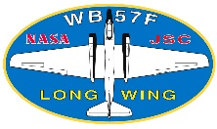

Results from the ATHENA-OAWL Venture Tech Flights
Sunil Baidar^{1,2}, S. Tucker³, M. Beaubien⁴, R. M. Hardesty^{1,2}
1. CIRES, University of Colorado Boulder, Boulder, CO
2. NOAA Earth System Research Laboratory, Boulder, CO
3. Ball Aerospace & Technologies Corp., Boulder, CO
4. Yankee Environmental Systems, Turner Falls, MA

Slide 2
Questions
How well does the GrOAWL instrument measures wind?
What is the accuracy?
What is the precision?
What was the instrument performance during the flights?
What can we say about the ATHENA-OAWL performance based on the aircraft measurements?

Slide 3
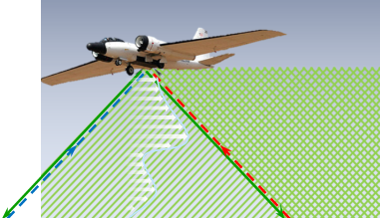
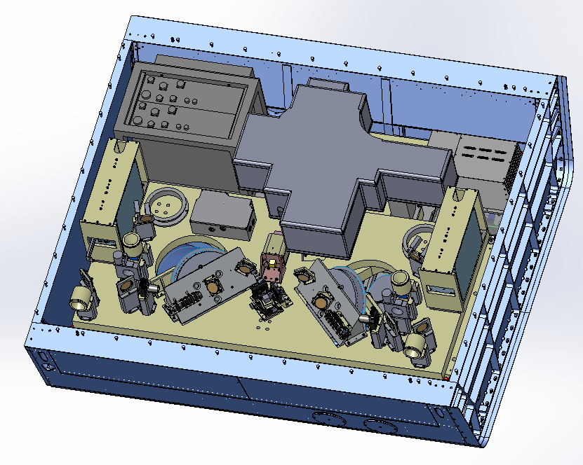
GrOAWL Instrument
Airborne demonstrator for ATHENA-OAWL
Aerosol based direct detection Doppler wind lidar
Operates at 532 nm
Uses a field-widened, quadrature channel, Mach Zehnder interferometer
Two azimuthally orthogonal Line of Sights
FWD look: 45° Elevation angle and 45° Azimuth angle
AFT look: 45° Elevation angle and 135° Azimuth angle
Remotely operated
Variable 532 nm output power
Laser-1
Laser Electronics
2-looks, 2 telescopes
GPS/ IMU
Fiber coupled OAWL Interferometer
Laser-2
Payload Controller

Slide 4
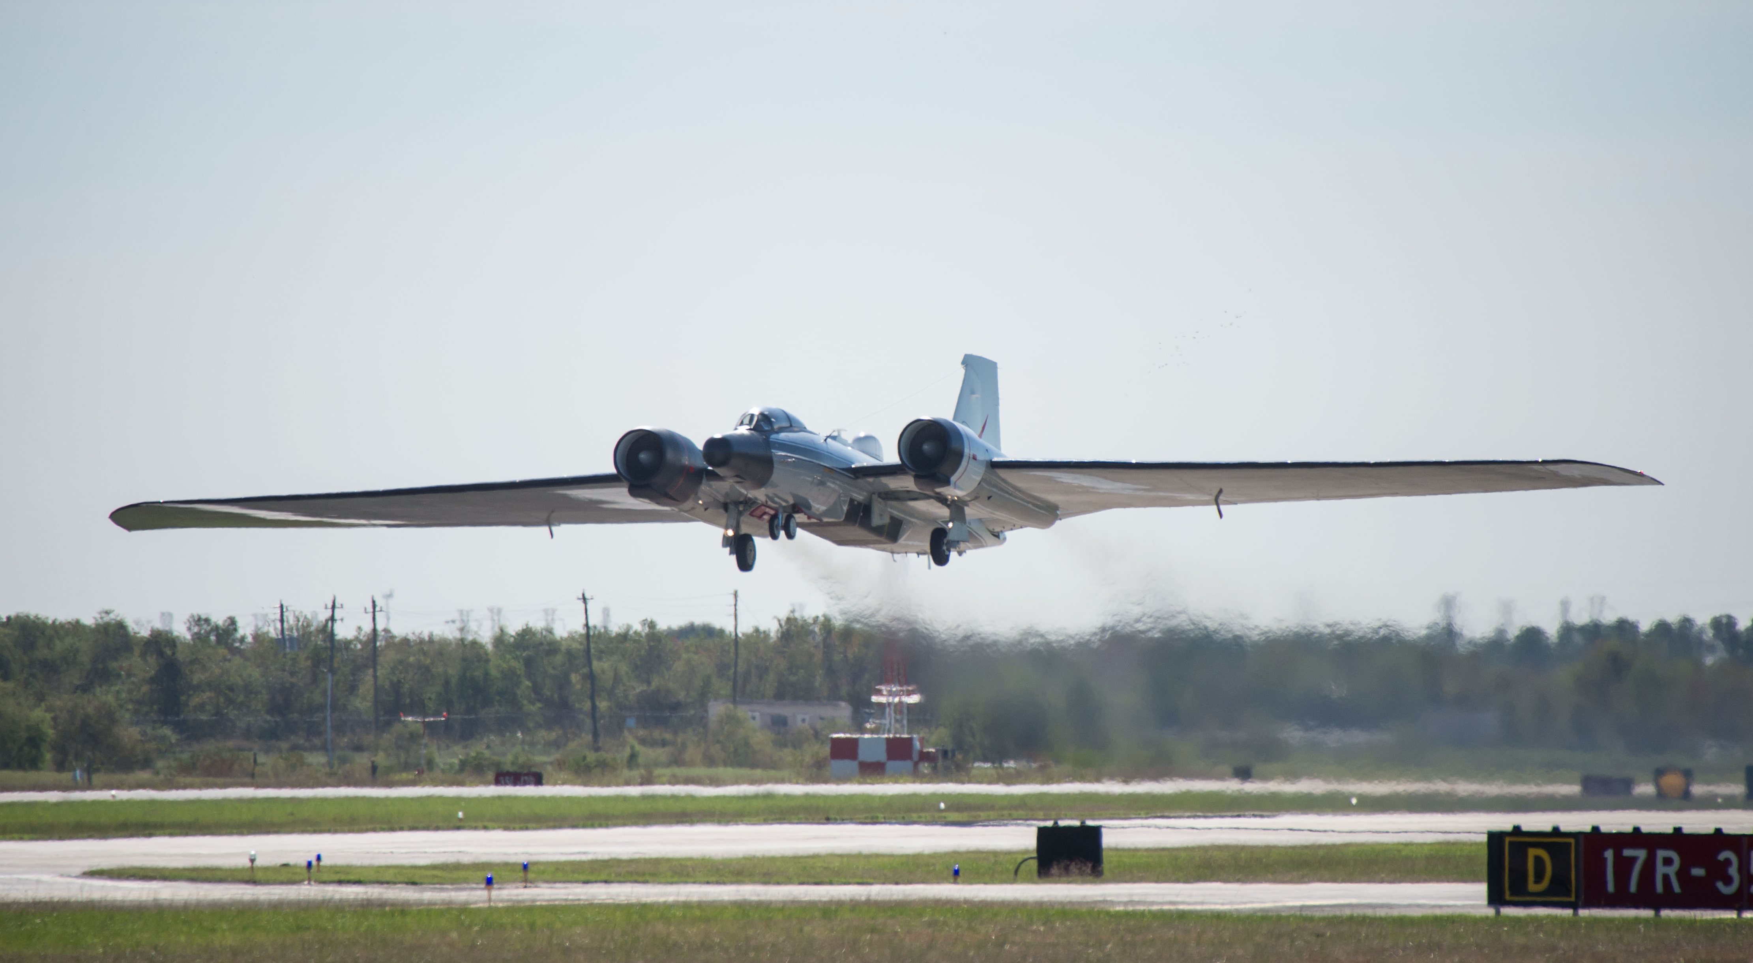
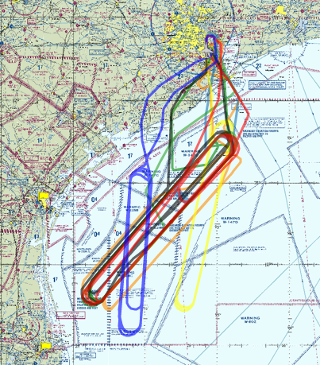
GrOAWL AOVT flights
Deployed on NASA WB-57
May-June 2016
8 flights
5 engineering
3 validation
Racetrack patterns over the Gulf of Mexico
Revisit times: ~1hr/loop
Launched dropsondes from the aircraft

Slide 5
Validation Efforts
Validation focused on sondes
High Definition Sounding System (HDSS) dropsondes
Yankee Environmental Systems with support from Office of Naval Research
Automated dropsonde system on WB-57
Dropped 40+ dropsondes
Balloon-sondes launched from NOAA NWS station at Corpus Christi
NOAA High Resolution Rapid Refresh (HRRR) model winds
3 km resolution, hourly updated
Radar data assimilated every 15 min over a 1-hour period
Comparison with 0 hour forecast/analysis winds

Slide 6
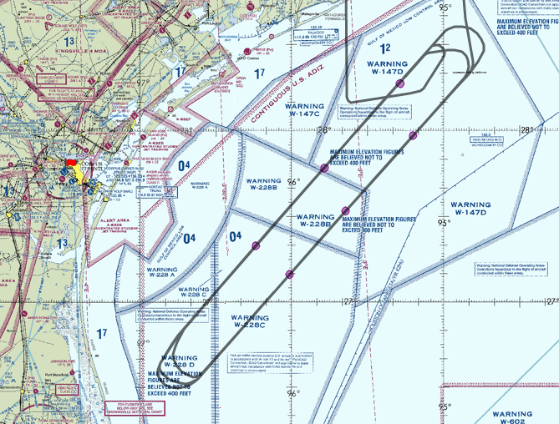
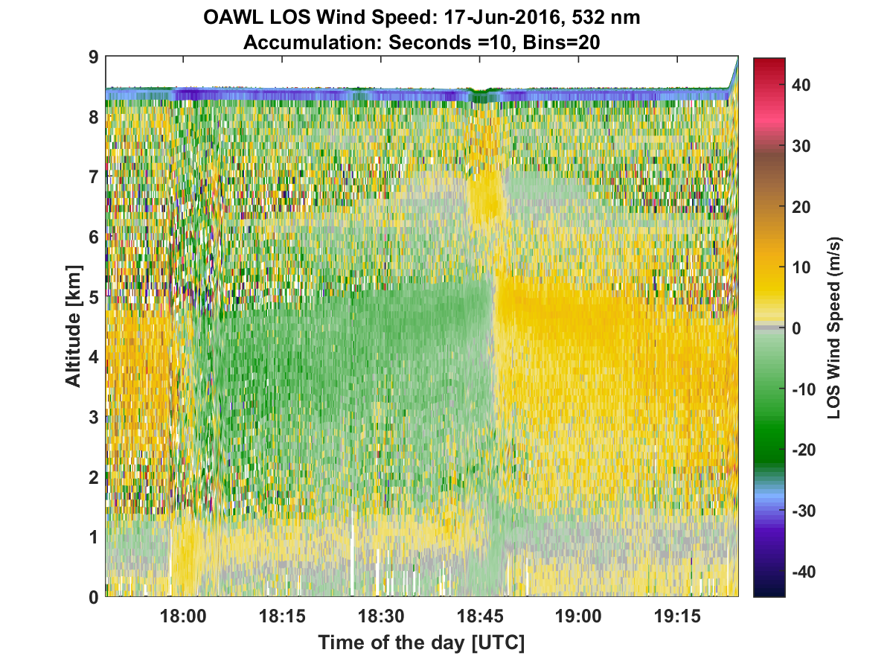
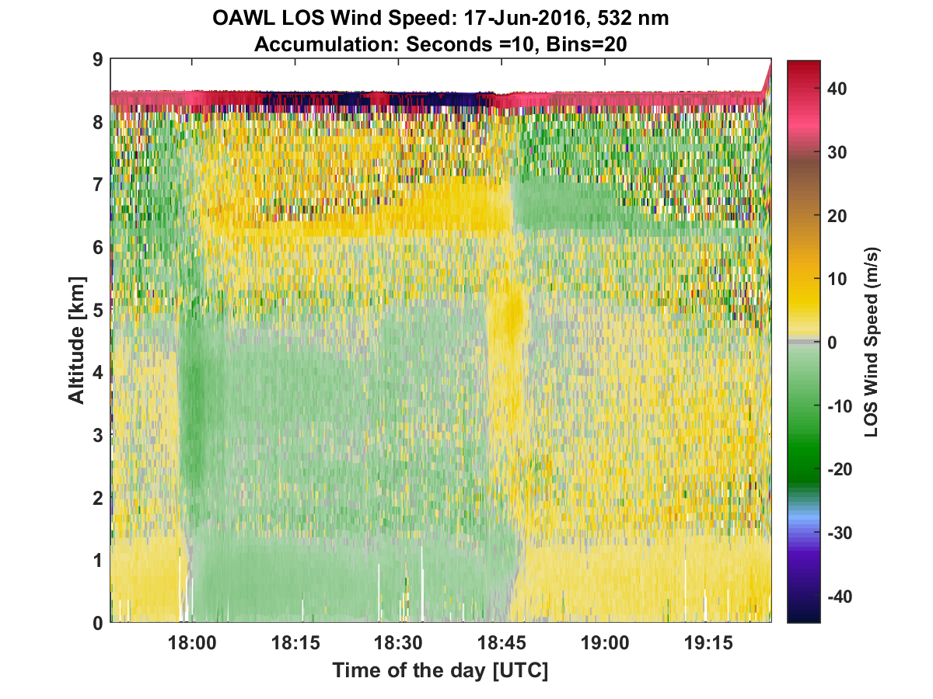
GrOAWL data
Time resolution: 10 seconds
Vertical resolution: ~120 m
Look 1 (FWD)
Look 2 (AFT)

Slide 7
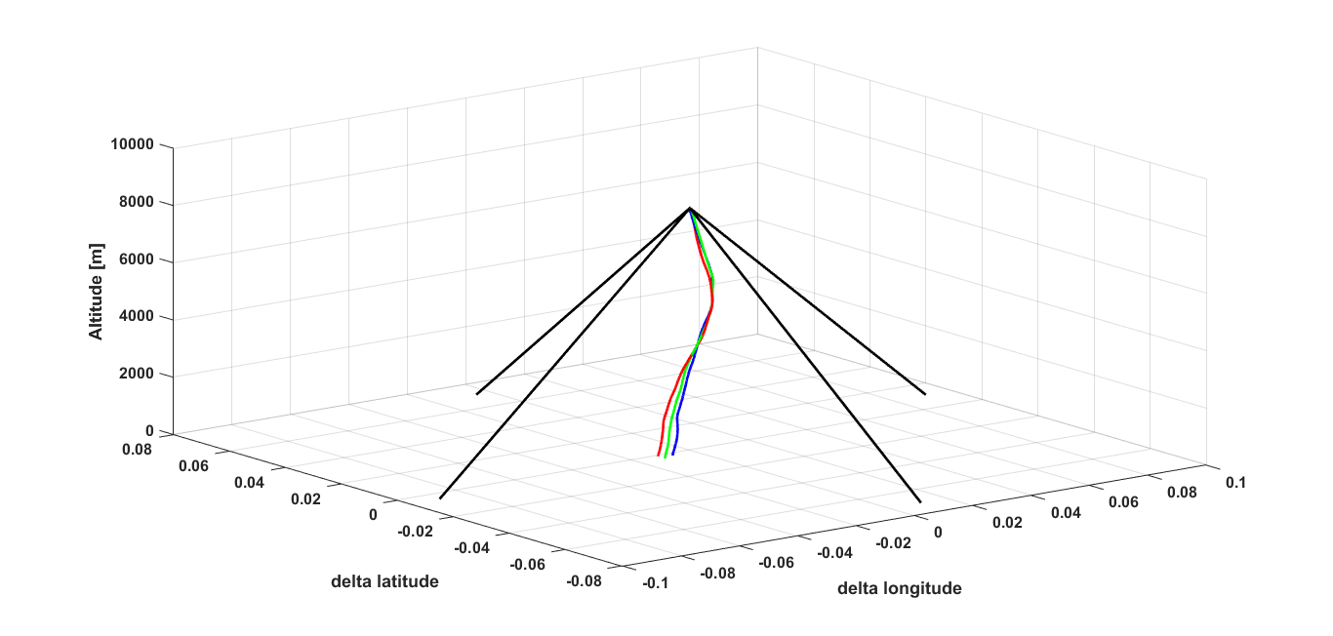
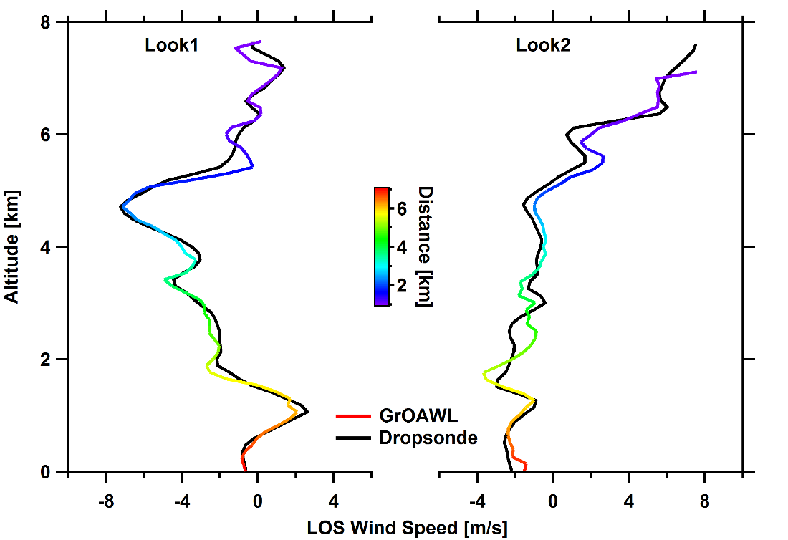
Dropsonde Comparison
No spatial overlap with dropsondes
Closest GrOAWL measurement in space to dropsondes
10 seconds profiles within 1 minute
Project dropsonde winds to GrOAWL LOS
Notes:
Change profile color coded by spatial difference.

Slide 8
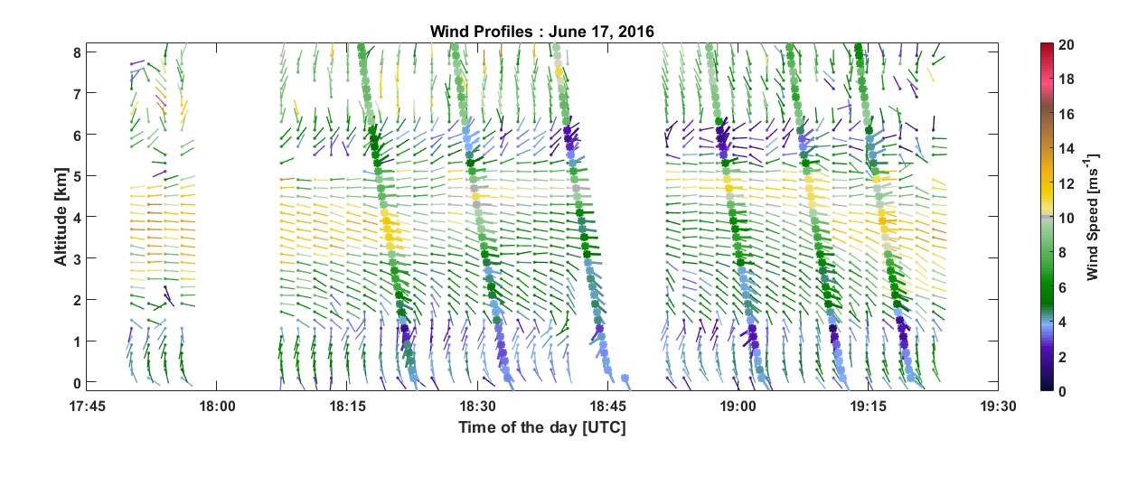
Wind Profiles: June 17 2016
8 km
16 km, ~2 mins
Combine two looks to retrieve wind speed and direction
Assume vertical velocity = 0.
Notes:
Add a slide with only the GrOAWL data. (like animation? 60

Slide 9
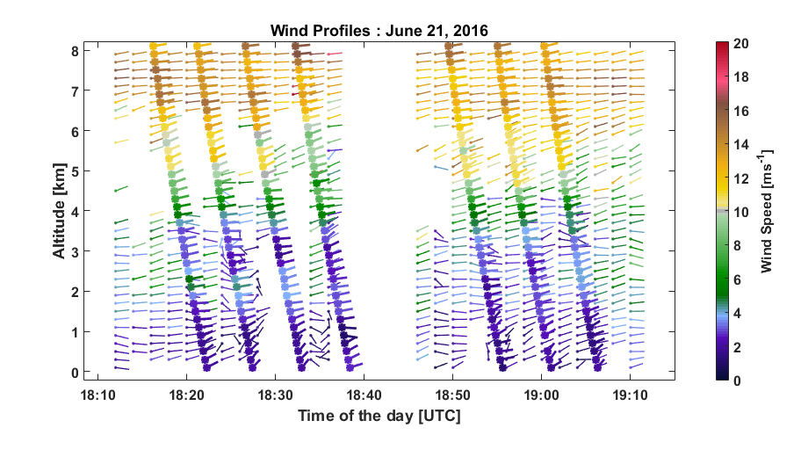
Wind Profiles: June 21 2016
8 km
16 km, ~2 mins
Combine two looks to retrieve wind speed and direction
Assume vertical velocity = 0.
Notes:
5

Slide 10
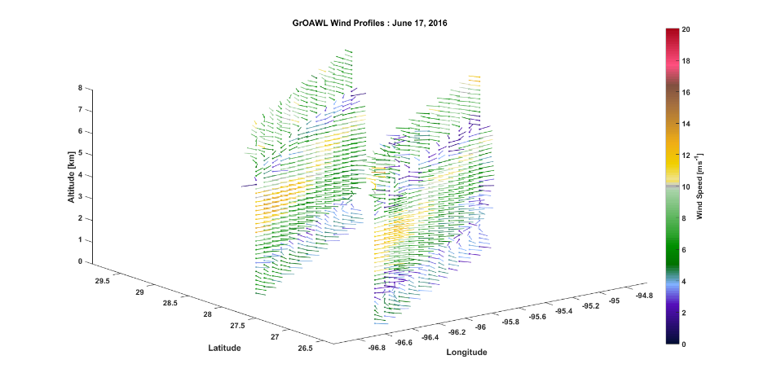
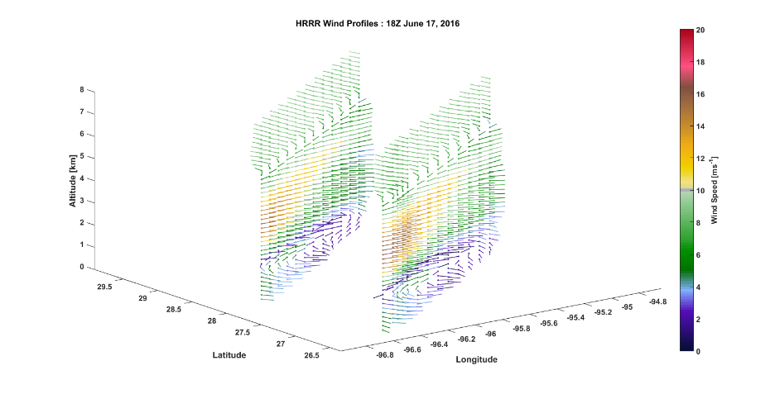
Spatial Variability
GrOAWL
HRRR
GrOAWL measurements captured the spatial variability predicted by HRRR.

Slide 11
What is the accuracy of the GrOAWL wind measurements?

Slide 12
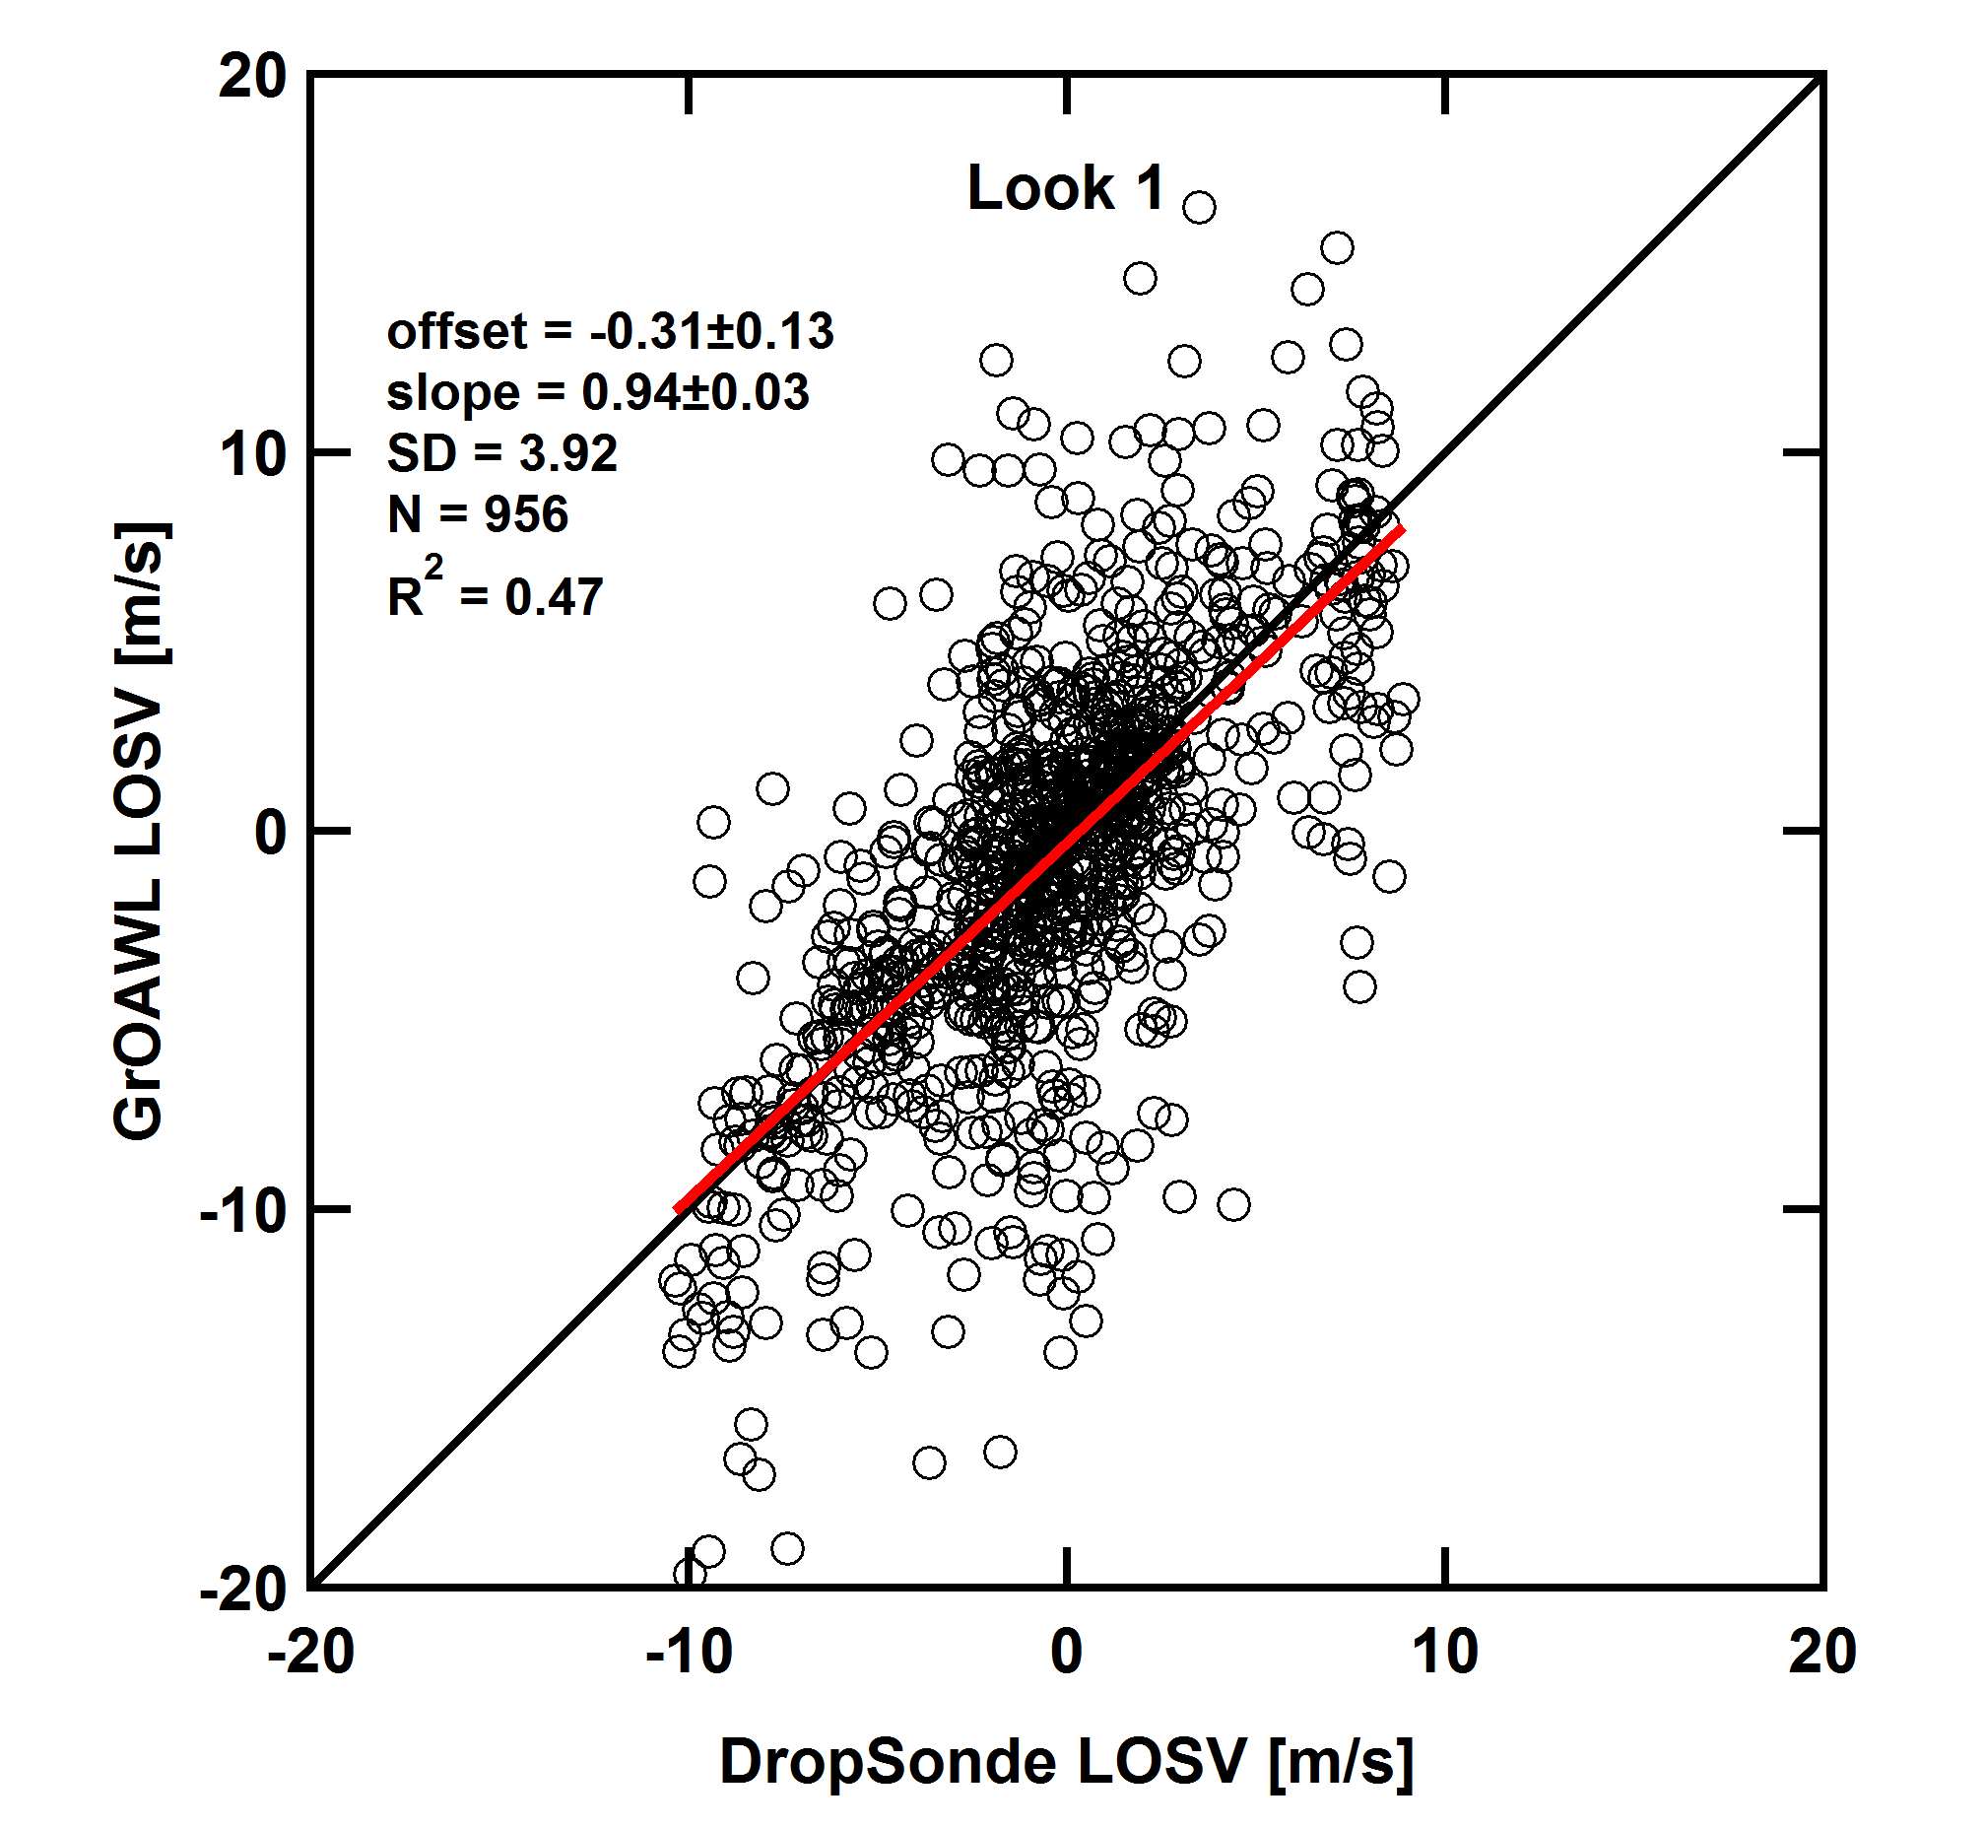
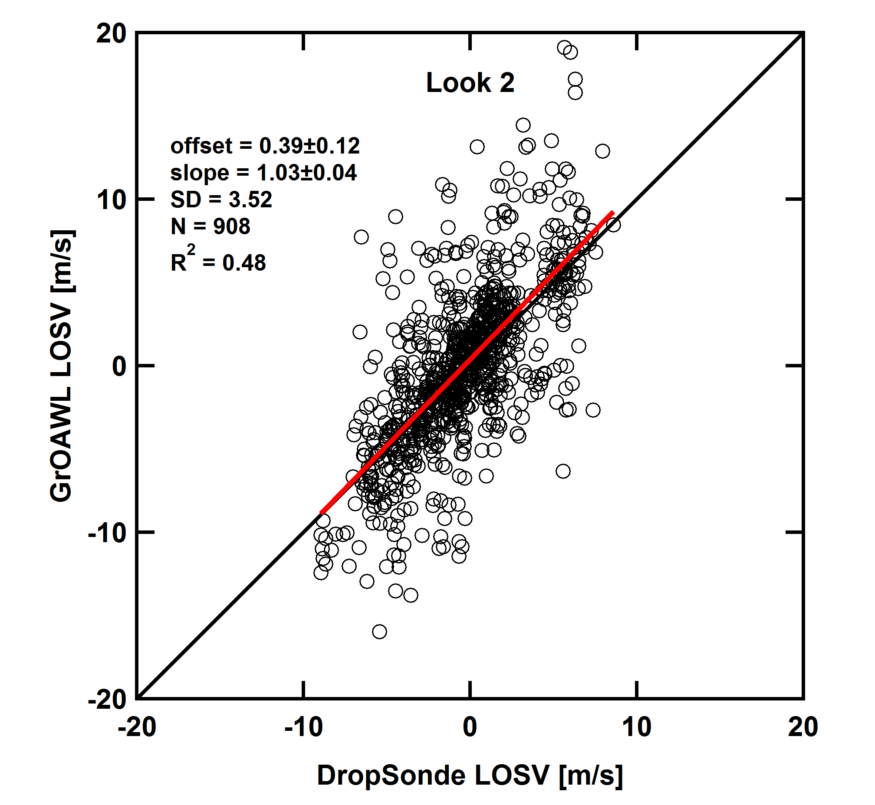
Accuracy
21 total dropsondes from 3 validation flights
Dropsonde data is considered the “True Value”
10 seconds data

Slide 13
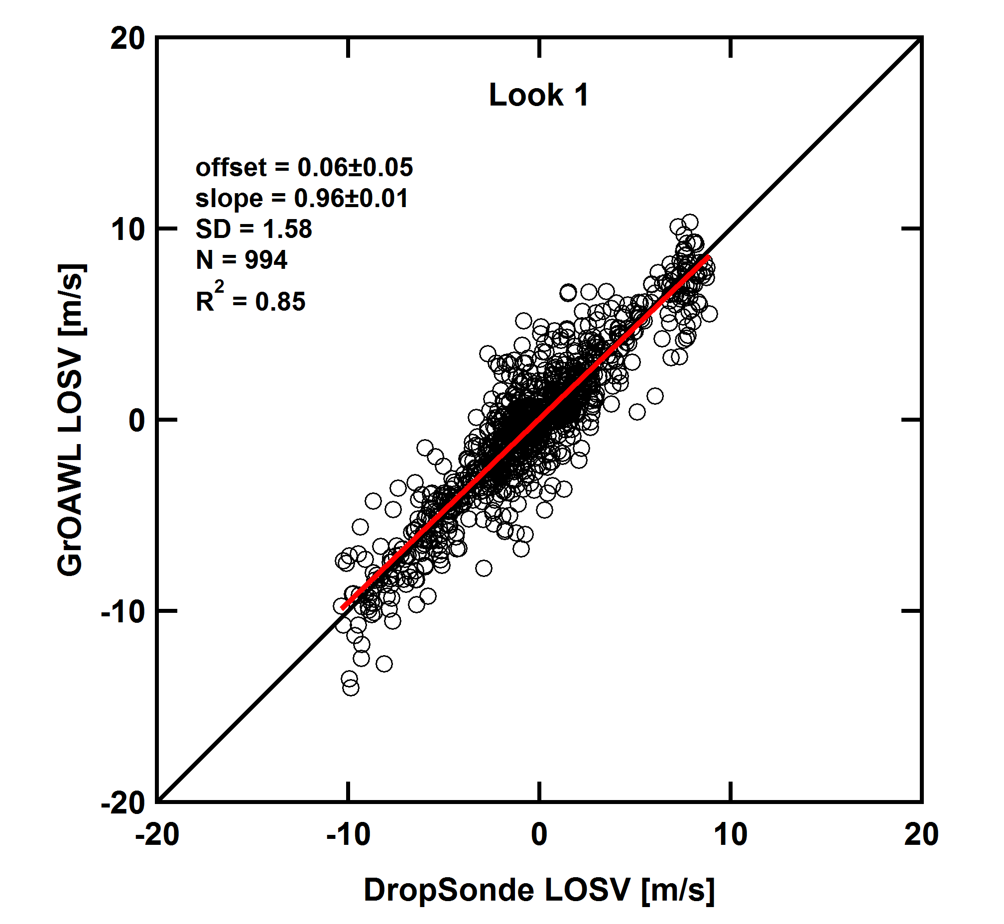
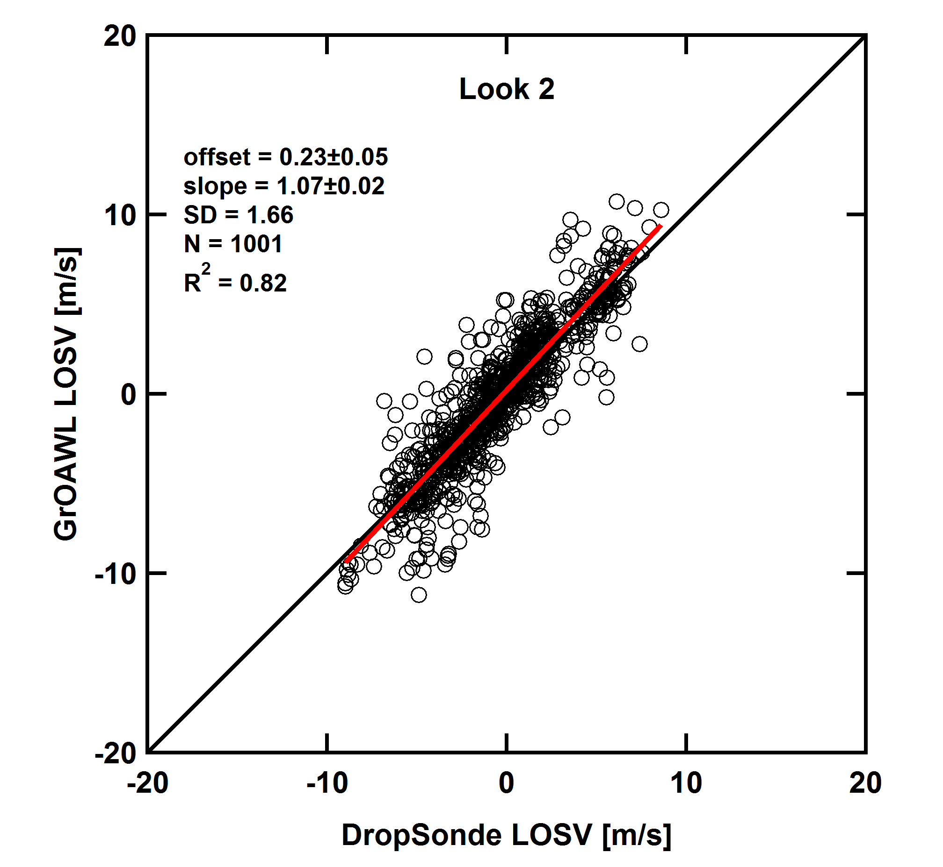
Accuracy
21 total dropsondes from 3 validation flights
Dropsonde data is considered the “True Value”
Many 10 seconds data to better estimate the GrOAWL accuracy (1 minute)

Slide 14
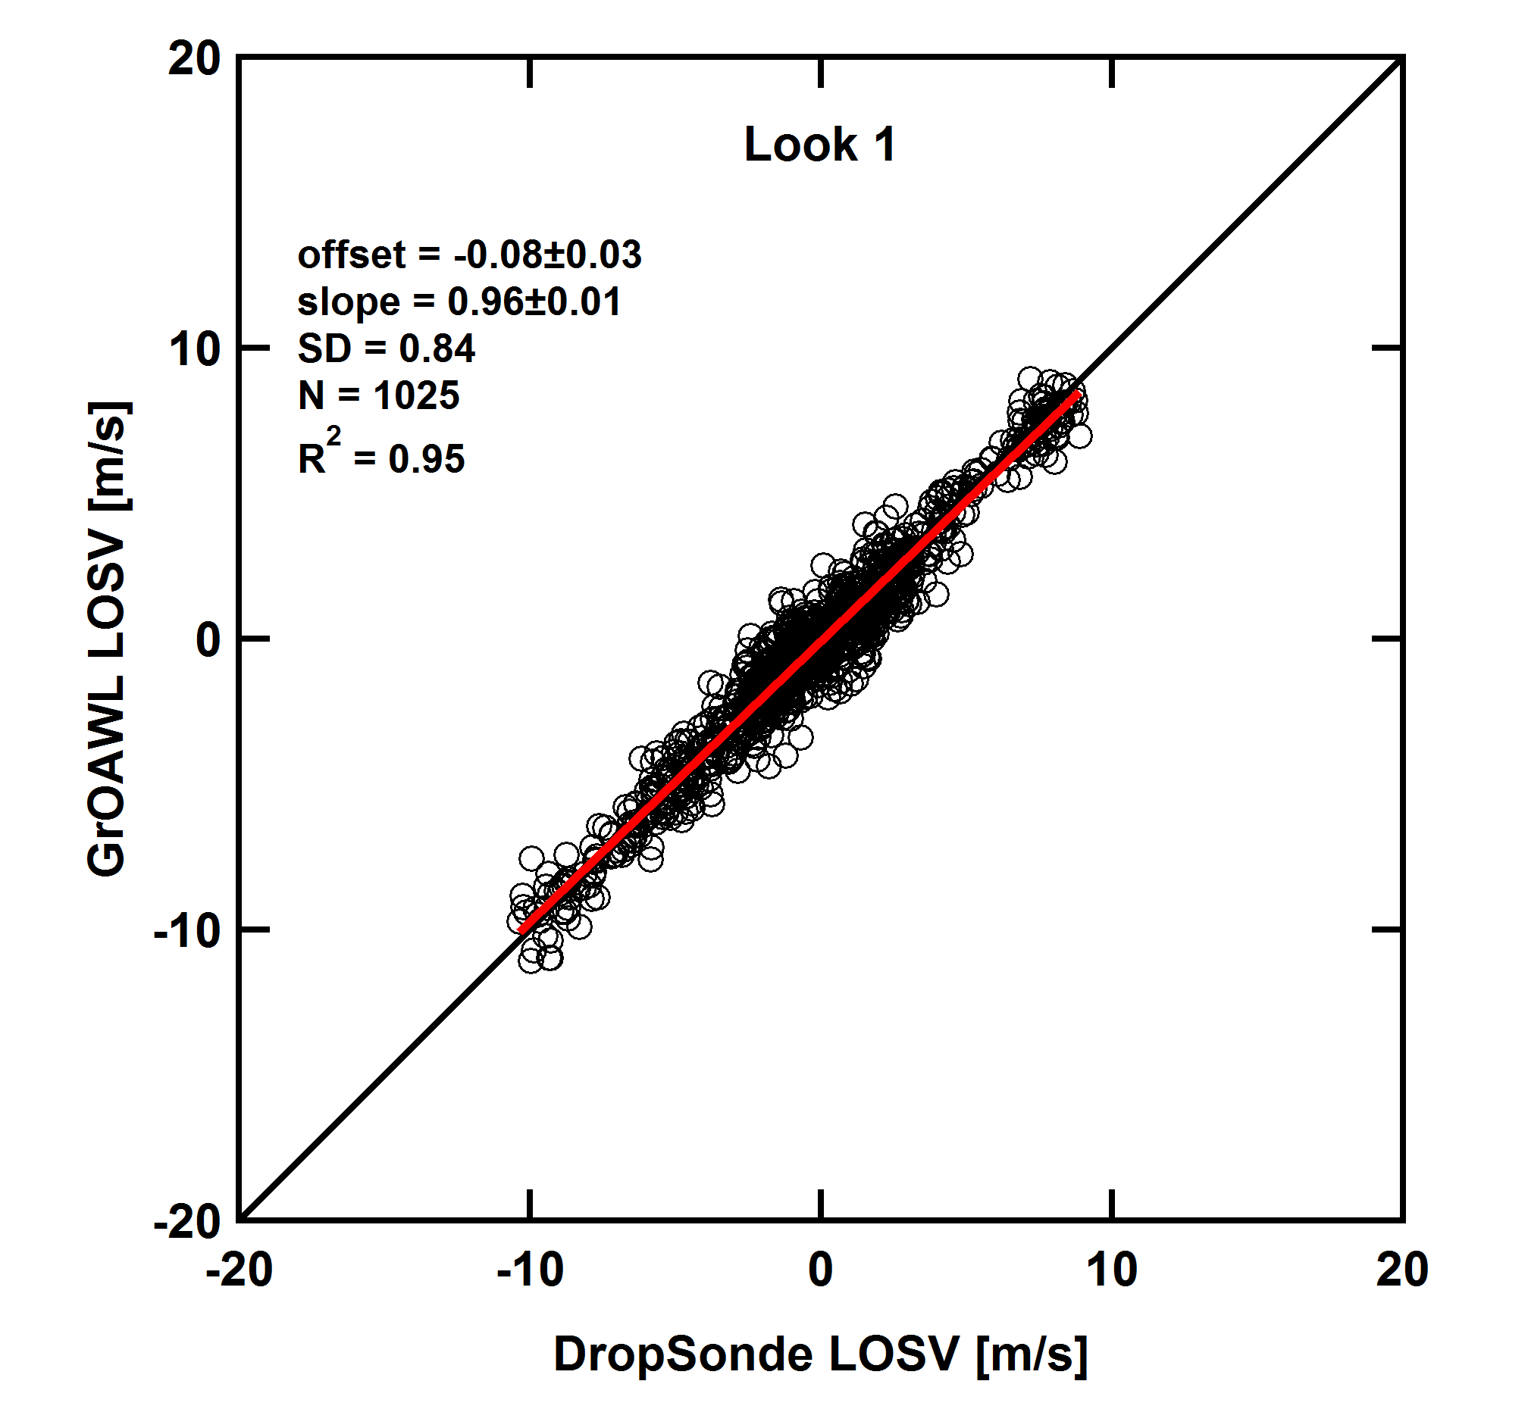
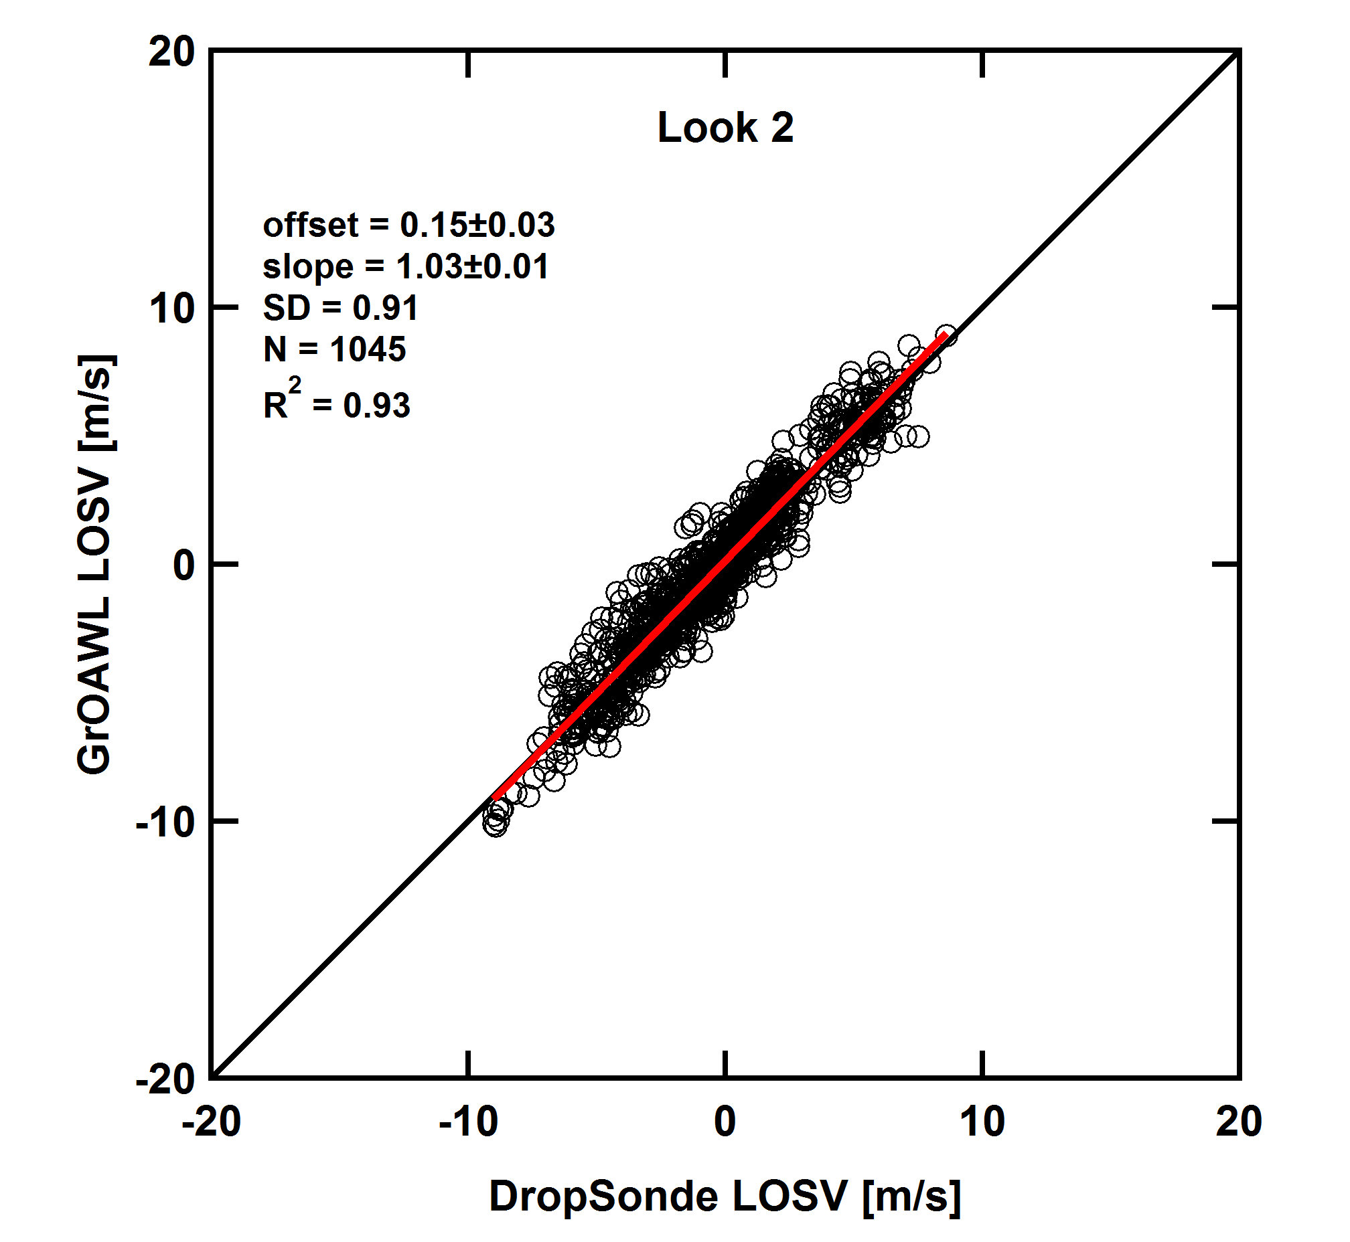
Accuracy
21 total dropsondes from 3 validation flights
Dropsonde data is considered the “True Value”
Many 10 seconds data to better estimate the GrOAWL accuracy (5 minutes)

Slide 15
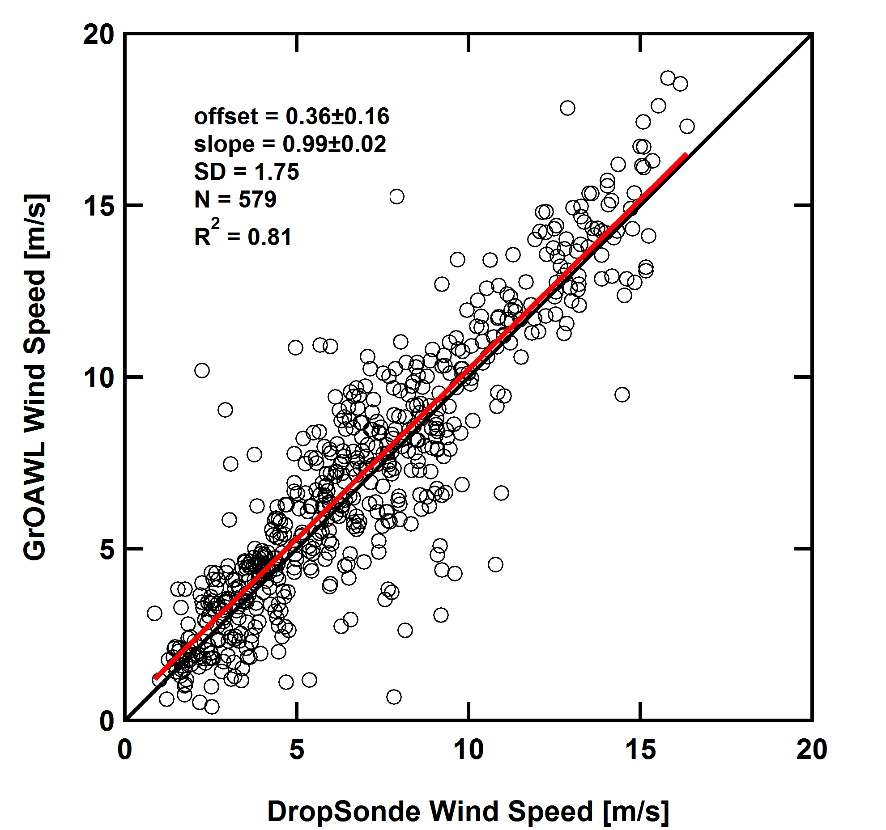
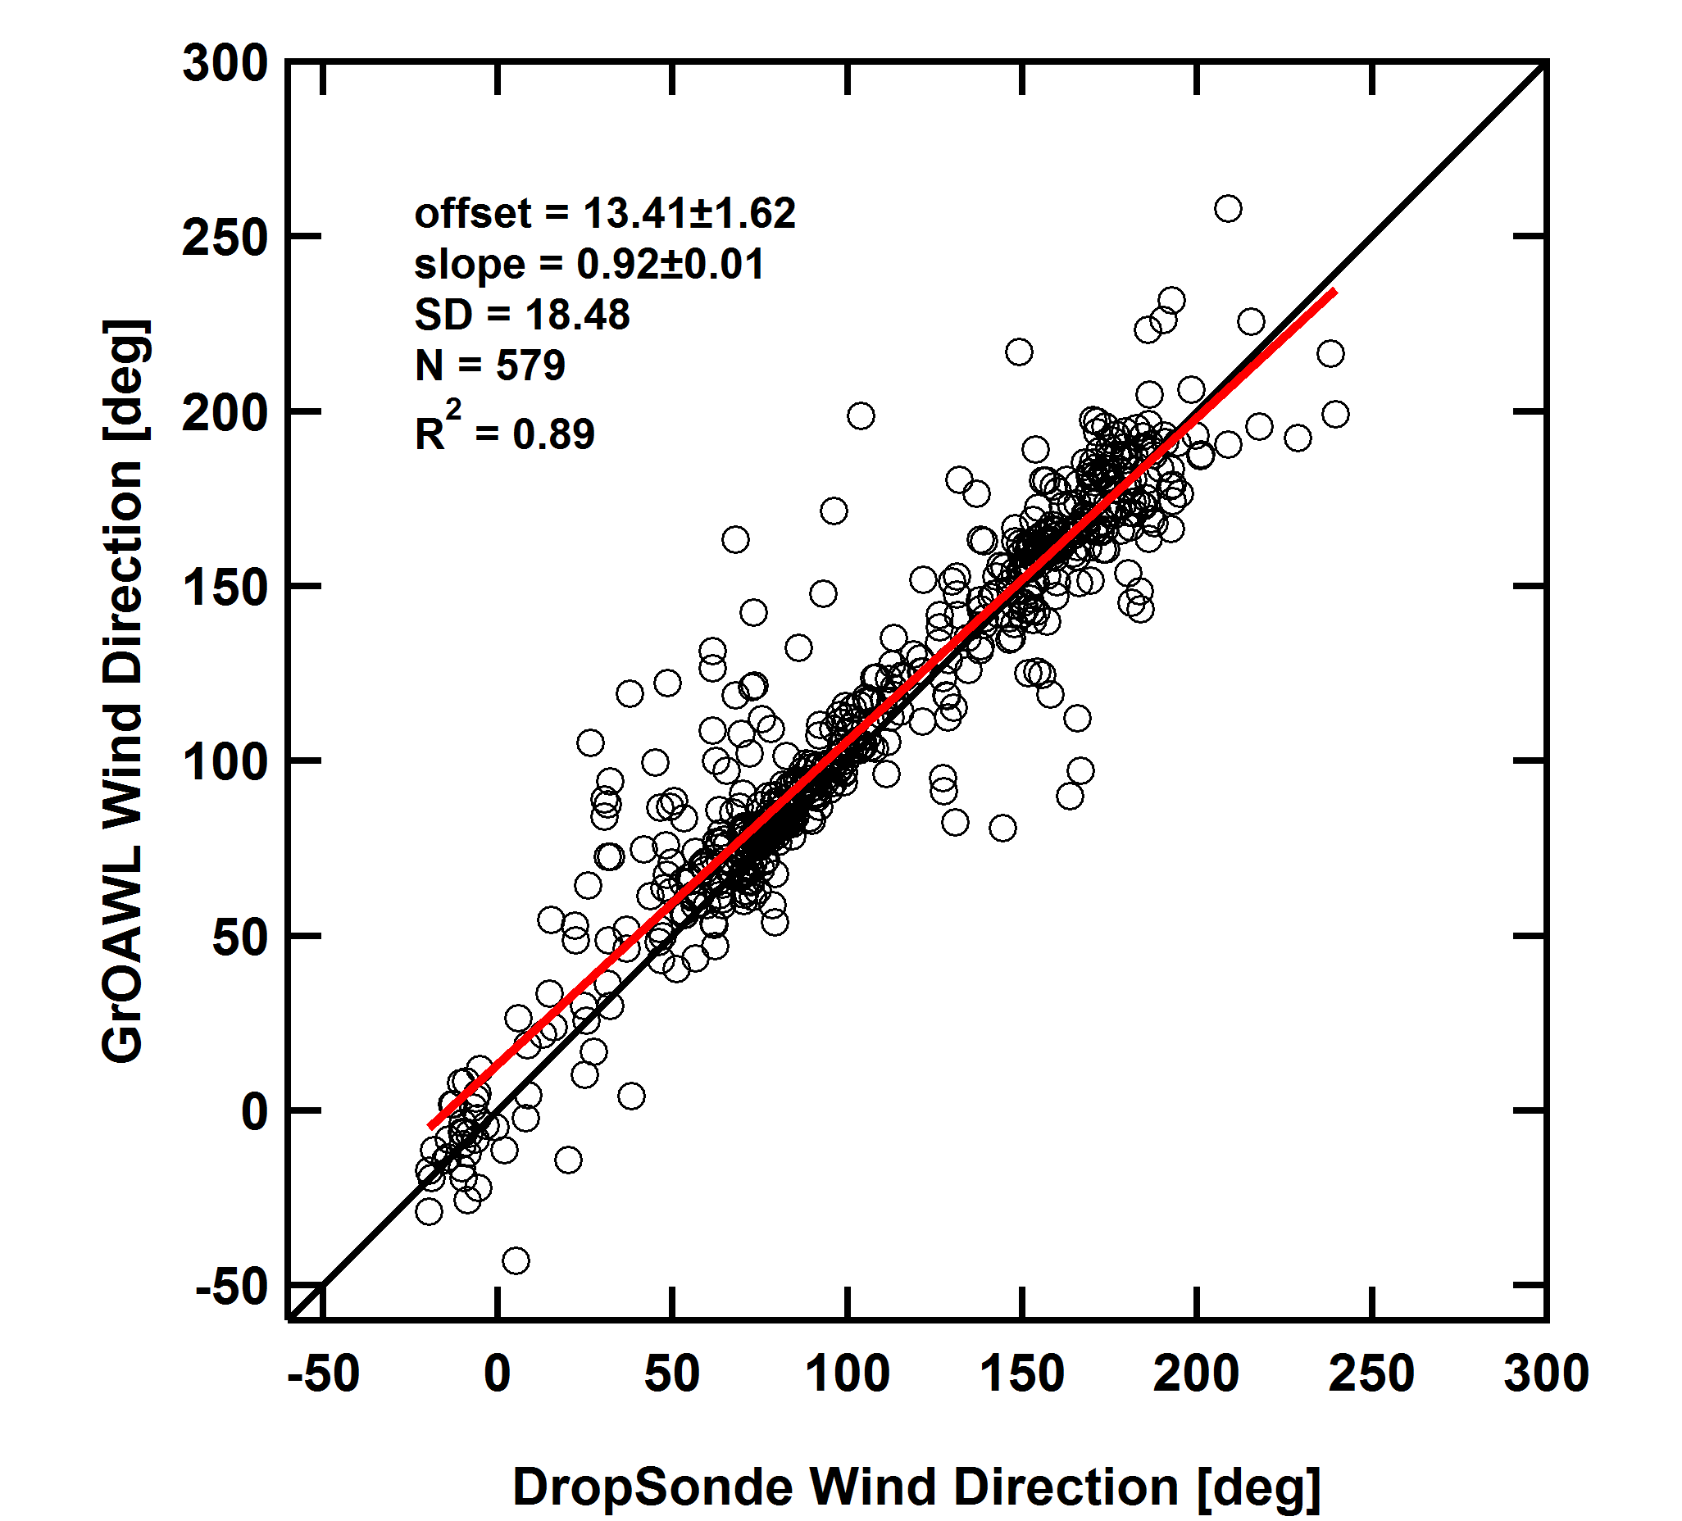
Wind Speed and Direction
Wind Speed
Wind Direction
Very good agreement between GrOAWL and Dropsondes.
Notes:
30

Slide 16
What is the precision of the GrOAWL wind measurements?

Slide 17
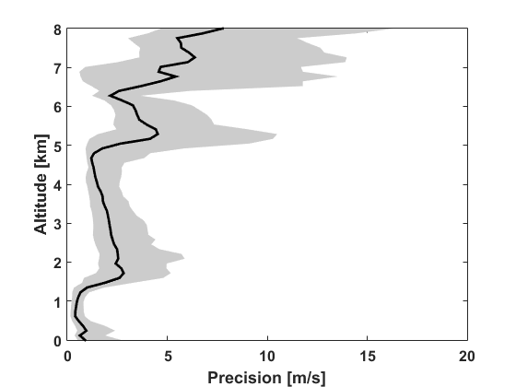
Precision
Depends on
Aerosol conditions
Range
Accumulation/Averaging
Precision for 10 seconds profiles
CNR based

Slide 18
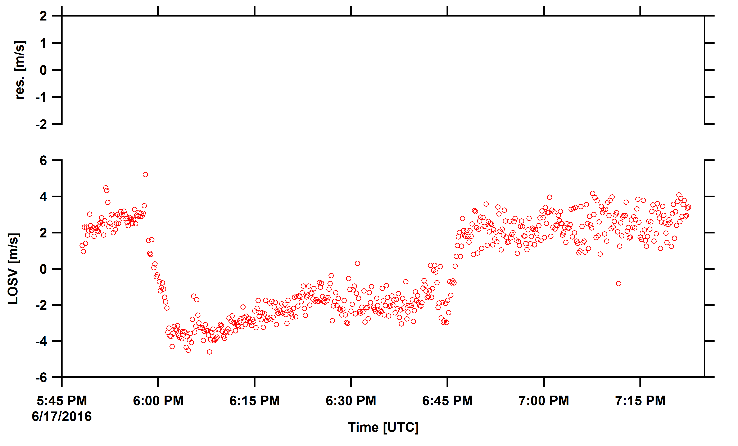
Precision: Time series

Slide 19
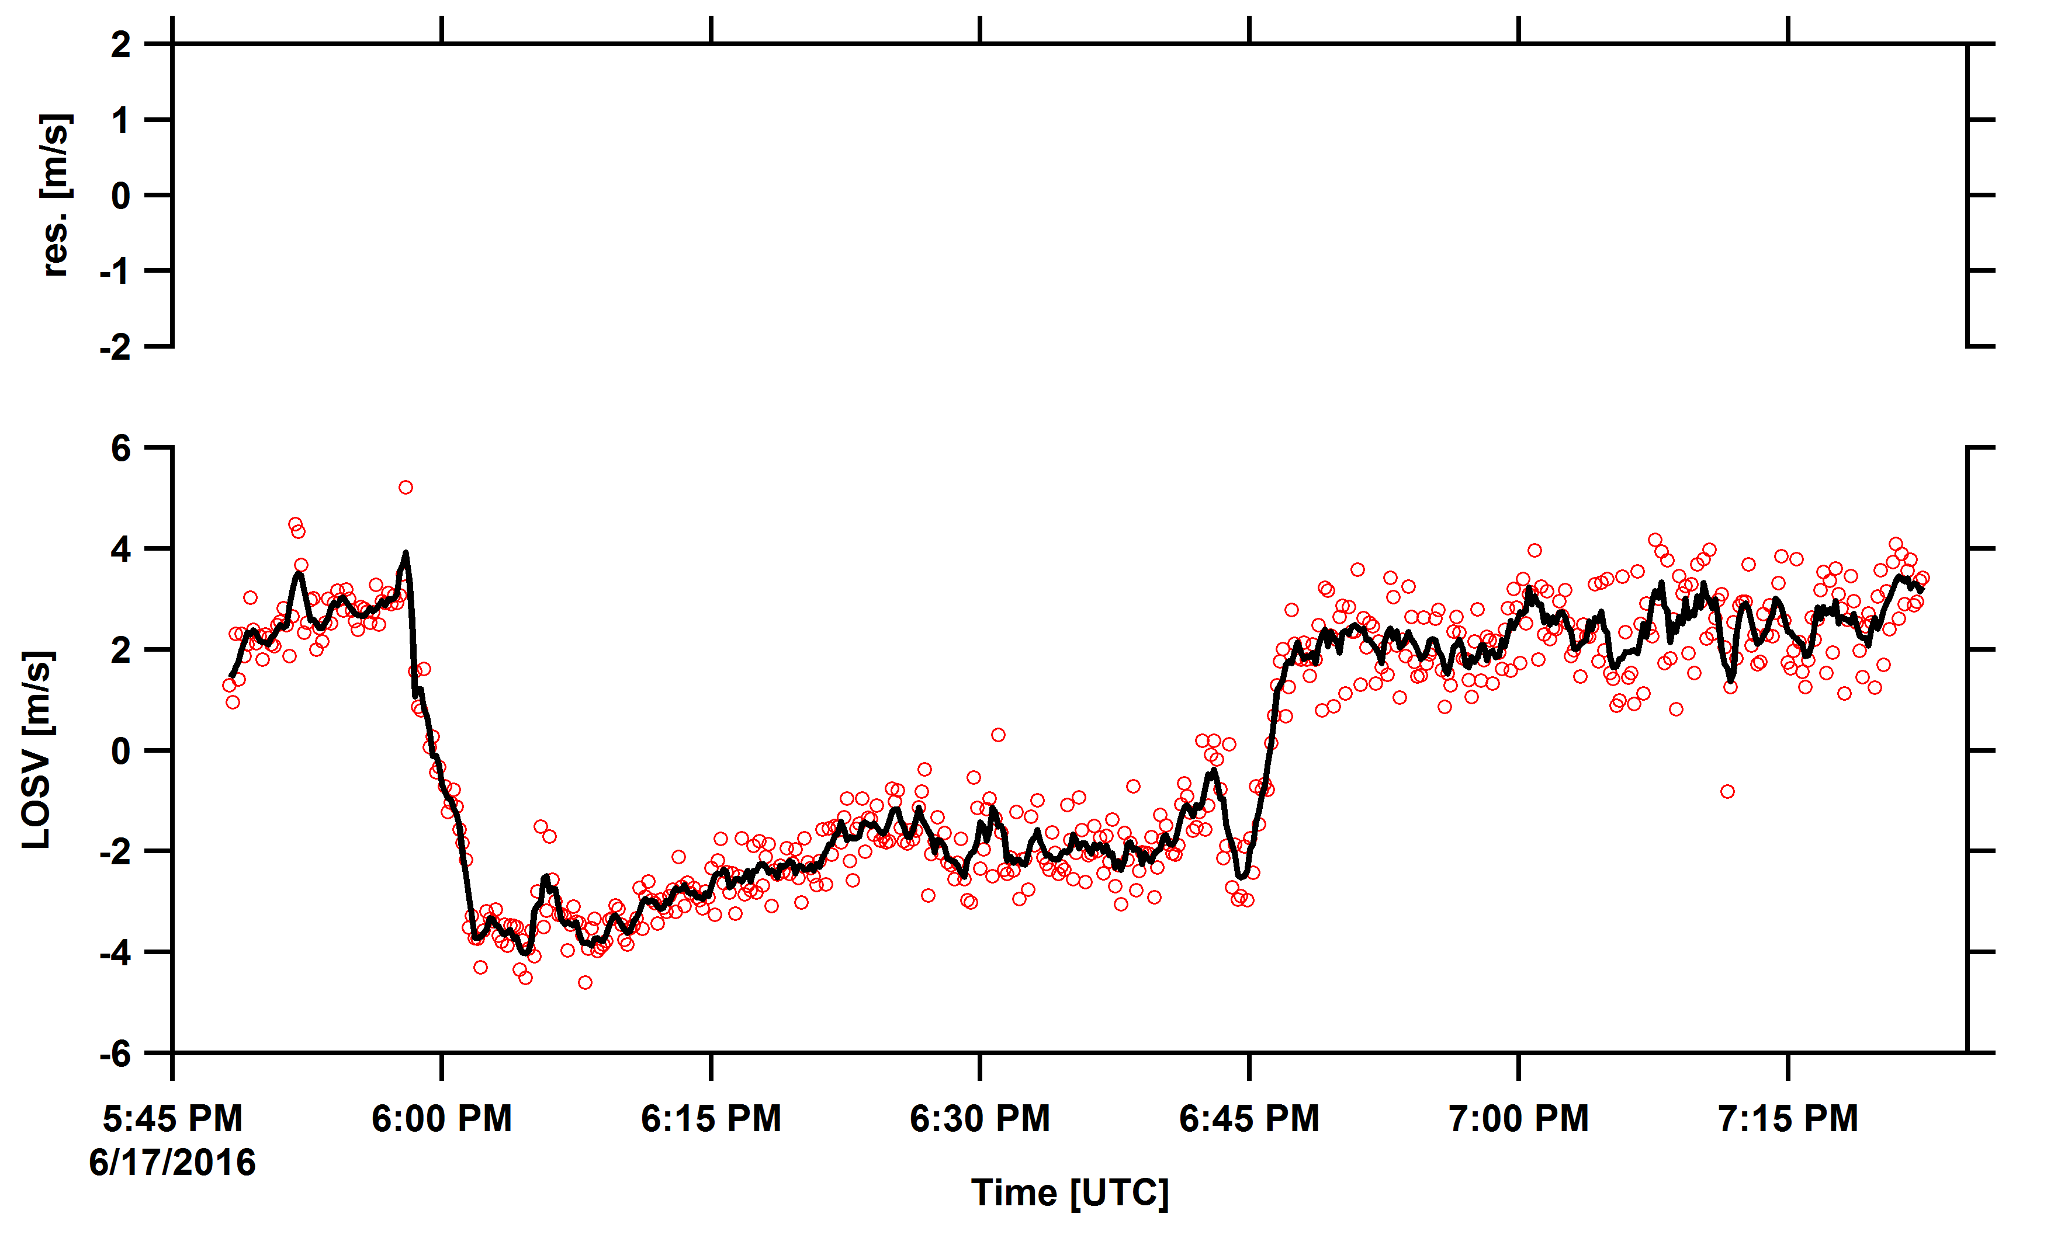
Precision: Time series

Slide 20
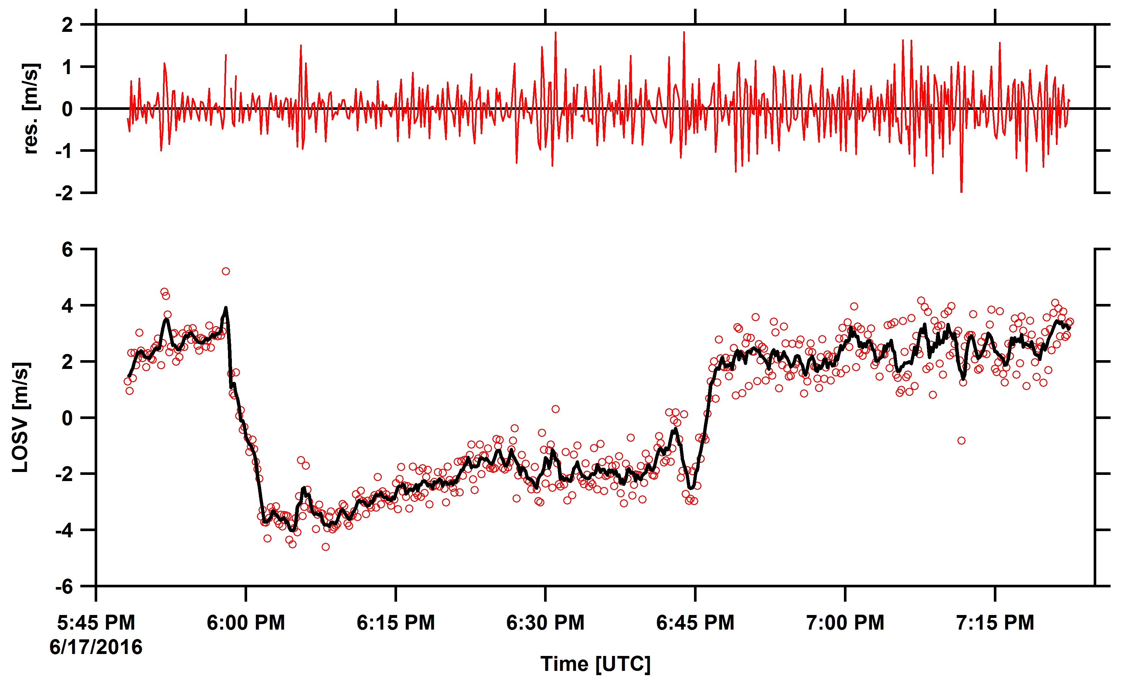
Precision: Time series

Slide 21
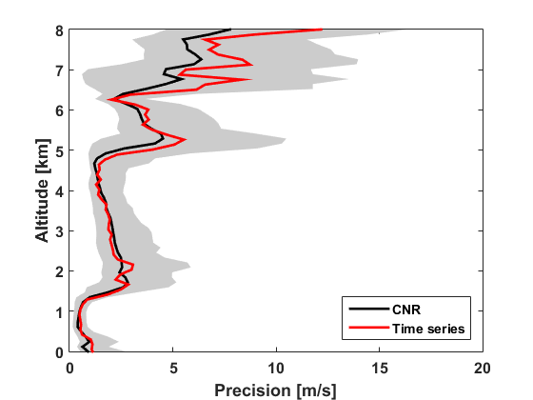
Precision
Depends on
Aerosol conditions
Range
Accumulation/Averaging
Precision for 10 seconds profiles
CNR based
CNR based precision estimate agrees very well with precision from time series analysis

Slide 22
What was the instrument performance during the flights?

Slide 23
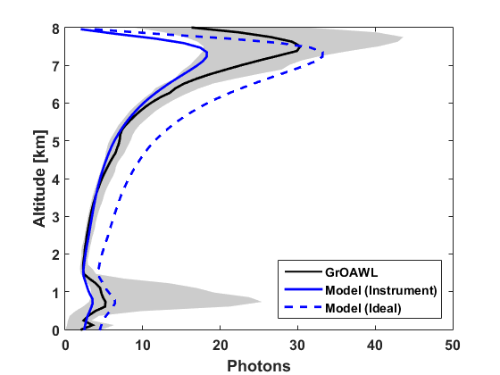
GrOAWL Performance
Detected Photons
Molecular + Aerosol photons
Temperature and pressure measured by the dropsonde
Notes:
Ground based measurement along with NCAR HSRL instrument is ongoing. – to better understand the instrument performance under low aerosol conditions.

Slide 24
GrOAWL Performance
Detected Photons
Overlap function is complicated
Focus on the lowest 5 km
Notes:
Ground based measurement along with NCAR HSRL instrument is ongoing. – to better understand the instrument performance under low aerosol conditions.

Slide 25
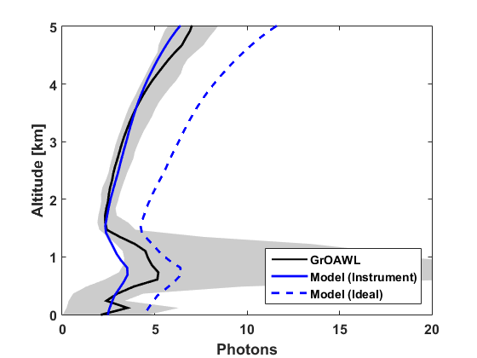
GrOAWL Performance
Detected Photons
~45% reduction in instrument throughput.
Cause:
Aircraft vibration
Window fogging
Ground based measurement along with NCAR HSRL -- ongoing
Notes:
Ground based measurement along with NCAR HSRL instrument is ongoing. – to better understand the instrument performance under low aerosol conditions.

Slide 26
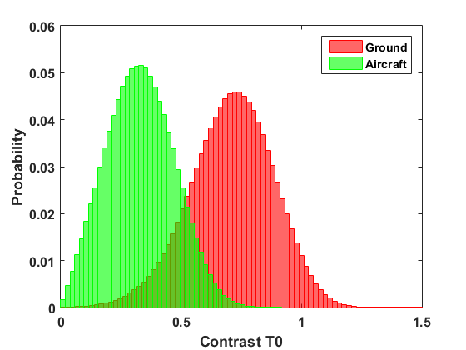
GrOAWL Performance
Instrument Contrast
Ability to resolve fringes
~55% reduction in instrument contrast
Cause:
Aircraft vibration.
Good understanding of the instrument performance during AOVT flights.
Notes:
Ground based measurement along with NCAR HSRL instrument is ongoing. – to better understand the instrument performance under low aerosol conditions.

Slide 27
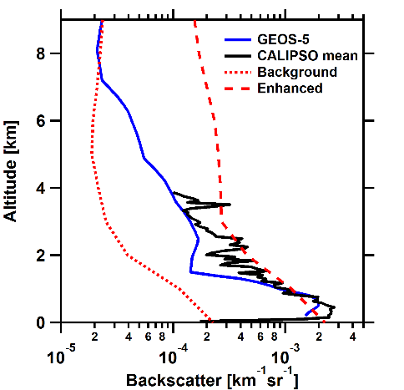
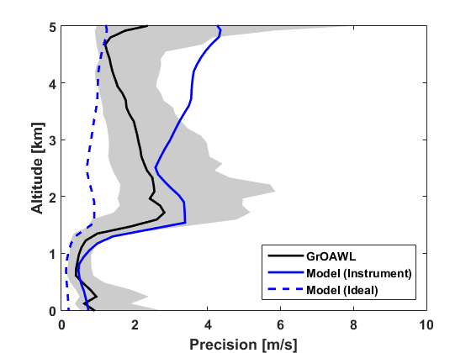
GrOAWL Performance
Detected Photons
Velocity Precision
Instrument performance by lower by factor of ~4.
Notes:
Ground based measurement along with NCAR HSRL instrument is ongoing. – to better understand the instrument performance under low aerosol conditions.

Slide 28
What can we say about the ATHENA-OAWL performance?

Slide 29
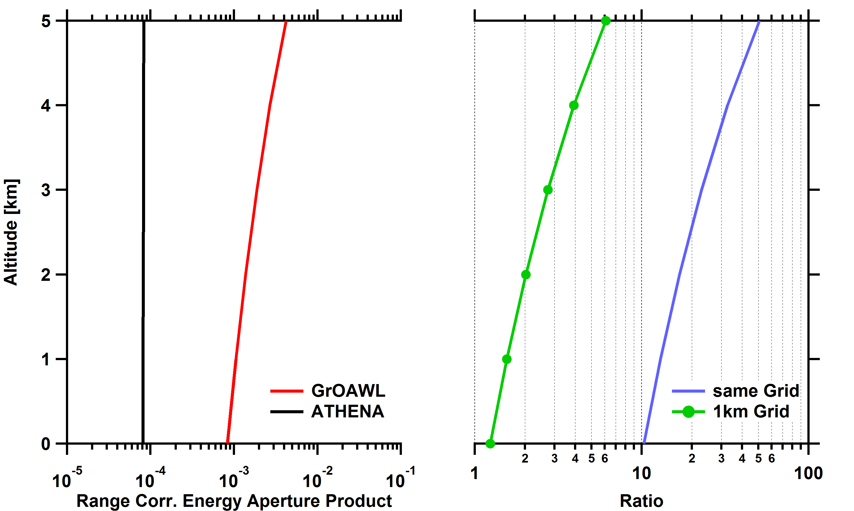
GrOAWL vs ATHENA-OAWL
Main Differences:
Energy
1.5 mJ vs 45 mJ
Telescope size
0.29 m vs 0.7 m
Range
10 km vs 400 km
Accumulation Volume Height
~120 m vs 1000 m
ATHENA-OAWL performance is expected to be similar to the GrOAWL performance during AOVT flights in the lower atmosphere.

Slide 30
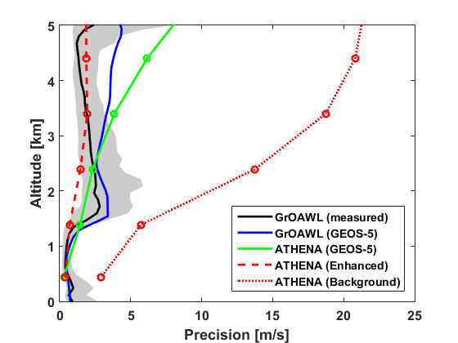
GrOAWL vs ATHENA-OAWL
ATHENA-OAWL performance is expected to be similar to the GrOAWL performance during AOVT flights in the lower atmosphere.

Slide 31
Summary
Comparison between GrOAWL measured winds and dropsonde winds show excellent agreement.
Accuracy
GrOAWL precision is very good (but depends upon aerosol conditions).
Sensitivity was down (4x) but the instrument performance is well understood.
Ground based measurement along with NCAR HSRL -- ongoing
Space-borne ATHENA-OAWL system is expected to perform very similar to the GrOAWL during the flights in the lower atmosphere.
Successfully demonstrated the ATHENA-OAWL two look concept
Airborne instrument for future science studies
Validated concept for space-based system

Slide 32
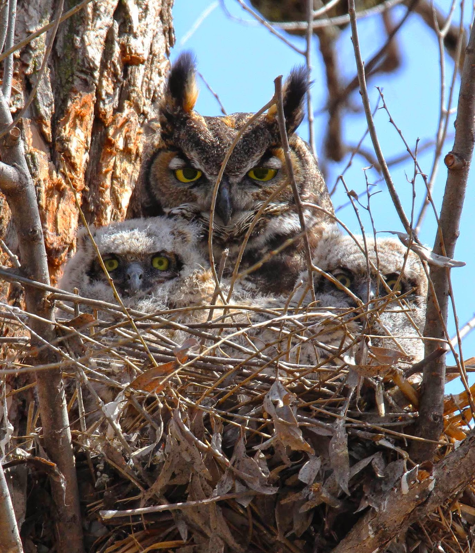
Thanks to:
ESSP and ESTO for the Venture-Technology funding
The Ball GrOAWL engineering team
Fibertek (Floyd Hovis)
YES (Mark Beaubien) & ONR for dropsonde validation support
NWS Corpus Christi office for the sonde launches
The engineering team, crew, pilots, and program staff of the WB-57 for all their excellent flight support

