Slide 1



Ball Aerospace &
Technologies Corp.
OAWL IIP Development Status: Year 1.5 C.J. Grund, J. Howell, M. Ostaszewski, R. Pierce, and S. Tucker Ball Aerospace & Technologies Corp. (BATC), cgrund@ball.com 1600 Commerce St. Boulder, CO 80303 Working Group on Space-based Lidar Winds Ft. Walton Beach, FL February 3, 2010
Agility to Innovate, Strength to Deliver

Slide 2

Acknowledgements
The OAWL Development Team:
Jim Howell – Systems Engineer, Aircraft lidar specialist, field work specialist
Miro Ostaszewski – Mechanical Engineering
Dina Demara – Software Engineering
Michelle Stephens – Signal Processing, algorithms
Mike Lieber – Integrated system modeling
Kelly Kanizay – Electronics Engineering
Chris Grund – PI system architecture, science/systems/algorithm guidance
Paul Kaptchen - Technician
Carl Weimer – Space Lidar Consultant
Sara Tucker – Performance Analysis
OAWL Lidar system development and flight demo supported by NASA ESTO IIP grant: IIP-07-0054
Any opinions, findings, and conclusions or recommendations expressed in this material are those of the author(s) and do not necessarily reflect the views of the National Aeronautics and Space Administration.
Notes:
No data or proprietary info

Slide 3
Addressing the Decadal Survey 3D-Winds Mission with An Efficient Single-laser All Direct Detection Solution
Molecular Winds➔Upper atmosphere profile
Etalon Molecular Receiver
OAWL Aerosol Receiver
Combined Signal Processing
Telescope
1011101100
Full Atmospheric Profile Data
Aerosol Winds➔
Lower atmosphere profile
UV Laser
HSRL➔ Aer/mol mixing ratio
Integrated Direct Detection (IDD) wind lidar approach:
Etalon (double-edge) uses the molecular component, but largely reflects the aerosol.
OAWL measures the aerosol Doppler shift with high precision; etalon removes molecular backscatter reducing shot noise
OAWL HSRL retrieval determines residual aerosol/molecular mixing ratio in etalon receiver, improving molecular precision
Result:
single-laser transmitter, single wavelength system, telescope driven by DD requirements not coherent detection
single simple, low power and mass signal processor
full atmospheric profile using aerosol and molecular backscatter signals
Ball Aerospace patents pending
Notes:
Previously approved
Top level description of a possible wind lidar architecture

Slide 4
Potential Performance Envelope
Note: notional approximation of slide presented for the etalon+coherent hybrid approach
1m OPD DD OAWL
IDD = OAWL+Etalon
Etalon DD
DWL
Altitude
0 5km 10 15 20
Coherent
DWL
Coherent
DWL
1 2 3
Velocity precision (m/s)

Slide 5
Purpose for OAWL Development and Demonstration
OAWL is a potential enabler for reducing mission cost and schedule
Aerosol wind precision similar to 2-μm coherent Doppler, but requires no additional laser
Accuracy not sensitive to aerosol/molecular backscatter mixing ratio
Tolerance to wavefront error allows simpler (and heritage) telescope and optics
Compatible with single wavelength holographic scanner allowing adaptive targeting
Wide potential field of view allows relaxed tolerance alignments, similar to CALIPSO
FOV ~120 mR feasible while supporting 10⁹ spectral resolution
Minimal laser frequency stability requirements
LOS spacecraft velocity correction without needing active laser tuning
Opens up multiple mission possibilities including multi-λ HSRL, DIAL compatibility
Challenges met by Ball OAWL approach
Elimination of control loops while achieving 10⁹ spectral resolution
Thermally and mechanically stable, meter-class OPD, compact interferometer
High optical efficiency (~97%)
Simultaneous high spectral resolution and large area*solid angle acceptance providing practical system operational tolerances with large collection optics
Notes:
No data or proprietary info

Slide 6
Optical Autocovariance Wind Lidar (OAWL) Development Program
Internal investment to develop the OAWL theory and implementable flight-path architecture and processes, performance model, perform proof of concept experiments, and design and construct a flight path receiver prototype.
NASA IIP: take OAWL receiver as input at TRL-3, build into a robust lidar system, fly validations on the WB-57, exit at TRL-5.
Notes:
No data or proprietary info

Slide 7
Ball Flight-path, Multi-wavelength, Field-widened OA Receiver IRAD Results

Slide 8
Ball OAWL Receiver Design Uses Polarization Multiplexing to Create 4 Perfectly Tracking Interferometers
Mach-Zehnder-like interferometer allows 100% light detection on 4 detectors
Cat’s-eyes field-widen and preserve interference parity allowing wide alignment tolerance, practical simple telescope optics
Receiver is achromatic, facilitating simultaneous multi-λ operations (multi-mission capable: Winds + HSRL(aerosols) + DIAL(chemistry))
Very forgiving of telescope wavefront distortion saving cost, mass, enabling HOE optics for scanning and aerosol measurement
2 input ports facilitating 0-calibration
patents pending
Notes:
Shown publicly (6/08) at the ILRC and wind lidar WG (2/08). Identical to previously ITAR and IP approved.

Slide 9
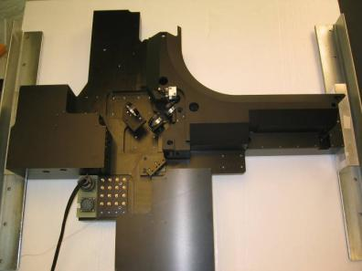
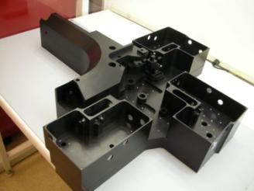
OAWL Receiver
A few simple components
Detector housings
Monolithic interferometer
Covers and base plate
mount to a monolithic base structure.
Detector amplifiers and thermal controls
are housed inside the receiver.
Notes:
Previously approved..
Identifies location of generic system components, but does not specify components.

Slide 10
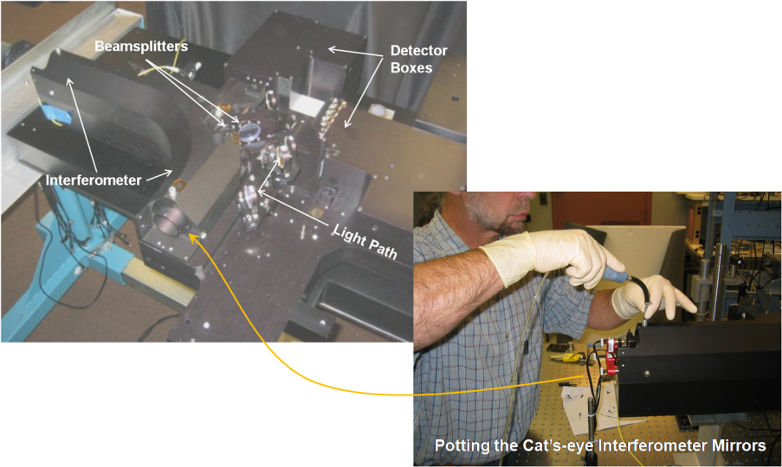
Completed Receiver / Permanently Potted Alignments (except for the final beamsplitter)
Notes:
New. Shows receiver as built and potting in progress. No data or IP.

Slide 11
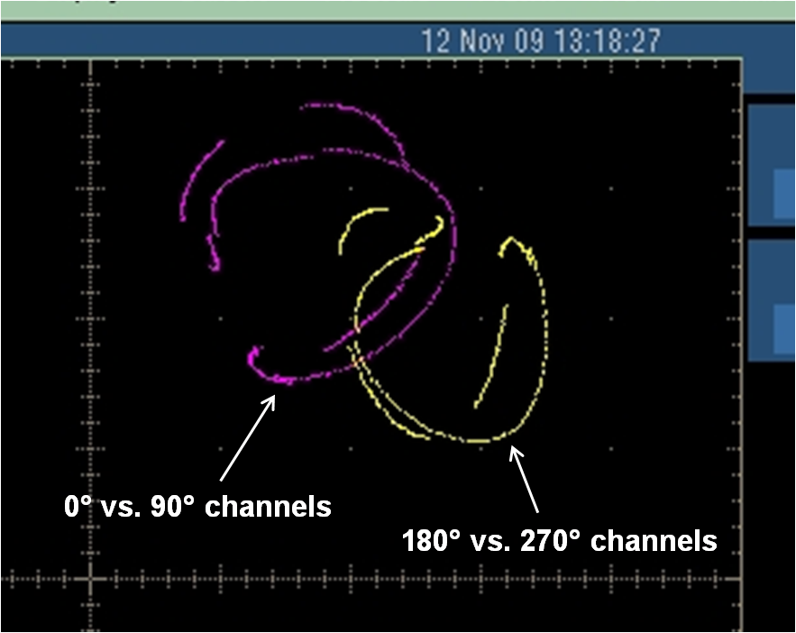
Receiver Checkout
Vectorscope showing
successful 4-channel optical quadrature.
Forced audio excitation enables repeatable phase space sampling, but does not generate pure OPD modulation, hence hysteresis loop.
Optical source: CW 532nm laser
Notes:
New. Shows normalized graphs of qualitative receiver function. No data.

Slide 12
OAWL IRAD Receiver Development Status
Receiver Status:
Optical design PDR complete Sep. 2007
Receiver CDR complete Dec. 2007
Receiver performance modeled complete Jan. 2008
Design complete Mar. 2008
COTS Optics procurement complete Apr. 2008
Major component fabrication complete Jun. 2008
(IIP begins------------------------------------------------------------------------ Jul. 2008)
Custom optics procurement vendor issues Aug. 2008
Custom optics procurement complete Dec. 2008
Accommodating rework complete Jan. 2009
Interferometric optics/mount bonding complete Feb. 2009
Interferometric alignment bond tests shrinkage / thermal issues Feb. 2009
New materials/process/mount design complete May, 2009
Assembly and Alignment complete Oct. 2009
Preliminary testing complete Oct. 2009
Delivery to IIP complete Nov. 2009
Notes:
No Data. Updated but otherwise identical in content to previously ITAR and IP approved slide.

Slide 13
OAWL System NASA-funded IIP

Slide 14
OAWL IIP Objectives
Demonstrate OAWL wind profiling performance of a system designed to be directly scalable to a space-based direct detection DWL (i.e. to a system with a meter-class telescope 0.5J, 50 Hz laser, 0.5 m/s precision, with 250m resolution).
Raise TRL of OAWL technology to 5 through high altitude aircraft flight demonstrations.
Validate radiometric performance model as risk reduction for a flight design.
Demonstrate the robustness of the OAWL receiver fabrication and alignment methods against aircraft flight thermal and vibration environments.
Validate the integrated system model as risk reduction for a flight design.
Provide a technology roadmap to TRL7
Notes:
No data, just a review of the objectives of the NASA IIP proposed work.

Slide 15
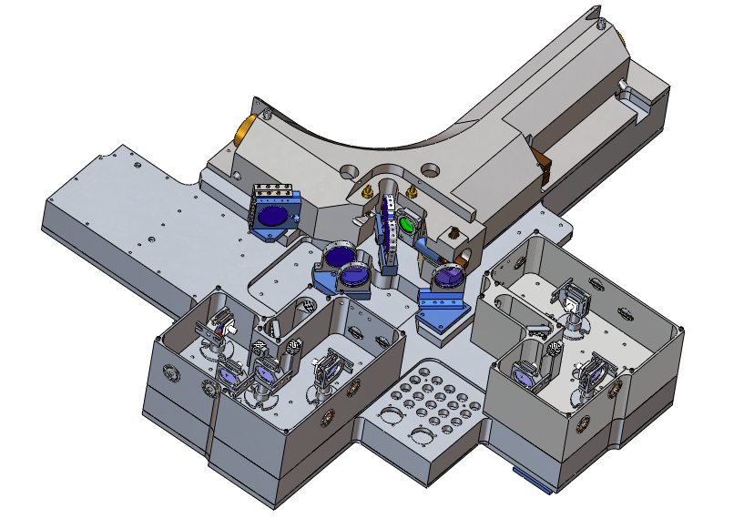
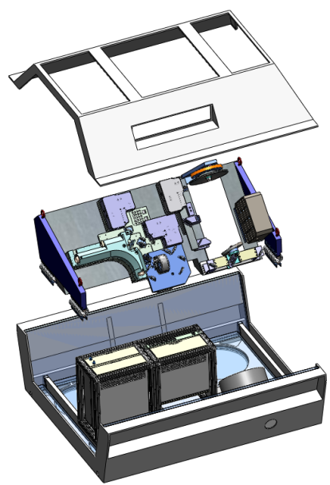
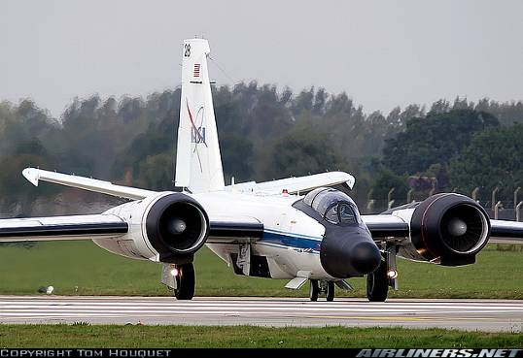
OAWL IIP Development Process
Provide IRAD-developed receiver to IIP: Functional demonstrator for OAWL flight path receiver design principles and assembly processes. (entry TRL 3 (2.5))
Shake & Bake Receiver: Validate system
design and test for airborne environment
Integrate the OAWL receiver into a
lidar system: add laser, telescope,
frame, data system, isolation, and
autonomous control software in an
environmental box
Validate Concept, Design, and Wind Precision Performance Models from the NASA WB-57 aircraft (exit TRL 5)
Notes:
No data. Previously approved

Slide 16
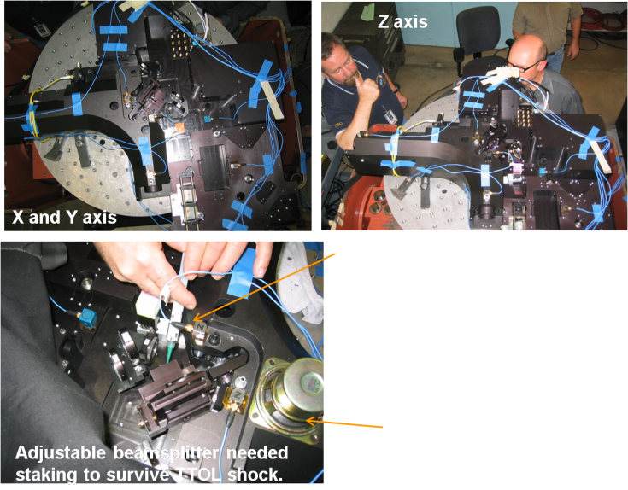
Receiver Vibration Testing - Acquisition
Receiver and mounts instrumented with multiple accelerometers
(blue wires)
WB-57 Taxi, takeoff and landing (TTOL) shock/vibe level testing (1.78 gRMS) showed the adjustable beamsplitter needed staking to prevent alignment drifts, but the permanent interferometer alignment potting method is stable at these levels.
Operational vibe (0.08 gRMS) effects are within expectations; not expected to affect WB-57 wind measurement performance
Audio speaker used to excite on organ pipe mode within the interferometer to repeatably sample the whole phase space.
Notes:
New. Shows configuration for vibration testing. Grms values are from published NASA WB-57 data.

Slide 17
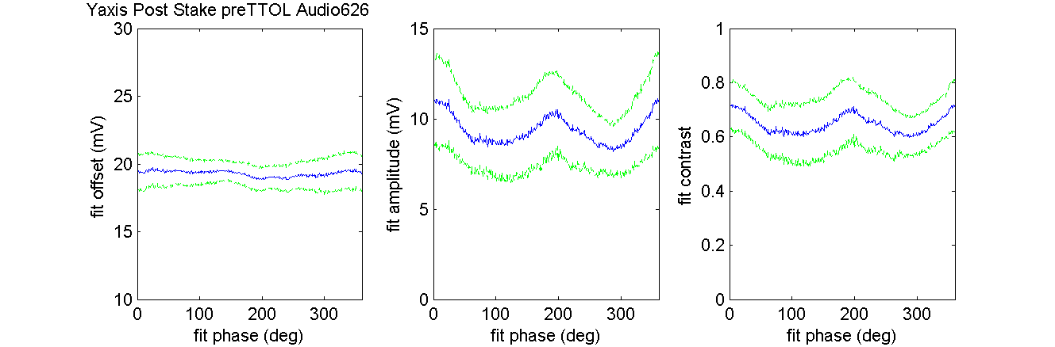
Results have some unexpected phase dependence
Offset, amplitude, and contrast of the sine fits to the 4 OA phase measurements exhibit dependency on the phase of the fit; expected to be flat.
Notes:
New material: shows problems exist with the system (the expectation is that the plots would be flat lines), and provides an opportunity to show how Ball systematically approaches and mitigates such real world effects.

Slide 18
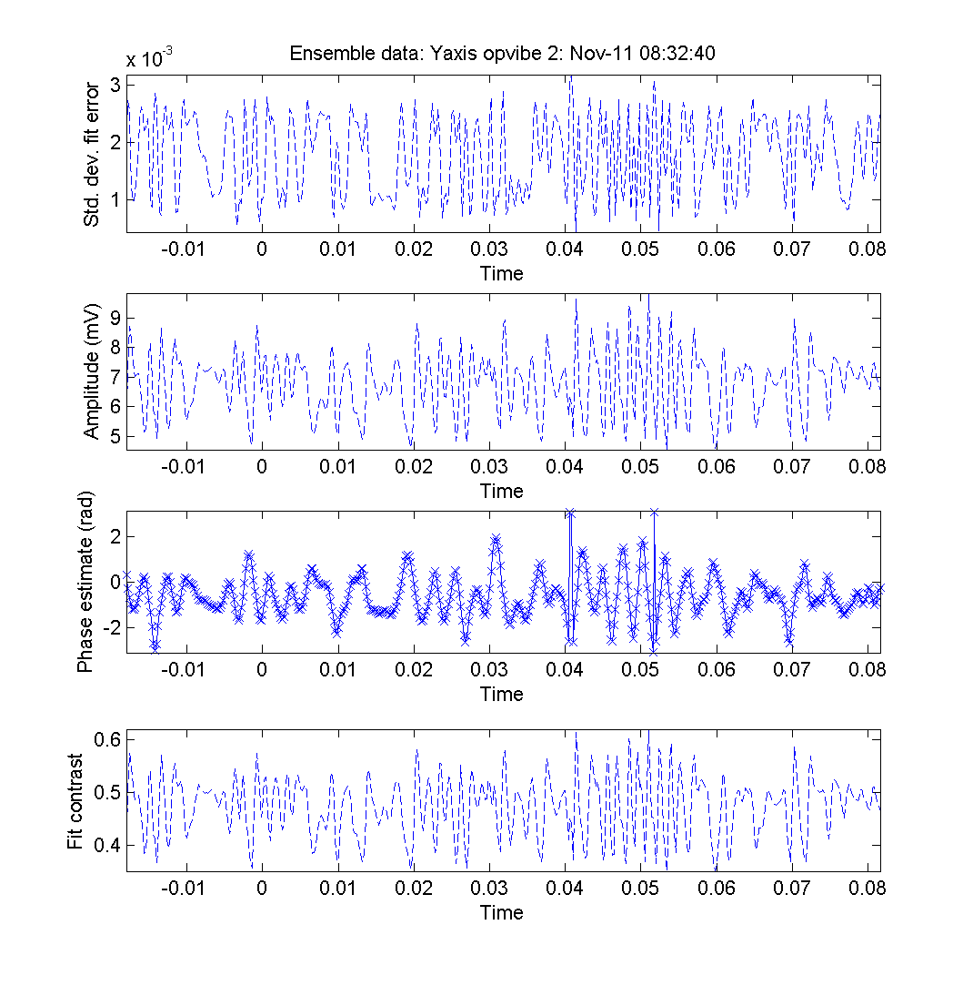
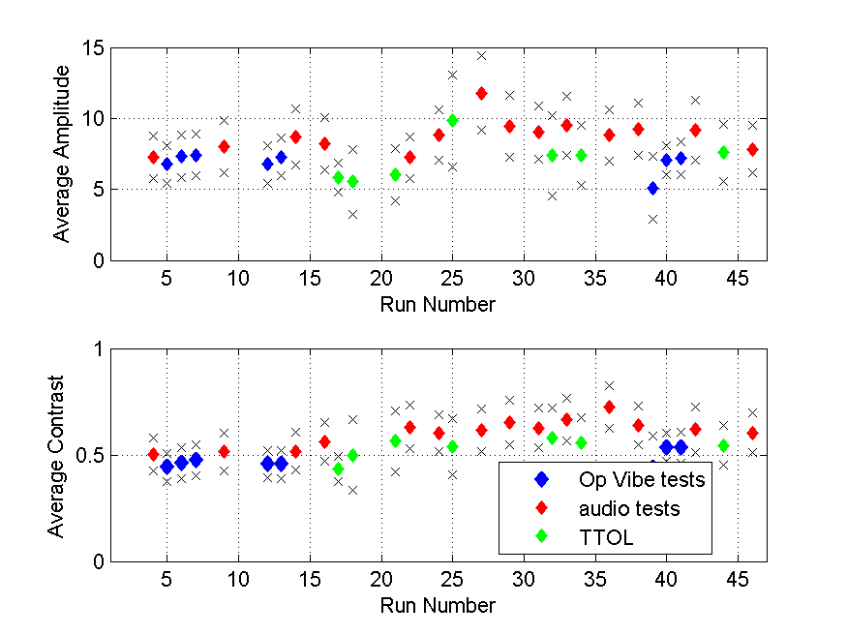
Typical results
Example of vibe test fit results
Average amplitude and contrast for audio and op-vibe tests, versus test number
x
y
z
x
y
z
Taxi, Take-off and Landing
Vibe levels: still operational
Notes:
New material shows results of vibe testing of the receiver. The purpose of this slide is to show that the receiver we built can make measurements as promised, and that it is stable against vibration and shock (a community concern before this testing).

Slide 19
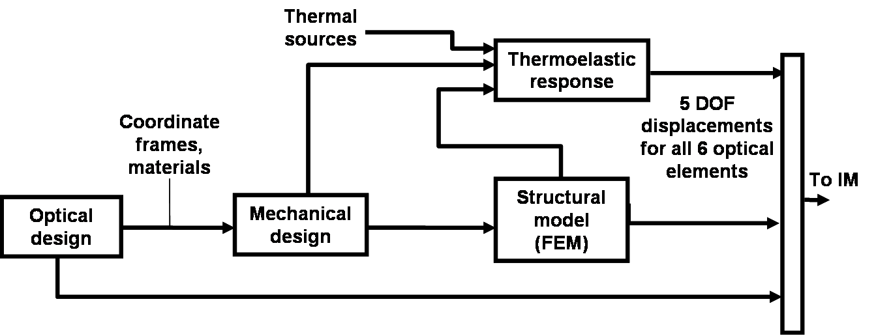
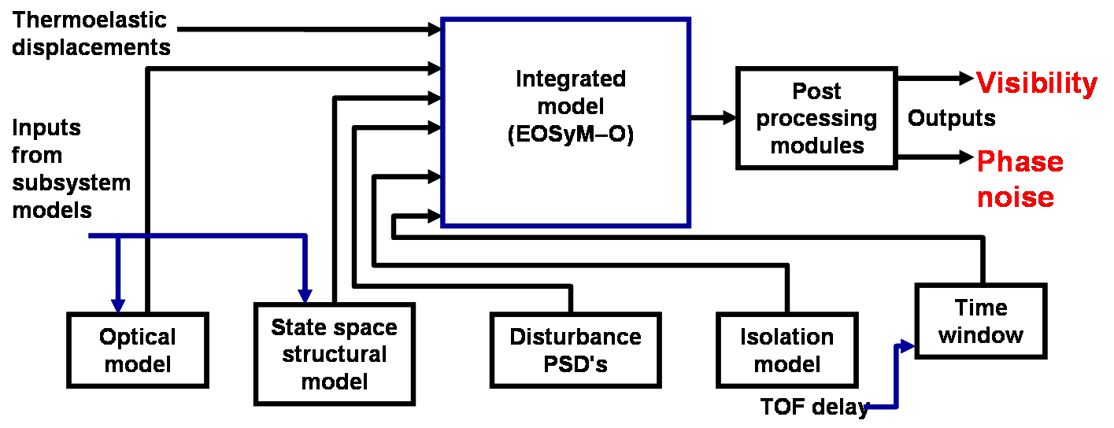
Integrated Model Process Developed at BATC
Goals:
<6 nm (0.11 rad phase error) vibration induced noise), 30 nm accep.
<5% visibility reduction due to thermoelastic distortions.
Main system modeling outputs
Fringe visibility
Phase noise
Code V
SolidWorks
6
NASTRAN
References:
M. Lieber, C. Weimer, M. Stephens, R. Demara, “Development of a validated end-to-end model for space-based lidar systems”, in SPIE vol 6681, U.N.Singh, Lidar Remote Sensing for Environmental Monitoring VIII, Aug 2007.
M. Lieber, C. Randall, L. Ayari, N. Schneider, T. Holden, S. Osterman, L. Arboneaux, "System verification of the JMEX mission residual motion requirements with integrated modeling", SPIE 5899, Aug 2005.
M. Lieber, C. Noecker, S. Kilston, “Integrated system modeling for evaluating the coronagraph approach to planet detection”, SPIE V4860, Aug 2002
Aircraft PSD
Notes:
Previously approved, no changes, no data

Slide 20
Integrated Model – Design Iteration: Vibration-Induced Phase Noise Convergence on Specification
3.5
1900 nm, initial hard mount
3
2.5
40/ 20 nm, 20 Hz isolators added, WC/ nom
8.5/ 6 nm, redesigned structure, WC/ nom
2
Log OPD (nm)
Requirement:
<1m/s/shot/100 μs
Random dynamic
error with WB-57 excitation
1.5
Current result (20nm RMS)
1
Final design Prediction Feb. 2008 : 8.5 nm RMS jitter, exceeding spec and meeting goal, suggests performance dominated by intensity SNR, not vibration environment
0.5
0
1
2
3
4
5
WC = Worst case
While current result does not match the original model predictions, the receiver was modified to include the plate beamsplitter, and the FEM has not yet been updated – this is in progress. Also, the real measurements have a small amount of measurement noise that is not accounted in the model. Model not quite validated.
IIP Upshot: >6000 pulse returns will be averaged per wind profile suggesting expected operational vibe induced errors ~0.03 m/s per profile (insignificant)
Notes:
Some new material (in orange), otherwise the slide has been approved before.
Output (and historical improvement) from our model predictions showing that we can meet the wind measurement goals of the customer community.
Orange: shows the results of as-built testing compared to pre-built model prediction, but this is not the final performance in vibe since the model needs to be updated to the current design. It is also not the final system performance since many other factors will affect that. The purpose of this slide is to inform the community of the Ball integrated modeling capability, and the measurements reported are to show how well the model can work.

Slide 21
Vibe Testing Results
Operational Vibe Level
WB-57 vibration environment will not appreciably affect wind profile performance (vibe-induced error ~0.03 m/s)
Integrated model expectation 8.5 nm RMS OPD variation is less than measured 20 nm RMS, however the interferometer design was changed (plate beamsplitter) requiring a new FEM run ( reanalysis in progress)
Taxi/Takeoff/Landing
After staking the single adjustable element in the interferometer, the average contrast remained relatively stable (i.e. did not degrade systematically over the tests) suggesting the interferometer alignment will survive multiple take-off and landing cycles for testing.
We took data during TTOL tests. The data suggest that useful (although lower precision) wind measurements can be achieved during much more severe operational conditions (hurricane flights?)
Anomalies in the amplitude, phase, and offset retrievals are being investigated. They are apparently instrumental effects (not specific to vibe). We expect once understood, corrections can be applied to the existing data, and an updated report issued. It is expected that average contrast will increase with corrections. These corrections are also important for wind retrieval precision.
Notes:
Summarizes information from previous several slides, nothing new added

Slide 22
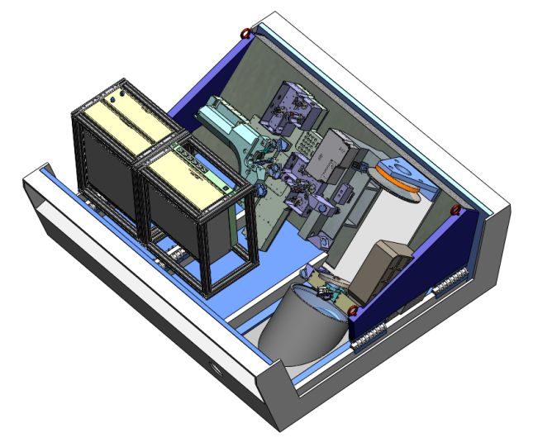
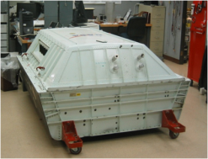
Integrated OAWL IIP System Arrangement in WB-57 Pallet
Chiller
Optic Bench
Receiver
Sub-Bench with Depolarization Detector
Electronics
Rack
Laser Power Supply
Telescope Primary Mirror
Power Condition Unit
Telescope Secondary Mirror
Data Acquisition Unit
Lifting Hooks
Wire Rope Vibration Isolators
Pallet Frame
Thermal Control
Isolation
Custom Double Window
Laser
Notes:
New
No data, just top level model showing architecture

Slide 23
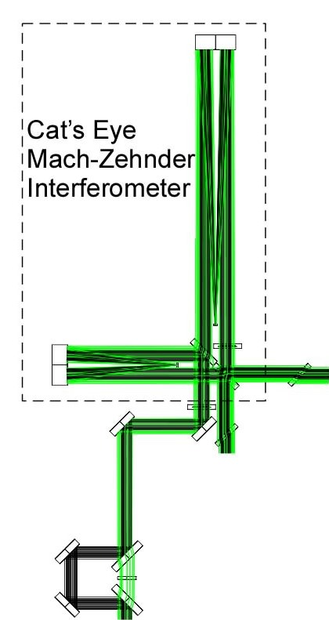
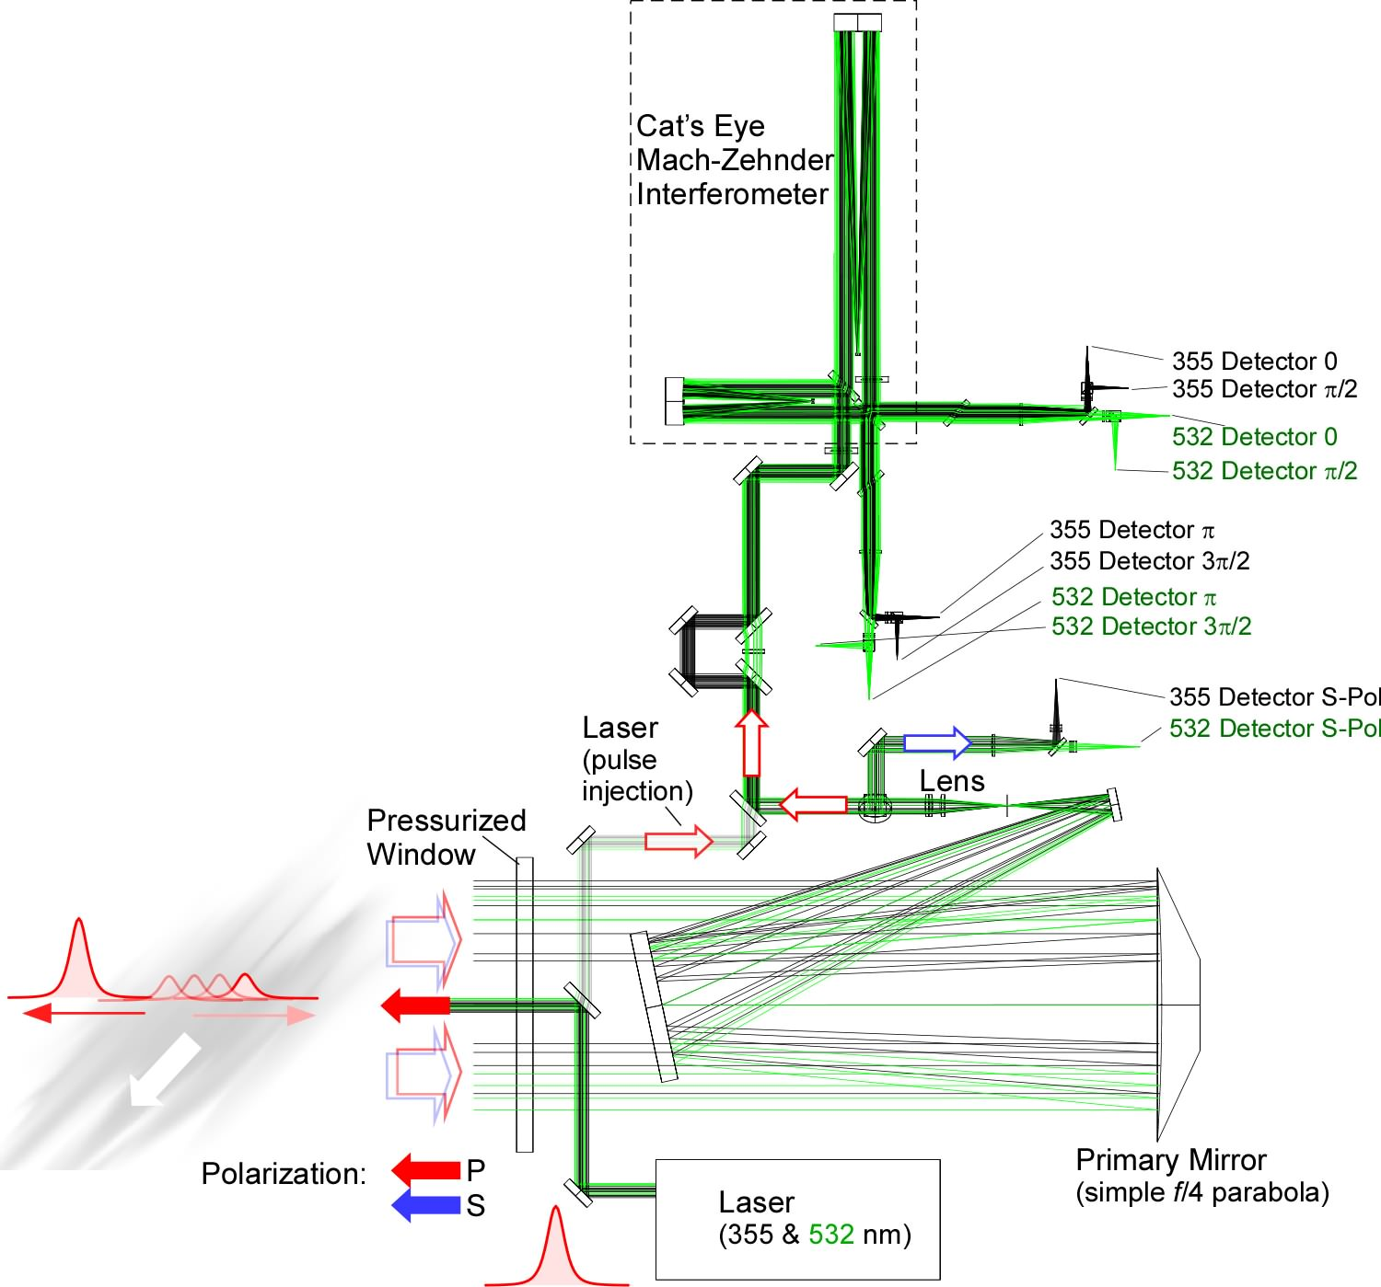
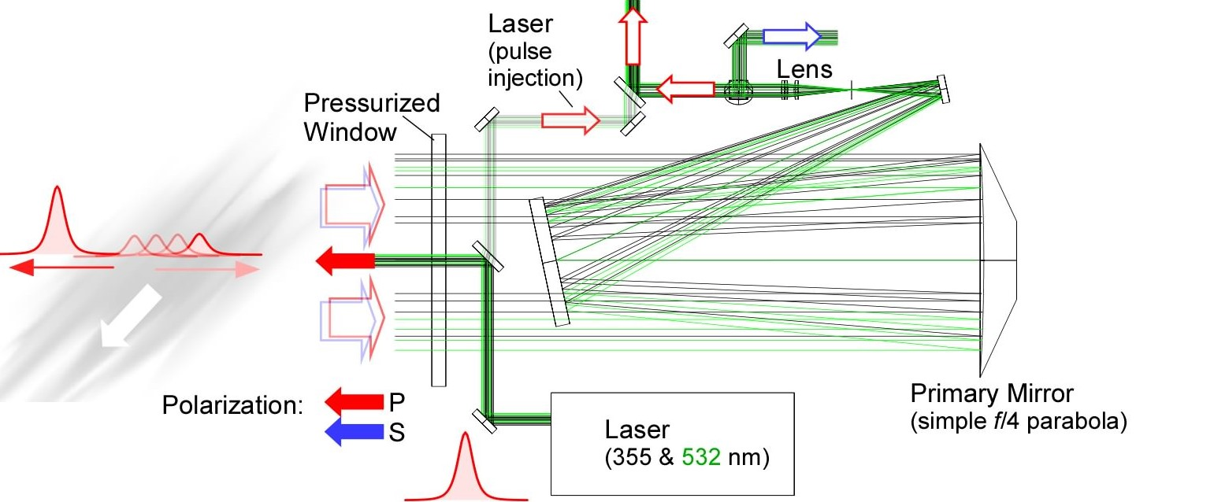
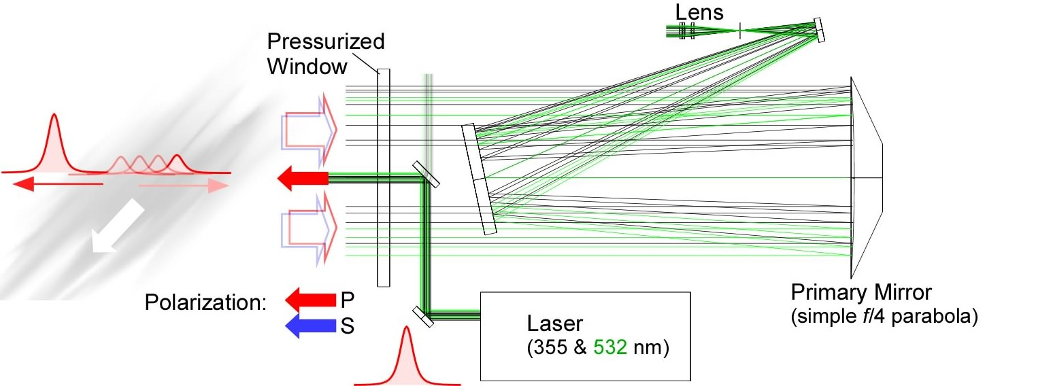
OAWL Transceiver Optical System
Interferometer
Detectors (10)
Zero-Time/OACF Phase Pulse
Pre-
Filter
Coaxial Bistatic R/T Alignment
Field Stop and Focus
Telescope
Laser
Ball Aerospace & Technologies
Notes:
New
The NASA funded IIP design architecture (no specific parts ID’s)
Repeat of the OAWL interferometer and detector architectures (essentially same as previously approved (2009 SPIE Defense and security)

Slide 24
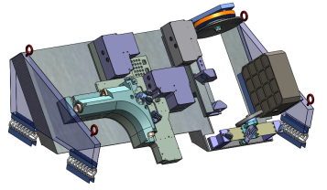
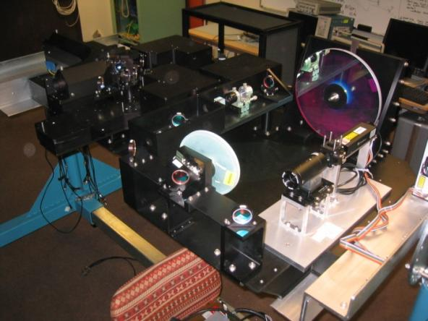
OAWL IIP System – Asssembled and Aligned
Temporary Laser
(50 μJ/pulse, 523 nm)
Notes:
New
No data, just top picture of as-built IIP transceiver.

Slide 25
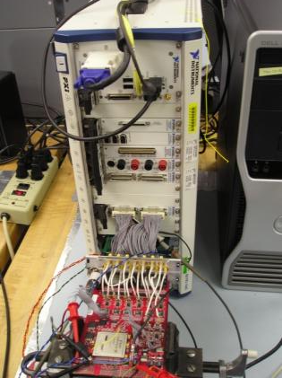
Data System In Test
Data system architecture
Based on National Instruments PXI Chassis
Utilizes mostly COTS Hardware
Custom (Ball) ADC daughter card on NI FPGA interface card
Custom (Ball) FPGA code to implement photon counting channels on NI card
Labview code development environment
Challenges & Solutions
Reduced air pressure at altitude degrades heat removal ability of stock cooling fans
Upgrade cooling fans, add fans as needed
Test system in altitude chamber
Jacket material used in COTS cables is PVC, which is not permitted on WB-57
Utilizing NI terminal strip accessories where possible
Fabricating custom cables made from allowable jacket materials
Ball Aerospace & Technologies
Notes:
New
No data just top level overview no specific parts identified

Slide 26

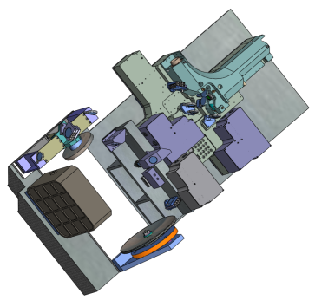
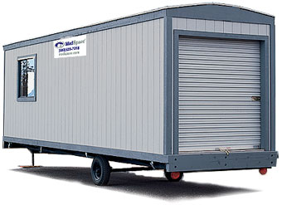
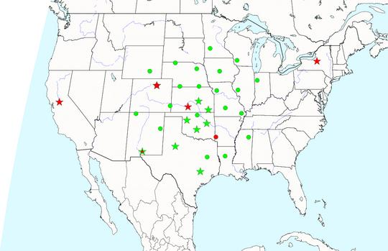
OAWL Validation Field Experiments Plan
NOAA HRDL 2μm Coherent Doppler Lidar
OAWL System
1. Ground-based-looking up
Side-by-side with the NOAA High Resolution Doppler Lidar (HRDL)
2. Airborne OAWL vs. Ground-based Wind Profilers and HRDL
(15 km altitude looking down along 45° slant path (to inside of turns).
Many meteorological and cloud conditions over land and water)
March 2010
Platteville, CO
Boulder, CO
Houston, TX
Leg 1
Leg 2
Multipass
Fall 2010
** Wind profilers in NOAA operational network
Ball Aerospace & Technologies
Notes:
No data. Previously approved

Slide 27
Taking an OAWL Lidar System Through TRL 5
NASA/ESTO Funded IIP Plan:
Program start, TRL 3 complete Jul. 2008 TRL-3
IRAD receiver delivered to IIP complete Nov. 2009
Receiver shake and bake (WB-57 level) complete Nov. 2009
System PDR/CDR complete Feb./Mar. 2009
Lidar system design/fab/integration complete Dec. 2009
Ground validations completed planned Apr. 2010 TRL-4
Airborne validations complete (TRL-5) planned Dec. 2010 TRL-5
Receiver shake and bake 2 (launch), or other exp? planned Apr. 2011
tech road mapping (through TRL7) planned May 2011
IIP Complete planned June 2011
Notes:
No data. Updated but otherwise identical in content to previously ITAR and IP approved slide.

Slide 28
Conclusions
The dual-wavelength, field-widened, OAWL receiver has been successfully completed and delivered to the IIP for lidar system integration.
Receiver testing showed that the receiver tolerates WB-57 Taxi, Takeoff, and Landing shock and vibe, and the data suggest that the receiver can actually operate with reduced performance under these extreme conditions.
The receiver performs near expectations during operational vibe conditions.
The IIP lidar system has been assembled and aligned, and data system debugging is in progress.
First light expected very soon.
Ground validations testing expected in March 2010.
Aircraft plans in place and flight conops understood.
WB-57 flight tests remain on track for Fall 2010 (TRL 5)
Ball Aerospace & Technologies
Notes:
Summarizes previous material, nothing new

Slide 29

Backups

Slide 30
Optical Autocovariance lidar (OAL) approach - Theory
Simplest OAL
(Not the IIP config)
Pulse Laser
CH 3
d
1
CH 2
Prefilter
From
CH 1
Atmosphere
Phase Delay
Receiver
Telescope
mirror
d
2
Beam
1
Splitter
2
3
Data
OPD=d₂-d₁
Detector
Detector
Detector
System
Frequency
Optical Autocovariance Wind Lidar (OAWL):
Velocity from OACF Phase: V = λ *Δφ * c / (2 * (OPD))
OA- High Spectral Resolution Lidar (OA-HSRL):
A = S_{a} * C_{aA} + S_{m} * C_{mA} , Θ = S_{a} * C_{aΘ} + S_{m} * C_{mΘ}
Yields: Volume extinction cross section, Backscatter phase function, Volume Backscatter Cross section, from OACF Amplitude
No moving parts / Not fringe imaging
Allows Frequency hopping w/o re-tuning
Simultaneous multi-λ operation
Δφ = phase shift as fraction of OACF cycle
Notes:
Previously approved: 2009 SPIE Defense and security

Slide 31
Ball Space-based OA Radiometric Performance Model – Model Parameters Using : Realistic Components and Atmosphere
LEO Parameters WB-57 Parameters
Wavelength 355 nm, 532 nm 355 nm, 532 nm
Pulse Energy 550 mJ 30 mJ, 20 mJ
Pulse rate 50 Hz 200 Hz
Receiver diameter 1m (single beam) 310 mm
LOS angle with vertical 45⁰ 45°
Vector crossing angle 90⁰ single LOS
Horizontal resolution* 70 km (500 shots) ~10 km (33 s, 6600 shots)
System transmission 0.35 0.35
Alignment error 5 μR average 15 μR
Background bandwidth 35 pm 50 pm
System altitude 400 km top of plot profile
Vertical resolution 0-2 km, 250m 100m (15m recorded)
2-12 km, 500m
12-20 km, 1 km
Phenomenology CALIPSO model CALIPSO model
Altitude (km)
Volume backscatter cross section at 355 nm (m⁻¹sr⁻¹)
λ-scaled validated CALIPSO Backscatter model used. (λ⁻⁴ molecular, λ^{-1.2} aerosol)
Model calculations validated against short range POC measurements.
Notes:
Previously approved (2009 SPIE Defense and security)
Input assumptions for hypothetical performance predictions from space-based lidar

Slide 32
OAWL – Space-based Performance: Daytime, OPD 1m, aerosol backscatter component, cloud free LOS
1km
Vertical Averaging (Resolution)
500 m
Threshold/Demo Mission Requirements
250 m
Objective Mission Requirements
Notes:
Latest hypothetical space prerformance predictions against customer given requirements, showing available margin
Previously approved (2009 SPIE Defense and security)

Slide 33
Looking Down from the WB-57 (Daytime, 45°, 33s avg, 6600 shots)
Notes:
Theoretical performance from aircraft,
Previously approved

