Slide 1


Ball Aerospace &
Technologies Corp.
Progress Toward Achieving Full-time Lidar Winds from Geostationary Orbit C.J. Grund, J.H. Eraker, B. Donley, and M. Stephens Ball Aerospace & Technologies Corp. (BATC), cgrund@ball.com 1600 Commerce St. Boulder, CO 80303 Working Group on Space-based Lidar Winds Ft. Walton Beach, FL February 3, 2010
Agility to Innovate, Strength to Deliver

Slide 2
Executive Summary
It appears feasible to simultaneously acquire ~64 independently targetable tropospheric wind profiles from GEO at 20 minute intervals with 3D wind mission precision (<1 – 2 m/s).
Both full scale mission (3m telescope) and smaller demo mission (0.5m telescope) scenarios are achievable within current technology limitations.
More wind profiles/day (4608) are acquired than all wind sondes in North America
DWL Paradigm shift: Staring from Geo allows long integration of single photon signals.
Ideal sampling for improved model predictions of high societal benefit weather events (difficult to observe with traditional LEO DWL approaches)
tropical cyclogenesis / cyclolosis
severe storms, clear air deformations / vorticity concentration leading to tornados
Rapid short wave amplification
Significant investments in needed technologies are already being made by NASA and Ball., (e.g. OAWL, ESFL, I²PC). More is need to fully develop this capability, but the payoff is high.
Ball Aerospace & Technologies

Slide 3
Why Winds from GEO? Isn’t LEO Hard Enough?
GEO: regional, 24/7 vantage ideal for observations of high societal benefit weather events difficult to observe from LEO:
Nowcasting and short term (6-36 hr) model predictions of severe storms
rapid flow deformation/ vorticity concentration
lower false alarms
geographically pin point tornado touchdown areas
High temporal/spatial density tropical cyclogenesis / cyclolosis observations
rapid updates in critical steering / sheer regions
improved hurricane landfall and intensity model prediction
Tracking rapidly evolving short waves
Supporting eddy flux measurements, regional pollution transport, night jets
Dwells to improve short/long range forecast uncertainty
Supporting wind farm power generation
Does not need hydrometeors to trace flow ➔ Clear air streamline curvature
Ball Aerospace & Technologies
Notes:
No data just hyperbole

Slide 4
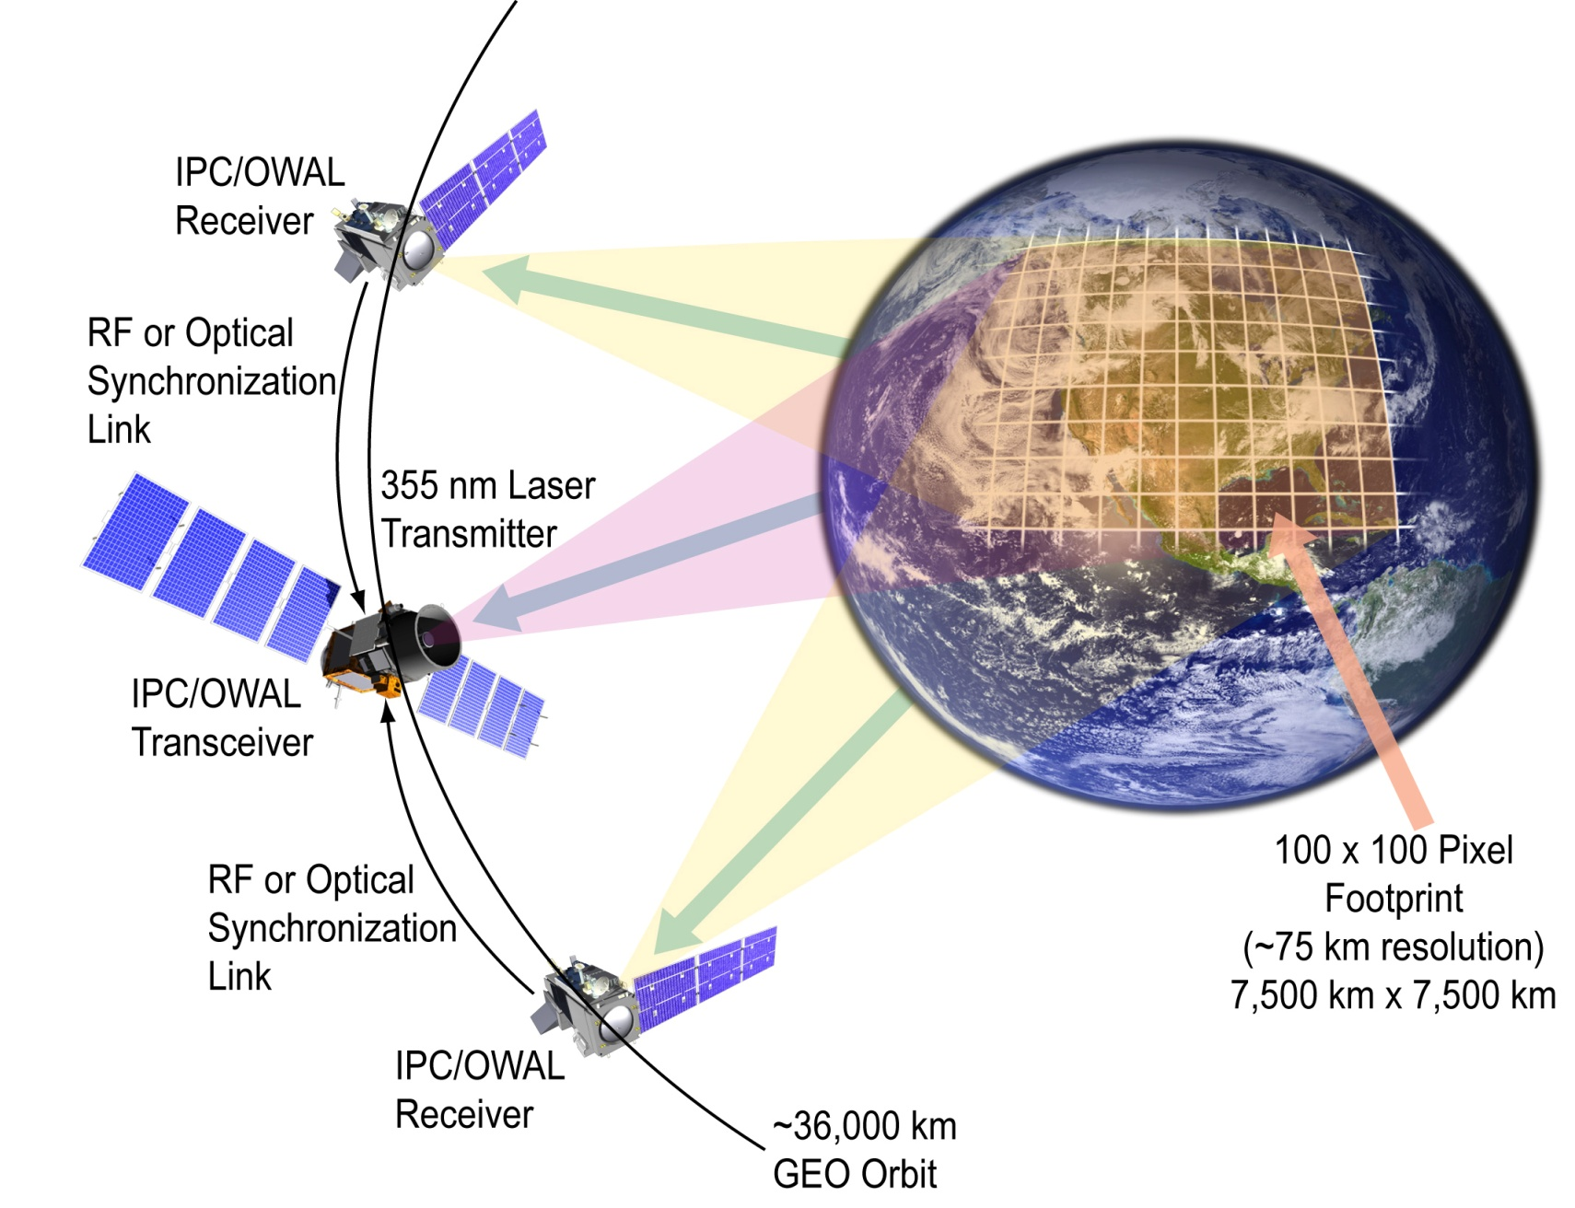
Imaging, Photon Counting Lidar Doppler Wind Profiling A DWL Measurement Paradigm Shift
Optional
Required
Staring
N * N Pixel Footprint
Optional
Concept first presented at the Snowmass WG meeting 7/07
Ball Aerospace & Technologies
Notes:
Previously approved and publically shown

Slide 5
GEO-OAWL Hardware Components – Confluence of Multiple Recent Technology Developments
Electrically Steerable Flash Lidar (ESFL) –
Subject of Carl Weimer’s current NASA ESTO IIP
(Desdyni focus) (1J/pulse OK, 90X90 independent beamlets OK)
355nm, 0.5 – 1J/pulse, 100 Hz (current tech)
Independently retargetable beams
No momentum compensation
Electronic Beam forming and steering
AOM
Laser
Subject of Ball IRAD development
and current NASA ESTO IIP demonstration
(3D Winds focus)
Patent pending
Patents pending
4-phase
Field-widened
OAWL Receiver
Fixed-pointing
Wide-Field
Receiver
Telescope (~3°X3°)
Subject of Ball IRAD development
for high-sensitivity and resolution flash lidar and low- light passive astrophysical imaging (Intensified Imaging Photon Counting (I²PC) FPA).
4 Photon counting Profiling,Flash Lidar Imaging Arrays
Co-boresighted
camera to geo-locate pixels from topographic outlines
Patent pending
ESFL allows targeting with high spatial resolution and adaptive cloud avoidance
Ball Aerospace & Technologies
Notes:
New. Top level hypothetical architecture block diagram, no data

Slide 6
GEO-OAWL Wind Performance Model Components
Geometric Model
Spherical earth/atmosphere geometry
Local surface normal altitude profiles
Local horizontal projection
Accurate incidence angle wrt lat/lon
Radiometric Model
Range
Extinction (mol + aer)
Background light
Aerosol backscatter
Optical Rx, efficiency
Detection efficiency
Signal Processing Model
OAWL 4-channel fit performance
Time integration (typ. 20 min.)
Geometric vector projections for winds/precisions
Plot Results
Not in Model
R/T beam overlap (ESFL mitigation)
Refractive turbulence (altitude errors)
Atmospheric dynamics
Clouds
Ball Aerospace & Technologies
Notes:
New: Performance model architecture, no data

Slide 7
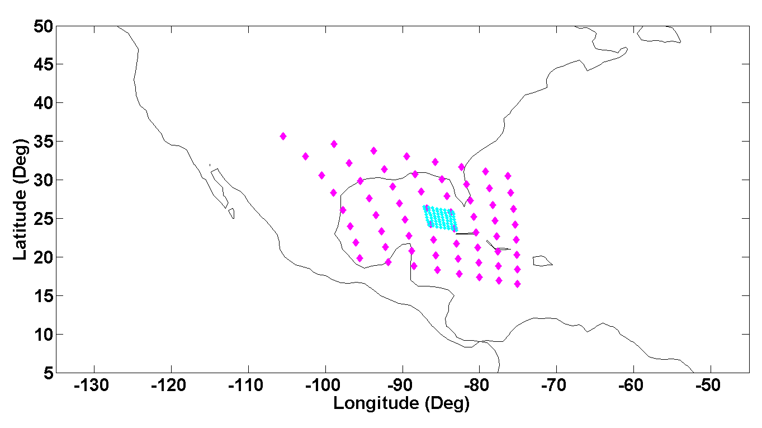
Typical Simultaneous Wind Measurement Domains
~ Current Technology
Full Mission (3m telescope)
3° X 3°, 8 X 8 pixels
~ Current Technology
Proof of Concept
(0.5m telescope)
0.5° X 0.5°, 4 X 4 pixels
(up to 10°X10° maybe feasible)
Ball Aerospace & Technologies
Notes:
New: Hypothetical coverage possible within currently available technologies.. No technologies specified.

Slide 8
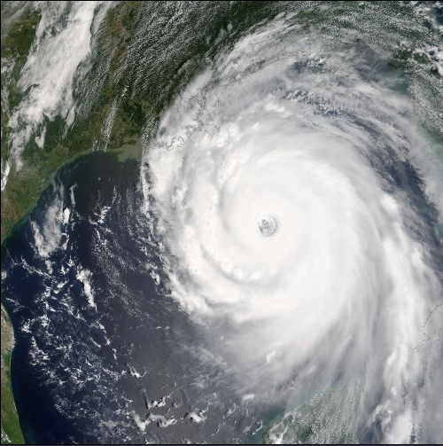
Hurricane Katrina Context, for Example
Shear
Steering
Eye-wall winds?
Inflow
Ball Aerospace & Technologies
Notes:
New: see previous slide

Slide 9
Space-based OAWL Radiometric Performance Model – Model Parameters Employ Realistic Components and Atmosphere
GEO Parameters
Wavelength 355 nm
Pulse Energy 1J
Pulse rate 100 Hz
Receiver diameter 3m, 0.5m (scenario)
Averaging/update time 20 min, 1 Hr (scenario)
LOS angle with vertical Lat/Lon dependent
Horizontal resolution 37.5km, 75km (scenario)
System transmission 0.35
Background bandwidth 35 pm
Vertical resolution 0-2 km, 250m
2-12 km, 1km
12-20 km, 2 km
Phenomenology CALIPSO model (right)
Wind backscatter aerosol only
Extinction aerosol + molecular
Altitude (km)
Volume backscatter cross section at 355 nm (m⁻¹sr⁻¹)
λ-scaled validated CALIPSO Backscatter model used. (λ⁻⁴ molecular, λ^{-1.2} aerosol)
Ball Aerospace & Technologies
Notes:
Previously approved (2009 SPIE Defense and security)
Input assumptions for hypothetical performance predictions from space-based lidar. Updated slightly for this scenario.

Slide 10
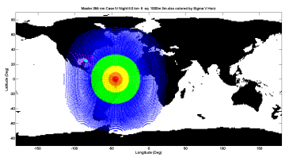
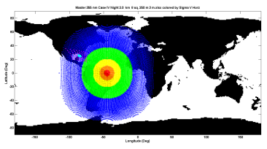
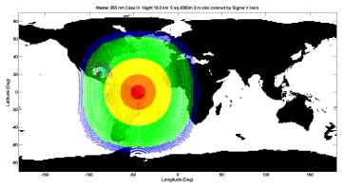
Full Mission 3m Telescope Scenario Predictions
(km) Alt Res_
<2 0.25
8 1.0
16 2.0
Scenario Parameters
Telescope dia. 3.0 m
Horizontal resolution 75 km
Simultaneous Pixels 8 X 8
Payload SWaP Projections
Mass < 800 kg
Power < 2 kW
Payload volume ~ 3.6 m³
Missions
Tropical cyclogenesis and storm tracking
Severe storm /tornado early warning
Short wave cyclogenesis
North Pacific /Canada obs for winter storm prediction
Targeted NWP model noise reduction
Targeted wind farm power prediction
Sampled region
73°
Accessible
Region
Horiz. Precision
< 1 m/s
1 – 2
2 – 4
4 – 10
> 10
73°
Ball Aerospace & Technologies
Notes:
New: theoretical wind measurement performance expectations from a hypothetical system.

Slide 11
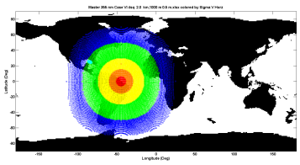
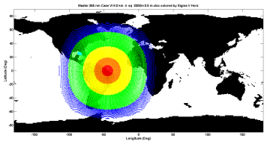
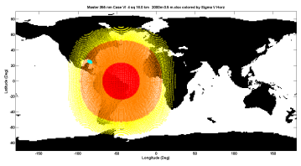
Proof of Concept Mission Scenario Predictions
(km) Alt Res_
<2 0.25
8 1.0
16 2.0
Scenario Parameters
Telescope dia. 0.5 m
Horizontal resolution 37.5 km
Simultaneous Pixels 4 X 4
Payload SWaP Projections
Mass < 250 kg
Power < 1.8 kW
Payload volume ~ 3.6 m³
Missions
Tropical cyclogenesis and storm tracking
Severe storm /tornado early warning
Short wave cyclogenesis
Targeted NWP model noise reduction
Targeted wind farm power prediction
Sampled region
73°
Accessible
Region
Horiz. Precision
< 1 m/s
1 – 2
2 – 4
4 – 10
> 10
Ball Aerospace & Technologies
Notes:
New: theoretical wind measurement performance expectations from a hypothetical system.

Slide 12
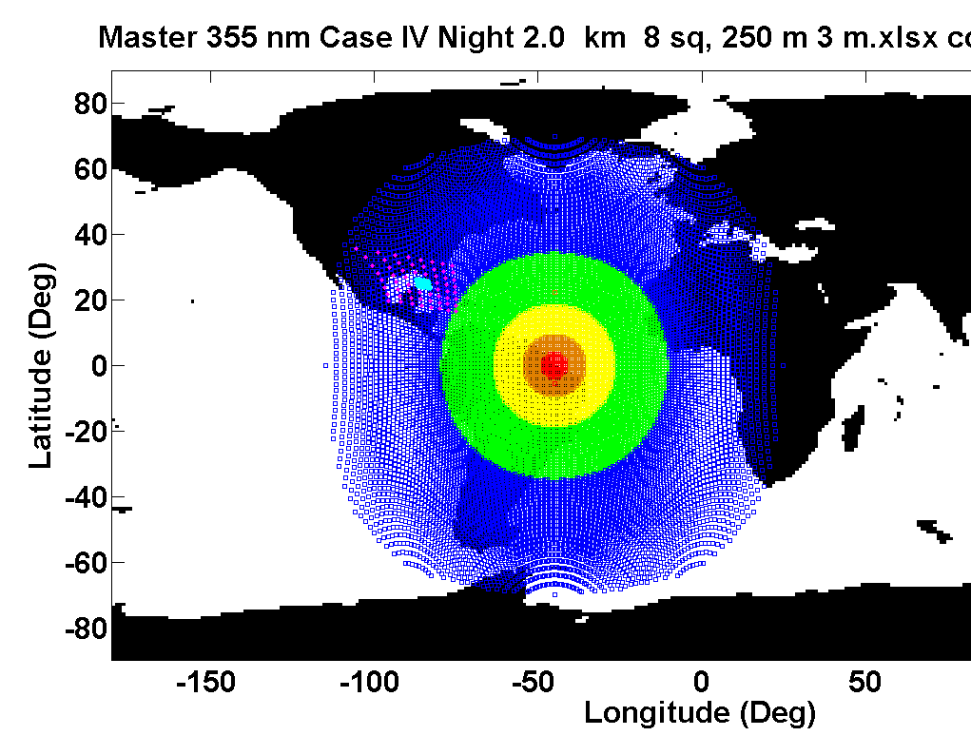
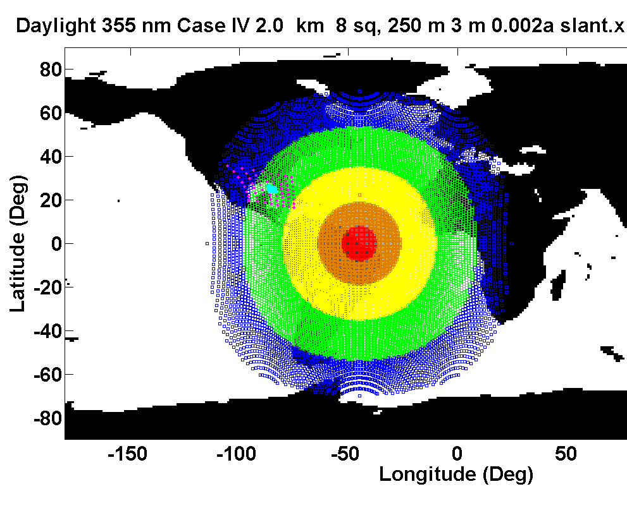
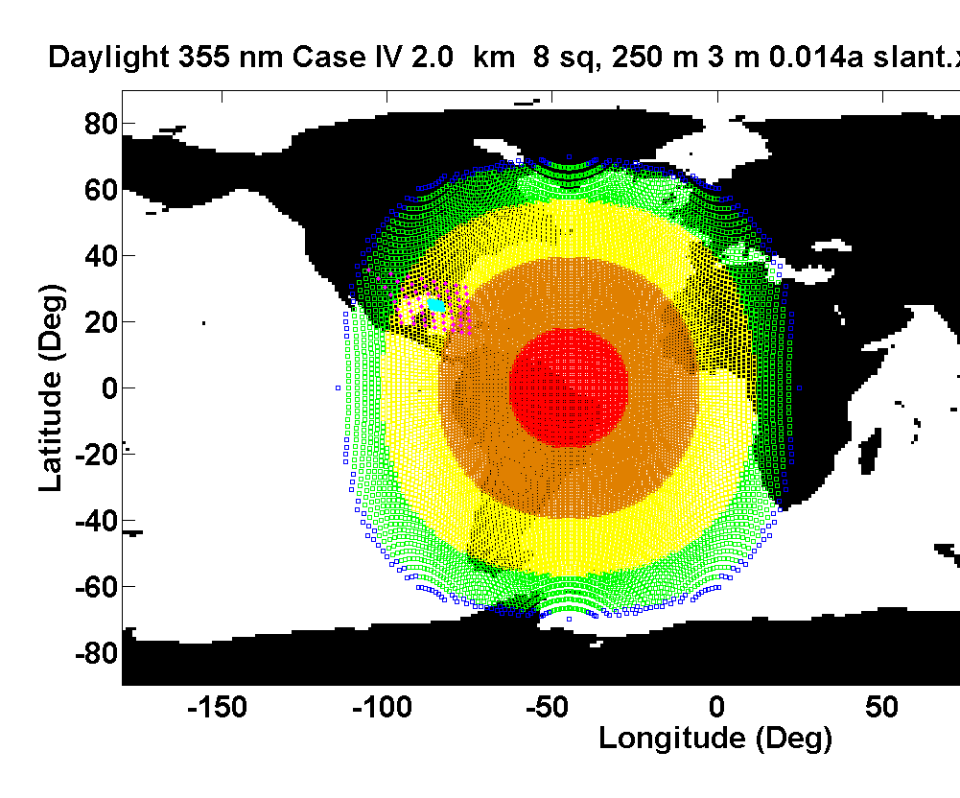
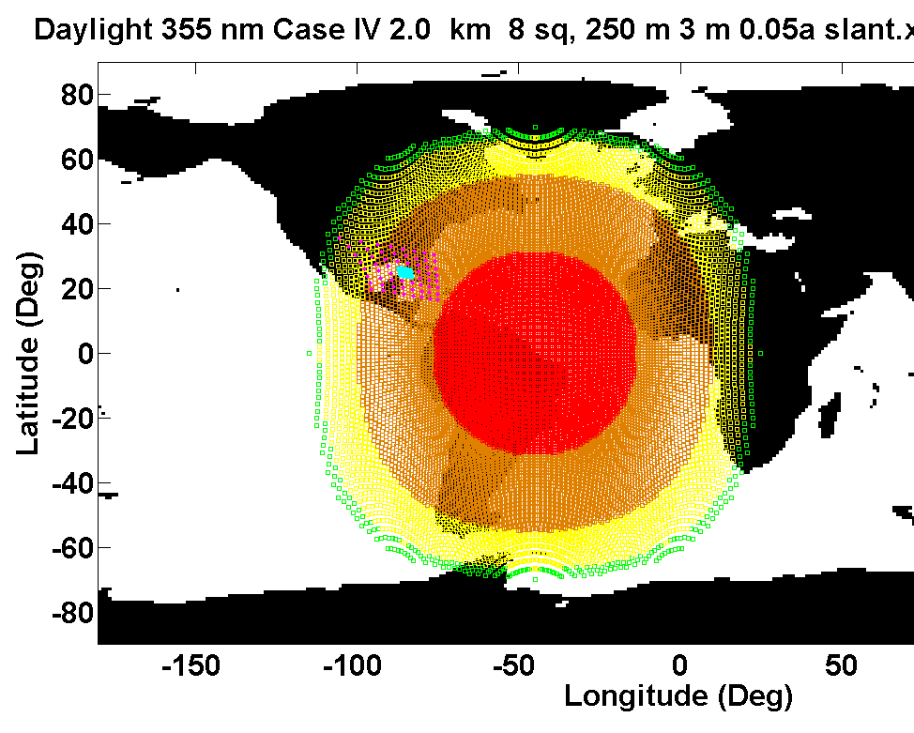
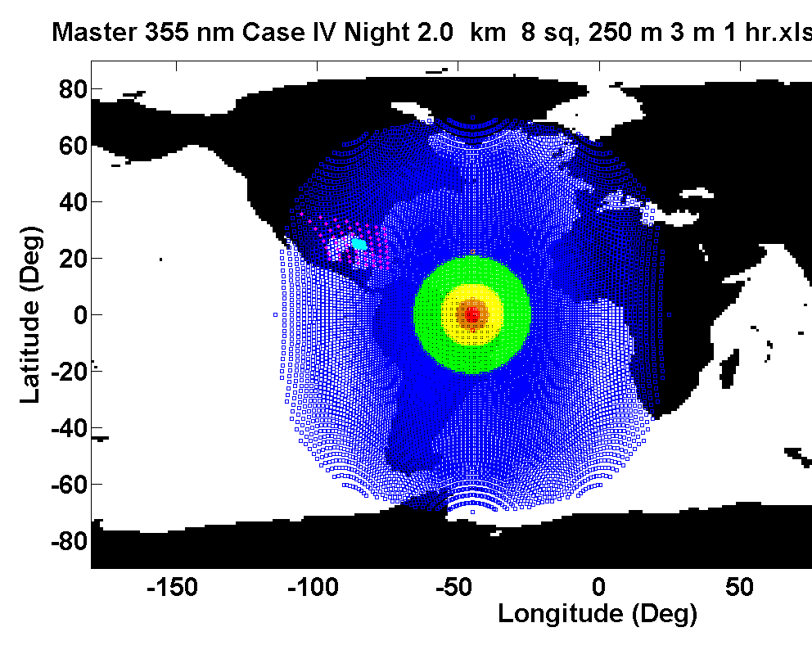
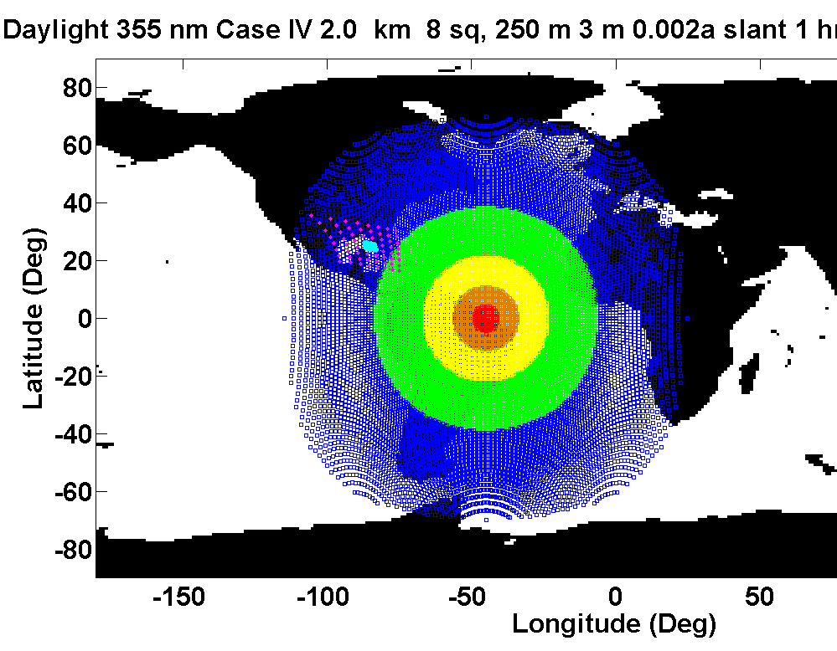
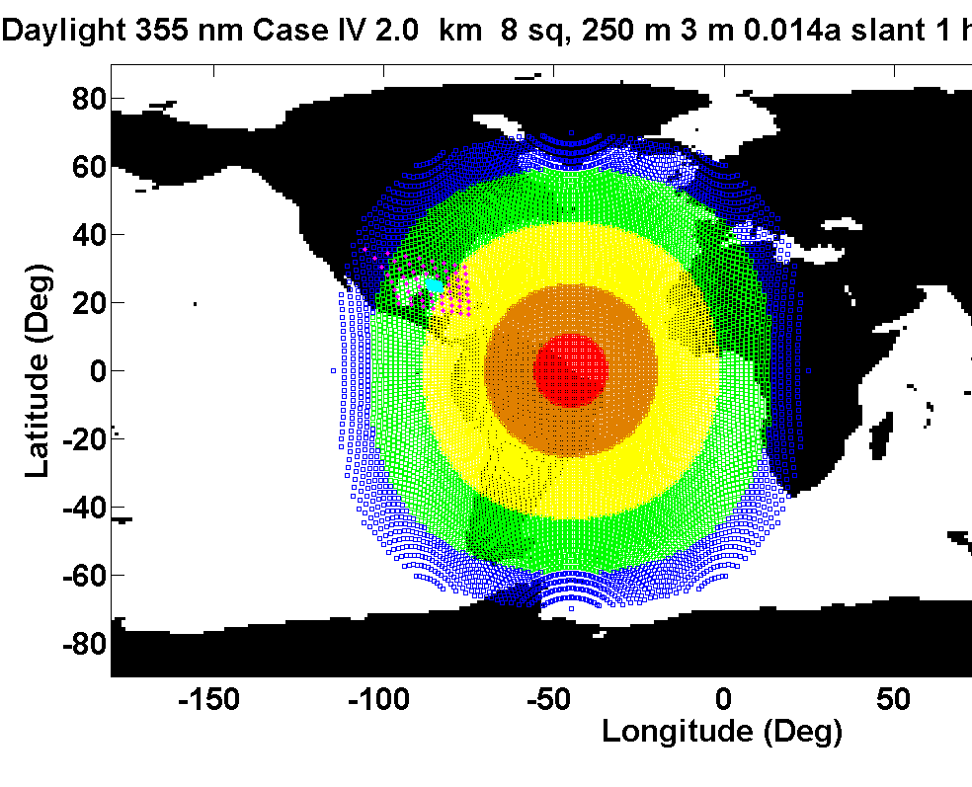

Effect of Daytime Background Light – Full Mission <2 km Altitude, 250m altitude resolution
20 Min: Night Day 90° Solar Angle Day 45° Solar Angle Day 135° Solar Angle
45° Solar angle
1 Hr: Night Day 90° Solar Angle Day 45° Solar Angle Day 135° Solar Angle
Horiz. Precision
< 1 m/s
1 – 2
2 – 4
4 – 10
> 10
Note: that multiple satellites (say 6) placed with overlapping fields of regard also mitigate sunlight; choose the satellite view that has the best sun angle.
Ball Aerospace & Technologies
Notes:
New: theoretical wind measurement performance expectations from a hypothetical system.

Slide 13
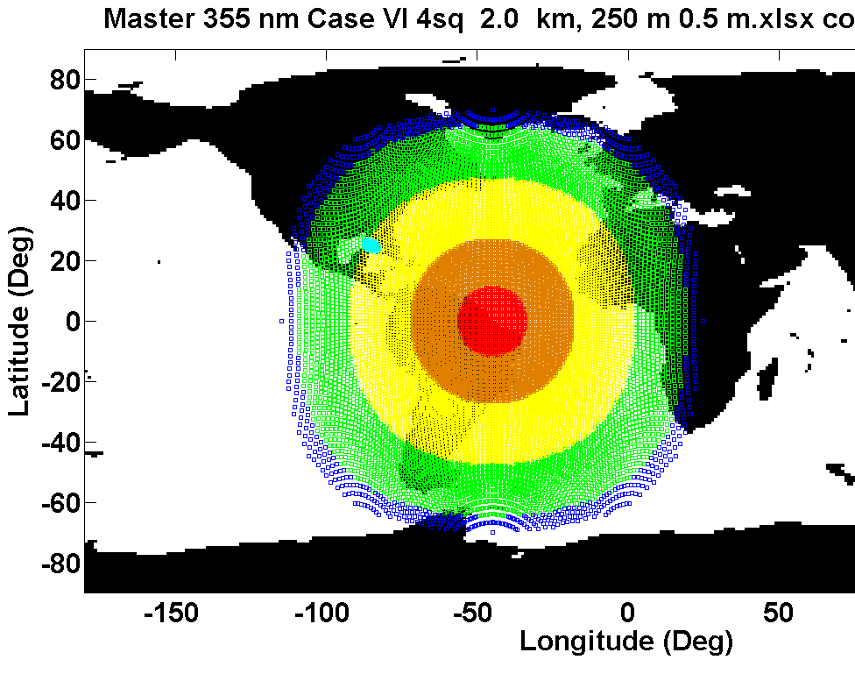



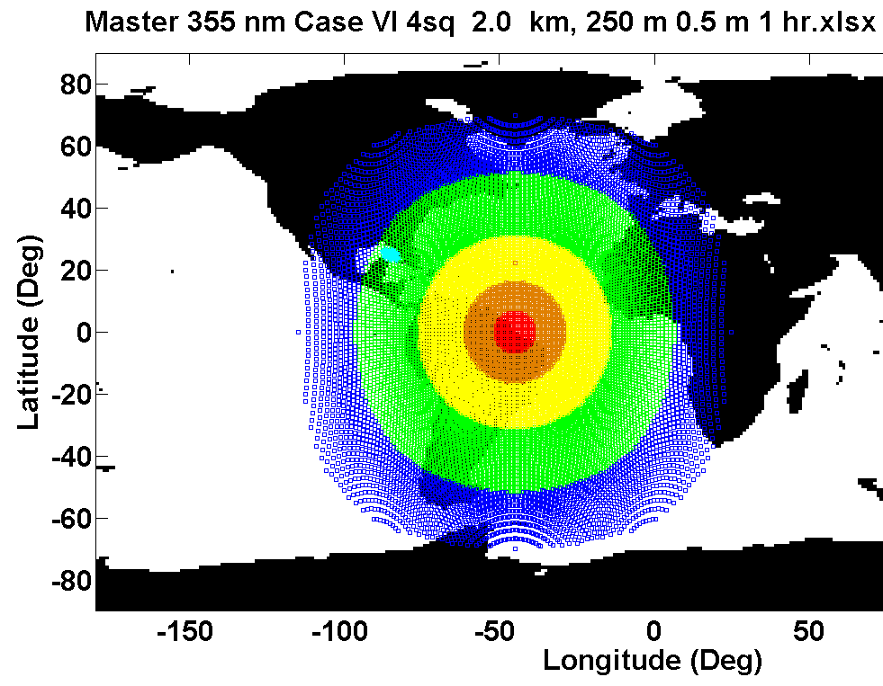



Effect of Daytime Background Light – POC Mission <2 km Altitude, 250m altitude resolution
20 Min: Night Day 90° Solar Angle Day 45° Solar Angle Day 135° Solar Angle
1 Hr: Night Day 90° Solar Angle Day 45° Solar Angle Day 135° Solar Angle
Horiz. Precision
< 1 m/s
1 – 2
2 – 4
4 – 10
> 10
Ball Aerospace & Technologies
Notes:
New: theoretical wind measurement performance expectations from a hypothetical system.

Slide 14
GEO Wind Lidar Characteristics
Simple staring receivers, no scanning or multiple telescope switching needed for up to 64 profiles anywhere within a 3° X 3° region.
Long integration perfect for photon counting but needs the right combination of existing technologies to make feasible (OAWL,I2PC, and ESFL are enabling,)
“Sees” through broken cloud, large footprint, long-duration observations
Graceful degradation in partially cloudy conditions, also ESFL smart targeting to avoid clouds
Combine with passive or DIAL profiling chemical sensing ➔ fluxes at regional and national boundaries
1 transmitter can service several receivers, simultaneous parallax vector obs
Temporal averaging inherently smoothes winds for direct incorporation in models (not single point or a narrow line average)
Inherent 2-D horizontal spatial average improves wind fidelity over oceans
Crude pointing sufficient. Use co-boresighted camera to navigate.
Use of ESFL allows rapid independent retargeting of profiling pixels W/O moving telescopes
Ball Aerospace & Technologies
Notes:
Summarizes previous material, nothing new

Slide 15
Potential Winds+ Missions
Combined NexRad and IPC/OAWL in GEO – both clear air stream flow and hydrometeor tracing in cloudy regions of severe storms
High precision severe storm warnings
Extended warning times
OAWL winds + OAWL HSRL + Passive trace gas profiling
Trace gas flux: transport across regional, state, and national boundaries
Visibility measurement and forecasting
Accurate regional moisture flux for convective storm and rainfall (flooding) forecasts
Climate source and sink studies
OAWL HSRL aerosol extinction corrects passive radiometry
OAWL winds + OAWL HSRL + DIAL trace gas sensing + Depolarization
Similar to above but higher altitude resolution and precision
High precision eddy correlation fluxes over land and oceans
DIAL, Depolarization, and OAWL can use the same laser; wavelength hopping no problem for OAWL
Cloud ice/water discrimination
Shared large aperture telescope
Notes:
Summarizes previous material, nothing new

Slide 16
Next Steps
Model improvements
effects of refractive turbulence on altitude/pointing errors
improved background light model with full solar and viewing geometry
incorporate cloud effects
evaluate vector winds using passive slave receivers
consider molecular signal use for upper/clean atmosphere (shorter OPD OAWL, IDD)
Technology developments
Telescope design to increase field of regard (in progress)
I²PC photon-counting flash arrays (in progress)
Electrically steerable flash lidar (ESFL) (in progress)
Optical Autocovariance Wind Lidar (in progress)
Programmatic
Complete and distribute white paper (in progress)
Peer review publication of concepts and performance (in progress)
seek CRAD funding opportunities for hardware, concept, and theory development
Ball Aerospace & Technologies
Notes:
No data just outlines planned work

Slide 17
Conclusions
Multiple full-time real-time high-quality lidar wind profiles can be simultaneously acquired from GEO orbit over a substantial region (3° X 3° or more) , and better than 1 m/s precision and 250 m vertical resolution using an imaging, photon-counting Optical Autocovariance wind lidar method.
Both scaled down proof of concept and full scale missions can be achieved with existing technologies.
GEO perspective provides significant advantages for some wind missions
Profiles where and when needed for Tropical Cyclone intensity and accurate track forecasting . 72 updates/24 hrs/pixel (4608 total profiles/day) exactly where needed.
Shear over tropical cyclones; potential eye-wall velocities.
Rapid convergence of vorticity, deformation in clear air (radar needs hydrometeors)
Pinpoint severe storm predictions, earlier tornado warning times, nowcasting
High temporal density wind soundings off coasts; north Pacific for example
High-efficiency electronic beam direction allows intelligent sparse/high density sampling
Modest processing requirements lead to low data rate com requirements
Notes:
Presents:
1. description of the atmospheric phenomenology exploited by wind lidars (well known theory).
2. description of Michelson interferometry (text book stuff)
3. top level description of the origin of the optical autocovariance lidar signal (covered by Ball patent applied for)
4. Top level system block diagram showing the main components implemented in an optical autocovariance lidar

Slide 18
Backups

Slide 19
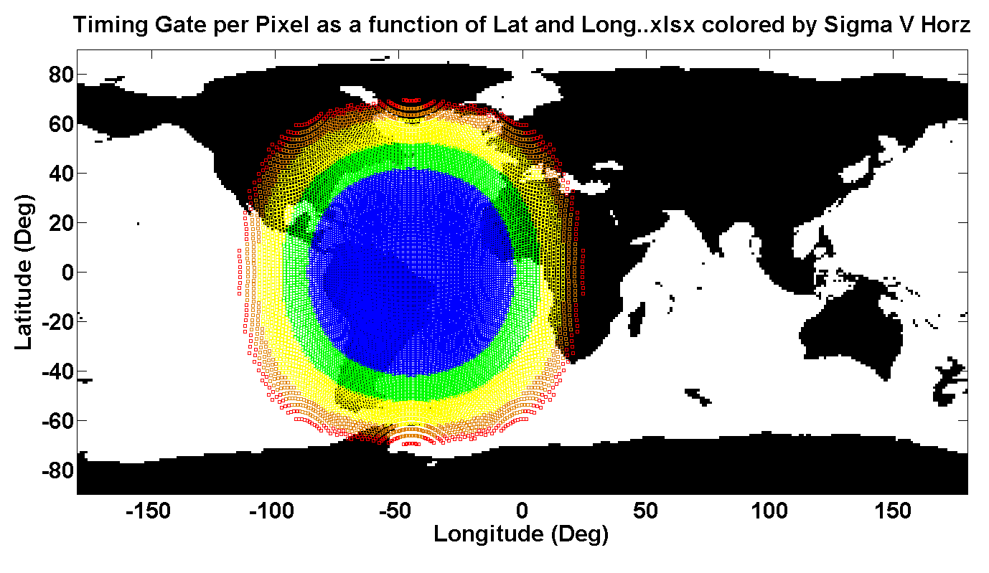
Geometry: interesting insights
Velocity precision improves toward the limb because the sampling volume elongates the horizontal sample distance for a given altitude (or range) resolution.
Voxels undergo only a few % distortion in the current limb scenarios
Relative Horizontal Elongation for a Fixed Range Gate
1-1.5 Blue
1.5-2 Green
2-3 Yellow
3-4 Red
> 4 Orange
Ball Aerospace & Technologies
Notes:
Now data, just theoretical geometric projections of hypothetical sampling scenarios.

Slide 20
OAWL – LEO Space-based Performance: Daytime, OPD 1m, aerosol backscatter component, cloud free LOS
1km
Vertical Averaging (Resolution)
500 m
Threshold/Demo Mission Requirements
250 m
Objective Mission Requirements
Notes:
Latest hypothetical space prerformance predictions against customer given requirements, showing available margin
Previously approved (2009 SPIE Defense and security)

