Slide 1
Application of a High-Pulse-Rate, Low-Pulse-Energy Doppler Lidar for Airborne Pollution Transport Measurement
Mike Hardesty^{1,4}, Sara Tucker^{4*},Guy Pearson^{2,3}, Fay Davies³, Raul Alvarez II¹, Christoph Senff⁴, and Richard Marchbanks⁴
¹NOAA Earth System Research Laboratory, Boulder, CO, USA
²Halo Photonics, Great Malvern, U. K.,
³University of Salford, Salford, U.K.
⁴Cooperative Institute for Research in Environmental Sciences Boulder, CO, USA
*now with Ball Aerospace

Slide 2
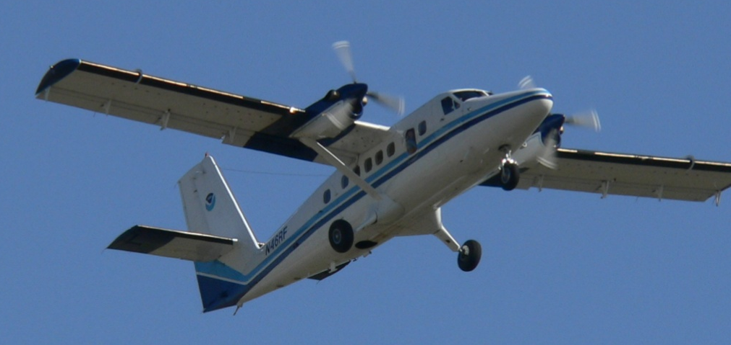
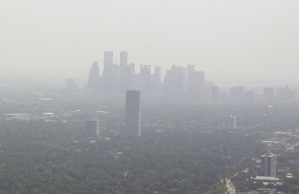
Overview
Objective: co-deploy a Doppler lidar with ozone lidar and AMAX-DOAS on an aircraft for pollution studies
Which Doppler lidar to use?
Ground-based comparisons of an off the shelf Doppler instrument with a research lidar
Aircraft deployment tests (summer 2009)
Future plans

Slide 3
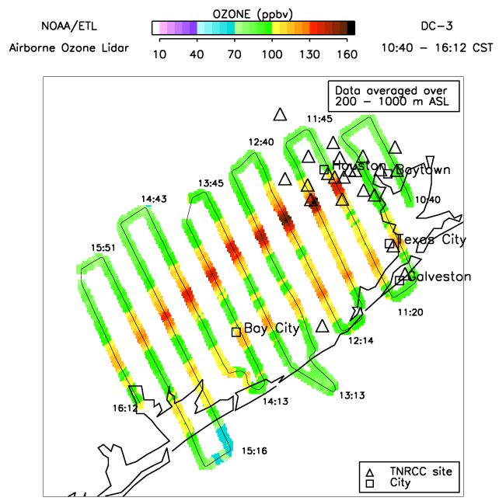
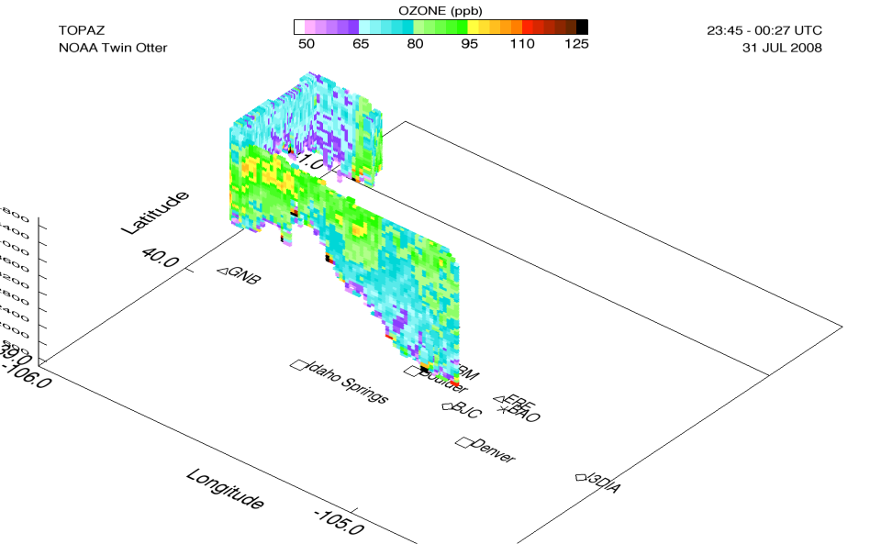
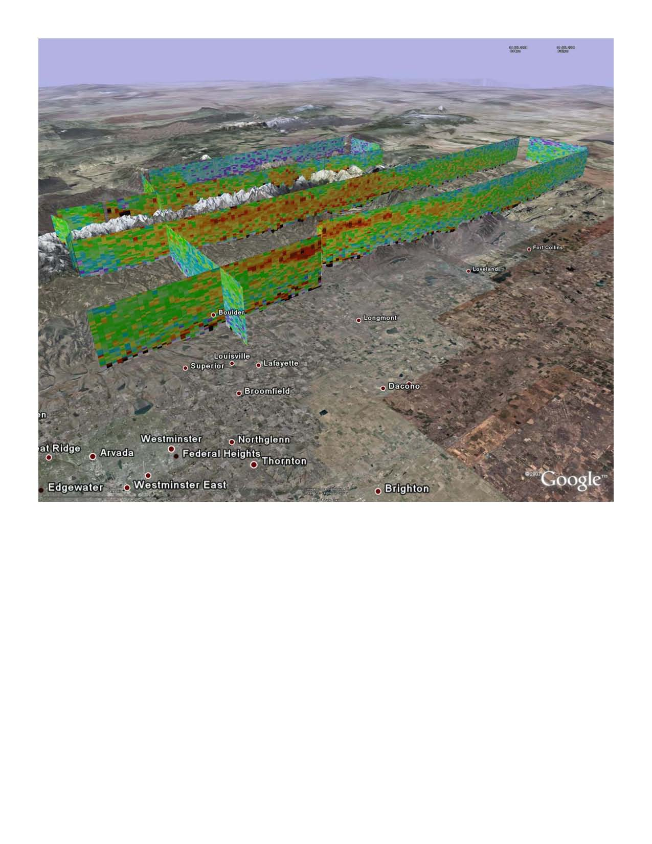
Background
NOAA has a goal to improve air quality forecasting with major field campaigns to characterize air quality in different regions
Field observations include DIAL ozone profiles and DOAS NO₂ column from a Twin Otter aircraft to observe 3-D regional ozone distribution
Better wind information is needed to determine transport of pollutants, particularly in complex terrain
Goal: study feasibility of adding a Doppler lidar to the Twin Otter to measure horizontal fluxes

Slide 4
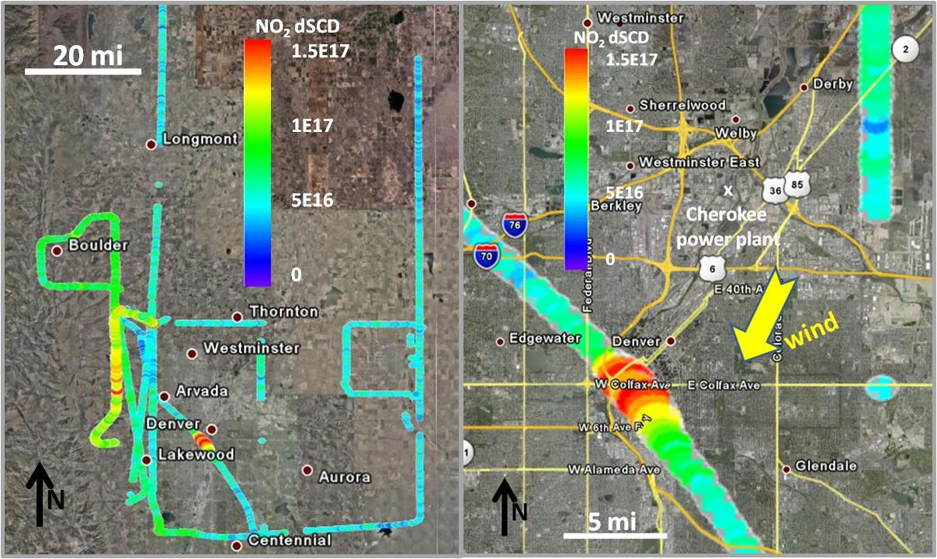
AMAX DOAS Measurements of NO₂
NO₂ slant column density below aircraft
NADIR telescope, QE65000 spectrometer #2, 5 sec data
NO₂ enhancements downwind
of Denver / over foothills
Expanded inset (from the left):
NO₂ plume downwind of the
Cherokee power plant

Slide 5
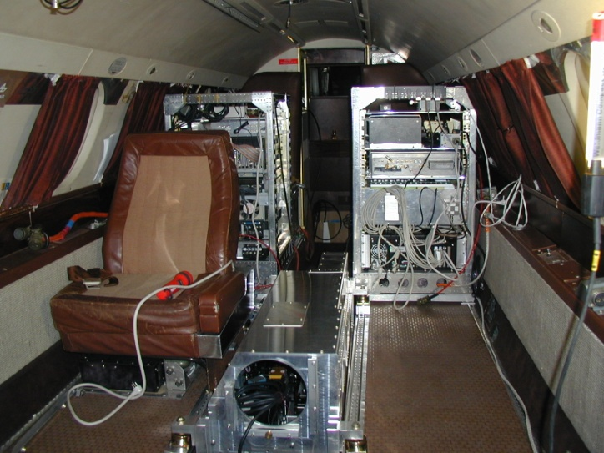
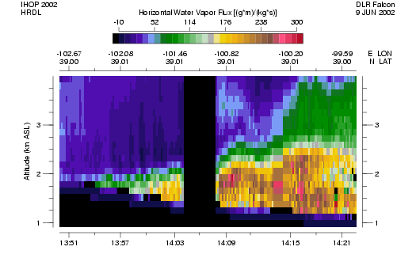
Previous airborne lidar measurements of species transport
Demonstrated capability of co-deploying lidar for species transport during 2002 IHOP campaign
Installed NOAA high resolution Doppler lidar with DLR water vapor DIAL on the DLR Falcon
Measured vertical and horizontal transport of water vapor in the boundary layer
Goal: duplicate this measurement with ozone DIAL
Problem: No room for HRDL on the NOAA Twin Otter
Proposed solution: Compact commercial lidar (Halo Photonics)
DIAL/Doppler lidar (1500 m spacing)

Slide 6
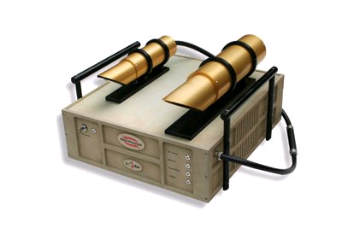
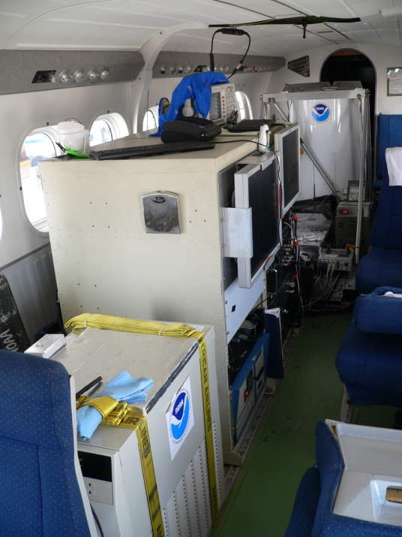
Experiment objectives
Characterize the Halo Photonics Doppler lidar by comparing with HRDL
Install the Halo lidar on the Twin Otter
Evaluate the ability of the lidar to operate in the aircraft environment
Evaluate sensitivity for boundary layer measurements for operation at 3-4 km flight altitudes
Demonstrate combined ozone and wind measurements

Slide 7
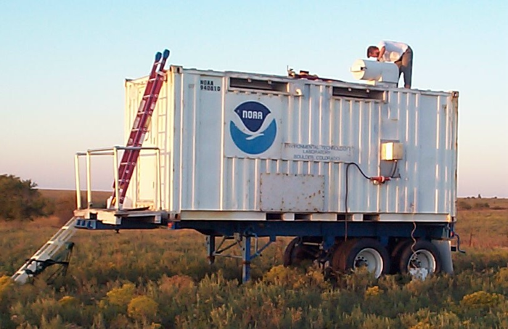
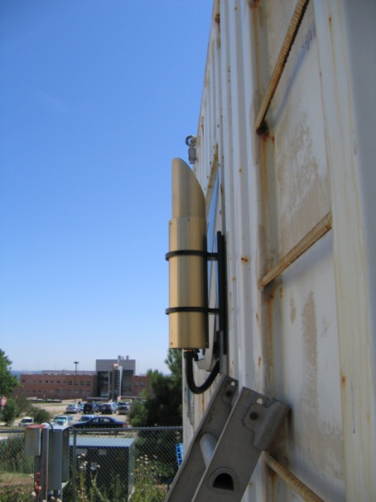
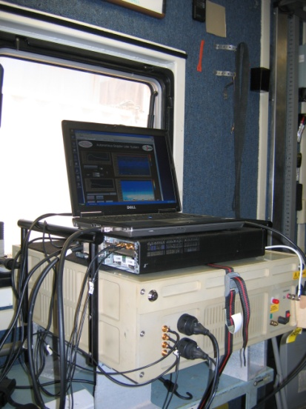
HRDL/Halo Comparison
 | Halo | HRDL
Detection type | coherent | coherent
Wavelength (µm) | 1.6 | 2.0
PRF (Hz) | 20 ,000 | 200
Pulse Energy | µJ | mJ
Aperture (cm) | 7.5 | 10
Range gate (m) | variable | 30
Operated for nearly 24 hours
Two modes: vertically and nearly horizontally pointing
Compare instantaneous velocity measurements with same averaging time (~1-2 s)

Slide 8
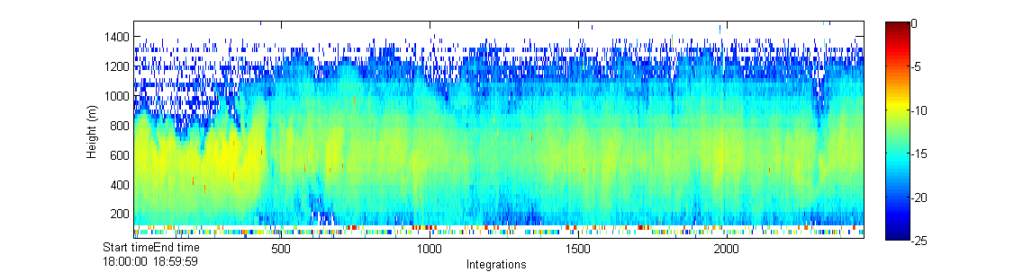
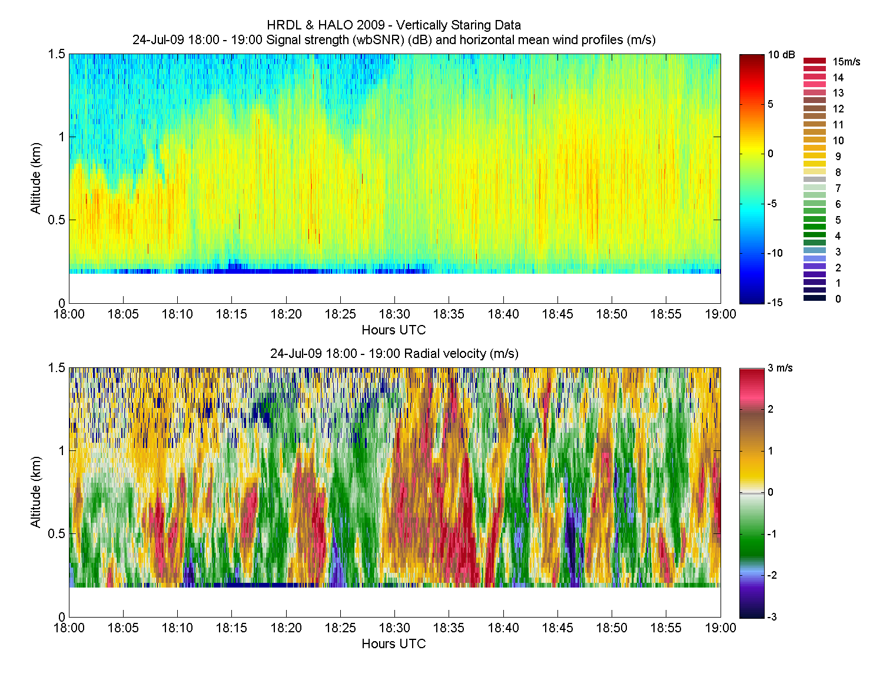
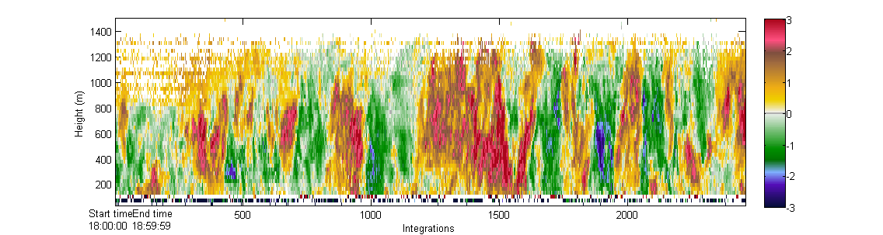
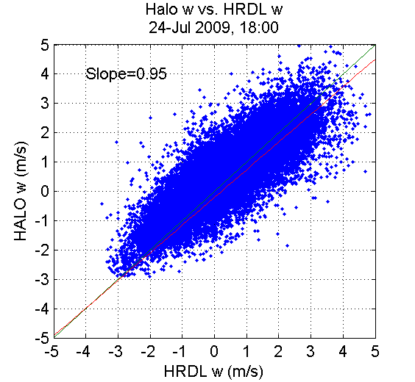
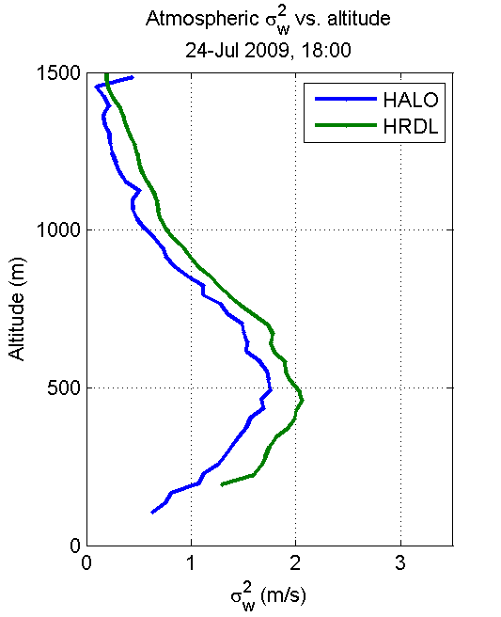
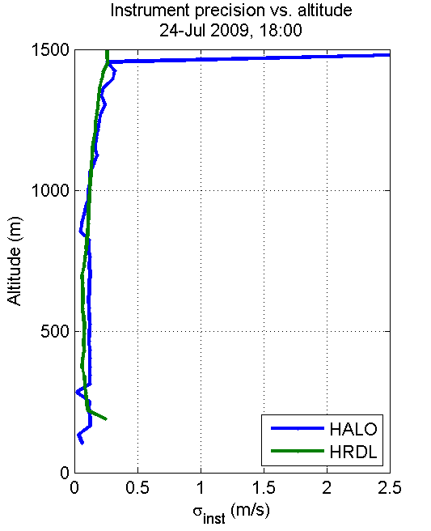

Slide 9
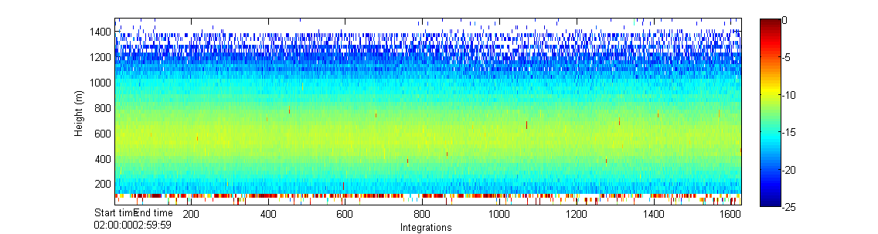
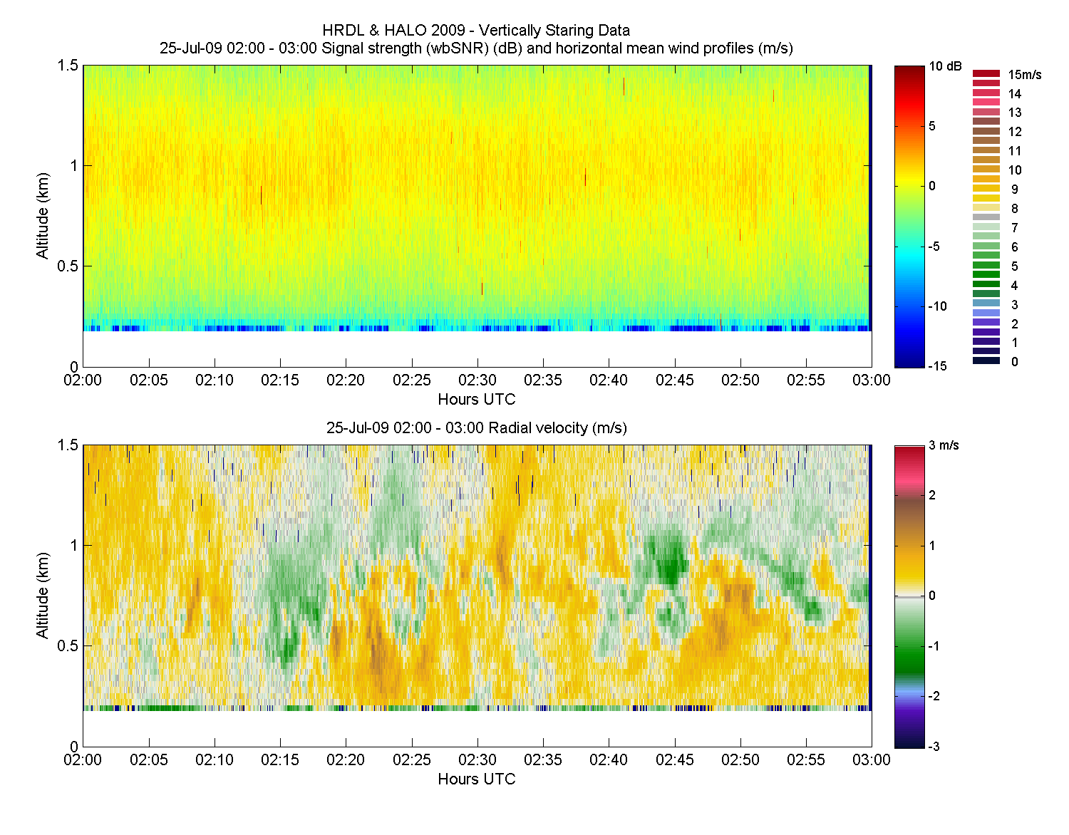
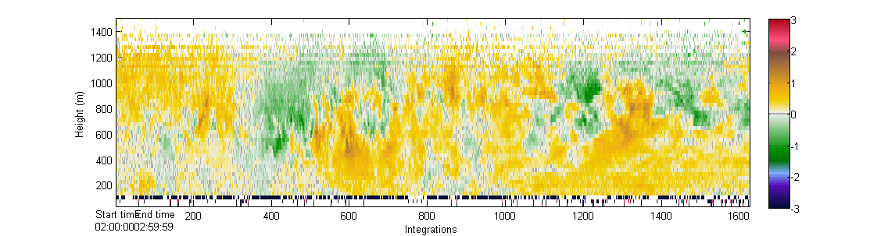
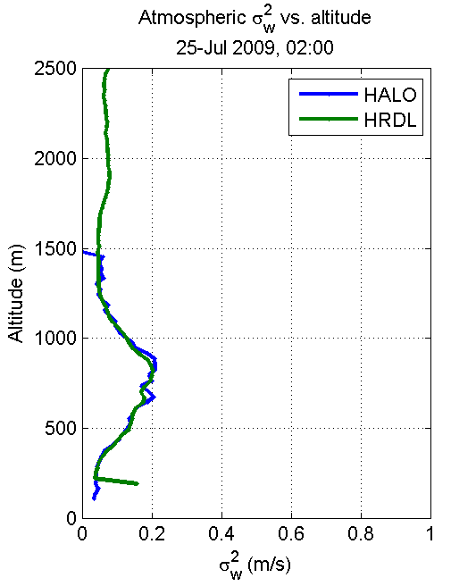
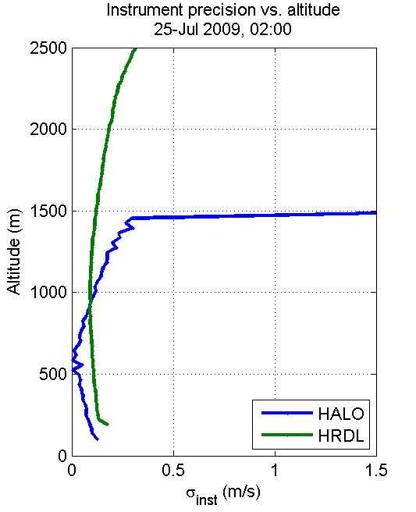
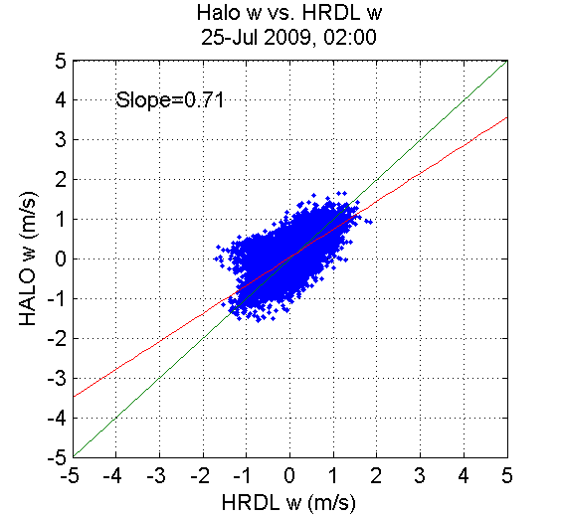

Slide 10
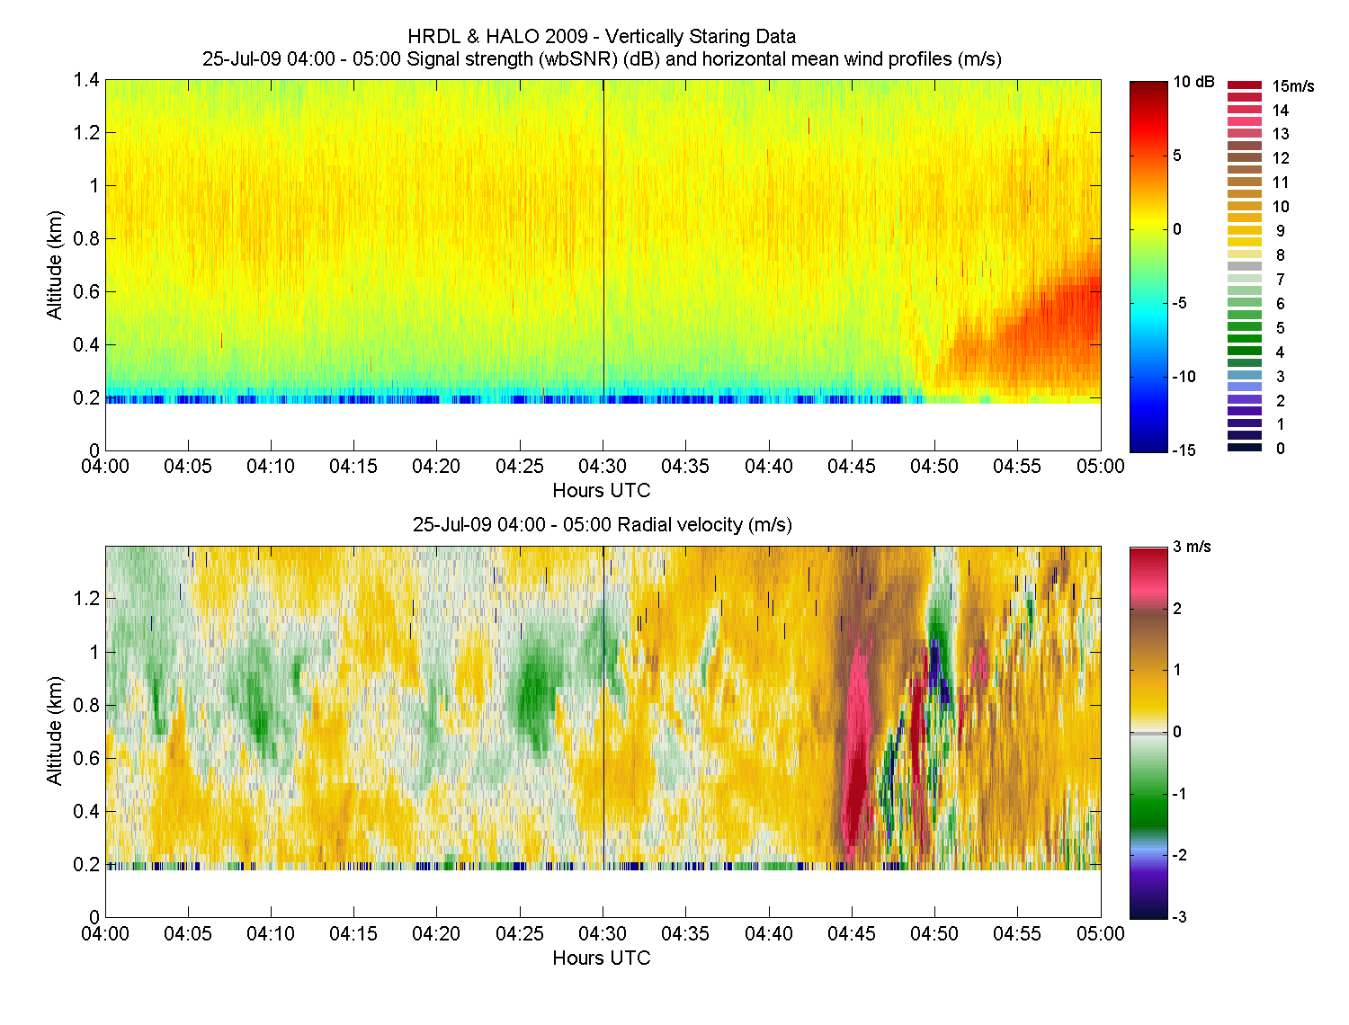
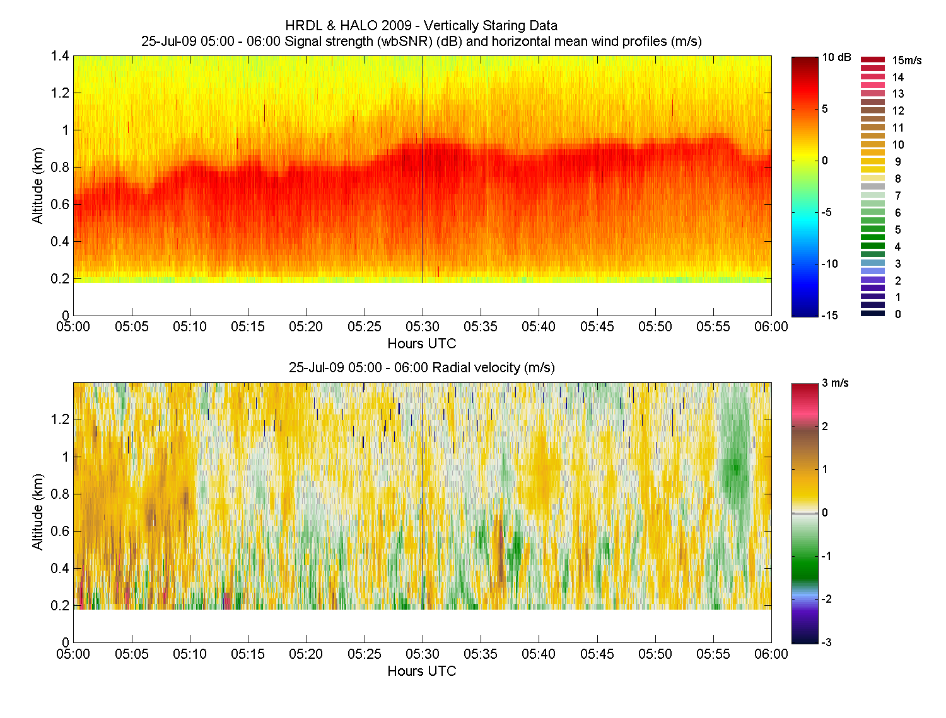
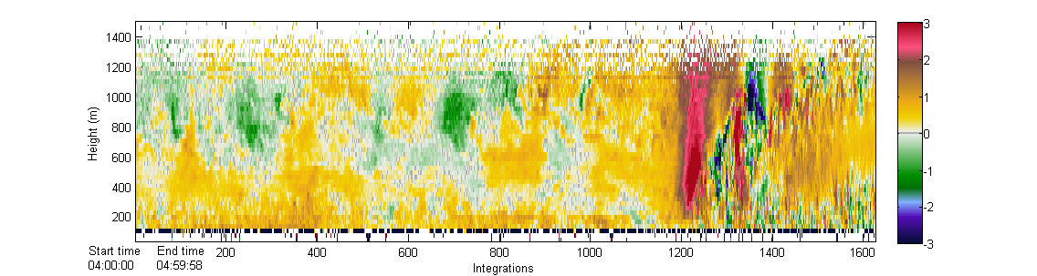
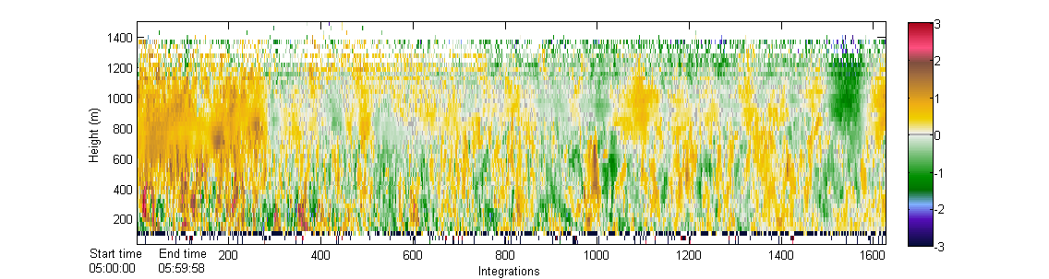
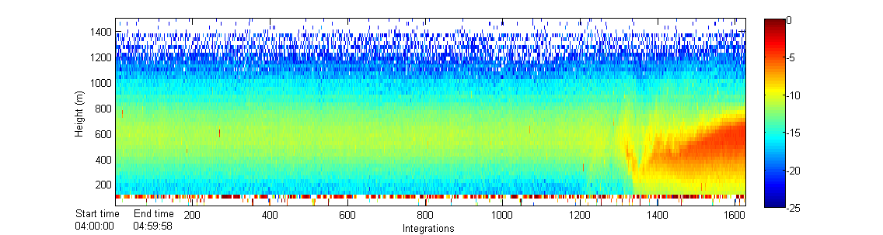
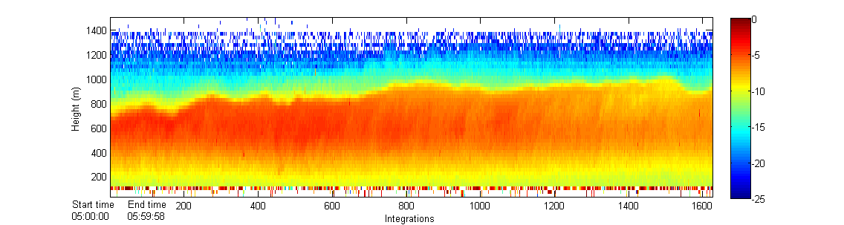
HRDL
1400 m max alt.
Halo Lidar

Slide 11
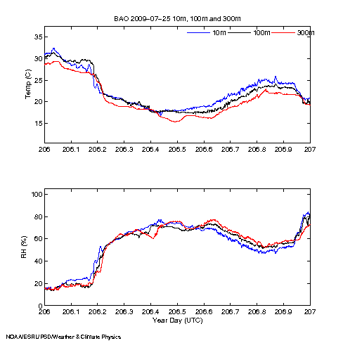
In situ temperature and humidity

Slide 12
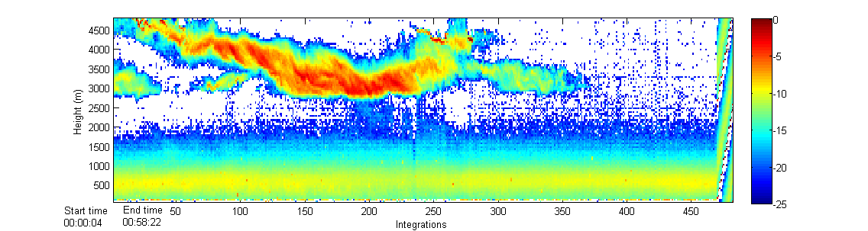
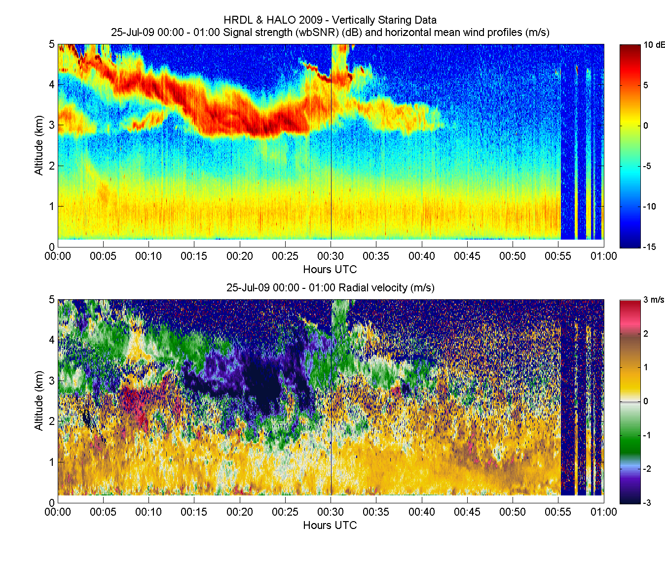
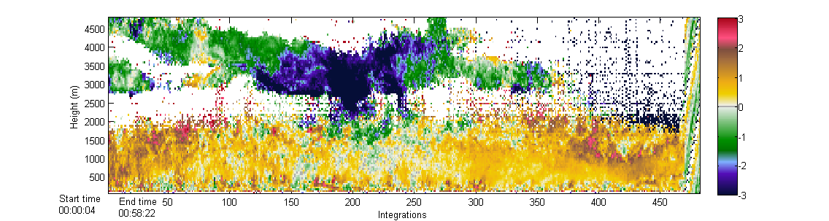
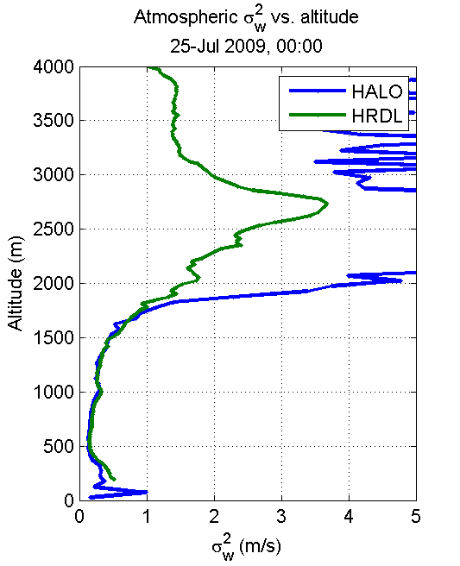
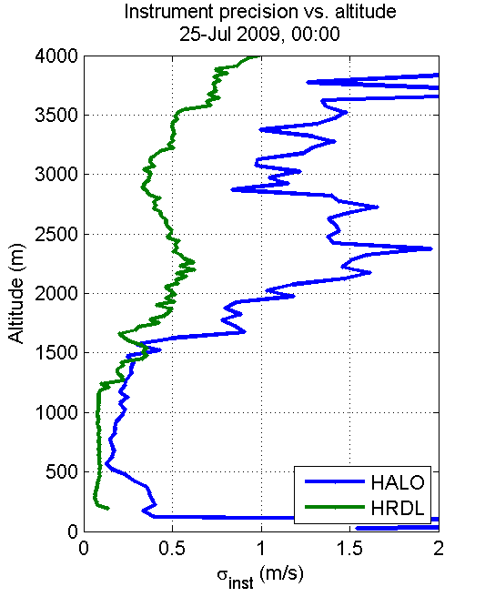
Halo Lidar
HRDL
Likely precip (drizzle, virga?)
More near-surface turbulence detail
96 gates x 50 m,
averaging over <30000> pulses -
27% duty cycle

Slide 13
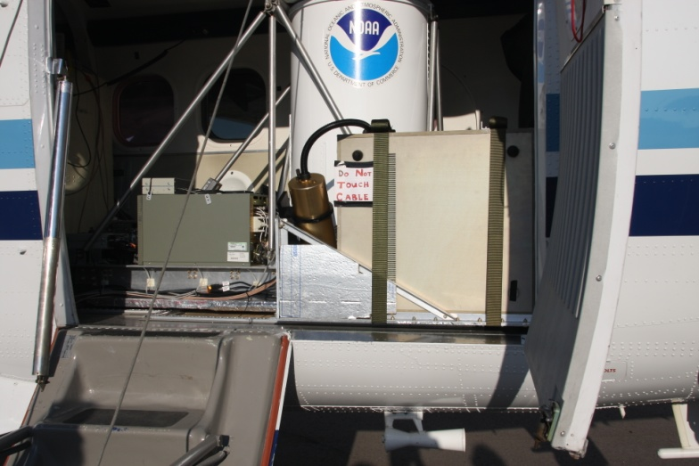
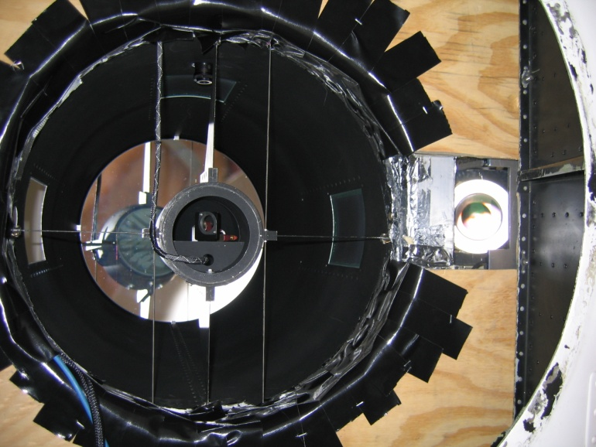
Installing the Halo instrument
No optical port was available, so Halo shared a port with the ozone lidar
Halo mounted looking transverse to the aircraft at 30 degrees off nadir
Velocity correction for aircraft motion computed from ground return

Slide 14
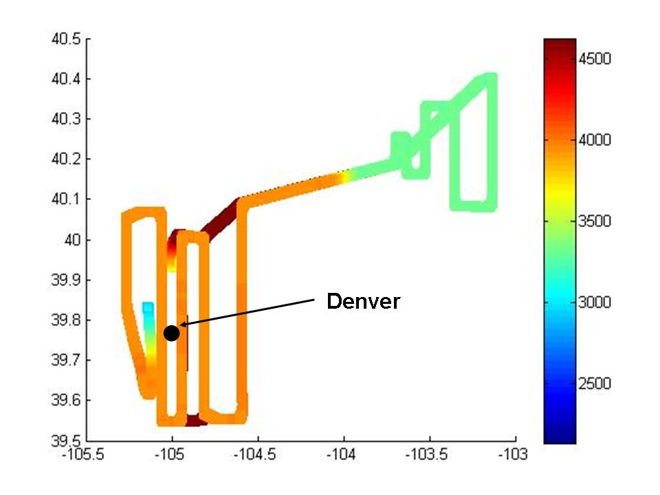
Flight test
Two flight tests of co-deployed Doppler and ozone
Weather was uncooperative: cool and cloudy
Second test aimed at investigating Denver plume and power plant plumes to the NE
Very little ozone above background
Flux profile
Profiler

Slide 15
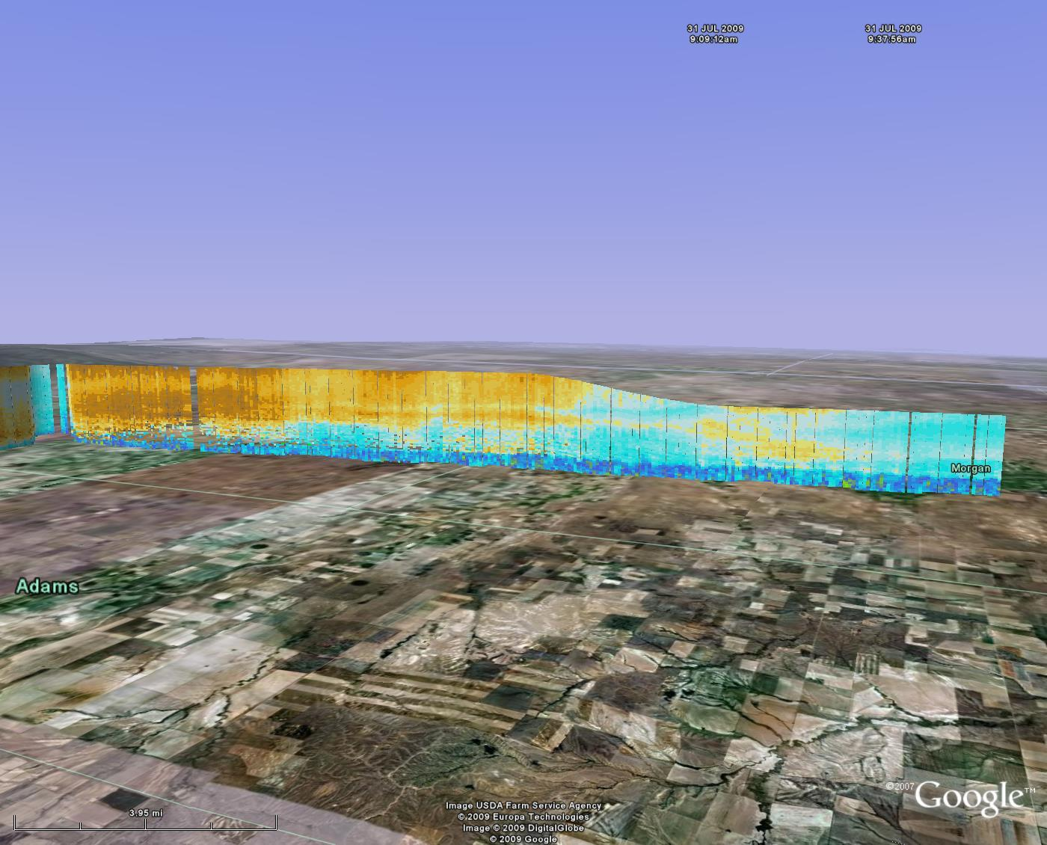
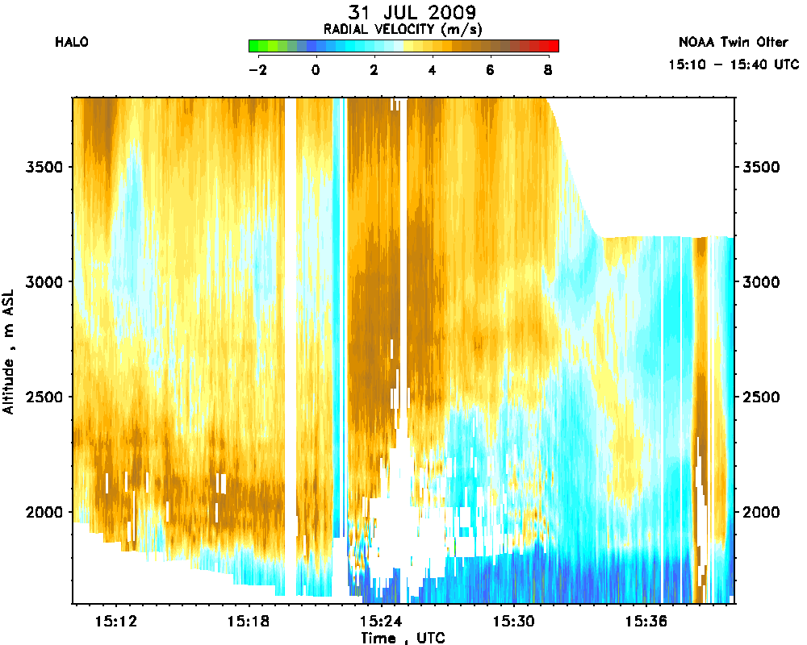
Wind component on NE-SW leg

Slide 16
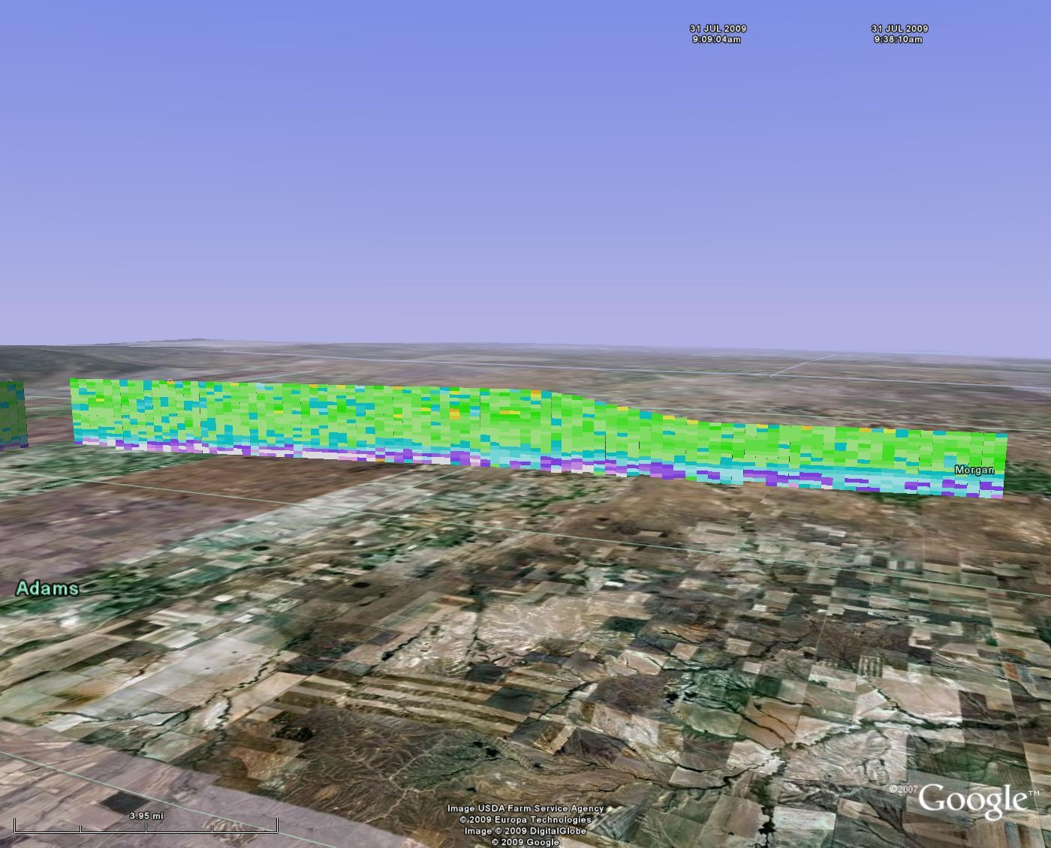
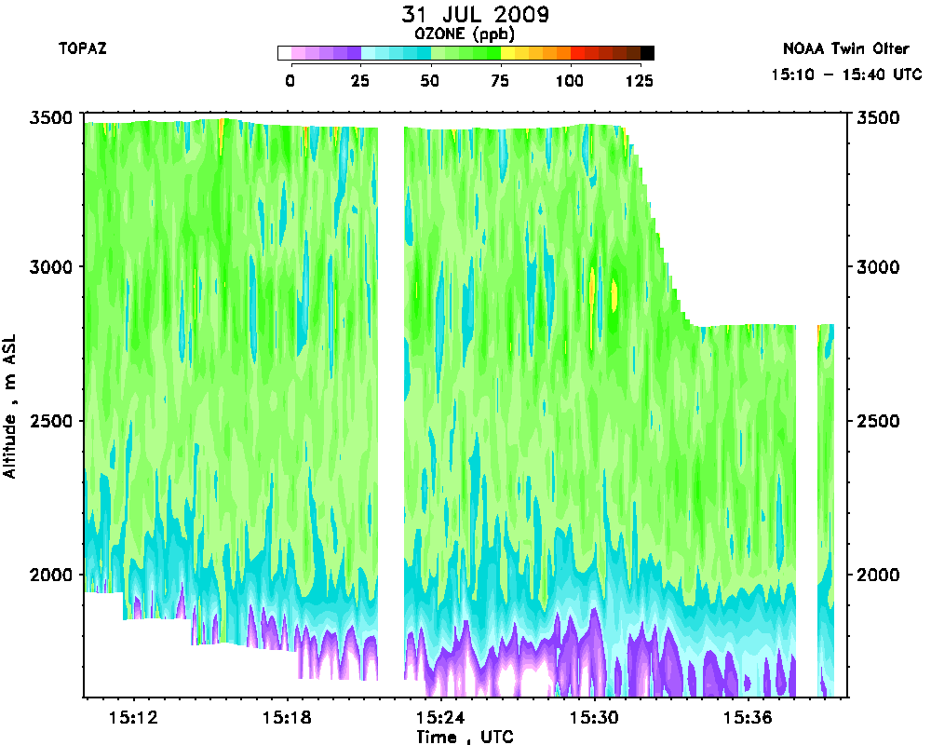
Ozone concentration on NE-SW leg

Slide 19
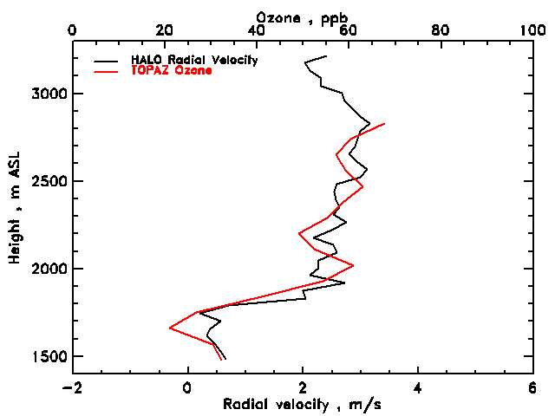
Horizontal ozone fluxes
Ozone flux component computed for every measurement point
Provided measurements with 500 m horizontal, 90 m vertical resolution

Slide 20
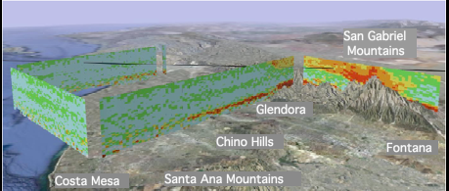

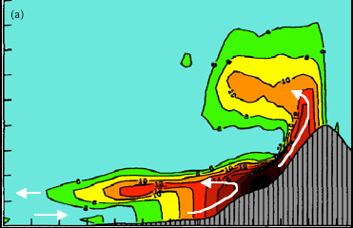
California ozone transport
From Lu and Turco (1966)
Langford et al, GRL, submitted

Slide 21
Measure 3-D winds and fluxes in CALNEX
Install a wedge scanner into the Twin Otter
Implement a 3-point scan (two orthogonal horizontal and one vertical)
Compute a 3-dimensional wind vector with 500 m horizontal , 30 m vertical resolution
Combine ozone and wind measurements to estimate ozone transport
45°
45°

Slide 22
Summary
Halo measurements compared well with HRDL , showing small scale structure and reasonable correlation
The Halo lidar operated well in the Twin Otter aircraft, showing minimal effects from vibration and temperature fluctuations
Sensitivity of the Halo instrument appeared to be adequate for characterization of the full boundary layer from 3-4 km
Demonstrated a capability to measure ozone transport profiles at 500 m horizontal resolution
Next application : 3-D winds and ozone fluxes over Southern California (summer 2010)
Hope to apply the small lidar for boundary layer ADM cal-val

