Slide 1
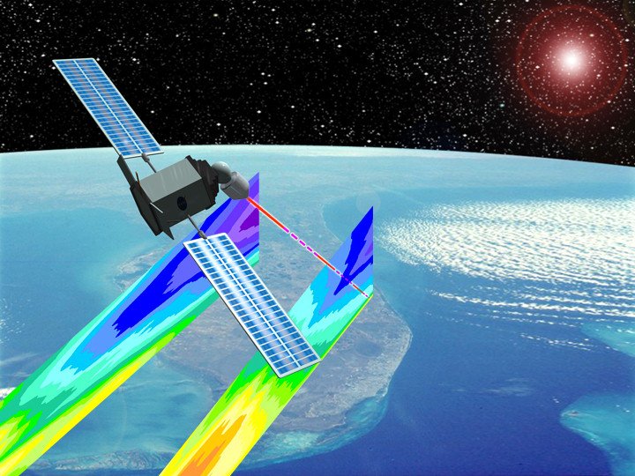
The Space-Based Lidar Winds Working Group
Some Further Reflections on a Hybrid DWL
The Space-Based Lidar Winds Working Group Meeting
Four Points by Sheraton - Hotel & Conference Center
Fort Walton, FL
February 2, 2010
Stephen A. Mango
NOAA/NESDIS Office of Systems Development
1335 East West Highway, Suite 6200, Silver Spring, MD 20910-3283
Phone (301) 713-1055 Ext 155; Stephen.Mango@noaa.gov

Slide 2
The Need for an operational, sustainable
Doppler Wind Lidar [DWL]
Still Exists

Slide 3
The Needed Measures of the Atmosphere
Mass Field --- T (z), P (z), g (z), mu (z)
NPOESS Atmospheric Sounders – CrIS, ATMS, OMPS, MIS
Moisture Field --- q (z)
NPOESS Atmospheric Sounders – CrIS, ATMS, OMPS, MIS
Motion Field --- v (u,v,z) “ 3D Winds”
Doppler Wind Lidar
Hybrid Doppler Wind Lidar for full atmosphere 3-D Winds
[DWL]
Vertical Wind Profiles
NPOESS # 1 Unaccommodated EDR

Slide 4
Observations of the Atmosphere
Some Previous Considerations for NPOESS 2st Generation (~2026-2042)
In addition to the 1st generation NPOESS Capabilities & Products [EDRs & FCDRs]
For the 2nd Generation NPOESS, NexGen, newer products, [EDRs and FCDRs]/sensors are being studied for potential newer baselines, such as:
  Aerosol Polarimetry Sensor [APS or APS-like]
  [for aerosol EDRs & FCDRs, cloud property EDRs & FCDRs]
  2. Improved Cross-track Infrared & Microwave Sensor Suites
  [improved temperature, moisture and pressure profiles and trace/greenhouse/photosynthetically active gases for atmospheric constituents, such as, CO, CH₄, CO₂, N₂O, O₃ EDRs & FCDRs]
  A Doppler Wind Lidar for vertical wind profile EDRs & FCDRs
  An advanced CO₂ observation system

Slide 5
Need for Improved Accuracy of Transport Estimates for Climate Applications
Improved reanalysis data sets are needed to provide a more accurate
environmental data record to study global warming; for example,
recent studies^{1,2} indicate that the recent dramatic reduction in sea ice extent
observed in the Arctic may be due, in large part, to heat transport into the
Arctic, but this finding is based on reanalysis wind data with large uncertainty
in the Arctic because of lack of actual wind measurements
The measurement of accurate, global winds is critical for climate monitoring:
“The nation needs an objective, authoritative, and consistent source of
. . . reliable. . . climate information to support decision-making. . .”³
____
¹ JCSDA Seminar by Erland Kallen, April 23, 2009
² Graverson et al., 2008, in Nature; Graverson et al., 2006, in J. Clim.
³ NOAA Annual Guidance Memorandum, Internal Draft, May 10, 2009

Slide 6
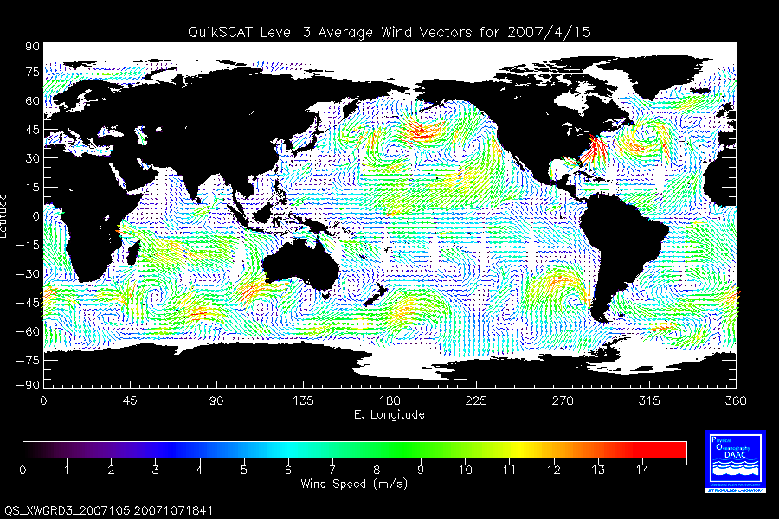
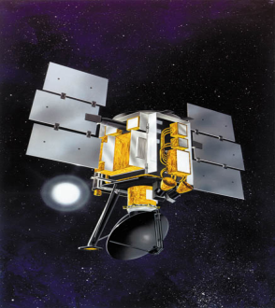
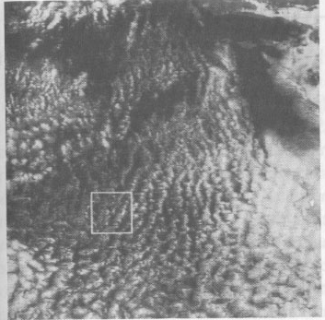
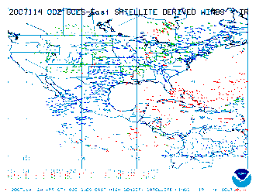
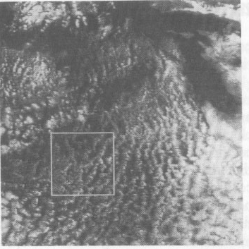
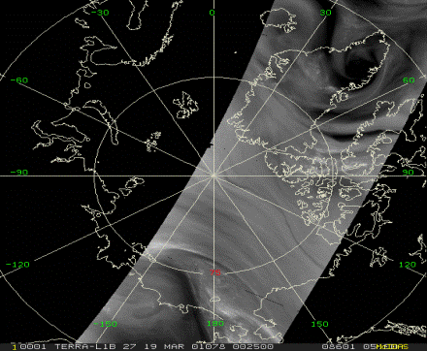
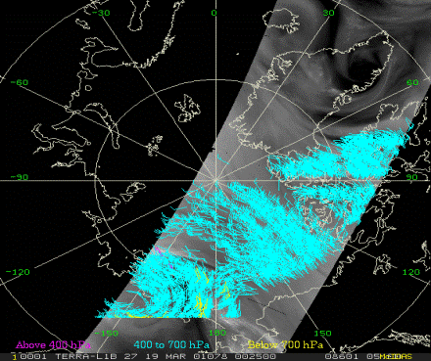
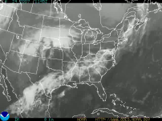
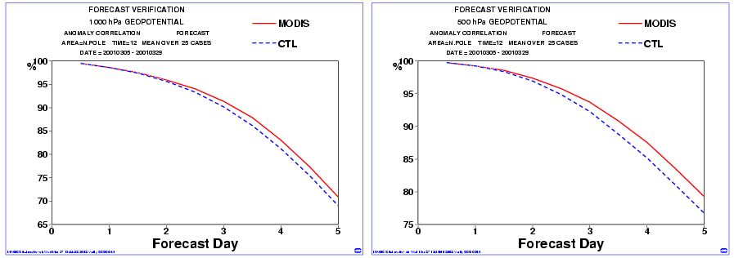
Conventional & HDWL Methods of Spaceborne Measurements of Atmospheric Winds
Successive GOES Cloud Images
Cross-Correlation Method
OVW
CMV
QuickSCAT
SeaWinds
WVMV
MODIS Polar H₂O Vapor Winds
HDWL 3D
Utilizes Lidar Dual Backscatter
From Aerosols & Molecules
Dual Doppler Receiver:
Coherent & Direct Detection
Science/technology trades
Coherent ‘heterodyne’
(e.g. SPARCLE-NASA/LaRC)
Direct detection
“Double Edge”
(e.g. Zephyr-NASA/GSFC)
Direct detection
“Fringe Imaging”
(e.g. Michigan Aerospace)
Backscattered Spectrum
Δν_{DOP}
Molecular (λ⁻⁴)
Aerosol (λ⁻²)
Surface
(1000 hPa)
Mid-trop (800 hPa)
Polar Water Vapor Winds Improve Weather Fcx
Courtesy of Dr. W. Paul Menzel – NOAA/NESDIS
Frequency

Slide 7
Conventional & HDWL Methods of Spaceborne Measurements of Atmospheric Winds
OVW – Ocean Vector Winds
CMV – Cloud Motion Vectors
Utilizes
Active – Radar Scatterometer
Microwave backscatter from ocean surface
(wind driven surface capillary waves)
Passive – Polarimetric Microwave Radiometer
Microwave emission ffrom ocean surface roughness
(wind driven surface capillary waves)
Clear, cloudy, light precipitation (not heavy precip)
Surface only (< MBL); 2D [Two Dimensional]
Sampling – high density and ~ uniform
Wide Swath
Utilizes
Several IR imaging channels in and near the
15 micron wavelength CO₂ absorption bands - CO₂ Slicing
(Channels closer to 15 micron CO₂ absorption band sensitive to higher clods [lower pressure; channels less than 15 microns sensitive to lower clouds [higher press.]
Determines winds in cloudy areas only; optically thin, isothermal clouds, vertically stacked layers (3-4) of clouds
Only a few height levels – where cloud layers are (usually lower level clouds); 2D [Two Dimensional at each height]
Sampling – low density and non-uniform
Wide Swath
WVMV – Water Vapor Motion Vectors
HDWL 3D–Hybrid Doppler Wind Lidar
Utilizes
6.7 micron wavelength water vapor imaging channel
Weighting function of 6.7 micron H₂O vapor peaks near ~450 hPa – very few trackable clouds at this level
Determines winds in clear areas
(no cloud interference)
2D [Two Dimensional] at usually a few heights;
High uncertainty in cloud height assignment
Sampling – high density and ~ uniform
Wide Swath
Utilizes
Lidar Backscatter from atmospheric aerosols (usu. coherent technique) and/or atmospheric molecules (direct detection technique); Hybrid DWL utilizes both. The coherent subsystem provides very accurate (<1.5m/s) observations when sufficient aerosols (and clouds) exist. The direct detection (molecular) subsystem provides observations meeting threshold requirements above 2 km, clouds permitting.
Clear and cloudy (porous clouds for small lidar beam )
3D [Three Dimensional]
Sampling – usually lower density and ~ uniform
Narrower Swaths

Slide 8
DWL Measurement Requirements
 | NASA-NOAA-DoD Science GWOS | NPOESS Operational NexGen
Vertical depth of regard (DOR) | 0-20 | 0-20 | km
Vertical resolution: Tropopause to top of DOR Top of BL to tropopause (~12 km) Surface to top of BL (~2 km) | 4 2 1 | 3 1 0.5 | km km km
Horizontal resolution^{A} | 350 | 350 | km
Minimum Number of horizontal^{A} wind tracks^{B} | 2 | 4 | -
Number of collocated LOS wind measurements for horizontal^{A} wind calculation | 2 = pair | 2 = pair | -
Velocity error^{C} Above BL In BL | 3 2 | 3 2 | m/s m/s
Minimum wind measurement success rate^{D} | 50 | 50 | %
^{A} Horizontal winds are not actually calculated; rather two LOS winds with appropriate angle spacing and collocation are measured for an “effective” horizontal wind measurement. The two LOS winds are reported to the user. ^{B} The 4 cross-track measurements do not have to occur at the same along-track coordinate; staggering is OK. ^{C} Error = 1s LOS wind random error, projected to a horizontal plane; from all lidar, geometry, pointing, atmosphere, signal processing, and sampling effects. The true wind is defined as the linear average, over a 100 x 100 km box centered on the LOS wind location, of the true 3-D wind projected onto the lidar beam direction provided with the data. ^{D}Scored per vertical layer per LOS measurement not counting thick clouds

Slide 9
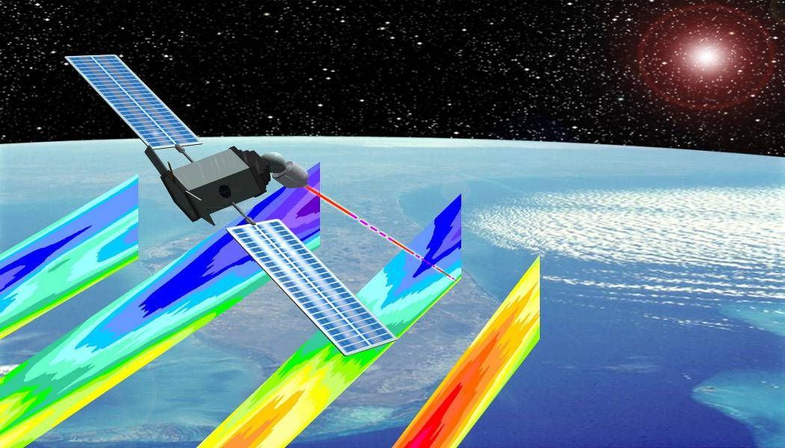
Submitted to National Academy of Sciences Committee on Earth
Science Applications from Space - May 16, 2005
Decadal Survey “Earth Observations from Space:
A Community Assessment and Strategy for the Future”
Providing Global Wind Profiles :
The Missing Link in Today’s Observing System
M. Hardesty (NOAA/ETL), W. Baker (NOAA/NWS), G. D. Emmitt, (SWA),
B. Gentry (NASA/GSFC), I. Guch (NOAA/NESDIS), M. Kavaya (NASA/LaRC),
S. Mango (NPOESS Integrated Program Office), K. Miller (Mitretek),
G. Schwemmer (NASA/GSFC), J. Yoe (NOAA/NESDIS)
Input to
ESAS RFI

Slide 10
NAS Decadal Survey Recommendations-17 Missions Total
(Pink = <$900 M; Green = $300-$600 M; Blue = <$300 M)
Timeframe # 3 [“Tier 3”]: 2016 -2020, Missions listed by cost
LIST | Land surface topography for landslide hazards and water runoff | LEO, SSO | Laser altimeter | $300 M
PATH | High frequency, all-weather temperature and humidity soundings for weather forecasting and SST* | GEO | MW array spectrometer | $450 M
GRACE-II | High temporal resolution gravity fields for tracking large-scale water movement | LEO, SSO | Microwave or laser ranging system | $450 M
SCLP | Snow accumulation for fresh water availability | LEO, SSO | Ku and X-band radars K and Ka-band radiometers | $500 M
GACM | Ozone and related gases for intercontinental air quality and stratospheric ozone layer prediction | LEO, SSO | UV spectrometer IR spectrometer Microwave limb sounder | $600 M
3D-Winds (Demo) | Tropospheric winds for weather forecasting and pollution transport | LEO, SSO | Doppler lidar | $650 M
*Cloud-independent, high temporal resolution, lower accuracy SST to complement, not replace, global
operational high-accuracy SST measurement
Notes:
10

Slide 11
The Need for a operational, sustainable “Hybrid”
Doppler Wind Lidar [HDWL]
Still Exists

Slide 12
Measuring Wind with a Doppler Lidar
DOPPLER RECEIVER - Multiple flavors - Choice drives science/ technology trades
Coherent or heterodyne aerosol Doppler receiver
Direct detection molecular Doppler receiver
Coherent
2 micron
355 nm
Direct detection
Backscattered Spectrum
Δν_{DOP}
Aerosol (λ⁻²)
Molecular (λ⁻⁴)
Frequency

Slide 13
GWOS/NWOS Hybrid DWL Technology Solution
Overlap allows:
- Cross calibration
- Best measurements selected in assimilation process
Direct Detection Doppler Lidar
-Uses molecular backscatter
-Meets threshold requirements
when aerosols not present
Altitude Coverage
Coherent Doppler Lidar
-Uses aerosol backscatter
High accuracy winds when
aerosols & clouds present
Velocity Estimation Error

Slide 14
GWOS Measurement Capability
24 km
21 km
18 km
16 km
Direct Detection
14 km
12 km
10 km
8 km
Coherent
Detection
6 km
2 km
1.5 km
1 km
0.5 km
0 km
4 km
1 2 3 4 m/s
Velocity Accuracy

Slide 15
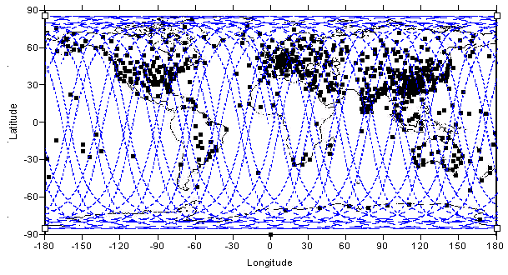
GWOS Coverage
Around 600 radiosonde stations (black) provide data every 12 h
GWOS (blue) would provide ~3200 profiles per day

Slide 16
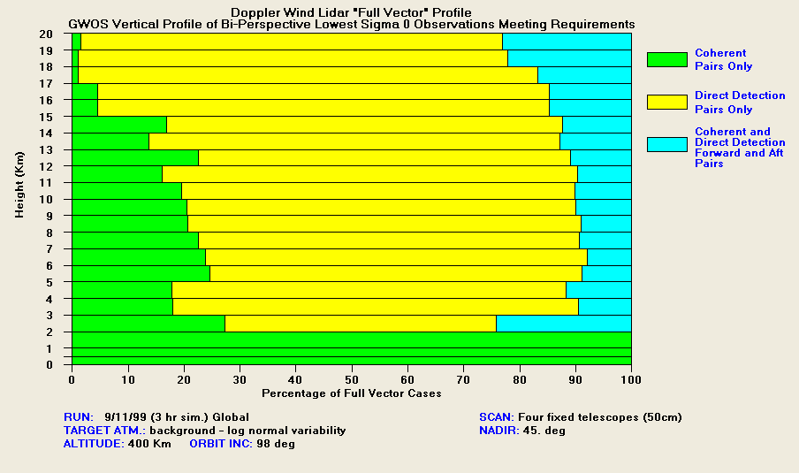
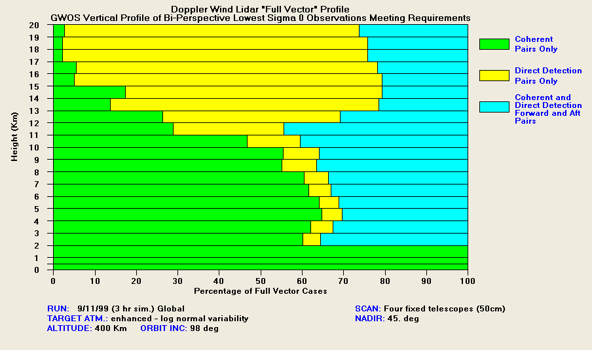
Simulated GWOS Synergistic Vector Wind Profiles*
(Provided by D. Emmitt)
Green: both perspectives
from coherent system
Yellow: both perspectives
from direct molecular
Blue: one perspective coherent;
one perspective direct
Enhanced aerosol mode
Background aerosol mode
Coherent aerosol and direct detection molecular channels work together to produce optimum vertical coverage of bi-perspective wind measurement
50% more vector observations
from hybrid technologies
* When two perspectives are possible

Slide 17
A Vision for a HDWL
That was generated

Slide 18
Concept for a U.S. Space-Based Wind Lidar
Global Wind Observing Sounder (GWOS) / NPOESS Wind Observing Sounder (NWOS)

Slide 19

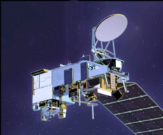
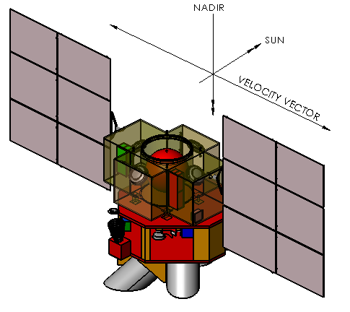
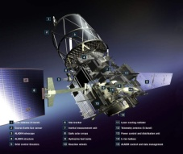
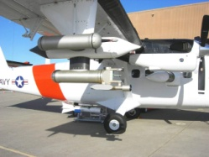
NexGen Hybrid Doppler Wind Lidar - NWOS
Possible NPOESS Wind Observing System For Vertical Wind Profiles
2007 NAS Decadal Survey
Recommendations for Tropospheric Winds
NexGen
NWOS
(2026)
NexGen
3D Tropospheric Winds mission called “transformational”
and ranked #1 by Weather panel.
3D Winds also prioritized by Water Cycle panel.
“The Panel strongly recommends an aggressive program
early on to address the high-risk components of the
instrument package, and then design, build, aircraft-
test, and ultimately conduct space-based flights of a
prototype Hybrid Doppler Wind Lidar (HDWL).”
“The Panel recommends a phased development of the
HDWL mission with the following approach:
  Stage 1: Design, develop and demonstrate a prototype HDWL system capable of global wind measurements to meet demonstration requirements that are somewhat reduced from operational threshold requirements. All of the critical laser, receiver, detector, and control technologies will be tested in the demonstration HDWL mission. Space demonstration of a prototype HDWL in LEO to take place as early as 2016.
  Stage II: Launch of a HDWL system that would meet fully-operational threshold tropospheric wind measurement requirements. It is expected that a fully operational HDWL system could be launched as early as 2022.”
GWOS
(2016)
Operational 3-D
global wind measurements
ADM Aeolus
(2011)
Demo 3-D
global wind measurements
GWOS
TODWL
(2002 - 2008)
Single LOS
global wind measurements
NWOS
DWL Airborne Campaigns, ADM Simulations, etc.
TODWL: Twin Otter Doppler Wind Lidar [CIRPAS NPS/NPOESS IPO]
ESA ADM: European Space Agency-Advanced Dynamics Mission (Aeolus) [ESA]
GWOS: Global Winds Observing System [NASA/NOAA/DoD]
NexGen: NPOESS [2nd] Generation System [PEO/NPOESS]

Slide 20
Notional NPOESS NexGen - HDWL Transitions
[Hybrid Doppler Wind Lidar]
CALENDAR YEAR
05
06
07
08
09
10
11
12
13
14
15
16
17
18
19
20
21
22
23
24
25
26
27
28
29
30
31
32
33
34
35
36
37
38
39
40
AM
F13
F19
F20
C4
F17
C2
NexGen 2
M
mid-AM
F16
F18
Metop A
Metop C
Post-EPS
Metop B
C3
PM
N
N’
C1
NexGen 1
AQUA
NPP
CALENDAR YEAR
05
06
07
08
09
10
11
12
13
14
15
16
17
18
19
20
21
22
23
24
25
26
27
28
29
30
31
32
33
34
35
36
37
38
39
40
HDWL
ESAS
“Decadal Survey”
Recommendations for Tropospheric Winds
Demo Development
HDWL
Transition
Res-to-Ops
Demo Mission
Pps Demo Devel.
Ops Demo Mission
Notes:
Other Attributes
Data Latency
SESS
Intl Treaty
Climate Continuity
Direct Read Out
User Impact

Slide 21
Polar Satellite Constellations
Notional NPOESS “2nd Generation” & European Post-EPS – Post 2026+
CALENDAR YEAR
05
06
07
08
09
10
11
12
13
14
15
16
17
18
19
20
21
22
23
24
25
26
27
28
29
30
31
32
33
34
35
36
37
38
39
40
F13
F19
F20
NPOESS C4
NexGen 4
AM
F17
NPOESS C2
NexGen 2
M
mid-AM
F16
F18
Metop A
Metop C
Post-EPS
Metop B
NPOESS C3
NexGen 3
PM
N
N’
NPOESS C1
NexGen 1
AQUA
NPP
Seasonal
Inter-Annual
Solar
Solar
Inter-Decadal

Slide 22
Early Studies that were performed for
The Vision for a HDWL
That was generated

Slide 23
NPOESS 2nd Generation [NexGen] - Study 1
Investigation of the Requirements for the Accommodation of a Hybrid DWL on NPOESS NexGen
Objectives
The study used/will use the NASA/GSFC Instrument Design Laboratory
(IDL), formerly the Instrument Synthesis and Analysis Laboratory
(ISAL), and the NASA/GSFC Integrated Mission Design Center (IMDC)
The IDL will identify instrument requirements if the 400 km altitude
demonstration instrument were scaled to operate at the NPOESS 824 km
altitude orbit with the same data product requirements
The IDL assessed the technology impact of scaling a demonstration class
DWL designed for a 400 km altitude orbit to produce a similar data
product at an NPOESS 824 km altitude orbit
The IMDC will identify NPOESS platform requirements to accommodate
the 824 km altitude orbit
NWOS IDL Portion Completed February 2008

Slide 24
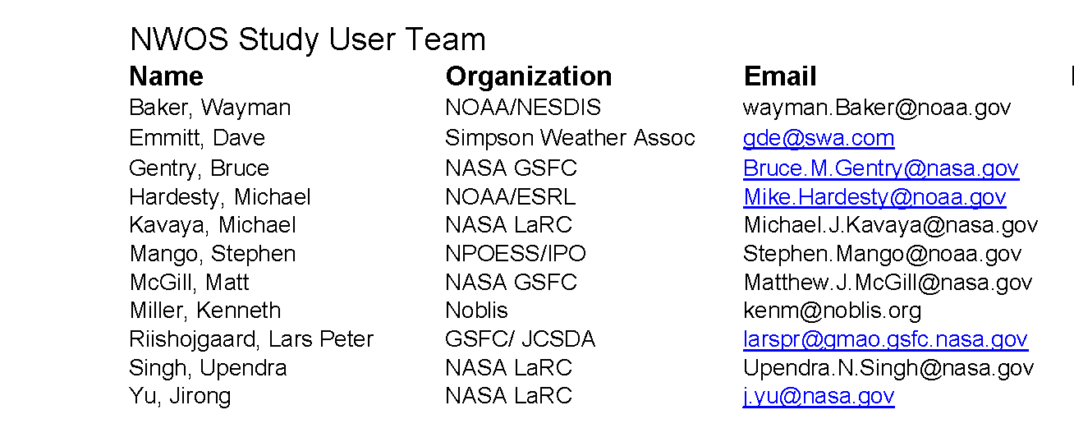
NWOS IDL Study User Team
NexGen

Slide 25
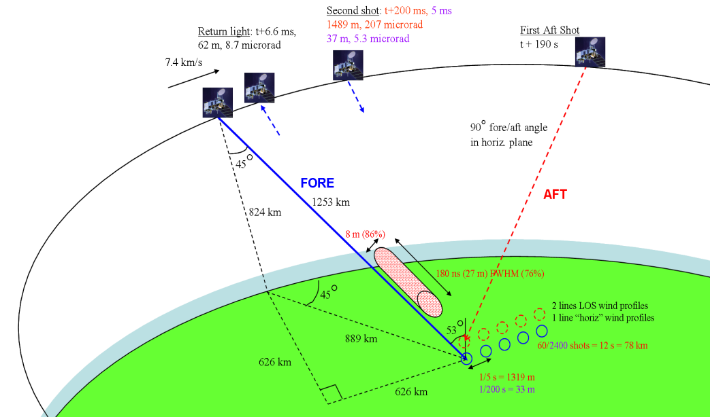
NexGen Hybrid Doppler Wind Lidar [HDWL] - NWOS
NPOESS Wind Observing System For Vertical Wind Profiles
HDWL [Hybrid Doppler Wind Lidar] Concept
Hybrid DWL Technology Solution
Utilizes Lidar Dual Backscatter
From Aerosols & Molecules
Dual Doppler Receiver:
Coherent & Direct Detection
Science/technology trades
Coherent ‘heterodyne’
(e.g. SPARCLE-NASA/LaRC)
Direct detection
“Double Edge”
(e.g. Zephyr-NASA/GSFC)
Direct detection
“Fringe Imaging”
(e.g. Michigan Aerospace)
The coherent subsystem provides very accurate (<1.5m/s) observations when sufficient aerosols (and clouds) exist.
The direct detection (molecular) subsystem provides observations meeting the threshold requirements above 2 km, clouds permitting.
When both sample the same volume, the most accurate observation may be chosen for assimilation into the NWP or Climate Model.
The combination of direct and coherent detection yields higher data utility than either system alone.
Backscattered Spectrum
Δν_{DOP}
Molecular (λ⁻⁴)
Aerosol (λ⁻²)
Frequency
NWOS Wind Measurement Concept
GWOS/NWOS Comparisons with ADM
Attribute | ADM | GWOS | NWOS
Orbit Altitude | 400 | 400 | 824
Orbit Inclin. | 98 | 98 | 98
Day/Night | Night only | Day/Night | Day/Night
Duty Cycle | 25% | 100% | 100%
Components per profile | Single –Model estimated second component | Two components - full horizontal vector | Two components - full horizontal vector
Horizontal Resolution | 200 km between single LOS’s | 300 km with full profile both sides of ground track | 300 km with full profile both sides of ground track
Vertical Resolution | PBL 0.25 – 0.5 km Troposphere 1-2 km | PBL 0.25-0.5 km Tropo 1 – 2 km | PBL 0.25 - 0.5 Tropo 1– 2km
Collector Diam. | 1.5 m (1x) | 0.5 m (4x) | 0.7 m (4x)
Adapted from & Courtesy of Bruce Gentry, Michael Kavaya, G. David Emmitt, Wayman Baker, Michael Hardesty, Stephen Mango

Slide 26
NWOS IDL Study Summary
NexGen
Study Objectives
Study the feasibility of modifying the original IDL design for GWOS at 400 km altitude to work at an 824km altitude on an NPOESS platform
Consider 3 instrument configurations in a trade space that trades telescope aperture, laser duty cycle, pulse power/repetition rate
Examine impact of new technologies, estimate improvements in laser
performance, identify technology tall poles.
Minimize power, volume, and mass, as much as possible (in that order)
Consider redundancy for a multi-year lifetime
Key Study Assumptions
824 km, sun-synchronous, dawn-dusk, 1730 ascending node local time, 98.7 deg. Inclination orbit.
5 yr life, 85% reliability goal
2/1 backup lasers direct/coherent
1/0 backup laser electronics direct/coherent
1 backup receiver for each
(direct & coherent)
Both coherent and direct lidars either 100% duty cycle (Configurations 1 & 3) or
50% duty cycle (Configuration 2)
Used 10-year beyond 2008 projections for laser efficiencies:
x 2 (direct), x 2.25 (coherent)
Either 4 fixed telescopes
(Configurations 1 & 2) or
1 holographic element (Configuration 3)
Key Findings
The NWOS IDL designs have shown that the Hybrid Doppler Wind Lidar can be operated at a reasonable electrical power and with reasonable reliability for the 5-year mission on board the NPOESS second generation satellite, NexGen.
There are no tall poles in any of the technical developments needed in the future to develop an NWOS.
Because the proof-of-concept GWOS flight is in advance of the NWOS, there should be good opportunity to verify the assumed requirements.

Slide 27
NexGen
NWOS IDL Study Conclusions
The NWOS IDL design study has shown that the Hybrid Doppler Wind Lidar can be operated at a reasonable electrical power and with reasonable reliability for the 5-year mission on board the NPOESS second generation satellite.
There are no tall poles that depend on unforeseen technical developments in the future.
Because the proof-of-concept GWOS flight is in advance of the NWOS, there should be good opportunity to verify the assumed requirements.

Slide 28
Status of NPOESS First Generation
[as presented by COL A. Robinson, Acting PEO for NPOESS
at the 90th American Meteorological Society Conference,
Atlanta, GA - January 2010]

Slide 29

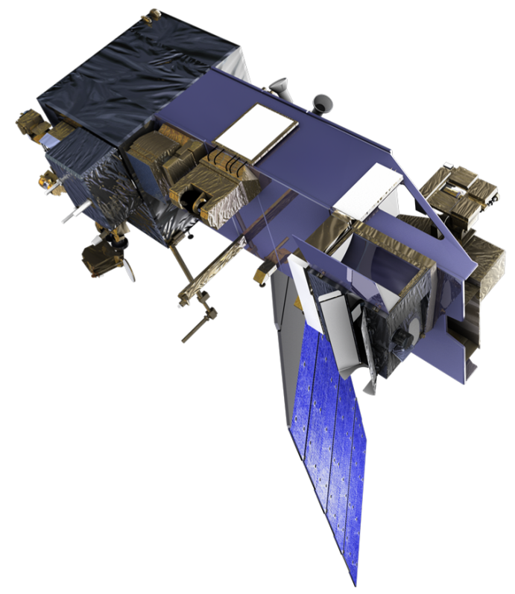
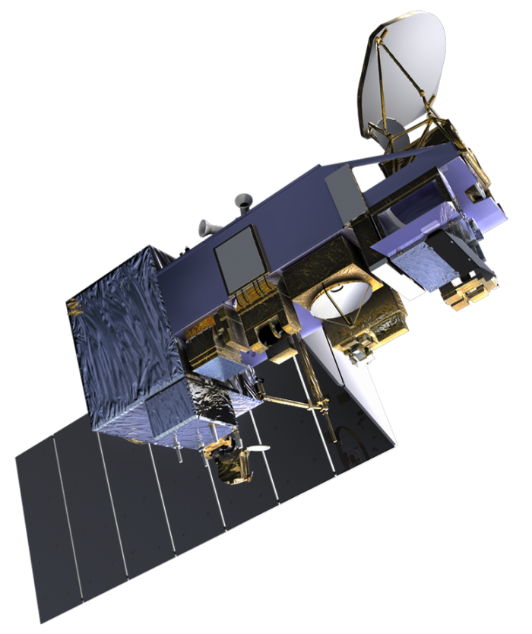
Satellite Architecture
OMPS
Spacecraft designed for Earth observation missions
Large nadir platform for maximum payload
accommodation on the EELV launch vehicle
Optical bench stability to ensure all
sensors meet pointing requirements
Thermally optimized with large cold-
side access for science payloads
Overall Satellite
Orbit: 828 km
13:30-C1 ascending node crossing
17:30-C2 ascending node crossing
Capacity to transmit 5.4 Terabytes a day
(half the library of Congress)
7-year duration to ensure no operational gaps
Ka-Band downlink to SafetyNetTM enables
downlink of all collected data with 4x
improvement of data latency (95% of
collected data delivered as EDRs in 28 min)
Large on-board recorder capacity and
SafetyNetTM architecture provides 99.99%
data availability
Leverages NASA’s Earth Observation Satellite
(EOS) heritage and experience
CERES
CrIS
SARSAT & A-DCS Tx Antennas
ATMS
L-Band LRD Link
TSIS
X-Band HRD Link
VIIRS
Ka-Band to Safety NetTM
S-Band Link
SARSAT & A-DCS Rx Antenna
Velocity Direction
(+X_{S/C} axis)
C1 1330 Satellite
(note that C2 will have MIS)
MIS
Velocity Direction
(+X_{S/C} axis)
CrIS & ATMS no longer manifested on C2
C2 1730 Satellite
VIIRS
ATMS
CrIS
TSIS
S-Band Link
X-Band HRD Link
SARSAT & A-DCS Rx Antenna
L-Band LRD Link
SARSAT & A-DCS Tx Antennas
Ka-Band to Safety NetTM

Slide 30
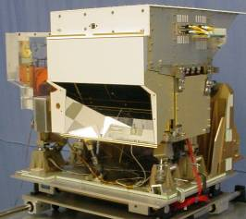
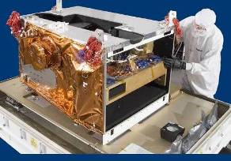
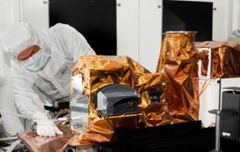
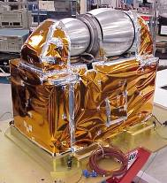
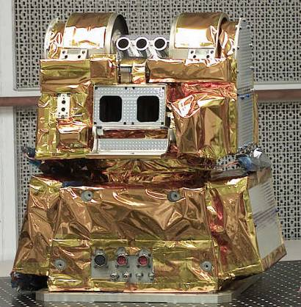
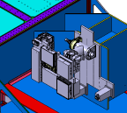
NPOESS Payloads
Cross-track Infrared Sounder
Visible/Infrared Imager/ Radiometer Suite
Ozone Mapping & Profiler Suite
CrIS Instrument (ITT)
VIIRS Instrument (Raytheon)
OMPS Instrument (Ball)
Advanced Technology
Microwave Sounder
Clouds and Earth’s
Radiant Energy System
Total Solar
Irradiance Sensor
ATMS Instrument (NGES)
CERES Instrument (NGAS)
TSIS Instrument (LASP)

Slide 31
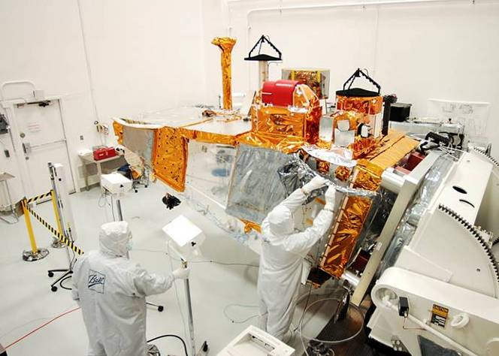
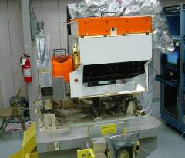
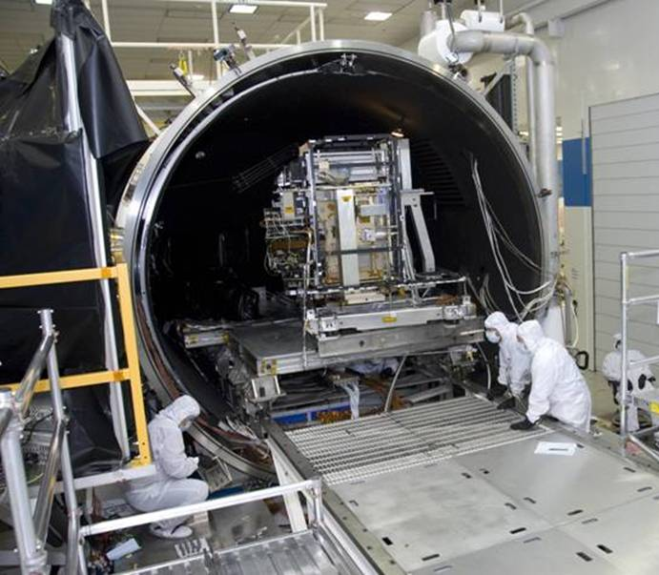
Three of Five Sensors Installed on NPP
CERES
OMPS
NPP Spacecraft
ATMS
CrIS Instrument
NPP Satellite at Spacecraft facility
VIIRS in Thermal Vacuum Chamber
NPOESS Preparatory Project (NPP) in integration phase

Slide 32


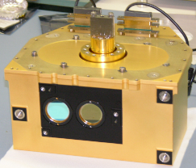

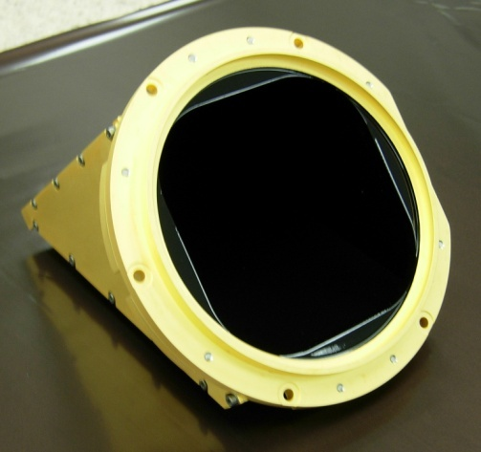
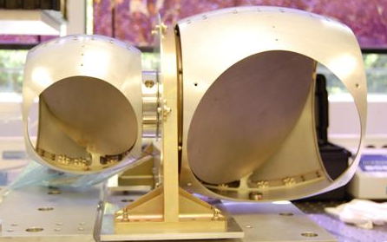

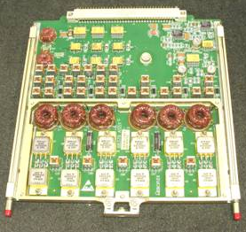
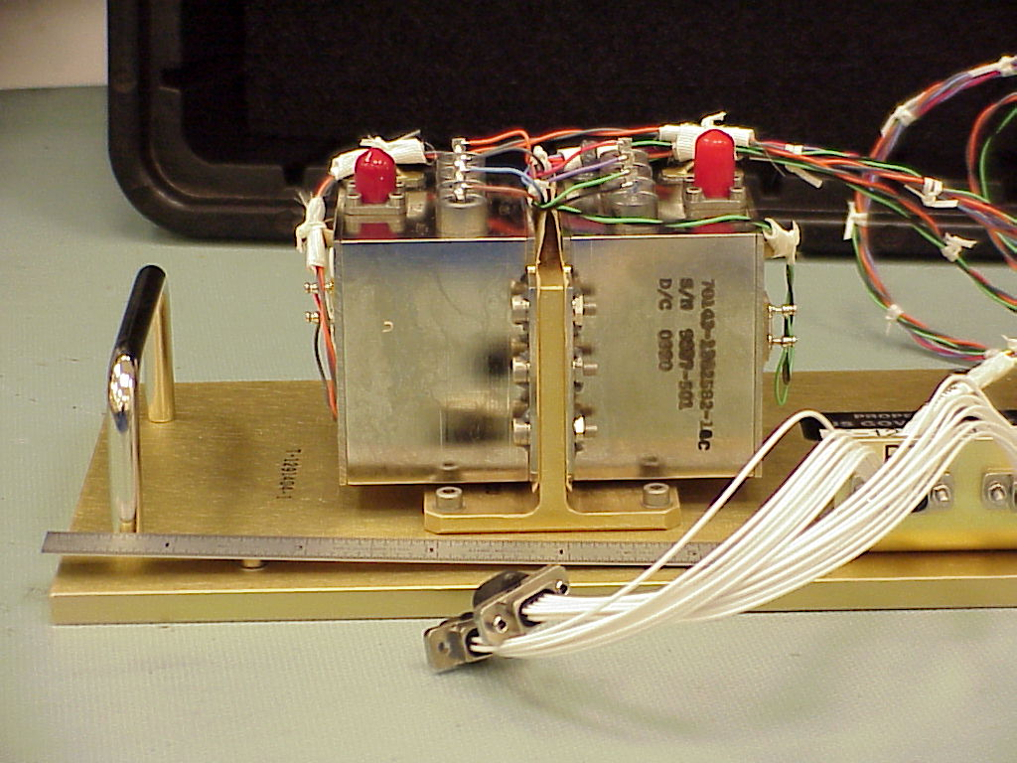

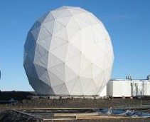

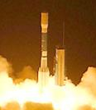
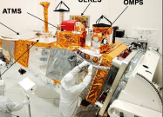


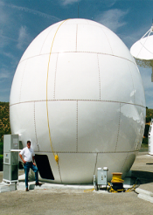

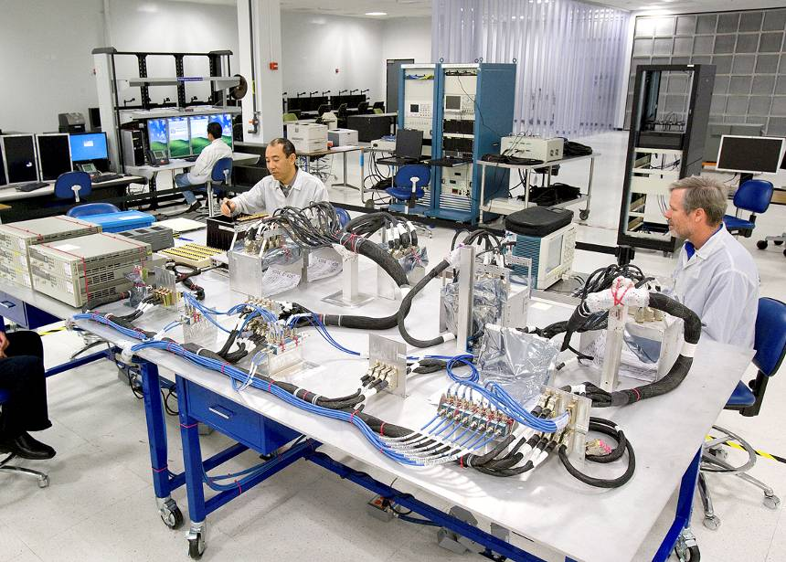
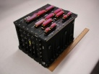
NPOESS Development Nearly Complete - Production in Progress
DEVELOPMENT
PRODUCTION
Delivered:
ATMS Flight 1
CERES Flight 5
OMPS Flight 1
VIIRS Flight 1
Completed Testing
CrIS Flight 1
Initial Sensors
All sensors delivered or completed testing
Flight 2 H/W
Coming together
Flight 2 schedules have margin to need dates
Final NPP Prep
On track
NPP
Launch
Command & Control Operational
Data processing Installed at 2 sites
Algorithms
Delivered
Operations
Ready
Ground Segment Mature
NPOESS C1 upgrade
On track
C1
Launch
Spacecraft
Design is complete, development on track
Key Engineering Models
Demonstrated
CDR
Conducted
EEMTB making
good
progress
I&T
schedule
has
schedule margin
2002
2004
2006
2008
2010
2012
2014
Completed or On Schedule
to Complete near-term
On Schedule and
progressing nominally
Behind Schedule;
progressing
Notes:
32
32
32

Slide 33
Updates/Changes Possible
1. NAS ESAS 2010-2020 Decadal Recommendations
2. NASA’s Considerations for Missions
3. Considerations for NPOESS Mission

Slide 34
The End … but definitely not “the end for a HDWL”

