Slide 1
Flight Results of the Langley DAWN Coherent Wind Lidar During the NASA GRIP Mission
M. Kavaya, J. Beyon, G. Creary, G. Koch, M. Petros, P. Petzar, U. Singh, B. Trieu, and J. Yu
NASA Langley Research Center
Working Group on Space-Based Lidar Winds
Coconut Grove, FL USA
8-9 February 2011

Slide 2
Acknowledgements
NASA SMD
Ramesh Kakar
GRIP
AITT-07 “DAWN-AIR1”
Jack Kaye $ Augmentation
NASA SMD ESTO
George Komar, Janice Buckner, Parminder Ghuman, Carl Wagenfuehrer
LRRP, IIP-04 “DAWN”
IIP-07 “DAWN-AIR2”
Airplane Change & Rephasing
NASA LaRC Director Office, Steve Jurczyk, $ Augmentation
NASA LaRC Engineering Directorate, Jill Marlowe, John Costulis, $Augmentation
NASA LaRC Chief Engineer, Clayton Turner, 1 FTE
NASA LaRC Science Directorate
Garnett Hutchinson, Stacey Lee, and Keith Murray

Slide 3
Project Personnel
Civil Service Personnel
Jeffrey Beyon | Software & Data Acquisition Lead
Frank Boyer | Mechanical Design
Garfield Creary | Project Management/PM
Fred Fitzpatrick | Electrical / Electronics
Mark Jones | Electrical / Electronics
Michael Kavaya | Science/Project Management/PI
Grady Koch | Instrument Science/Chief Engr
Edward Modlin | Mechanical Technician
Mulugeta Petros | Laser
Paul Petzar | Electrical / Electronics Lead
Geoffrey Rose | Mechanical Design
Bo Trieu | Mechanical Design Lead
Jirong Yu | Laser Lead
Contract Personnel
Michael Coleman | Mechanical Design
Adam Webster | Mechanical Support
Welch Mechanical | Mechanical Support

Slide 4
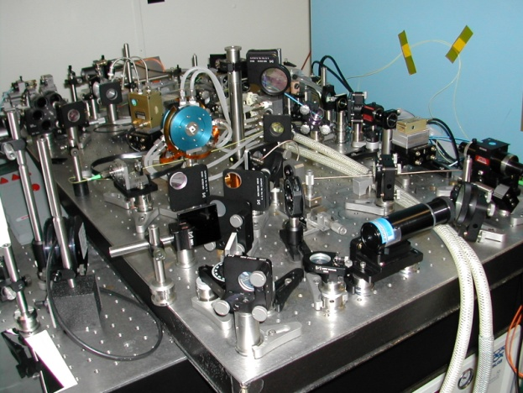
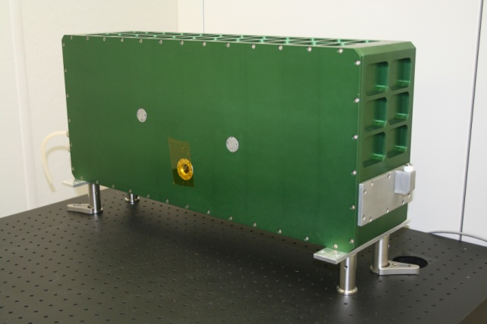
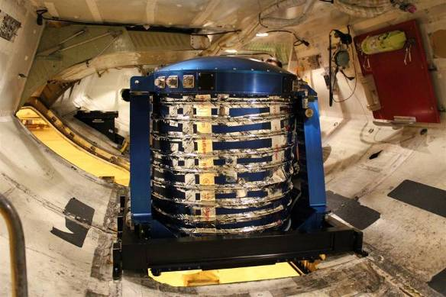
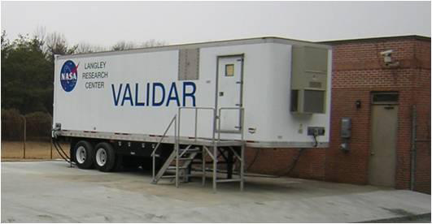
2-Micron Pulsed Wind Lidar System Development
prior to 2007
2008
2010
5.9” x 11.6” x 26.5”; 75 lbs
90-mJ energy, 5-Hz rep. rate
breadboard implementation
required frequent re-alignment
required highly skilled operators
required constant oversight
250-mJ energy, 5-Hz rep. rate
rugged compact packaging of
laser and parts of receiver
no re-alignment needed, even
after transport to field sites
requires moderately skilled operator
unattended operation
installed in mobile trailer
250-mJ energy, 10-Hz rep. rate
rugged compact packaging of
complete optical system
no re-alignment needed, even
in high vibration environment
installed in DC-8 aircraft

Slide 5
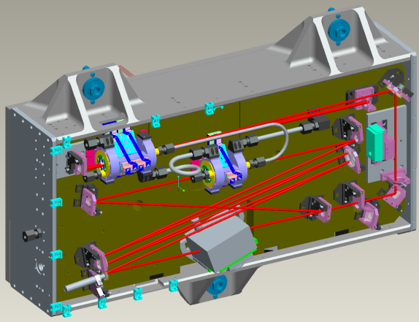
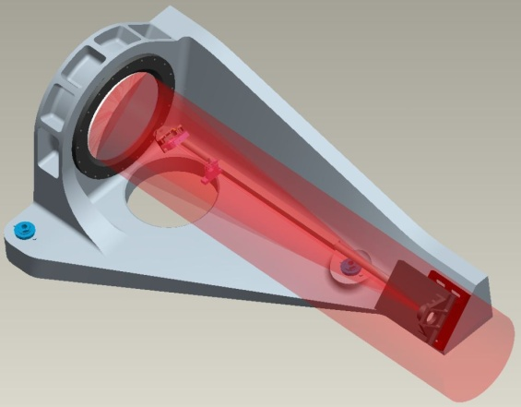
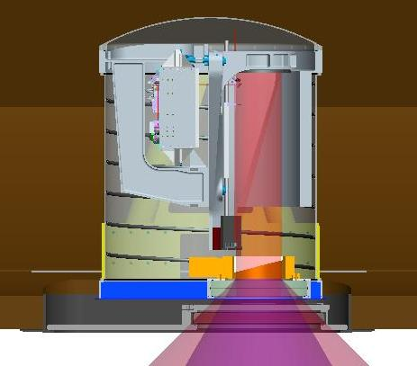
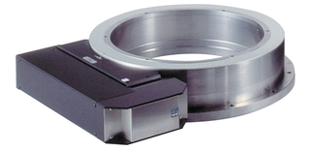
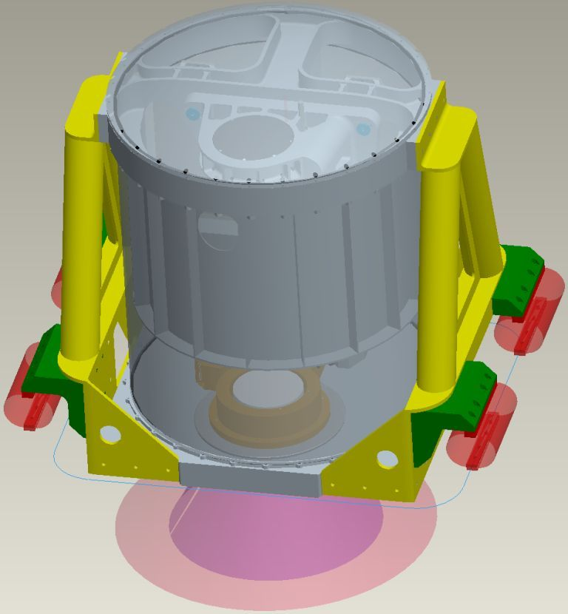
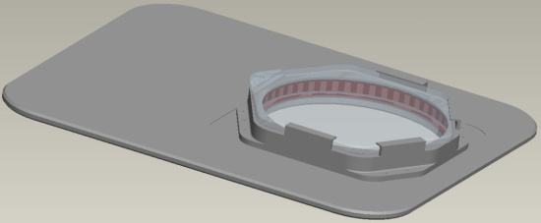
DAWN System Integration
DAWN TXCVR
Telescope
Newport Scanner
(RV240CC-F)
DC8 Port/Window/Shutter
29” x 36” x <37” Tall
Sealed Enclosure & Integrated Lidar Structure
3/8” Cooling Tube

Slide 6
DAWN depicted in DC-8
Mechanical Connections
Scan Pattern During GRIP
0 deg Azimuth at Surface is 4.6 km fore of DC-8

Slide 7
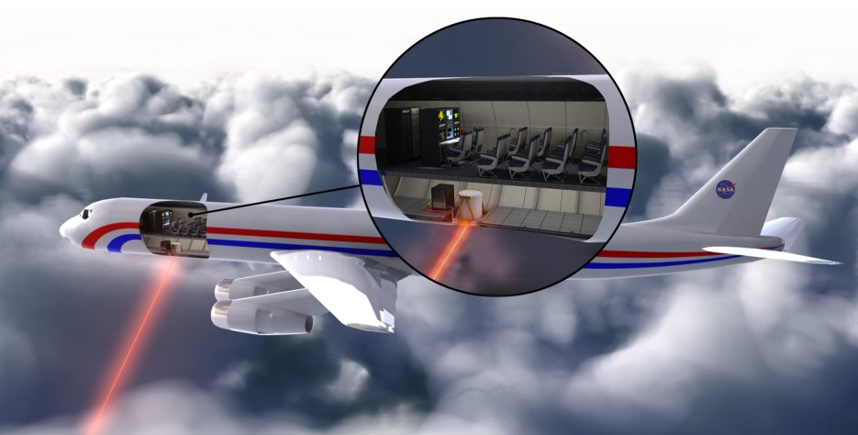
DAWN Lidar Specifications
Pulsed Laser
Ho:Tm:LuLF, 2.05 microns
2.8 m folded resonator
~250 mJ pulse energy
10 Hz pulse rate
200 ns pulse duration
Master Oscillator Power Amplifier
One amplifier
Laser Diode Array side pumped, 792 nm
~Transform limited pulse spectrum
~Diffraction limited pulse spatial quality
Designed and built at LaRC
2 chillers
Mobile and Airborne
NASA DC-8
LaRC VALIDAR Trailer
Lidar System in DC-8
Optics can in cargo level
Centered nadir port 7
One electronics rack in cargo level
Two electronics racks in passenger level
Refractive optical wedge scanner, beam deflection 30.12 deg
Conical field of regard centered on nadir
All azimuth angles programmable
Lidar System
15-cm diameter off-axis telescope
12-cm e⁻² beam intensity diameter
Dual balanced heterodyne detection
InGaAs 75-micron diameter optical detectors
Integrated INS/GPS
One chiller

Slide 8
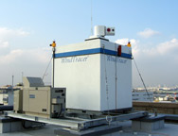
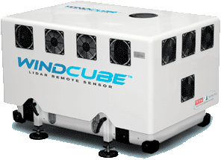
DAWN Compared to Commercial Doppler Lidar Systems
Coherent detection wind lidar figure of merit*
Lidar System | Energy | PRF | D | FOM | FOM Ratio
Lockheed Martin CT WindTracer | 2 mJ | 500 Hz | 10 cm | 4,472 | 40
Leosphere Windcube | 0.01 | 20,000 | 2.2 | 7 | 25,400
LaRC DAWN | 250 | 10 | 15 | 177,878 | 1
The LaRC DAWN advantage in FOM may be used to simultaneously improve aerosol sensitivity, maximum range, range resolution, and measurement time (horizontal resolution).
*SNR is not a good FOM
29” x 36” x <37” Tall

Slide 9
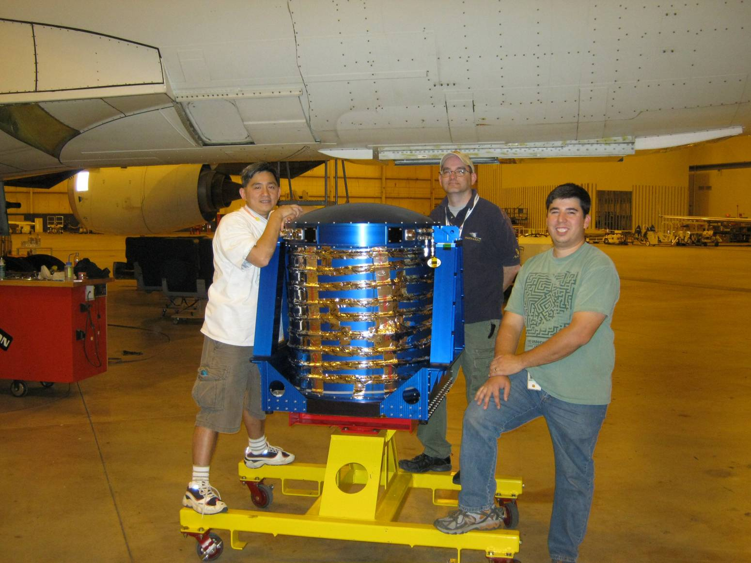
Optics Canister Below DC-8

Slide 10
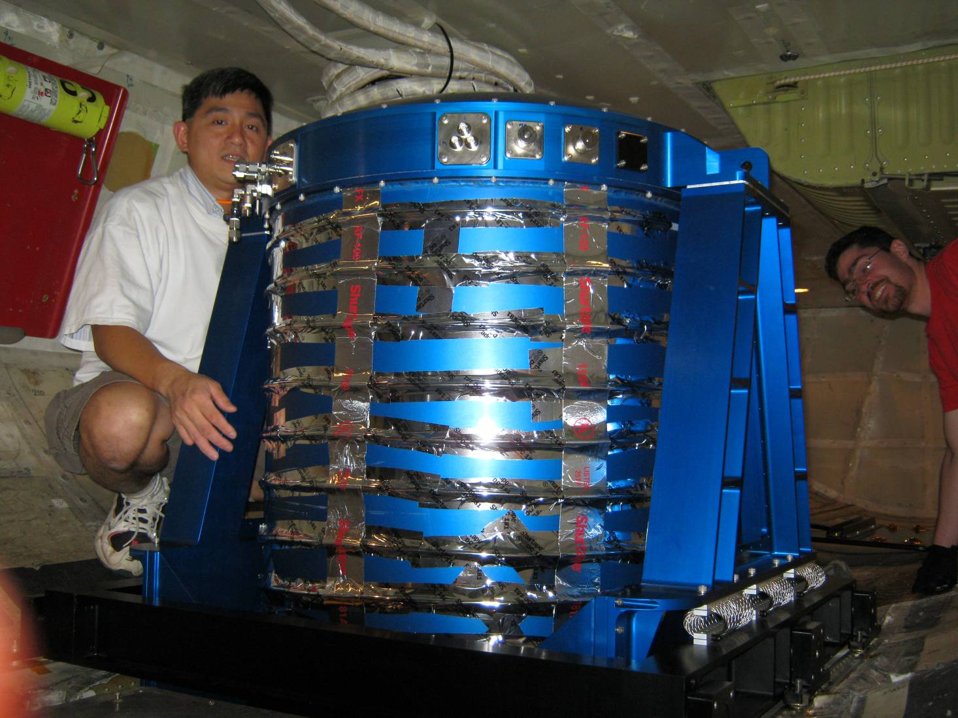
DAWN Optics Mounted in DC-8

Slide 11
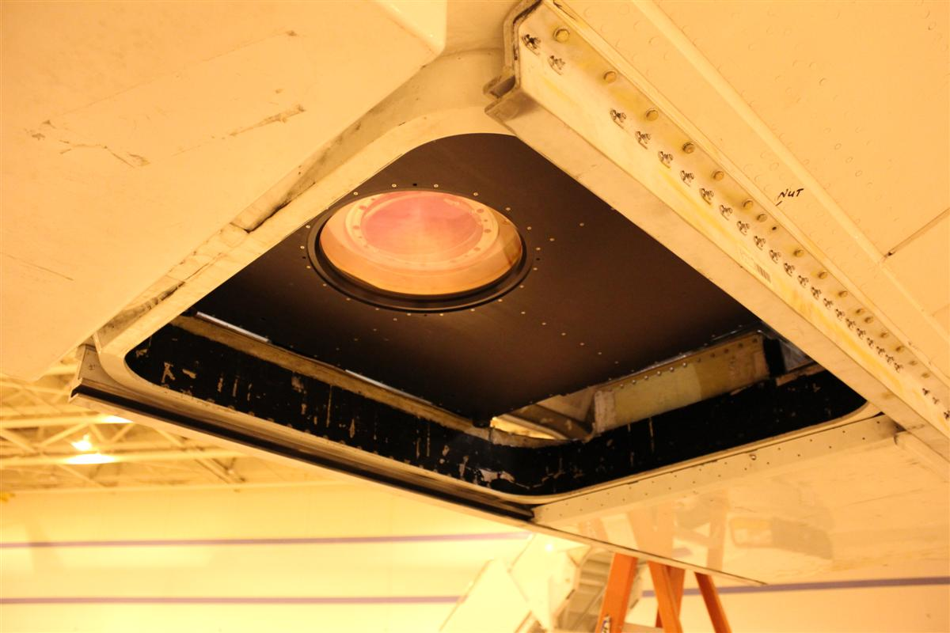
View From Outside DC-8
Optics canister window, but no DC-8 window yet

Slide 12
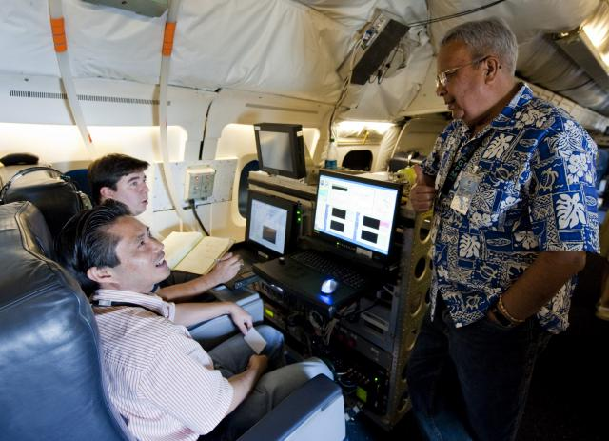
Two of Three Cabin Stations
Laser Control & Data Processing

Slide 13
GRIP FLIGHTS

Slide 14
Lidar Operation in GRIP
DAWN had one single, 3-hr checkout flight
DAWN “worked” on its first flight in the sense of getting atmospheric return signal
The DC-8 departed for the GRIP science campaign 3 days later
During GRIP, the DC-8 flew 3 shakedown, 1 checkout, 6 ferry, and 15 science flights for 113 science hours and139 total hours. Shakedown flight days included pilot proficiency training with many takeoff/landings
Targets included 4 named storms: TD5, Earl, Gaston, Karl
Most flights were in or over thick clouds, and over water
Problems with DAWN were discovered and worked on with ad hoc priority
In the end, DAWN collected wind data for a majority of the flight hours
The alignment of DAWN lasers and optics was maintained through cross-country shipment, forklift ferrying, 139 flight hours, 3 hurricanes, amazingly strong bumps, and ~40 takeoff/landing pairs

Slide 15
Lidar Operation in GRIP
Right away, a decrease in laser pulse energy when at altitude was observed
The problem was the very cold temperature of the DC-8 bottom
Trial and error by clever laser operators discovered the laser running time could be extended by constant tweaking of the optical bench to lower temperatures
On different days, insulation was added between DAWN and the bottom, external heaters were added, the optics air stream for condensation was removed, and a heater/fan was added inside the optics canister
Each action improved the situation and we quickly could get laser operation for all of the long flights albeit with a lot of operator attention
The problems are being investigated now and some of the solutions will be “permanently” added
This will not be a problem in the future

Slide 16
Lidar Operation in GRIP
The laser pulse energy was calibrated after GRIP. It appears to have been in the range of 130-190 mJ instead of the planned 250 mJ, for a loss of 1.2-2.8 dB
Prior to GRIP, schedule slips and a broken laser rod on 6/24/10 led to a compressed schedule for integration, alignment and testing
We think the laser was not optimally aligned for GRIP
This may tie in to the thermal sensitivity of the laser
We believe we can restore the full 250 mJ for the future
The three laser diode array power supplies would fault several times during each flight
No fix was found during GRIP. Each time cost perhaps 15 minutes of data
Working with the vendor (DEI) has already fixed one unit. The other two will be fixed
The problem was an overly aggressive fault sensing procedure in the units

Slide 17
Lidar Operation in GRIP
Also from the very first flight, the data appeared to have much too low SNR
The calculated and displayed wind magnitude and direction were clearly incorrect
Without some facts that we would discover later, a multipronged approach was launched
Noise whitening was added to the processing
Changes in displays were made to permit better diagnostic views
The receiver electronics were checked and amplifier/attenuator changes were made
The wind calculation equations including rotation matrices were called in to question. Other algorithms and matrices were tried
We repeatedly asked the GRIP mission and DC-8 for low altitude flights over land, but this was largely unmet due to various reasons

Slide 18
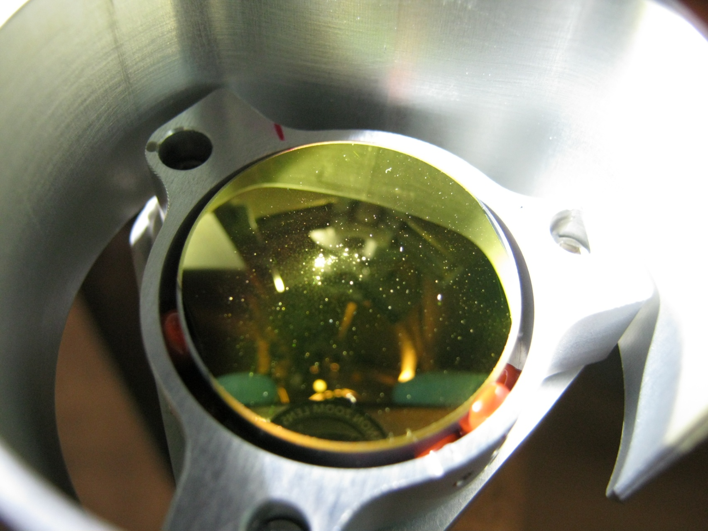
Lidar Operation in GRIP
After GRIP, the telescope secondary mirror was found to have a burn area right where the beam reflects
This probably started with a piece of dust, burned by the laser
Unfortunately, the mirror faces up, so dust might settle on it
We are considering adding a swing in cover and/or an air puff system
The loss of SNR is estimated to be 10 dB
We think it was burned for all of GRIP
The telescope has been returned to Nu-Tek and found to have maintained alignment
The telescope secondary mirror is being replaced, and a spare mirror being made
The lower SNR (~13 dB) is making other investigations very difficult, such as rotation matrix and equation confirmations

Slide 19
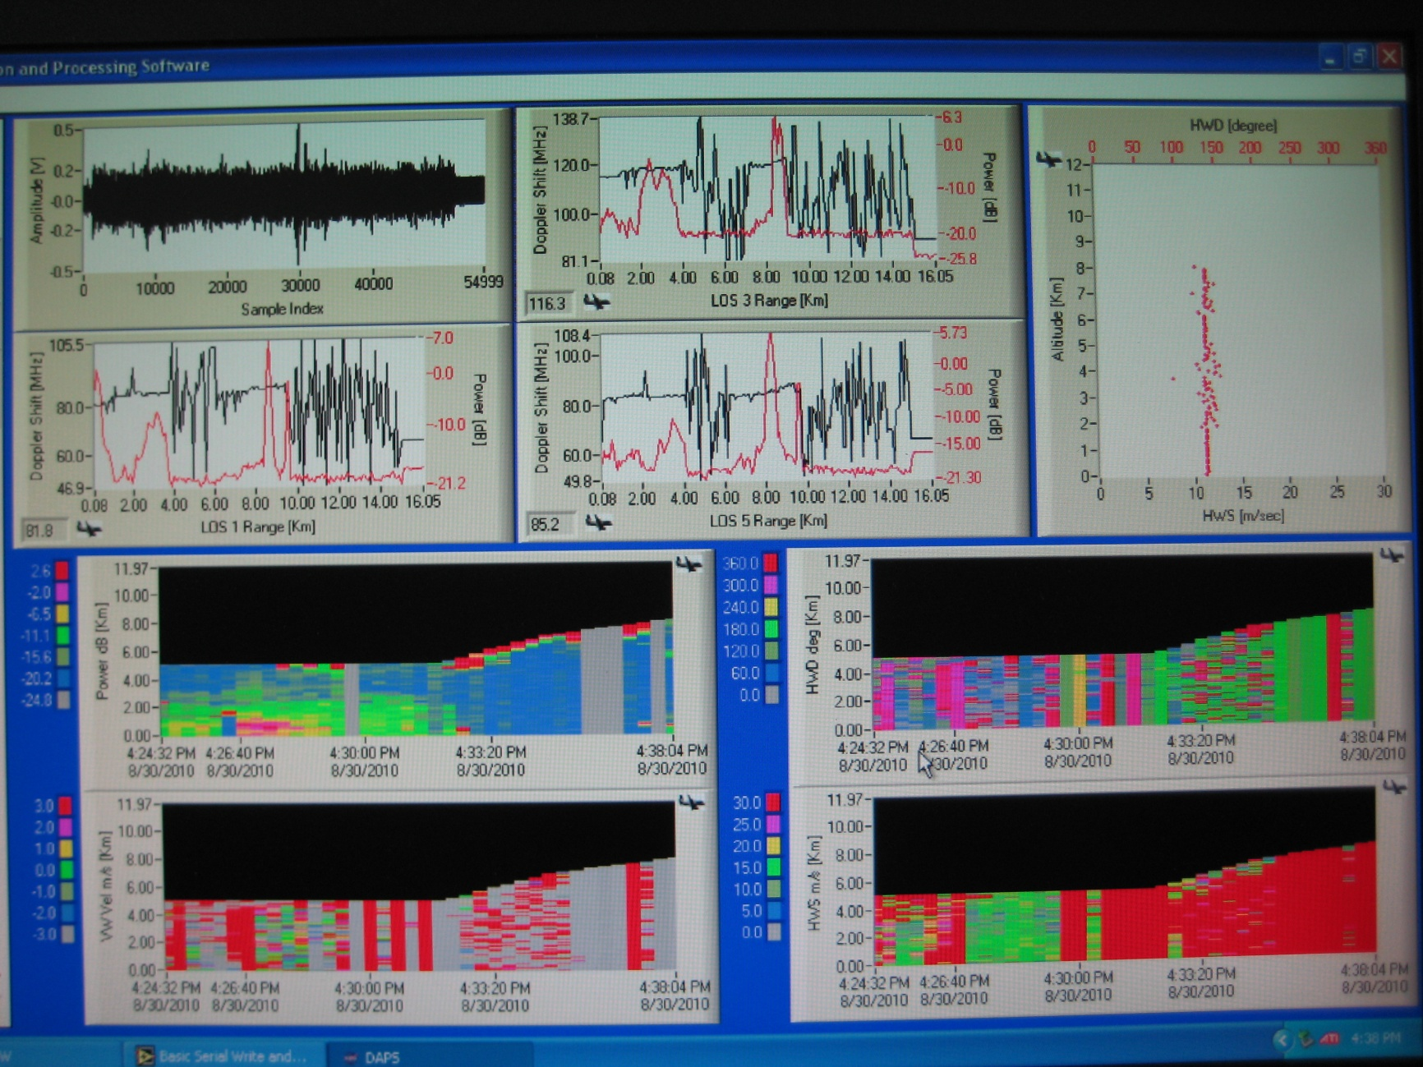
Signal Processing Station Display

Slide 20
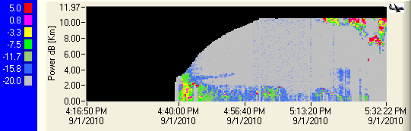
Received Power vs. Altitude vs. Time – 9/1/10
Taking off from Fort Lauderdale to fly into Earl
Note 15 min ending at 5:13 pm.
Very close to full profiles of wind from 10 km to surface
Probably because laser not yet cooled so bench T not yet lowered so receiver aligned

Slide 21
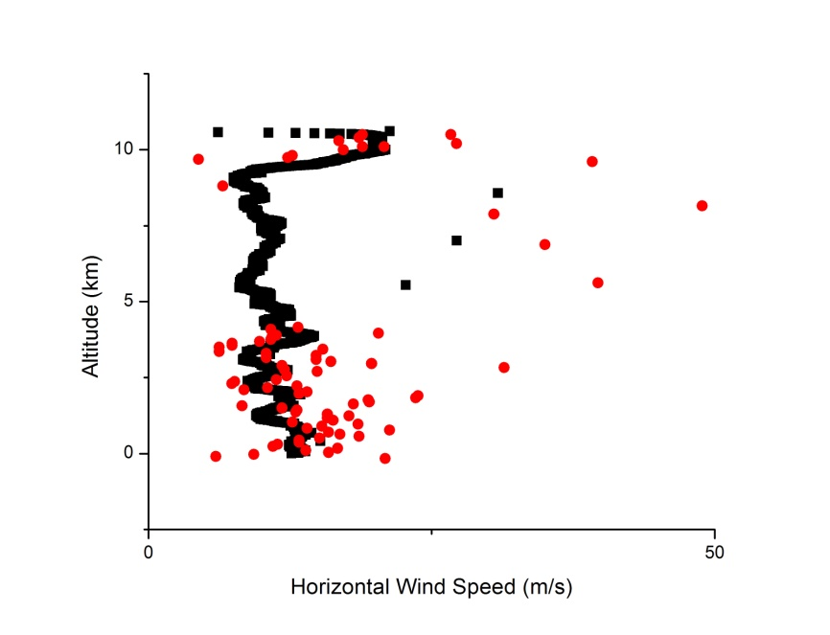
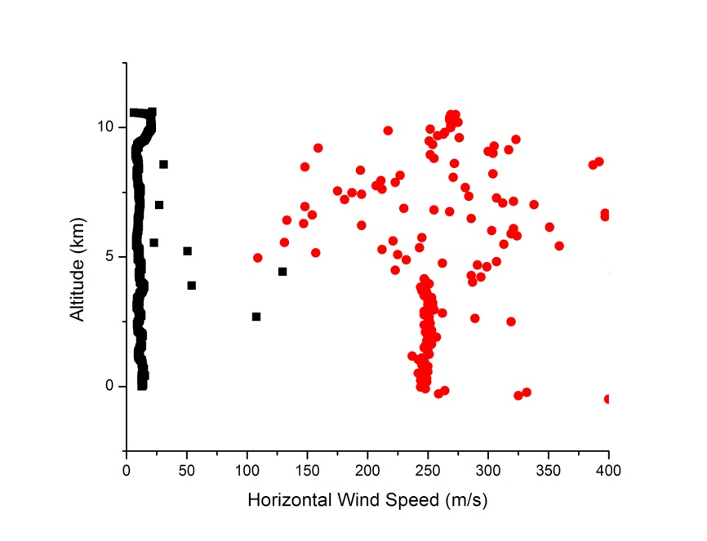
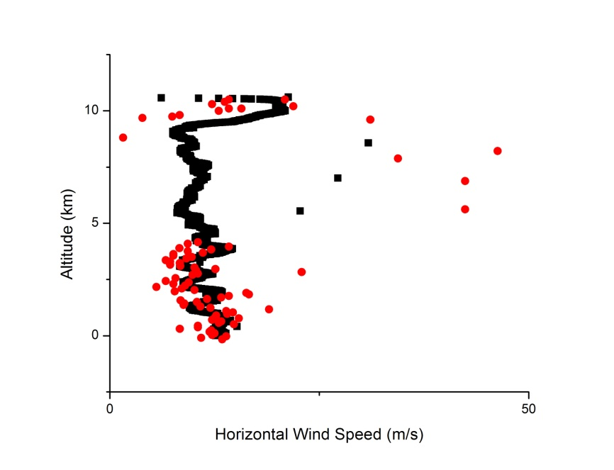
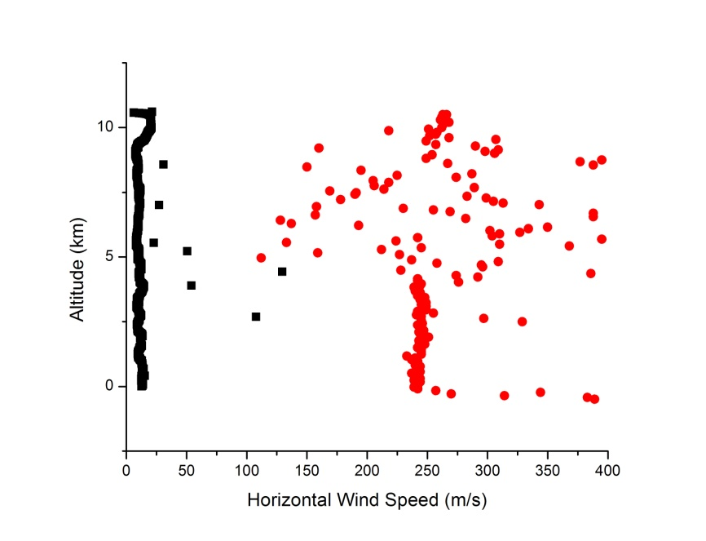
Lidar & Dropsonde Wind Magnitude, 9/1/10
+f₀
30.12°
GRIP DAWN (L) & Dropsonde (D) 9-1-2010 D Begin 17:19:27 Zulu DC-8 at 10,586.40 m L Pattern 118
V8-016
RPY
V8-016
RIPIYI
Very Preliminary
V8-016
YPR
V8-016
YIPIRI

Slide 22
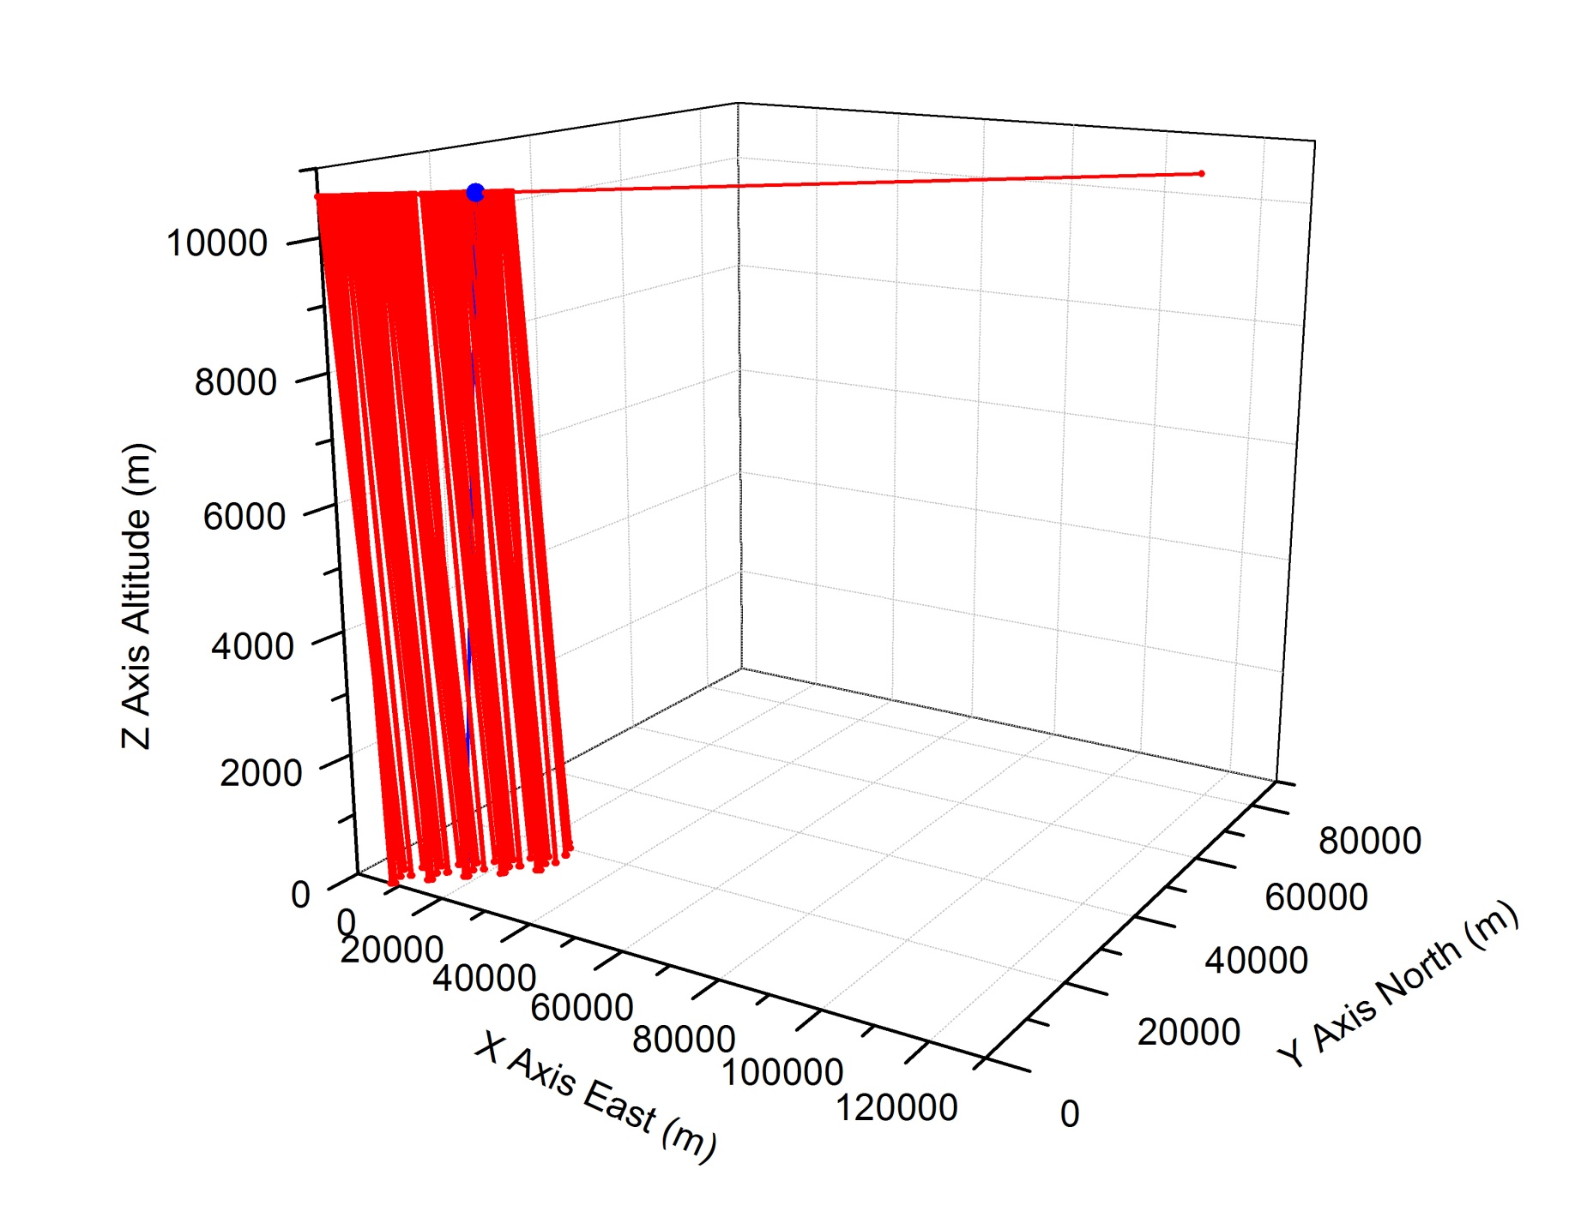
DAWN During GRIP Campaign Nominal Scan Pattern
To Scale, Measurement Altitude = 0 m
Must remember what is being compared
When the subject dropsonde splashed, the DC-8 was 115.3 km away from the launch position
Sept. 1, 2010 Dropsonde launched at 17:20:15.49 Zulu
Dropsonde hit water 17:33:36.5 Zulu
13 min, 21 sec total

Slide 23
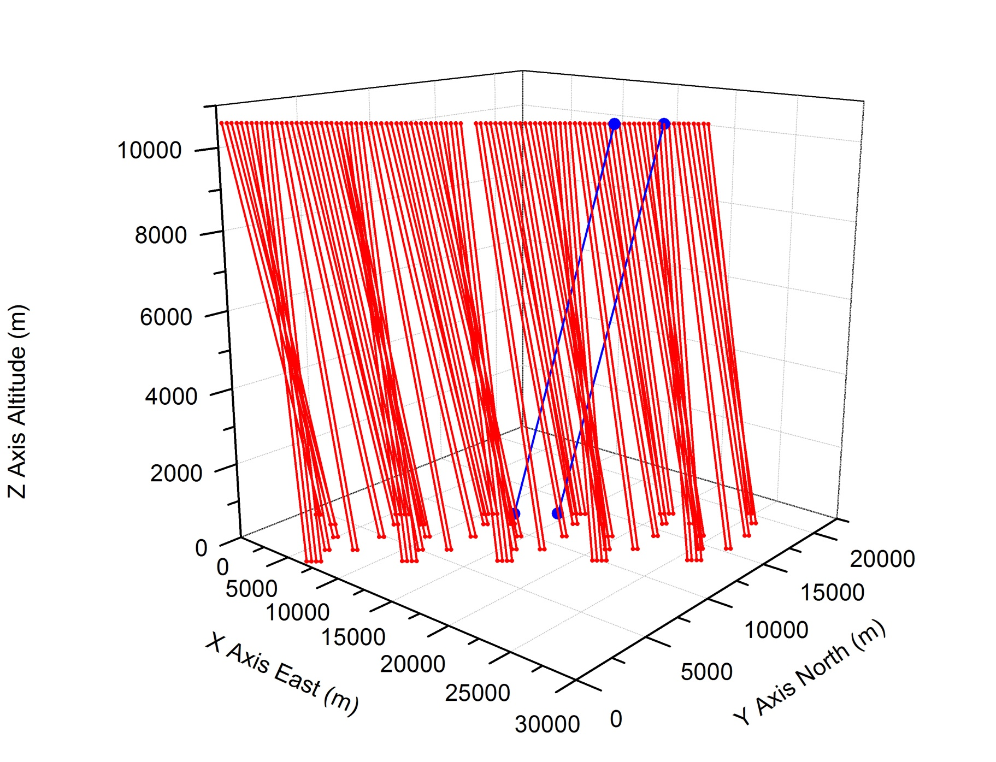
DAWN During GRIP Campaign Nominal Scan Pattern
To Scale, Measurement Altitude = 0 m
196 seconds = 3 min, 16 sec = 28,224 m

Slide 24
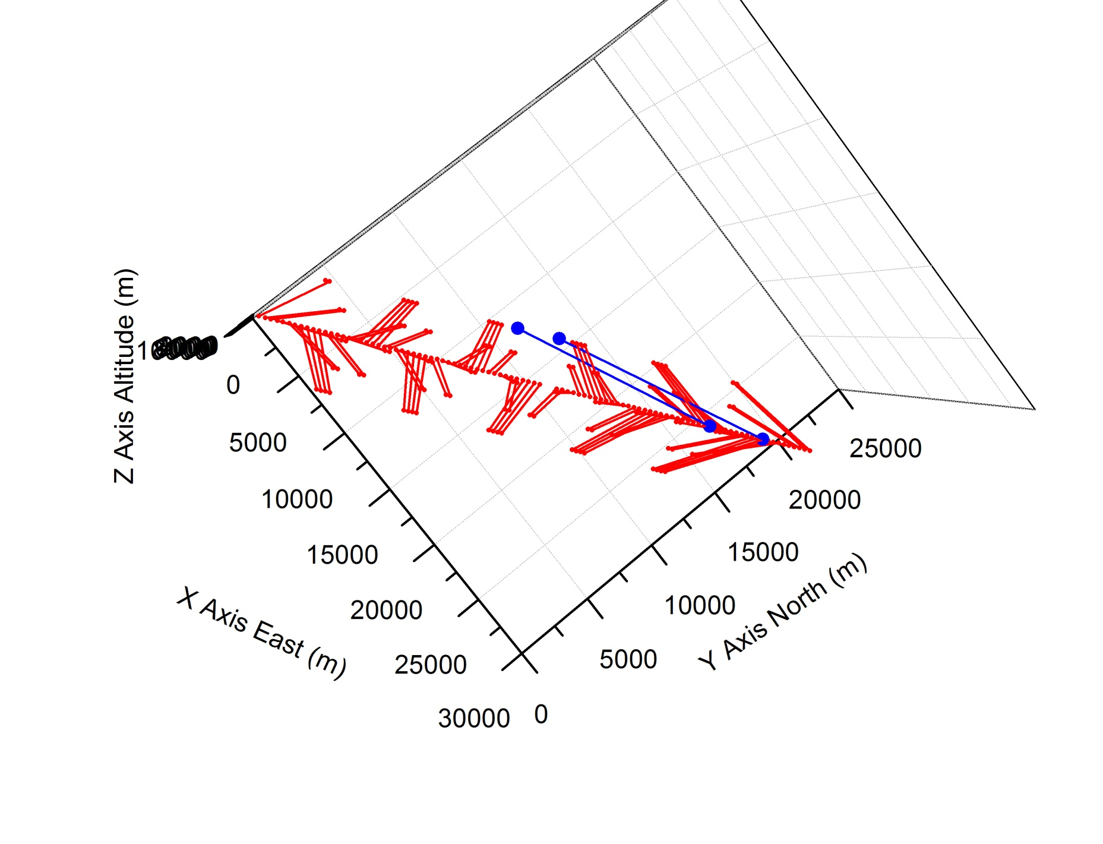
DAWN During GRIP Campaign Nominal Scan Pattern
To Scale, Measurement Altitude = 0 m
Top View

Slide 25
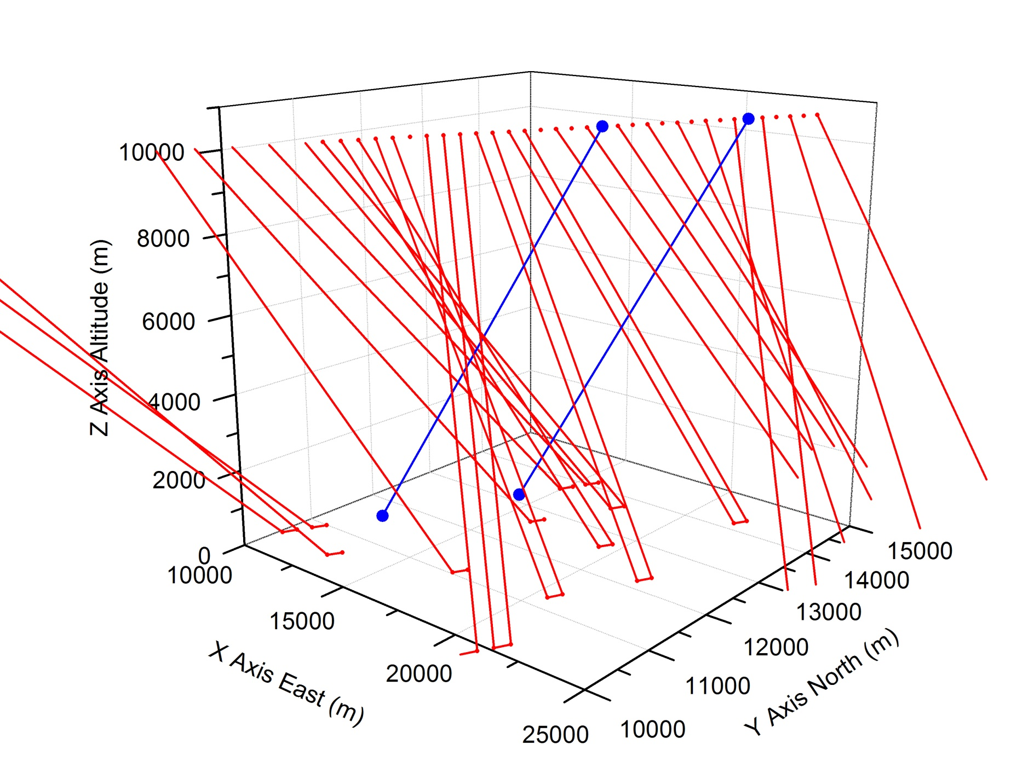
DAWN During GRIP Campaign Nominal Scan Pattern
To Scale, Measurement Altitude = 0 m
Very close up

Slide 26
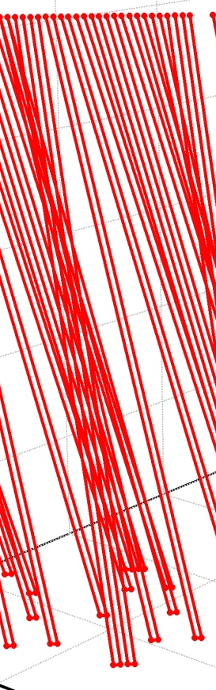
Wind Measurement Volume
Each shot accumulation rectangle consists of 2 sec and 20 laser shots
Each scan pattern has 5 of these “20 string harps” tilted rectangles. Each “harp string” is approximately a cylinder of 20 cm diameter.

Slide 27
Plans
Investigation of the DAWN lidar hardware, algorithms, and software is continuing
Repairs and improvements are underway
Data processing is proceeding. We are slowly making progress in understanding coordinate transformations, rotation matrices, our INS/GPS unit, and key lidar behavior for data reduction. Dave Emmitt will help us.
Have requested modest funds to piggy back on DC-8 in FY11 to better show capability of technology

Slide 28
Back Up

Slide 29
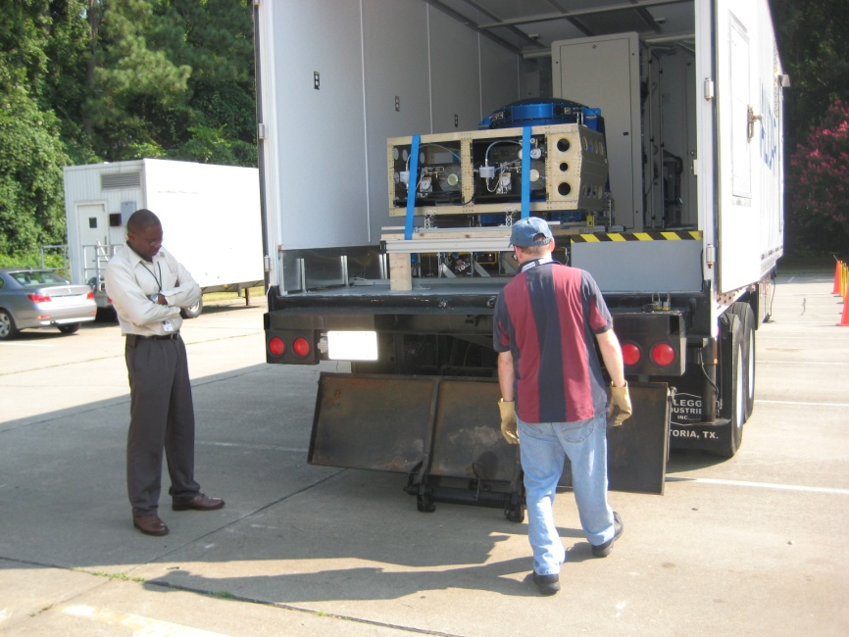
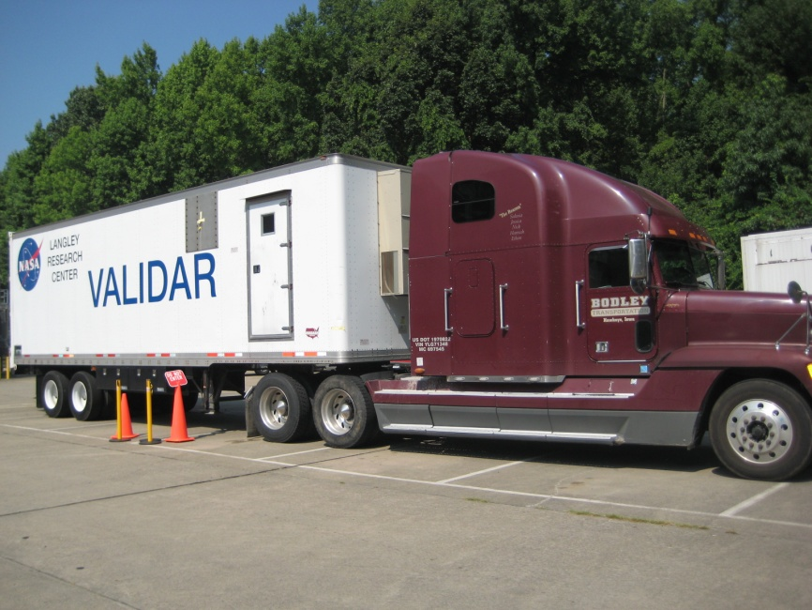

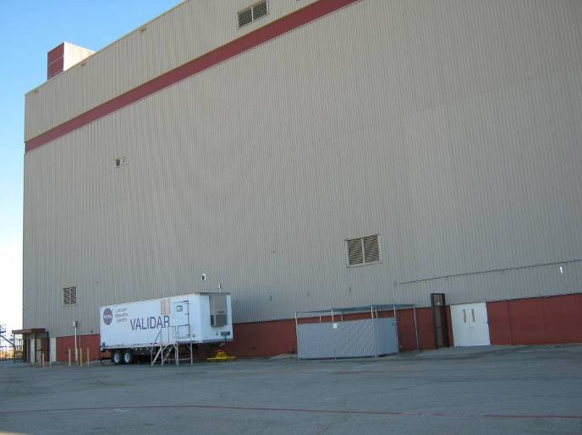
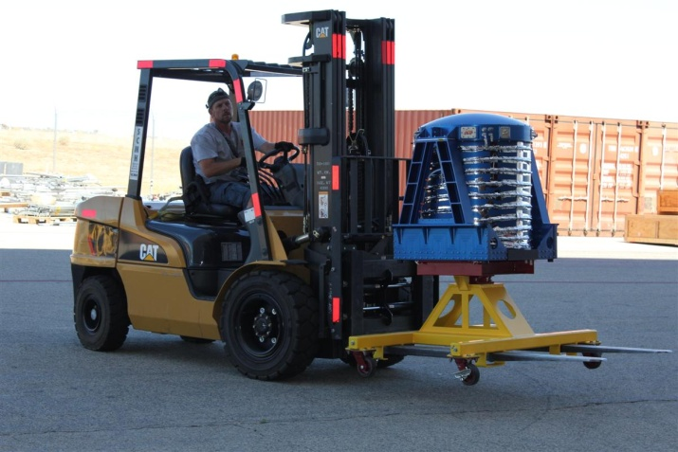
DAWN Shipment
LaRC
Palmdale
CA

Slide 30
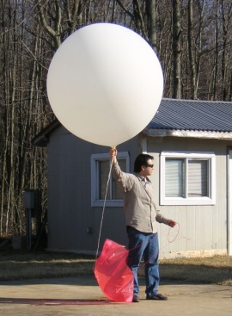
Ground-Based Lidar Compared with Wind Sonde
lidar wind measurements were validated against balloon sondes.
agreement (RMS difference) to 1.06-m/s speed and 5.78-degrees direction.
airborne lidar results are being compared to dropsondes (a complicated
analysis) and in-situ wind sensor at aircraft altitude.

Slide 31
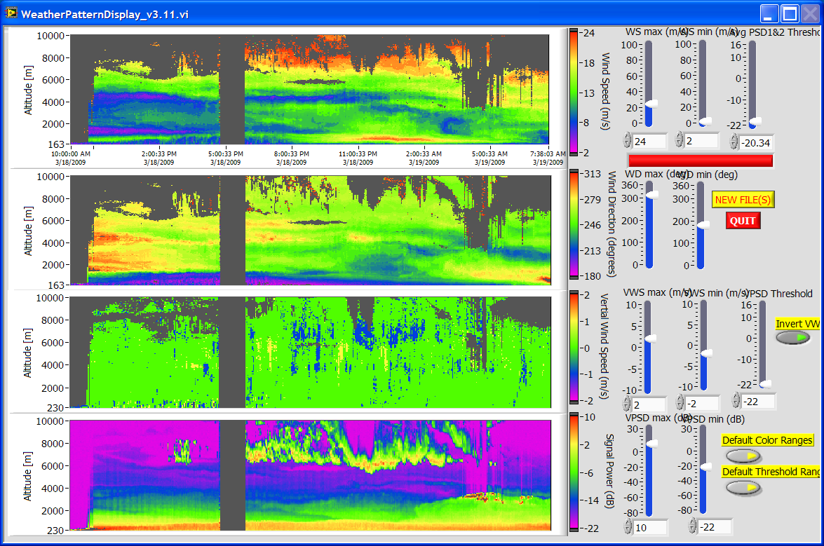
Ground-Based Field Test
nocturnal jet
shear
field test showed:
unprecedented
capability for
high altitude
wind measurements.
agreement with
balloon sondes.
hybrid lidar demo
alongside GSFC
lidar.

Slide 32
Pulsed Coherent-Detection 2-Micron Doppler Wind Lidar System

Slide 33
Telescope & Scanner
beam from transceiver
coherent lidar uses the same
path for transmit and receive—
transmitted path is shown here.
λ/4 wave plate
telescope
scanner optical wedge
scanner rotation stage
aircraft body
window

Slide 34
Pulsed Coherent Lidar Measurement of Wind
Frequency Shifts of Light

Slide 35
1 Direction, 1 Laser Shot
Nominal Data Capture Parameters
Sample 1024
Sample 1025
Typical Range Gate
512 ADC samples
1.024 microseconds
153.49 m ΔLOS
132.93 m Δz
DFT
f_{MAX} = 250 MHz
f_{RES} = 0.9766 MHz
V_{RES} = 1.0027 m/s
1024 samples for outgoing Δf measurement
Range gate 2
Range gate 0
Sample 54,999
Sample 55,000 (75,000 possible)
t ~ 109 microsec
R ~ 16,334 m
Sample 0
Sample 1
Range gate 1
Range gate 3
t = 0
Laser pulse begins
Sample 512
Sample 513
t
ADC = 500 Msamples/sec, λ = 2.0535 microns, zenith angle = 30 deg., round-trip range to time conversion = c/2 = 149.896 m/microsec

Slide 36
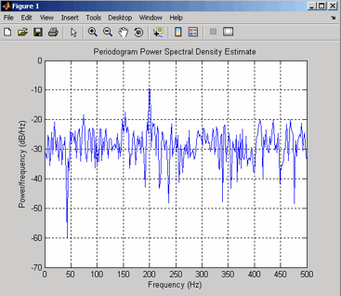
Periodogram: Estimating Signal Frequency After N_{P} Shot Accumulation One Range Gate, One Realization
Mean Data Level = L_{D}
Data Fluctuations = σ_{D} = L_{D} /√N_{P}
Mean Signal Power = area under mean signal bump but above mean noise level. P_{S} = A_{S} = [(L_{D} – L_{N}) • Δf • 1] (if signal in one bin)
Mean Noise Level = L_{N}
Noise Fluctuations = σ_{N}= L_{N} /√N_{P}
Mean Noise Power = area under mean noise level = P_{N} = A_{N} = L_{N} • Δf • (# Noise Bins)
Φ = (L_{D} - L_{N})/L_{N}
Data = Signal + Noise, D = S + N

Slide 37
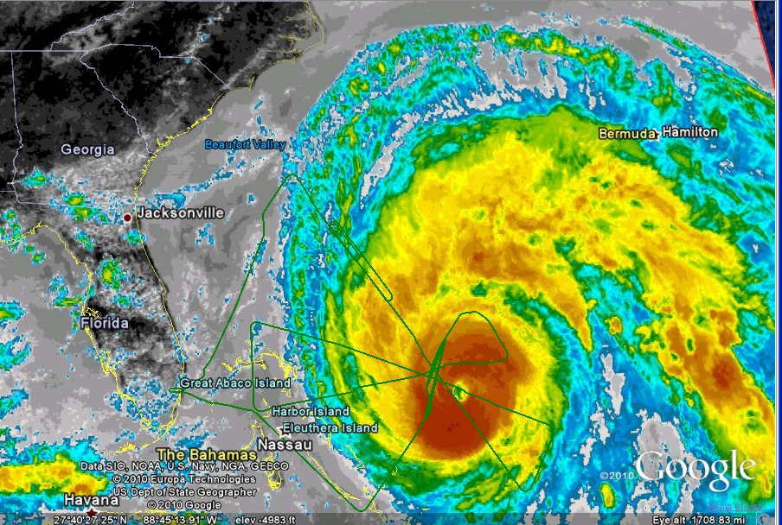
Aircraft Location in Hurricane Earl (GOES 13 infrared)
(green line is aircraft track for entire flight)
DC-8 location

