Slide 1
The Role of High-value Observations for Forecast Simulations in a Multi-scale Climate Modeling Framework
Gabriel J. Kooperman, Michael S. Pritchard,
and Richard C. J. Somerville
Scripps Institution of Oceanography
University of California, San Diego
Notes:
Mike and I will be presenting some work we've done in our group to set up forecast simulations with SPCAM.
The approach we've taken and some of the code modifications originally came from Marat.
I'll discuss a bit about the method he proposed and our implementation, and then pass off to Mike to discuss some test cases we've started looking in more detail.
We're familiar with some previous studies of SPCAM's climatology the have identified critical aspects that need fixing: too many high clouds, weird low clouds - stratofogulus, the “supermonsoon” and the Great Red Spot.
The new turbuluence parameterization and microphysics in SAM may help improve some of these things.
And we think that testbed forecast simulations will be crucial to understanding why/how the current SPCAM fails in the ways it does, and for evaluating these improvements against high value ground-based data such as fixed ARM sites or during intense field champaings.
This is especially true for looking at new chemistry features like the work in Bill Collins’ group discussed this morning or the efforts at PNNL on the CAM5 based MMF, for which chemical observations, at least above the surface, are intermittent.

Slide 2
Model: Steps the atmospheric state vector X(t) forward in time as an initial value problem.
∂X_{M}
∂t
=
f (X_{M}) , X = (V, T, q,…)
X(t) = horizontal winds (V), temperature (T), and humidity (q); subscript M is a model variable.
But f is imperfectly known and includes simplified representations of complicated physics, such as cloud and precipitation processes, heating and cooling by radiative energy fluxes, etc., all on small (unresolved) space and time scales.
Notes:
Nudging is a method of data assimilation that relaxes a climate model toward analyzed observations through the addition of tendency terms at the end of each model time step.
The model is constrained to follow a realistic observed weather state by nudging its horizontal winds, temperature, and humidity fields, while allowing the rest of the model fields to evolve freely.
The choice of tau, the relaxation parameter, determines the magnitude of nudging that is applied. There are some dark arts in the selection of tau. The reanalysis is cubically interpolated in time to the model time step, but you wouldn't really want to relax to anything less then its original time resolution. However, there are also some considerations depending on your application and how nudging effects on the rest of the model that need to addressed as well.
This approach adds some unphysical terms to the model, so you have to be somewhat careful how you implement it.

Slide 3
Parameterization: Algorithm for representing the statistical effects of an ensemble of small-scale unresolved processes, on the resolved large-scale fields, as an explicit function of those resolved fields themselves. Example:
∂T_{M}
∂t
=
f (advection, sources, sinks)
Diabatic sources and sinks of energy can be “parameterized” as functions of V, T, q,…
Notes:
Nudging is a method of data assimilation that relaxes a climate model toward analyzed observations through the addition of tendency terms at the end of each model time step.
The model is constrained to follow a realistic observed weather state by nudging its horizontal winds, temperature, and humidity fields, while allowing the rest of the model fields to evolve freely.
The choice of tau, the relaxation parameter, determines the magnitude of nudging that is applied. There are some dark arts in the selection of tau. The reanalysis is cubically interpolated in time to the model time step, but you wouldn't really want to relax to anything less then its original time resolution. However, there are also some considerations depending on your application and how nudging effects on the rest of the model that need to addressed as well.
This approach adds some unphysical terms to the model, so you have to be somewhat careful how you implement it.

Slide 4
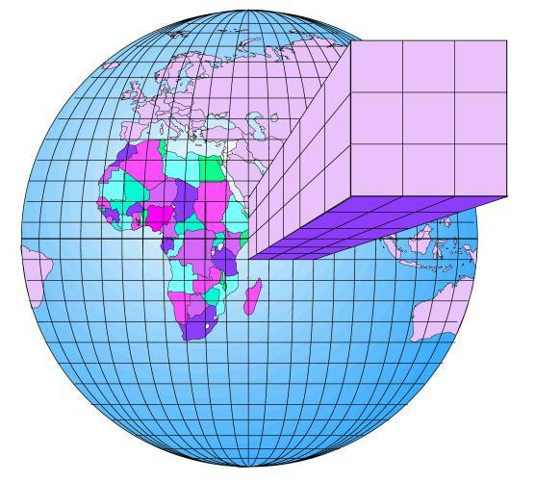
GCM: [conventional] Global Climate Model
http://www.developers.net/storyImages/062404/inteldemystifying1.jpg
Notes:
Understandably, the grid resolution of global climate models has increased in tandem with this computing power, but we’re still a long way from where we’d like to be.

Slide 5
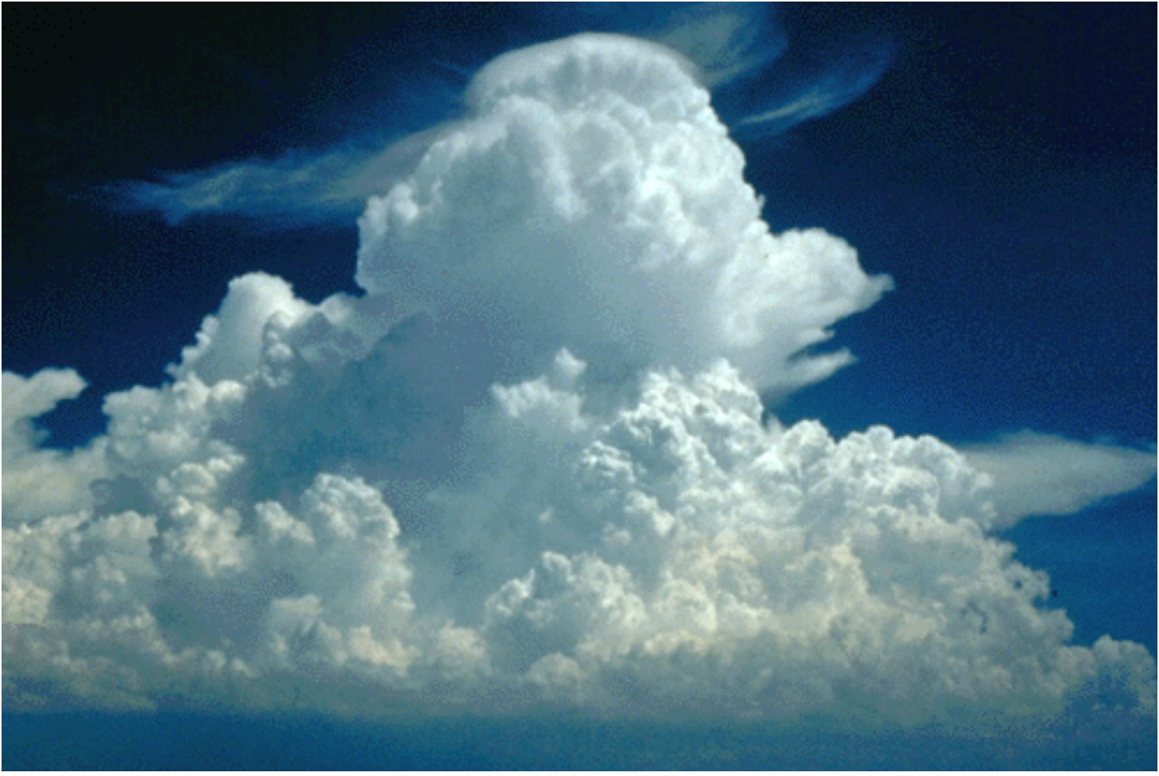
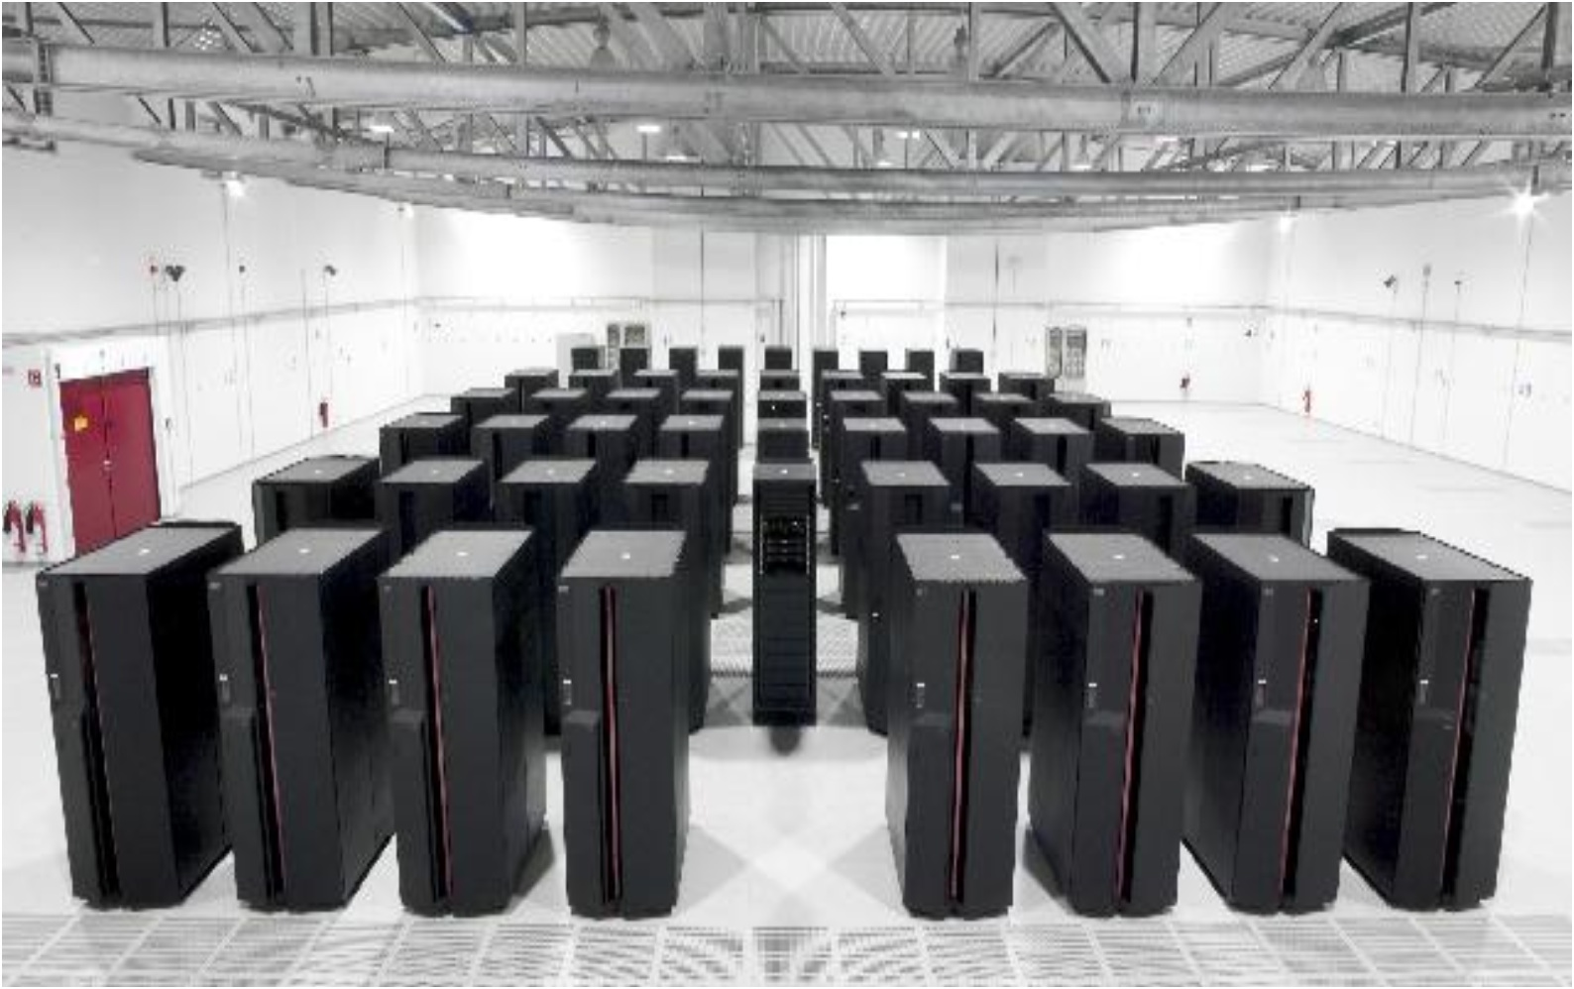
PP
Physical complexity and spatial resolution trade-off vs. computer power and/or simulation duration.
Notes:
There is still a fundamental trade-off that is made when doing climate modeling between the amount of physical complexity we choose to resolve, in terms of cloud processes, and either a) the available horsepower or b) the simulation length.
For centennial scale climate change simulations, projections have been made that assuming Moore’s law continues to increase computing power at its observed pace, and does not encounter a physical barrier, we are still 20 to 30 years away from being able to make global cloud resolving centennial scale climate simulations.

Slide 6
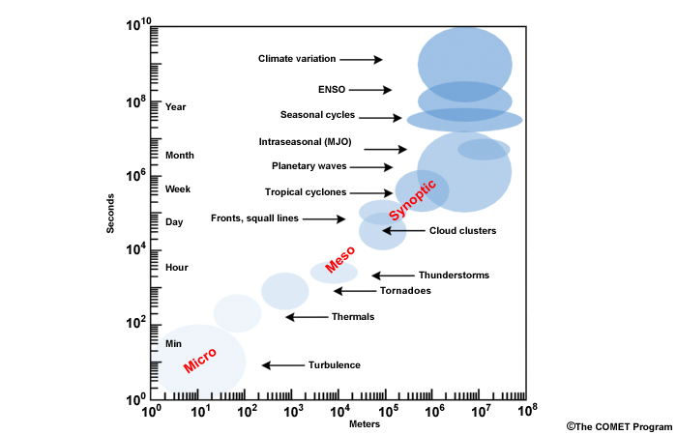
PPhenomena span 8 to 10 orders of magnitude in space and time.
GCM
CRM

Slide 7
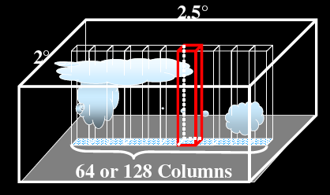
Embedding cloud resolving models in a GCM is a potential interim strategy for progress. MMFs cost only 200x more than GCMs.
The Multi-scale Modeling Framework (MMF) approach
(a.k.a. “super-parameterization”)
Exterior global
climate model
Interior cloud
resolving model
Grabowski,
www.cmmap.org
“Center for Multiscale Modeling of Atmospheric Processes”
An NSF Science and Technology Center at Colorado State U. the cost of the inner domain.
Notes:
Its affordability is won by making substantial idealizations in the expensive inner model that reduce the amount of calculations it does (by reducing its dimensionality) and reducing the parallel communication overhead it incurs (by splitting it into thousands of periodic subdomains that can only feel each other via their mutual influence on the host model's scale of dynamics). [[ Bifurcations in the physics across the interface separating the two resolved scales are (avoided? circumvented?) by using nudging as a tool to keep the inner model in a similar state as the outer, but nonetheless allow its complex resolved plume dynamics to control subgrid vertical fluxes of heat, moisture, etc. that would ordinarily be rigidly tied to parameterization in the exterior model.
The implications of these idealizations have not been

Slide 8
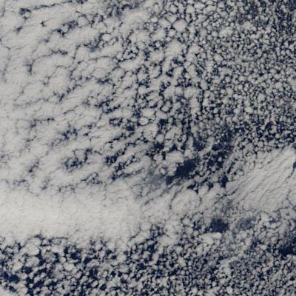
“Superparameterization” a.k.a. multi-scale climate modeling
≅
MMF: Multiscale Modeling Framework
Notes:
Multiscale modeling was proposed in this context, as in interim tool that may allow us to answer important questions about cloud-climate interactions before GCRMs become affordable. If you look at a slice of nature on the sort of scale of the grid that is affordable for centennial climate projections today, about 100 km, there is incredible structure in cloud fields, which is indicative of a host of physical processes at the subgrid scale that are note resolved but must surely interact in nontrivial multi-scale ways with broader climate evolution. Many believe these sorts of interactions may be 0th order feedbacks on the trajectory of climate change in coming decades. The idea in MMFs is that recognizing we cannot afford to resolve all of this structure let’s at least represent some of it on its native scales, and allow it to interact with large scale variability in order to begin probing these questions about cloud feedbacks on large scale climate evolution in a technically affordable way. MMFs are 100s of times more expensive to run than GCMs but 1000s of times less expensive that GCRMs; ten years from now they will be routinely affordable for climate experiments.
CMMAP hopes that the MMF approach may one day be used to study the interactivity of regional/small/fast cloud phenomena with global/big/slow climate phenomena. To achieve this goal, we must repeatedly test, understand, and try to improve its performance at both large scales and small scales.

Slide 9
GLOSSARY: Superparameterization: Replacing a conventional parameterization by an embedded array of models of small-scale processes (array of CRMs in a GCM) GCM = Global Climate Model CRM = Cloud-Resolving Model MMF = Multiscale Modeling Framework SP = Superparameterized model = MMF CAM = Community Atmospheric Model (a GCM) SP-CAM = Superparameterized CAM (our MMF) ECMWF = European Centre for Medium-Range Weather Forecasting, a leading prediction center
Notes:
Proof of concept. Learning opportunity. Look forward to
This has been a proof of concept and we’re looking forward to the exciting scientific learning opportunities ahead, and we really want your input on what you think the highest priorities should be! < open floor for discussion >
Re: point 1; higher standard of scrutiny; leverage ARM and ground based radar data not easily brought to bear on MMF diagnosis on climate timescales to explore cloud biases at high frequencies.
Re: point 2 < we can try to break the model to learn more about it > - CRM orientation, scale coupling time interval, inner vs. outer resolution, FV vs spectral dycore, etc..
Re: point 3; efficient testbed for these new features getting merged in.

Slide 10
PHENOMENA THAT IMPROVE using the MMF: - Convectively coupled atmospheric motions (hourly, daily and yearly timescales). - Intermittency and intensity statistics of rainfall. NEW PROBLEMS that emerge in the MMF: - Cloud biases and a supermonsoon.
Notes:
On “Convectively coupled” point, emphasize MJO indirectly “including a slow large scale pulse of tropical convection that has eluded weather and climate models for decades”.
On “intermittency”, mention that the old mantra “GCMs rain too weakly, too frequently” no longer applies. Mention importance e.g. to ecosystem or agricultural impact modelers, of getting these sorts of things right.
- On the “New Problems” point, mention that some problems need to be solved if this class of model if ever going to join in the official IPCC exercises. These are areas of active research. Example: The interior model doesn’t completely resolve all of the fine scale processes within clouds; but the frontier of parameterization has shifted 2 orders of magnitude, from 100 km to 1km, introducing new challenges that need to be understood. This sets up the next half of the talk.

Slide 11
Question: Can forecast simulations help identify critical aspects of MMF climate simulations? Can we use observations to improve the model?
Analyzed
weather data
Data from field programs
Climate data
Initialize model
MMF model
Make forecasts
Identify forecast & physics errors
Simulate climate
Find climate errors
Evaluate & modify the superparameterization
Notes:
This forecast method is of course not new, through the cloud associated parameterization testbed - CAPT it has been taking hold in the GCM community. Although, to our knowledge, no one else is doing it with the MMF, so we'll have the benefit of characterizing the predictability characteristics for the first time, which may be a potential knowledge transfer opportunity for CMMAP to NWP.
This is the basic workflow of the CAPT paradigm. A GCM, here the MMF, is initialized, we make forecasts, we understand the physical nature of the forecast errors. This last part involves picking a process of interest, something that was well observed or well understood physically by NWP or field campaigns.
(click). The idea is to leverage high value data in the workflow. Best estimates of the atmosphere from NWP are used for initialization and in combination with high quality instrumented field sites like ARM for error evaluation. Data from the internal model physics packages help isolate which parameterizations are contributing to errors at the process level.
(click). We can then look at modifications to super-parameterization and see if things improve at the process level.
(click). Which in theory gives some confidence that things will improve at the climate level before getting into climate compositing and statistics from long expensive runs.
It can be difficult to identify particular parameterization deficiencies solely by analyzing a model’s climate statistics, which reflect compensating errors resulting from the nonlinear interactions of many different processes. The CAPT premise is that studying climate GCMs in a weather-forecasting framework is generally a more effective way to identify parameterization deficiencies and to gain insights on how these might be improved.
We're at the early stages, but that’s the vision and our long term interest. Our purpose here is to convince you this sort of thing is possible now with the MMF, even if a little tricky.
(click). In the first part of the talk I’ll speak about an MMF specific challenge not previously dealt with in the CAPT community, which is how to initialize both resolved scales of an MMF appropriately.
(click). In the second part of the talk Mike will describe a preliminary forecast application, focusing on nocturnal convective systems over the US in SPCAM, which our group is interested in understanding better at the process level. This is mostly to demonstrate the sorts of diagnostics that will soon be possible, and to solicit suggestions for high priority forecast process runs for the near future.

Slide 12
Problem: How to initialize the interior idealized 2-D CRM for MMF forecasts?
Global data resolution ≈ 50 km.
GCM resolution ≈ 200 km. ✔
CRM resolution ≈ 4 km. ✗
Initializing the MMF is critical, because we want to make MMF short-range forecasts to compare with high-value data so as to evaluate parameterizations.
Notes:
The MMF has 2 resolved scales - the large scale GCM and the internal cloud resolving model.
(click). In normal GCM forecasts you can take a global analysis product and interpolate it to the model's grid to be used as an initial conditions files for starting forecasts from a realistic weather state.
(click). This works fine when the model is at a lower resolution than the analyzed observations.
(click). But doesn't work when part of the model is at a much higher resolution.
In the MMF, the CRM usual starts with an empty atmosphere and spins up in a couple of days, but that spin up time in a forecast simulation would destroy its skill.
Since global observations don't exist at a resolution high enough to be useful for initializing the CRM and (click) its not even clear what a 2D idealized representation of observations would be, we needed another approach for initializing the CRM.
This approach is to run the model in an observationally constrained, 'nudging', mode to generate initial conditions files with a spun-up CRM.conditions files with a spun-up CRM state.

Slide 13
Solution: Spin up CRM by “nudging” the GCM toward analyzed observational data.
∂X_{M}
∂t
( )
Resolved Dynamics
X_{M} - X_{A}
τ
= … -
Nudging
X = horizontal winds (V)
temperature (T)
humidity (q)
M = model values of variables
A = analyzed observational data
= relaxation time constant
Sub-grid Physics/CRM
Notes:
Nudging is a method of data assimilation that relaxes a climate model toward analyzed observations through the addition of tendency terms at the end of each model time step.
The model is constrained to follow a realistic observed weather state by nudging its horizontal winds, temperature, and humidity fields, while allowing the rest of the model fields to evolve freely.
The choice of tau, the relaxation parameter, determines the magnitude of nudging that is applied. There are some dark arts in the selection of tau. The reanalysis is cubically interpolated in time to the model time step, but you wouldn't really want to relax to anything less then its original time resolution. However, there are also some considerations depending on your application and how nudging effects on the rest of the model that need to addressed as well.
This approach adds some unphysical terms to the model, so you have to be somewhat careful how you implement it.

Slide 14
Note: Forecast quality depends sensitively on regridding observational data to the model grid.
Orography comparison of two GCMs: ECMWF and CAM
Interpolation must
account for:
Orographic and surface pressure differences
Field-specific vertical interpolation procedures
False supersaturation (relative humidity > 100%)
Grid type differences (Gaussian vs. finite volume)
Notes:
First of all you need to be careful with interpolation of analysis to the model grid, its more complicated than it originally appears.
Here we use ECMWF interim reanalysis as our nudging product, which is on a much higher resolution Gaussian grid.
Topography differences between models, shown here, can cause all kinds of inconsistencies if not accounted for properly. These differences can be quite large, I cut this figure off at plus or minus 200m, but values range up to 600m in some places.
Elevation differences effect the surface values of all fields and need to be adjusted assuming lapse rates and vertical profiles.
Resulting differences in surface pressure also enter into the vertical interpolation of hybrid coordinates.
You can also inadvertently create artificial supersaturated conditions through interpolation, that need to be removed.
If these aren't dealt with nudging will be dominated by pushing the model toward orographic or systematic differences rather than realistic weather.
With help from Jerry Olson and David Williamson at NCAR, we think we've overcome most of these issues.

Slide 15
Check 1: With appropriate care, interpolation issues can be overcome…
Root mean square error from CAM experiments:
Analysis Products:
CAM-DART Analysis
ECMWF Interim
Nudged Fields:
Horizontal Winds
Temperature
Humidity
Surface pressure error is not affected by humidity nudging.
ECMWF error is similar to CAM-DART.
Notes:
And as a validation we've done some CAM tests using another analysis product based on a data assimilation version of CAM, that doesn't require any interpolation, called CAM-DART or the Data Assimilation Research Testbed.
Kevin Raeder, also at NCAR, set us up with CAM-DART analyses to compare our ECMWF interpolation against.
In addition we tested the effect of nudging with and without humidity with each of these products.
This figure shows the daily average root mean square error of horizontal winds, temperature, humidity, and surface pressure from the 4 experiments. The error is relative to the analysis product used in each experiment. Solid lines are from the experiments that included winds, temperature, and humidity nudging. Dashed lines didn't include humidity. Red is CAM-DART and blue is ECMWF.
The take away here is that the model nudges to a relatively small minimum error over the course of a day or so and that ECMWF is fairly comparable to CAM-DART - the blue line is slightly higher than the red line everywhere except surface pressure, but both are similar.
When humidity isn't nudged it maintains a larger error, but none of the other fields are effected much.

Slide 16
Check 2: …and nudged tendencies are not too large. They do not dominate model tendencies.
Nudging is smaller than “dynamics” and total “physics”
Nudging ECMWF data is comparable to CAM-DART data
Notes:
Another important check is the nudging tendencies.
If its a lot larger than other model tendencies and then there may be systematic model differences.
Here this figure shows the absolute magnitude of the global mean tendencies after the model spun up a couple days to its minimum error values, shown on the previous slide. There are 4 simulations - 2 CAM-DART and 2 ECMWF both with and without humidity nudging. There blue bars are total dynamics and physics tendencies. The red is the nudging tendency. And the rest are individual parameterization packages.
The main point here again is that ECMWF is comparable to CAM-DART. The nudging terms a little larger with ECMWF, but still smaller than total dynamics and physics.
You could imagine that if the nudging terms we really large and the model wanted to move toward a different state, then the forecast skill wont be very good once the model is let go freely in a forecast simulations.

Slide 17
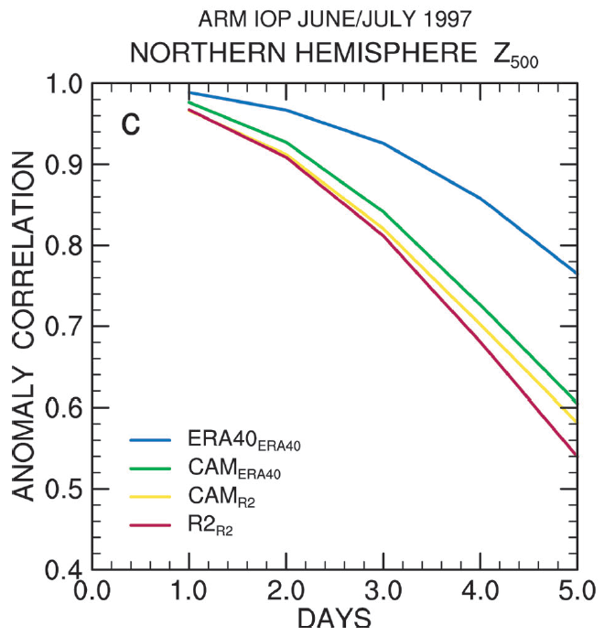
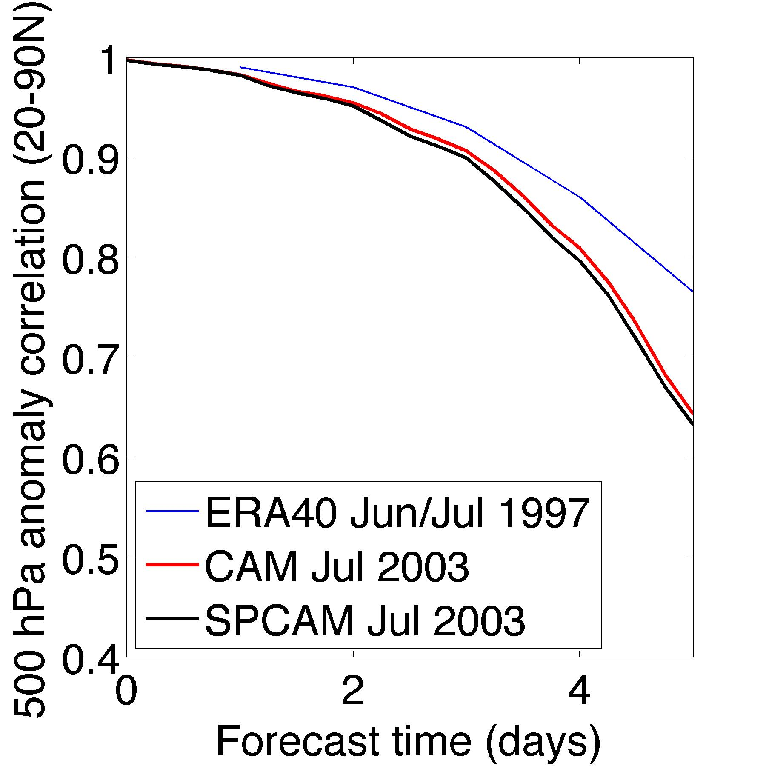
Skill: SP-CAM can now be run in forecast mode!
Our result
Phillips et al., BAMS, 2004
Notes:
But we have reason to believe this is working quite well now and we can do forecasts with good results.
These figures show the 500mb anomaly correlation or what is sometimes call the forecast skill for CAM and SPCAM forecast simulations.
The figure on the right is from the Phillips et al. 2004 BAMS paper, which discuses an overview of the CAPT idea.
Here the 500mb climatology is subtracted from models and analysis to make an anomaly. Then you take a cosine latitude weighted correlation, excluding the tropics.
The blue line in the left hand figure is ripped from the Phillips paper for comparison to a real forecast model.
CAM and SPCAM skill looks reasonable.
There are a few more things we can look at and we'll be starting to characterize SPCAM in forecast mode in more detail soon, but I'll leave it here for now and we'll turn to some preliminary forecast application and test cases.

Slide 18
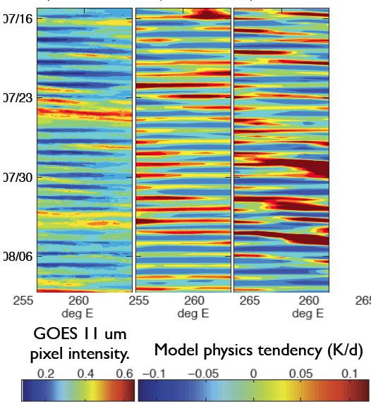
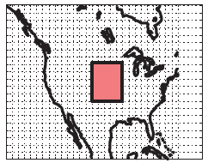
We knew SP-CAM3.5 admits orogenic Central US nocturnal convective systems in free-running mode…
OBS 2005
CAM3.5
SPCAM3.5
Pritchard et al., JAS, in revision.

Slide 19
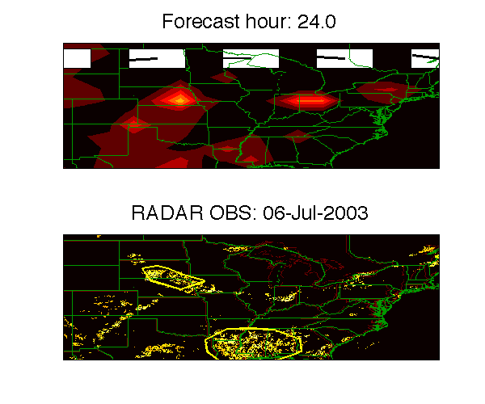
… Now we also know SP-CAM in forecast mode can skillfully predict a real nocturnal convective system.

Slide 20
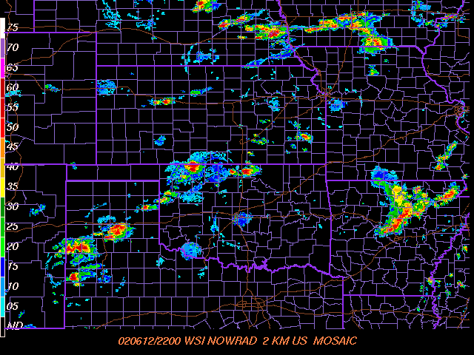
This advance enables us to evaluate SPCAM cloud schemes at the process level against high-value data.
x = ARM SGP Site

Slide 21
CONCLUSION
Superparameterized climate models show great promise as a bridging technology until the day when faster computers make global cloud-resolving models practical.
Nudging to build an initial state can lead to improving superparameterized models by comparing short-range MMF forecasts with high-value observational data.
Notes:
Mike and I will be presenting some work we've done in our group to set up forecast simulations with SPCAM.
The approach we've taken and some of the code modifications originally came from Marat.
I'll discuss a bit about the method he proposed and our implementation, and then pass off to Mike to discuss some test cases we've started looking in more detail.
We're familiar with some previous studies of SPCAM's climatology the have identified critical aspects that need fixing: too many high clouds, weird low clouds - stratofogulus, the “supermonsoon” and the Great Red Spot.
The new turbuluence parameterization and microphysics in SAM may help improve some of these things.
And we think that testbed forecast simulations will be crucial to understanding why/how the current SPCAM fails in the ways it does, and for evaluating these improvements against high value ground-based data such as fixed ARM sites or during intense field champaings.
This is especially true for looking at new chemistry features like the work in Bill Collins’ group discussed this morning or the efforts at PNNL on the CAM5 based MMF, for which chemical observations, at least above the surface, are intermittent.

