Slide 1
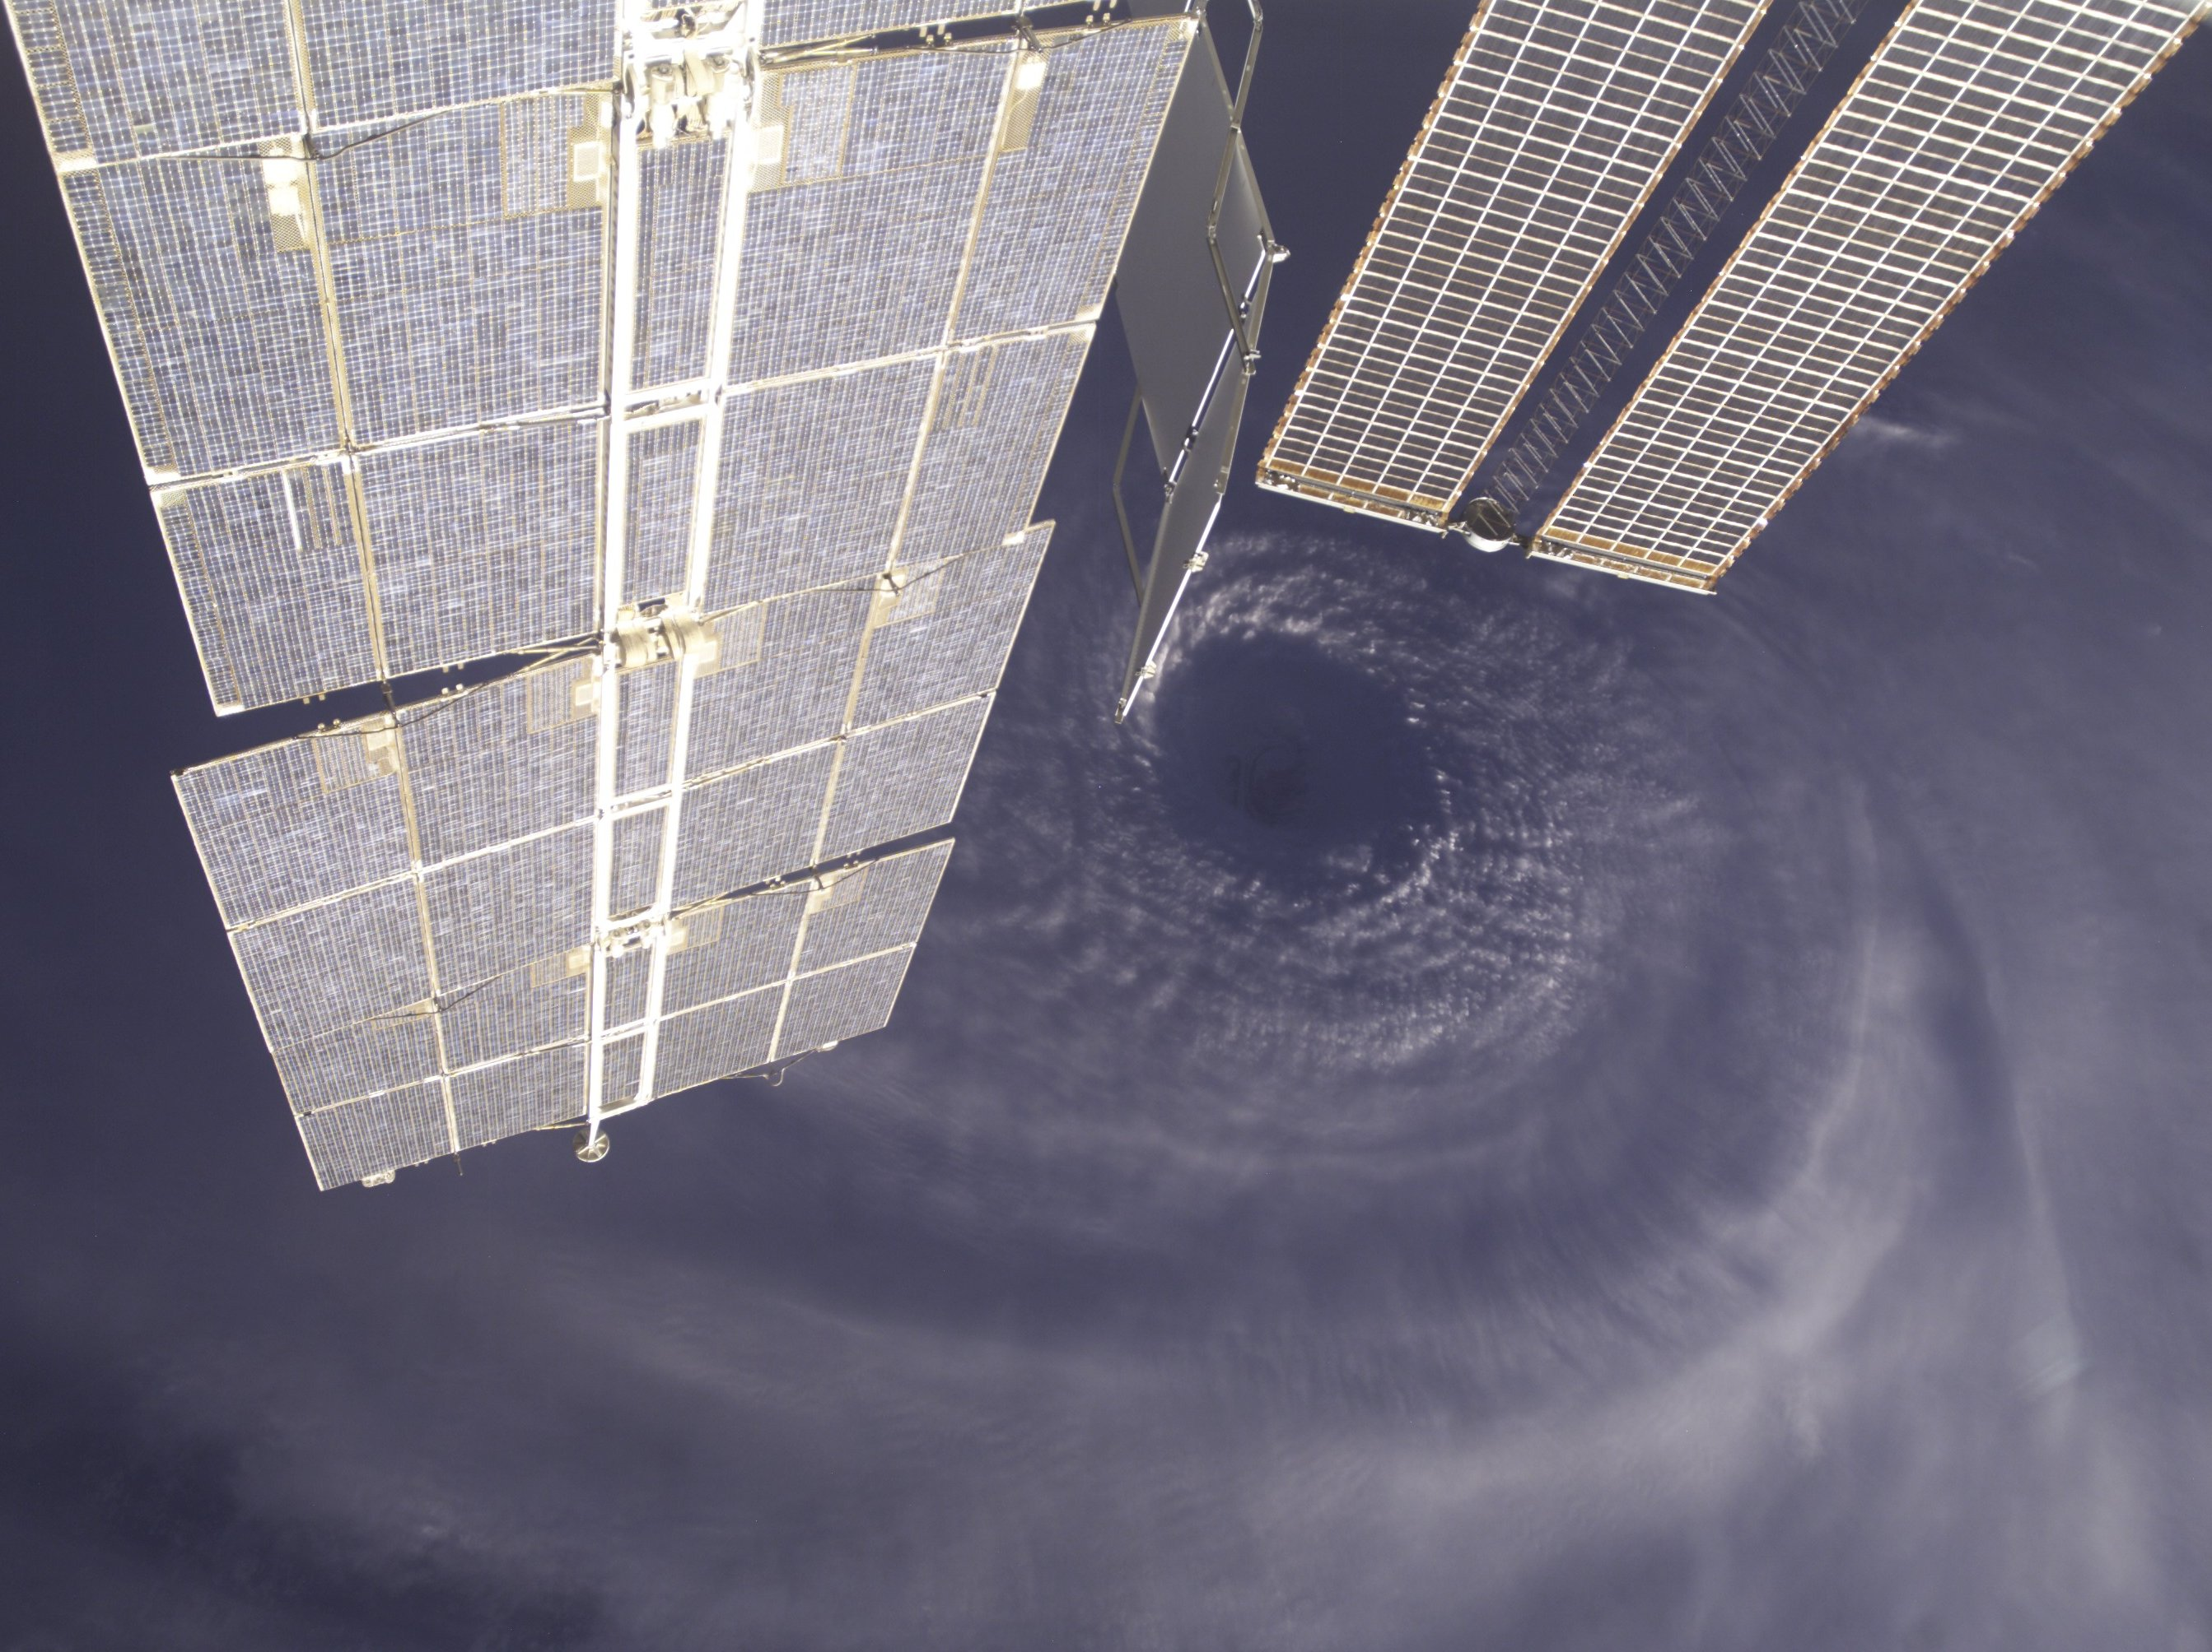
Hurricane Research from the ISS
Frank Marks NOAA/AOML/Hurricane Research Division
11 February 2011
Notes:
Hurricane Earl 2 September 2010

Slide 2

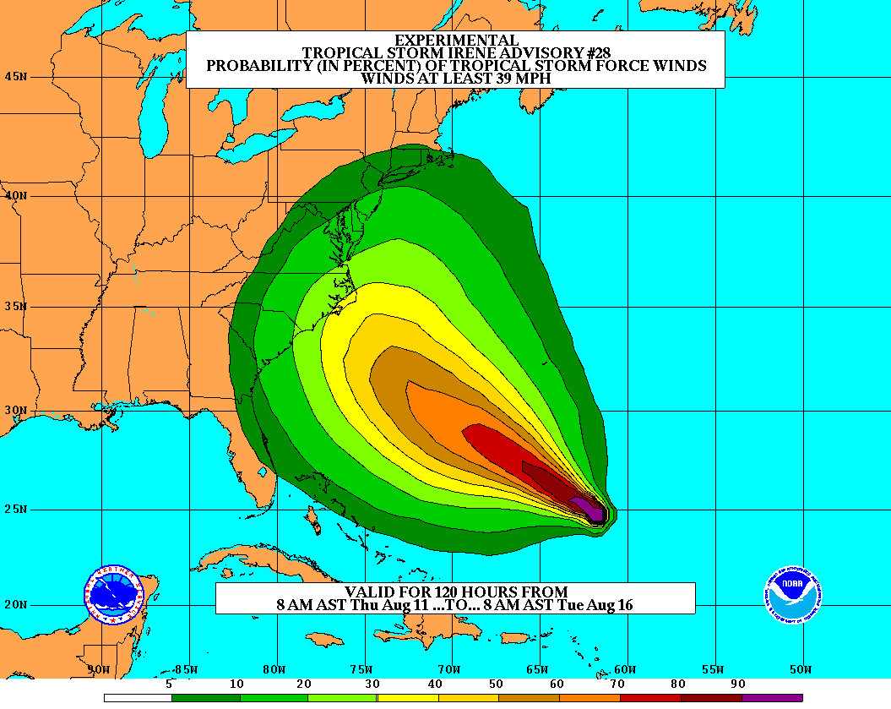
Goals
Improve Forecast Accuracy
Hurricane impact areas (track) – 50% in 10 years
Severity (intensity) – 50% in 10 years
Storm surge impact locations and severity
Extend forecast reliability out to 7 days
Quantify, bound and reduce forecast uncertainty to enable risk management decisions
Notes:
http://www.nrc.noaa.gov/HFIPDraftPlan.html
HFIP Team
Frank Marks, research lead
Ed Rappaport, operations lead
Fred Toepfer, project manager
Robert Gall, development manager
Mark DeMaria
Chris Fairall
Jim McFadden
Scott Kiser
Daniel Melendez
Roger Pierce
HFIP executieve oversight board:
OAR DAA/Sandy MacDonald, co-chair
NWS AA/Jack Hayes, co-chair
NCEP/Louis Uccellini,
TPC/Bill Read,
NESDIS/Mark DeMaria,
NOS/Jesse Feyen,
AOML/Bob Atlas
PPI/Paul Doremus
NMFS/Bonnie Ponwith,
NOS/Liz Scheffler,
NMAO-PM Aircraft/Phil Kenul,
OFCM/Sam Williamson
Executive Secretariat: OAR/Joseph Bartosik and NWS/John Iacabucci

Slide 3
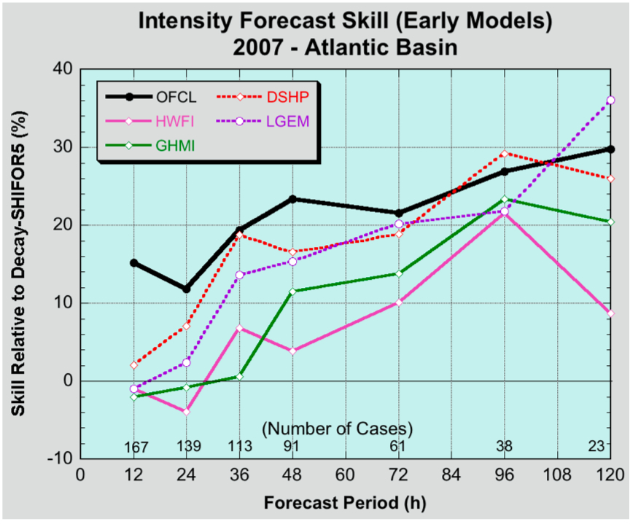
Current Capabilities: Statistical-dynamical models
Statistical-dynamical models (SHIPS, LGEM, & RI-index) are skillful sources of intensity guidance primarily from global models
SHIPS & LGEM contain ~55-60% of the variance in intensity change, RI-Index ~30% of RI variance, primarily from large-scale in GFS.
Until regional models improve there is value in improving statistical- dynamical approaches.

Slide 4

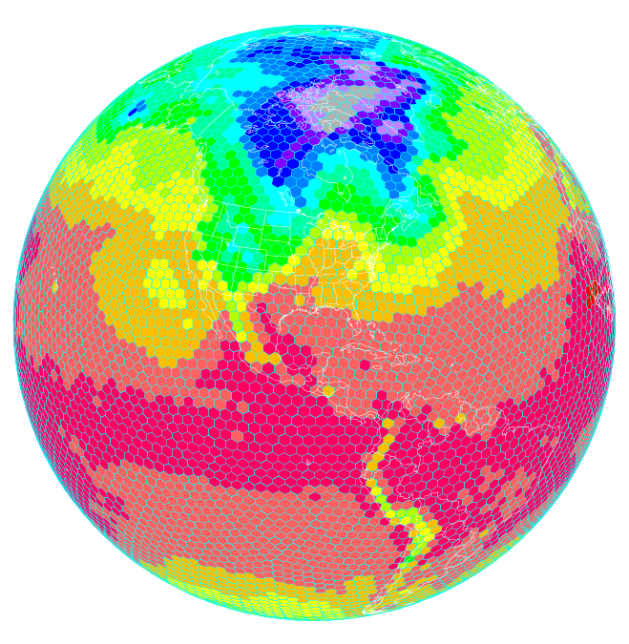
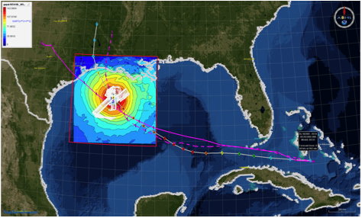
HFIP Activities
Traditional Hurricane Research Activities:
Observations, analysis, database, & instrument R&D (IFEX)
Statistical-dynamical model development
Advances in operational models (Stream 1)
New HFIP Research Thrusts:
Experimental global and regional hurricane model development (Stream 2)
Data assimilation techniques and observing system strategy analysis development (Stream 1 & 2)
Model evaluation tool development
Socioeconomic research and development
D1
D2
Partnership: NCEP, AOC, AOML, ESRL, GFDL, DTC, USWRP, NESDIS/STAR
Notes:
Two Stream Approach to HFIP developments:
Stream 1– Operational Transition and Implementation
Stream 2 – Advanced Technology Demonstration
Unconstrained by near-term availability of operational computing
Uses both NOAA’s and computing resources from major supercomputing centers for testing and evaluation.
Emphasis is on high resolution global and regional models run as ensembles
Real-time or near real time runs during hurricane season
Stream 1.5 (JHT-like)
NHC Forecaster Defined.
Subset of Stream 2 that forecasters see as particularly promising or provides demonstrated capability
Will be configured to run in real-time and products made available to NHC.

Slide 5
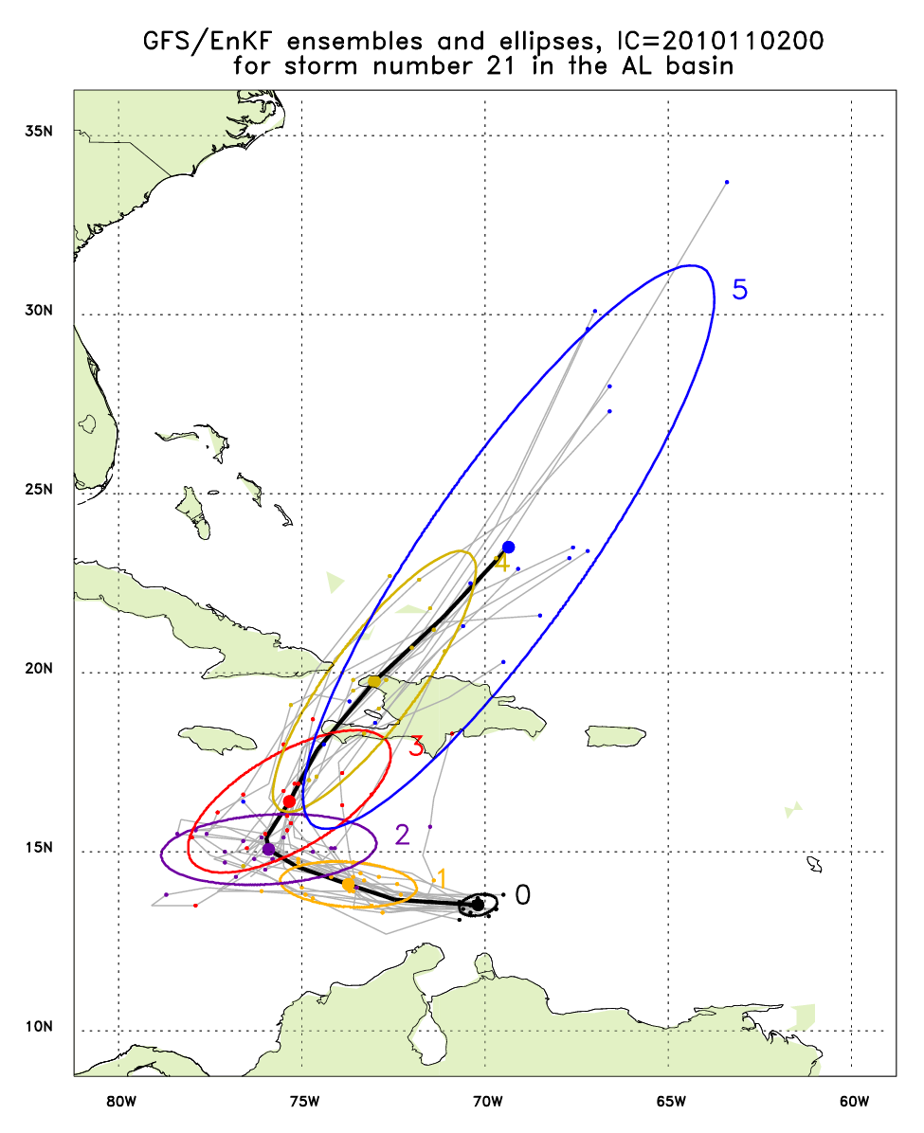
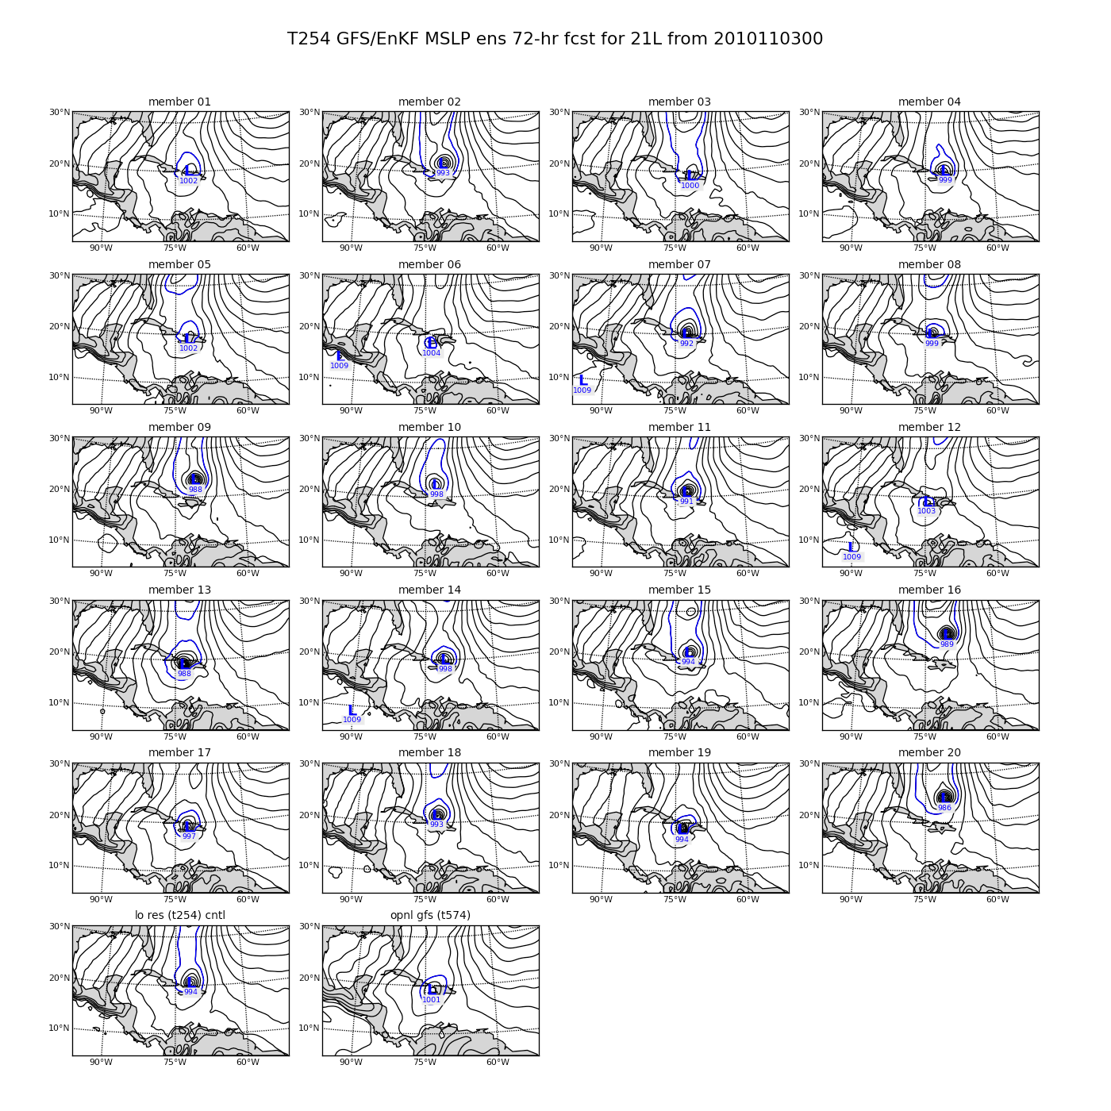
Current Capabilities Global Model – Ensembles
Tomas (21L) – init 00Z 2 November
http://ruc.noaa.gov/hfip/gfsenkf
GFS
Courtesy of Tom Hamill & Jeff Whitaker (ESRL)
Notes:
Global Ensembles:
80-member T254 GFS ensembles cycled every 6-h continuously from 1 August to current time
Look at 20 members of the 80 member ensemble
Left panels shows ellipse plot of 20 members at each forecast time – ellipse shape shows the spread along/across track
Right panel show surface pressure post stamp images of 20 members

Slide 6
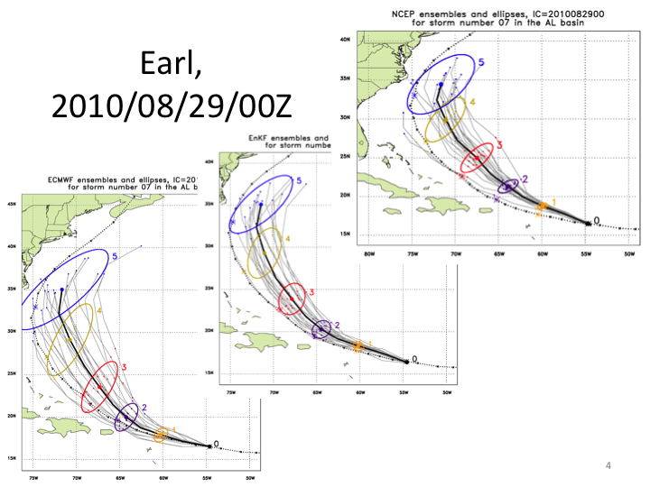
Current Capabilities Global Model – Ensembles
http://ruc.noaa.gov/hfip/gfsenkf
Courtesy of Tom Hamill & Jeff Whitaker (ESRL)
Notes:
Global Ensembles:
80-member T254 GFS ensembles cycled every 6-h continuously from 1 August to current time
Look at 20 members of the 80 member ensemble
Left panels shows ellipse plot of 20 members at each forecast time – ellipse shape shows the spread along/across track
Right panel show surface pressure post stamp images of 20 members

Slide 7
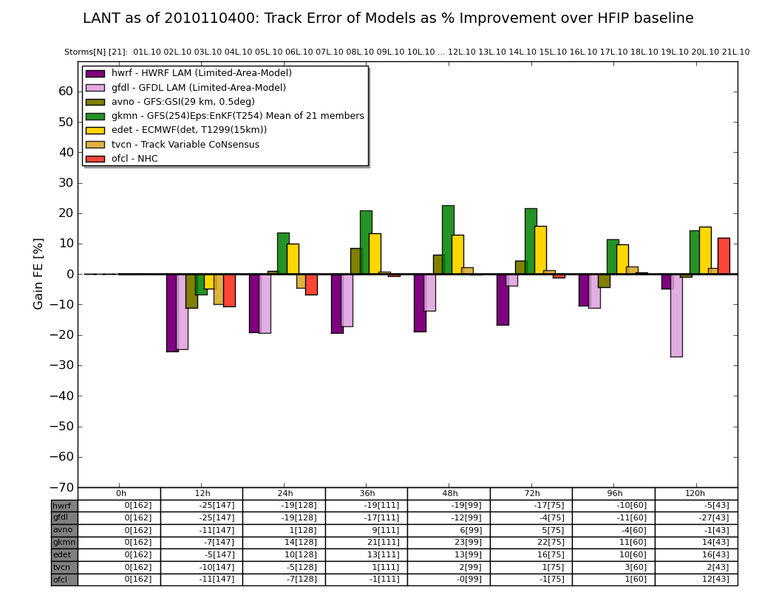
Current Capabilities Global Model – Ensembles
Shary
Tomas
Courtesy of Stan Benjamin & Mike Fiorino (ESRL)
Notes:
FIM Deterministic models run each day during Aug-Sep 2009:
30 km (Initialized with GSI-3DVAR and EnKF).
15 km (Initialized with EnKF).
10 km (Initialized with EnKF).
Global Ensembles:
30 km FIM (initialized with EnKF) 20 members.

Slide 8
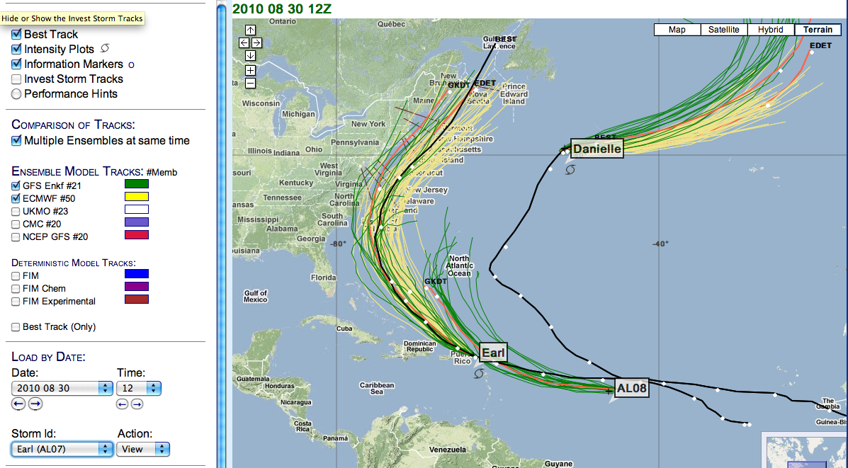
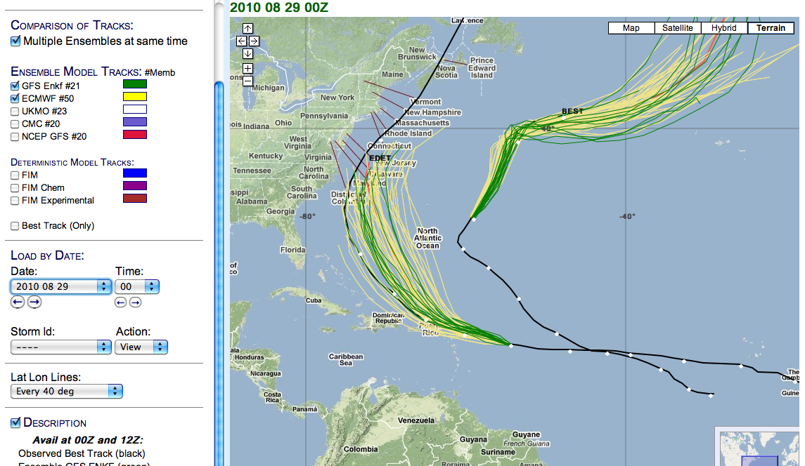
Current Capabilities Global Model – Ensembles
Courtesy of Stan Benjamin & Mike Fiorino (ESRL)
Notes:
FIM Deterministic models run each day during Aug-Sep 2009:
30 km (Initialized with GSI-3DVAR and EnKF).
15 km (Initialized with EnKF).
10 km (Initialized with EnKF).
Global Ensembles:
30 km FIM (initialized with EnKF) 20 members.

Slide 9
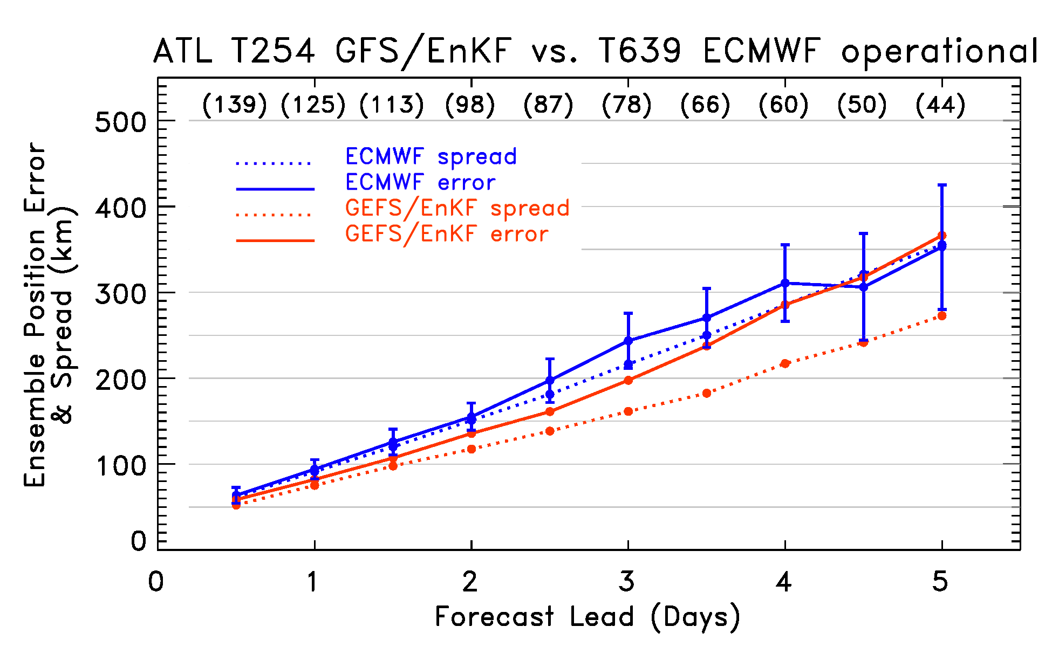
Current Capabilities Global Model – Ensembles
Tomas (21L) – init 00Z 2 November
http://ruc.noaa.gov/hfip/gfsenkf
GFS
Courtesy of Tom Hamill & Jeff Whitaker (ESRL)
Notes:
Global Ensembles:
80-member T254 GFS ensembles cycled every 6-h continuously from 1 August to current time
Look at 20 members of the 80 member ensemble
Left panels shows ellipse plot of 20 members at each forecast time – ellipse shape shows the spread along/across track
Right panel show surface pressure post stamp images of 20 members

Slide 10
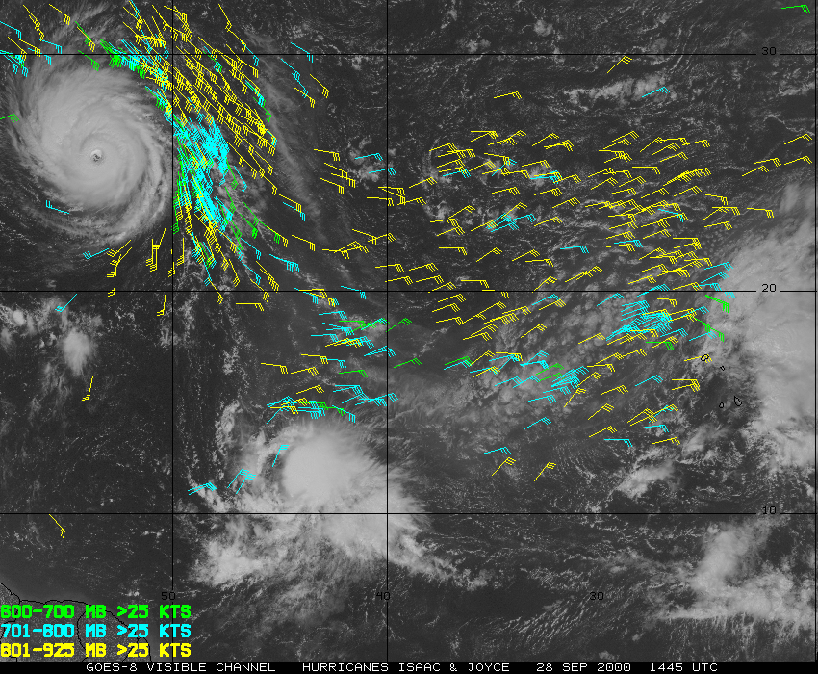
Track Issues
Sensitivity to environmental circulation beyond TC envelope
Environment wind and thermodynamic structure through targeted observations (dropsondes) and satellite radiances.
Issues include:
poor data coverage in important areas,
inability to cover necessary targets
temporal and spatial resolution (24 h, horizontal >100 km, integrated or limited vertical resolution)

Slide 11
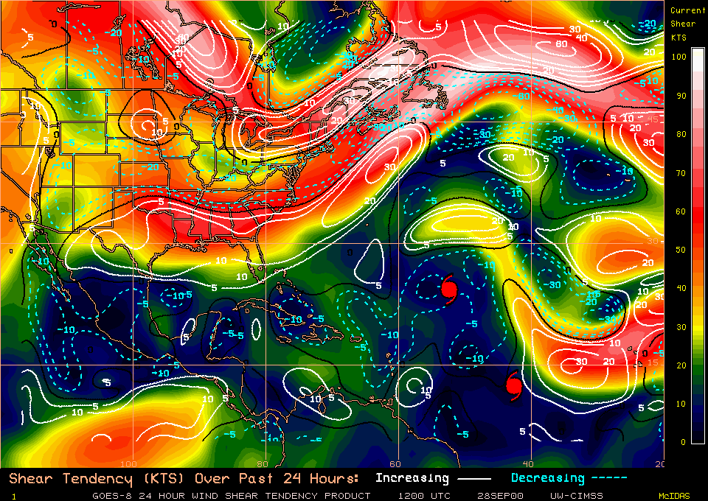
Intensity Issues
Sensitive to environmental circulation beyond TC envelope (shear, eddy flux, etc.)
Sensitive to boundary conditions, interactions, and changes along track
Sensitive to inner core dynamics
Sampling limited by presence of heavy rain, clouds, strong winds.
Issues include:
poor data coverage in important areas,
temporal & spatial resolution (3-6 h, 5-10 km horizontal, 1 km vertical)

Slide 12
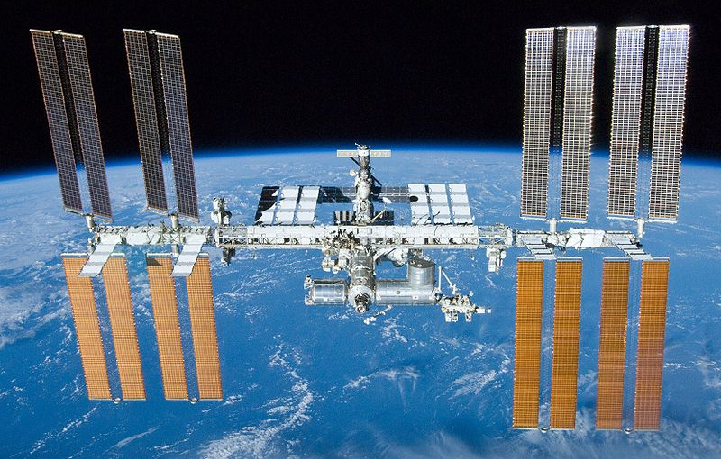
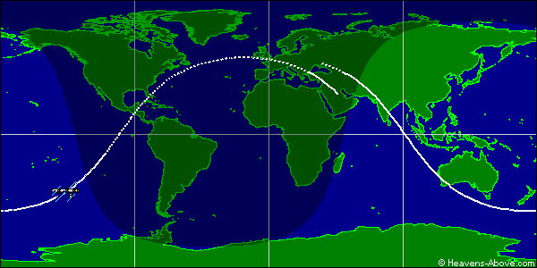
ISS
Good coverage of global tropics and TC basins (15-16 orbits/day)
Inclination: 51.6°
Altitude: 350 km
Revolutions/Day: 15.7

Slide 13
How can ISS DWL help?
Track:
provide regularly spaced data coverage in important areas surrounding TC for data assimilation into numerical models.
Need temporal resolution at least 24 h, horizontal resolution of 250 km, and vertical resolution of 1 km.
Accuracy to better than 1 m s⁻¹ for mean wind surrounding TC - 1 m s⁻¹ error in mean wind yields 86.4 km track error in 24 h.

Slide 14
How can ISS DWL help?
Intensity (beyond those above):
improved vertical structure of environment surrounding and above core, particularly near the tropopause for use in determining shear, divergence, and eddy flux.
higher temporal resolution 12 h, horizontal resolution 25 km, vertical resolution <1 km.
Accuracy to 1 m s⁻¹ for vertical shear in vicinity of TC - large differences in storm intensity change for small changes in vertical shear.

Slide 15
Summary
ISS DWL can have great impact on TC forecasts and research through improved horizontal and vertical wind structure in environment immediately surrounding storm.
DWL does not need to provide data in core for major impact.
Major advantages:
better temporal & spatial wind coverage surrounding TC than currently possible with targeted obs and satellite radiances.
higher vertical resolution especially useful near top and bottom of environment
improved accuracy of wind estimates

Slide 16
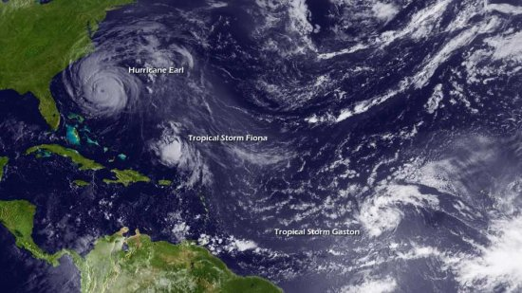
Questions?

