Slide 1

The Simulation of Doppler Wind Lidar Observations in Preparation for ESA’s Aeolus Mission Will McCarty NASA/Goddard Space Flight Center Global Modeling and Assimilation Office R. Errico, R. Yang, R. Gelaro, M. Rienecker

Slide 2
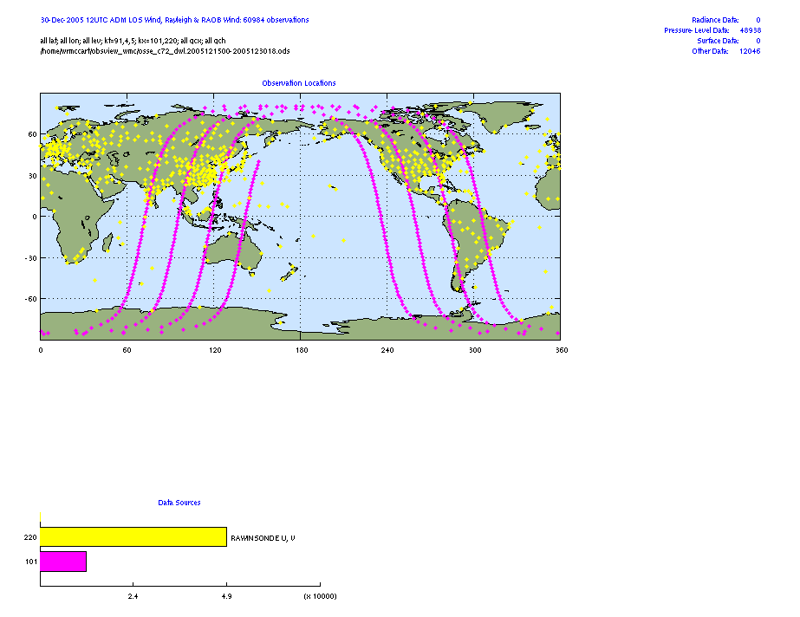
ESA Aeolus
Direct-Detection technique (355 nm)
Vertical single-component profiles in clear sky (Rayleigh)
Higher quality measurements in presence of scattering agent (Mie)
Orbit Characteristics
408 km
Dawn-dusk
Sun-synchronous
Viewing Geometry/Sampling
90° off-track (away from sun)
35 ° off-nadir
Continuous sampling @ 50 Hz

Slide 3
ADM-Aeolus Pre-Launch Preparedness
Realistic Proxy Data - No spaceborne heritage, must simulate observations
Utilize OSSE framework
Joint OSSE Nature Run (ECMWF, T511)
Existing observing system developed in-house at GMAO (R. Errico)
conventional and remotely-sensed observations
Simulate ADM observations
Lidar Performance Analysis Simulator (LIPAS), via KNMI (G.-J. Marseille & A. Stoffelen)
Need proper sampling (spatial & vertical), yield, and error characteristics
Not intended to sell Aeolus (already sold)

Slide 4
What is an OSSE
Assimilation of Real Data
Real Evolving Atmosphere, with imperfect observations. Truth unknown
Analysis
Analysis
Analysis
Time
Analysis
Analysis
Analysis
Climate simulation, with simulated imperfect “observations.” Truth known.
Observing System Simulation Experiment

Slide 5
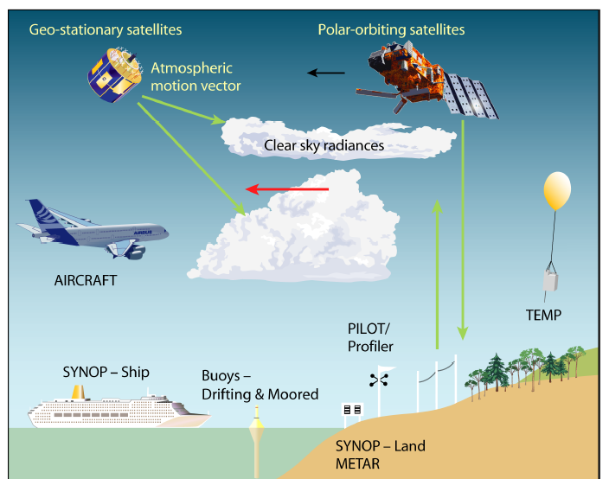
Simulating Observations
Six million+ observations are assimilated globally, daily
Most observations are from satellites
A successful OSSE requires realistic fake observations
Figure via ECMWF

Slide 6
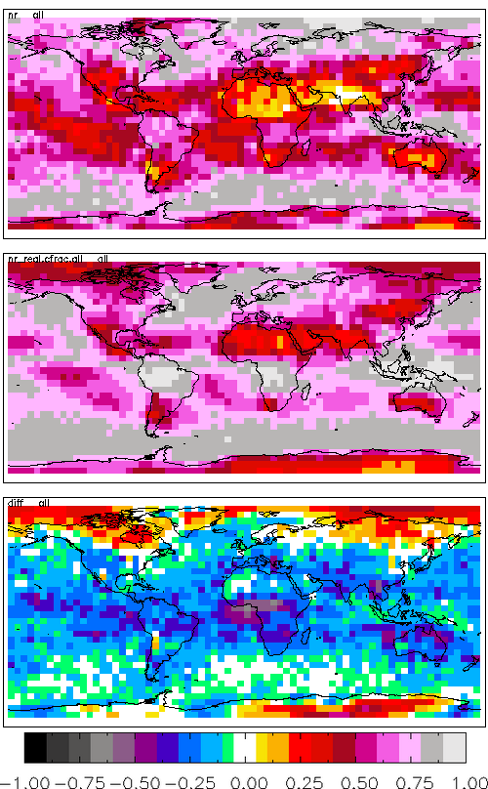
Clouds in the Joint OSSE Nature Run
Importance of clouds
The top of a cloud can act as a scattering agent
Optically thick clouds limit wind retrievals
Placement of clouds
Realistic vertical placement of clouds
NR underestimates cloud amount
~12% globally
Related to measurement yield
DJF Cloud Fraction Difference
(NR – CloudSat/CALIPSO)
NR Under-Represents clouds
NR Over-Represents clouds
Improper Cloud Representation…
…Improper Observation Yield & Quality

Slide 7
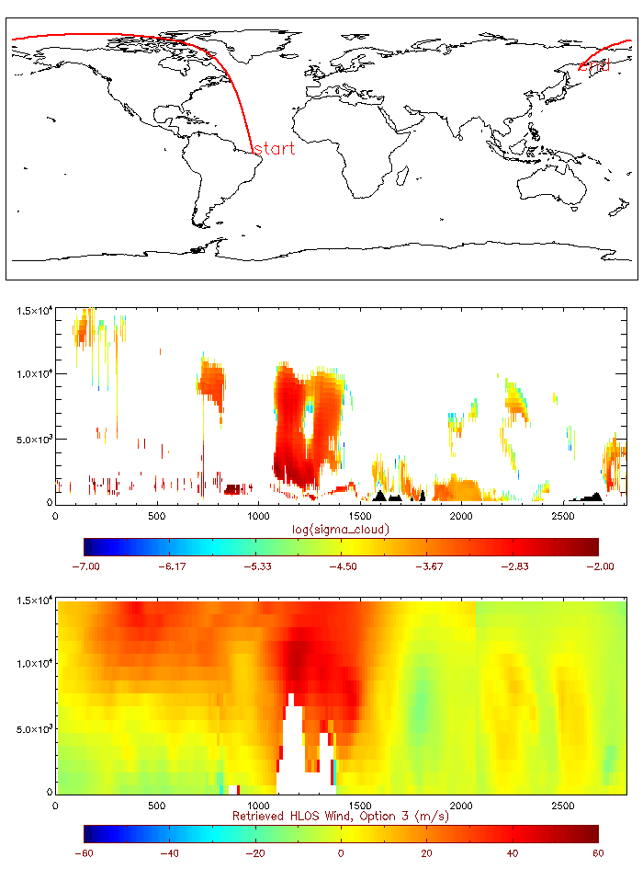
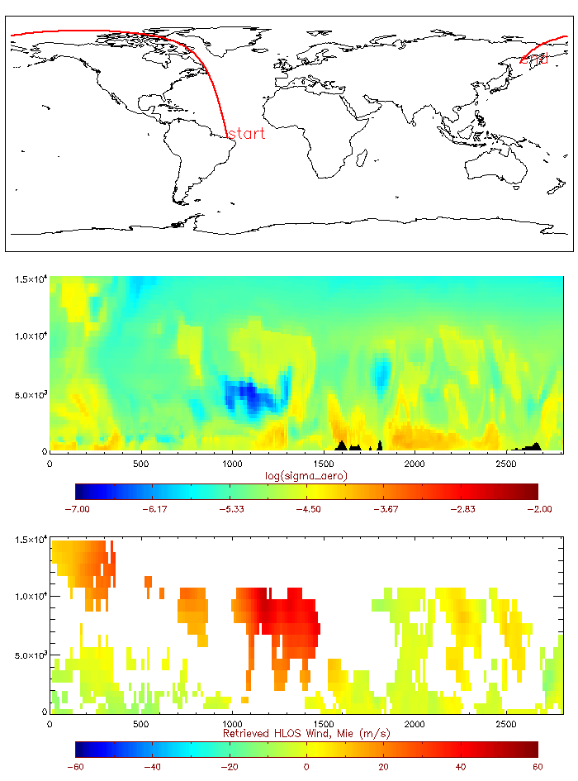
Observation Simulation
Lidar Performance Analysis Simulator (LIPAS)
Single-LOS observations generated from NR
Meteorology from NR
Clouds from NR w/ maximum-random overlap
Aerosols from GOCART replay forced by NR Meteorology

Slide 8
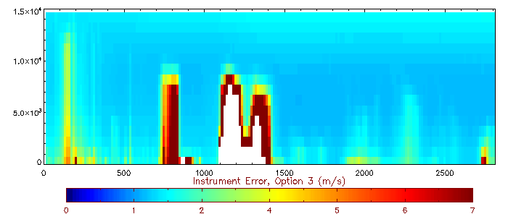
Observation Simulation
Lidar Performance Analysis Simulator (LIPAS)
Single-LOS observations generated from NR
Meteorology from NR
Clouds from NR w/ maximum-random overlap
Aerosols from GOCART replay forced by NR Meteorology

Slide 9
Assimilation Results
All results shown are from January of Joint OSSE Nature Run
0000 and 1200 UTC analyses only
Control experiment include conventional & remotely sensed observation simulated from Nature Run
Radiances include TOVS/ATOVS, AIRS
Remotely sensed atmospheric winds from Atmospheric Motion Vectors (AMVs)
Experiments:
DWL – Both Rayleigh and Mie observations
RAY – Rayleigh only
MIE – Mie only

Slide 10
Assimilation Results
Results shown are in terms of reduction of RMS relative to the Nature Run Truth:
δRMS = RMS(DWL – Truth) – RMS(CTL – Truth)
If δRMS < 0, RMS is reduced by adding DWL observation, or the analysis is improved relative to the NR truth
If δRMS > 0, RMS is increased by adding DWL observations, or the analysis is degraded relative to the NR truth

Slide 11
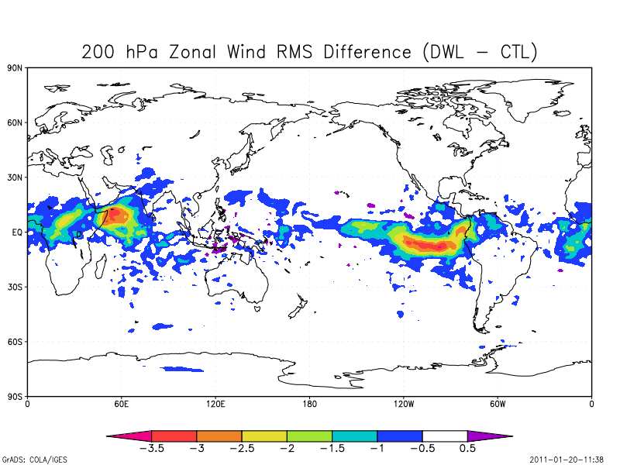
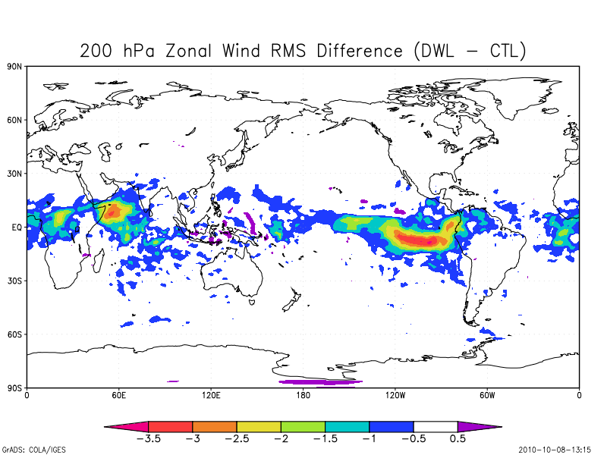
Assimilation Results
Large reductions of RMS seen over tropics
Existing Observations primarily of mass field (passive satellite radiances)
Winds cannot be inferred through balance assumptions
Reduction in RMS by adding DWL
Zonal Wind RMS Difference (ms⁻¹)
Increase in RMS
by adding DWL

Slide 12
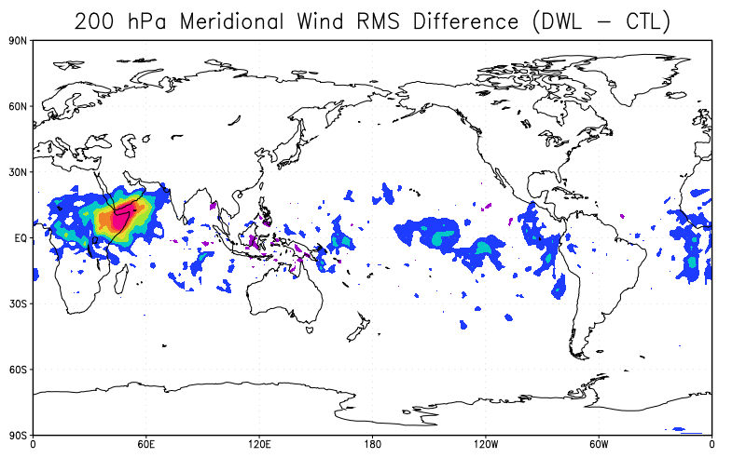
Assimilation Results
Reductions also seen in meridional wind field
At equator, single-LOS obs are nearly u (~83º from due-north @ equator)
Reduction in RMS by adding DWL
Meridional Wind RMS Difference (ms⁻¹)
Increase in RMS
by adding DWL

Slide 13
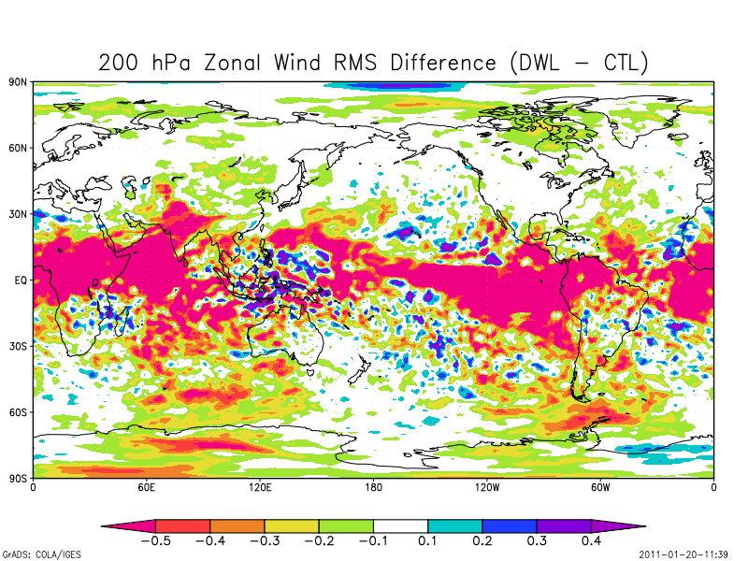
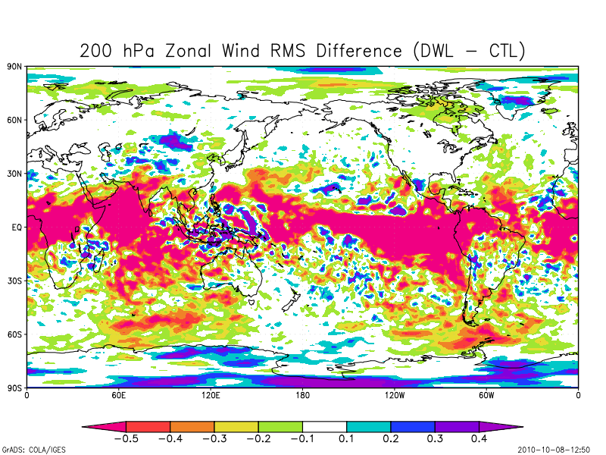
Assimilation Results
Smaller contour intervals show mostly positive in both N. & S. hemispheres
Evidence of satellite tracks
Less in data-rich N. Hemisphere
00/12 UTC Sondes
Reduction in RMS by adding DWL
Zonal Wind RMS Difference (ms⁻¹)
Increase in RMS
by adding DWL

Slide 14
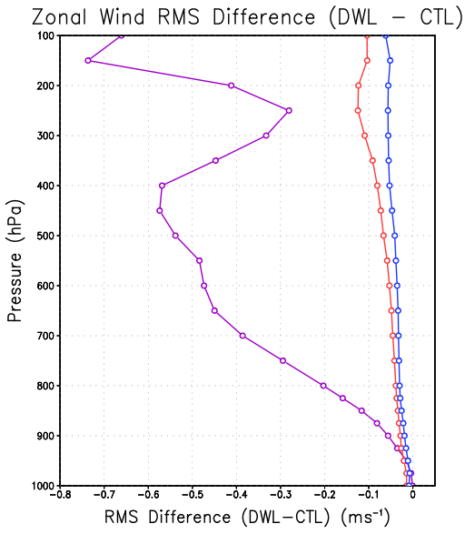
Assimilation Results
Impact at 200 hPa consistent through troposphere
Less impact towards surface
Less observations
Increased contamination
Lesser impacts in N./S. hemispheres
Winds through mass-wind balance
Tropics (-30º to 30º)
NH Extratropics (30º to 90º)
SH Extratropics (-90º to -30º)

Slide 15
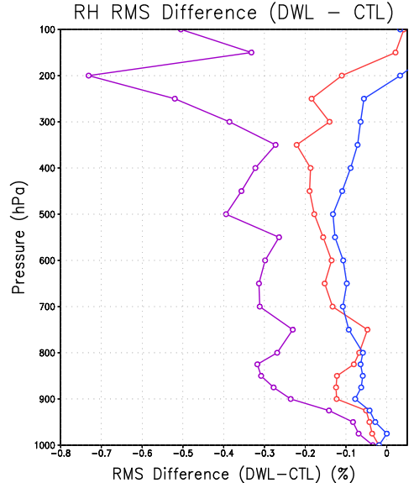
Assimilation Results
Relative humidity similar to winds
Largest impacts again seen in Tropics
The improved characterization of the winds improves the transport of moisture
No balance between moisture/winds in analysis procedure
Tropics (-30º to 30º)
NH (30º to 90º)
SH (-90º to -30º)
Tropics (-30º to 30º)
NH Extratropics (30º to 90º)
SH Extratropics (-90º to -30º)

Slide 16
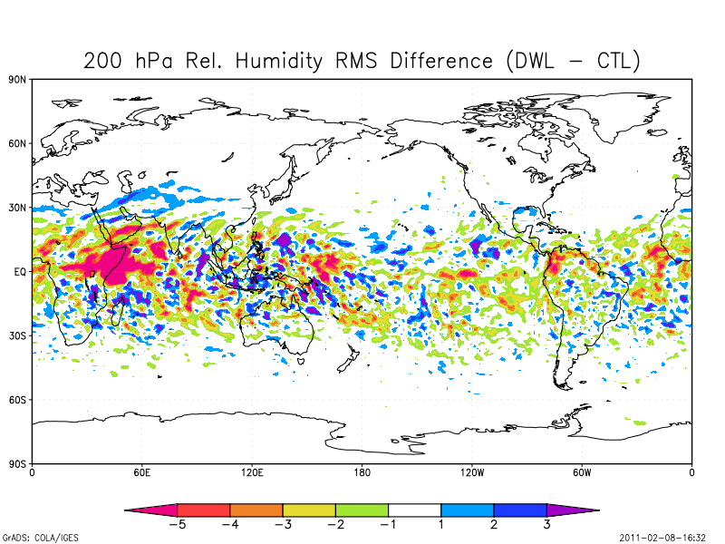
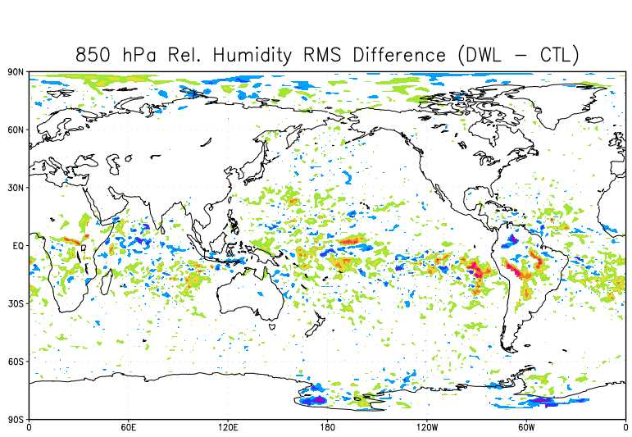
Assimilation Results
Relative Humidity RMS Difference (%)
Improvement less uniform, but still dominant signal

Slide 17
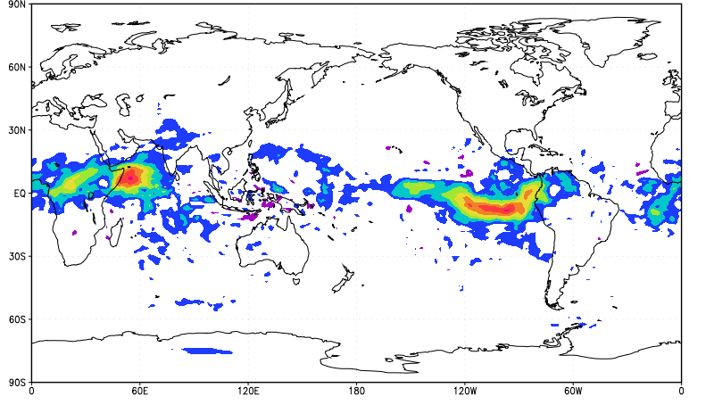
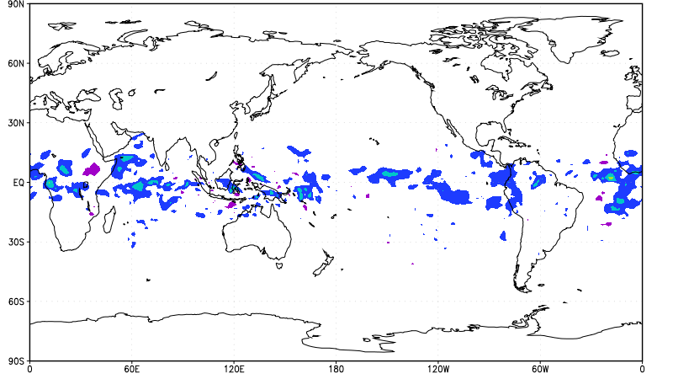
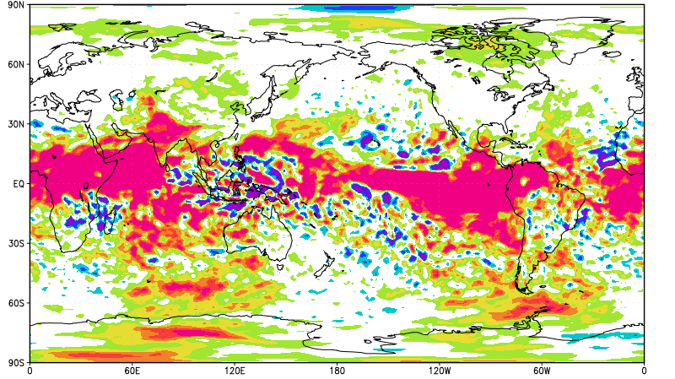
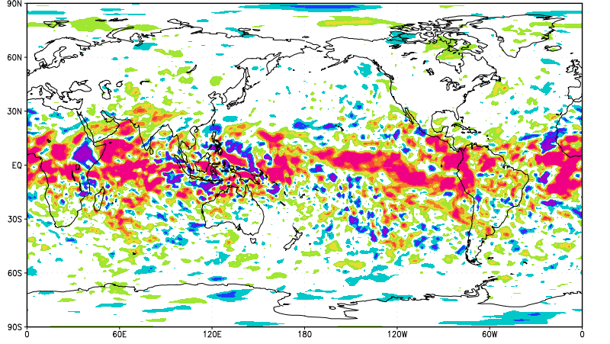
Assimilation Results
DWL (Rayleigh + Mie)
Mie Only
Larger impact from Rayleigh Obs
~3x More Observations aloft
Rayleigh obs error characteristics more predictable
Mie positive in tropics, neutral in extratropics
Zonal Wind RMS Difference (ms⁻¹)

Slide 18
Assimilation Results
DWL (Rayleigh + Mie)
Rayleigh Only
Larger impact from Rayleigh Obs
~3x More Observations aloft
Rayleigh obs error characteristics more predictable
Mie positive in tropics, neutral in extratropics
Zonal Wind RMS Difference (ms⁻¹)

Slide 19
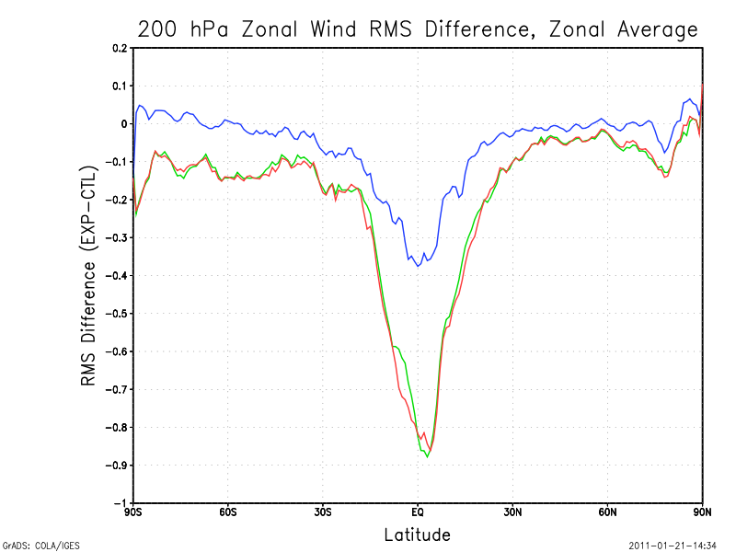
Assimilation Results
Larger impact from Rayleigh Obs
~3x More Observations aloft
Rayleigh obs error characteristics more predictable
Mie positive in tropics, neutral in extratropics
DWL (Both)
Rayleigh Only
Mie Only

Slide 20
Assimilation Results
200 hPa
850 hPa

Slide 21
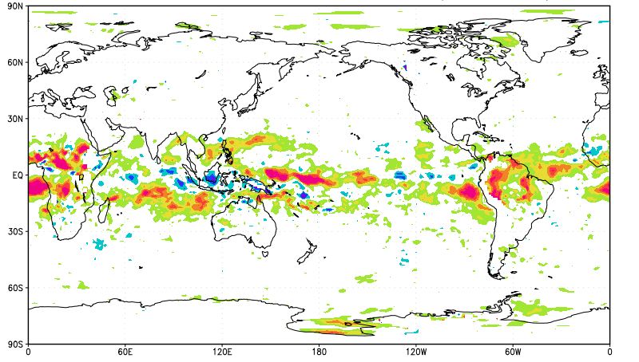
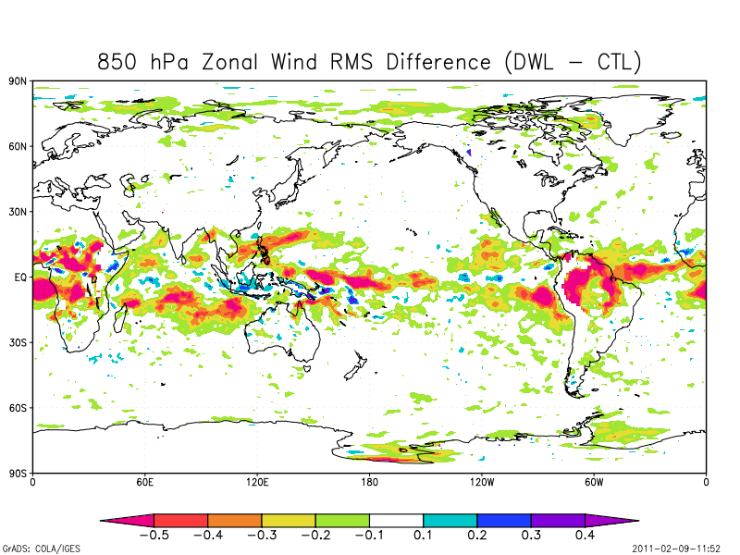
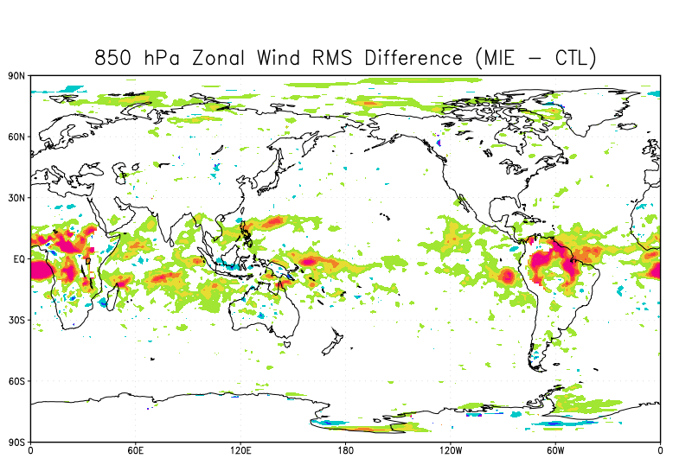
Assimilation Results
RAY
At 850 hPa, impacts are more similar w/ two observation types
DWL
MIE
Zonal Wind RMS Difference (ms⁻¹)

Slide 22
Conclusions, Caveats, and Future Efforts
These results are overstated!
Error in simulated DWL observations inherently understated
No added representativeness error, engineering change from Burst Mode to Continuous Mode
Error in Yield
Lack of clouds in NR not accounted for in DWL obs simulation
Forecast height anomaly scores improved, though not beyond 95% significance for sample size
Shows expected result that largest impact is expected in tropics
Future work
Include incorporation of L2B processing into DA System (GSI)
Redo experiment w/ simulator updated for continuous mode ops

Slide 24
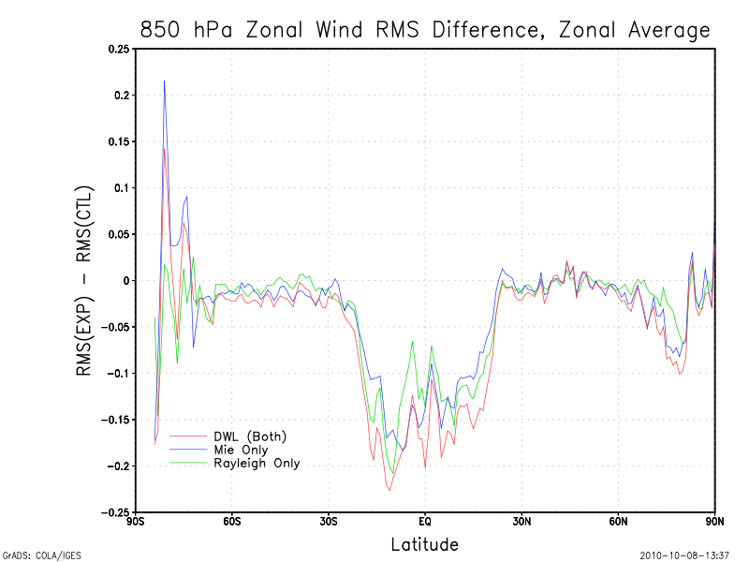
Assimilation Results
Similar impact from both obs types
Counts similar
Sampling issue near Antarctic
Mie potentially slightly improved in tropics
DWL (Both)
Rayleigh Only
Mie Only

