Slide 1
Variability of Tropical to Extra-tropical Transport in the Lower Stratosphere
Mark Olsen
UMBC/GSFC
Anne Douglass, Paul Newman, and Eric Nash

Slide 2
Purpose
Demonstrate the year to year variability of lower stratospheric poleward subtropical transport using ozone observations.
Show the potential of higher resolution wind data to examine the transport characteristics in greater detail.

Slide 3
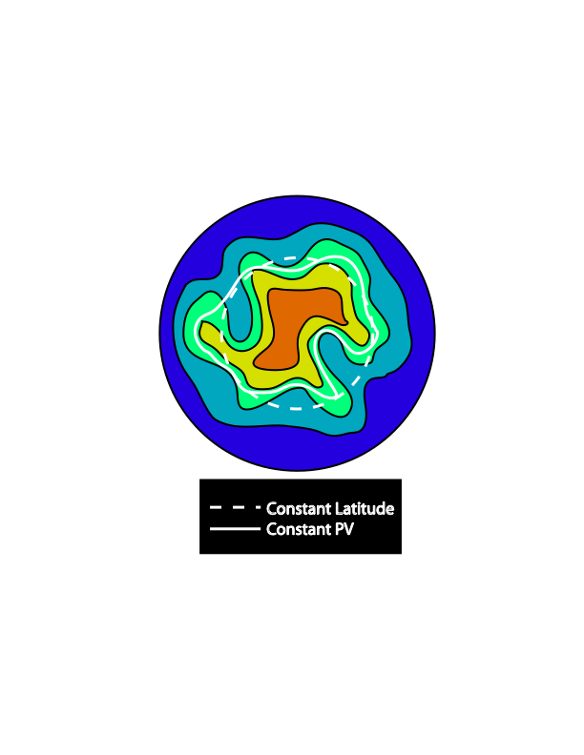
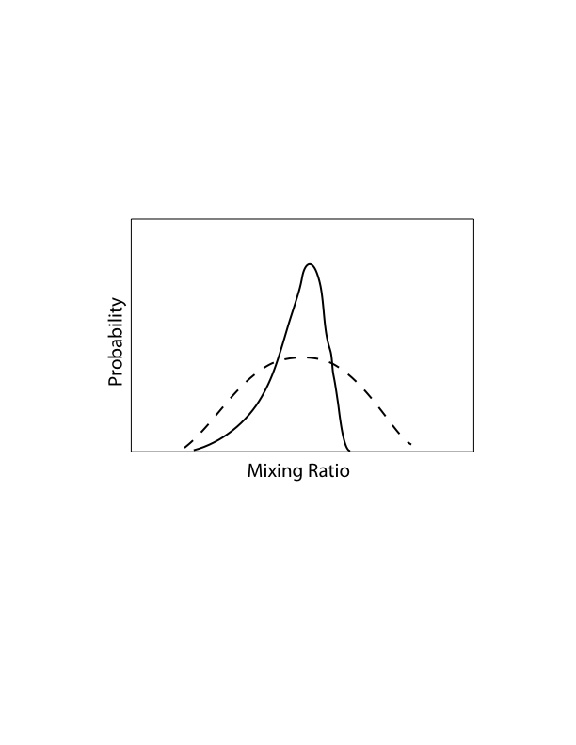
Equivalent Latitude
Example: poleward increasing tracer on isentropic surface.
Exploits the correlation of PV and ozone to reduce the variability.
Does not “see” the variability due to reversible transport at these altitudes and timescales. (Irreversible transport does not conserve PV/Equivalent Latitude).
Exhibits skewed, less Gaussian distributions where there is considerable irreversible transport [Sparling, 2000].
Example probability distribution function (PDF)
Signature of
irreversible
transport
Signature of
reversible
transport
Equivalent Latitude: the latitude that encloses the same area as that enclosed by a contour of PV.

Slide 4
Ozone Data
Limb Profilers on Aura (polar orbiting)
HIRDLS
~ 1 km vertical resolution in the lower stratosphere.
MLS
2-3 km vertical resolution in the lower stratosphere.

Slide 5
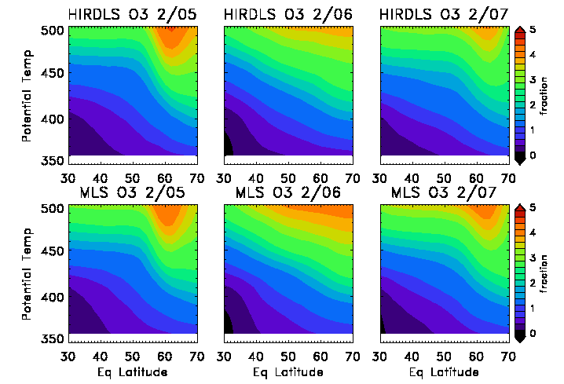
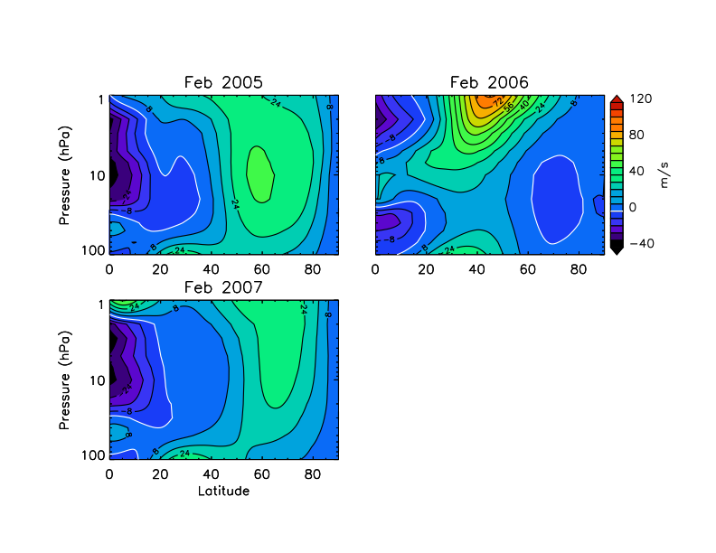
Zonal Mean Picture
Zonal Mean Ozone; February
2005
2006
2007
Zonal Mean Wind; February

Slide 6
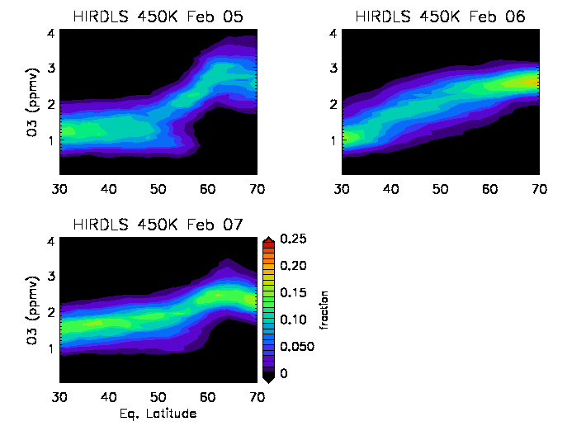
Ozone Distributions as a Function of Eq. Lat.
Data from HIRDLS in February at 450 K
2005
2006
2007
2005
2006
2007

Slide 7
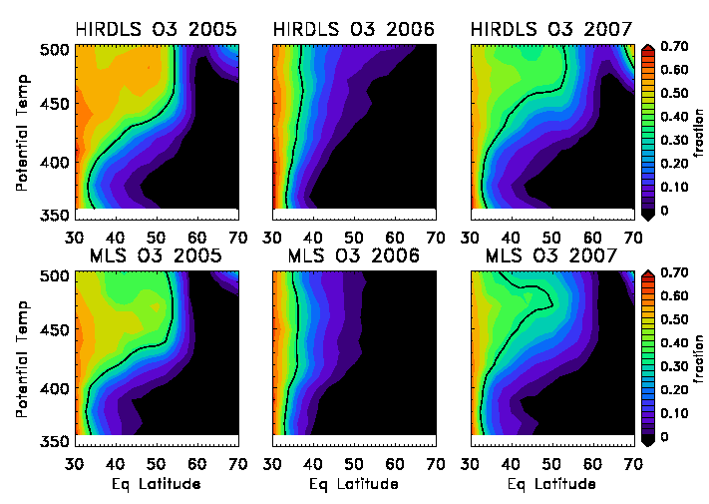
A Measure of Irreversible Transport Using The PV-Ozone Correlation: The “Tropical Influence” Fraction
HIRDLS
2005
2006
2007
Black line is
0.3 contour
MLS
2005
2006
2007
Fraction of observations with ozone mixing ratio less than the
30° mean at the same potential temperature.

Slide 8
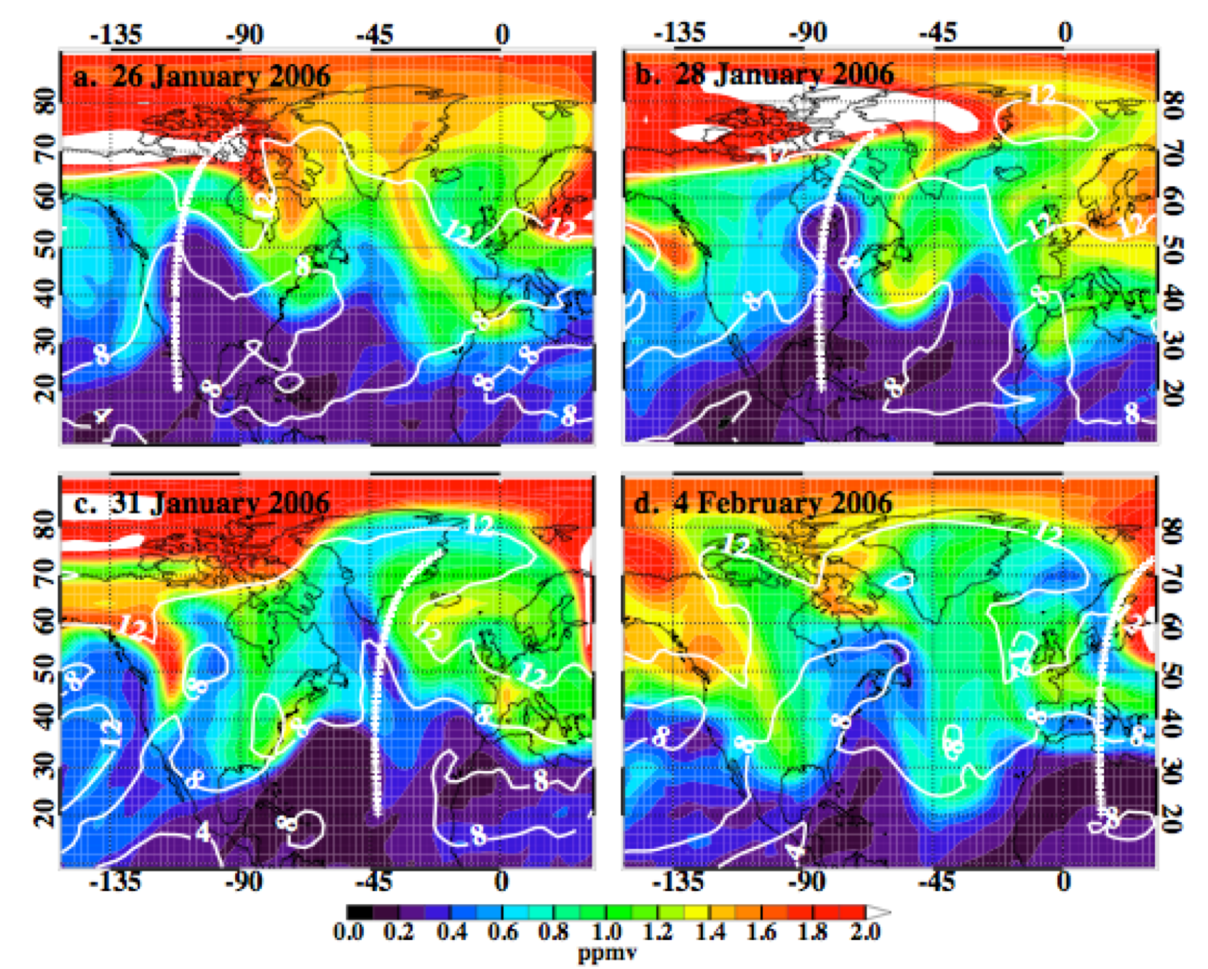
Meridional Transport Occurs In Wave-Like Lamina
GMI model simulation of ozone on 405 K surface [Olsen et al., 2008].

Slide 9
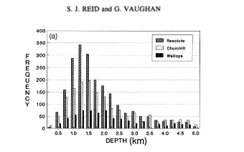
Lamina Identification With HIRDLS O₃ Data

Slide 10
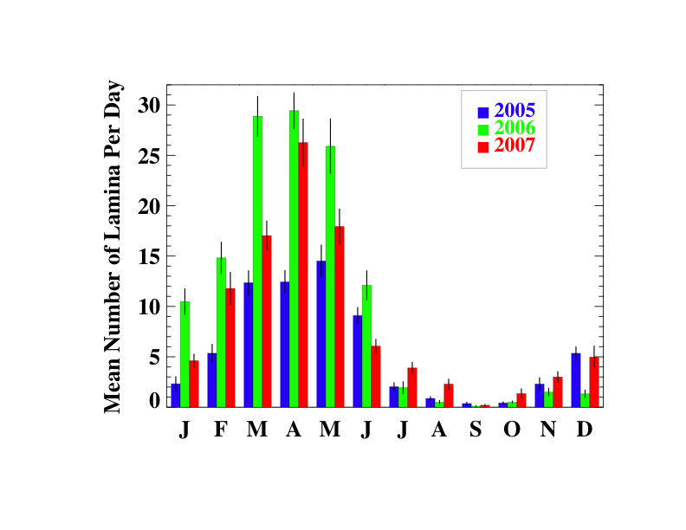
Annual Cycle of Laminae Frequency
Average number of laminae identified per day for each month using the 2° mean profiles.
2005
2006
Lamina Between 400 K-500 K and
34°-60° N
Note that lamina identified may be associated with reversible or irreversible transport

Slide 11
Summary of the 3 years with HIRDLS data
Frequency of laminae observations greater in 2006 but more irreversible transport in other two years.
Not necessarily more lamina transport events. Irreversible transport will reduce the observable lifetime of laminae.
Why is the transport more reversible in 2006?
Whether or not the waves break

Slide 12
“Streamers” As Indicators Of Wave-Breaking
We look for “streamers” in the HIRDLS data by looking for local minimums on horizontal surfaces along the orbit track. (Similar algorithm to the vertical search when identifying laminae).
Streamers/day north of 34°N between 440 K - 500 K:
As a percent of 2005:
6.2±0.7 4.6±0.7 5.4±0.7
100% 74% 87%

Slide 13
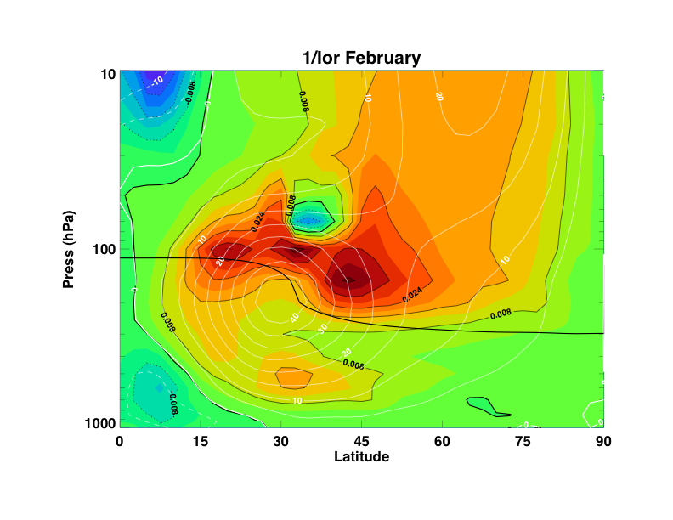
Index of Refraction Provides Insight into Wave Propagation
Waves bend toward higher IOR (low 1/IOR). No propagation in negative IOR.
Critical line at high IOR (1/IOR=0) => Non-linear.
32 year February average
MERRA
Rean.
IOR is dependant on the second derivative of zonal wind in latitude.

Slide 14
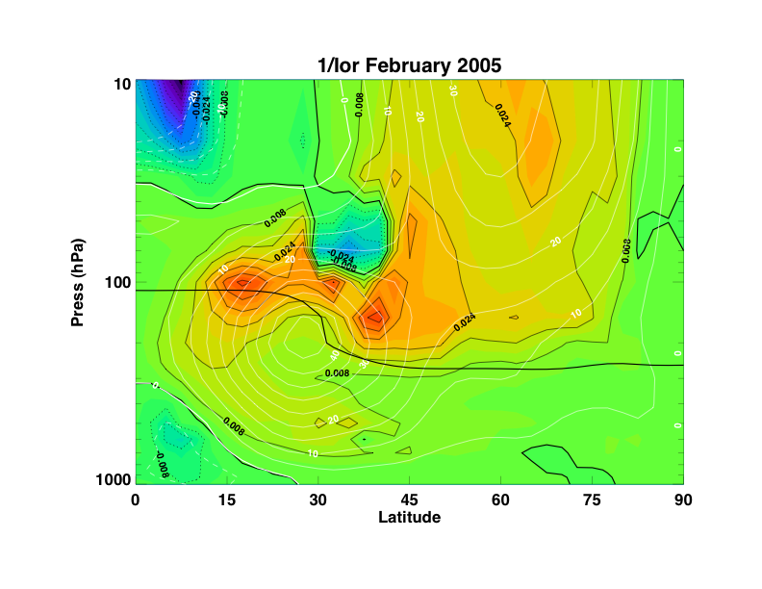
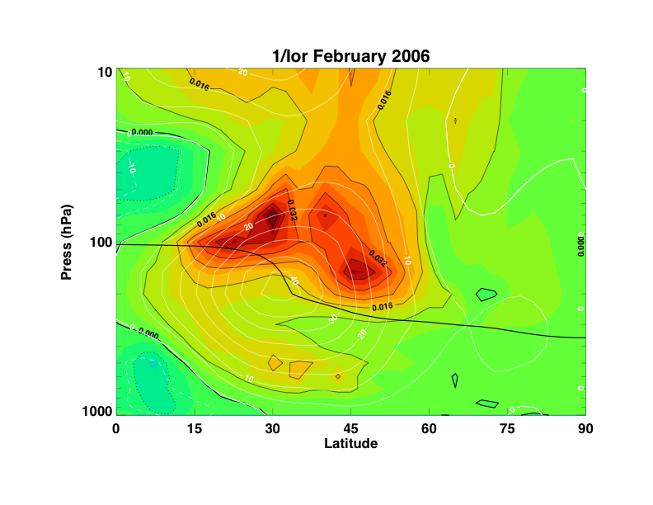
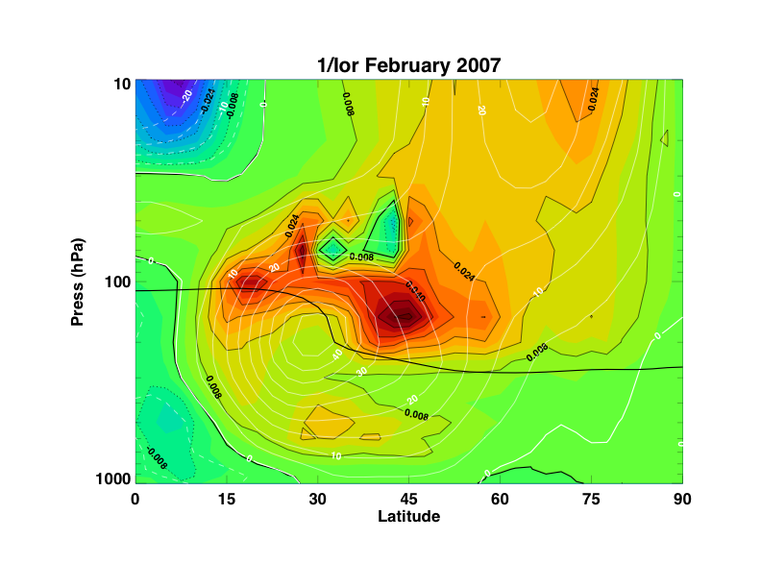
Index of Refraction Provides Insight into Wave Propagation

Slide 15
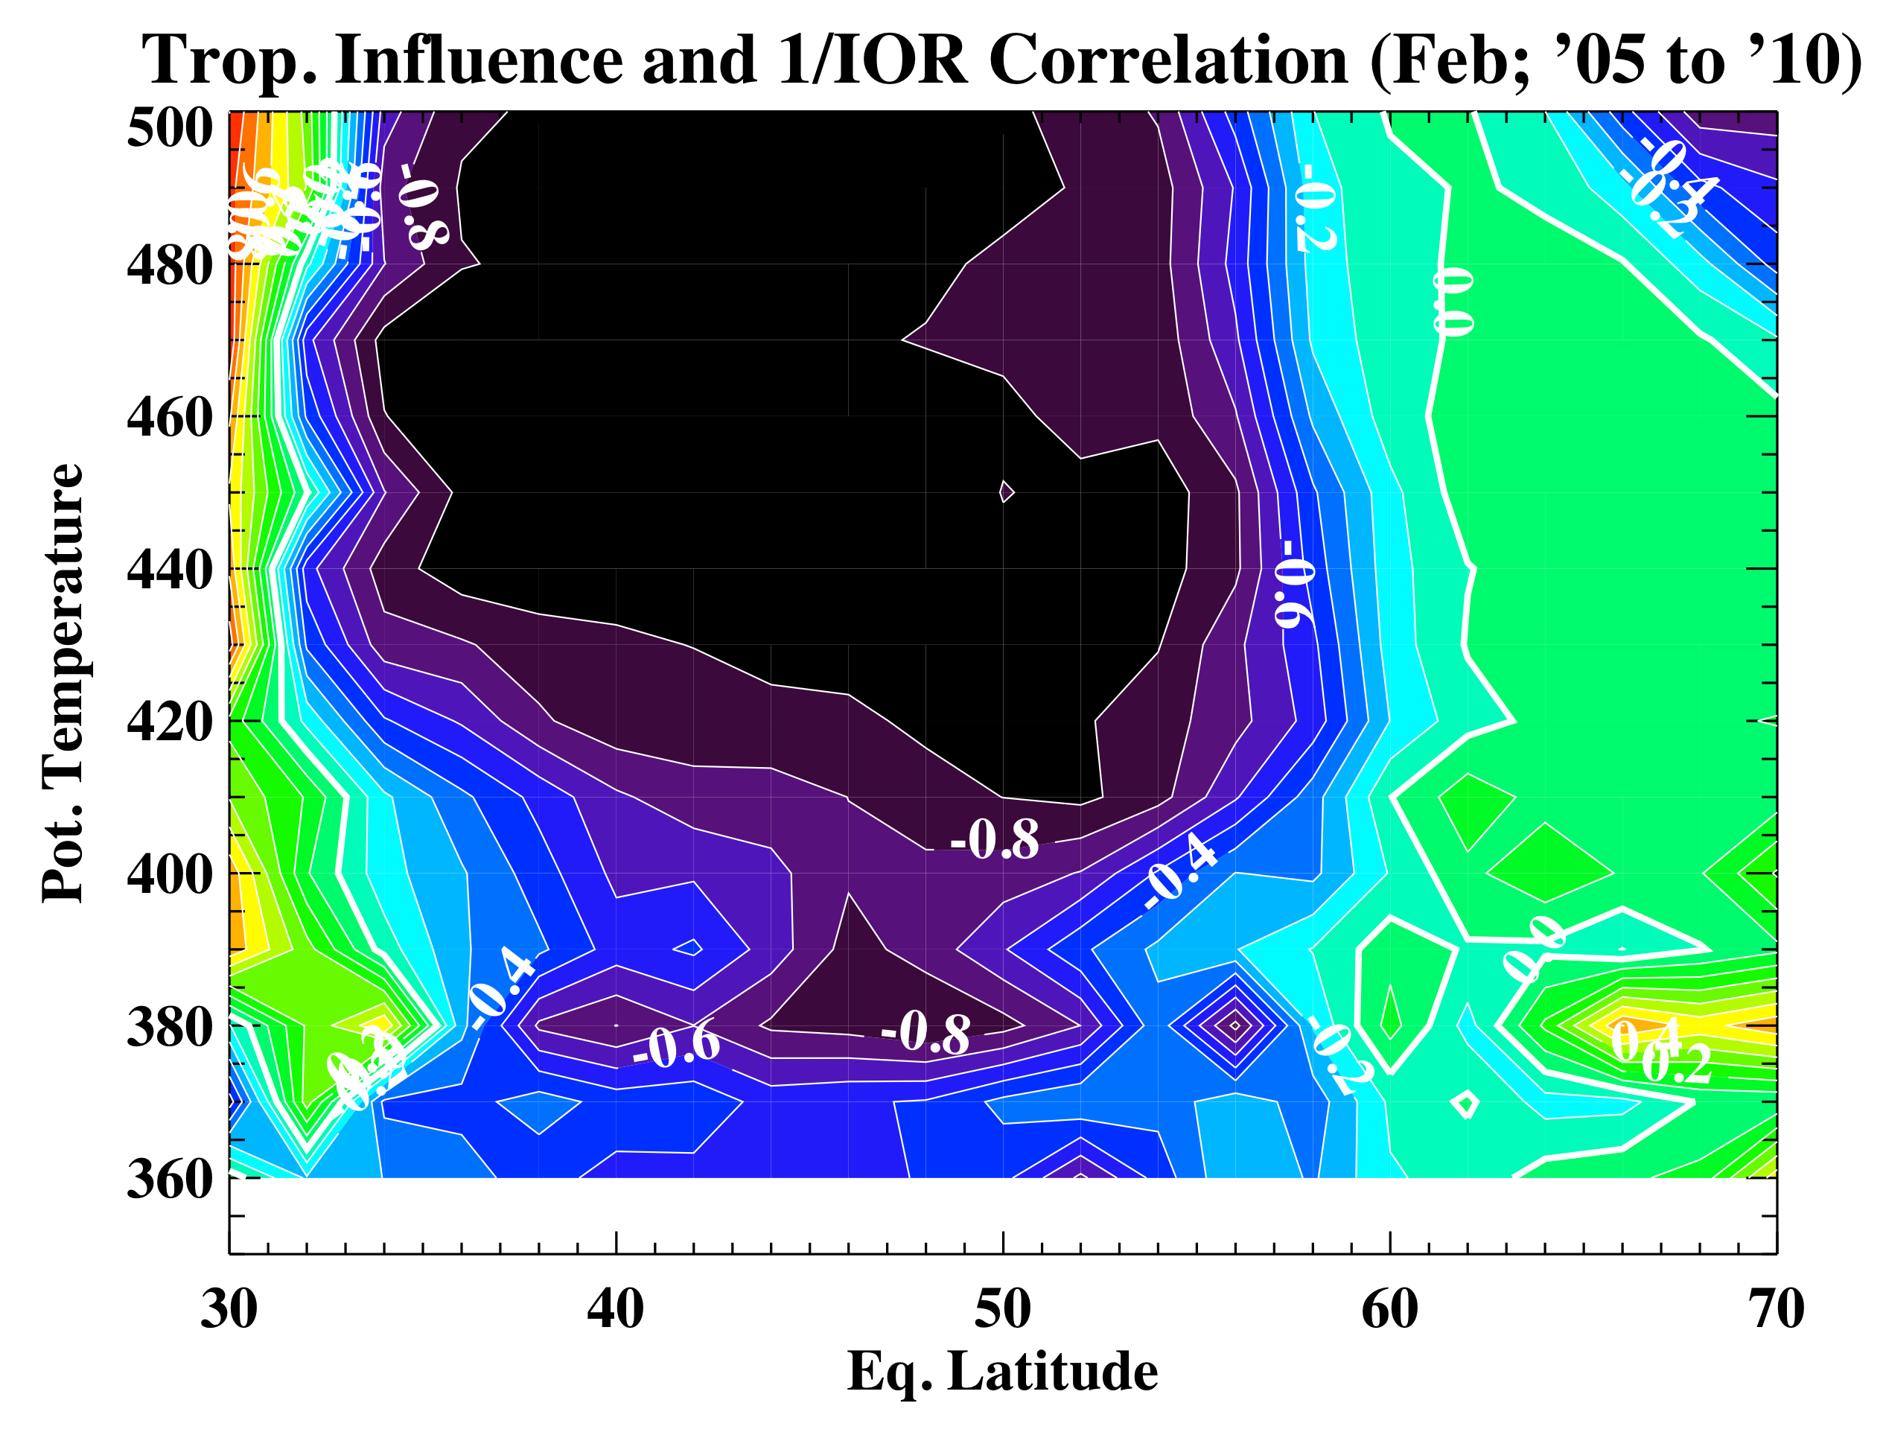
Negative IOR Feature Well-Correlated With Irreversible Transport Into Extratropics
10
“Tropical influence” calculated from MLS ozone data (February)
The R=-0.8 is about the
95% confidence level
February mean 1/IOR of three grid points
at 37°, 38°, 39° N and 70 hPa
correlated with
February mean tropical influence fraction

Slide 16
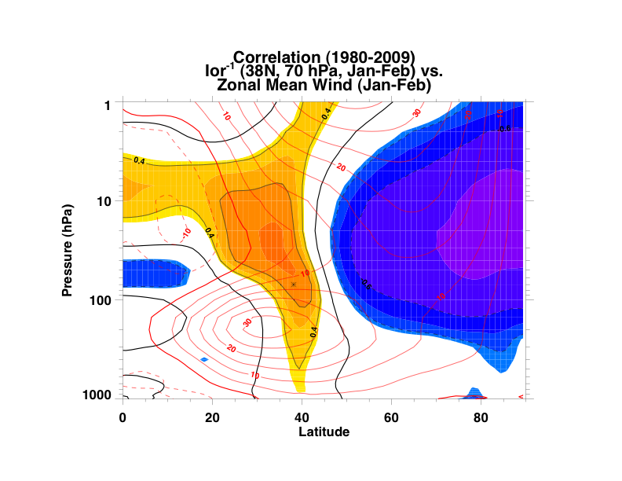
Significant Correlation With Both the QBO and Polar Vortex

Slide 17
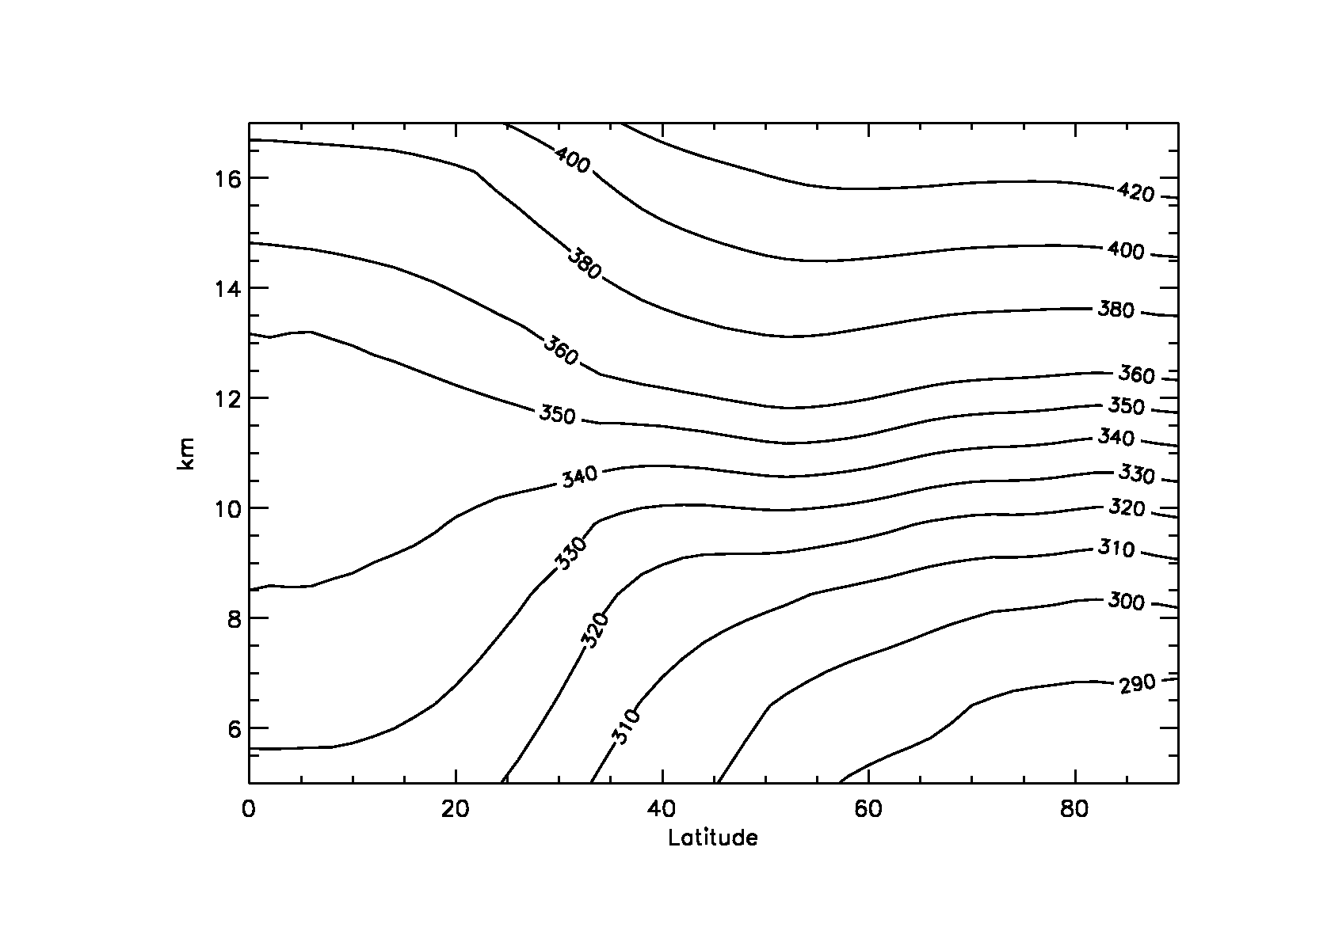
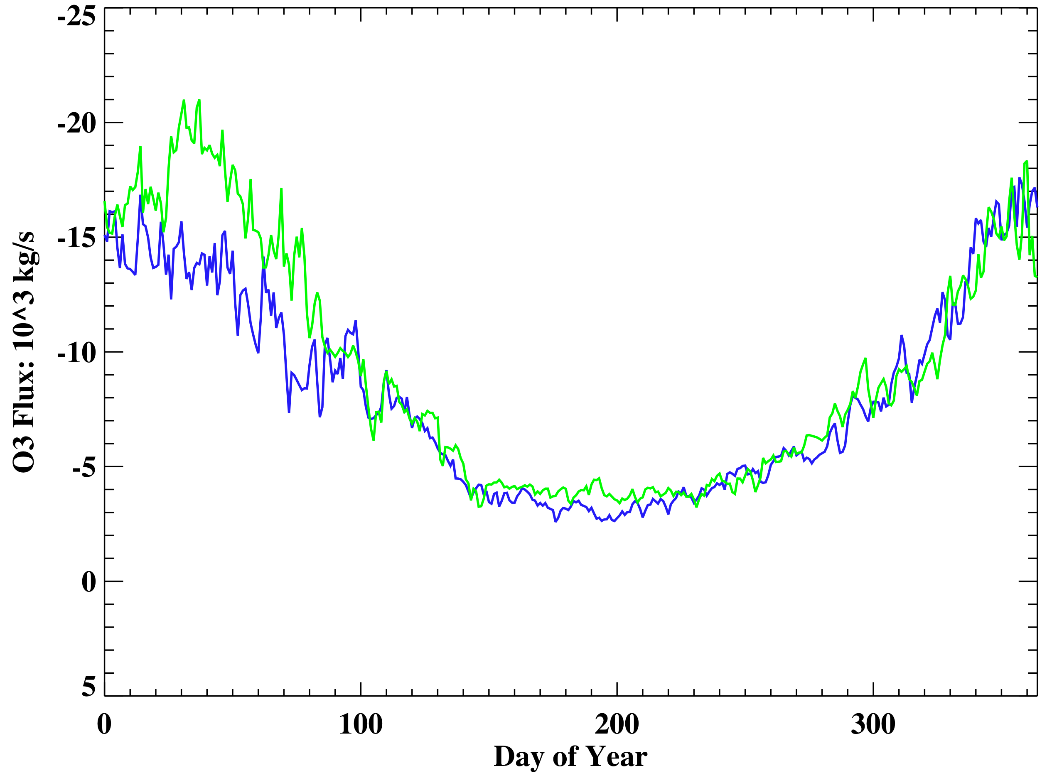
This Transport Can Be A Significant Factor in Ozone STE Variability
380 K
Lowermost
Stratosphere
380 K Flux from MLS v3
“Trajectory Enhanced
Horizontal Resolution”
TP
EQ
(Olsen et al., 2004)
NP
Increasing Downward Flux
2005: 259 Tg
2006: 291 Tg

Slide 18
Summary
There can be large year to year differences in the amount of irreversible transport of subtropical air into the middle latitudes. Frequency of laminae (sondes and other data-sparse surface measurements) is not a good indicator of the NET transport.
The interannual differences in the net transport likely related to differences in wave breaking frequency.
Wave propagation and breaking strongly dependant on the wind state in the lower stratosphere.
This is a mechanism that can contribute significantly to the year-to-year variability of extratropical constituent transport from the stratosphere to the troposphere.
(Olsen et al., JGR, 2010 and other work in prep.)

Slide 19
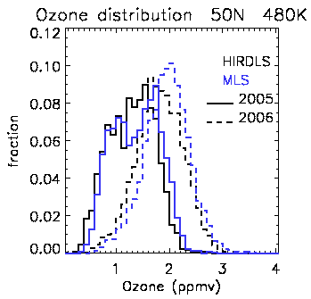
A Closer Look at the Distribution
HIRDLS and MLS distributions are similar, even though HIRDLS vertical resolution is 2-3 times greater.
2005 distributions are broader and more skewed.

Slide 20
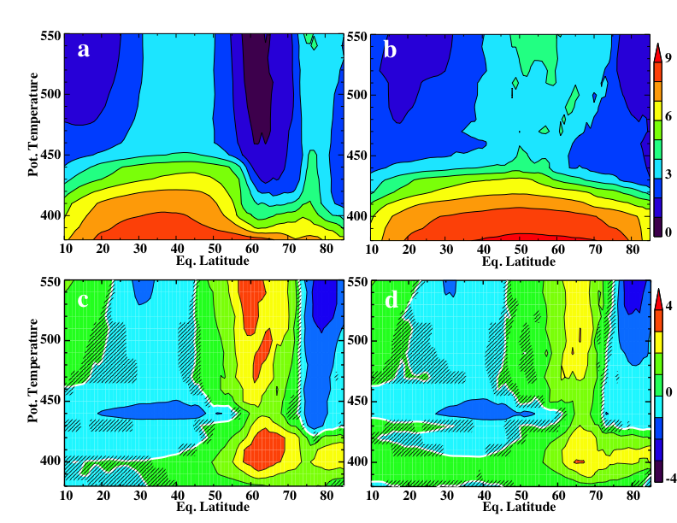

A More Formal Diagnostic of Mixing: Equivalent Length
Using MLS N₂O data; increasing resolution using trajectory mapping
Greater
Mixing
2005
2006
Greater
in 2006
Greater
in 2005/7
2006-2005
2006-2007
Normalization:
Notes:
Trajectory mapping: Schoeberl et al. 2007

Slide 21
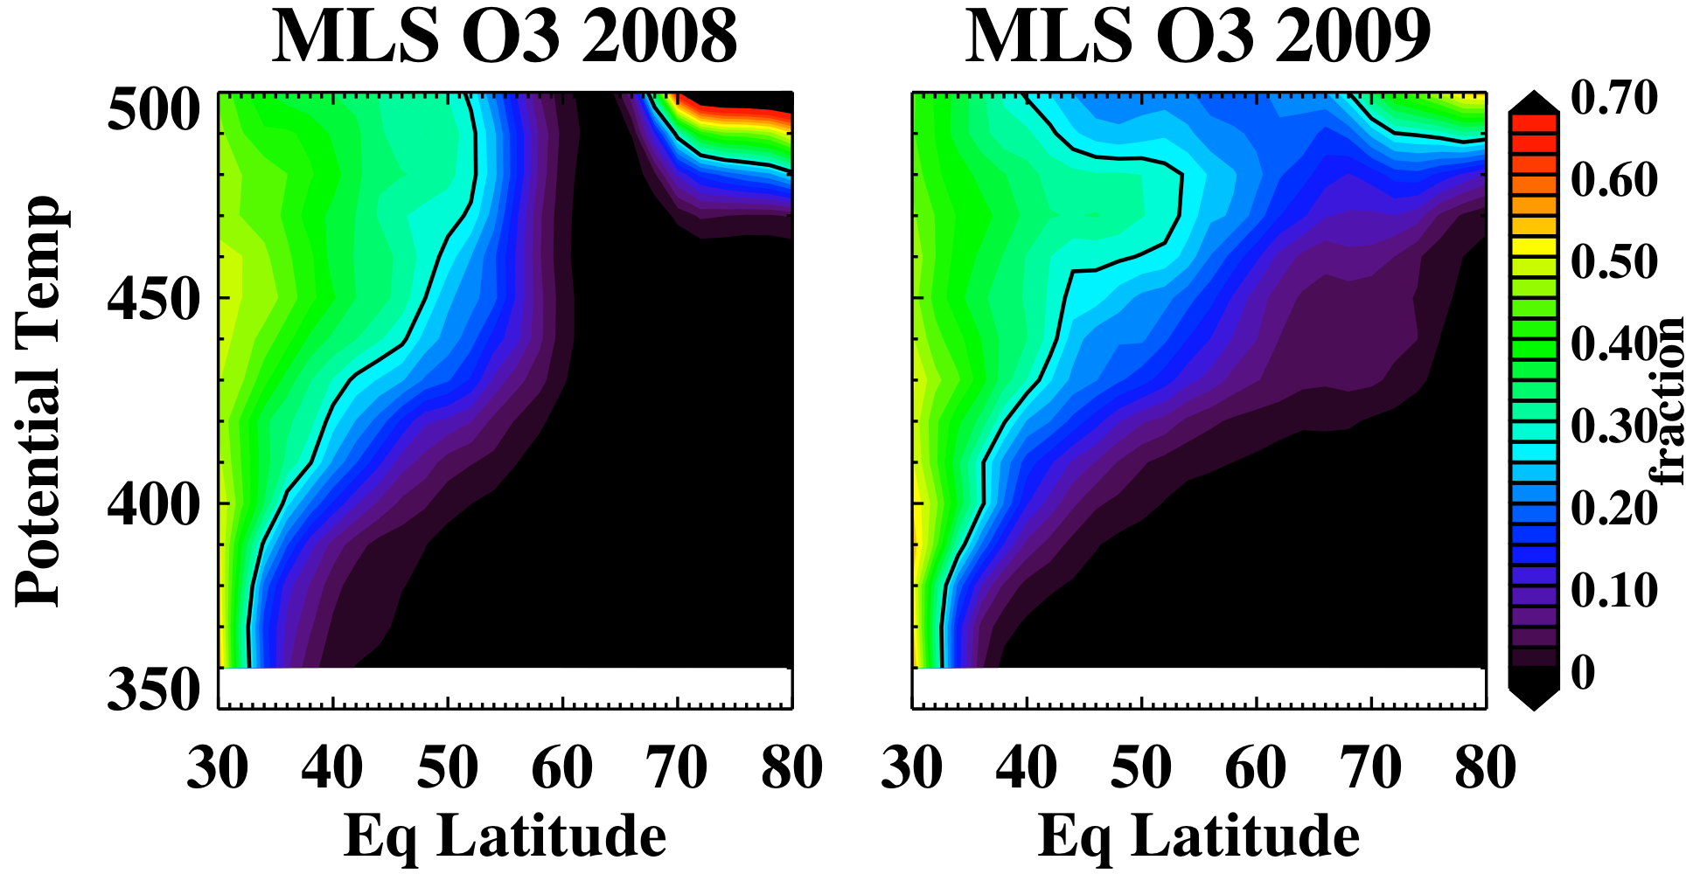
“Tropical Influence” Metric in 2008 and 2009
2008: Easterly QBO, no SSW
2009: Westerly QBO, major warming

Slide 22
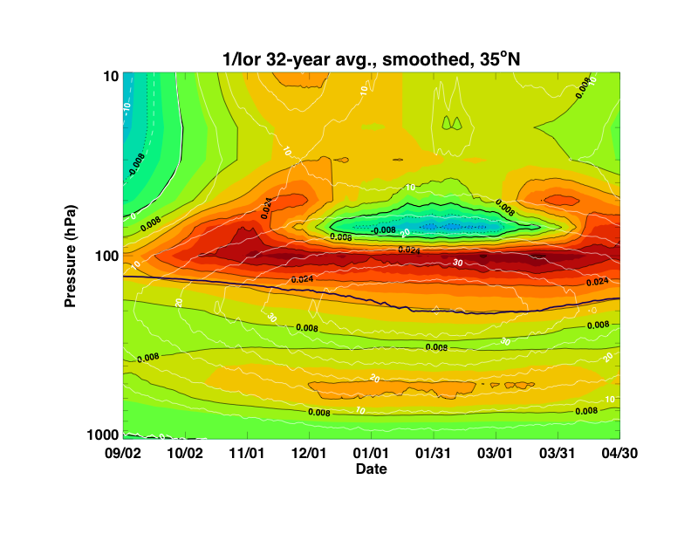
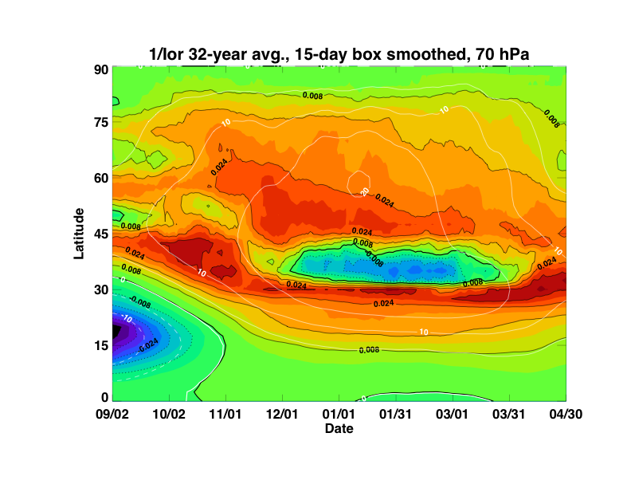

Slide 23
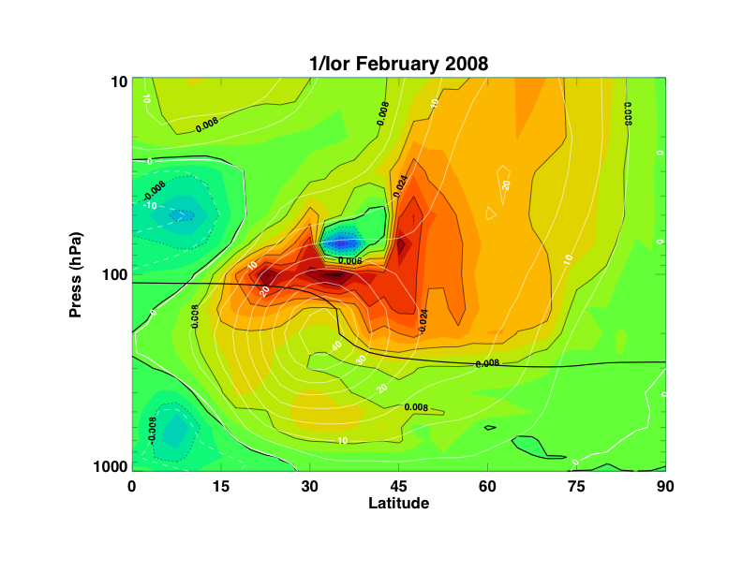
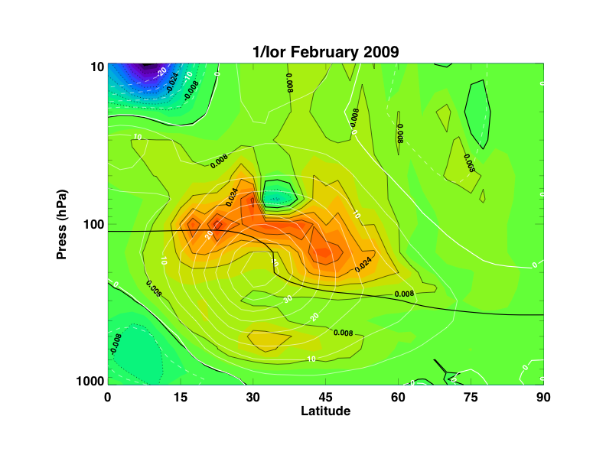
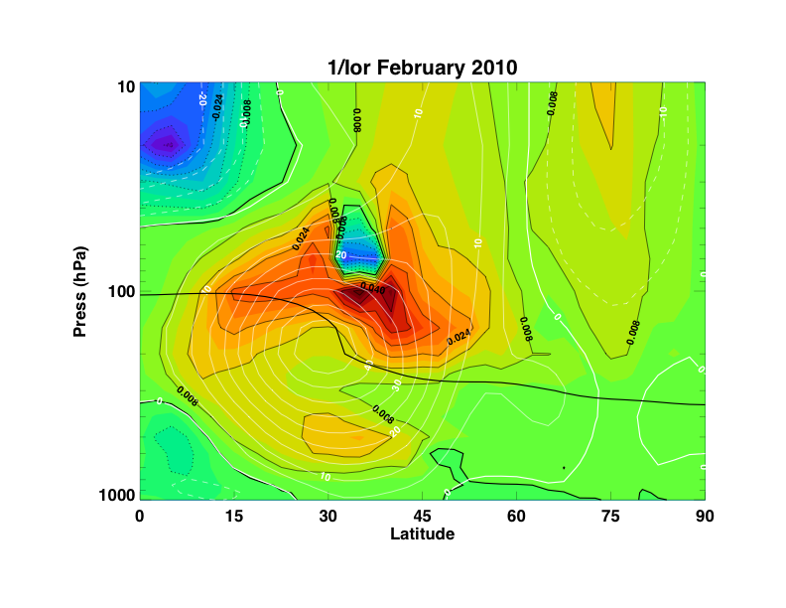
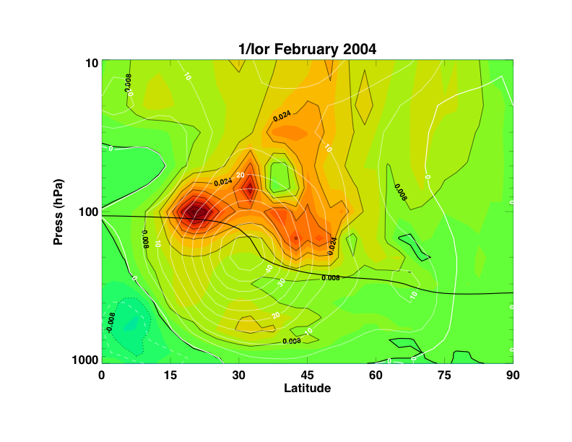

Slide 24
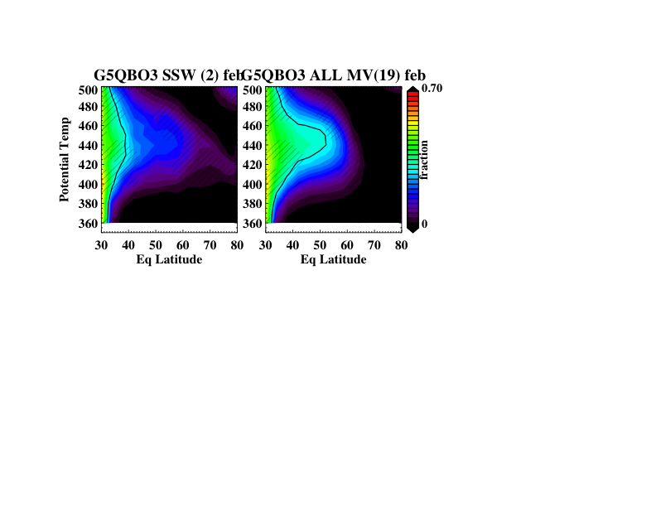
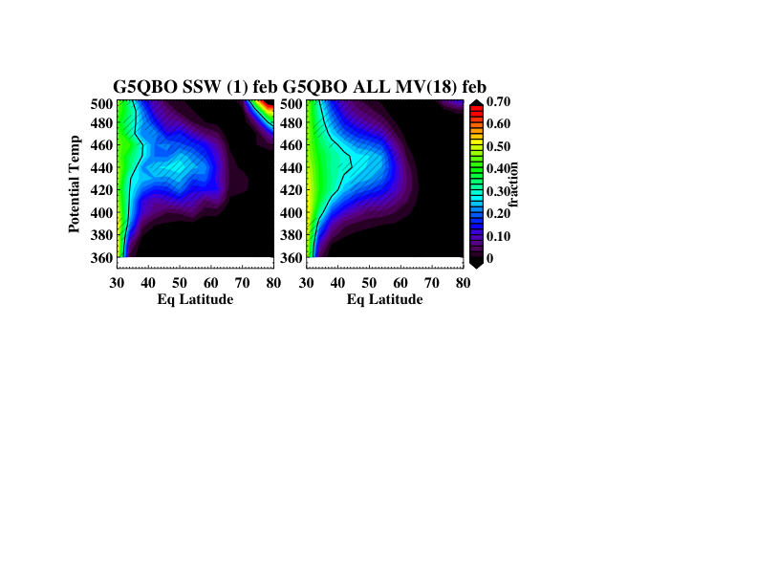

Time-Slice Runs With Internally Generated QBO
Warmings vs. No Warmings (Medium to Strong Vortex)
Run #1
1 year
18 years
warming
no warming
Run #2
4 years
17 years
Run #3
2 years
19 years
Notes:
Medium vortex greater than 18 m/s at 66 N and 500 K. Strong vortex greater than 30 m/s.

