Slide 1
Low level jet study from the ISS
Zhaoxia Pu
Department of Atmospheric Sciences
University of Utah
ISS Winds Mission Science Workshop
Miami, FL
February 10-11, 2011

Slide 2
Low Level Jet (LLJ)
A region of relatively strong winds in the lower part of the atmosphere.
Specifically, it often refers to a southerly wind maximum in the boundary layer, common over the Plains states at night during the warm season (spring and summer).
The term also may be used to describe a narrow zone of strong winds above the boundary layer, but in this sense the more proper term would be low-level jet stream.

Slide 3
Importance of LLJs (not a completed list)
LLJ plays as the major conveyor of low-level moisture from the Gulf of Mexico into central US. Contribution of LLJ transport is almost 50% above average of non-LLJ values.
It promotes nocturnal thunderstorm development
LLJ is an important ingredient in the initiation of mesoscale convective complexes (MCCs) by advecting warm moist air into the genesis region of the MCCs.
LLJ was found to be present for 75% of the squall lines that
occurred in the Great Plains.

Slide 4
Categorical LLJ criteria from Whiteman (1997, LLJ-0)
and Bonner (1968, LLJ-1 – LLJ-3)
Category of LLJ | Max Wind Speed Below 1500m V_{max} (m/s) | Largest decrease from the max wind speed in the layer from the height of the max to 3000m ΔV (m/s)
LLJ-0 | ≥10 | ≥5
LLJ-1 | ≥12 | ≥6
LLJ-2 | ≥16 | ≥8
LLJ-3 | ≥20 | ≥10

Slide 5
LLJ Over US
Bonner (1968)
Southerly Great Plains Jet

Slide 6
Mean nocturnal LLJ (NLLJ) and 500 AGL wind at local midnight
for 1985-2005 (Rife et al. 2010)

Slide 7
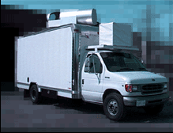
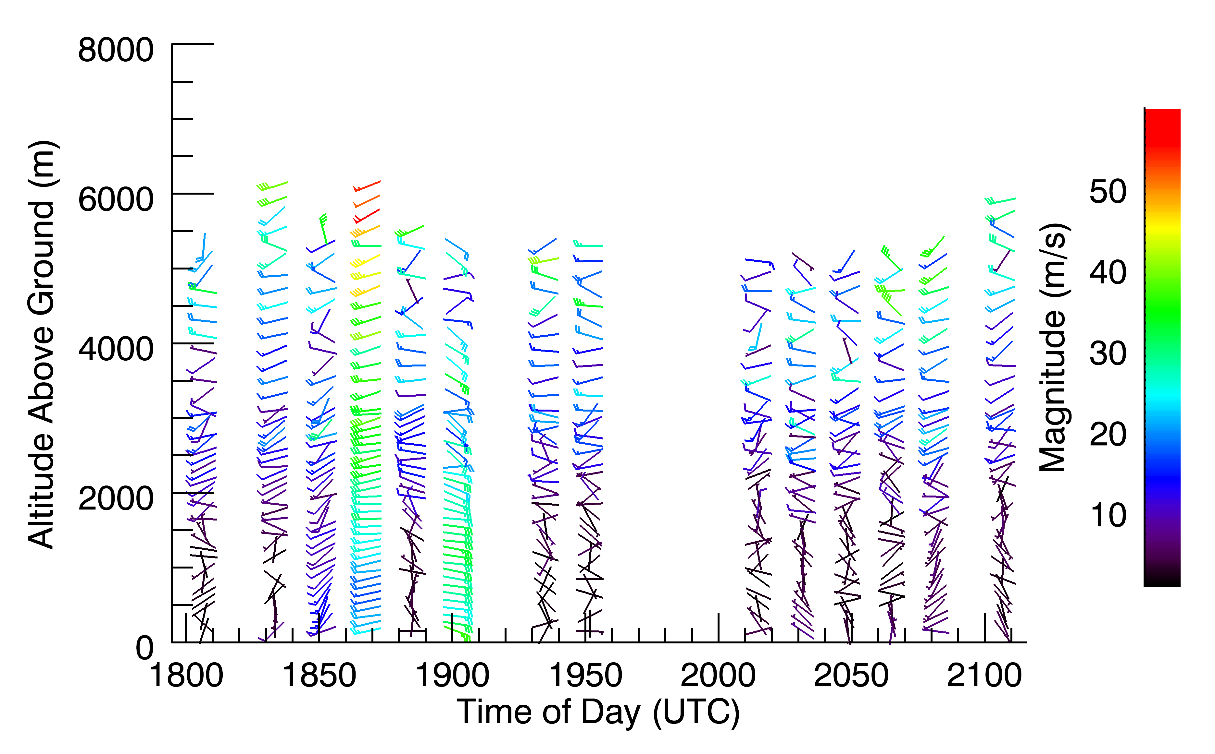
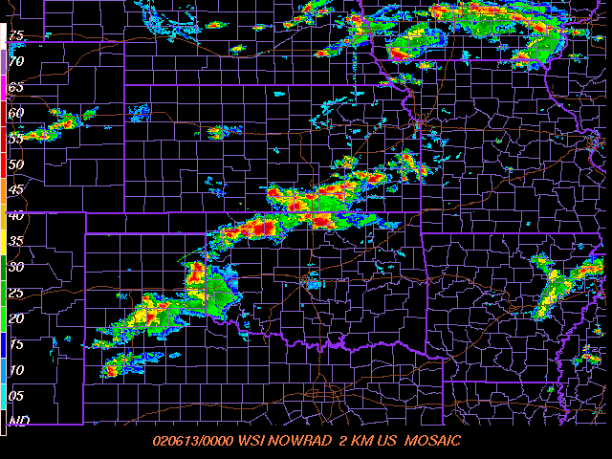
GLOW (Goddard Lidar Observatory for Winds) Lidar Wind Observations
International H₂ O Program (IHOP)
field program: May and June 2002
Wind profile Resolution: 10 minutes;
100m below 3km and 200m above 3km of the height
Over 240 h of data in 35 days
x
Observations at Homestead site, OK
during 12-13 June 2002
Bruce Gentry, NASA/GSFC

Slide 8
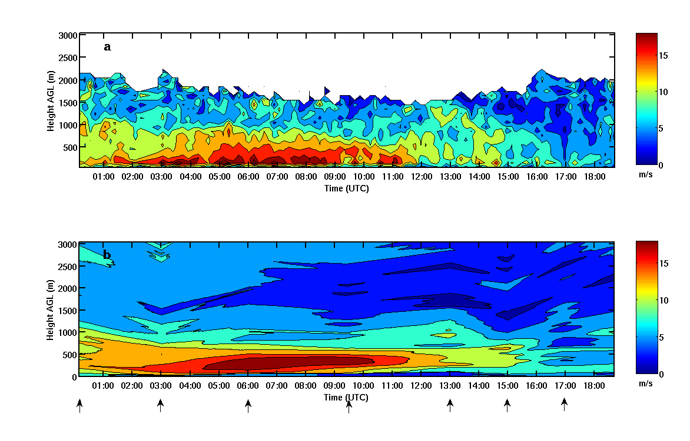
LLJ Case During IHOP (2002)
Time-height variation of the wind: Lidar vs. Sonde
GLOW
Sonde
Li et al. (2011)
June 25 , 2002

Slide 9
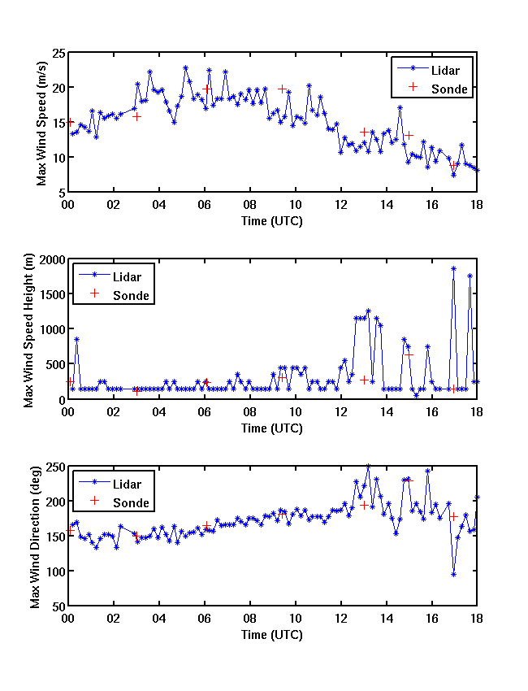
Distribution of the maximum wind

Slide 10
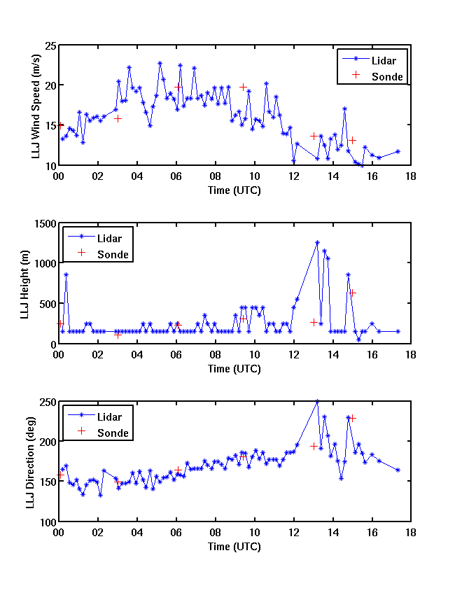
LLJ-0

Slide 11
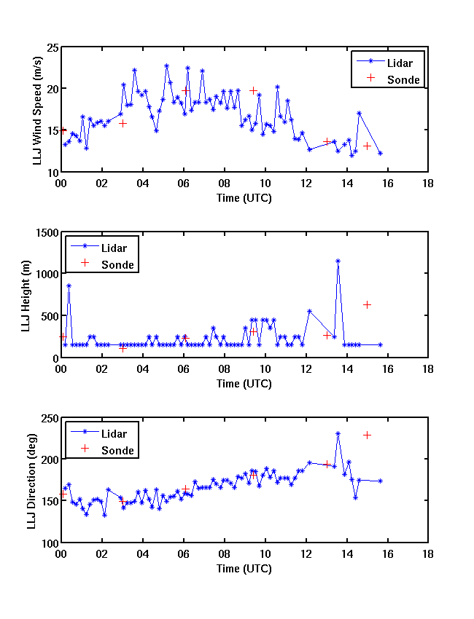
LLJ-1

Slide 12
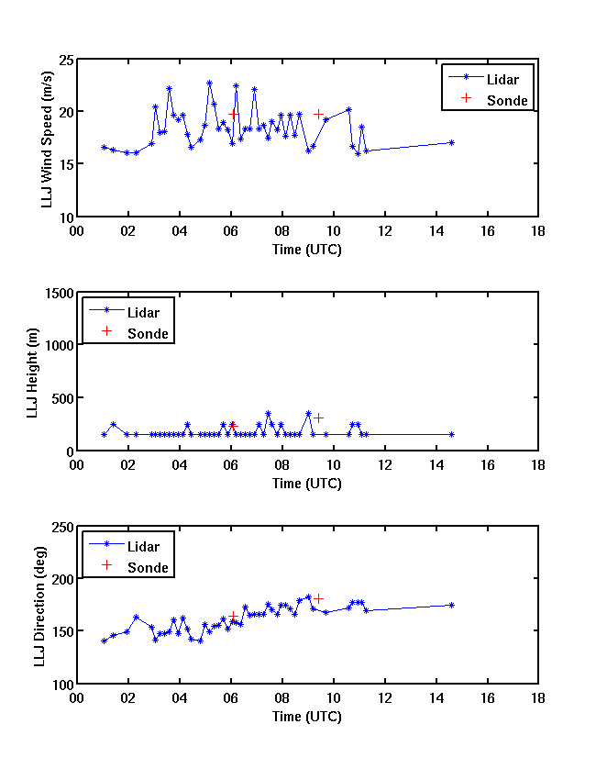
LLJ-2

Slide 13
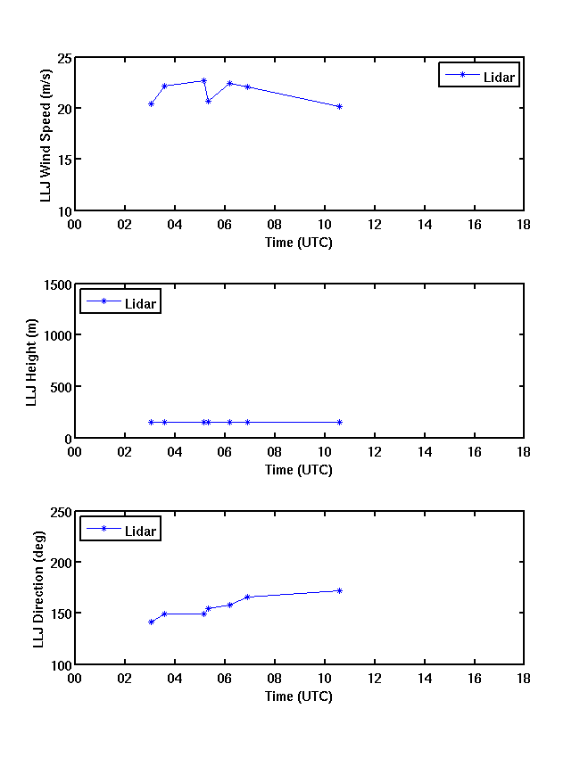
LLJ-3

Slide 14
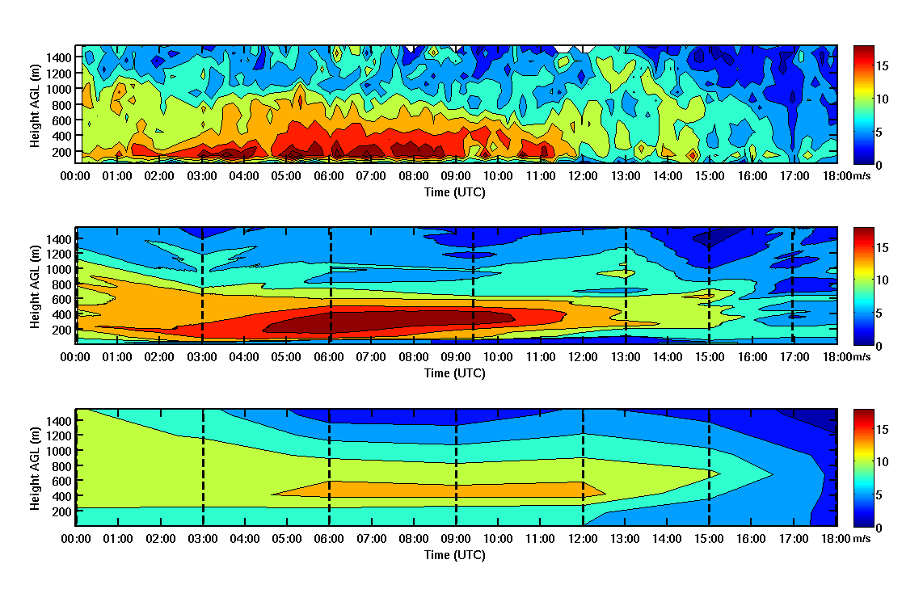
LLJ Case During IHOP (2002)
GLOW
Sonde
NARR

Slide 15
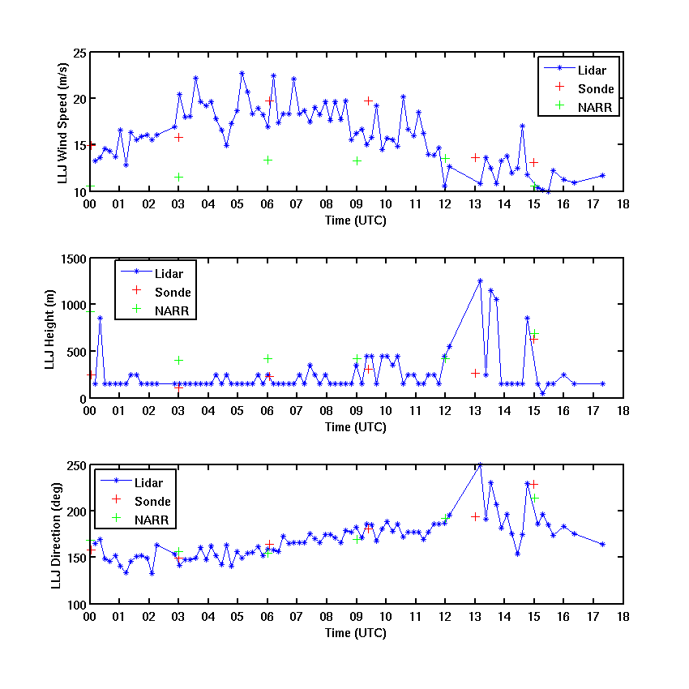
LLJ-0

Slide 16
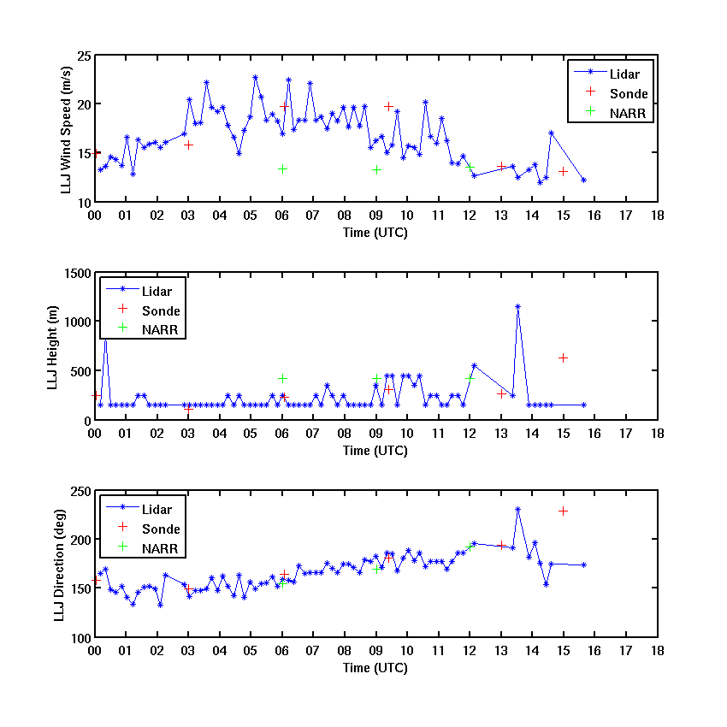
LLJ-1

Slide 17
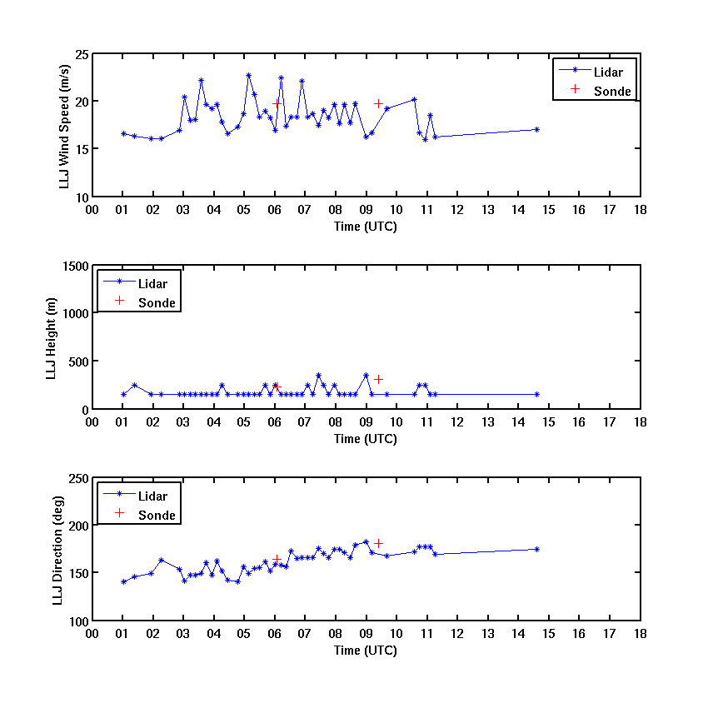
LLJ-2

Slide 18
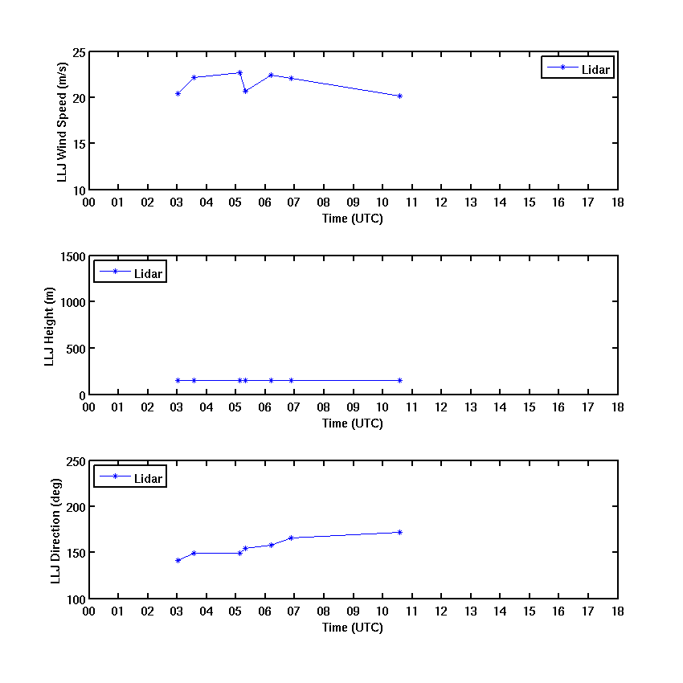
LLJ-3

Slide 19
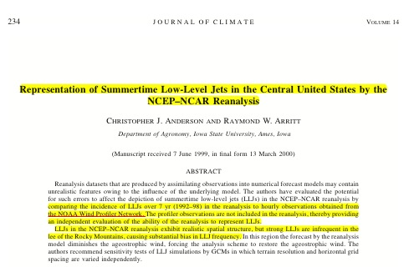
LLJs in the NCEP-NCAR reanalysis exhibit realistic spatial
Distribution, but strong LLJs are infrequent……

Slide 20
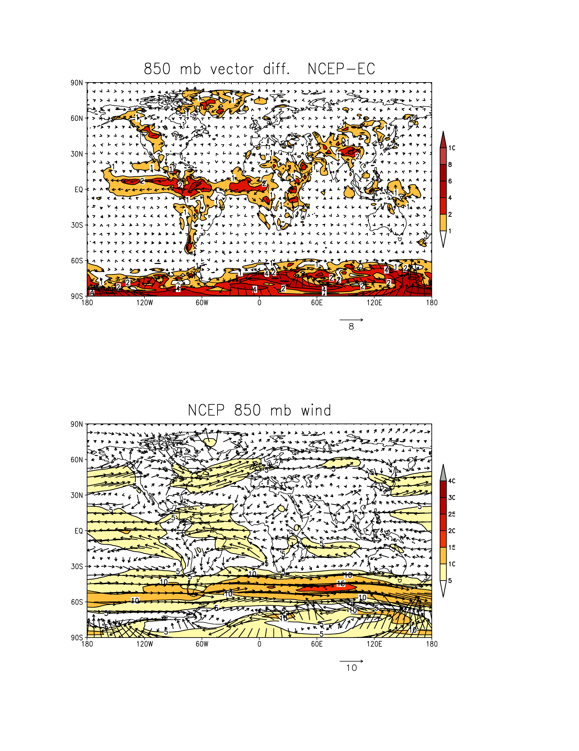
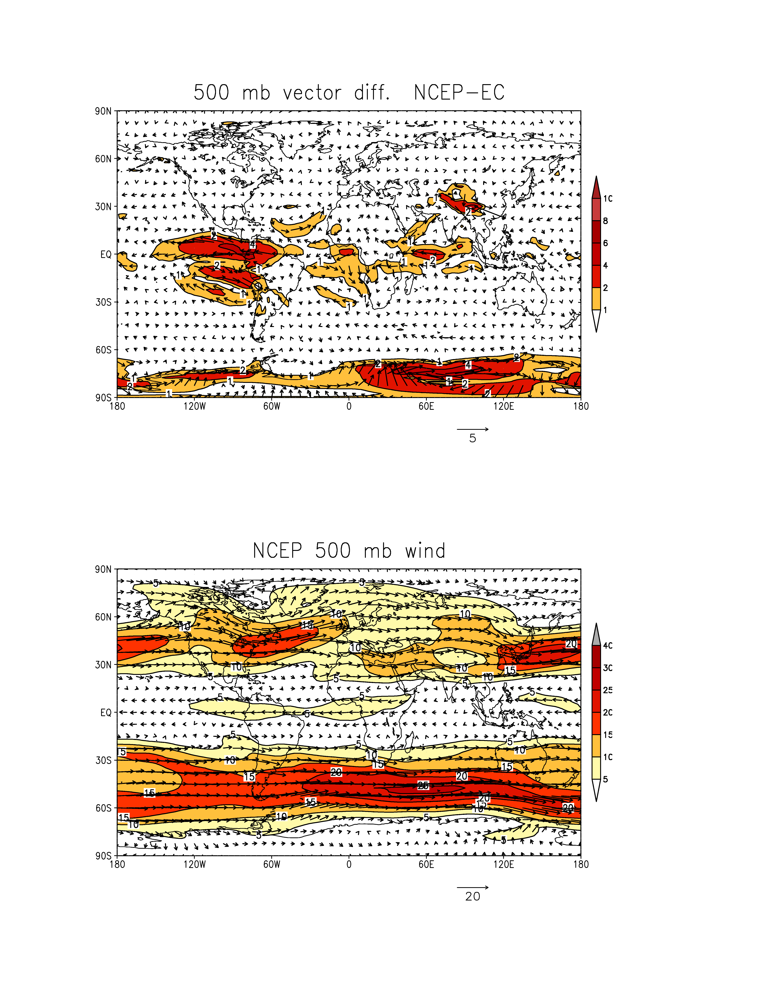
The uncertainties of global wind analysis
NCEP/NCAR Reanalysis vs. ERA-40, 1980-1999
Mean wind speed and vector differences
between two reanalyses at 850mb
Mean wind speed and vector
from NCEP reanalysis at 850mb
Mean wind speed and vector differences
between two reanalyses at 500mb
Mean wind speed and vector
from NCEP reanalysis at 500mb

Slide 21
ISS should bring an opportunity to improve analysis and
forecasts of LLJs !

