Slide 1
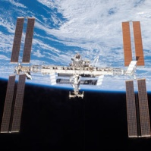
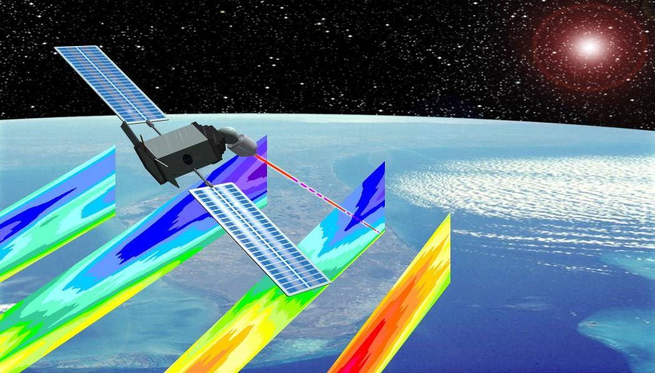
NOAA/NESDIS/OSD and Wind Lidars
Space-based Wind Lidar Working Group
Miami, Florida
February 8-9, 2011
Richard Fulton
Special Projects Manager
NOAA/NESDIS/Office of Systems Development
1335 East West Highway, Suite 6200, Silver Spring, MD 20910-3283
Phone (301) 713-0088 Ext 153; Richard.Fulton@noaa.gov

Slide 2
NOAA Programs with
Requirements for Atmospheric Winds
GOAL | Program | Priority 1 | Priority 2 | Totals
Climate (CL) | Climate Observations & Modeling (COM) | 1 |  | 1
Commerce & Transportation (C&T) | Aviation Weather (AWX) | 4 |  | 4
 | Marine Weather (MWX) | 1 |  | 1
 | Surface Weather (SWX) | 2 |  | 2
Weather & Water (W&W) Mission Support (MS) | Air Quality (AQL) | 1 |  | 1
 | Hydrology (HYD) |  | 1 | 1
 | Local Forecasts & Warnings (LFW) | 3 | 1 | 4
 | Modeling and Observing Infrastructure (MOBI)/Environmental Modeling (EMP) | 1 |  | 1
Total: 4 Goals | 8 PROGRAMS | 13 | 2 | 15
Data provided by NOAA’s Technology, Planning and Integration Office
Consolidated Operational Requirements List [CORL] Team

