Slide 1
The Winds from the International Space Station for Climate Research (WISSCR) Mission
Mike Hardesty, Bruce Gentry, Wayman Baker, Dave Emmitt, Michael Kavaya, Steve Mango, Ken Miller
Working Group on Space-based Lidar Winds
February 8, 2011

Slide 2
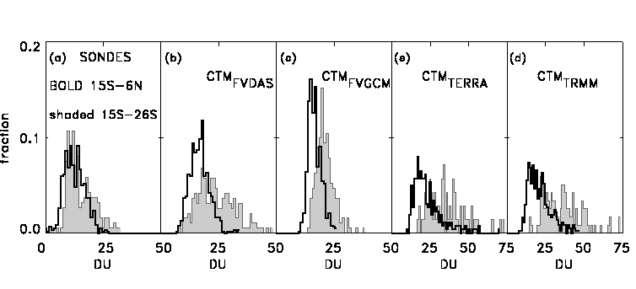
WISSCR Science
WISSCR will produce more accurate Earth science products, advance NASA Earth system modeling efforts, and provide critical input to the Intergovernmental Panel on Climate Change (IPPC) for future IPCC assessments of climate trends
.
  Transport of atmospheric constituents – bias in model-supplied winds in the upper troposphere/lower stratosphere for transport studies (Rood and Bosilovich, 2010; Tan et al., 2004, J. Geophys. Res.)
  Formation and strength of the Somali Jet over Northwestern Indian Ocean (Reale, 2010, personal communication)
  Monsoon circulations - Current wind data do not adequately characterize the Asian and African monsoons with significant resolution to understand events such as the recent Pakistan floods
Latitudinal displacement in the ozone probability distribution function between data from ozonesondes and data assimilation-supplied winds (Rood and Bosilovich 2010)

Slide 3
WISSCR Science (2)
  Differences in the Hadley and Walker circulations between the NCEP/NCAR and ECMWF reanalyses due to large differences in the tropical divergent wind (Rood and Bosilovich, 2010, published by Springer; Chen, 2008a, J. Climate)
  Formation of the African Easterly Jet – major differences exist between NASA MERRA reanalysis and other major reanalysis datasets (Wu et al., 2009, J. Climate)
  Energy and water cycles –consistency of precipitation, outgoing long wave radiation and upper level divergence among the three reanalyses was very low (Rood and Bosilovich, 2010; Newman et al., 2000, Bull. AMS)
  Tropical cyclone formation and dissipation – Role of large scale features (variability in tropical circulation modes, effects of dust)
Dynamic fields differ significantly
between reanalyses (Chen 2008a)

Slide 4
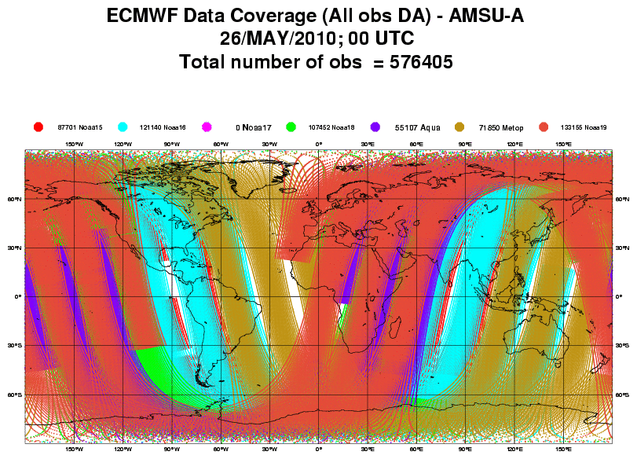
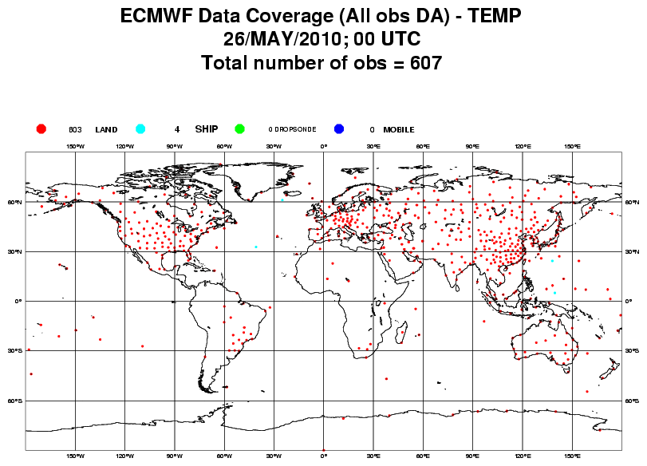
WISSCR Science (3)
Outside of the data rich land areas, the lack of wind profiles also limits our ability to optimally specify the initial conditions for numerical weather forecasts. The wind field plays a unique dynamical role in forcing the mass field to adjust to it in the tropics, and at small scales in the extratropics (Baker et al. , 1995, Bull. Amer. Meteorol. Soc.).
Although satellite obs are dominated by mass, winds provide more impact per obs.
But almost no direct observations of wind are available in tropical and extratropical oceanic regions!

Slide 5
Relevance to NRC Decadal Survey, NASA SMD, and Other Priorities
The WISSCR mission will address important national and international recommendations and priorities as follows:
The NRC Decadal Survey (NRC 2007) recommended a global wind mission, and the NRC Weather Panel, in the same report, determined a lidar winds mission in low earth orbit could make a transformational impact on global tropospheric and stratospheric analyses. The WISSCR mission will be an important step toward, but not a substitute for, a global wind mission.
The WISSCR mission will support the NASA SMD 2010 Science Plan by ”Understanding the causes and consequences of climate change [which] is one of the grand challenges of the 21st century”
The World Meteorological Organization (WMO 1996) determined that global wind profiles are “. . .essential for operational weather forecasting on all scales and at all latitudes. . .”
A 2007 letter from the USAF Director of Weather to the NASA Associate Administrator for the SMD, stated that “. . . Among the 15 missions recommended by the NRC Decadal Survey, the measurement of global tropospheric winds provides the greatest benefit to the USAF. . .”

Slide 6
WISSCR Mission Concept/Design
WISSCR will be a 5-year mission to build a hybrid Doppler wind lidar and deploy it on the ISS to investigate tropical and subtropical processes
Operational Scenario
  2012 - 2017 Instrument Design and construction; science algorithm development
  2017 - 2019 2–year science mission observing winds from the ISS and applying results to climate research
    Mission will include calibration validation activities using NOAA and NASA aircraft
Instrument
  Hybrid Doppler Wind Lidar measuring radial winds from two look angles +/- 45 deg from normal to velocity vector (e.g. fore and aft) on a common ground track.
  Measurements alternate between look angles with programmable dwell time (typ. 4, 12 or 24 sec) and max time to switch and settle of 0.5 sec.
  Nominal nadir angle is 35 deg

Slide 7
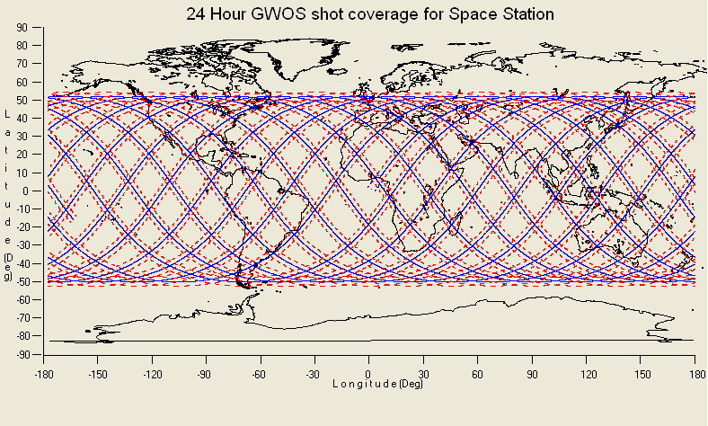
WISSCR One-day ground track

Slide 8
Selectable Dwell Times
Flexible dwell time management would allow high horizontal resolution profiling by the coherent subsystem while allowing sufficient shot integration for the direct subsystem to achieve useful measurement accuracies.
By operating through just two telescopes on either the port or starboard side the repeat (revisit) intervals can be kept short.
By keeping the repeat intervals short, the longitudinal offset (due to earth’s rotation) between the fore and aft shots can be also reduced (average of 14km for ISS orbit)
Dwell (sec) | Dwell (kms) | 4 tele | 2 tele
24 | 175 |  | x
12 | 88 | x | x
4 | 30 | x | x
1 | 7.5 | x | x

Slide 9
NASA Space Flight Project
Standard WBS Dictionary (2 of 5)
Element 1 - Project Management:
Element 2 - Systems Engineering
Element 3 - Safety and Mission Assurance
Element 4 - Science / Technology
Element 5 - Payload
Element 6 - spacecraft(s)
Element 7 - Mission Operations System
Element 8 - Launch Vehicle / Services
Element 9 - Ground System(s
Element 10 - Systems Integration and Testing
Element 11 - Education and Public Outreach

Slide 10
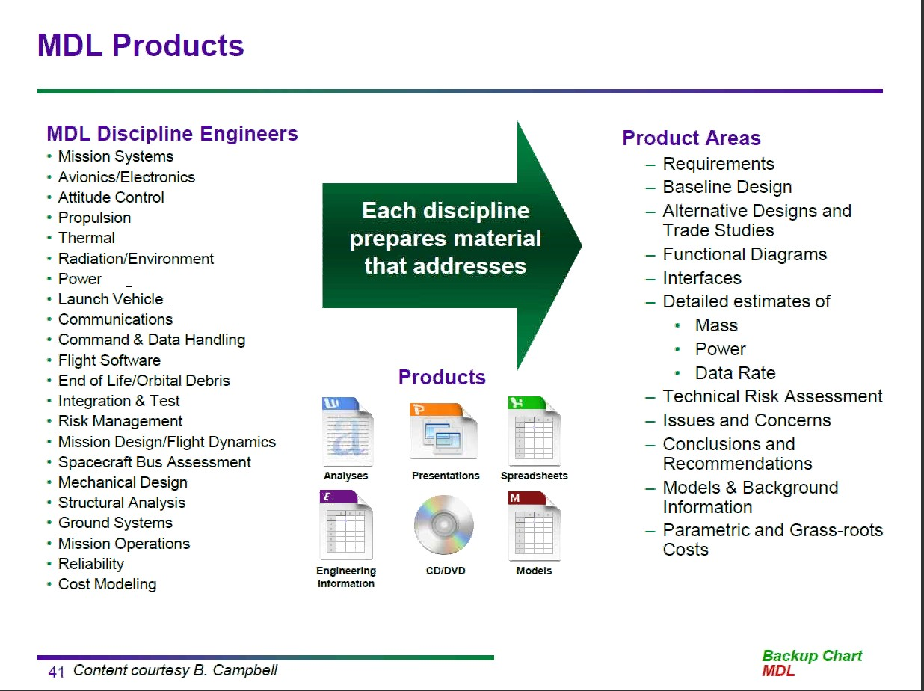
MDL Output

Slide 11
IDL/MDL Study
IDL/MDL study funded from 4 sources: (ESTO), NASA Headquarters Earth Science, NESDIS OSD, USAF)
Develop instrument design for the ISS mission (NASA WBS 5)
  Initial: November 29 – December 3, 2010
  Follow up: January 13 – 14, 2011
MDL Study: Investigate overall aspects of the mission
  January 18 -19 2011
Several discussions carried out prior to the IDL/MDL study
  Presentation to Goddard New Business
  Discussions with GSFC on mechanisms for partnering with industry
  Discussion with ISS Payload/STP on space station location options

Slide 12
IDL SOW (1 of 2)
The instrument design will meet GWOS data requirements using a hybrid DWL and the ISS 52 degree inclined orbit. It will continue taking data through the earth shadow portion of the orbit.
IDL will:
  Incorporate any improvements from NWOS, airborne experience, and technology advances to define an updated GWOS instrument conceptual design for the ISS;
  Use the GWOS data requirements and ISS capabilities;
  Use shared optics (coherent detection and direct detection lidars) with 2 azimuth angles (+/- 45 deg from normal to ram direction), crossed-beam optical design as in NWOS , and 35 degree nadir angle ;
Use two-year technology projections, and provide estimates for time and cost to achieve projected technologies;
Assume resources (mass, power, volume, thermal) defined as available from the JEM-EF. Assume we will use attach point EFU#1?

Slide 13
IDL SOW (2 of 2)
Deliverables from the IDL study
  Updated GWOS instrument design and implementation cost;
  Mass, volume, and dimensions of major components of the instrument (e.g., transceiver, optics);
  Thermal requirements;
  On-board computational requirements;
  Downlink bandwidth;
  Identify Instrument vibration modes. Assess impact of vibration on instrument performance in ISS environment.
  Assume a on-orbit life of 2 years, assess the redundancy of critical components with respect to mass, volume, power, and cost.
  Assume the NWOS concept with a reduced instrument volume using a crossed-inward optical design.
  Update and document the efficiency estimates for the laser, optics, and detectors;
  Identify any technology or engineering “tall poles” and risks;
  Identify any special spacecraft/instrument/ISS interface requirements from the instrument perspective; and,
  Identify any potential instrument advantages/disadvantages from operating in one of the ISS attached modules, e.g., the pressurized Japanese Experiment Module.

Slide 14
IDL Study Assumptions
A demonstration mission that will not be held to operational lifetime, duty cycle and data download requirements.
Instrument based on existing GWOS (2006) and NWOS (2008) IDL instrument concepts using the hybrid DWL approach.
The pointing issues will be handled with “knowledge” rather than “control” (i.e. no gimbaling).
Impact of vibration on instrument performance in ISS environment needs to be assessed. Currently we assume passive vibration isolation will be sufficient.

Slide 15
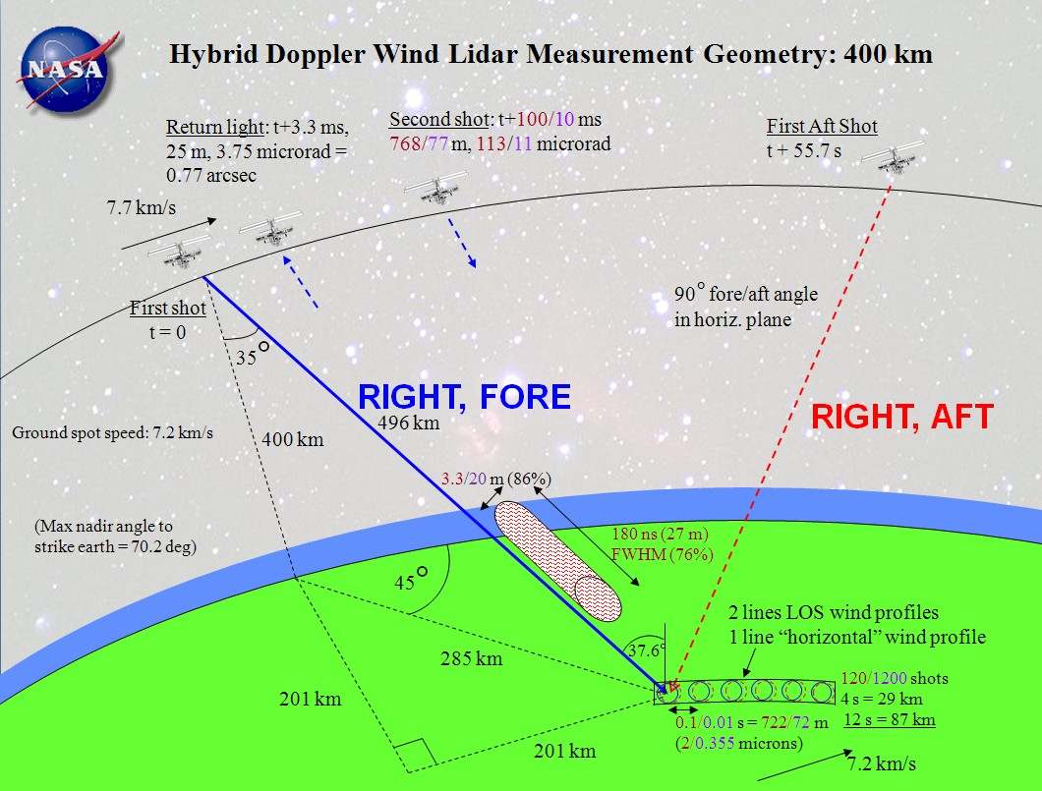

Slide 16
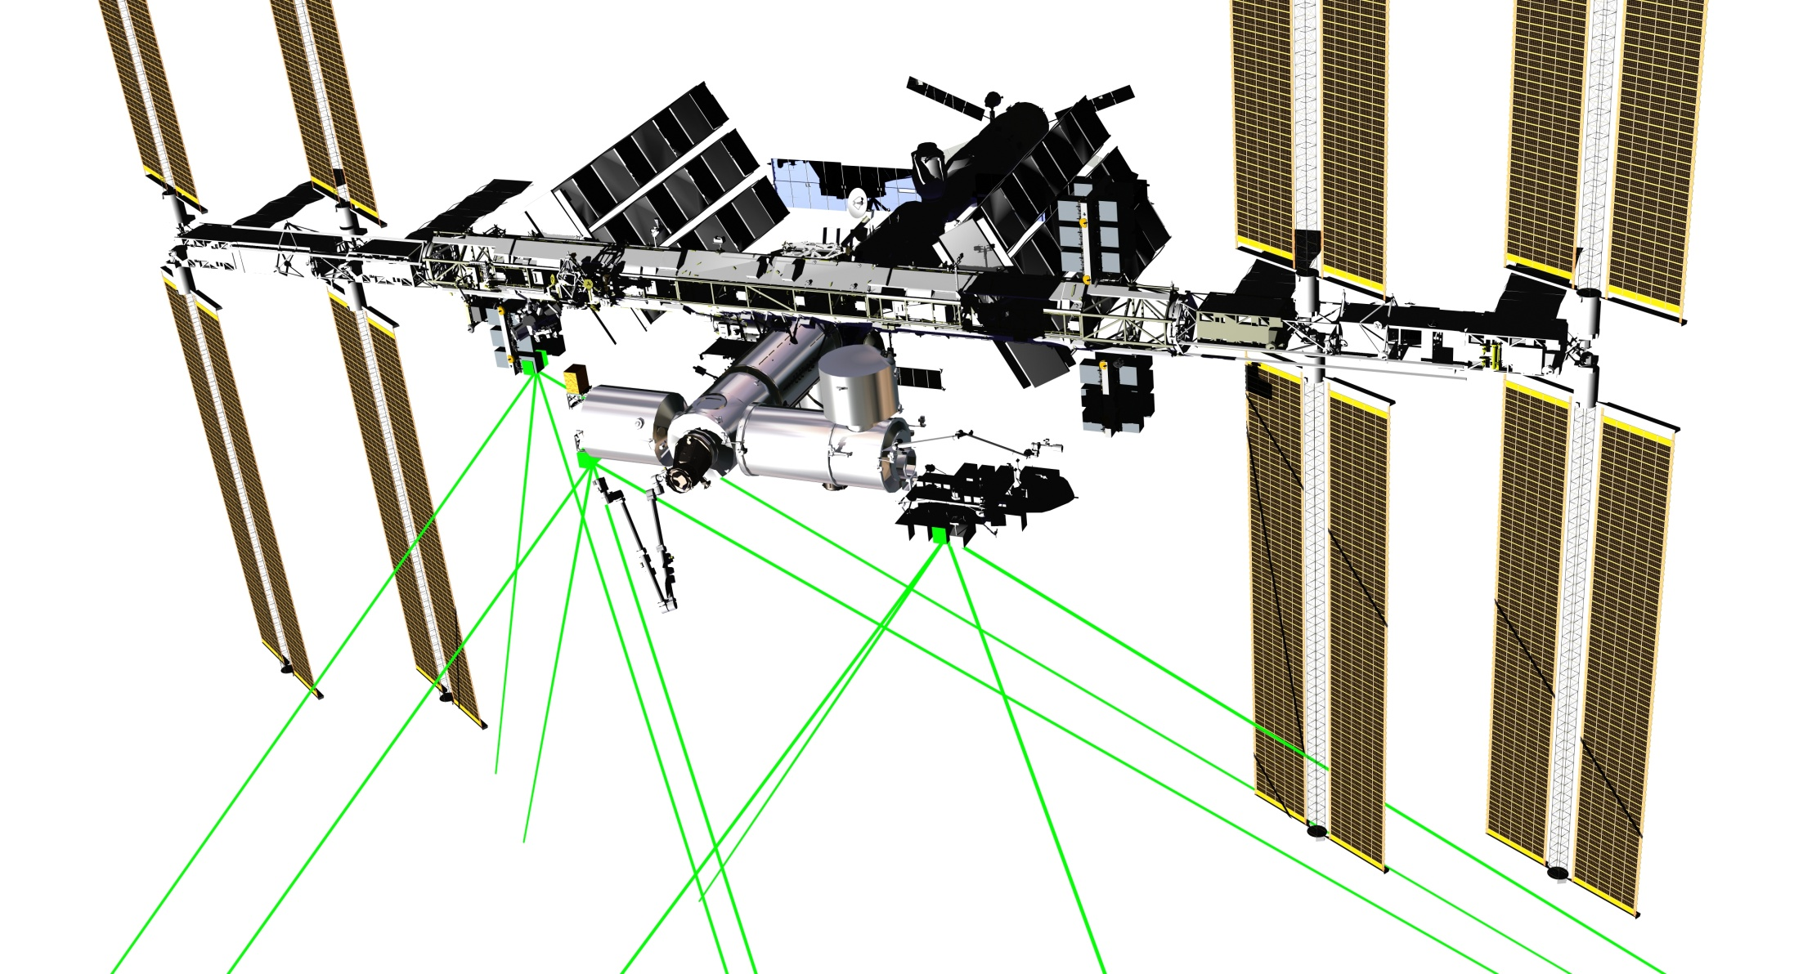
WIND Lidar FOV assessment
J.Budinoff, NASA GSFC

Slide 17
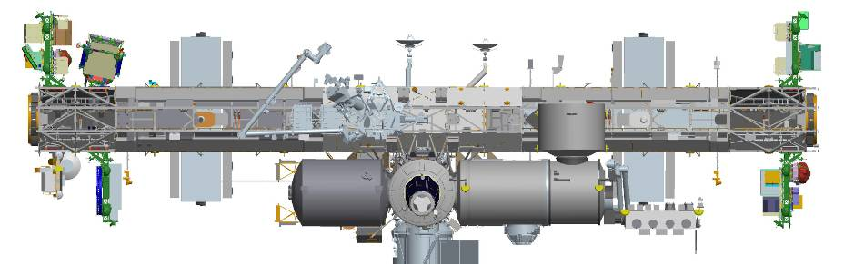
ISS Configuration
JEM Location: EFU #1
JEM Pressurized
Module (PM)
Soyuz
docks here
2 beams – fore and aft
ISS RAM direction
Out of the page
JEM Exposed
Facility (EF)
Laser direction
35 degrees off nadir

Slide 18
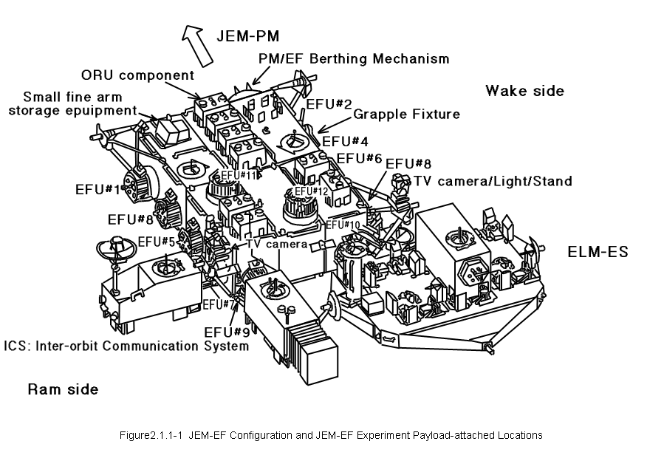
Japanese Experiment Module (JEM)
Exposed Facility (EF)
Wind Lidar
Location: EFU #1
ISS RAM Direction

Slide 19
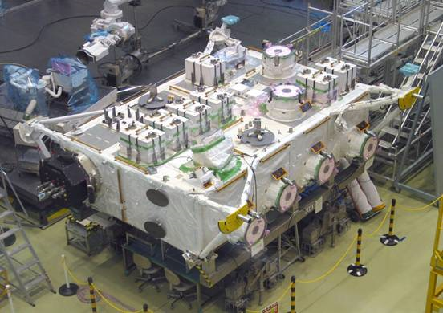
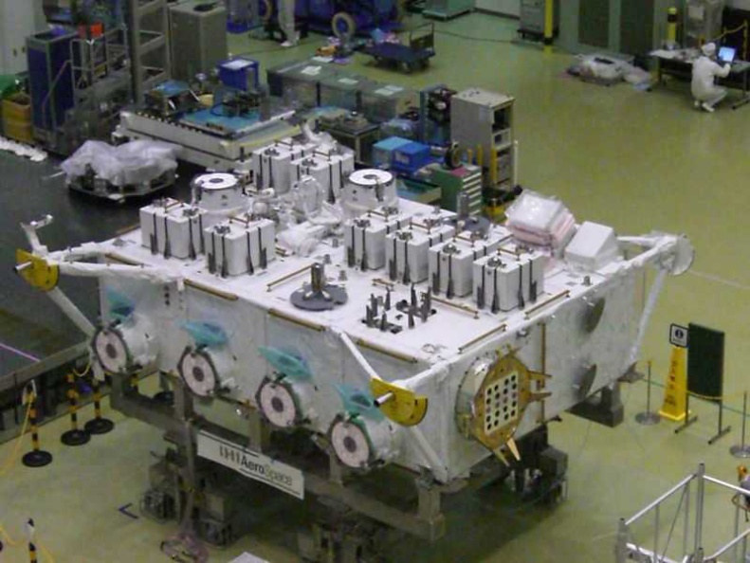
JEM-EF Configuration
RAM Side
Advantages to Exposed Facility Unit (EFU) #1:
3-6kW Cooling loop (only 1 other EF position has this interface, but it’s on the wake side)
Clear line of sight for fore and aft laser pointing
Wake Side
JEM-PM
Connection
EFU #1
ISS RAM Direction

Slide 20
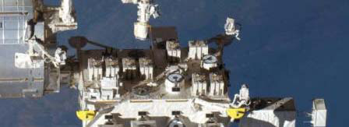

Laser Ground Spots
Nadir View
Ram View
35 degrees off nadir
Starboard side of ISS
Aft position (WAKE)
ISS Ground Track
90 degrees apart
+/- 45 degrees fore and aft
Fore position (RAM)
Laser direction
35 degrees off nadir
ISS RAM
Direction

Slide 21
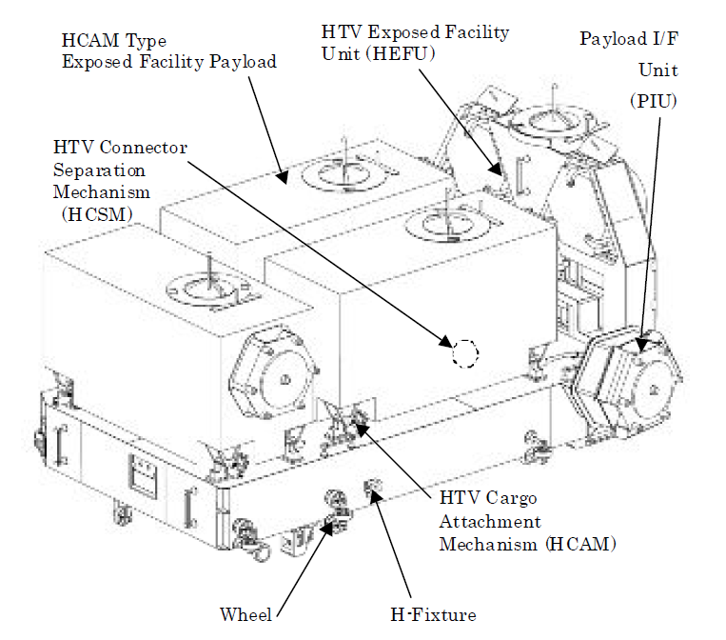
HTV Exposed Pallet (EP) Configuration
Exposed Pallet (EP)
Provides mechanical support during launch and transport support of payloads to JEM-EF
Also used to temporarily store payloads that will later be disposed of via de-orbit re-entry burn as there is no capability for payload retrieval (once Shuttle is retired)
Shown is EP Type 1 for EF Payloads; there are other EP versions for non-payload cargo such as EF battery replacement
JEM-EF Payload
HTV-EP

Slide 22
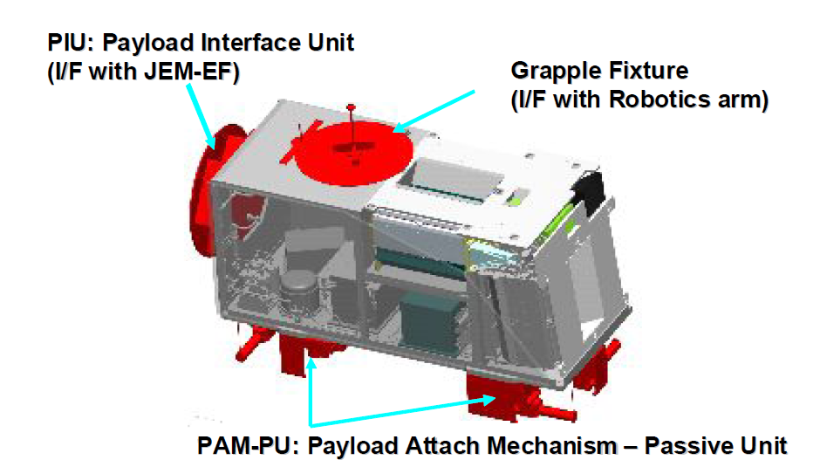
HTV-EP Mechanical Interface
Payload Attach Mechanism (PAM)
Secure payload to the launch and transport pallot
May or may not include an electrical interface for survival heater power
It is not clear if this is gov’t furnished equipment (GFE)
The PAM is the JEM version of a flight releasable attachment mechanism (FRAM)

Slide 23
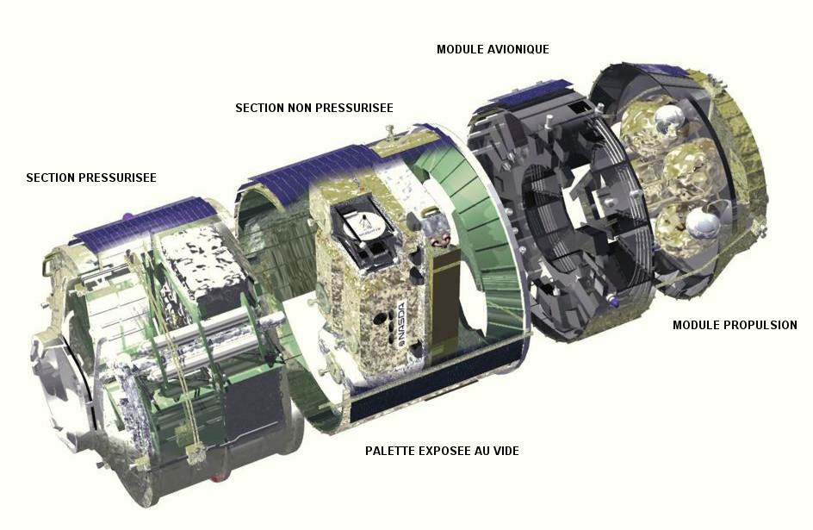
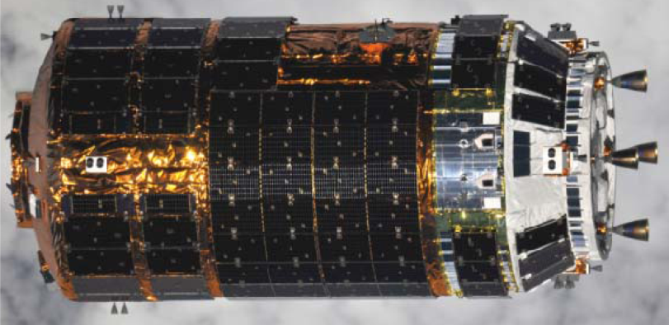
H2A Transfer Vehicle (HTV)
Avionics
Module
Propulsion
Module
Non-Pressurized
Section
Pressurized
Section
Exposed
Pallet (EP)

Slide 24
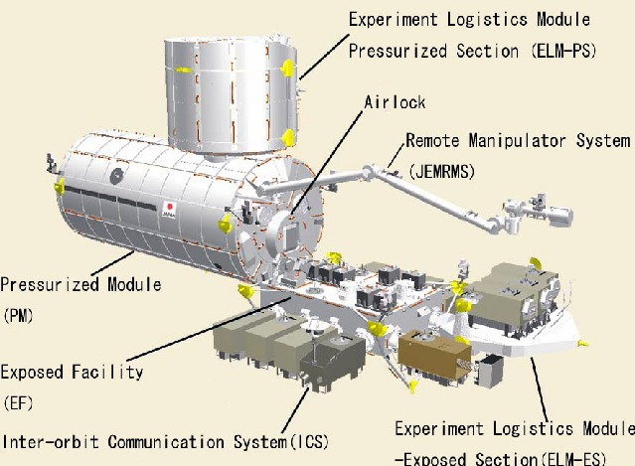
JEM-EF EFU Payload Installation
Installation Procedure
H2A Transfer Vehicle (HTV) launch and arrival at ISS in orbit
JEMRMS attaches the HTV External Pallet (EP) to JEM External Facility (EF)
JEMRMS removes payload from HTV and attaches it to JEM-EF
Payloads must comply with H2A launch constraints as well as on-orbit transport

Slide 25
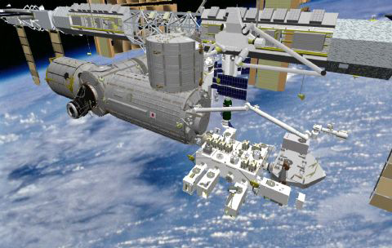
Current JEM Configuration
EFU #1 is currently occupied by MAXI
RAM Direction

Slide 26
WISSCR Requirements / Constraints / Assumptions
Item | Requirements / Constraints / Assumptions
Mission Duration | 2 years (2017-2018)
Orbit | ~350 to 400 km 51.6 deg inclination
Instrument Mass | NTE 500 kg
Power | NTE 3kW
Volume | Envelope 1850x800x1000 mm
Lasers | Direct Laser: 0.355u; 0.8J/pulse; 100 Hz rep rate Coherent Laser: 2.0 u; 0.25 J/pulse; 10 Hz rep rate
Detector | Direct Channel (molecular measurement): Photon Multiplier Tube (PMT) Coherent Channel (aerosol measurement): InGaAs PIN Photodiode
Mechanisms | Telescope Select Mechanism Bright Object Safety Shutter Nadir Angle Compensation Mechanism (Coherent Channel) 1D Output Alignment Mechanism (4x) Aperture Cover
Pointing Knowledge | TBD Accuracy; will need payload mounted star tracker
Thermal Control | Interface to JEM-EF Cooling Loops; 3 kWt minimum, negotiable up to 6 kWt

Slide 27
WISSCR Requirements / Constraints / Assumptions
Item | Requirements / Constraints / Assumptions
Telescope | 2x; 0.5 m primary
Look Angle | 45 deg from RAM and Wake; starboard side
Nadir Angle | 35 deg

Slide 28
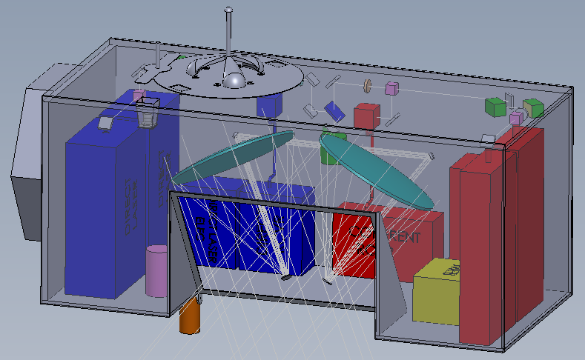
Mechanical Configuration

Slide 29
WISSCR Block Diagram
3 axis
Accelerometer
MEB
Beam Expander (BE) Risley Prism Pair (RPP)
Fold Mirror)
Star Tracker
Camera Head Unit and
Data Processing Unit
Coherent Laser #2
Coherent Laser Electronics
Half Wave Plate – 2 position
Single use to swap in spare laser
1 of 2
Telescopes
Coherent Laser #1
BE/RPP
Polarizing BS
Coherent
Receiver Assembly
(includes
local oscillator)
Includes local injection laser
Nadir Angle
Compensator
Mirror
Bright Object
Safety Shutter
BOSS
1D Output Alignment Mechanism
Orthogonal to each other
To align xmit & receive
Will execute open loop ‘signal search’ algorithm
Gnd command to new position
Quarter Wave
Circular Polarizer
Fiber
coupler
Fold Mirror
Dichroic B/S
Fold Mirror
Polarizing BS
Quarter Wave
Circular Polarizer
Telescope Select
Mechanism
Polarizing BS
Direct Laser #1
BE/RPP
RPP to coalign to coherent laser
Direct Laser Electronics
Fold Mirrors
Half Wave Plate – 2 position
Single use to swap in spare laser
Common Components
Direct Laser #2
BE/RPP
Fiber coupler
2nd RPP pair may be necessary in the coherent laser path
The telescope is not intended to be aligned to the laser
Path Key:
Fold Mirrors
Multi-Mode
Optical Fiber
Coherent beam
Direct beam
Fiber
Direct
Receiver
Assembly
Transmit Components
Receiver Components

Slide 30
Design Discussions / Decisions
Instrument Layout
  The entire instrument layout is predicated on the assumption that the instrument is located at EFU #1
    JEM-EF payloads are typically required to be capable of mounting in 2 locations
  Several changes were made to the initial concept to add alignment capabilities to the system
    Risley Prism Pair within the Beam Expander of at least one of the Beam Expander Assembly pairs for each set of lasers
      Due to NRE savings the IDL recommended implementing RPPs in all Beam Expander Assemblies
    A downstream RPP was added to the Direct Channel after the Quarter Wave Circular Polarizer
    The location of the 1D Alignment Output Mechanisms was debated but left unchanged from the initial concept (just after the half wave plate of each channel)
      Suggestion was made to move mechanisms closer to receivers but this was not pursued as the mechanical packing effort was too far along
  The Nadir Angle Compensation Mechanism was descoped to a fixed mirror
    The potential signal loss (<< 4 dB) was considered low enough to not require a moveable mirror that would change position to accommodate the respective fore and aft looking telescopes
      The position of the fixed mirror will be set to accommodate both fore and aft nadir angles
    Like the Telescope Select Mechanism, a mechanized Nadir Angle Compensation Mirror would be very high duty cycle (> 16M) and need very high reliability actuators
    The Science team indicated that the variations between the fore and aft nadir angle due to earth oblateness effects could be compensated for through timing of laser shots
  The proposed Auto-alignment System was descoped as it was deemed redundant
  The initial decision to not fiber feed the coherent channel receiver was reversed to simplify mechanical packaging of the receiver
  The Coherent Lasers were located at the forward end of the payload in order to use the top and front as a passive radiator

Slide 31
Design Discussions / Decisions
Transmit / Receiver configuration
  The IDL concept assume separate Transmit and Receiver assemblies for both channels
  The IDL did not assess if a combined Transceiver volume could be accommodated in the payload envelope
Direct Laser Composition
  The Direct Laser composition documented in the MEL is a composite of modular functions from in-house laser development efforts at GSFC (i.e. there is not an integrated design for the direct laser as of yet)
Laser pulse timing
  The direct and coherent laser pulses are assumed to be offset to minimize the fluence on common path optical components to preserve their coatings

Slide 32
Design Discussions/Decisions
Bright Object Protection
  Anecdotal evidence from other JEM-EF payload shows there is a need for Bright Object Protection
    Sun glint from the robotic arm while operating or parked near the JEM-EF may be of concern
  The IDL Concept includes a Bright Object Safety Shutter (BOSS) located after the telescope select mechanism to prevent an intense beam from reaching the receiver assemblies
    The aperture door was consider too large to serve as a quick response mechanism for this purpose
  It is not clear as to what procedures/steps should be followed to determine when it is safe to open the BOSS
  The star-tracker assembly does not have bright object protection in the IDL concept

Slide 33
Design Discussions / Decisions
Aperture Door Cover
  The IDL concept includes and aperture cover to protect the instrument from periodic events (e.g. docking) that may contaminate the system
  A cutout in the payload was applied to allow a flat, single panel door
  The payload envelope must be violated to open the aperture door
GFE
  Government Furnished Equipment is counted toward payload mass allocation and must be located at specific positions on the payload
    Payload Interface Unit (PIU): 29kg
    Flight Releasable Grapple Fixture (FRGF): 17.58kg
    HTV Connector Separator Mechanism (HCSM): 2kg
    HTV Cargo Attachment Mechanism (HCAM): 1kg for each leg; 4kg total – (impacts instrument volume)
JEM-EF Cooling Loop
  The JEM-EF cooling loop inlet temperature varies from 16C to 24C
  The IDL did not find any specification on the potential rate of change of the inlet temp and assumed that the instrument can tolerate slow changes in the inlet temperature
  The payload design must also allow for internal cooling loop plumbing connections and a fluid accumulator to account for pressure differentials
    Mass and Number of accumulators is TBD

Slide 34
Design Discussions / Decisions
Pointing Knowledge Support Hardware
  The IDL concept includes a single star tracker (DTU uASC) and a 3-axis accelerometer to support pointing knowledge
  Expected jitter input to the payload is TBD and requires further discussion with JAXA
    Actual environment may be influenced by neighboring payloads and their mechanisms
The IDL concept implements a SpaceCube processor to take advantage of the development to date in on-board science data processing implemented efficiently between processor and FPGA domains
  SpaceCube has been successfully demonstrated as an ISS payload
  The SpaceCube processor board also comes with generous memory storage for raw data
  The customer is encouraged to contact T. Flatley/587 to negotiate for an extra set of production boards from another project’s development

Slide 35
WISSCR MASS BY SUBSYSTEM
WISSCR | Mass (kg) | % of total
Contamination | 2.5 | 0.6%
Electrical | 4.8 | 1.2%
Harness | 17.6 | 4.6%
ISS GFE | 52.6 | 13.6%
Laser | 139.1 | 36.0%
Mechanical | 67.8 | 17.6%
Mechanism | 2.1 | 0.5%
Optical | 21.3 | 5.5%
Thermal | 60.1 | 15.6%
5% misc Hardware | 18.4 | 4.8%
Total (+ 5% hardware and no margin): | 386.3 | 100.0%

Slide 36
Instrument Power Summary
Power Breakdown
Load | Avg. Power (Watts)
Coherent Laser Subsystem | 306.9
Direct Laser Subsystem | 997.0
Main Electronics Box | 42.0
Fore/Aft select motor | 10.0
low duty cycle motors and actuators (cover, pin-pullers etc.) | ~
Star Tracker | 4.2
3-axis accelerometer | 0.5
Instrument Total: | ~ 1,360.6
ISS/Instrument Power Bus Requirement ~ 1,360Watts

Slide 37
Data Rates
Coherent Laser Channel Data Rate
Given: 10Hz Laser rep Rate, and 8bits/Sample
Assume: 250MHz ADC sample rate for 125μsec duration per laser shot.
(250Msamples/sec) x (125μsec/shot) ~ 31.25Ksamples/shot
Data Rate ~ (31.25KSamples/shot x 8bits/Sample x 10shots/sec) ~ 2.5Mbps
Also, Energy monitoring Data Rate ~ 10Samples/sec x 12bits/Sample ~ 120bps
Direct Laser Channel Data Rate
Given: 100Hz Laser rep rate, 3x400bins/sample, 10samples/sec, 10bits/bin
Date Rate 1200bins/sample x 10samples/sec x 10bits/bin ~ 120Kbps
Also, Energy monitoring Data Rate ~ [100Samples/sec x 12bits/Sample] ~ 1.2Kbps
3-axis accelerometer & Star Tracker Data Rate < 400 Kbps (tbr.)
Instrument Total Data Rate ~ 3.0Mbps (+150Kbps for housekeeping)
1 Orbit Data storage: => 95min x (60sec/min) x 3.0Mbps) ~ 17.1Gbits (uncompressed raw data)
Assume 196Gbits storage on Processor Card => 196Gbits/(17.1Gbits/orbit) ~ 11.5 orbits
24 Hour Data storage: => 24hrs x (60sec/min) x (60min/hr) x 3.0Mbps) ~ 260Gbits
Coherent Data Rate Reduction
Save data between specified latitudes only (say +30deg) could reduce data rate by ~ 3:1
Perform onboard FTT could reduce data rate by ~ 100:1 (~30Kbps, over the 1553 bus)
Rice Algorithm Compression in FPGA (possibly 2:1 ratio, ie. 1.5Mbps)

Slide 38
Mechanisms Summary
There are five types of mechanisms in the Wind LIDAR instrument:

Slide 39
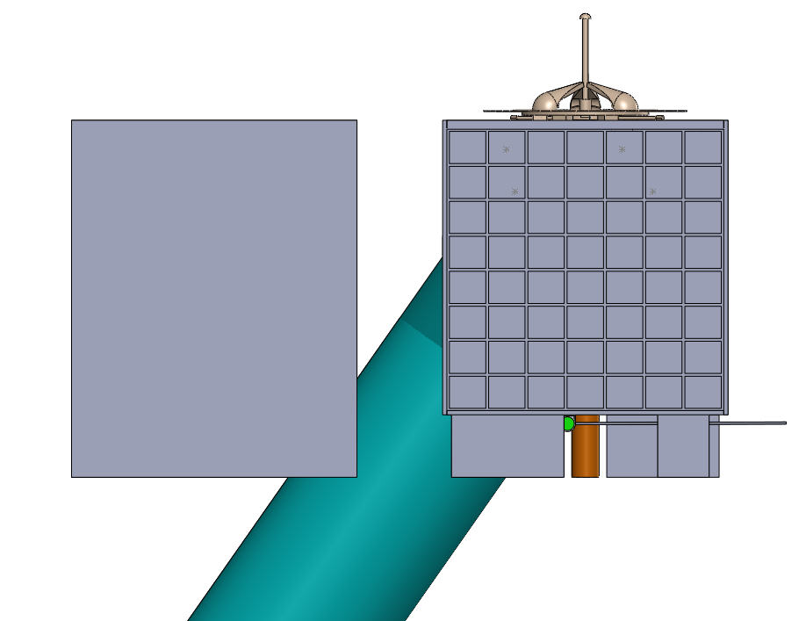
WISSCR cannot be reconfigured to OPERATE beside an inboard adjacent payload
240mm
Pressurized Facility
(inboard direction)
The optics cannot be rotated to avoid this clearance issue because of the 35 degree off nadir angle requirements. There is not enough room to shift all the optics lower in the volume and to the outboard side to avoid this clearance issue.
ISS RAM Direction
(out of the page)

Slide 40
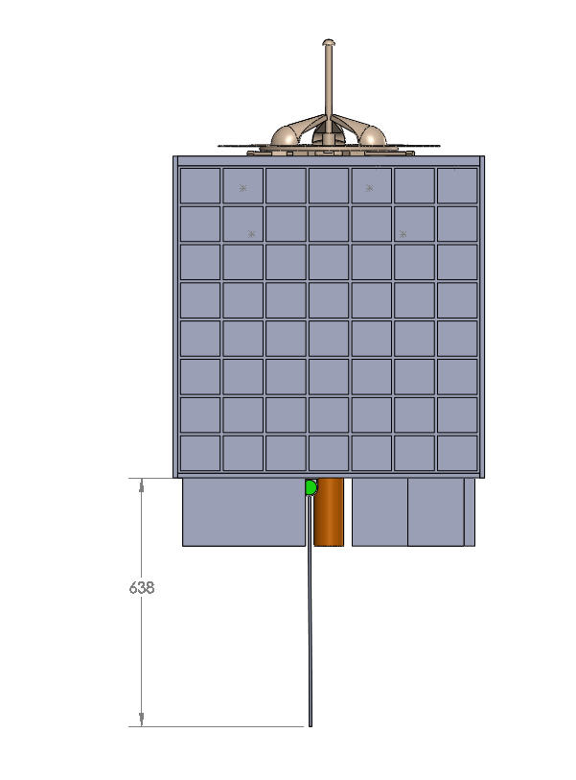
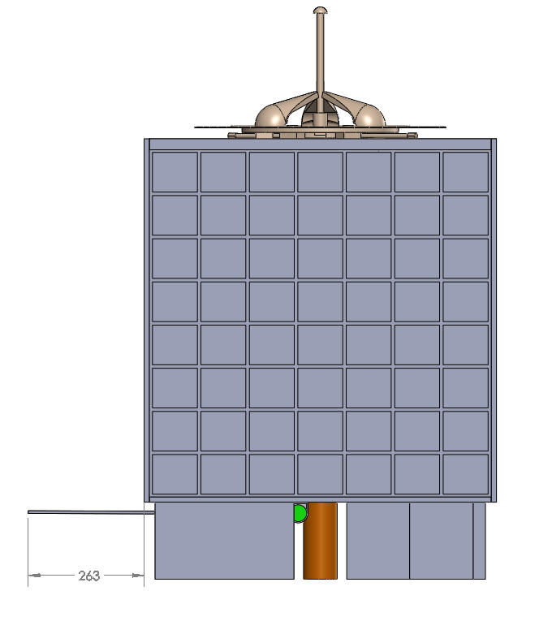
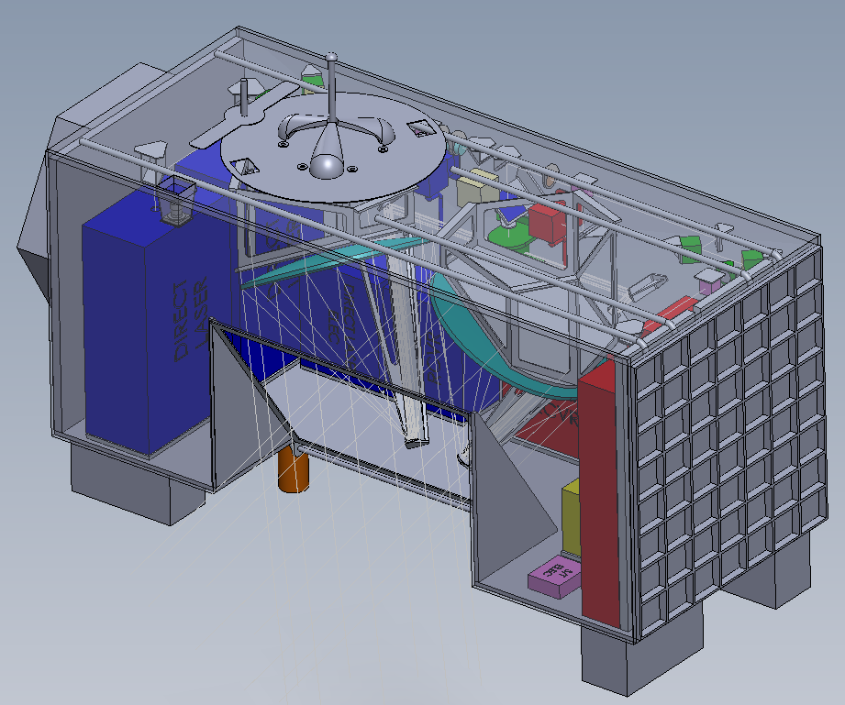
WISSCR volume excursions
during transition of current door design
Pressurized Facility
(inboard direction)
ISS RAM Direction
(out of the page)

Slide 41
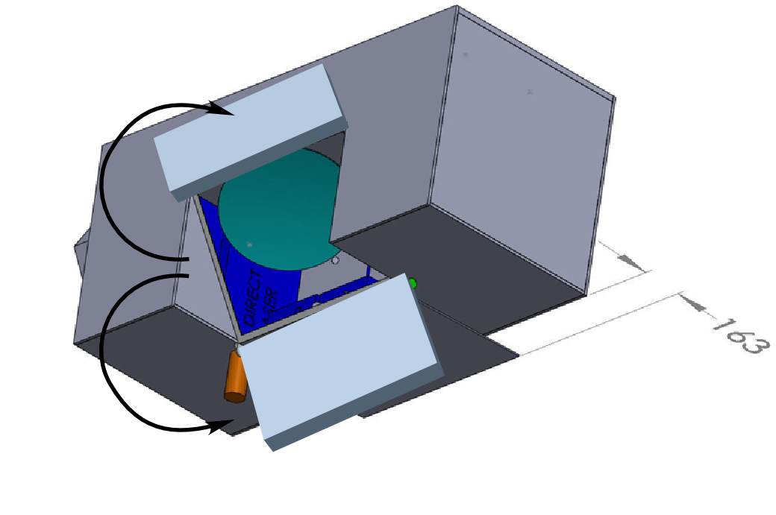
WISSCR volume excursions
during transition of a split door design (2 hinges)
The top half of the door could be 220mm so as to not interfere with an adjacent payload if necessary (although the lasers would still interfere with an adjacent payload on the inboard side).
Pressurized Facility
(inboard direction)
Current door design extends 163mm beyond envelope allocation
Then the bottom half of the door would be 380mm and would not exceed the volume allocation when stowed in the open position (while the current door as shown exceeds the volume allocation by 163mm if it remains a single hinge).
ISS RAM Direction

Slide 42
Me5: Aperture Cover Revisit (cont.)
The previous Wind LIDAR study concluded with a single door whose motion envelope during deployment would extend into the envelope of an adjacent instrument.
However, since the LIDAR laser beams would also extend into the envelope of an adjacent instrument, it was concluded that the LIDAR instrument aperture door could also violate that envelope.
Notwithstanding, two alternate door configurations have been conceived that do not violate the envelope of an adjacent instrument.

Slide 43
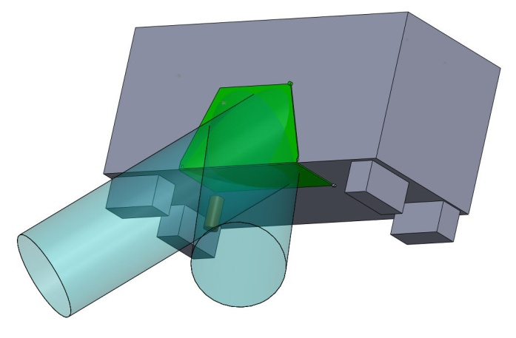
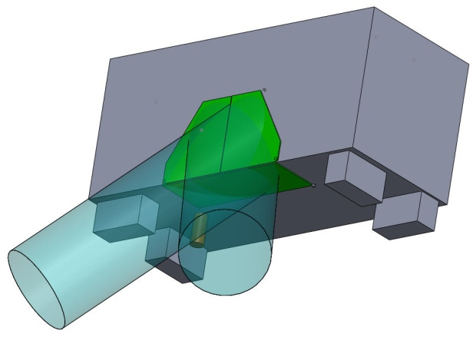
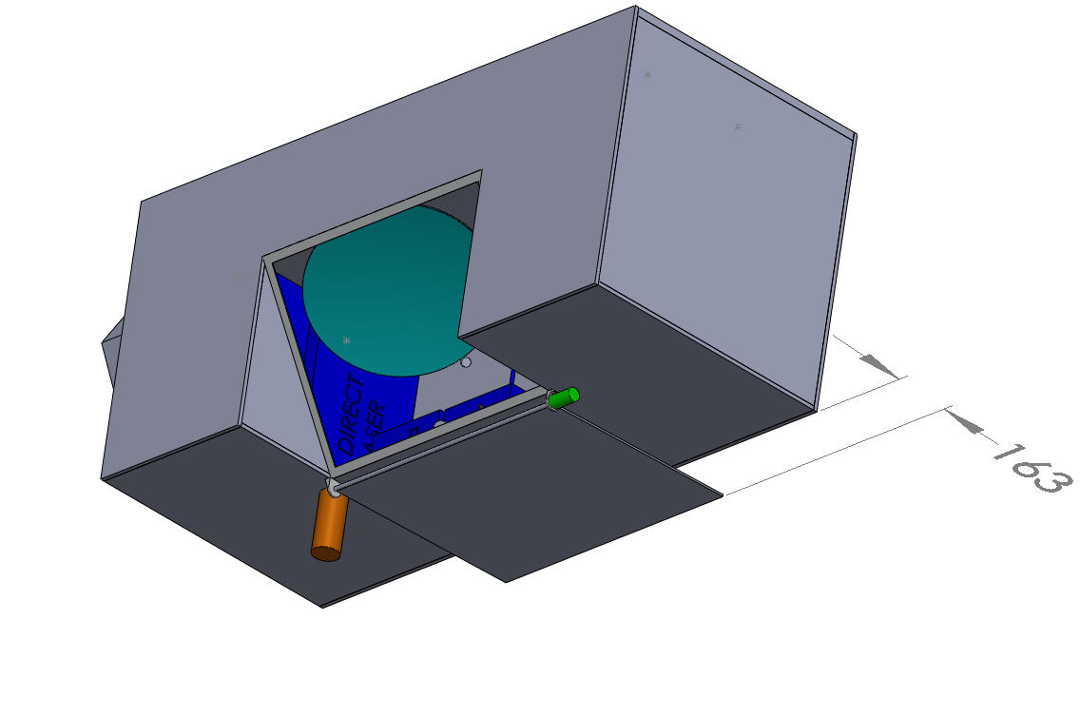
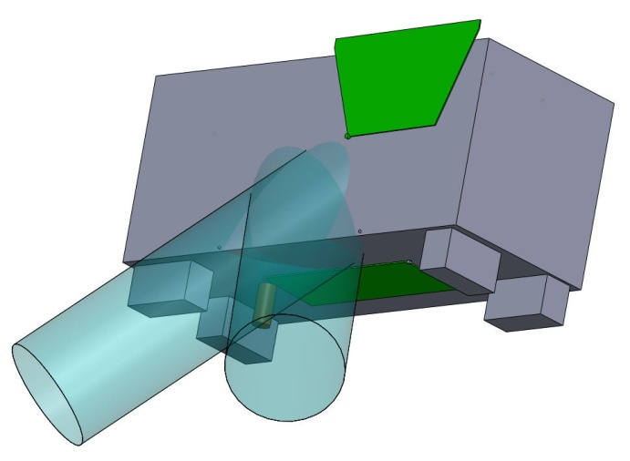
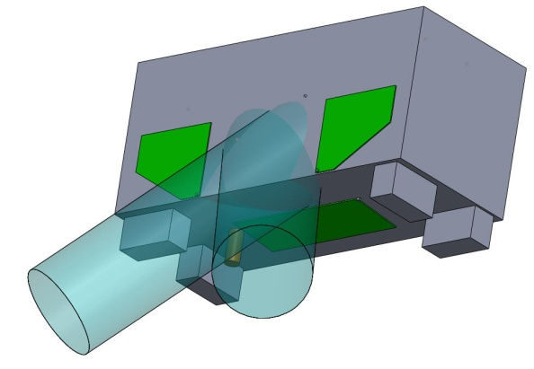
Me5: Aperture Cover Revisit (cont.)
Baseline (1 door)
Option A (2 doors)
Option B (3 doors)
Closed >
(n/a)
Launch Lock
Open >
Motor /Gearbox

Slide 44
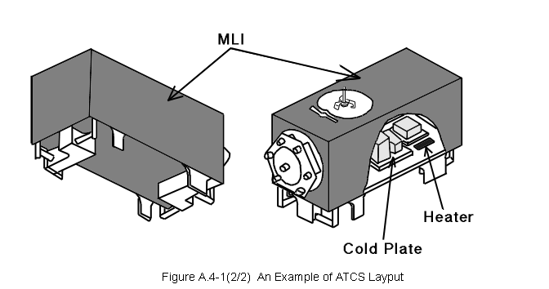
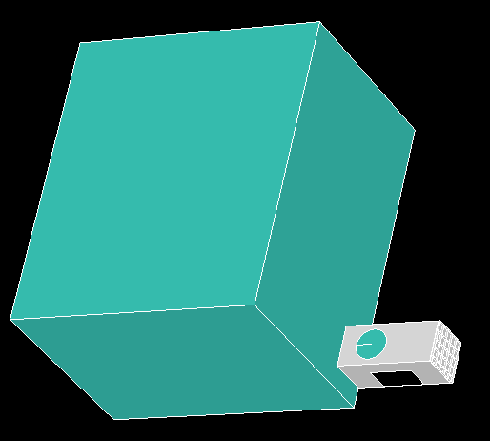
Thermal
JEM-EF has a thermal control loop with temperature = 16 -24 C
Coolant loop removes waste heat from components, except coherent lasers, mounted to cold plates
Coherent lidar requires additional cooling
  Thermo electric cooler
    Electrical power requirement
    Coolant flow rate
  Hybrid system with both ACTS active cooling and passive (side) radiator cooling

Slide 45
Updated data transfer issues
A telecon with JSC/MSFC folks were held on Jan 14. The following is a summary of the discussion:
  JEM/EF data transfer rate to ISS is 5Mbps. This bandwidth is shared between the instruments connected to the JEM/EF. There is no minimum data bandwidth that is guaranteed for any one instrument.
  There is data storage on-board the ISS for storing data during LOS. There is no guarantee that this item works 100% of the times. It is recommended that the instruments store their important data until ground receipt is verified.
  There will be some enhancement to the ISS components and JEM/EF to increase data transfer rate in the future. The new capability may be in-place by the time Wind LIDAR instrument is launched. This information is documented in a CCR and will be available upon request.
  In general, it seems that there won’t be any issues in down-linking any instrument data at 3Mbps rate

Slide 46
IDL Design Summary
On-board Science Data Processing
  On-board data processing is included in the current IDL design
  The software captures raw data at all times. If on-board processing function of the software is enabled, the software processes data and downlinks the data via the Low Rate Telemetry routing (1553). The on-board processing reduces the data volume by a factor of 100.
  The result of the quick look data can be used to remove the low-quality data from the data storage to reduce the downlink data volume.
  The flight software is up-loadable in parts or whole. The on-board processing function of the software can be updated as more enhanced processing algorithms are established on the ground.
Data Rate and Data Storage presented at IDL
  Science data rate is estimated at 3.0 Mbps (17Gbits/orbit)
  Assuming 196Gbits storage on Processor Card, we can store raw science data for 11.5 orbits.
  Storing 24 hours data requires 260Gbits storage

Slide 47
Conclusions
The notional 2-telescope design fits within the mass, power, and volume allocations of a JEM-EF payload seated at EFU #1
  It is not clear if WISSCR could operate successfully at a different location
The 2 year reliability of the IDL concept is estimated to be ~84% which is reasonable for a class C instrument
Implementing Spacecube would be highly beneficial to the instrument
Instrument design need only take a conservative approach to lightweighting optical elements given that mass rack up will be well within mass allocation
Manufacturability and I&Tof the current telescope design is considered risky
High reflective, dielectric coatings may contribute to polarization aberrations. Metal coatings pose a lower polarization risk, but have lower throughput.
Dielectric polarization beamsplitters are recommended for both the coherent and direct channels.
There are no technology concerns for the detectors in either channel
The high duty cycle and total actuations of the Telescope Select Mechanism call for extra attention to the design of that mechanism for lifetime reliability
The ISS contamination environment poses concerns for the payload and mitigations will have to be factored into the payload design (e.g. aperture door)
Thermal requirements for the coherent laser drive the implementation of a passive radiator on the payload

Slide 48
Next Steps
Develop plan to raise TRL level for elements where TRL<6
Develop science plan and traceability matrix
Issue Proposal Opportunity Document (POD) for industry partnering on the WISSCR instrument
Develop an effective message showing application of Doppler lidar technology
Develop Partnerships for cost sharing
  Data archiving and dissemination
  Launch and deployment
  Mission Operations
  Science

