Slide 1
Update on High Efficiency Laser Designs for Airborne and Space-Based Lidar Applications F. Hovis, R. Burnham, M. Storm, R. Edwards, P. Burns, E. Sullivan, J. Edelman, K. Andes, B. Walters, K. Li, C. Culpepper, J. Rudd, X. Dang, J. Hwang, T. Wysocki Fibertek, Inc

Slide 2
Presentation Overview
Approaches to high efficiency lasers
ICESat-2 prototype laser design overview
Bulk Nd solid-state
High-efficiency, single-frequency ring laser development
NASA Phase 1 SBIR
Laser Vegetation Imaging System – Global Hawk (LVIS-GH) transmitter
Future design updates

Slide 3
ICESat-2 Laser Requirements
Parameter | ATLAS Laser Transmitter
Wavelength | 532 ± 1 nm
Pulse Energy | 0.9 mJ, adjustable from 250-900 µJ
Pulse Energy Stability | 10% RMS over 1 s
Pulsewidth | < 1.5 ns
Repetition Rate | 10 ±0.3 kHz
Linewidth/Wavelength Stability | 85% transmission through 30 pm filter
Polarization Extinction Ratio | > 100:1
Spatial Mode | M² < 1.6, Gaussian
Beam Diameter | 15 mm limiting aperture
Beam Divergence | < 108 µrad
Pointing Stability (shot-to-shot) | < 21.6 µrad (RMS) over 1 s
Pointing Stability (long-term) | < 100 µrad
Lifetime | 3 years plus 60 days on orbit
Mass | 20 kg
Volume (cm) | < 50(L) x 30(W) x 15(H)
Wall plug efficiency | >5% for 750 µJ – 900 µJ energies
Original Laser Support Engineering Services (LSES) contract was to support rebuild of original ICESat laser for ICESat-2
1064 nm
50 mJ/pulse
50 Hz
After LSES award the ICESat-2 design transitioned to micro-pulse lidar approach updates

Slide 4
Fibertek Design Approaches
Diode-pumped, bulk solid-state 1 µm lasers
Transverse pumped
Well developed technology
Scaling to > 1 J/pulse, > 100 W demonstrated for fieldable systems
Maintaining M² < 1.5 a challenge at higher powers
True wall plug efficiencies have been limited to ~7%
End pumped
Well developed technology
Power scaling has been limited by pump sources
High brightness and power, fiber-coupled pump sources are a rapidly developing and enabling technology
COTS devices with > 100 W CW from 200 µm core fibers are readily available
True wall plug efficiencies of >10% are possible
High efficiency is easier in low energy, high repetition rate systems
Fiber lasers
Ultimate high efficiency end pumped transmitters
Kilowatts of high beam quality have been demonstrated in CW lasers
High brightness and power, fiber-coupled pump sources are a rapidly developing and enabling technology
Energy scaling is key challenge
Technical maturity, efficiency, and schedule constraints led to choice of end-pumped, bulk solid-state solution

Slide 5
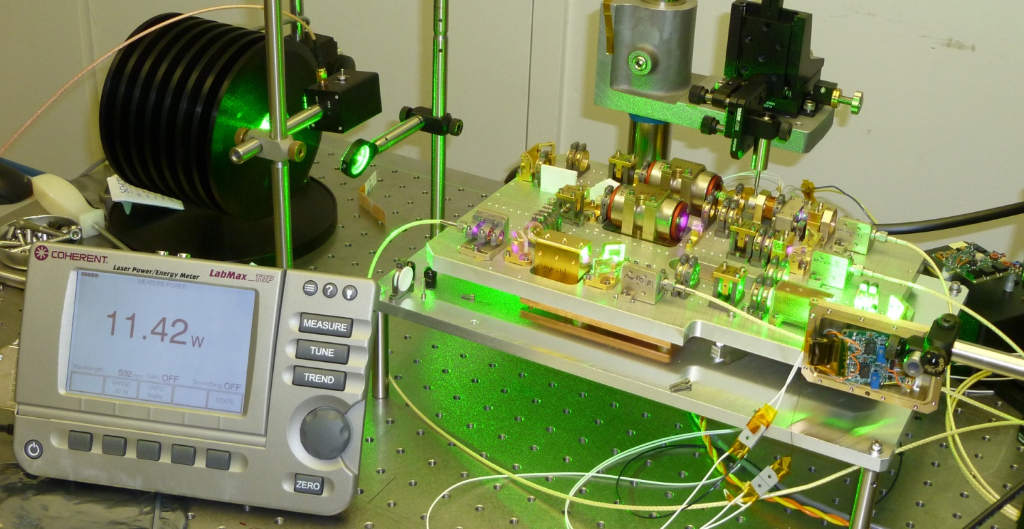
Bulk Solid State Transmitter Optical Design Overview
Bulk solid-state approach
Short pulse Nd:YVO₄ oscillator
Nd:YVO₄ preamp
Nd:YVO₄ power amp
High brightness 880 nm fiber coupled pump diodes
Better mode overlap
Lower thermal loading
Transmitter Optical Bench
Oscillator
Amp
Preamp
SHG

Slide 6
Short Pulse Oscillator
Nd:YVO₄ gain medium
Nd:YVO4 is more efficient
1 ns pulses can be achieved in Nd:YVO4 at fluences well below optical damage thresholds
Relatively high absorption at 880 nm
Short linear cavity with electro-optic Q-switch
< 1.5 ns pulsewidth
Low timing jitter
High brightness 880 nm fiber coupled pump diodes
Better overlap with TEM_{oo} mode
Lower thermal effects than 808 nm
1 µm polarizer
880 nm HR
λ/4
Conduction Cooled
Diode Array
Pump Source
Fiber
Coupling
Optics
Composite YVO₄ rod with HR
EO
Q-Switch
Output coupler

Slide 7
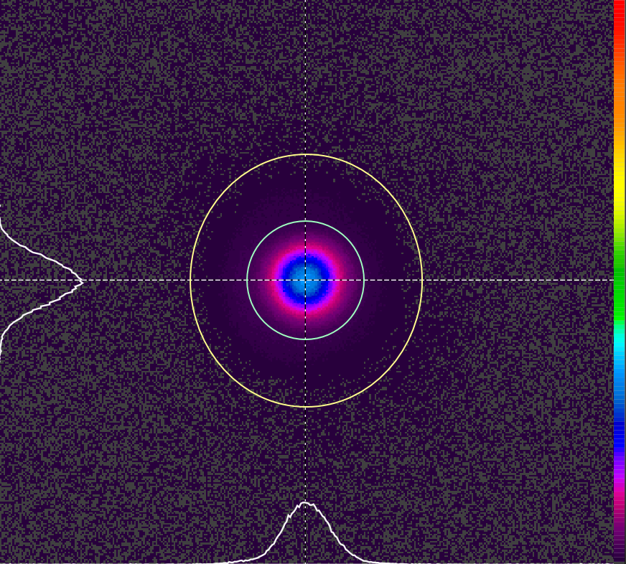
Typical Short Pulse Oscillator Performance
Parameter | Laser Performance
Pulse Energy | 146 µJ
Pulse Energy Stability | 2.7% RMS over 1 s
Pulse Width | .98 ns
Repetition Rate | 10 kHz
Pulse Interval Stability | < 0.01 µs
Center Wavelength (IR) | 1064.14 nm
Spatial Mode | M²_{x} - 1.2, M²_{y} - 1.2
Pointing Stability (shot-to-shot) | 0.43% of divergence
Pointing Stability (1 hour) | 0.53% of divergence
Beam profile at output coupler
X diameter = 291 µm
Y diameter = 295 µm

Slide 8
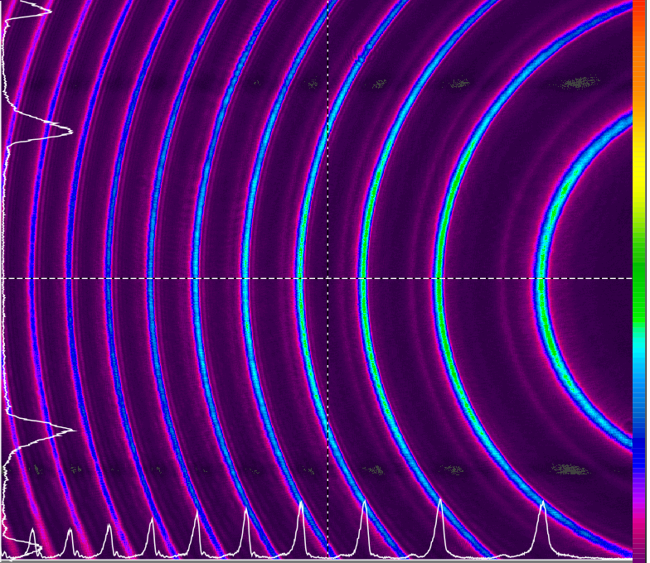
Oscillator 1064nm Linewidth
Oscillator is linewidth narrowed
Analyzer etalon resolution is 4.9 pm
8 mm etalon
Reflectivity finesse 14
Linewidth = 5.9 pm

Slide 9
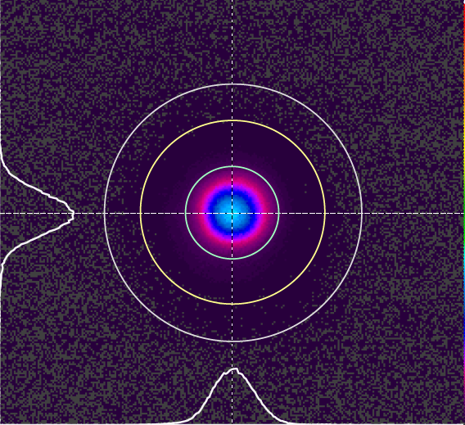
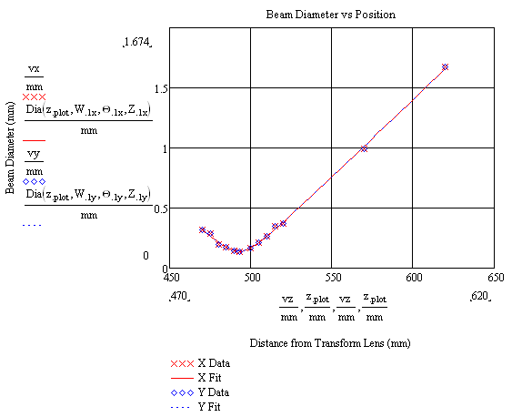
Oscillator/Preamp Results
M² = 1.3
Total output energy – 470 µJ
Extracted energy – 357 µJ
Pump power @ 10kHz 14.5 W
Optical to optical efficiency 24.6%

Slide 10
Amplifier Output vs. Total Diode Pump Power
>18% Optical to optical efficiency at 532 nm

Slide 11
Bulk Solid-State 532nm Beam Quality vs. Amp Pump Power
Amp pump Power (W) | 532 nm laser power | M_{x}² | M_{y}²
40 | 12.6 | 1.184 | 1.272
40 | 12.6 | 1.142 | 1.179
32 | 10.5 | 1.09 | 1.1
24 | 7.6 | 1.19 | 1.1
16 | 4.5 | 1.03 | 1.04
8 | 2.2 | 1.015 | 1.032
Beam quality improves at lower amp pump powers

Slide 12
Solid State Brassboard Full Transmitter Performance Summary
Laser meets specifications for
Energy: achieved 12.9W at 532nm
68% conversion efficiency from 1064nm to 532nm in LBO
532nm laser energy can be tuned with 2 methods:
Adjust power amplifier pump power
Adjust timing between Q-switch pulse and amplifiers.
Constant input power
Data shows NO change in divergence or pointing.
532 nm beam quality: ~ 1.2
532 nm pulsewidth: <1.3ns
532 nm linewidth: <16 pm with etalon OC
Instrument limited
Fully linewidth narrowed oscillator not yet incorporated
Pointing stability at 1064nm: 2% of the divergence

Slide 13
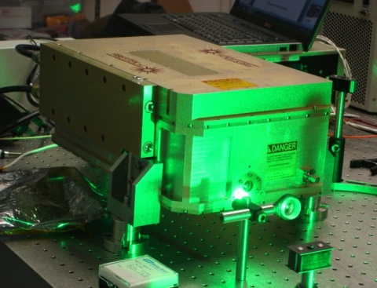
Engineering Design Unit (EDU)
Dual compartment design derived from wind lidar transmitter
Integrated electronics module
Delivered to GSFC in December 2011
9 W at 532 nm
Adjustable down to 2.5 W
Wall plug efficiency > 5%
532 nm linewidth <5 pm
M² of 1.2
1.4 ns pulsewidth
EDU in operation at GSFC
Electronics module
Laser module

Slide 14
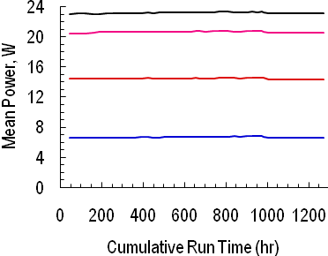
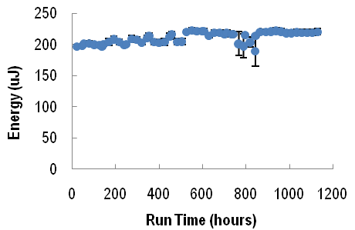
Ongoing Lifetime Testing
Amp modules
4 fiber coupled diode pump modules
Short pulse oscillator
Brassboard MOPA
Preamp module
Oscillator module
Pump module life test results
Short pulse oscillator life test results
Brassboard MOPA life test results

Slide 15
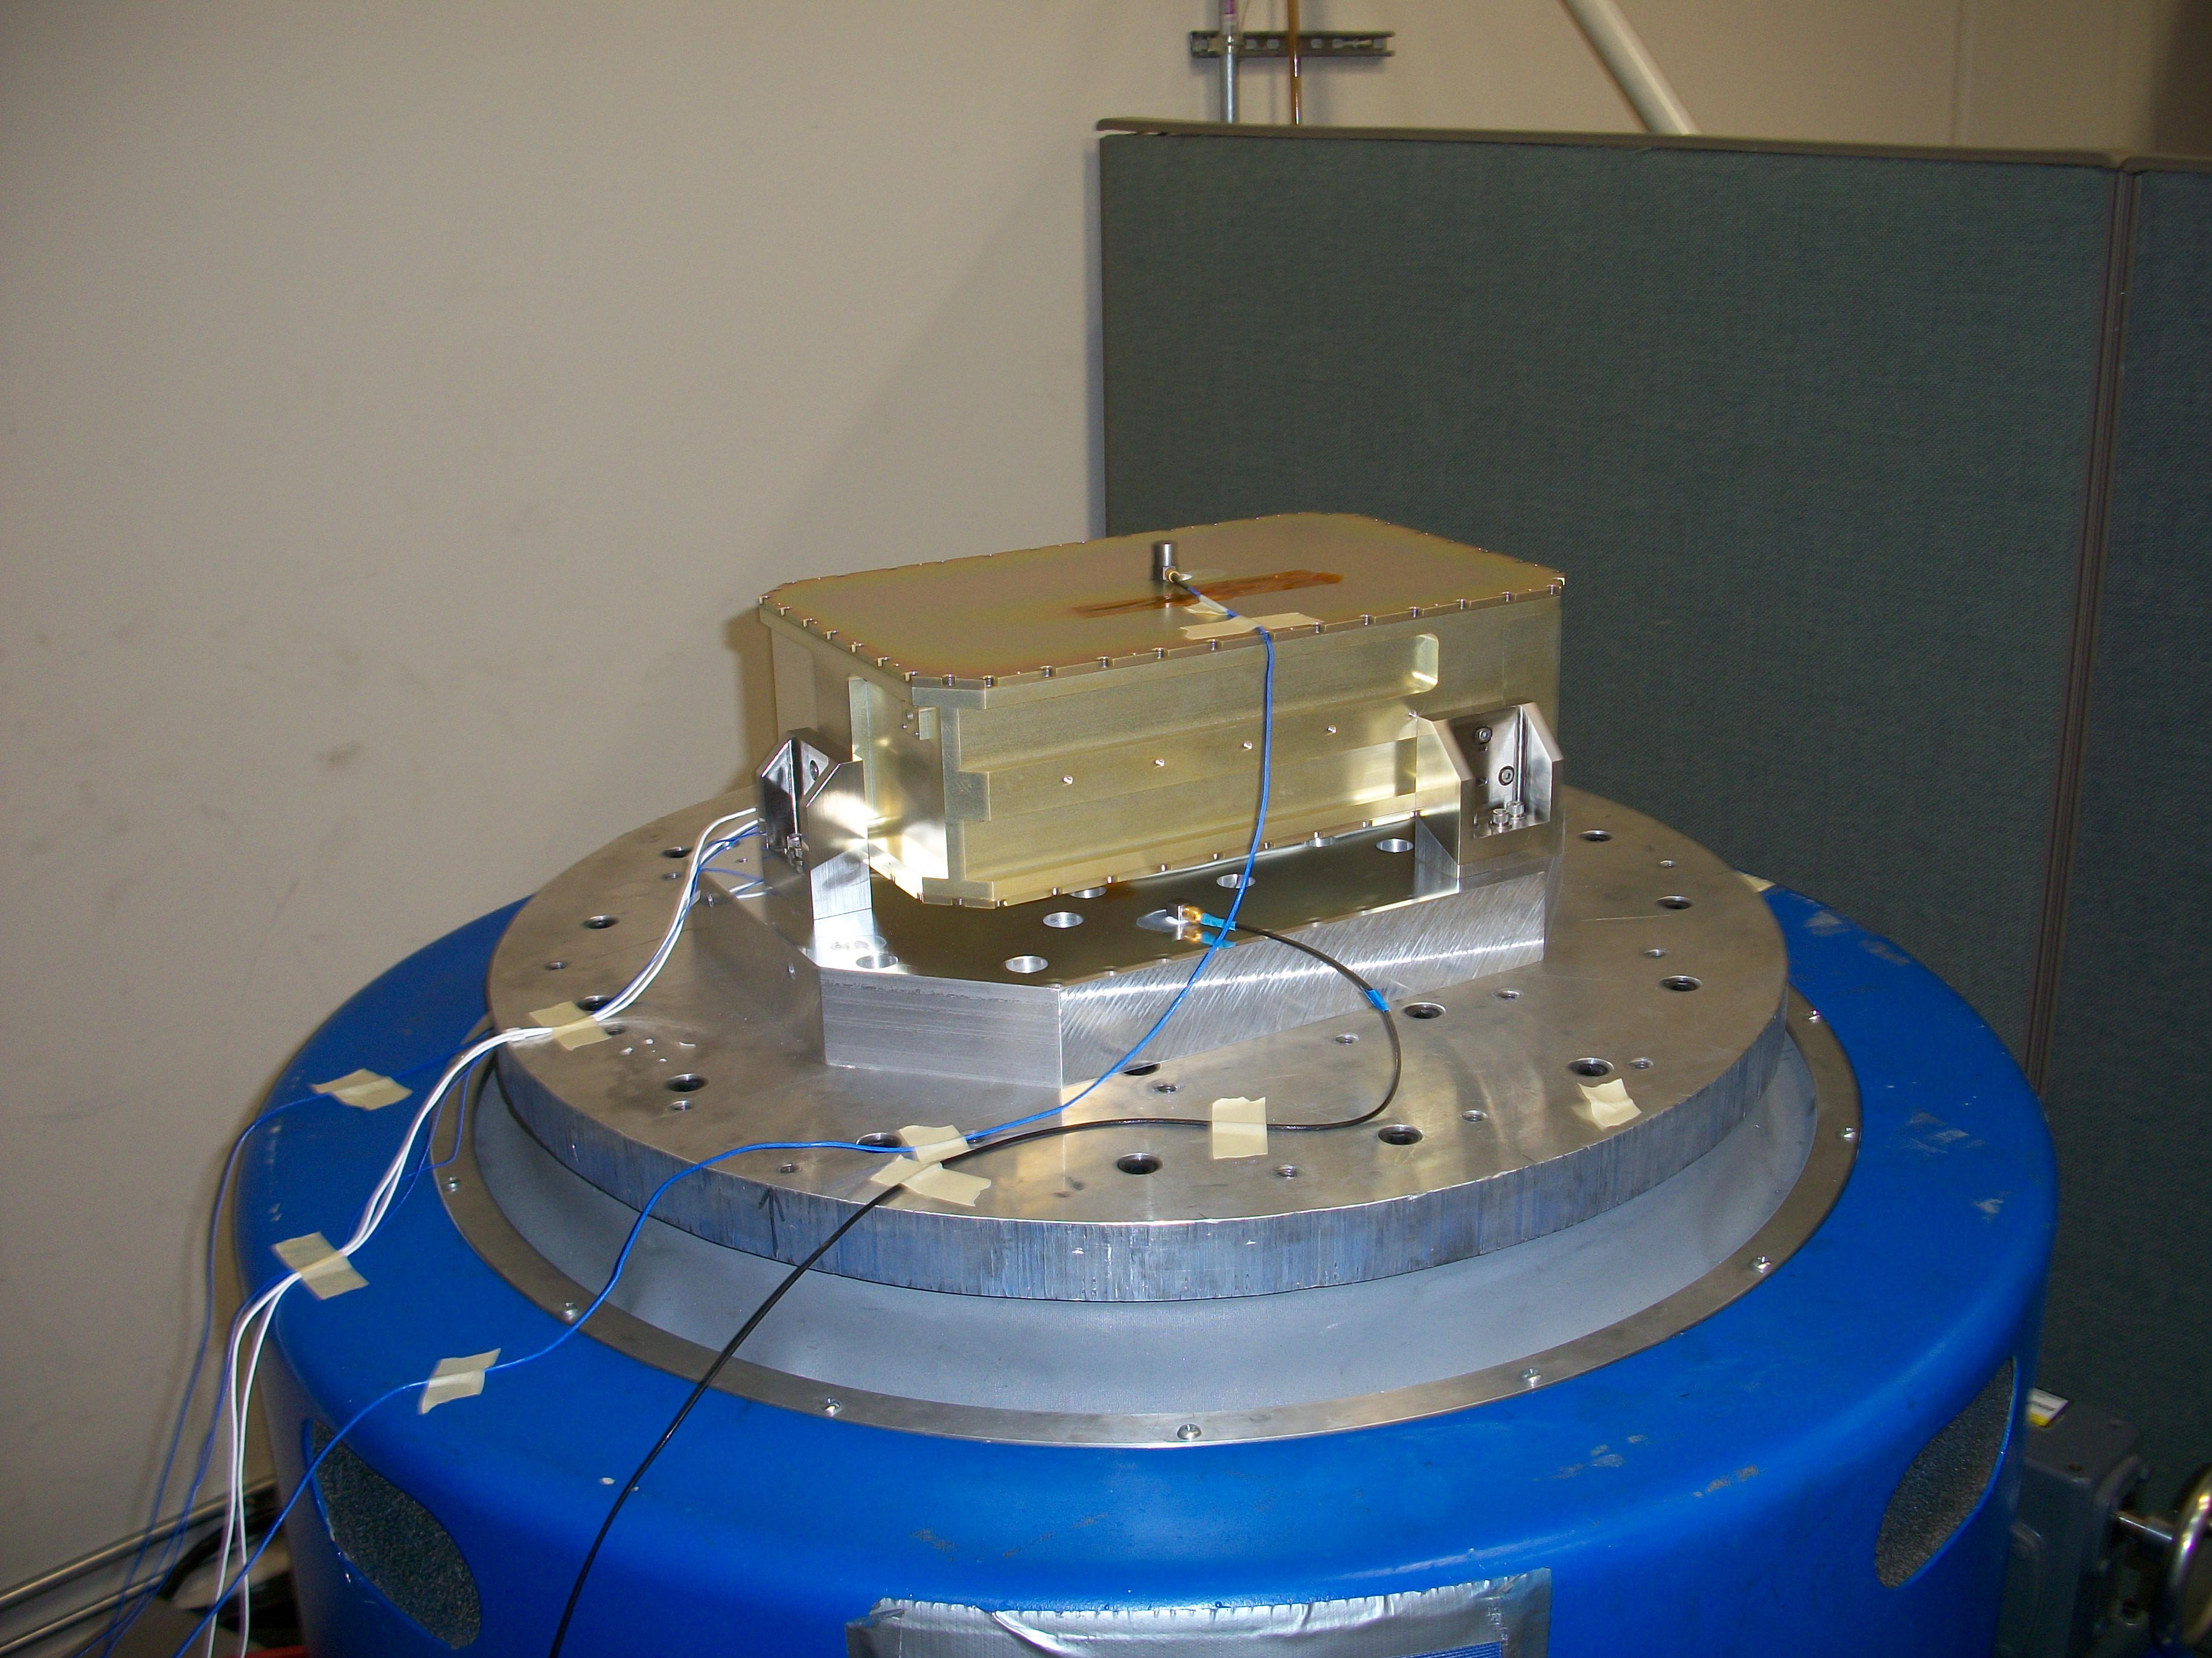
Transition to TRL 6
Mechanical integrity of laser canister has been verified at full random vibration levels (14.1 g_{rms})
Seal testing of the canister has verified leak rates that are compatible with a > 5 year mission
Preparations for operational thermal/vacuum testing are underway
Random vibration testing of the fully assembled laser will follow
Vibration testing of laser canister

Slide 16
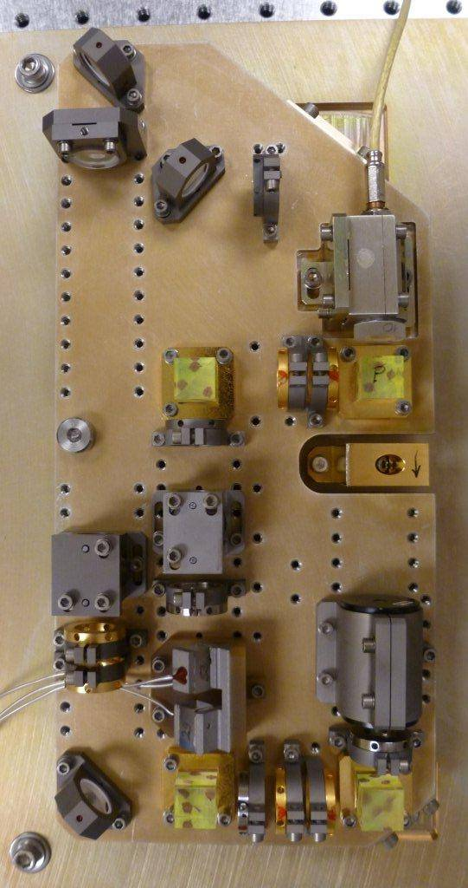
High-Efficiency, Single-Frequency Ring Laser Development
Synthesis of other Fibertek development work
High efficiency bulk solid-state gain media
Single- frequency ring lasers
Robust packing designs for field applications
Appropriate design for longer pulsewidth applications
≥ 3 ns
Lidar systems for winds, clouds, aerosols, vegetation canopy, ozone, ……..
Initial work supported by NASA Phase 1 SBIR
Phase 1 SBIR led to contract for Laser Vegetation Imaging Sensor – Global Hawk (LVIS-GH) lidar transmitter
LVIS short pulse ring oscillator
1064 nm output
Fiber coupled 880 nm pump
5X output telescope
End pumped Nd:YVO₄ or Nd:YAG

Slide 17
Final Optical Bench Performance Test Results
Parameter | Proposed Performance | Measured Performance
Wavelength (nm) | 1064 | 1064.161 – 1064.174 (in air)
Pulse energy (mJ) | 1.5-2.5 | 1.5-1.7¹
Pulse width (ns) | ~5 | 4.8
Repetition rate (kHz) | 2.5 | 2.5
Beam quality | M² < 1.3 | Mx² = 1.14, My² = 1.12
Beam size (mm) | 3.5+/-0.5 | 3.5+/-0.5¹
Beam divergence (mrad) | <0.5 | <0.43¹
Primary power | < 100 W @ 28 VDC | < 46 W @ 28 VDC²
Wall plug efficiency | Not specified | >9.3%²
Cooling | Conductive to liquid | Conductive to liquid
Operational environment | Vacuum or high altitude | Vacuum or high altitude
Electrical cabling | 15’, mil-spec connector based | 15’, mil-spec connector based
Optical head size | ~5”x5”x9” | ~5”x5”x9”
Lifetime | Flight quality design & derating compatible with 10 billion shot | Flight quality design & derating compatible with 10 billion shot
¹After internal 5X telescope with thermal interface varied from 15°C to 24°C
²Some loss of efficiency due to output coupling set for faster pulse decay time. >10% achieved with output coupling optimized for efficiency

Slide 18
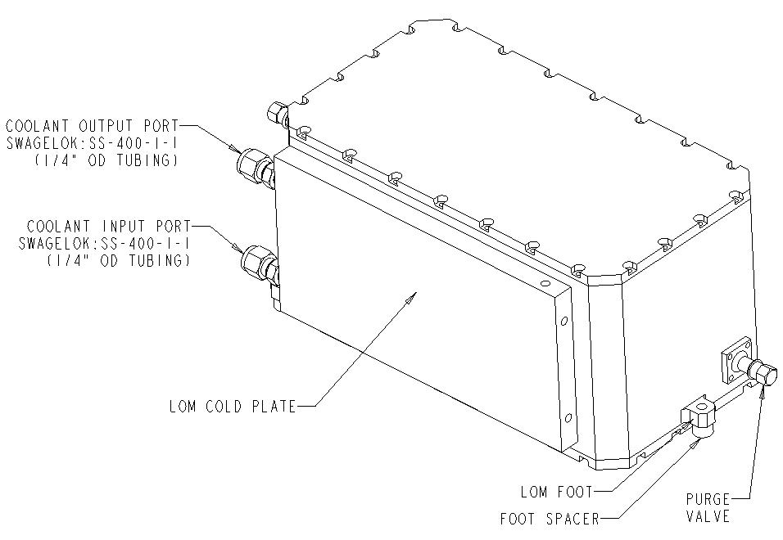
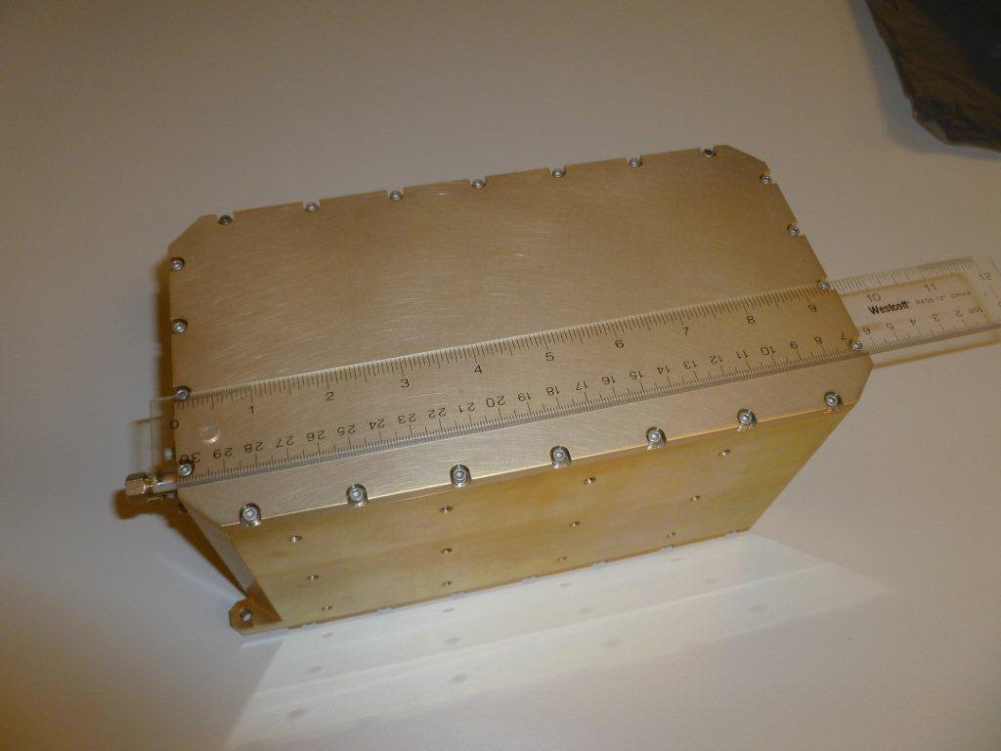
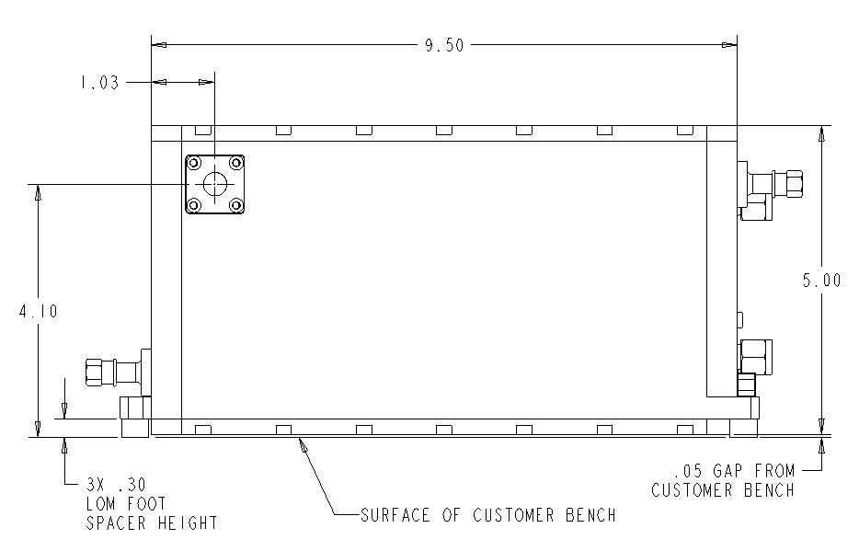
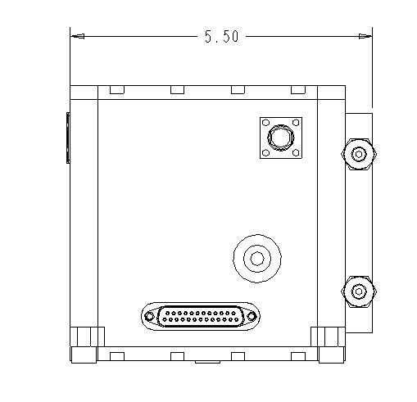
LVIS Laser Canister Dual Compartment Hermetic Design
Dual compartment canister 9.5 in x 5 in x 5 in

Slide 19
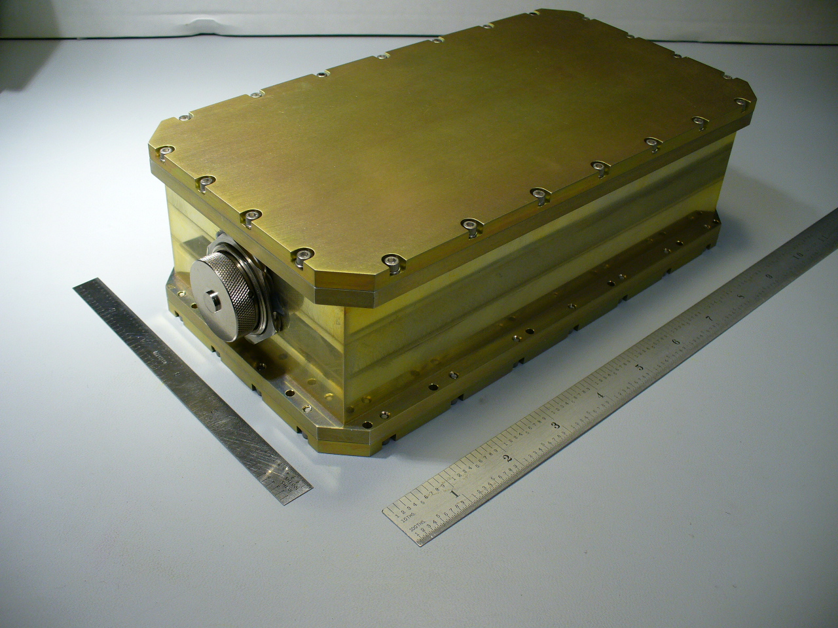
LVIS Electronics Module Hermetic Design
3 in x 5 in x 9.5 in

Slide 20
LVIS Status
Optical bench is fully integrated and tested
Seal testing of the canister has verified leak rates that are compatible with a > 5 year mission
Electronics module is fully assembled and tested
Integration of the opical bench into the laser canister is underway
Delivery to GSFC is planned for laate February 2011

Slide 21
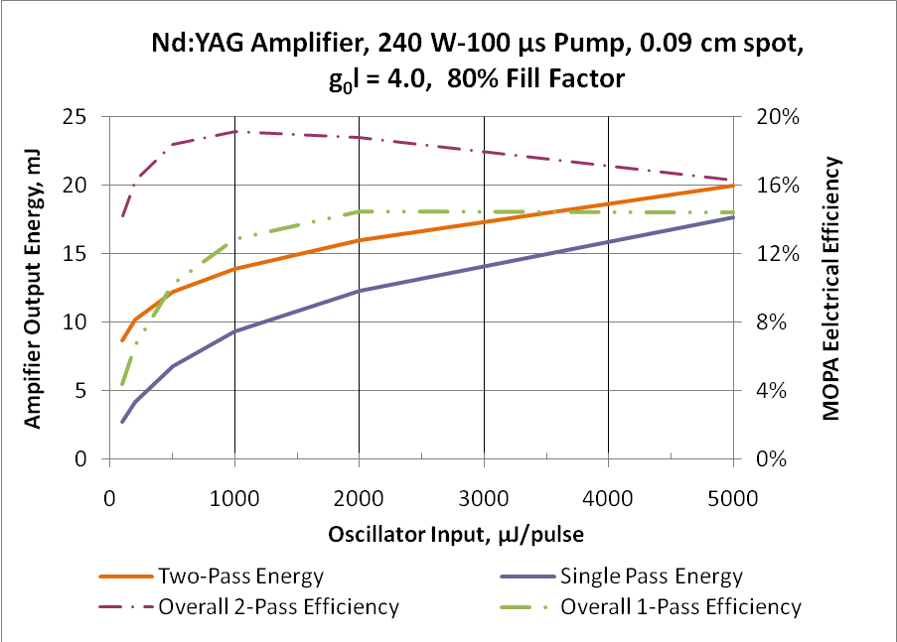
Future Work
Funded NASA Phase 2 SBIR
Injection seeding
Modified ramp & fire approach
Scale to > 2 kHz
Power scaling
End pumped amplifier
Derived from ICESat-2 and Phase 1 designs
Field hardened packaging
Sealed for high altitude use
Dual compartment
Separate electronics module
Suitable for multiple near and longer term applications
HSRL 1 transmitter replacement
Hurricane & Severe Storm Sentinel transmitter
Next generation aerosol lidars
Pump for methane lidar
Pump for ozone lidar

Slide 22
Acknowledgements
Support for this work was provided by Goddard Space Flight Center and the NASA SBIR office
Notes:
For testing purposes, most system parameters that are fixed during normal operation will be implemented as programmable parameters. These parameters will be optimized during testing, and then made fixed for the final deliverable system.
Parameters that are adjustable will in general be accessible through the serial communications interface. A command protocol will be developed that will provide a set of commands for commanding the laser operating modes, gathering important measurement and performance data from the laser, and adjusting a selected set of operating parameters.
Other command functions that can be included are: hardware serial numbers, software version ID, self-test functions, and ground-test functions (low-power mode, reprogrammability of FPGA or software, watchdog enable/disable, etc.).

