Slide 1

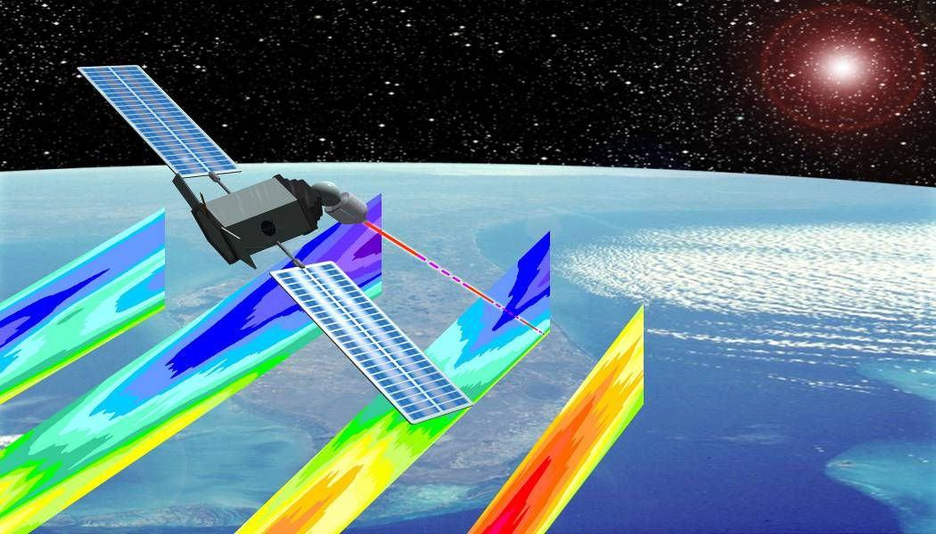
Status Update NPP and NPOESS → JPSS & DWSS
Space-based Wind Lidar Working Group
Miami, FL
February 8-9, 2011
Stephen A. Mango^{1,2}
¹Short & Associates, Inc., ²NOAA/NESDIS/OSD,
1335 East West Highway, Suite 6200, Silver Spring, MD 20910-3283
Phone (301) 713-1055 Ext 155; Stephen.Mango@noaa.gov

Slide 2
Restructuring the NPOESS [OSTP – Feb 1, 2010] U.S. Polar-orbiting Operational Satellite Systems [1 of 3]
After reviewing options, including those suggested by an Independent Review Team (IRT) and Congressional Committees, the President’s FY2011 budget takes significant new steps. Today the White House is announcing that NOAA and the Air Force will no longer continue to jointly procure the polar-orbiting satellite system called NPOESS. This decision is in the best interest of the American public to preserve critical operational weather and climate observations into the future.
The three agencies (DOD, NOAA and NASA) have and will continue to partner to ensure a successful way forward for the respective programs, while utilizing international partnerships to sustain and enhance weather and climate observation from space.
• The major challenge of NPOESS was jointly executing the program between three agencies of different size with
divergent objectives and different acquisition procedures. The new system will resolve this challenge by
splitting the procurements. NOAA and NASA will take primary responsibility for the afternoon orbit,
and DOD will take primary responsibility for the morning orbit.
The agencies will continue to partner in those areas that have been successful in the past, such as a shared
ground system. The restructured programs will also eliminate the NPOESS tri-agency structure that
has made management and oversight difficult, contributing to the poor performance of the program.
• NOAA and the Air Force have already begun to move into a transition period during which the current joint
procurement will end. A detailed plan for this transition period will be available in a few weeks. The agencies
will continue a successful relationship that that they have developed for their polar and geostationary
satellite programs to date. NOAA’s portion will notionally be named the “Joint Polar Satellite System”
(JPSS) and will consist of platforms based on the NPP satellite.

Slide 3
Restructuring the NPOESS [OSTP – Feb 1, 2010] U.S. Polar-orbiting Operational Satellite Systems [2 of 3]
• In addition, these Agencies have a strong partnership with Europe through the European
Organisation for the Exploitation of Meteorological Satellites (EUMETSAT) that will continue
to be a cornerstone of our polar-orbiting constellation, and will ensure our ability to provide
continuous measurements.
• These changes to the NPOESS program will better ensure continuity of crucial civil climate and
weather data in the future. Decisions on future satellite programs will be made to ensure the
best plan for continuity of data.
• While the Air Force continues to have remaining Defense Meteorological Satellite Program
(DMSP) polar-orbiting satellites available for launch for the next few years, NOAA launched
its final polar-orbiting satellite in February 2009. Given that weather forecasters and climate
scientists rely on the data from NOAA’s current on-orbit assets, efforts will focus development
of the first of the JPSS platforms on ensuring both short- and long-term continuity in crucial
climate and weather data.
• NASA’s role in the restructured program will be modeled after the procurement structure of the
successful POES and GOES programs, where NASA and NOAA have a long and effective
partnership. Work is proceeding rapidly with NOAA to establish a JPSS program at NASA’s
Goddard Space Flight Center (GSFC).

Slide 4
Restructuring the NPOESS [OSTP – Feb 1, 2010] U.S. Polar-orbiting Operational Satellite Systems [3 of 3]
o The NASA developed and operating Earth Observing System (EOS) Aqua satellite and ground system
are very similar in scope and magnitude to the proposed JPSS program.
o NOAA and NASA will strive to ensure that all current NPOESS requirements are met on the most
rapid practicable schedule without reducing system capabilities.
o NASA program and project management practices have been refined over decades of experience developing
and acquiring space systems and NASA anticipates applying its current practices to JPSS. NASA program
and project management processes will include thorough and ongoing review and oversight of project
progress. Cost-estimates will be produced at or close to the 80% confidence level.
• DOD remains committed to a partnership with NOAA in preserving the Nation's weather and climate sensing
capability. For the morning orbit, the current DOD plan for deploying DMSP satellites ensures continued
weather observation capability. The availability of DMSP satellites supports a short analysis (in cooperation
with the partner agencies) of DOD requirements for the morning orbit and solutions with the start of a
restructured program in the 4th quarter of fiscal year 2011. While this study is being conducted, DOD will
fully support NOAA's needs to ensure continuity of data in the afternoon orbit by transitioning appropriate.
[Update to OSTP Statement: the DOD system is being called the DWSS – Defense Weather Satellite
System]
• We expect much of the work being conducted by Northrop-Grumman and their subcontracts will be
critical to ensuring continuity of weather observation in the afternoon orbit. DOD will work closely
with the civil partners to ensure the relevant efforts continue productively and efficiently, and ensure the
requirements of the national weather and climate communities are taken into consideration in building the
resultant program for the morning orbit.

Slide 5
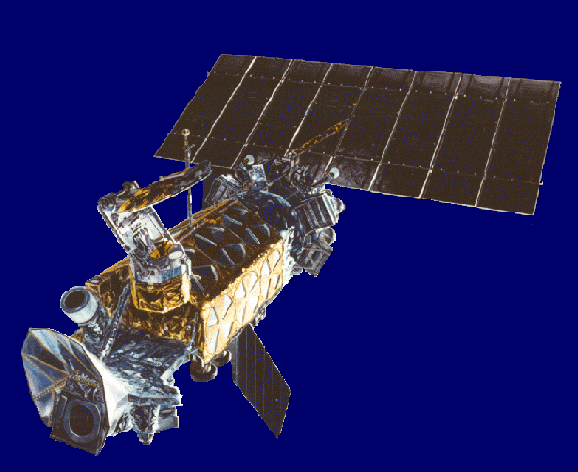
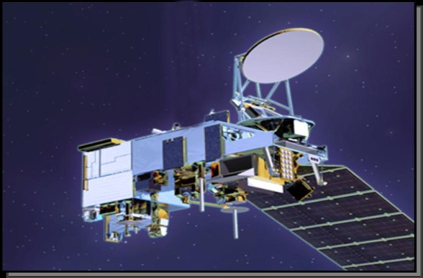
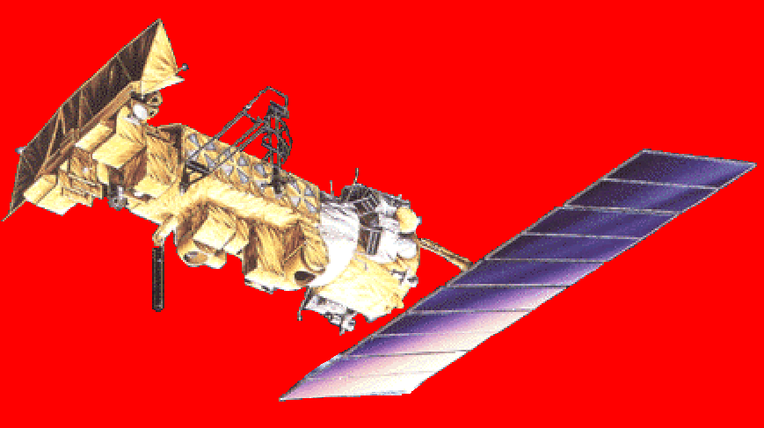
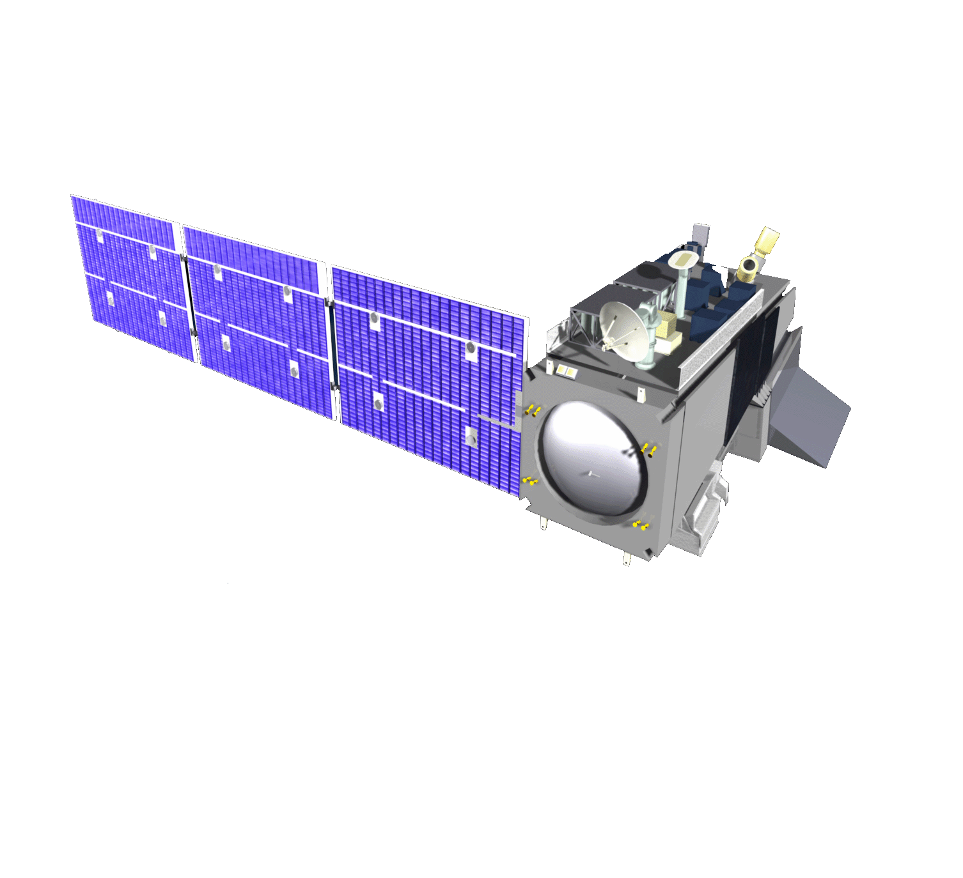
“Passages”
Two Acquisitions
One Acquisition
Two Acquisitions
LAN 1730 - 2000
DoD
LAN 1730
DoD
LAN 1330 and 1730
DoD/NOAA/NASA
DMSP
S/C ?
DWSS
LAN 1330
NOAA/NASA
LAN 1330
NOAA/NASA
NPOESS
POES
S/C ?
JPSS
< Oct 1994
Oct 1994 – Feb 2010
> Feb 2010
Acquisition Transitions

Slide 6
“Passages”
OLS SSM/I, SSM/T-1, SSM/T-2 or SSMIS SES
VIIRS or ?
SEM-N or ?
MIS or ?
?
LAN 1730 - 2000
LAN 1730
VIIRS MIS CrIS, ATMS OMPS SESS or SEM-N CERES or ERBS TSIS ALT, APS ADCS SARSAT
LAN 1330 and 1730
-Imaging
-Sounding
-Space Environment
DMSP
-Imaging
-Sounding
-Space Environment
DWSS
AVHRR HIRS AMSU-A, AMSU-B, MHS SBUV SEM DCS SARSAT
VIIRS CrIS, ATMS OMPS CERES TSIS* ADCS * SARSAT *
LAN 1330
LAN 1330
NOAA/NASA
-Imaging
-Sounding
-Climate
-Ozone
-Space Environment
NPOESS
-Imaging
-Sounding
-Climate
-Ozone
-Space Environment
-Imaging
-Sounding
-Climate
-Ozone
POES
JPSS
< Oct 1994
Oct 1994 – Feb 2010
> Feb 2010
Evolution/Transition of Missions/Sensors/Requirements

Slide 7
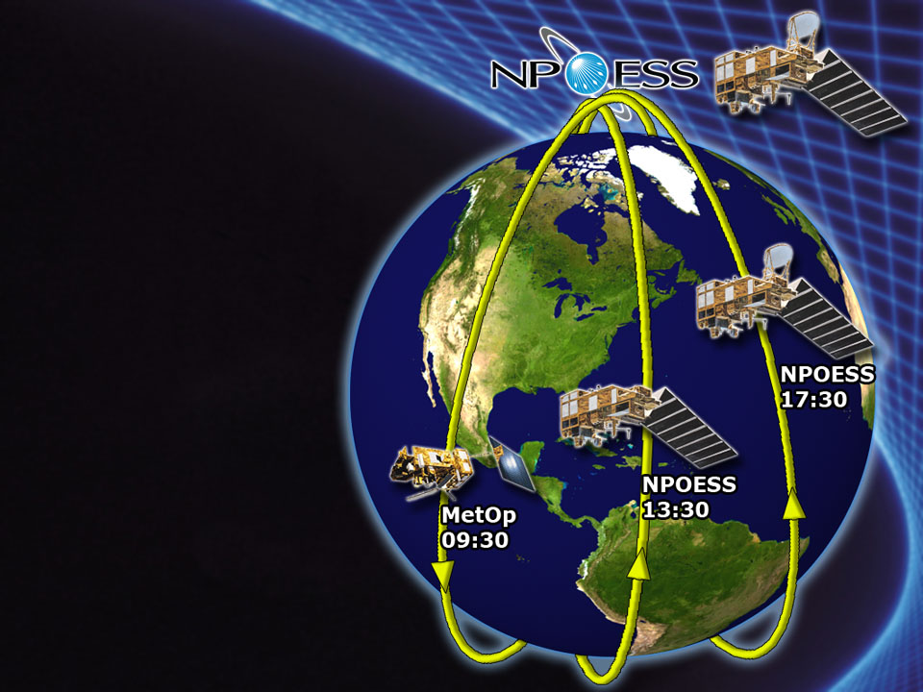
NPOESS Restructured Certified Program 2006-2007
Two polar, sun-synchronous orbits instead of three for NPOESS.
Dependence on MetOp for third orbit of constellation.
4 Satellites [2 EMD + 2 production]
instead of six (6), namely
[C1(1330),C2(1730),C3(1330),C4(1730)].
S/C Bus sized to carry all sensors
VIIRS, CrIS, ATMS, OMPS-N,
CERES, SEM, ADCS,
SARSAT remain [are manifested]
CMIS deleted from C1;
MIS planned for C2, C3 & C4
APS, TSIS, OMPS-L, ERBS, ALT, SuS, SESS de-manifested from C1 & C2 [accommodation remains]
Ground architecture essentially unchanged
NPOESS
LAN 17:30
NPOESS
LAN 13:30
MetOp
LAN 21:30

Slide 8
NPOESS Restructured Program 2010-2011
Two U.S.polar, sun-synchronous orbits with two separate procurements: NOAA/NASA procurement [JPSS] for early afternoon [LAN 1330], USAF/DoD procurement [DWSS]for early morning orbit [LAN 1730]
Dependence on MetOp for third orbit of constellation, mid-morning [LAN 2130].
4 U.S. Satellites namely,
JPSS -1 and JPSS-2,
DWSS-1 and DWSS-2.
S/C Bus sized to carry its sensors:
JPSS --- “NPP-like”
DWSS --- “NPOESS-like” ? [TBD]
JPSS - VIIRS, CrIS, ATMS, OMPS,
CERES, TSIS*, SEM *, DCS*, SARSAT*
DWSS – VIIRS or ?, MIS ? [TBD],
SEM-N, ADCS ? [TBD], SARSAT ? [TBD]
TSIS in NOAA/NASA Mission;
APS, ALT not manifested on JPSS or DWSS
Ground architecture may be mostly unchanged ???
DWSS
LAN 17:30
JPSS
LAN 13:30
MetOp
LAN 21:30

Slide 9
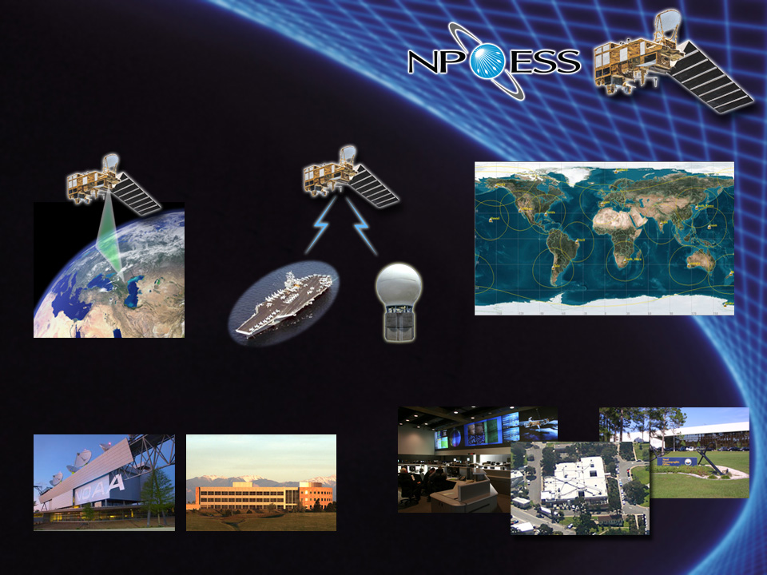
NPOESS Concept of Operations JPSS/DWSS ConOps – Similar !?
1. Sense phenomena
2. Downlink raw data
3. Transport data to Centrals for processing
X and L
bands
Ka-band
SafetyNet !?
Global fiber network connects 15 receptors to Centrals
Field Terminals
SafetyNetTM Receptors
Monitor and control Satellites
and Ground Elements
4. Process raw data into EDRs and deliver to Centrals
MMC (Suitland)
Aurora MMC
Full IDP Capability at each Central NESDIS, AFWA, FNMOC, NAVO

Slide 10
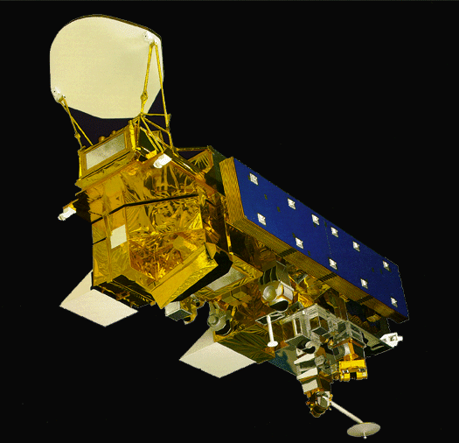

NPOESS Preparatory Project [NPP] “Bridge from EOS to NPOESS”
LTAN 1330
“Bridges EOS & NPOESS Climate Measurement Missions”
NPP
AQUA
C1
LTAN 1330
LTAN 1330
EOS
NPOESS
Notes:
Continuity of Measurements – especially Climate Measurements
DMSP
OLS SSM/I, SSM/T-1, SSM/T-2 or SSMIS SES (incl. SSB,SSF,SSH,SSIES,SSJ,SSM or SSULI,SSUSI)

Slide 11
NPOESS Preparatory Project [NPP] “Bridge from EOS to JPSS & DWSS”
“Bridges EOS & JPSS Climate Measurement Missions and DWSS Measurements”
LTAN 1330
NPP
LAN 1330
AQUA
LTAN 1330
LAN 1330
S/C ?
JPSS
EOS
S/C ?
DWSS
Notes:
Continuity of Measurements – especially Climate Measurements
DMSP
OLS SSM/I, SSM/T-1, SSM/T-2 or SSMIS SES (incl. SSB,SSF,SSH,SSIES,SSJ,SSM or SSULI,SSUSI)

Slide 12


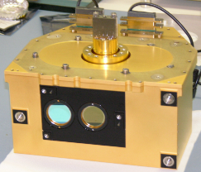

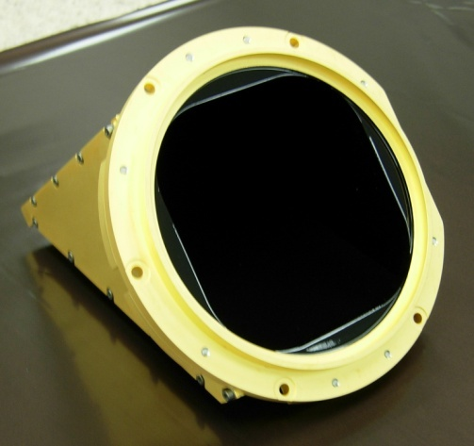
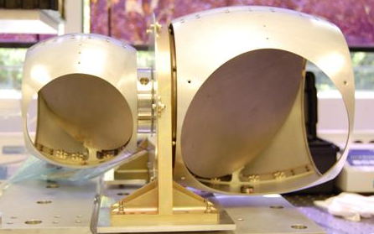

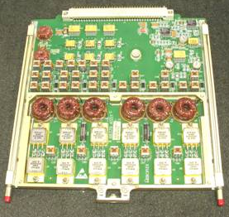
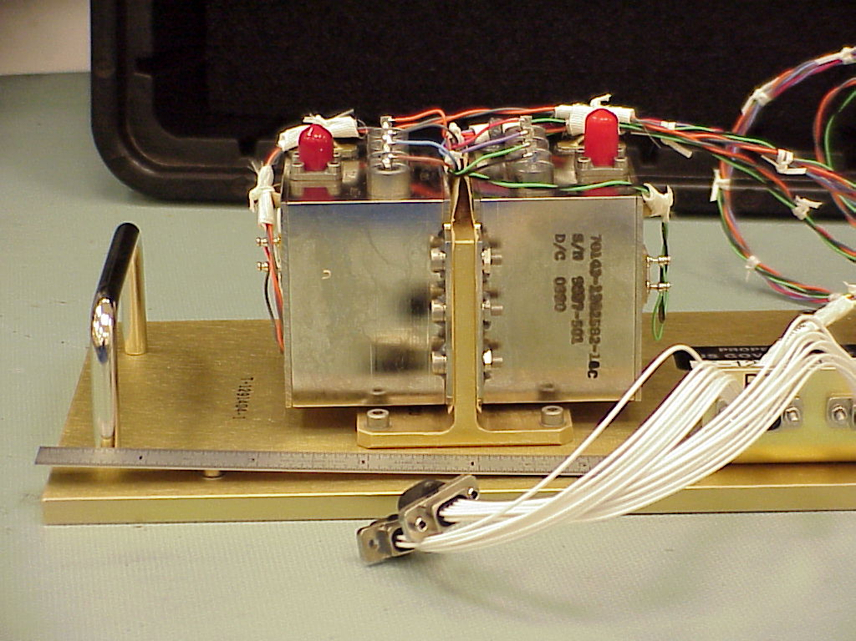

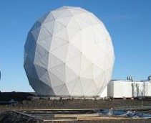

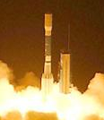
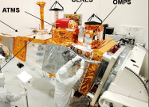


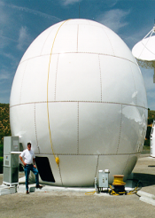

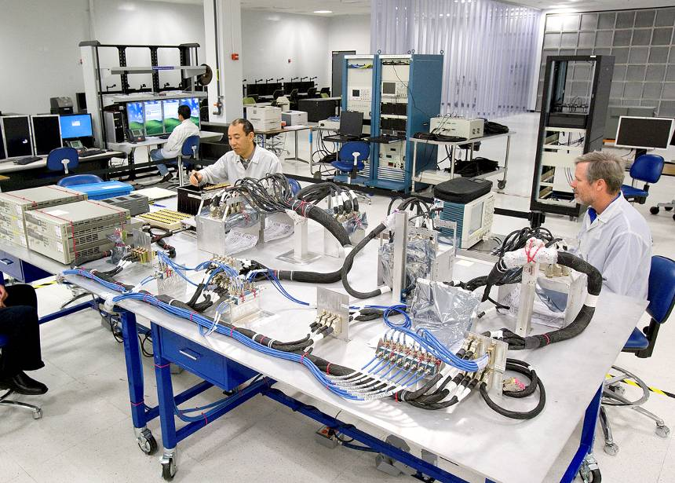
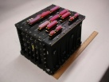
As of Feb 2010 - NPP Development was Nearly Completed NPOESS Production was in Progress & on Schedule for 2014 Launch
DEVELOPMENT
PRODUCTION
Delivered:
ATMS Flight 1
CERES Flight 5
OMPS Flight 1
VIIRS Flight 1
CrIS Flight 1
Flight 2 H/W
Coming together
Initial Sensors All sensors delivered
[as of June 2010]
Flight 2 schedules have margin to need dates
Final NPP Prep
On track
NPP Launch
Command & Control Operational
Data processing Installed at 2 sites
Algorithms Delivered
Operations Ready
Ground Segment Mature
NPOESS C1 upgrade On track
C1 Launch
Spacecraft Design is complete, development on track
Key Engineering Models Demonstrated
CDR Conducted
EEMTB making good progress
I&T schedule has schedule margin
2002
2004
2006
2008
2010
2012
2014
Completed or On Schedule to Complete near-term
On Schedule and progressing nominally
Behind Schedule; progressing
Notes:
12
12
12

Slide 13
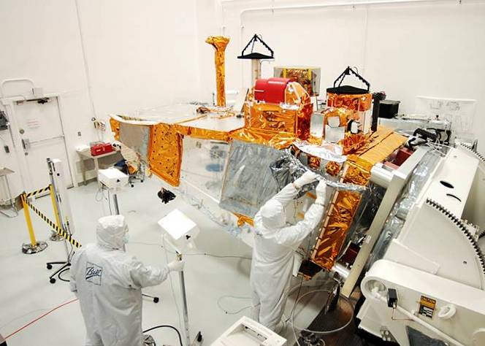
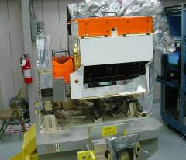
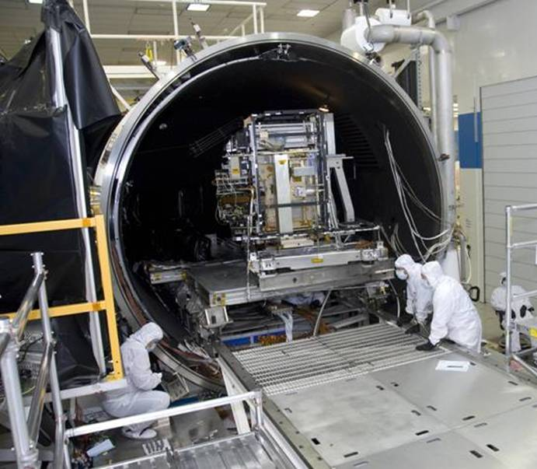
All Five Sensors Installed on NPP
NPP Launch – October 2011
CERES
OMPS
NPP Spacecraft
ATMS
CrIS Instrument
NPP Satellite at Spacecraft facility
VIIRS in Thermal Vacuum Chamber
NPOESS Preparatory Project (NPP) in system integration & test phase

Slide 14
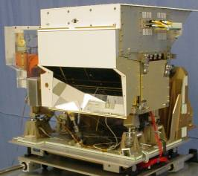
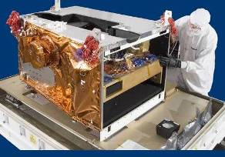
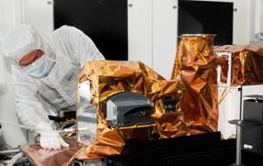
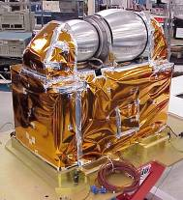
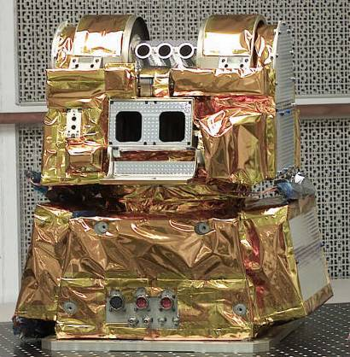
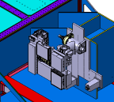
JPSS-1 [was NPOESS C1] Payloads [LAN 1330]
Cross-track Infrared Sounder
Visible/Infrared Imager/ Radiometer Suite
Ozone Mapping & Profiler Suite
CrIS Instrument (ITT)
VIIRS Instrument (Raytheon)
OMPS Instrument (Ball)
Advanced Technology Microwave Sounder
Clouds and Earth’s Radiant Energy System
Total Solar Irradiance Sensor
S/C ?
ATMS Instrument (NGES)
CERES Instrument (NGAS)
TSIS Instrument (LASP)

Slide 15
A Next Generation Perspective for Approaching A Hybrid DWL

Slide 16
The Need for an operational, sustainable
Doppler Wind Lidar [DWL]
Still Exists

Slide 17
NOAA / NESDIS Wind Lidar Activities
NOAA and DoD, through NPOESS/IPO, have been funding risk reduction, calibration/validation, research and simulation studies related to Wind Profiling LIDAR for several years.
Risk Reduction Efforts
Requirements definitions and refinements, realizability studies
LIDAR scatterers’ distributions and characterization studies
Ground based Wind LIDAR Validation Systems
Airborne Validation of the Concept [DDWL (various), CDWL, Hybrid]
LIDAR Technology Studies e.g. HOE, Tunable LOs, Detectors, efficient, long-life, high-rep Lasers
Hybrid DWL feasibility studies; Adaptive Targeting studies
Platform Accommodation Studies [airborne & spaceborne (incl. NPOESS, NPOESS Lite)]
Calibration/Validation of space-based WL
Ground ( stationary and mobile) system development & demonstrations
Airborne system development & demonstrations
Utilization of Sondes [Rawinsondes, Dropsondes]; Collateral measurements req. (e.g. aerosols)
Comparison of “truth techniques” for space based WL
OSSEs [Observing System Simulation Experiments] & OSEs
Showing the relative benefits of various Space-based DWL concepts.
Space based Doppler Wind LIDAR Mission Studies – Demonstration NWOS
BalloonWinds – NOAA/NESDIS Office of Systems Development
International Space Station Wind Lidar Study- NASA/GSFC IDL/MDL
NOAA/NESDIS/OSD co-sponsoring w/NASA & USAF

Slide 18
NOAA Programs Requiring Atmospheric Winds*
GOAL | Program | Priority 1 | Priority 2 | Totals
Climate (CL) | Climate Observations & Modeling (COM) | 1 |  | 1
Commerce & Transportation (C&T) | Aviation Weather (AWX) | 4 |  | 4
 | Marine Weather (MWX) | 1 |  | 1
 | Surface Weather (SWX) | 2 |  | 2
Weather & Water (W&W) Mission Support (MS) | Air Quality (AQL) | 1 |  | 1
 | Hydrology (HYD) |  | 1 | 1
 | Local Forecasts & Warnings (LFW) | 3 | 1 | 4
 | Modeling and Observing Infrastructure (MOBI)/Environmental Modeling (EMP) | 1 |  | 1
Total: 4 Goals | 8 PROGRAMS | 13 | 2 | 15
Data provided by NOAA/ Technology, Planning and Integration Office/
Consolidated Operational Requirements List [CORL] Team

Slide 19
The Needed Measures of the Atmosphere
For NWP
Mass Field --- T (z), P (z), g (z), mu (z)
NPOESS Atmospheric Sounders – CrIS, ATMS, OMPS, MIS
Moisture Field --- q (z)
NPOESS Atmospheric Sounders – CrIS, ATMS, OMPS, MIS
Motion Field --- v (u,v,z) “ 3D Winds”
Doppler Wind Lidar
Hybrid Doppler Wind Lidar for full atmosphere 3-D Winds
[DWL]
Vertical Wind Profiles
# 1 Unaccommodated EDR

Slide 20
Need for Improved Accuracy of Transport Estimates for Climate Applications
Improved reanalysis data sets are needed to provide a more accurate
environmental data record to study global warming; for example,
recent studies^{1,2} indicate that the recent dramatic reduction in sea ice
extent observed in the Arctic may be due, in large part, to heat transport
into the Arctic, but this finding is based on reanalysis wind data with
large uncertainty in the Arctic because of lack of actual wind
measurements
The measurement of accurate, global winds is critical for climate
monitoring:
“The nation needs an objective, authoritative, and consistent source of
. . . reliable. . . climate information to support decision-making. . .”³
___
¹ JCSDA Seminar by Erland Kallen, April 23, 2009
² Graverson et al., 2008, in Nature; Graverson et al., 2006, in J. Clim.
³ NOAA Annual Guidance Memorandum, Internal Draft, May 10, 2009

Slide 21
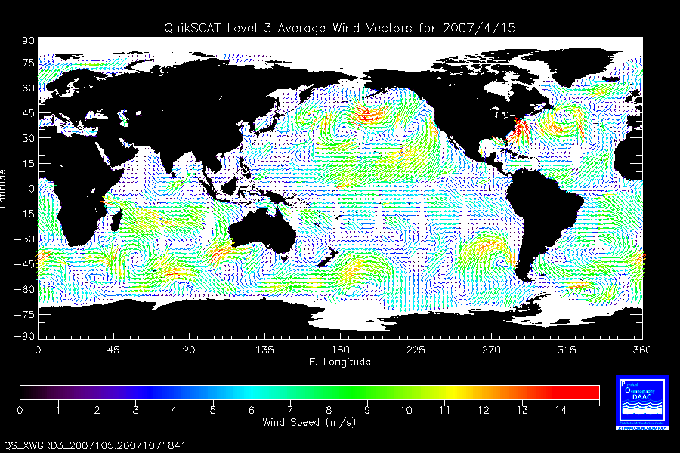
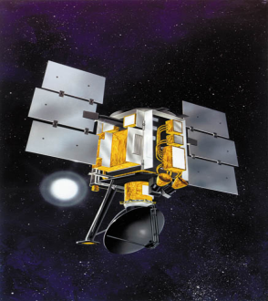
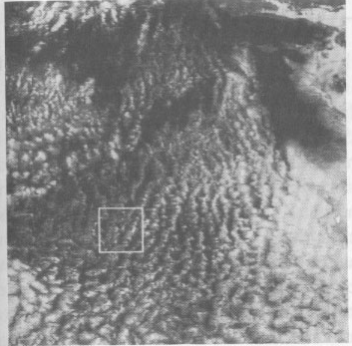
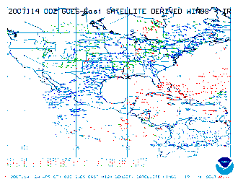
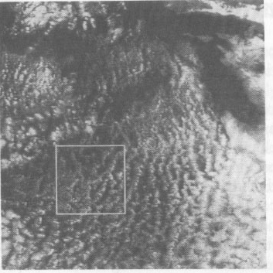
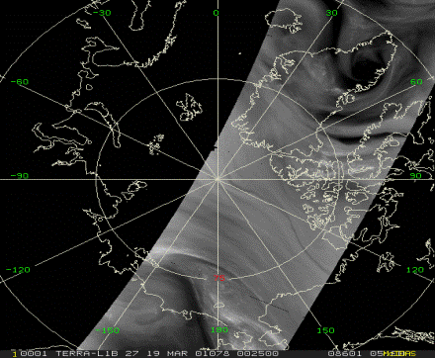
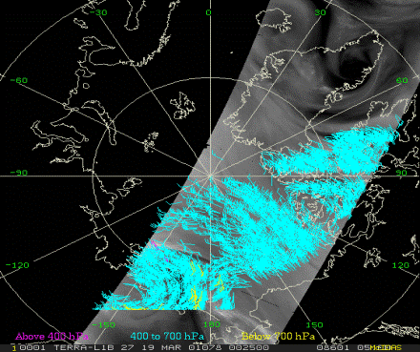
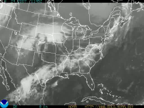
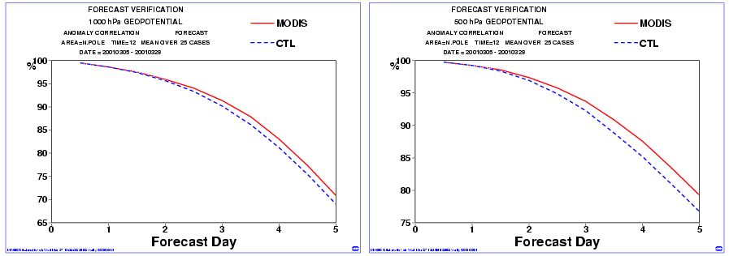
Conventional & HDWL Methods of Spaceborne Measurements of Atmospheric Winds
Successive GOES Cloud Images Cross-Correlation Method
OVW
CMV
QuickSCAT SeaWinds
WVMV
MODIS Polar H₂O Vapor Winds
HDWL 3D
Utilizes Lidar Dual Backscatter
From Aerosols & Molecules
Dual Doppler Receiver:
Coherent & Direct Detection
Science/technology trades
Coherent ‘heterodyne’
(e.g. SPARCLE-NASA/LaRC)
Direct detection
“Double Edge”
(e.g. Zephyr-NASA/GSFC)
Direct detection
“Fringe Imaging”
(e.g. Michigan Aerospace)
Backscattered Spectrum
Δν_{DOP}
Molecular (λ⁻⁴)
Aerosol (λ⁻²)
Surface (1000 hPa)
Mid-trop (800 hPa)
Polar Water Vapor Winds Improve Weather Fcx
Courtesy of Dr. W. Paul Menzel – NOAA/NESDIS
Frequency

Slide 22

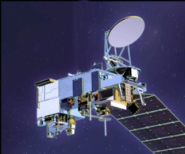
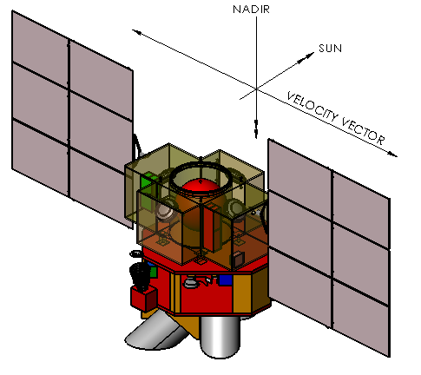
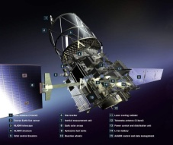
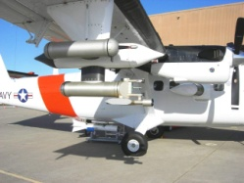
NexGen Hybrid Doppler Wind Lidar - NWOS Possible NPOESS Wind Observing System For Vertical Wind Profiles
2007 NAS Decadal Survey Recommendations for Tropospheric Winds
NexGen
NWOS
(2026)
NexGen
3D Tropospheric Winds mission called “transformational”
and ranked #1 by Weather panel.
3D Winds also prioritized by Water Cycle panel.
“The Panel strongly recommends an aggressive program
early on to address the high-risk components of the
instrument package, and then design, build, aircraft-
test, and ultimately conduct space-based flights of a
prototype Hybrid Doppler Wind Lidar (HDWL).”
“The Panel recommends a phased development of the
HDWL mission with the following approach:
Stage 1: Design, develop and demonstrate a prototype HDWL system capable of global wind measurements to meet demonstration requirements that are somewhat reduced from operational threshold requirements. All of the critical laser, receiver, detector, and control technologies will be tested in the demonstration HDWL mission. Space demonstration of a prototype HDWL in LEO to take place as early as 2016.
Stage II: Launch of a HDWL system that would meet fully-operational threshold tropospheric wind measurement requirements. It is expected that a fully operational HDWL system could be launched as early as 2022.”
GWOS
(2016)
Operational 3-D
global wind measurements
ADM Aeolus
(2011)
Demo 3-D
global wind measurements
GWOS
TODWL
(2002 - 2008)
Single LOS
global wind measurements
NWOS
DWL Airborne Campaigns, ADM Simulations, etc.
TODWL: Twin Otter Doppler Wind Lidar [CIRPAS NPS/NPOESS IPO]
ESA ADM: European Space Agency-Advanced Dynamics Mission (Aeolus) [ESA]
GWOS: Global Winds Observing System [NASA/NOAA/DoD]
NexGen: NPOESS [2nd] Generation System [PEO/NPOESS]

Slide 23
NexGen Hybrid Doppler Wind Lidar - JWOS Possible Joint [JPSS/DWSS] Wind Observing System For Vertical Wind Profiles
2007 NAS Decadal Survey Recommendations for Tropospheric Winds
NexGen JWOS
(2022 ?)
NexGen
3D Tropospheric Winds mission called “transformational”
and ranked #1 by Weather panel.
3D Winds also prioritized by Water Cycle panel.
“The Panel strongly recommends an aggressive program
early on to address the high-risk components of the
instrument package, and then design, build, aircraft-
test, and ultimately conduct space-based flights of a
prototype Hybrid Doppler Wind Lidar (HDWL).”
“The Panel recommends a phased development of the
HDWL mission with the following approach:
Stage 1: Design, develop and demonstrate a prototype HDWL system capable of global wind measurements to meet demonstration requirements that are somewhat reduced from operational threshold requirements. All of the critical laser, receiver, detector, and control technologies will be tested in the demonstration HDWL mission. Space demonstration of a prototype HDWL in LEO to take place as early as 2016.
Stage II: Launch of a HDWL system that would meet fully-operational threshold tropospheric wind measurement requirements. It is expected that a fully operational HDWL system could be launched as early as 2022.”
Joint
JPSS/DWSS
Acquisition ?
ISS HDWL
(2017)
Operational 3-D
global wind measurements
ADM Aeolus
(2011)
Demo 3-D
global wind measurements
ISS
HDWL
TODWL
(2002 - 2008)
Single LOS
global wind measurements
JWOS?
DWL Airborne Campaigns, ADM Simulations, etc.
TODWL: Twin Otter Doppler Wind Lidar [CIRPAS NPS/NPOESS IPO]
ESA ADM: European Space Agency-Advanced Dynamics Mission (Aeolus) [ESA]
ISS HDWL: International Space Station Hybrid Doppler Wind Lidar [NASA]
NexGen: Joint [JPSS/DWSS] Wind Observing System [NASA/NOAA/DoD ???]

Slide 24
Thanks for the Opportunity
to Talk to You

