Slide 1
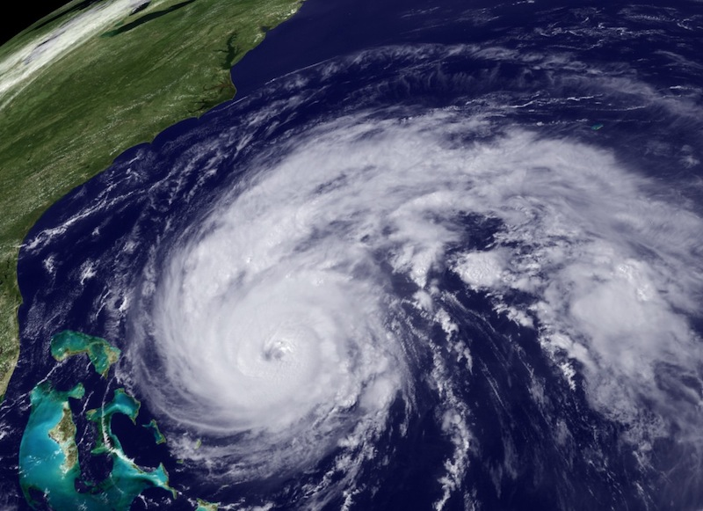
NOAA Hurricane Forecast Improvement Project
Frank Marks
NOAA HFIP Lead
9 February 2011
Notes:
Hurricane Earl 2 September 2010

Slide 2
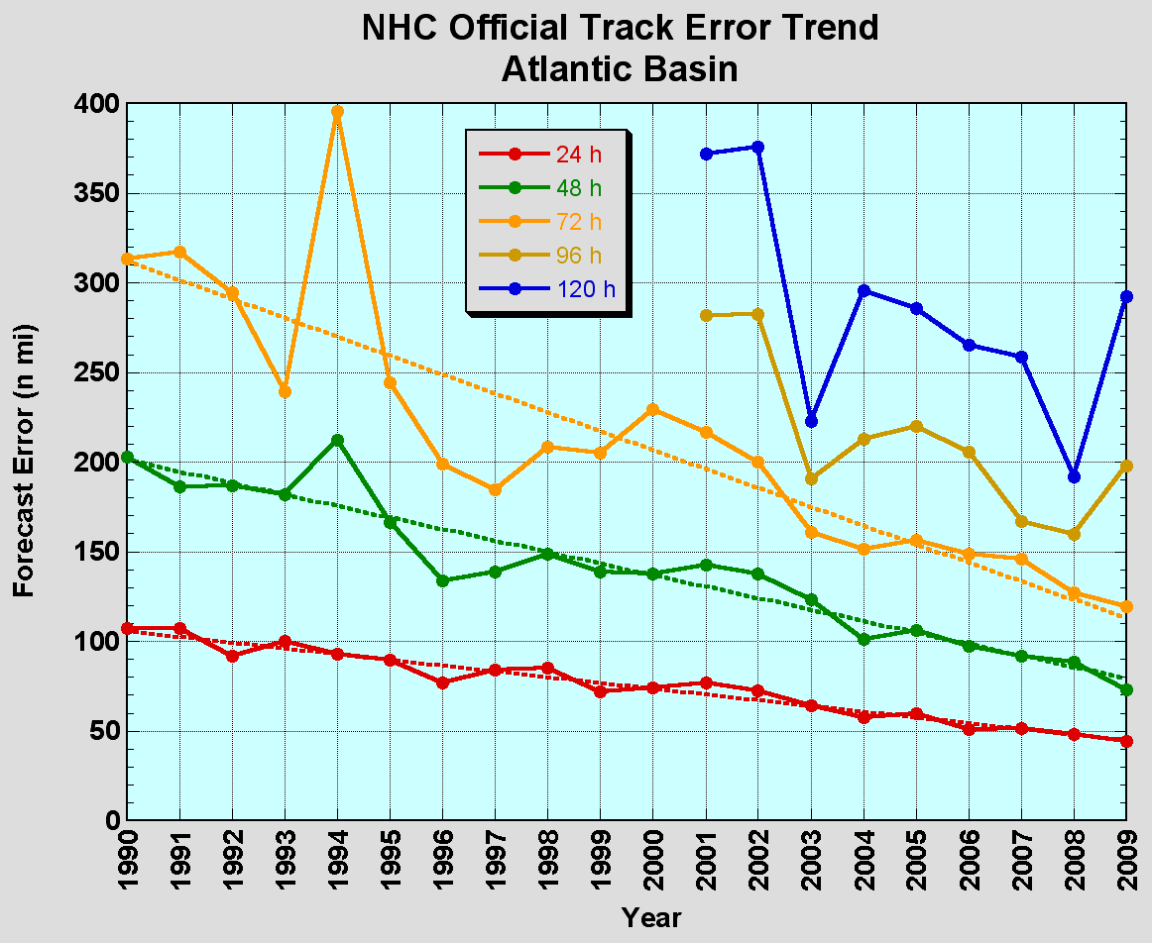
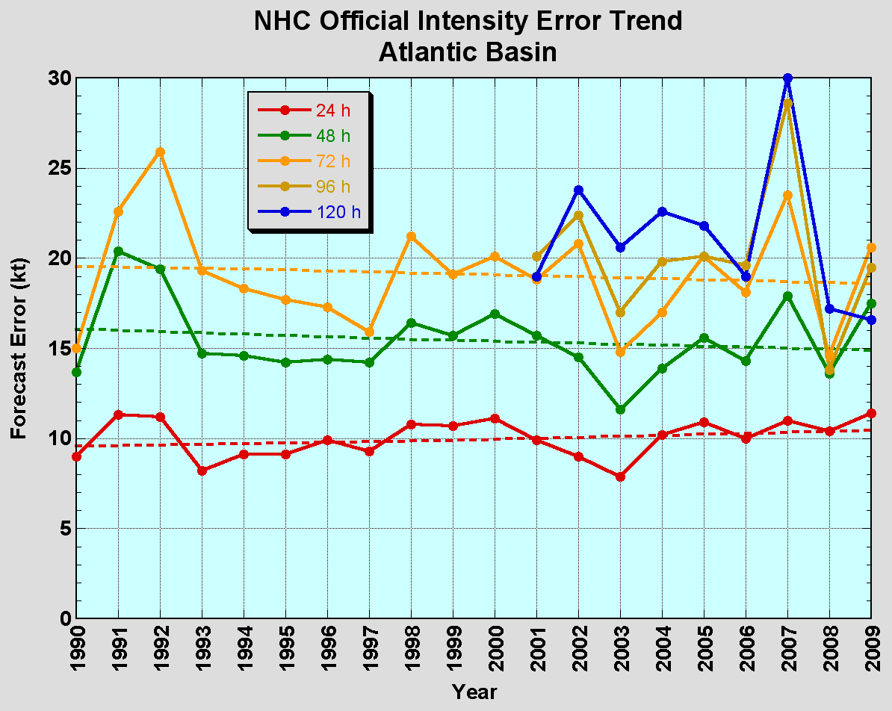
The Good – track forecast improvements
Current Capabilities
The Bad - Intensity no real gains
No progress with intensity in last 15-20 years
Errors cut in half over past 15 years
10-year improvement - As accurate at 48 hours as we were at 24 hours in 1999
24-48h intensity forecast off by 1 category
Off by 2 categories perhaps 5-10% of time

Slide 3
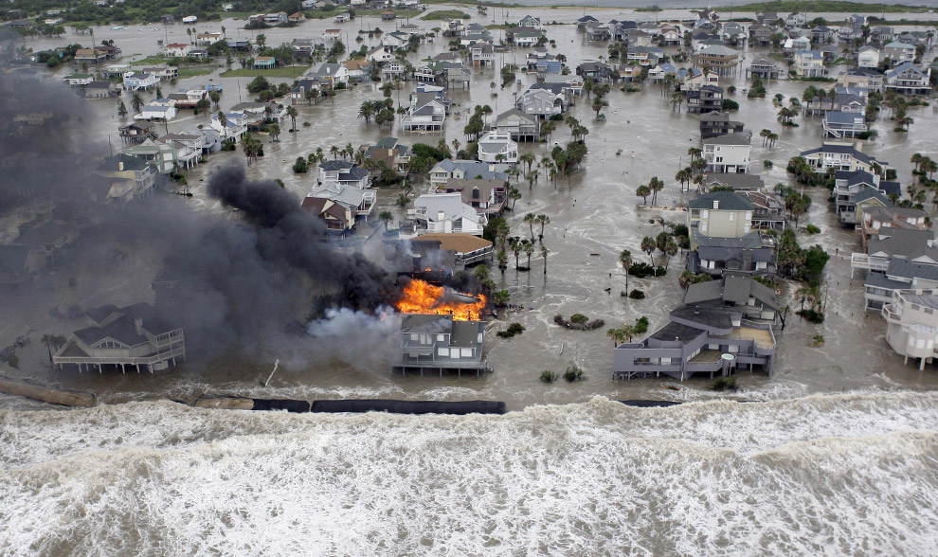
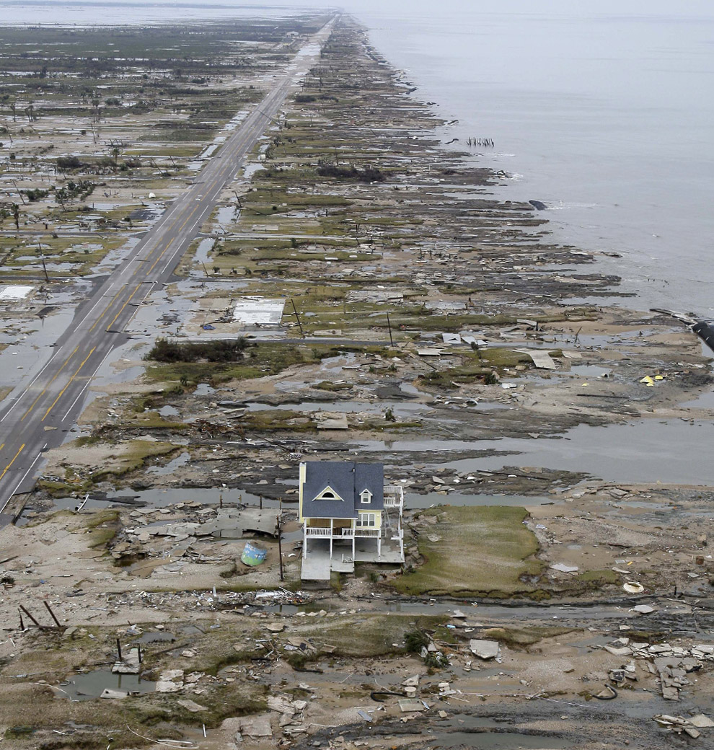
Improvements still needed!
Risk to life and property continues to escalate in coastal regions
  Population continues to increase – 50% of US population now live within 50 miles of coast.
  Value of coastal infrastructure and economic activity continues to rise – estimated at over $3 Trillion
More accurate hurricane forecasts and warnings can reduce response and recovery costs
  More accurate forecast ➔ fewer false alarms, reduced warning footprint
Galveston–Ike 2008
Bolivar Peninsula after Ike 2008

Slide 4

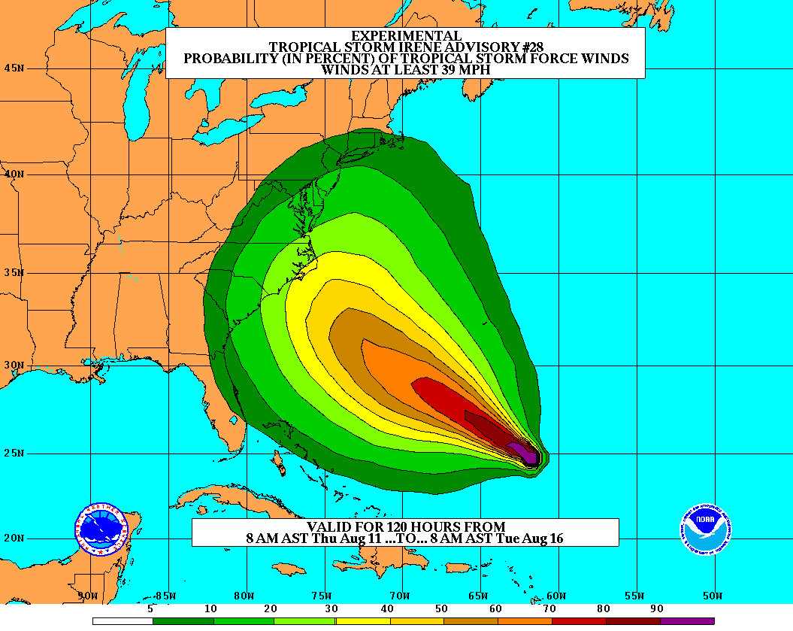
Goals
Improve Forecast Accuracy
  Hurricane impact areas (track) – 50%
  in 10 years
  Severity (intensity) – 50% in 10 years
  Storm surge impact locations
  and severity
Extend forecast reliability out to 7 days
Quantify, bound and reduce forecast uncertainty to enable risk management decisions
Notes:
http://www.nrc.noaa.gov/HFIPDraftPlan.html
HFIP Team
Frank Marks, research lead
Ed Rappaport, operations lead
Fred Toepfer, project manager
Robert Gall, development manager
Mark DeMaria
Chris Fairall
Jim McFadden
Scott Kiser
Daniel Melendez
Roger Pierce
HFIP executieve oversight board:
OAR DAA/Sandy MacDonald, co-chair
NWS AA/Jack Hayes, co-chair
NCEP/Louis Uccellini,
TPC/Bill Read,
NESDIS/Mark DeMaria,
NOS/Jesse Feyen,
AOML/Bob Atlas
PPI/Paul Doremus
NMFS/Bonnie Ponwith,
NOS/Liz Scheffler,
NMAO-PM Aircraft/Phil Kenul,
OFCM/Sam Williamson
Executive Secretariat: OAR/Joseph Bartosik and NWS/John Iacabucci

Slide 5
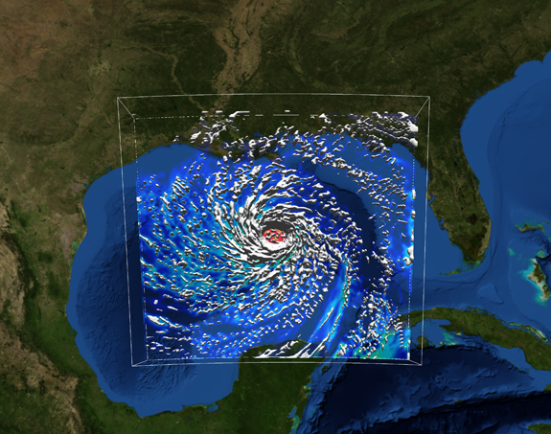
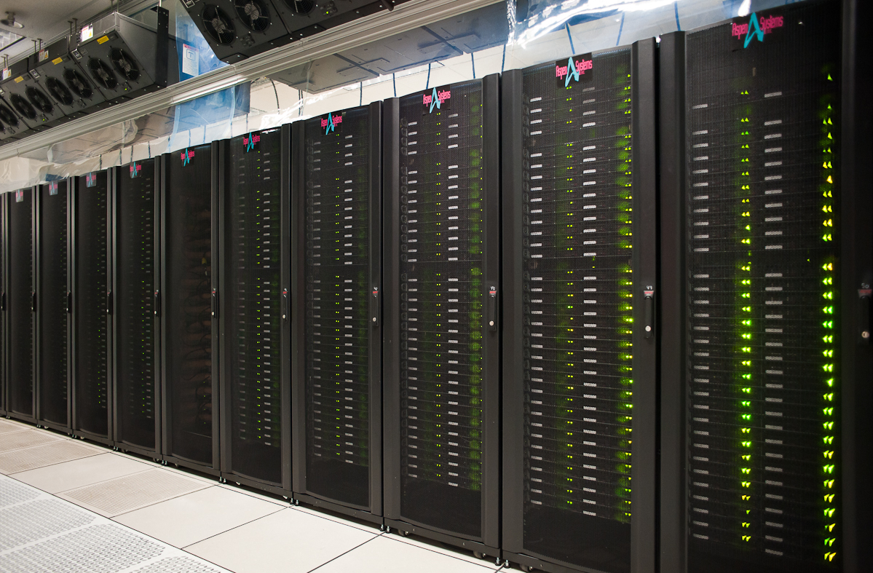
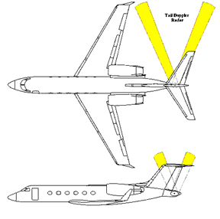

How to get there?
Science (8 Teams)
  Improved understanding from combination of observations & models
  Higher resolution coupled models – critical to storm evolution forecasts – especially intensity changes
  Forecast techniques to understand, reduce &communicate uncertainty
Information Technology
  Increased computing power - run advanced hurricane/global models and reduce uncertainty
  IT infrastructure for inter-agency data exchange
Observing Strategy
Improved use of existing and planned systems
Improved Products for Forecasters
Notes:
HFIP 2008-2009 activities
HRH Workshop:
http://www.dtcenter.org/plots/hrh_test/workshop2009/presentations/1_Gall_HRH%20HFIP%20presentation.pdf
http://www.dtcenter.org/plots/hrh_test/index.php
HFIP-TACC Real-time test
ftp://ftp.aoml.noaa.gov/pub/hrd/marks/HFIP-TACC_Summary.pdf
Diagnostics Team Workshop:
http://rammb.cira.colostate.edu/research/tropical_cyclones/hfip/workshop_2009/

Slide 6

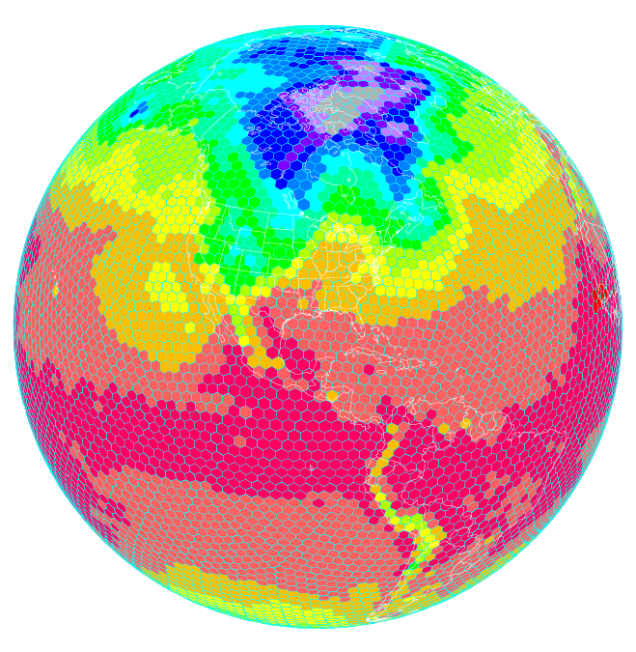
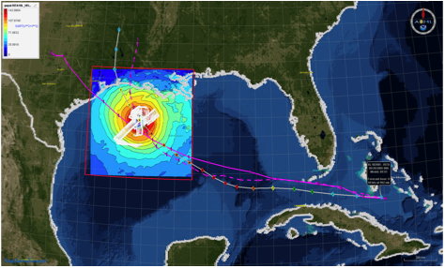
HFIP Activities
Traditional Hurricane Research Activities:
Observations, analysis, database, & instrument R&D (IFEX)
Statistical-dynamical model development
Advances in operational models (Stream 1)
New HFIP Research Thrusts:
Experimental global and regional hurricane model development (Stream 2) - Gopal
Data assimilation techniques and observing system strategy analysis development (Stream 1 & 2) - Tomi
Model evaluation tool development
Socioeconomic research and development
D1
D2
Partnership: NCEP, AOC, AOML, ESRL, GFDL, DTC, USWRP, NESDIS/STAR
Notes:
Two Stream Approach to HFIP developments:
Stream 1– Operational Transition and Implementation
Stream 2 – Advanced Technology Demonstration
Unconstrained by near-term availability of operational computing
Uses both NOAA’s and computing resources from major supercomputing centers for testing and evaluation.
Emphasis is on high resolution global and regional models run as ensembles
Real-time or near real time runs during hurricane season
Stream 1.5 (JHT-like)
NHC Forecaster Defined.
Subset of Stream 2 that forecasters see as particularly promising or provides demonstrated capability
Will be configured to run in real-time and products made available to NHC.

Slide 7
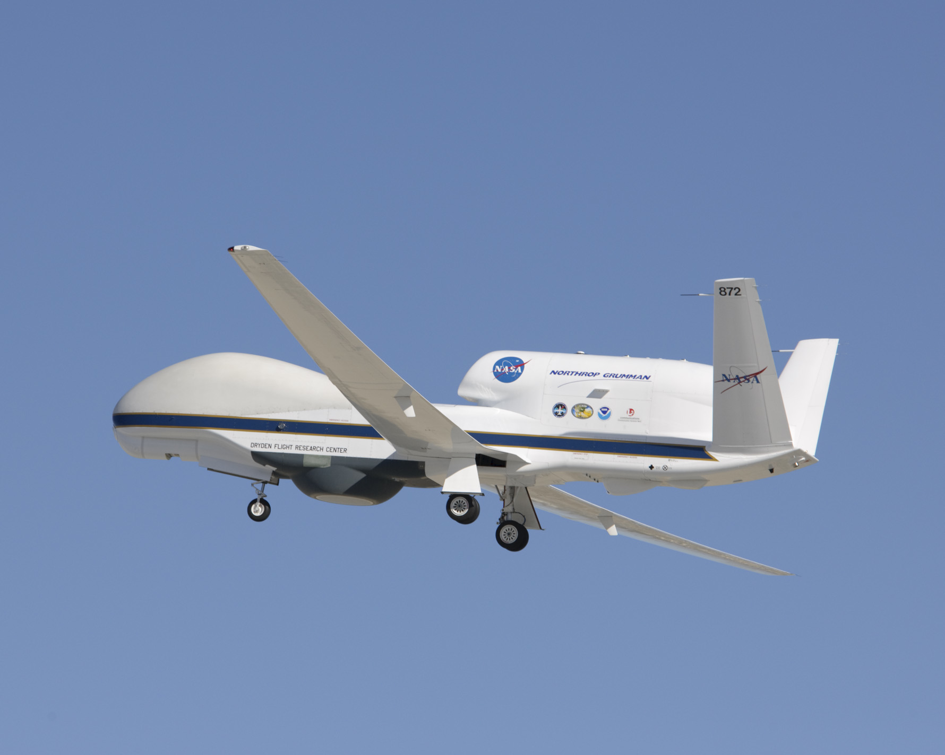
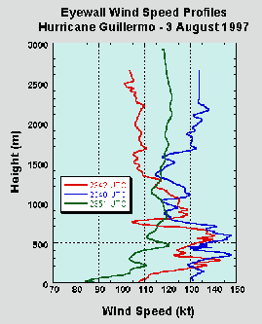
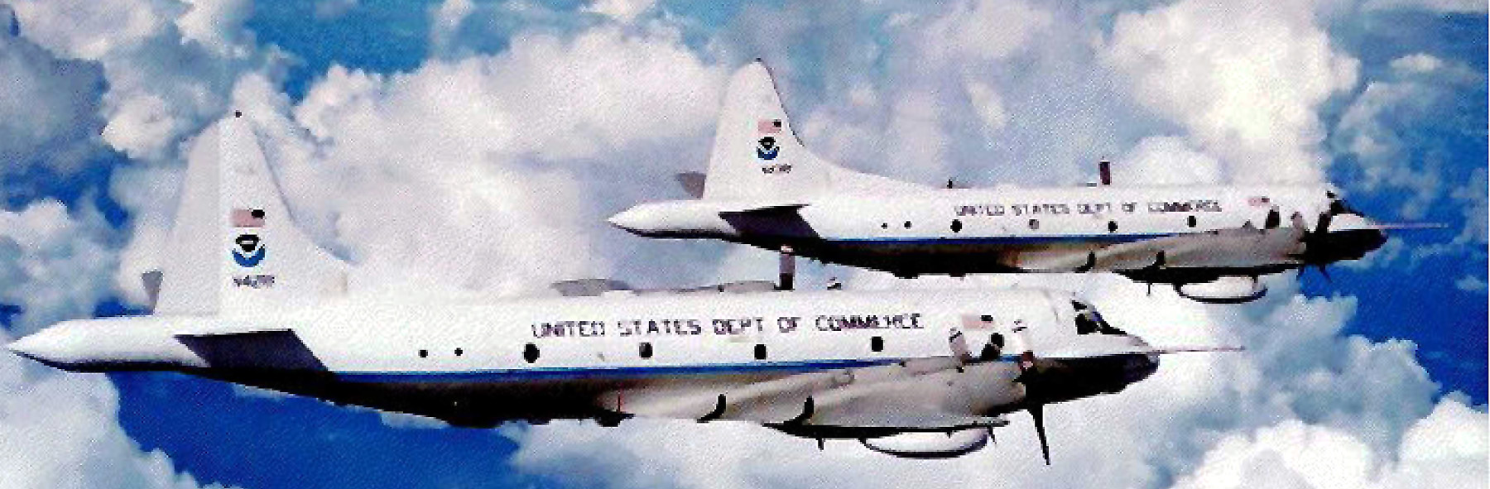

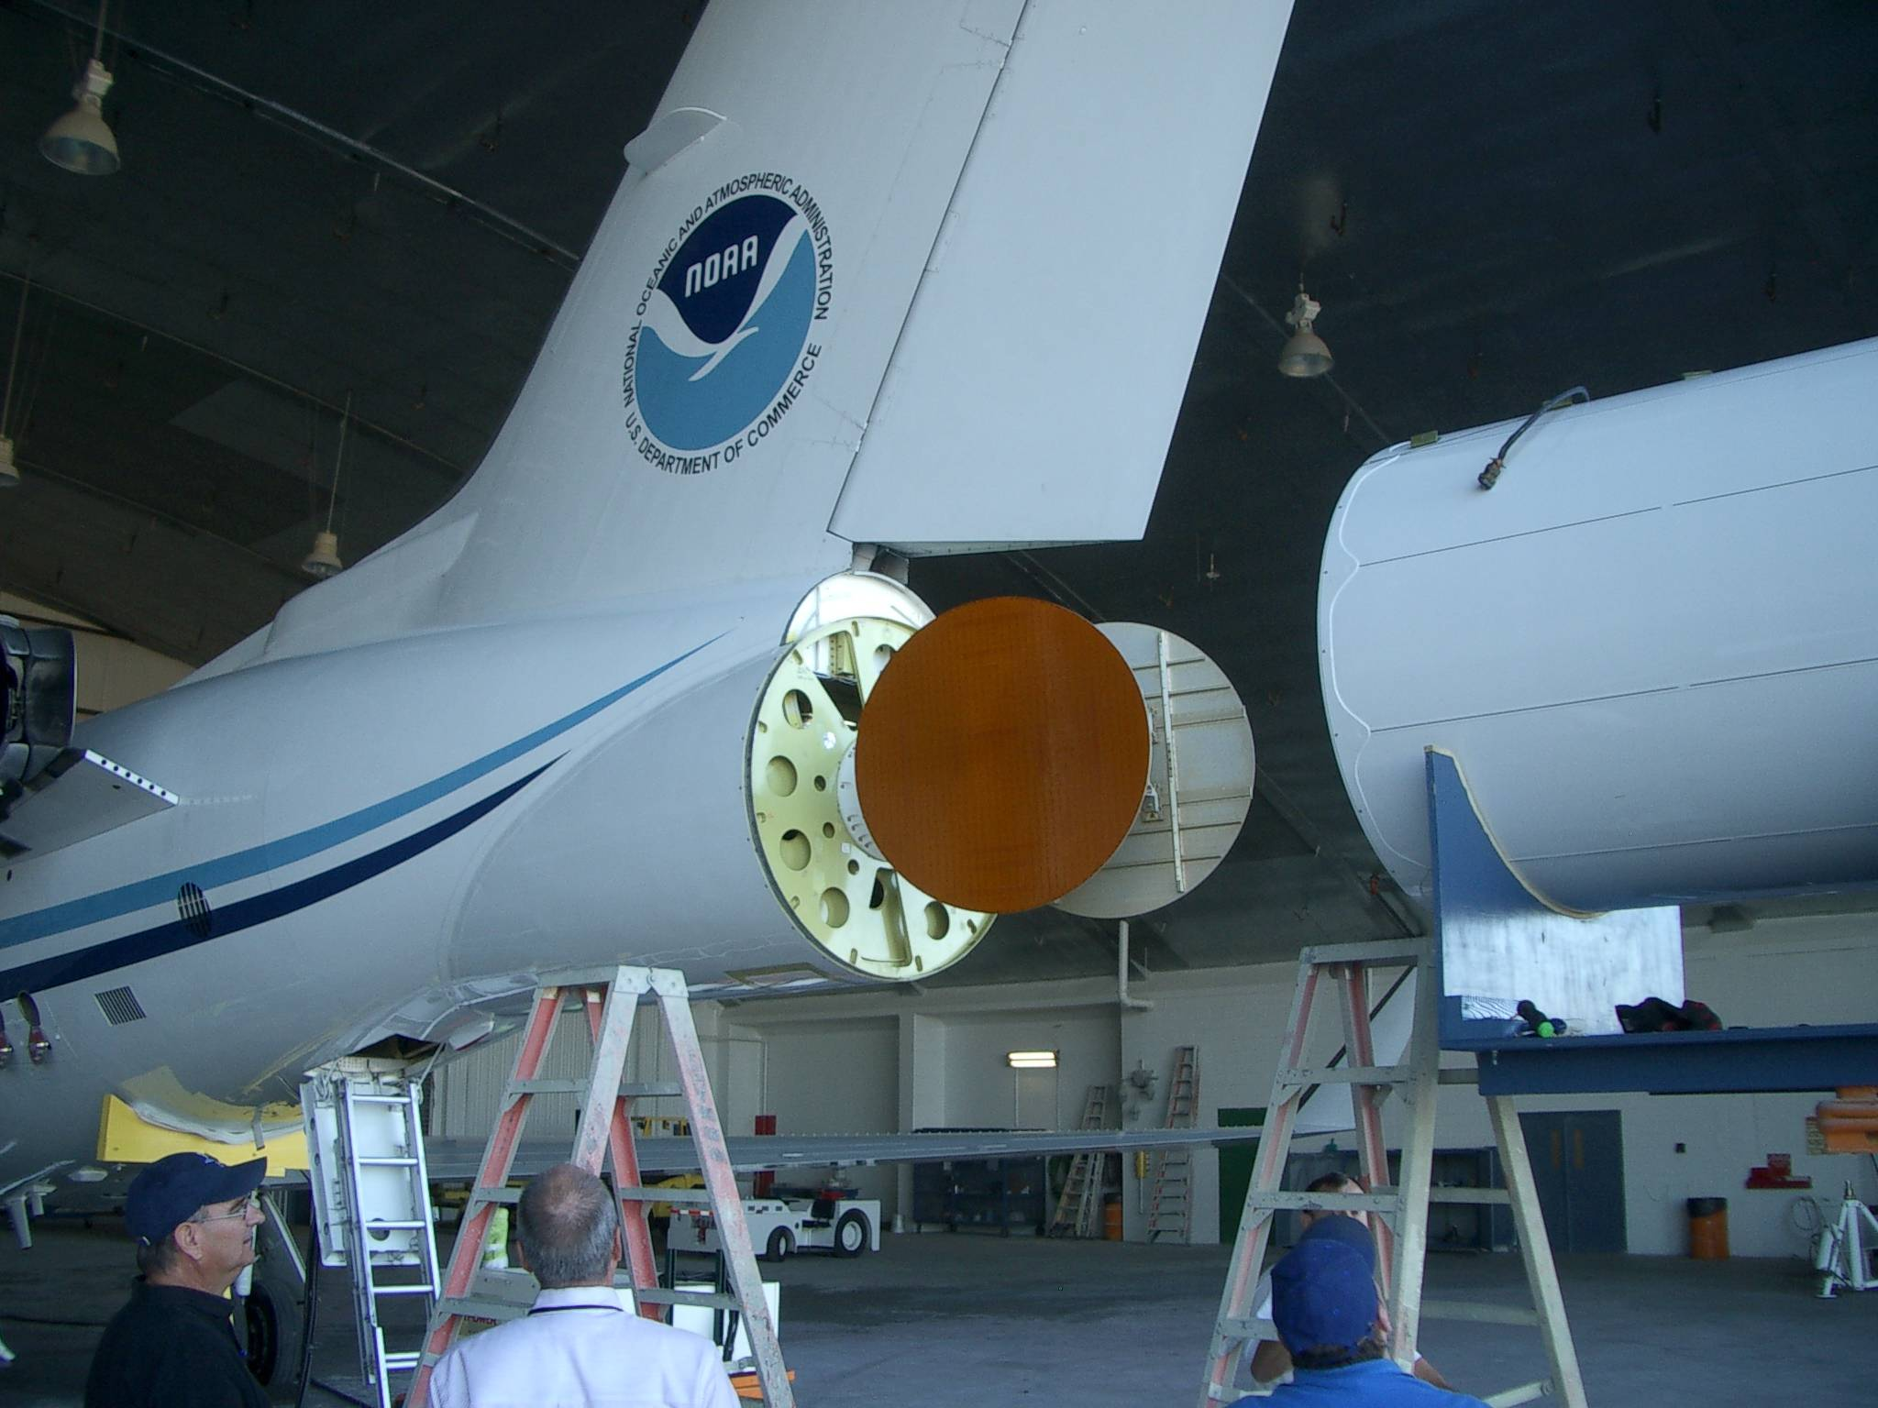
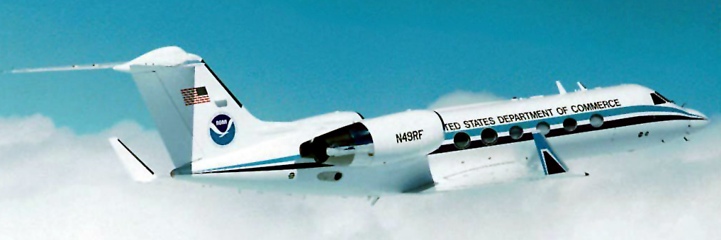
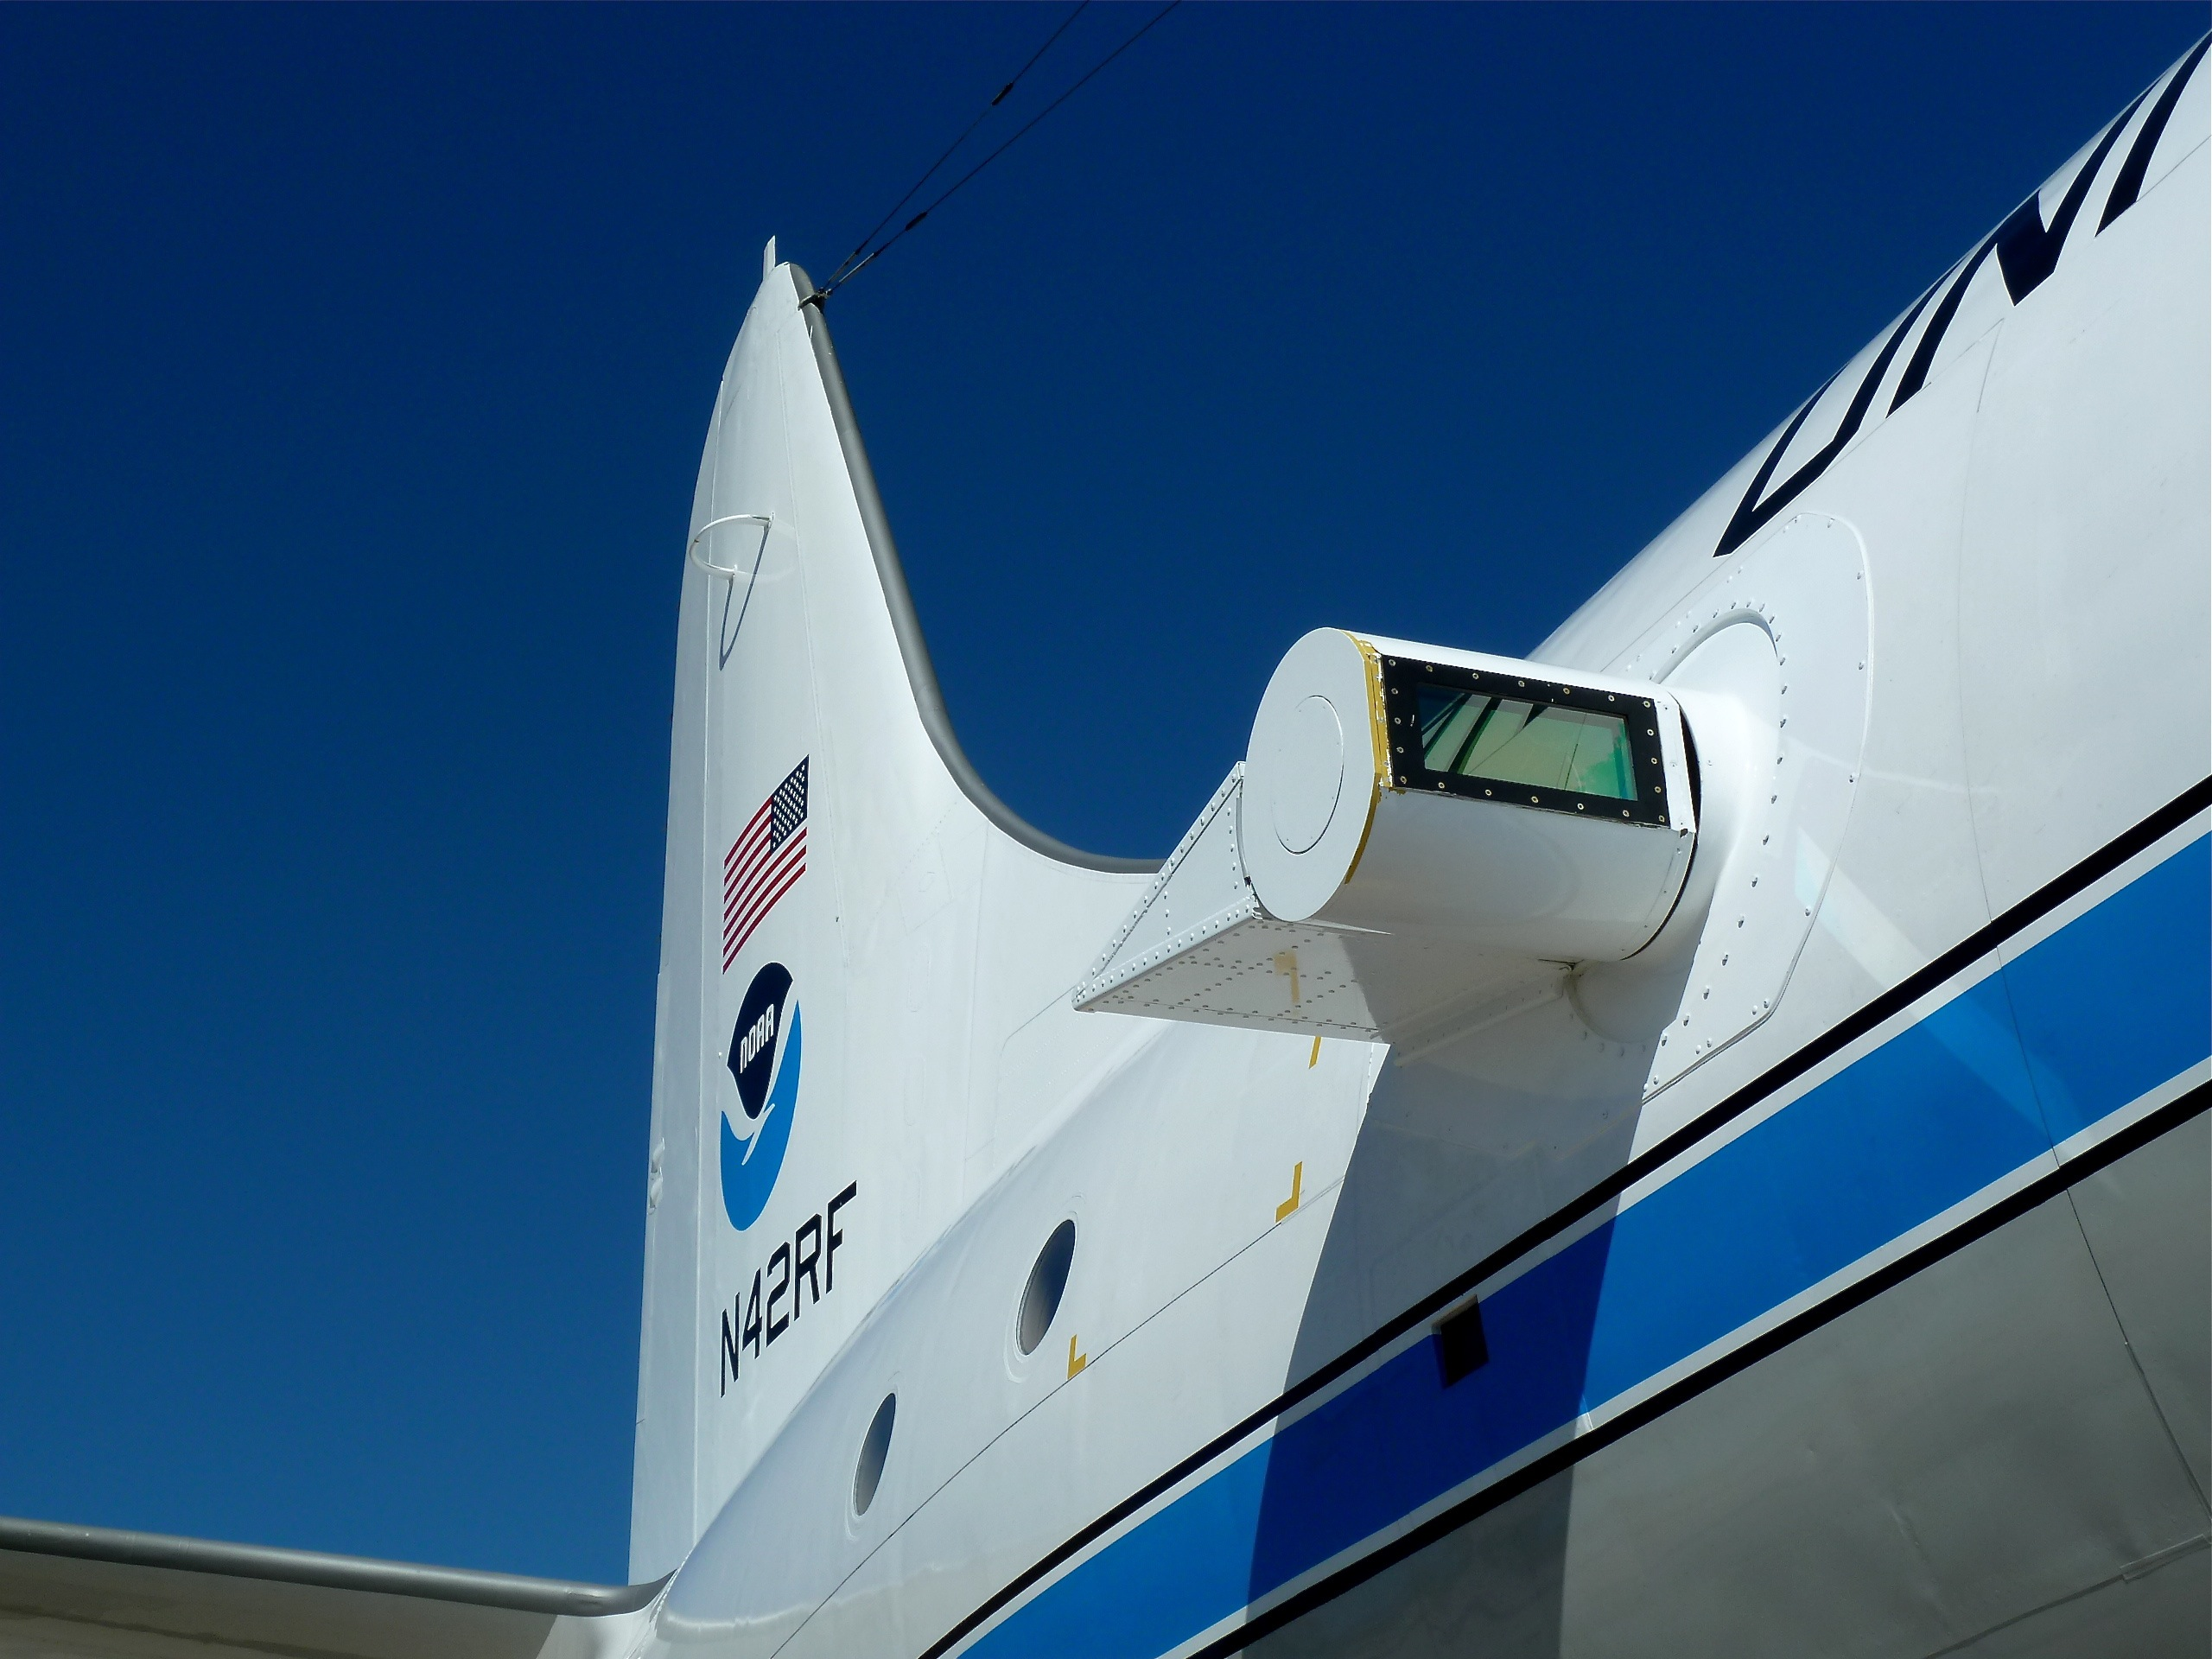
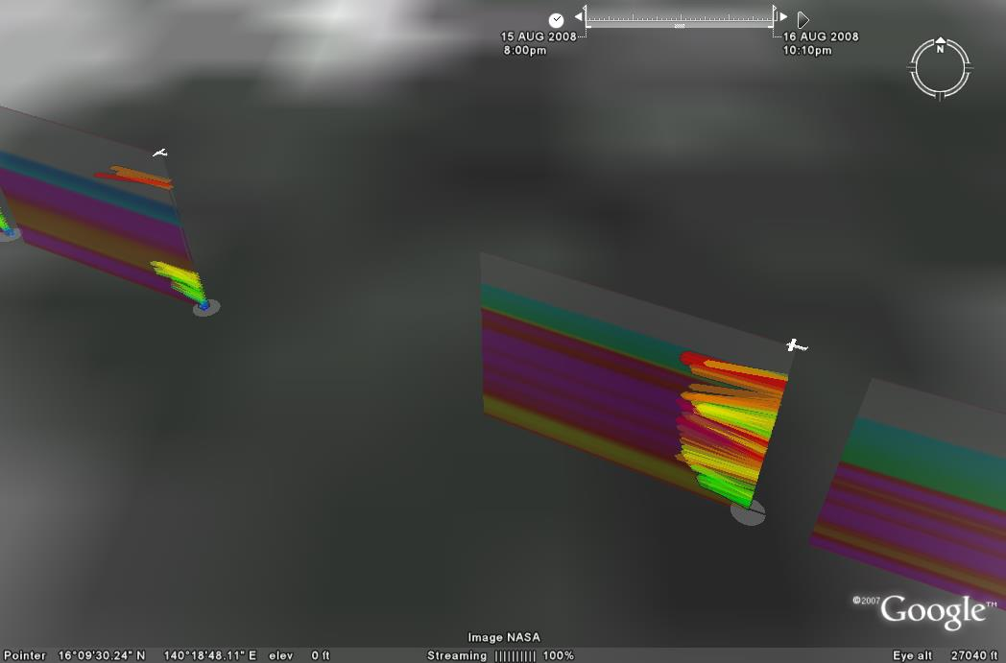
Improved Use of Observations:
Intensity Forecast experiment (IFEX 2010)
In-situ
  Wind, press., temp.
Expendables
  Dropsondes
  AXBT, AXCP, buoy
Remote Sensors
  Doppler Radar
  SFMR/HIRAD
  WSRA
  Scatterometer/profiler
  UAS
Global Hawk UAS
G-IV Tail Doppler Radar
ONR DWL
Rob Rogers, AOML/HRD
Notes:
UR image depicts dropsonde profiles in eyewall of Hurricane Guillermo (1997)
LR image is Doppler Wind Lidar profiles from TCS-08

Slide 8
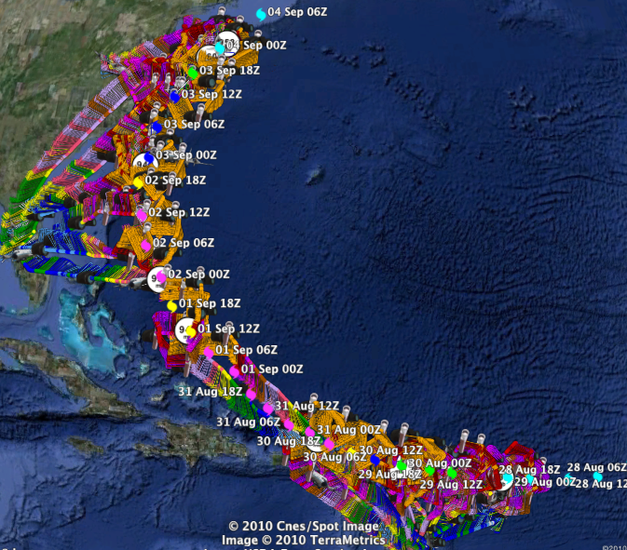
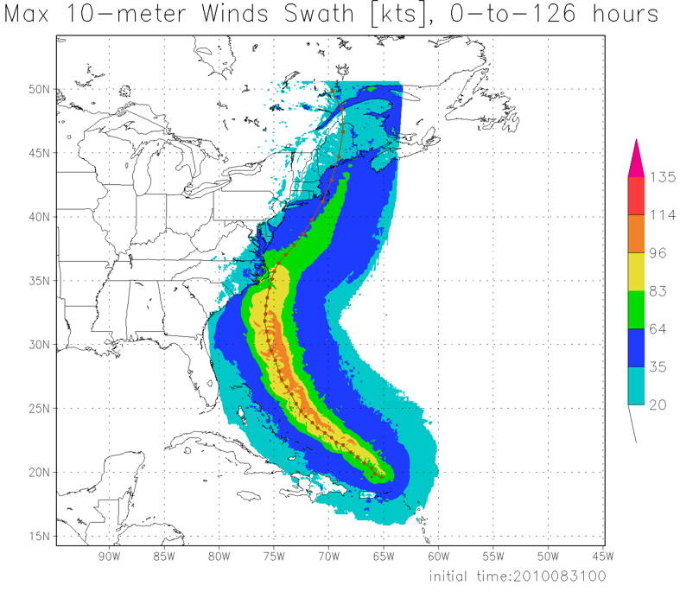
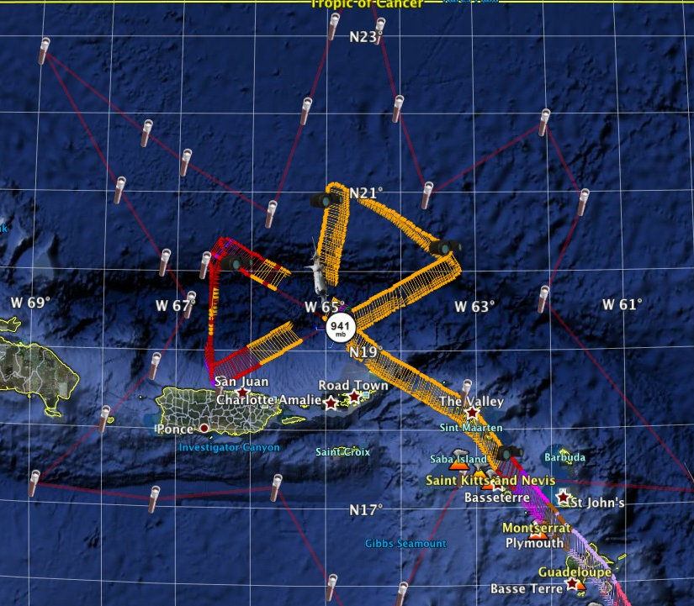
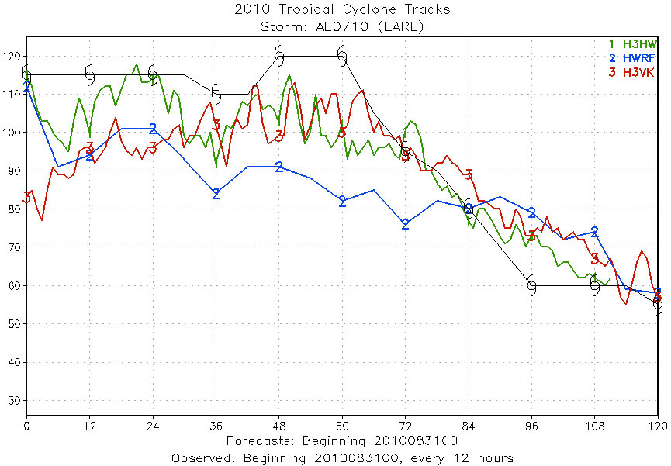
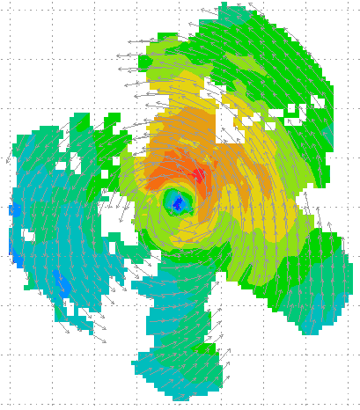
Improved Use of Observations:
HFIP 2010 Demo: Earl
11 P-3 Flights
28 August – 3 September 2010
HWRFx/HEDAS
20100831 00UTC
Doppler SO (EnKF) transmitted in real-time to HRD for assimilation into HWRFx model
20100830I1
2126-0229 UTC
5 missions at 12-h intervals
00Z 28 – 12Z 30 August, 6 missions at 12-h intervals 00Z 1 September – 00Z 3 September collecting Doppler SO (HEDAS)
HWRFx/HEDAS
20100831 00UTC
J. Gamache, A. Aksoy, T. Vukicevic, Gopal (AOML/HRD)
Notes:
Left hand image - Flight pattern for 11 P-3 Doppler mission For Earl beginning 00Z 28 August 2010, ending at 12Z 3 September 2010
middle image – show real-time Doppler analyses for three legs mission centered on 00Z 30 August used to generate Sos
Right images – HWRFx forecasts track and maximum wind swath (top), and intensity (bottom) initialized at 00Z 30 August
IFEX 2010: Hurricane Earl WP-3D (11 missions: 5 missions at 12-h intervals, 00Z 28 – 12Z 30 August, & 6 missions at 12-h intervals, 00Z 1 September – 00Z 3 September collecting Doppler SO (HEDAS)
Deployed 756 dropwindsondes and 238 AXBTs. 55 real-time TDR analyses transmitted to NHC and Doppler radial files transmitted to EMC. TDR superobs transmitted in Paloma, Bill and Danny provided real-time assimilation of TDR data into ARW model at TACC. 60 real-time H*Wind surface analyses

Slide 9


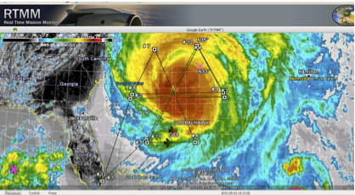
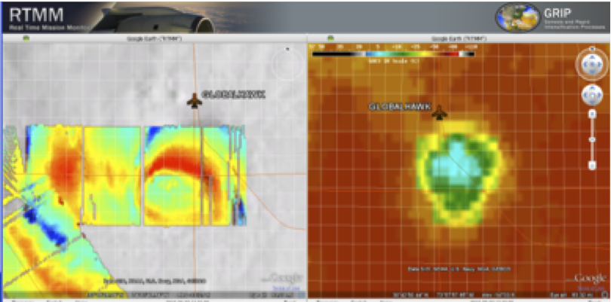
Successes from Earl Flight
Improved Use of Observations:
Global Hawk UAS flight into Hurricane Earl
RTMM GH-DC8 Coordination (top) and HAMSR imagery overlaid on satellite images (bottom)
24 h mission (8 h on station)
Ability to overfly a major hurricane (7 overpasses of eye)
Mission scientists able to work with GH pilots on real time track changes
Coordination with other aircraft possible and effective (3 passes with DC-8)
All instruments worked well* and most provided real-time data and/or imagery
*GPS dropsonde system not installed
M. Black (AOML/HRD) & G. Heymsfield (NASA/GSFC)
Notes:
Images on Right: RTMM GH-DC8 Coordination (top) and HAMSR imagery overlaid on satellite images (bottom)
7 eye passes attempted, 5 directly over, 1 near miss, 1 detoured around eyewall due to lightning
3 passes were coordinated with NASA DC8 beneath the GH
Very little turbulence encountered at 60 kft
Many real time flight changes were made

Slide 10
Improved Models & Data:
Model evaluation
Critical to HFIP success: Massive amounts of simulation output:
  High-resolution hurricane (HRH) test: 69 cases (2005 & 2007) for 6 model teams - >50 Tb
  2008 – 2010 HFIP Real-time tests - >200 cases plus multi-model regional ensembles - >200 Tb
Need diagnostic tools to evaluate more than track and peak wind (e.g., large-scale, vortex-scale, convective scale, probability)
Application Development & Diagnostics Team

Slide 11
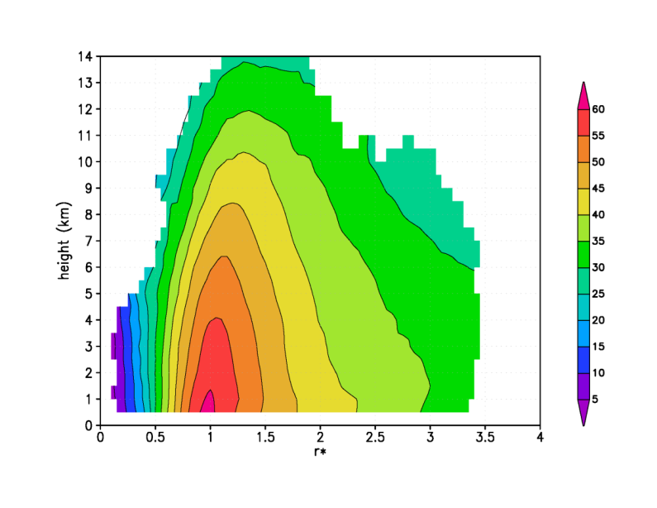
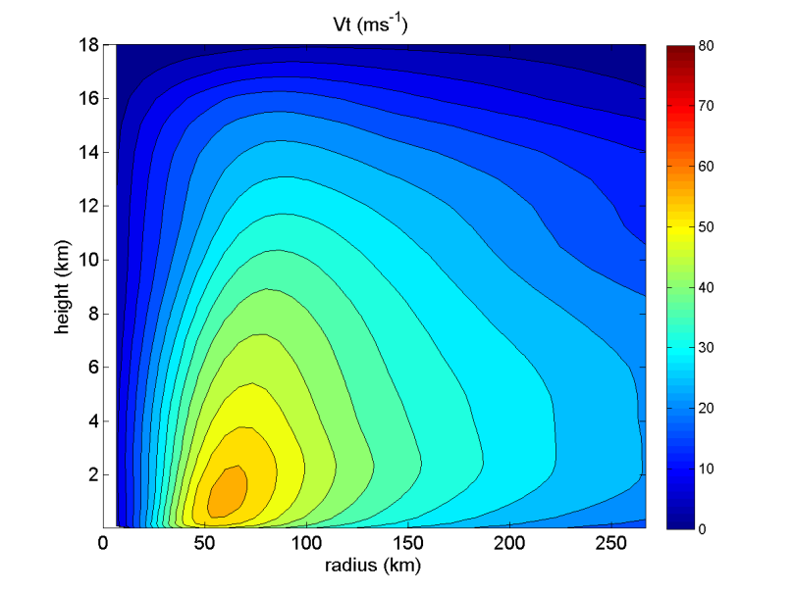
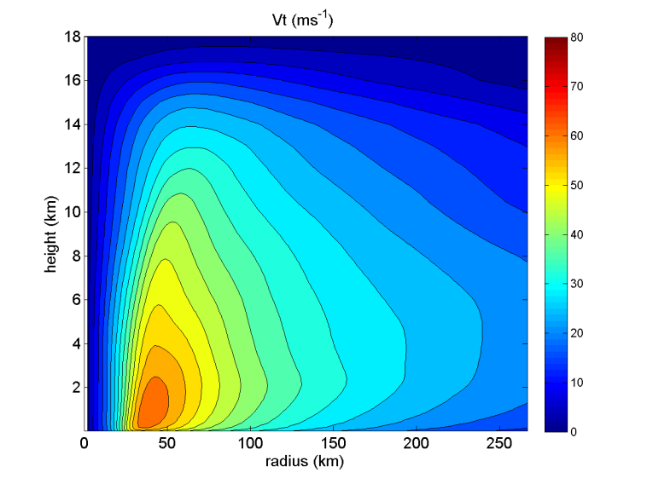
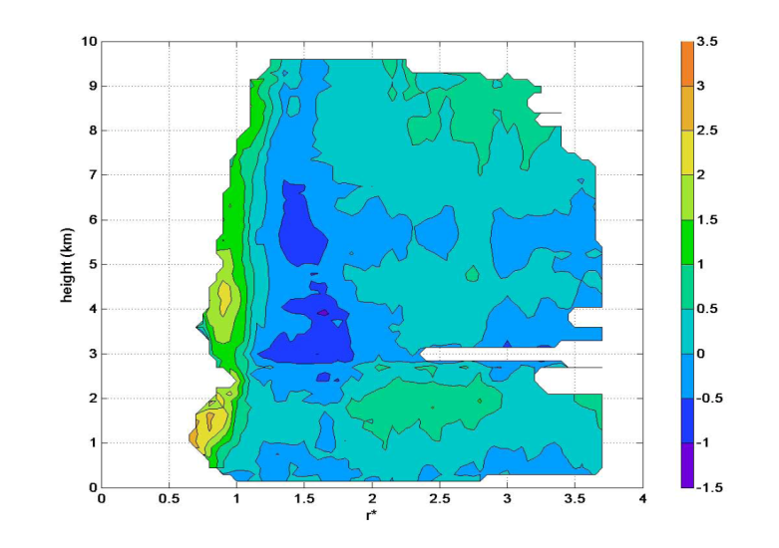
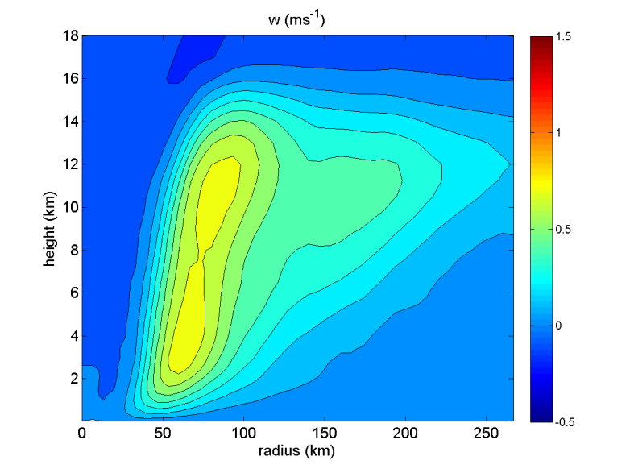
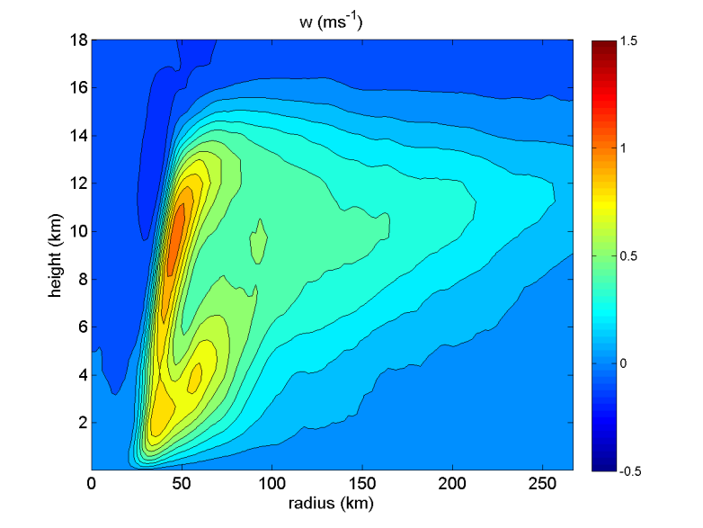
Improved Models & Data:
Model evaluation: Vortex-scale
Tangential wind (m/s)
9-km HWRFx
3-km HWRFx
normalized radius
R*=R/RMW
Vertical wind (m/s)
9-km HWRFx
3-km HWRFx
normalized radius
R. Rogers, J. Zhang, P. Reasor, & S. Lorsolo (AOML/HRD)
Notes:
Comparison of composites using different horizontal resolution

Slide 12
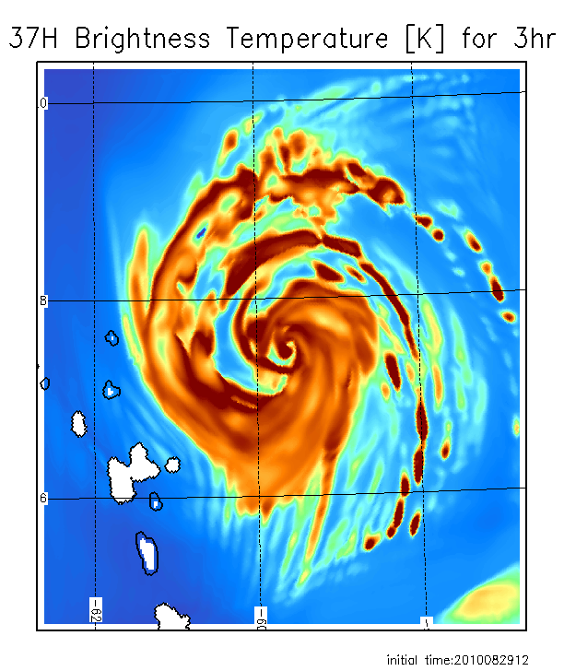
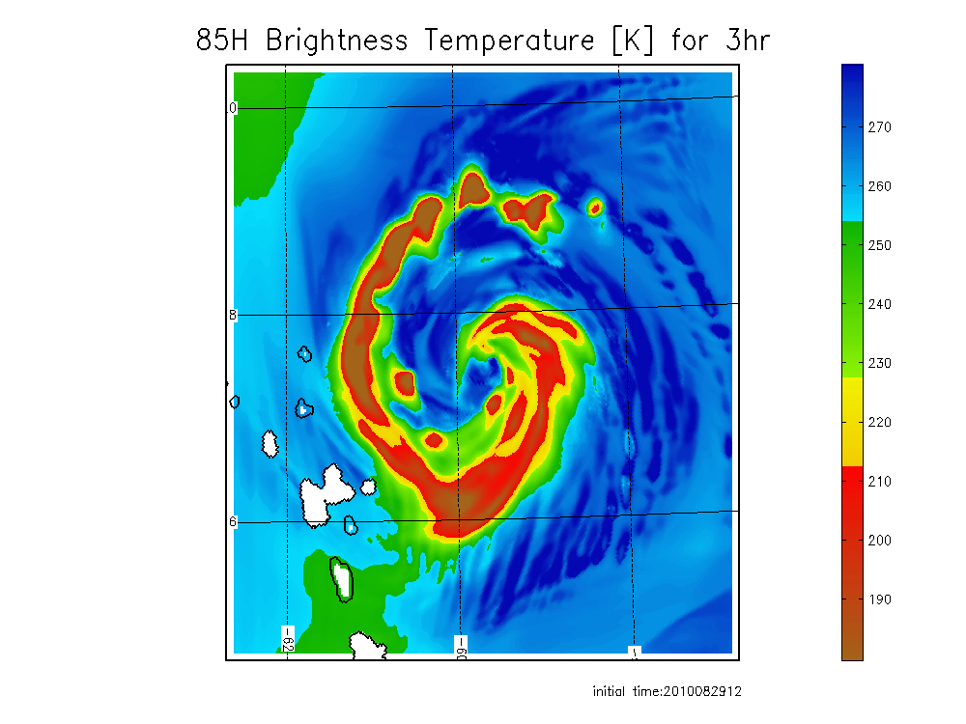
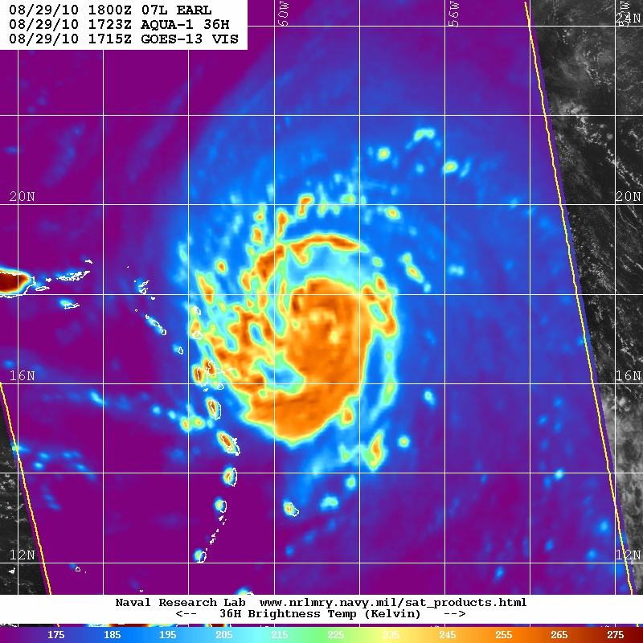
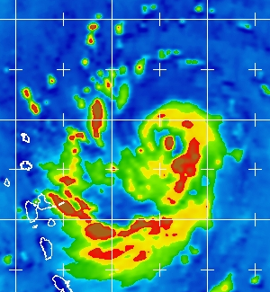
Improved Models & Data:
Model evaluation: Convective-scale
Observed AQUA 37/89 GHz closest time within 1 h
3h synthetic
37/85 GHz forecast from HEDAS IC
Use Model (HWRFV3.2) & DA (HEDAS) system to evaluate observing strategies in TC environments
Microwave satellite imagery (37- & 85-GHz)
Forecast initial time 12Z, 08/29/2010
Tomi Vukicevic (AOML/HRD)
Notes:
Comparison of observed and forecast images for hurricane Earl from HEDAS and HWRF ICs

Slide 13
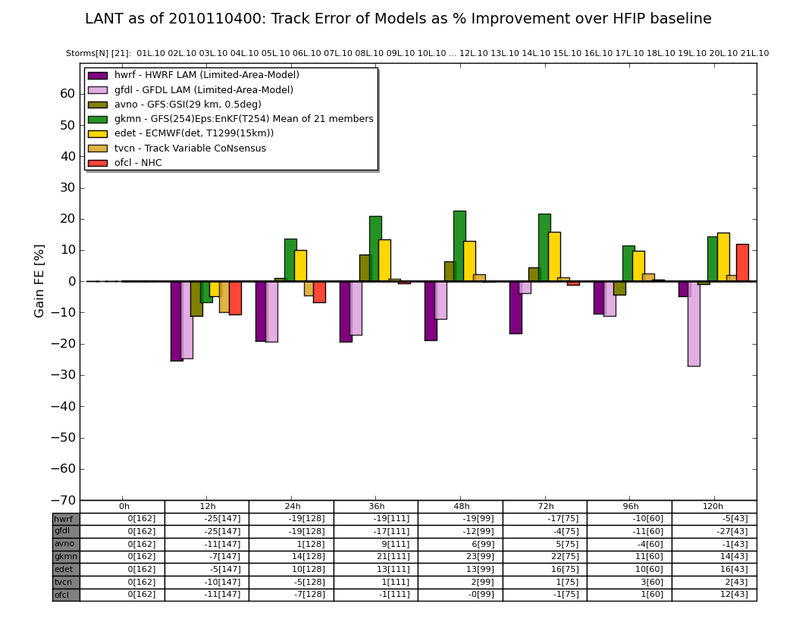
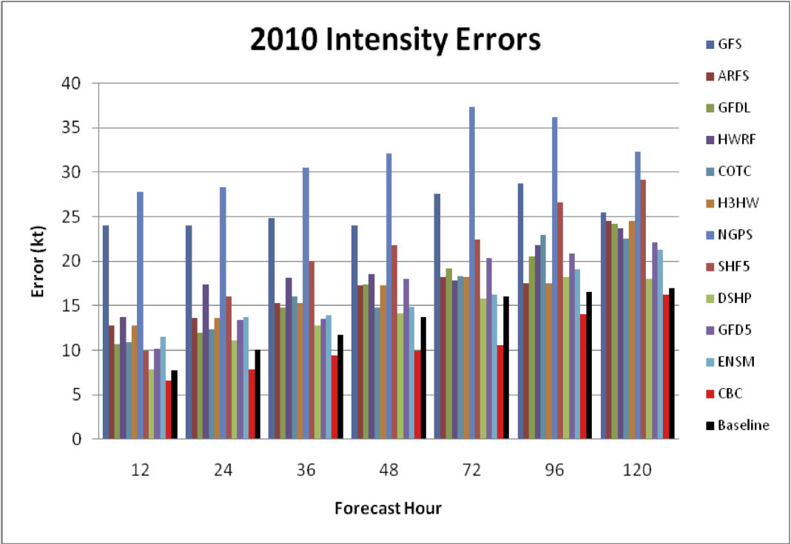
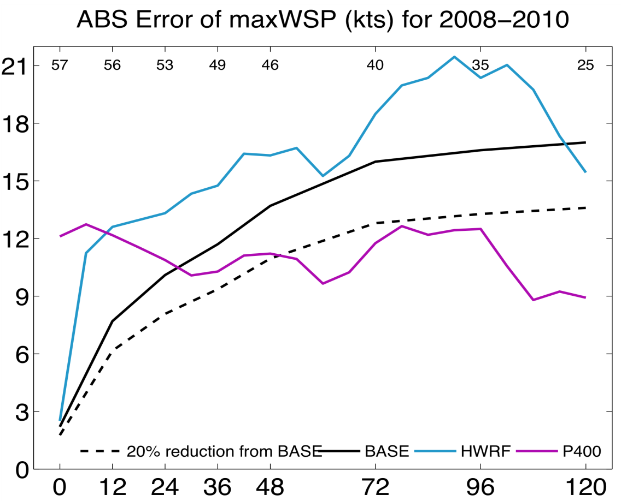
Conclusions from 2010 Experiments
Can reach HFIP track goals out to at least 5 days using current global models initialized with EnKF
    Will need to be run at higher than current resolution to ensure continued gains
Radar data appears to be critical in initializing regional models (may require ENKF to use effectively)
    May solve intensity problem for storms effecting U.S.
    Need increased use of satellite data for storms further away
Statistical post processing provides a several percentage point improvement over raw scores (Bias Correction, Correlation Based Correction, other)

Slide 14
HFIP Science Priorities
Advancement in DA techniques for hurricane NWP
Physics Advancements
  Microphysical processes
  Air-sea processes and BL processes
R&D for determining optimal resolution and complexity of coupling
Advanced model diagnostic techniques (more than 3 numbers)
  Analyses and forecast of large-scale and hurricane environment evolution
  Identification and analyses of sources of model errors
Development of high resolution ensembles (global & regional)
  Identify resolution and optimality of number of ensemble members
  Improve intensity guidance
Techniques to maximize the usefulness of observations (OSE/OSSE)

Slide 15
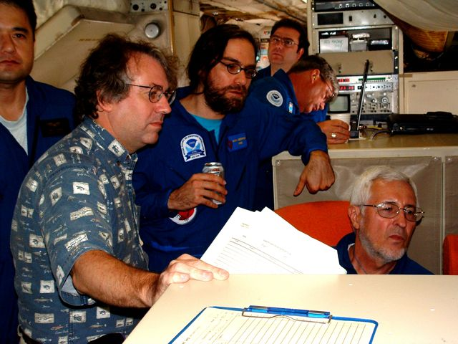
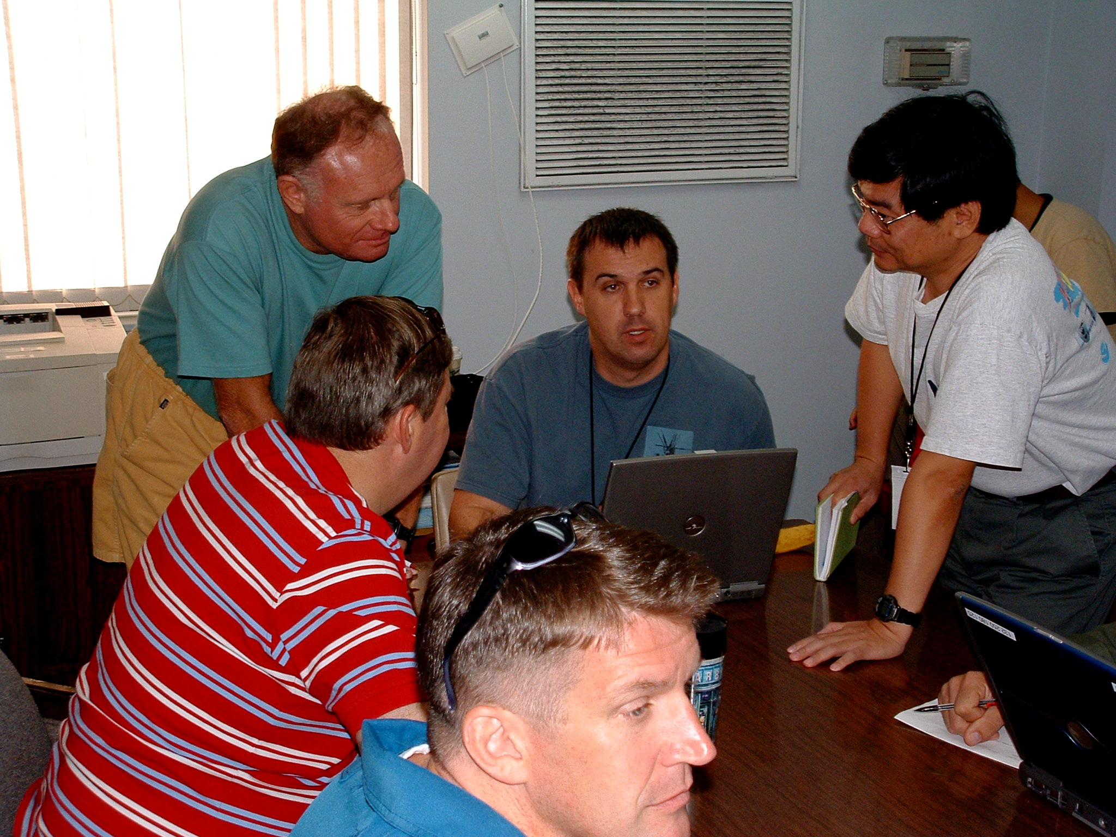
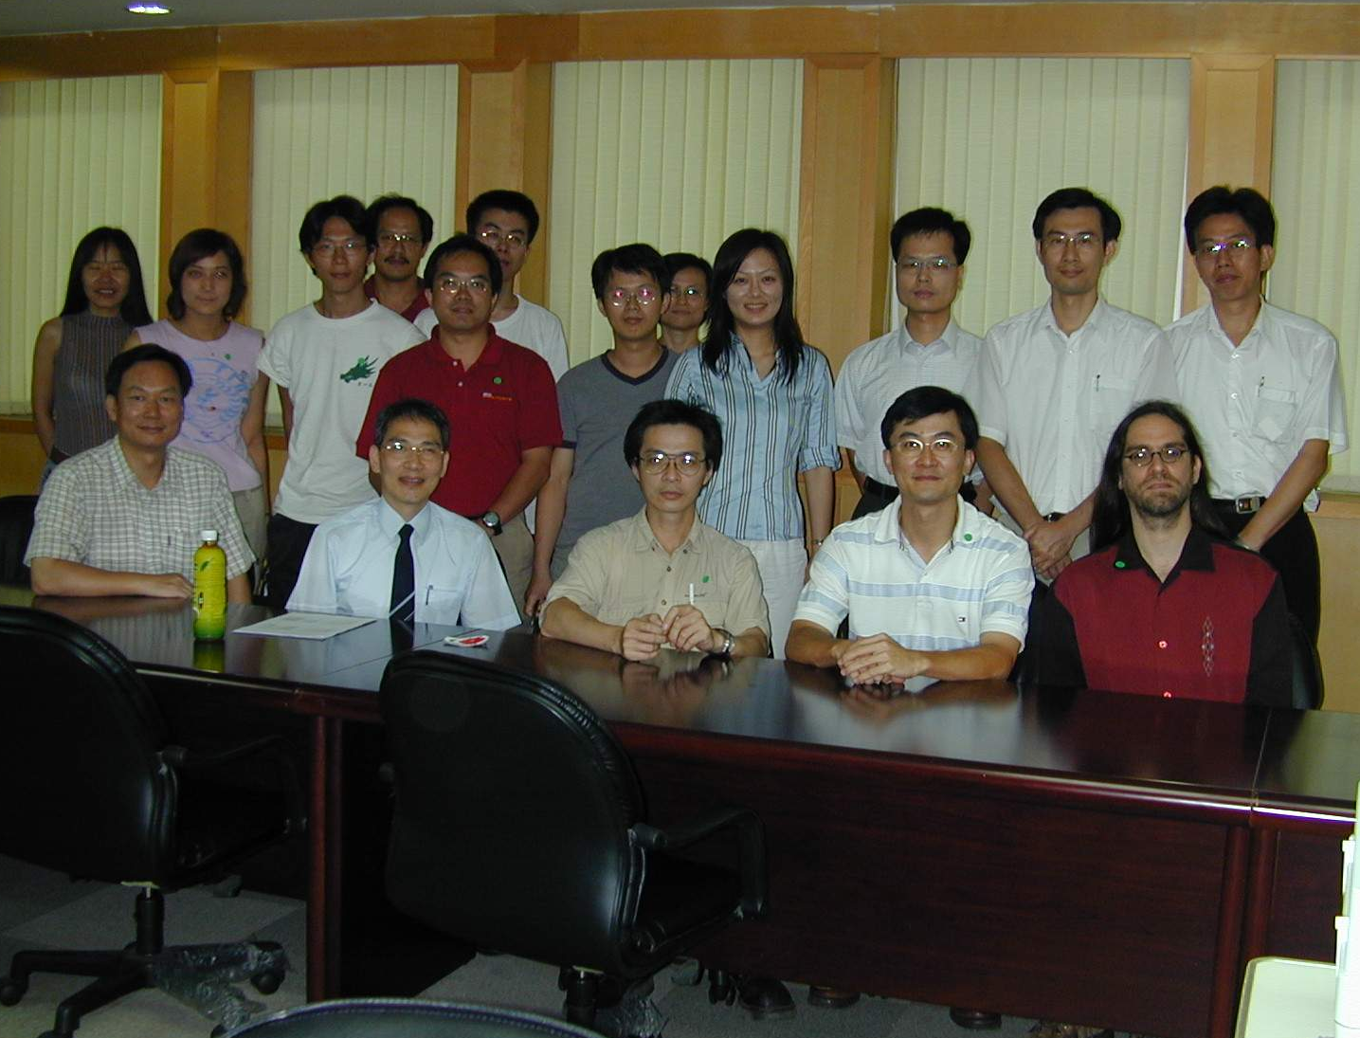
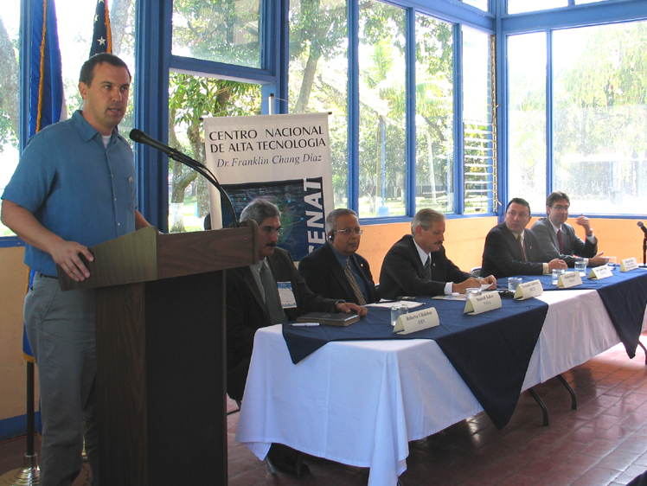
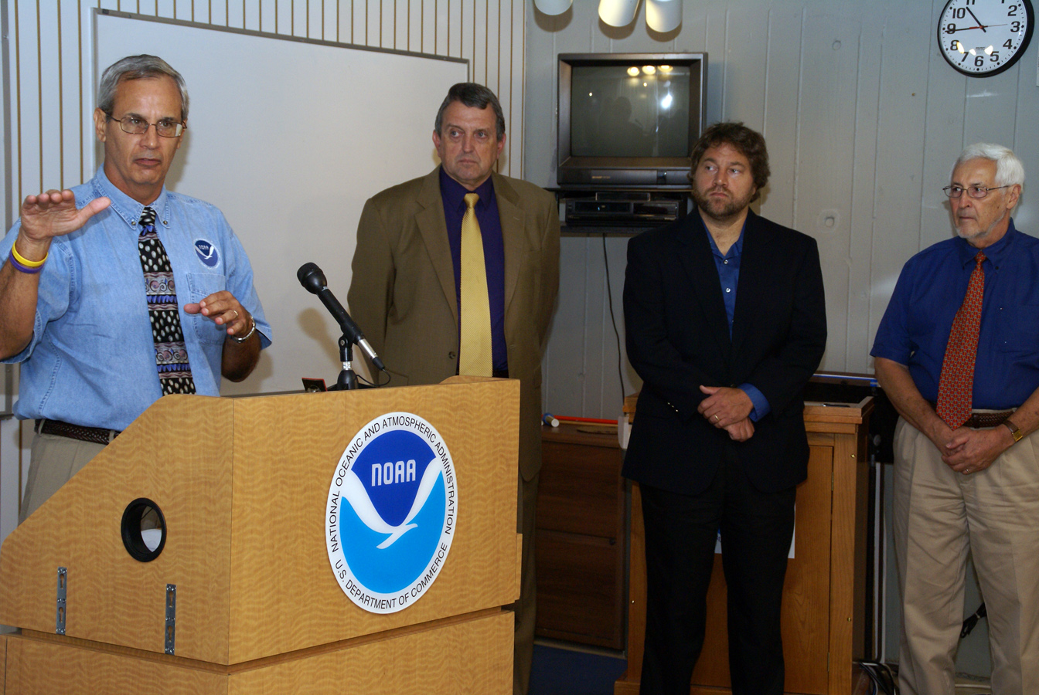
Keys to Success
  Partnership: AOML, ESRL, GFDL, DTC, USWRP, NESDIS/STAR working closely with Operations (EMC, NHC, AOC) and Federal & Academic Partners (NASA, NSF, ONR, NRL, NCAR, BOEMRS)
  More integrated use & support of Testbeds: JHT, DTC, JCSDA
  Blend Traditional hurricane research activities and HFIP research activities
  Manpower (diversity) to evaluate model performance with hurricane data sets is a critical need
CBLAST
IFEX/RAINEX
DOTSTAR
IFEX/TCSP
IFEX/PREDICT/GRIP

Slide 16
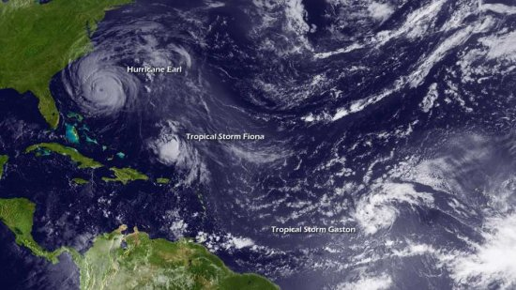
Questions?

