Slide 1
JCSDA-HFIP Workshop on Satellite Data Assimilation for Hurricane Forecasting, AOML, Dec 2-3 2010
Lars Peter Riishojgaard

Slide 2
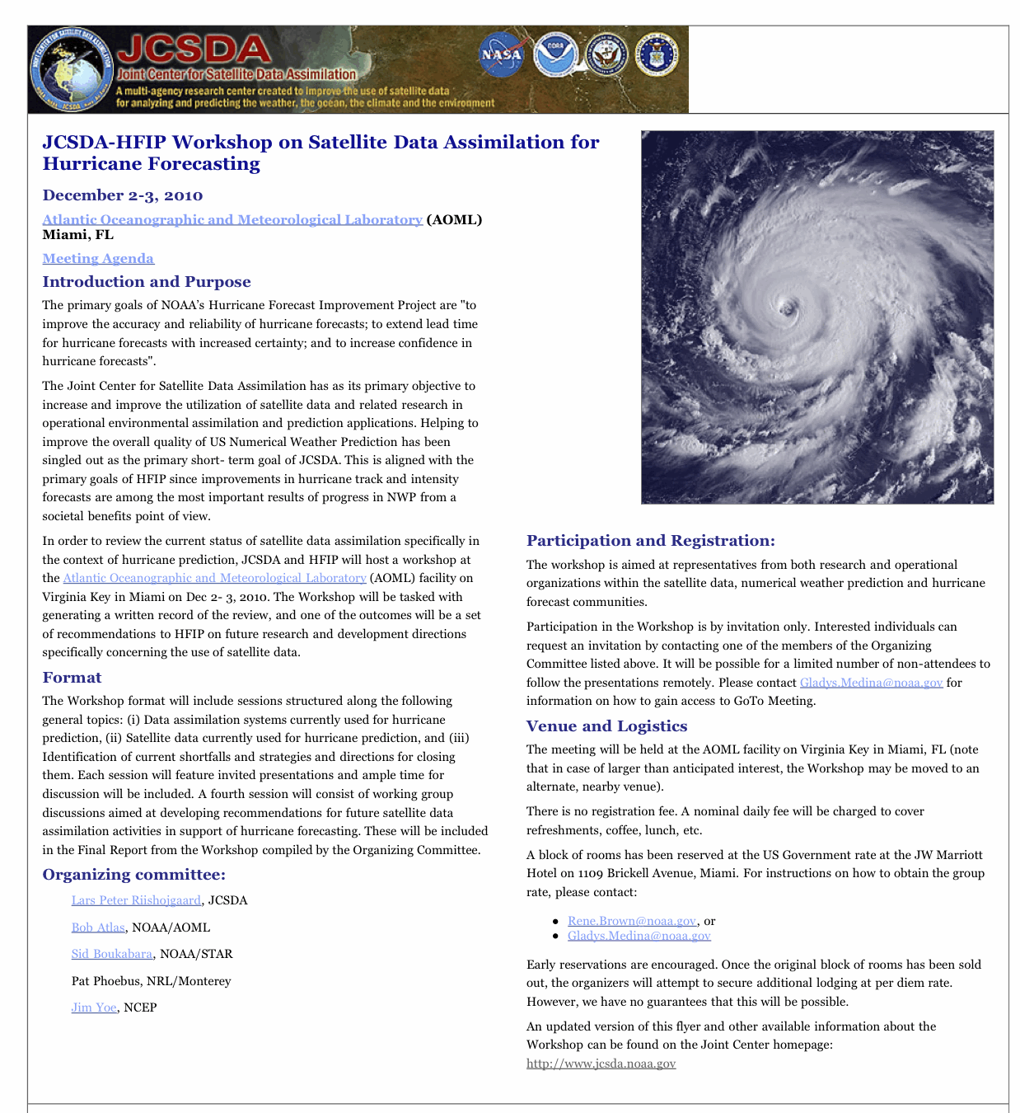

Slide 3
Full Workshop Report available at: http://www.jcsda.noaa.gov/meetings_JCSDA-HFIPWorkshop2010.php
Some key recommendations (many more in the full report):
Three-dimensional data assimilation methodology has come close to exhausting its potential for hurricane forecasting. 4D-VAR or ensemble methods are needed.
Hyperspectral IR sensors (e.g. AIRS, IASI) are underutilized, especially near hurricanes.
Satellite winds are generally underutilized; especially rapid-scan geostationary winds contain information about the circulation that is not currently exploited.
The microwave sensors are underutilized over cloudy and (especially) precipitating areas.
Ocean surface winds from scatterometers contain information about the hurricane circulation, and yet these data have had minimal impact on forecast skill in 3D-VAR systems. This will change with the next generation of data assimilation systems, and new investigations into the use of these data are needed.

